Slide 1
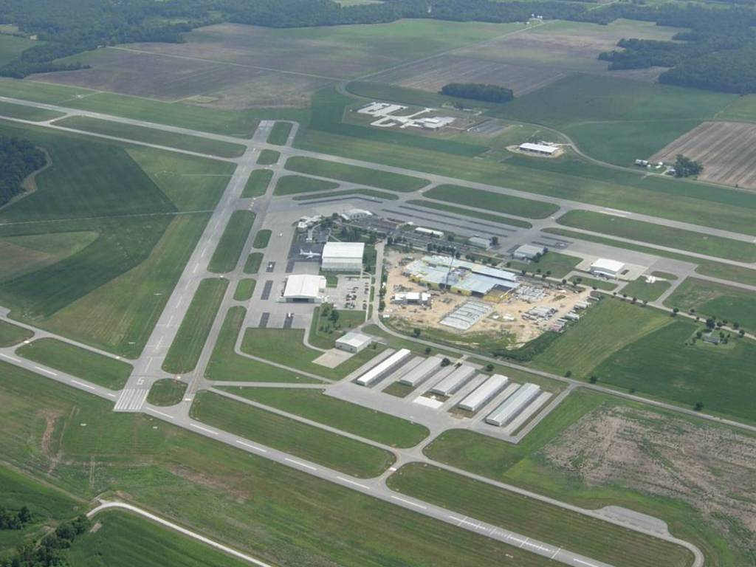
Through-the-fence operations
Replace photo with an aerial view of the airport
Date
Name of the Airport
Notes:
Introductory Notes
This presentation provides talking points for discussion with airport policymakers, TTF entities, and/or stakeholders about the background on TTF operations, the current situation (airport and TTF operation) at the airport, assessment of TTF operations, and recommendations on TTF operations. This presentation is designed to be modified for the audience, the current situation, and the recommendations. Slides can be changed, added, or deleted (as needed).
The presentation audiences consists of:
Policymakers = individuals that have oversight and policy making authority over the operation and management of the airport.
TTF entities = individuals/companies that have property adjacent to the airport that have or are seeking ground access by an aircraft across the airport’s property boundary to the airport’s airside infrastructure and permission to engage in associated activities from property adjacent to the airport.
Stakeholders = individuals that have an interest in the airport (overall) or the existing, proposed, or future TTF operation (more specifically).
While all slides can be presented to policymakers, some slides may not need to be presented to stakeholders – as identified in the notes section of the slide.
Notes for Cover Slide
Insert an aerial view of the airport, the date of the presentation, and the name of the airport.
After customizing the base presentation for policymakers, save the file by identifying the name of the audience, the version of the file, and the date of the file in the file name (e.g., Policymakers-Version 1-022814).
Then, modify the policymaker presentation for stakeholders and save the file by identifying the name of the audience, the version of the file, and the date of the file in the file name (e.g., Stakeholders-Version 1-022814).

Slide 2
Agenda
Background on TTF Operations
What are Through-The-Fence (TTF) Operations?
Airport Sponsor Obligations
Legal Principles
Planning, Management, and Compliance Tools
Current Situation
Airport
TTF Operation(s)
Assessment of TTF Operations
Recommendations
Structure of TTF operation(s)
Management of TTF operation(s)
Notes:
Modify this agenda to ensure that it is relevant and appropriate for the airport, the TTF operation(s), and the presentation audience (policymakers, TTF entities, and/or stakeholders).

Slide 3
Background on TTF Operations
Notes:
Use this section to provide background on TTF operation(s). In essence, the information conveyed in this section serves as the background for making decisions regarding the permitting, restricting, or prohibiting of TTF operations.

Slide 4
What are Through-The-Fence Operations?
Through-The-Fence (TTF) operations occur when an airport sponsor grants an entity ground access by an aircraft across the airport’s property boundary to the airport’s airside infrastructure (e.g., runways and taxiways) and permission to engage in associated activities from property adjacent to the airport.
Notes:
For more background information on TTF operations, see Chapter 1 (in general) and Section 1.1 (specifically) of the Guidebook on TTF Operations.

Slide 5
Types of TTF Activities
Residential TTF Activities
Commercial Aeronautical TTF Activities
Non-Commercial Aeronautical TTF Activities
Non-Aeronautical TTF Activities
Governmental/Military TTF Activities
Notes:
For more background information on the types of TTF activities, see Chapter 1 (in general) and Section 1.6 (specifically) of the Guidebook on TTF Operations.
The presentation may be edited to focus solely on the types of TTF activities that are existing, proposed, and/or considered for the future.

Slide 6
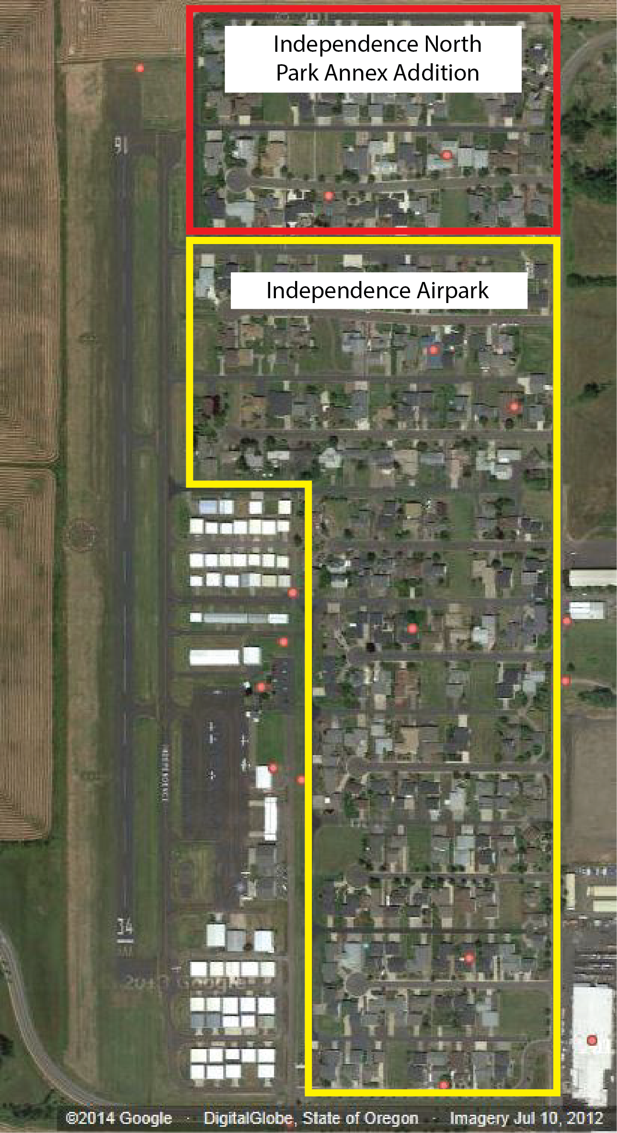
Residential TTF Activities
Residential TTF activities encompass TTF entities with single and multi-unit (user) residences (e.g., homes, duplexes, apartments, etc.) located on TTF property with an attached or detached hangar. A hangar on TTF property that incorporates living quarters for permanent or long-term use is considered a residential TTF activity as well.
Independence Airport
Independence, Oregon
Notes:
For more background information on the types of TTF activities, see Chapter 1 (in general) and Section 1.6 (specifically) of the Guidebook on TTF Operations.
The presentation may be edited to focus solely on the types of TTF activities that are existing, proposed, and/or considered for the future.

Slide 7
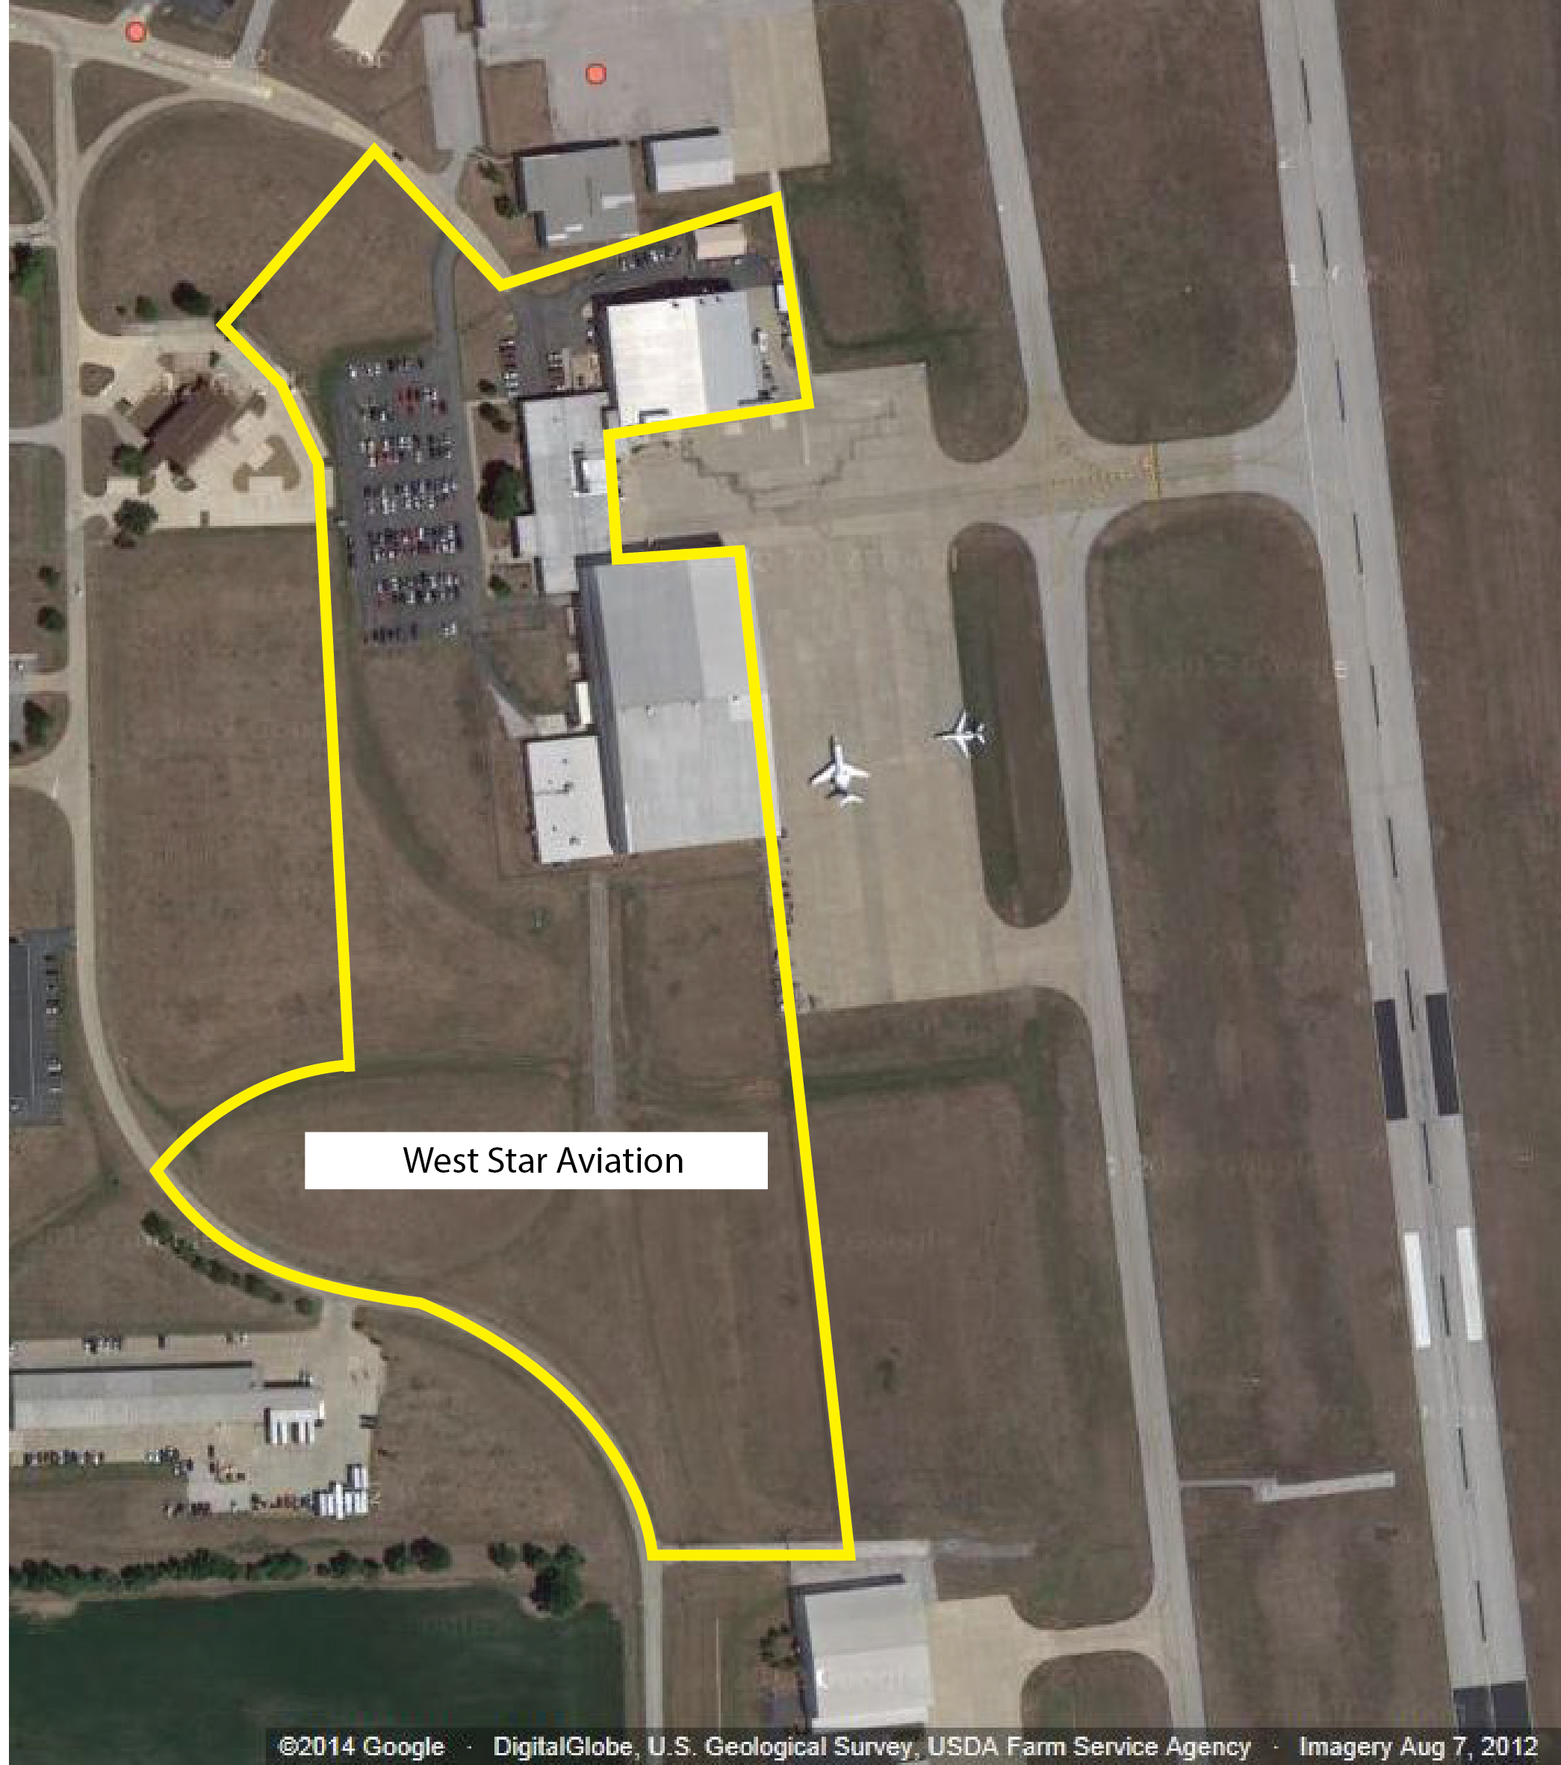
Commercial Aeronautical TTF Activities
Commercial aeronautical TTF activities include any commercial activity, located on TTF property, that involves, makes possible, or is required for the operation of an aircraft, or which contributes to, or is required for conducting aircraft operations – fixed base operators (FBO) or specialized aviation service operators (SASO).
St. Louis Regional Airport
East Alton, Illinois
Notes:
For more background information on the types of TTF activities, see Chapter 1 (in general) and Section 1.6 (specifically) of the Guidebook on TTF Operations.
The presentation may be edited to focus solely on the types of TTF activities that are existing, proposed, and/or considered for the future.

Slide 8
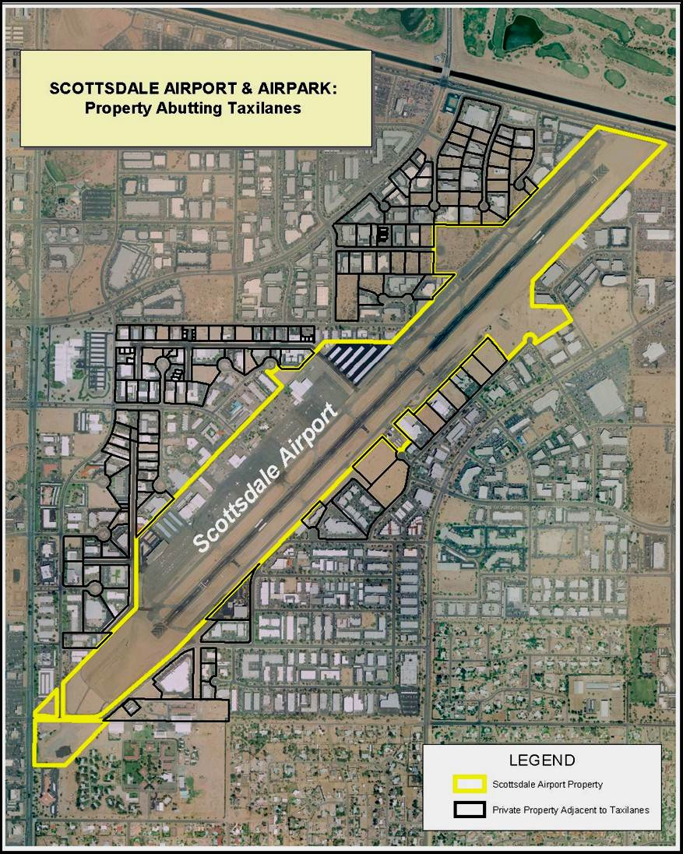
Non-Commercial Aeronautical TTF Activities
Non-commercial aeronautical TTF activities encompass TTF entities owning, leasing, or having the full and exclusive control of aircraft -- for non-commercial purposes -- located on and operated from TTF property.
Scottsdale Airport
Scottsdale, Arizona
Notes:
For more background information on the types of TTF activities, see Chapter 1 (in general) and Section 1.6 (specifically) of the Guidebook on TTF Operations.
The presentation may be edited to focus solely on the types of TTF activities that are existing, proposed, and/or considered for the future.

Slide 9
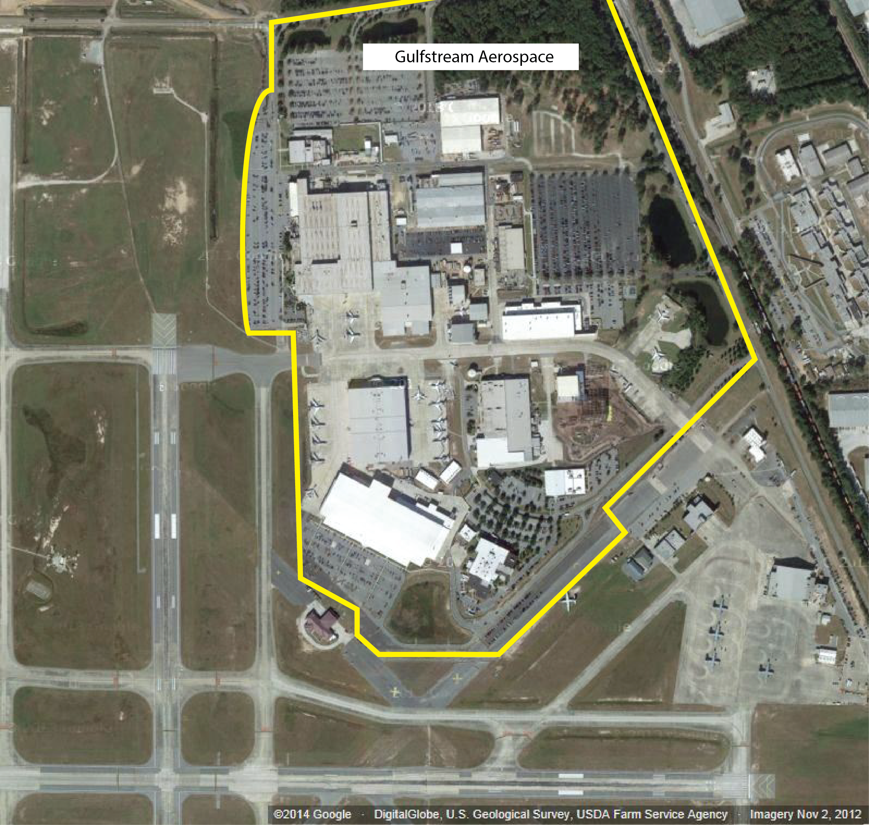
Non-Aeronautical TTF Activities
Non-aeronautical TTF activities encompass activities that do not involve, make possible, or are not required for the operation of aircraft or do not contribute to or are not required for the safety of aircraft operations. Non-aeronautical activities include the manufacturing of aircraft, parts, and accessories; ground based aviation training; and non-flying aircraft museums.
Savannah/Hilton Head Int’l Airport
Savannah, Georgia
Notes:
For more background information on the types of TTF activities, see Chapter 1 (in general) and Section 1.6 (specifically) of the Guidebook on TTF Operations.
The presentation may be edited to focus solely on the types of TTF activities that are existing, proposed, and/or considered for the future.

Slide 10
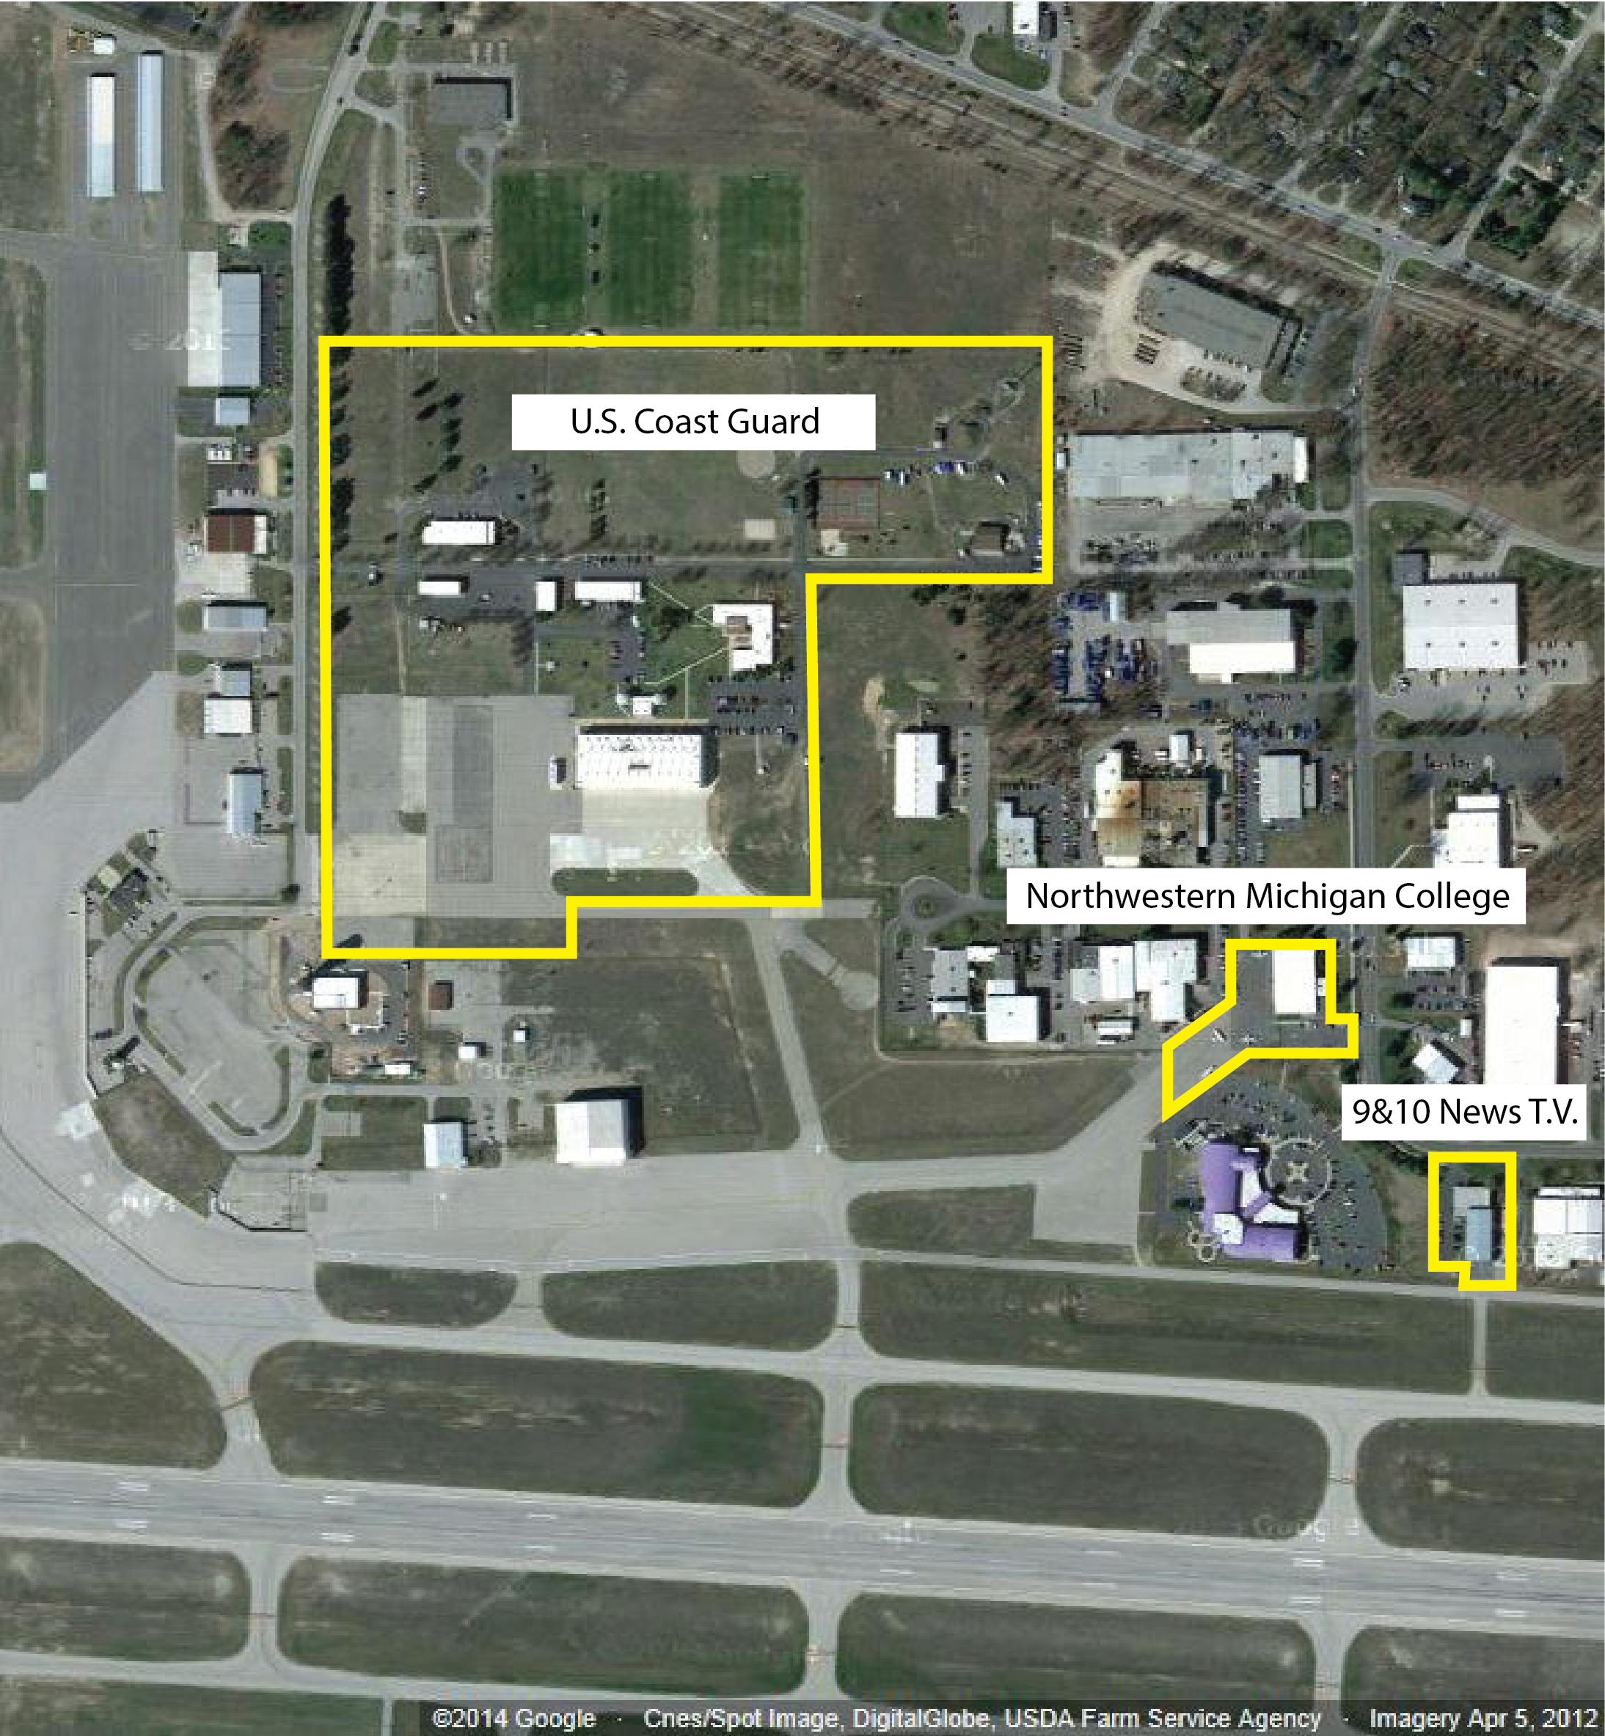
Governmental/Military TTF Activities
Governmental/military TTF activities typically encompass federal and state government and military agencies and institutions occupying TTF property to engage in aeronautical and non-aeronautical activities which primarily benefit the airport, the community, and/or national defense.
Cherry Capital Airport
Traverse City, Michigan
Notes:
For more background information on the types of TTF activities, see Chapter 1 (in general) and Section 1.6 (specifically) of the Guidebook on TTF Operations.
The 9 and 10 News TV TTF operation is not considered a governmental/military TTF activity, but a non-commercial aeronautical TTF activity.
The presentation may be edited to focus solely on the types of TTF activities that are existing, proposed, and/or considered for the future.

Slide 11
Airport Sponsor Obligations
Eligibility for federal and state funding
Airports must maintain compliance with numerous airport sponsor obligations including:
Statutes
Regulations
Airport Sponsor Assurances
Executive Orders
Policies
Guidance
Airport sponsor obligations contribute to the safety, utility, and efficiency of airports for the benefit of the public.
Notes:
For more background information on airport sponsor obligations, see Chapter 2 of the Guidebook on TTF Operations.

Slide 12
Airport Sponsor Obligations
Key federal obligations related to TTF operations:
Federal Statute
Section 136 of the FAA Modernization and Reform Act of 2012 (Public Law 112-95)
Airport Sponsor Assurances
39 Airport Sponsor Assurances (as of April 2012)
FAA Policy
Policy Regarding Access to Airports from Residential Property (Federal Register Vol. 78, No. 136, Page 42419 on July 16, 2013)
FAA Guidance
Order 5190.6B, Airport Compliance Manual
Compliance Guidance Letter 2013-1: FAA Review of Existing and Proposed Residential TTF Access Arrangements
Notes:
For more background information on airport sponsor federal obligations, see Chapter 2 (in general) and Sections 2.2, 2.3, and 2.4 (specifically) of the Guidebook on TTF Operations.
If the airport sponsor has specific state obligations related to TTF operations, a new slide identifying and discussing the obligations should be created and added after this slide.

Slide 13
Airport Sponsor Obligations
If an airport sponsor is found non-compliant with its obligations, eligibility for future grant funds may be suspended and/or payment of funds for open grants may be withheld. This could create significant ramifications on the airport.
Notes:
For more background information on airport sponsor federal obligations, see Chapter 2 (in general) and Sections 2.2, 2.3, and 2.4 (specifically) of the Guidebook on TTF Operations.

Slide 14
Legal Principles
Legal principles established through FAA decisions:
Airport sponsors are not obligated to permit TTF operations.
Airport sponsors are obligated to protect on-airport FBOs and SASOs.
Airport sponsors may establish fees for TTF operations utilizing different methodologies.
The FAA does not consider the reasonableness of fees imposed on TTF operations to be an FAA matter.
The right to engage in self-service fueling (on-airport) does not extend to a TTF entity on TTF property.
Airport sponsors are obligated to impose reasonable restrictions on TTF operations.
Airport sponsors must maintain a current Airport Layout Plan.
Notes:
For more background information on legal principles established through FAA decisions, see Chapter 3 (in general) and Section 3.3 (specifically) of the Guidebook on TTF Operations.

Slide 15
Legal Principles
Legal principles established through court rulings:
An easement granting TTF access does not negate the right of the airport sponsor to require a TTF agreement and require payment of appropriate rents and fees.
An airport sponsor may prohibit TTF operations.
An airport sponsor may establish reasonable ordinances, policies, standards, rules, and regulations for TTF operations.
TTF entities must comply with county or municipal ordinances promulgated where the property exists.
Notes:
For more background information on legal principles established through court rulings, see Chapter 3 (in general) and Section 3.4 (specifically) of the Guidebook on TTF Operations.

Slide 16
Planning, Management, and Compliance Tools
Notes:
For more background information on airport planning, management, and compliance tools, see Chapter 4 of the Guidebook on TTF Operations.

Slide 17
Planning, Management, and Compliance Tools
Airport Planning Documents
Airport Strategic Business Plan
Establishes the airport’s mission, vision, values, goals, and objectives
Airport Master Plan
Conveys the airport’s short, medium, and long-term planning and development goals
Airport Layout Plan
Depicts the existing land, infrastructure, and improvements on the airport and planned capital improvement projects
Notes:
For more background information on airport planning documents, see Chapter 4 (in general) and Section 4.2 (specifically) of the Guidebook on TTF Operations.

Slide 18
Planning, Management, and Compliance Tools
Airport Sponsor Regulatory Measures
Ordinances
Protects public health, safety, and general welfare
Zoning Codes
Permits, restricts, and/or prohibits specific land uses, consistent with the applicable land use plans (that mitigate adverse impacts and minimize incompatible land uses)
Building Codes
Stipulates minimum acceptable levels of safety for the design and construction of infrastructure, improvements, and facilities
Notes:
For more background information on airport sponsor regulatory measures, see Chapter 4 (in general) and Section 4.3 (specifically) of the Guidebook on TTF Operations.

Slide 19
Planning, Management, and Compliance Tools
Airport Management and Compliance Documents
Leasing/Rents and Fees Policy
Sets forth the parameters for leasing airport land and improvements and outlines the process for establishing and adjusting rents and fees
Minimum Standards
Conveys the qualifications and minimum requirements and standards that must be met as a condition for the right to conduct a commercial aeronautical activity
Rules and Regulations
Contributes to the safety, utility, and efficiency of the airport for the benefit of the public
Development Standards
Governs the design, construction, or modification of infrastructure, improvements, and facilities on the airport
Notes:
For more background information on airport management and compliance documents, see Chapter 4 (in general) and Section 4.3 (specifically) of the Guidebook on TTF Operations.

Slide 20
Current Situation
Notes:
Use this section to provide an overview of the airport and the TTF operation(s) and the information utilized during the assessment of TTF operations. In essence, the information conveyed in this section serves as the basis for making recommendations regarding the permitting, restricting, or prohibiting of TTF operations.

Slide 21
Airport
Land Attributes
Location
Size
Acreage, square feet
Airside Infrastructure Access
Landside Infrastructure Access
Availability of Utilities
Replace the photo with a relevant photo or graphic to
Land attributes.
Notes:
NOTES: Use this section to provide an overview of the airport (in general) and the attributes of the airport impacted by existing, proposed, or future TTF operations (specifically). Expand or add slides – as needed. Add interesting photos or graphics of the airport to improve/enhance the visual impact of the slides in this section.
If you have completed Worksheet 5-2: Airport Profile, much of the information can be utilized to complete these slides.

Slide 22
Airport
Improvements Attributes
Type
Hangar, office, shop, etc.
Apron, vehicle parking, storage, etc.
Square Footage
Type of Construction
Age and Condition
Hangar door height and width
Location
Apron
Dimensions, weight bearing capacity, type of pavement, condition, etc.
Replace the photo with a relevant photo or graphic to
improvements attributes.
.
Notes:
NOTES: Use this section to provide an overview of the airport (in general) and the attributes of the airport impacted by existing, proposed, or future TTF operations (specifically). Expand or add slides – as needed. Add interesting photos or graphics of the airport to improve/enhance the visual impact of the slides in this section.
If you have completed Worksheet 5-2: Airport Profile, much of the information can be utilized to complete these slides.

Slide 23
Airport
Infrastructure Attributes
Runways
Dimensions
Weight bearing capacity
Type of pavement
Condition
Taxiways
Same descriptions as Runways
Aprons
Same descriptions as Runways
Infrastructure adjacent to TTF property
Replace the photo with a relevant photo or graphic to
Infrastructure attributes.
Notes:
NOTES: Use this section to provide an overview of the airport (in general) and the attributes of the airport impacted by existing, proposed, or future TTF operations (specifically). Expand or add slides – as needed. Add interesting photos or graphics of the airport to improve/enhance the visual impact of the slides in this section.
If you have completed Worksheet 5-2: Airport Profile, much of the information can be utilized to complete these slides.

Slide 24
Airport
Security Attributes
Type of physical perimeter
Fencing and gates
Security mechanisms
Pedestrian
Vehicle
Replace the photo with a relevant photo or graphic to
Security attributes.
Notes:
NOTES: Use this section to provide an overview of the airport (in general) and the attributes of the airport impacted by existing, proposed, or future TTF operations (specifically). Expand or add slides – as needed. Add interesting photos or graphics of the airport to improve/enhance the visual impact of the slides in this section.
If you have completed Worksheet 5-2: Airport Profile, much of the information can be utilized to complete these slides.

Slide 25
Airport
Activities
Commercial Aeronautical
Products, services, and facilities
Non-Commercial Aeronautical
Non-Aeronautical
Governmental/military
Replace the photo with a relevant photo or graphic to
activities.
Notes:
NOTES: Use this section to provide an overview of the airport (in general) and the attributes of the airport impacted by existing, proposed, or future TTF operations (specifically).
Identify the existing on-airport activities by type and entity.
Expand or add slides – as needed. Add interesting photos or graphics of the airport to improve/enhance the visual impact of the slides in this section.
If you have completed Worksheet 5-2: Airport Profile, much of the information can be utilized to complete these slides.

Slide 26
Airport
Airport Planning Documents
Airport Strategic Business Plan
Mission
Vision
Goals
Objectives
Operating budget
Non-operating budget
Performance measures
Airport Master Plan
Goals
Capital Improvement Plan
Airport Layout Plan
Notes:
NOTES: Use this section to provide an overview of the airport (in general) and the attributes of the airport impacted by existing, proposed, or future TTF operations (specifically).
If existing, identify the airport’s mission, goals, objectives, budgets, and performance measures. Also provide information on the goals and capital improvement plan associated with the airport master plan (pictures and graphics are like a 1000 words).
Expand or add slides – as needed. Add interesting photos or graphics of the airport to improve/enhance the visual impact of the slides in this section.
If you have completed Worksheet 5-2: Airport Profile, much of the information can be utilized to complete these slides.

Slide 27
Airport
Airport Sponsor Regulatory Measures
Ordinances
Name (and date) of ordinances related to airport and TTF operations
Zoning Codes
Name (and date) of zoning codes related to airport and TTF operations
Building Codes
Name (and date) of building codes related to airport and TTF operations
Notes:
NOTES: Use this section to provide an overview of the airport (in general) and the attributes of the airport impacted by existing, proposed, or future TTF operations (specifically). Expand or add slides – as needed. Add interesting photos or graphics of the airport to improve/enhance the visual impact of the slides in this section.
If you have completed Worksheet 5-2: Airport Profile, much of the information can be utilized to complete these slides.

Slide 28
Airport
Airport Management and Compliance Documents
Leasing/Rents and Fees Policy
Name (and date) of policies related to TTF operations
Minimum Standards
Name (and date) of standards related to commercial aeronautical TTF activities
Rules and Regulations
Name (and date) of rules and regulations related to TTF operations
Development Standards
Name (and date) of standards related to TTF operations
Notes:
NOTES: Use this section to provide an overview of the airport (in general) and the attributes of the airport impacted by existing, proposed, or future TTF operations (specifically). Expand or add slides – as needed. Add interesting photos or graphics of the airport to improve/enhance the visual impact of the slides in this section.
If you have completed Worksheet 5-2: Airport Profile, much of the information can be utilized to complete these slides.

Slide 29
TTF Operation(s)
TTF Property Attributes
Location
Size
Airside infrastructure access
Landside infrastructure access
Availability of utilities
Ordinance restrictions
Zoning restrictions
Building code restrictions
Environmental issues
Replace the photo with a relevant photo or graphic to
TTF property attributes.
.
Notes:
NOTES: Use this section to provide an overview of the attributes of the existing, proposed, or future TTF operations. Expand or add slides – as needed. Add interesting photos (if existing) or graphics (if proposed) of the TTF operation to improve/enhance the visual impact of the slides in this section.
If you have completed Worksheet 5-1: TTF Operation Profile, much of the information can be utilized to complete these slides.

Slide 30
TTF Operation(s)
TTF Improvement Attributes
Type of improvements
Square footage
Type of construction
Age and condition
Height
Hangar door height and width
Type of fencing and gates
Type of landscaping
Location
Proximity to airport equipment
Replace the photo with a relevant photo or graphic to
TTF improvement attributes.
Notes:
NOTES: Use this section to provide an overview of the attributes of the existing, proposed, or future TTF operations. Expand or add slides – as needed. Add interesting photos (if existing) or graphics (if proposed) of the TTF operation to improve/enhance the visual impact of the slides in this section.
If you have completed Worksheet 5-1: TTF Operation Profile, much of the information can be utilized to complete these slides.

Slide 31
TTF Operation(s)
TTF Infrastructure Attributes
Apron
Dimensions
Weight bearing capacity
Type of pavement
Condition
Taxilanes/Taxiways
Same descriptions as Aprons
Roadways
Same descriptions as Aprons
Walkways
Same descriptions as Aprons
Replace the photo with a relevant photo or graphic to
TTF infrastructure attributes.
Notes:
NOTES: Use this section to provide an overview of the attributes of the existing, proposed, or future TTF operations. Expand or add slides – as needed. Add interesting photos (if existing) or graphics (if proposed) of the TTF operation to improve/enhance the visual impact of the slides in this section.
If you have completed Worksheet 5-1: TTF Operation Profile, much of the information can be utilized to complete these slides.

Slide 32
TTF Operation(s)
TTF Activities
Residential
Type of residence and hangars
Commercial Aeronautical
Products, services, and facilities
Non-Commercial Aeronautical
Non-Aeronautical
Governmental/military
Replace the photo with a relevant photo or graphic to
airport security.
Notes:
NOTES: Use this section to provide an overview of the attributes of the existing, proposed, or future TTF operations. Expand or add slides – as needed. Add interesting photos (if existing) or graphics (if proposed) of the TTF operation to improve/enhance the visual impact of the slides in this section.
If you have completed Worksheet 5-1: TTF Operation Profile, much of the information can be utilized to complete these slides.

Slide 33
TTF Operation(s)
TTF Access
Aircraft
Number, type, and size
Frequency
Purpose for access
Vehicles
Same descriptions as aircraft
Pedestrians
Same descriptions as aircraft
Replace the photo with a relevant photo or graphic to
TTF access
Notes:
NOTES: Use this section to provide an overview of the attributes of the existing, proposed, or future TTF operations. Expand or add slides – as needed. Add interesting photos (if existing) or graphics (if proposed) of the TTF operation to improve/enhance the visual impact of the slides in this section.
If you have completed Worksheet 5-1: TTF Operation Profile, much of the information can be utilized to complete these slides.

Slide 34
TTF Operation(s)
TTF Access Point(s)
Location
Type
Security mechanisms
Replace the photo with a relevant photo or graphic to
TTF access points.
Notes:
NOTES: Use this section to provide an overview of the attributes of the existing, proposed, or future TTF operations. Expand or add slides – as needed. Add interesting photos (if existing) or graphics (if proposed) of the TTF operation to improve/enhance the visual impact of the slides in this section.
If you have completed Worksheet 5-1: TTF Operation Profile, much of the information can be utilized to complete these slides.

Slide 35
TTF Operation(s)
Economic and Social Impacts
Jobs
Number
Type
Average Compensation
Taxes
Property
Personal
Other
Economic
Direct
Indirect
Multiplier Effect
Social
Replace the photo with a relevant photo or graphic to
Economic and social impacts.
Notes:
NOTES: Use this section to provide an overview of the attributes of the existing, proposed, or future TTF operations. Expand or add slides – as needed. Add interesting photos (if existing) or graphics (if proposed) of the TTF operation to improve/enhance the visual impact of the slides in this section.
If you have completed Worksheet 5-1: TTF Operation Profile, much of the information can be utilized to complete these slides.

Slide 36
Assessment of TTF Operation(s)
Notes:
Use this section to provide an overview of the assessment conducted on TTF operations and the advantages, disadvantages, and impacts associated with existing, proposed, or future TTF operations. In essence, the information conveyed in this section serves as the basis for making recommendations regarding the permitting, restricting, or prohibiting of TTF operations.

Slide 37
Alternatives
Which alternatives are viable for the TTF operation(s)?
Can TTF operation(s) be accommodated on airport?
Is TTF entity willing to lease airport land and improvements?
Is TTF entity willing to donate or sell TTF property to airport?
Does the airport have funding to purchase TTF property?
Notes:
NOTES: Use this section to provide an overview of the alternatives identified and assessed during the assessment process. Expand or add slides – as needed. Add interesting photos or graphics of the airport or TTF operation to improve/enhance the visual impact of the slides in this section.
If you have completed Worksheet 5-3: TTF Operation Assessment, much of the information can be utilized to complete these slides.

Slide 38
Airport Sponsor Obligations
What type of impacts will the TTF operation(s) have on the airport sponsor maintaining compliance with:
Assurance 5 (Preserving Rights and Powers)
Assurance 19 (Operation and Maintenance)
Assurance 20 (Hazard Removal and Mitigation)
Assurance 21 (Compatible Land Use)
Assurance 22 (Economic Discrimination)
Assurance 23 (Exclusive Rights)
Assurance 24 (Fee and Rental Structure)
Assurance 29 (Airport Layout Plan)
Other Federal Obligations
Other State Obligations
Notes:
NOTES: Use this section to provide an overview of the assessment of the impact of TTF operations on the airport maintain compliance with airport sponsor obligations. Expand or add slides – as needed. Add interesting photos or graphics of the airport or TTF operation to improve/enhance the visual impact of the slides in this section.
If you have completed Worksheet 5-3: TTF Operation Assessment, much of the information can be utilized to complete these slides.

Slide 39
Primary Planning Documents
What type of impacts will the TTF operation(s) have on the Airport Strategic Business Plan’s:
Mission Statement
Vision Statement
Goals and Objectives
Operating Budget
Non-Operating Budget
Financial Budget
Performance Measures
What type of impacts will the TTF operation(s) have on implementation of the Airport Master Plan/Airport Layout Plan?
Notes:
NOTES: Use this section to provide an overview of the assessment of the impact of TTF operations on the airports primary planning documents. Expand or add slides – as needed. Add interesting photos or graphics of the airport or TTF operation to improve/enhance the visual impact of the slides in this section.
If you have completed Worksheet 5-3: TTF Operation Assessment, much of the information can be utilized to complete these slides.

Slide 40
Airport Sponsor Regulatory Measures
Does the airport sponsor have regulatory measures that address TTF operations?
Ordinances
Zoning Codes
Building Codes
Will the TTF operation(s) be compliant with airport sponsor regulatory measures?
Ordinances
Zoning Codes
Building Codes
Notes:
NOTES: Use this section to provide an overview of the airport sponsor regulatory measures that address TTF operations and the ability of the TTF operation to be compliant with the same. Expand or add slides – as needed. Add interesting photos or graphics of the airport or TTF operation to improve/enhance the visual impact of the slides in this section.
If you have completed Worksheet 5-3: TTF Operation Assessment, much of the information can be utilized to complete these slides.

Slide 41
Management and Compliance Documents
Does the airport sponsor have management and compliance documents that address TTF operations?
Leasing/Rents and Fees Policy
Minimum Standards
Rules and Regulations
Development Standards
Will the TTF operation(s) be compliant with airport sponsor management and compliance documents?
Leasing/Rents and Fees Policy
Minimum Standards
Rules and Regulations
Development Standards
Notes:
NOTES: Use this section to provide an overview of the airport management and compliance documents that address TTF operations and the ability of the TTF operation to be compliant with the same. Expand or add slides – as needed. Add interesting photos or graphics of the airport or TTF operation to improve/enhance the visual impact of the slides in this section.
If you have completed Worksheet 5-3: TTF Operation Assessment, much of the information can be utilized to complete these slides.

Slide 42
Land, Infrastructure, and Improvements
What type of impacts will the TTF operation(s) have on existing and future:
Airside land, infrastructure, and improvements
Landside land, infrastructure, and improvements
Aviation real estate land, infrastructure, and improvements
Non-aviation real estate land, infrastructure, and improvements
Notes:
NOTES: Use this section to provide an overview of the assessment of the impact of TTF operations on existing and future land, infrastructure, and improvements. Expand or add slides – as needed. Add interesting photos or graphics of the airport or TTF operation to improve/enhance the visual impact of the slides in this section.
If you have completed Worksheet 5-3: TTF Operation Assessment, much of the information can be utilized to complete these slides.

Slide 43
Activities
What type of impacts will the TTF operation(s) have on existing and future:
Commercial aeronautical activities
Future non-commercial aeronautical activities
Non-aeronautical activities
Governmental activities
Notes:
NOTES: Use this section to provide an overview of the assessment of the impact of TTF operations on existing and future activities. Expand or add slides – as needed. Add interesting photos or graphics of the airport or TTF operation to improve/enhance the visual impact of the slides in this section.
If you have completed Worksheet 5-3: TTF Operation Assessment, much of the information can be utilized to complete these slides.

Slide 44
Interested Parties
What type of impacts will the TTF operation(s) have on the following interested parties and what input has been provided?
FAA
State aviation organization
Airport operators, tenants, and users
Adjacent property owners
Community
Notes:
NOTES: Use this section to provide an overview of the assessment of the impact of TTF operations on all interested parties and the input provided by these parties during the assessment process. Expand or add slides – as needed. Add interesting photos or graphics of the airport or TTF operation to improve/enhance the visual impact of the slides in this section.
If you have completed Worksheet 5-3: TTF Operation Assessment, much of the information can be utilized to complete these slides.

Slide 45
Interested Parties
What type of impacts will the TTF operation(s) have on the airport sponsor’s:
Administrative and operational personnel
Airport certification manual
Airport security plan
Airport safety management system (SMS)
Airport sustainability management plan
Airport wildlife management plan
Airport emergency preparedness/response plan
Notes:
NOTES: Use this section to provide an overview of the assessment of the impact of TTF operations on the airport sponsor. Expand or add slides – as needed. Add interesting photos or graphics of the airport or TTF operation to improve/enhance the visual impact of the slides in this section.
If you have completed Worksheet 5-3: TTF Operation Assessment, much of the information can be utilized to complete these slides.

Slide 46
Interested Parties
What type of impacts will the TTF operation(s) have on the airport sponsor’s:
Airport irregular operations plan
Airport business and operational continuity plan
Airport environmental plan
Airport noise abatement plan
Airport stormwater management plan
Airport pavement maintenance/repair plan
Airport snow removal or mowing program
Notes:
NOTES: Use this section to provide an overview of the assessment of the impact of TTF operations on the airport sponsor. Expand or add slides – as needed. Add interesting photos or graphics of the airport or TTF operation to improve/enhance the visual impact of the slides in this section.
If you have completed Worksheet 5-3: TTF Operation Assessment, much of the information can be utilized to complete these slides.

Slide 47
Recommendations
Notes:
Use this section to provide an overview of the recommendations associated with existing, proposed, or future TTF operations, based upon the information provided in the assessment section of this presentation. In essence, the information conveyed in this section serves as the basis for making decisions regarding the permitting, restricting, or prohibiting of TTF operations.

Slide 48
Structure of TTF Operations
What does a sound structure of TTF operation(s) provide?
Contributes to the potential of TTF operations having a positive impact on the airport and the community.
Mitigates and/or eliminates any potential negative impacts on the airport and the community related to TTF operations.
Promotes a level playing field among providers of commercial aeronautical activities (e.g., FBOs and SASOs) on TTF property and on-airport).
Assists with maintaining compliance with the airport sponsor federal and state obligations.
Notes:
NOTES: Use this section to provide an overview of the benefits associated with providing a sound structure for TTF operations. Expand or add slides – as needed. Add interesting photos or graphics of the airport or TTF operation to improve/enhance the visual impact of the slides in this section.

Slide 49
Structure of TTF Operations
Recommendations for TTF operation policy:
Application and approval process
Restrictions
Prohibitions
Grounds for denial
Notes:
NOTES: Use this section to provide an overview of the recommendations associated with a TTF operation policy. Expand or add slides – as needed. Add interesting photos or graphics of the airport or TTF operation to improve/enhance the visual impact of the slides in this section.

Slide 50
Structure of TTF Operations
Recommendations for setting TTF operations rents and fees :
On-airport land, infrastructure, and improvements
TTF property land, infrastructure, and improvements
TTF activities
TTF access
Recommendations for adjusting TTF operations rents and fees :
On-airport land, infrastructure, and improvements
TTF property land, infrastructure, and improvements
TTF activities
TTF access
Notes:
NOTES: Use this section to provide an overview of the recommendations associated with setting and adjusting TTF operations rents and fees. Expand or add slides – as needed. Add interesting photos or graphics of the airport or TTF operation to improve/enhance the visual impact of the slides in this section.

Slide 51
Structure of TTF Operations
Recommendations for type of TTF operations agreement:
Deed restriction
Easement
Lease
License/Permit
Contract
Notes:
NOTES: Use this section to provide an overview of the recommendations associated with the type of TTF operations agreement. Expand or add slides – as needed. Add interesting photos or graphics of the airport or TTF operation to improve/enhance the visual impact of the slides in this section.

Slide 52
Structure of TTF Operations
Recommendations for terms and conditions of TTF operations agreement:
Term of agreement
Permitted, restricted, and prohibited TTF access and activities
TTF rents and fees
Infrastructure and improvements
Maintenance and repair
TTF entity obligations
Airport sponsor obligations
Transfer, sublease, assignment
Insurance
Default and termination
Notes:
NOTES: Use this section to provide an overview of the recommendations associated with the terms and conditions of the TTF operation agreement. Expand or add slides – as needed. Add interesting photos or graphics of the airport or TTF operation to improve/enhance the visual impact of the slides in this section.

Slide 53
Management of TTF Operations
Recommendations for management of TTF operations:
Airport sponsor regulatory measures
Ordinances
Zoning codes
Building codes
Planning documents
Airport strategic plan
Airport master plan/layout plan
Management and compliance documents
Minimum standards
Rules and regulations
Development standards
Other documents
Notes:
NOTES: Use this section to provide an overview of the recommendations associated with the management of the TTF operations. Expand or add slides – as needed. Add interesting photos or graphics of the airport or TTF operation to improve/enhance the visual impact of the slides in this section.

Slide 54
Management of TTF Operations
Recommendations (continued) for management of TTF operations:
Airport operations
TTF access
Safety and security
Maintenance
Incursions
Education
Enforcement
Notes:
NOTES: Use this section to provide an overview of the recommendations associated with the management of the TTF operations. Expand or add slides – as needed. Add interesting photos or graphics of the airport or TTF operation to improve/enhance the visual impact of the slides in this section.

Slide 55
Approval to Move Forward?
Notes:
At this point, the approval of policymakers to permit, restrict, or prohibit TTF operations needs to be obtained. This is one of the most important steps in the process.

