Slide 1
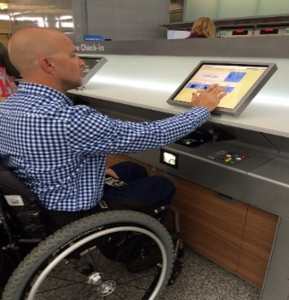
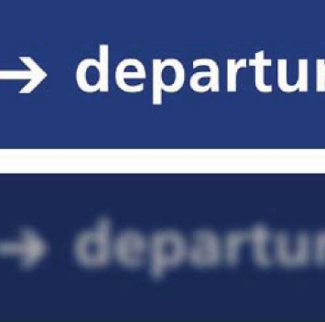
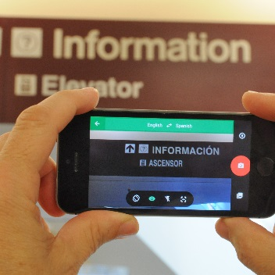
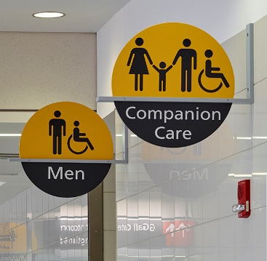
ACRP Research Report 177
Enhancing Wayfinding for Aging Travelers
and
Persons with Disabilities
February 17, 2017
Notes:
Please use these pages to keep notes from our Focus Group discussion.

Slide 2
RESEARCH

Slide 3
RESEARCH TEAM
Gresham, Smith and Partners (Principal Investigator)
Open Doors Organization
Arora Engineers
Georgia Tech - Center for Assistive Technology and Environmental Access
University of South Florida - Center for Urban Transportation Research
John Duval
Southwest Airlines
Notes:
GS&P – aviation industry wayfinding expertise
ODO – advocacy group for PWD’s in the aviation market
Arora – digital signing and technology expertise in the aviation market
GaTech CATEA – Testing of mobile app technology and app criteria
USF CUTR – mobile technology development and app criteria
John Duval – airport industry representative
Southwest Airlines – aviation industry representative

Slide 4
RESEARCH PERIOD
Research was conducted from 2014 to 2016
Guidebook scheduled to be published in fall of 2017

Slide 5
- ACRP Synthesis 51: Impacts of Aging Travelers on Airports
- ACRP Report 52: Wayfinding and Signing Guidelines for Airport Terminals and Landside
The purpose of ACRP Research Report 177: Enhancing Wayfinding for Aging Travelers and Persons with Disabilities is NOT to repeat the content in ACRP Report 52
PREVIOUS RESEARCH
Notes:
The purpose is to extract and distill relevant information as required to create an easy-to-follow guide that supports the recommendations resulting from ACRP 07-13 research.
For additional information and details associated with the specific aspects of wayfinding in airports not addressed in this guidebook, please reference ACRP Report 52.

Slide 6
OBJECTIVEE

Slide 7
The key overall goal of the guidebook’s content is to:
Engage the reader, understand the user, and equip the reader with the WHO, WHAT, WHY and HOW an airport can…
Create a difference that creates change…
…that promotes Independent Travel.
OBJECTIVE

Slide 8
In order to achieve the overall objective of helping aging travelers and persons with disabilities to travel independently, an airport has to consider more than just helping these customers know where to go.
Unless a comprehensive list of considerations are addressed, these customers will encounter issues that affect their ability to travel independently regardless of their wayfinding abilities.
Therefore, the 07-13 guidebook is about more than just wayfinding; it is about a customer experience aimed at promoting independent travel for aging travelers and persons with disabilities.
OBJECTIVE

Slide 9
Objective of this presentation:
Provide overview of the research, content, with a selected examples from what you will find in each chapter. travelers and persons with disabilities.
OBJECTIVE

Slide 10
ORGANIZATION

Slide 11
ORGANIZATION
Chapter 1: Introduction
Chapter 2: Understanding the Needs of Aging Travelers and Passengers with Disabilities
Chapter 3: Wayfinding Strategies via Visual, Verbal, and Virtual Communication
Chapter 4: Airport Planning & Design Considerations
Chapter 5: Departing Customer Journey
Chapter 6: Arriving Customer Journey
Chapter 7: Connecting Customer Journey
Chapter 8: Wayfinding Technologies for Aging Travelers and Persons with Disabilities

Slide 12
Chapter 1
WHY this research is important
Over a 10-year period, the DOT Annual Reports to Congress showed a 139% increase in disability complaints for all air carriers.
Source: U.S. Department of Transportation Annual Report of Disability-Related Air Travel Complaints
Notes:
The needs of these user groups are not being met

Slide 13
Chapter 1
WHY this research is important
Objective: to help airports successfully communicate information to
aging travelers and persons with disabilities to help them find their way
using the principles of universal design.

Slide 14
Chapter 1
WHY this research is important
What is Wayfinding?
Information systems that guide people through a physical environment and enhance their understanding and experience of the space.
Source: Society for Experiential Graphic Design

Slide 15
Chapter 2
Understanding WHO are the different types of passengers with disabilities and aging travelers
Outlines universal design and its principles, illustrating their application in airports.
Why? Because Universal Design benefits almost everyone
Height & Reach
Average
Abilities
= the focus of universal design
= the focus of design for disability
Health
Conditions
Age
Source: Pruett, Scott and Sarah, Universal Design Guide for Inclusive Tourism

Slide 16
Chapter 2
WHO are the different types of passengers with disabilities and aging travelers?
Broad disability categories include blind and low vision, deaf and hard of hearing, ambulatory and non-ambulatory, and intellectual disabilities including autism and dementia.
Very important to understand that each person with a disability is an individual with unique needs.
For example, the needs of a traveler with late onset vision loss will be different from someone born partially sighted, even though their visual acuity is more or less identical. Coping skills, psychological makeup, past travel experiences and much more have a role to play.
Because of these individual differences that the primary focus must be on creating universal accessibility, enabling wayfinding by all travelers regardless of ability, rather than meeting the assumed needs of a general disability type.

Slide 17
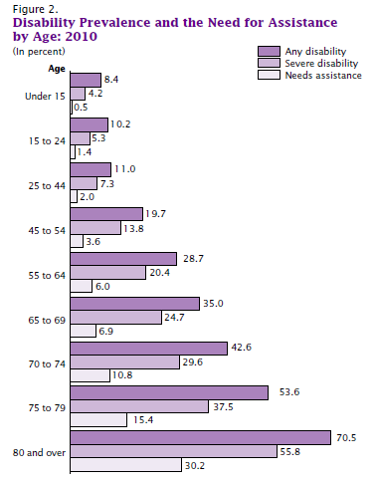
Chapter 2
While disability affects all age groups, its prevalence rises steeply with age.
Source: U.S. Census Bureau, Americans with Disabilities: 2010
Notes:
While disability affects all age groups, its prevalence rises steeply with age.
According to the U.S. Census Bureau (2012), 18.7 percent of Americans (56.7 million people) report having some degree of disability. By age 45-54, almost one-fifth (19.75 percent) have a disability. By age 65-69, this jumps to more than one-third (35 percent) and by 80 and older to more than two-thirds (70.5 percent). Among Americans 65 and older, more than half (51.8 percent) have a disability, 36.9 percent have a severe disability.

Slide 18
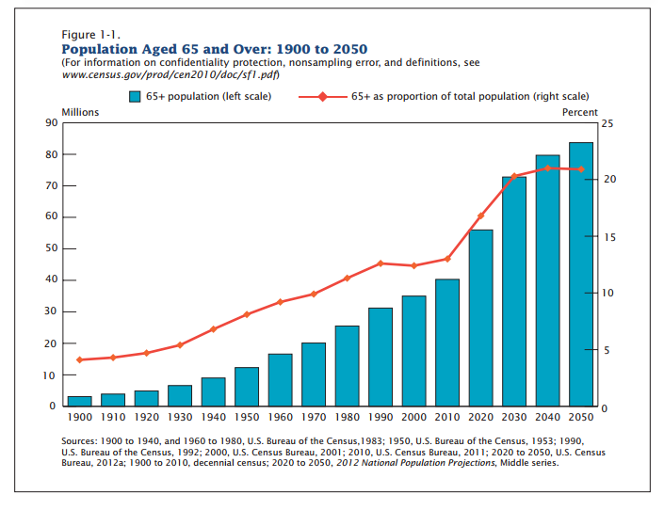
Chapter 2
Population Aged 65 and Over:
1900-2050
Source: U.S. Census Bureau, 65+ In The United States: 2010
Notes:
It’s not just in the U.S. that the population is rapidly aging. According to the World Health Organization (WHO), the percentage of people over age 60, which in 2000 was 11 percent, will double to 22 percent of the world population in 2050; equivalent to 2 billion people (WHO 2014).

Slide 19
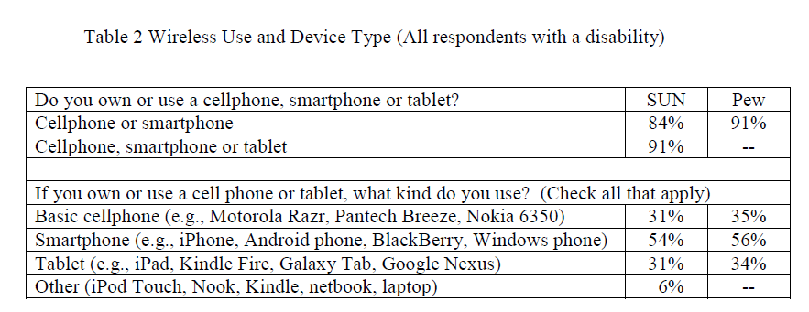
Chapter 2
Wireless Use and Device Type
  Americans with disabilities (SUN) vs.
  General population (PEW)
The 2012-13 Survey of User Needs (SUN) by the Rehabilitation Engineering Research Center for Wireless Technologies (RERC) finds that "as a group, people with disabilities own and use wireless technology at rates similar to the general population” (Morris et al 2013).
Sources: Wireless RERC, Survey of User Needs, 2012-2013. Pew Internet Surveys, 2006-2013
Notes:
Shows the adoption of mobile technology is very similar between PWD’s and the general population -
Rehabilitation Engineering Research Center for Wireless Technologies and Pew Research Center (fact tank in Washington DC)

Slide 20
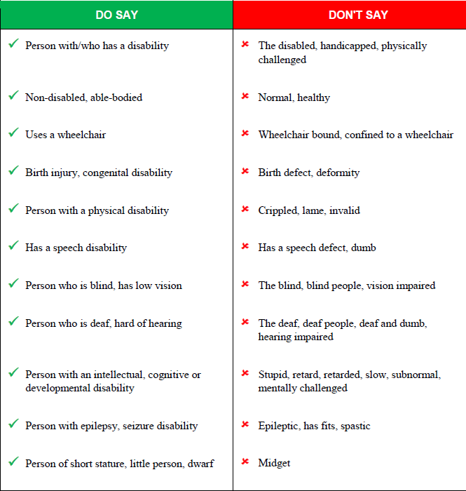
Chapter 2 Principles of Universal Design
Appropriate language
By acknowledging the person first, one is recognizing that this individual is more than just their disability.
Therefore, person-first language is used throughout this guidebook, e.g., "a man who is blind" rather than "a blind man."
Source: Open Doors Organization

Slide 21
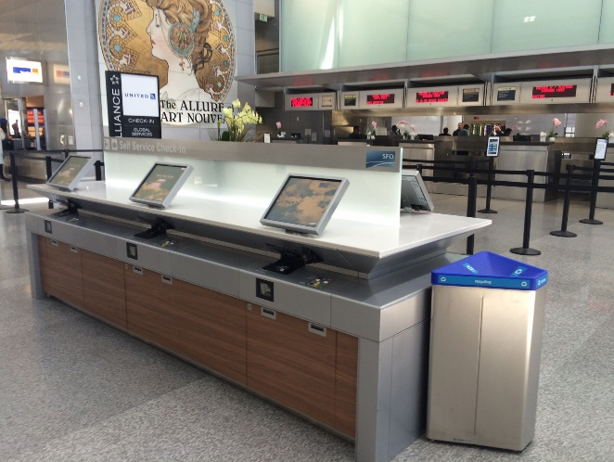

Chapter 2
Example of universal design Principle 2 - Flexibility in Use:
The design accommodates a wide range of individual preferences and abilities.
Source: ACRP 07-13 Research Team
SFO
Notes:
New common-use self-service (CUSS) kiosks, at San Francisco International Airport, allow standing and seated users to input information in a variety of ways: by scanning a passport or other ID, typing on the touch screen or using the EZ Access keypad. An audio jack allows those who are blind to get instructions verbally. Since all six stations at each table are accessible [exceeding the 25 percent mandated under Air Carrier Access Act (ACAA) regulations] these CUSS kiosks also illustrate Principle 1: Equity in Use.

Slide 22




Chapter 3
WHAT type of information is needed to communicate with the various passenger types
VISUAL VERBAL VIRTUAL TACTILE
Notes:
Chapter 3 looks at WHAT these strategies are, and how they apply to the target audience

Slide 23
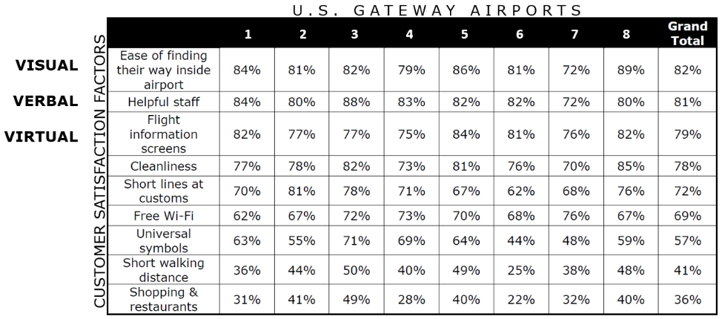
Chapter 3
“3 V’s” of Communication
1
2
3
Source: ACRP Report 161 - results from eight U.S. gateway airports, show percentages of the level of customer satisfaction for each factor surveyed
Notes:
Survey included 1,000 international customers at 8 US gateway airports. All of the 3 V’s of communication were at the top of what is most important to customers!

Slide 24



Chapter 3
Visual
Communication
Age 20 Age 60 Age 75
Human vision deteriorates with age, with older adults often experiencing significant vision problems in low-light environments. The above images show how much aging changes the relative transmission of light through the optic media for viewers of ages 20, 60 and 75
Uniform, legible typefaces like the sans-serif font, Frutiger Bold, as it would be seen by a viewer with no vision problem (left) compared to an example of how it would be perceived by a viewer experiencing a loss of light and focus (right). Despite loss of resolution, the message remains legible.
Source: Typography and the Aging Eye: Typeface Legibility for Older Viewers with Vision Problems by Paul Nini (01.23.06).
Notes:
It is important to understand how vision impacts access to information. The eye loses light with age. Eyes also lose focus.

Slide 25
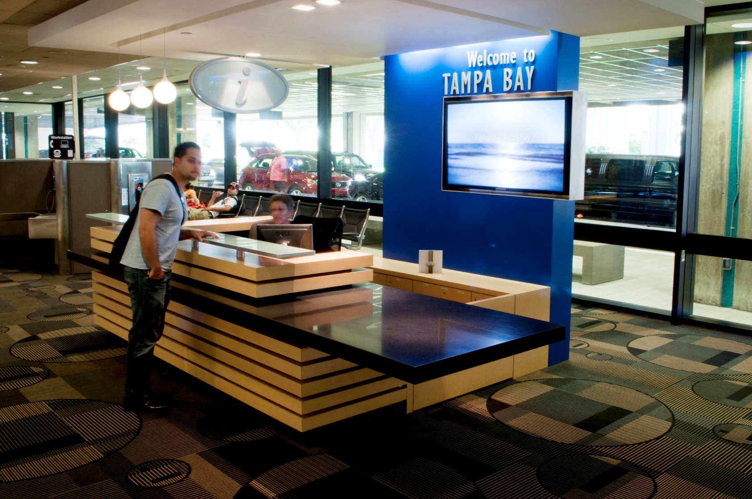
Chapter 3
Verbal
Communication
Verbal communication is a very important part of the wayfinding experience for aging travelers and persons with disabilities.
A building’s design should allow people to use its features in more than one prescribed way, e.g., standing and seated, as at this information desk at Tampa International Airport.
UD Principle 2. Flexibility in Use: The design accommodates a wide range of individual preferences and abilities.
TPA
Notes:
Verbal communication is a very important part of the wayfinding experience for aging travelers and persons with disabilities.
A building’s design should allow people to use its features in more than one prescribed way, e.g., standing and seated, as at this information desk at Tampa International Airport.
UD Principle 2. Flexibility in Use: The design accommodates a wide range of individual preferences and abilities.

Slide 26
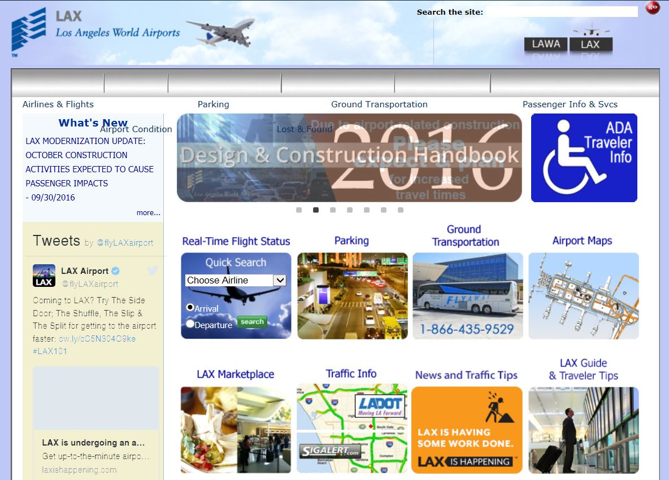
Chapter 3
Virtual Communication via Pre-trip Planning
The ability to plan in advance via digital media is becoming more and more effective. For older adults and pax with disabilities, advance knowledge can greatly enhance the wayfinding experience. The Wayfinding Accessibility Audit Checklist recommends including a link for disability-related information and resources. The preferred LOS is to have a link on the home page. A higher LOS would have the link visible above the scroll
LAX
Notes:
The ability to plan in advance via digital media is becoming more and more effective. For older adults and pax with disabilities, advance knowledge can greatly enhance the wayfinding experience. The Wayfinding Accessibility Audit Checklist recommends including a link for disability-related information and resources. The preferred LOS is to have a link on the home page. A higher LOS would have the link visible above the scroll

Slide 27
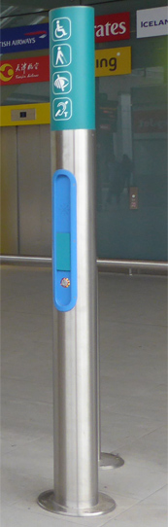
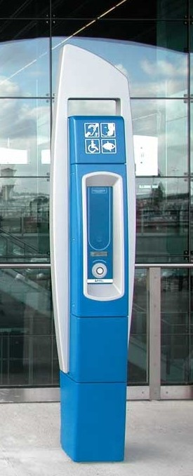
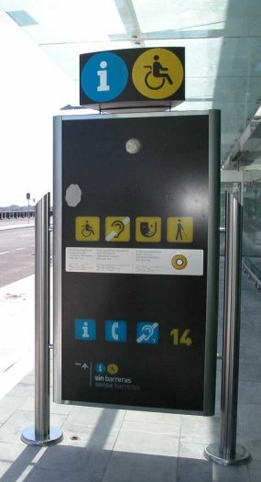
Chapter 3
Virtual & Verbal Communication
Accessible help/call points are easy-to-use communication devices that provide means for arriving travelers needing accessibility information or assistance to connect to a remotely located service provider.
These devices help provide convenient points for people with disabilities to initiate their wayfinding experience upon their arrival at the terminal.
CDG/LGA/MAD
Notes:
Accessible help/call points are easy-to-use communication devices that provide means for arriving travelers needing accessibility information or assistance to connect to a remotely located service provider.
These devices help provide convenient points for people with disabilities to initiate their wayfinding experience upon their arrival at the terminal.

Slide 28
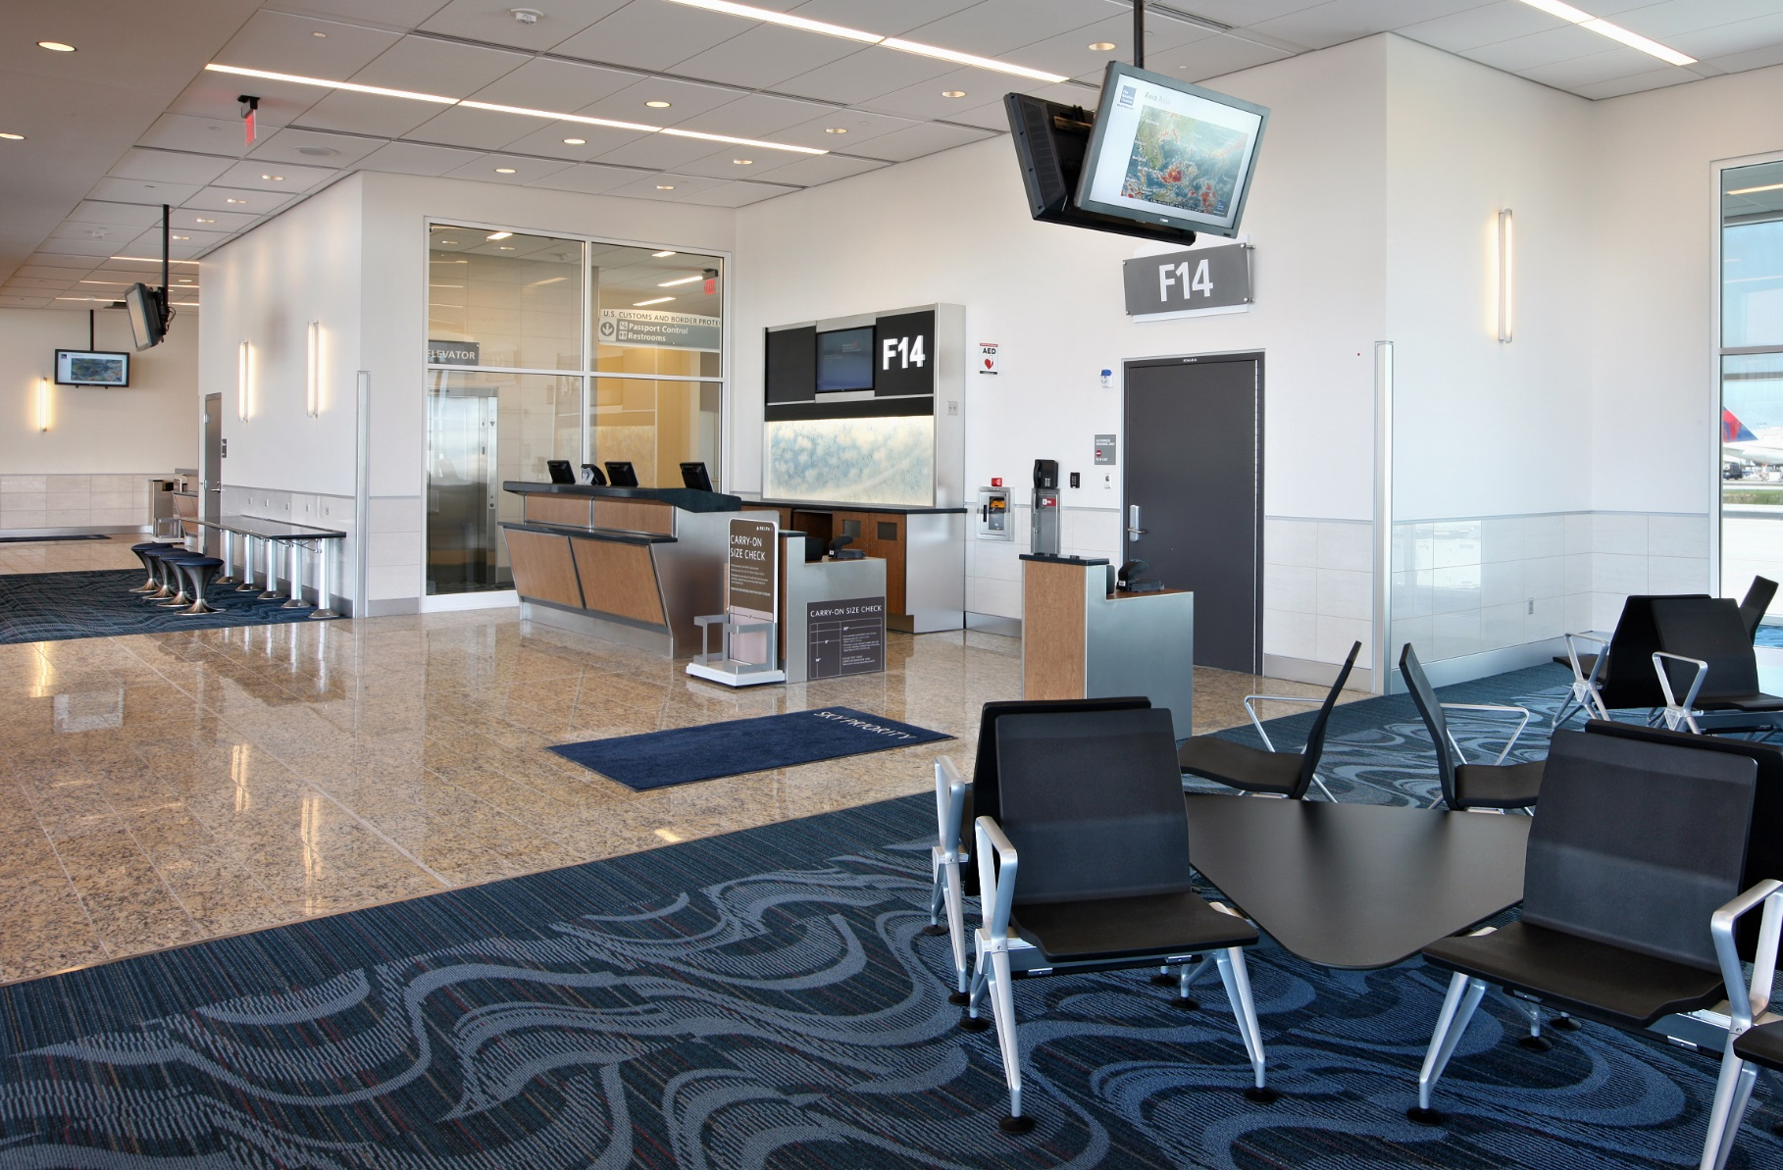
Chapter 3
Tactile
Communication
Uses of tactile information can be less obvious. For instance, clear delineation between a hard surface floor in the main concourse, versus a soft, carpeted surface in a hold-room seating area creates a shoreline that can provide a detectable, navigable path. A similar concept can also be applied to the boarding gate area. For those with low vision, contrasting light and dark colors provide an additional cue.
Source: ACRP Research Team
ATL
Notes:
Uses of tactile information can be less obvious. For instance, clear delineation between a hard surface floor in the main concourse, versus a soft, carpeted surface in a hold-room seating area creates a shoreline that can provide a detectable, navigable path. A similar concept can also be applied to the boarding gate area. For those with low vision, contrasting light and dark colors provide an additional cue.

Slide 29
Chapters 4, 5, 6, & 7 -
4. Airport Planning and Design Considerations
5. Departing Customer Journey
6. Arriving Customer Journey
7. Connecting Customer Journey
HOW to create a difference that creates a change and where appropriate WHY it is important.

Slide 30
Wayfinding Accessibility Audit Checklist
First of its kind consolidated tool that merges both wayfinding analyses AND accessibility audits into a single all-inclusive assessment.
Includes wayfinding strategies and accessibility features relevant to a passenger’s specific disability.
The following key factors must be evaluated:
Type of passenger: Departing - Arriving - Connecting
Passenger journey touch points
Type of disability or functional limitation
3V’s of communication: Visual - Verbal - Virtual
Standards and/or regulations that apply
Notes:
Heretofore, there has not been a consolidated tool that merges both wayfinding analyses AND accessibility audits into a single all-inclusive assessment. The wayfinding accessibility audit checklist includes wayfinding strategies and accessibility features relevant to a passenger’s specific disability. To conduct a successful wayfinding accessibility audit, the following key factors must be evaluated:

Slide 31
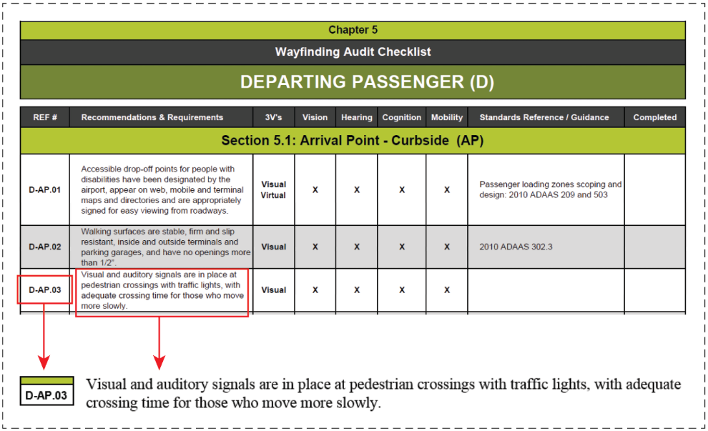
Recommendations and/or Requirements
Notes:
Excerpt from the Chapter 5 Wayfinding Accessibility Audit Checklist

Slide 32
Type of communication
Notes:
Excerpt from the Chapter 5 Wayfinding Accessibility Audit Checklist

Slide 33
Types of disability
Notes:
Excerpt from the Chapter 5 Wayfinding Accessibility Audit Checklist

Slide 34
Standards reference
Notes:
Excerpt from the Chapter 5 Wayfinding Accessibility Audit Checklist

Slide 35
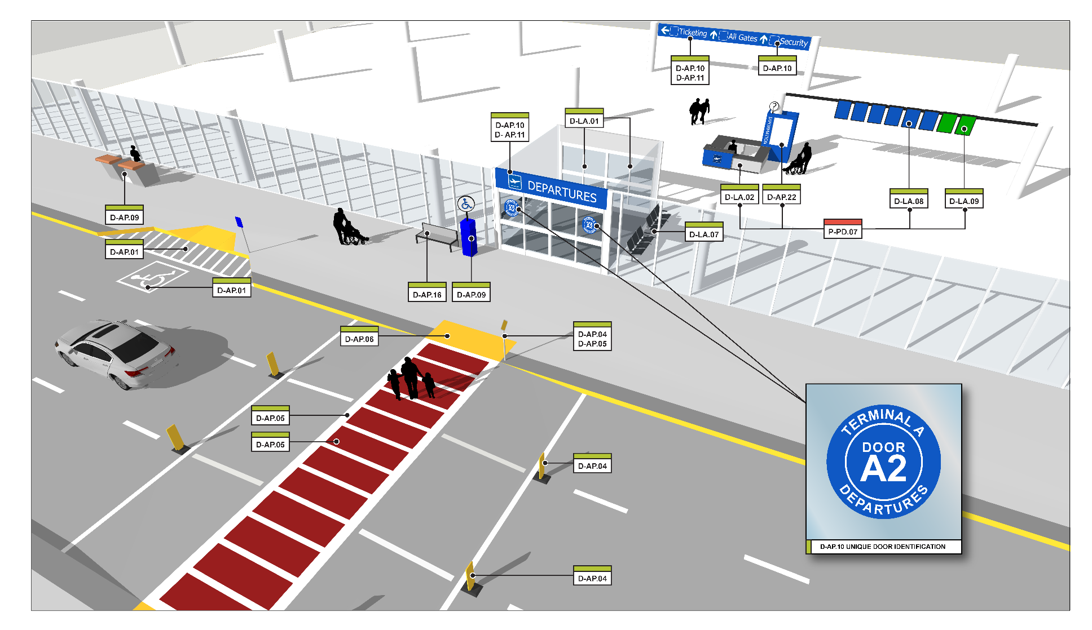
VIRTUAL MODEL
Checklist is illustrated in 3D virtual airport model
Notes:
The guidebook includes virtual models of each customer journey segment

Slide 36
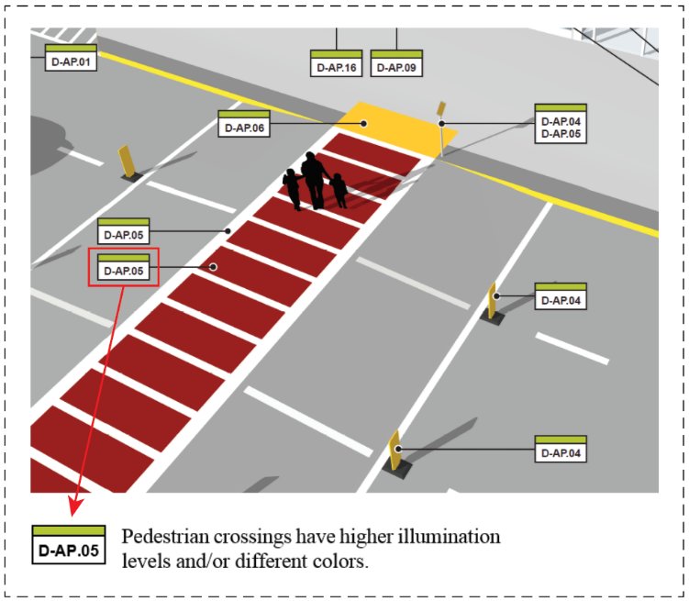
VIRTUAL MODEL
Unique reference number labels in the 3D virtual model correlate with the checklist

Slide 37
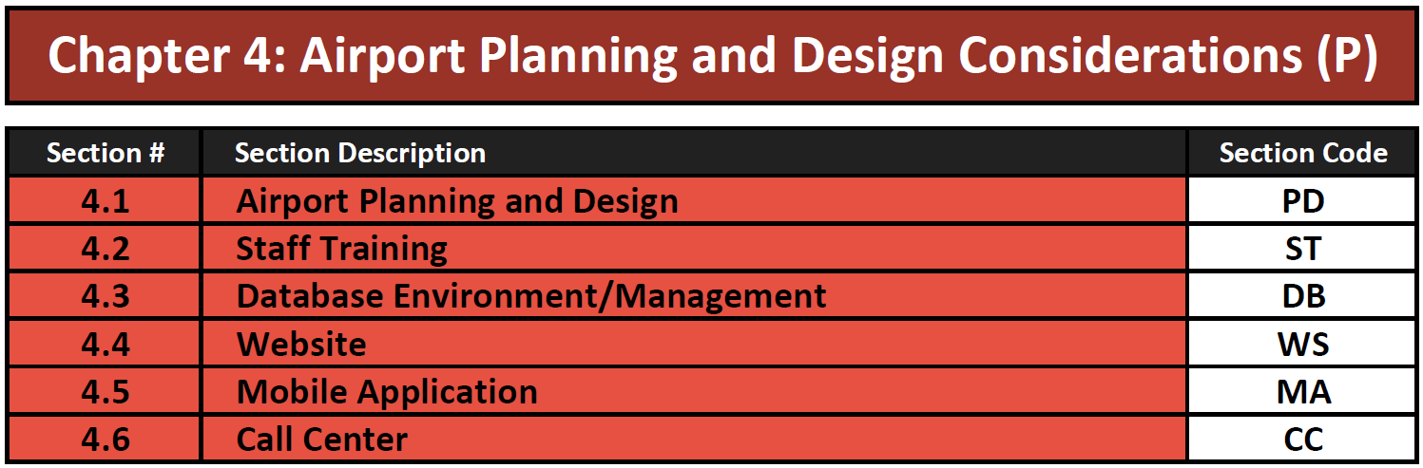
Chapter 4

Slide 38
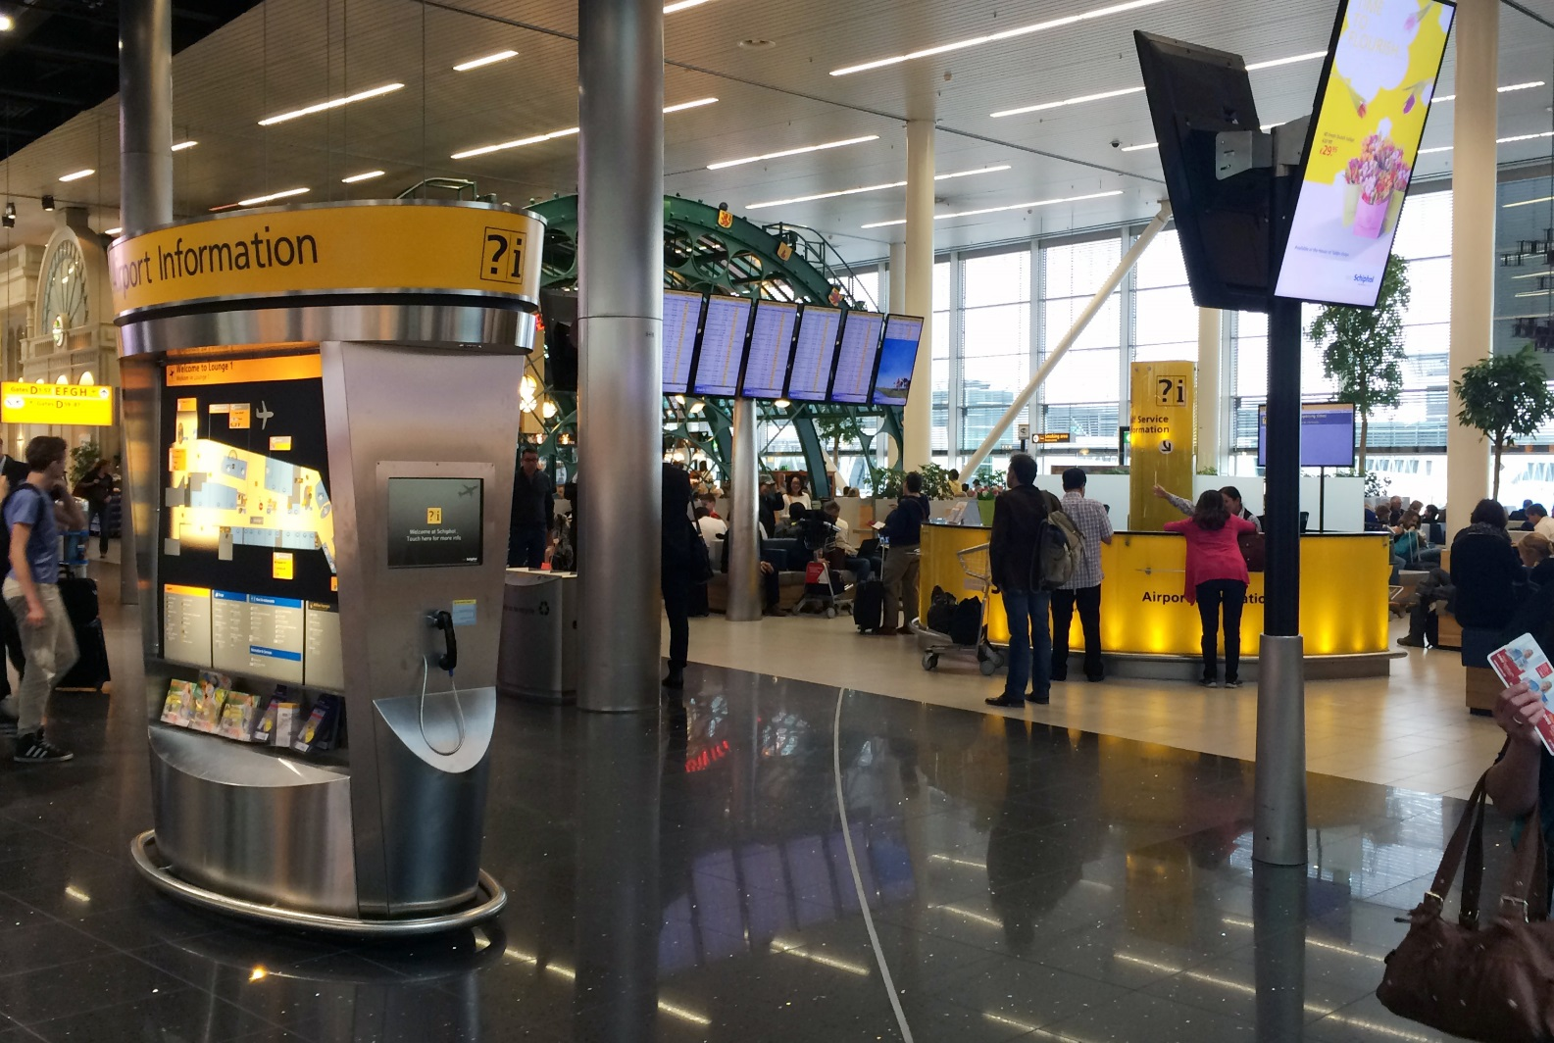
Chapter 4
Planned adjacencies
There are planned adjacencies at key decision nodes for information sources:
Virtual, e.g., Flight Information Display Systems (FIDS)
Verbal, e.g., staff positions and information desks
Visual, e.g., airport directories, etc.
AMS
Notes:
There are planned adjacencies at key decision nodes for information sources:
Virtual, e.g., Flight Information Display Systems (FIDS)
Verbal, e.g., staff positions and information desks
Visual, e.g., airport directories, etc.

Slide 39
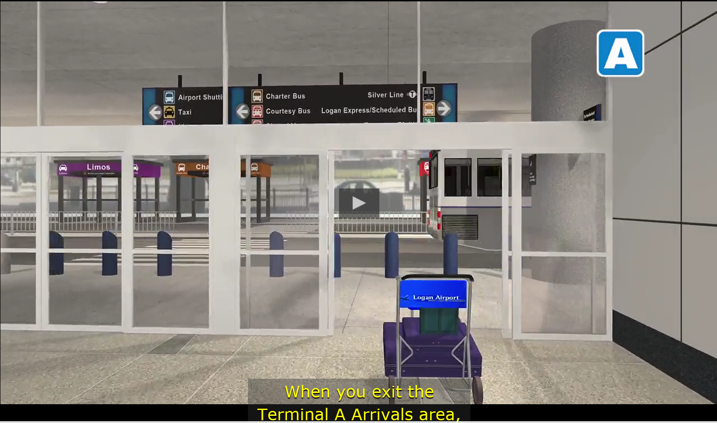
Chapter 4
Pre-trip planning information
Online virtual tour for pre-trip planning is captioned 2 that uses both captioning for those who cannot hear as well as audio for persons who are blind or have low vision
BOS
Notes:
Online virtual tour for pre-trip planning is captioned 2 that uses both captioning for those who cannot hear as well as audio for persons who are blind or have low vision

Slide 40
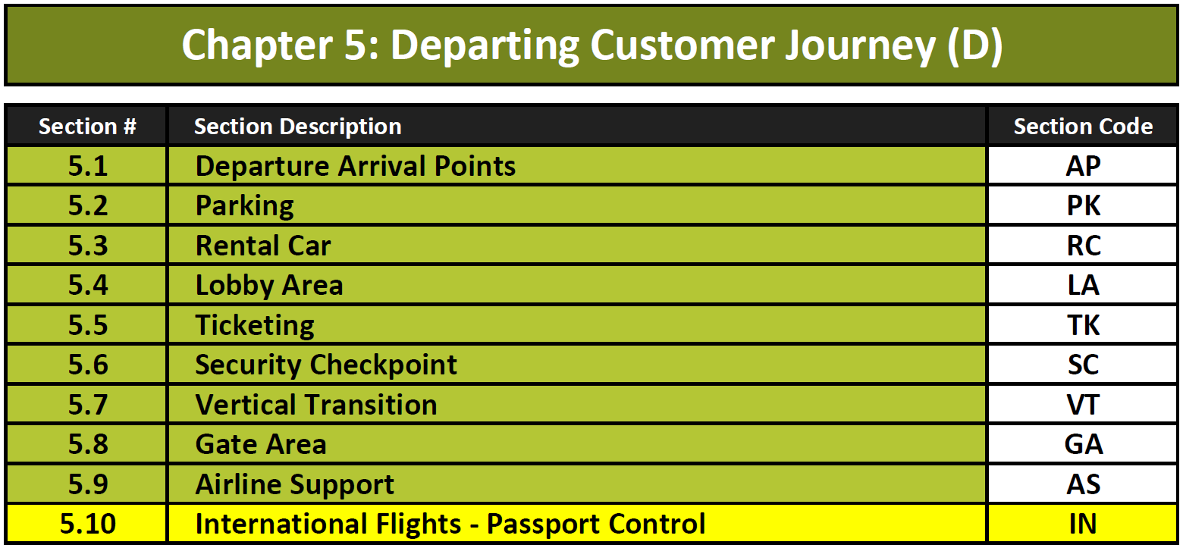
Chapter 5

Slide 41
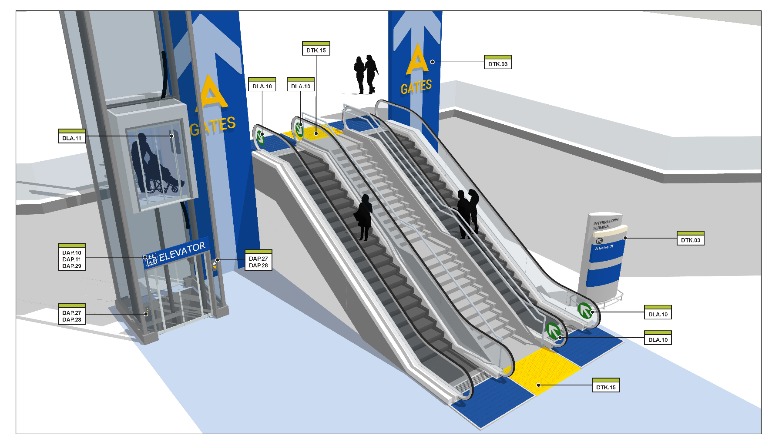
Chapter 5
Vertical Transitions: Section 5.7
Intuitive
Clear line of sight
Adjacency
Notes:
The virtual model of vertical transitions show how it is important to plan and design for Intuitive circulation with Clear lines of sight with logical Adjacencies of stairs, escalators, and elevators. DO NOT hide the elevators!

Slide 42
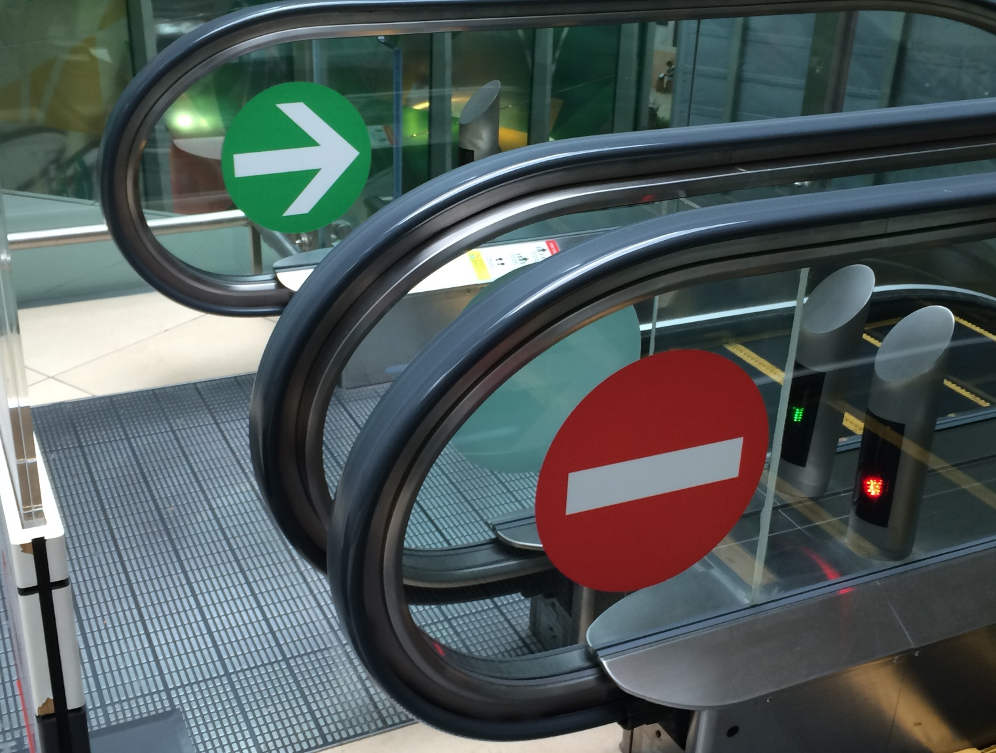
Chapter 5
Vertical Transitions: Section 5.7
Escalators include visual reinforcement of operating direction.
Simple, bold graphic indicators help customers with cognitive issues, as well aging travelers who may struggle with visual acuity, know which escalator to use at vertical transitions, and also helps mitigate safety concerns associated with escalators
CHANGI
Notes:
Escalators include visual reinforcement of operating direction. Simple, bold graphic indicators help customers with cognitive issues, as well aging travelers who may struggle with visual acuity, know which escalator to use at vertical transitions, and also helps mitigate safety concerns associated with escalators

Slide 43
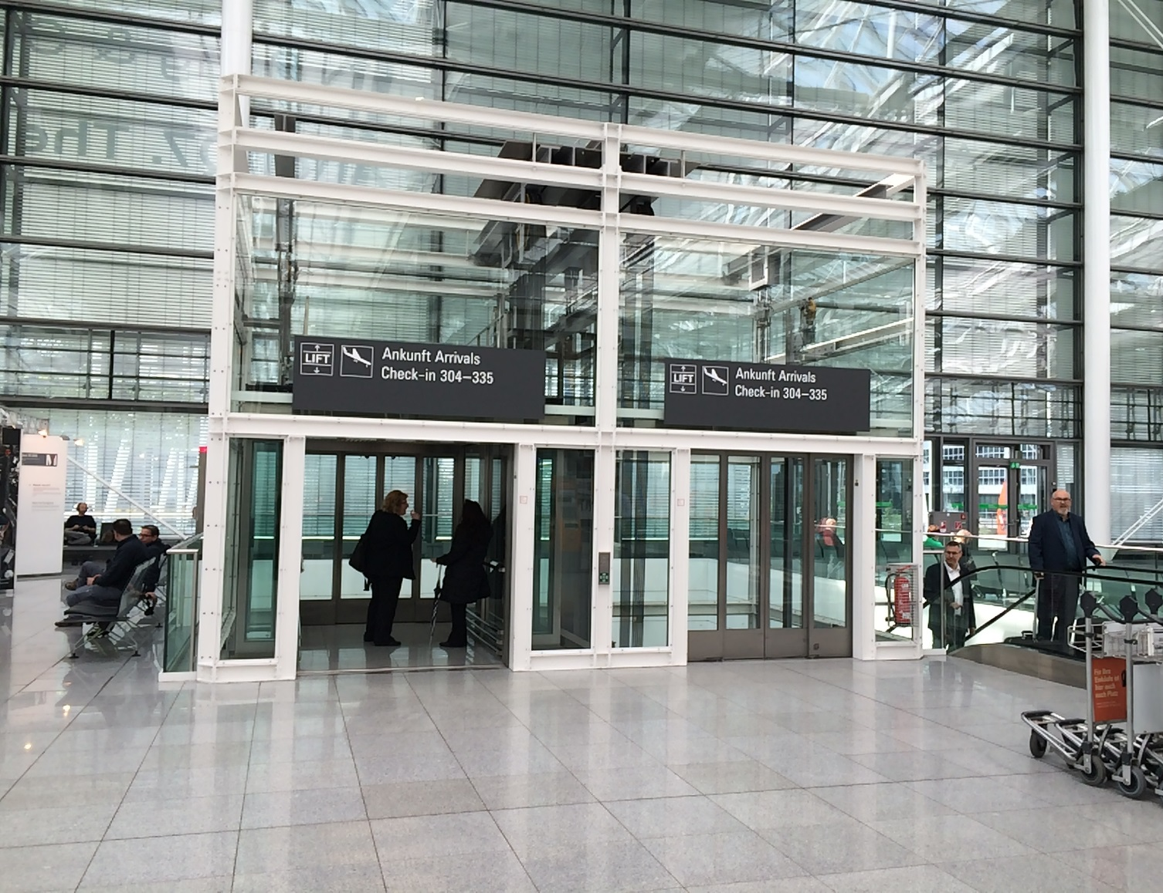
Chapter 5
Vertical Transitions: Section 5.7
Elevators that have glass doors promote open sight lines and ease of identification.
The consequence of architectural design that hides essential vertical transportation is adding extra signage and wayfinding.
MUC
Notes:
Elevators that have glass doors promote open sight lines and ease of identification. The consequence of architectural design that hides essential vertical transportation is adding extra signage and wayfinding.

Slide 44
Chapter 5
Vertical Transition: Intuitive design
Over-signing is commonly used to compensate for the complex floor plan layouts where wayfinding is a chronic problem.
Increases in plan complexity are directly related to decreases in wayfinding performance. The presence of signs is not able to compensate for wayfinding problems due to the complexity of the floor plan.
The next 2 slides are a comparison of non-intuitive versus intuitive wayfinding at vertical transitions and WHY architecture plays a critical role.

Slide 45
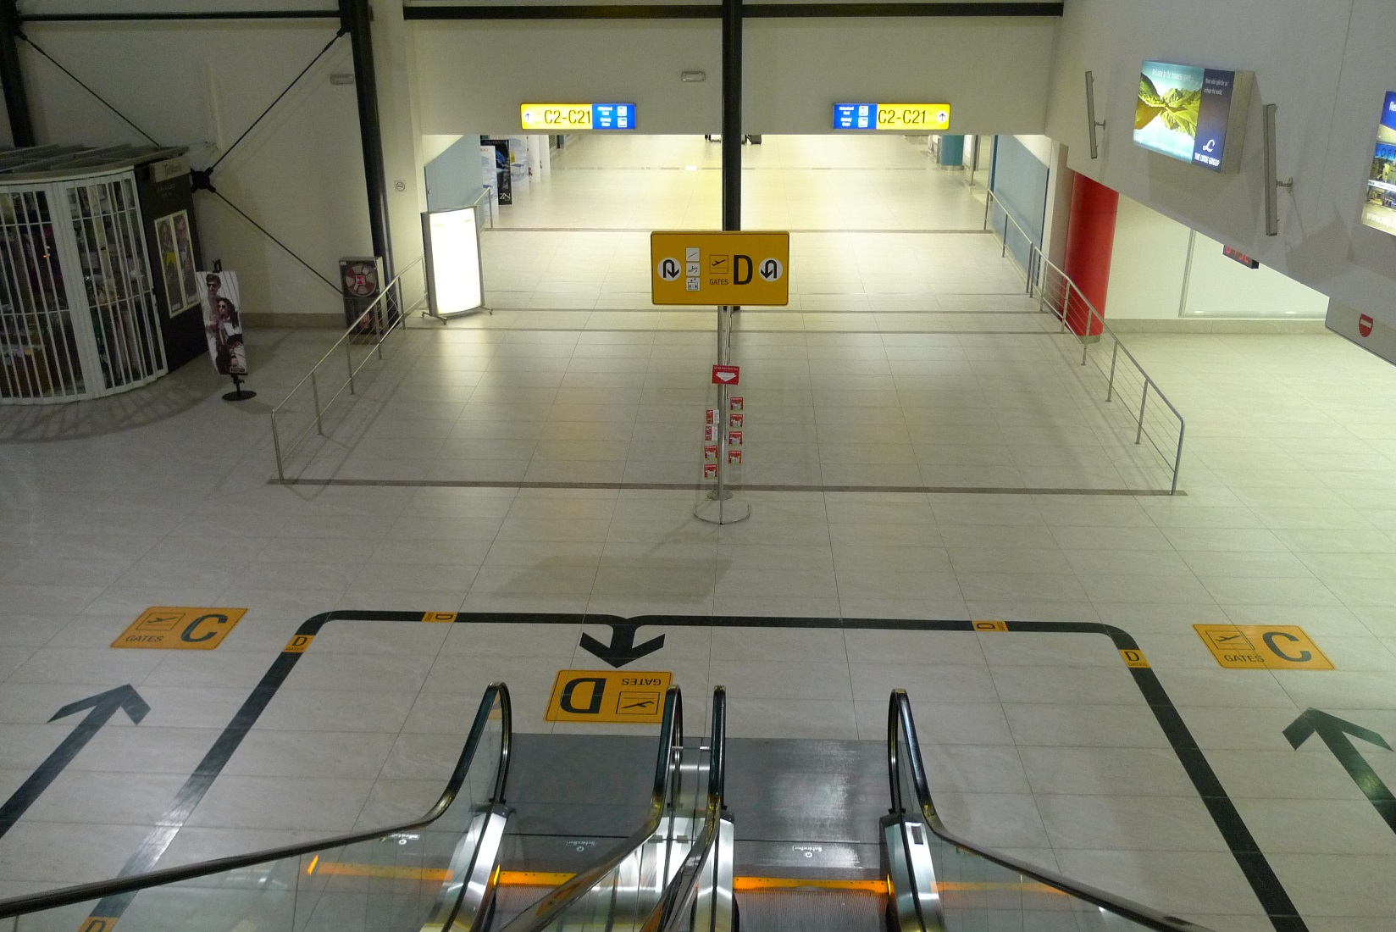
Chapter 5
Vertical Transition: Non-intuitive design
The Prague International Airport (PRG), illustrates the challenges of trying to overcome non-intuitive architecture that dictates counterintuitive passenger circulation at the bottom of the escalators.
PRG
Notes:
The Prague International Airport (PRG), illustrates the challenges of trying to overcome non-intuitive architecture that dictates counterintuitive passenger circulation at the bottom of the escalators.

Slide 46
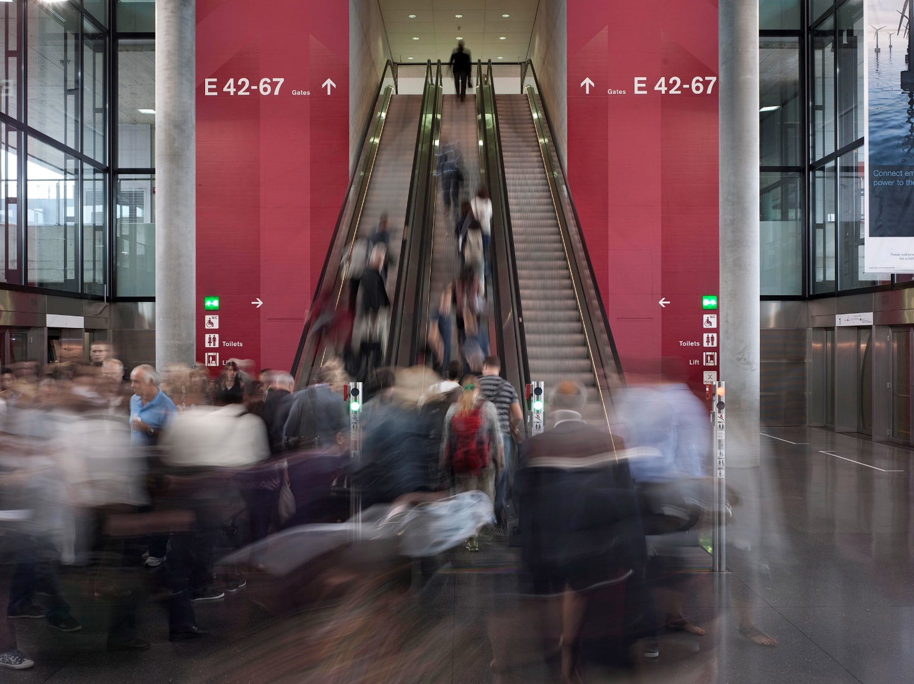
Chapter 5
Vertical Transition: Intuitive design
By comparison, escalators at the Zurich Airport provide simple, clear and bold visual graphics that support intuitive wayfinding in ways that can help customers with cognitive disabilities.
ZRH
Notes:
By comparison, escalators at the Zurich Airport provide simple, clear and bold visual graphics that support intuitive wayfinding in ways that can help customers with cognitive disabilities.

Slide 47
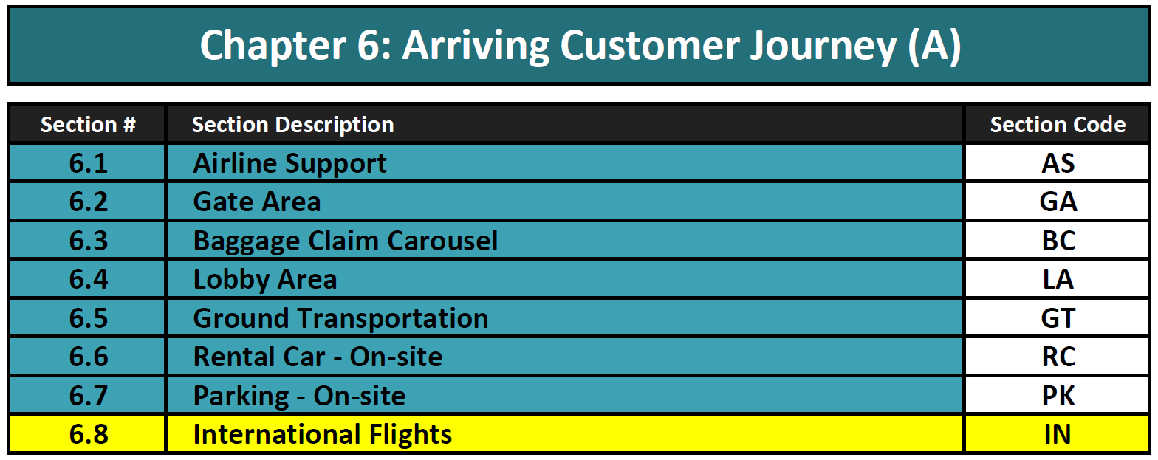
Chapter 6

Slide 48
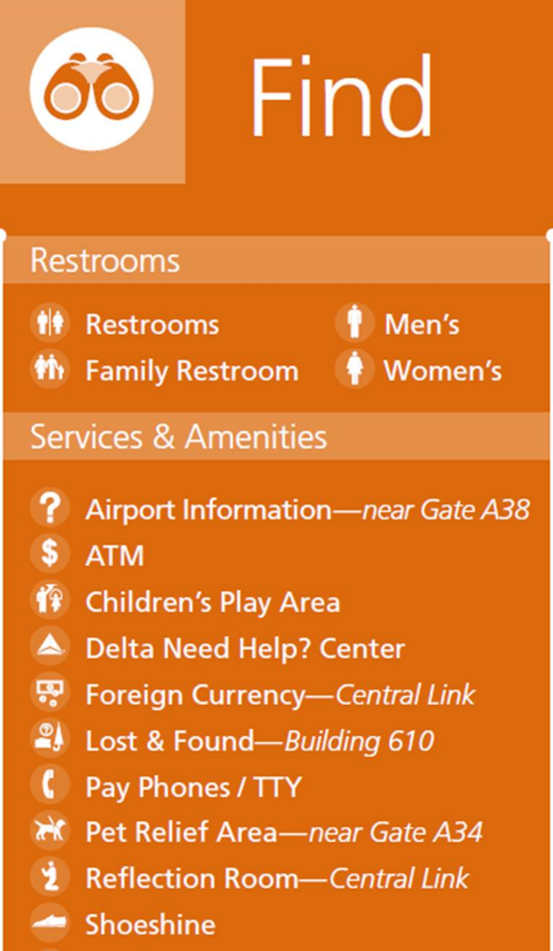
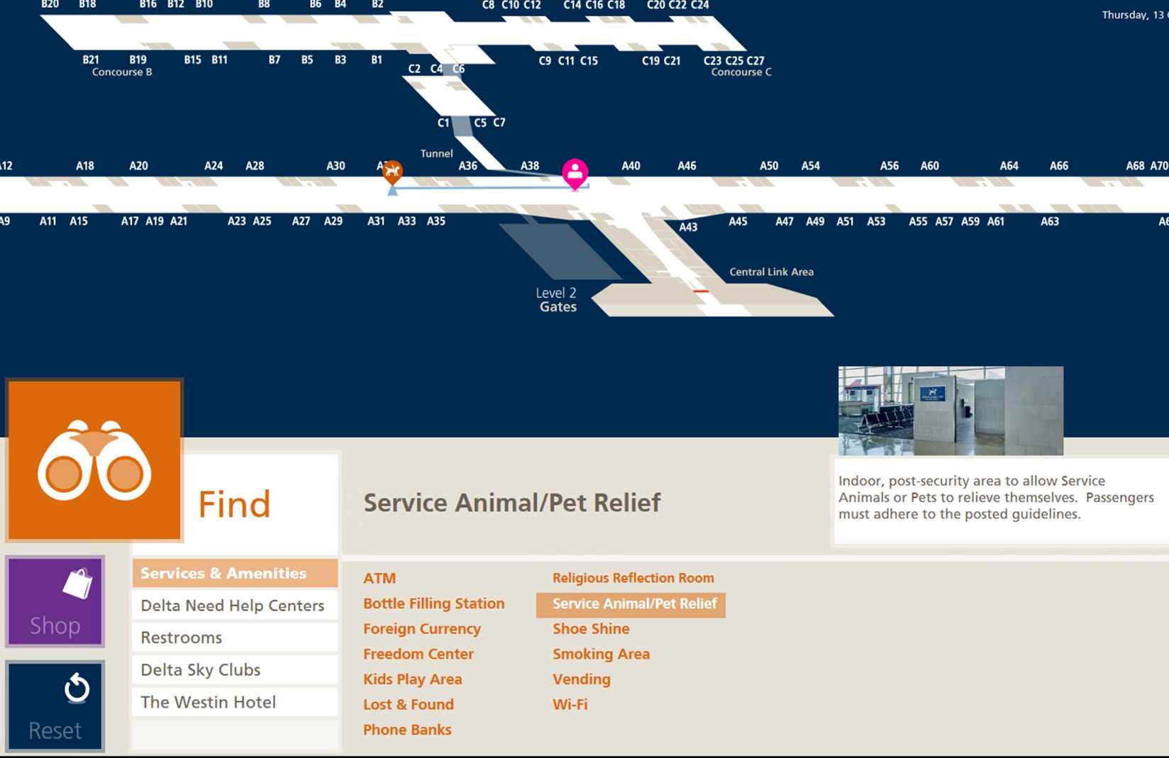
Chapter 6
Service Animal Relief Area (SARA) at DTW McNamara
DTW
Notes:
Interactive digital technology can help customer find destinations with highlighted routes – walking distances – time – etc. Photos of the destination help customers with cognitive issues with recognition and confirmation

Slide 49
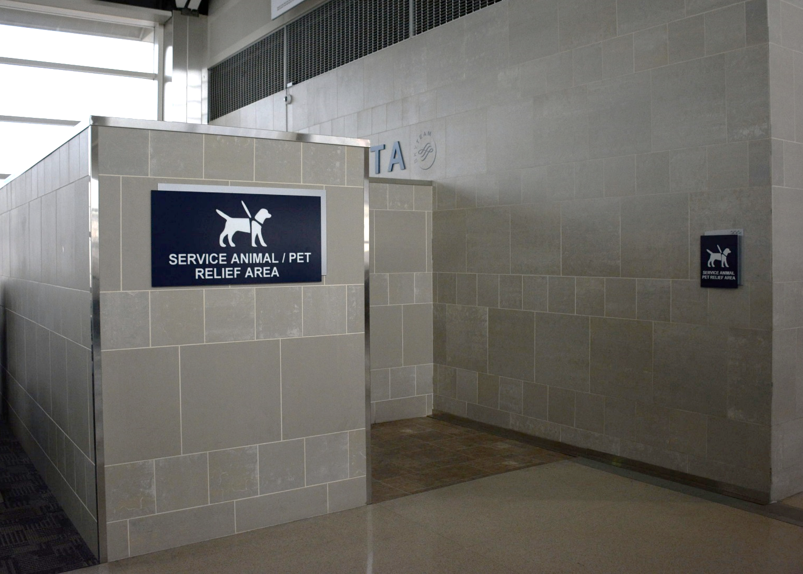
Chapter 6
Service Animal Relief Area (SARA)
Service Animal Relief Area (SARAs) available airside are centrally located to minimize walk times, have appropriate directional and identification signage, appear on maps directories. 49 CFR Part 27.71 requires SARAs airside with limited exceptions.
Location of the SARA at DTW is communicated virtually through the interactive directories, that show route and photo of destination to help with recognition and confirmation visually.
DTW
Notes:
Service Animal Relief Area (SARAs) available airside are centrally located to minimize walk times, have appropriate directional and identification signage, appear on maps directories. 49 CFR Part 27.71 requires SARAs airside with limited exceptions.
Location of the SARA at DTW is communicated virtually through the interactive directories, that show route and photo of destination to help with recognition and confirmation visually.

Slide 50
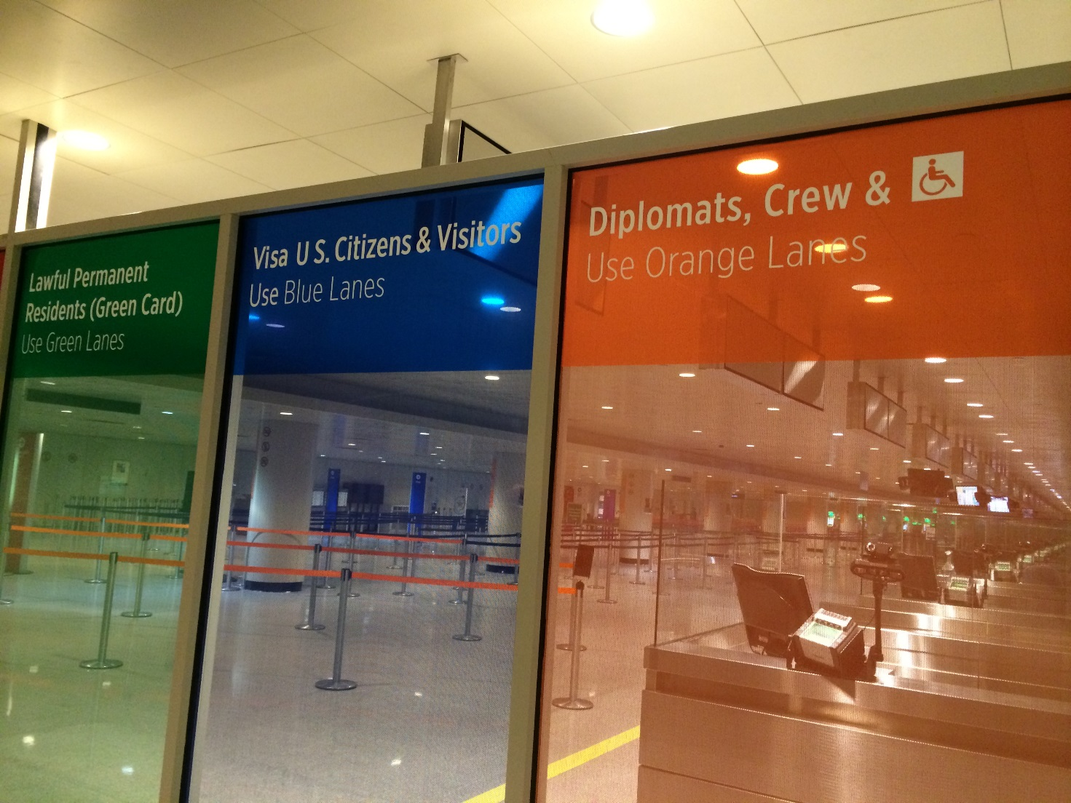
Chapter 6
International arrivals
Signs, visually indicate lanes for employees and people with disabilities. This benefits those not being escorted, especially those with hidden disabilities.
Color-coded wayfinding in the Customs and Border Patrol area at BOS helps visually guide persons with disabilities with advance education prior to the queue and confirmation at queue entry point.
BOS
Notes:
Signs, visually indicate lanes for employees and people with disabilities. This benefits those not being escorted, especially those with hidden disabilities.
Color-coded wayfinding in the Customs and Border Patrol area at BOS helps visually guide persons with disabilities with advance education prior to the queue and confirmation at queue entry point.

Slide 51
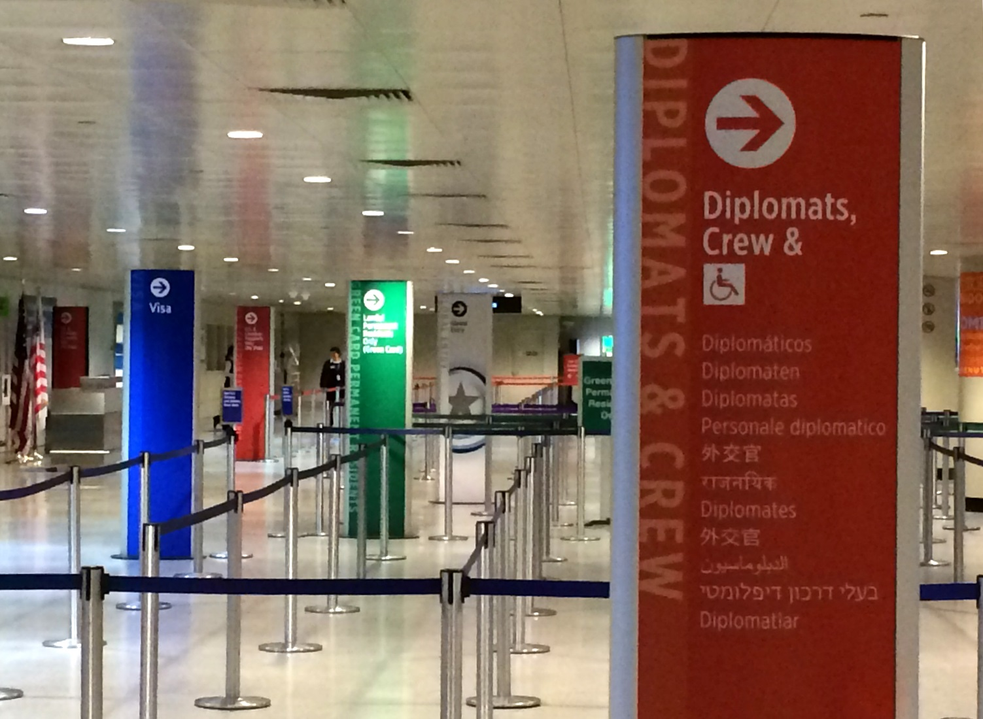
Chapter 6
International arrivals
Dedicated lanes for persons with disabilities at Boston Logan International Airport
BOS
Notes:
Color coding at CBP Primary inspection with Dedicated lanes for persons with disabilities at Boston Logan International Airport

Slide 52
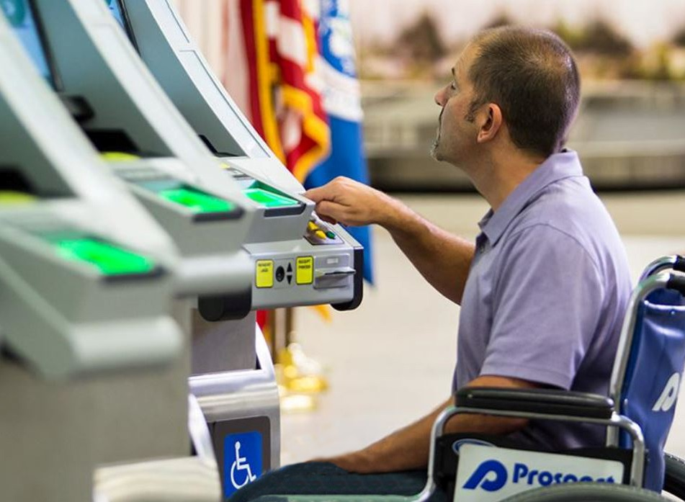
Chapter 6
International arrivals
Accessible passport kiosks enables U.S. passengers to scan passport and customs forms and print a receipt to show CBP officers
TPA
Notes:
Accessible passport kiosks enables U.S. passengers to scan passport and customs forms and print a receipt to show CBP officers

Slide 53
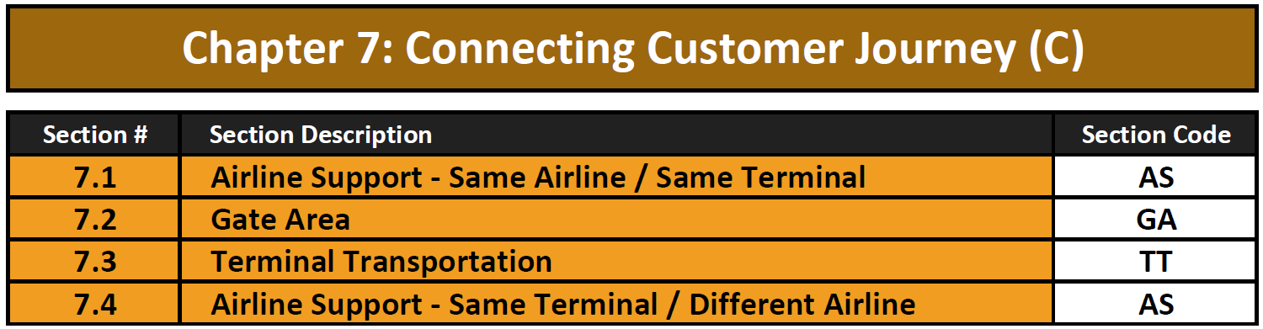
Chapter 7

Slide 54
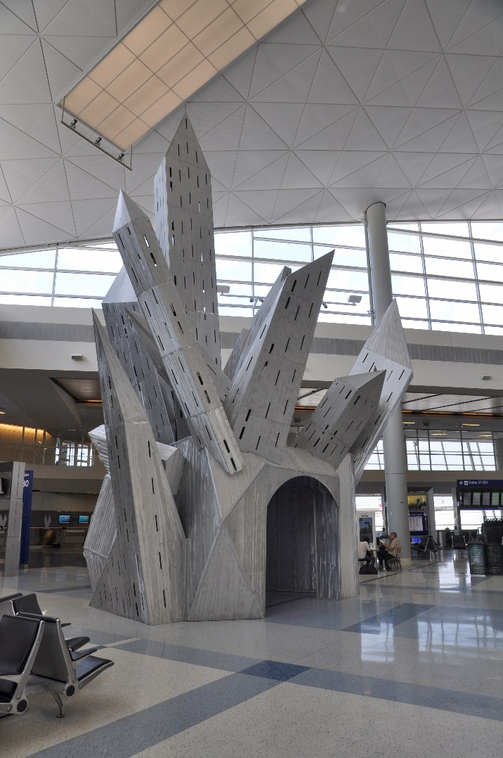
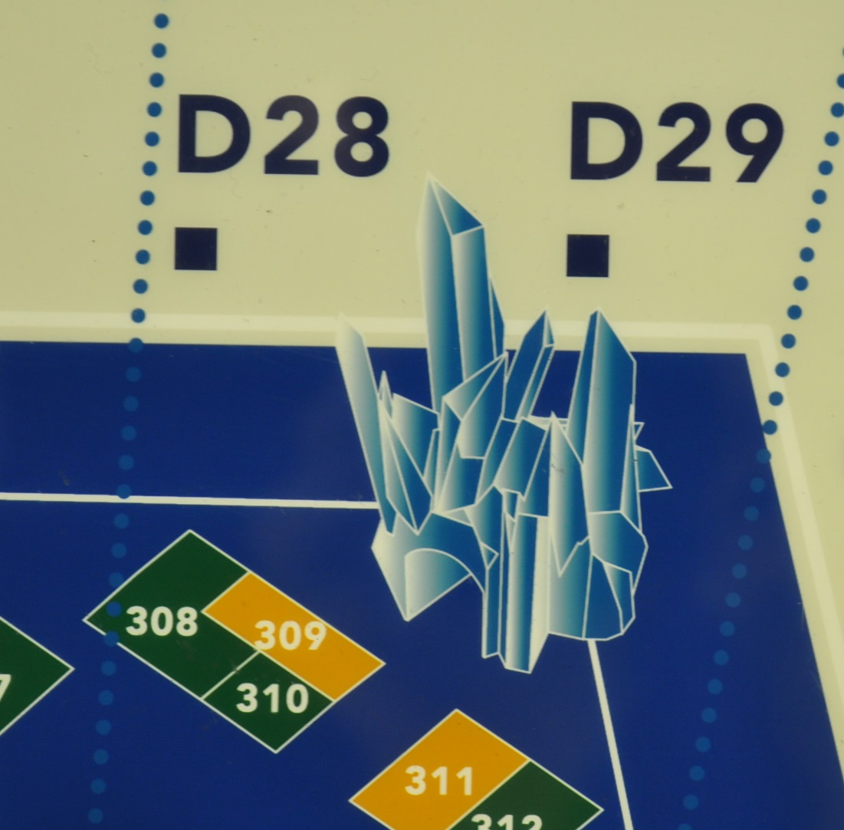
Chapter 7
Landmarks
Providing information that can help customers establish relationships between concrete landmarks and graphic representations on maps is one way to help aging travelers and persons with disabilities navigate a complex airport environment and confirm they are on the correct path to find their connecting gate.
Example at DFW shows how artwork, in this case a castle, can be used as a recognizable landmark for navigation.
DFW
Notes:
Providing information that can help customers establish relationships between concrete landmarks and graphic representations on maps is one way to help aging travelers and persons with disabilities navigate a complex airport environment and confirm they are on the correct path to find their connecting gate.
Example at DFW shows how artwork, in this case a castle, can be used as a recognizable landmark for navigation.

Slide 55
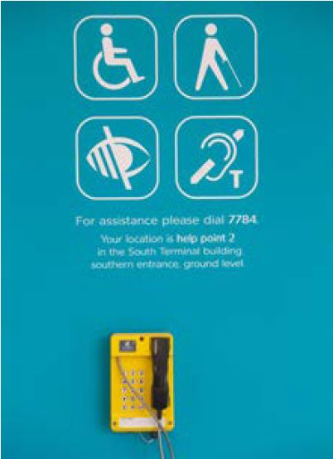
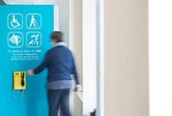
Chapter 7
Help points
Courtesy phones are located at regular intervals along the concourse, including at major decision points, and identified by visual and tactile signage. In Europe, help points are used as an additional level of support to connect with aging travelers and persons with disabilities as shown at London Gatwick. Pictograms denote the service. Information includes the location of the courtesy phone.
LGW

Slide 56
Chapter 8
Technology that shows HOW to create a difference that creates a change and where appropriate, WHY it is important.

Slide 57
Chapter 8
Recent years have seen an explosion of digital devices, software and content in many aspects of life.
Because mainstream access was feasible for all of these technologies when developed, the digital revolution should have been a powerful engine for integration of people with disabilities through equal access to these enhancements of modern life.
Unfortunately, only recently have developers of these technologies begun to recognize the benefits of and need for universal design of these technologies to permit access by people with disabilities.

Slide 58
Chapter 8
8.1 Overview
8.2 Accessible Websites
8.3 Mobile Wayfinding Applications
8.4 Accessible Help/Call Points
8.5 Interactive Kiosks
8.6 Digital Wayfinding Directories
8.7 FIDS (Flight Information Display System)
8.8 Hearing Loops
8.9 Visual Paging

Slide 59
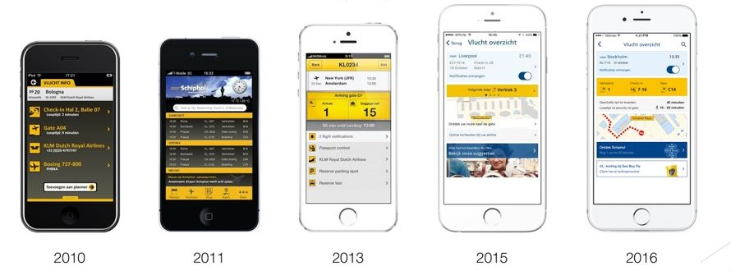
Chapter 8
Section 8.3 Mobile Wayfinding Applications
Current mobile applications for airport wayfinding do not meet the needs of users with disabilities. The research team asked participants to download and test award-winning and industry-leading applications from airports around the world, such as the airport app at Amsterdam Airport Schiphol that is now in its fifth generation.

Slide 60
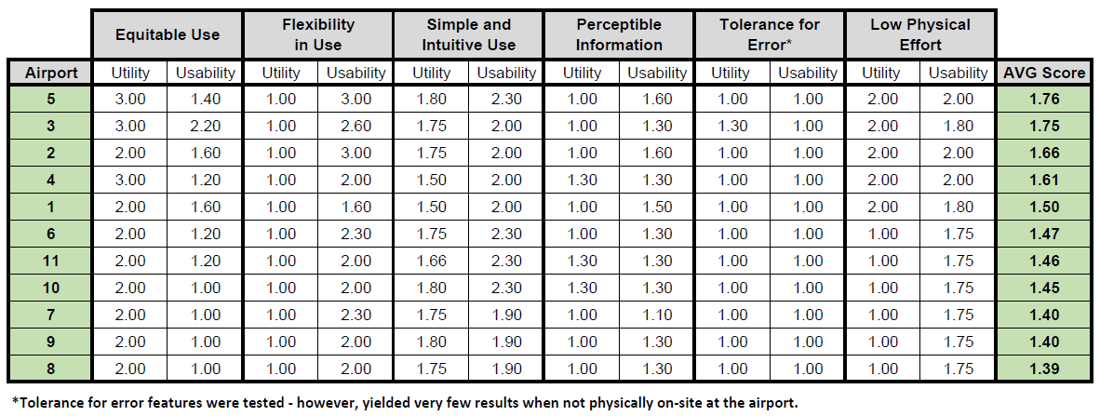
Chapter 8
Section 8.3 Mobile Wayfinding Applications
Each airport’s app was rated for functionality or capability as it pertained to the universal design principles as good (4), fair (3), poor (2), and absent (1). The scores were averaged over the users and applied to each category. In general, the applications tested demonstrated great usability for users without disabilities, but scored poorly for users with disabilities.
Airports tested listed in alphabetical order included:
Amsterdam
Copenhagen
Dallas Fort Worth
Dubai
Fort Lauderdale
Frankfurt
Heathrow
Miami
Munich
San Francisco
Zurich
Notes:
Airports tested listed in alphabetical order included:
Amsterdam – Copenhagen - Dallas Fort Worth – Dubai - Fort Lauderdale – Frankfurt – Heathrow – Miami – Munich - San Francisco - Zurich

Slide 61
Chapter 8
Section 8.3 Mobile Wayfinding Applications
These test results illustrate that most airport wayfinding apps are not currently designed to accommodate users with disabilities.
Section 8.3.4 discusses a set of research-based guidelines that can help app developers who are creating or updating wayfinding apps avoid common pitfalls and achieve universal design principles in their apps.
A number of indoor and outdoor mobile wayfinding and navigation applications have been developed for specific user groups, including the general public, people with mobility disabilities, and people with vision disabilities.
Similarly, where applications have used alternative inputs (e.g., speech recognition) and outputs (e.g., voice output, high contrast) to provide accessible information for users with vision loss, no single application has been developed that is usable by people with a wide range of physical, sensory and cognitive abilities.

Slide 62
Chapter 8
Section 8.3 Mobile Wayfinding Applications
However, to date, no single application has been developed that provides essential route information useful to all users.

Slide 63
Chapter 8
Section 8.3 Mobile Wayfinding Applications
However, to date, no single application has been developed that provides essential route information useful to all users.
The goal of the guidelines in Section 8.3 is to provide mobile app developers (e.g., airlines, airports, third-parties) with a set of principles and accompanying checklist that they can reference when creating or improving wayfinding mobile apps in order to maximize the utility and usability for all travelers, especially travelers with disabilities.
These guidelines are relevant regardless of the underlying positioning technology used to determine the user’s location and orientation (e.g., beacon, Wi-Fi trilateration, camera).

Slide 64
Chapter 8
Section 8.3 Mobile Wayfinding Applications
The guidelines reinforce the extension of the seven Principles of Universal Design (Center for Universal Design, 1997) beyond the design of physical objects and spaces to the development of airport and other wayfinding applications.
Each guideline discusses a general principle to be followed, and is accompanied by a checklist of “Do’s and Don’ts” to help make it easier for developers to organize and implement each concept.
“Do’s” are actions that developers should take to improve their application for travelers, while “Don’ts” are common pitfalls that developers should avoid.

Slide 65
Chapter 8
Section 8.3 Mobile Wayfinding Applications
To ensure the guidelines are grounded in real-world conditions and environments as well as empirical evidence, the research team tested a prototype wayfinding app that was based on the principles of universal design.
Utility testing of this prototype app was conducted by the Georgia Tech Center for Assistive Technology and Environmental Access on-site in the Austin-Bergstrom International Airport in Austin, Texas.
Usability testing of the prototype app was conducted at the Georgia Tech Center for Assistive Technology and Environmental Access.
Participants included a variety of impairments including blind, low vision, deaf, hard of hearing, mobility and cognitive..

Slide 66
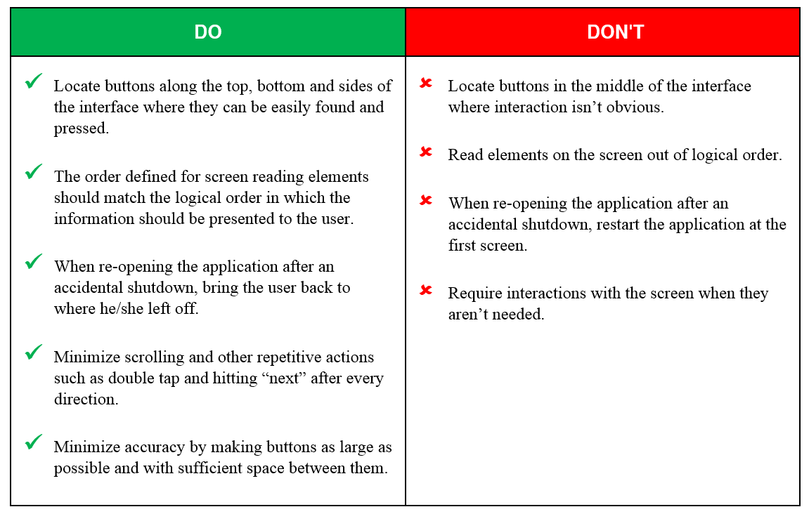
Chapter 8
Section 8.3 Mobile Wayfinding Applications
The mobile app guidelines consists of 19 criteria, e.g.: Design Your Application for a Wide Range of Devices to Low Physical Effort
Example of Do’s and Don’ts from Low Physical Effort
8.3.4.9 Provide Choice in Wayfinding Directions
8.3.4.9 Provide Choice in Wayfinding Directions
8.3.4.11 Advanced Planning

Slide 67
SUMMARY
In order for airports to properly apply the recommendations and requirements in ACRP Research Report 177, it is important to understand
WHY this research is important as presented in Chapter 1.

Slide 68
SUMMARY
It is also important to understand WHO the users are and the needs of the different types of passengers with disabilities and aging travelers in Chapter 2.

Slide 69
SUMMARY
It is also important to focus on WHAT kind of information is needed to communicate with the various passenger types in Chapter 3

Slide 70
SUMMARY
Apply the best practices and recommendations from the Wayfinding Accessibility Audit Checklist in Chapters 4, 5, 6 and 7 that will help the reader understand HOW to create a difference that creates a change.

Slide 71
SUMMARY
Virtual wayfinding systems encompass a diverse and rapidly changing range of wired and wireless communications-based information and electronics technologies.
Chapter 8 covers some of the technologies encountered in the airport wayfinding travel experience, best practices for implementation, and how the principles of universal design can be incorporated to expand or enhance the capabilities of the technology to be inclusive of as many people as possible regardless of limitations or disabilities.

Slide 72
SUMMARY
The cumulative result of ACRP Research Report 177 will equip airports with the information they need to
create a difference that creates a change…
…that promotes Independent Travel
for aging travelers and persons with disabilities

