Slide 1
Implementing Airport Privatization/P3: Guidance for Airport Decision Makers

Slide 2
Research Objectives
  Identify lessons learned in U.S. and international airport privatization and P3 models, expanding on ACRP Report 66 (2012)
  Operationalize information to help airport leaders consider if a P3 is right for them
  Provide guidance on strategies and capabilities necessary to implement a P3
  Broaden the airports and projects using P3

Slide 3
Who should use this research?
  Airport practitioners
    Procurement and finance staff
    Executive staff
    Project management and construction management staff or those overseeing the design, construction and operations of airport assets
  Airport stakeholders
    Airlines
    Policy decision-makers
    Consultants

Slide 4
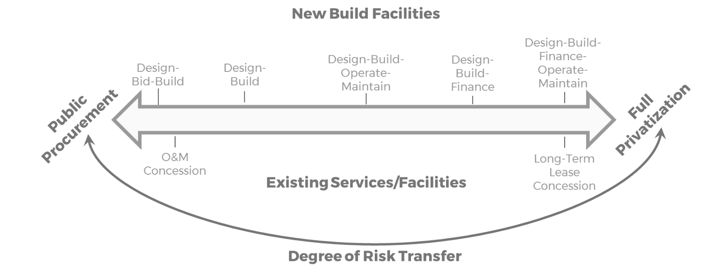
What is a public-private partnership (P3)?
  A range of delivery methods outside of the traditional design-bid-build method for contracting
  Includes privatization (asset monetization or recycling)
  Research focuses on P3 with operational and/or financing risk held by private party
Range of Alternative Delivery Methods and Spectrum of Risk Transfer

Slide 5
Privatization vs. P3
  In P3, the private operator is responsible for at least two of the following:
    Design and construction of a project;
    Operations of the facility developed; and/or,
    Providing financing with the expectation of repayment over time through project revenue or availability payments from the airport owner.
  Privatization is the full private ownership and/or control of an asset
    Private entity holds airport operating certificate

Slide 6

Research Results
  Guidebook
    Distills case study research into effective practice
    Organized by the project development lifecycle
  P3 Readiness Tool
    Interactive online questionnaire
    Designed to assist airport owners in assessing if:
      If their organization is prepared to implement a P3
      If project is a strong candidate for P3.
https://www.acrp-p3readiness.org

Slide 7
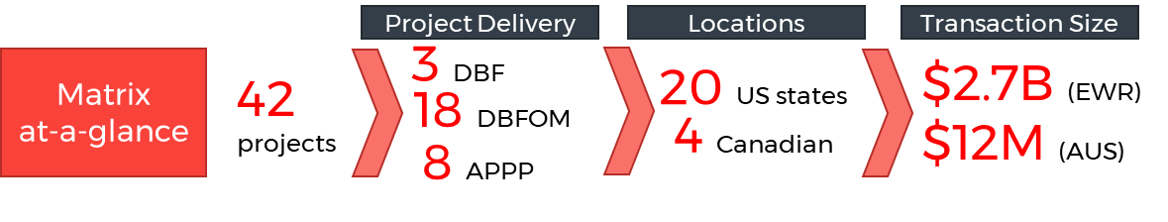
Research Approach: Precedents
  Annotated existing resources relevant to airport P3 developed after ACRP 66:
    Airport-specific sources focused on definitions, not best practices
    Industry sources oriented toward case studies and market analysis
    Federal/state: Transferable best practices related to P3, not tailored to operating environment of airports
  Federal and local legal considerations
  Comparative Deal Matrix of predecessor transactions:
AIPP
Notes:
Project Characteristics
Airport development vs. monetization of existing asset
Term
Payment mechanism
FAA pilot program vs. outside program
Full airport vs. facilities
Successfully closed vs. P3 abandoned
Impetus for P3 (airport, political, equity, etc.)
Project status (in development, operating, etc.)
Applicability to other airports
Airport/Local Characteristics
Airport size and usage
Governance structure
US, Canada, international
Agency experience with P3/alternative delivery
State/local law contemplating P3
Airport rates and charges structure
Availability of documents and key participants

Slide 8
The Guidebook

Slide 9





How do you use the Guidebook?
  Begins with terminology, resource assessment, landscape of P3s in the US, legal considerations
  Organized by project phase
  Chapters contain lessons learned from case studies
  Checklists and icons to indicate best practice:
Legal, policy, and regulatory considerations
Stakeholder considerations
Issues that present challenges or obstacles
Best practice
  Concludes with the identification of P3 Principles
9

Slide 10
Guidebook Table of Contents
Section I: The Context for Airport P3s
Chapter 1: Understanding the State of Practice Chapter 2: Legal and Regulatory Context for Airport P3 Chapter 3: Case Studies
Section II: Implementing an Airport P3
Chapter 4: Project Planning Chapter 5: Selecting a Project Delivery Method Chapter 6: Structuring the Procurement Process Chapter 7: Procurement – Advertisement to Shortlist Chapter 8: Procurement – Preferred Proponent to Financial Close Chapter 9: Contract Management and Oversight Chapter 10: P3 Principles for Airport Projects

Slide 11
Project Status: Case Studies
2017 EPAX (millions)
Primary Purpose
P3 Delivery Model¹
Transaction Size²
Current Status
1
Austin
South Terminal
6.8
New Facility
DBFOM
$10M
In Operation
2
Denver
Great Hall
29.8
Renovation
DBFOM/ Availability Payment
$650M
Terminated
3
Everett Paine
Field Terminal
N/A
New Facility
DBFOM
$40M
Under Construction
4
Gary Airport Management and Development
N/A
Development
Private Operation
$170M
In Operation
5
LaGuardia Terminal B
14.6
Renovation
DBFOM
$4B
Under Construction
6
LAX Automated People Mover
41.2
New Facility
DBFOM/ Availability Payment
$2B
Under Construction
7
San Juan Privatization
4.2
Monetization
APPP
$620M
In Operation
8
Stewart Int’l.
Privatization and Reversion
0.2
Monetization
APPP
$35M³
Lease Sold⁴
¹The following abbreviations are used: DBF (Design Building Finance), DBFOM (Design Building Finance Operate Maintain), AIPP (Airport Investment Partnership Program)e Air
² Transaction size is capital value of project at time of project’s current status
³ $35 million in lease payments + 5% of gross income on 10th anniversary and $10 million CAPEX
⁴ Lease sold to PANYNJ in 2007 for $78.5M

Slide 12
Example Checklist: Assessing Market Interest
What are the developer's P3 qualifications? Financial capability? Track record in meeting performance-based requirements?
Are there other studies or information needed to show sufficient due diligence regarding the feasibility of the project?
Are there additional responsibilities that a developer can suggest to drive innovation, generate cost savings or increase lifecycle efficiencies? Are there untapped revenue generation capabilities that the owner has not thought of?
What is the developer's sense of the concession lease timeframe required to make the project financially feasible to the developer?

Slide 13
Example Checklist: Assessing Market Interest
Given the desired performance level and broad functional specification of the project, is the project too big or too small to generate private equity's return on investment?
Given the project's characteristics and the airport's goals, what contract structure is most suitable for the project? What risks are not acceptable for the developer to assume or mitigate? Are there risks that would be appropriate for the developer to assume that the airport has not proposed to transfer?
Is the developer interested in bidding on the project and are there any issues that would stop the developer from doing so?

Slide 14
Visual Aids to Enhance Understanding
Typical Transaction Timeline

Slide 15
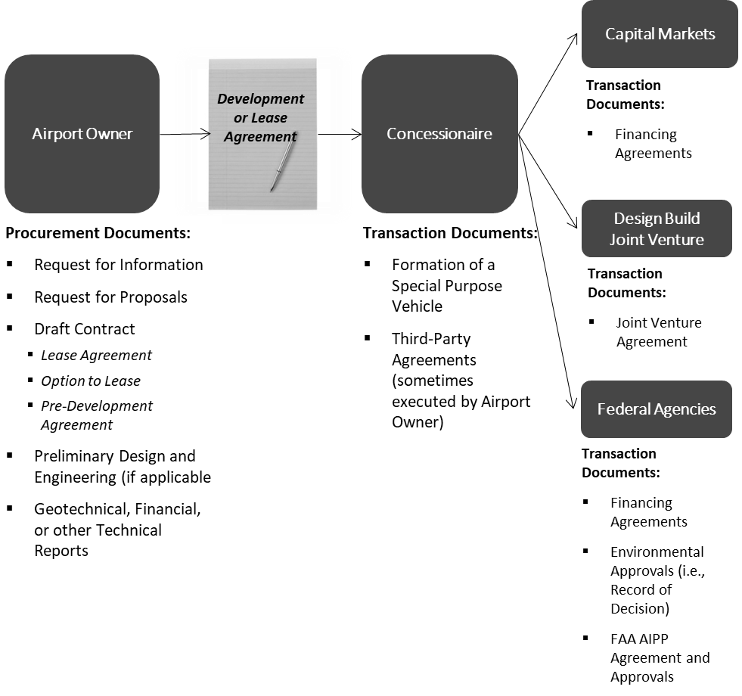
Visual Aids to Enhance Understanding
Key Transaction Documents

Slide 16

Readiness Assessment Tool
Not Ready for P3
Ready for P3

Slide 17
Online, Interactive Tool
  Helps determine if the project and operating environment may yield a successful P3 project
    Tool identifies fatal flaws called “ground-stops”
    input provided by users defines the end outcome report
  Six defined end outcomes
  Provides links to Guidebook and other resources
  Fully confidential – no identifying information required
https://www.acrp-p3readiness.org
17

Slide 18
Factors Contributing to Airport P3 Readiness
  Airport Owner Characteristics:
    Does the owner have clear goals and objectives?
    Understanding of the project's scope and involvement of key stakeholders?
    Staff resources for intensive procurement process?
    Access to external legal, financial, technical advisors?
  Project Screening: does the project scope align with the value a private developer can bring?
  Legal and Policy: procurement processes and contract formats are allowable?
  Risk: Are key risks identified? Which will owner retain, transfer, or share?
18

Slide 19
P3 Readiness Assessment Tool Outcomes
  Identifies areas that require guidance
    Building internal capacity and support
    Assessing Project feasibility
    Understanding the Policy and Regulatory Framework
    Effective Procurement Strategies
    Embarking on the AIPP path
  Points to useful case studies and vignettes
  Identifies chapters to read first
  Provides links to external resources
19
Notes:
Cait

Slide 20
Key Findings

Slide 21

P3 Principles: Project Elements and Market Conditions
  Politics and economics greatly impact P3 delivery
  P3 usually works best for large, complex projects but can also be applicable to smaller airports
  The value of to private sector developers is highly dependent on market conditions at the time the transactions occur
  P3 delivery can drive competition and innovation by private parties.
Source: BizJournals
21

Slide 22

P3 Principles: Stakeholder Engagement
  Stakeholders must be engaged and educated about P3 in every stage of project development
  Political leaders and project champions are critical to spur a project onward
  A politicized procurement process can be difficult to overcome
  Educating decision-makers and the public about P3 is essential for success
Source: Gateway LA
22

Slide 23
P3 Principles: Procurement Mechanics
  The P3 procurement process is far more complex than traditional delivery
    Requires greater internal resources
    More expensive for owner and bidders
  The procurement process should match the project and its airport's operating context.
    Airports requiring more interaction with decisionmakers and the public require more open procurement processes
    Smaller airports or those with greater enterprise-level decision-making capability may be best suited for private negotiations.
23
Source: Airports Data Net

Slide 24
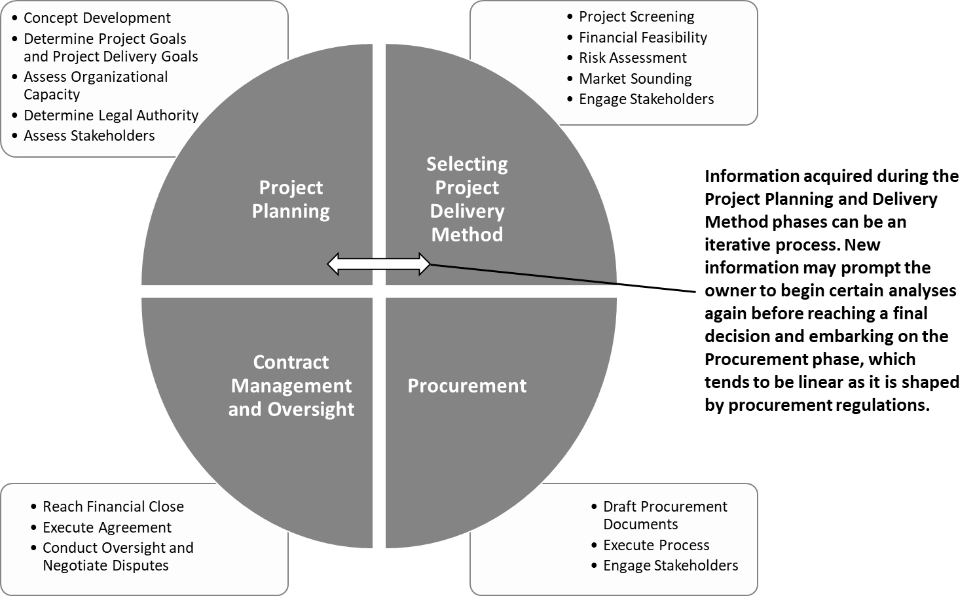
The Iterative Process

Slide 25
Risk Allocation
  P3 is about transferring the right risk, not the most risk
  Proponents will price risk into bids
  Some risk, such as interfaces with other agencies, are often best retained by the owner
  Costs are minimized by allocating risks to the party in the best position to control and manage them at the lowest cost

Slide 26
Selected Resources for Further Understanding
  Airport-Specific Resources
  Guidebook Annotated Bibliography
  ACRP Report 66: Considering and Evaluating Airport Privatization
  International Air Transport Association (IATA) https://www.iata.org/ Airport Ownership and Regulation Guidance Booklet
  Airport Consultants Council (ACC) https://www.acconline.org/ Airport Owners’ Guide to Project Delivery Systems
  General P3 Transportation Resources
  FHWA User Guidebook on Implementing Public-Private Partnerships for Transportation Infrastructure Projects in the United States (2007)
  The National Conference of State Legislatures' (NCSL) Public-Private Partnerships for Transportation: A Toolkit for Legislators (2010)
26

Slide 27
Contact Information
Airport Cooperative Research Program
Theresia H. Schatz, A.A.E.
Senior Program Officer
202-334-2981
tschatz@nas.edu
Research Team
Louis D. Wolinetz, WSP
Principal Investigator
202-661-5323
Louis.Wolinetz@wsp.com
Caitlin Ghoshal, WSP
303-390-5906
Caitlin.Ghoshal@wsp.com

