Slide 1
NextGen and its Impact on You
& Your Impact on It
[Airport Name]
[Date of Presentation]

Slide 2
Agenda
Introductions
Our Airport
Past
Present
Future
Our Community
Past
Present
Future
Aviation Benefits
Aviation Impacts
Our NextGen
What is NextGen?
What are its effects?
What does it mean for us?
Noise is a big concern
Why is noise a big concern?
What can be done?
What are we doing?
What can you do?
What’s Next?

Slide 3
Introductions
[Name, title, brief bio, headshot (if available) of speakers]

Slide 4
[airport code]’s Past
Established in [year established]
Primarily provided [early type of air service] to
[Destination/Market Region 1]
[Destination/Market Region 2]
[Destination/Market Region 3]
[Original number and length of runways]
Significant Milestones
[Milestone 1]
[Milestone 2]
[Milestone 3]
Notes:
Summarize airport’s past to set context, set a tone of movement into the future, highlight important role airport has played, point out that airport may have been there before community encroached.

Slide 5
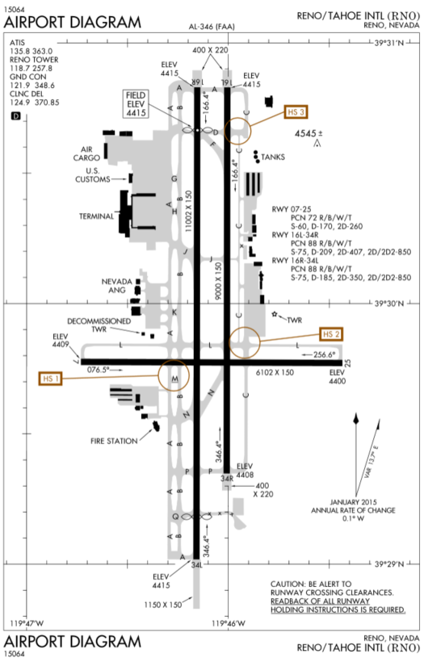
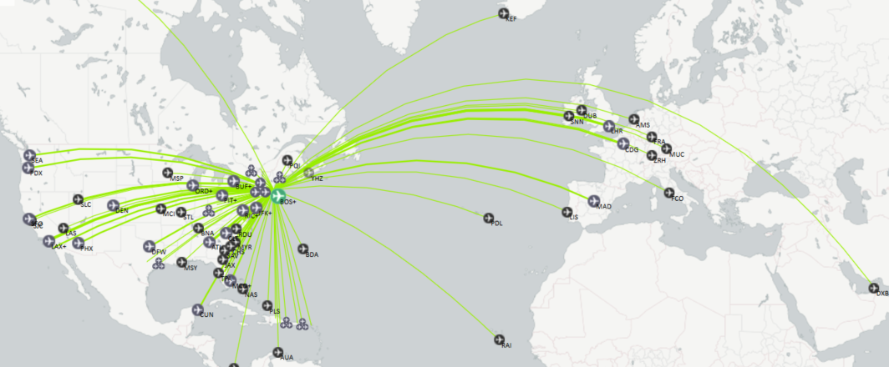
[airport code]’s Present
Our Aircraft [total based aircraft]
[Current number and length of runways]
Passengers served [number of enplanements]
Primary Destinations
[Destination/Market Region 1]
[Destination/Market Region 2]
[Destination/Market Region 3]
Notes:
http://www.airnav.com/airport/K[airport code]
http://openflights.org

Slide 6
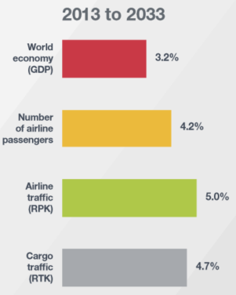
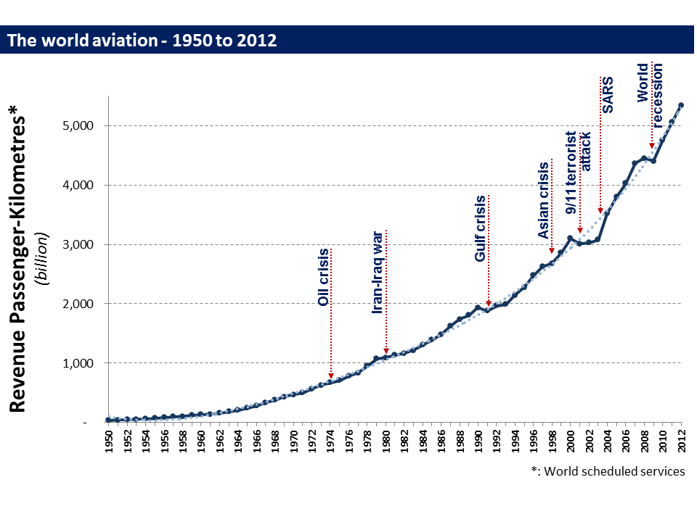
[airport code]’s Future
The Trend is Clear
Our Near Term Plans
[Initiative 2]
[Initiative 2]
[Initiative 2]
Source: Boeing
Source: ICAO

Slide 7
Our Community’s Past
Our community was established [era when community was founded]
Early settlers came from [origins early settlers]
Growth was fueled by
[Economic Driver 1]
[Economic Driver 2]
[Economic Driver 3]
Transportation played a major role

Slide 8
Our Community Today
Population of [regional population]
Early settlers came from [orgins early settlers]
Economy was driven by
[Economic Driver 1]
[Economic Driver 2]
[Economic Driver 3]
Notes:
http://factfinder.census.gov/faces/nav/jsf/pages/community_facts.xhtml
http://demographics.coopercenter.org/DotMap/
https://www.socialexplorer.com

Slide 9
Our Community’s Future
[Community Direction 1]
[Community Direction 2]
[Community Direction 3]
[Community Direction 4]
[Community Direction 5]

Slide 10
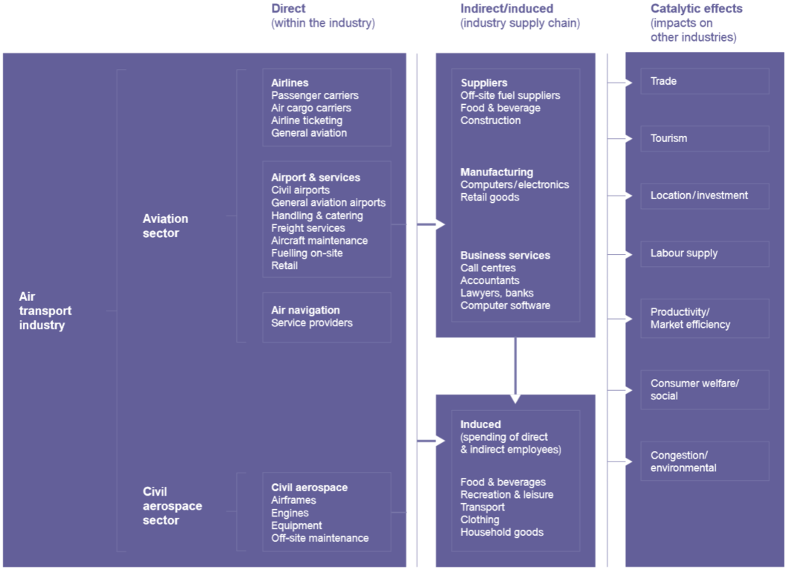
Aviation’s Fuels our Growth
Source: OEF 2005

Slide 11
Makes It Possible
Room to grow via air service capacity improvements
Improved safety
Improved operational efficiency
Reduced environmental impact

Slide 12
What is NextGen?
New technology
New processes
New capabilities

Slide 13
What are the effects of NextGen?
Increase
Operational Efficiency
Safety
Capacity
Economic Growth
Noise*
Decrease
Noise*
Emissions
Operational cost
Airfield Congestion
Source: % of respondents to ACRP 01-28 survey who indicated an expected effect of NextGen
* Noise has been consistent mentioned as an effect that will increase in some areas and decrease in others. The general feeling, based on research thus far, is that the overall (i.e. national) effect will be to reduce aircraft noise.

Slide 14
How will NextGen Effect You?
Noise may increase or decrease
Air Transportation options will improve and become more reliable
Delays will be reduced
Emissions will decline improving the environment for all of us

Slide 15
Why is Noise such a Concern?
Annoying
Distracting
May be linked to increased health risks
Congress found¹ that aviation noise is critical
Jet Noise From National Airport Pushes D.C. And Virginia Residents To Sound Off
¹ 1990 Airport Noise and Capacity Act

Slide 16
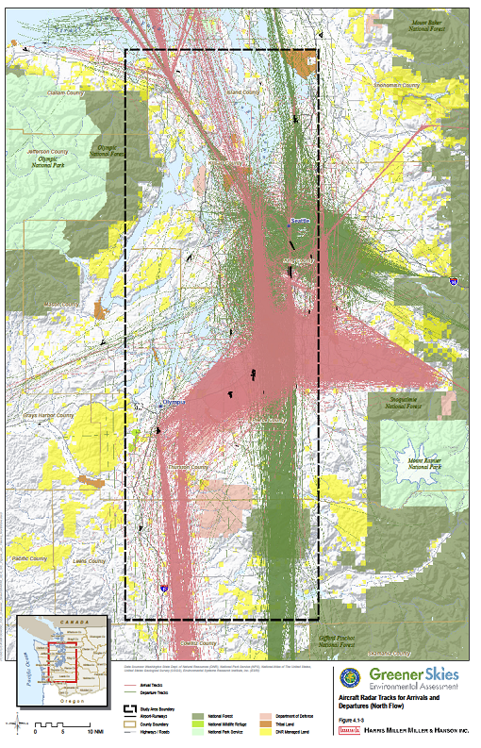
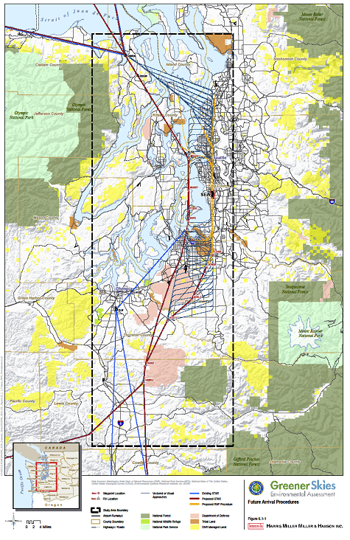
How will I be Effected?
[Before and after maps showing flight tracks and or noise contours]

Slide 17
What Has Been Done?
Congress
Noise policy to be carried out at a national level
Quieter (Stage 3) jets by 2000
FAA
National program to review and approve noise and access restrictions¹
Since 1990 has not approved any airport access restrictions²
Airports²
Cannot establish access restrictions, like a curfew, without federal approval
Difficult to impose restrictions, because FAA has determined they are discriminatory
Study and monitor noise impacts, establish and manage sound insulation programs, create and encourage use of noise abatement procedures, control and notify about run-ups, plan and encourage compatible land use, keep the community informed
¹ 14 CFR 161
² Minneapolis / St. Paul Metropolitan Airports Commission

Slide 18
What can you do?
Stay informed
Participate in meetings (see [Airport’s URL] for announcements)
Express your concerns

Slide 19
Questions & Answers
[Enter Airport Contract Information Here]

