Slide 1
Notes:
Customizable Talking Points – The slides in this deck are designed to provide a customized introduction to scenario planning for use in your own scenario planning working group. Suggested talking points in the ‘slide notes’ offer thought starter language for delivering the slides.
Suggested talking points - The future is uncertain, that much we know. Fifty years from now, will technology win with a game-changing generation of faster, cheaper, cleaner, and safer driverless vehicles that launches a new era of economic, population and travel growth? Could more intense weather patterns combined with geo-political disorder curtail GDP growth while creating energy price instability and sending infrastructure budget shortfalls skyrocketing?
NCHRP’s Foresight 750 Series is built upon six volumes of research covering topics as varied as freight movement, climate change, technology, sustainability, energy and socio-demographics and explains how these topics may shape the transportation system of the future.
Together, the reports embody the importance of foresight in managing for an uncertain future by giving DOTs a better understanding of the significance and nature of needs or events before they occur.

Slide 2
Using Scenario Planning to Inform Transportation’s Future -
Latest Lessons from NCHRP’s
Foresight 750 Series
Guidebook | Customizable Presentation
Notes:
TRB’s Foresight 750 Series encourages transportation policy makers to adopt scenario planning as a practical tool for considering future investment in mobility needs. Scenario planning uses information about projected directions for various ‘driving forces’ as building blocks for a set of distinct stories that distill voluminous data into a digestible set of plausible scenarios the future might follow. Scenario planning helps avoid overconfidence and tunnel vision in decision-making that otherwise lead to consideration of a narrow range of futures that leave us inadequately prepared for unanticipated outcomes.
The fast pace of change in transportation makes the timing right to provide supplemental Foresight content that helps agencies keep pace with the changing transportation landscape. New materials include a guidebook, fact books (instead of research that takes years), fresh scenario ‘thought starters’ that complement original Foresight concepts, and customizable materials for stakeholders from a state’s executive branch to DOT staff. The Massachusetts Commission on the Future of Transportation served as the pilot for these approaches and materials. Lessons learned in 2018 as part of the Commission process were used to update and expand materials and information initiated under Foresight.

Slide 3
SCENARIO PLANNING - CORE ELEMENTS
A
B
C
RESEARCH &
GATHER DATA
SCENARIO
DEVELOPMENT
RECOMMENDATIONS
DISCUSSION & DELIVERY
Notes:
Suggested talking points:
Scenario planning is a flexible tool for helping inform future transportation investments and policies.
Practical implementation of NCHRP Foresight series-style scenario planning has proven that three core elements will likely feature in any agency’s process.
This presentation introduces the core elements.

Slide 4
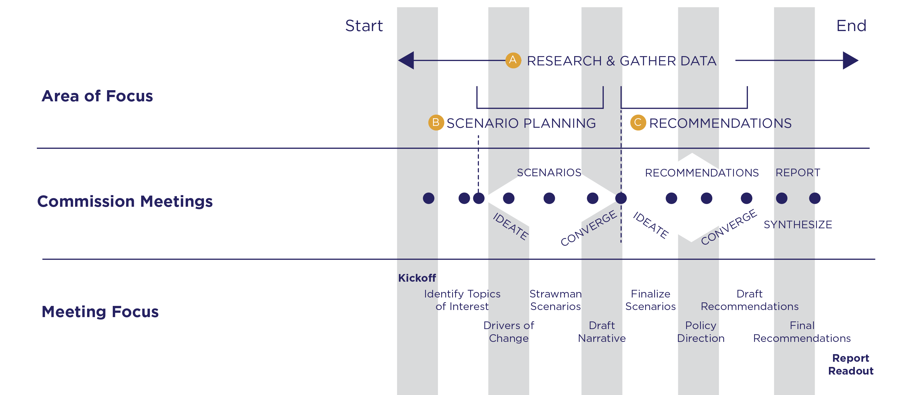
PROCESS OVERVIEW
Notes:
Suggested talking points:
This process overview depicts how scenario planning’s three core elements fit together.
Your timeline will be set by your agency’s particular demands.
White diamonds during ‘scenario development’ and ‘recommendations’ show how initial exploration or ideating moves to convergence on common ideas.

Slide 5
A
B
C
RESEARCH &
GATHER DATA
SCENARIO
DEVELOPMENT
RECOMMENDATIONS
DISCUSSION & DELIVERY
Notes:
Suggested talking points:
Let’s walk through the process of scenario planning, starting with ‘research & data gathering.’

Slide 6
A
KICKOFF: INTRODUCE SCENARIO PLANNING
RESEARCH &
GATHER DATA
STEP
1
Establish your workgroup’s charge
Choose a planning horizon
20 years? 40 years? 60 years? Beyond?
Use facts and trends data to support discussion
Notes:
Suggested talking points:
At the kickoff, give an introduction to scenario planning along with thought starters on key facts and trends to spur thinking. At this stage, other important checkpoints to cover include:
Establishing and/or clarifying the group’s charge (which may already be set by leadership)
Choosing the planning horizon
Have participants to identify data they think would help the discussion.
Encourage sharing of data, articles and other information throughout the scenario planning process.
Consider establishing rules for discussion that help to increase openness of public discussion on controversial issues.

Slide 7
Why do We plan for the Future?
Does it really make a difference?
Notes:
Suggested talking points:
All our great transportation achievements would not have been possible without people like you willing to look forward and invest in the future

Slide 8
IT’S EASY TO GET THE FUTURE WRONG
We have a long history of it, in fact.
Notes:
There’s a difference, though, between looking forward and planning for the future and trying to PREDICT it.
We humans have a long history of trying to predict the future – and a long history of getting it wrong. In fact, some very smart people have gotten it completely wrong at times.

Slide 9
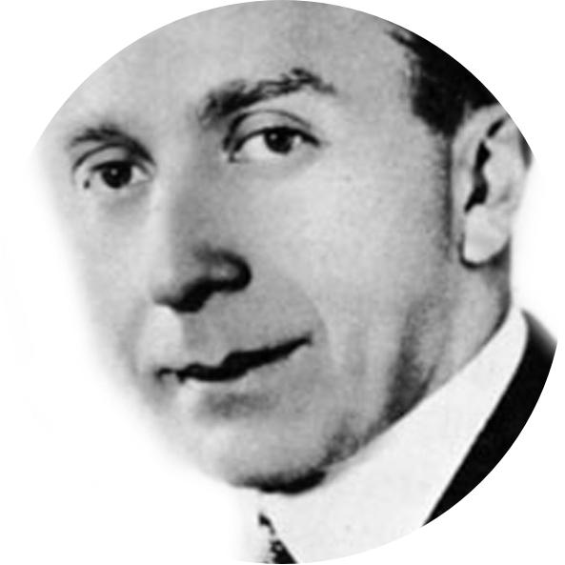
HARRY WARNER 1925
One of the Warner Brothers
“Who the hell wants
to hear actors talk?”
Notes:
For example, there’s Harry Warner. In 1925 he doubted anyone would want to hear actors talk.
Two years later, in October 1927, Warner released the first “talkie” “The Jazz Singer” starring Al Jolson. It essentially saved a struggling Warner Brothers studio.

Slide 10
THOMAS WATSON 1943
Chairman of IBM
“I think there is a world
market for maybe
five computers.”
Notes:
And, then there was Thomas Watson.
He obviously had this one wrong. Over 300 million computers are sold each year.

Slide 11
PACE OF CHANGE IS ACCELERATING
Years until technology was used by one-quarter of Americans
ELECTRICITY
RADIO
PC
WORLD WIDE WEB
46 years
31 years
16 years
7 years
1876
1926
1983
1873
1897
1975
1991
TELEPHONE
TELEVISION
MOBILE PHONE
WHAT’S NEXT?
35 years
26 years
13 years
faster adoption
Notes:
Suggested talking points:
Take a moment to look at the years to adopt different technologies.
The rate at which we adopt new technology is accelerating. It took us 35 years to adopt a landline telephone but only 13 years to adopt mobile phones. Sixteen years to adopt personal computers but the world wide web was built out in less than half that time.
So how do transportation agencies decide how and when to invest in new technology? This volume introduces STREAM – an evaluation methodology DOTs can use to select the right technology investments at the right time.
But this graphic also begs the question: what is next transportation technology will Americans adopt? Will it be autonomous vehicles? Will it be a connected network of vehicles and infrastructure, where vehicles are in constant contact with each other and the roadway features, creating a potentially “crash less” driving environment? Some argue it isn’t a matter of if but rather when. And will DOTs be ready?
(Source The Atlantic)

Slide 12
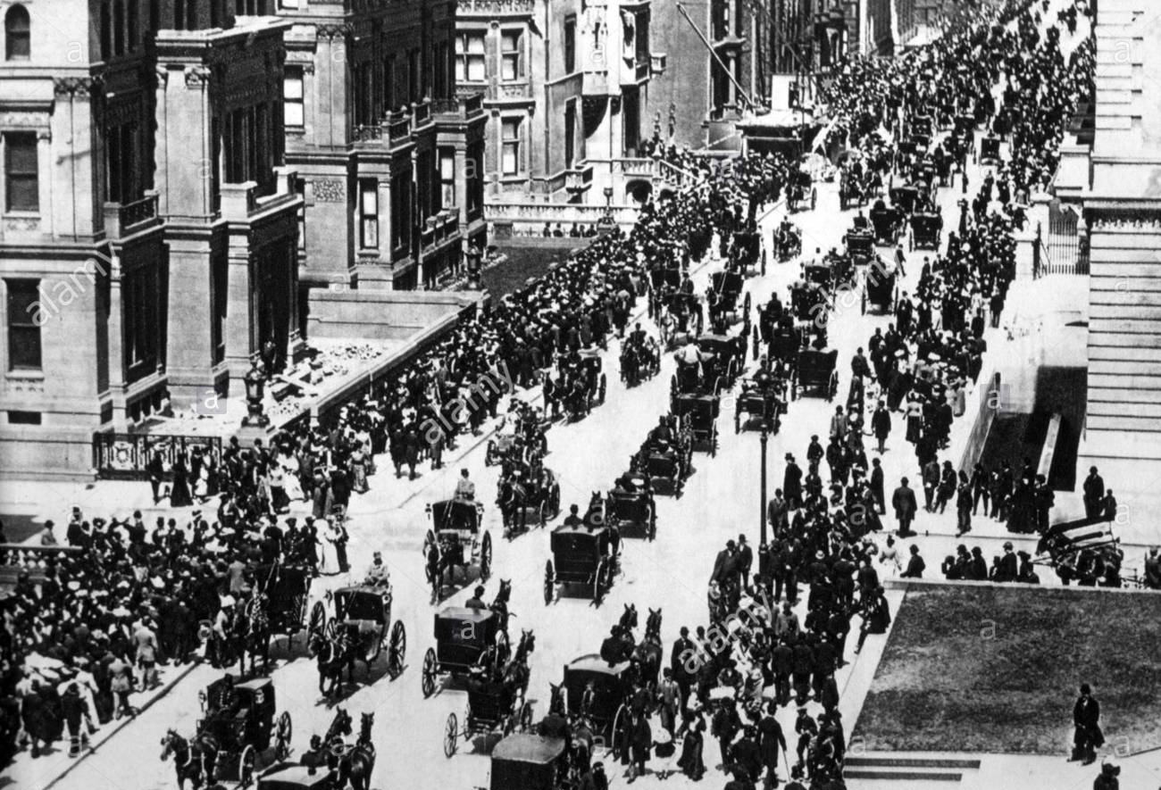
5th Avenue
New York City
1900
WHERE IS THE CAR?
2016 Tony Seba
Notes:
Suggested talking points:
Two pictures from NYC provide us with a great view of the accelerating pace of change – and the importance of technology adoption. Here’s a view of 5th Avenue in New York in 1900. Where’s the car?

Slide 13
5th Avenue
New York City
1900
WHERE IS THE CAR?
2016 Tony Seba
Notes:
Suggested talking points:
There it is – one car in a mass of horses.

Slide 14
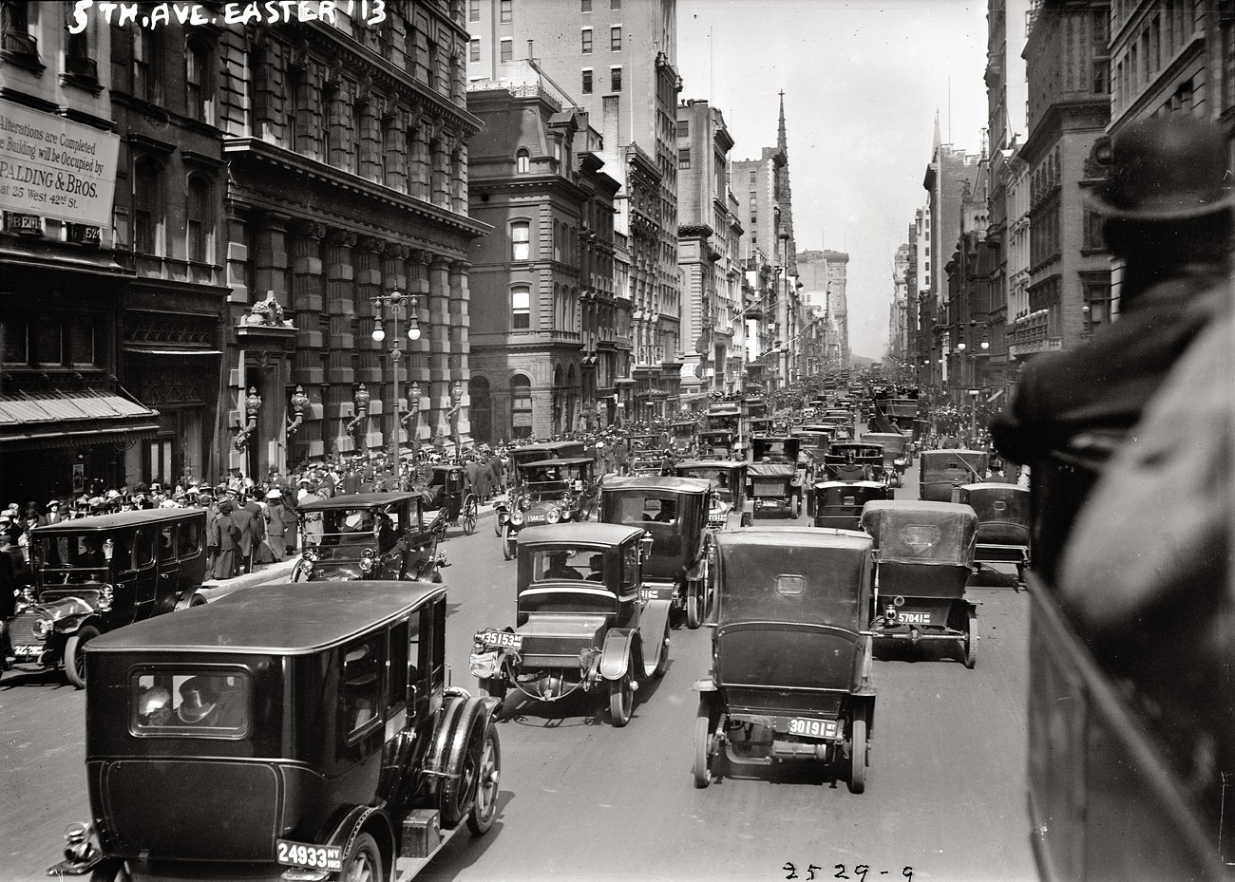
5th Avenue
New York City
1913
WHERE IS THE HORSE?
2016 Tony Seba
Notes:
Suggested talking points:
Fast forward just 13 years; the same street view. Where’s the horse?

Slide 15
5th Avenue
New York City
1913
WHERE IS THE HORSE?
2016 Tony Seba
Notes:
Suggested talking points:
There it is.
These slides not only illustrate the rapid adoption – but pause for a moment and think how disruptive it was for those 13 years to have horses and early automobiles sharing the road. Many parallels to the both the transformation and disruption we’ll see with automated vehicles in the future.

Slide 16
HOW TO NAVIGATE AN UNCERTAIN FUTURE
?
Notes:
Suggested talking points:
Before we take a closer look at the driving forces and trends suggested in the original Foresight series, I’d like to pause on this slide and ask for your thoughts on issues we might want to consider as we plan for the future of transportation in [insert state, or region or the US]?

Slide 17
A
IDENTIFY DRIVING FORCES FOR CHANGE
RESEARCH &
GATHER DATA
STEP
2
What are Driving Forces?
Issues likely to shape the future. Look for:
Predictable Trends – Elements of driving forces with momentum and therefore a clear trajectory
Uncertainties – Elements of driving forces that could follow different trajectories and therefore are hard to predict.
Notes:
Suggested talking points:
Driving forces are issues that we expect to play a large role in shaping the future for the topic we are examining. They usually contain a blend of two components:
Predictable Trends– Trends are the elements of driving forces that possess considerable momentum and continuity and therefore are known and certain, at least for a particular period. E.g. Rising sea levels, aging population.
Uncertainties – Uncertainties are the elements of driving forces that may emerge in the future, but could follow different trajectories and therefore are unknown and hard to predict. E.g. Extreme weather patterns, technology advances.

Slide 18
A NOTE: Gather Relevant Data
Members will often find “mainstream or pop culture” articles, photos, and real-world examples from the internet compelling and interesting.
Academic sources may not be accessible enough to everyday users.
Strike a balance between types of research sources.
Notes:
Information from a range of sources will likely be needed to inform scenarios and cover the quickly changing transportation landscape, including:
Research reports; E.g. governments, think tanks, and private firms knowledgeable about the industry.
Media articles - News story articles are more current than reports and can help your members stay engaged on fast changing areas like electrification, mobility as a service, and autonomous vehicles.
Academic peer reviewed journals – Some of this information may be too dense to support high level recommendations.
Consider the charge of your group as you curate information sources. Always cite sources.

Slide 19
Disruptive drivers of change
FREIGHT
Socio-DEMOGRAPHICS
How will freight change in the future? More automation?
Our population is aging. What will we need to do to accommodate changing trends?
SIX TOPICS
AT-A-GLANCE
ENERGY & FUELS
Extreme weather
Will we be plugging in rather than fueling up?
How will your agency prepare for more frequent extreme weather events?
SUSTAINABILITY
TECHNOLOGY
With fewer fuel tax dollars how does your agency sustain itself?
Will technology drastically change your core mission? Will it help or hurt?
Notes:
Suggested talking points:
The original Foresight focuses on six topics that may effect the future of transportation including freight, climate, technology, sustainability, energy and socio-demographics.
Lets examine some of the ‘signposts’ in each of these topics that could suggest different scenarios for transportation in the future.

Slide 20
EXAMPLE FREIGHT SIGNPOSTS
Re-shoring of manufacturing?
Global shipping trends
Advances in industrial technology?
Trade protectionism
Growth in the digital economy?
Notes:
Suggested talking points:
What other signposts will be important to follow?

Slide 21
EXAMPLE EXTREME WEATHER signposts
Long term weather patterns?
Frequency and scale of extreme weather events
New risk management practices?
New design standards?

Slide 22
EXAMPLE Tech signposts
Fatality rates?
Autonomous car technology trends?
Fleet turnover rate?
Vehicle costs?

Slide 23
EXAMPLE SUSTAINABILITY signposts
Population change?
Economic growth patterns?
Energy use changes?
Transportation revenue?

Slide 24
EXAMPLE FUELS signposts
Electric car adoption?
Driverless cars?
Costs of technology?
Notes:
There are so many questions and possibilities associated with energy and fuels – and we to keep a close eye on the signposts.
For example, the percentage of the fleet using alternative fuels is a very small , however, the signs point towards a change in that percentage. The question is how significant will that change be, and how long before we start to feel its effects? Likewise, how and when should we try to capture revenues from alternative fuels?

Slide 25
EXAMPLE Demographics signposts
VMT and VMT/capita?
Dependency ratio?
Immigration?
Labor force participation?
Birth rate/life expectancy?
Household size?

Slide 26
A shift from prediction to preparation
TODAY
PLANNING HORIZON
POINT FORECAST
Planning for a short term point in time.
Future Scenario 1
FUTURE SCENARIO PLANNING
Future Scenario 2
Looking out decades and letting the future drive the planning.
Future Scenario 3
Notes:
Suggested talking points:
With the accelerating pace of change, it’s time to think further into the future and plan for multiple potential futures.
Many DOTs find themselves planning for the very short term. This approach of making single point forecasts may be driven by uncertain budgets or politics, and it is what many of us are asked to do.
But what we’re going to talk about is long term planning where we identify multiple future scenarios and work backwards to identify the work that needs to happen today. So, we begin with the end in mind and let that drive our planning.
In other words, a scenario is a set of assumptions about how drivers of change interact. Scenario planning is about thinking about implications of deficient profiles.
Scenarios are planning aids used to develop long-range plans by considering potentially different futures; they are not predictions.

Slide 27
EXAMPLE: DRIVING FORCES CONSIDERED BY
MASSACHUSETTS COMMISSION ON FUTURE OF
TRANSPORTATION
Demographics & Land Use
Transit, Active Transportation, & Mobility Services
Autonomous & Connected Vehicles
Climate Change & Resilience
Transportation Electrification
Note - MA conducted transportation scenario planning as part of the process followed by a Governor-appointed Commission on the Future of Transportation in the Commonwealth. For more information – see ‘Choices for Stewardship: Background Books’ (Vol II) of the report by the Commission on the Future of Transportation in the Commonwealth.
Notes:
Suggested talking points:
In MA, data and trends were gathered and presented about each of the forces on this slide; the materials are collected in factbooks that are included on the Foresight website.

Slide 28
A
IT’S YOUR TURN
RESEARCH &
GATHER DATA
STEP
3
What facts and trends do you think are important for the workgroup to consider?
What issues are important today to your cities, suburbs, and rural communities?
Put yourself in the future:
- How do you (or your children) get to work?
- How do you receive a package from California?

Slide 29
A
B
C
RESEARCH &
GATHER DATA
SCENARIO
DEVELOPMENT
RECOMMENDATIONS
DISCUSSION & DELIVERY
Notes:
We’re now at phase B – develop scenarios.

Slide 30
B
ATTRIBUTES OF GOOD SCENARIO PLANNING
SCENARIO
DEVELOPMENT
STEP
4
Avoid too much complexity by having four or fewer scenarios
Challenge conventional wisdom about the future
Present dramatically different visions
Avoid a preferred scenario, “heaven & hell” contrasts, or a ‘business as usual’ scenario.
Notes:
Suggested talking points:
Developing scenario names and narratives that resonate typically takes a couple of iterations. Push the bounds of plausibility by framing the first iteration or two of the scenarios as “strawmen”.

Slide 31
WHAT MAKES A GOOD SCENARIO?
Plausible—Users must believe scenario grows from the past to the future. A scenario with “save the world” technology, for example, may feel unrealistic.
Internally Consistent—The logic in a scenario should be consistent. One aspect of the scenario cannot contradict others.
Memorable— Scenarios should be easy to recall. Names should be descriptive and catchy. They will become touchstones for future conversation.

Slide 32
FORESIGHT SCENARIO EXAMPLES
MOMENTUM
GLOBAL CHAOS
TECH TRIUMPH
GENTLE FOOTPRINT
Notes:
Suggested taking points:
In the original Foresight work, several possible scenarios of the future were constructed by taking a number of pressing global trends and issues and using them as “lenses” through which to view the world.

Slide 33
Foresight 750
Analysis of Driving Forces
MOMENTUM
GLOBAL CHAOS
TECH TRIUMPH
GENTLE FOOTPRINT
Economy
Technology
Politics
Society
Environment

Slide 34
B
CONNECT SCENARIOS WITH DRIVING FORCES –
Example from Commonwealth Commission
SCENARIO
DEVELOPMENT
STEP
5
Widespread tech
adoption
Scenario:
Statewide
Spread
Scenario:
Vibrant Core
Scenario:
Multiple
Hubs
Uneven tech
adoption
Scenario:
Gridlock
Jobs/housing are
more concentrated
Jobs/housing are widely dispersed
Source: Massachusetts Commission
Notes:
Suggested talking points:
In the Commission example, the primary drivers of change in the future were identified as ‘technology’ and ‘the location of growth in jobs/people.’

Slide 35
A
B
C
RESEARCH &
GATHER DATA
SCENARIO
DEVELOPMENT
RECOMMENDATIONS
DISCUSSION & DELIVERY
Notes:
Suggested talking points:
We’re now at phase C – discuss and deliver recommendations.
The next few slides provide a summary of how to lead your workgroup through recommendation development.

Slide 36
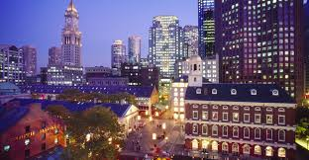
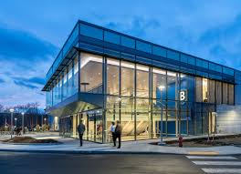
Practical Tips –
Scenarios are a means to an end
Use scenarios to start talking about futures
Focus on recommendations you can offer that work across scenarios
Scenarios are your sandbox to develop recommendations
What kinds of transportation systems will be needed in each scenario?
How might your DOT need to be reshaped to deliver those systems?
What investment strategies might be needed?
What other sorts of policies might be needed?

Slide 37
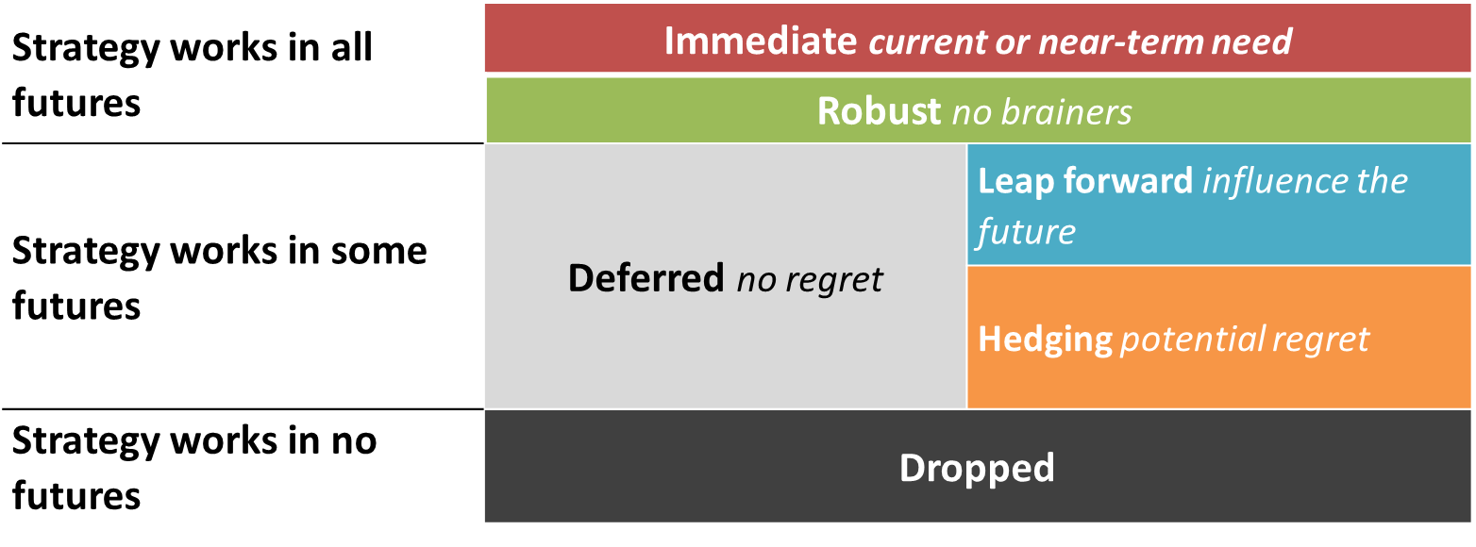
C
BRAINSTORM POLICY RECOMMENDATIONS
RECOMMENDATIONS
STEP
6
Notes:
Suggested talking points:
This is an important graphic. Challenge the group to to think about recommendations using this categorization approach, with particular focus on leap forward recommendations.

Slide 38
SOURCES FOR RECOMMENDATIONS
Consider existing DOT planning efforts and other state agency efforts
Background books
Speakers
Workgroup members
Best practices from other states, municipalities and academia

Slide 39
WHAT MAKES GOOD RECOMMENDATIONS?
Fact-based
Address problems
Cross-cutting, systems concepts not ‘siloed’ solutions
Desirable in multiple future scenarios

Slide 40
RECOMMENDATION CHECKLIST
Concept: _______________
Addresses which scenario(s): ___________
Timeframe: ______________
Pursuing this strategy may involve (actions/implementers/stakeholders): _____________
Financial Implications: ______________
Organizational Implications: ______________
Rationale: ______________
Counter-Rationale - ______________

Slide 41
EXAMPLE RECOMMENDATION GROUPINGS
DEVELOPED BY MASSACHUSETTS COMMISSSION
Modernize existing state and municipal transit and transportation assets to more effectively and sustainably move more people throughout a growing Commonwealth.
Create a 21st century “mobility infrastructure” that will prepare the Commonwealth and its municipalities to capitalize on emerging changes in transportation technology and behavior
Substantially reduce greenhouse gas (GHG) emissions from transportation sector in order to meet Commonwealth’s Global Warming Solutions Act (GWSA) commitments, while also accelerating efforts to make transportation infrastructure resilient to a changing climate
Coordinate and modernize land use, economic development, housing, and transportation policies and investment in order to support resilient and dynamic regions and communities throughout the Commonwealth
Make changes to current transportation governance and financial structures in order to better position Massachusetts for the transportation system that it needs in the next years and decades

Slide 42
SCENARIO PLANNING - CORE ELEMENTS IN A NUTSHELL
A
B
C
RESEARCH &
GATHER DATA
SCENARIO
DEVELOPMENT
RECOMMENDATIONS
DISCUSSION & DELIVERY
Notes:
Suggested talking points:
Scenario planning is a flexible tool for helping inform future transportation investments and policies.
Practical implementation of NCHRP Foresight series-style scenario planning has proven that three core elements will likely feature in any agency’s process.
This presentation introduces the core elements.

Slide 43
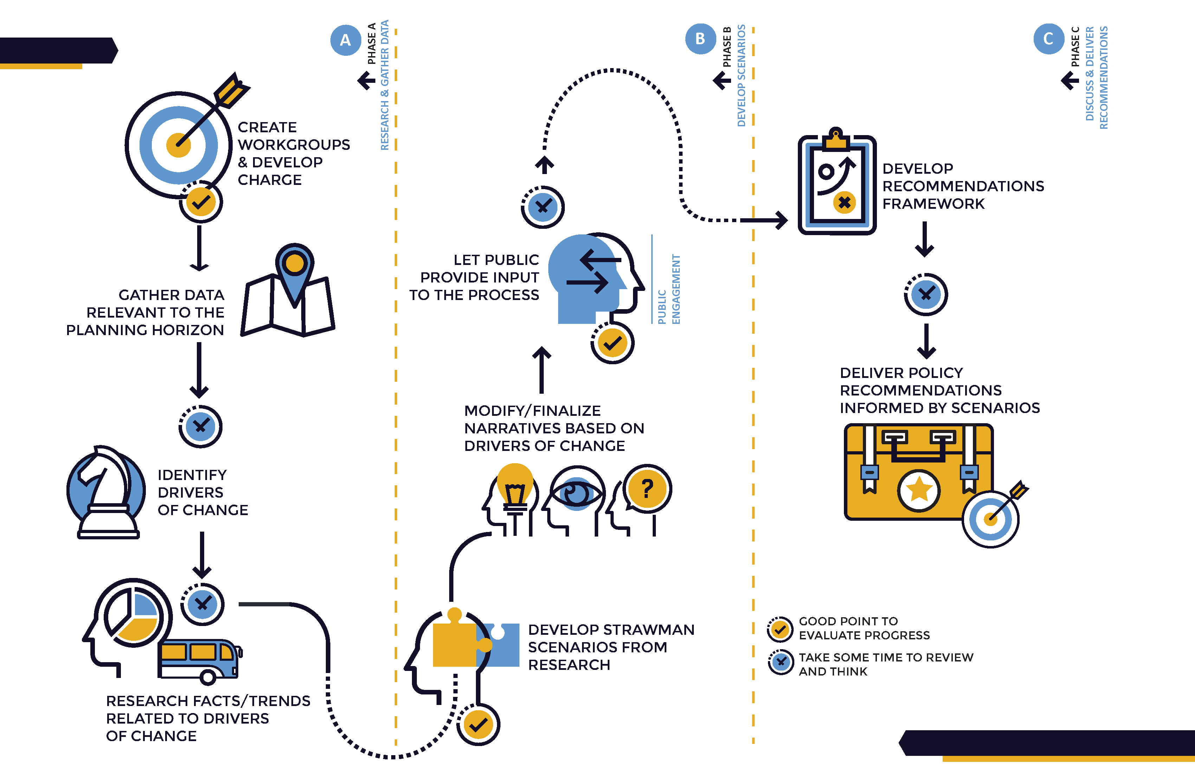

Slide 44
THANK
YOU
See you in the FUTURE!

