Slide 1
Guidance for Scenario Planning

Slide 2
Objective and Outline

Slide 3
Guidance for Scenario Planning
Scenario Planning is important because:
Organizations have found that a rapidly-changing future frustrates point-to-point forecasting techniques
It helps transportation agencies plan for futures that are uncertain and establish signposts where plans can be reconsidered
It provides a framework for the evaluation of different types of risk and risk response
Objective and Outline

Slide 4
Guidance for Scenario Planning
This guidance is specifically intended to help small-to-medium-sized organizations
Pass down lessons from larger organizations
Disseminate best practices through the industry
Objective and Outline

Slide 5
Guidance for Scenario Planning
This presentation will:
Introduce the theory and terminology of Scenario Planning
Walk through the process of developing a Scenario Planning study:
Defining a question
Identifying variables
Envisioning scenarios
Achieving objectives
Introduce tools that assist Scenario Planning
Communication and engagement tools
Modeling tools
Objective and Outline

Slide 6
Theory of Scenario Planning

Slide 7
Continuum First, define a continuum – the “x axis” of our plot The continuum is the “independent variable.” What you are testing for on the y axis will change as you move from left to right. One example of a continuum is time. Another, less concrete example is a sequence of decisions.
Theory

Slide 8
Variables Next, let’s define a variable – the “y axis” of our plot
Theory
Variables can be actors, factors, or sectors:
Actors are people or organizations whose actions impact the future
Factors are concepts, constructs, or characteristics
Sectors are the arenas where actors and factors interact
Let’s use population, and look at it over time.

Slide 9
Trends Anything that happens between today and a horizon, or between horizons, is a trend.
Theory
population
time

Slide 10
Trends Your trends might be intuitive…
High
Theory
Moderate
Low
population
time

Slide 11
Trends Or they could be formal – informed by data or defined by you
High
Theory
Moderate
Low
population
time

Slide 12
Outcomes As the continuum progresses, you may end up with discrete outcomes.
Theory
population
time

Slide 13
Decisions Alternatively, maybe you know the outcomes but need to describe how you get there… For example, you want to evaluate several potential policy decisions.
Theory
development
decisions

Slide 14
Decisions You can establish decision points: In this example, the first decision leads to a certain outcome if things go one way, but to two potential outcomes in the other. That’s a second decision point.
Theory
development
decisions

Slide 15
Scenarios Your decisions may be based on trends. Let’s combine our two variables together. Your policies impact population growth. When we reach our second horizon, we have combinations of policy and population outcomes. These are scenarios. Of course, there can be many variables and they can all interact to produce scenarios together. Alternatively, you can define a subset of scenarios based on variables independently.
Scenario
Policy
Decision
Theory
population
We can change a policy to influence land use. We’ll do it in response to population growth.
time

Slide 16
Normative Let’s look at our decisions here… Since we know what will happen when we decide a certain way, we can choose which scenario we want. Thus, our policies (or investments) are determined by what we think is good. This is called normative planning.
Scenario
Policy
Decision
Theory
population
We can change a policy to influence land use. We’ll do it in response to population growth.
time

Slide 17
Explorative But what if several scenarios are equally possible? We select policies that will work for as many plausible futures as possible. That’s called explorative planning.
Theory
population
time

Slide 18
Predictive And if we know what’s going to happen and we need to be ready for it… That’s predictive planning.
Theory
population
time

Slide 19
Advice for Scenario Planning

Slide 20
Defining a Question
A question is defined by:
A subject (“our region” or “our transit system”)
A timeframe/horizon (“by 2050”)
An objective (“in order to prioritize investments”)
Questions can be…
Predictive | What do we think is going to happen?
Normative | How can we make something desirable happen?
Explorative | What could possibly happen?
In practice, you will combine these
Fully predictive may seem to lack imagination
Fully normative may seem biased
Fully explorative may seem wasteful
Advice

Slide 21
Identifying Variables Commonly-cited variables adapted from NCHRP 750: Foresight Series
Economics
Income, unemployment, GDP, inequality
Global and local trade levels, shipping, supply chains
Domestic manufacturing, online retailing
Environment and Land Use
Water scarcity, sea level rise, fires
Emissions and air quality
Development rates and open/rural land preservation
Technology
Printed fabrication/micromanufacture
Automation in manufacturing and transportation
Transportation
Transportation network companies - TNCs (Uber/Lyft), mobility as-a-service
Mode choice
Demographics
Aging population
Growth rate, inward/outward migration, labor force participation
Advice

Slide 22
Envisioning Scenarios
Scenarios are defined by trends
The current trend accelerates
The current trend maintains
The current trend plateaus, decelerates, or reverses
Scenarios can be based on
A single variable, trend, or event
Multiple variables interacting
Land use patterns
Finances
Advice
Florida Department of Transportation

Slide 23
Achieving Objectives
What is your study meant to inform?
What practices can we change?
What rules can we make?
What efforts can we empower?
What investments can we make?
What should our community prepare for in their lives?
How you select recommended actions depends on philosophy
Predictive | Future is certain, so actions address impacts
Normative | Future is desirable, so actions make it more likely
Explorative | Actions address as many futures as possible
Prioritize what is helpful, not what is wanted most
Seek help from advisors and input from engaged stakeholders
Advice

Slide 24
Tools for Scenario Planning

Slide 25
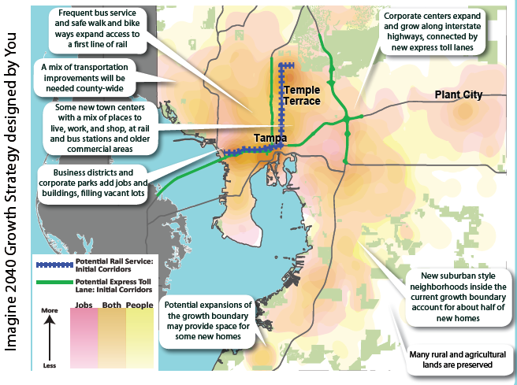
Communication Tools
The most effective tool is in-person engagement
Attend fairs, block parties, other local gatherings
Markers, posters, post-it notes, other low-tech feedback gathering tools
Advisory committees of subject-matter and local history experts, other luminaries
Many types of software tools
Survey (Google Forms, SurveyMonkey)
Mapping (Google Maps, ArcGIS Online)
Project website (Squarespace, Wix)
Blogging, livestreaming, podcasting
Packages (MetroQuest, Bang the Table, Public Input)
Tools
Hillsborough MPO

Slide 26
Modeling Tools
For small agencies, consider the following:
Take advantage of the cyclical process of long-range planning, starting small and building with each round
Partnerships with State agencies (DOTs, large MPOs) who already own models and pooled fund/effort with peer agencies can spread modeling capabilities without breaking the budget
Modeling tools may include:
Land use models
CommunityViz
CorPlan
EnvisonTommorow
SPARC/INDEX
Urbanfootprint
Travel demand models
Cube
Emme
TransCAD
Visum
Econometric models (REMI TransSight, TREDIS)
Federal models (FHWA, EPA, CDC tools)
Tools

Slide 27
Takeaways

Slide 28
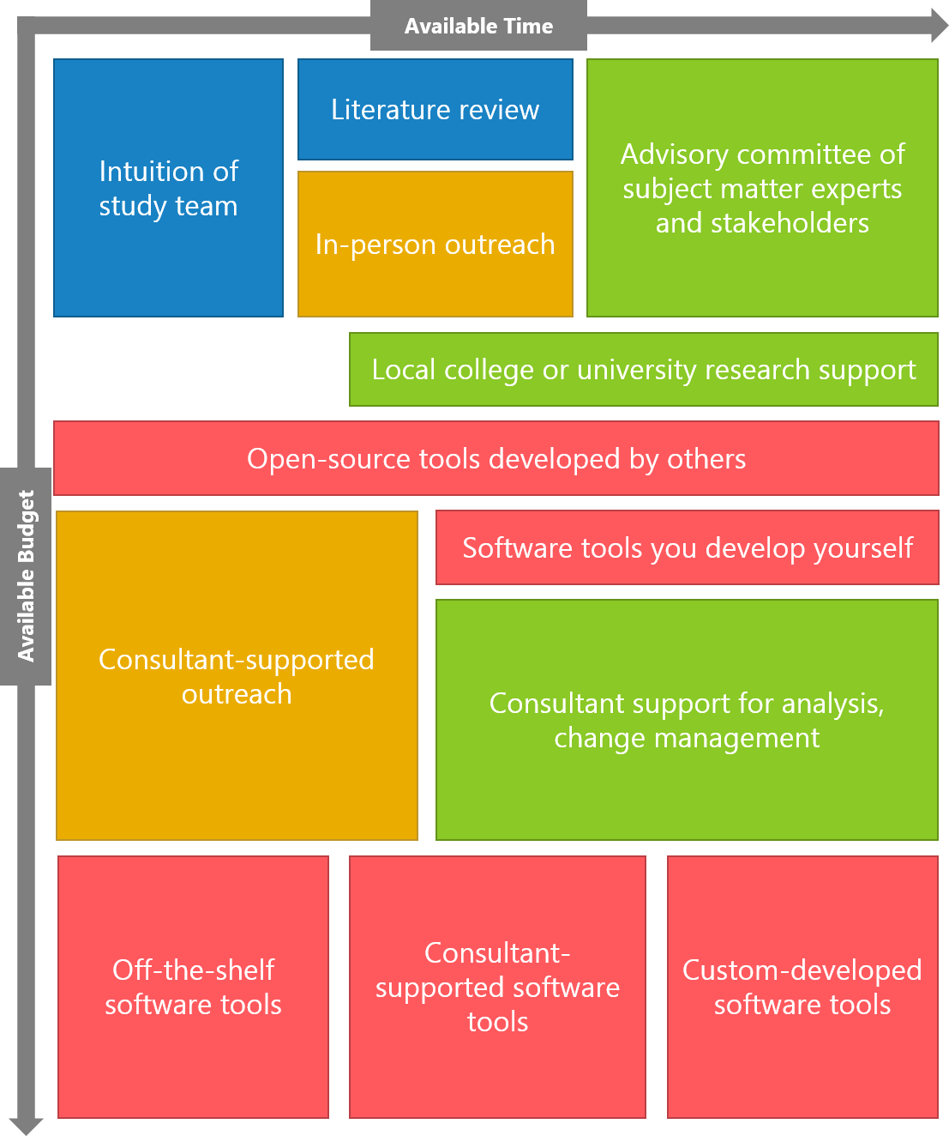
Rules-of-Thumb
Your Mind is (Mostly) Free
Scenario Planning is mostly about imagining the future collaboratively with others in your organization and in your community. What do you think could happen, and what would that mean for your region? Imagining doesn’t cost a dime.
Start the Conversation
Every community, no matter how big or small, is full of smart folks. Public outreach and advisory committees can be very inexpensive and very high-value – not only can they reveal public preferences and beliefs you may not have anticipated, they also lend your effort credibility, integrity, and approachability in the eyes of your public and stakeholders.
Take Your Time and Ask for Help
Your region, state, and country are full of potential partners that can pool resources or share their advantages with you. Also, Long-term planning is cyclical, and you don’t need to get all the way there the first time. If you don’t have the staff time to spend all at once, do one step for this LRTP and make a plan for what you’ll tackle next time.
Takeaways

