Slide 1
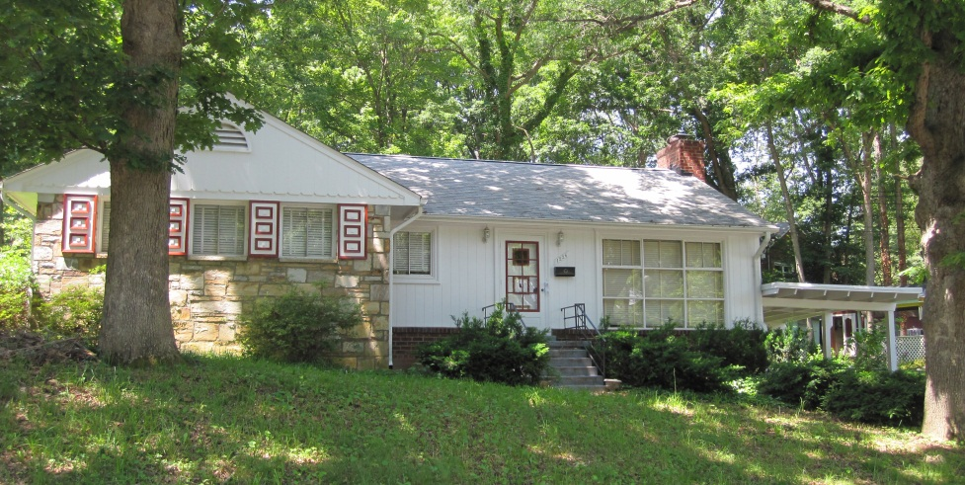
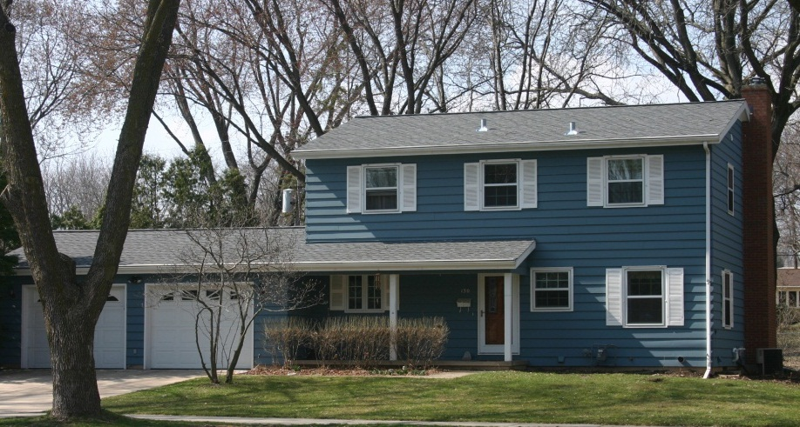
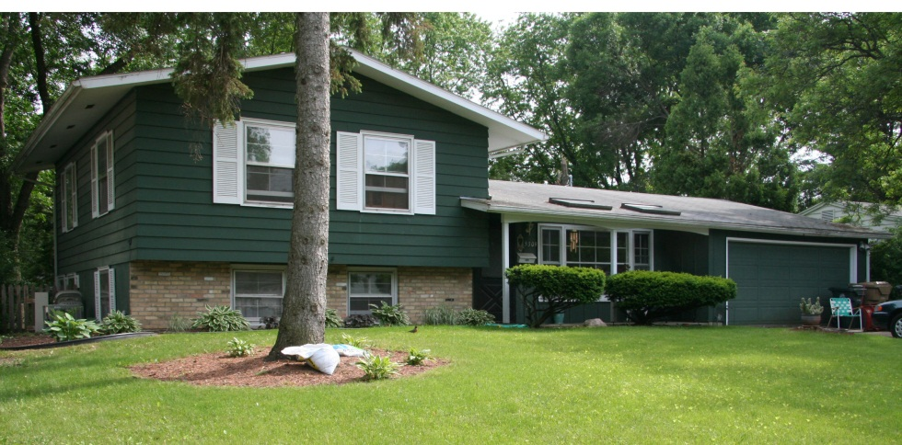
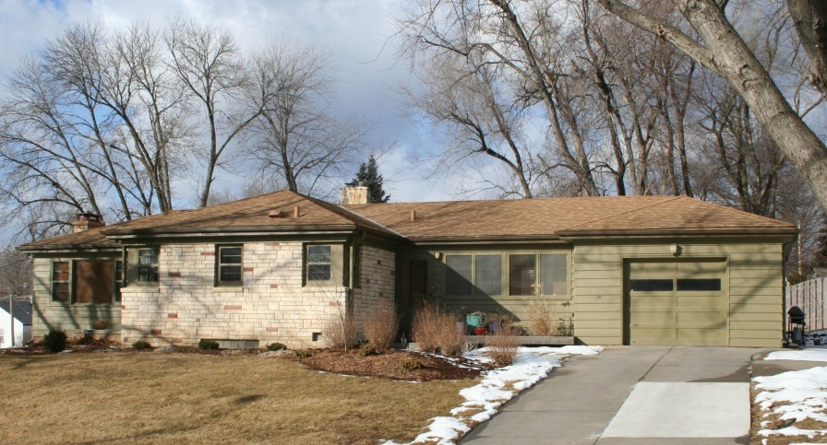
A Model for Identifying and Evaluating the Historic Significance of Post-World War II Housing
National Cooperative Highway Research Report 723

Slide 2
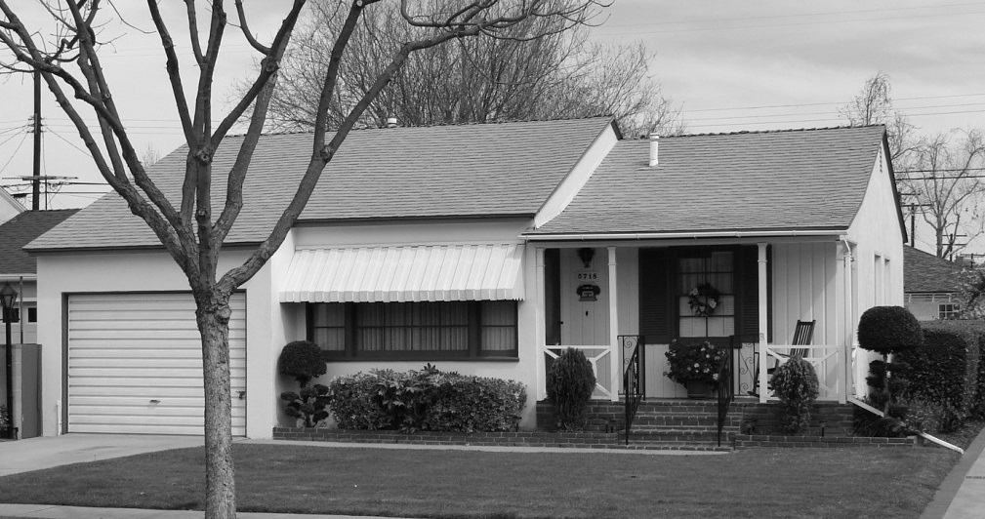
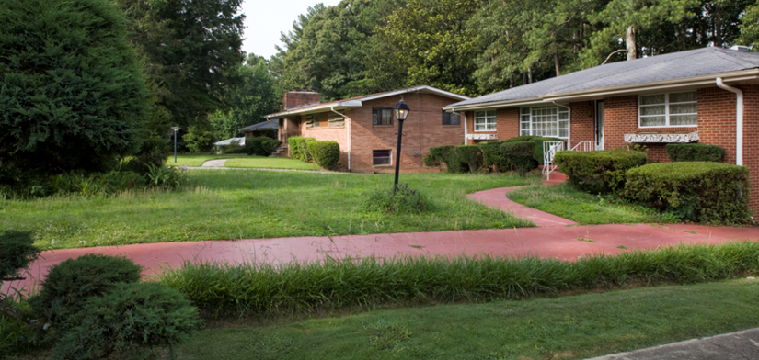
Project Team
Mead & Hunt, Inc.
Emily Pettis, Co- Principal Investigator
Amy Squitieri, Co- Principal Investigator
Christina Slattery
Christine Long
Louis Berger Group
Patti Kuhn
Debra McClane

Slide 3
Project Research Panel
Sandra Lawrence, Georgia DOT – Chair
Anne E. Bruder, Maryland State Highway Administration
John A. Burns, National Park Service
Richard Cloues, Georgia DNR, Historic Preservation Division
Jeffrey L. Durbin, National Park Service
Andrew C. Hope, Caltrans
Dianna L. Litvak, Colorado DOT
Toni M. Prawl, Missouri DOT
Helen Ross, Virginia DOT
Claudette C. Stager, Tennessee Historical Commission
MaryAnn D. Naber, FHWA
Lori L. Sundstrom, TRB Staff Representative

Slide 4
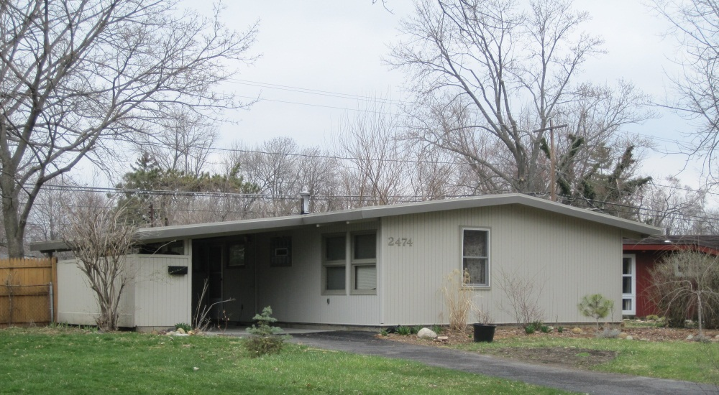
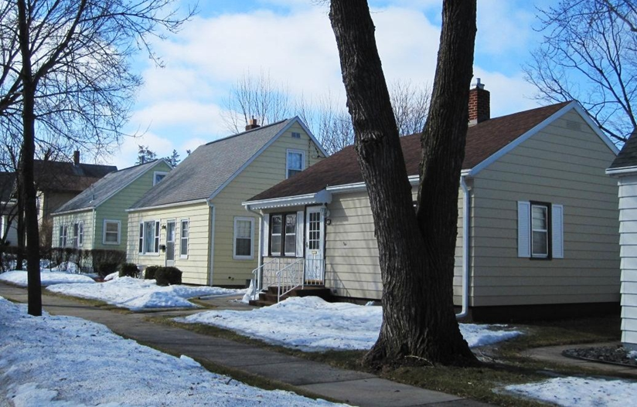
Project Goal
Develop a model for identification (survey) and evaluation of post-World War II residences
Streamline the identification of postwar residences
Provide greater consistency among state agencies in National Register eligibility evaluations under Section 106
Notes:
Study period ranges from 1946-1975

Slide 5
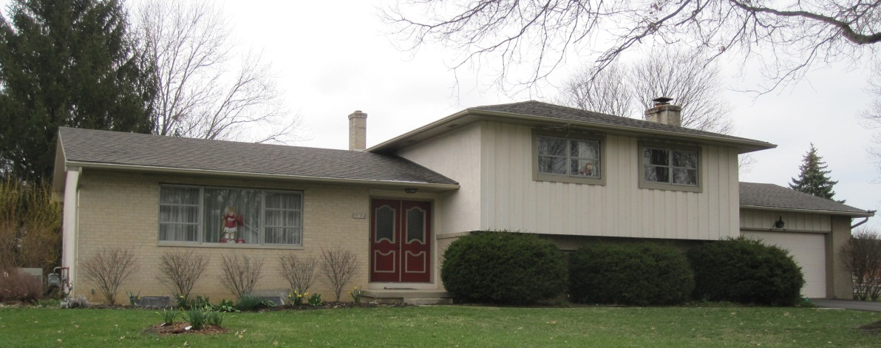
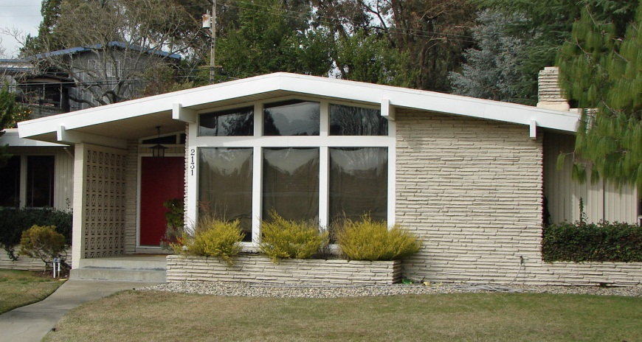
Overall Project Components
Literature review and preliminary bibliography
National and demonstration area historic contexts
Survey and evaluation methodology
Test survey and refine methodology
Prepare final report

Slide 6
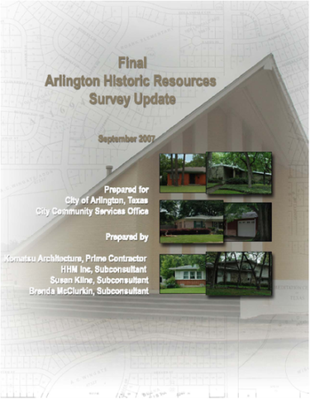
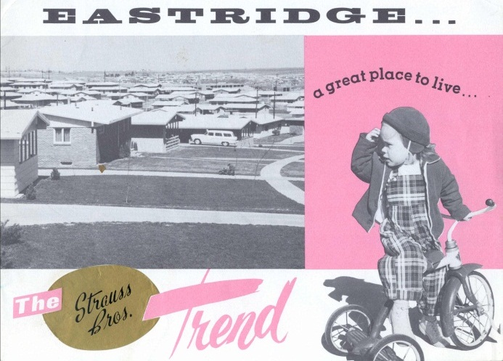
Literature review
Articles
Published sources
Government publications
Advertisements
Plan books
Magazines
Theses and dissertations
Survey reports, historic contexts, case studies
National Register Nominations and Multiple Property Documents
Notes:
Literature review resulted in a bibliography that informed the development of subsequent tasks, specifically the development of the national historic context and the historic context for the primary demonstration area

Slide 7
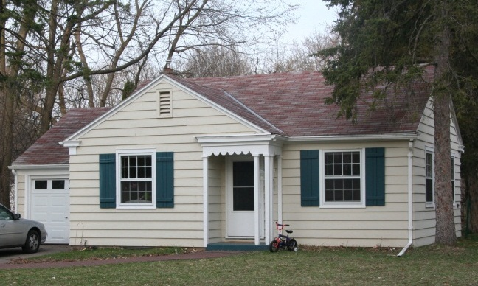
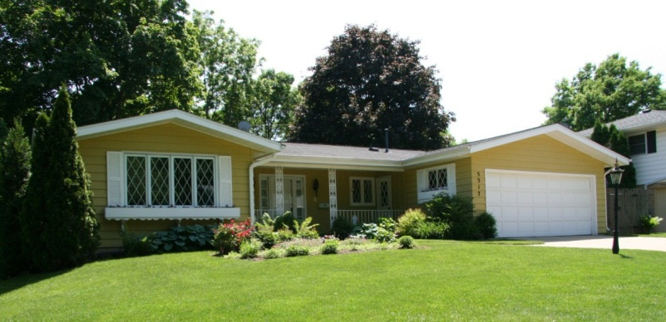
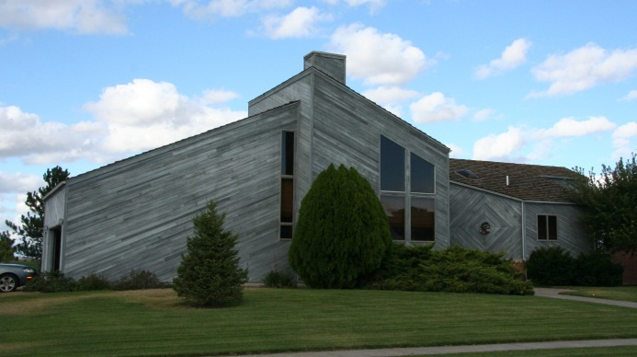
National Historic Context
Transportation trends
Government programs and policies
Social, economic, and cultural trends
Planning and development
Postwar building materials and construction techniques
Architecture, site, and landscape, including the popular architectural forms and styles
Notes:
Focuses on major themes of postwar period that influenced residential development

Slide 8
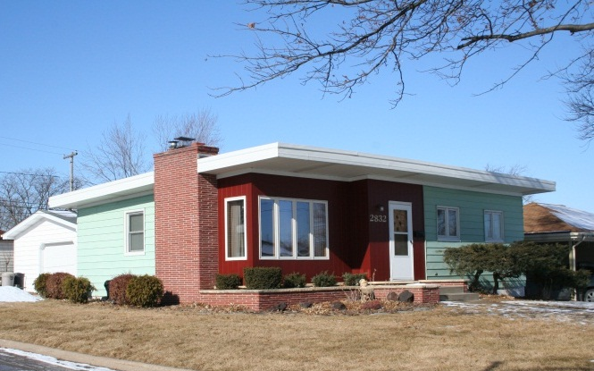
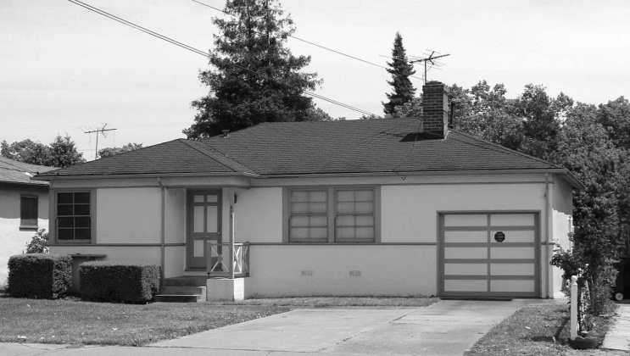
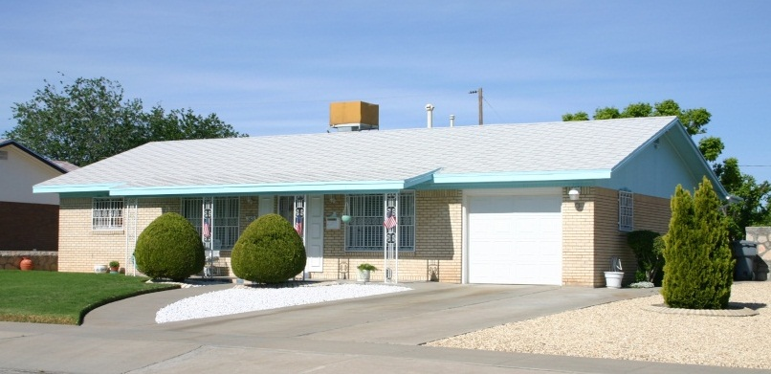
Model Context Outline
Model Context Outline provides guidance for developing project-specific regional or local contexts
Mirrors themes identified in the national context
Tested in Arlington County, Virginia, primary demonstration area

Slide 9
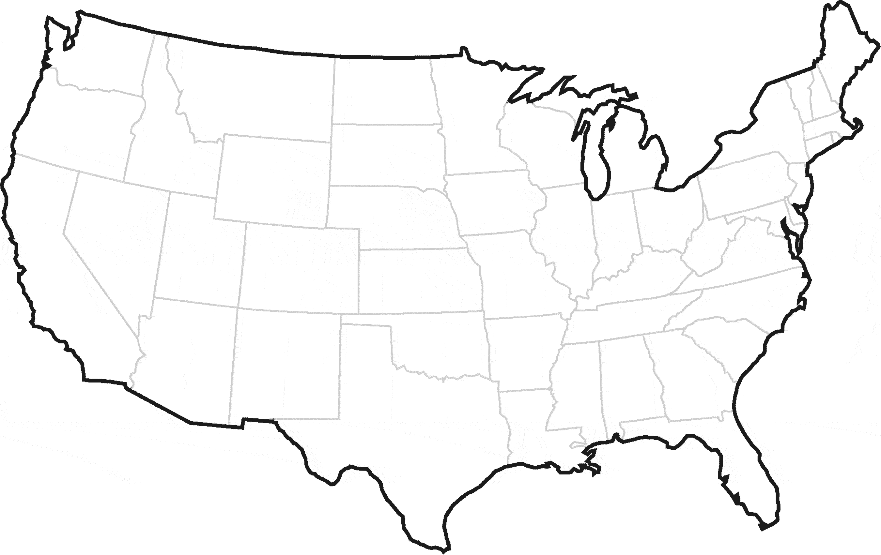
Demonstration Areas
Criteria for selection included:
Distribution of postwar housing
Proximity to major transportation corridors
Housing variations
Cooperation of state and local jurisdictions
Available reference material
Social, ethnic, and economic diversity of neighborhoods
Arlington County, Virginia
Madison, Wisconsin
Arlington, Texas
Notes:
Distribution of housing to include planned subdivisions, unplanned neighborhoods, and isolated locations
Reasonable proximity to transportation corridors
Substantial representation of property types from 1946-1975 study period
Cooperation of local and state jurisdictions
Available reference material, including previous surveys and developed historic contexts
And social, ethnic, and economic diversity
To gain geographic diversity, the project team identified three demonstration areas
Arlington, Virginia – which served as the primary demonstration area
Madison, Wisconsin, and Arlington, Texas, served as additional demonstration areas
Application of methodology and context outline in demonstration areas allowed for refinements

Slide 10
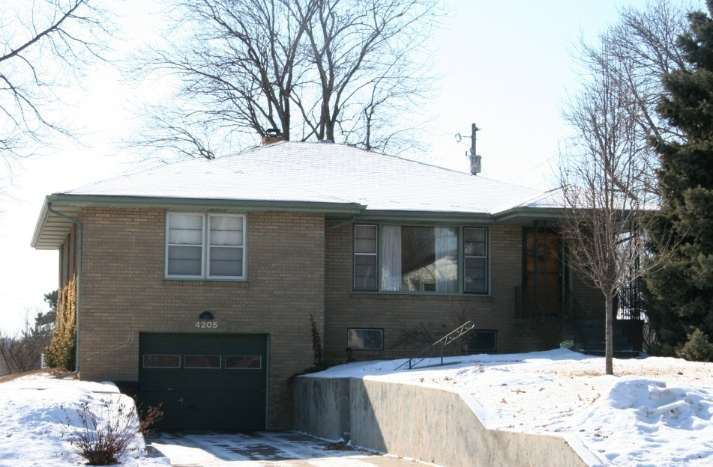
Survey and Evaluation Methodology
Intended to guide state and federal agencies needing to identify and evaluate individual properties, neighborhoods, and subdivisions
Provides streamlined and efficient survey and evaluation process
Allows for consistent results across geographic areas
Notes:
Methodology provides guidance for survey of neighborhoods/subdivisions and selective survey of individual houses

Slide 11
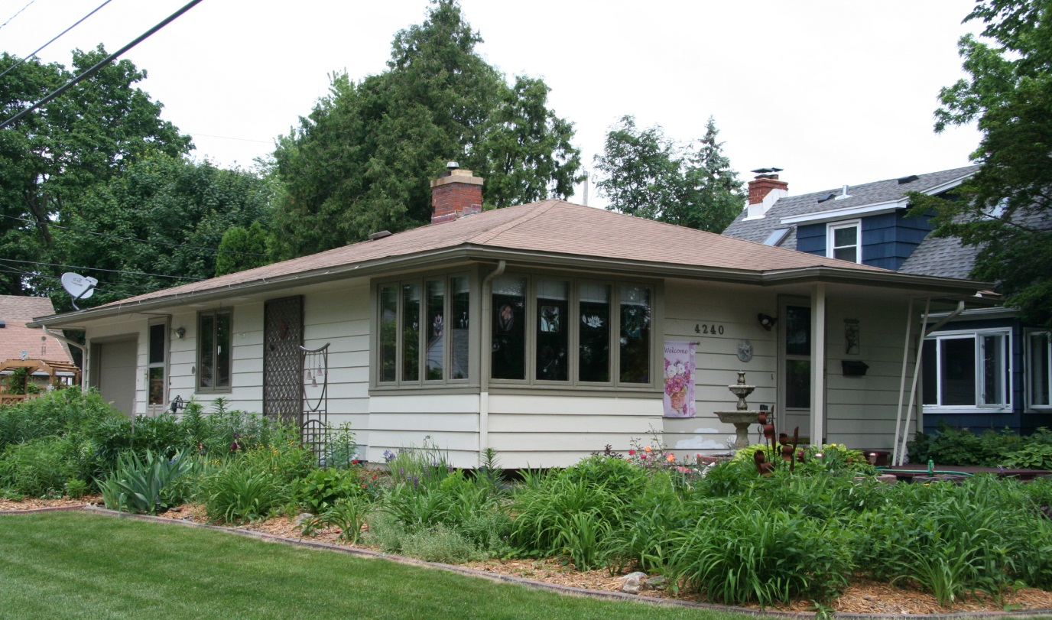
Survey and Evaluation Methodology
Project preparation
Identification
Historic context development
Evaluation
Documentation
Notes:
The methodology covers the five major steps needed to complete the survey and evaluation of postwar properties
Within the identification step, additional guidance is provided to streamline the survey process
This includes methodologies for the survey of neighborhoods and subdivisions and individual properties

Slide 12
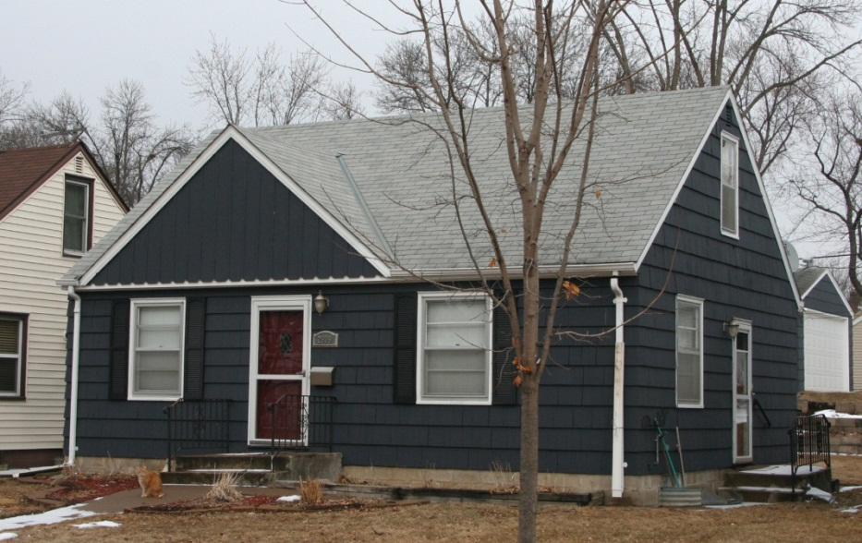
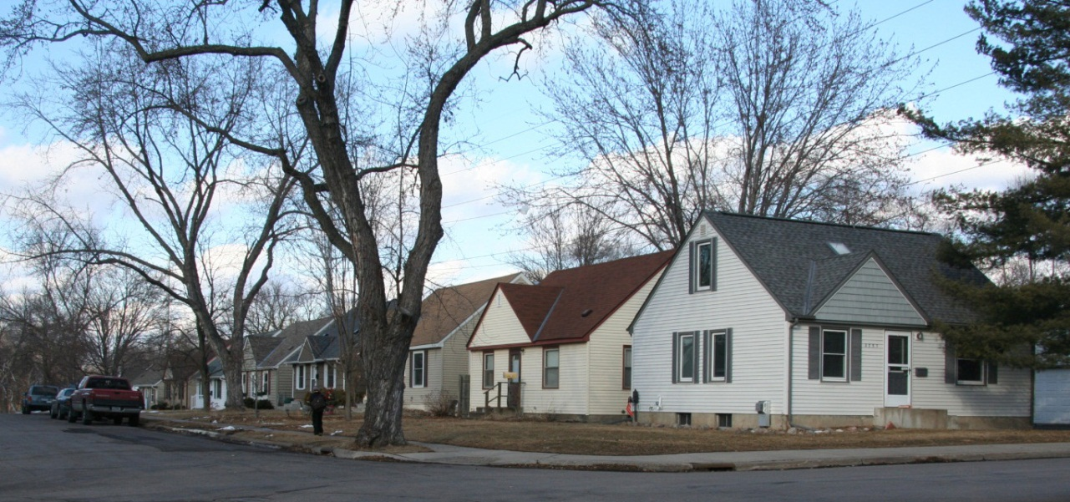
Survey Methodology
Survey of planned subdivisions and unplanned neighborhoods
Survey and documentation of similar properties as a group
Classifying resources within the grouping
Guidelines for data collection

Slide 13
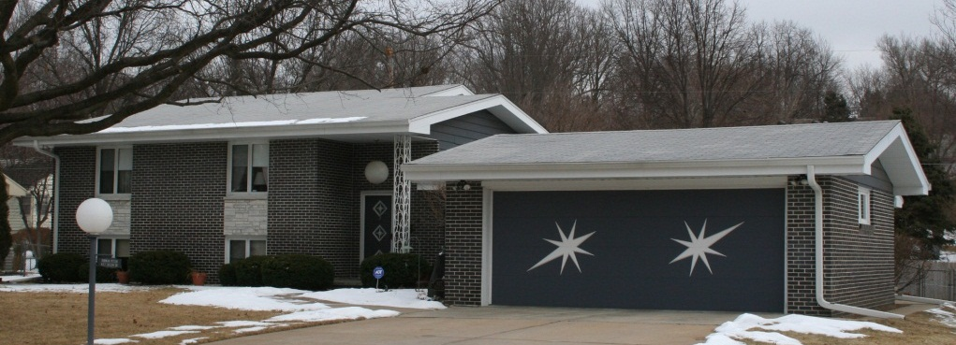
Survey Methodology
Selective survey of individual properties
Based on integrity, character-defining features, and architectural elements
Criteria for popular postwar architectural forms and styles
Minimal Traditional
Cape Cod
Transitional Ranch
Ranch
Split-level and Split-foyer
Colonial Revival and Georgian Revival
Storybook
Spanish Colonial Revival
Asiatic
Contemporary
Prefabricated

Slide 14
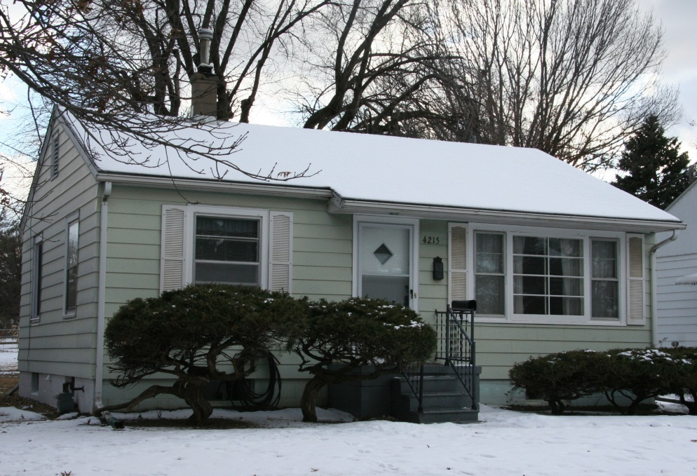
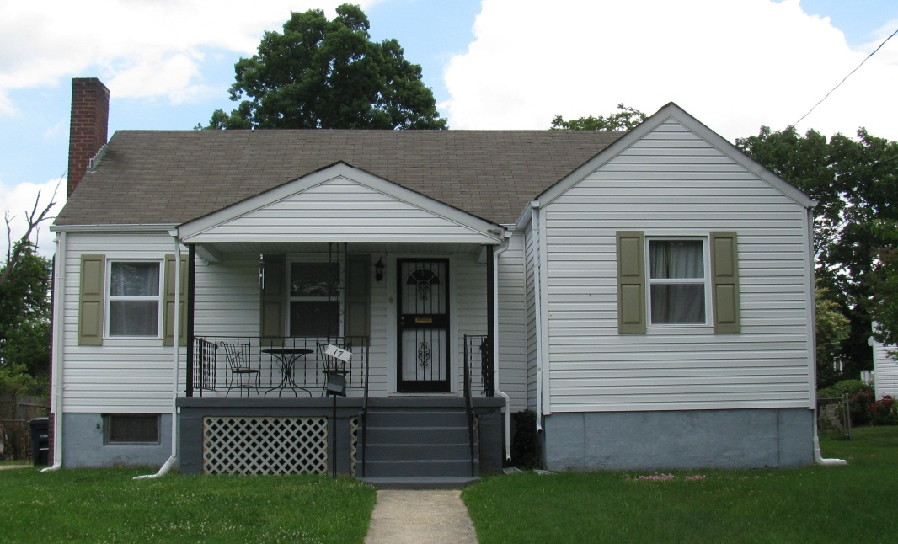
Survey Methodology
Selective survey of Minimal Traditional Homes
Retain massing
Retain original siding materials
Retain original windows and doors
Retain original roofline
Notes:
Simplicity of Minimal Traditional is primary character-defining feature
House on left met survey criteria
House on right did not criteria- replacement vinyl siding, replacement windows, altered stoop

Slide 15
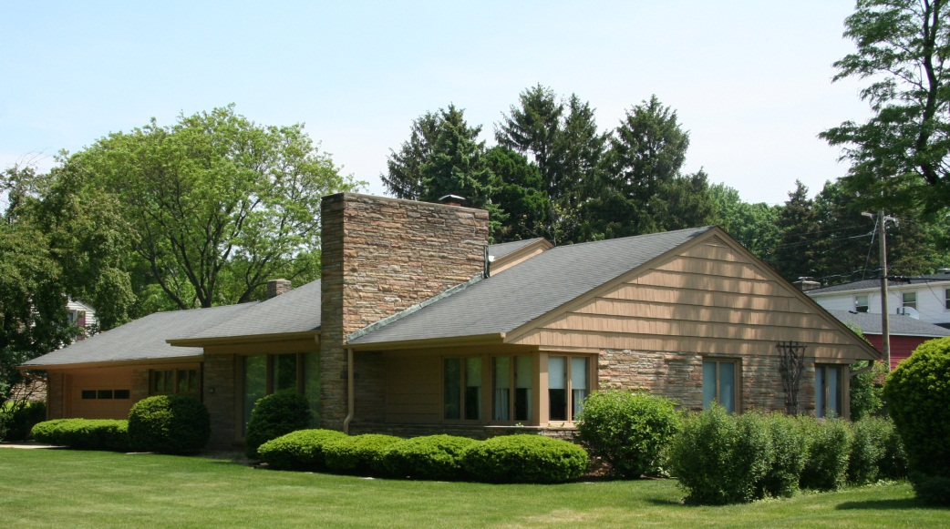
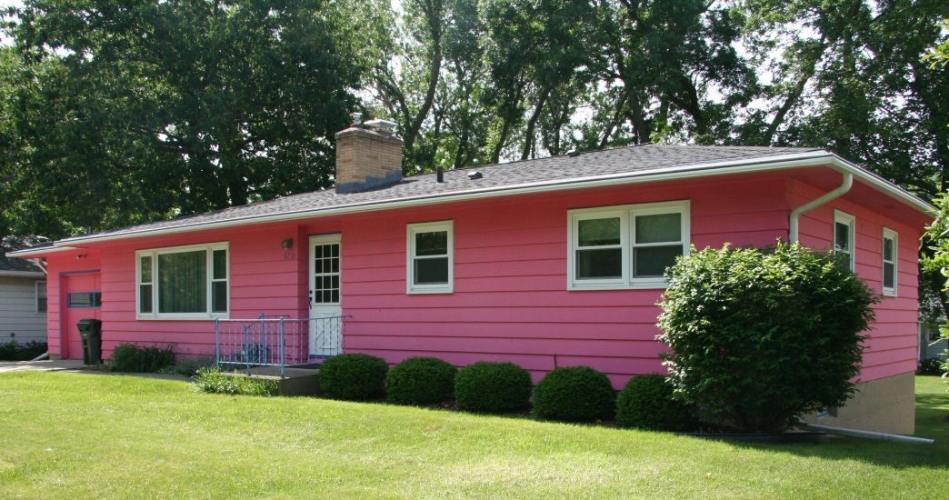
Survey Methodology
Selective survey of Ranch Homes
Retain massing, roofline, and eave overhang
Retain original exterior materials, or replacement-in-kind
Retain a minimum of three architectural elements, which include prominent chimneys, accent siding materials, planters, wrought-iron details, patios, and applied stylistic features
Notes:
To merit individual survey, Ranch houses should retain a degree of integrity and character-defining features and architectural elements
This list of architectural elements is not inclusive
House in left meets survey criteria – retains massing and materials and displays a wide prominent chimney, accent wood shingle siding, and corner windows.

Slide 16
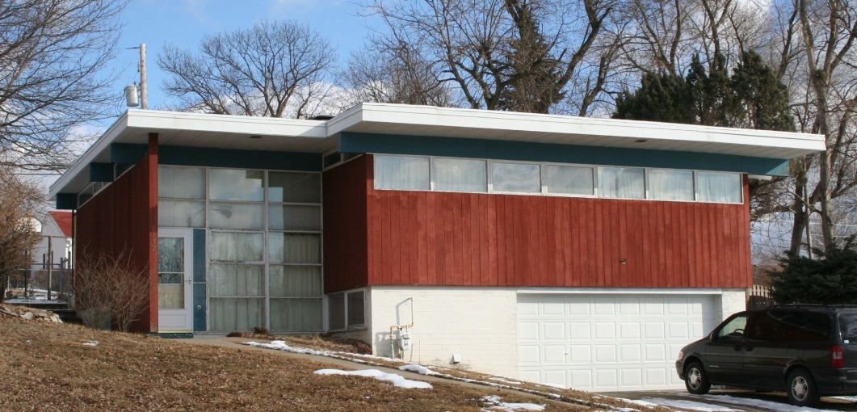
Evaluation Methodology
Guidance for applying National Register Criteria to individual properties and historic districts
Illustrated with listed and eligible examples
Discussion of integrity and alterations
Notes:
Evaluation methodology based on the National Register Criteria and Bulletins

Slide 17
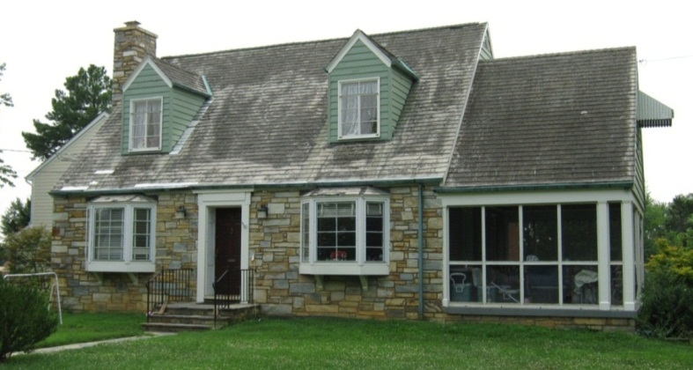
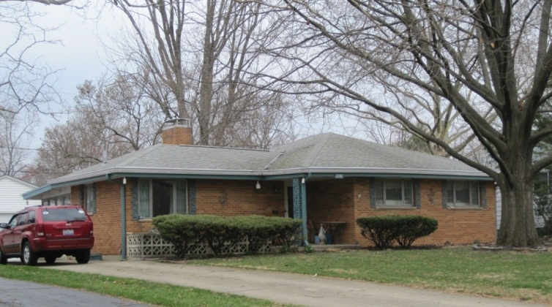
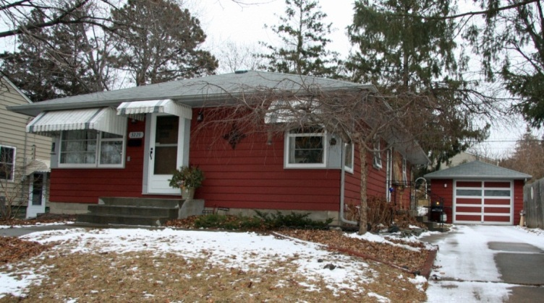
Recommendations
Widespread distribution of final report
Adoption by DOTs, SHPOs, and other agencies
Future development of local and regional historic contexts to support evaluations

Slide 18
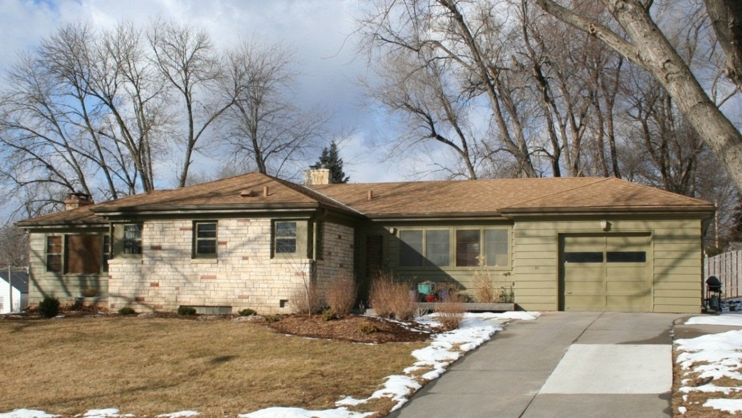
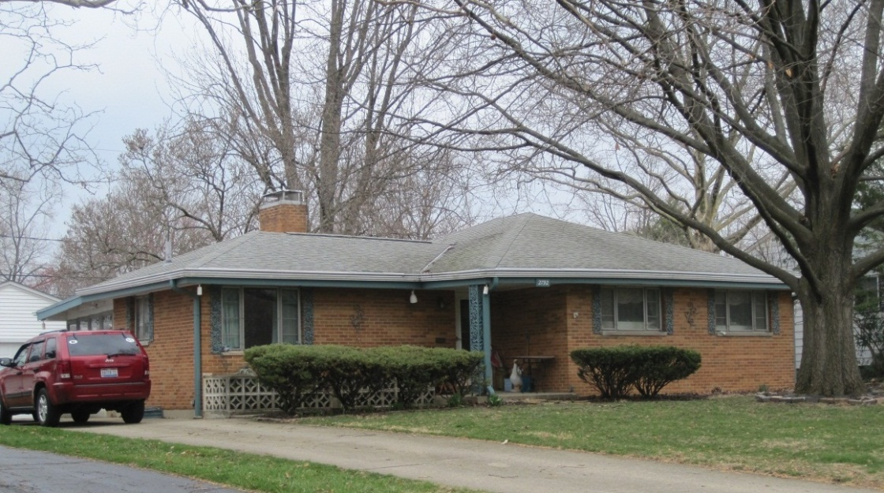
Questions?

