Slide 1
National Cooperative Highway Research Program NCHRP 25-25B (Task 101) STATE DEPARTMENTS OF TRANSPORTATION STORMWATER MONITORING PROGRAM GOALS, OBJECTIVES, AND PROTOCOLS
Summary Findings and Protocol Overview
Final Presentation – December 2017

Slide 2
Presentation Overview
Project Overview
Project team
Project objective
Report organization
Stormwater monitoring literature review
Monitoring goals
Key Elements of monitoring
Monitoring Protocol

Slide 3
Project Overview
Task 1:
Literature Review
Synthesis of Current Monitoring Goals
Interim Memo Report
Task 2:
Identify Key Monitoring Elements Based on Literature Review
Interim Memo Report
Task 3:
Develop Protocol for Each Identified Monitoring Goal
Draft Final Report
Task 4:
Final Report
PowerPoint

Slide 4
NCHRP 25-25B (Task 101) Project Team
Study team
Chin Lien, P.E.; D.WRE – Principal Investigator
Nancy Skinner – QA/QC
Kelley Moxley, P.E. - Researcher
Antti Koskelo - Researcher
Veronica Seyed - Researcher
Oversight
Ann Hartell, NCHRP Senior Program Officer
Scott McGowen, Michael Baker International (Chair)
Henry Barbaro, Massachusetts DOT
William Fletcher, Oregon DOT
Kenneth Stone, Washington State DOT
Nicklas Tiedeken, Minnesota DOT
Susan Jones, FHWA Liaison

Slide 5
Project objective
Provide guidance to State DOTs in designing an effective monitoring program that is:
Appropriate in scale and duration,
Includes the appropriate parameters and pollutants of concern, and
Meets the objectives of their specific stormwater sampling program.

Slide 6
Report organization
Executive Summary
Chapter 1 - Monitoring goals
Chapter 2 - IDENTIFY KEY MONITORING ELEMENTS ESSENTIAL FOR THE DEVELOPMENT OF AN EFFECTIVE DOT MONITORING PROGRAM
Chapter 3 - EFFECTIVE MONITORING PROTOCOLS FOR A STATE DOT MONITORING PLAN
Additional resources

Slide 7
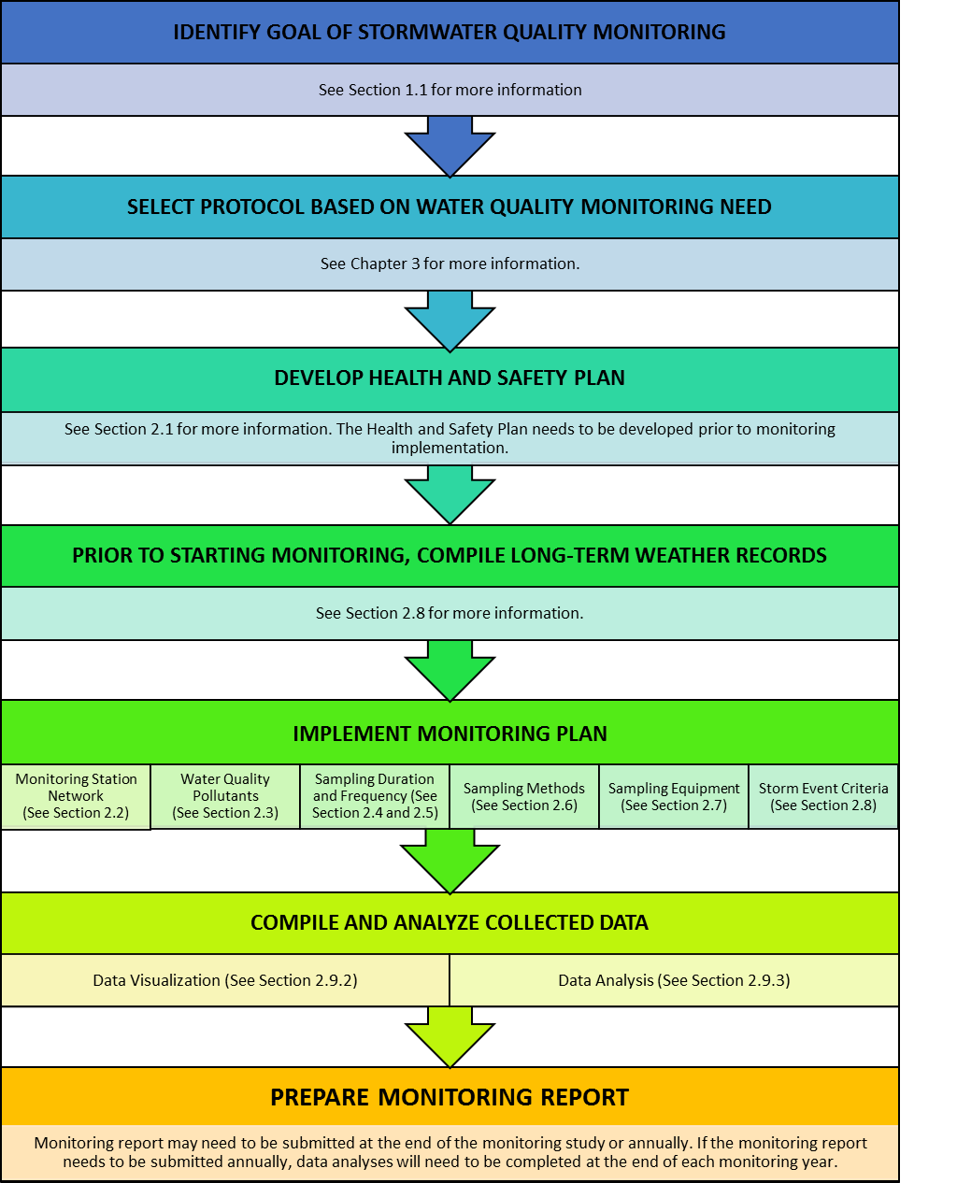
Report organization
*A Handout for this Figure will be provided.

Slide 8
Stormwater monitoring literature review
Caltrans Stormwater Monitoring Guidance Manual - Caltrans (State of California Department of Transportation)
State-of-the-Practice Report: Water Quality Monitoring - aashto’s Stormwater Management Community of Practice (CoP)
Handbook for Sampling and Sample Preservation of Water and Wastewater – United States Environmental Protection Agency
National Field Manual for the Collection of Water-Quality Data – United States Geological Survey
Sampling and Testing of Stormwater Runoff from North Carolina Highways – North Carolina Department of Transportation

Slide 9
Stormwater monitoring literature review
Urban Stormwater BMP Performance Monitoring – Geosyntec Consultants and Wright Water Engineers
Monitoring of Contaminants in Delaware Street Sweeping Residuals and Evaluation of Recycling/Disposal Options – Delaware Department of Transportation
Standard Operating Procedure for Automated Sampling for Stormwater Monitoring – Federal Highway Administration
Characterization of Highway Runoff in Austin, Texas Area – University of Texas at Austin
Minnesota Stormwater Manual – Minnesota Pollution Control Agency
Stormwater Sampling Manual – Washington Department of Ecology

Slide 10
Monitoring goals
Goal 1 - Characterize Stormwater Runoff Quality
Goal 2 - Assess Best Management Performance (BMP) Performance
Goal 3 - TMDL Effectiveness Monitoring
Goal 4 - Evaluate Efficiency Of Routine Maintenance Activities

Slide 11
Key elements of monitoring
Monitoring station network
Location Of Monitoring Stations
Number Of Monitoring Stations
Water Quality pollutants
Duration of monitoring
Number of storms to sample
Sampling methods
Grab Sampling
Automated Sampling
Composite Sampling
Monitoring equipment
Precipitation
Flow
Sample Collection
Storm event criteria
Health and safety plan
Data analysis technique
Data Validation
Database Development
Data Visualization
Qc procedures

Slide 12
Monitoring plan Goal 1 characterize stormwater runoff quality
Location of Monitoring stations:
DOT Storm Drainage Network (Ditches, Curb Inlets, Catch Basins, Pipe Outfalls)
Number of Monitoring Stations:
*Varies with diversity of the highway to be monitored as well as other factors for example eco regions, land use, TMDLs, and traffic counts.
Type of Monitoring Study | Recommended Number of Monitoring Stations
State-Wide | 10 to 50 stations, depending on the area of the state.
Transportation Facility/Hotspot | 1 to 3 stations
Highway Specific | 3 to 5 stations*

Slide 13
Monitoring plan Goal 1 characterize stormwater runoff quality
Water quality Pollutants¹
Pollutant Category | Pollutants
Particulates | TSS
Nutrients – Nitrogen | TKN, NO3-2, NH3-N, Organic Nitrogen, TN
Nutrients - Phosphorus | TP, PO4
Metals | Cadmium, Lead, Zinc, Copper, and Iron (total and dissolved)
Bacteria | E. Coli., Fecal Coliform, and Enterococcus
Organic Contaminants | TPH, Oil, and Grease
 | PCBs (Total)
 | PAHs (Total)
General/Conventional | Water Temperature, DO, Specific Conductivity, pH, Hardness, and TDS
Herbicides | Varies based on chemical control utilized
De-Icing | Chlorides, TDS, Conductivity
¹Toxicity is discussed separately. See report for details.

Slide 14
Monitoring plan Goal 1 characterize stormwater runoff quality
Duration of monitoring:
2 Years For States With At Least 30” Of Annual Rain
Eastern U.S., Northern California, And Pacific Northwest
3 Years For States With Less Than 30” Of Annual Rain
Western U.S.
Number of Storms to sample:
10 Storms Per Year
Sampling Method:
Discrete (by Automated Sampler)*
Flow-Weighted Composite
*The term “discrete” is used here to differentiate from “grab” samples. Discrete in this context refers to samples that are collected by an automated sampler, as opposed to grab samples which are collected by hand. Discrete sampling by an automated sampler means collecting a series of individual samples for laboratory analysis to provide data on the within-storm variability of the water quality pollutants.

Slide 15
Monitoring plan Goal 1 characterize stormwater runoff quality
Monitoring equipment*:
*Applies to all goals
Monitoring Parameter or Equipment Type | Recommended Equipment
Precipitation | tipping bucket rain gauge
Flow | depends on nature of flow at monitoring station
Sample Collection – Automated | automated sampler (suggest refrigerated model in warm climates)
Sample Collection – Grab | laboratory bottles, powder-free nitrile gloves, cooler with ice, extension pole, intermediate container, chain of custody, pen
Telemetry | cellular modem, antenna, vendor software, cellular phone account, data logger
Power | Power is only needed if using automated samplers. AC power is ideal. If not available, use a 12 V deep-cycle marine battery and possibly a solar array.

Slide 16
Monitoring plan Goal 1 characterize stormwater runoff quality
Storm event criteria*:
*Applies to all goals
Storm Event Criteria | Arid or Semi-Arid Climates | Humid Climates
Rainfall Depth | Minimum 0.1” | Minimum 0.1”
Rainfall Duration | At least 1 hour | At least 1 hour
Antecedent Dry Period¹ | At least 72 hours | At least 24 hours
Inter-Event Dry Period | 10 hours | 10 hours
¹Dry period is defined as less than 0.04” in previous 6 hours. See Section 2.8 for details.

Slide 17
Monitoring plan Goal 1 characterize stormwater runoff quality
Data Analysis Technique:
Goal | Summary Table | Bar Graph | Hyetograph | Hydrograph | Box Plot | Scatter Plot | Trend Plot
1 | X | X | X | X | X | X | X
Goal | Calculation of EMCs | Calculation of Pollutant Loads | Calculation of Treatment Efficiency | Conducting Statistical Analysis | Conducting a Regression Analysis | Conduct a Trend Analysis
1 | X | X |  | X | X | X

Slide 18
Monitoring plan Goal 2 assess bmp performance
Location of Monitoring stations:
Monitoring Locations Should Be Located At The Influent And Effluent Point(s) Of The BMP Being Monitored.
Precise Location of Sampler Intake can Affect the Quality and Accuracy. See Section 1.1 for more information.
Number of Monitoring stations¹:
BMPs With A Single Influent And Effluent Point: 2 Monitoring Stations, One At Each
BMPs With A Single Influent Point And No Effluent Point: 2 Monitoring Stations, One At Influent And One Interior
BMPs With Multiple Influent Points And Multiple Effluent Points: Monitor At Each Influent And Effluent Point To Capture All Inflows And Outflows, Up To A Maximum Of 4 Monitoring Stations. BMPs With More Than 4 Influent And Effluent Locations Are Not Recommended For Monitoring.
Treatment Train BMPs : Two Paired Inflow-outflow Stations For Each Individual Treatment Train Component.

Slide 19
Monitoring plan Goal 2 assess bmp performance
Water quality Pollutants¹
Pollutant Category | Pollutants
Particulates | TSS
Nutrients – Nitrogen | TKN, NO3-2, NH3-N, Organic Nitrogen, TN
Nutrients - Phosphorus | TP, PO4
Metals | Total and Dissolved Cadmium, Zinc, Copper, and Lead
General/Conventional | DO, temperature, pH, hardness, and TDS
Bacteria | Fecal Coliform and Enterococcus
Organic Contaminants | PAHs, Oil and Grease
¹Toxicity is discussed separately. See report for details.

Slide 20
Monitoring plan Goal 2 assess bmp performance
Duration of monitoring:
2 Years For States With At Least 30” Of Annual Rain
Eastern U.S., Northern California, And Pacific Northwest
3 Years For States With Less Than 30” Of Annual Rain
Western U.S.
Number of Storms to sample:
10 Storms Per Year
Sampling Method:
Flow-weighted Composite

Slide 21
Monitoring plan Goal 2 assess bmp performance
Monitoring equipment:
See Slide 15
Storm event criteria:
See Slide 16
Data Analysis Technique:
Goal | Summary Table | Bar Graph | Hyetograph | Hydrograph | Box Plot | Scatter Plot | Trend Plot
2 | X | X | X | X | X |  | X
Goal | Calculation of EMCs | Calculation of Pollutant Loads | Calculation of Treatment Efficiency | Conducting Statistical Analysis | Calculation of Runoff Volume Reductions | Conducting a Regression Analysis | Conduct a Trend Analysis
2 | X | X | X | X | X |  | X

Slide 22
Monitoring plan Goal 3 tmdl effectiveness
Location of Monitoring stations:
See Goals 1 and 2
Number of Monitoring stations:
TMDL Compliance Monitoring Applies To DOTs That Are Subject To TMDL Requirements. For These Dots, It Is Difficult To Recommend A Specific Number Or Even Range Of Stations Since It Differs Case By Case. Some Factors To Consider Include:
The relative contribution of pollutant loads of the DOT and size of the area to the impaired TMDL waterway.
The size of the area where stormwater treatment is needed to comply with the TMDL.
The heterogeneity of these areas.
How much monitoring is needed to populate and calibrate a water quality model for pollutant load analysis.

Slide 23
Monitoring plan Goal 3 tmdl effectiveness
Water quality Pollutants
DEPENDENT ON THE NATURE OF THE IMPAIRMENTS IN THE LOCAL WATERWAYS
Common TMDLs Include:
Sediment
Pathogens
Nutrients
Metals
Pesticides/Toxics
Bacteria
Temperature
Less Typical TMDLs Include:
Biological Integrity
Turbidity
Fecal Coliform
Selenium
Chloride

Slide 24
Monitoring plan Goal 3 tmdl effectiveness
Duration of monitoring:
2 Years For States With At Least 30” Of Annual Rain
Eastern U.S., Northern California, And Pacific Northwest
3 Years For States With Less Than 30” Of Annual Rain
Western U.S.
Number of Storms to sample:
10 Storms Per Year
Sampling Method:
Flow-weighted Composite

Slide 25
Monitoring plan Goal 3 tmdl effectiveness
Monitoring equipment:
See Slide 15
Storm event criteria:
See Slide 16
Data Analysis Technique:
Goal | Summary Table | Bar Graph | Hyetograph | Hydrograph | Box Plot | Scatter Plot | Trend Plot
3 | X | X | X | X | X | X | X
Goal | Calculation of EMCs | Calculation of Pollutant Loads | Calculation of Treatment Efficiency | Conducting Statistical Analysis | Conducting a Regression Analysis | Conduct a Trend Analysis
3 | X | X | X | X | X | X

Slide 26
Monitoring plan Goal 4 routine maintenance activities
Location of Monitoring stations:
Herbicide Applications: Monitor At Centroid Of Herbicide Spray Area And Immediately Downslope Of The Spray Area. It Is Also Recommended To Monitor At A Control Site Where Herbicides Were Not Sprayed But All Other Conditions Are The Same. This Can Either Be At A Separate Location Nearby, Or Along The Road Shoulder Just Before Runoff Enters The Spray Area.
De-icing/Salt Applications: Monitor Along The Road Shoulder Or In A Catch Basin Adjacent To Roads Where De-icing Materials Are Applied. Stations May Also Be Located At Bridge Decks Where Runoff Is Discharged Into A Downstream BMP.
Street Sweeping/Catch Basin Clean-outs: Storm Drain Pipe Outfalls At The Base Of The Catchment Area Where Street Sweeping Occurs.
Vegetation Maintenance (Mowing): Edge-of-pavement At The Road Shoulder, In The Centroid Of The Mowing Area, Immediately Downslope Of The Mowing Area.
Note: Precise Location of Sampler Intake can Affect the Quality and Accuracy. See Section 1.1 for more information.

Slide 27
Monitoring plan Goal 4 routine maintenance activities
number of Monitoring stations:
Type of Routine Maintenance Activity | Recommended Number of Monitoring Stations
Herbicides¹ | 2 to 3 stations at control sites and 2 to 3 stations at treatment areas
De-icing/Salt Applications during Adverse Weather Conditions | 2 per bridge crossing or 1 station per catchment
Street Sweeping/Catch Basin Clean-Out | 2 stations per monitoring study (1 station per catchment)
Vegetation Maintenance (Mowing) | 1 to 3 stations per mowing area
¹The intent is to characterize the use of herbicides at the treatment site and compare the data to a control site where there is no use of herbicides to assess whether the use of herbicides could be a contributor to the load of herbicides. See page 12 of report.

Slide 28
Monitoring plan Goal 4 routine maintenance activities
Water quality Pollutants
Pollutant Category | Pollutants
Street Sweeping | TSS, TDS, VSS, particle size distribution
Catch Basin Clean-outs | TSS, TDS, VSS, particle size distribution
Herbicide Applications | Varies depending on what herbicide was used for vegetation control (i.e. Glyphosate, Diuron, and etc.), hardness, temperature, pH
Application of De-icing Materials | Chloride, conductivity
Vegetation Maintenance (Mowing) | TSS, TDS, VSS, particle size distribution

Slide 29
Monitoring plan Goal 4 routine maintenance activities
Duration of monitoring:
2 Years For States With At Least 30” Of Annual Rain
Eastern U.S., Northern California, And Pacific Northwest
3 Years For States With Less Than 30” Of Annual Rain
Western U.S.
Number of Storms to sample:
Variable: 5 to 10 Storms per Year
Sampling Method:
Flow-weighted Composite

Slide 30
Monitoring plan Goal 4 routine maintenance activities
Monitoring equipment:
See Slide 15
Storm event criteria:
See Slide 16
Data Analysis Technique:
Goal | Summary Table | Bar Graph | Hyetograph | Hydrograph | Box Plot | Scatter Plot | Trend Plot
4 | X | X | X | X
Goal | Calculation of EMCs | Calculation of Pollutant Loads | Calculation of Treatment Efficiency | Conducting Statistical Analysis | Conducting a Regression Analysis | Conduct a Trend Analysis
4 | X |  | X

Slide 31
Additional information
Glossary
Abbreviations
References
Appendices
Site maintenance
Calibration and testing of equipment
Laboratory methods

Slide 32
Project Final Report Available at: http://apps.trb.org/cmsfeed/TRBNetProjectDisplay.asp?ProjectID=3970

