Slide 1
NCHRP 25-25(85)
Nutrient (Nitrogen/ Phosphorus) Management and Source Control

Slide 2
Project Overview
Goals and Objectives:
Identify and critically evaluate DOT strategies for assessing nutrient concerns and reducing nutrient loads from highway runoff
Document Organization:
Introduction
Nutrient Regulations and Trends
Nutrients in the Environment
Removal Processes
BMP Types and Performance
Strategies and Designs for Nutrient Control
Summary and Recommendations
Notes:
The focus is on developing strategies for DOT-controllable nutrients sources
BMPs include source controls, gross solids removal devices, and runoff (a.k.a. treatment) controls

Slide 3
Nutrient Regulations and Trends

Slide 4
Nutrient Impairments
Nutrient impaired waters identified by the U.S. EPA in 2013
Over 100,000 miles of rivers and streams
Almost 2.5 million acres of lakes, reservoirs, and ponds
Over 800 square miles of bays and estuaries
Total Maximum Daily Loads (TMDLs) often include Waste Load Allocations (WLAs) for stormwater that DOTs may be subject to
Chesapeake Bay TMDL
Nitrogen and phosphorus load reductions of 25% and 24%, respectively, are required
Gulf of Mexico Hypoxia
Scientific advisory board (SAB) recommends at least a 45% reduction in total nitrogen and phosphorus load to the Mississippi-Atchafalaya River basin
Notes:
As of 2013, the quantity of nutrient impaired waters identified by the U.S. EPA is staggering
Chesapeake Bay TMDL
Covers approximately 166,000 km² (64,000 mi²)
Gulf of Mexico Hypoxia
Approximately 14,250 km² (5,500 mi²) hypoxic zone

Slide 5
EPA Nutrient-Related Water Quality Policies
National Nutrient Strategy Program
National Nutrient Strategy (1998)
National Water Program (2009)
Framework for State Nutrient Reductions (2011)
Ecoregions
Spatial classification of major ecosystems
Structure for ecosystem management collaboration
Ambient Water Quality Criteria Recommendations
Guidelines for states when developing nutrient criteria
Ecoregional nutrient documents for:
Reservoirs and lakes
Rivers and streams
Estuarine and coastal areas
Wetlands
Notes:
National Nutrient Strategy: developed to help states adopt numeric water quality standards and build scientific and technical knowledge for developing new nutrient criteria
National Water Program: established to provide safe and reliable sources of water through source water protection and security, wastewater management, wetland and watershed conservation, and aquatic life and human health protection
Framework for State Nutrient Reductions: intended as a planning tool to initiate dialogue with states, tribes, and other partners and stakeholders on achieving reduction in nitrogen and phosphorus in the nation’s waters
Ecoregions are areas that have similar geology, physiography, vegetation, climate, soils, land use, wildlife, and hydrology.
Ecoregions provide structure for collaboration of federal, state, and other agencies to implement ecosystem management strategies
Ecoregional nutrient criteria reflect surface waters that are minimally impacted by human activity

Slide 6
Source: http://www2.epa.gov/nutrient-policy-data/ecoregional-criteria-documents
Notes:
14 distinct ecoregions used for National Nutrient Strategy

Slide 7
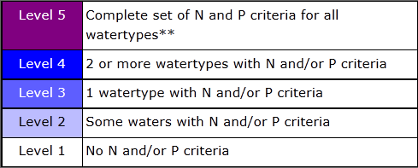
States with Numeric Nutrient Criteria
Source: http://cfpub.epa.gov/wqsits/nnc-development/

Slide 8
State Water Quality Policies and Programs
DOTs being listed as stakeholders in nutrient TMDLs
e.g, California, Delaware, Florida, Michigan, Minnesota, New York, North Carolina, and Washington
States increasingly developing nutrient reduction strategies and management plans
e.g., Kansas, Wisconsin, Iowa, Missouri, Maryland, and Virginia
Nutrient trading being explored in many states
e.g., North Carolina, Missouri, Oregon, Virginia, California
Many states have laws that limit nutrient use:
Banned P in Dishwashing Detergent | Banned P Fertilizer Use or Sale
Illinois, Indiana, Maryland, Massachusetts, Michigan, Minnesota, Montana, New Hampshire, Ohio, Oregon, Pennsylvania, Utah, Vermont, Virginia, Washington, Wisconsin | Illinois, Maine, Maryland, Michigan, Minnesota, New Jersey, New York, Vermont, Virginia, Washington, Wisconsin
Notes:
The Washington State DOT permit requires an assessment of TMDL wasteload allocations
Kansas adopted a nutrient reduction plan in 2005 that included watershed restoration action plans, over 40 nutrient TMDLs, point source nutrient reductions, agriculture nutrient reductions, funding mechanisms, and a timeline for restoration
Missouri is currently developing a nutrient reduction strategy with over 90 stakeholders
Trading programs provide a means to meet regulatory obligations by purchasing environmentally equivalent (or superior) pollution reduction credits from another source at lower cost, thus achieving the same or greater water quality improvement at lower overall cost.

Slide 9
Nutrients in the Environment

Slide 10
Nutrient Sources By Land Use
Land Use | Nutrient Source
Agriculture | Chemical Fertilizers
 | Livestock Manure
 | Aquaculture Wastes
 | Excessive Soil Erosion
Urban or Developed (* Potential contributor to nutrients in highway runoff) | Lawn Fertilizers
 | Plant Stabilization Fertilizers*
 | Detergents
 | Human Waste
 | Pet Waste
 | Attracted Wildlife*
 | Fossil Fuels*
 | Machine Lubricants*
 | Construction Materials*
 | Traction/Deicing Compounds*
 | Land Disturbance and Streambank Erosion*
 | Herbicides and Pesticides*
 | Leaf and Grass Litter*
Undeveloped | Fish and Wildlife Wastes
 | Minerals
 | Plant Litter
 | Wildfires and Land Disturbance
Notes:
As shown, there are many sources of nutrients that discharge to surface waters that have nothing to do with highway runoff (e.g., WWTP discharges, leaching from septic systems, animal waste, fertilizers, agricultural runoff, etc.).
Highways and highway drainage systems often receive inputs via runoff or direct deposition from many of these land uses and thus many nutrient sources shown in this table could contribute to the load observed in highway runoff, even though the highway was not the original source.

Slide 11
Sources of Nutrient Impairment
Sewage Treatment Plant Discharge
Source: Paerl et al. (2006)
Notes:
All of these sources contribute to excess nitrogen and phosphorus reaching receiving waters.

Slide 12
Relative Contribution from Major Sources
Source: Nutrient Innovations Task Group (NITG, 2009)
Notes:
But sources do not contribute evenly….
As an example, nutrient contribution analysis for the Chesapeake Bay indicates that urban stormwater contributes about 30% of phosphorus loads and about 10% of nitrogen loads.
For the Gulf of Mexico with contributions from the Mississippi River, this fraction is even lower (note that urban population and related sources includes both stormwater and municipal wastewater).

Slide 13
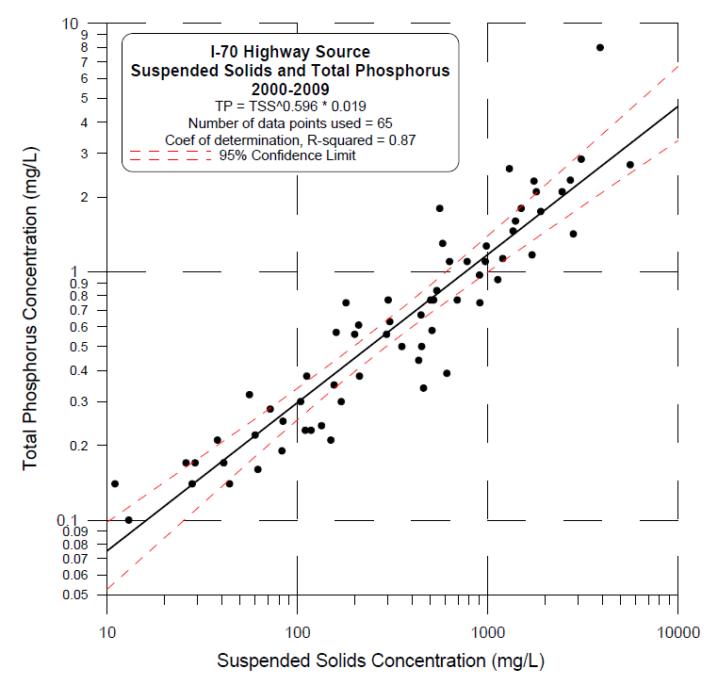
DOT Contribution
Pollutant | Median Concentration (mg/L)
 | Highways |  | Runoff from other Anthropogenic Sources
 | Rural | Urban | Urban | Agricultural
OP | 0.16 | 0.40 | 0.33 | 0.80
NO₃-N | 0.46 | 0.76 | 0.70 | 3.00
Source: CDOT (2013)
Source: Driscoll et al. (1990).
Nutrient concentrations in highway runoff similar to urban stormwater
Influenced by surrounding land uses
Nitrogen is largely atmospheric
Phosphorus is largely particulate bound

Slide 14
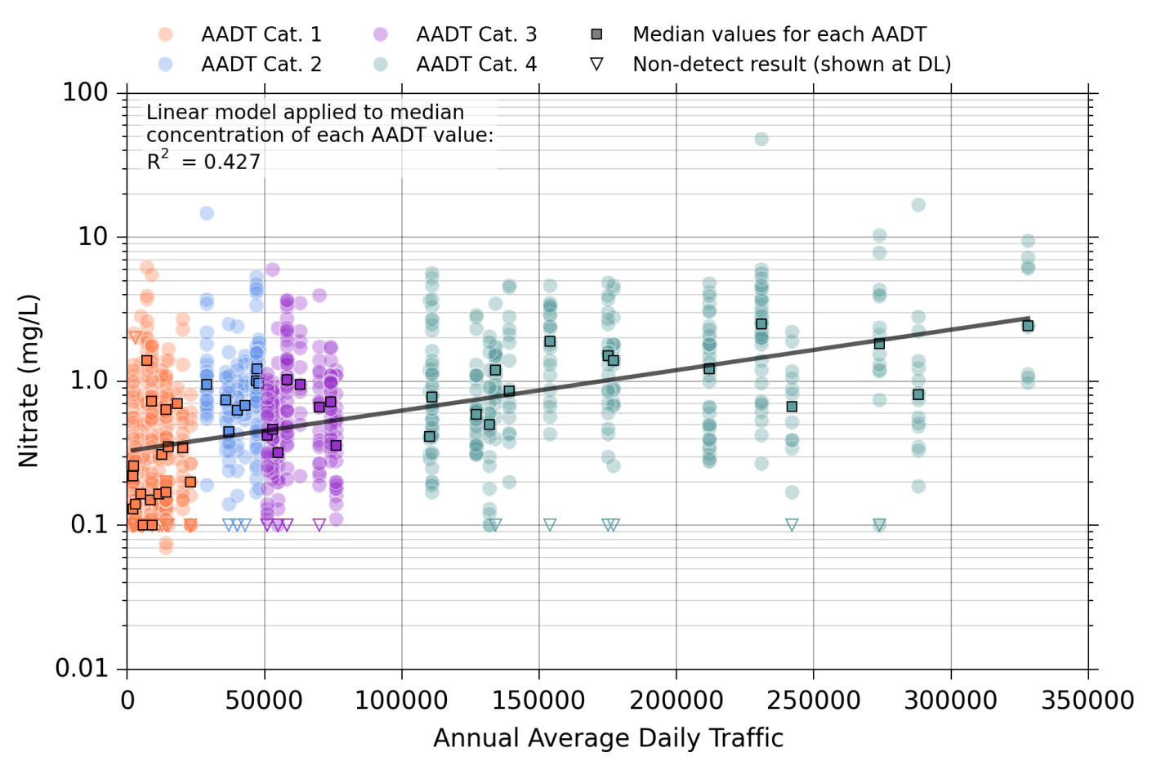
Nitrate Correlation with Annual Average Daily Traffic
Notes:
Log-linear regression analyses were conducted using data from the Highway Runoff Database (HRDB) (Smith and Granato, 2010) and the National Stormwater Quality Database (NSQD) (Pitt, 2008)
Nitrate has a weak positive correlation with AADT
Urban areas are expected to have higher NOx emissions from vehicles and industrial sources.
Also, high traffic freeways typically have piped drainage systems thereby providing more opportunities for build-up and transport of organic nutrients, such as plant matter (e.g., leaves) and animal waste.

Slide 15
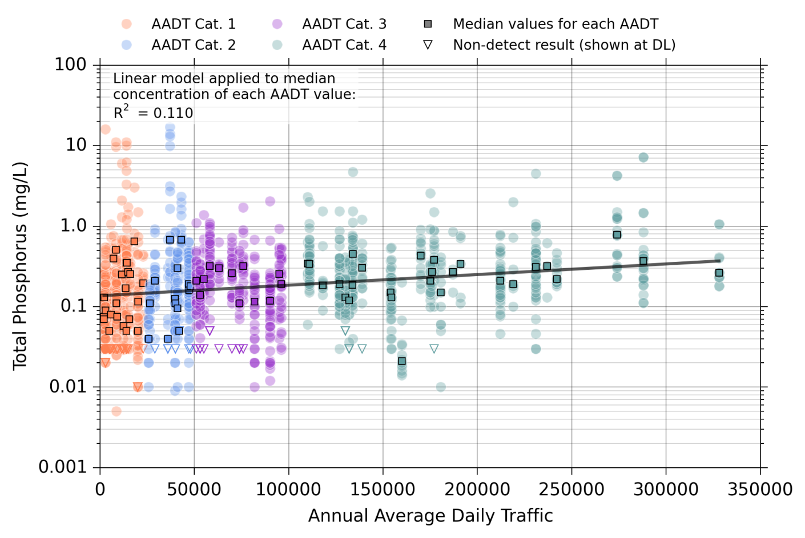
Phosphorus Correlation with Annual Average Daily Traffic
Notes:
Phosphorus concentrations do not correlate as well with AADT

Slide 16
Nutrient Removal Processes

Slide 17
Phosphorus Treatment Mechanisms
Form | Treatment Mechanism | Factors Influencing Treatment
Particulate | filtration, sedimentation | partitioning of phosphorus between particulate and soluble forms particle size distribution oxidation-reduction potential pH bacterial communities that transform phosphorus into soluble forms (microbial transformation) temperature
Dissolved | adsorption, precipitation | contact with reactive media/soils pH oxidation-reduction potential presence of calcium, magnesium, iron, aluminum
 | biological uptake | vegetation and root density presence of nitrogen and other essential nutrients bacterial communities periodic harvesting of vegetation temperature
Notes:
The primary treatment mechanisms for phosphorus are filtration, sedimentation, adsorption/precipitation, and biological uptake.

Slide 18
Nitrogen Treatment Mechanisms
Form | Treatment Mechanism | Factors Influencing Treatment
Nitrogenous Organic Solids | physical separation (screening, filtration, settling) | partitioning of nitrogen between particulate and soluble forms
 | ammonification (transform via microbial decomposition to NH4) | temperature pH bacterial community
Nitrate (NO₃) | plant uptake | vegetation density presence of phosphorus periodic harvesting of vegetation
 | denitrification (transformation via biological reduction to N2 gas) | bacterial community oxidation-reduction potential/dissolved oxygen
Ammonium (${\text{NH}}_{\text{4}}^{\text{+}}$) Ammonia (NH₃) | volatilization | temperature pH circulation and air flow
 | nitrification (transform via biological oxidation to NO3) | temperature pH bacterial community
Notes:
Removing nitrogenous solids (plant matter) is the first and most effective treatment mechanism.
Once organic matter breaks down, volatilization, nitrification/denitrificaiton, and plant uptake are needed

Slide 19
BMP Types and Performance

Slide 20
Overview of Nutrient Source Control BMPs
BMP | Description
Fertilizer Application Management | Management of fertilizer application types, timing, location, rates, and storage to reduce or eliminate nutrients
Permanent Erosion and Sediment Control | Measures to control erosion and sediment after construction including vegetated embankments, check dams, and erosion control blanket
Permeable Friction Course (PFC) | Layer of porous asphalt placed on top of existing conventional concrete or asphalt to improve safety and reduce undercarriage washing from road spray
Pet Waste Control | Management strategies for pet waste including education efforts, increased rests stops and signage
Wildlife Waste Control | Constructing wildlife crossings and bird roosting deterrents to reduce the incidence of roadkill and animal droppings on the road surface
Plant Material Management | Management strategies to minimize roadside vegetation and leaf litter from entering roadway, including mowing and grooming practices
Plant Selection and Installation Methods | Selection of plants and trees that will enhance nutrient uptake and installation methods that reduce compaction to promote root growth and infiltration
Planting Medium Selection | Selection of a planting medium that will not leach nutrients
Street Sweeping | Remove the buildup of sediment and detritus that have been deposited along the street or curb, using a vacuum assisted sweeper truck
Winter Road Management | Management of application types, timing, location, rates, and storage to reduce or eliminate nutrients. Includes road sanding and deicing.

Slide 21
Source Control Performance
Fertilizer application management load reduction credits in Maryland (MDE, 2011)
17% total nitrogen
22% total phosphorus
PFC Overlay (Stanard et al., 2008)
64% reduction in total phosphorus concentration
Increase in nitrate/nitrite concentration
Street sweeping (CWP, 2006; Law et al., 2008; MDE, 2011; Selbig and Bannerman, 2007)
3-9% removal of nitrogen and phosphorus
PFC layer on Loop 360, Austin, Texas
Source: Bradley J. Eck.
Notes:
Limited performance information for nutrient source control BMPs

Slide 22
Overview of Gross Solids Removal BMPs
BMP | Description
Catch Basin Insert | Passive devices that are fitted below the grate of a drain inlet to intercept gross solids (e.g., litter and vegetation) and coarse sediment
Catch Basin Sump | Inlet structure with enlarged storage capacity used to capture gross solids (e.g., litter and vegetation) and coarse sediment
Hydrodynamic Device | Cyclonic trapping of solids, oil/grease, floatables, and other debris
Nutrient Baffle | Baffle for gross solids (e.g., litter and vegetation) and coarse sediment
Oil/Water/Grit Separator | Device designed to separate oil and suspended solids/grit from runoff

Slide 23
Gross Solids Removal Performance
Catch basin sumps (CWP, 2006; Pitt, 1984; Smith, 2002)
1-18% total nitrogen load reduction via nitrogenous solids removal
5-30% total phosphorus load reduction via sediment removal
Baffle Box w/ horizontal screen to keep debris out of standing water (GPI Southeast, 2010)
Up to 28% reduction in total nitrogen loads
Up to 19% reduction in total phosphorus loads
Oil/Water/Grit Separators (Smith, 2002)
31% TKN load reduction via nitrogenous solids removal
19-36% total phosphorus load reductionl via nitrogenous solids removal
Baffle Box Source: Caltrans (2003)
Notes:
Gross solids removal devices would not be expected to reduce nutrient concentrations, but would be expected to reduce total nutrient loads via the removal of organic debris before it breaksdown and releases nitrogen and phosphorus.
Leaf litter control most effective at reducing nutrient loads if kept dry

Slide 24
Overview of Runoff Control BMPs
BMP | Description
Bioretention (no underdrain) | Vegetated, shallow depressions which may include engineered planting media that temporarily store stormwater prior to infiltration
Bioretention (with underdrain) | Vegetated, shallow depressions with engineered planting media and an underdrain outlet. Underdrain outlet may be elevated or controlled to provide internal water storage for increased infiltration and denitrification.
Bioswale | Shallow vegetated channels that remove pollutants through sedimentation, filtration, and infiltration. Check dams and soil amendments to improve performance.
Dry Detention Basin | Grass-lined basins that temporarily detain water through outlet controls to reduce peak stormwater runoff release rates and provide sedimentation treatment
Infiltration Facility | Stormwater management control that provides storage to capture and hold stormwater runoff and allow it to infiltrate into the surrounding native soils; includes infiltration basins, infiltration trenches, and infiltration vaults
Media Filter | A constructed bed or container (cartridge) with filtration media that provides treatment when inflows percolate through the bed. Outflow from the media filter system can be through underdrains or infiltration
Media Filter Drain | A linear, flow-through treatment system that includes gravel, grass strip, and media filter bed treatment zones and associated conveyance system
Multi- Chambered Treatment Train | Three treatment chambers with grit removal, sedimentation, and filtration through media

Slide 25
Runoff Control BMPs (cont.)
BMP | Description
Porous Pavement | Pavement that allows for infiltration through surface void spaces into underlying material; includes modular block, pervious concrete, porous aggregate, porous asphalt, and porous turf
Subsurface Flow Wetland | Engineered system that can include a combination of wetland vegetation, porous media, and the associated microbial and physiological ecosystems
Vegetated Filter Strip | Vegetated strips that provide treatment via filtration, sedimentation, infiltration, biochemical processes and plant uptake
Wet Pond | Constructed basins that have a permanent pool of water, treats stormwater runoff through settling and biological activity
Wetland Basin | Constructed naturalistic pond, lake, or wetland that incorporates design elements such as a sedimentation pool (forebay), permanent or seasonal treatment pool, vegetation, and outlet control structure
Wetland Channel | Densely vegetated waterways used to treat and convey runoff

Slide 26
Runoff Control BMP Performance
Statistical significance of nutrient concentration reductions from BMP data contained in the International Stormwater BMP Database (Version 03 24 2013)
Note: Solids grey circles indicate statistically significant increase
Notes:
Three different methods of evaluating statistical significant differences between influent and effluent concentrations were used.
The most effective BMP for all nutrient types is wet ponds.
Vegetated filter strips, bioswales, and bioretention systems tend to export or are ineffective for phosphorus concentration reduction
Export of TKN is indicated for dry detention basins and wetland basins.
Export of nitrate is indicated for bioretention and sand filters.

Slide 27
Strategies and Designs for Nutrient Control

Slide 28
General Strategies
Source controls to minimize exposure of nutrient sources to stormwater
Gross solids removal BMPs to reduce overall loadings from breakdown of organic debris
Runoff control BMPs to reduce runoff volumes and nutrient concentrations with BMPs with unit treatment processes that specifically target the nutrient of concern
Phosphorus → Filtration, Sedimentation, Adsorption
Nitrogen → Nitrification/Denitrification, Plant Uptake

Slide 29
Filter Media and Additives
Phosphorus Removal Enhancement
Iron aggregate or filings
Water treatment residuals
Oxide-coated sands
Nitrogen Removal Enhancement
Activated carbon or biochar to sorb ammonium and promote nitrification and plant uptake
Carbon source such as wood chips or newspaper to promote denitrification
Notes:
Media and additives to improve nutrient reductions is an area of continued research

Slide 30
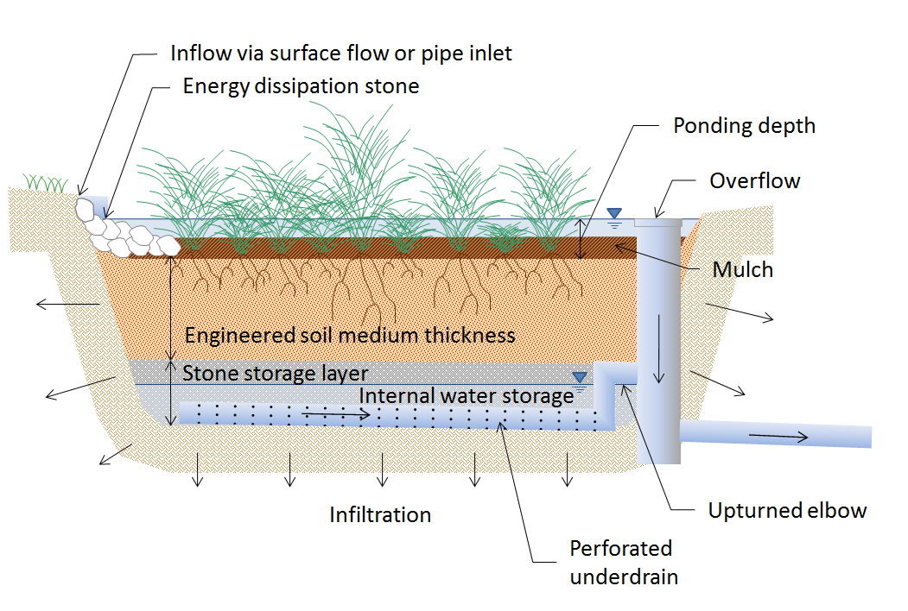
Saturation Zone
Create anaerobic zone to promote denitrification
Standard component of surface and subsurface wetlands
Possible to create within bioretention systems using internal water storage design

Slide 31
Hydraulic Design Considerations
Hydraulic Residence Time
Increase the opportunity for settling, sorption, and plant uptake
Larger length-to-width ratio
Longer, more tortuous flow path
Infiltration / Filtration Capacity
Pretreatment of solids to minimize clogging
Spread flows over larger areas / reduce ponding depth
Dense, woody vegetation to keep soils open
Minimize compaction of underlying soils
Install boreholes or trenches to increase storage volume and infiltration surface area

Slide 32
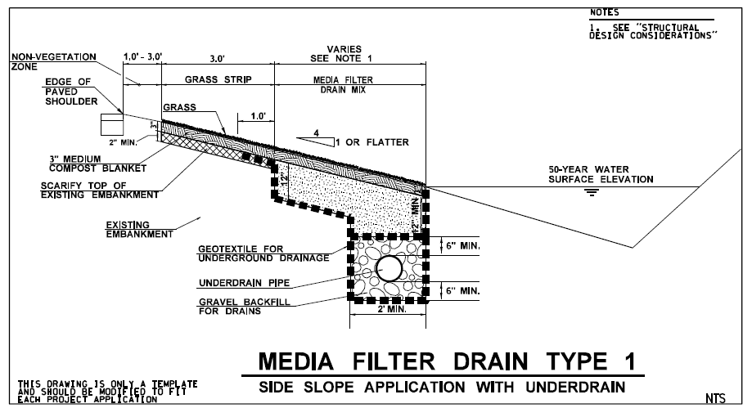
Space Constrained Options
Cartridge filter vault with engineered media
Multi-Chamber Treatment Train (MCTT)
Media Filter Drain
Source: WSDOT (2014)

Slide 33
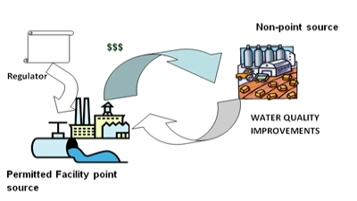
Watershed Based Approaches
Restoration Mitigation
Conservation Mitigation
In-Lieu Fee Programs
Stormwater Banking Mitigation
Water Quality Trading
Ecosystem Services Markets
Source: http://bearriverinfo.org/htm/water-quality-trading/water-quality-trading-conclusions
Notes:
Watershed-based approaches are become more streamlined and available as a mitigation strategy for nutrients
Water quality trading approaches have U.S. EPA policy backing, specifically to encourage voluntary trading programs that facilitate implementation of TMDLs
Challenge today is that only a few states have established programs to facilitate watershed-based stormwater mitigation approaches
Two ongoing related projects include:
NCHRP 25-37 A Watershed Approach to Mitigating Storm Water Impacts
FHWA Feasibility Study for the Development of a Framework for an Effective Stormwater Quality Credit/Banking/Trading System

Slide 34
Summary and Recommendations

Slide 35
Summary
Nutrients are a major source of impairment to our nations waters
DOTs are seeing increased pressures to control nutrients from their rights-of-way
Primary sources of nutrients in highway runoff are atmospheric deposition, soil erosion, decomposing organic debris, animal waste, and fertilizer applications
Source controls and gross solids removal BMPs are important components of overall nutrient control strategies
Infiltration is the most effective strategy for nutrient control where feasible
Nutrient removal can be enhanced by filter media additives, saturated anaerobic zones, dense vegetation, and increased hydraulic residence times

Slide 36
Source Control and Gross Solids Removal BMP Recommendations
Source Control BMPs
Roadside Fertilizer Management (where applicable)
Animal Waste Controls (rest stops, wildlife crossings, overpasses)
Permanent Erosion and Sediment Control
Permeable Friction Coarse Overlay
Roadside Vegetation Management
Street Sweeping
Winter Road Management (where applicable)
Gross Solids Removal BMPs
Catch Basin Sumps
Nutrient Baffles
Oil/Water/Grit Separators
Notes:
Based on review of data and understanding of sources and what is controllable by DOTs, cost-effective source control and gross solids removal BMPs appear to be….
Nutrient baffles that are designed with horizontal screens that keep captured debris out of the permanent pool are the most effective.

Slide 37
Runoff Control BMP Recommendations
Volume reduction BMPs wherever feasible/desirable
e.g., permeable shoulders, infiltration trenches, bioretention,
Media filtration designs with engineered media for phosphorus and ammonia adsorption and to provide carbon source
e.g., iron additives, water treatment residuals, oxide-coated sand, activated carbon, biochar, woodchips
Saturated zones / internal water storage to promote denitrification
Dense vegetation and long residence times needed for plant uptake
Wet ponds are the most effective BMP for both phosphorus and nitrogen reduction
Notes:
Catch basin inserts are not recommended due to lack of performance, issues with clogging, and high level of maintenance
Catch basin sumps can be somewhat effective, but concerns with resuspension of captured materials and

Slide 38
Key References
CDOT. (2013). I-70 Clear Creek Corridor Sediment Control Action Plan. September. http://www.coloradodot.info/projects/i-70mountaincorridor/documents/clear-creek-scap-final-report.pdf
Center for Watershed Protection (CWP). (2006). Technical Memorandum 1- Literature Review Research in Support of an Interim Pollutant Removal Rate for Street Sweeping and Storm Drain Cleanout Activities. October.
Driscoll, E.D., Shelley, P.E., and Strecker, E.W. (1990). Pollutant Loadings and Impacts from Highway Stormwater Runoff Volume III: Analytical Investigation and Research Report. Federal Highway Administration, Publication No. FHWA-RD-88-008.
Law, N. L., DiBlasi, K., and Ghosh, U. (2008). Deriving Reliable Pollutant Removal Rates for Municipal Street Sweeping and Storm Drain Cleanout Programs in the Chesapeake Bay Basin. September.
Maryland Department of Environment (MDE) (2010) Maryland’s TMDL Implementation Framework, http://www.mde.state.md.us/assets/document/TMDL_Implementation_Framework.pdf
Paerl, H, Valdes, L., Peierls, B., Adolf, J., and Harding, L. (2006). Anthropogenic and Climatic Influences on the Eutrophication of Large Estuarine Ecosystems. Limnology and Oceanography. 51:448-462.

Slide 39
Key References (cont.)
Pitt, R. (1984). Characterization, Sources, and Control of Urban Runoff by Street and Sewerage Cleaning. Contract No. R-80597012, U.S. EPA, Office of Research and Development, Cincinnati, OH.
Selbig, W.R., and Bannerman, R.T. (2007). Evaluation of Street Sweeping as a Stormwater-Quality-Management Tool in Three Residential Basins in Madison, Wisconsin. U.S. Geological Survey Scientific Investigations Report 2007–5156.
Smith, K.P., and Granato, G.E. (2010). Quality of Stormwater Runoff Discharged from Massachusetts Highways, 2005–07: United States Geological Survey Scientific Investigations Report 2009–5269. Retrieved 2013 from: http://pubs.usgs.gov/sir/2009/5269/
Stanard, C.E., Barrett, M.E., and Charbeneau, R.J. (2008). Stormwater Quality Benefits of a Permeable Friction Course. Center for Research in Water Resources, University of Texas at Austin. CRWR Online Report 08-03.
U.S. EPA (2013a). Nutrient Pollution website, http://www2.epa.gov/nutrientpollution/where-nutrient-pollution-occurs
Washington State Department of Transportation (WSDOT). (2014). Highway Runoff Manual. April

Slide 40
Questions?

