Slide 1
NCHRP 25-25 TASK 97
HISTORIC ROADS –
A SYNTHESIS OF IDENTIFICATION AND
EVALUATION PRACTICES
Prepared for:
WSP
1015 Half Street SE, Suite 650
Washington, D.C. 20003
Report Prepared by:
New South Associates, Inc.
6150 East Ponce De Leon Avenue
Stone Mountain, Georgia 30083
September 2017
The information contained in this report was prepared as part of NCHRP Project 25-25, Task 97, National Cooperative Highway Research Program.
SPECIAL NOTE: This report IS NOT an official publication of the National Cooperative Highway Research Program, Transportation Research Board, National Research Council, or The National Academies.

Slide 2
ACKNOWLEDGMENTS
This study was conducted for the AASHTO Standing Committee on the Environment (SCOE), with funding provided through the National Cooperative Highway Research Program (NCHRP) Project 25-25, Task 97, Historic Roads – A Synthesis of Identification and Evaluation Practices. The NCHRP is supported by annual voluntary contributions from the state Departments of Transportation. Project 25-25 is intended to fund quick response studies on behalf of SCOE. The report was prepared by Robbie Jones, Patrick Sullivan, and Mary Beth Reed of New South Associates. The work was guided by a technical working group that included:
  Margaret Barondess, Michigan Department of Transportation;
  Renee Benn, Texas Department of Transportation;
  Gail D’Avino, chair, Georgia Department of Transportation;
  Ann Miller, Virginia Department of Transportation;
  Mary Ann Nabors, Advisory Council for Historic Preservation;
  Stephanie Stoermer, Federal Highway Administration;
  Libby Wielenga, formerly with the Iowa Department of Transportation; and
  David Zimmerman, Arizona Department of Transportation.
The project was managed by Ann Hartell, NCHRP Senior Program Officer.
Disclaimer
The opinions and conclusions expressed or implied are those of the research agency that performed the research and are not necessarily those of the Transportation Research Board or its sponsoring agencies. This report has not been reviewed or accepted by the Transportation Research Board Executive Committee or the Governing Board of the National Research Council.

Slide 3
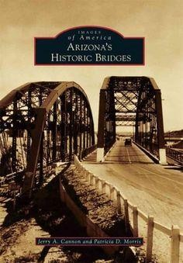
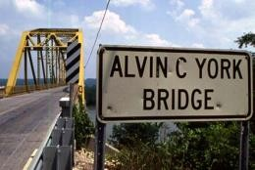
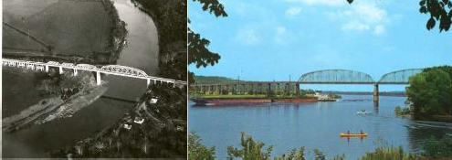
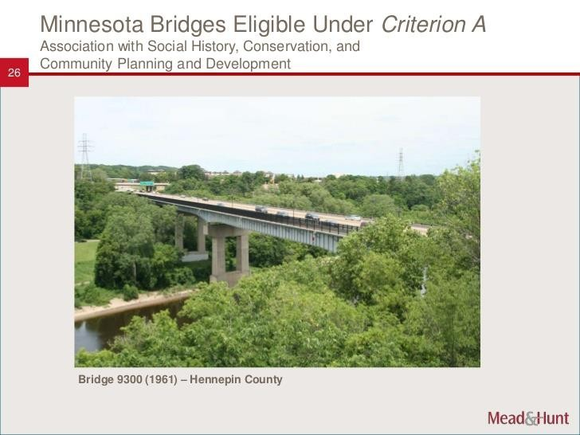

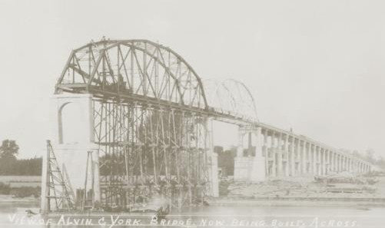

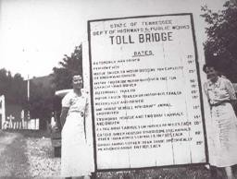
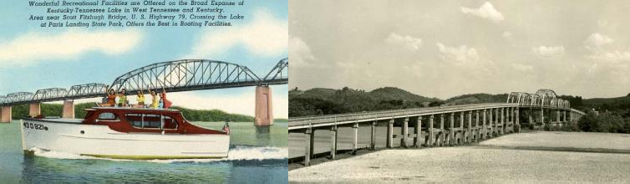
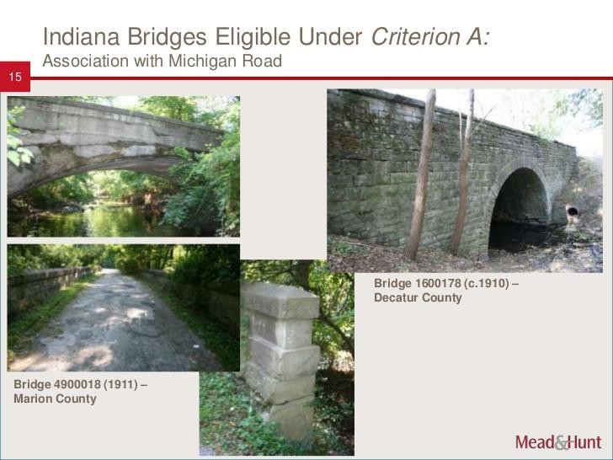

The recognition of historic roads as National Register-eligible resources began in the 1980s as the first generation of historic bridges required replacement. National Register-eligible bridges were documented for HAER, relocated, converted into pedestrian bridges, or rehabilitated for continued use.

Slide 4
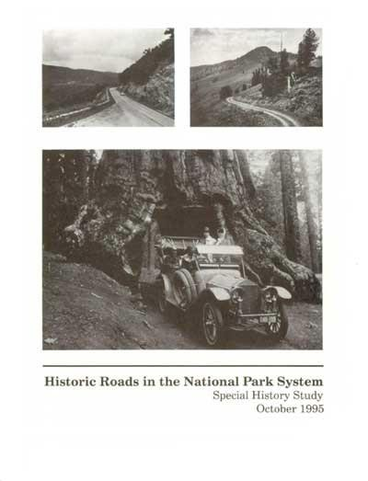
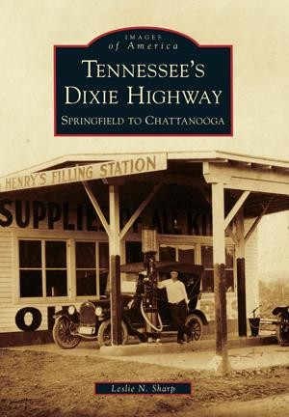
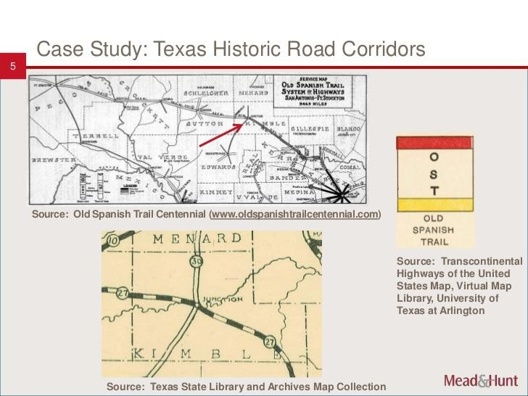

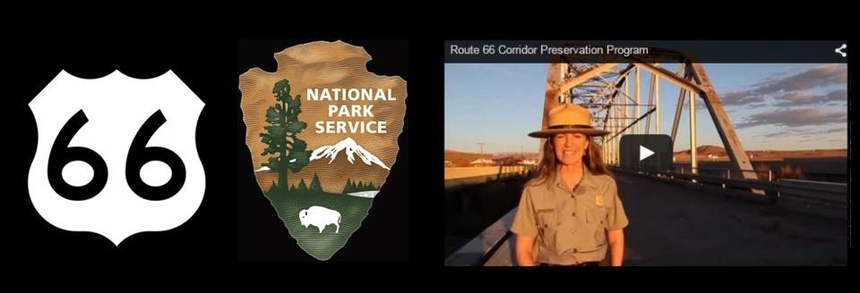
Soon thereafter, many state DOTs and federal agencies began to recognize that the roads themselves were also historic resources worthy of study. Efforts to accurately survey and evaluate historic roads began in earnest in the 1990s and continue to develop into the present.

Slide 5
THE CHALLENGES
Historic roads are challenging resources to identify, document, and evaluate.
The Federal Highway Administration and state DOTs must consider the effects of their projects on National Register-eligible historic roads under Section 106 and Section 4(f).
Over the years, various states and organizations have created historic contexts for the survey and evaluation of historic roads and some guidance has been developed regarding specific historic roads and historic road typologies. This information, however, had never been assembled and reviewed in a systematic manner at the national level.

Slide 6
THE
STUDY

Slide 7
Historic Roads: A Synthesis of Identification and Evaluation Practices
In January 2016, the Transportation Research Board commissioned New South Associates to undertake the “Historic Roads: A Synthesis of Identification and Evaluation Practices” project as part of the National Cooperative Highway Research Program contract with WSP/Parsons Brinckerhoff.
The project’s Research Task Panel included cultural resource staff members of DOTs from across the country, as well as representatives from the Federal Highway Administration and Advisory Council on Historic Preservation.

Slide 8
Project Objectives
1. Create Annotated Bibliography by
Reviewing Historic Roads Studies across the U.S.
2. Survey Practitioners by
Interviewing Historic Road Experts across the U.S.
3. Produce Synthesis Report by
Summarizing Results and Recommendations

Slide 9
ANNOTATED BIBLIOGRAPHY

Slide 10
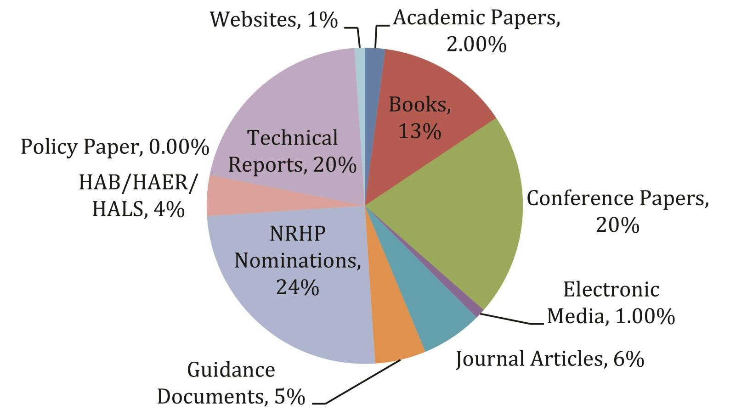
Annotated Bibliography:
Types of Sources Found (N=564)
Compiled to enable researchers to more readily access information about historic roads, and develop policy and approaches to their treatment as a resource.
Annotated sources are national in scope and present research and publications from the 1970s forward.
Sources grouped by genre regarding the identification, evaluation, and treatment of historic roads.
An inclusive approach was taken in gathering entries, even if they were not readily available online, such as conference papers.

Slide 11
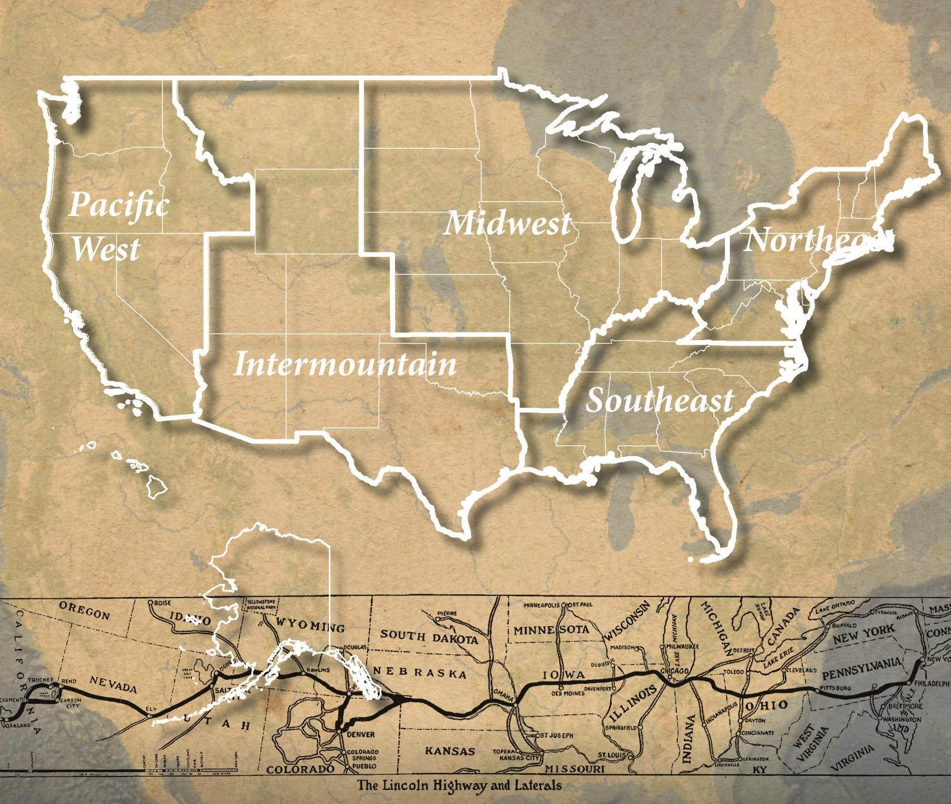
Annotated Bibliography
Sources were grouped by the National Park Service (NPS) region in which the subject matter resides.
These are the Northeast; Southeast, including the Caribbean territories; Midwest; Intermountain; and Pacific West, including Alaska, Hawaii, and the Pacific territories.
Source subjects that extend across multiple regions such as the Lincoln Highway, Route 66, or materials related to Federal policies, were assigned a National grouping.

Slide 12
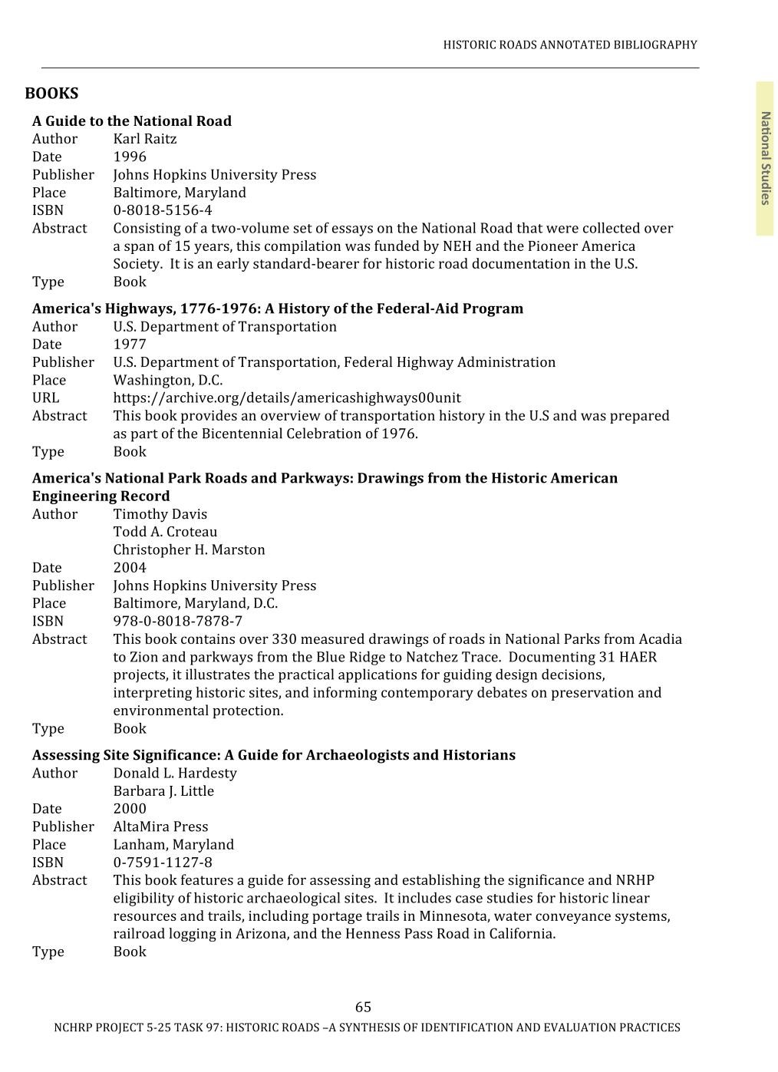
Annotated Bibliography
The bibliography was developed using:
Recommendations provided by members of the task panel and colleagues;
Notable online bibliographies such as the FHWA’s History Bibliography and Dan Marriott’s Historic Roads; and
Online document libraries provided by various DOTs and SHPOs.
URL’s and ISBN numbers were included where available.
(left) Example Page from Annotated Bibliography

Slide 13
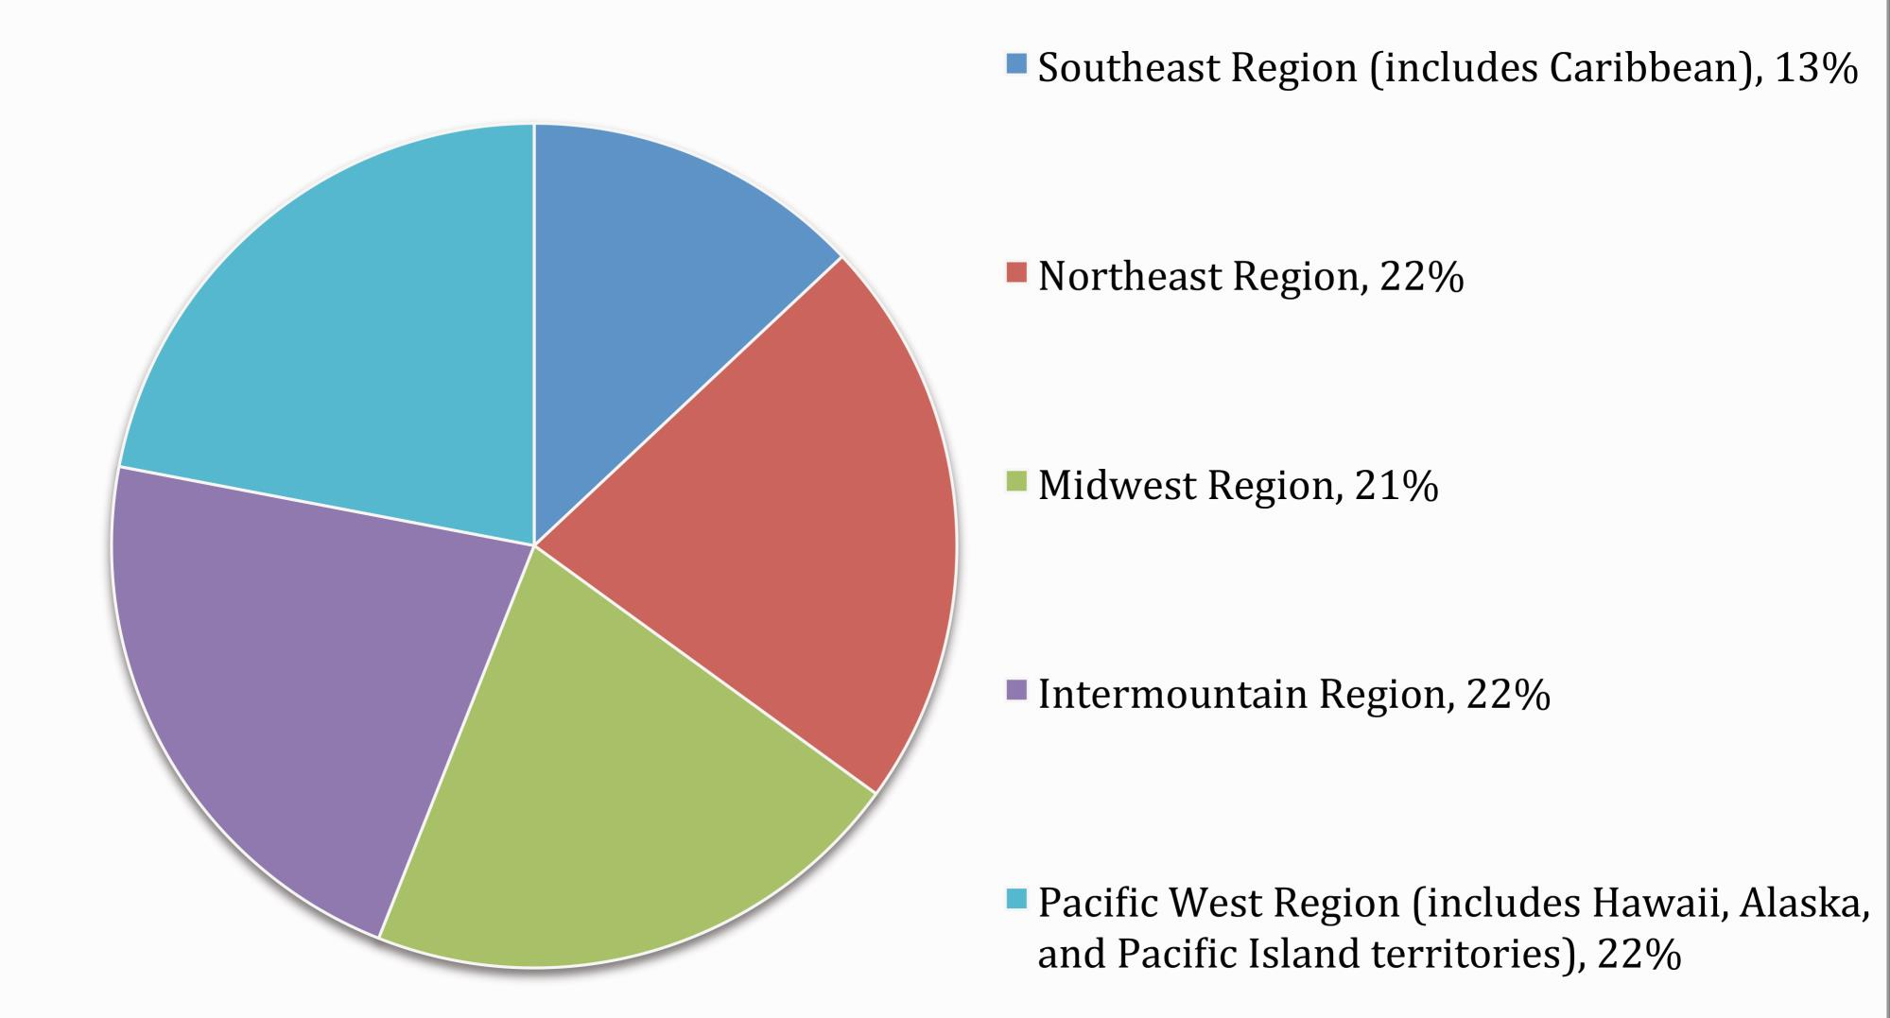
National Register of Historic Places Nominations by Region (N=140)
While nominations for many historic districts may include a historic road segment as a contributing property, the selected nominations either focus on a particular road or a historic road figures prominently.
All regions were equally well represented with the exception of the Southeast Region, which lags behind the others significantly.
The number of nominations in the Intermountain and Pacific West regions appears to suggest greater attention given to historic roads and trails by the BLM and NPS in federally managed areas.
National Register nominations, including NHLs, constitute almost one fourth of the 564 sources.

Slide 14
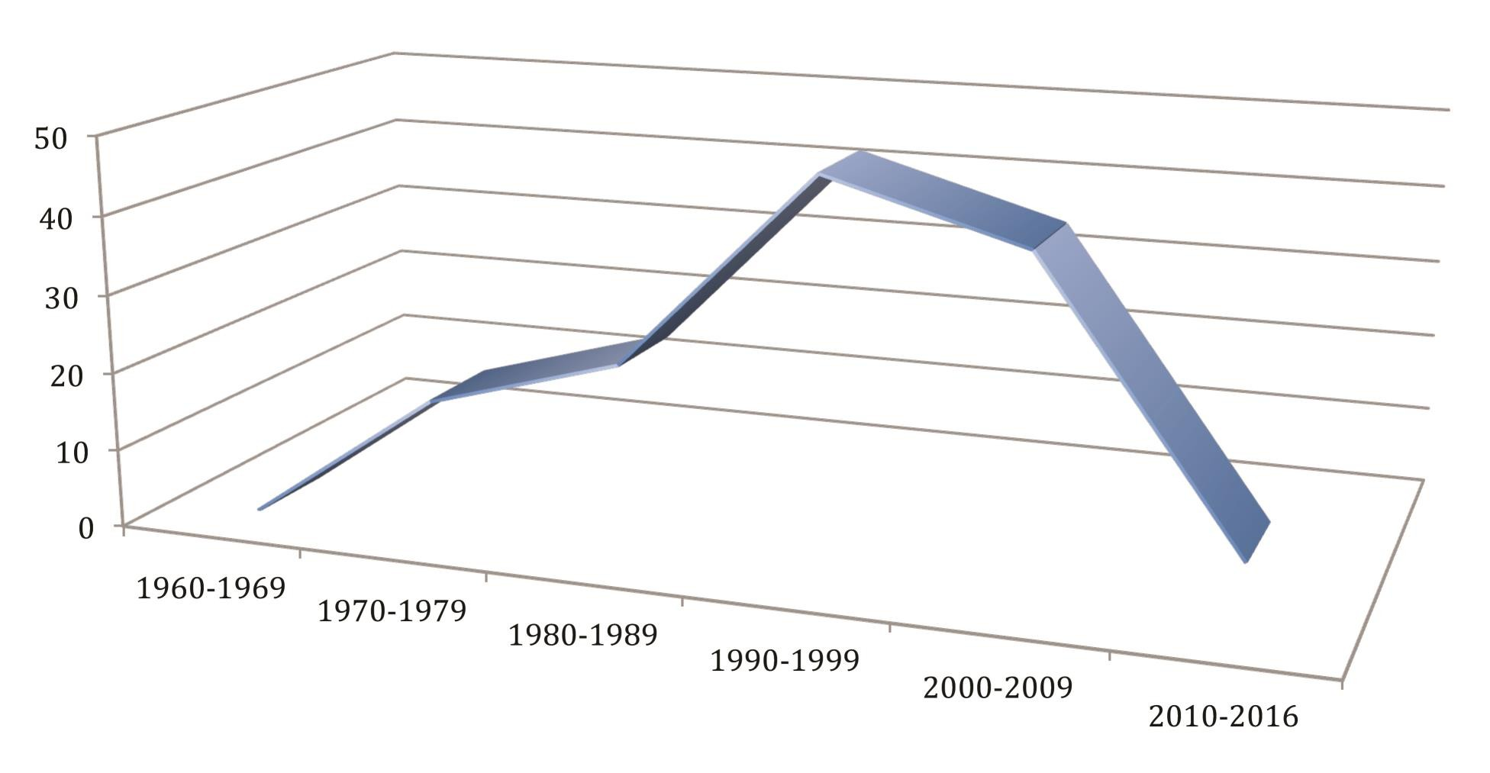
Timeline of Historic Road Associated NRHP Nominations, 1960 - 2016
The timing of the National Register nominations helps to chart the development of interest in historic roads. Two factors may account for the increase during the 1990s and early 2000s: the public’s nostalgia for Route 66 and the Federal-Aid Highway Act of 1987, which mandated the National Register evaluation of all pre-1956 bridges owned by local and state authorities. That comprehensive survey of historic bridges prompted a wider look at historic roads they served.

Slide 15
THE SURVEY

Slide 16


Goals of the Survey
Survey focus was the identification and treatment of historic roads - rather than management, assessment of effects, or Section 106 mitigation.
Comprised of 40 individual questions in five separate categories, including:
Respondent Information, Resource Identification,
General Information,
Challenges, and
Education and Training.
Focused on gathering information about the respondents and their background, the types of historic road-related resources they have experience with, and the challenges they face.

Slide 17
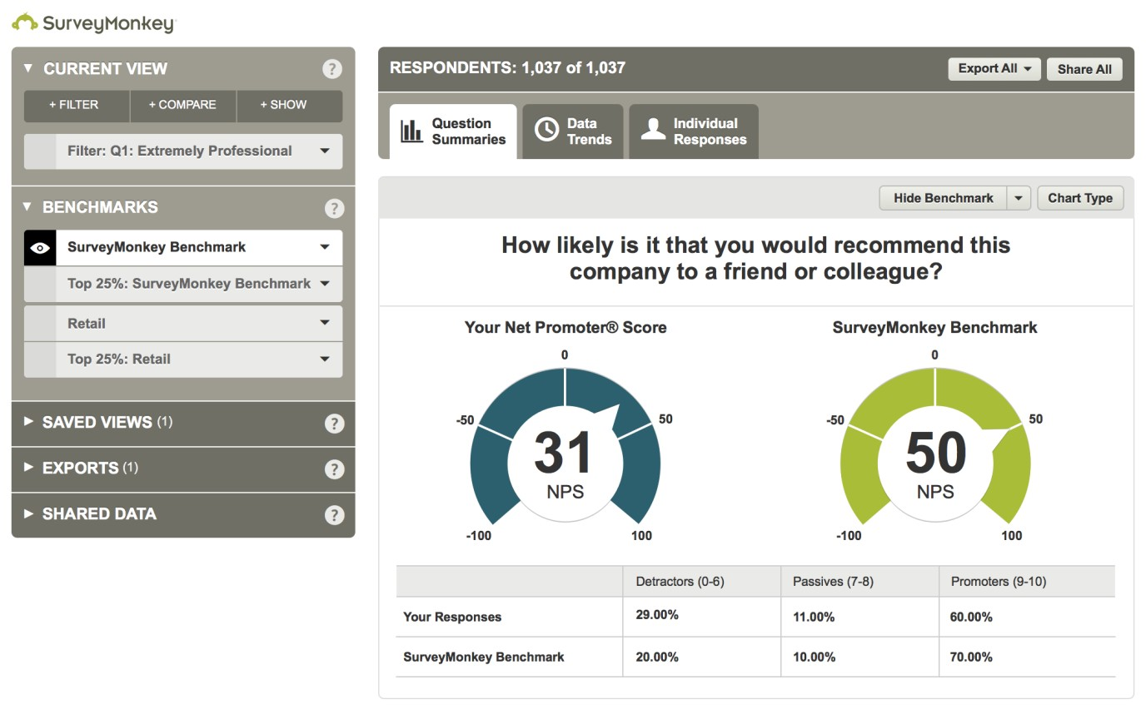
Question Types (N=40)
Development of the Survey
The online survey was created using the SurveyMonkey cloud-based software service.
The survey took advantage of SurveyMonkey’s paid back-end programs that provided data analysis, sample selection, bias elimination, and data presentation tools.
All but five of the questions were designed to be multiple-choice with pre-selected answers that are easily quantified.
Three questions required individual responses - two open-ended questions, and one requesting five pre-selected answers be ranked in order.
Multiple Choice | 18 | 45%
Yes or No | 16 | 40%
Other | 6 | 15%

Slide 18
Survey Response Data
53% of the email invitations were opened; 43.6% were unopened; and 2.4% were not delivered
  The survey received a 35.4% click through rate with 590 clicking through the entire survey
    The survey received 524 responses or 31.4% of the total recipients
      80% answered all 40 questions; 20% were partial completions
Survey Groups
SHPOs | 720 | 43.2%
State DOTs | 350 | 21.0%
CRM Practitioners | 290 | 17.4%
THPOs | 166 | 10.0%
Federal Agencies | 140 | 8.4%

Slide 19
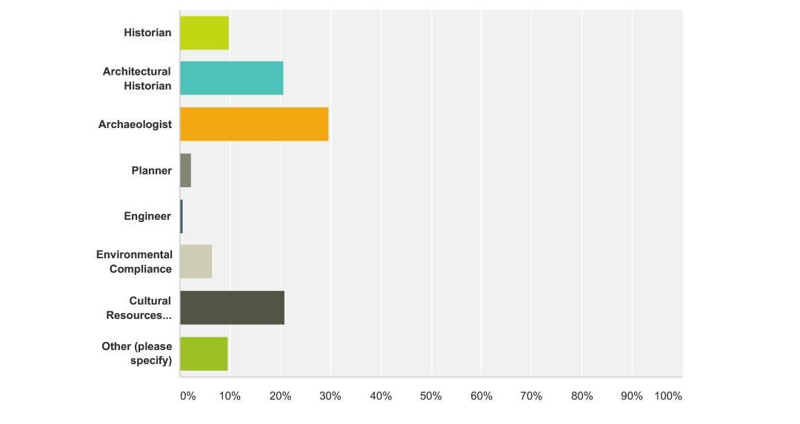
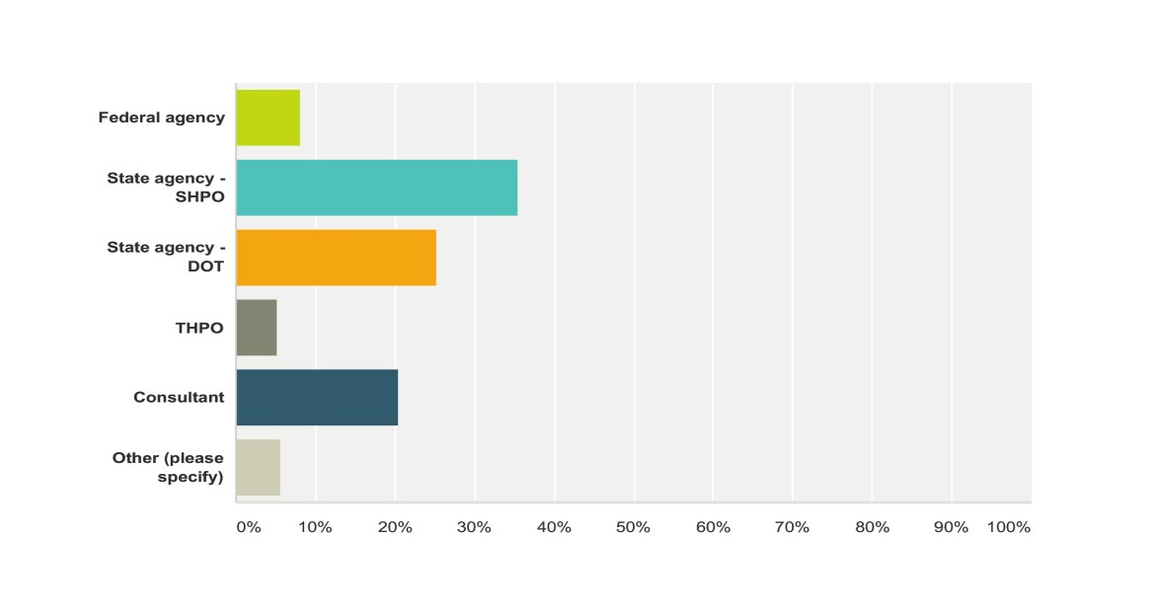
Historic Roads Online Survey Questions - Respondents
CATEGORY 1 – RESPONDENT INFORMATION
Q1 Which of the following best describes your current occupation?
Answered: 522 Skipped: 2
Q2 Which of the following best describes your professional affiliation?
Answered: 519 Skipped: 5
Answer Choice | Responses
Historian | 9.77% | 51
Architectural Historian | 20.69% | 108
Archaeologist | 29.69% | 155
Planner | 2.30% | 12
Engineer | 0.57% | 3
Environmental Compliance | 6.51% | 34
Cultural Resources Management | 20.88 | 109
Other (see below) | 9.58% | 50
Total | 522
Answer Choice | Responses
Federal Agency | 8.09% 42
State Agency – SHPO | 35.45% 184
State Agency – DOT | 25.24% 131
THPO | 5.20% 27
Consultant | 20.42% 106
Other (see below) | 5.59% 29
Total | 519
The majority of respondents were historians, architectural historians, archaeologists, or cultural resources managers. Several noted that their response represented multiple staff members at their particular office.
Most respondents worked for SHPOs, state DOTs, or as consultants.

Slide 20
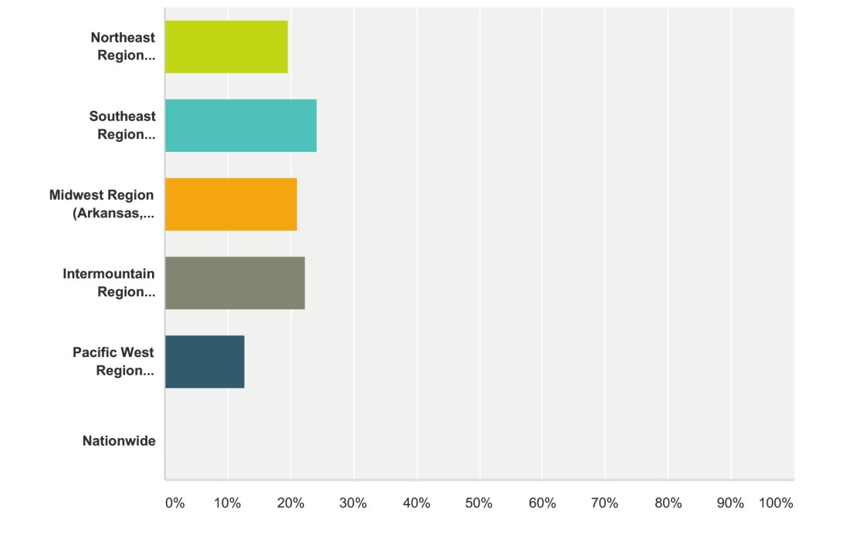
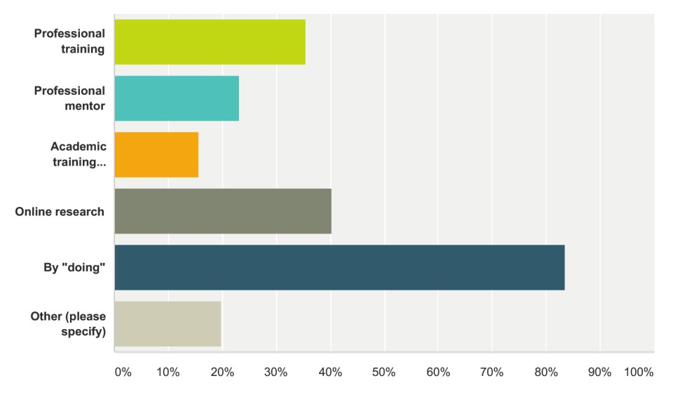
Historic Roads Online Survey Questions – Knowledge and Region
Q7 How have you acquired your knowledge of historic roads? (Choose all that apply) Answered: 511 Skipped: 13
Answer Choice | Responses
Northeast Region (Connecticut, Delaware, District of Columbia, Maine, Maryland, Massachusetts, New Hampshire, New Jersey, New York, Pennsylvania, Rhode Island, Vermont, Virginia, and West Virginia) | 19.54% | 101
Southeast Region (Alabama, Florida, Georgia, Kentucky, Louisiana, Mississippi, North Carolina, Puerto Rico, South Carolina, Tennessee, and U.S. Virgin Islands) | 24.18% | 125
Midwest Region (Arkansas, Illinois, Indiana, Iowa, Kansas, Michigan, Minnesota, Missouri, Nebraska, North Dakota, Ohio, South Dakota, and Wisconsin) | 21.08% | 109
Intermountain Region (Arizona, Colorado, Montana, New Mexico, Oklahoma, Texas, Utah, and Wyoming | 22.44% | 116
Pacific West Region (Alaska, California, Hawaii, Idaho, Nevada, Oregon, Washington, and U.S. Minor Islands | 12.77% | 66
Nationwide | 0.00% | 0
Total | 517
Answer Choice | Responses
Professional training | 35.42% | 181
Professional mentor | 23.09% | 118
Academic training (please list the institution in the "Other" line below) | 15.66% | 80
Online research | 40.31% | 206
By "doing" | 83.56% | 427
Other (see below) | 19.77% | 101
Total | 511
Response was fairly evenly distributed across regions
Most respondents noted they learned about historic roads by “doing.”

Slide 21
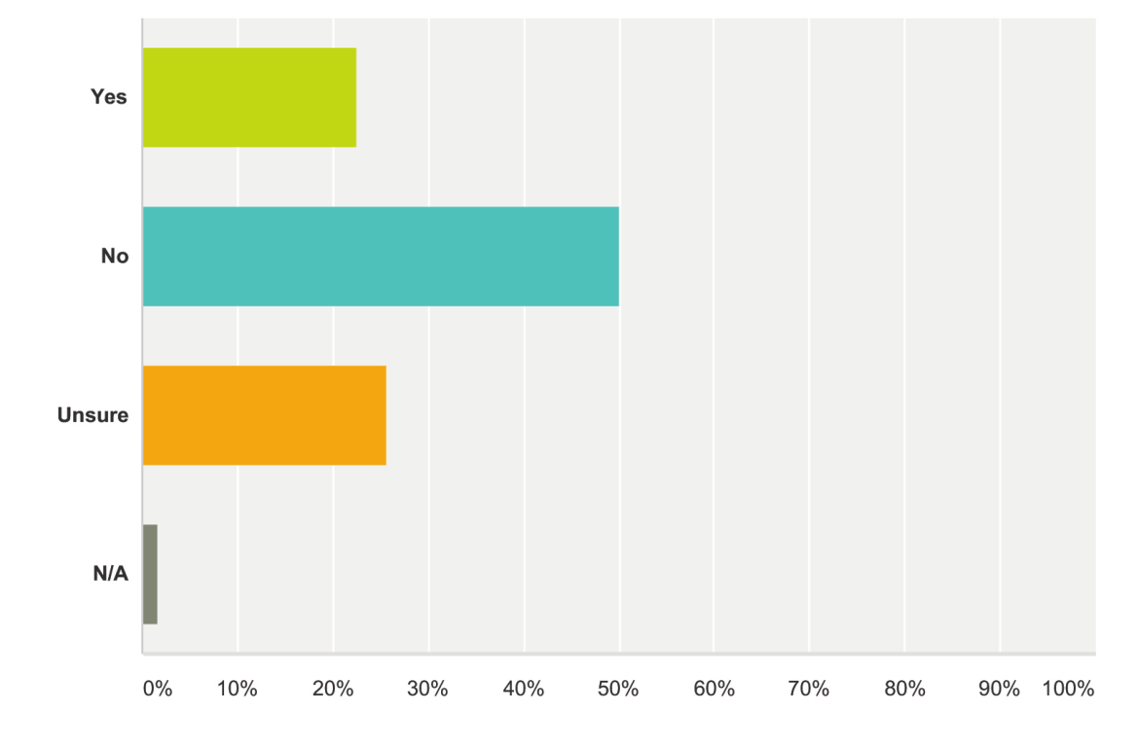
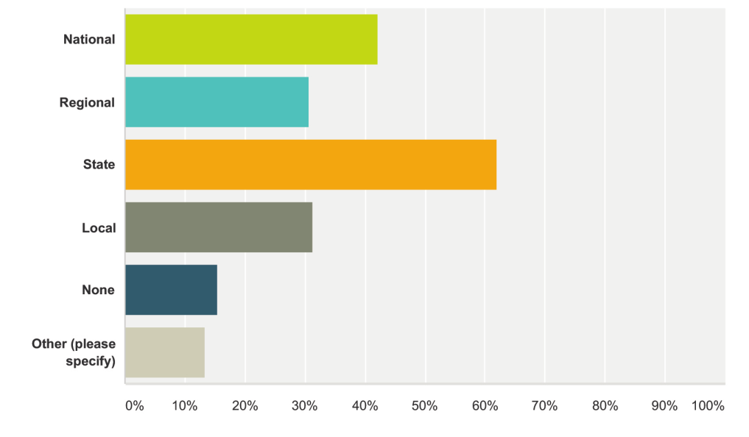
Historic Roads Online Survey Questions – Available Guidance
Q12 Is formal guidance provided on historic road survey methodology in your state?
Answered: 467 Skipped: 57
CATEGORY 2 – RESOURCE IDENTIFICATION
Q9 Which of the following historic road contexts are available in the state where you are based? (Choose all that apply)
Answered: 458 Skipped: 66
Answer Choice | Responses
Yes | 22.48% 105
No | 50.11% 234
Unsure | 25.70% 120
N/A | 1.71% 8
Total | 467
Answer Choice | Responses
National | 42.14% | 193
Regional | 30.79% | 141
State | 62.01% | 284
Local | 31.22% | 143
None | 15.50% | 71
Other (see below) | 13.32% | 61
Total | 458
Respondents noted they mostly relied on existing state contexts, followed by national, local, and regional contexts.
Several respondents answered that historic roads context studies at the local or state level were in progress.

Slide 22
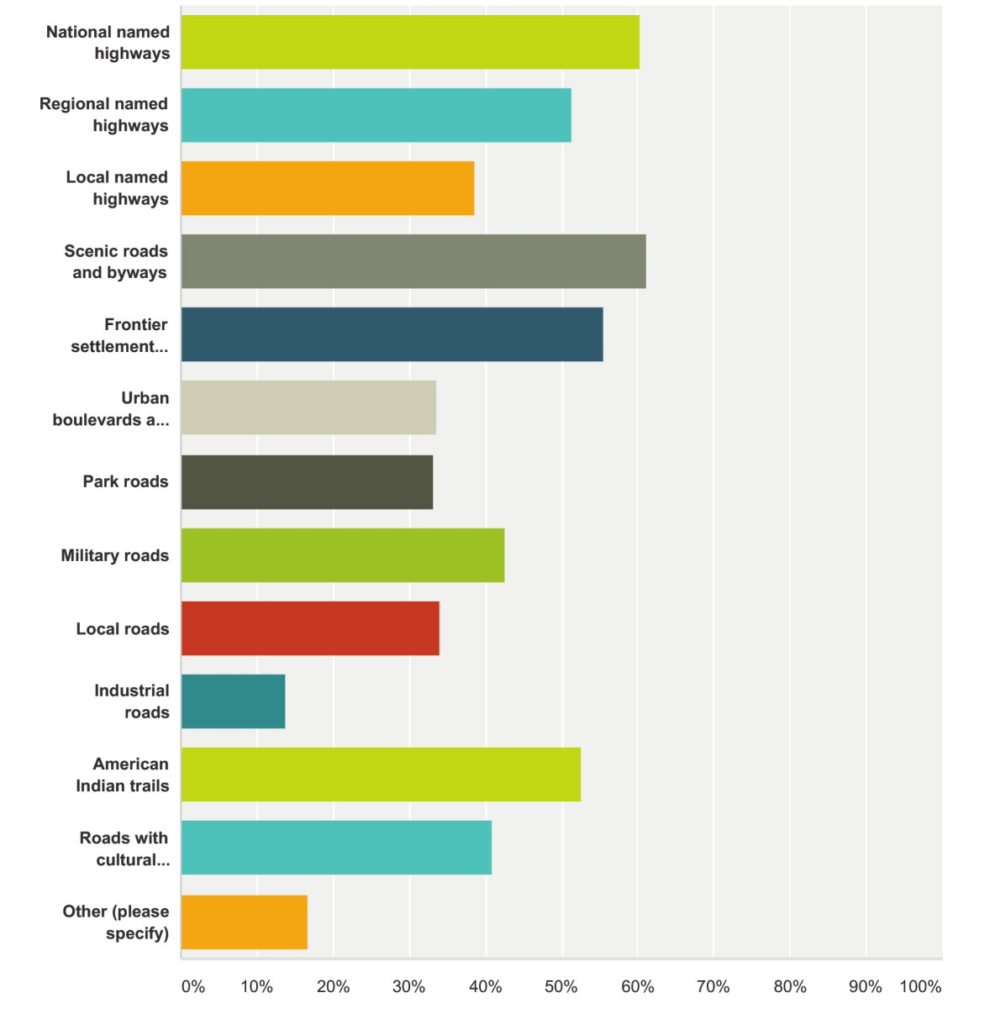
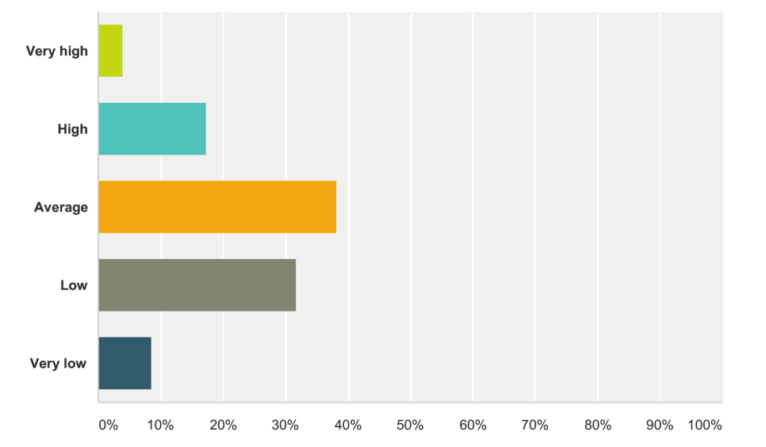
Historic Roads Online Survey Questions – Road Priorities
Q15 What types of roads are NRHP listed or considered potentially NRHP eligible in the state where you are based? (Choose all that apply)
Answered: 448 Skipped: 76
CATEGORY 3 - GENERAL INFORMATION
Q16 What is the priority for historic road survey and context development in the state where you’re based?
Answered: 421 Skipped: 103
Answer Choice | Responses
Very high | 4.04% 17
High | 17.34% 73
Average | 38.24% 161
Low | 31.83% 134
Very low | 8.55% 36
Total | 421
Types of roads most often NRHP listed or eligible included: Scenic Roads and Byways, National Named Highways, Frontier Settlement Roads, American Indian Trails, and Regional Named Highways.

Slide 23
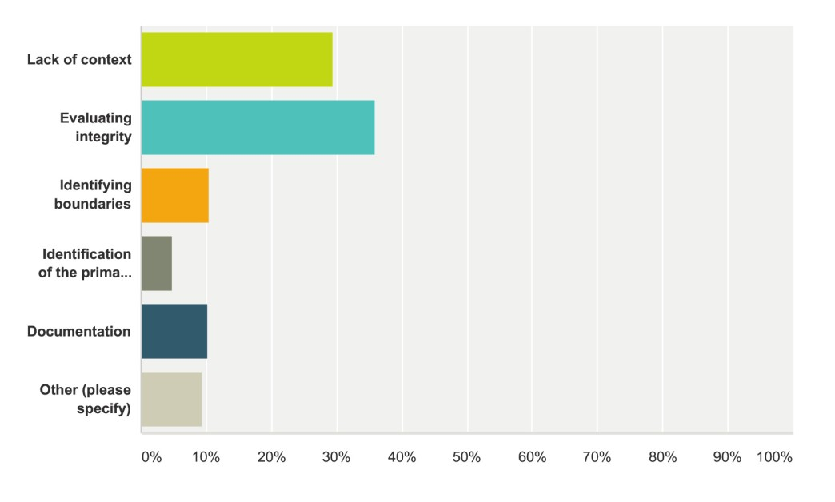
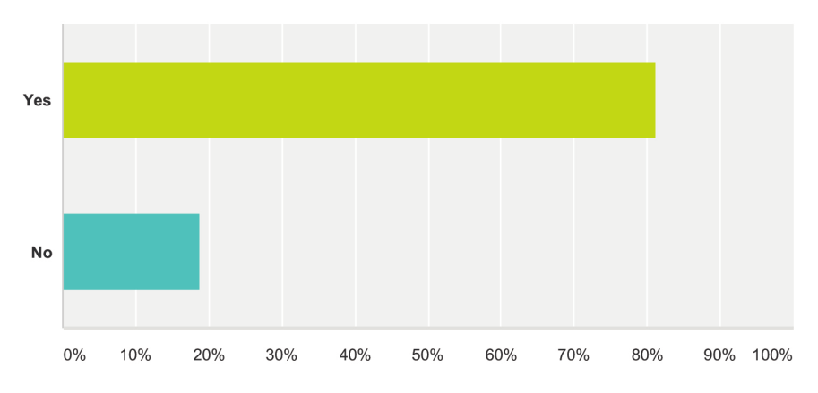
Historic Roads Online Survey Questions – Needs and Challenges
Q27 Is a more defined framework for the identification and evaluation of historic roads needed in the area where you’re based?
Answered: 385 Skipped: 139
Q28 What is the biggest challenge for applying the NRHP criteria when evaluating roads?
Answered: 395 Skipped: 129
Answer Choice | Responses
Yes | 81.30% 313
No | 18.70% 72
Total | 385
Answer Choice | Responses
Lack of context | 29.37% 116
Evaluating integrity | 35.95% 142
Identifying boundaries | 10.38% 41
Identification of the primary resource type (engineering, roadside architecture, cultural landscapes, etc.) | 4.81% 19
Documentation | 10.13% 40
Total | 395
Over 80% of respondents stated that a more defined framework for evaluating historic roads was needed in their area.
Most respondents cited Evaluating Integrity as the biggest challenge for applying National Register criterion to historic road resources, while a lower number felt the difficulties resulted from the lack of a local, state, or national context.

Slide 24
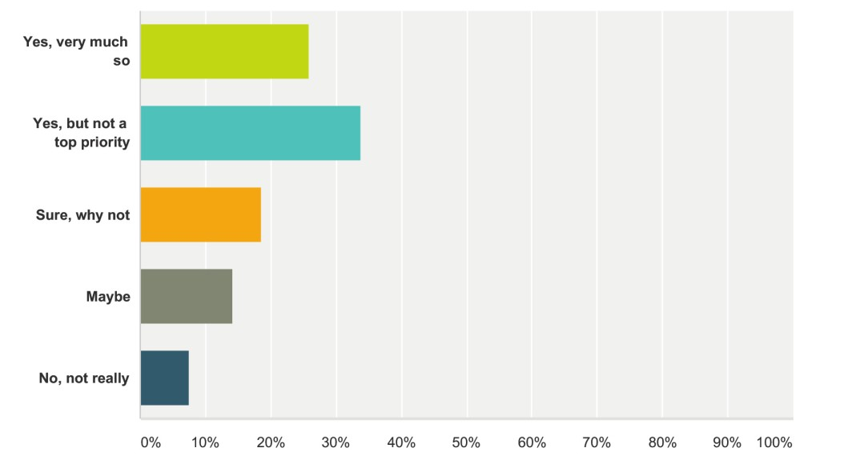
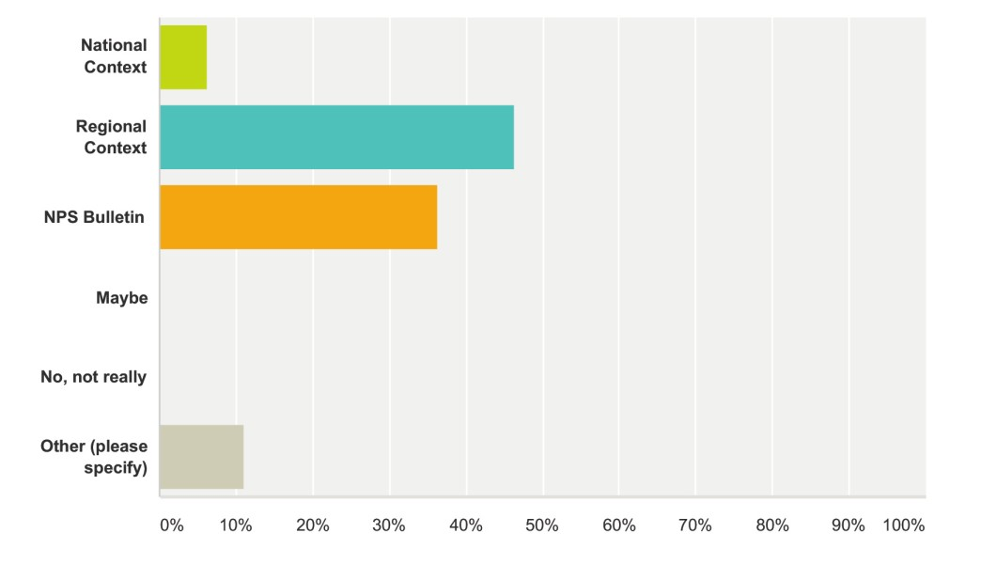
Historic Roads Online Survey Questions – Guidance Priorities
Q29 Would a national context for historic roads be of benefit to your agency/organization?
Answered: 409 Skipped: 115
Q30 Which would be of most use to your agency/organization?
Answered: 401 Skipped: 123
Answer Choice | Responses
Yes, very much so | 25.92% 106
Yes, but not a top priority | 33.74% 138
Sure, why not | 18.58% 76
Maybe | 14.18% 58
No, not really | 7.58% 31
Total | 409
Answer Choice | Responses
National Context | 6.23% 25
Regional Context | 46.38% 186
NPS Bulletin | 36.41% 146
Maybe | 0.00% 0
No, not really | 0.00% 0
Total | 401
Nearly 60% of respondents stated that a national context for historic roads would benefit their agency or organization.
The vast majority of respondents felt that a regional context or National Park Service Bulletin would be of the most use.
Other choices included: local and state contexts; the need to address roads as part of a comprehensive “transportation landscape approach”;
and most commonly, “all of the above.”

Slide 25
SUMMARY AND RECOMMENDATIONS

Slide 26
SUMMARY OBSERVATIONS & RECOMMENDATIONS
1. National Context vs State/Regional Contexts
2. Lack of Guidance
3. Need for Professional Training
4. Lack of Contexts and Consistent Survey Methods
5. Shortage of Cooperation Between States
6. Need for more Public Awareness of Historic Roads

Slide 27
National Context vs. State/Regional Contexts
Most participants preferred focusing on the development of state and regional contexts.
Only six percent believed a national context could be of value, but noted that it should not be a top priority. There was also significant interest in local contexts.
The majority preferred development of contexts that go beyond looking at the major national roads.
A substantial number of respondents also called for the development of a National Park Service Bulletin on historic roads.

Slide 28
Lack of Guidance
Respondents made it clear that a lack of guidance was a major obstacle to identifying and evaluating historic roads, particularly when assessing integrity.
Adding to the complexity is the fact that numerous methods are often used to record historic roads, identifying them as archaeological sites, commercial corridors, transportation infrastructure, cultural landscapes, and linear engineering resources.

Slide 29
Need for Professional Training
93% of survey participants stated a need for professional training in order to better document and evaluate historic roads.
A large majority said they have never attended any professional sessions or workshops and had accumulated their knowledge and experience with historic roads by working on the job.
Additionally, despite the growing number of historic roads conferences over the past 10 years, nearly three-quarters of respondents said they never attended any.

Slide 30
Lack of Contexts and Consistent Survey Methods
Only 12 statewide historic road contexts were identified in the research for the Annotated Bibliography.
The lack of adequate historic contexts to better evaluate the significance of roads, rather than simply relying on integrity, was strongly cited as a challenge along with no consistent survey methodology and assessment tools.
Some responses also brought attention to preservation, management, and interpretation of roads.

Slide 31
Shortage of Cooperation Between States
Besides the Congressionally-mandated Route 66 Corridor program, administered by the National Park Service out of its office in New Mexico, most intrastate national and regional highways are dealt with on a state-by-state basis.
Indications were that cooperation over historic roads between states, or SHPOs and THPOs, was relatively rare and sporadic in nature, if it occurred at all.

Slide 32
Need for more Public Awareness of Historic Roads
A common thread was the lack of public awareness and concern for roads as historic resources that are significant and worthy of preservation.
Only 8% said the public placed a high value on historic roads in their state. 15% stated that historic roads were “not important” and 12% claimed roads were not considered worthy of survey.
The popularity of Route 66, which is ingrained in the national identity through popular culture, appears to be an exception; however, other equally significant major road corridors, such as the National Road or the Dixie Highway, are not part of the wider public consciousness.

Slide 33
For More Information and Project Resources
Visit the Project Web Page:
http://apps.trb.org/cmsfeed/TRBNetProjectDisplay.asp?ProjectID=3972

