Slide 1
NCHRP Project 20-59(37) Debris Management Handbook

Slide 2
Outline
Debris Issues
Project Overview
Phase I
Literature Review
Field Review and Analysis
Outline
Phase II
Case Studies
Handbook
Discussion

Slide 3
Debris Issues
Widespread
Costly
Immediacy
Notes:
PETER
Debris issues are varied, widespread and costly. Debris removal and disposal often constitutes the single most costly activity faced by local and state jurisdictions.
They have an immediacy to them that requires quick decision making in order to provide access to critical facilities as well as access for emergency vehicles and rescue operations.

Slide 4
Project Overview
Objective: Develop a comprehensive, actionable handbook for state and local staff tasked with post-disaster debris management.
Target Audience: Local Departments of Transportation tasked with debris management
Notes:
JULIA
This handbook has the potential to serve as:
A single, comprehensive body of knowledge on academic and practical considerations for debris planning and operations.
A foundation for developing and refining debris related planning and operations for state and local agencies.
A road-map towards enhancing overall debris management programs at the state and local levels, reducing the overall disaster related costs.
Our document while not a guide specific to planning it supports a department’s ability to plan, prepare and operate during response and recovery.

Slide 5
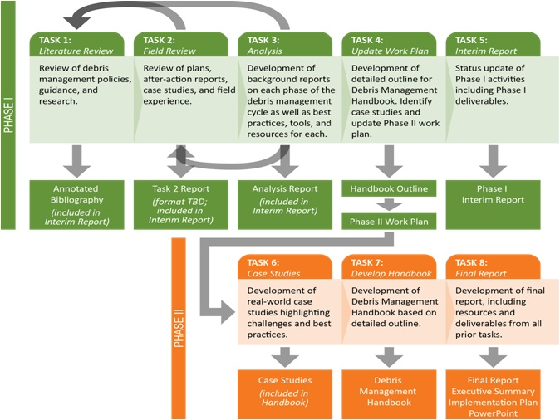
Research Plan

Slide 6
Phase I
Method and Results

Slide 7
Approach: Identifying Publications
Databases:
FEMA Library
Transport Research International Documentation (TRID)
Thomas (Library of Congress)
Lessons Learned Information Sharing (LLIS)
International Risk Management Institute (IRMI)
ISI Web of Science
Google Searches
Recommendations from Field Survey
Recommendations from Subject Matter Experts (SMEs)
Note that only publicly available, English publications were reviewed.

Slide 8
Approach: Evaluation
Was the publication useful?
Very
Somewhat
Not at all
Was the publication actionable?
Very
Somewhat
Informational, but not actionable
Not informational or actionable
This qualitative review helped prioritize use of publications for the handbook.

Slide 9
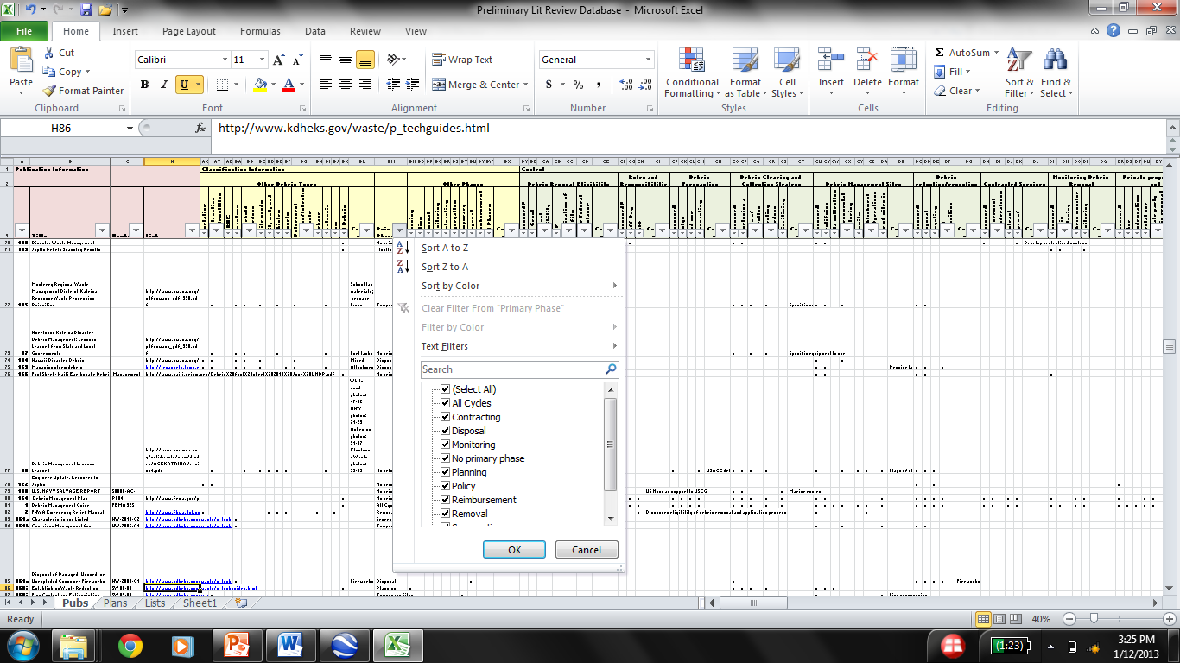
Outcome: Literature Database
Filter on any criterion

Slide 10
General Conclusions
Large amounts of duplicative information.
Largest volume of information does not necessarily correspond to highest confidence among debris management staff.
Many areas specific to disaster type (e.g. 9/11).
Interagency coordination→ major theme of after action reports.

Slide 11
Goals of the Field Survey
Identify trends and the “state of the art” of debris management among state and local staff.
Identify additional plans and publications for inclusion in the literature review.
Identify potential interviewees for expanded Case Studies to be developed.

Slide 12
Survey Outreach
Transportation Research Board (TRB) state representatives
International City/County Management Association (ICMA)
American Public Works Association (APWA)
Solid Waste Association of North America (SWANA)
International Association of Emergency Managers (IAEM)
Notes:
Identifiers: Name, organization, organization type, etc.
Documents in place: Description and access to:
Plans
Policies
Lessons learned and after-action reports
Contracts
Site management: Identified? Owned? MOUs in place?
Years of experience
Areas of confidence: Where experience and confidence lies in debris management cycle
Potential for follow up: Willing to participate in a case-study interview?

Slide 13
Survey Respondents by Geography
Responses were received from every FEMA region.

Slide 14
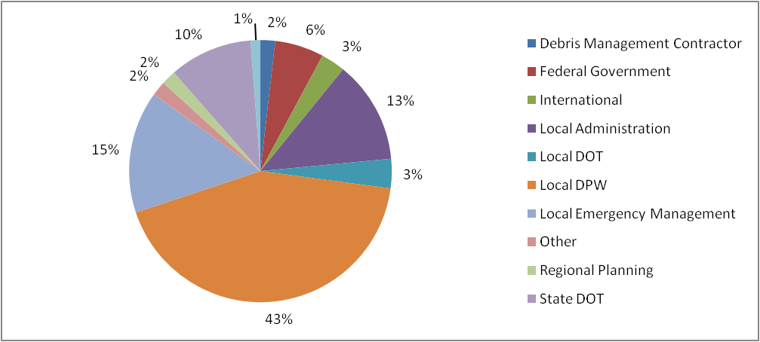
Survey Respondents by Organization Type
Nearly 75% of respondents were from local entities.

Slide 15
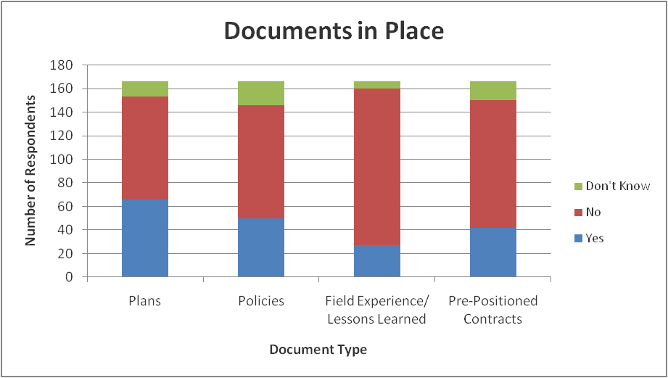
Documents Available to Respondents
Fewer than half of respondents had debris management plans in place. Even fewer had policies or pre-positioned contracts.

Slide 16
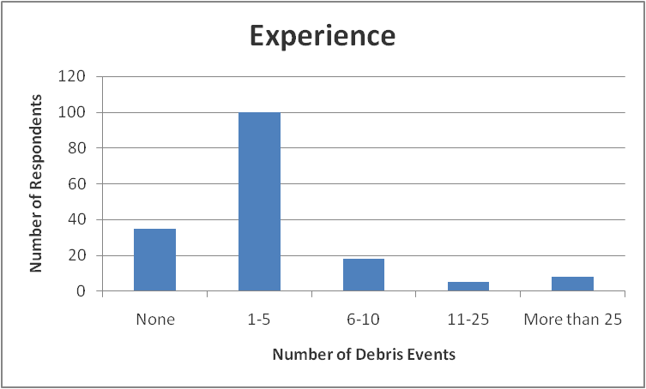
Experience in Debris Management
The majority of respondents have participated in 5 or fewer debris management events.
This could indicate a generational gap in debris management experience.

Slide 17
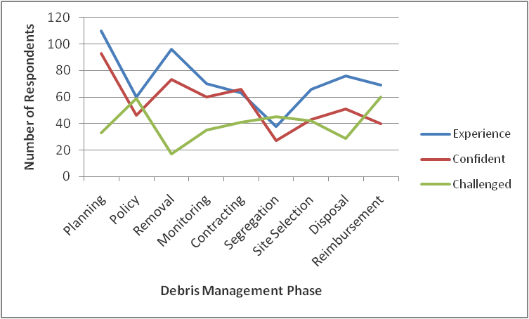
Debris Management Experience
Policy, segregation, site selection, and reimbursement presented the greatest challenges to respondents.

Slide 18
Handbook Format
One chapter for each phase, in chronological order
Each chapter includes:
Why is this phase important?
What does this phase entail?
When does this phase occur?
Who is involved in this phase?
How does this phase happen?
Each chapter also includes:
A relevant case study, as available
Resource list

Slide 19
Handbook Outline
Introduction
Planning
Debris Estimating
Policy
Contracts
Operations
Removal
Segregation
Debris Management Site Selection
Monitoring
Reduction and Disposal
Reimbursement
Special Considerations
More Information

Slide 20
Phase II
Method and Results

Slide 21
Case Studies
Based on list identified in Field Survey, call respondents around the country.
Step 1: Team conducted preliminary (15-20 minute) phone interviews with potential case study contributors.
Based on survey respondents, identify 2 local and 2 state from each region
Step 2: Team SMEs conducted in-depth interviews by phone or in person with strongest contributors.
Notes:
Do you manage debris operations? If not, who within your organization does?
Describe your jurisdiction’s most challenging debris-generating event.
What debris management challenges did you face during that event?
If you were going to advise a novice about debris management, what would you tell them they absolutely must do?
If you were going to advise a novice about debris management, what would you tell them they should avoid doing?
In your experience, what tools, information, and/or resources are critical to managing a debris operation? In other words, what can you not live without?
In your experience, what tools, information, and/or resources would improve operations from a management standpoint? From a field operations standpoint? In other words, what would you like to have that you do not?

Slide 22
Preliminary Interview Outcomes
21 preliminary interviews from 7 regions

Slide 23
Handbook Development
Chapters developed based on outline
Subject Matter Expert input
Additional chapters identified and drafted
Graphics and tools developed
Notes:
Our primary authors began writing the draft of the handbook based on the outline approved by the project panel. Each chapter was drafted based on the background reports developed in the first phase of the project to ensure pertinent information gathered in the previous tasks were included in each chapter. The primary authors utilized Subject Matter Experts and Case Study Liaisons as they draft each chapter to ensure information and examples were presented accurately. After the initial draft of the handbook was complete, the Principal Investigator, Subject Matter Experts and Case Study Liaisons conducted a technical review of the chapters relevant to their particular area of expertise to provide feedback and edits. Our primary authors incorporated these edits into a revised draft. During this initial review additional chapters and topic areas were identified as needing to be included and were drafted or added to the initial draft handbook.

Slide 24
Final Handbook
The Debris Management Handbook should:
Be the Go-to resource for state and local agencies to develop policies, plans, and operational procedures, including reimbursements, in matters related to Debris.
Be a simple, easy to read document that outlines a comprehensive debris management framework based on analysis of academic and applied research from national and international sources.
Exemplify national best-practices on debris management for state and local agencies to develop insights into the implicit issues and challenges that could affect the best-laid out plans and help develop adequate mitigation strategies.
Lay the foundation for development of comprehensive and coordinated debris management strategy that will enhance cooperation and participation between state and local stakeholders.

Slide 25
Target Audience
The handbook is applicable to a wide variety of users that routinely encounter debris clearance, control, or removal issues.
It is also attractive to academic research bodies like the National Academies of Science (NAS), and more specifically TRB, to conduct further research on specific areas outlined in the handbook.
The handbook serves to identify effective practices to ensure maximum reimbursement from federal agencies associated with debris operations.

Slide 26
Application
This handbook serves as a resource for preplanning to help direct documentation and administrative policies, training and exercises, a field guide to help direct debris operations and minimize impacts, and an accounting reminder to supervisors and administrative staff on the requirements of debris documentation for reimbursement.
It also encourages cooperation and partnerships between different state and local agencies.

Slide 27
Conclusions
The existing body of literature (as well as the additional documents suggested by the panel) served as an excellent starting point for a draft handbook.
The field survey and case studies helped to focus the handbook development on real-world examples and areas in which local and state debris managers feel most challenged (especially policy, segregation, and reimbursement).
The team was able to draw the best from existing publications and tools and identified new ways to present information to try to improve the understanding of lessons observed and effective practices associated with those phases.

Slide 28
Questions?

