Slide 1
Land Value Return and Recycling to Fund Transportation
NCHRP Project 19-13
September 21, 2017

Slide 2
Purpose
With transportation investment needs significantly outweighing available resources, exploring land value return and recycling (land value return) —a largely overlooked revenue source—could benefit the public agencies that build, maintain, and operate the transportation system.
Notes:
This presentation provides an introduction to the concept of land value return and recycling as a land value return method. Land value return and recycling raises funds for transportation facilities and services while simultaneously encouraging more intense and compact development around new and existing infrastructure. Clustering development around infrastructure can help make transportation infrastructure more effective while avoiding the expensive duplication of infrastructure required by sprawl development patterns. If members of the audience wish to explore land value return as a funding method in greater detail, they should obtain the accompanying Guidebook from the Transportation Research Board for NCHRP Project 19-13.
(This slide can be supplemented with state specific context of funding methods in use to motivate the discussion of LVR)

Slide 3
Agenda
Defining Land Value Return and Recycling (Land Value Return)
What Is Land Value Return and Recycling (Land Value Return)?
Is Land Value Return the Same as Value Capture?
Why Land Value Return?
What Is “Land Value Return-Like”?
How Does Land Value Return Work?
Implementation Considerations
What Are the Policy Considerations?
What Are the Keys to Stakeholder Support?
What Are the Strategies to Develop Stakeholder Support?
What Are the Key Steps to Implementation?
What Are the Potential Rewards?
For More Information

Slide 4
Defining Land Value Return and Recycling

Slide 5
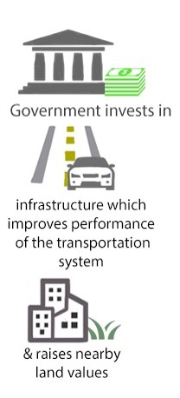
What Is Land Value Return and Recycling?
An overlooked revenue source for transportation
Well-performing transportation infrastructure can increase nearby land value (as a result of higher willingness to pay)
Land value return and recycling funding methods:
Enable the public recovery and reuse of a portion of the increased land value created by public investment in transportation infrastructure
Note: For remainder of presentation, “Land Value Return and Recycling” is shortened to “Land Value Return”
Notes:
The fact is that Land value return and recycling is an underutilized funding method and it is well known that access to good transportation infrastructure can lead to beneficial effects for the most accessible and proximate land. (A few examples may help here. For example: Brookings Institutions’ analysis of a proposed $140 million streetcar line in the District of Columbia showed that the line would create $3 in land appreciation for nearby private landowners for every $1 spent on the project [Leinberger, 2010]. Office rents are also often higher near highway exits and interchanges.)
The last bullet notes that HOW we raise funds is just as important as HOW MUCH we raise. It is noted that transportation problems often don’t have “transportation” solutions. Instead, land use patterns and interventions may be the key to both understanding and solving the funding problem. User fees can influence user behavior to promote conservation and efficiency. Similarly, land value return methods can influence development so that infrastructure is more likely to provide intended benefits and avoid unintended consequences.

Slide 6
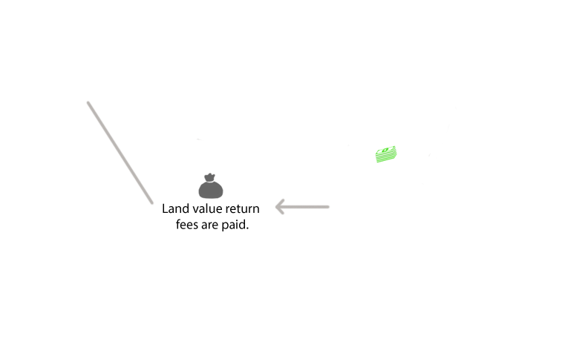
What Is Land Value Return and Recycling, cont.?
Notes:
Well-performing transportation investments tend to increase nearby land values. Although land value increases can sometimes equal or exceed the cost of infrastructure investments, typically, between 80 and 90 percent of this value ends up as a pure windfall to a few well-served landowners. As this graphic shows, land value return fees allow a greater proportion of publicly created land value to return to the public sector. This simultaneously enhances the financial self-sufficiency of infrastructure investments while also reducing land speculation profits. Reduced profits from land speculation diminish the speculative demand for land, thereby keeping well-served land more affordable to the businesses and residents who wish to take advantage of new or improved infrastructure by locating businesses or homes nearby.

Slide 7
Is Land Value Return the Same as Value Capture?
Land value return is a subset of what is commonly referred to as value capture
Value capture encompasses a broader range of funding methods related to real estate that do not always involve the public recovery of publicly created land values
Land value return limits the definition to methods that recover publicly created land values
“Capture” does not reflect how land value return methods result in a more equitable distribution of the societal value created by transportation infrastructure investment
Notes:
Value capture refers to a broad range of real-estate-based methods, but land value return is only limited to those methods directed at the land portion of property values.
The key take-away here is to distinguish between publicly created land value and privately created values (buildings, income, sales, etc.). Property values include both these components—land and improvements (or buildings).
Some techniques such as development impact fees, exactions, and property taxes applied to building values transfer privately created building values to the public. This will make development subject to these fees more expensive. If the public sector wants to encourage development near new or improved transportation infrastructure, making that development more expensive can reduce the quantity and quality of that development while driving some development to cheaper, but more remote, sites (sprawl). Land value return, however, returns publicly created land value. These fees are the same regardless of whether a site is developed or not. Therefore, constructing a building near infrastructure is not more expensive than constructing one farther away. However, land value return methods make it more expensive to hold land vacant (or underutilized) near new or improved infrastructure. This encourages development of land where value is high—which is near the new or improved infrastructure. And typically, these are the areas where communities want development to occur. Indeed, infrastructure is typically created or improved to facilitate development.
Land value return can not only create higher land values but also lead to recycling and sharing of those values, leading to a more equitable distribution of the value generated from transportation improvements.

Slide 8
Why Land Value Return and Recycling?
Overlooked source of funding for transportation
Recovers a portion of increased land values from landowners that benefit uniquely and directly
Results in a more equitable distribution of the monetary benefits of well-performing transportation facilities
Enhances environmental and financial sustainability of land use and transportation infrastructure

Slide 9
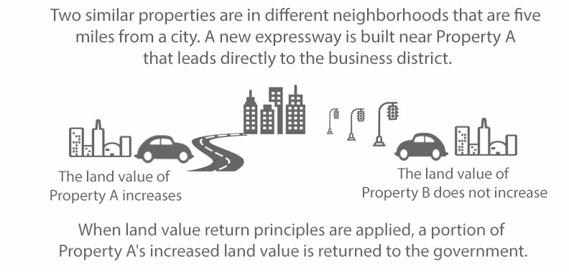
Why Land Value Return and Recycling, cont.?
Adheres to “beneficiary pays” principle

Slide 10
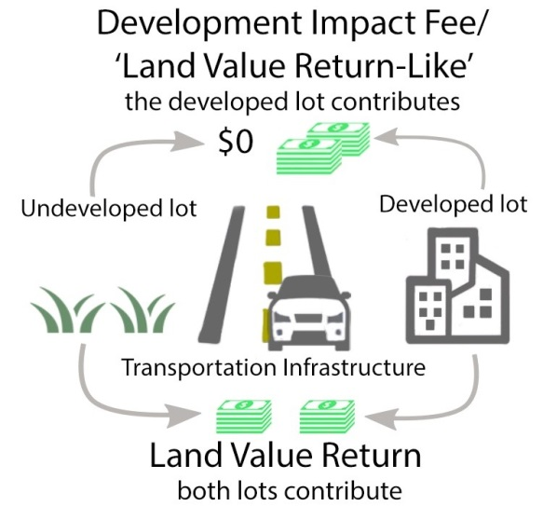
Why Land Value Return and Recycling, cont.?
Can help achieve public policy goals related to sustainable economic and land development, environment, and transportation system performance
Encourages development where land values are high (fees are the same on developed and undeveloped parcels)
Removes incentives for land speculation
Encourages more rational growth and development
Notes:
In the illustration, transportation infrastructure is created or improved near two lots. One lot is vacant and the other is improved. Under a “development impact fee,” the improved property pays the fee and the vacant lot pays nothing. Thus, a development impact fee increases the cost of constructing, improving, and maintaining buildings subject to the fee. However, under a “land value return” funding method, both the vacant lot and the improved lot pay the same fee. There is no financial cost/penalty for constructing, improving, or maintaining a building as a result of a land value return. Compared to a development impact fee, land value return increases the cost of holding land vacant (or underutilized). This encourages infill development where land values are high.

Slide 11
Land Value Return versus Land Value Return-Like?
Recognizing interest in topic is driven by ability to generate funding; funding methods presented are not limited to those defined as land value return
“Land Value Return-Like” methods
Provide additional transportation funding methods related to real estate
Involve a fee on property values (on land and privately created building value jointly) or other metric related to actual land use and development activity (like trips generated)
Do not have the same incentive effects as land value return
Differ with regard to effects on economic development, transportation, and land use goals and policies
Notes:
Land value return-like methods belong to the broader spectrum of real-estate-based value capture methods, with the fundamental difference being that they target property values instead of land values alone or target activity based on land use. Therein lies the difference. Land values can directly capitalize on access features of transportation improvements, while property values can include other effects. Land value return like methods are also viable sources of transportation funding but must be used with caution since the effects can be different and sometimes even contrary to goals and policies. As mentioned in Slide 10, incentive effects can differ. A development impact fee will increase the cost of new development subject to the fee, whereas land value return will not increase the cost of new development. Therefore, in a place where infrastructure is at maximum capacity, a development impact fee might be appropriate to ensure that new infrastructure required by new development is not subsidized by the general public but paid for by the new development. Alternatively, a development impact fee might redirect new development to an area where additional infrastructure capacity already exists (typically an “infill” development opportunity where no impact fee will be charged). On the other hand, where infrastructure capacity is robust, land value return funding methods will help draw development to these areas.

Slide 12
How Does Land Value Return Work? The Methods
Land Value Return
Land Value Return-Like
Land Value Tax or Split Rate Tax
Transportation Utility Fee
Betterment Levy
Tax Increment Financing
Special Assessment Districts
Development Impact Fee
Sale of Public Land or Public Air Rights
Exaction or Proffer
Lease of Public Land or Public Air Rights
Joint Development Fee & Interface Fee
Notes:
This slide depicts the different real-estate-based methods classified as land value return and recycling (land value return for short) or land value return-like. Land value return and recycling methods are sparse in the United States based on land only—as is seen in the examples and in the Guidebook—thus justifying the untapped source of funding and there are more examples of land value return like methods. All the land value return and recycling methods generate “new monies,” which can be used in a variety of ways to fund and finance transportation. The same can be said of land value return-like methods, with the exception of tax increment financing (goes by different names across the country), which does not involve any new fees and hence no new revenues are generated. Instead, it relies on increment (over a base year) revenue sharing agreements between local agencies, or between local and state agencies.
The first 3 in the land value return column are mandatory, implying that they are decided by the state as ways to establish return. The same can be said of TUFs, DIFs as well as most TIF’s. The rest are voluntary approaches or agreements to develop between government agency and owner.

Slide 13
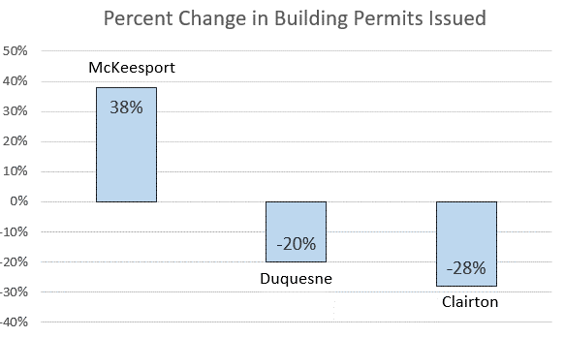
Land Value Return: Land Value Tax or Split Rate Tax
Overview:
Variants of traditional property tax
Split Rate Tax: Land is taxed at a higher rate than improvements
Land Value Tax: Only land is taxed (no tax on improvements)
Case Example: McKeesport, Duquesne, and Clairton, PA
Distressed suburban Pittsburgh cities with year-over-year decline in building permits
McKeesport adopted split rate tax; building permits increased
Revenues paid for locality’s general expenses including local transportation projects and, in rare cases, state projects
Increased infill development reduced transportation needs
Notes:
Land values reflect the value of transportation and other infrastructure. Thus, the portion of the property tax levied against land values is a land value return fee that charges property owners in proportion to the benefit that they receive from nearby infrastructure. About 15 communities in Pennsylvania have transformed their property tax into a land value return fee by reducing the tax rate applied to privately created building values while increasing the rate applied to publicly created land values. Pittsburgh and Harrisburg are the largest cities that pursued this approach. Results include increases in building permits and greater infill development.
Infill development utilizes existing transportation infrastructure. Infill reduces the need for infrastructure expansion created by sprawl development.
This approach could be marketed as a “universal abatement” for homeowners, reducing or eliminating the tax penalty that they experience under a traditional property tax when they maintain or improve their homes.

Slide 14
Land Value Return: Betterment Levy
Overview:
One-time payments on actual (or estimated) increase in land value resulting from new or improved infrastructure
Not implemented in the U.S. to date and limited international examples
Case Example: Bogotá, Columbia
Funds road and bridge improvements
Levy assessed on all properties affected by a project (or set of projects, such as a corridor)
Levy amount calculated based on benefit factors (travel speeds, land use changes, real estate market value, integration into urban structure, circulation optimization, depressed area recovery)
Typically, levy capped at cost of the project
Notes:
The U.S. Constitution requires that the government compensate property owners for “takings.” Betterment levies (and land value return in general) require that property owners compensate the government for “givings.” Although widely accepted in Columbia, where they have been used successfully, betterment levies have been contentious elsewhere. The primary challenge impacting implementation is creating a reliable estimate of future land value increase and transport benefits due to an infrastructure project, which requires analytical rigor and use of right approaches. The variant of a betterment levy in the United States is the special assessment district fee, which as noted earlier is based on the assessed value, not the land value.

Slide 15
Land Value Return: Special Assessment Districts
Overview:
A defined geographic area determined to benefit from an infrastructure investment
Property owners are charged a fee or tax on their property’s assessed land* value (in addition to property tax)
Also known as benefit districts, improvement districts, business development districts, special service areas, etc.
Case Example: State Route 28 Transportation Improvement District, Fairfax and Loudoun Counties, VA
Project improves access to properties in corridor
District formed by petition of commercial and industrial property owners of at least 51% of the land area or assessed value
Up to a $0.20 surcharge per $100 of assessed value levied on commercial and industrial property tax bills
Revenues support bonds that cover 75% of project cost (Virginia DOT covers 25%)
Funds several Route 28 corridor projects (intersection upgrades to grade separated interchanges, widening) by providing debt service finance for those projects
*Note: If the assessment is based on land value, special assessment districts are land value return. If the assessment is based on the value of land and improvements, they are land value return-like. This example showcases a context where assessment is based on both land and improvements, so it is land value return-like. There are no special assessments in the country based on land value.
Notes:
As mentioned in the footnote, special assessments are “land value return” only if the fee is levied against the value of land. Fees levied against the value of improvements (buildings) are similar to development impact fees. They transfer privately created building value to the public and are not land value return.
The example discussed in this slide refers to the Route 28 corridor in Virginia (spanning Loudon and Fairfax counties) and the form of special assessment used in that context- the transportation improvement district (TID). The TID was passed by the Virginia General Assembly specifically to fund and finance the corridor improvements in the mid 1980s’. A similar TID is also used to fund and finance the Silverline extension to the DC Metrorail system.

Slide 16
Land Value Return: Sale or Lease of Public Land or Air Rights
Overview:
Sale or lease of publicly owned land or air rights at market value
Leases provide ongoing income streams and opportunity to renegotiate terms at end of lease (unlike a one-time sale)
Leasing retains public ownership
Sales provide upfront capital infusion
Income streams allow revenue sharing agreements between multiple agencies
Case Example: Copley Place, Boston, MA
Air Rights Lease
Mixed-use joint development on 9.5-acre site over Massachusetts Turnpike
Turnpike Authority leased air rights for 99 years to developer
Turnpike Authority used revenue for capital, operating, and maintenance expenses of the turnpike
Reconnected urban neighborhoods of city, which were divided by the turnpike
Notes:
The value of land and air rights reflects the value of transportation and other infrastructure provided to particular sites. Therefore, the sale or lease of land (or air rights) at market value will return publicly created land value. The key distinctions are that a sale provides a one-time infusion of cash and fails to return any future increases in land value. A lease provides a continual stream of income (over the life of the lease). Furthermore, public ownership is retained, providing both public control over the site and the opportunity to obtain a return on future increases in land value either through a rent escalation clause or through a renegotiation of the rent when the lease is renewed.
(Several other examples of air rights or sale of land can be mentioned.)
The example included here refers to a famous air right sale on the Massachusetts Turnpike. The specific arrangement is a revenue sharing agreement between the state agency (Turnpike Authority) and developer with support from Boston Redevelopment Authority from the 99-year lease to develop a real estate project near the turnpike. The revenue from the lease supported the turnpike to offset operating, maintenance, and capital costs.

Slide 17
Land Value Return: Joint Development Fee & Interface Fee
Overview:
Cooperative undertaking of a development project by a public agency and a private developer
Often includes sale or lease of public land or air rights
Joint development fee: Paid to government for ability to develop public land or air rights adjacent to a transportation facility
Interface fee: Paid to government for ability to create/maintain direct connection from private property to a transit facility
Works when there are no restrictions between real estate development and agency land use actions
Case Example: High Street Cap, Columbus, OH Joint Development and Air Rights Lease
Retail development with main street design on air rights above I-670
Federal funds were used to acquire the real estate as part of I-670 construction; FHWA sought to ensure appropriate payment for its use
Restrictions on use of air rights platform made determining fair market value complex
FHWA agreed to an unconventional base rent with a profit sharing component
Notes:
Joint development differs from the simple sale or lease of public land to the extent that the public sector maintains significant control over the development objective and product. For example, a government might mandate mixed-use development, open space, and/or the provision of affordable housing (just to name a few possible requirements). Depending upon public-sector objectives and requirements, the market value of the land or air rights might be increased or decreased. Joint development on highway rights of way is guided by Title 23 Code of Federal Regulations 710.
There are several examples of transit agencies involved in joint development. Other recent examples of joint development on urban highways with air right involvement include Capitol Crossing I-395 in Washington, D.C. This is discussed in the Guidebook where the air rights are sold outright and used to contribute to “decking” over I-395.
Interstate 70 corridor from Kansas City to Missouri provides a different kind of joint development with no air rights involved in a rural context where joint development occurs in the form of a tourist center and other forms of use of public agency right of way. This is an example of use of space beside the highway right of way. This is highway joint development that is different from joint development of air rights.

Slide 18
Land Value Return-Like: Transportation Utility Fee
Overview:
Ongoing fees to pay for transportation operation and maintenance costs (in theory, also could fund capital costs)
Paid by real estate occupants based on
Intensity and type (commercial, residential) of use
Assumptions about utilization of transportation (i.e., number of trips generated, apartments, parking spaces, etc.)
Jurisdiction wide or within a benefit area
Case Example: Pavement Maintenance Utility Fee, Oregon City, OR
Monthly charge collected through regular utility bill from residences and businesses
Based on number of trips a particular land use generates using Institute of Transportation Engineers data
Fee was phased in over several years to lessen immediate burden
Notes:
A transportation utility fee (TUF) is intended to mimic a user fee. However, a TUF is based on an estimate of use rather than on actual use. Also, a real user fee allows the fee payer to reduce payment by reducing consumption. Under a TUF, changes in infrastructure utilization create no change in the amount of the fee that is owed. So, unlike a genuine user fee, a TUF does not provide financial incentives for conservation or other behavioral changes.
As noted in the Guidebook, the benefits of transportation facilities and services are capitalized into land values and land rents. Therefore, real estate occupants might already be paying for the value of available transportation infrastructure through their rents. The addition of a TUF might make the area subject to the TUF economically undesirable because occupants will, in effect, be paying twice for transportation infrastructure. Over time, the TUF may create downward pressure on rents. Alternatively, if the TUF is implemented when infrastructure is created or improved, the TUF may preclude the rent increases that would otherwise be expected. Thus, the timing of the imposition of a TUF is an important consideration.

Slide 19
Land Value Return-Like: Tax Increment Financing
Overview:
Captures all or part of future tax revenue increases—above a base level—within a designated geographic area that will benefit from a transportation investment
Can collect increases in a variety of existing taxes (i.e., property taxes, sales taxes, hotel and restaurant taxes, and other taxes)
No new taxes or fees imposed; instead, revenue is segregated for dedicated transportation use
Can limit availability of tax revenues for other municipal investments and services
Case Example: Transportation Reinvestment Zones, El Paso, TX
Texas municipalities may designate contiguous zones in which they promote a specific transportation project
A base year is established and, thereafter, a portion of incremental property tax revenue within the zone funds a portion of the project’s cost
El Paso used such zones to generate revenue for over $400 million in projects in 2008 plan
Revenue used as loan collateral in the financing of transportation projects in the zone.
Notes:
Taxpayers in a typical tax increment financing (TIF) district pay the same taxes and fees at the same rate as they would in the absence of a TIF. Thus, although TIF is often referred to as “value capture,” there is no value capture other than what was already present in the existing taxes and fees. TIF is more aptly characterized as “revenue segregation” than as either “value capture” or “land value return.” A TIF does not create any new monies. It is essentially a revenue sharing method or a revenue segregation approach where general revenue funds are partitioned to address different infrastructure and service needs of the community.

Slide 20
Land Value Return-Like: Development Impact Fees
Overview:
One-time charges to cover costs incurred by the public sector in providing needed infrastructure including transportation to serve a new development
Payment is a condition for obtaining development permits
Amount of fee must be related to and proportional to the anticipated additional public infrastructure costs required by new private development
Case Example: Transportation System Development Charges (TSDC), Portland, OR
Oregon statutes authorize TSDC and require:
Adopting a capital plan designating investments
Calculating TSDC as a reimbursement fee for existing improvements with capacity or an improvement fee for future improvements
City identified a list of growth-oriented, multi-modal projects to guide spending TSDC revenues for 10 to 20 years
Rate is based on number of trips the development is expected to create
Notes:
Because development impact fees (DIFs) are related to the size, character, or value of the development being created, they are a “cost of production.” (If there is no development, there is no fee.) Thus, DIFs increase the cost of development where DIFs are applied.
If a community’s infrastructure is at capacity, then it is fair to increase the cost of new development by an amount necessary to provide the additional infrastructure needed. Indeed, DIFs can be characterized as “cost reimbursement” for required infrastructure.
However, if there is excess infrastructure capacity and a community wants to encourage development near that infrastructure, a DIF might be counterproductive. In such a case, a land value return method might be more appropriate. (Land value return methods charge the same fee regardless of whether land is developed or not. Thus land value return methods do not increase the cost of development.)

Slide 21
Land Value Return-Like: Exactions and Proffers
Overview:
One-time negotiated requirements for a private developer to provide in-kind services, property, or payment
Condition for development approval where infrastructure lacks capacity to accommodate development
Can be private provision of land or construction of transportation or other infrastructure facilities
Applied to site-specific improvements
Rationale similar to development impact fees
Case Example: Cash Proffers, Loudoun County, VA
Incorporated into rezoning; stipulate how property may be used or developed
Offset impacts of development by providing funding for new roads, schools, other public facilities, and services
Over 75% of new streets in Loudoun County are developer funded
Transportation plan analyzes development impact statements and requests fair share contributions, including road improvements
Can be local match for Virginia DOT funds
Notes:
Exactions or proffers are similar to DIFs. Exactions and proffers can be characterized as infrastructure “cost avoidance.” Like DIFs, exactions and proffers will increase the cost of development where they are applied.

Slide 22
Implementation Considerations

Slide 23
What Are the Policy Considerations?
Are Revenues Worth It?
Is it Fair?
Are There Other Benefits?

Slide 24
What Are the Policy Considerations, cont.?
Are Revenues Worth It?
Do expected revenues justify costs?
How to avoid fragmenting tax base (districts)?
How to manage change in taxpayer liability?
Notes:
These considerations are mostly straightforward. For instance, it is important to identify potential revenues per dollar of cost since this is quite variable and requires an assessment of those returns prior to consideration. Tax base fragmentation relates to whether a community will create one or more “special districts.” If there is a single infrastructure project with a well-defined benefit area, then a special district might make sense. On the other hand, if there are many projects with overlapping areas of benefit, then creating special districts for each project becomes difficult. If there are multiple and/or overlapping infrastructure projects, a regional approach to funding, like a jurisdiction-wide assessment district or land value return method, may be more suitable. Managing taxpayer liability is associated with the level of the fee, which typically must have bearing on the benefits themselves and should be limited by the improvement costs.

Slide 25
What Are the Policy Considerations, cont.?
Where to apply (broadly, in districts, case-by-case)?
How to be consistent in application?
Will tax burden be more equitable?
Is it Fair?
What are criteria for use?
How is it decided which investments benefit?
Will beneficiaries pay?
Notes:
Fairness considerations are associated with the determination of the beneficiaries, and the benefit areas. Consistency in application requires a similar procedure to be followed across all applicable projects. It may also imply that specific screening steps are taken to decide which investments benefit, which benefits to consider, and how to value or determine those benefits. Equity in tax burden may require the consideration of exclusions of some land uses or other criteria base, like use of credits for specific modal options, or even the use of equity-based fee levels for different types of beneficiaries.

Slide 26
What Are the Policy Considerations, cont.?
Are There Other Benefits?
Will it encourage desired development?
Will it reduce sprawl?
Notes:
Regarding land use, note the earlier discussion.
Land value return methods tend to draw development toward high-value locations where infrastructure facilities already exist.
Fees that transfer privately created value to the public sector tend to push development away from wherever the fee is established.

Slide 27
What Are the Keys to Stakeholder Support?
Clear communication of:
Land value return benefits and other applicable economic benefits
Transportation funding needs
Stakeholders
Overlooked funding source
Furthers development and land use goals
More equitably distributes tax burden
Returns amount of benefit that jurisdiction deems appropriate
Landowner payments are in proportion to benefits received

Slide 28
What Are the Strategies to Develop Stakeholder Support?
Reach complete array of stakeholders through a variety of methods:
Enlist support from influential persons/ institutions
Identify conveners to bring diverse groups together
Create task forces, commissions, advisory groups
Develop content for publications read by stakeholders
Develop educational videos for social media or meetings
Tailor presentations to specific constituencies
Conduct one-on-one meetings and interviews
Develop materials to explain technical information & showcase project
Develop website and social media outreach
Notes:
These steps for public outreach and involvement are important. Timing, not mentioned here, is equally important. Often, the mere announcement of a new infrastructure project can generate increasing land values based on the expectations associated with the project. Once these values have been created on private land, they are difficult to obtain for public purposes. Therefore, it is important to engage the public and establish the legislative and regulatory foundations for land value return funding methods before infrastructure projects are begun. In some instances, agreement by landowners to participate in land value return might be a prerequisite for a public decision to proceed with an infrastructure project or program.

Slide 29
What Are the Key Steps to Implementation?
These steps can determine when land value return is suitable and help ensure implementation success.
Administrative resources and institutional capacities must be established or outsourced
Multi-jurisdictional and interagency coordination and partnering may be required
Legal prerequisites, authorizations, approvals, and political acceptance must exist or be established
Monetary value of benefits must be accurately estimated
Geographic scale/boundary of benefits must be defined
Significant benefits must accrue to a defined area
Notes:
Partnering, when required, will involve the development of memorandums of agreement or understanding between partner agencies (intergovernmental agreements between state and local agencies; voluntary agreements between owner of land (which can be a state agency) and a private entity) depending on type of method used. SAD’s for instance will involve memorandums of understanding, while air rights development will involve a voluntary agreement between the government agency and private party.

Slide 30
What Are the Key Steps to Implementation, cont.? Partnering
State transportation investments confer benefits onto property that is taxed and regulated by local jurisdictions
Capitalization of benefits of well-performing transportation facilities into land values depends on local land use regulations and complementary service investments (water, sewer, and other infrastructure)
States have the authority to implement land value return, but it is typically implemented at the local level
Implementing land value return and ensuring that publicly created land values are returned to the appropriate governmental entities may require partnering between different levels of government (e.g., state, county, city/town) and between multiple neighboring jurisdictions
Funding state projects will likely require state and local partnering

Slide 31
What Are the Key Steps to Implementation, cont.? Partnering
Notes:
This slide explains the concept and need for partnering to further land value return and recycling.
The first type of partnering occurs between a public agency (federal or state) and another public agency (local government) so that a portion of the returned land values could be recycled for funding transportation.
The second type could occur between a public agency (federal or state) (who is the owner of the land and rights) (subject to restrictions if any) and the private entity via cost or revenue sharing agreements for land in the right of way of the improvement

Slide 32
What Are the Potential Rewards for State and Local Agencies?
Generates revenue
Advance critical transportation investments
Achieve transportation and other policy goals
Creates land use incentives
Achieve land use goals/incentivize desired development
Discourage sprawl
Encourage reinvestment/discourage disinvestment
Enhance zoning regulations
Makes tax burden more equitable and fair
Beneficiaries of transportation infrastructure contribute to its cost
Share monetary benefits of public investment
Opportunity to reduce taxes on those who do not benefit directly
Notes:
There is direct value to state and local agencies from considering land value return methods. Land value return methods generate funding that can be used to finance transportation projects and achieve transportation goals related to congestion relief or other broader sustainability goals. In some cases, they can provide the extra seed money needed to get a project off the ground.
The creation of land use incentives helps address environmental and sustainable development goals while discouraging sprawl.
With regard to zoning, even when economic demand is robust, landowners might leave land vacant or underutilized. Land value return methods make it more expensive to withhold high-value land from development, thereby encouraging infrastructure-adjacent development up to the limits imposed by zoning.
Finally, since it is driven by the beneficiary pay principle it has the potential to lead to a more equitable distribution of benefits in relation to costs.

Slide 33
For More Information
See www.trb.org
NCHRP Research Report 873: Guidebook to Funding Transportation Through
Land Value Return and Recycling

