Slide 1
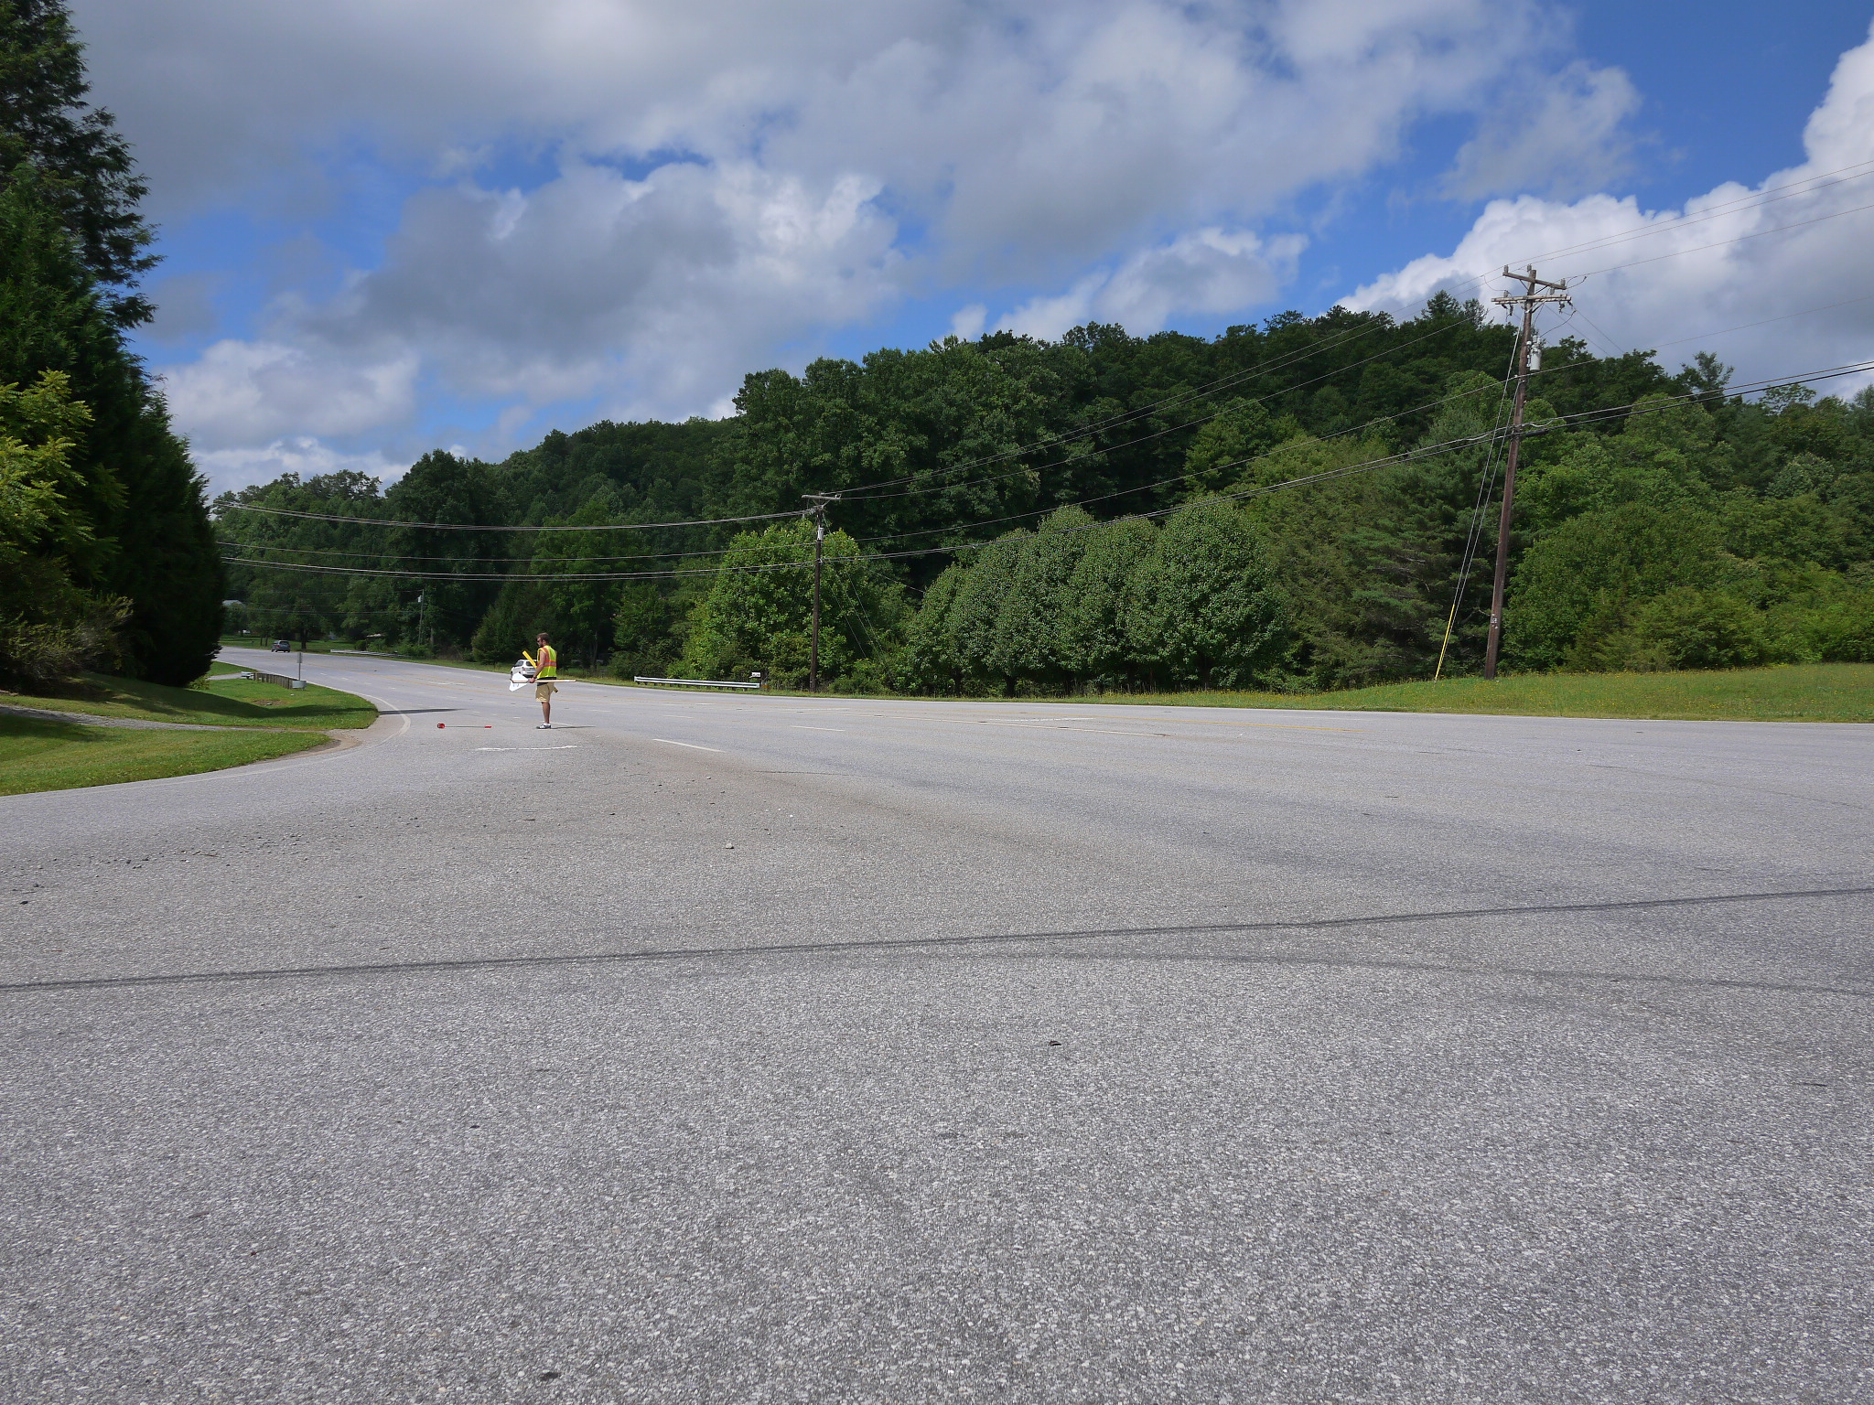



NCHRP 17-59: Safety Impacts of Intersection Sight Distance
Presented by
[Insert Name]

Slide 2
Overview
NCHRP 17-59 Background and Objectives
Research Methods
Research Findings
  Models
  Application
Conclusions

Slide 3
Project Background and Objectives

Slide 4
NCHRP 17-59: Safety Impacts of Intersection Sight Distance
Project initiated in 2012
Project Team:
  VHB
  Wayne State University
  Portland State University
  Mr. Stephan Parker, NCHRP Senior Program Officer
  NCHRP 17-59 Panel Members
  Highway Safety Information System

Slide 5
Research Issues
Gap acceptance crashes:
  One of most common crashes at unsignalized intersections
  Influenced by intersection sight distance (ISD)
ISD:
  Key design element at intersections
  Contributes to ability of drivers on minor road to identify appropriate gaps
  Drivers on major road approach can see vehicles on minor road
AASHTO provides criteria for minimum ISD, yet …
  ISD may change over time
  Physical conditions, vehicle performance, and driver behavior influence gap acceptance
  Adequate ISD alone may not be sufficient

Slide 6
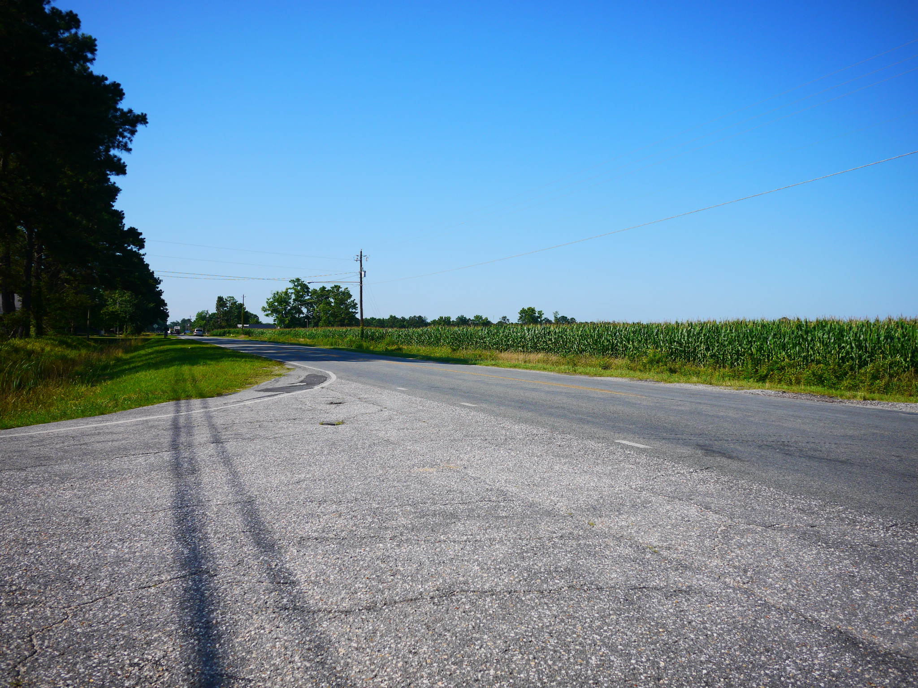
How does sight distance at this intersection relate to
crash frequency?

Slide 7
Objectives
Identify appropriate definitions and existing methods to measure ISD
Identify a standardized method for measuring ISD
Quantify the relationship between safety and ISD for stop-controlled intersections
Develop easy to use graphics for practitioners to evaluate the safety impact of ISD

Slide 8
Key Terminology
Design ISD: Minimum ISD as identified in the Green Book
Existing (or available) ISD: ISD as measured in the field
Proposed ISD: ISD under consideration and is expected to result from a change in the intersection environment
Minor Road: Roadway that is stop-controlled, drivers must yield to approach vehicles
Major Road: Uncontrolled at the intersection, typically higher traffic volumes
Target Crash: Involves vehicle from major road colliding with vehicle entering from minor road
Target Fatal and Injury Crash: Target crash that results in at least one injury or fatality

Slide 9
Research Methods

Slide 10
Research Approach and Methods
Literature review
Review of existing ISD practices
Establish ISD protocol
Collect data with protocol
  Field data collection
  Desk-top data collection
Data analysis

Slide 11
Literature Review
Relevant past ISD-related safety studies are somewhat inconsistent in direction and magnitude
Review provided direction for data collection plan and study design; confirmed wide range of factors should be field-collected and thoughtfully considered
Identified countermeasures that are used or could be used by agencies to improve locations with sight distance concerns

Slide 12
Review of Documented ISD Practices
Purpose: To understand how State and local agencies define visual obstructions and collect ISD measurements in the field
Helped determine what processes and parameters should be followed in field
Readily-available policies were collected from State and local transportation websites

Slide 13
Findings of Review of ISD Practices
Most reviewed policies did NOT define specific field procedures for determining ISD
Most reviewed policies incorporate exact AASHTO values for driver eye height and object height, although some elect to use 4.25 ft for object height instead of reciprocal 3.5 ft
Many agency policies confirm acceptance that objects can be located within the sight triangle and not necessarily obstruct ISD

Slide 14
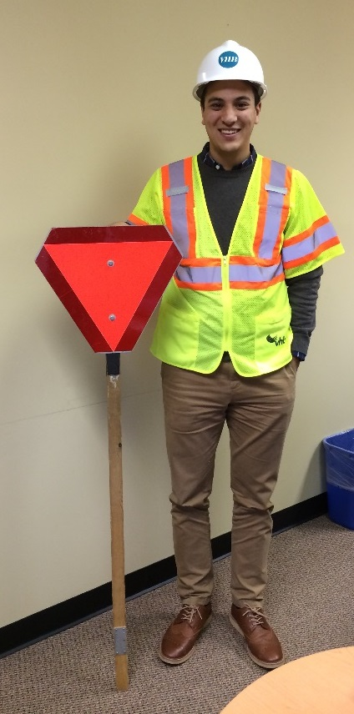
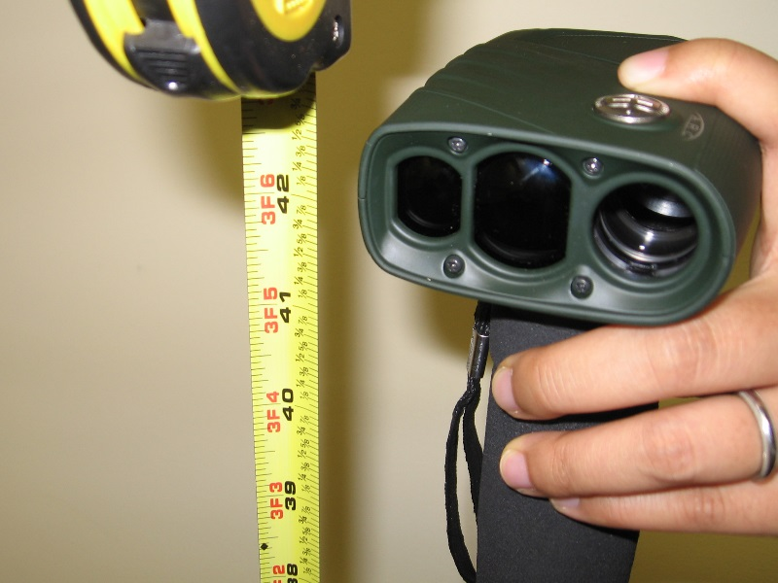
Establish ISD Collection Protocol
Tested data collection methods
Identified a standardized method for measuring ISD in field

Slide 15
Key Terms
ISD is the sight distance provided at intersections to perceive the presence of conflicting vehicles.
Available ISD is the measurable unobstructed view a driver has at an intersection.
Decision point (DP) is the location where drivers on the minor road stop, view traffic, and decide when to enter the intersection.
Critical point (CP) is the location on the road where the observed object begins to appear.
Target crashes involve a vehicle from the major road colliding with a vehicle from a minor road.

Slide 16
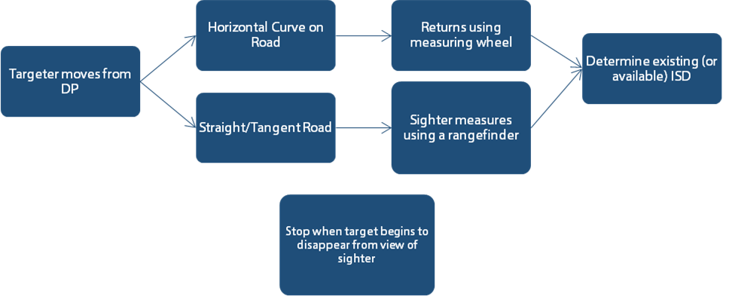
Data Collection Approach
Two-person team: sighter and targeter

Slide 17
Data Collection: Applying the Protocol

Slide 18



Process Overview
OH
WA
3
States
NC
800+
Intersections
1,658
ISD measurements

Slide 19
Sites Visited
NC - 286
WA - 265
OH - 281

Slide 20
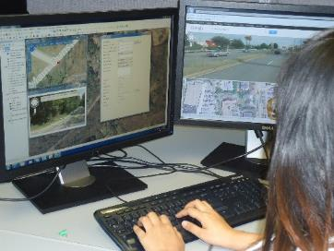
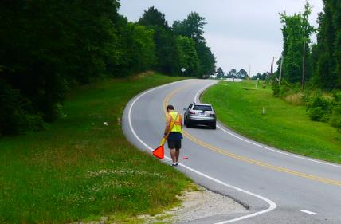
Data Collected in the Office, Verified in the Field
Roadway
  Number of through lanes
  Divided/undivided major road
  Horizontal curvature
Traffic/Ops
  Traffic control
  Presence of left-turn lanes(major & minor)
  Presence of right-turn lanes (major & minor)
  Presence of on-street parking

Slide 21
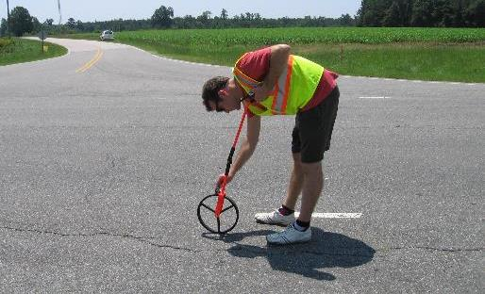
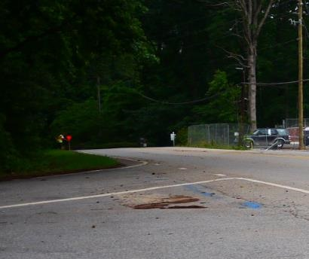
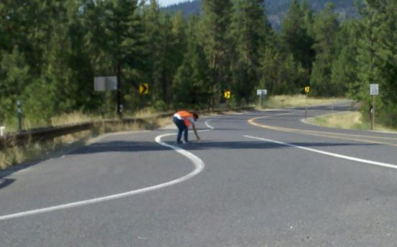
Data Collected in the Field
Roadway
  Standard available ISD
  Best available ISD
  Confirm visibility of traffic control
  Lane width
  Shoulder Width
  Median width
  Lighting Presence
  Vertical grade

Slide 22
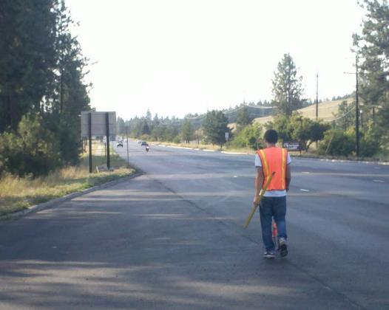
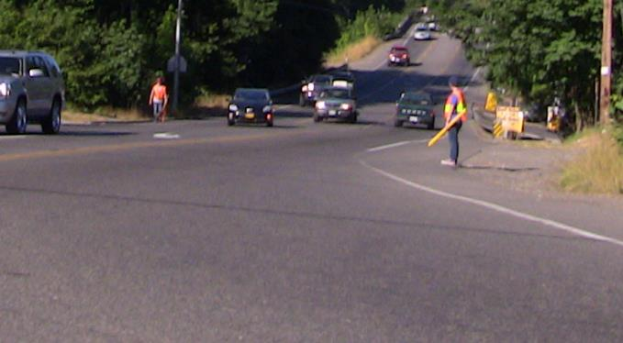
Data Collected in the Field
Traffic/Ops
  Major road traffic volume
  Minor road traffic volume
  Posted speed limit

Slide 23
Data Collected in the Office
Crash
  Location
  Type
  Severity
  Initial direction of vehicles
  Sequences of events
  Light condition
  Weather condition
  Vehicle type
Roadway
  Major road functional class
  Minor road functional class
  Area type
  Access density
  Quality of sight distance
Traffic/Ops
  Major road traffic volume
  Minor road traffic volume
  Intersection angle

Slide 24
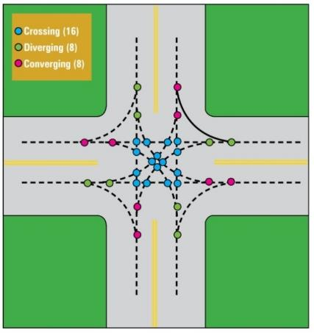
Crash Data Collection – Total Target Crashes
Total crashes: A crash occurring at, or within, the influence area of an intersection.
  Influence area includes crashes that occur within 250 feet of the intersection along the major road.
  One vehicle on the mainline and one on the minor road.

Slide 25
Crash Data - Subsets of Target Crashes
Injury Crashes: KABC
Right-angle crashes
Angle
Left-turn
Right-turn
Day-time crashes: Daylight

Slide 26
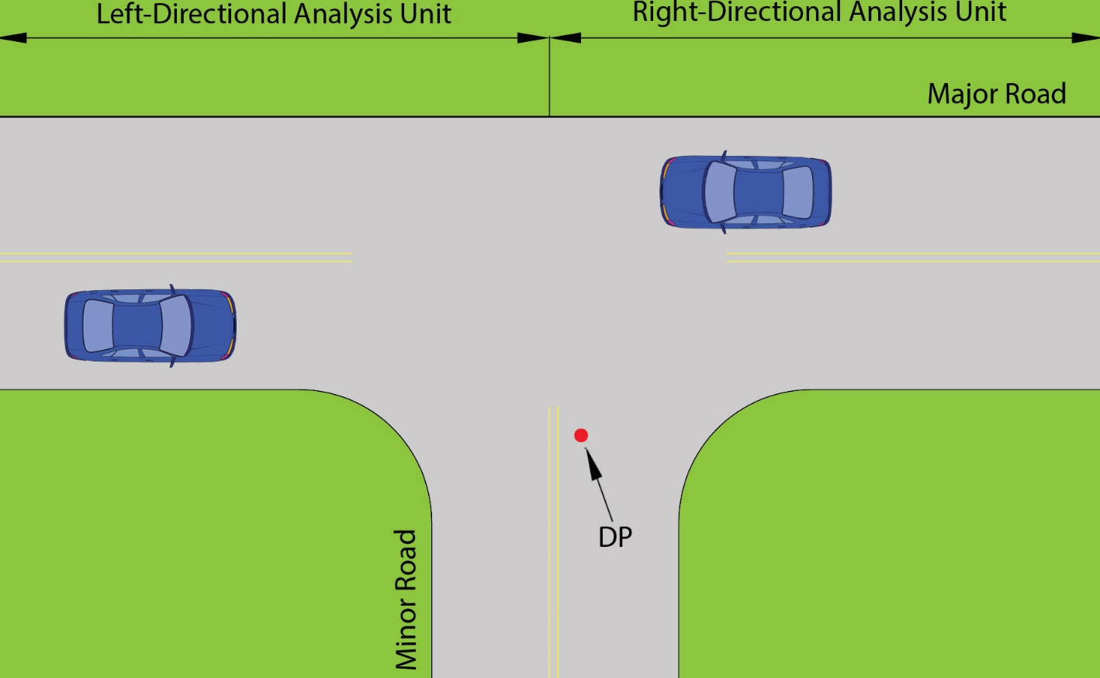
Analysis Unit
Each site was divided into two analysis units (i.e., left-direction and right-direction) by major road direction

Slide 27
Data Collection Summary
Terrain | NC(286) |  | OH(281) |  | WA(265)
 | Rural | Urban | Rural | Urban | Rural | Urban
Level | 34 | 1 | 128 | 62 | 71 | 49
Mountainous | 48 | 36 | 0 | 0 | 1 | 0
Rolling | 74 | 93 | 48 | 43 | 55 | 89
Grand Total | 156 | 130 | 176 | 105 | 127 | 138
Major Route Type | NC |  | OH |  | WA
 | Rural | Urban | Rural | Urban | Rural | Urban
2-lane Major | 65 | 43 | 112 | 53 | 72 | 62
4-lane Major Undivided | 40 | 46 | 23 | 33 | 8 | 47
4-lane Major Divided | 51 | 41 | 41 | 19 | 48 | 28
Grand Total | 156 | 130 | 176 | 105 | 128 | 137
State | 2008 | 2009 | 2010 | 2011 | 2012 | Total
WA | 36 | 38 | 46 | 37 | -- | 157
OH | 64 | 75 | 80 | 84 | -- | 303
NC | -- | 44 | 72 | 75 | 75 | 266
Total | 100 | 157 | 198 | 196 | 75 | 726

Slide 28
Research Findings

Slide 29
Models

Slide 30
Final Models
Expected number of crashes are associated with available ISD
Models depend on:
  Available ISD
  Major road AADT
  Posted speed
Operational and geometric characteristics significantly associated with higher crash frequency:
  Major/minor road AADT
  Four-leg intersection indicator
  Left-direction indicator
  Vertical grade on major road approach
  Speed limit on the major road approach

Slide 31
Model Considerations
Safety effects of available ISD differ by volume and speed limit
  Practitioners should use this information when possible
  If not available, practitioners can use average conditions
Model estimations describe relationship between target crash frequency, available ISD, and other intersection characteristics
  Available for target crashes and target fatal and injury crashes
  Target fatal and incapacitating injury crashes, target angle crashes, and target daytime crashes revealed similar trends between crash frequency and ISD

Slide 32
Target Crashes
Three main variables capturing safety effects of available ISD and estimated parameters:
  Speed Limit/ISD interaction (spdlmt/ISD)
  Major road AADT/ISD interaction (LmajAADT/ISD)
  Major road AADT/ISD interaction (MmajAADT/ISD)
Major road AADT ranges:
  Low major road AADT: ≤ 5,000
  Mid major road AADT: > 5,000 but ≤ 15,000
  High major road AADT: > 15,000
Notes:
Speed Limit/ISD interaction (spdlmt/ISD):
Indicates expected number of target crashes increases as ISD decreases
Non-linear association between ISD and expected target crash frequency
The sensitivity of the expected number of target crashes to changes in ISD increases as the speed limit on the major road increases (e.g., the safety benefit of increasing ISD from 300 to 600 feet is expected to be substantially larger on high speed roads compared to low speed roads).
Major road AADT/ISD interaction (LmajAADT/ISD): This variable represents an interaction between major road two-way AADT and ISD. Its value is zero if the major road AADT is greater than 5,000. Its value is one divided by available ISD for the applicable minor road approach direction (i.e., the inverse of available ISD) if the major road AADT is less than or equal to 5,000. The negative parameter represents the finding that the effect of ISD on the expected number of target crashes is smaller on lower-volume roads than on higher-volume roads.
Major road AADT/ISD interaction (MmajAADT/ISD): This variable represents a second interaction between major road two-way AADT and ISD. Its value is zero if the major road AADT is less than or equal to 5,000 or greater than 15,000. Its value is one divided by available ISD for the applicable minor road approach direction (i.e., the inverse of available ISD) if the major road AADT is greater than 5,000 and less or equal to 15,000. The negative parameter represents the finding that the effect of ISD on the expected number of target crashes is smaller on medium-volume roads than on higher volume roads. However, the parameter is less negative than for the low volume interaction, representing the finding that the effect of ISD on the expected number of target crashes is larger on medium-volume roads than on lower volume roads.

Slide 33
Model Estimation Results for Expected Number of Target Crashes
Variable | Coefficient | Standard Error | Z-Score | P-Value
Constant | -8.147 | 1.382 | -5.90 | <0.001
β1 (log-majAADT) | 0.244 | 0.120 | 2.04 | 0.042
β2 (log-minAADT) | 0.536 | 0.072 | 7.42 | <0.001
β3 (LmajAADT/avaiISD) | -243.0 | 185.3 | -1.31 | 0.190
β4 (MmajAADT/avaiISD) | -177.8 | 86.53 | -2.06 | 0.040
β5 (LT) | 0.334 | 0.120 | 2.79 | 0.005
β6 (fourleg) | 0.845 | 0.126 | 6.68 | <0.001
β7 (median) | -0.016 | 0.166 | -0.09 | 0.925
β8 (spdlmt) | -0.021 | 0.008 | -2.75 | 0.006
β9 (spdlmt/ISD) | 7.194 | 2.450 | 2.94 | 0.003
β10 (grd500) | -0.061 | 0.026 | -2.32 | 0.021
β11 (lnT) | 1 (exposure)
Dispersion (α) | 2.66 | 0.278
N = 1653; Log-likelihood = -1296.89; Pseudo R² = 0.055

Slide 34
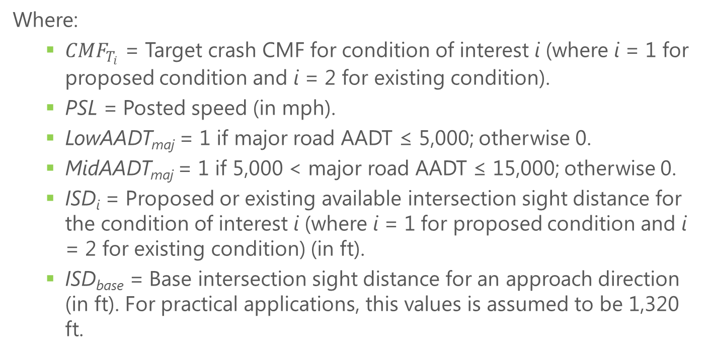
Target Crashes CMFunctions
Where:
${CMF}_{T_{i}}$ = Target crash CMF for condition of interest i (where i = 1 for proposed condition and i = 2 for existing condition).
PSL = Posted speed (in mph).
LowAADT_{maj} = 1 if major road AADT ≤ 5,000; otherwise 0.
MidAADT_{maj} = 1 if 5,000 < major road AADT ≤ 15,000; otherwise 0.
ISD_{i} = Proposed or existing available intersection sight distance for the condition of interest i (where i = 1 for proposed condition and i = 2 for existing condition) (in ft).
ISD_{base} = Base intersection sight distance for an approach direction (in ft). For practical applications, this values is assumed to be 1,320 ft.

Slide 35
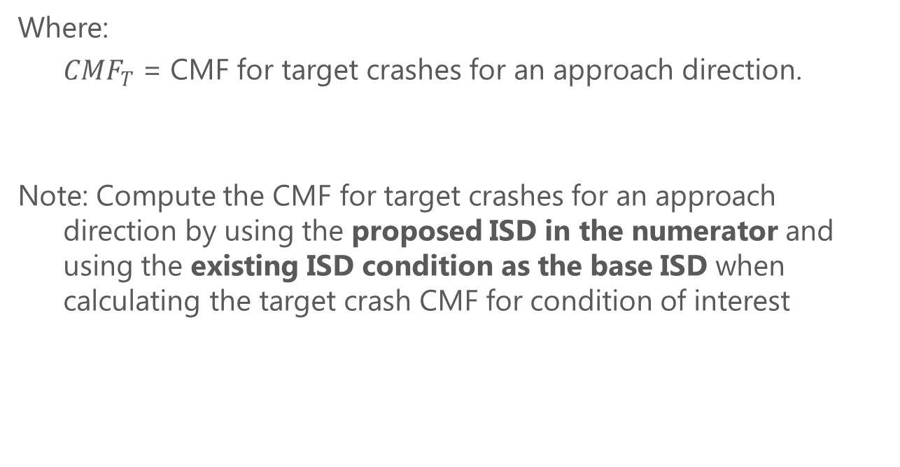
Target Crashes CMF for Approach Direction
Where:
${CMF}_{T}$ = CMF for target crashes for an approach direction.
Note: Compute the CMF for target crashes for an approach direction by using the proposed ISD in the numerator and using the existing ISD condition as the base ISD when calculating the target crash CMF for condition of interest

Slide 36
Target Fatal and Injury Crashes
General trends and directions of safety effects were consistent with target crash model
Major road AADT categories:
  Low-mid major road AADT: ≤ 15,000
  High major road AADT: > 15,000

Slide 37
Model Estimation Results for Expected Number of Target Fatal and Injury Crashes
Variable | Coefficient | Standard Error | Z-Score | P-Value
Constant | -8.234 | 1.431 | -5.75 | <0.001
β1 (log-majAADT) | 0.115 | 0.117 | 0.98 | 0.325
β2 (log-minAADT) | 0.498 | 0.090 | 5.55 | <0.001
β3 (LMmajAADT/avaiISD) | -155.5 | 108.6 | -1.43 | 0.152
β4 (LT) | 0.507 | 0.152 | 3.33 | 0.001
β5 (fourleg) | 0.953 | 0.162 | 5.89 | <0.001
β6 (median) | 0.215 | 0.210 | 1.03 | 0.305
β7 (spdlmt) | -0.009 | 0.010 | -0.95 | 0.340
β8 (spdlmt/ISD) | 6.335 | 2.915 | 2.17 | 0.030
β9 (grd500) | -0.054 | 0.035 | -1.54 | 0.125
β10 (lnT) | 1 (exposure)
Dispersion (α) | 3.136 | 0.155
N = 1653; Log-likelihood = -820.79; Pseudo R² = 0.049

Slide 38

Target Fatal and Injury Crashes CMFunctions
Where:
${CMF}_{T{FI}_{i}}$ = Target fatal and injury crash CMF for condition of interest i (where i = 1 for proposed condition and i = 2 for existing condition).
LowMidAADT_{maj} = 1 if major road AADT ≤ 15,000; otherwise 0.

Slide 39
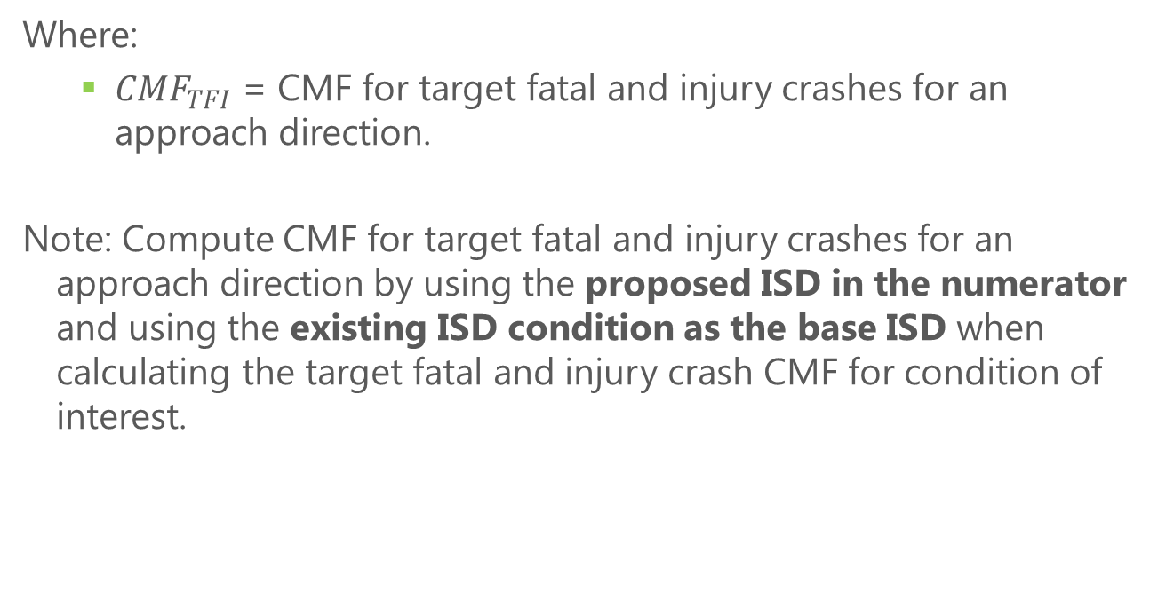
Target Fatal and Injury Crashes CMF for Approach Direction
Where:
${CMF}_{TFI}$ = CMF for target fatal and injury crashes for an approach direction.
Note: Compute CMF for target fatal and injury crashes for an approach direction by using the proposed ISD in the numerator and using the existing ISD condition as the base ISD when calculating the target fatal and injury crash CMF for condition of interest.

Slide 40
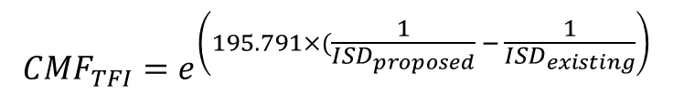
Unknown AADT
If AADT and posted speed are known, the charts provide a more informed estimate of safety impacts
Reduced versions of the CMFunctions may be applied for situations where major AADT and posted speed are unknown
Target Crashes
$${CMF}_{TFI}=e^{\left(195.791×(\frac{1}{{ISD}_{proposed}} − \frac{1}{{ISD}_{existing}}\right)}$$
Target Fatal and Injury Crashes

Slide 41
Application

Slide 42
Guidance for Evaluating the Safety Impacts of Intersection Sight Distance
Purpose:
  Serve as a resource for evaluating intersection safety
Audience:
  Practitioners in planning, design, operations, and traffic safety management of stop-controlled intersections
Scope:
  Three- and four-leg intersections
  Stop-control on the minor road approaches
  Planned and existing conditions

Slide 43
Guidance Organization
Chapter I: Introduction
Chapter II
Chapter III
Chapter IV
Chapter V
Chapter VI

Slide 44
Guidance Organization
Chapter I
Chapter II: Measuring Sight Distance & Other Critical Information
Chapter III
Chapter IV
Chapter V
Chapter VI
Notes:
The purpose of this chapter is to provide users instructions on collecting field data for the available ISD and other relevant data needed to use the guidance.

Slide 45
Guidance Organization
Chapter I
Chapter II
Chapter III: Safety Performance & Intersection Sight Distance
Chapter IV
Chapter V
Chapter VI
Notes:
The purpose of this section is to provide practitioners information on the anticipated impact on crashes at an intersection from changing the sight distance from one distance to another (e.g., lengthening the distance at an intersection from 400 ft to 750 ft by removing a sight distance obstruction). The results can be applied to both existing and design stage intersections.

Slide 46
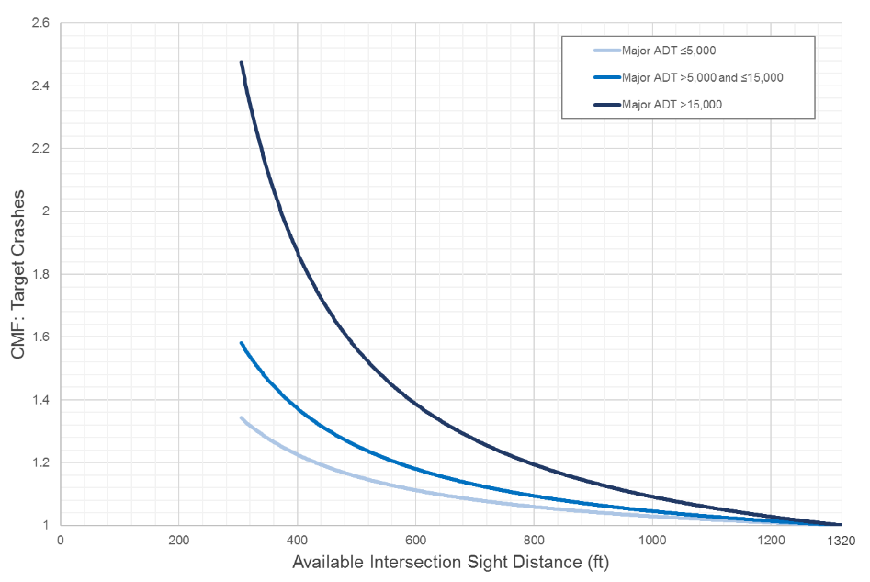
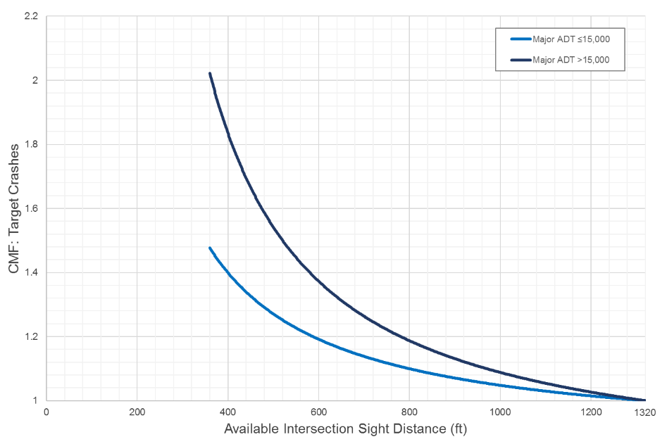
CMFunction Charts in the Guidance
Charts A-1 to A-6
CMFunctions for target crashes
Charts B-1 to B-6
CMFunctions for target fatal and injury crashes
Notes:
The Guidance presents a series of charts depicting CMFs for target crashes and target fatal and injury crashes. Charts A-1 to A-6 present CMFunctions for target crashes. Charts B-1 to B-6 present CMFunctions for target fatal and injury crashes. The charts are based on the CMFunctions developed from the research and provided for reference in Chapter VI. Detailed instructions are provided in the Practitioner Tips: Detailed Instructions for Using CMFs to help practitioners use these charts in practice, with the key steps identified on the sample chart (Figure 6).

Slide 47
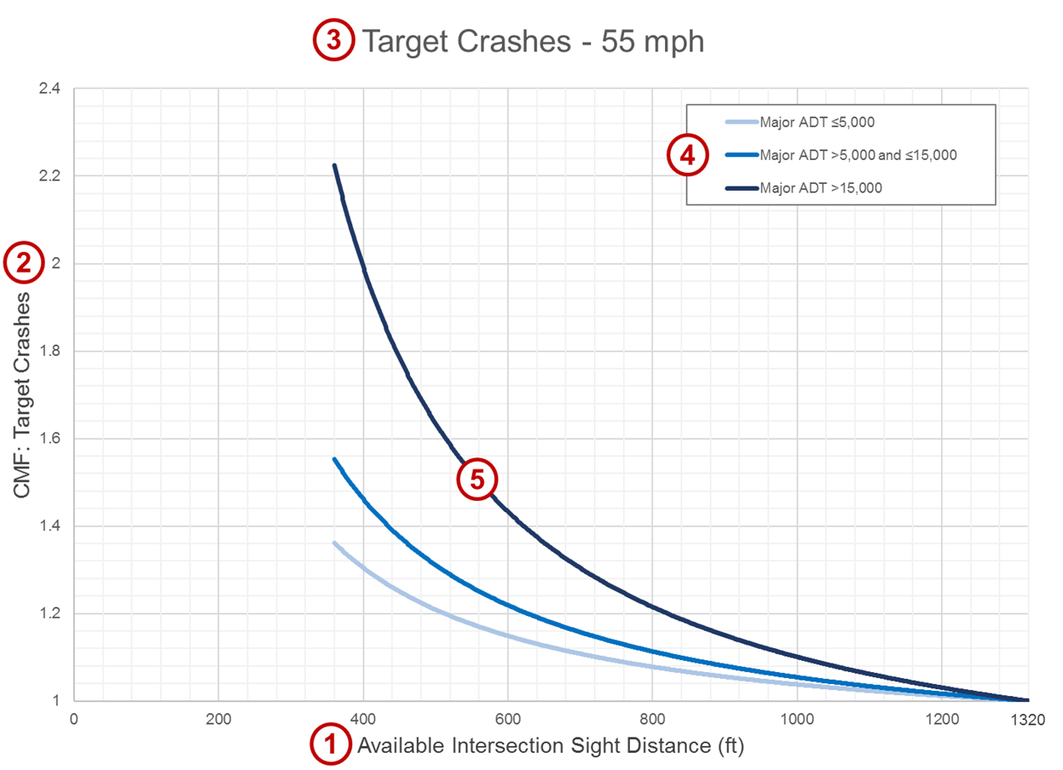
Step 1. Identify the minor road approach sight distance of interest (left-looking or right-looking) for which a new ISD is proposed. Measure the sight distance along the major road for that direction using the method in Chapter II. This is the existing ISD for the approach and direction.

Slide 48
Step 2. Identify the type of crash of interest for the analysis: Target or Target Fatal or Injury Crash.
Target crashes are defined as a crash involving a vehicle from the major road and a vehicle entering from the minor road.
Target fatal and injury crashes are a subset of target crashes that involve one or more injuries or fatalities.

Slide 49
Step 3. Identify the appropriate chart type based on the type of crash and major road posted speed.

Slide 50
Step 4. Identify the curve that corresponds with the appropriate major road AADT range.
Three ranges of major road AADT are used for target crashes.
Two ranges of major road AADT are used for target fatal and injury crashes.

Slide 51
Step 5. Using the selected curve, plot the existing and the proposed ISD. If any ISD exceeds 1,320 ft, use 1,320 ft in the chart as this is the maximum.
Notes:
Not shown:
Step 6. Calculate the CMF for changing the site distance from the existing to the proposed by dividing the CMF from the chart for the proposed ISD by the CMF from the chart for the existing ISD.
Step 7. Apply the resulting CMF to the crashes of interest associated with the corresponding direction.

Slide 52
Guidance Organization
Chapter I
Chapter II
Chapter III
Chapter IV: Examples
Chapter V
Chapter VI
Notes:
This chapter presents examples to demonstrate how practitioners can apply the charts presented in Chapter III.

Slide 53
Example: One-direction ISD Upgrade
Three-leg intersection
Stop-control on the minor road approach
Major road AADT = 7,000, speed = 55 mph
Existing left-looking ISD = 400 feet
How would increasing left-looking ISD to 750 ft affect target crashes at this intersection?

Slide 54
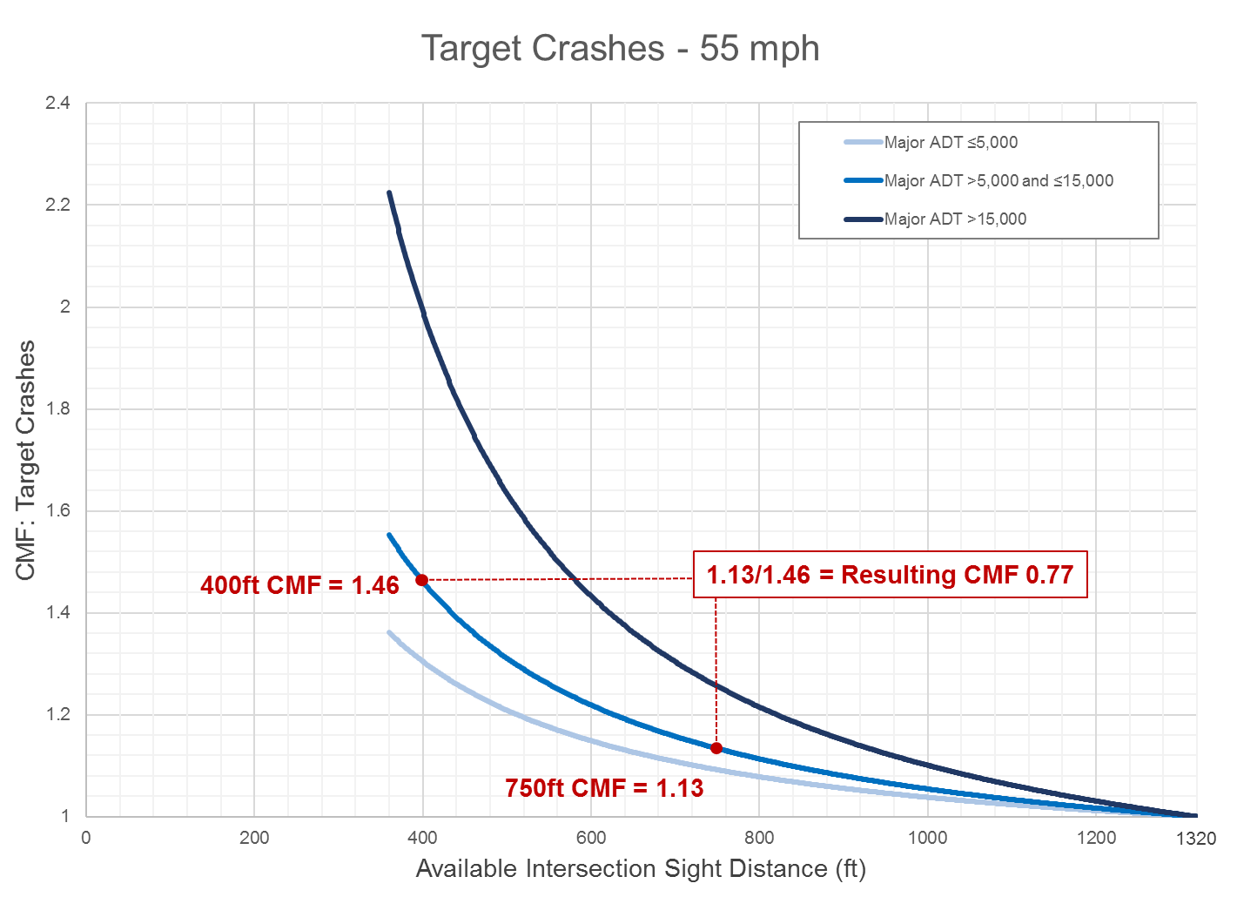
Example: One-direction ISD Upgrade
Notes:
The CMF is 1.13 with a new (proposed) ISD of 750 ft. The CMF is 1.46 with the existing ISD of 400 ft. Therefore, the target crashes CMF for improving ISD is 1.13/1.46, or 0.77.

Slide 55
Example: One-direction ISD Upgrade
Resulting CMF = 0.77
Applies to:
  Multi-vehicle crashes involving vehicles from the minor road
  Vehicles approaching from the left
Increasing left-looking ISD from 400 ft to 750 ft would reduce target crashes on the approach by 23 percent at this intersection.

Slide 56
Guidance Organization
Chapter I
Chapter II
Chapter III
Chapter IV
Chapter V: Other Considerations and Resources
Chapter VI
Notes:
This chapter provides countermeasures related to ISD. However, ISD is just one consideration for intersection enhancement. There are many other effective countermeasures available to practitioners. The countermeasures for ISD can be categorized with other measures that improve intersection safety and should be considered in a comprehensive approach to intersection safety.

Slide 57
Countermeasures
Clear sight triangles as much as possible without geometric improvements.
Geometric improvements to improve ISD.
Increase awareness and visibility of the intersection.
Warn drivers of presence of conflicting vehicles.
Choose appropriate traffic control.
Better accommodations for pedestrians and bicyclists.

Slide 58
Guidance Organization
Chapter I
Chapter II
Chapter III
Chapter IV
Chapter V
Chapter VI: Base Equations for Reference
Notes:
This chapter contains the CMFunctions for the charts in the Guidance.

Slide 59
Project Conclusions

Slide 60
NCHRP 17-59 Summary
Established methods for collecting available ISD
Developed analytical models based on data to explore relationship between crashes, available ISD, and other factors
Resulted in two multivariable count regression models: target crashes and target fatal and injury crashes
Developed stand-alone guidance for practitioners to assess safety impacts of ISD

Slide 61
Future Directions
Incorporate results of NCHRP 17-59 into existing policies, practices, and design manuals
Explore the difference in CMFs for intersections with higher ISD-related crash counts
Consider the impact of right-turns on the major roads
Explore effects of dynamic ISD on safety
Examine relationship between available ISD and total crashes
Explore safety effects of roadside visual clutter

Slide 62

Stephan Parker | saparker@nas.edu
Kim Eccles | keccles@vhb.com
Dr. Scott Himes | shimes@vhb.com
Dr. Timothy Gates | gatestim@msu.edu
Dr. Christopher Monsere | Monsere@pdx.edu
www.vhb.com
Offices located throughout the east coast

