Slide 1
NCHRP Research Report 893:
Systemic Pedestrian Safety Analysis
Final Presentation Materials
MAY 2018

Slide 2
Presentation Overview
Background
Project Description
  Objectives
  Key Tasks and Findings
Guidebook Overview
  Systemic Analysis Process
  Highlights of Guidebook Steps
Conclusions
  Project Limitations and Considerations
  Future Research Needs
Notes:
This is an outline of what is presented in the rest of the slide deck.

Slide 3
Background

Slide 4
Tenets of a Systemic Approach*
Identifies a safety concern based on an evaluation of data at the system (or network) level
Establishes common characteristics (risk factors) of locations where severe crashes frequently occur
Emphasizes low-cost safety countermeasures to address the risk factors identified
Prioritizes locations across the entire roadway network where risk factors are present, regardless of prior crash history
*From FHWA’s Systemic Safety Project Selection Tool (Preston et al. 2013)
Background | Project Description | Guidebook Overview | Conclusions

Slide 5

Benefits of a Systemic Approach
Improved safety with more proactive approach
  Don’t simply “chase the hot spots”
Informed decision-making utilizes data on key risk factors
Optimized investment
  Cost-effective use of resources
  Consistency in application
Background | Project Description | Guidebook Overview | Conclusions
Notes:
From the 17-73 Guidebook:
“A systemic approach resides on a spectrum of ways that transportation agencies may address safety issues (see Figure 2 on next page) and is considered a more proactive approach than those that focus only on treating specific locations with a crash history.”
Stronger Basis for Decisions—Takes into account important factors, such as activity/exposure and randomness that are often excluded from a traditional crash “hot spot” approach when identifying locations for improvement.
Effective Use of Resources—Helps focus resources on crash risks that are most prevalent across the jurisdiction and guides selection of appropriate treatments and locations to reduce the most serious crashes.
Data-Driven Approach—Provides a data-driven/analytical method and screening tools that can be used to justify funding decisions, even if there is not a specific crash history at a given location. A data-driven process also creates new opportunities to provide an equitable evaluation across a jurisdiction.
More Proactive Approach—Takes a forward-looking approach to address safety issues without waiting for a crash history to develop at any given location.
Consistency—Helps avoid dealing with broad safety issues one project at a time and instead treats risks more widely and consistently.

Slide 6
Key Takeaway: Systemic Approach Definition
“A systemic approach is a data-driven, network-wide (or system-level) approach to identifying and treating high-risk roadway features correlated with specific or severe crash types. Systemic approaches seek not only to address locations with prior crash occurrence, but also those locations with similar roadway or environmental crash risk characteristics.”
Background | Project Description | Guidebook Overview | Conclusions
Notes:
Notes from the 17-73 Guide:
“Definition: Systemic Approach
A systemic approach is a data-driven, network-wide (or system-level) approach to identifying and treating high-risk roadway features correlated with specific or severe crash types. Systemic approaches seek to not only address locations with prior crash occurrence, but also those locations with similar roadway or environmental crash risk characteristics.”

Slide 7
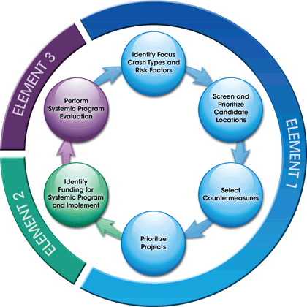
FHWA’s Systemic Approach to Safety
Identifies focus crash types and risk factors
Screens the network to identify locations with relevant risks for treatment
Identifies candidate countermeasures to address risks
Prioritizes projects
Identifies / allocates funding
Evaluates safety and other impacts of systemic projects
Background | Project Description | Guidebook Overview | Conclusions
Notes:
FHWA has defined a systemic approach, which several states and localities have been applying. As you will see in the next few slides, this research project aimed to build on this process, adapting it for additional steps needed to understand and address pedestrian risks and issues with data limitations.
Graphic is from FHWA’s Systemic Safety Project Selection Tool (Preston et al. 2013)
Image: Preston et al. 2013

Slide 8
Why Do We Need a Systemic Safety Process Specific to Pedestrians?
Pedestrian crashes may be rare or widely dispersed across a network, making a hot spot approach unreliable and cost-ineffective in identifying and addressing pedestrian safety.
Crash risk factors for pedestrians are different than for motor vehicles, and there is a need for specific guidance and research to augment existing tools and guides.
The process needs to be tailored to data related to pedestrians, and to provide guidance on how to gather needed data.
Background | Project Description | Guidebook Overview | Conclusions

Slide 9
Project Description

Slide 10
Project Objectives
Develop a process (and Guidebook) that includes:
  Analytical methods to identify roadway features, behaviors, and other contextual risk factors associated with pedestrian crashes
  Methods to identify appropriate and cost-effective systemic pedestrian safety improvements to address the associated risk factors
  Information to enable transportation agencies to prioritize candidate locations for selected safety improvements
Background | Project Description | Guidebook Overview | Conclusions
Notes:
The objective of this research was to develop a process for (1) conducting systemic safety analyses for pedestrians using analytical techniques to identify roadway features, behaviors, and other contextual risk factors such as land use that are associated with pedestrian crashes; (2) identifying appropriate and cost-effective systemic pedestrian safety improvements to address the associated risk factors; and (3) enable transportation agencies to prioritize candidate locations for selected safety improvements based on risk.
The research results should aid transportation agencies in more effectively allocating and prioritizing resources for systemic pedestrian safety improvements.

Slide 11
Key Project Tasks
Phase 1: Review State of the Practice
  Conduct a literature review and interviews with practitioners
  Focus on differences and challenges for implementing an analytic systemic process for pedestrian safety
  Identify data needs and sources for a robust systemic pedestrian process
Phase II: Conduct Additional Research
  Compile risk factors (associated with pedestrian crash frequency and/or severity) from published analyses
  Conduct original analysis to identify additional risk factors associated with two types of pedestrian midblock collisions
  Review and identify a select set of candidate pedestrian crash countermeasures compatible with systemic processes
Phase III: Develop Guidance
  Develop Guidebook on a systemic pedestrian safety process
  Develop and incorporate case studies describing real or hypothetical applications
Background | Project Description | Guidebook Overview | Conclusions

Slide 12
Phase I Key Findings
Some agencies misunderstood what a systemic approach entails
While many agencies face data and other limitations, there is high motivation to collect and compile the needed types of data to perform more robust analyses to determine factors associated with pedestrian crash risk and develop reliable prioritization metrics
There is an extensive body of pedestrian risk research that could be mined for potential use (done in Phase II and incorporated into Guidebook)
Background | Project Description | Guidebook Overview | Conclusions
Notes:
In phase I, the team conducted the literature review and interviewed key stakeholders to learn more about how they defined and applied systemic processes.
Given bullet #1, this provided impetus for the team to spend more time defining the key features of a systemic process and further articulating the steps in the Guidebook.
Data was the limiting factor for most agencies in performing more robust analyses. The NCHRP panel was emphatic in not wanting the guidebook to play to the lowest common denominator, but rather articulate an optimal approach and then provide additional guidance or considerations for the agencies still struggling with data. The team also heard in the interviews with key stakeholders that agencies are working to improve their data quality, coverage, and linkage and that this project could offer further motivation for the benefits of doing that work.
Through the literature review, we also amassed an extensive body of prior literature establishing pedestrian risk factors, which could be used at various steps in a systemic process.

Slide 13
Phase II Key Findings
  Analysis of two types of segment-related (midblock) pedestrian collisions using network-wide data was performed to:
    Test an application of a systemic analysis
    Identify additional risk factors associated with segments
    Risks identified were incorporated into the Guidebook
    Applied results to illustrate identification and prioritization of sites
  Identified more than a dozen effective countermeasures feasible for systemic application
Background | Project Description | Guidebook Overview | Conclusions
Notes:
Findings from phase I and phase II were both used in the development of the Guidebook (phase III).

Slide 14
Guidebook Overview

Slide 15
Guidebook Elements
Overview
  Background on a Systemic Process and key features
  How to use the Guidebook and intended audience
  Relation to other agency processes
Process steps
Examples
Glossary of key terms
Appendices
Companion: Final Report
Background | Project Description | Guidebook Overview | Conclusions

Slide 16
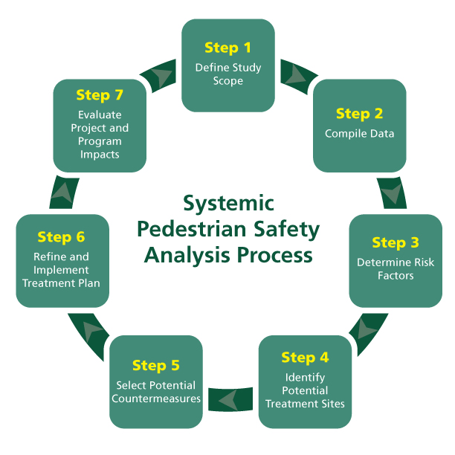
Steps in the Guidebook
Background | Project Description | Guidebook Overview | Conclusions
Notes:
The project team refined and added to the six steps in FHWA’s original systemic process by adding an additional step focusing on compiling necessary data to perform a robust analysis in subsequent steps. Sources and availability for pedestrian-related risk and exposure data may differ from those used in motor vehicle focused analyses and therefore merit additional focus and guidance.
Step 1 involves defining the area for analysis, identifying the facility or location type target for focus, and identifying subsets of target crash type(s) for systemic focus. This step sets the stage for all subsequent steps.
Step 2 involves compiling the roadway and other location characteristics and crash data that will be needed to identify risk factors in Step 3. All systemic processes require data, and the compiled data will serve as an important foundational database to identify potential treatment sites in Step 4.
Step 3 involves analyzing data to determine factors associated with the target pedestrian crash type or location of interest or using alternate approaches from research or local knowledge to identify key risk factors.
Step 4 involves identifying an optimal set of sites that have common risk and site characteristics that are suitable for similar packages of treatments, using various screening and ranking methods.
Step 5 involves identifying appropriate countermeasures or combinations of measures that could potentially address risks identified. In Step 5, there is also a chance to further refine and prioritize the locations identified in Step 4.
Step 6 involves considering additional priorities, performing diagnostics, performing economic assessments, and allocating funding as part of the process to refine and implement a systemic treatment plan.
Step 7 involves evaluating project and program impacts before starting the process anew.
The following slides describe some Guidebook highlights from each step.

Slide 17
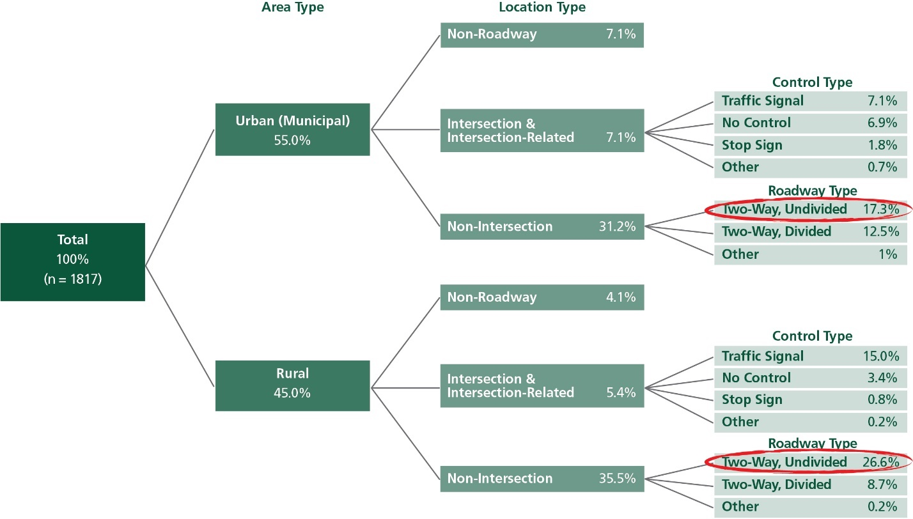
Step 1: Define Study Scope
Purpose is to identify a ‘problem’ type that accounts for a large % of the problem
Typically, only crash data is used
Uses descriptive means such as crash tree diagrams (see NC example at right)
Background | Project Description | Guidebook Overview | Conclusions
Notes:
From the Guidebook:
“The first step of the systemic process is to define the study scope. This step sets the stage for all subsequent steps. This step outlines basic procedures to identify a focus (i.e., a “targeted” risk problem) for a systemic pedestrian safety analysis, regardless of the agency or network size. These include:
Defining the jurisdiction or network area for analysis;
Identifying one or more target facility or location types; and
Identifying subsets of target crash type(s) for systemic focus (if any).”
Crash data only can be used for Step 1.
“It is a good idea to identify an analysis network that has clear boundaries, within which an agency has the authority to make changes, since the goal is to implement treatments. The data types needed for risk analysis (in Step 3) are also more likely to be available and readily compiled for cohesive urban or rural regions or municipalities that tend to compile land use and other types of planning data.
“The purpose of identifying a specific target crash type or types is to narrow traffic safety efforts down to target crash types that lend themselves to more readily identifying risk patterns and potential treatments.” This begins the step of ‘diagnosing’ the problem or determining treatable crash factors.

Slide 18
Step 2: Compile Data
Guidebook provides information and examples on how and why to make data: current and complete, easily accessible, centralized, digitized, linkable across databases, and spatially-referenced
Recommended data for systemic analysis include:
  Pedestrian crash records, including injury severity, crash type, and spatial references
  Detailed roadway data with key characteristics such as # of lanes
  Vehicle traffic and pedestrian volumes or secondary data to estimate volumes (e.g., transit ridership, population/employment density, etc.)
  Other measures of the built and social environment
Background | Project Description | Guidebook Overview | Conclusions
Notes:
Guidebook Steps are outlined to:
“Compile roadway data, including traffic and pedestrian volumes (if available), for the relevant target facility type(s);
Add land use and socio-demographic data using spatial methods to the specific locations for the relevant facility type; and
Count the focus crashes and add these data to the specific locations. Crash frequencies by location are the dependent (outcome) measures of safety.”
More information:
Detailed roadway inventory and key characteristics (e.g., speed limits or measures of traffic speed, number and type of lanes, traffic control, crosswalk presence/type, commercial driveways, transit stops, etc.).
Vehicle traffic and pedestrian volumes, transit use to help account for potential motor vehicle-pedestrian crash risk.
Other measures of the built and social environment (e.g., land uses and density measures, alcohol establishments, and demographic data for adjacent areas) that have been found to be associated with pedestrian crash risk.
Counts of pedestrian crashes by target crash type.
System-wide availability - These would ideally be available across the region of interest (system-wide) to take into account during risk estimation and to consider when prioritizing candidate locations.

Slide 19
Step 3: Identify Risk Factors
Recommended approach:
  Identify risk factors from regression modeling of jurisdiction-wide data (i.e., develop Safety Performance Functions or SPFs)
  Alternative approaches:
    Identify risk factors from prior research plus local judgment
    Infer risk factors from roadway and crash data frequency analyses
Background | Project Description | Guidebook Overview | Conclusions
Notes:
Step 3 in the Guidebook describes the recommended approach and two alternatives. The examples in the Guidebook also show the three different basic ways that state and local DOTs have approached risk factor identification.

Slide 20
Advantages of a Modeling/SPF Approach
More reliable than other methods:
  Accounts for crash randomness to identify sites with more than average risk
  Simultaneously accounts for multiple risk factors, including activity/ exposure of people to vehicles
  Accounts for local context, which may differ from where other risk factor studies were developed
Expedites subsequent steps in the process since data are already available for screening/prioritization and application of SPFs
Builds on the current best practice (from the traffic engineering field) for estimating risk of crashes at particular locations
Background | Project Description | Guidebook Overview | Conclusions
Notes:
To best accomplish the goals of a systemic process—to identify and cost-effectively address risks system-wide—the current best practice (from the traffic engineering field) for estimating risks at locations across a roadway network involves developing Safety Performance Functions (SPF) for particular facility/location types.
An SPF is a statistical model used to predict crashes based on measured risk factors including motor vehicle traffic and pedestrian volumes or activity, roadway features, and other characteristics of the built and social environment.
Alternative approaches for when use when data or other constraints prevent this idealized process are described in following slides and the Guidebook.
Relative Strengths and Limitations of methods for determining risk are described in Table 6 of the Guide.

Slide 21
Recommended Method: Identify Risk Factors by Developing Safety Performance Functions
Identify treatable risk factors from the model
Example treatable risk factors identified from models predicting segment-related pedestrian crash types:
  Presence of one or more midblock crosswalks
  Number of through lanes = 4, or 5+
  Presence of a two-way left turn lane (TWLTL)
  Presence of striped on-street parking
  Presence of a right turn lane at an adjacent intersection
  Speed limits >/ = 30 mph
Background | Project Description | Guidebook Overview | Conclusions
Notes:
The primary advantages of developing SPFs for crash prediction in a systemic pedestrian safety analysis (as well as a crash-based approach to safety) are the following:
Local crashes are used to identify risk factors relevant for the network.
The modeling process can examine a number of potential risk factors, while simultaneously accounting for traffic and pedestrian volume and other risk factors.
The factors identified in the model can be used to identify sites.
Sites with risk variables may also be ranked or prioritized as needed, using various tested, and more reliable ranking methods that utilize the model-derived predictions.
If agencies develop pedestrian crash-based SPFs, the models may be useful for both identifying high or excess expected crash sites, and sites with lower levels of risk that, if widely treated, may help to improve pedestrian safety at many more locations.

Slide 22
Alternate Method: Identify Risk Factors from Prior Research
High volumes of vehicles
Long distance (wide roads) that pedestrians are exposed to on-coming traffic
Multiple lanes
Lack of separation (in space and/or time)
Higher speed traffic
Dark or sparsely-lit roads or crossings
Commercial driveways
Transit activity
Commercial land uses
Background | Project Description | Guidebook Overview | Conclusions
Notes:
From the Guidebook:
Tables 7 and 8 provide details for variables that have been associated with pedestrian crashes or injury in prior studies.
If SPF development is beyond the resources of an agency, an alternative method is to apply risk factors from prior research. Advantages and Disadvantages are described in Table 6 of the Guidebook.

Slide 23
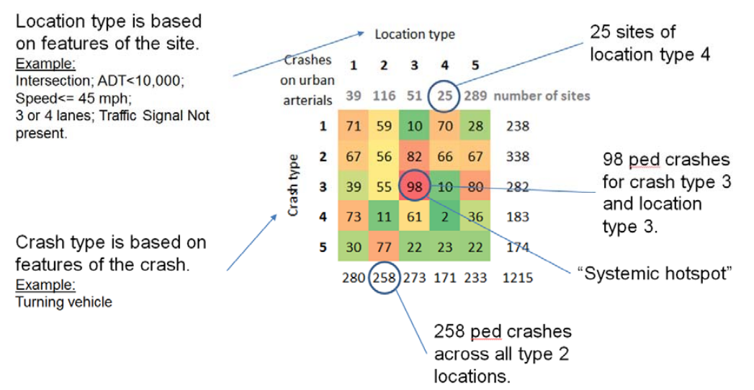
Alternate Method: Infer Risk Factors from Roadway and Crash Data
Background | Project Description | Guidebook Overview | Conclusions
Notes:
Another method, used by Caltrans (described in case example #4), uses local crashes, roadway, and other data to identify risk factors relevant for the network based on crash frequency associations.
The pros and cons of this approach are also described in Table 6 of the Guidebook.
Image: Grembek et al. 2013

Slide 24
Step 4: Identify Potential Treatment Sites
Combinations of identified risk factors can be used to identify/prioritize sites
Background | Project Description | Guidebook Overview | Conclusions
Notes:
When identifying systemic risks across an entire network, it is likely necessary to perform a screening step to help focus on a smaller number of high-priority (i.e., high-risk) sites that have treatable risk factors.
If an agency has developed an SPF (recommended approach), then it can screen locations using model-identified risks, risk combinations ( see table example), and countermeasure context (such as traffic volume).
If still needed to limit the number of sites for treatment or meet cost-effectiveness objectives, then sites can be further prioritized using crash prediction metrics generated by the model outputs (SPF-prediction or EB-estimate) in economic analysis (Step 6 in the Guidebook).
An alternative approach is on the next slide.

Slide 25
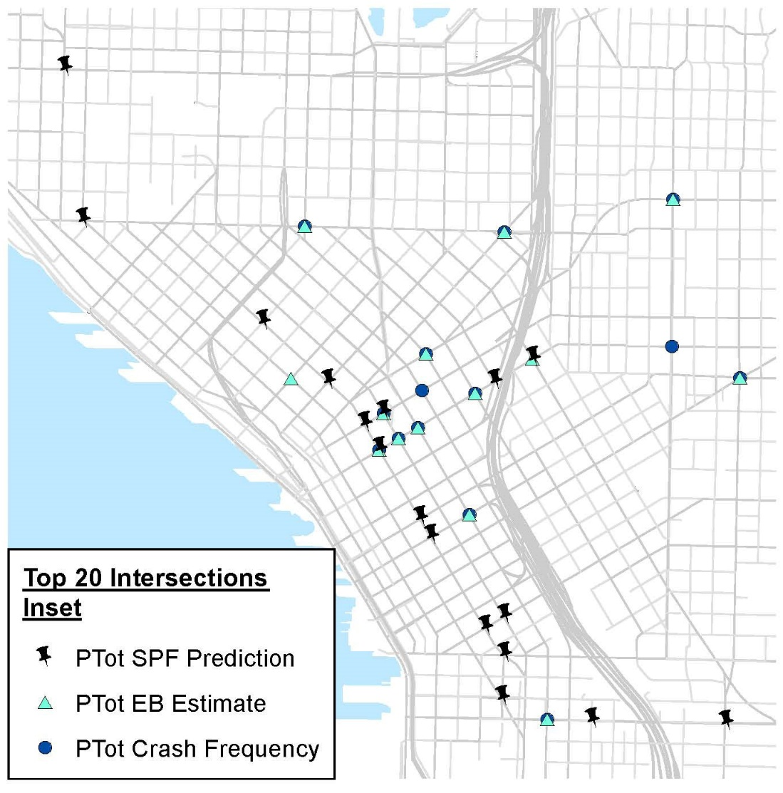
Options for Performing Network Screening / Ranking
Iterative screening and ranking methods possible
SPF-derived ranking metrics (if available) are useful for prioritization
Background | Project Description | Guidebook Overview | Conclusions
Notes:
If SPFs or other crash estimates are developed through modeling:
An agency may also rank sites first by SPF-prediction and/or EB-estimates, then identify common risk factors (among those significant in the model) for higher ranking sites.
Regardless of which ranking method is used first, SPF-derived ranking metrics (SPF-prediction or EB-estimates) are useful for prioritization since they account for all the model-identified risks to help identify locations that might be most likely to experience crashes within a given time frame.
From Case Example 1: “However, due to the data limitations, further field diagnoses were carried out at highly-ranked sites to further diagnose the potential conflicts and risks. For example, traffic volume and unrestricted turning movements were identified as a risk factors for many of the signalized intersections.”
“The City is pursuing a mix of local and state Highway Safety Improvement Program funds to help implement leading pedestrian intervals (LPIs) at around 150 intersections—about 50 per year over the next few years. The City has used observed crashes to prioritize about 35 locations, and with the state’s approval, is using the crash prediction estimates (EB estimates) derived from the SPFs to justify about 115 others.”
Image from Thomas et al. 2017 – inset of map of high predicted crash locations (SPF predicted and EB estimated) compared to crash frequency crash locations.
Image: Thomas et al. 2017

Slide 26
Step 5: Select Countermeasures
Criteria for selecting countermeasures:
  Relation to systemic program focus or target crash types or locations
  Safety effectiveness
  Cost (initial + maintenance)
  Feasibility of systemic implementation
Countermeasure selection process:
  Iterative process to match treatment sites (i.e., exhibiting focus risk factors or crash types) with potential countermeasures
  Perform diagnosis at proposed treatment sites to confirm
Background | Project Description | Guidebook Overview | Conclusions
Notes:
From the Guidebook:
5.1 Establish a framework for selecting countermeasures
Relation to systemic program focus or target crash types or locations
Safety effectiveness – crash based (CMFs) or significant other evidence
Cost – “Cost is a concern for systemic safety measures…. Absolute cost should not necessarily over-ride cost-effectiveness…”
Feasibility—The feasibility of implementing countermeasures on a systemic basis.

Slide 27
Step 5: Select Countermeasures
12 recommended countermeasures provided in detail in Appendix:
Signalized or Unsignalized crossing locations (including midblock) | Unsignalized locations only (midblock or intersection) | Signalized Intersections only (or signal is added)
High visibility crosswalks | In-Roadway Yield-to-Pedestrian (R1-6) sign | Leading pedestrian interval
Traffic calming (raised devices) | Advance Stop/Yield Bars and R1-5/5a Sign | Longer pedestrian phase
Median crossing island | Pedestrian Hybrid Beacon | Restricted left turn
Reduce number of lanes / road diet Curb extension and parking restriction
Location-specific lighting improvement
Background | Project Description | Guidebook Overview | Conclusions
Notes:
Table 13 in the Guidebook provides an initial list of countermeasures identified with potential.
Match the potential countermeasures to the focus crash types, identified pedestrian crash risks, and corresponding location types.
Additional tables provide information on countermeasures relations to crash types, risk factors and location types (Table 15); and Application context (e.g. traffic and speed conditions; Table 16),

Slide 28
Step 5: Example
Notes:
An example showing how risk factors used to help identify potential countermeasures is provided– using results from prior steps. Table 14 in Guidebook.
Next Slide:
Refine the list of sites and appropriate countermeasures based on community priorities, additional diagnoses, treatment costs, and expected safety benefits for the intended degree of application system-wide.
Current information on safety effectiveness is also provided (Table 1, Step 5 ).

Slide 29
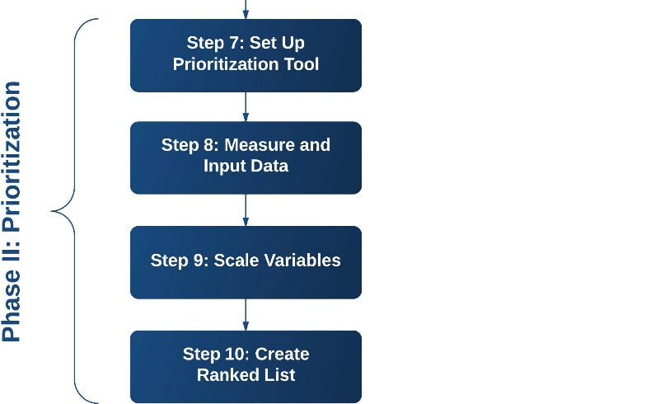
Step 6: Refine and Implement Treatment Plan
Provides guidance and supplemental resources for:
  Considering additional community priorities;
  Performing additional diagnostics;
  Performing economic assessments; and
  Allocating funding.
Example Prioritization Tool: ActiveTrans Priority Tool Guidebook (Lagerwey et al. 2015)
Example economic analysis tool from ODOT (Siddique et al. 2017)
Background | Project Description | Guidebook Overview | Conclusions
Notes:
The CMF Clearinghouse, Highway Safety Manual and other resources detail how to perform traditional cost-benefit analyses.
An example is provided in Table 18 of the Guidebook.
A systemic approach can make use of expected crash reductions across all proposed treatment sites to justify funding. Some agencies have:
Bundled high risk sites with similar high crash sites for economic assessment and treatment (see Case Example 3); or
Used predicted crashes from SPFs to estimate crash savings and make final prioritizations (see Case Example 2).
Other prioritization considerations may be derived from other plans, safety objectives, or community priorities. ActiveTrans Prioritization Tool and NCHRP Report 803, Pedestrian and Bicycle Transportation Along Existing Roads—ActiveTrans Priority Tool Guidebook is available to assist with completing a prioritization process, using risk-based weighting factors, as well as these other types of community prioritization factors.
Top image: Lagerwey et al. 2015

Slide 30
Step 7: Evaluate Projects and Process
  Evaluate the program - Process evaluation
    Implementation
    Barriers/data needs
Evaluate projects – Safety evaluation
  Across all sites
  Crashes (preferred) or surrogate measures (e.g., speed, yielding, conflicts)
    Renew the process
      Improve data
      Update analyses
      New screening/ranking
Background | Project Description | Guidebook Overview | Conclusions

Slide 31
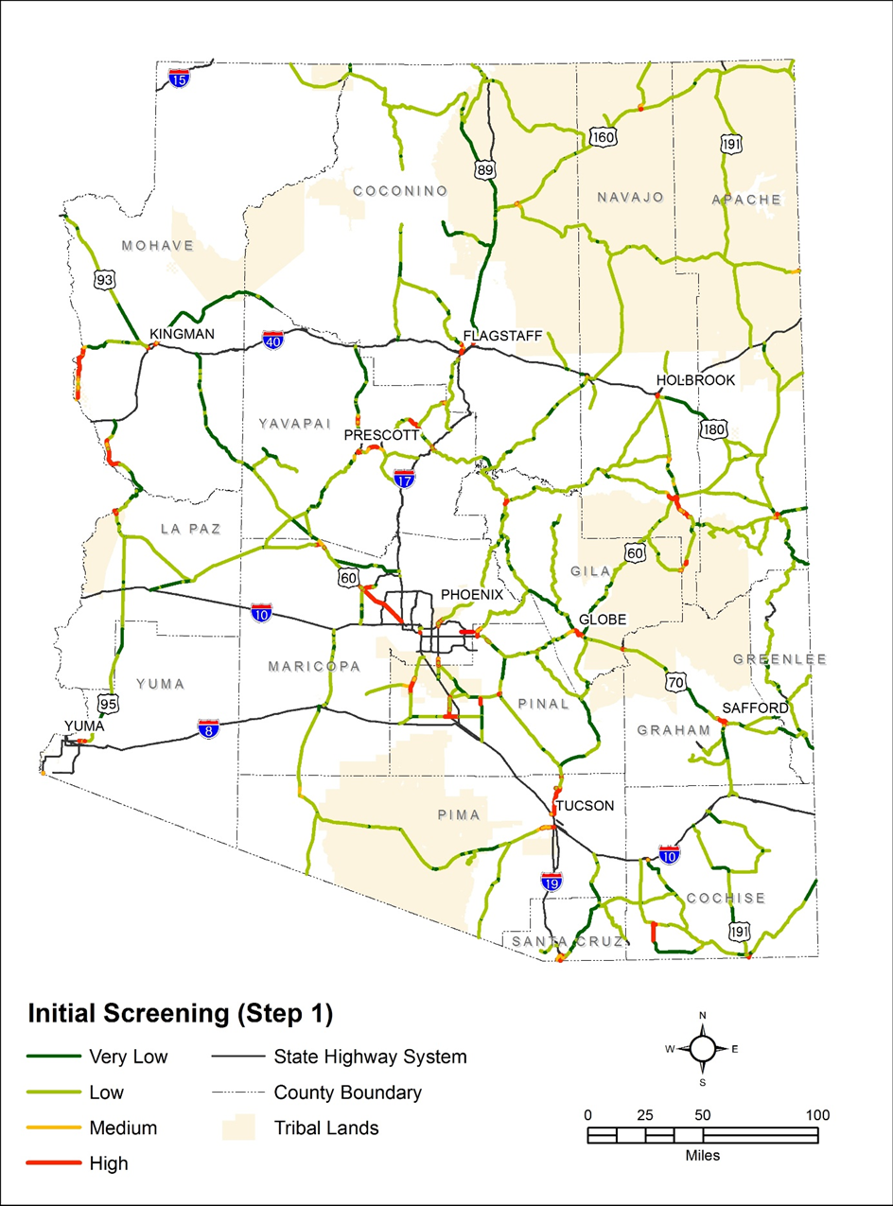
Examples with Key Takeaways
Seattle DOT
Oregon DOT
Arizona DOT
California DOT (Caltrans)
Preliminary Identification of High-Risk Segments (ADOT 2017).
Background | Project Description | Guidebook Overview | Conclusions
Notes:
Image: Kimley-Horn 2017

Slide 32
Conclusions

Slide 33
Limitations and Considerations
Recognition that limited data is a primary obstacle to implementing a robust systemic safety analysis process
Limited data on behavior-based risk factors or examples in practice
Limited research or evaluation of Steps 6-7 in practice
CMFs for treatments applied systemically may differ from those applied based on crash history
See Final Report for more rationale, caveats, and considerations
Background | Project Description | Guidebook Overview | Conclusions

Slide 34
Interagency Collaboration Opportunities
Continued work to improve data: coverage, quality, standardization, timeliness, and spatial linkage
  Pedestrian and motor vehicle traffic counts & volume estimation
Build training/skills, tools, methodologies for developing SPFs for different contexts
Conduct systemic countermeasure evaluations
Background | Project Description | Guidebook Overview | Conclusions
Notes:
Agencies within a state or region may collaborate to address these types of issues.

Slide 35
Future Research Needs
Research/guidance on how to better measure and account for individual- or behavior-based risk factors, such as motorist speed or pedestrian behaviors
Further evaluation of the safety impacts of treatments in systemic applications
Pooled sources of data or research to help quantify risk factors that are more generally applicable to many jurisdictions
Studies evaluating the safety impacts of systemic vs. traditional (e.g., hotspot) approaches
Background | Project Description | Guidebook Overview | Conclusions

Slide 36
NCHRP 17-73 Contacts
Project Team:
Laura Sandt, Libby Thomas, Charlie Zegeer, Wesley Kumfer, Katy Lang, Bo Lan, Krista Nordback
Highway Safety Research Center, University of North Carolina – Chapel Hill, Chapel Hill, NC
Casey Bergh, Andrew Butsick, Zachary Horowitz, Bastian Schroeder, Joseph Toole
Kittelson & Associates, Inc., Portland, OR
Robert J. Schneider
University of Wisconsin-Milwaukee, consultant
NCHRP Program Officers:
Lori Sundstrom and Ann Hartell
Background | Project Description | Guidebook Overview | Conclusions

Slide 37
NCHRP Research Report 893
For more information see NCHRP Research Report 893: Systemic Pedestrian Safety Analysis (NCHRP Project 17-73) http://www.trb.org/Main/Blurbs/178087.aspx

