Slide 1
NCHRP 20-112 Health and Transportation Research Roadmap
Final Presentation

Slide 2
Presentation Overview
Background
Project Activities
Goals, scope, tasks, and deliverables
Research Roadmap
Conclusions

Slide 3
Background
World Health Organization (WHO) offers a basic definition of health: a "state of complete physical, mental and social well-being and not merely the absence of disease or infirmity.”
Transportation infrastructure and services, and related policies and designs, have been identified as a key factor influencing or determining health status.
Background | Project Activities | Key Findings | Research Roadmap | Recommendations

Slide 4
Pathways to Health
Health domains relevant to DOTS
Background | Project Activities | Key Findings | Research Roadmap | Recommendations
Notes:
We asked numerous interviewees what they meant when they talked about health, and we reviewed many studies and gray literature to see what was considered in/bound or not. We found that 5 key topics were consistently described:
Access – easy/affordable access to destinations (including schools, jobs, healthcare, healthy foods)
Active travel/physical activity
Community – a number of agencies spoke to the role of transportation agencies in supporting broader quality of life, community well-being, cohesion, and talked about ways that they were going about measuring this, including looking at traffic stress, mental health, affordability, etc.
Exposure to environmental risk (noise, air, water quality)
Safety
Later in the project, we began to see some studies and comments emerge around resiliency, and we heard from Departments of Transportation (DOTs) that there may be an interest in seeing how sustainable infrastructure can be integrated into recovery plans. This topic came up a bit later in our review process than the others and was not part of the original set of health areas we included in the survey or lit review, but we determined that it was within scope and so it is woven into some sections of the Final Report.
Recognizing these six (somewhat inter-related) domains in which transportation agency practices can influence health helped us early in the project to both define and expand the breadth of the literature we included in the search for materials to inform research needs.

Slide 5
Project Goals and Scope
Develop a holistic and strategic research roadmap providing a broad overview of highly relevant research needs at the intersection of transportation and public health in the United States.
Identify evidence to support practical and useful information, and implementable tools, for state DOTs and partners.
Background | Project Activities | Key Findings | Research Roadmap | Recommendations

Slide 6
Project Deliverables
10-year strategic roadmap
Six specific Research Problem Statements
Communications/implementation plan
PowerPoint slides
Technical report
Database of literature (not required but provided upon request)
Background | Project Activities | Key Findings | Research Roadmap | Recommendations

Slide 7
Guiding Principles and Priorities
Focus on State DOT practices/interests/needs
Also serve: regional/local agencies and health practitioners
Priorities of the panel:
Emphasize active travel, community, access, and equity
Lower priority: traditional DOT areas of work and research (safety and environmental impacts on health)
Background | Project Activities | Key Findings | Research Roadmap | Recommendations
Notes:
Priorities we heard in our kick off call and with subsequent feedback from our panel members.

Slide 8
Project Activities
Literature collection, tagging, review, and synthesis
Stakeholder identification and interviews
Draft outline of strategic research roadmap (revised with panel input)
Panel review/prioritization of needed research problem statements
Additional stakeholder input on research problem statements
Development of draft and final deliverables
Background | Project Activities | Key Findings | Research Roadmap | Recommendations

Slide 9
Literature Review Process
300+ research articles referenced in Final Report
30+ Institutional and agency reports
Including committee/task force reports
State of practice/case studies and other gray literature
12+ Strategic plans
From agencies including USDOT/FHWA, EPA, DHHS, National Institute on Aging, NIH, and Step It Up! The Surgeon General’s Call to Action to Promote Walking and Walkable Communities
42+ TRB Research Needs Statements and Research in Progress records
Background | Project Activities | Key Findings | Research Roadmap | Recommendations
Notes:
Research team members searched, gathered, and screened potentially relevant studies, agency reports, and strategic research agendas. More than 300 articles were considered relevant and were referenced in the Final Report. The team also collected health-related research needs statements.
Search terms: 50+ terms
Sources: TRID, RNS, RiP, PubMed, Cochrane Library, Articles+, individual websites, Google and Google Scholar, works cited/reference lists
Literature screening and tagging:
Systematic review of abstracts by multiple team members
Identification of priority and secondary articles
Tagging of key topics (for cross referencing with health domains/outcomes, transportation processes, study types)

Slide 10
Stakeholder Engagement
Federal, state, and local stakeholders with various geographies/roles:
Rural and urban states and cities
Planning or analysis, policy, engineering design, program evaluation, etc.
Staff in transportation agencies and also some in public health
TRB committee members and researchers
CDC and USDOT
Identified by:
Role in prior health and transportation related efforts or research
Referrals made by other stakeholders interviewed
Pre-interview questionnaire
Background | Project Activities | Key Findings | Research Roadmap | Recommendations
Notes:
We conducted 22 interviews with individuals or small groups, from:
State agencies:
Massachusetts Department of Transportation
Florida Department of Transportation
California Department of Transportation
North Carolina Department of Transportation
Iowa Department of Transportation
Oregon Department of Public Health
Minnesota Department of Public Health
City or regional agencies:
Arlington County, VA
Kane County, IL
Washington County, OR
Delaware County, PA
San Francisco Department of Public Health
Centralina Council of Governments (Charlotte, NC, region).
Columbus, IN
LA Metro (the Los Angeles, CA Transit Authority)
Members of TRB’s Health and Transportation Subcommittee
Members of TRB’s Arterials and Health Task Force
USDOT Office of Secretary
CDC (including representatives from physical activity, policy, and injury prevention branches)
Private consulting firms (working with municipalities on transportation plans and projects)

Slide 11
Findings: Existing Research
Wealth of research showing health impacts of transportation infrastructure and policies
Large body of literature on Health Impact Assessments (HIAs) as a tool to consider health impacts in transportation and other projects
Many studies to document the development and evaluation of health-related policies, plans and programs:
Complete Streets
Vision Zero
Health in All Policies
Safe Routes to School
Background | Project Activities | Key Findings | Research Roadmap | Recommendations

Slide 12
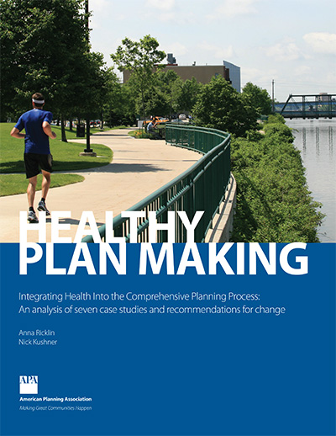
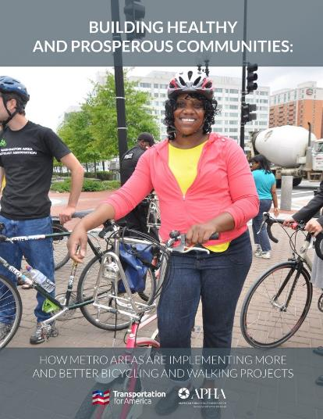
Findings: Existing Resources and Guidance
Many reports and case studies have shown discrete examples of transportation and health agency collaborations, policies, and practices
Background | Project Activities | Key Findings | Research Roadmap | Recommendations

Slide 13
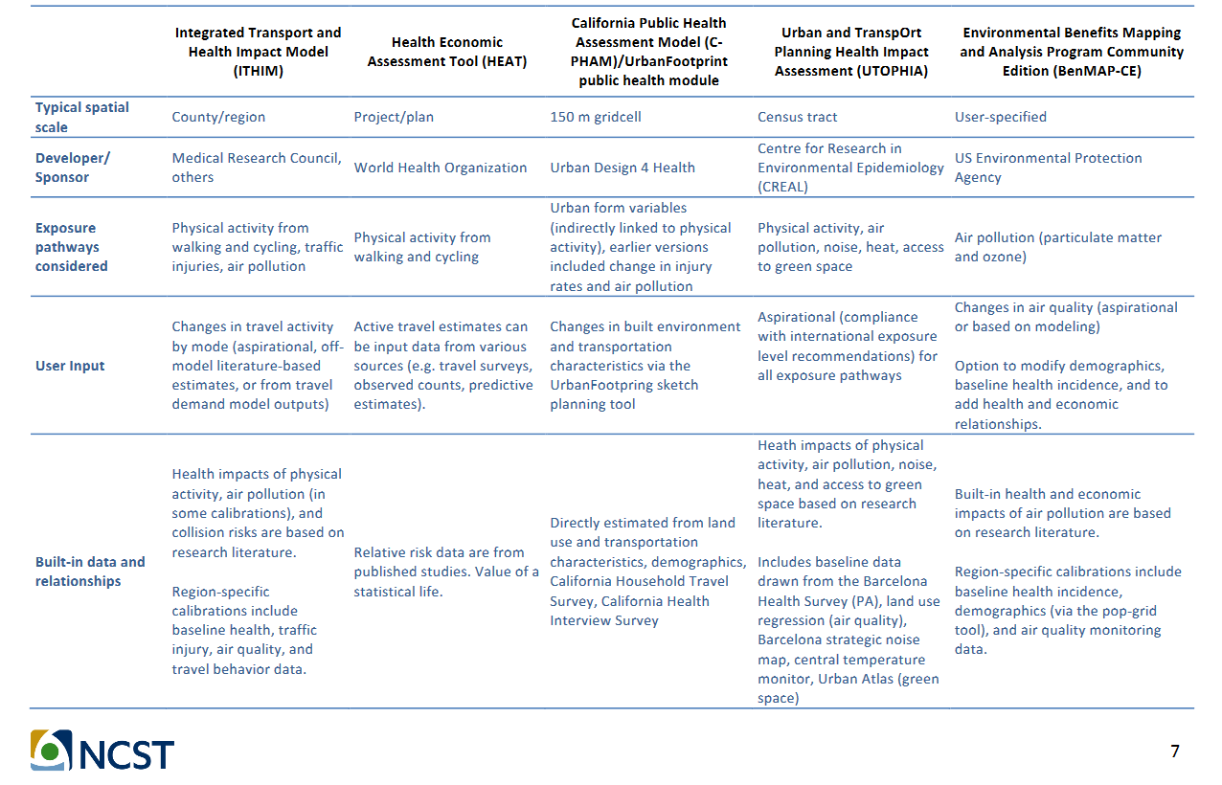
Findings: Existing Tools
Table 1
Comparison of Commonly Employed Tools for Assessing the Health Impacts of Transportation Plans
Source: National Center for Sustainable Transportation, https://regionalchange.ucdavis.edu/sites/g/files/dgvnsk986/files/inline-files/NCST-TO-033.3-London_ITHIM_Final-Report_OCT-2017.pdf
Background | Project Activities | Key Findings | Research Roadmap | Recommendations

Slide 14
Findings: Existing Practices
Many innovative approaches to institutionalize health considerations in transportation agency processes and practices:
Executive or legislative mandates and policy approaches
Intra-department and intra-agency collaboration and staffing agreements
Data integration and sharing
Applying health decision-making tools in various transportation processes
Setting health performance targets and measuring outcomes
Pilot-testing new technologies in transit projects
Health and physical activity data collection, including ped/bike counts and travel surveys as well as qualitative methods
Background | Project Activities | Key Findings | Research Roadmap | Recommendations

Slide 15
Findings: Emerging Issues
Less-well documented in the research are issues related to the health impacts and transportation best practices surrounding:
Micromobility travel modes (e.g., electric kick/standing scooters)
Highly automated vehicles
Population-level demographic shifts and related changes in travel behaviors
Rising incidence of opioid use/abuse and mental health issues
New technology related to transit and shared mobility services
Access to healthcare and physical activity opportunities in rural settings
Big data access, management, and analytics to support decision-making
Background | Project Activities | Key Findings | Research Roadmap | Recommendations

Slide 16
Findings: General Knowledge and Research Gaps
Lack of basic resources for transportation and health practitioners to use to build a common understanding of key terminology and respective processes (aka, health in transportation literacy)
Lack of data fundamental for research or practice
Lack of research to develop models and decision-making tools
Lack of practitioner-oriented guidance on implementing research or best practices
Or, in some instances, guidance/examples are available but under-utilized
Lack of understanding of where approaches are applied and documentation of current and best practices
Or, lack of examples from diverse contexts (e.g., rural areas)
Background | Project Activities | Key Findings | Research Roadmap | Recommendations

Slide 17
Findings: Topic Specific Research Gaps (Selected)
Evaluations of health outcomes related to transportation pricing and policy measures intended to decrease auto-dependency
Enhanced data, methods, and metrics for measuring “accessibility,” community “well-being,” and equity
Data and methods for quantifying health related costs and benefits
Research examining the role of transportation projects in relation to housing affordability and health equity
“Resiliency” and recovery practices
Background | Project Activities | Key Findings | Research Roadmap | Recommendations

Slide 18
Findings: Topic Specific Research Implementation Gaps (Selected)
Lack of best practices, challenges, and lessons in:
Collecting and analyzing non-fatal injuries involving active travel modes
Institutionalizing practices for collection and integration of active travel data (such as counts, trip-making)
Aligning policies and performance measures with health and equity goals
Applying tools and checklists to consider health during project scoping and project development
Background | Project Activities | Key Findings | Research Roadmap | Recommendations

Slide 19
Research Roadmap
Framed around key transportation agency processes and practices
Community Engagement / Data Integration
Public involvement | Coordination with local, regional, and tribal governments
Data Collection | Performance metrics
Policy-making Vision and/or Mission Statewide multimodal transportation plan Agency guidance | Planning Long-range plans Mode-specific plans Corridor studies Scenario plans Small area plans | Capital programs, projects and implementation Project evaluation Project selection Environmental assessment | Monitoring and Evaluation Design review and comparison Construction Operation Maintenance
Background | Project Activities | Key Findings | Research Roadmap | Recommendations

Slide 20
Research Problem Statement Topic Identification
Panel ranked gaps based on urgency and magnitude of the problem
Project team scored specific “needs” to fill gaps based on:
Practicality
Innovation
Scalability
Equity addressed
Health outcomes addressed
Transportation modes addressed
High ranking “needs” within priority “gap” areas were selected for development.
Background | Project Activities | Key Findings | Research Roadmap | Recommendations

Slide 21
Research Problem Statement Topics Developed
Synthesis of Best Practices for Including Health Outcomes in Transportation Project Prioritization
Data Sources for Establishing Health Outcome Performance Measures for Transportation Projects
Practices and Recommendations in Reporting and Integrating Pedestrian and Bicycle Non-Fatal Injury Data Systems
A Guidebook for Considering the Public Health Impacts of Public Transportation Decisions
Effect of Demographic Change on Travel Behavior and Health
Evaluating and Integrating Emerging Data Sources to Support Transportation and Health Planning and Operations
Background | Project Activities | Key Findings | Research Roadmap | Recommendations
Notes:
In the research problem statements, many include research objectives or sub-tasks that focus on equity issues. As we mentioned in slide 20, equity was a primary consideration used to prioritize research gaps, so nearly all the projects touch on some element of transportation or health equity. In particular, three projects focus explicitly on equity: Number 7 aims at developing health equity performance measures; Number 8 looks at how disparities in rural population health can be addressed through improved trail network development and coordination; and Number 10 focuses on research to understand the needs of older adults and address disparities in meeting those transportation needs.

Slide 22
Implementation Plan: Call to Action
Share project deliverables widely:
AASHTO committee mid-year meetings
TRB Executive Committee members
TRB Health and Transportation Subcommittee
Upcoming conferences related to health and transportation
Utilize TRB committees (particularly Health and Transportation Subcommittee) to regularly revisit roadmap and advance or update research problem statements
Identify state-level champions involved with AASHTO committees
Identify NGO, regional/local, and university-based supporters as well
Background | Project Activities | Key Findings | Research Roadmap | Recommendations

Slide 23
Potential End Users and Champions
AASHTO and TRB: Standing Committee on Environment (SCOE), Standing Committee on Planning (SCOP), subcommittee on performance measurement, and Standing Committee on Highway Traffic Safety (SCHOTS), Active Travel Council, and TRB committees/liaisons
State DOT and MPO Research and Data Program Managers
Federal agencies: USDOT (FHWA, NHTSA, FTA, OST), CDC, and EPA
UTCs: CARTEEH (Tier 1, air quality/environment), Collaborative Sciences Center for Road Safety (National, safety), and National Institute for Transportation and Communities (National, mobility), National Center for Sustainable Transportation (National, environmental preservation)
Member organizations: APA, NACCHO, APHA , ITE Health Task Force
Foundations and other organizations: Robert Wood Johnson Foundation/Convergence Partnership, Center for Neighborhood Technology, key NGOs, etc.
Background | Project Activities | Key Findings | Research Roadmap | Recommendations

Slide 24
Project Team Members
Laura Sandt (PI), Alyson West, Kristen Brookshire, Meg Bryson, Sarah Johnson, Kelly Evenson, Jackie MacDonald Gibson |  | Lauren Blackburn, Kara Peach, Margaret Tartala, Curtis Ostrodka |  | Anna Ricklin, Sagar Shah
Independent Consultants: Daniel A. Rodriguez, Jason Corburn
For more information, please contact Laura Sandt at sandt@hsrc.unc.edu

