Slide 1
NCHRP Project 17-77
Guide for Quantitative Approaches to Systemic Safety Analysis
Summary of Project Findings and Future Research Needs
Notes:
This presentation presents the research conducted under NCHRP Project 17-77: Guide for Quantitative Approaches to Systemic Safety Analysis.

Slide 2
Outline
Introduction
Safety Management Approaches
Systemic Safety Management in Depth
Selecting Appropriate Systemic Approach and Software Tool
Systemic Safety in Use (Best Practices)
Summary of Systemic Safety Management Approach
Primary Products of Research
Future Research Needs
Notes:
An outline of the presentation is as follows:
Introduction to the Research
Safety Management Approaches
Systemic Safety Management in Depth
Selecting the Appropriate Systemic Approach and Software Tool
Systemic Safety in Use (Best Practices)
Summary of Systemic Safety Management Approach
Primary Products of Research
Future Research Needs

Slide 3
Introduction
12/11/2020

Slide 4
Background
Focusing safety treatments on “hot spot” locations has limitations:
  Short-term crash counts can fluctuate
    Not good predictor of future crashes
    Regression to the mean
  Severe crashes tend to be spread out across system
  Most money is spent at only a few locations
  Hot-spot analysis is reactive
Notes:
Highway agencies have traditionally managed their highway safety improvement process by identifying and correcting high-crash locations (“hot spots”). However, this approach has several limitations:
Short-term crash counts can fluctuate substantially.
Short-term crash history is not necessarily a good predictor of future crashes. Many short-term crash patterns may not recur, even if no improvement is made (i.e., regression to the mean effect).
Most severe crashes tend to be spread out across the system.
More money is spent on a few locations (often focuses safety investments at urban locations where multiple crashes in a short period occurred due to random chance).
Hot-spot analysis is reactive in nature as individual sites are identified for potential safety improvement only after having a documented crash history.

Slide 5
Background
Agencies seek complement to crash-history-based safety management approach (i.e., hot-spot analysis)….
Systemic Safety Management:
  More proactive
  Solutions that address more locations
  Strategies address crash types spread across system
Notes:
As a complement to their crash-history-based safety management approach, some highway agencies have incorporated a systemic safety management approach within their Highway Safety Improvement Program (HSIP) and other safety programs.
The systemic safety management approach is proactive in nature as sites can be prioritized for safety improvements even if they do not have a history of crashes. It utilizes either crash prediction models or rating systems to prioritize opportunities to reduce crashes.
It implements proven safety treatments, primarily low cost, across a large number of sites to reduce crash potential.

Slide 6
Objectives and Scope
Objective—Develop guide and training materials to assist state DOTs, MPOs, local agencies, and other safety practitioners to better understand, use, and implement quantitative approaches to systemic safety analysis
Scope—
  Define quantitative approaches to systemic safety and distinguish from other safety management approaches
  Communicate benefits of systemic safety analysis
  Review existing tools and resources
    Data needs
    Capabilities
    Appropriate applications
  Recommend methods for evaluating results
  Identify best practices
Notes:
The objectives of NCHRP Project 17-77 were to develop a guide and training materials to assist state departments of transportation (DOTs), metropolitan planning organizations (MPOs), local agencies, and other safety practitioners to better understand, use, and implement quantitative approaches to systemic safety analysis.
The scope involved:
Define quantitative approaches to systemic safety analysis and distinguish them from other approaches for identifying safety improvements such as the traditional crash-history-based (e.g., “hot-spot”) and policy-based approaches
Communicate the benefits of quantitative approaches to systemic safety analysis for identifying safety improvements
Provide a review of existing methods and tools to conduct quantitative approaches to systemic safety analysis, including the FHWA Systemic Safety Project Selection Tool, U.S. Road Assessment Program software (usRAP Tools and ViDA), and AASHTOWare Safety Analyst, addressing:
Data needs, capabilities, and appropriate applications
Recommend or develop methods that agencies may use to evaluate the results (i.e., safety impacts) of improvements implemented using quantitative approaches to systemic safety analysis
Identify best practices through case studies

Slide 7
Safety Management Approaches
12/11/2020
Notes:
This section presents the six primary steps of the roadway safety management approach described in Part B of the HSM.
This section also describes the three primary approaches to roadway safety management:
The Crash-History-Based Safety Management Approach
The Systemic Safety Management Approach
The Policy-Based Safety Management Approach

Slide 8
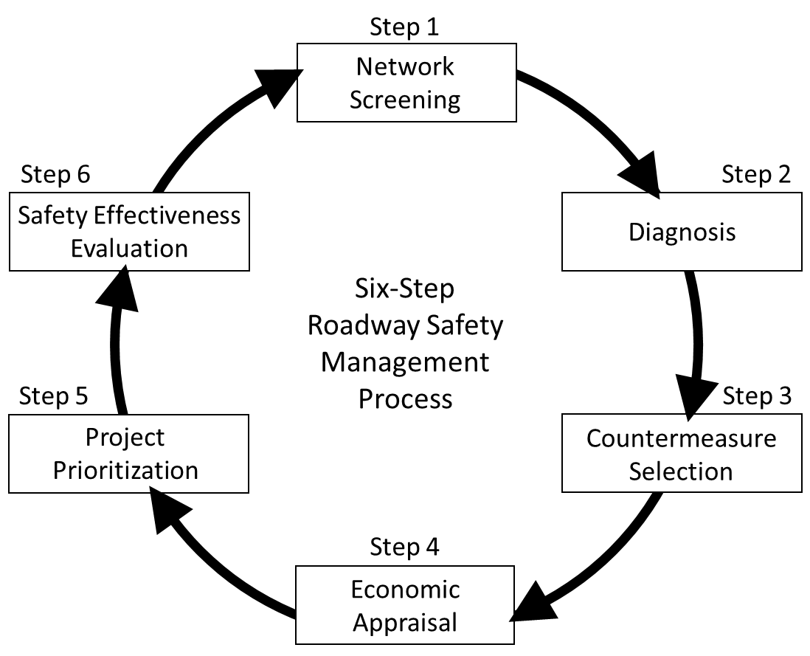
Six-Step Safety Management Process (HSM)
Notes:
Part B of the Highway Safety Manual (HSM) presents a six-step safety management approach that can be generalized to apply to any safety management approach. Many agencies follow these general steps for programming safety improvement projects; the inputs and outputs for each step vary based on the safety management approach employed. Generally, the six-step process helps agencies develop a prioritized list of safety improvement projects (both treatments and implementation locations) and then evaluate the effectiveness of the projects or treatments in reducing crash frequency and/or severity. The six steps include:
Network screening
Diagnosis
Countermeasure selection
Economic appraisal
Project prioritization
Safety effectiveness evaluation
This generalized six-step process is used here as a framework for comparing differences in the three primary roadway safety management approaches:
The Crash-History-Based Safety Management Approach
The Systemic Safety Management Approach
The Policy-Based Safety Management Approach

Slide 9
Crash-History-Based Safety Management Approach
Purpose: Identify locations on system where high frequency or rate of crashes has occurred and to improve those sites to remedy the situation
Identifies locations with high crash experience
Requires reliable crash data with location information
Performance measures:
  Observed crash frequencies and/or rates
  Expected and/or excess crash frequencies
  Level of service of safety (LOSS)
Goal is to reduce crash patterns of interest that occur with high frequency at individual locations
Notes:
The purpose of the crash-history-based safety management approach, sometimes referred to as a “black-spot” or “hot-spot” analysis, is to identify locations on the system where a high frequency or rate of crashes has occurred and to improve those sites to remedy the situation.
The crash-history-based safety management approach requires high-quality crash data with accurate location data throughout the roadway network.
Crash experience may be estimated based on traditional performance measures—such as observed crash frequencies, observed crash rates, or equivalent property damage only (EPDO) observed crash frequencies—or other performances measures considered more statistically reliable (as described in the HSM)— such as level of service of safety (LOSS) or expected and excess crash frequencies.
The goal is to reduce crash patterns of interest that occur with a high frequency at individual locations, and to do so at sites with the highest overall crash experience.
This approach can be used to address a particular crash type, but it does not necessarily have to.

Slide 10
Crash-History-Based Approach Benefits and Limitations
Benefits:
  Focuses resources at sites with crash history
  Treatments tailored to crashes at individual sites
  Addresses wide range of safety conditions and tradeoffs using quantitative and logical process
Limitations:
  Sites need crash history before improvements are made
  May be addressing crashes that would not occur again (i.e., regression to the mean)
  Higher cost treatments limit number of improved sites
  Difficult to address crash types dispersed across system
Notes:
The benefits of a crash-history-based safety management approach include the ability to:
Focus funds where there is a documented crash history
Identify treatments that address the specific crash patterns at each site
Tailor treatments to the specific characteristics of the locations
Address a wide range of safety conditions and tradeoffs using a quantitative and logical process
Potential limitations or disadvantages associated with the crash-history-based safety management approach include:
Crashes must occur at a site before an improvement is made
Safety improvements may be made at sites to remedy specific crash types that may not occur again, even if no improvements are made
Implementation of higher-cost safety improvements at a limited number of sites may not effectively reduce crash frequency across the network
Crash types that occur frequently, but are dispersed across the network, may not be effectively addressed

Slide 11
Systemic Safety Management Approach
Purpose: Be more proactive in programming safety improvements and address crash types not well suited for remedy using crash-history-based safety management approach by widely implementing low-cost countermeasures
Works well for highly-dispersed crash types:
  Lane departure
  Rollover
  Fixed object
  Speed-related
Performance measures are expected future crashes, based on presence/absence of site characteristics associated with certain crash types or crash prediction models
  Impaired driving
  Young/elderly driver involved
  Pedestrians
  Bicyclists
  Nighttime
Notes:
The purpose of the systemic safety management approach is to be more proactive in programming safety improvements and to address specific crash types not well suited for remedy using a crash-history-based safety management approach by widely implementing primarily low-cost countermeasures.
Some of the specific crash types that agencies have focused on when implementing systemic safety management procedures include:
Lane departure
Rollover
Fixed object
Speed-related
Younger driver involvement
Impaired driving
Pedestrians
Bicyclists
Nighttime
The network screening step in a systemic safety management approach generally uses one of two methods to prioritize sites for potential safety improvement. With one method, crash prediction models or safety performance functions (SPFs) are used to calculate predicted and/or expected crash frequencies of target crash types. With the second method, a rating system is developed to represent crash potential at sites within the network. Crash potential is generally assessed by identifying crash contributing factors present/absent at each site.

Slide 12
Systemic Safety Approach Benefits and Limitations
Benefits:
  Can be applied in absence of high-quality crash data
  Proactive
  Program projects further into future based on site characteristics that do not change year to year
  Easier to more equally distribute funds regionally
  Adaptable based on available data
Limitations:
  Software tools can be expensive, data intensive, or require substantial training or resources
  Process for evaluating benefits not well understood
  Staff may be reluctant to spend resources at sites with no crashes
Notes:
The potential benefits of implementing a systemic safety management approach include:
This approach can be used in the absence of high-quality historical site-level crash data.
This approach is proactive because countermeasures can be programmed for implementation at locations that may not have a history of crashes.
This approach provides the ability to program projects further into the future as projects can be based on the presence or absence of crash contributing factors (i.e., roadway characteristics) that do not change frequently from year to year.
With this approach, it is easier to more equally distribute safety funds regionally or across jurisdictions compared to programming safety improvements based solely on a crash-history-based safety management approach.
This approach is adaptable based on available data.
The potential limitations or disadvantages associated with the systemic safety management approach include:
Available software that can be used for quantitative systemic safety analyses is used on a limited basis either because it is considered expensive, data intensive, or agencies do not invest the time and resources to collect the necessary data for use with the software.
The process for evaluating the benefits of a systemic safety management approach is not well understood.
Staff may be reluctant to incorporate a systemic safety management approach within their safety management procedures because it deviates from the traditional crash-history-based safety management approach (i.e., hot-spot analysis) and may be reluctant to treat sites without crashes.

Slide 13
Policy-Based Safety Management Approach
Purpose: Bring design or operational features of sites up to specified standard or policy
Applies proven countermeasure to all sites on system where treatment is relevant:
  Does not require detailed crash data for all sites
  Primarily low-cost treatments
  Implementation can be done by incorporating into other scheduled projects (reducing costs)
Economic analyses are often not performed
Notes:
The purpose of the policy-based safety management approach is to bring design or operational features of sites up to a specified standard or policy. The policy-based safety management approach is intended to reduce both liability and crash potential.
After a countermeasure has been shown to effectively reduce crashes, agencies may develop a policy to implement the countermeasure as part of their regular design, construction, operations, and maintenance programs, including new construction and reconstruction. The agency may also choose to improve existing facilities for safety purposes only. Implementing a policy-based approach does not require detailed crash location data for all sites. In most cases, it involves the implementation of low-cost treatments. Detailed economic analyses may not be performed after a policy has been established. Once the policy for treatment implementation has been determined, the agency budgets the necessary funding into future projects as part of construction and/or maintenance costs.

Slide 14
Policy-Based Approach Benefits and Limitations
Benefits:
  Focuses on low-cost, proven treatments
  Can be used where crash data are not available
  Proactive
  Easily understood
  Implementation costs may be less when incorporated into programmed projects
Limitations:
  May take years to fully implement
  May be viewed as increasing construction/maintenance costs
  Resources may not be allocated efficiently to address sites with greatest potential for crash reduction first
Notes:
The potential benefits of implementing a policy-based safety management approach include:
Countermeasures proven to effectively reduce crashes are implemented.
This approach can be used in the absence of high quality historical site-level crash data.
This approach is proactive because countermeasures can be programmed for implementation at locations that may not have a history of crashes.
This approach is easily understood.
Implementation costs may go down when installation is programmed into scheduled construction and maintenance projects, eliminating separate project start-up and traffic control costs.
The potential limitations or disadvantages associated with the policy-based safety management approach include:
It may take years to bring the targeted facility types up to the desired standard/policy.
This approach can be perceived as increasing the total cost of projects by adding countermeasure implementation costs that may not have otherwise been included.
Resources may not be allocated as efficiently as possible because treatments may be implemented at locations with low potential to reduce crashes.

Slide 15
Distinguishing Systemic Safety Management from Other Safety Management Approaches
Sometimes safety management steps are re-ordered where analysis starts with crash type of interest or even countermeasure of interest and then sites are prioritized for addressing that crash type/using specified countermeasure
Network screening generally uses one of two approaches:
  Safety performance functions (or crash prediction models) address specific crash types
  Rating system used to prioritize locations based on presence/absence of features associated with crashes
Diagnosis and countermeasure selection cursory in nature
Notes:
Sometimes safety management steps are re-ordered where analysis starts with crash type of interest or even countermeasure of interest and then sites are prioritized for addressing that crash type, using a specified countermeasure.
The primary factors that distinguish the systemic safety management approach from the crash-history-based and policy-based safety management approaches are conceptual approaches to network screening and diagnosis and countermeasure selection.
Network screening generally uses one of two approaches:
Safety performance functions (or crash prediction models) address a specific crash type
Rating system used to prioritize locations based on presence/absence of features associated with crashes
Target crash types are addressed with the systemic safety management approach so less time and resources are spent on the diagnosis and countermeasure selection steps as some subtasks are no longer necessary or are only cursory in nature due to focusing on particular target crash types and implementation of select countermeasures.

Slide 16
Systemic Safety Management
12/11/2020

Slide 17
Systemic Safety Management Approaches
Application of FHWA Systemic Safety Project Selection Tool
Application of SPFs for systemic safety
Application of usRAP methodology and ViDA software
Notes:
Agencies use a variety of implementation approaches for their systemic safety management programs. Differences in crash data availability, roadway characteristic inventory availability, and scope of the systemic safety program may impact how an agency applies a systemic safety management approach.
In general, agencies have used three approaches to implement systemic safety management:
Application of FHWA Systemic Tool methodology, customized to local data availability and program goals
Application of safety performance functions (SPFs) using in-house tools or Safety Analyst
Application of the usRAP methodology, using the associated ViDA software

Slide 18

Application of FHWA Systemic Safety Project Selection Tool
Notes:
FHWA published the Systemic Safety Project Selection Tool guidance document to outline the systemic safety process and to support agency implementation of the approach.
This section of the presentation focuses on the first element of the Systemic Tool methodology--the systemic safety planning process. This process contains four basic steps:
Identify target crash types and crash contributing factors
Screen and prioritize candidate locations
Select countermeasures
Prioritize projects
Not all applications of a systemic safety management approach follow these steps, so agencies considering using this tool should evaluate whether these steps will help them achieve their desired outcomes.

Slide 19
Application of FHWA Systemic Safety Project Selection Tool (cont’d)
Target crash types and contributing factors
  Options for identifying target crash types:
    Conduct systemwide analysis of crash and/or roadway inventory data
    Refer to state or regional safety plan
  Common crash data elements used to identify target crash types:
Crash Severity Manner of Collision/Collision Impact First Harmful Event Speeding Related | Alcohol Involvement Drug Involvement Light Condition Sequence of Events
Notes:
To begin the systemic safety planning process, target crash types, facility types, and associated contributing factors are first identified. One option for an agency to identify target crash types is by conducting a systemwide analysis of their crash data, and as necessary roadway inventory data.
If an agency conducts a systemwide analysis of their crash data, the crash data elements of interest for identifying target crash types will vary from agency to agency, but several of the common crash data elements of interest across agencies include:
Crash Severity
Manner of Collision/Collision Impact
First Harmful Event
Speeding Related
Alcohol Involvement
Drug Involvement
Light Condition
Sequence of Events

Slide 20
Application of FHWA Systemic Safety Project Selection Tool (cont’d)
Target crash types and contributing factors
  Common target crash types:
    Lane departure
    Rollover
    Fixed object
    Head on
    Angle
  Where are target crash types occurring?
    Common approach is using crash tree diagrams
    Speed-related
    Impaired driving
    Young/elderly driver involved
    Pedestrians/bicyclists
    Nighttime
Notes:
Target crash types commonly identified as being widely dispersed across a network, rather than occurring frequently at specific locations, and often identified as target crash types to be addressed as part of a systemic safety management approach include:
Lane departure
Rollover
Fixed object
Speed-related
Younger driver involvement
Impaired driving
Pedestrians
Bicyclists
Nighttime
Once target crash types are identified, the next step is to identify where the crashes are occurring. To do so, agencies should identify similar facilities and document crash histories and patterns as well as physical and traffic characteristics based on the crash types being considered. A common way of doing this is using a crash tree diagram which provides a visual way of disaggregating crash data by facility attributes, such as jurisdiction, setting (i.e., rural versus urban), intersection versus non-intersection, and more.

Slide 21
Application of FHWA Systemic Safety Project Selection Tool (cont’d)
Target crash types and contributing factors
  Common crash data elements used to identify facility types of interest:
Crash severity Relation to junction Type of intersection Trafficway description Total lanes in roadway Roadway alignment and grade | Roadway functional class Annual average daily traffic Motor vehicle posted/statutory speed limit Width of lane(s) and shoulder(s) Access control
Notes:
The common crash data elements used for generating crash tree diagrams to identify facility types of interest include:
Crash severity
Roadway functional class
Relation to junction
Annual average daily traffic
Type of intersection
Motor vehicle posted/statutory speed limit
Trafficway description
Width of lane(s) and shoulder(s)
Total lanes in roadway
Access control
Roadway alignment and grade
The figure illustrates a sample crash tree diagram of roadway departure crashes by area type, number of lanes, and median type. For this sample diagram, roadway departure crashes are overrepresented on rural two-lane and rural multilane divided highways.

Slide 22
Application of FHWA Systemic Safety Project Selection Tool (cont’d)
Target crash types and contributing factors
  Common target crash types and facility types
Facility Type | Crash Type
 | Run-off-road | Lane-departure | Head-on | Angle | Rollover
Roadway Segments
Rural, two-lane roads on horizontal curve sections | X | X | X |  | X
Rural, two-lane roads on tangent sections | X | X | X | X | X
Intersections
4-leg minor-road stop controlled intersections on rural two-lane roads |  |  |  | X
4-leg minor-road stop controlled intersections on urban, two-lane roads |  |  |  | X
3-leg minor-road stop controlled intersections on rural, two-lane roads |  |  |  | X
4-leg signalized intersections on urban, multilane divided roads |  |  |  | X
4-leg signalized intersections on urban, multilane undivided roads |  |  |  | X
4-leg minor-road stop controlled intersections on rural, multilane divided roads |  |  |  | X
Notes:
The Focus Crash Types and Contributing Factors: Quick Reference Guide provides a list of common target crash type and facility type combinations potentially addressed through a systemic safety management approach based on an analysis of national and state data.

Slide 23
Application of FHWA Systemic Safety Project Selection Tool (cont’d)
Target crash types and contributing factors
  Common target crash
  types and potential
  contributing factors
Target Crash Types | Potential Contributing Factors
Roadway departure | Lane width
 | Shoulder width/type
 | Median width/type
 | Horizontal curvature, delineation, or advance warning devices
 | Superelevation
 | Horizontal curve density
 | Horizontal curve and tangent speed differential
 | Presence of a visual trap at a curve or combination of vertical grade and horizontal curvature
 | Roadway gradient
 | Roadside or edge hazard rating (potentially including sideslope design and frequency of fixed objects)
 | Driveway presence, design, and density
 | Sight distance from access location
 | Presence of shoulder rumble strips
 | Presence of centerline rumble strips
 | Posted speed limit or operating speed
 | Presence of lighting
 | Quality of roadway surface (or pavement condition and friction)
 | Average daily traffic volumes
Rollover | Roadside or edge hazard rating (potentially including sideslope design and frequency of fixed objects)
 | Quality of roadway surface (or pavement condition and friction)
 | Shoulder width/type
 | Median width/type
 | Posted speed limit or operating speed
Notes:
Using historic crash data, the target crash type(s) and facility type(s) are then assessed to identify potential contributing factors that should be considered in the analysis. Analysts look for common characteristics among facilities where crashes have occurred that may correlate to specific road user behaviors or reduced safety performance. Though the correlation between crash types and identified contributing factors does not imply a causal relationship, roadway characteristics are useful for identifying and prioritizing locations which may be expected to perform similarly and for distinguishing locations which may have greater potential for severe crashes based on a systemwide analysis.
This slide provides a sample list of potential contributing factors of two crash types (roadway departure and rollover) commonly addressed using a systemic safety approach. The Guidance Document includes a more extensive table of target crash types and potential contributing factors for use in systemic safety management.

Slide 24
Application of FHWA Systemic Safety Project Selection Tool (cont’d)
Target crash types and contributing factors
  Potential contributing
  factors and associated
  MIRE and MMUCC
  data elements
Contributing Factor | MIRE Data Element | MMUCC Data Element
Roadway Segments
Number of lanes | Number of Through Lanes (FDE) | Total Lanes in Roadway
Lane width | Outside Through Lane Width Inside Through Lane Width | Width of Lane(s) and Shoulder(s)
Shoulder surface width/type | Right Shoulder Type Right Shoulder Total Width Right Paved Shoulder Width | Width of Lane(s) and Shoulder(s)
Median width/type | Median Type (FDE) Median Width | Median Width
Horizontal curvature, delineation, or advance warning devices | Horizontal Curve Degree or Radius | Roadway Curvature Roadway Alignment and Grade
Superelevation | Curve Superelevation | No relevant variable available
Horizontal curve density | No relevant variable available | No relevant variable available
Horizontal curve and tangent speed differential | No relevant variable available | No relevant variable available
Presence of a visual trap at a curve or combination of vertical grade and horizontal curvature | No relevant variable available | No relevant variable available
Roadway gradient | Vertical Alignment Feature Type Percent of Gradient | Grade Roadway Alignment and Grade
Roadside or edge hazard rating (potentially including sideslope design and frequency of fixed objects) | Roadside Clear Zone Width Right Sideslope Right Sideslope Width Left Sideslope Left Sideslope Width Roadside Rating | No relevant variable available
Notes:
This slide presents a sample table of potential contributing factors for roadway segments and specifies the data elements from MIRE and MMUCC related to each contributing factor. Analysts may find these datasets helpful in conducting an analysis of contributing factors.
The Guidance Document includes a more extensive table of potential contributing factors for roadway segments and intersections and associated MIRE and MMUCC data elements for use in systemic safety management.
Descriptive statistics can be generated to compare the proportion of sites where the contributing factors are present with the percentage of crashes occurring at sites where the contributing factors are present for the severity level of interest. Contributing factors found to be overrepresented at locations experiencing crashes should be considered for inclusion in network screening procedures.

Slide 25
Application of FHWA Systemic Safety Project Selection Tool (cont’d)
Screen and Prioritize Candidate Locations
  Screening methodology based on presence/absence of contributing factors
  Methodology can weigh contributing factors equally or assign weights to contributing factors
Countermeasure Selection
  Countermeasures should be:
    Appropriate for target crash and facility types
    Evidence-based
    Low cost
    Provide significant crash reduction
Project Prioritization
  Decision-making framework should be established based on potential countermeasures, contributing factors, and characteristics of candidate locations
Notes:
Screen and prioritize candidate locations
Once crash types, focus facility types, and crash contributing factors are identified, the next step is to conduct network screening to prioritize locations for potential safety improvement. An agency can develop a network screening ranking methodology based on the presence or absence of the relevant contributing factors. Based on the assumption that target crashes will likely occur at locations where more contributing factors are present, sites with more contributing factors present are locations with greater potential to reduce future crashes. A network screening ranking methodology can be developed that weighs each contributing factor equally or assigns relative weights to each of the contributing factors. Ranking system helps agencies prioritize sites where countermeasures that may be most appropriate to address the target crashes should be installed.
Countermeasure selection
To address the contributing factors at identified candidate locations, a selection of countermeasures should be identified for potential deployment. These countermeasures should be appropriate for the identified target crash types and facility types being considered in the systemic safety analysis. Countermeasures should be evidence-based, proven to be applicable and reliable within the context of the analysis. Ideally, the countermeasures should be low cost, feasible to be deployed widely across a system, and proven to provide significant crash reduction. Countermeasure should be evaluated for each target crash type and facility based on effectiveness, implementation costs, and unique agency policies, practices, and experiences, as these commonly influence project decision-making.
Project prioritization
To determine which candidate locations receive different treatments, a decision-making framework should be established. It should be based on the countermeasures selected as well as contributing factors and other characteristics of each candidate location which impact the applicability, effectiveness, and viability of each treatment. The decision-making framework should be applied to identify one or more specific countermeasures for potential implementation at each candidate location, and then prioritize the projects for implementation by considering such factors as available funding, individual project costs, other programmed projects, time to develop project plans, expected crash reduction, public outreach, environmental constraints, right-of-way constraints, agency policies, and program goals

Slide 26
Application of Safety Performance Functions (SPFs) for Systemic Safety Management
Application of SPFs for network screening
  SPF: equation that predicts number of crashes on a roadway or at an intersection based on site characteristics
Network screening SPFs do not require same amount of data as SPFs for project level analysis (i.e., HSM Part C)
Potential Inventory Data Elements for Network Screening SPFs
Description | MIRE Data Element
Roadway Segments
Segment length | Segment Length (FDE)
Area type | Rural/Urban Designation (FDE)
Number of through lanes (by direction) | Number of Through Lanes (FDE)
Median type (divided / undivided) | Median Type (FDE)
Two-Way versus One-Way Operation | One-/Two-Way Operations (FDE)
Access control (freeway/nonfreeway) | Access Control (FDE)
Within interchange area (freeways only) | No relevant variable available
Intersections
Area type | No relevant variable available
Number of intersection legs | Intersection/Junction Number of Legs Intersection/Junction Geometry (FDE)
Type of traffic control | Intersection/Junctional Traffic Control (FDE)
Notes:
A second variation to applying systemic safety management is through the use and application of safety performance functions (SPFs) for network screening (i.e., to prioritize locations for potential safety improvement). An SPF is an equation that predicts the number of crashes on a given roadway or at a specific intersection based on characteristics of the site.
SPFs used for network screening analyses do not require the same amount of data to develop or calibrate as SPFs intended for project level analysis, such as the SPFs included in HSM Part C. With SPFs for network screening, the required inventory data elements associated with either SPF development or calibration are primarily used to define the facility types to which the SPFs apply. For SPFs used in project level analyses, typically the data requirements are greater since the data elements are used to both define the facility types to which the SPFs apply and address base conditions associated with crash modification factors (i.e., CMFs) used in conjunction with the SPFs. With SPFs for network screening, generally base conditions are undefined which reduces the data requirements for SPF development or calibration.
Several roadway and intersection inventory elements which may be used to define the facility types and associated SPFs for network screening are shown here.

Slide 27
Application of Safety Performance Functions (SPFs) for Systemic Safety Management (cont’d)
SPFs can be used to calculate multiple performance measures such as predicted, expected, or excess crash frequencies of target crashes
Agencies may develop SPFs or calibrate existing SPFs for their entire network or portions of network
Agencies may develop in-house tools or use existing software
  AASHTOWare Safety Analyst
Notes:
Network screening SPFs can be used to calculate multiple performance measures such as predicted, expected, or excess crash frequencies. One or more performance measures are then selected to rank sites for their potential to reduce future crashes. When using SPFs in the context of systemic safety management, the purpose is not to calculate the predicted, expected, or excess crash frequencies for all crash types combined. Rather, the SPFs are used to calculate predicted, expected, or excess crash frequencies of target crash types such as lane departure or roadway departure crashes.
Some agencies may not have robust roadway inventory, traffic volume, and crash datasets for all of the roads within their jurisdiction. As a result, agencies may choose to calculate predicted, expected, or excess crash frequencies using SPFs for only a portion of the roadways and intersections within their jurisdiction for network screening purposes; but for the other portions of the network for which they do not have high-quality roadway inventory, traffic volume, and crash datasets, they cannot address through a systemic safety management approach using SPFs.
To implement a systemic safety management approach using SPFs, agencies with the necessary technical expertise can develop their own SPFs and in-house tools for data management and network screening, or they can hire universities and/or consultants with the technical expertise to do so. Alternatively, agencies can use existing safety management software that utilizes SPFs to implement a systemic safety management approach. The most direct and comprehensive existing software that implements a systemic safety management approach using SPFs is the AASHTOWare Safety Analyst software.

Slide 28
Application of Safety Performance Functions (SPFs) for Systemic Safety Management (cont’d)
Capabilities of Safety Analyst
  Module 1—Network Screening Tool
  Module 2—Diagnosis Tool and the Countermeasure Selection Tool
  Module 3—Economic Appraisal Tool and the Priority Ranking Tool
  Module 4—Countermeasure Evaluation Tool
  Module 5—Systemic Site Selection Tool
Notes:
The Safety Analyst software incorporates the six main steps of the roadway safety management process into five modules as follows:
Module 1—Network Screening Tool
Module 2—Diagnosis Tool and the Countermeasure Selection Tool
Module 3—Economic Appraisal Tool and the Priority Ranking Tool
Module 4—Countermeasure Evaluation Tool
Module 5—Systemic Site Selection
The operational workflow of Modules 1, 2, and 3 can be used to implement more of a systemic safety management approach; however, Module 5 was recently incorporated within the software to more efficiently provide the capability to select an individual countermeasure that is intended to remedy a target crash type and identify the most cost-effective sites for implementation of the countermeasure.
Module 5, designated as the Systemic Site Selection Module, enables users to initiate a systemic safety analysis and prioritize sites for implementation of a specific countermeasure by efficiently working through, in a single module, modified inputs similar to Module 1 (network screening) and Module 3 (economic appraisal and priority ranking).

Slide 29
Application of Safety Performance Functions (SPFs) for Systemic Safety Management (cont’d)
Input data needs for Safety Analyst
  Required data elements:
    Inventory data for roadway segments, intersections, and ramps
    Traffic volume data
    Crash data
  Most “required” data elements are Fundamental Data Elements (FDEs)
    States are required to have access to complete collection of MIRE FDEs on all public roads by September 30, 2026
Notes:
The required data elements for the Safety Analyst software include inventory data for roadway segments, intersections, and/or ramps; traffic volume data; and crash data. Lack of a required data element will invalidate a site or crash or prevent it from being analyzed.
Most of the “required” data elements are FDEs as designated in MIRE. States are required to have access to a complete collection of the MIRE FDEs on all public roads by September 30, 2026

Slide 30
Application of Safety Performance Functions (SPFs) for Systemic Safety Management (cont’d)
Input data needs for Safety Analyst
Required Safety Analyst Data Elements
Data Element | Description
Roadway Segment Data
Segment ID (MIRE FDE) | This item is a unique, agency-specific, identifier for the roadway segment.
Route Type (MIRE FDE) | The value of this item is the category of the route where the site is located. This item should be included whether it is part of the location identifier or not, as searches may be conducted separately on this item. Default values include: Interstate - Route category interstate US route - Route category US route State route - Route category state route Business route - Route category business route Business loop - Route category business loop Spur route - Route category spur route County road - Route category county road Township road - Route category township road Local road - Route category local road Other - Route category other Unknown - Route category unknown
Route Name (MIRE FDE) | The value of this item is the number or name of the route where the site is located. Where routes overlap, the more important route type and the corresponding lower route number normally take precedence. For routes without numbers, the road or street name should be used.
Segment ID (MIRE FDE) | This item is a unique, agency-specific, identifier for the roadway segment.
Notes:
The Guidance Document includes a table of the required data elements for Safety Analyst. This slide shows a sample of the table of required Safety Analyst data elements presented in the Guidance Document.
Agencies can still use Safety Analyst if they do not have all of the required data elements. For example, if an agency has a roadway inventory database, but not an intersection or ramp inventory database, the agency can still bring their roadway data into the software and use Safety Analyst to analyze roadway segments but not intersections and ramps. Similarly, most state agencies only have comprehensive inventory data for their statewide network and/or intersections of state routes, but not comprehensive inventory data for local routes or intersections of state and local roads. Therefore, most state agencies initially develop their Safety Analyst dataset for their statewide network so they can analyze their statewide network, with the goal to incorporate and analyze data for local roads and intersections at a later date.

Slide 31
Application of Safety Performance Functions (SPFs) for Systemic Safety Management (cont’d)
Sample Safety Analyst systemic site selection: network screening results
ID | Site Type | Site Subtype | County | Route | Site Start Location | Site End Location | Average Observed Crashes for Entire Site¹ | Location with Highest Potential for Safety Improvement |  |  |  |  |  |  |  |  |  |  |  |  |  | Rank | Additional Windows of Interest
 |  |  |  |  |  |  |  | Average Observed Crashes¹ | Predicted Crash Frequency¹ | Expected Crash Frequency |  |  |  | Excess Crash Frequency |  |  |  | Modified LOSS |  | Start Location | End Location
 |  |  |  |  |  |  |  |  |  | Expected Frequency¹ | Variance² | No. of Fatalities | No. of Injuries | Excess Frequency¹ | Variance² | No. of Fatalities | No. of Injuries | ∆ | Cat
4148 | Seg | Seg/Rur; 2-lane | 18 | 1425710 | 19.485 | 24.148 | 0.23 | 3.00 | 0.22 | 0.61 | 0.01 | 0.02 | 0.68 | 0.40 | 0.03 | 0.01 | 0.44 | 0.81 | III | 19.985 | 20.085 | 1 | '20.285_20.385; 20.385_20.485; 21.285_21.385; 21.685_21.785; 22.385_22.485; 23.885_23.985'
6204 | Seg | Seg/Rur; 2-lane | 18 | 1427301 | 2.516 | 6.204 | 0.29 | 3.09 | 0.20 | 0.57 | 0.01 | 0.02 | 0.64 | 0.37 | 0.03 | 0.01 | 0.41 | 0.80 | III | 5.016 | 5.116 | 2 | '2.616_2.716; 3.716_3.816; 4.716_4.816; 5.816_5.916; 6.016_6.116'
2516 | Seg | Seg/Rur; 2-lane | 18 | 1427301 | 0.000 | 2.516 | 0.48 | 2.84 | 0.20 | 0.56 | 0.01 | 0.02 | 0.62 | 0.37 | 0.03 | 0.01 | 0.41 | 0.80 | III | 2.000 | 2.100 | 3 | '0.500_0.600; 0.700_0.800; 1.000_1.100; 1.600_1.700; 1.800_1.900; 2.100_2.200'
8177 | Seg | Seg/Rur; 2-lane | 17 | 551706 | 4.826 | 8.177 | 0.18 | 2.79 | 0.19 | 0.55 | 0.01 | 0.02 | 0.61 | 0.36 | 0.03 | 0.01 | 0.40 | 0.79 | III | 6.926 | 7.026 | 4 | ''
6628 | Seg | Seg/Rur; 2-lane | 17 | 551310 | 13.576 | 16.628 | 0.17 | 2.43 | 0.18 | 0.51 | 0.01 | 0.02 | 0.56 | 0.33 | 0.02 | 0.01 | 0.37 | 0.75 | III | 13.976 | 14.076 | 5 | ''
0306 | Seg | Seg/Rur; 2-lane | 14 | 502809 | 8.991 | 10.306 | 0.71 | 4.65 | 0.12 | 0.51 | 0.01 | 0.02 | 0.56 | 0.38 | 0.01 | 0.01 | 0.42 | 1.06 | III | 9.691 | 9.791 | 6 | ''
6275 | Seg | Seg/Rur; 2-lane | 16 | 933209 | 5.027 | 6.275 | 0.26 | 1.54 | 0.27 | 0.49 | 0.01 | 0.02 | 0.54 | 0.22 | 0.04 | 0.01 | 0.24 | 0.40 | III | 5.127 | 5.227 | 7 | '5.727_5.827'
1166 | Seg | Seg/Rur; 2-lane | 17 | 551706 | 8.177 | 11.166 | 0.34 | 1.46 | 0.19 | 0.47 | 0.02 | 0.02 | 0.52 | 0.29 | 0.03 | 0.01 | 0.32 | 0.64 | III | 9.277 | 9.477 | 8 | ''
7932 | Seg | Seg/Rur; 2-lane | 15 | 899407 | 4.302 | 7.932 | 0.32 | 2.69 | 0.16 | 0.46 | 0.01 | 0.02 | 0.51 | 0.30 | 0.02 | 0.01 | 0.34 | 0.74 | III | 5.702 | 5.802 | 9 | '7.402_7.502'
3065 | Seg | Seg/Rur; 2-lane | 15 | 899004 | 0.000 | 3.065 | 0.20 | 1.42 | 0.25 | 0.46 | 0.01 | 0.02 | 0.51 | 0.20 | 0.04 | 0.01 | 0.23 | 0.38 | III | 2.000 | 2.100 | 10 | '2.200_2.300; 2.500_2.600; 2.800_2.900'
0265 | Seg | Seg/Rur; 2-lane | 16 | 933209 | 6.275 | 10.265 | 0.12 | 1.53 | 0.25 | 0.45 | 0.01 | 0.02 | 0.50 | 0.20 | 0.04 | 0.01 | 0.22 | 0.38 | III | 6.875 | 6.975 | 11 | '8.175_8.275; 9.575_9.675'
9443 | Seg | Seg/Rur; 2-lane | 14 | 503510 | 6.128 | 9.443 | 0.17 | 2.58 | 0.15 | 0.45 | 0.01 | 0.02 | 0.49 | 0.29 | 0.02 | 0.01 | 0.32 | 0.73 | III | 9.328 | 9.428 | 12 | '9.343_9.443'
2453 | Seg | Seg/Rur; 2-lane | 12 | 565810 | 1.207 | 2.453 | 0.41 | 2.58 | 0.15 | 0.44 | 0.01 | 0.02 | 0.48 | 0.29 | 0.02 | 0.01 | 0.32 | 0.72 | III | 2.107 | 2.207 | 13 | ''
5832 | Seg | Seg/Rur; 2-lane | 16 | 932308 | 0.859 | 5.832 | 0.06 | 2.90 | 0.15 | 0.43 | 0.01 | 0.02 | 0.48 | 0.29 | 0.02 | 0.01 | 0.32 | 0.73 | III | 1.859 | 1.959 | 14 | ''
6556 | Seg | Seg/Rur; 2-lane | 18 | 1425710 | 9.381 | 16.556 | 0.25 | 2.78 | 0.15 | 0.43 | 0.01 | 0.02 | 0.48 | 0.29 | 0.02 | 0.01 | 0.32 | 0.73 | III | 12.281 | 12.381 | 15 | '15.181_15.281'
3524 | Seg | Seg/Rur; 2-lane | 18 | 1431908 | 0.000 | 3.524 | 0.18 | 1.49 | 0.22 | 0.41 | 0.01 | 0.01 | 0.45 | 0.19 | 0.03 | 0.01 | 0.21 | 0.38 | III | 1.000 | 1.100 | 16 | '1.200_1.300; 2.300_2.400; 2.400_2.500'
7164 | Seg | Seg/Rur; 2-lane | 17 | 551310 | 0.000 | 7.164 | 0.12 | 1.37 | 0.14 | 0.38 | 0.01 | 0.01 | 0.42 | 0.24 | 0.02 | 0.01 | 0.26 | 0.62 | III | 1.900 | 2.100 | 17 | '2.000_2.200'
5172 | Seg | Seg/Rur; 2-lane | 15 | 899310 | 13.009 | 15.172 | 0.17 | 2.20 | 0.13 | 0.37 | 0.00 | 0.01 | 0.41 | 0.25 | 0.01 | 0.01 | 0.27 | 0.67 | III | 13.909 | 14.009 | 18 | ''
7445 | Seg | Seg/Rur; 2-lane | 12 | 566510 | 1.497 | 7.445 | 0.20 | 1.48 | 0.14 | 0.37 | 0.01 | 0.01 | 0.41 | 0.23 | 0.02 | 0.01 | 0.26 | 0.62 | III | 3.997 | 4.197 | 19 | ''
1778 | Seg | Seg/Rur; 2-lane | 12 | 565703 | 0.303 | 1.778 | 0.21 | 2.84 | 0.12 | 0.36 | 0.00 | 0.01 | 0.40 | 0.24 | 0.01 | 0.01 | 0.27 | 0.68 | III | 1.503 | 1.603 | 20 | ''
Notes:
Two types of output reports are generated from Module 5 analyses. The first type of output report presents the network screening results based on the initial steps of the systemic site selection process. The network screening output report lists, in priority order, the sites that were analyzed, met the screening criteria, and have the highest potential for safety improvement. Entire sites are presented in priority order based either on the expected crash frequency, excess crash frequency, or modified LOSS of the peak window for roadway segments or based on a simple ranking criteria for intersections and ramps. The number of expected and excess fatalities and injuries (i.e., at the person level) is also included on the output report.
This slide presents a sample network screening output table that identifies the highest ranked sites along rural two-lane highways for potentially installing shoulder rumble strips to reduce the frequency of run-off-the-road crashes. The analysis is based on fatal and all-injury crashes. Sites meet the screening criteria if the peak window has at least 0.36 fatal and all-injury run-off-the-road crashes/mi/yr. The sites are ranked based on expected crash frequency. Twenty sites met the screening criteria.

Slide 32
Application of Safety Performance Functions (SPFs) for Systemic Safety Management (cont’d)
Sample Safety Analyst systemic site selection: optimization results (ranked by total crashes reduced per site)
Proposed Site-CM | Site ID | Site Type | County | Route | Beginning Location | Ending Location | Countermeasure | CM Start Location | CM End Location | Construction Cost for Single Implementation | Safety Benefit | Present Value of Construction Cost for Analysis Period | Net Benefits per Site | Net Benefits per Mile | Total Crashes Reduced per Site* | Total Crashes Reduced per Mile*
19 | 7445 | Seg/Rur; 2-lane | 12 | 566510 | 1.497 | 7.445 | Install continuous milled-in shoulder rumble strips | 1.497 | 7.445 | $8,922 | $3,157,561 | $14,949 | $3,142,611 | $528,348 | 36.21 | 6.09
16 | 3524 | Seg/Rur; 2-lane | 18 | 1431908 | 0.000 | 3.524 | Install continuous milled-in shoulder rumble strips | 0.000 | 3.524 | $5,286 | $2,803,583 | $8,857 | $2,794,726 | $793,055 | 17.85 | 5.07
15 | 6556 | Seg/Rur; 2-lane | 18 | 1425710 | 9.381 | 16.556 | Install continuous milled-in shoulder rumble strips | 9.381 | 16.556 | $10,763 | $2,254,955 | $18,033 | $2,236,921 | $311,766 | 14.22 | 1.98
17 | 7164 | Seg/Rur; 2-lane | 17 | 551310 | 0.000 | 7.164 | Install continuous milled-in shoulder rumble strips | 0.000 | 7.164 | $10,746 | $1,680,840 | $18,006 | $1,662,834 | $232,110 | 13.71 | 1.91
14 | 5832 | Seg/Rur; 2-lane | 16 | 932308 | 0.859 | 5.832 | Install continuous milled-in shoulder rumble strips | 0.859 | 5.832 | $7,460 | $728,645 | $12,499 | $716,146 | $144,007 | 9.33 | 1.88
2 | 6204 | Seg/Rur; 2-lane | 18 | 1427301 | 2.516 | 6.204 | Install continuous milled-in shoulder rumble strips | 2.516 | 6.204 | $5,532 | $1,305,400 | $9,269 | $1,296,131 | $351,445 | 7.92 | 2.15
4 | 8177 | Seg/Rur; 2-lane | 17 | 551706 | 4.826 | 8.177 | Install continuous milled-in shoulder rumble strips | 4.826 | 8.177 | $5,026 | $564,834 | $8,422 | $556,412 | $166,043 | 6.15 | 1.84
1 | 4148 | Seg/Rur; 2-lane | 18 | 1425710 | 19.485 | 24.148 | Install continuous milled-in shoulder rumble strips | 19.485 | 24.148 | $6,994 | $869,347 | $11,720 | $857,627 | $183,922 | 5.90 | 1.27
10 | 3065 | Seg/Rur; 2-lane | 15 | 899004 | 0.000 | 3.065 | Install continuous milled-in shoulder rumble strips | 0.000 | 3.065 | $4,598 | $890,929 | $7,703 | $883,226 | $288,165 | 5.56 | 1.82
3 | 2516 | Seg/Rur; 2-lane | 18 | 1427301 | 0.000 | 2.516 | Install continuous milled-in shoulder rumble strips | 0.000 | 2.516 | $3,774 | $906,394 | $6,324 | $900,071 | $357,739 | 5.35 | 2.13
6 | 0306 | Seg/Rur; 2-lane | 14 | 502809 | 8.991 | 10.306 | Install continuous milled-in shoulder rumble strips | 8.991 | 10.306 | $1,972 | $482,598 | $3,305 | $479,293 | $364,481 | 4.40 | 3.35
7 | 6275 | Seg/Rur; 2-lane | 16 | 933209 | 5.027 | 6.275 | Install continuous milled-in shoulder rumble strips | 5.027 | 6.275 | $1,872 | $540,478 | $3,137 | $537,341 | $430,562 | 4.07 | 3.26
9 | 7932 | Seg/Rur; 2-lane | 15 | 899407 | 4.302 | 7.932 | Install continuous milled-in shoulder rumble strips | 4.302 | 7.932 | $5,445 | $492,633 | $9,123 | $483,510 | $133,198 | 3.68 | 1.01
8 | 1166 | Seg/Rur; 2-lane | 17 | 551706 | 8.177 | 11.166 | Install continuous milled-in shoulder rumble strips | 8.177 | 11.166 | $4,484 | $302,767 | $7,512 | $295,254 | $98,780 | 3.60 | 1.20
11 | 0265 | Seg/Rur; 2-lane | 16 | 933209 | 6.275 | 10.265 | Install continuous milled-in shoulder rumble strips | 6.275 | 10.265 | $5,985 | $404,996 | $10,028 | $394,968 | $98,990 | 3.13 | 0.79
12 | 9443 | Seg/Rur; 2-lane | 14 | 503510 | 6.128 | 9.443 | Install continuous milled-in shoulder rumble strips | 6.128 | 9.443 | $4,972 | $104,990 | $8,332 | $96,658 | $29,158 | 1.62 | 0.49
20 | 1778 | Seg/Rur; 2-lane | 12 | 565703 | 0.303 | 1.778 | Install continuous milled-in shoulder rumble strips | 0.303 | 1.778 | $2,212 | $205,119 | $3,707 | $201,412 | $136,551 | 1.56 | 1.06
13 | 2453 | Seg/Rur; 2-lane | 12 | 565810 | 1.207 | 2.453 | Install continuous milled-in shoulder rumble strips | 1.207 | 2.453 | $1,869 | $231,050 | $3,132 | $227,918 | $182,920 | 1.53 | 1.23
5 | 6628 | Seg/Rur; 2-lane | 17 | 551310 | 13.576 | 16.628 | Install continuous milled-in shoulder rumble strips | 13.576 | 16.628 | $4,578 | $89,658 | $7,671 | $81,987 | $26,863 | 0.56 | 0.18
18 | 5172 | Seg/Rur; 2-lane | 15 | 899310 | 13.009 | 15.172 | Install continuous milled-in shoulder rumble strips | 13.009 | 15.172 | $3,245 | $15,862 | $5,436 | $10,426 | $4,820 | 0.11 | 0.05
Totals: |  |  |  |  |  |  |  |  |  | $105,735 | $18,032,639 | $177,166 | $17,855,473 | $4,862,923 | 146.48 | 38.73
Notes:
This slide presents a sample output of optimization results considering implementation of continuous milled-in shoulder rumble strips along the twenty rural two-lane highways with the highest expected frequency of run-off-the-road crashes. Sites are presented in priority order for implementation of continuous milled-in shoulder rumble strips based on the total number of crashes reduced per site. With a budget of a little less than $106,000, continuous milled-in shoulder rumble strips could be installed along the entirety of these sites with an expected net benefits of $17,855,473 and total crashes reduced of 146.48, amounting to $4,862,923 per mile in savings over the analysis period (i.e., 20 years).

Slide 33
Application of Safety Performance Functions (SPFs) for Systemic Safety Management (cont’d)
Key strengths and advantages of Safety Analyst
  Software improves effectiveness of decision making by automating state-of-the-art statistical approaches to improve identification and programming of site-specific safety improvements
  Software improves efficiency of decision support by integrating all parts of safety management process into single software package
  Software includes default SPFs which are automatically calibrated. Software also provides capability to enter alternative SPF functional forms and parameter values.
  Software provides capability to easily adjust input values and rerun analyses efficiently
Notes:
Key strengths and advantages of the Safety Analyst software are as follows:
The software improves the effectiveness of decision making by automating state-of-the-art statistical approaches described in HSM Part B to improve the identification and programming of site-specific highway safety improvements.
The software improves the efficiency of decision support by integrating all parts of the safety management process into a single, modular software package.
The software includes default SPFs which are automatically calibrated to local conditions using an agency’s crash data. The software also provides the capability to enter alternative SPF functional forms and parameter values for use in analyses.
The software provides the capability to adjust input values quickly and rerun analyses in an efficient manner.

Slide 34
Application of Safety Performance Functions (SPFs) for Systemic Safety Management (cont’d)
Key strengths and advantages of Safety Analyst (cont’d)
  Most “required” data elements are FDEs. Software can also make use of existing roadway inventory, traffic volume, and crash databases, when available.
  Decisions on where to systemically place selected countermeasures are based on quantitative economic analyses
  Full crash history is reviewed for each site
  Statistical procedures account for traffic volume
  Analyses can explicitly consider pedestrian, bicycle, and motorcycle crashes, in addition to motor-vehicle crashes
  All default countermeasures included in software, with safety effectiveness information provided, are considered reliable. If safety effectiveness information in not provided, user has capability to input as part of analysis.
Notes:
Key strengths and advantages of the Safety Analyst software are as follows:
Most of the “required” data elements for the software are FDEs, for which all states are required to have access on all public roads by September 30, 2026. The software also makes use of existing roadway inventory, traffic volume, and crash databases when available.
Decisions on where to systemically place selected countermeasures are based on quantitative economic analyses. Sites for economic analysis can be based on all ranked sites from network screening, all screened sites, or selected sites from the site list.
The full crash history is reviewed for each site.
The statistical procedures explicitly account for traffic volume.
All of the default countermeasures included in the software, with safety effectiveness information provided, are considered reliable. If safety effectiveness information is missing for a countermeasure, the user has the capability to input the information as part of the analysis.

Slide 35
Application of Safety Performance Functions (SPFs) for Systemic Safety Management (cont’d)
Key weaknesses and limitations of Safety Analyst
  Software requires mapping and importing of data elements which can be quite burdensome
  Systemic site selection procedures only consider one countermeasure at a time
  Limited information on reliable countermeasures is incorporated into software due to current state of knowledge
  Software requires purchasing annual license
  Only a few states have limited experience using systemic site selection module since this functionality was only recently added to software
Notes:
Key weaknesses or limitations of the Safety Analyst software are as follows:
The software requires mapping and importing of data elements which can be quite burdensome to agencies.
Systemic site selection procedures only consider one countermeasure at a time. Multiple countermeasures cannot be considered in systemic site selection.
Limited information on reliable countermeasures is incorporated into the software due to the current state of knowledge on countermeasures.
The software requires purchasing an annual license.
Only a few states have limited experience using the systemic site selection module since this functionality was only recently added to the software. This should not be viewed as a weakness or limitation of Safety Analyst. It simply reflects the evolution and continued enhancement of the software. The functionality and capabilities of Safety Analyst can be used to implement both the crash-history-based and the systemic safety management approaches. For years, several agencies have been using Safety Analyst for network screening, identifying potential countermeasures, and prioritizing and selecting infrastructure-related safety improvement projects; however, it has been in the context of using the crash-history-based safety management approach. Over time, as licensed agencies become more familiar with the systemic site selection module in Safety Analyst, it is anticipated that the functionality and capabilities of Module 5 will be more fully utilized to identify the most cost-effective sites for implementation of specific countermeasures.

Slide 36
Application of usRAP methodology and ViDA software
Capabilities of usRAP and ViDA software
  Software can perform two types of analyses:
    Develop star ratings
    Develop safer roads investment plans
  Star ratings and safer roads investment plans are developed for 328-ft (100-m) sections of roadway and then combined to provide recommended improvements for specific road sections, entire routes, and entire road networks
Notes:
The ViDA software, available through the U.S. Road Assessment Program (usRAP), is a safety management tool used to rate the safety of a roadway based on an assessment of the presence and condition of roadway, roadside, and intersection design elements and to identify cost-effective countermeasures to reduce fatal and serious-injury crashes. ViDA was developed cooperatively by usRAP and its international partner, the International Road Assessment Programme (iRAP). The ViDA software is available for use by any public agency and their consultants at no cost.
The ViDA software can be used to perform two types of analysis:
Develop star ratings
Develop safer roads investment plans
Star ratings and safer roads investment plans are developed for 328-ft (i.e., 100-m) sections of roadway and are then combined to provide recommended improvements for specific road sections, entire routes, and entire road networks.

Slide 37
Application of usRAP methodology and ViDA software (cont’d)
Capabilities of usRAP and ViDA software (cont’d)
  Star ratings indicate extent to which geometric design and traffic control features known to have positive effects on safety are present on each 328-ft (100-m) segment of road network
  Star ratings range from one star to five stars
  Star ratings are assigned using scoring system based on available research on safety effects of road design features from around the world
  Scoring system includes factors for both crash likelihood and crash severity for specific crash types
Notes:
Star ratings indicate the extent to which geometric design and traffic control features known to have positive effects on safety are present on each 328-ft segment of a road network.
Star ratings range from one star to five stars. A one-star road is generally the most basic two-lane undivided roadway with few safety features. Freeways are generally four- or five-star roads.
Star ratings are assigned using a scoring system based on available research on the safety effects of road design features from around the world.
The scoring system includes factors for both crash likelihood and crash severity for specific crash types. Separate star ratings are assigned to vehicle-occupant, motorcycle, bicyclist, and pedestrian crashes, because the factors that influence crash frequency and severity for each of these user groups vary widely.

Slide 38
Application of usRAP methodology and ViDA software (cont’d)
Capabilities of usRAP and ViDA software (cont’d)
  Safer roads investment plans are infrastructure improvement programs consisting of cost-effective infrastructure improvements for specific locations across an entire road network
  In developing a safer roads investment program, ViDA software considers over 70 specific countermeasures
Notes:
Safer roads investment plans are infrastructure improvement programs consisting of cost-effective infrastructure improvements for specific locations across an entire road network.
In developing a safer roads investment program, the ViDA software considers over 70 specific countermeasures. The development of a safer roads investment plan for each 328-ft road segment proceeds as follows:
Crash frequency and severity for the road segment are estimated from the scoring system used to develop the star ratings and are calibrated based on the entire network crash history.
Each of the 70 specific countermeasures is evaluated for each road segment. If there appears to be an engineering need for the countermeasure and that countermeasure is not already present on the roadway segment, the countermeasure is identified for consideration in an economic analysis.
All countermeasures identified in the previous step are considered in a benefit-cost evaluation. The software calculates the expected frequencies of fatal and serious-injury crashes before implementation of any countermeasure, the reduction in fatal and serious- injury crashes that would result from implementation of the countermeasure, and the benefits and costs of the countermeasure in monetary terms. Countermeasures are placed into the final safer roads investment plan if all of the following are true:
The benefit-cost ratio for the countermeasure exceeds a minimum benefit-cost ratio specified by the user.
The countermeasure is compatible with other cost-effective countermeasures for the same location.
The countermeasure is not overridden by a mutually exclusive countermeasure for the same location that is more cost-effective.
The countermeasure is consistent with countermeasures recommended for adjacent road segments.
Safer roads investment plans represent the combined output of Steps 2 (diagnosis), 3 (countermeasure selection), 4 (economic appraisal), and 5 (project prioritization) of the roadway safety management system.

Slide 39
Application of usRAP methodology and ViDA software (cont’d)
Input data needs for ViDA software
  Primary input data for ViDA is a spreadsheet file of more than 50 roadway characteristics for each 328-ft (100-m) roadway segment on road network
  Input data can be coded from review of aerial photos and street-level photos of sites using highway agency photologs or web-based tools
  Technicians or students can be trained as data coders
    On average, it takes about 30 minutes of labor per mile for trained coder to prepare input data for a roadway
  Coding tools available to prepare input data
Notes:
The primary input data for ViDA is a spreadsheet file of more than 50 roadway characteristics for each 328-ft roadway segment on the road network.
The input data can be coded from review of aerial photos and street-level photos of the site using highway agency photologs or web-based tools such as Google Earth® or Bing Streetside®.
Technicians or graduate students can be trained as data coders. On average, it takes about 30 minutes of labor per mile for a trained coder to prepare the input data for a roadway.
Coding tools that can be used to prepare input data are available from usRAP.

Slide 40
Application of usRAP methodology and ViDA software (cont’d)
Sample input data for ViDA software
Sample Input Variables Needed to Create Star Ratings and Safer Roads Investment Plans in ViDA
Roadway type (divided/undivided) Upgrade cost (extent of roadside development that would influence the cost of installing countermeasures) Land use (separately for each side of the road) Area type (rural/urban) Speed limit Truck speed limit (may be the same or differ from the general speed limit Traffic volume [average annual daily traffic (AADT)] Median type Centerline rumble strips Shoulder rumble strips Roadside severity (object type and distance to object, separately for each side of the road) Paved shoulder width Intersection type Intersection channelization Intersecting road volume (grouped into broad categories) Others…
Notes:
This slide includes several of the roadway characteristics used as input data for the ViDA software, to develop star ratings and fatal and serious-injury estimates for each roadway segment and determine which countermeasures are present or not present on the roadway segment.
Roadway data are generally coded in one direction of travel for undivided roads and separately for each direction of travel for divided roads. If a highway agency already has particular input variables available in an appropriate form in a database, these can be used as input to ViDA without the need to recode those particular variables.
The Guidance Document includes a table with the full list of required data elements for the ViDA software.

Slide 41
Application of usRAP methodology and ViDA software (cont’d)
Sample usRAP ViDA star rating summary table
Star Rating | Vehicle Occupant |  | Motorcyclist |  | Pedestrian |  | Bicyclist
 | Length (mi) | Percent | Length (mi) | Percent | Length (mi) | Percent | Length (mi) | Percent
5 Stars | 259.6 | 5% | 146.2 | 3% | 126.2 | 2% | 83.2 | 2%
4 Stars | 681.1 | 13% | 267.9 | 5% | 174.6 | 3% | 54.6 | 1%
3 Stars | 2,253.4 | 42% | 2,168.3 | 40% | 248.5 | 5% | 328.3 | 6%
2 Stars | 1,252.5 | 23% | 1,595.5 | 30% | 202.1 | 4% | 916.4 | 17%
1 Star | 937.5 | 17% | 1,206.2 | 22% | 725.0 | 13% | 773.3 | 14%
Not Applicable | 2.0 | 0% | 2.0 | 0% | 3,909.8 | 73% | 3,230.2 | 60%
Totals | 5,386.1 | 100% | 5,3861.1 | 100% | 5,3861.1 | 100% | 5,3861.1 | 100%
Notes:
For star ratings, the analysis results include:
Tables that show the distribution of roads on a road network by star rating level (sample table provided). By default, the tables cover the entire road network, but the software can also create tables for individual routes and individual road sections.
Maps can also be displayed that show all roads for the road network being analyzed, color coded by star ratings. By default, the maps cover the entire road network, but the software can also create maps for individual routes and individual road sections.

Slide 42
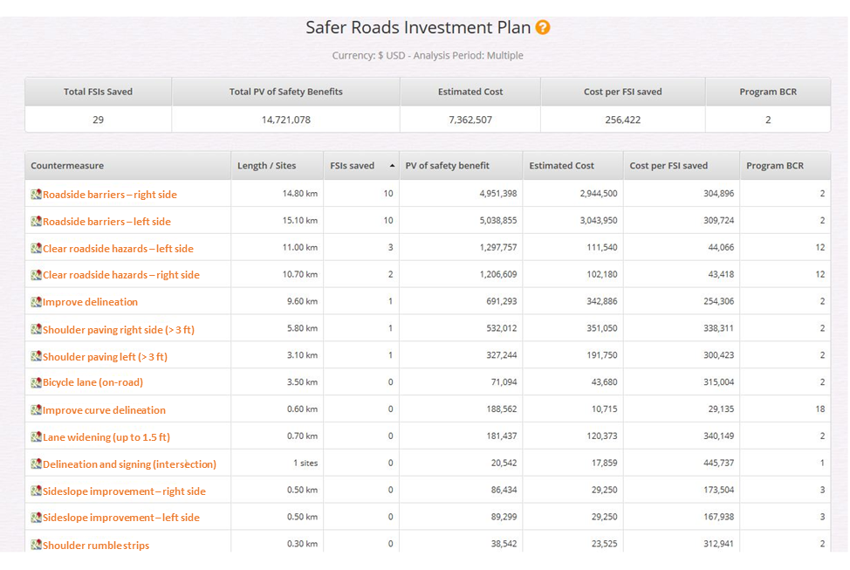
Application of usRAP methodology and ViDA software (cont’d)
Sample usRAP ViDA star rating summary table
Notes:
The results for safer roads investment plans include a table that summarizes the countermeasures in the safer roads investment plan by countermeasure type, including:
Countermeasure name
Number of fatalities and serious injuries reduced
Length of road or number of sites improved
Present value of crash reduction benefits over the analysis period (typically, 20 years)
Present value of countermeasure implementation cost over the analysis period (typically 20 years)
Cost-effectiveness (dollars spent per fatality or serious injury reduced)
Benefit-cost ratio
The table summarizes the countermeasures in the safer roads investment plan for each 328-ft road segment. The benefit-cost ratio for each countermeasure within each 328-ft road segment must exceed the minimum benefit-cost ratio specified by the user. The sample table shows a typical table summarizing a safer roads investment plan. By default, the table covers the entire road network, but the software can also create tables for individual routes and individual road sections.
Maps for any given countermeasure can be displayed to show the locations where implementation of each countermeasure is recommended. Each 328-ft road segment where a given countermeasure is recommended is represented by a dot on the map.

Slide 43
Application of usRAP methodology and ViDA software (cont’d)
Key strengths and advantages of ViDA
  Software is web-based and readily accessible
  Software is free
  Access to software is password protected
  Software is easy to use
  Input data consists mostly of familiar design and traffic control parameters that can be coded from aerial and street-level photographic images by trained technicians or students
  Input data can be managed with commercially available software
Notes:
Key strengths and advantages of the usRAP ViDA software are as follows:
The software is web-based and readily accessible.
Any public agency and their consultants may use the software free of charge.
Access to the software is password protected, so users can control access to their data.
The software is relatively easy to use. New users can acquire a basic familiarity with the software in one to two hours of training. Full understanding of the data needs and data acquisition for the software requires approximately 12 hours of training.
Input data consists mostly of familiar design and traffic control parameters that can be coded from aerial and street-level photographic images, such as Google Earth or Bing Streetside, and can be coded by trained technicians or students with an average of approximately 30 minutes of labor per mile of roadway.
Input data can be readily managed with commercially available spreadsheet software, such as Microsoft Excel.

Slide 44
Application of usRAP methodology and ViDA software (cont’d)
Key strengths and advantages of ViDA (cont’d)
  User can customize analysis parameters to match agency’s experience and practices
  Software can be calibrated if crash data are available
  Software processes data rapidly to develop safer roads investment plans
  All 70+ countermeasures built into software are considered for each 328-ft (100-m) road segment, reducing possibility that any desirable countermeasure will be missed
  Results provide program of cost-effective potential infrastructure improvements to reduce fatal and serious-injury crashes
  Software includes large amount of support information and transparency of process
Notes:
Key strengths and advantages of the usRAP ViDA software are as follows:
The user can customize analysis parameters including fatality and serious injury costs, unit countermeasure costs, and minimum benefit-cost ratios to match their agency’s experience and practices.
The software can be calibrated for application to a particular roadway network if network-wide fatal and serious-injury crash history data are available.
The software processes data rapidly to develop safer roads investment plans. Most data sets can be uploaded to the software in a minute or two. Processing of data to develop a safer roads investment plan requires approximately 10 minutes for a typical county road system and approximately 20 minutes for state routes in a typical highway district.
All of the 70+ countermeasures built into the software are considered for each 328-ft road segment, unless the user chooses to turn off consideration of any particular countermeasure. This reduces the possibility that any desirable countermeasure will be missed.
The results provide a program of cost-effective potential infrastructure improvements to reduce fatal and serious-injury crashes, with specific countermeasures recommended for implementation at specific locations.
The software includes a large amount of support information and transparency of the process. It is well documented and the publications are easy to understand.

Slide 45
Application of usRAP methodology and ViDA software (cont’d)
Key weaknesses and limitations of ViDA
  Software uses crash prediction models based on best worldwide safety research, much of which are from countries other than the U.S.
  For many agencies, most of their network will rate as poor-to-fair simply because they are two-lane facilities
    However, many low-volume and/or well-maintained roads may be perfectly adequate for their expected traffic
  Software currently displays results in metric units
Notes:
Key weaknesses or limitations of the usRAP ViDA software are as follows:
The software uses crash prediction models based on the best worldwide safety research, much of which are from countries other than the U.S. Thus, the software does not use the crash prediction models most familiar to U.S. users, such as those in the HSM. However, the ViDA software provides results that are appropriate for U.S. application because the crash reduction effectiveness of specific countermeasures is likely to be similar among the U.S. and other developed countries, and the calibration process can incorporate local crash experience.
For many agencies (especially those that do not maintain freeways), most or all of their network will always rate as poor-to-fair simply because they are two-lane facilities. However, many low-volume and/or well-maintained roads may be perfectly adequate for their expected traffic, even if the usRAP ViDA software indicates they are one- to three-star roadways.
The software currently displays results in metric units (i.e., distance in km, speeds in km/h). The software has been partially customized to U.S. highway engineering terminology, and countermeasure descriptions can be displayed with U.S. customary units (i.e., lane and shoulder widths in ft). Further customization to U.S. customary units is expected in the future.

Slide 46
Selecting the Appropriate Systemic
Safety Management Approach
and Software Tool
12/11/2020

Slide 47
Selecting the Appropriate Systemic Safety Management Approach and Software Tool
Deciding which systemic safety management approach and/or software tool to use depends on several factors:
  Which step in the process the agency is focused on
  Availability and reliability of crash and roadway inventory data
  Ability to develop and apply planning-level SPFs
  Extent and type of roadway system to be evaluated
  Amount of time and resources available to develop systemic safety project plans
  Role of systemic safety in agency’s overall safety management program
Notes:
There are a number of systemic safety management approaches and software tools available to help agencies implement a systemic safety management program. Deciding which systemic safety management approach and/or software tool to use depends on several factors including:
Which step in the process the agency is focused on—Some agencies may come into the process with a blank slate, needing to identify the focus crash types, facility types, and contributing factors in order to then select countermeasures. Other agencies may have already identified crash types, facility types, and countermeasures and need tools for project prioritization.
The availability and reliability of crash data—One of the advantages of implementing a systemic safety management program is that location-specific crash data are not necessarily needed. However, for one of the systemic approaches and software tools, reliable crash data are required.
The availability and reliability of roadway inventory data—To determine where best to implement systemic projects, roadway inventory data are needed to first identify which roadway features are associated with the highest numbers of crashes and second, where certain countermeasures are likely to be the most appropriate for installation.
The ability to develop and apply planning-level safety performance functions (SPFs)—Some agencies may have already developed SPFs that can be used to implement a systemic safety management program. Other agencies may choose to develop them, or to partner with a university or consultant with the technical expertise to develop them. In some cases, the development of SPFs may be too costly. Some agencies may choose to calibrate existing SPFs developed by others.
The extent and type of roadway system being evaluated—City or county-level systemic safety management often requires a different approach than state-level systemic safety because these networks often have differences in their mix of facility types, available and reliable data elements, the types of countermeasures that can be considered, and the number of projects that can be completed. In addition, states are more likely than cities or counties to have a robust safety plan in place with target crash types (and sometimes facility types and contributing factors) already identified.
The amount of time and resources available to develop the systemic safety project plans—Implementing a systemic safety management approach can range from a fairly simplistic analysis and project prioritization based almost entirely on data from crash reports and published information about treatment effectiveness to a detailed, agency-specific, data-driven approach.
The role of systemic safety in the agency’s overall safety management program—Agencies that want to shift a substantial amount of safety planning from crash-history-based and policy-based programs to a systemic program might be more willing to invest the time and resources.

Slide 48
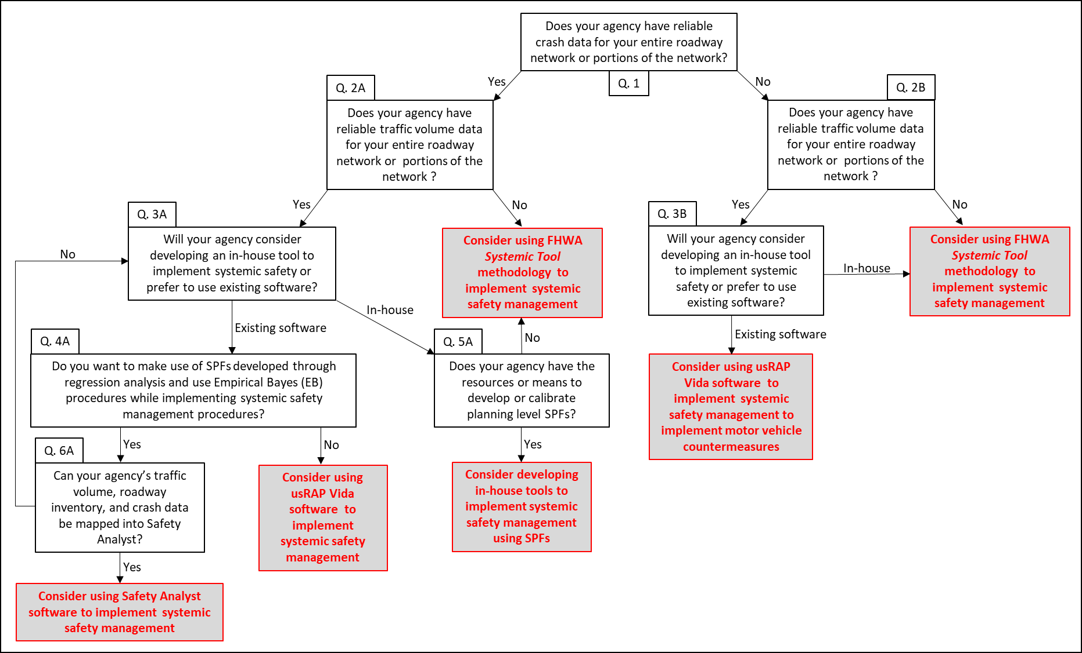
Selecting the Appropriate Systemic Approach and Software Tool (cont’d)
Notes:
A framework and logic was developed to help agencies select a preferred systemic safety management approach and/or software tool for implementation.
The framework includes a series of questions to assist agencies in selecting a systemic safety management approach and potential software tool that will best help them meet their systemic safety program goals and needs. The questions will help an agency assess their needs, data, and resources which will then guide the agency toward a recommendation for selecting a preferred systemic safety management approach and/or software tool for implementation. The systemic safety management approaches and software tools addressed in this series of questions and guided recommendations include:
Application of FHWA Systemic Tool methodology
Application of systemic safety management using SPFs
Application of systemic safety management using usRAP ViDA software
AASHTO Safety Analyst software
Development of in-house tools to implement systemic safety management using SPFs

Slide 49
Systemic Safety in Use
(Best Practices)
12/11/2020
Notes:
This section highlights the experiences and best practices of several state and local highway agencies in implementing systemic safety programs to illustrate the application of a systemic safety approach in three main topic areas:
Applications of the three primary systemic safety program implementation approaches
Application of systemic safety by local agencies
Evaluation of systemic safety management programs
These case studies are presented to show a broad range of systemic safety program implementation approaches, and to provide examples of how various agencies have approached systemic safety.

Slide 50
Case Studies: Applications of the Three Primary Systemic Safety Program Implementation Approaches
FHWA Systemic Safety Project Selection Tool
  Several states and local agencies have implemented this approach
  Focus Crash Types, Facility Types, and Contributing Factors
    Maine focused on lane departure crashes on two-lane rural roads
    TxDOT and Thurston County (Washington State) focused on roadway departure crashes
Notes:
Since its publication in 2013, the systemic safety management approach described in the FHWA Systemic Tool has been utilized by several state and local agencies. This section steps through the elements of the systemic safety planning process of the Systemic Tool, highlighting the ways several state and local highway agencies have implemented the FHWA Systemic Tool.
Beginning first with focus crash types, in Maine, the DOT found that 67% of severe crashes occur on two-lane rural roads and lane departure crashes represent 72% of the fatal crashes. Therefore, MaineDOT focused on their systemic program on lane departure crashes on two-lane roads. The Texas Department of Transportation (TxDOT) and Thurston County Public Works Department in Washington State also identified roadway departure crashes as a focus crash type to be addressed with a systemic safety approach because they represented a large percentage of total serious crashes.

Slide 51
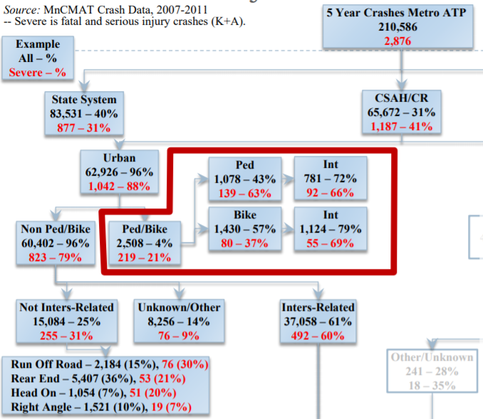
Case Studies: Applications of the Three Primary Systemic Safety Program Implementation Approaches (cont’d)
FHWA Systemic Safety Project Selection Tool (cont’d)
  Focus Crash Types, Facility Types, and Contributing Factors
    MnDOT used a crash tree diagram to identify crash types and facility types of interest
Notes:
Minnesota Department of Transportation (MnDOT) used a crash tree diagram to determine the crash types occurring on various facility types. The figure shows a portion of a crash tree diagram, which offers a simple visual way of disaggregating crash data by various facility attributes, such as jurisdiction, setting (i.e., rural versus urban), intersection versus non-intersection, and more.
Using a crash tree diagram, MnDOT determined that approximately 70% of severe pedestrian and bicycle crashes occur at urban intersections of county state aid highways (CSAH) and county roads (CR), especially signalized intersections. Because their network includes over 1500 signalized intersections, with only a few exhibiting any recent pedestrian or bicycle crash history, a traditional hot-spot approach was not considered appropriate to mitigate potential pedestrian and bicycle crashes. As a result, this facility type (i.e., urban intersections of CSAH/CR) was selected as a key focus facility type for the systemic safety application.

Slide 52
Case Studies: Applications of the Three Primary Systemic Safety Program Implementation Approaches (cont’d)
FHWA Systemic Safety Project Selection Tool (cont’d)
  Focus Crash Types, Facility Types, and Contributing Factors
    MaineDOT compared risk ratio scores on two-lane roads to identify which contributing factors should receive most focus
Contributing Factor (Run-Off-Road Crashes) | Comparison | Risk Ratio (Score)
Horizontal curvature | > 4° versus < 4° | 8.5
Horizontal curvature | > 2° versus < 2° | 3.5
Vertical curvature | Vertical curve versus tangent | 2.5
Light conditions | Dusk-dark-dawn versus daylight | 2.5
Grade | > 3% vsersus< 3% | 2.0
Percent of Crashes (fatal and severe)
Risk Ratio =
Percent of Exposure (VMT))
Notes:
To develop a score for ranking the contributing factors under consideration, MaineDOT used crash and exposure percentages to compute a “risk ratio”. The table here lists the contributing factors with the highest risk ratio scores. The table shows that horizontal curvature sharper than 4 degrees (vs flatter curves) scored highest. Based on this information, MaineDOT focused its systemic treatment of run-off-road crashes on horizontal curves sharper than 4 degrees (1,400-ft radius).

Slide 53
Case Studies: Applications of the Three Primary Systemic Safety Program Implementation Approaches (cont’d)
FHWA Systemic Safety Project Selection Tool (cont’d)
  Screen and Prioritize Candidate Locations
    MnDOT developed a methodology to prioritize potential improvements on curves
Crash Contributing Factors | Value | Threshold | Star Assignment
Speed limit (mph) | 55 | 45 ≤ speed limit ≤ 55
Radius (ft) | 719 | 500 ≤ radius ≤ 1400
Traffic volume (vpd) | 1650 | 600 ≤ traffic volume ≤ 1300
Lane width (ft) | 11 | 11
Shoulder type | Gravel | None, curb, composite
Total cross section width (ft) | 30 | 28 ≤ total cross section width ≤ 34
Adjacent intersection | None | Intersection, railroad
Visual trap | None | Present
Lighting | None | None
Outside edge risk | 2 | 2 or 3
Total Stars
Notes:
In order to screen and prioritize candidate locations for potential countermeasure implementation, a safety assessment is conducted. This assessment uses roadway and traffic data to characterize the potential for a severe focus crash to occur at a given location or along a given segment of roadway based on certain characteristics present at these network elements. The presence of crash contributing factors at these locations is scored, tabulated, and used to prioritize locations with a high number of crash contributing factors present.
A sample of such an assessment conducted by MnDOT during a 2019 systemic safety analysis is shown here which summarizes the safety assessment results for a single horizontal curve, indicating the presence of various crash contributing factors, such as a curve radius between 500 ft and 1,400 ft, a cross section width between 28 and 34 ft, and the absence of lighting with a star.
The number of stars associated with each location is used to rank locations based on the presence of identified crash contributing factors. Locations that have a number of stars (i.e., crash contributing factors) that exceeds a determined threshold are considered high-priority sites for improvement.

Slide 54
Case Studies: Applications of the Three Primary Systemic Safety Program Implementation Approaches (cont’d)
FHWA Systemic Safety Project Selection Tool (cont’d)
  Screen and Prioritize Candidate Locations
    TxDOT developed a method to prioritize locations for pedestrian safety improvements
Category | Weight (points)
 | 0 | 1 | 2 | 3 | 4 | 5 | 6 | 7 | 8 | 9 | 10
Crash Total | ≥ 0% and < 10% | ≥ 10% and < 20% | ≥ 20% and < 30% | ≥ 30% and < 40% | ≥ 40% and < 50% | ≥ 50% and < 60% | ≥ 60% and < 70% | ≥ 70% and < 80% | ≥ 80% and < 80% | ≥ 90% and < 100% | 100%
Crash Over-Representation | 0% | > 0% and < 2% | ≥ 2% and < 3% | ≥ 3% and < 4% | ≥ 4% and < 5% | ≥ 5% and < 6% | ≥ 6% and < 7% | ≥ 7% and < 8% | ≥ 8% and < 9% | ≥ 9% and < 10% | ≥ 10% and ≤ 100%
Crash Under-Representation | 0% | > 0% and < 2% | ≥ 2% and < 3% | ≥ 3% and < 4% | ≥ 4% and < 5% | ≥ 5% and < 6% | ≥ 6% and < 7% | ≥ 7% and < 8% | ≥ 8% and < 9% | ≥ 9% and < 10% | ≥ 10% and ≤ 100%
Total Weight = 10 + CT + CO – CU
Where:
CT = weight based on crash total
CO = weight based on crash over-representation
CU = weight based on crash under-representation
Notes:
The Texas Department of Transportation (TxDOT) used a unique weighting method to prioritize sites in their 2017 systemic safety analysis for pedestrian safety improvements. The process uses an assessment of overrepresentation of target crashes (e.g., pedestrian crashes) associated with different location attributes, such as median type (no median, unprotected, curbed barrier), number of lanes (1 or 2, 3 or 4, 5 or more), or traffic volume (low, moderate, high), assigning weights to each attribute which are then summed for each location. As a result, each location has a weighted score based on its unique combination of attributes, with all locations being ranked based on these computed scores. This method creates a data-driven process to rank locations based on crash contributing factors which have been shown to correlate with high frequencies of pedestrian crashes relative to other crash types. It also can capture the relative influence of different types of crash contributing factors which have different levels of correlation with safety performance, such as various types of medians or pavement widths, providing for more possible scoring outcomes than a binary method which indicates the presence or absence of a defined crash contributing factor. The table here lists the weighting factor values used in the weight calculation formula.

Slide 55
Case Studies: Applications of the Three Primary Systemic Safety Program Implementation Approaches (cont’d)
FHWA Systemic Safety Project Selection Tool (cont’d)
  Screen and Prioritize Candidate Locations
    Summary of calculated contributing factor weightings used by TxDOT to prioritize pedestrian improvements
Contributing Factor |  | Weight (points)
 |  | Rural | Urban
Median Type | No Median | 7 | 8
 | Unprotected | 21 | 12
 | Curbed | 10 | 13
 | Barrier | 17 | 19
Number of Lanes | 1 or 2 | 6 | 5
 | 3 or 4 | 23 | 22
 | 5 or more | 11 | 21
Pavement Width (ft) | ≤ 16 | 9 | 10
 | 17-24 | 2 | 4
 | 25-50 | 23 | 21
 | > 50 | 23 | 23
Vehicle Volume Level | Low | 2 | 2
 | Moderate | 9 | 5
 | High | 27 | 26
Truck Percentage (%) | ≤ 10 | ≤ 5 | 4
 | 10-20 | 5-10 | 22
 | 20-30 | 10-20 | 19
 | > 30 | > 20 | 21
Notes:
This table presents a summary of the weights for the respective contributing factors, calculated based on historic pedestrian crash data and based on the methodology developed by TxDOT to prioritize pedestrian improvements.

Slide 56
Case Studies: Applications of the Three Primary Systemic Safety Program Implementation Approaches (cont’d)
FHWA Systemic Safety Project Selection Tool (cont’d)
  Countermeasure Selection
    WSDOT and MaineDOT have deployed centerline and shoulder rumble strips
Several Countermeasures Implemented as Part of Systemic Safety Management
Context | Common Countermeasures
Roadway segments | Rumble strips (both shoulder and centerline) Cable median barrier SafetyEdgeSM High friction surface treatments Enhanced pavement markings Curve warning signs Chevrons/delineators Lane/shoulder widening Speed feedback signs Tree/clear zone removal
Intersections | Signal backplates Crosswalk enhancements – striping, signing, rectangular rapid flashing beacons Countdown pedestrian signals Pedestrian refuge islands Curb extensions Reflective strips on sign posts Mini-roundabout Lighting
Notes:
In Washington State, the first systemic treatment project deployed was cable median barrier along freeway segments in 1995. This medium-cost strategy is used to reduce severe roadway departure crashes, being especially effective in addressing cross-median head-on collisions. Since then, Washington State DOT, along with MaineDOT and many other state and local agencies, have performed systemic deployment of centerline and shoulder rumble strips, targeting roadway departure crashes on rural roads. Maine, in particular, reviewed the benefit-cost ratio of improved striping, curve signing, edge line and centerline rumble strips to determine the most appropriate treatment for sites selected.
Several countermeasures that agencies have implemented as part of their systemic safety management projects are listed here.

Slide 57
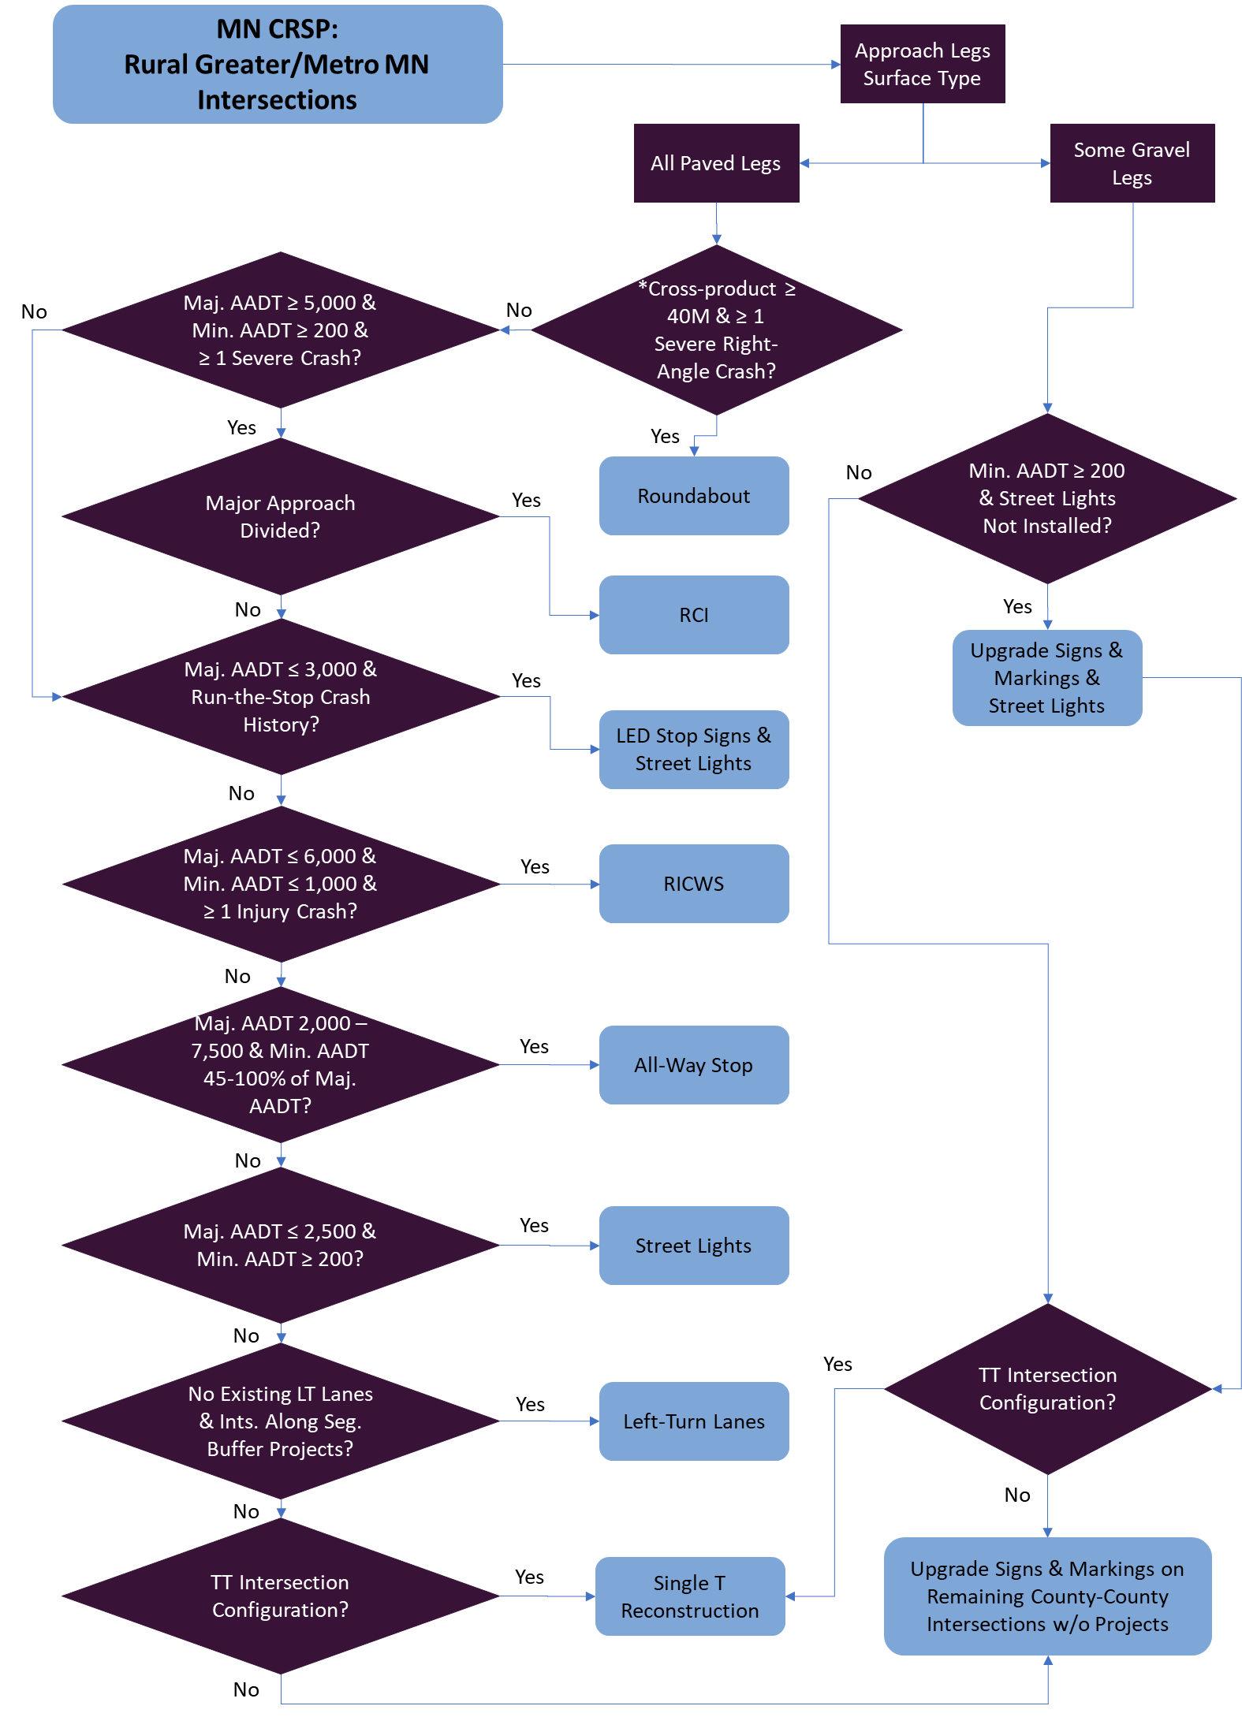
Case Studies: Applications of the Three Primary Systemic Safety Program Implementation Approaches (cont’d)
FHWA Systemic Safety Project
Selection Tool (cont’d)
  Project Prioritization
Notes:
To determine which candidate locations receive different treatments, a decision-making framework should be established. It should be based on the potential countermeasures as well as crash contributing factors and other characteristics of each candidate location which impact the applicability, effectiveness, and viability of each treatment. Additionally, project cost, agency policy, and program goals should be considered during the project selection process. A sample framework in the form of a decision tree is presented here. This flow chart shows a portion of the decision-making logic developed by MnDOT to support project selection for rural intersections in their 2019 systemic analysis.

Slide 58
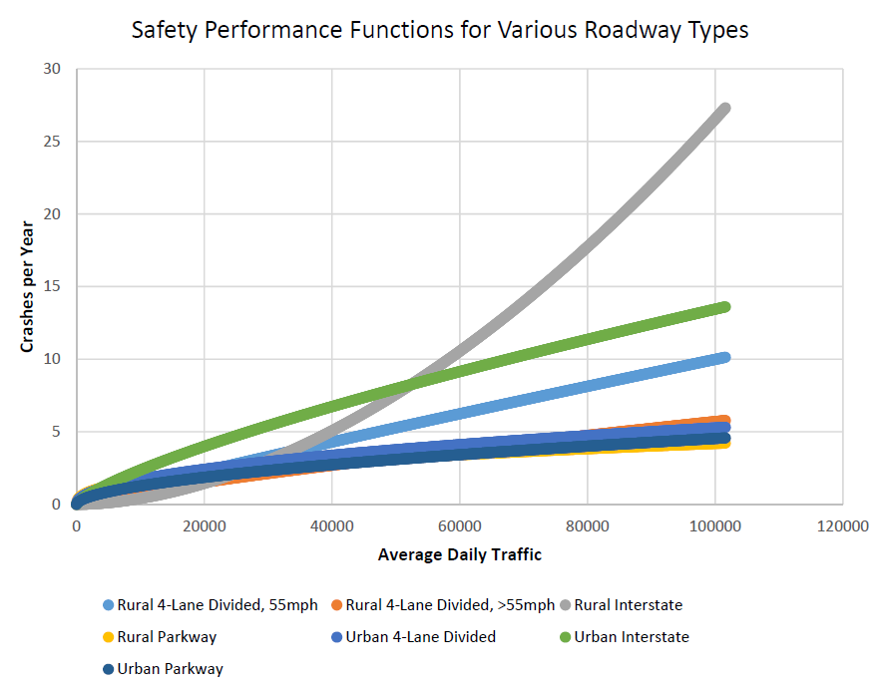
Case Studies: Applications of the Three Primary Systemic Safety Program Implementation Approaches (cont’d)
Implementing Systemic Safety using SPFs
  Identifying focus facility types using SPFs
    KYTC developed SPFs
    to prioritize locations of
    cable median barrier
    to address roadway
    departure crashes
Notes:
Some agencies have used SPFs to help implement their systemic safety program. A systemic safety analysis using SPFs can be designed to suit the specific needs of an agency or project, as well as specific circumstances, limitations, and goals. Some of these processes are similar to those outlined in the Systemic Tool, focusing on reducing target crash types and the selection of countermeasures to address the target crash types. Another approach begins with an identified countermeasure and uses a systemic process to identify the locations where installation of the countermeasure would likely have the greatest benefit.
Kentucky Transportation Cabinet (KYTC) worked closely with the University of Kentucky to develop SPFs, similar to those in Part B of the HSM, for systemic safety management. SPFs were developed for seven roadway types in Kentucky to identify locations most likely to see a safety benefit due to the installation of cable median barrier (see figure here).

Slide 59
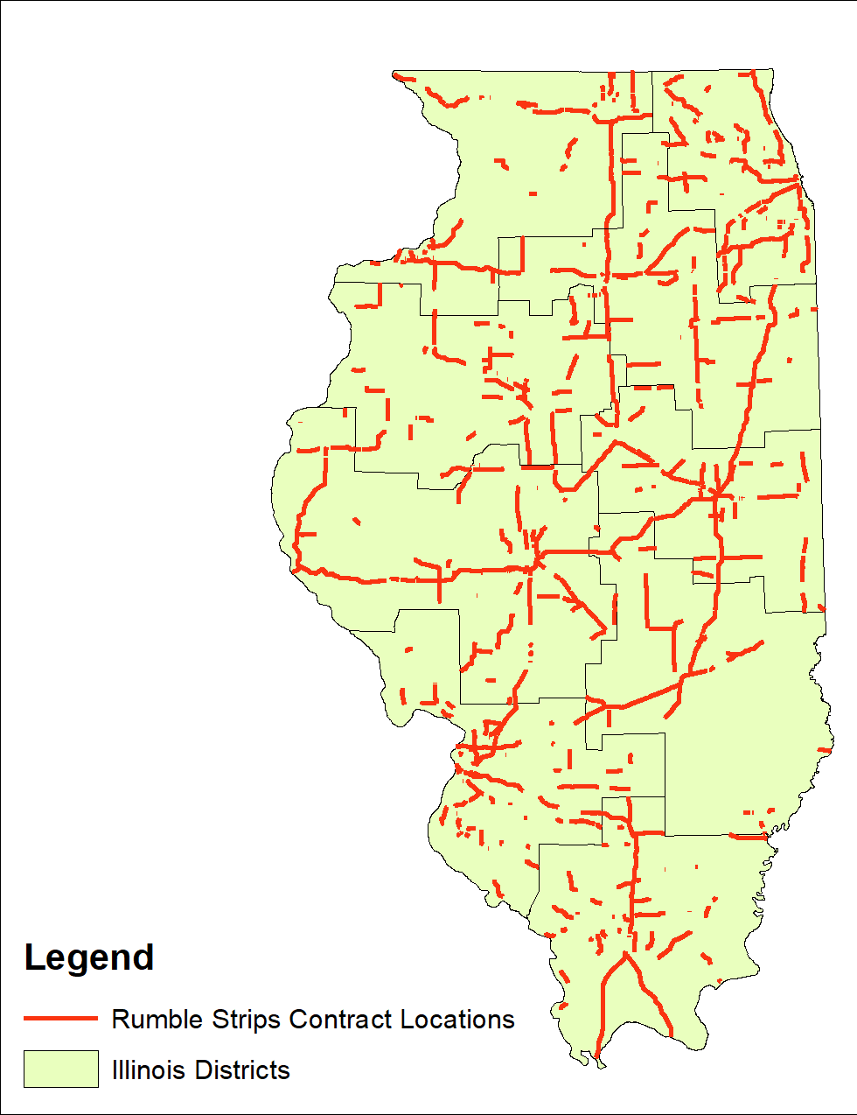
Case Studies: Applications of the Three Primary Systemic Safety Program Implementation Approaches (cont’d)
Implementing Systemic Safety using SPFs (cont’d)
  Prioritizing installation of select countermeasures
    Illinois DOT used SPFs to compute
    potential for safety improvement on
    rural two-lane roads with speed limits
    of 50 mph or greater
    Ranked locations based on expected
    frequencies of head-on and sideswipe
    opposing-direction crashes for centerline
    rumble strips and overturned and
    fixed-object crashes for shoulder rumble strips
Notes:
In recent years, Illinois Department of Transportation (IDOT) made an effort to broadly deploy rumble strips on rural two-lane roadways across the state. This countermeasure was selected as a low-cost solution that has proven highly effective in reducing roadway departure crashes. Because of the breadth of the agency’s network of target facilities, it was necessary to identify a simple, systemic, method for prioritizing locations for deployment to produce the greatest improvements over time.
A prioritization process was developed that utilized a network screening SPF to compute the potential for safety improvement on all state jurisdiction rural two-lane roads with speed limits of 50 mph or greater, which was the target facility for the assessment. These results were used to rank locations based on expected frequencies of head-on and sideswipe, opposing-direction crashes for centerline rumble strips and overturned and fixed-object crashes for shoulder rumble strips.
This map shows the locations where rumble strips were subsequently installed during the years following the assessment.

Slide 60
Case Studies: Applications of the Three Primary Systemic Safety Program Implementation Approaches (cont’d)
Implementing systemic safety using usRAP
  In 2013, Utah DOT chose to implement usRAP because it was a less resource-intense alternative to Safety Analyst
  Used lidar-equipped van to drive all state highways and collected data for input into ViDA
    Data collected by van provide approximately 80 percent of required data
    Hired university to collect remaining data
  usRAP provided star ratings for all state highways as well as recommendations for safety countermeasures along each 328-ft (100-m) segment
Notes:
In 2013, the Utah DOT chose to implement the usRAP program, because it was presented to them as a less resource-intense alternative to Safety Analyst. Utah DOT drove a lidar-equipped van along all of their state-managed highways and collected data that they then reduced, coded, and input into the ViDA software. The data collected using the van provide approximately 80% of the data required by the software. Some additional data, such as location of bike routes, were pulled from planning data. A university was hired to reduce street-view imagery of the network and gather the remaining data, and then to perform a quality control analysis and validate all of the data. The usRAP program provided Utah DOT with a star rating for all their state-managed highways as well as recommendations for safety countermeasures along each 328-ft segment of that roadway network.

Slide 61
Case Studies: Applications of the Three Primary Systemic Safety Program Implementation Approaches (cont’d)
Implementing systemic safety using usRAP
Sample of Star Ratings for State Maintained Roads (Non-Interstates) in Utah
Notes:
This map illustrates the star ratings assigned to state-maintained roads (non-interstates) around Salt Lake City and Provo, Utah, based on the usRAP methodology.

Slide 62
Case Studies: Applications of the Three Primary Systemic Safety Program Implementation Approaches (cont’d)
Implementing systemic safety using usRAP (cont’d)
  In Utah, DOT central office aids regional offices in selecting and prioritizing safety projects. Generally, regions identify projects they would like to complete and send their recommendations to central office where staff evaluate those projects to determine the benefit-cost (B-C) ratio using three methodologies:
    Calculate expected crash reduction using HSM predictive method
    Apply CMF to average number of crashes from past three years
    Use expected crash reduction calculated by usRAP
  When regions need help identifying potential safety projects, central office provides assistance by suggesting projects recommended by usRAP
Notes:
In Utah, the DOT central office aids the four regional offices in selecting and prioritizing safety projects. Generally, the regions identify projects they would like to complete and send their recommendations to the central office, where staff evaluate those projects to determine the benefit-cost ratio. The benefit-cost ratio is calculated using three methodologies:
Calculate expected crash reduction using HSM predictive methodology, where available
Apply a CMF to the average number of crashes from the past three years
Use the expected crash reduction calculated by usRAP
Utah uses its own treatment implementation costs to calculate the benefit-cost ratio (rather than entering the cost data required by usRAP and relying on the software to make the calculation).
In Utah, for years HSIP funding was divided among the regions. Any project recommended by the region, and found to have a benefit-cost ratio greater than 1.0 by any of the three methods, was funded. However, the DOT is now trying to ensure the most beneficial projects are funded first. Moving forward, projects will be funded based entirely on the highest benefit-cost ratio.
Regions generally identify potential projects based on crash history, but when regions need help identifying potential safety projects, the DOT central office provides assistance by suggesting projects recommended by usRAP data. The types of projects suggested often include rumble strips, shoulder widening, guardrail, and intersection turn lanes.

Slide 63
Case Studies: Applications of the Three Primary Systemic Safety Program Implementation Approaches (cont’d)
Considerations for Success
  Agencies appreciated flexibility and adaptability of approach described in FHWA Systemic Tool with small investment in training and data collection
  Agencies that get their data into Safety Analyst and usRAP ViDA appreciate functionality and capabilities of these tools
  Systemic safety management approach is adaptable based on available data but can still be data-intensive
  Strong leadership support and an effective communication plan are essential for establishing the systemic approach and for expanding the program
Notes:
Agencies that have used the systemic safety management approach have made it an integral part of their statewide and agency-wide roadway safety management process. Agencies have appreciated the flexibility and adaptability of the systemic safety management approach described in the FHWA Systemic Tool with a small investment in training and data collection, and agencies that have taken the effort to get their data into Safety Analyst and usRAP ViDA appreciate the functionality and capabilities of the software tools.
One of the strengths of the systemic safety management approach is that it is adaptable based on available data. It is not necessary to have a comprehensive, integrated database of roadway inventory, traffic volume, and crash data to begin implementing a systemic safety management program. Agencies should start by understanding the purpose and use of data in the context of systemic safety analysis, and the tradeoffs and opportunities that data provide, whether in the use of a ranking methodology or in the use of a required data element within a software tool. Priorities can also be established to develop a more comprehensive dataset—first, for a portion of the network; then, for other parts of the network. The emphasis should be on developing an initial systemic safety management approach based on available data or data that can be easily collected in the short term. Priorities can then be set for incrementally collecting additional data elements and developing a more comprehensive and reliable dataset over time. As more reliable data become available, the systemic analytical or methodological approach can evolve and become more robust and/or be expanded to additional parts of the network.
A number of agencies have indicated that strong leadership support and an effective communication plan was essential for establishing the systemic approach and for expanding the program.

Slide 64
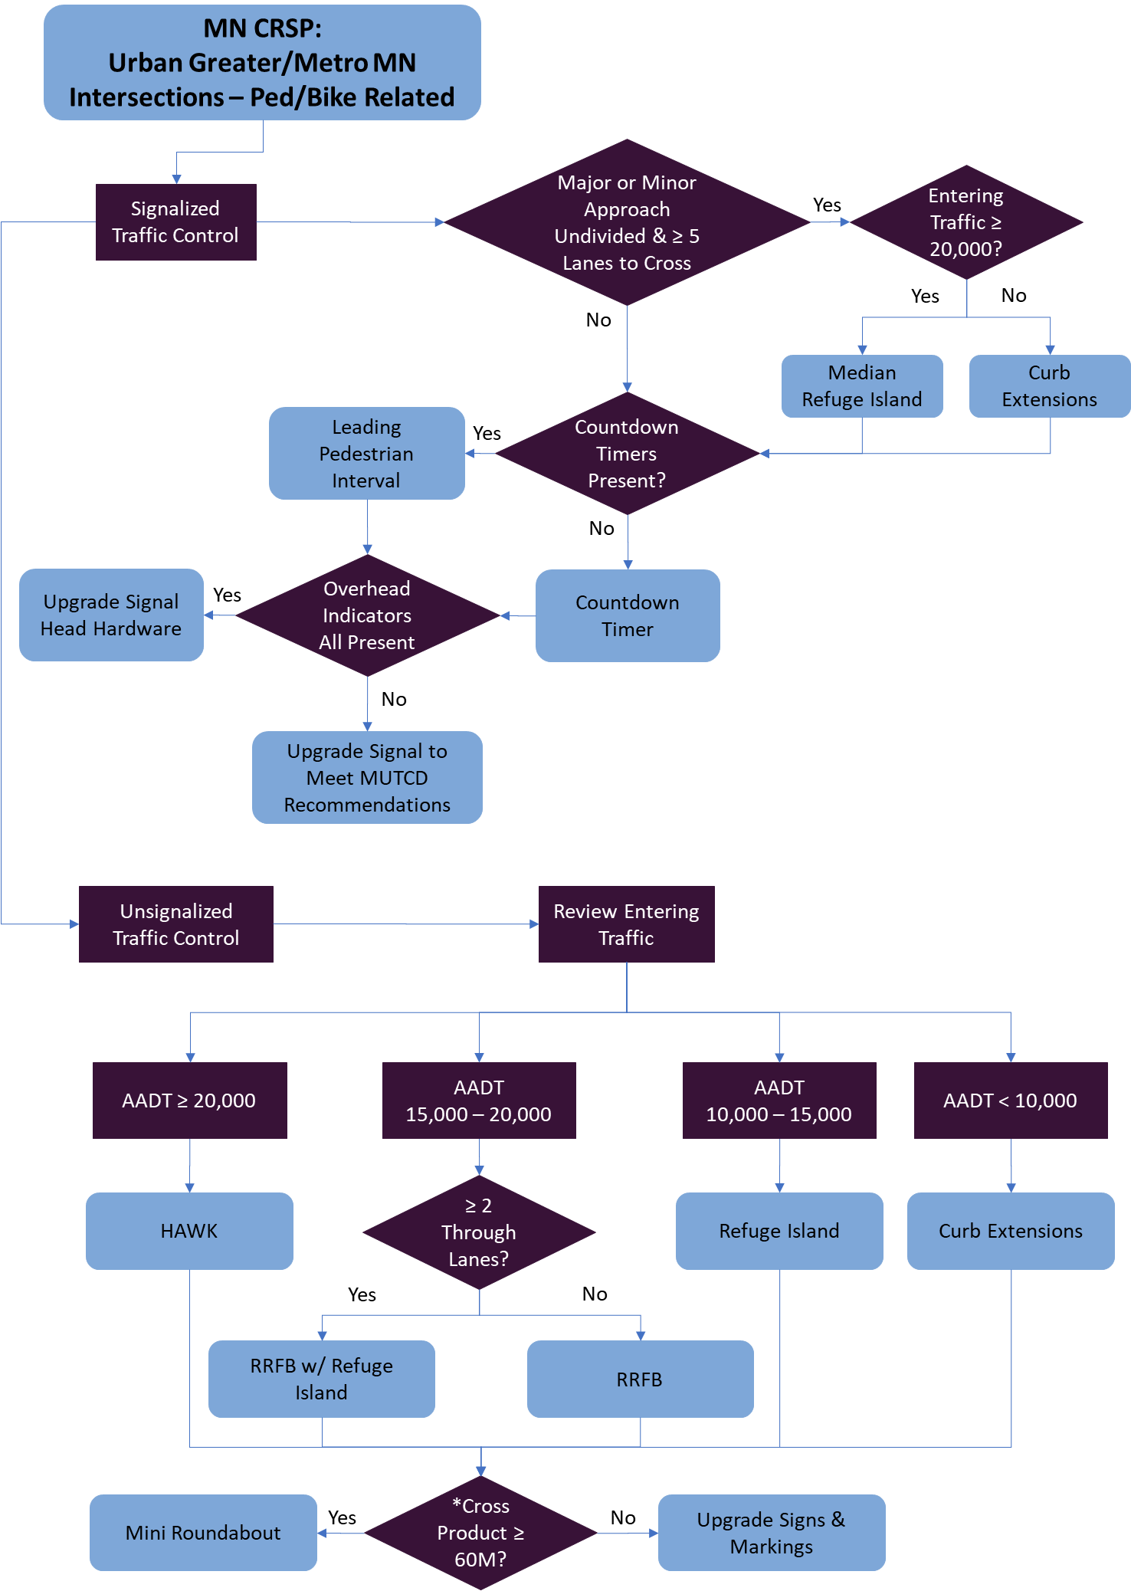
Case Studies: Local Applications of Systemic Safety
Systemic safety management
beneficial to local agencies
with incomplete data
  For their County Roadway
  Safety Plan, MnDOT developed
  a decision tree for intersections
  which takes into consideration
  contributing factors and
  assigns one or more safety
  treatments to reduce pedestrian
  and/or bicycle crashes
Notes:
The next few slides address effective applications of the systemic approach on local roadway networks, focusing on local applications to address pedestrian, intersection, and roadway departure crashes.
Because the systemic safety management approach described in the FHWA Systemic Tool is less reliant on high quality, comprehensive historic crash data, it provides a means for identifying and addressing highway safety needs that are not explicitly addressed with the traditional hot-spot approach. This has proven beneficial for local agencies whose inventory, traffic volume, and/or crash data are sometimes incomplete or of poor quality. The systemic approach provides a way to prioritize safety improvement projects without the need for high-quality data. Additionally, because the systemic approach is not exceedingly complex or difficult, it is relatively easy for local agencies to employ without the need for extensive training or experience.
In their 2019 County Roadway Safety Plans, MnDOT assisted county and area transportation agencies in analyzing urban intersections, working to identify locations with contributing factors found to be associated with a high likelihood of pedestrian and bicycle crashes. MnDOT developed a decision tree (shown here) for intersections, which takes into consideration certain contributing factors and assigns one or more safety treatments. This framework guides the project identification process for all county jurisdiction roads being assessed, providing prioritization that can be used to inform safety programming.

Slide 65
Case Studies: Local Applications of Systemic Safety (cont’d)
Thurston County selected the following contributing factors and thresholds to screen their roadway network to address roadway departure crashes:
  Roadway class of major rural collector
  Presence of an intersection
  Traffic volume of 3,000 to 7,500 AADT
  Edge clearance rating of 3
  Paved shoulders equal to or greater than 4 ft in width
  Presence of a vertical curve
  Consecutive horizontal curves
  Speed differential between posted speed and curve advisory speed of 0, 5, and 10 mph
  Presence of a visual trap (i.e., a minor road on the tangent extended)
Notes:
Thurston County Public Works Department identified a selection of crash contributing factors associated with their county rural roadway network. These crash contributing factors provide a means for identifying sections of roadway throughout their system which, whether or not they have a history of severe crashes, may be expected to exhibit the greatest potential for severe crashes, especially roadway departure crashes. This empowers the agency to proactively work to reduce crashes and save lives on their rural roadway network.

Slide 66
Case Studies: Local Applications of Systemic Safety (cont’d)
Considerations for Success
  States have reached out to local jurisdictions to assist in developing local road safety plans
  Limited information is available for local roads to implement a crash-history-based safety management approach so states have been working with local agencies to implement systemic safety management
  FHWA Systemic Tool method is well suited for local agencies
    Less reliant on crash data
    Easy to employ without extensive training or experience
  Application of usRAP methodology also well suited for use by local agencies
    However, use is not particularly widespread among local agencies
Notes:
Due to HSIP requirements to improve safety on all public roads, state transportation agencies have been reaching out to local jurisdictions within their states to assist in various ways. Several states have assisted local agencies by developing local road safety plans. In most cases, limited information is available for local roads to implement a traditional crash-history-based safety management approach to identify high-crash locations off the state system. Therefore, states have been working with local agencies to implement the systemic safety management approach to utilize data-driven safety analyses to prioritize and program safety improvements.
The systemic safety management approach described in the FHWA Systemic Tool is well suited for local agencies because it is less reliant on high quality crash data. It is also relatively easy for local agencies to employ without the need for extensive training or experience. Application of the usRAP methodology, using the associated ViDA software, is also particularly well suited for use by local agencies as coding tools can be used to prepare input data for the usRAP ViDA software. However, application of the usRAP methodology using the associated ViDA software is not particularly widespread among local agencies.

Slide 67
Case Studies: Evaluation of Systemic Safety Management Programs
Evaluation of systemic safety management programs can be conducted in a number of ways, depending on type and amount of data available, goals of evaluation, and available resources in terms of time and expertise
Quantitative impacts of systemic safety management programs are most commonly analyzed using:
  Trend analysis
  Simple before-after study method
  Shift of proportions method
  Empirical-Bayes before-after study method
Current state of practice and knowledge only provides limited information concerning overall effectiveness of systemic treatments
Notes:
Evaluations of systemic safety management programs have been conducted in a number of ways, depending on the type and amount of data available, the goals of the evaluation, and the agency’s available resources in terms of time and expertise. Quantitative impacts of systemic safety management programs are most commonly analyzed using a trend analysis, the simple before-after study approach (with or without traffic volume correction), the shift of proportions method, or the Empirical Bayes before-after study method. Agencies have implemented these evaluation methods to inform future decision making to maximize the safety program and achieve goals. The evaluation results should be tailored to meet the needs of the target audience.
It should be recognized, however, that the current state of practice and knowledge in terms of the evaluation approaches can only provide a limited amount of information concerning the overall effectiveness of safety treatments implemented as part of a systemic safety management approach. With the systemic safety management approach, sites across the network may be improved but may not have any crash history prior to being treated. Because the evaluation methods either directly or indirectly compare the crash history of sites before and after implementation of treatments, the current evaluation methods can only provide a limited perspective on the overall safety effectiveness of treatments implemented as part of a systemic safety management approach. This becomes more of an issue as the number of evaluated sites, having no crash history prior to being treated, increases.

Slide 68
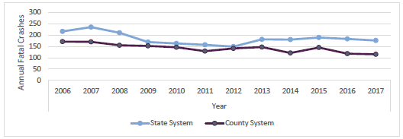
Case Studies: Evaluation of Systemic Safety Management Programs (cont’d)
Trend analysis
Minnesota State and Local Fatality Trends
Notes:
The most common approach to evaluating a systemic safety management program is to use trend analysis. This approach evaluates a program by computing the aggregate number of target crashes that occur on the system under consideration, and tracking changes to the crash frequency before, during, and after deployment of a strategy. If the deployment is successful in improving safety performance, this will be reflected in the crash data, represented by a downward trend in target crash frequency over the course of the deployment period.
The trend analysis approach has minimal data needs.
Trend analysis is commonly used as a first stage of evaluation as it is easy to perform, and has minimal training and data requirements. This figure shows fatality trends on state and local routes in Minnesota. MnDOT’s systemic safety management program focuses on reducing fatal and serious-injury crashes on local routes. The figure illustrates the relative success of MnDOT’s systemic safety program in reducing fatalities on local roads.

Slide 69
Case Studies: Evaluation of Systemic Safety Management Programs (cont’d)
Simple before-after method
Safety Performance Evaluation of Maine Corridors with Centerline Rumble Strips
Installed between 2006 and 2014
 | All severities |  | Fatalities |  | Serious Injuries
 | BEFORE | AFTER | BEFORE | AFTER | BEFORE | AFTER
Overall Lane Departure
Number | 727 | 199 | 31 | 1 | 71 | 21
Rate(/100 miles) | 143.56 | 111.20 | 6.12 | 0.56 | 14.02 | 11.74
Percent Improvement (RATE) |  | 22.5% |  | 90.9% |  | 16.3%
Head On
Number | 145 | 32 | 28 | 1 | 42 | 16
Rate(/100 miles) | 28.63 | 17.88 | 5.53 | 0.56 | 8.29 | 8.94
Percent Improvement (RATE) |  | 37.5% |  | 89.9% |  | -7.8%
Went Off Road
Number | 582 | 167 | 3 | 0 | 29 | 5
Rate(/100 miles) | 114.92 | 93.32 | 0.59 | 0.00 | 5.73 | 2.79
Percent Improvement (RATE) |  | 18.8% |  | 100.0% |  | 51.2%
All corridors pro-rated on Miles and Before/After years of exposure (10 corridors, 55.56 miles). Rates based on Crashes/Road miles per Year exposure in each corridor’s available Before and After review period. Example: If a 10 mile rumble strip corridor had 8 years of Before history and 4 years of After, crash rate would be based on 80 miles (8 yrs × 10 miles) Before, and 40 miles (4 yrs × 10 miles) After. Exposure bases in annual miles of corridors reviewed: Before = 506.42 miles; After = 178.95 miles.
Notes:
A simple before-after study evaluation approach can be used to quantify the effectiveness of a safety program by comparing the total frequency of target crashes that occur prior to the deployment of a strategy to the total frequency after the deployment. Generally, before and after periods of 3 to 5 years are assessed, with the year during which deployment occurs being excluded from the analysis. Once aggregate crash frequencies are computed, they can either be directly compared or they can be normalized. If traffic data are available, the results can be normalized by the mean AADT values for the before and after periods.
The primary benefits of the simple before-after study evaluation approach are that data requirements and training needs to perform the analysis are low. To perform a crash frequency assessment, only basic strategy information and crash data for the before and after periods are necessary. If an agency elects to expand the evaluation by accounting for changes in traffic volumes, AADT values for the analysis period years are required.
MaineDOT conducted a simple before-after study evaluation of their systemic implementation of centerline rumble strips. Over several years, MaineDOT deployed centerline rumble strips on their roadways, and recently they performed an evaluation using a simple before-after study approach. MaineDOT used varying lengths of before and after periods, with between 6 and 10 years of before data and between 2 and 9 years of after data for their evaluation. To adjust for the varying periods, the aggregated crash data were normalized by the mileage of the sites being considered. Results were then analyzed to determine the percentage change from the before to after periods for all crash severities, fatalities, and incapacitating injuries, by all lane departure crashes as well as head-on and run-off-road crash types. Results of the simple before-after analysis are summarized here.
Although the simple before-after study evaluation approach is commonly used, the results of such evaluations are simplistic and may not be reliable, especially in cases with small data sets or few locations being analyzed, where results are easily skewed by random crashes. Additionally, the approach does not account for traffic variability across the study period unless rates are calculated and does not account for regression to the mean or broad state or national trends. To avoid these issues, other approaches may be considered.

Slide 70
Case Studies: Evaluation of Systemic Safety Management Programs (cont’d)
Shift of proportions
  Common method when traffic is expected to be an influencing factor but traffic data are not available
  Method computes ratio of total target crashes to total crashes of all types for before and after periods for population of project locations
    Two ratios are compared to determine whether proportion of target crashes changed between before and after periods, indicating treatment may have influenced rate of target crashes
  KYTC used method to evaluate impact of systemic treatments such as cable median barrier, high-friction surface treatments, and rumble strips
    Found significant reduction in target crashes for all treatments
Notes:
The shift of proportions method is a common approach for evaluating the effectiveness of systemic safety management programs and treatments when traffic is expected to be an influencing factor but traffic data are not available. It is also used to supplement other analysis methods, offering additional insight in the evaluation processes. The method computes the ratio of total target crashes to total crashes of all types for both a before period and an after period for a population of project locations. These two ratios are then compared to determine whether the proportion of target crashes changed between the before and after periods for each location, indicating that the deployed treatment may have influenced the rate of target crashes at the project location. Generally, before and after periods of 3 to 5 years are assessed, with the year during which deployment occurs being excluded from the analysis. Once these ratios are calculated for all sites included in the program being evaluated, a statistical test is applied to determine if the shift of proportions is significant.
A primary benefit of the shift of proportions method is the ability to evaluate locations where changes in traffic may occur between the before and after periods of the evaluation without requiring traffic volume data in the analysis. This can be beneficial for evaluating treatments along corridors where traffic volume data may be limited or unreliable. Because of the impact of traffic on crash patterns as well as the random nature of crashes, the method may not be reliable for evaluating treatments applied only at a small number of locations or at locations with very few crashes.
KYTC utilized the shift of proportions method for assessing the impact of their systemic safety management program and treatments. KYTC evaluated the safety performance of multiple treatments included in their HSIP programming, such as cable median barrier, high-friction surface treatment, and rumble strips. Results of their shift of proportions evaluations for treatment locations showed statistical significance for all treatments and have helped to inform programmatic decision making by the state as they continue to develop their systemic safety management program.
The shift of proportions method is most effective when used in conjunction with other evaluation methods to obtain a more complete understanding of the impacts of systemic safety management programming.

Slide 71
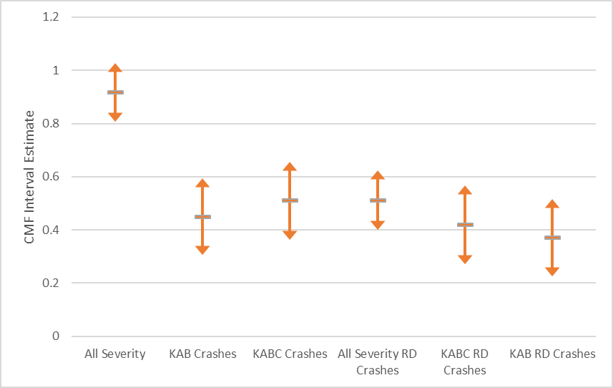
Case Studies: Evaluation of Systemic Safety Management Programs (cont’d)
Empirical Bayes Before-After Method
  Evaluates effectiveness of treatment by comparing number of observed crashes at treated sites to expected number of crashes that would have occurred had there been no treatment
  Requires use of SPFs
IDOT Crash Modification Factor 95% Confidence Intervals
for Addition of Paved Shoulders with Rumble Strips and Pavement Markings
Notes:
The Empirical Bayes (EB) before-after study evaluation method is an approach that can be used to evaluate the effectiveness of a program or treatment by comparing the number of observed crashes at a selection of treated sites to the expected number of crashes that would have occurred had there been no treatment. This is an advanced methodology that is being deployed by a selection of states to evaluate the performance of safety programming as well as to develop state-specific CMFs, which can actively influence future programming and project selection.
Because the approach utilizes expected crashes in its computations, it is necessary to have the appropriate SPFs developed for the local network or calibrated to local conditions. Because of the significant level of effort required to produce these SPFs, as well as the data processing and computational complexity, this method may be difficult for some agencies to implement and may require additional, application-specific training.
IDOT recently completed the development of state-specific CMFs using the Empirical Bayes before-after method for the addition of paved shoulders with rumble strips and pavement markings. Results found statistically significant reductions to different crashes types and severities. These results offer quantitative insight into the overall impact of the safety programming, which resulted in the systemic implementation of the paved shoulder with rumble strips treatment. With the CMF development using the EB before-after study approach, IDOT was able to achieve an effective evaluation of their systemic programming.

Slide 72
Case Studies: Evaluation of Systemic Safety Management Programs (cont’d)
Considerations for Success
  Because evaluation methods require several years of crash data, evaluations tend to lag behind program deployment
  Because format of crash data may change over the evaluation period, it may be difficult to achieve consistency between before and after period datasets
    Crash patterns may also change over time due to circumstances outside of the scope of an evaluation
  Another challenge for evaluating systemic safety management programs and treatments is dataset size and reliability
  Because needs of roadway system change over time, important that regular program evaluation is performed
    Keeps systemic programming balanced and helps to optimize effectiveness
Notes:
Because all evaluation methods require several years of before and after crash data, evaluations tend to lag behind program deployment by a number of years. This lag is dependent on how many years of after data are considered in the evaluation, as well as the time it takes for each year of crash data to become available after the next year begins.
Because the format of crash data may change over the range of years during the evaluation period, it may be difficult to achieve consistency between before and after period datasets as well as sometimes between individual years within a single period. Crash patterns may also change over time due to circumstances outside of the scope of an evaluation, such as technology, demographics, and driver behavior. Because of this, it is important to try to isolate the impacts of the treatments being evaluated from the impacts of other factors as much as possible. This can be achieved through the use of multiple evaluation methods, the use of more rigorous approaches such as the EB approach, and the use of multiple calibration factors for different years when using SPFs.
Another challenge for evaluating systemic safety management programs and treatments is dataset size and reliability. Depending on the program or treatment being evaluated, crash and network location datasets may be very small and highly variable. This can yield unreliable results and is difficult to address within the methodological approach. Additionally, if a large number of sites are being evaluated, it may be difficult to maintain consistent datasets over the study period.
Because the needs of each roadway system change over time, it is important that regular program evaluation be performed. This keeps systemic programming balanced and helps to optimize effectiveness from year to year.

Slide 73
Summary of Systemic Safety
Management Approach
12/11/2020

Slide 74
Summary of Systemic Safety Management Approach
Primary advantages of implementing systemic safety:
  Can be implemented in absence of high-quality crash data
  Countermeasures can be programmed for implementation at locations without crash history
  Crash types that occur with high frequency but are dispersed across network can be remedied
  Data-driven approach adaptable based on available data
Common target crash types:
  Lane departure
  Rollover
  Fixed object
  Head on
  Angle
      Speed-related
      Impaired driving
      Young/elderly driver involved
      Pedestrians/bicyclists
      Nighttime
Notes:
The systemic safety management approach focuses on implementing proven, low-cost safety improvements at a large number of sites across the network with a high potential for future target crashes. The primary advantages of the systemic safety management approach are that
It can be used in the absence of high-quality crash data
Countermeasures can be programmed for implementation at locations that may not have a history of crashes
Crash types that occur with high frequency but are dispersed across the network can be remedied, and
The data-driven approach is adaptable based on available data
Common crash types that agencies have addressed using a systemic safety management approach include:
Lane departure
Rollover
Fixed object
Head on
Angle
Speed-related
Impaired driving
Young/elderly driver involved
Pedestrian/bicyclists
Nighttime

Slide 75
Summary of Systemic Safety Management Approach (cont’d)
Common focus facility types:
  Rural freeways
  Rural multilane highways
  Rural two-lane roads
  Rural roads with pavement width less than 24 ft
  Horizontal curves on rural, two-lane roads
  Rural local roads
  Low-volume local roads
  Unpaved roads
  Signalized and stop-controlled intersections
Notes:
Several facility types that agencies have focused on using systemic safety management approaches to address target crash types include:
Rural freeways
Rural multilane highways
Rural two-lane roads
Rural roads with pavement width less than 24 ft
Horizontal curves on rural, two-lane roads
Rural local roads
Low-volume local roads
Unpaved roads
Signalized and stop-controlled intersections

Slide 76
Summary of Systemic Safety Management Approach (cont’d)
Common countermeasures implemented as part of systemic safety
Context | Common Countermeasures
Roadway segments | Rumble strips (both shoulder and centerline) Cable median barrier SafetyEdgeSM High friction surface treatments Enhanced pavement markings Curve warning signs Chevrons/delineators Lane/shoulder widening Speed feedback signs Tree/clear zone removal
Intersections | Signal backplates Crosswalk enhancements – striping, signing, rectangular rapid flashing beacons Countdown pedestrian signals Pedestrian refuge islands Curb extensions Reflective strips on sign posts Mini-roundabouts Lighting
Notes:
Types of countermeasures that agencies have implemented as part of their systemic safety management projects include:
Roadway segments:
Rumble strips (both shoulder and centerline)
Cable median barrier
SafetyEdgeSM
High friction surface treatments
Enhanced pavement markings
Curve warning signs
Chevrons/delineators
Lane/shoulder widening
Speed feedback signs
Tree/clear zone removal
Intersections:
Signal backplates
Crosswalk enhancements – striping, signing, rectangular rapid flashing beacons
Countdown pedestrian signals
Pedestrian refuge islands
Curb extensions
Reflective strips on sign posts
Mini-roundabouts
Lighting

Slide 77
Summary of Systemic Safety Management Approach (cont’d)
Application of FHWA Systemic Safety Project Selection Tool
  Least complex
  Most adaptable
Application of SPFs for systemic safety
  Requires high-quality datasets
  Most direct and comprehensive existing software is Safety Analyst
Application of usRAP methodology and ViDA software
  Unique in that it is most defined methodological approach yet is still adaptable for use
  Tools available to develop required datasets
Notes:
In general agencies have used three approaches to implement systemic safety management:
Application of FHWA Systemic Tool methodology, customized to local data availability and program goals
Is least complex of the three types of applications and most adaptable for agencies with incomplete or poor quality inventory, traffic volume, and/or crash data
Application of safety performance functions (SPFs) using in-house tools or Safety Analyst
Requires high-quality, robust datasets for all roads within an agency’s jurisdiction, or at least for the roadways an agency is interested in managing
The most direct and comprehensive existing software that implements a systemic safety management approach using SPFs is the AASHTOWare Safety Analyst software. Safety Analyst can be used to implement both the crash-history-based and the systemic safety management approaches.
Application of the usRAP methodology, using the associated ViDA software
Unique in that it is a more defined methodological approach to systemic safety; but again, it can be adapted for use within the context of an agency’s needs
Having tools available to develop the required datasets makes this approach appealing.

Slide 78
Summary of Systemic Safety Management Approach (cont’d)
Systemic safety management programs are most commonly analyzed using:
  Trend analysis
  Simple before-after study method
  Shift of proportions method
  Empirical-Bayes before-after study method
Evaluation results should be tailored to meet needs of target audience
Notes:
As more agencies are potentially interested in implementing systemic safety management programs, interest in evaluating the effectiveness of the programs increases. Common evaluation approaches such as a trend analysis, a simple before-after study approach, a shift of proportions method, and the EB before-after study method can be conducted.
Evaluations results should be communicated in an appropriate manner to meet the needs of the target audience and to inform future decision making to maximize the effectiveness of an agency’s safety program to achieve their goals.

Slide 79
Primary Products of Research
12/11/2020

Slide 80


Primary Products of Research
Guidance document
Final report
Two-page flyer to serve as marketing material to promote implementation of quantitative approaches to systemic safety analysis
Two-page document to highlight benefits of systemic safety analysis to decision makers
Technical memorandum on implementation of research findings and products
Notes:
Guidance Document: The purpose of the guidance document is to help safety engineers and managers program safety improvement projects using systemic safety management approaches. It’s intended for potential publication by NCHRP/TRB.
Final Report: Presents overview of research project. Not intended for publication.
A two-page flyer to serve as marketing material to promote the implementation of quantitative approaches to systemic safety analysis. Included as appendix in Guidance Document.
A two-page document to highlight the benefits of systemic safety analysis to decision makers. Included as appendix in Guidance Document.
A technical memorandum on implementation of research findings and products. Included as appendix in Final Report.

Slide 81
Future Research Needs
12/11/2020

Slide 82
Future Research Needs
New statistical methods to estimate effectiveness of treatments in absence of observed crashes prior to treatment implementation
Selection and application of crash contributing factors for range of crash types and facility types
Software to implement procedures in FHWA Systemic Safety Project Selection Tool
Notes:
Several related gaps in knowledge identified throughout the research and related research needs include:
In general, the same methodological approaches are being used to evaluate the safety effectiveness of treatments implemented as part of the three primary safety management approaches (i.e., crash-history-based, systemic, or policy-based). However, the current state of practice and knowledge of the existing evaluation approaches can only provide a limited amount of information concerning the overall effectiveness of safety treatments implemented as part of a systemic safety management approach, especially as the number of sites included in the evaluation that have no crash history prior to being treated increases. New statistical methods should be explored to estimate the effectiveness of safety treatments in the absence of observed crashes, prior to treatment implementation.
Agencies often rely on local data to determine crash contributing factors for certain crash types and facility types. More research is needed on the selection and application of crash contributing factors for a range of crash types and facility types.
Software should be developed for agencies to efficiently implement procedures described in the FHWA Systemic Safety Project Selection Tool.

Slide 83
Questions???
12/11/2020

