Slide 1
Management Integration Matters
NCHRP 08-113: Integrating Effective Transportation Performance, Risk and Asset Management Practices

Slide 2
Agenda
Why Integrate?
Fundamental Agency Questions for Integration
The Integration Framework – 5 Key Areas
Integration Maturity Assessment
Developing a Roadmap
Using the Integration Guidance
Key Integration Observations
NCHRP 08-113: Integrating Effective Transportation Performance, Risk and Asset Management Practices

Slide 3
Why Integrate ? How Does an Agency Benefit?
More comprehensive and trustworthy decision-making process
Advance capital improvement planning with more complete data
Improve system performance and resiliency with a more holistic risk consideration
Enhance agency structure and management efficiency with data transparency and an agency culture of cooperation and collaboration
Reduce data or effort redundancies and make better decisions that optimize agency position
Allow all parts of the organization to move in the same direction
“We own $6B worth of assets and spend $100M per year on replacement. If we can’t maximize performance under uncertainty for the whole lifecycle, we’ll be wasting a lot of money”
“A proven way to raise morale, reduce costs of maintaining the transportation network, and improve customer service.”
“We need to clearly stretch and maximize taxpayer dollars.”
VTrans Asset Manager
MnDOT Systems Planner
TriMet Director
Notes:
The value in integrating performance, risk and asset management practices on its surface lies in the more comprehensive, holistic approach in managing increasingly complex transportation systems. Including a more realistic lens on decision-making and planning discussions that can consider the real trade-offs present in transportation management and investment.
Effective integration however requires a systematic and directly connected agency culture that promotes collaboration, cooperation and communication. This need impacts agency leadership, vision and strategy, resource management, data governance and use, personnel staffing and development and so much more.
An agency can benefit from management integration in a myriad of ways as each agency is on a unique journey that depends on personnel, environment and integration maturation at their specific agency; however, the integration journey is critical in empowering an agency to continue on a process of improvement in meeting financial constraints, performance and risk targets and public use travel demands.

Slide 4
How can your agency develop a less siloed, more collaborative environment? Is your agency able to access and share data across the enterprise and are data and process owners identified and understood? How is project and operational risk being incorporated into your agency’s investment strategy?
Fundamental Questions when Integrating Management Practices in your Transportation Agency:
These are some of the realities agencies are facing all over the world as their organizations are becoming more sophisticated and complex.
NCHRP 08-113: Integrating Effective Transportation Performance, Risk and Asset Management Practices
Notes:
How does an agency position themselves to initiate a more formal discussion about integration?
These questions represent fundamental gaps found during the research in many agencies of varying sizes and management development maturity.

Slide 5
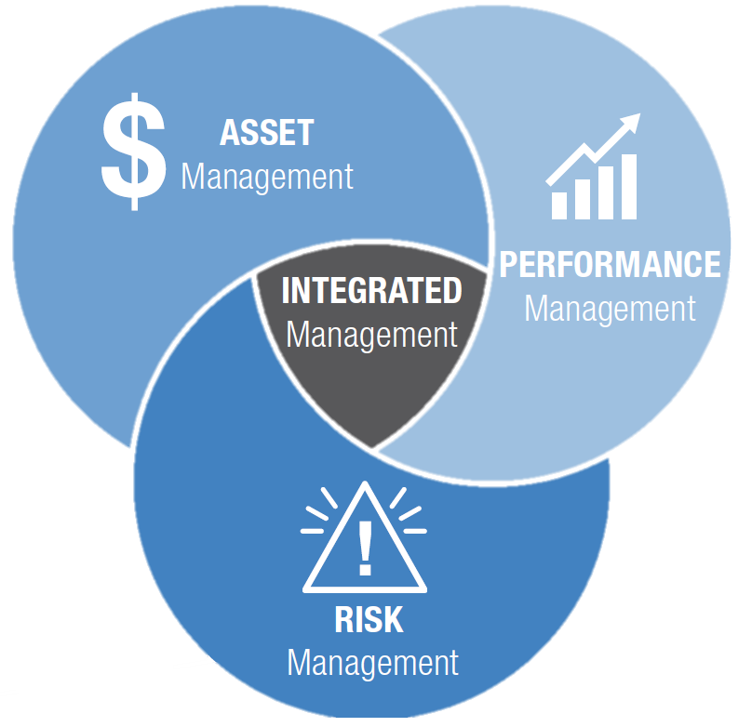
Integrating Performance, Risk and Asset Management
As transportation agencies mature, recognizing process, data, and staffing synergies in the different ways the organization is managed –move to a more holistic perspective.
A synergistic perspective does more than reduce inefficiencies, it drives overall agency performance forward.
Notes:
Those gaps in system management captures on the previous slide are all directly impacted by effective management integration practices and for those who have dealt with these conditions as process or progress roadblocks, they can begin to illustrate the opportunities that integrating performance, risk and asset management can address with the right circumstances.
These integration circumstances and a process for development were the focus of research conducted in coordination with transportation and transit agencies across the country and can provide guidance in assessing, developing and managing an agency’s integration journey.

Slide 6
Available Integrated Management Resources
Agencies can now utilize NCHRP research to take initial integration steps or identify next steps on their integrated management journey.
Primary research objectives were to provide agencies with practical guidance, recommendations, and implementation practices for:
Integrating performance, risk, and asset management into transportation agencies
Identifying, evaluating, and selecting appropriate management frameworks
Recruiting, training, and retaining human capital to support these integrated management functions
Notes:
The primary research objectives were to provide guidance as an agency invests time and resources to:
Integrating performance, risk, and asset management into transportation agencies
Identifying, evaluating, and selecting appropriate management frameworks
Recruiting, training, and retaining human capital to support these integrated management functions
The research and resulting guidance are developed through elaborate assessment of national and international agencies as well as direct coordination and process development with a diverse group of agency’s where the research team dug into agency-specific environments and conditions to gauge integration maturity and needs as well as develop an integration framework that can be used in unique agency situations while being versatile enough to be applicable to any agency at any integration maturity level.

Slide 7
The Integration Framework
“Our annual capital planning process is what gets everyone's attention around here. To make a difference, let's call out projects that address climate resilience”
Shared efforts and challenges consistently fall into one or more of 5 Key Areas
5 Key Areas for Management Integration
"If we had a cross-silo task force for integrated asset, performance, and risk management, we could share data and collaborate more”
“Singular assets that are shared across divisions allow for actual life-cycle costing, analysis and staffing requirements”
Notes:
Initial research determined that agency efforts and challenges could be consistently held in one or more of five key themes. Further research demonstrated that an integration strategy and focus on these 5 areas of management integration was effective in targeting integration and investment efforts and propelling integration maturity forward.
Some key elements from each of these 5 Key areas include:
Approaches to Integration: Integration champion and agency executive buy-in, agency culture that promotes collaboration and communication, business processes that entice and enable integration
Data and Software Needs: enterprise data governance structure that seeks to standardize datasets to be more usable and accessible
Personnel and Skills: enterprise training capability that drives agency vision, communication and “soft-skill” development, knowledge retention practice
Policy and Agency Structure: Executive level buy-in, agency structure that promotes communication, cooperation and collaboration across divisional lines
Resource Requirements: Skills and data requirements identified and communicated, innovative funding schemes to propel integration

Slide 8
Fitting the Key Areas to YOUR Agency
Each agency is on a unique integration journey, however using the 5 Key Areas as a framework for the discussion can be fruitful:
Cross-department conversations on potential process, effort, or data synergies
Identified gaps in training, organizational structure, etc.
Immediate and longer-term ideas for tasks and objectives to follow-up on
A more holistic understanding of agency maturity in integrating management
Notes:
Although concepts are defined and example efforts are included in the guidance, the research demonstrated consistently that effective integration happened at the staff-level so therefore unique to an agency depending on the staff, skills and integration development level at the time.
As agencies follow the guidance and plan to mature their management integration, the framework should be applied liberally and specifically to realize the value in integration.

Slide 9
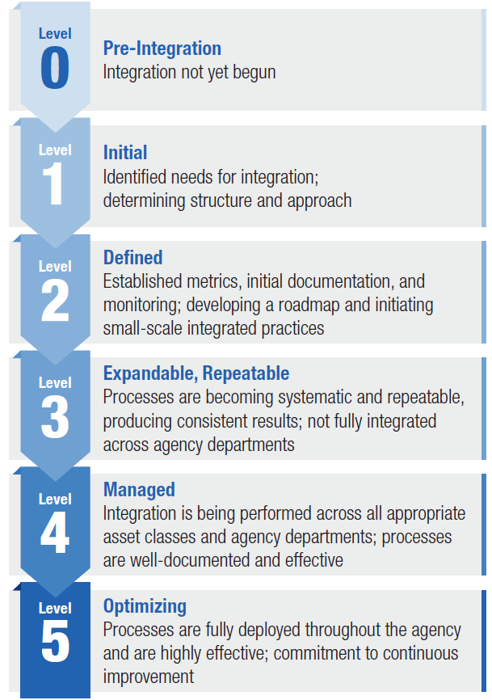
Integration Maturity Assessment
The Integration Maturity Assessment was developed for the Guidance to:
Enable agencies to self-assess progress in each of the 5 Key Areas
Standardize (generally) agency maturity assessment metrics
Results from a group of diverse agency staff show where integration efforts are progressing and highlight where challenges remain.
Notes:
The intent of the Integration Maturity Assessment is to utilize a standardized framework of assessment to gauge current maturity in each of the 5 key areas. This will serve to initiate the integration discussion as well as perpetuate further progress as an agency regularly “re-assesses” integration maturity and tracks progression in each area.
The discussion element in this maturity assessment process will reveal challenges and opportunities between the three management practices, these elements will be key in developing the integration roadmap

Slide 10
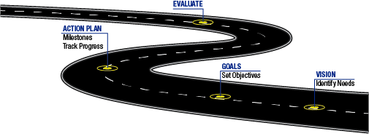
Developing an Integration Roadmap
Making observations of challenges and opportunities from maturity assessment actionable and trackable.
Roadmap development includes:
Vision statement consistent with enterprise strategic direction
Time-bound goals that break down the vision into actionable components
Strategies and an action plan that achieve those goals
Clear strategy to evaluate progress, re-assess maturity and optimize efforts
OPTIMIZE
EVALUATE
ACTION PLAN
Milestones
Track Progress
GOALS
VISION
Set Objectives
Identify Needs
Notes:
The roadmap is the primary “what” and “how” from the guidance. This is a living document that reflects the continuous process of integration and can therefore mature along with the agency as integration efforts take hold. The structure of the roadmap supports enterprise efforts both in connecting directly to the agency’s vision as well as aligning agency culture with development metrics.
The roadmap development process incorporates the results from the maturity assessment and follows a process that includes staff and process leads from performance, risk and asset management to create an goals and actions that capitalize on opportunities and address challenges the agency faces in its current condition.
Critical to furthering integration maturity, the roadmap also sets forth a period for review where maturity progress can be assessed and goals and actions can be revitalized to drive integration forward.

Slide 11
A Guidance for Integrating Management
A Guidance developed around these 5 Key Areas is available for agencies to reference in their individual efforts
Agencies can understand what they need to do (regardless of progress) and the “Value Add” of integrating management practices
Agencies will understand the “how” of integration:
Frameworks for effective integration
Strategies to promote organizational and workforce readiness
Benefits of integration and common challenges agencies face
Checklist to assess level of maturity variations based on existing practices
Notes:
The process and concepts in this process are provided in a guidance that can further direct agencies on common roadblocks and rules of thumb as specific integration efforts are considered.

Slide 12
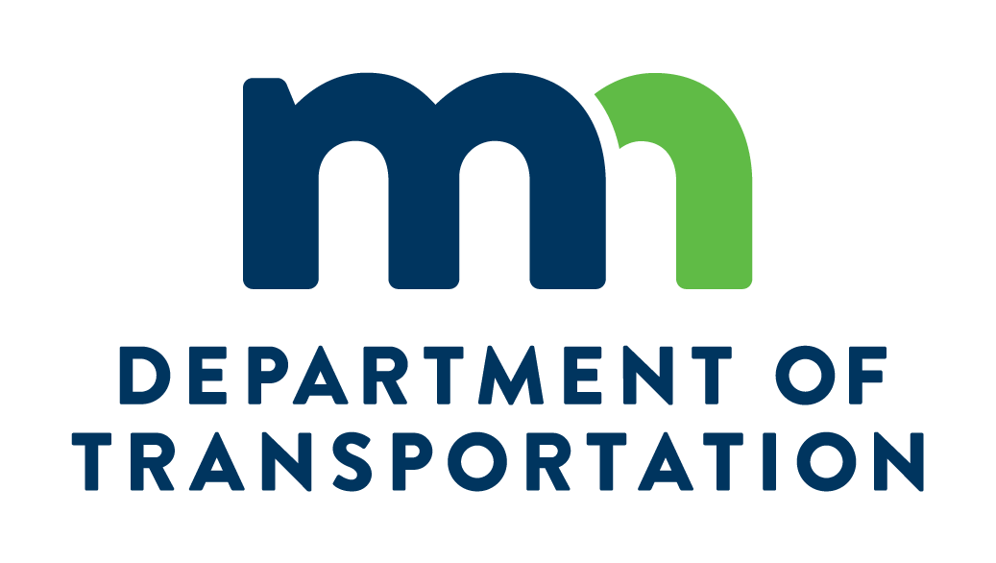
Guidance Resource Proof of Concept
Guidance was “Test Driven” during workshops with agencies of varying size and situations. The case study examples, common challenges, and implementation ideas from these workshops can help YOUR agency.
Core implementation discussion features when following the Guidance:
Organized scope of discussion within Key Areas
Identifying gaps and opportunities with the Integration Maturity Assessment
Development of a Roadmap to set the vision, identify tasks, and track progress
Notes:
To ensure the guidance was applicable to any agency, the research included test-driving the recommendations with volunteer agencies. Agencies were intentionally selected to cover a diverse range of size, complexity , environments and processes. This process test included taking maturity assessments, the development of a roadmap and action plan. An agency executive initiated each discussion prior to roadmap development and clearly communicated the agency value in the efforts.
These volunteer agencies have since internalized these action plans and have already communicated short-term plans to re-assess integration maturity again and further develop the goals in their roadmap.

Slide 13
Key Observations from the Research
What can an agency count on as champions for change?
Champions are the voice of “why” and the force of “how”!
Champions have walk-in privileges with the people who control bridge and pavement inventories, GIS systems, etc.
Champions facilitate the documentation of current practices and the development of a critical path
Champions secure financial resources and executive-level endorsement for change to business practices and standard operating procedures
Champions ensure that if they leave the organization, others can continue their work.
Observations that guided conversations and/or were shared between many agencies are included as lessons learned including
The critical need for a Champion – someone to drive the change
Underlying agency culture has significant impact on integration level-of-effort, complexity, feasibility and success
The common need for enterprise standards and data glossaries
Notes:
In conclusion, some key observations will be included that were gathered during the research and engagement functions of research development that were general and foundational to overall integration.

Slide 14
Other Key Observations
Necessity of executive level buy-in and a supportive organizational structure for integration management
The need to modify or change agency culture to support a more inclusive working process and enable integration efforts
The need to motivate agencies to integrate performance, asset, and risk management while recognizing the need for standardized methods of modeling how threats may undermine performance goals or accelerate asset deterioration

Slide 15
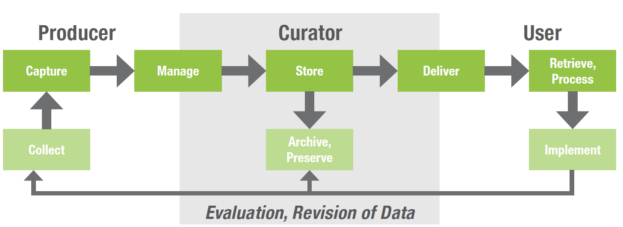
Other Key Observations
The important role of enterprise standards to lay the foundation for integrated processes, communications, data and resource sharing
Data governance can play a pivotal role in identifying integration strengths and barriers
The impact of an ongoing discussion of data needs and access support the evolution of an agency’s integrated framework
Identifying and building policy frameworks for management area integration that are most effective for transportation agencies
Sample Data Governance Map

Slide 16
What Should Happen Next?
Communicate need for executive buy-in for a push for more effective decision-making
Identify an Integration Champion, they will collect others to the effort and drive these changes.
Give authority and responsibility to the integration Champion to bring the right people, use the Guidance as a framework and develop a Roadmap
Utilize the Maturity Self- Assessment to identify growth opportunities

