Slide 1
NCHRP Web-Only Document 262
This presentation describes the research effort that led to the Sustainable Highway Construction Guidebook
Principal Investigators:
Dr. Stephen T. Muench, University of Washington
Dr. Giovanni Migliaccio, University of Washington
Dr. Amlan Mukherjee, Michigan Technological University
Dr. Jeralee Anderson, Greenroads Foundation
Dr. Jessica Kaminsky, University of Washington
Chaitanya Bhat, Michigan Technological University
Milad Zokaei Ashtiani, University of Washington
Contributing Authors:
LTCOL Ryan Howell, USAF
Bita Astaneh, University of Washington
James Feracor, University of Washington
Julian Yamaura, University of Washington
Dhrupad Rupwate, University of Washington
Amy Moore, University of Washington
Steven Tuttle, University of Washington
Yousif Almaroof, University of Washington
Rachel Tan, University of Washington
Catherine Wang, University of Washington
Notes:
This presentation is intended to overview the contents of the Guidebook.
Where appropriate, the “notes” section provides relevant Guidebook text or other relevant information.
The intention of the notes section is to provide general information and background rather than a strict script, which can be limiting.

Slide 2

NCHRP Web-Only Document 262:
Presentation
Project:
Budget:
Duration:
Objectives:
NCHRP 10-91A
Sustainable Highway Construction Practices
$300,000
26 months (October 2016 – December 2018)
Identify effective sustainability practices than can be done during the construction of highway projects;
Prepare a guidebook that can be used to identify, evaluate, and select these practices.
Notes:
Photo by Steve Muench, used with permission
If you want, you can unhide this slide and show the time and contract amount. Note that this was a second attempt at completing this contract. The first, when originally issued was in 2013 for $450,000.

Slide 3




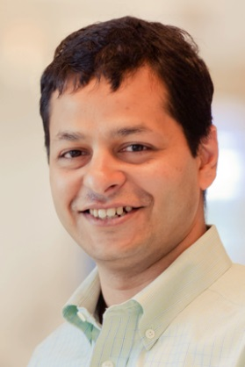
Research Team
Steve Muench, Ph.D., P.E.
Professor, U. of Washington
Sustainable roadway design/construction
Interactive guides: Pavement Interactive
Pavement materials/construction
Founder/board: Greenroads rating system
Founder/board: Pavia Systems, Inc.
Jeralee Anderson, Ph.D., P.E.
Executive Director, Greenroads
Greenroads rating system
Exclusive Greenroads data & experience
Principal author for v1.5 and v2.0 manuals
200+ project ratings in U.S. and worldwide
Designed professional certification program
LEED-AP
Principal Investigator
CO-PI
Giovanni Migliaccio, Ph.D., P.Ing.
Associate Professor, U. of Washington
Project delivery
Project procurement, contracting
Project management
NCHRP research experience
Report 690 and Report 787
Jessica Kaminsky, Ph.D.
Assistant Professor, U. of Washington
Questionnaire design & research methods
Interview research expertise
Qualitative analysis
Social sustainability of infrastructure systems
International/developing country expertise
CH2M prior experience
CO-PI
CO-PI
Amlan Mukherjee, Ph.D., P.E.
Associate Professor, Michigan Tech
Sustainable construction
Life cycle assessment (PE2, PCRs, EPDs)
Web-based construction simulation
ASCE digital project delivery committee
UAV assessment for MDOT
CO-PI
Notes:
Not sure why you would every want to show the investigator’s faces, but you can if you unhide this slide.

Slide 4

Project Definition
Sustainable Construction Practices
Construction practices able to assist in (1) building highways, (2) preserving and restoring surrounding ecosystems, (3) meeting basic human needs such as equity, employment, health, safety, and happiness, and (4) managing resources wisely (including, but not limited to, money).
Scope
Limited to construction (not design, planning, etc.)
Limited to things we can do now
Focus
Beyond the minimum required.
Construction practices that are above-and-beyond the required regulatory minimum or standard practice, or construction practices that show innovation in meeting these minimum standards in support of people and the environment.
This is typically how sustainability is presented in the construction industry. Required/standards are already addressed.
Notes:
Picture credit: Steve Muench (used with permission)

Slide 5
Major Tasks
SCP = Sustainable Construction Practice
Work Item | Highlights
PHASE 1: Determine State-of-Practice
Literature Review | Identified 65 SCPs, Developed framework
Online Survey | Identified 57 SCPs, learned state-of-practice
Interviews | Identified 32 SCPs, more SCP details
Workshop | 14 November 2017, Beckman Center Feedback on work and proposed Guidebook
PHASE 2: Products
Write a Guidebook | PRINCPLE PROJECT PRODUCT
Implementation Memo | Top Recommendation: Web delivery
Final Report | Research description and details
Notes:
This presentation takes you through the research work from beginning to end. It makes transparent how the concepts and ideas were developed and modified throughout the research process. It is meant to compliment the NCHRP Guidebook on Sustainable Construction Practices since it provides lots of details necessarily left out of the Guidebook.
The research had 2 basic phases: (1) determine state-of-practice, and (2) write a Guidebook. The intention is for the Guidebook to be the lasting output from the project although, as always, a final report is required.

Slide 6
Key Findings of Phase 1
Determine State-of-Practice

Slide 7
Literature Review
Key Findings
Identified 64 SCPs
Developed framework for construction
Developed framework for sustainability
Notes:
Task 1: Review existing literature for (1) similar efforts previously undertaken in related fields, (2) frameworks within which to view sustainability, construction and related topics, and (3) specific sustainable construction practices.
Key findings: Reviewed 196 published sources and identified 64 sustainable construction practices (SCPs), which are listed in Task 3. Defined sustainability, developed preliminary categories for both construction and sustainability and how they relate.

Slide 8
Highway Construction Framework
Level | Category
Project Delivery | Delivery method
 | Financing
 | Procurement
 | Contracting
Project | Scheduling
 | Estimating
 | Project Controls & Administration
 | Earthwork
 | Drainage/Sewer/Water
 | Structures
 | Pavement
Level | Category
Project | Work Zone Traffic Control
 | Materials
 | Safety
 | Employment
 | Training
 | Community & Health
 | Noise
 | Light
 | Constructability
 | Quality
 | Equipment
 | Utilities
 | Landscaping
Notes:
Construction framework. We created a framework for highway construction “depth” meaning that it encompasses all organizational levels at which SCPs may be identified. Direction from the NCHRP panel is to focus on “project” level practices more thoroughly while still providing information on programmatic and project delivery practices. This framework was modified throughout the process. You are looking here at the final framework.

Slide 9
Sustainability Framework
Dimension | Category
Human Wellbeing | Workers
 | Neighbors & Stakeholders
 | Users
Environmental Wellbeing | Pollution
 | Local Ecosystems & Habitat
 | Consumption
 | Climate
Economic Wellbeing | Project Budget
 | Maintenance & Operations
 | Economic Dev./Employment
Notes:
Sustainability framework. A framework that defines specific sustainability subtopics is useful so all participants understand the full breadth of sustainability and can use common language to refer to specific components. We begun with a framework based on previous research but after the workshop decided to abandon that one because it had lots of unfamiliar terms. Replaced it with ones that were focused on highway construction. You will notice the dimensions are the typical 3, and the categories are how those dimensions typically show up in a highway construction project.

Slide 10
Sustainability and Highway Construction Framework
Notes:
This table shows how the two frameworks relate. You can use this table to (1) enter with a sustainability idea/goal and see what parts of construction are likely to address it, or (2) enter with a construction element and see what parts of sustainability it might affect.

Slide 11
Survey Findings
Key Findings
Identified 57 SCPs
Survey Descriptive Data
Descriptor | Data
Total Responses (total number of surveys taken, complete or not) | 367
Completed surveys (number of surveys completely filled out) | 141
Partial completions (number of surveys that were not completely filled out but still used in the analysis of survey results) | 226
Availability (when the survey is available to be taken) | 3/9/17 – 5/10/17
Average response rate per day | 5.94/day
Agreed to be contacted for interviews and workshop participation | 124 (34%)
Mean and Median time to complete survey (367 respondents) | 23 min / 5 min
Best estimate of time to take entire survey | 8-10 minutes
Notes:
The Task: Conduct an online survey to: (1) generate leads for potential inclusion in the interview process and/or workshop, and (2) capture some basic information on perceptions of sustainability within the highway construction industry. Since the survey distribution was not random, or purposefully equally distributed amongst categories of respondents, conclusions about the industry based on the survey are limited to very general statements or speculation. The survey is designed to take less than 10 minutes to complete and collect from each participant (1) basic demographics, (2) general views on sustainability, and (3) sustainable construction practices with which they are familiar.
Here are statistics from the survey. The following pages show selected results

Slide 12
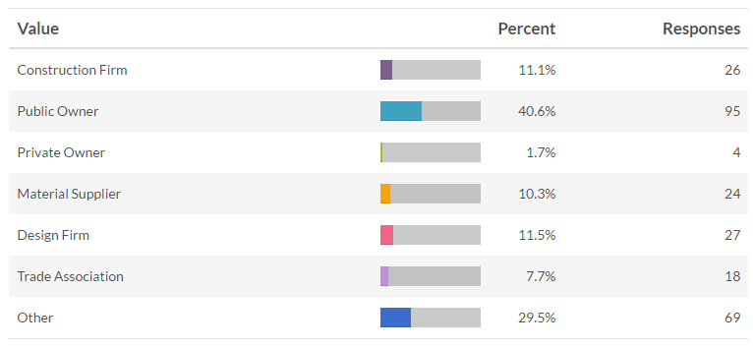
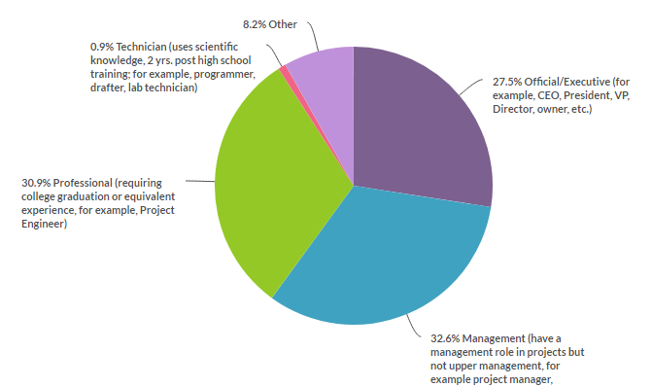
About the
Survey
Respondent
Organizations
Respondent
Job Categories
Notes:
Demographics. Respondents were a reasonable mix by industry role, organization size, job category, and geography. Specific findings were:
Construction firms and material suppliers comprised 21.4% of respondents; a minority when compared to owners’ 42.3% share of respondents. This was expected and interviews were designed to focus more on contractors to allow them more of a voice than captured in the survey.
Using U.S. Small Business Administration definitions, 13.9% of responses came from small business.
Job categories were split among professionals (30.9%), management (32.6%) and official/executive (27.5%) rather equally. Technicians were not significantly represented (0.9%). “Other” comprised the remaining 8.2%.

Slide 13
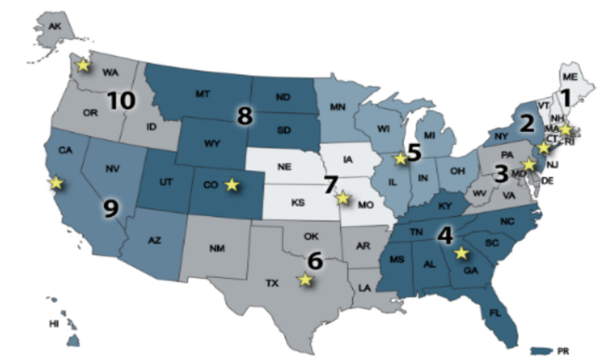
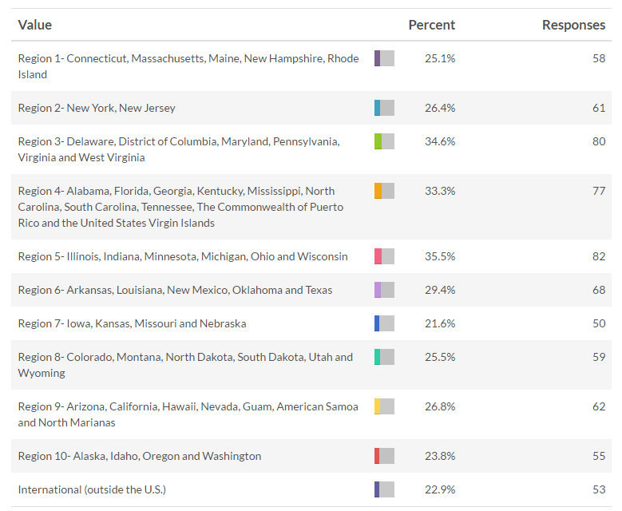
About the
Survey
Geographic
Diversity
Notes:
One last bit on demographics:
All geographic regions were represented well, including international (22.9%). Of the 10 U.S. DOT geographic regions, the lowest response rate came from Region 7 – Iowa, Kansas, Missouri and Nebraska (21.6%) and the highest response rate came from Region 5 – Illinois, Indiana, Minnesota, Michigan, Ohio and Wisconsin (35.5%).

Slide 14
State-of-Practice Finding:
Respondent views on sustainability emphasize durability/endurance and reduced consumption.
182 responses
  26: specifically mention reduced consumption
  57: durability and endurance concepts
  5: referred only to sustainability of infrastructure assets
Impacts of highway projects generally viewed as negative and something to be minimized
Notes:
Here’s what the survey told us about the state-of-practice in highway construction sustainability:
26 responses specifically mentioned reducing consumption in some way.
57 responses directly referred to durability and endurance concepts (long-life, lasts a long time, etc.).
5 responses defined “sustainability” to refer to the sustainability of infrastructure assets specifically.
When responses discussed impacts of highway projects (to humans, environment, economy) they almost unanimously discussed reducing negative impacts.

Slide 15
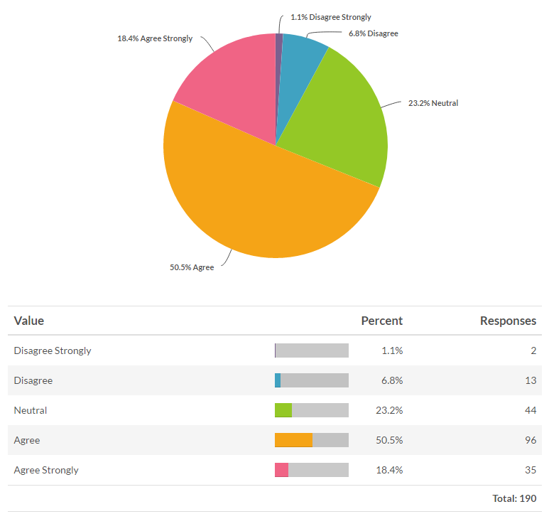
State-of-Practice Finding:
Most respondents said sustainability was a core value of their organization.
Respondents’ level of agreement with the statement “Sustainability is a core value of my organization/company.”
Notes:
Most respondents (68.9%) agree that sustainability is a core value of their organization/company.

Slide 16
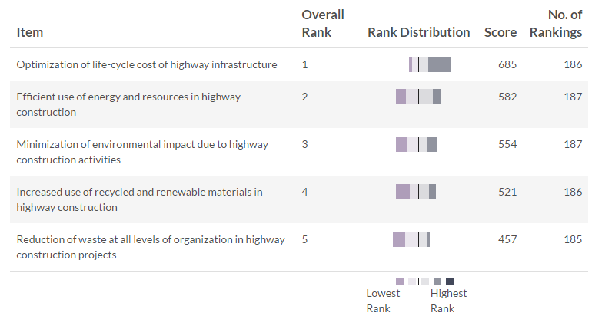
State-of-Practice Finding:
Motivations for doing sustainability are more about cost than environment.
Notes:
We asked participants to rank order five motivations for sustainability as identified in a previous study. “Optimization of life-cycle cost of highway infrastructure” emerged as the clear top rank, and “reduction of waste at all levels of organization in highway construction projects” was the clear lowest rank, while other motivations were quite close together in the middle. This led us to a sentiment that cost seems to rank a bit higher than environment

Slide 17
SCP Survey Response Summary (340 total)
Level | Category | SCPs | Failed | Not recognized | Rewarded | TOTAL
Program | Org. Strategy/Culture/Ex. Support | 14 |  | 1 | 1 | 16
 | Policy/Program | 31 | 3 | 4 | 5 | 43
 | Human Resources | 6 |  |  |  | 6
 | Environmental Management Syst. | 18 | 1 | 1 | 3 | 23
Project Delivery | Project Delivery Method | 17 |  |  | 1 | 18
 | Project Procurement | 10 |  | 1 | 1 | 12
 | Contracting | 7 |  | 1 |  | 8
Project | Scheduling | 4 |  |  |  | 4
 | Estimating | 3 |  |  |  | 3
 | Project Controls | 7 |  |  |  | 7
 | Contract Administration | 15 |  |  | 1 | 16
 | Earthwork | 11 | 2 | 2 |  | 15
 | Drainage/Sewer/Water | 13 | 5 | 1 | 1 | 20
 | Structures (Aesthetics) | 0 | 1 |  | 1 | 2
 | Structures (Bridges) | 3 |  | 2 | 3 | 8
 | Structures (Walls) | 1 | 1 | 1 |  | 3
 | Pavement | 8 | 4 | 2 | 4 | 18
 | Work Zone Traffic Control | 24 |  |  |  | 24
 | Materials | 98 | 31 | 11 | 8 | 148
 | Safety | 10 |  |  |  | 10
 | Employment | 10 | 1 |  | 2 | 13
 | Training | 6 | 2 |  |  | 8
 | Public Outreach | 22 |  |  |  | 22
 | Noise | 4 | 1 |  |  | 5
 | Light | 1 |  |  | 1 | 2
 | Design for Constructability | 25 | 1 | 2 | 1 | 29
Notes:
The survey also collected 340 responses to open-ended questions about sustainable construction practices. Rather than reviewing all those here, this table shows a rough categorization of the responses. Some observations on these responses are…(see next slide)

Slide 18
Observations from SCPs
Materials are the most common sustainability topic, by far.
  21% of responses addressed materials
Recognition (or lack of it) for sustainability efforts is not a significant concern.
  Recognition was rarely identified as motivation
SCPs tend to work when done.
  340 SCPs comments
  53 comments talked about failures – most about the same few things
Notes:
A few observations at a very high level. So it looks like materials (recycled materials especially) are most synonymous with sustainability. Organizations aren’t doing sustainability to obtain recognition (at least it’s not their primary motivator), and the sustainable practices reported on generally tend to work. 53 comments addressed things that didn’t, but most were about the same few things (too much RAP, too much RAS, etc.)

Slide 19
Interviews
Key Findings
26 interviews
32 SCPs identified
Interview Descriptive Data
Descriptor | Data
Total Interviews: | 26
Interview subjects: | 1 academic (4%) 12 constructors (46%) 8 DOT/Owner (31%) 5 designer/consultant (19%)
Interview time statistics: | Total interview time: 16.2 hours Mean interview length: 37 minutes Shortest interview: 19 minutes Longest interview: 60 minutes
Notes:
The Task: Conduct interviews to (1) generate leads for potential inclusion in the workshop, and (2) capture specific information on sustainable highway construction practices and perceptions within the highway construction industry. The interview value is in uncovering information that is not typically published, and unable to be captured in the brief format of the survey (e.g., opinions on SCPs, influence of business practices on accomplishment of SCPs, impacts of SCPs on contractors and owners, etc.). Interview topics were limited to what the interview subjects knew. Therefore, some things that their organizations may have done or experienced may not have been captured if the subject was unfamiliar with the topic. Interview subjects were intentionally selected to ensure a diverse set of topics were addressed. The number of subjects addressing a topic is not necessarily indicative of its popularity in industry.
Some summary statistics here

Slide 20
Interview Findings
Selected findings:
  In a competitive bid environment, contractors are likely to implement SCPs that directly reduce their costs or make them money; other practices must be compensated for by the owner.
  There is no leading entity in sustainable highway construction.
  Most SCPs can provide benefit if used in the proper context.
Notes:
Interview findings were broad and don’t lend themselves to statistics quite as easily. We made the decision to not pursue coding to a research-repeatable level because we felt the returns on doing so were not worth it. Each interview subject was asked a few general questions, but many questions were unique to each subject depending upon their expertise.
Select results are here.

Slide 21
Workshop
Key Findings
109 suggestions, 28 participants
There is little guidance on procuring sustainability in highway construction
In construction, sustainability is not currently as important as cost or schedule
Isolating construction from other highway sustainability contributors is difficult
A programmatic approach may be better than one-off attempts
Notes:
We conducted a day-long workshop on November 14th, 2017 at the National Academy’s Beckman Center in Irvine, CA. Attendees were:
4 research team members
5 panel members
1 NCHRP Senior Program Officer
18 participates from industry invited by the research team
The purpose of the workshop was to review and revise:
our list of Sustainable Construction Practices (SCPs) uncovered so far
the framework we have developed for classifying construction and sustainability
our preliminary idea for how best to present this information in a guidebook
For this slide, the first 2 bullet points were influential in the direction and content of the Guidebook.

Slide 22
Key Products of Phase 2

Slide 23
Guidebook: Audience/Purpose
This guidebook is intended for the highway construction industry: the practitioners who work for and with owner agencies, construction contractors, designers and related professions.
It is intended to assist in:
  Selecting appropriate sustainable construction practices (SCPs)
  Specifying sustainability in contract documents
  Using sustainability as a criterion to evaluate construction practices
Notes:
The Guidebook is the principal product from this project. Intent is shown here.

Slide 24
Guidebook: Guiding Principles
Provide concise, useful information to practitioners
  Short on time
  Information, not essays
  Concise and direct: details left to other publications
Do not tell industry how to construct highways
  Use Guidebook as an “idea book” as in remodeling
  Not an instructional textbook
  Highway construction is best understood by the industry that does it every day for a living
Notes:
2 guiding principles shown here. We felt is was important to avoid telling the audience how to construct highways – a comprehensive guide wasn’t going to be very useful since we expect readers to be experts in that subject. Or at least associated with such experts. Rather, it was a better approach to provide an idea book from which readers could read suggestions and generate their own ideas (or use the ones in the guidebook) to come up with sustainable construction practices.

Slide 25
Guidebook: How to Use
Use the sustainability definition as the common meaning of “sustainability” when included in construction procurement and contracting
Use the sustainability framework to more precisely describe owner goals and objectives in project procurement and contracting
Identify what construction categories and practices best address what sustainability components.
A source of SCP ideas
Evaluate any construction practice for sustainability
Aid in procuring and contracting sustainability
Notes:
Here is how the authors envision the Guidebook being used

Slide 26
Guidebook: Limitations
Guidebook can’t do this… | Because… | Instead it will do this…
Identify a set of construction practices as sustainable in all circumstances | Sustainability is context sensitive, what may be a great idea in one project may be bad in another | Stimulate SCP ideas by describing each category and including SCP examples
Say how much a SCP costs | Cost is context sensitive (e.g., project scope/type) | Provide a subjective gauge of effort (input) and impacts on human, environment, economic (outputs)
Tell contractors how to build something more sustainable | The contractor for a particular project is much better qualified to determine what works best | Describe what sustainability is in straightforward terms, help owners/contractors speak the same language, stimulate creative ideas
Notes:
This slide comes from what we originally perceived as information desired from a Guidebook on sustainable highway construction and what could reasonably be produced. Ideally, a full list of things to do, their prices, and how to do them sounds appealing, but is not possible to produce.

Slide 27
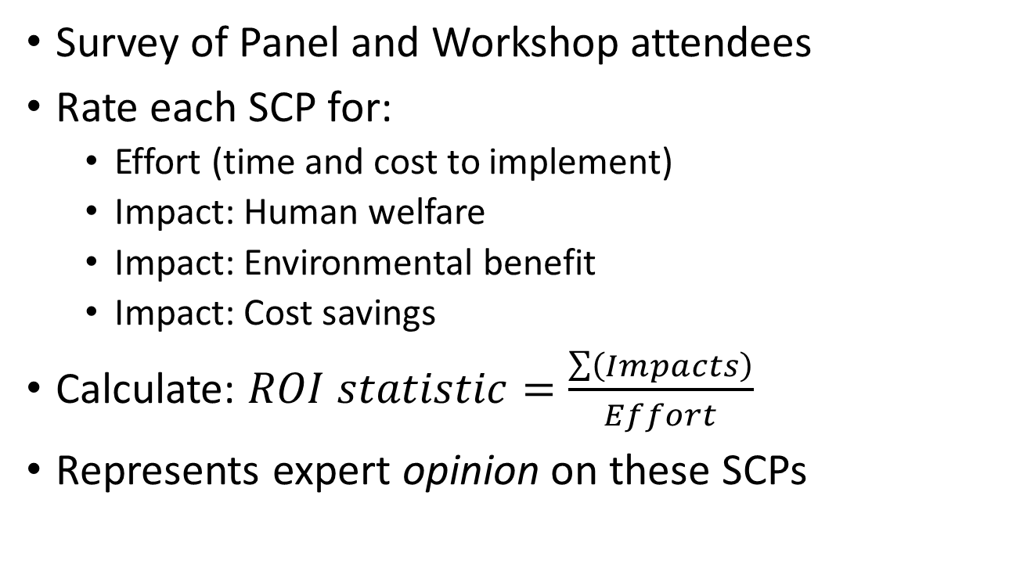
Guidebook: SCP Rating Survey
Survey of Panel and Workshop attendees
Rate each SCP for:
  Effort (time and cost to implement)
  Impact: Human welfare
  Impact: Environmental benefit
  Impact: Cost savings
Calculate: $ROI statistic=\frac{\sum{\left(Impacts\right)}}{Effort}$
Represents expert opinion on these SCPs
Notes:
One thing the Guidebook does is provide a “rating” for each SCP on effort (what it costs in time and money) and impact (environmental, human, budget). Then a sort of “return on investment” statistic that sums the impacts and divides by effort. Importantly, these ratings are the perceptions of those surveyed. More about the rating below if you want to know:
In the conduct of Task 7 the research team believed a numerical rating of each SCP was useful based on research presentation feedback and an internal sense that numerical rating would heighten interest in the SCPs. A proposal to the panel to conduct a limited survey of panel members and workshop attendees/invitees to produce these ratings was submitted and approved along with a 2-month no-cost project extension.
Survey purpose. The Rating Survey is meant to quantify aspects of sustainability for each SCP. This quantification, based on participant perception, should be interpreted to represent a rough perception of each SCP and nothing more. We feel that the presence of these numbers because, while they do not represent any sort of measured truth, they can function as a useful beginning point for dialog about the SCPs and their impacts/efforts.
About the survey. An online survey was prepared and distributed to the panel members, workshop attendees, workshop invitees (those invited but unable to attend), and researchers.
Participants were asked to assign 0-5 stars to each of four categories for each of the 76 SCPs:
Effort. A combined rating that represents the cost and time you believe it takes to do or implement this sustainable practice.
Human welfare. The impact the sustainable practice has on human health and well-being. How much it directly benefits people in terms of basic needs (food/water/sanitation), health and happiness (health, safety, culture, aesthetics), and personal/social development (education, equality, good governance).
Environmental benefit. The positive impact the sustainable practice has on the environment. How much it contributes to clean air/water/land, natural resources (ecological resources, water resources, and reduced consumption of these things), and climate/energy (contribution to renewable energy, reduced fossil fuel use, and GHG emissions reduction).
Cost savings. The immediate and long-term cost savings from the sustainable practice. Think broadly here: some things may cost more up front and provide savings in the long term, and some things may seem to cost money, but may actually save money if you consider all impacts over the long term.
A summary statistic called “impact-to-effort ratio” was calculated by adding up the three impact category scores and dividing by the effort score. This creates a single metric by which SCPs can be measured.
$$\text{impact}\text{−}\text{to}\text{−}\text{effort} \text{ratio}=\frac{\text{human} \text{welfare}\text{ + }\text{environmental} \text{benefit}\text{ + }\text{cost} \text{savings}}{\text{effort}}$$
Notes on interpretation of survey results. This survey is decidedly non-scientific for the following reasons:
Participants are not randomly selected. The survey was intentionally distributed to a select group of participants (NCHRP panel and workshop participants/invitees) considered to have a level of expertise in highway construction sustainability.
The survey is uncalibrated. Participant responses are not calibrated to one another (a 2-star response from one participant may not represent the same effort/impact as a 2-star response from another), nor are impact/effort categories calibrated to each other (a 3-star response in one category may not represent equal impact/effort as a 3-star response in another category).
Effort/impacts of SCPs vary with project context. Project context is not specified; participants are asked to respond based on their own personal experience with the SCP, which may be different than others.
In fact, there are common issues when trying to quantify sustainability: (1) few efforts are true random surveys, (2) there are no common units in which to express “sustainability”, and (3) sustainability is context sensitive so there is no consistent quantification.

Slide 28
Guidebook: Outline
Introduction
  Audience, purpose, scope, organization, how to use
Background
  Sustainability defined, trends, enabling factors
Sustainable construction practices (SCPs)
Using sustainability as a criterion to evaluate highway construction practices
Procuring sustainability
Contracting sustainability
Notes:
Here is what’s in the Guidebook. The major contributions are the catalog of SCP ideas (listed in Section 3, more detail in the Appendix), and ideas on how to use sustainability as a criterion to evaluate ANY construction practice, how to procure sustainability, and how to contract sustainability. Remember from the workshop that these ideas came out as strong limiters of sustainability use in construction.

Slide 29
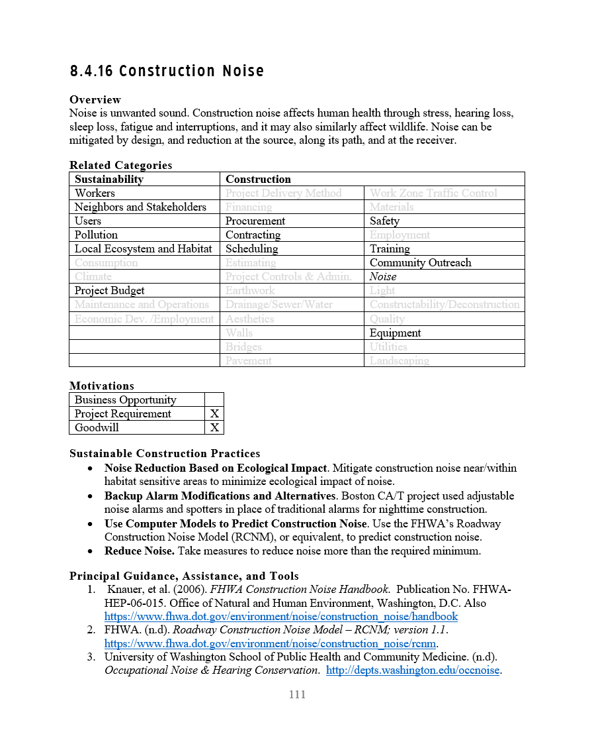
A Peak at the Guidebook SCPs
Construction Category Page Contents
Title of the Construction Category
Overview of what the category is and general sustainability practices
Of the 10 sustainability and 26 construction categories, highlights those related to this category.
Of the 3 possible motivations for SCPs, which apply in this category
Brief listing of SCPs addressed in this category
Best resources to consult for SCP guidance, assistance and tools in this category
Notes:
Each construction category has an introductory page that summarizes the category. Looks like this.

Slide 30
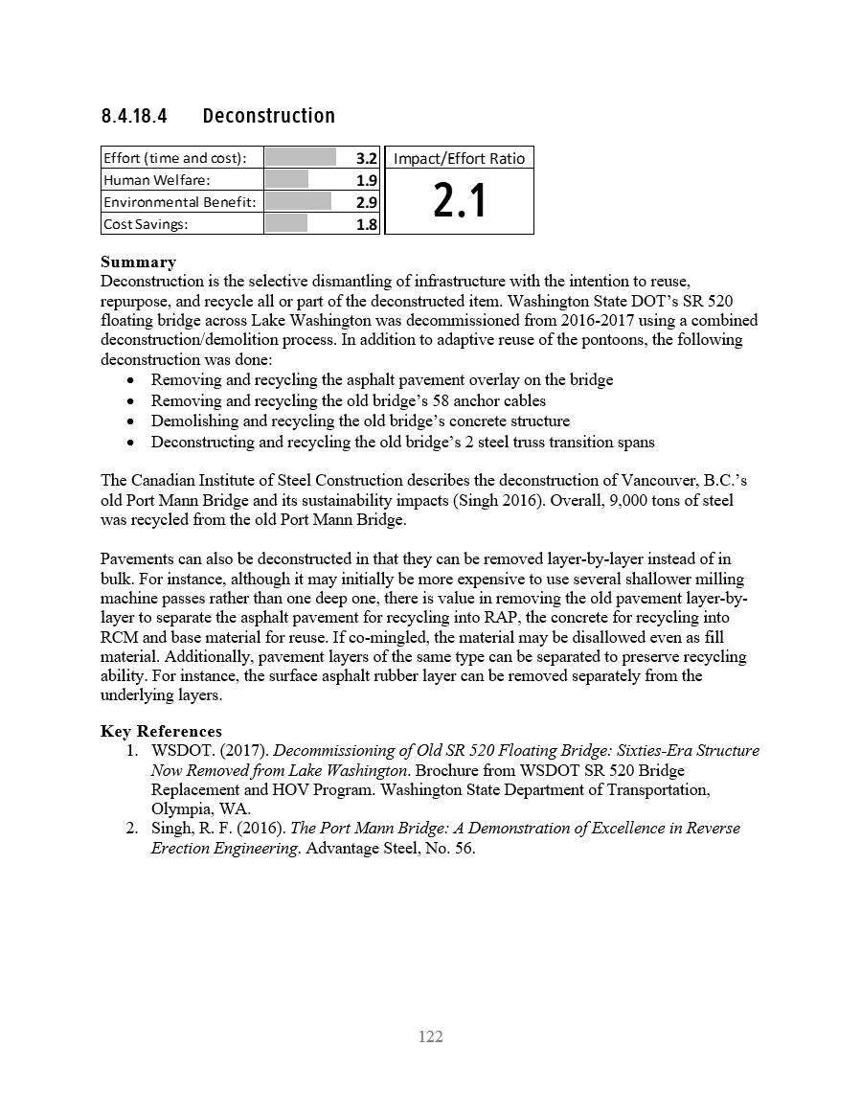
A Peak at the Guidebook SCPs
Sustainable Construction Practice Contents
Title of the SCP
SCP ratings
Summary of the SCP.
Key references that describe the SCP in more detail, provide examples or otherwise give more information

Slide 31
Implementation Memo
Online delivery
  5 million views instead of 500
  Need model for continued service
Guidelines
  Incorporating sustainability into construction contracts
  Development of sustainability management plans
Training
Feedback to sustainability rating systems
Methods/tools to quantify/evaluate/document
Notes:
The Task: A technical memorandum was prepared in accordance with Special Note E in the request for proposals that read:
“The required technical memorandum titled “Implementation of Research Findings and Products” should (a) provide recommendations on how to best put the research findings/products into practice; (b) identify possible institutions that might take leadership in applying the research findings/products; (c) identify issues affecting potential implementation of the findings/products and recommend possible actions to address these issues; and (d) recommend methods of identifying and measuring the impacts associated with implementation of the findings/products. Implementation of these recommendations is not part of the research project and, if warranted, details of these actions will be developed and implemented in future efforts.”
The following are recommended implementation efforts:
Online delivery of the Guidebook. Convert the Guidebook (Deliverable K) to an online resource like WebMD, HowStuffWorks, LifeHacker, Wolfram, or, in the highway industry, Pavement Interactive. This could be done through original development or including Guidebook content on already-popular sites like Pinterest or Diigo.
Guidelines for incorporating sustainability into highway construction contracts. Provide guidance, including archetype language, on how to incorporate sustainability into highway construction contracts. This could be a catalog of approaches to contracting and contract language organized by contract type.
Guidelines for development of sustainability management plans for transportation agencies. Provide guidance to develop and a set of prototype sustainability management plans that can be used for highway construction projects.
Sustainable highway construction training. Develop and deliver online training on the contents of the Guidebook. Online training could take the form of a self-guided course, webinar, or combination.
Feedback to sustainability rating systems. Provide written feedback to major U.S. sustainability rating systems (Greenroads, INVEST, Envision) concerning (1) how they address highway construction, (2) SCPs identified in this project that the rating systems include and omit, and (3) suggestions for inclusion of the project’s findings.
Methods and tools to quantify, evaluate and document sustainability efforts. Develop methods and tools to quantify, evaluate, and document sustainability efforts. Currently, it takes much time and effort to quantify, evaluate, and document the impact of many sustainability efforts. While methods exist to quantify metrics like greenhouse gas emissions, energy use, and life-cycle cost (e.g., life cycle assessment, life cycle cost analysis) they must be performed by subject matter experts in a one-off manner and are often not repeatable at a reasonable price point. Existing industry professionals are generally not trained in these methods, and the few readily available estimating tools use inconsistent methods. The best subject to start with is life cycle assessment (LCA).

Slide 32
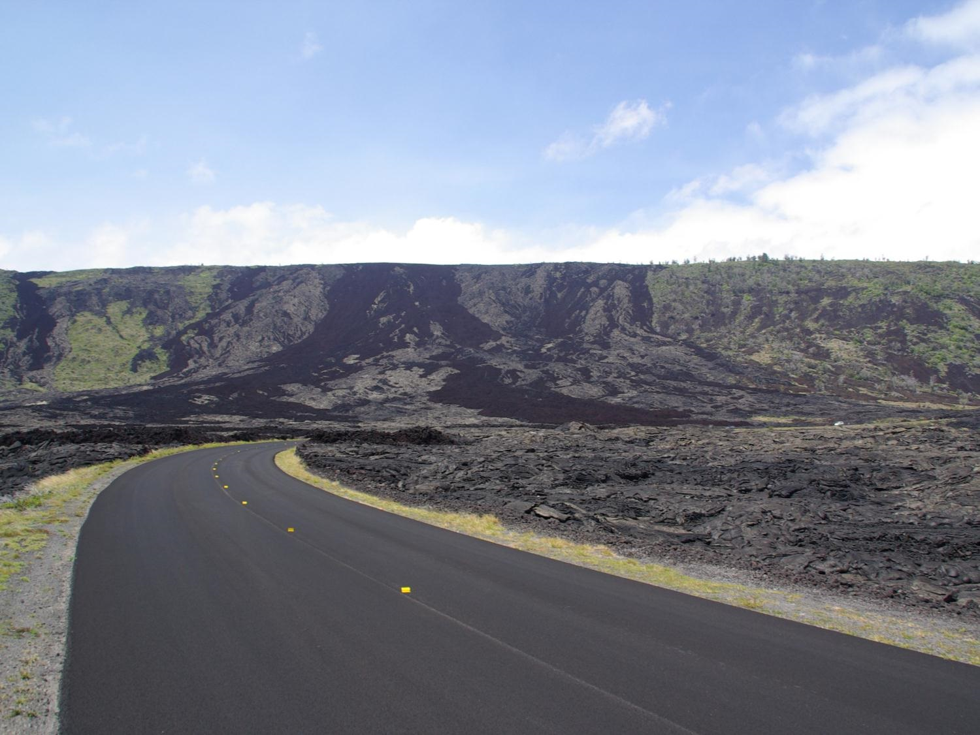
Notes:
Time for questions.
Picture by Steve Muench, used with permission

