Slide 1
DESIGN IDEA BOOK
NCHRP 25-25, Task 118: Context-Sensitive Design Options for Workhorse Bridges in Rural Historic Districts
November 2019
Visual guide to context-sensitive design of workhorse bridges in or adjacent to rural historic districts.
Notes:
Image courtesy of Trevor Wrayton, VDOT)

Slide 2
ACKNOWLEDGEMENT OF SPONSORSHIP
This work was sponsored by one or more of the following as noted:
☒ American Association of State Highway and Transportation Officials, in cooperation with the Federal Highway Administration, and was conducted in the National Cooperative Highway Research program,
☐ Federal Transit Administration and was conducted in the Transit Cooperative Research Program,
☐ Federal Aviation Administration and was conducted in the Airport Cooperative Research Program,
☐ The National Highway Safety Administration and was conducted in the Behavioral Traffic Safety Cooperative Research program,
which is administered by the Transportation Research Board of the National Academies of Sciences, Engineering, and Medicine.
DISCLAIMER
This is an uncorrected draft as submitted by the contractor. The opinions and conclusions expressed or implied herein are those of the contractor. They are not necessarily those of the Transportation Research Board, the Academies, or the program sponsors.

Slide 3
ACKNOWLEDGEMENTS
This study was conducted for the AASHTO Committee on Environment and Sustainability, with funding provided through the National Cooperative Highway Research Program (NCHRP) Project 25-25, Task 118, Context-Sensitive Design Options for Workhorse Bridges in Rural Historic Districts. The NCHRP is supported by annual voluntary contributions from the state Departments of Transportation. Project 25-25 is intended to fund quick response studies on behalf of the Committee on Environment and Sustainability.
This Design Idea Book was prepared in November 2019 by Steven Bedford, Camilla McDonald and Kate Umlauf, WSP. The work was guided by a technical working group that included:
Ann L.B. Miller, Virginia DOT
Michael A. Fitzpatrick, HDR
Robert W. Hadlow, Oregon DOT
Dennis A. Randolph, City of Grandview (MO)
Kristina Thompson, Pennsylvania DOT
Kristen Zschomler, Minnesota DOT
David Clarke, FHWA (Liaison)
Melissa A. Savage, AASHTO (Liaison)
The project was managed by Ann Hartell NCHRP Senior Program Officer and Jarrel McAfee, Senior Program Assistant.
Permission to use any unoriginal material has been obtained from all copyright holders as needed.

Slide 4
CONTRIBUTORS
We would like to thank the following departments of transportation, project consultants, and SHPO staff for contributing their time and expertise to this project.
Delaware DOT
Indiana DOT
Michigan DOT
New Mexico DOT
Ohio DOT
Oregon DOT and SHPO
Pennsylvania DOT
Texas DOT
Virginia DOT
New Hampshire DOT
Oakland County Road Commission
Oakland County Planning & Economic Development Services
City of Rochester Hills, MI
Joanne Keim
Ira Beckerman
Trevor Wrayton
Beam, Longest and Neff
Benesch Engineering
IH Engineers, P.C.
Urban Engineers
Mead & Hunt
Madison County Historic Preservation Commission

Slide 5
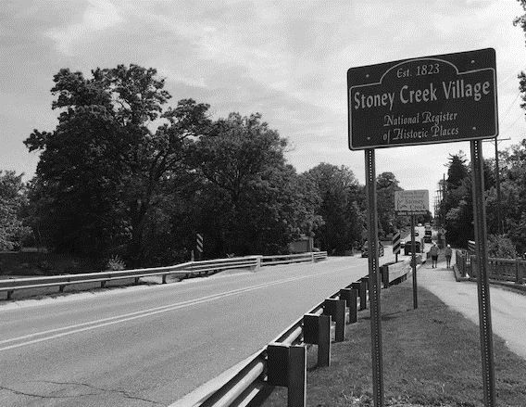
TABLE OF CONTENTS
Chapter 1: Introduction
Chapter 2: Guided Questions
Chapter 3: Guiding Principles
Chapter 4: Design Features
References and Additional Resources

Slide 6
CHAPTER 1
INTRODUCTION
Intent
How to Use This Idea Book
Approaches to Context-Sensitive Design/Solutions
Bridge Terminology
Notes:
NOTE TO USER: This section provides an overview of how to use this idea book, potential approaches to CSD/S solutions and common bridge terminology.
Image Courtesy of WSP

Slide 7
INTRODUCTION
Intent
The intent of this design idea book is to present design features that have been used to achieve context-sensitive designs in or adjacent to rural historic districts through illustrations of successful workhorse bridge designs exhibiting features that might be used in typical rural settings.
It is laid out for use during the design and public involvement process to provide a range of possible bridge designs and approaches to the CSD/S of workhorse bridge replacements.
“Context Sensitive Design (CSD) is design process that not only considers physical aspects or standard specifications of a transportation facility, but also the economic, social, and environmental resources in the community being served by that facility.” (FHWA)
Workhorse bridges can be defined as spans of less than 300 feet, generally constant girder-type structures assembled from standard structural components and systems.
1-2
Chapter 1 \ Introduction
Notes:
¹ An accompanying technical summary report details the methods and results of a literature review, state of practice survey, and case study analysis. This report can be found on the Transportation Research Board website here: https://apps.trb.org/cmsfeed/TRBNetProjectDisplay.asp?ProjectID=4488

Slide 8
How to Use This Idea Book
This Design Idea Book can be used as a visual guide during design and public meetings to aid in making compatible design choices for workhorse bridge replacements in or adjacent to rural historic districts.
The bridge designs highlighted in this book are not all appropriate for all rural historic districts. When considering the design of a bridge in or adjacent to any historic district, decisions must be made in conjunction with an understanding of the local historic context as well as current engineering and safety standards.
Chapters 2 and 3 of this design book provides guided questions and guiding principles designed to steer practitioners and stakeholders to a successful replacement design.
Chapter 4 details the most common design elements or features that contribute to successful workhorse bridge replacements in rural historic districts.
Chapter 1 \ Introduction
1-3

Slide 9
Approaches to Context Sensitive Design/Solutions
Research conducted as part of NCHRP 25-25, Task 118, revealed five general approaches to Context-Sensitive Design/Solutions (CSD/S) for replacement bridges in or adjacent to rural historic districts. Although each bridge replacement is unique, most projects will follow one of these approaches:
Regional – This approach draws influence from regional bridge styles as well as from a desire to create a modern, regional tradition.
Replication – This approach is straightforward in its name; replacing a bridge with a replica design.
Previous Bridges – This approach draws design influence from previous iterations of the existing bridge.
Stakeholder-Driven – This approach is centered on the public involvement process and uses stakeholder input as a driving factor in proposed design elements.
Design/Safety Driven – This approach stems from the necessity of a replacement design to address design and safety issues of the existing bridge.
1-4
Chapter 1 \ Introduction

Slide 10
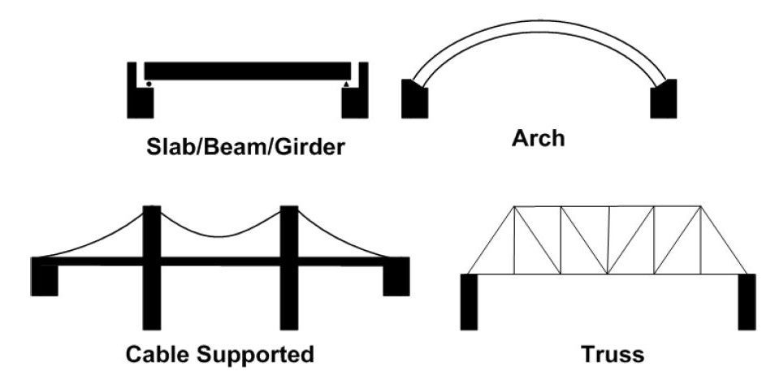
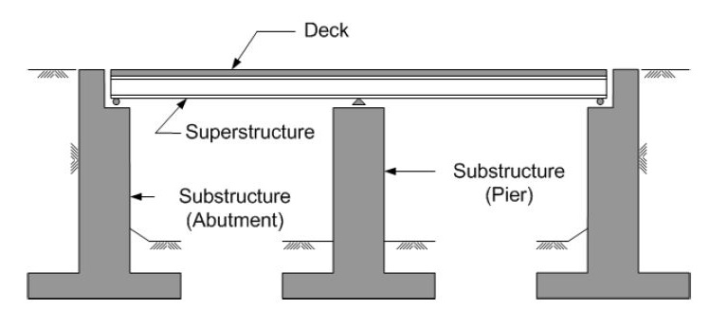
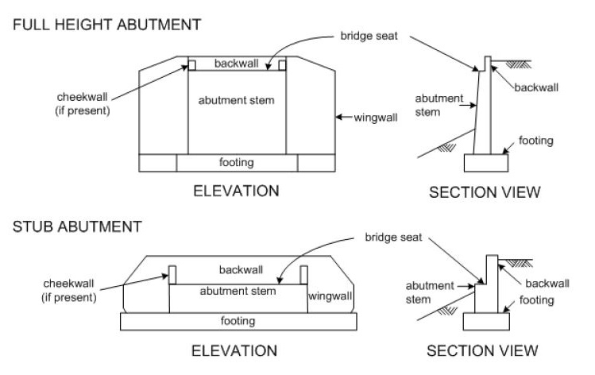
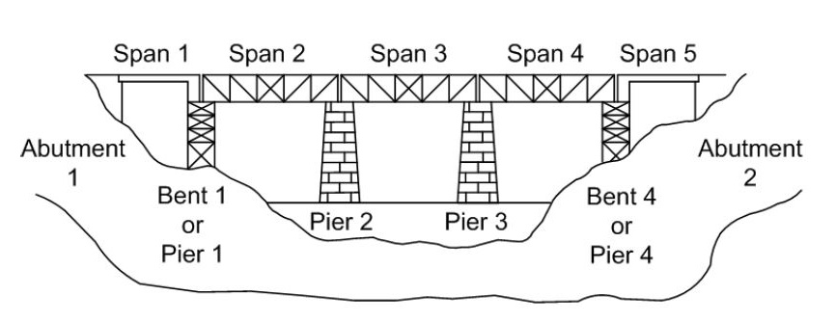
Bridge Terminology
From Bridge Inspector’s Reference Manual, U.S. Department of Transportation, 2002.
Chapter 1 \ Introduction
1-5

Slide 11
CHAPTER 2
GUIDED QUESTIONS
Topics
Setting/Context Significance
Design
Safety
Public Involvement
Choosing a CSD/S Approach
Regional
Replication
Previous Bridge
Stakeholder-Driven
Design/Safety-Driven
Notes:
NOTE TO USER: This chapter first poses a series of questions designed to guide the practitioner and the public in an evaluation of the historic context and character-defining features of the bridge to be replaced. The bridge itself, location, setting, and materials and design are common sources of significance that can lead to identifying character-defining features of a bridge that could be reflected in a new design.
Useful tools when evaluating the significance of a bridge within a local historic context are state bridge survey reports and state historic bridge contexts or multiple property contexts listed in the NRHP. A compiled list of completed contexts (in 2004) is included as an appendix to the A Context for Common Historic Bridge Types (PB and EIH 2005), which itself is a good resource for understanding the context of a bridge. This is the report produced from NCHRP 25-25, Task 15.
Other tools for evaluating local historic contexts include consultation with DOT and SHPO staff historians, collaboration with stakeholders, utilization of Geographic Information System (GIS) software to understand spatial relationships within the area, and visual observations and analysis to understand scale and aesthetic treatments.
Second, a section on Choosing a CSD/S Approach outlines five general approaches to the context-sensitive replacement of a workhorse bridge in or near a historic district (Regional, Replication, Previous Bridge, Stakeholder-Driven, and Design/Safety-Driven). These approaches typically evolve naturally from the specific circumstances of the bridge, its context, the attitudes/interest of the public, and the design requirements of the new structure.
While each bridge replacement is unique, review of existing project examples indicates that most projects will follow one of these approaches. Understanding these approaches may assist practitioners in guiding stakeholders and other interested parties through the CSD/S design process to a successful outcome.
Image Source: HAER HI-75-33

Slide 12
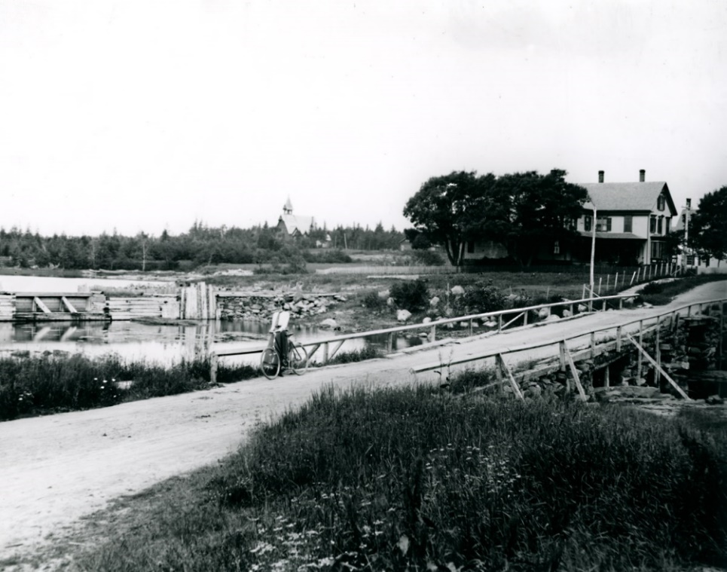
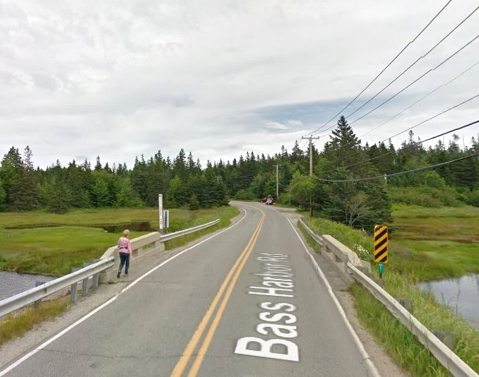
TOPICS
Setting/Context
Historically, how many bridges have been at the site?
Do previous bridges have more of a historical connection to the historic district than the current bridge?
(Courtesy of Southwest Harbor Public Library Digital Archive)
(© Google 2011)
2-2
Chapter 2 \ Topics
Notes:
The existing bridge, at the time of replacement, is not always the original bridge. One or more bridges may have existed at the location and are potentially a source of design inspiration.

Slide 13
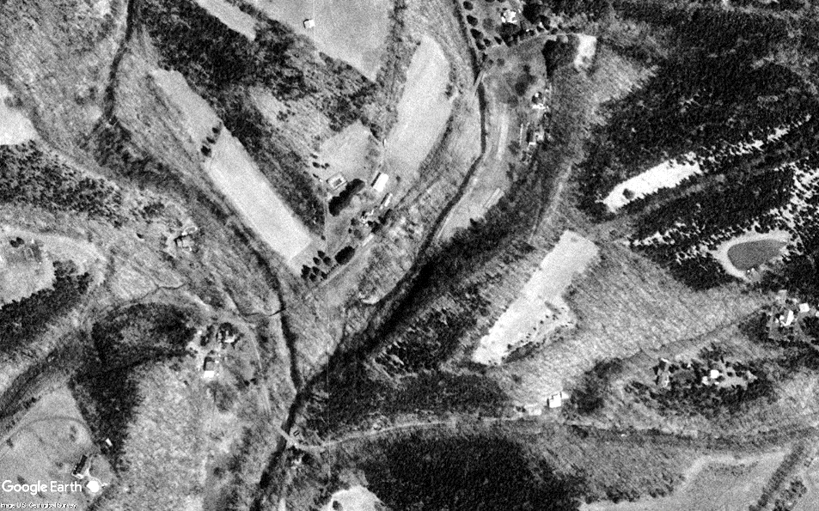
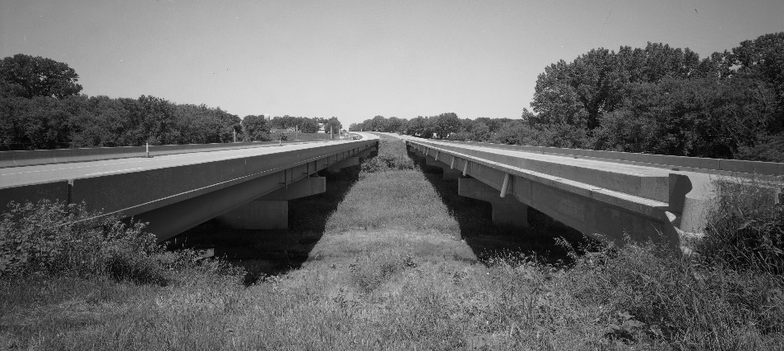
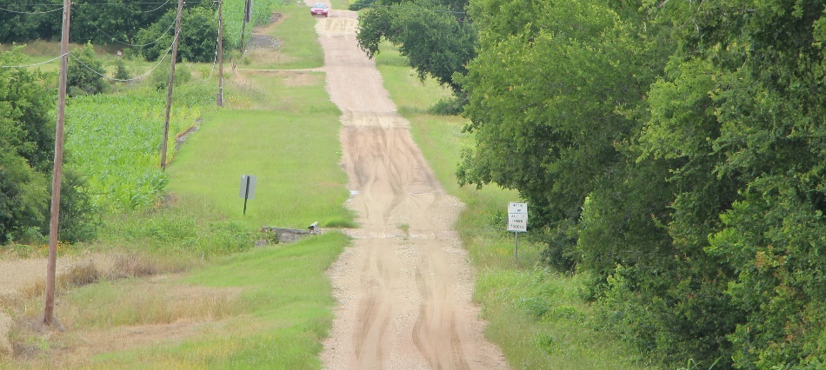
Setting/Context
Why was the site historically chosen for a bridge?
(USGS; Ottsville, PA 1999)
(HAER OR-36)
Natural/advantageous river crossing?
Part of a scenic route/parkway?
Need to find engineered roadway photo
(HAER IA-98)
(Courtesy of TxDOT/Mead & Hunt)
(Courtesy of TxDOT)
Part of an engineered road network?
Agricultural (farm to market) network?
Chapter 2 \ Topics
2-3
Notes:
The location of a bridge may contribute to the overall circulation network and integrity of feeling of a historic district, characteristics that should be retained in a new design. Roads, bridges, pathways, and waterways facilitate movement within a landscape, and principal features of those routes can be contributing elements to a district. They must relate to the significant land use patterns presented within the historic period.
Another consideration on bridge location is how the design relates to the landscape it directly crosses or interacts with. Does the bridge take on a unique shape to accommodate a challenging landscape or crossing feature? This consideration is more immediate than the broader surrounding landscape, which may not have a direct impact on the design of the bridge.

Slide 14
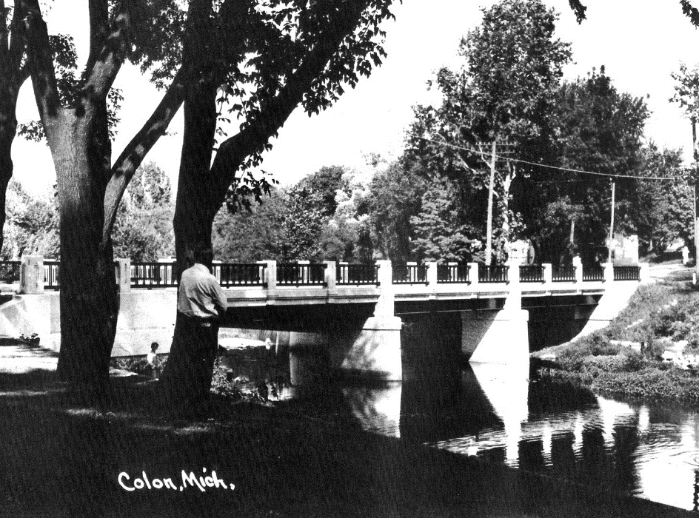
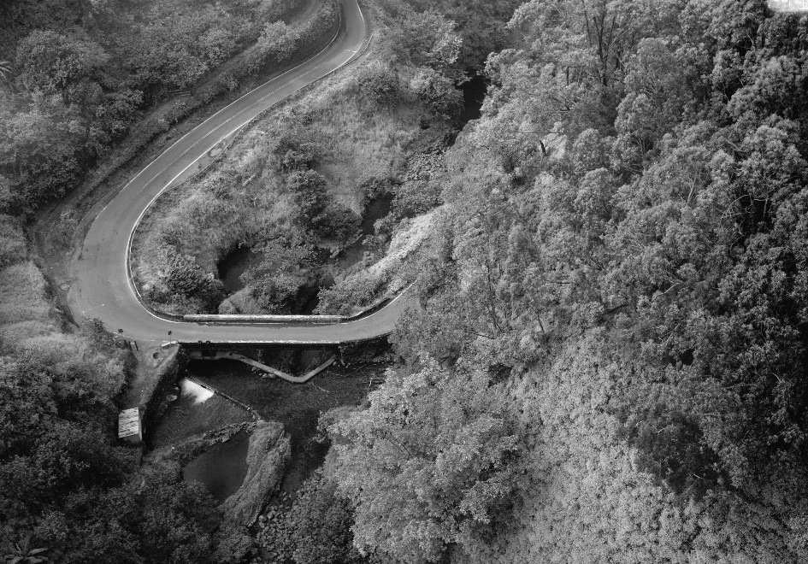
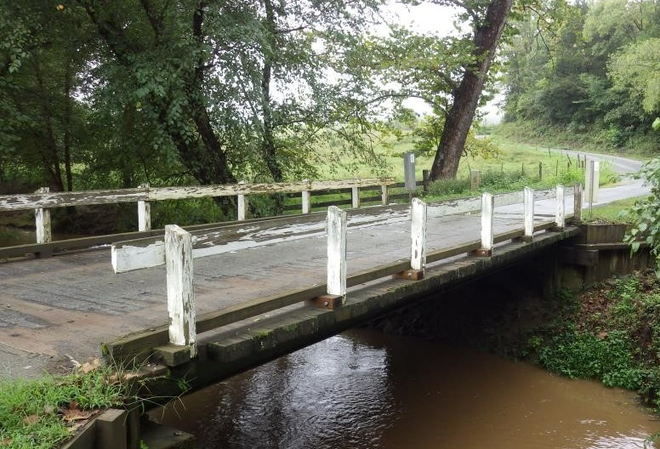
Setting/Context
What was the historic function of the bridge within the HD circulation network?
(Courtesy of Colon Museum)
(HAER HI-75-33)
Gateway
Transportation Link
Utility Bridge
Waterway or Land Feature Crossing
(Courtesy of VDOT)
2-4
Chapter 2 \ Topics
Notes:
A gateway bridge marks a specific point of entry or departure from a historic district, which often carries a level of significance because it signals a transition in character. That function and feeling should be retained in the design of a gateway bridge replacement. Maintaining exact location, scale, and shape will aid in that retention.
A bridge located on a main thoroughfare within a historic setting may take on a more distinct visual image. Is it a landmark bridge within the town? To what is the bridge providing access? The location of a bridge may also signal use as a utility bridge, allowing transport of commercial goods or access to resource areas.

Slide 15
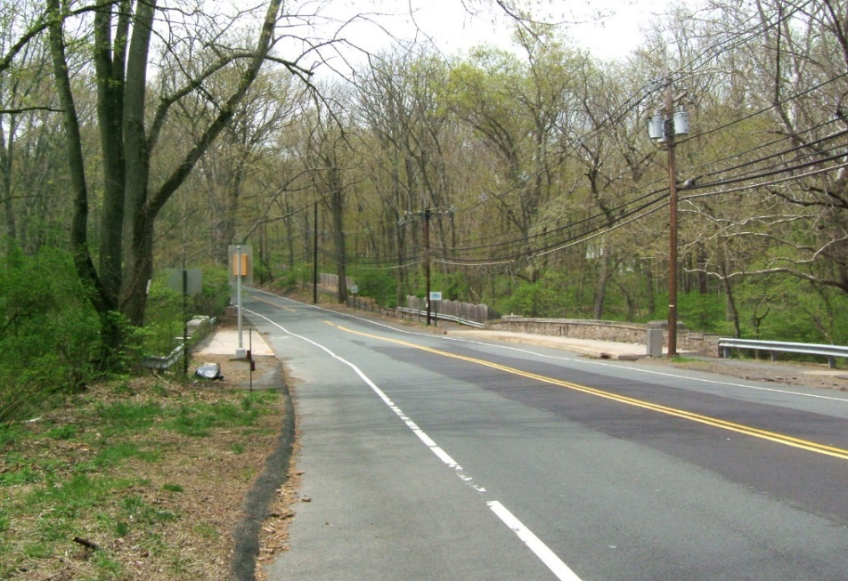
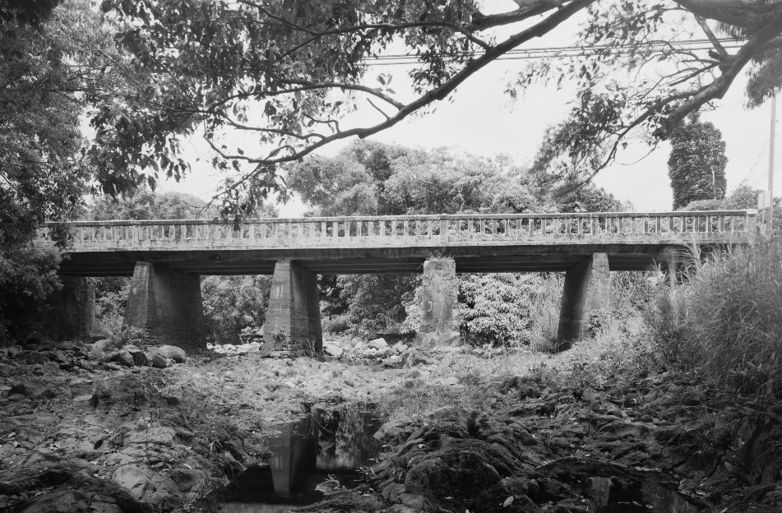
Setting/Context
Was the workhorse bridge designed to blend with the landscape or stand out?
(Courtesy IH Engineers, April 2005)
(HAER HI-71-4)
Chapter 2 \ Topics
2-5
Notes:
Consider the scale relationship between the existing bridge with other visible built structures as well as the surrounding natural landscape features. Does the scale of the bridge allow certain viewsheds of other significant features in the district? Does the scale of the bridge contribute to the visual harmony of the setting? The scale relationship between a bridge and its surroundings plays a large role in the visual characteristics of a district, contributing to integrity of setting, feeling, and association. Generally, bridges in rural areas are built modestly to defer focus to the surrounding landscape rather than bring attention to the structure itself. A similar sense of scale should be retained in a replacement bridge design in a historic district.
An evaluation of character-defining features of a landscape is just as critical to understanding the historic context of a bridge as an evaluation of the bridge itself and should aid in the design process.
Bridge design will therefore differ from state to state and district to district, based on the natural characteristics of the setting as well as the interests of the cultural group building them and the guiding modern design standards and technology. An evaluation of the natural landscape in relation to the existing bridge design may highlight areas of significance.

Slide 16
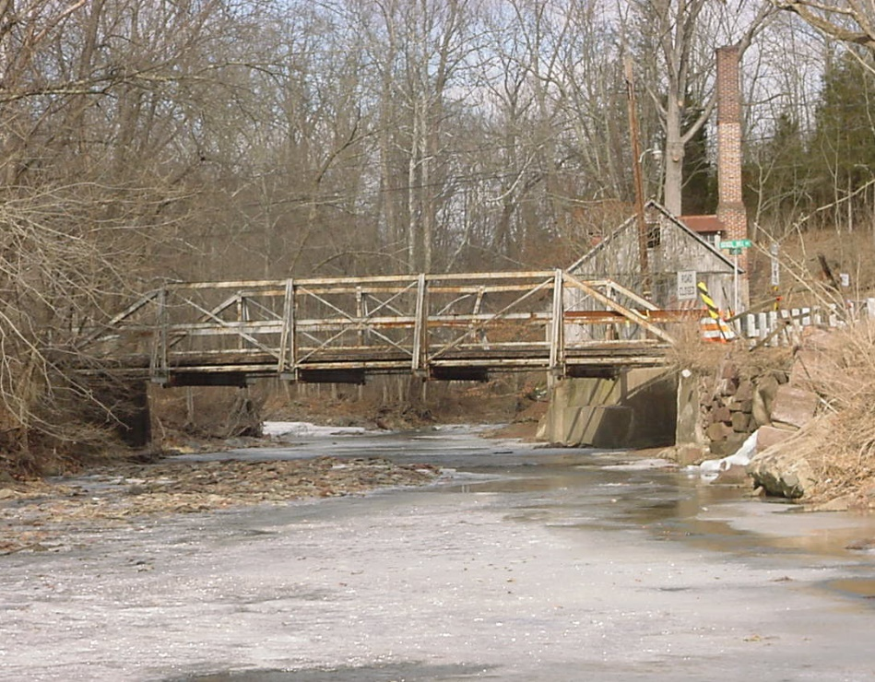
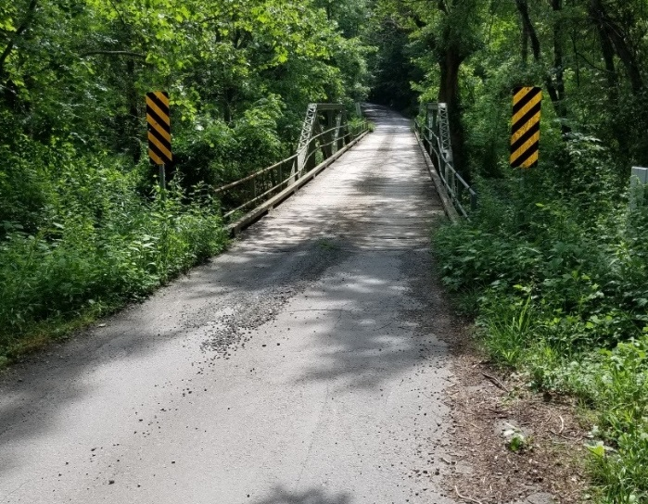
Significance
Is the bridge individually significant as well as contributing to a historic district?
(Courtesy of Benesch Engineering)
How is the bridge contributing to the historic district?
(Courtesy of VDOT)
(Courtesy of VDOT)
2-6
Chapter 2 \ Topics
Notes:
The problem with workhorse bridges is that their straightforward construction may seem to result in few significant or character-defining features, leaving CSD/S practitioners to look elsewhere for historic context, overlooking the fact that the low-key structural nature of the bridge actually is a significant feature. In this case, CSD/S practitioners may turn to the historic district and surroundings for context, which may or may not be relevant to the bridge’s significance individually or as a contributing structure to the district. This can often lead to creating a historicized version of the new bridge.
Use the remaining questions to pin point what makes the bridge contributing or non-contributing to the historic district and reflect those characteristics in the resulting replacement design.
Historic workhorse bridges are often representations of the technology of bridge design from a certain point in time. They reflect common forms, plans, and styles highly significant to historic character. They are not showpieces typically, or designed by notable designers, nor do they normally have overt aesthetic treatments. They are everyday working structures with no frills. The construction materials used identify the resources and technology available when a bridge was built and can provide clues into the character of the broader historic perspective.

Slide 17
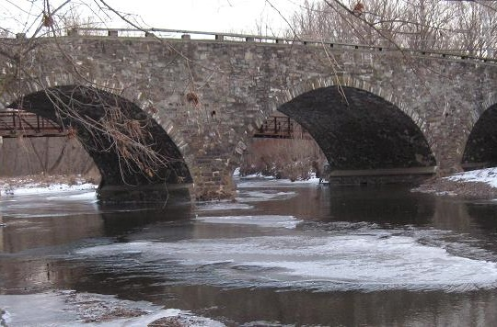
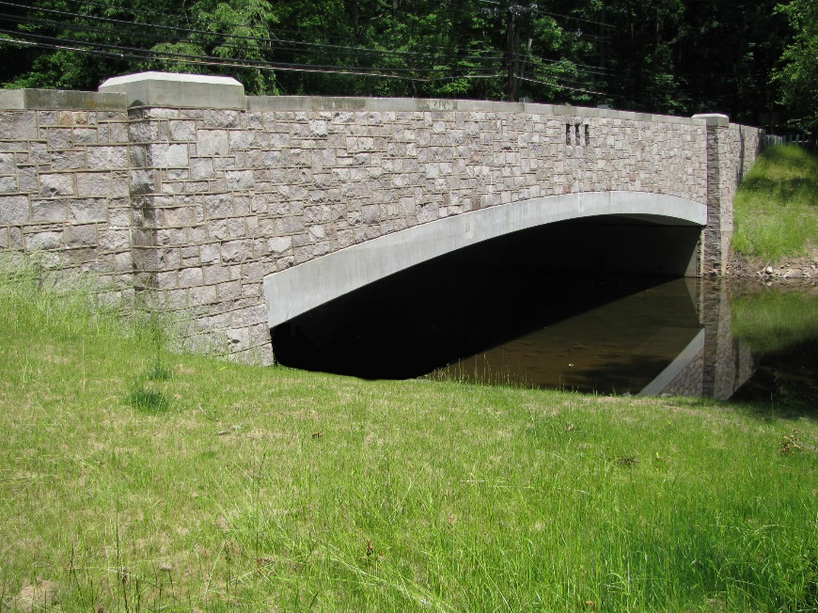
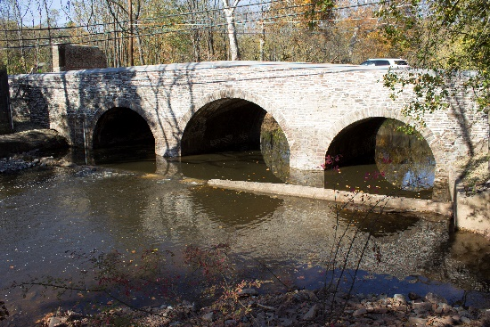
Significance
Does the bridge share any aesthetic qualities (materials, form, etc.) with buildings or structures, particularly other bridges, within the historic district?
(alpsroads.net)
(Courtesy of IH Engineers, September 2010)
The Rosedale Road Bridge (replacement pictured above) shared continuity of material with nearby bridges in Princeton, NJ (right).
(NJDOT)
Chapter 2 \ Topics
2-7
Notes:
Existing local/regional architectural traditions can aid in understanding local historic context. A CSD/S approach encourages replacement designs that pay homage to a region’s significant architecture.
Consider the materials and design of nearby bridges. Are those materials native to the area? Do they contribute to a sense of architectural tradition in the area?
Sources:
https://www.alpsroads.net/roads/nj/cr_583/ (Mercer Road Bridge)
https://www.nj.gov/transportation/about/press/2018/images/StonyBrookBridgeRibboncutting44.jpg (Stony Brook Bridge, NJDOT)

Slide 18
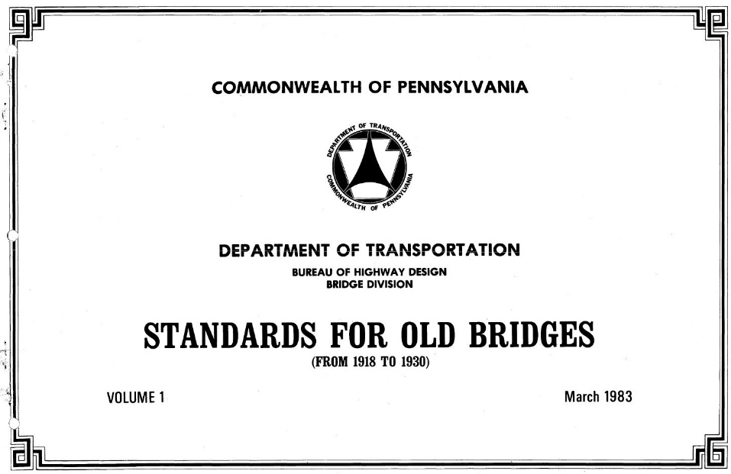
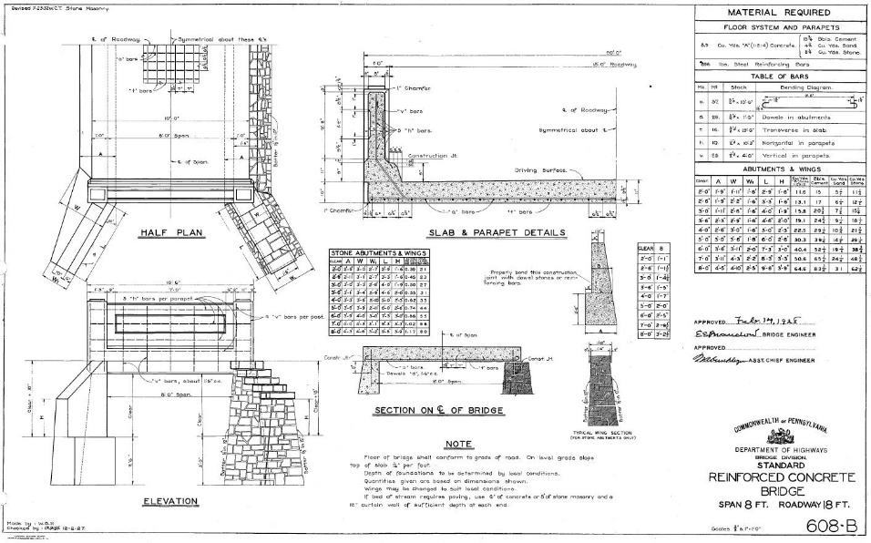
Design
Is the bridge a standard state highway design?
(PennDOT, Standard Plans For Old Bridges, Vol 1, 1918-1930)
2-8
Chapter 2 \ Topics
Notes:
The character-defining features of workhorse bridges are related to the structure type and standardized features. It is important to remember that a workhorse bridge was designed according to the technology, design standards, and specifications that were in effect at the time of its construction. The form of the bridge may have been from a standard design that was used by the highway department at the time of its initial construction, reflecting the time and place of its inception.
Consider statewide bridge building trends during the period of significance of the historic district and how that may have contributed to the design choices of the existing bridge. What modern design trends are similar to those seen in the past?
Source:
Standard Plans For Old Bridges (Source: PennDOT; http://www.dot.state.pa.us/public/Bureaus/BOPD/Bridge/Old_Standards/Standards_for_Old_Bridges_1918-1930_Vol._1.pdf)

Slide 19
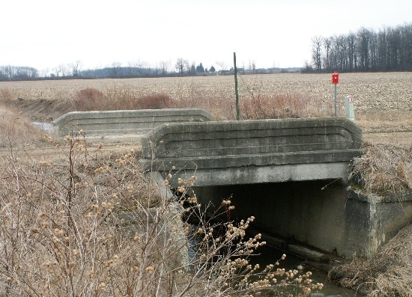
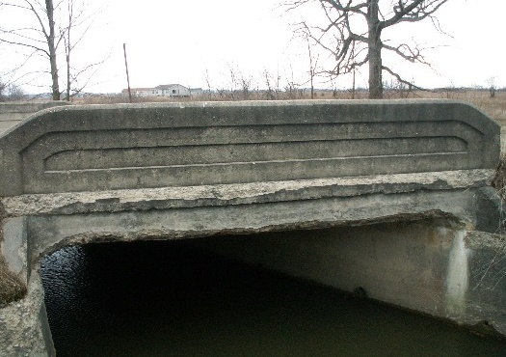
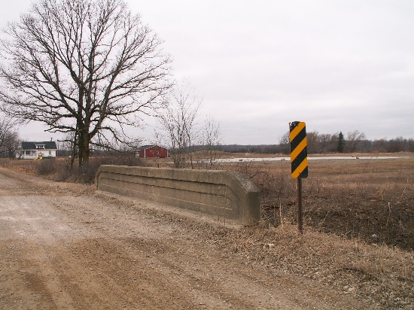
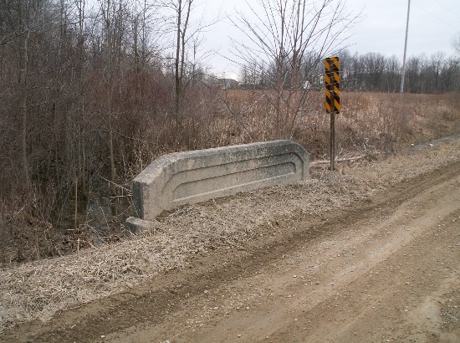
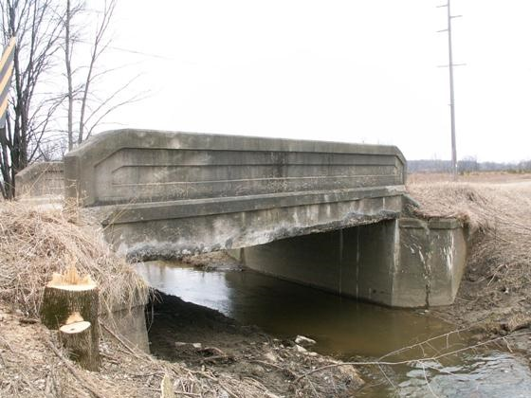
Design
Are there other workhorse bridges within the historic district or nearby?
Do they share common design features?
Five Fisher Road Bridges of varying sizes with matching rail designs.(Images Courtesy of Nathan Holth, Historicbridges.org)
Chapter 2 \ Topics
2-9
Notes:
Are the other nearby workhorse bridges similar in type and form to the existing bridge being replaced? Consider replacement with a similar bridge type if type continuity is seen across the district or area.
Taking inspiration from regional traditions and similar structures nearby maintains a sense of place and can project a historical impression on a bridge or area without creating a false sense of history.

Slide 20
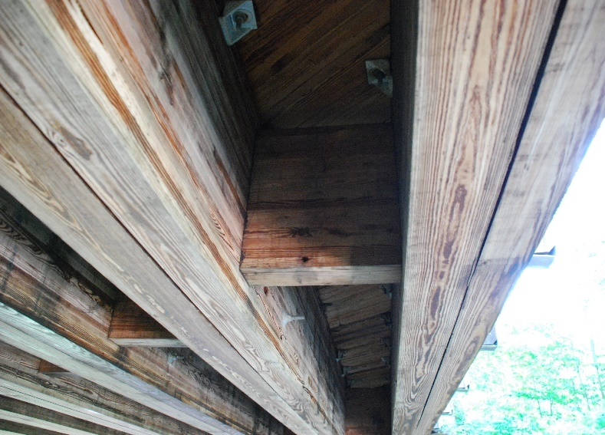
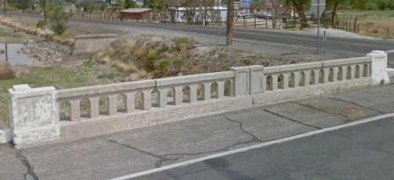
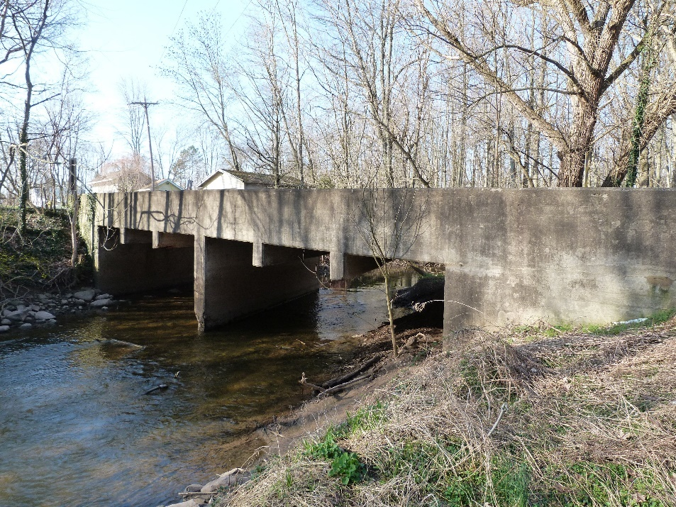
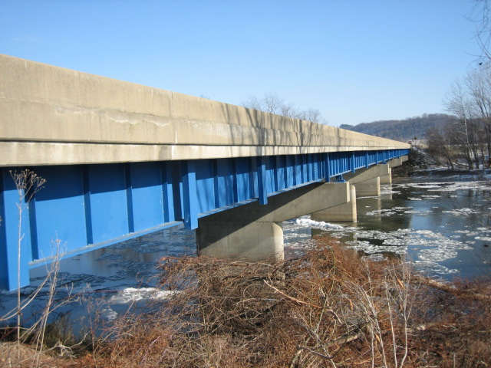
Design
What are the design details/character- defining features of the workhorse bridge?
Materials
(WSP)
Railing
(© Google 2015)
Structure Type
Color
(Courtesy of Nathan Holth, Historicbridges.org)
(Courtesy Ohio DOT)
2-10
Chapter 2 \ Topics
Notes:
Although most aesthetic treatments, especially applied ornamentation, should not be exactly replicated on the new bridge, any existing bridge elements that contribute to a distinct aesthetic appearance may be significant to the historic context. Is the railing of a particular ornate design? What colors, if any, contribute to the blending or prominence of the bridge in the setting? What materials and finishes were used on the existing bridge? When evaluating a historic context, consider the native materials available to the builders and why certain aesthetic choices were made. Workhorse bridges are most often simple working structures with no frills; any aspect that stands out as of particular aesthetic appearance may hold significance.
Source:
Ohio DOT (Bridge Inventory): Coshocton Co. SR 83 (#1601717)

Slide 21
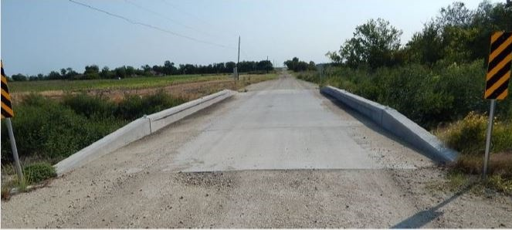
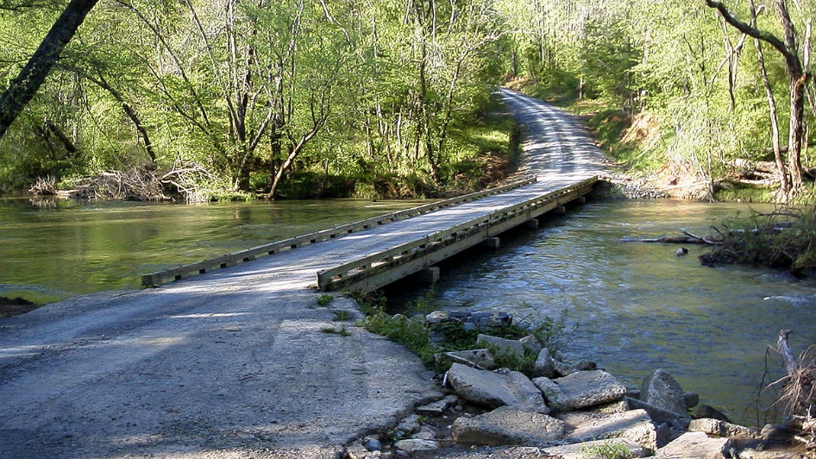
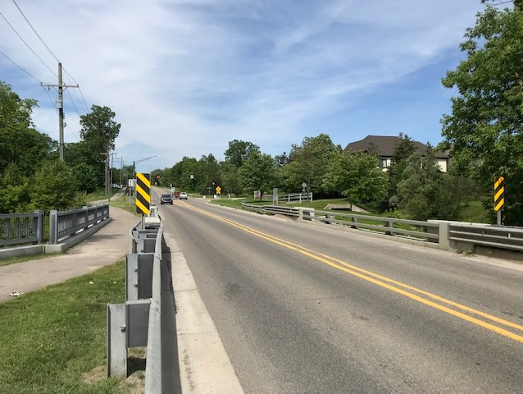
Design
Are there any other community/area –specific design parameters to consider?
(Courtesy of TxDOT)
Large machinery crossing in agricultural area
(Wikimedia Commons)
Flood Resiliency
(WSP)
Pedestrian Crossing
Chapter 2 \ Topics
2-11
Notes:
Consider the community needs in the replacement design. Does the historic context of the bridge also relate to current functions of the bridge? For example, use by agricultural machinery? Are their modern functions that need to be retained, such as a truck route with weight requirements or an area where a pedestrian crossing is also needed? Potentially the bridge crosses a waterway prone to flooding and measures need to be taken to improve stability and safety during flood events.

Slide 22
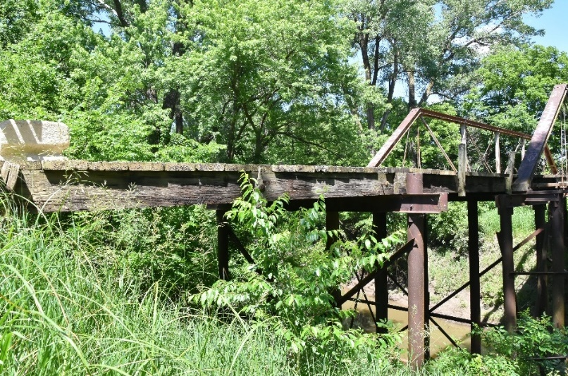
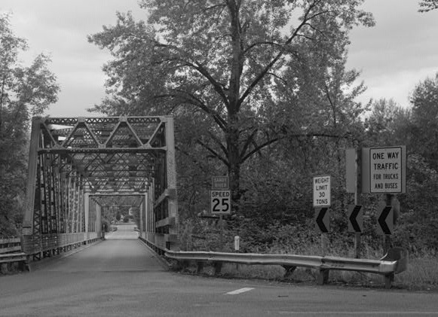
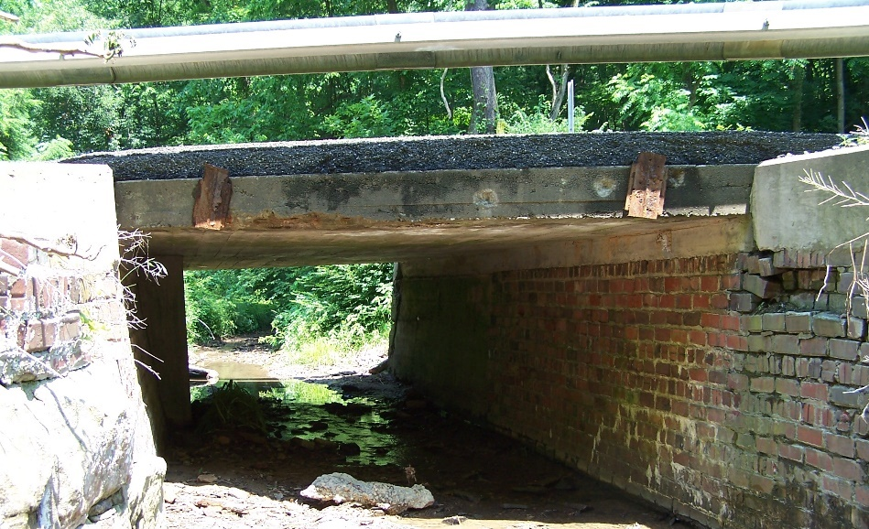
Safety
Does the existing bridge to be replaced have substandard design elements?
What is the posted speed of the roadway that the bridge carries?
(Courtesy of Nathan Holth, Historicbridges.org)
(HAER OR-36-A)
Does the existing bridge to be replaced have any critical safety hazards?
(Ohio DOT)
2-12
Chapter 2 \ Topics
Notes:
Critical safety hazards and substandard features could spark the necessity for an expedited replacement and design.
Source:
Ohio DOT (Bridge Inventory): Muskingum Co. SR 666 (#6006515)

Slide 23
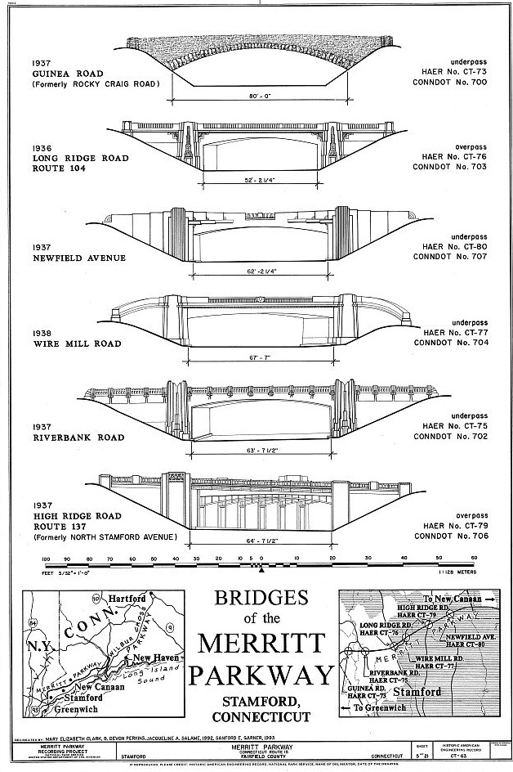
CHOOSING A CSD/S APPROACH
Regional
Regional bridge designs
Regional architectural tradition
Common design trends and characteristics of an area
Relate to significance of the region
Create a continuity of design
(HAER CONN, 1-GREWI,2- (sheet 5 of 21))
Chapter 2 \ Approaches to CSD/S
2-13
Notes:
After an evaluation of the historic context of the bridge, choose a CSD/S approach based on the characteristics of the bridge and the specific needs of the project. Typically projects fall within one of these approaches, some may use pieces of multiple approaches, as applicable. These approaches can help to keep a project grounded in certain objectives and not become complicated with multiple visions for design or disorganized consultation processes.
The regional approach to CSD/S draws design influence from existing regional bridge designs (often historic when near a historic district) and/or from a desire to create a modern, regional architectural tradition. The approach considers replicating common design trends seen amongst the area standards or regional architectural traditions to create continuity of design throughout a region.
A region could refer to a state, county or counties, a city, a town/village, a historic district—any area defined by its common characteristics.
Historic roads and scenic byways would be a common area or region that would exhibit a collective style for replacement bridges.
Identifying the most applicable “region” to the replacement project is important when considering this approach to CSD/S. The bridge to be replaced should relate its significance to whichever region type is chosen. For example, if a bridge is identified as built using a standard state design and is a common bridge type throughout the state, a statewide architectural tradition could be adhered to or created.
The region can be as large or as small as can be accurately distinguished by architectural traditions or the potential for architectural tradition.

Slide 24
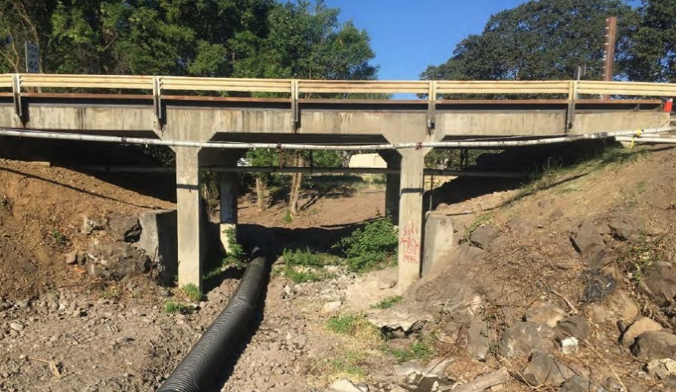
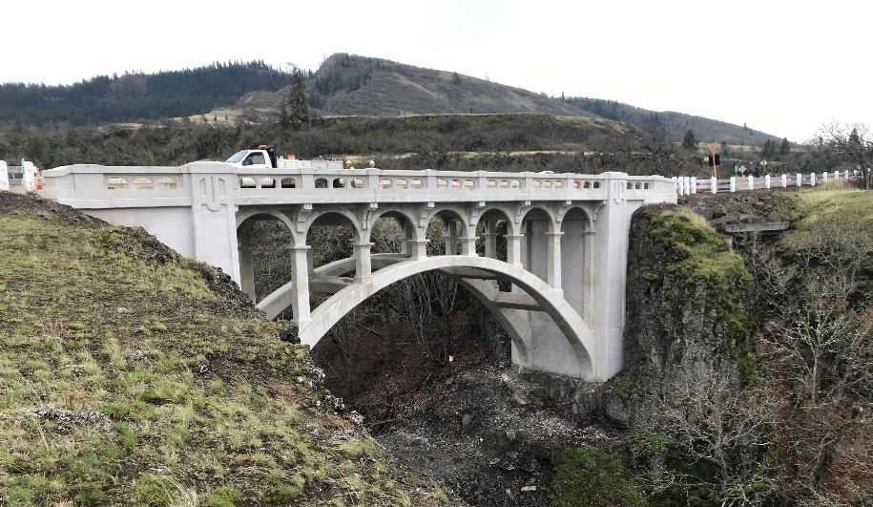
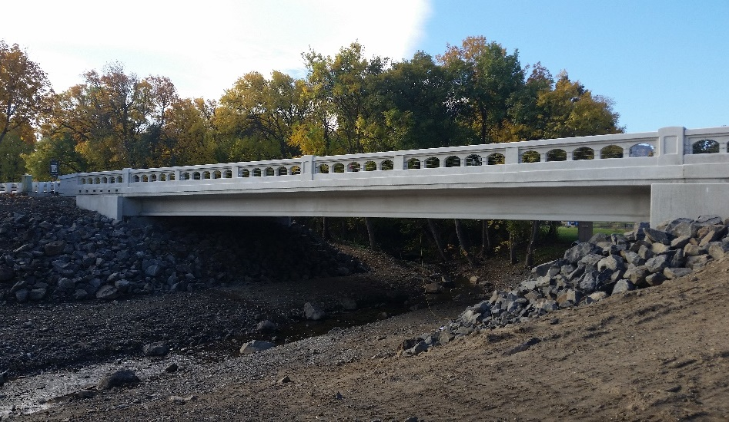
Regional
Columbia River Highway, Chenoweth Creek Bridge Before (top) and After (bottom); Existing regional architectural traditions (below) used as inspiration for replacement railing design.
(Courtesy of Oregon DOT)
(Courtesy of Oregon DOT)
(Courtesy of Oregon DOT)
2-14
Chapter 2 \ Approaches to CSD/S
Notes:
Chenoweth Creek Bridge, Wasco County, Oregon
The goal for the Chenoweth Creek Bridge replacement was to replace the original bridge while meeting modern safety and engineering standards and to create a design that complimented nearby bridges and was appropriate for the location.
The replacement design needed to be compatible with the nationally significant historic landmark. The CRH was the first scenic highway in the United States. In addition, the project was expedited as a rapid bridge replacement.
ODOT used CSD principles to improve the safety of the bridge while also achieving a compatible design within the historic context, primarily achieved by the railing design which complements the 1920s railings retained on the nearby Mosier Creek and Dry Canyon bridges. The original Chenoweth Creek Bridge’s 1920s railing, before being retrofitted with a metal guardrail, was of the same style.

Slide 25
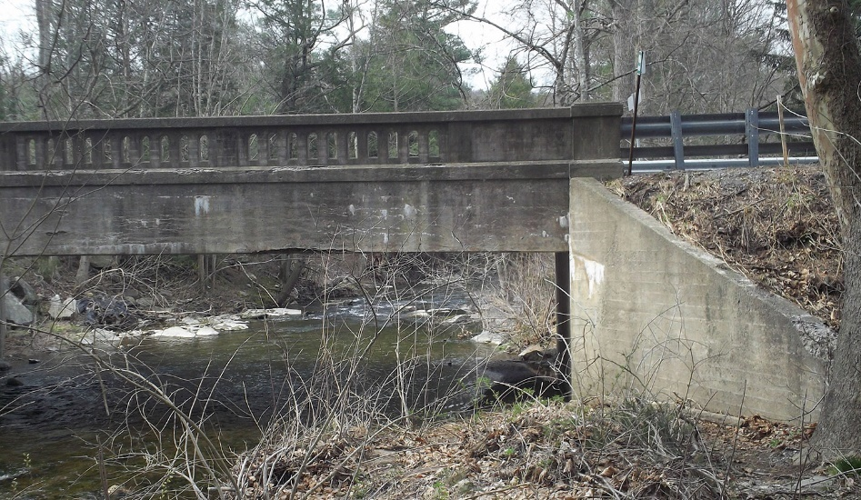
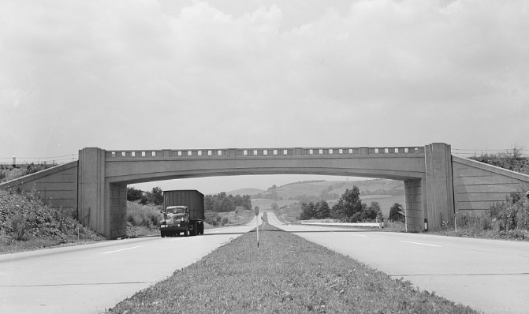
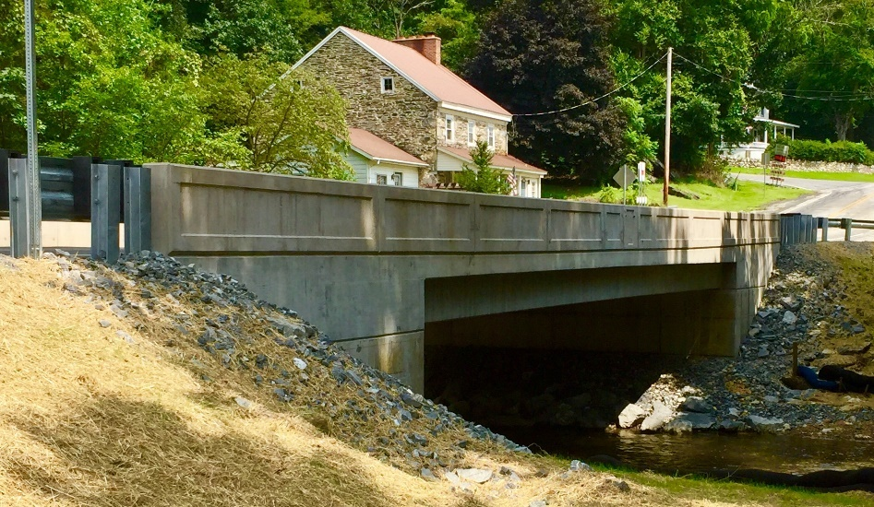
Regional
Pennsylvania Rapid Bridge Replacement Program (RBRP), Conwego Creek Bridge Before (top) and After (bottom); Creation of a modern regional tradition inspired by historic Pennsylvania Turnpike bridges (below) and other 1920s examples.
(Plenary Group | Walsh Group | Granite | HDR)
(Library of Congress)
(Plenary Group | Walsh Group | Granite | HDR)
Chapter 2 \ Approaches to CSD/S
2-15
Notes:
Conwego Creek Bridge, Pennsylvania.
The P3 RBRP is a public-private partnership (P3) program implemented by PennDOT to replace 558 structurally deficient state bridges. P3 RBRP bridge designs were heavily influenced by PennDOT’s work to modernize standard bridge designs. Regarding single-span workhorse bridges, the stated goal was to develop a regional bridge style, based on historic bridge designs, by implementing updates to available material, using current technology, and highlighting simple motifs.
PennDOT’s approach to replacement design under the P3 RBRP allows for design flexibility while also creating a cohesive bridge aesthetic that can be applied to both historic and non-historic bridges.
See The Pennsylvania P3 Rapid Bridge Replacement Program Case Study in the NCHRP 25-25:Task 118 Practitioners Guide.

Slide 26
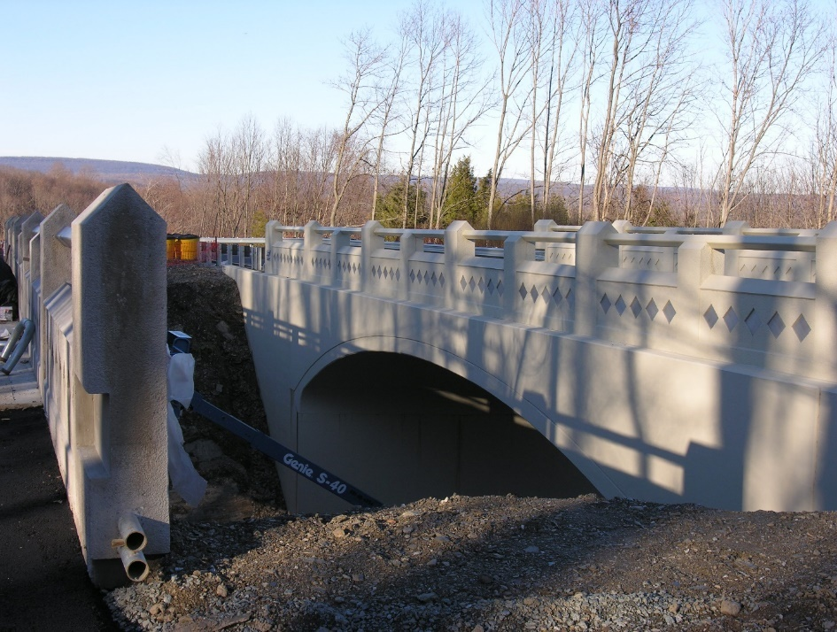
Replication
Replica using modern technology
New differentiated from the old
Compatible
Bridge integral to historic landscape or district
Use of engineering design exceptions
(Wikimedia Commons)
Hope Road Bridge, Blairstown, New Jersey
2-16
Chapter 2 \ Approaches to CSD/S
Notes:
The replication approach to CSD/S is straightforward in its name. It aims to replace a bridge with a replica design using modern technology.
Replication Guidance:
The SOI Standards state that “new work will be differentiated from the old and will be compatible with the historic materials, features, size, scale and proportion, and massing to protect the integrity of the property and the environment.”
AASHTO explores replication in the Bridge Aesthetics Sourcebook and states that “unless the new design is going to be a faithful reproduction of what is being replaced, which is rarely the case, national preservation guidance…calls for using contemporary design that is compatible with the historic context” (AASHTO 2010:51).
AASHTO finds a reproduction of a bridge in a historic district acceptable when a certain “period character of a manipulated landscape” is desired to be preserved (AASHTO 2010:53).
Therefore this approach is most often, and most appropriately, taken when the surrounding landscape would be significantly adversely affected by the loss of the bridge; likely to happen when a bridge is identified as an integral/contributing feature of a historic landscape or district and often individually eligible for inclusion in the NRHP.
Because of the challenge of producing a faithful reproduction, practitioners must be critical in their use of this approach. Modern safety and engineering standards make retaining features such as width and railing design only achievable through design exceptions and buy-in from all stakeholders. It is important at the start of a project to determine the likelihood and achievability of acquiring multiple design exceptions.

Slide 27
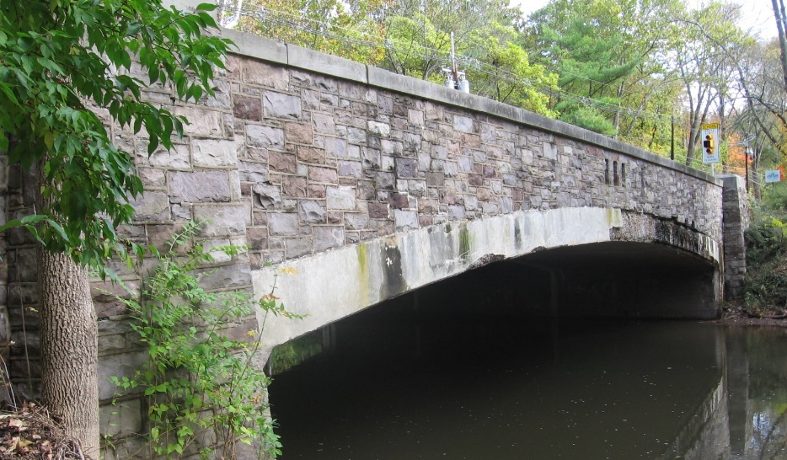
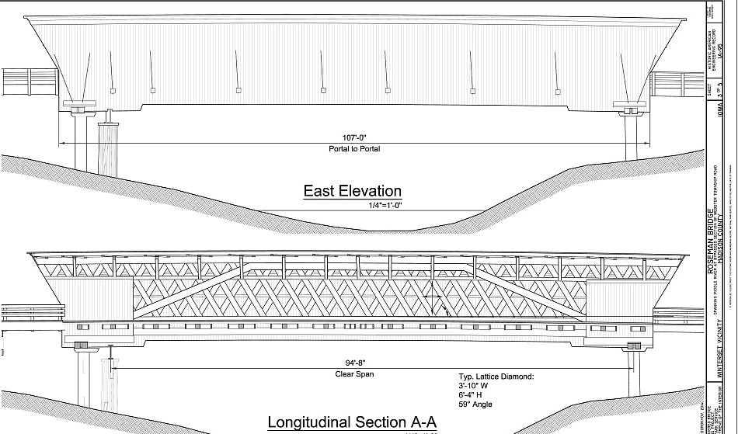
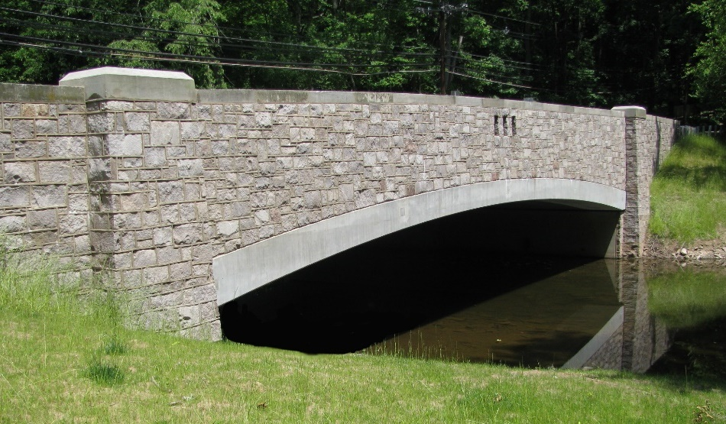
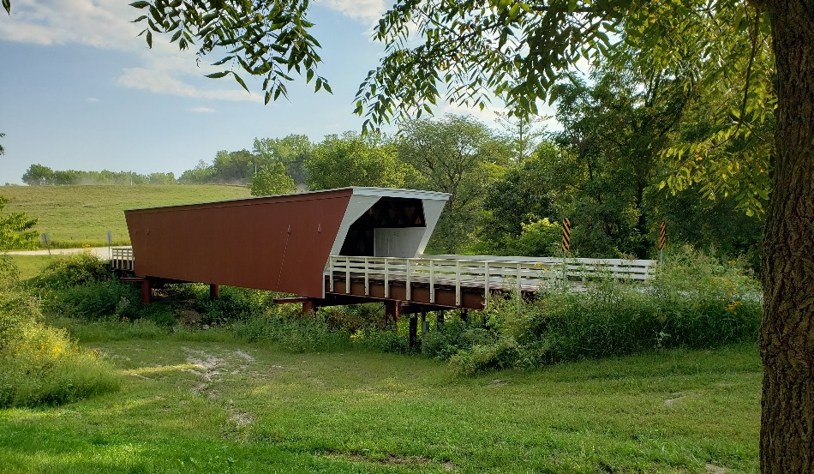
Replication
(Courtesy of IH Engineers)
(HAER IA-95)
(Courtesy of Madison County Historic Preservation Commission)
(Courtesy of IH Engineers)
Rosedale Road Bridge Before (top) and After (bottom) Replacement , Princeton, New Jersey
Cedar Bridge HAER Drawings (top) and replacement (bottom), Madison County, Iowa
Chapter 2 \ Approaches to CSD/S
2-17
Notes:
Rosedale Road Bridge, Princeton, NJ.
Decisions were guided by a desire for a resemblance to the original structure while meeting current safety and structural requirements (IH engineers).
The resulting replacement bridge consists of a replica of the previous structure, with the incorporation of current structural requirements and safety standards.
Design sensitivity was successfully achieved through the appropriate reuse of salvaged materials and replication of the historic design. Because this bridge was located adjacent to a historic district and not in a district, the design did not have to follow SOI Standards. Design considerations therefore fell to AASHTO recommendations, which suggest that a replication is appropriate when the bridge is integral to the character of the surrounding area and the replication is a faithful reproduction. The aesthetics of the original Rosedale Road bridge, including the stone and limestone caps, were integral to the character of the surrounding area, and thus replication was appropriate to retain the character of the area. Modern technology is evident in the structural design, which differentiates the new bridge from the old, in accordance with the SOI Standards.
Cedar Bridge, Madison County, IA.
The Cedar covered bridge was replaced in 2019 after it was destroyed by arson. The previous bridge had also been a replica of the original bridge, shown in the HAER drawings on the slide. In keeping with that tradition, the county again used the original drawings to replicate the historic covered bridge in the new design.

Slide 28
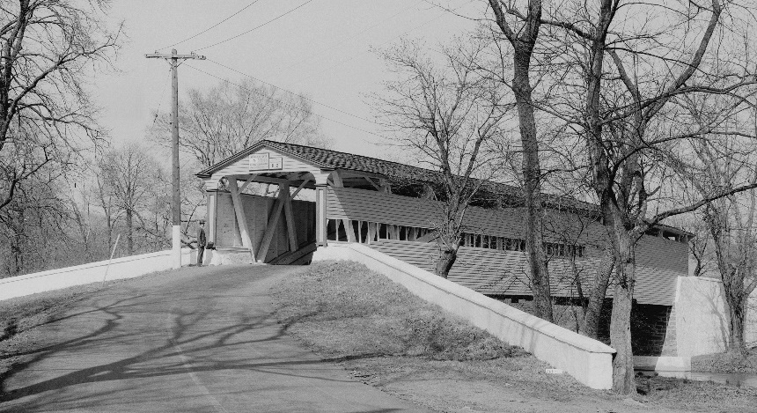
Previous Bridge
Previous design at same location
Historical research
Value in previous design
Not exact replication
Use of engineering design exceptions
Public Input
c. 1936
(HABS DE-1 )
c. 1962
(Courtesy of DelDOT)
c. 2002
Smith’s Bridge, Delaware
(Courtesy of Bridgehunter.com)
2-18
Chapter 2 \ Approaches to CSD/S
Notes:
The Previous Bridge approach to CSD/S draws design influence from previous iterations of the bridge. The existing bridge, at the time of replacement, is not always the original bridge. One or more bridges may have existed at the location and in this approach are a source of design inspiration.
This approach uses historical research to accurately determine which type or types of bridges were previously constructed at the location.
Through evaluation of the historic context and public input, organizations may find value in referring to an older design. This approach does not, however, call for an exact replication of a historic design and is likely to require design exceptions.
Public input is a large part of this approach. It is often the values a local community associates with a past bridge that inspires returning to a specific tradition. Value may be associated with particular bridges, for example, as a place of meeting, entrance to a neighborhood, or related to community tradition, potentially establishing associations or a sense of feeling not experienced by or accessible to CSD/S practitioners.

Slide 29
Previous Bridge
c. 1978
Previous bridge (top left) was a standard state plan
Michigan DOT used a similar standard plan railing (top right) from a salvaged bridge in replacement (bottom right)
Chapter 2 \ Approaches to CSD/S
2-19
Notes:
Stoney Creek Mill Bridge, Oakland County, Michigan
This standard railing design, while not exact, was similar to the original railing on this bridge which had been removed several years prior to the replacement project. In effect, the previous original railing design (pictured top right) provided design inspiration, manifested in the use of a similar historic design.
In this example, a previous iteration of the bridge railing (top left) inspired the use of original plans for the Michigan State Highway Department R4 standard railing (top right). The County salvaged an existing R4 railing and installed it on the replacement bridge (bottom right), reminiscent of the previous metal railing, removed several years prior. (Images courtesy of the Oakland County Road Commission (left), courtesy of the City of Rochester Hills Museum (top right), and WSP (bottom right).

Slide 30
Stakeholder-Driven
Public involvement and Input
Flexible design features
Design options
(DelDOT)
(DelDOT)
2-20
Chapter 2 \ Approaches to CSD/S
Notes:
The stakeholder-driven approach to CSD/S is centered on the public involvement process and uses stakeholder input as a driving factor in proposed design elements.
This does not mean the public designs the entire bridge but rather that specific features, such as rail type, form liner finish, or factors of multimodalism, are choices posed to stakeholders for a vote or opinion.
Additionally, taking polls and collecting questionnaires is particularly helpful in learning the, sometimes unspoken, opinions of the public.

Slide 31
Stakeholder-Driven
Mix of rural and urban settings
Public wanted a signature gateway bridge
Stinesville history of limestone quarrying
Use of simulated stone form liners on retaining wall
Stinesville Road Bridge, Monroe County, Indiana. (All images courtesy of Beam, Longest and Neff).
Chapter 2 \ Approaches to CSD/S
2-21
Notes:
Stinesville Road Bridge, Monroe County, Indiana.
The Stinesville Road Bridge is a gateway bridge to a small town surrounded by a mix of agricultural fields and forested area. The town side of the bridge enters an urban setting while the opposite end enters a rural setting. The bridge was not individually eligible for the National Register and is located on the boundary of a historic district. The town of Stinesville is significance for its associations with limestone quarrying and milling.
As stipulated by the State Historic Preservation Office, designing engineers achieved compatibility primarily through the use of a decorative concrete façade on a new retaining wall that mimics the look of natural limestone, a prominent material in the historic district.
The public was highly influential in the resulting design. During public meetings, project staff presented the public with overall design options and aerial images of the project area, to which the public responded that they were interested in a signature gateway bridge and not a conventional everyday design.

Slide 32
Design/Safety-Driven
Preferred design for public comment
Address critical safety hazards and substandard features
Design and Safety issues prioritized above public input and aesthetics
Accommodate CSD within expedited timeline
Creative hydraulic and geometric solutions
Minimal/Limited aesthetic treatments
(Courtesy of Mead & Hunt/TxDOT)
2-22
Chapter 2 \ Approaches to CSD/S
Notes:
The design/safety-driven approach to CSD/S stems from the necessity of a replacement design to address design and safety issues of the existing bridge.
Critical safety hazards and substandard features will spark that necessity, and solutions to those problems will be prioritized above public input and aesthetic treatments.
Additionally, the replacement is often expedited to a rapid bridge replacement. The project team must still be able to accommodate CSD principles of public involvement and design compatibility within the expedited timeline.
Design decisions are based on how to eliminate safety issues, such as overtopping during flood events and substandard railing heights and road width causing increased traffic accidents, by use of creative hydraulic and geometric solutions. Aesthetic treatments are limited to only what is necessary to achieve compatibility with the surroundings, if used at all.
The public involvement process often takes the approach of a delayed presentation of a preferred design rather than an open-ended initial meeting seeking public input on design.

Slide 33
Design/Safety-Driven
Route 206 Flood Channel Bridge Before Replacement (Image courtesy of Urban Engineers).
Route 206 Flood Channel Bridge After Replacement. (Image courtesy of Urban Engineers).
Chapter 2 \ Approaches to CSD/S
2-23
Notes:
Route 206 Flood Channel Bridge, Princeton, NJ
A smooth underside of the bridge deck beams reduces snagging and build of a debris during high water events.

Slide 34
Design/Safety-Driven
Morgan’s Ford Bridge, Warren County, Virginia Before (top) and After (bottom)
(VDOT)
(Courtesy of Trevor Wrayton, VDOT)
2-24
Chapter 2 \ Approaches to CSD/S
Notes:
Morgan’s Ford Bridge, Warren County, Virginia
The replacement design for Morgan’s Ford bridge in Warren County, Virginia was driven by the clear safety issues of the low-water structure. Flooding events consistently caused overtopping making the bridge impassable 60 days out of the year and resulted in several deaths prior to replacement.
VDOT designed a heightened superstructure composed of box beams side by side to create a smooth bottom to more effectively pass debris running under the bridge.
With safety as a number one priority, two design goals guided the design process. The first goal was to elevate the bridge so as to reduce overtopping events, but avoid excessively lengthening the bridge, which would increase costs and complicate the design. Secondly, considerable time was spent on the railing design from a safety perspective as well as an aesthetics perspective. The railing had to be high enough to safely contain vehicles on the bridge and be visually compatible with the location.
VDOT consultation with NPS directed the project team to use the Caltrans Concrete Barrier Type 80, which was considered sympathetic to the historic district, yet sturdy enough to withstand beating from water.

Slide 35
CHAPTER 3
GUIDING PRINCIPLES
Key Principles
Secretary of the Interior’s (SOI) Standards
Design Elements that Can’t Really be Changed
Design Elements with More Flexibility
Notes:
NOTE TO USER: This chapter dives deeper into the design and historic preservation principles that frame the actual design of a replacement bridge in a rural historic district. Whatever CSD/S approach is chosen, this section can be used to educate stakeholders on the design process and the options that are available for a replacement bridge.
Image Courtesy of Virginia DOT

Slide 36
KEY PRINCIPLES
Consideration of character-defining features of the historic bridge.
Proper implementation of the principles of design aesthetics.
Stakeholder engagement.
Incorporate proper aesthetic design principles to achieve reference to past features of historic significance.
Use desirable features of a historic bridge as basis for commonality between the old and the new.
Avoid creating new visual elements.
3-2
Chapter 3 \ Key Principles

Slide 37
APPLICABLE SOI STANDARDS
Standard 3: “each property will be recognized as a physical record of its time, place and use. Changes that create a false sense of historical development such as adding conjectural features or elements from other historic properties, will not be undertaken.”
Standard 9: “New additions, exterior alterations or related new construction will not destroy historic material features, and spatial relationships that characterize the property. The new work will be differentiated from the old and will be compatible with the historic materials, features, size, scale and proportion, and massing to protect the integrity of the property and the environment.”
Chapter 3 \ Applicable SOI Standards
3-3
Notes:
Following the SOI Standards, the new bridge would be expected not to have decorative elements that echo the former bridge by use of skirts and form liners unless it was differentiated enough to be clearly modern. In addition, disguising the structural technology of the new bridge with features that represent historical bridge types should be avoided. Use the source of historical significance as influence for the replacement design.

Slide 38
DESIGN ELEMENTS THAT CAN’T REALLY BE CHANGED
Vertical and Horizontal Geometry
Superstructure Type
Superstructure Shape
Pier Placement
Abutment Placement
(Courtesy of Beam, Longest, and Neff)
(Courtesy of Elaine Deutsch, Historicbridges.org)
3-4
Chapter 3 \ Design Elements That Can’t Really be Changed
Notes:
Stakeholders frequently influence the aesthetic design of a bridge. CSD/S calls for increased stakeholder involvement to reflect the values they place on a bridge in its design. However, not every design aspect of a bridge can be dictated by stakeholders because not every element is flexible in design. For a workhorse bridge there is little control over vertical and horizontal geometry (e.g., how high the bridge is) because geometry is usually dictated by the existing highway layout. Other design considerations with limited flexibility include superstructure type, pier placement, abutment placement, and superstructure shape.

Slide 39
DESIGN ELEMENTS WITH MORE FLEXIBILITY
Pier Shape
(Courtesy of Ohio DOT)
(WSP)
(WSP)
(WSP)
Chapter 3 \ Design Elements with More Flexibility
3-5
Notes:
Pier shape, abutment shape, parapet and railing details, colors and textures, and ornamentation are the more flexible considerations, potentially more compatible with stakeholder desires.
Source:
Ohio DOT (Bridge Inventory): Muskingum Co._SR 83 (#6004059)

Slide 40
DESIGN ELEMENTS WITH MORE FLEXIBILITY
Abutment Shape
(WSP)
(WSP)
(Courtesy of Beam, Longest, and Neff)
3-6
Chapter 3 \ Design Elements with More Flexibility

Slide 41
DESIGN ELEMENTS WITH MORE FLEXIBILITY
Parapet and Railing Details
(Wikimedia Commons)
(HAER PA-407)
(Highway Safety Corps)
Chapter 3 \ Design Elements with More Flexibility
3-7
Notes:
http://www.highwaysafety.net/sbwoodrail.htm

Slide 42
DESIGN ELEMENTS WITH MORE FLEXIBILITY
Colors and Texture
Plenary Group | Walsh Group | Granite | HDR
Plenary Group | Walsh Group | Granite | HDR
(WSP)
(WSP)
3-8
Chapter 3 \ Design Elements with More Flexibility

Slide 43
CHAPTER 4
DESIGN FEATURES
The most common design elements or features that contribute to successful workhorse bridge replacements in rural historic districts are:
Bridge Type and Material
Texture
Color
Scale
Abutments and Wing Walls
Rails
Notes:
Image Courtesy of Virginia DOT

Slide 44
BRIDGE TYPE AND MATERIAL
Decide bridge type as early as possible
Replace with a similar structure type to existing or nearby structures
Modern design standards
Characteristically subdued in setting
Structural design accuracy and suitability
Materials appropriate to context
Regionally available materials
Reproduce elements of similar size, shape, and proportion
(WSP)
(Courtesy of VDOT)
4-2
Chapter 4 \ Bridge Type and Material
Notes:
Bridge type principally refers to form. Other elements, such as material, span type, and connection method, also contribute to bridge type and can place a bridge into a more specific subtype.
Bridge type, as well as other substantial design aspects such as form and shape, holds significantly more weight in design compatibility within a historic context than applied ornamentation or smaller-scale design elements (Simon 2006:126).
Most often in a rural setting, substructures are composed of stone or concrete, or both (Beckerman 2019a). Does the type reflect local vernacular forms built with local materials, or does the type reflect a state standard design built with materials acquired or manufactured elsewhere? Does the superstructure type reflect the functionality of the bridge? The superstructure type may allow only passenger vehicle use or it may lend to use by agricultural machinery or delivery of goods. A standard design superstructure may reflect a statewide or regional pattern of design and character in rural areas.
Suggested Strategies:
Bridge type should be decided as early as possible in the design process. An incompatible bridge type cannot be overcome by ornamentation during the final design stages.
Replace the existing bridge with a structure of similar type to existing, or consider drawing from the dominant structure types in the immediate area.
Workhorse bridges were designed in line with design standards and specifications that were in effect at the time of its construction; a replacement bridge designed in line with modern design standards and specifications of the same or similar bridge type is often compatible.
Workhorse bridges are characteristically subdued in their setting; a statement or signature bridge is likely not a compatible replacement.
Maintain structural design accuracy and suitability through appropriate choice of material and connection method (e.g., a concrete beam bridge is not suited for stone facing because a concrete beam bridge would never be constructed of stone).
Choose materials appropriate to the context of surrounding area (e.g., proposing a red brick bridge where stone masonry structures are prominent would be incompatible with the context of the surrounding area) (Maryland DOT 1993:II-7).
Use regionally available materials when possible (see the Milwaukee Co. example on Honey Creek Parkway Stone Veneer Bridge where local stone was used on the old bridge and the new bridge).
Simulation of historic materials with modern technology is a risk. For example, as the Maryland DOT has described, reproducing fieldstone with cast concrete could significantly detract from appearance (Maryland DOT 2008:II-9). Consider instead reproducing elements of similar size, shape, and proportions to the existing bridge in the new design.

Slide 45
BRIDGE TYPE AND MATERIAL
A three-span concrete-encased steel stringer bridge (left) was replaced with a single-span concrete slab beam bridge (right). (Images Courtesy of Urban Engineers).
(Courtesy of Urban Engineers)
Chapter 4 \ Bridge Type and Material
4-3
Notes:
Route 206 Flood Channel Bridge, Princeton, NJ. Replaced in 2018.

Slide 46
TEXTURE
Historically used, local stone
Textures from surrounding area
Reduce scale of large substructure elements with texture
Repetitive features
(Courtesy of Nathan Holth, Historicbridge.org)
(Courtesy of Urban Engineers)
(Courtesy of Monica Harrower, PennDOT)
4-4
Chapter 4 \ Texture
Notes:
Texture works to develop surface treatments on various bridge features.
Abutments, wing walls, and retaining walls are often subjects of applied textures, including form liners, stamping, veneers, panels, and acid treatments to achieve a desired visual effect or material representation.
Texture applied as facing can be used to reflect structural capabilities and historic use (Maryland DOT 1993:V-12).
However, similar to the consideration of bridge type and material of construction, textured applications must not logically contradict the structural framework of the new bridge.
Suggested Strategies:
Consider which type of stone is local to the area and if it was historically used on similar types of bridges. Fieldstone, brick, and cut stone all can provide texture, as appropriate to the context.
Because substructure elements of workhorse bridges are often largest in scale relative to the surroundings, incorporating texture and repetitive features to these elements can help reduce their scale (Abraham and Showers 2007:35).

Slide 47
TEXTURE
As part of the Pennsylvania Rapid Bridge Replacement Program, the standard replacement design can be enhanced with the use of form liners (below) to achieve compatibility when the existing bridge (left) is set within a historic district.
(Images: Plenary Group | Walsh Group | Granite | HDR; parapidbridges.com)
Chapter 4 \ Texture
4-5
Notes:
West Woodview Road Bridge, Chester County, Pennsylvania.
One of the main sources of incompatibility in a replacement bridge design is the inappropriate type of stone, or the textural components are exhibited out of scale.
Form liners are a convenient source of texture, useful for mimicking a specific material appearance, and often appealing to the budget as well as public stakeholders; however, there is an inherent risk in the easy application of texture/ornament, which may have nothing to do with the historic context or the previous bridge and can often result in an out of scale or out of context design.

Slide 48
COLOR
Random, natural colors and patterns
No more than three colors
Highlight or disguise
Background structure – subdued colors
Statement structure – Contrasting colors
Research historic colors used
(Courtesy of PennDOT)
4-6
Chapter 4 \ Color
Notes:
Color is a visual design element with the capability of changing perceptions and conveying visual ideas. Color can be achieved, among other methods, through material choice, paint, or stain. Color seen on workhorse bridges in rural historic districts commonly defers to colors in the surrounding landscape. Typically, workhorse bridges will not exhibit contrasting colors so that the bridge remains subdued.
Suggested Strategies:
Use random and natural patterns for bridges within a wooded or other natural background (Stantec 2018:4-8).
Use no more than three colors on one bridge (PennDOT 2014:14-4).
Use color to highlight or disguise certain elements (PennDOT 2014:14-4).
Consider natural colors of materials to better blend with a rural landscape; weathering steel or natural-tone concrete likely will have a more natural appearance than painted beams.
If the bridge is meant to stand out, incorporate more contrast in colors or contrast with the surrounding landscape.
If the bridge is a background structure, keep colors simple and subdued but do not match to its surroundings.

Slide 49
COLOR
Research into the historic paint colors of bridges prior to replacement will likely reveal compatible color choices for the replacement bridge. Metal truss bridges are likely candidates for color application. (Images: courtesy of VDOT).
Chapter 4 \ Color
4-7
Notes:
Be careful to choose a color that does not falsely historicize the new bridge. Colors that may seem historic, may not have had anything to do with the historic bridge.

Slide 50
SCALE
Harmony with setting
Maintain vertical profile
Maintain masonry characteristics in stone size, and mortar width
Addition of lanes will change scale
Design to narrowest possible width
(Courtesy of Beam, Longest, and Neff
(Plenary Group | Walsh Group | Granite | HDR; parapidbridges.com)
4-8
Chapter 4 \ Scale
Notes:
Scale refers to “the size relationship among various features of the structure and between the total structure and its surroundings” (HNTB 1995:2-4). A bridge should not appear out of human scale, which refers to the response a structure has with the human form. If it is too large, a bridge may appear monumental. A bridge should not have a heavy, bulky appearance that dominates a rural environment.
Scale is particularly important in the design of workhorse bridges in a rural historic district. Because these bridges are historic owing to their location within a district boundary and not as individually NRHP-eligible bridges, their relation to the surrounding landscape, built and natural, can be a character-defining feature of the bridge within its historic context. Workhorse bridges were designed to complement their setting and so should a replacement design. Scale becomes a significant aspect in achieving that harmony.
Suggested Strategies:
Retain sense of scale similar to the existing bridge.
Maintain existing vertical profile so as not to substantially alter the viewsheds to and from the bridge. Obscuring views of any structures or landscape features could change character-defining spatial relationships in the historic district.
Consider the number of columns used (if applicable); too many can have the appearance of a wall and on a shorter span can appear too bulky.
Maintain existing masonry characteristics, if applicable (e.g., size of stone, width of mortar).
Addition of driving lanes will impact bridge scale and should be avoided.
Design bridge with the narrowest possible width under DOT guidance and transportation needs.

Slide 51
SCALE
The Oyster River Bridge replacement exhibits a successful retention in scale. Before replacement (left) and after (bottom), Durham, NH. (Images: courtesy of NHDOT).
Chapter 4 \ Scale
4-9

Slide 52
ABUTMENTS AND WING WALLS
Commonly stone, integrated into landscape
Texture and height
Use similar material and form to existing
Exposures good surface for texture and color
Only use form liners when examples are nearby
(Plenary Group | Walsh Group | Granite | HDR; parapidbridges.com)
(Courtesy of Urban Engineers)
4-10
Chapter 4 \ Abutments and Wing Walls
Notes:
Abutments are a major structural element as well as a major design element. Although a load-bearing member of the bridge, abutments are limited to the structural necessities that dictate their general size and placement. However, abutments and their extended wing walls still serve as an opportunity for design flexibility. On short-length workhorse bridges abutments often stand out because of their size in relation to the bridge span; they become a main aspect of the overall image of the bridge. In a rural setting abutments are commonly constructed of local stone or integrated into the natural landscape. When designing abutments, questions frequently arise concerning texture on wing walls and the height of the abutments.
Suggested Strategies
Replace existing abutments with those of similar material and form (For example, replace stone masonry abutments with stone veneer applied to cast-in-place concreate) (TxDOT and Mead & Hunt 2018:43).
Consider abutment/wing wall exposure and finish. A shorter exposure may require paved embankments, which are not desirable in a rural setting. More exposure can allow the application of panels chosen for the specific context or increased surface area for color and texture options.
Simulated stone (using form liners) on abutments and wing walls should only be used when there are existing examples on nearby bridges. Using form liners to reproduce a material appearance has a high risk of incompatibility.

Slide 53
ABUTMENTS AND WING WALLS
A two-span, concrete channel beam bridge with rock masonry abutments and pier (left) replaced with a single-span concrete bridge, retaining the original stone abutments (right). A concrete sill was applied to the tops of the existing abutments to create a level surface for the new beams. (Images: courtesy of WSP).
Chapter 4 \ Abutments and Wing Walls
4-11
Notes:
Defouri Street Bridge, Santa Fe, New Mexico.

Slide 54
RAILS
Railing type should match bridge type
Open railings often preferred in settings with scenic views
True openings to replicate historic openings preferred over indentations when possible
(Mercer County, NJ)
(Courtesy of ODOT)
(Plenary Group | Walsh Group | Granite | HDR)
4-12
Chapter 4 \ Rails
Notes:
Bridge barriers, parapets, and railings carry significant weight in the compatibility of a replacement design. Although the bridge type chosen initially dictates compatibility of scale and function within a historic context, an incompatible rail design can be easily and overtly inconsistent with a historic context.
Provided that the railing meets modern safety standards, it is a common tool for visually relating a new bridge to its historic context and setting.
Suggested Strategies:
Railing types should match bridge type. It is “…not acceptable to specify metal lattice traffic railings on an all reinforced concrete unit T beam bridge, which would have had open concrete railings or solid parapets” (KCI and TranSystems 2012:24).
Reinforced concrete railings made to look historic in design are often successful (see ODOT Stealth Rail design in Chenoweth Creek Bridge Case Study, p. 59).
Open railings are preferred in settings with scenic views. Metal railings generally maintain views better than solid concrete barriers.
When possible, true openings, rather than indentations made to replicate the shape of historic true openings, are preferred (ODOT ).
Consider points of rail type transitions, specifically the transition between different materials. They should be compatible with each other and the surroundings.
Seek community input and feedback on rail design.
Design innovations such as lower test level rails can be considered for aesthetic reasons” (Ray and Carrigan 2014:95).

Slide 55
RAIL OPTIONS
Oregon DOT Stealth Rail
Nevada DOT Beaux Arts Bridge Rail
Caltrans Concrete Barrier Type 80
TxDOT T223
Kansas Corral Rail 32” without curb
Modified Kansas Corral Rail, 27”
Timber Guardrail
PennDOT Type 10M
Texas Rail (Open Concrete Parapet)
2 Tube Metal
NMDOT Type D
These railing designs have been used by state and county DOTs for workhorse bridge replacements.
Chapter 4 \ Rails
4-13

Slide 56
Oregon DOT Stealth Rail
SUITABLE TO | IMAGE
TL-4 rating (to ODOT Design Standards) Rocky terrain Reinforced concrete bridges
COST
$1,000/LF (Oregon 2017) 10x the cost of a standard rail
(Photo: Courtesy of Robert Hadlow, ODOT)
4-14
Chapter 4 \ Rails
Notes:
See Chenoweth Creek Bridge Case Study in NCHRP 25-25:Task 118 Practitioners Guide

Slide 57
Nevada DOT Beaux Arts Bridge Rail
SUITABLE TO | IMAGE
TL-3 Historic Beaux Arts style bridges in Nevada Reinforced concrete bridges Rural and urban settings
COST
Total bridge cost of example pictured: $622,000 (Nevada 2016)
(Photo: © Google 2016)
Chapter 4 \ Rails
4-15
Notes:
Harrigan Road Bridge, Fallon, Nevada.

Slide 58
Caltrans Concrete Barrier Type 80
SUITABLE TO | IMAGE
TL-4 Coastal/Rural
COST
$325/unit (To $1/10,000) – Caltrans 2018 Contract Cost Data – expected $120/LF (Virginia 2018 bid) $150/LF (Bridge Rail Guide, 2005)
(Photographer: Trevor Wrayton, VDOT)
4-16
Chapter 4 \ Rails
Notes:
See Morgan’s Ford Bridge Case Study in NCHRP 25-25:Task 118 Practitioners Guide
Bridge Rail Guide (2005), FHWA California Division, FHWA HQ Structures, FHWA Federal Lands Division, and Caltrans.

Slide 59
TxDOT T223
SUITABLE TO | IMAGE
TL-3 Rural Agricultural context
COST
T223 is an improved version of the TxDOT T203 rail which costs $55/LF (TxDOT 2010)
(Photo: Courtesy of Renee Benn, TxDOT)
Chapter 4 \ Rails
4-17
Notes:
See Falls County Road Bridge Case Study in NCHRP 25-25:Task 118 Practitioners Guide

Slide 60
Kansas Corral Rail 32” without curb
SUITABLE TO | IMAGE
TL-4 Rural
COST
Approximately $250/LF (VDOT 2017)
(Photo: FHWA)
4-18
Chapter 4 \ Rails

Slide 61
Modified Kansas Corral Rail, 27”
SUITABLE TO | IMAGE
TL-2 Rural
COST
$350/LF (VDOT 2019)
(Photo: © Google 2016)
Chapter 4 \ Rails
4-19

Slide 62
Timber Guardrail
SUITABLE TO | IMAGE
Rural Village Agricultural Context
COST
No cost information could be found for this rail. Example pictured is located in Oakland County, MI, constructed in 2015
(Photo: Courtesy of Ron Campbell, RCOC)
4-20
Chapter 4 \ Rails
Notes:
Byers Farm, Oakland County, Michigan

Slide 63
PennDOT Type 10M
SUITABLE TO | IMAGE
TL-4 Rural Village
COST
$250/LF, painted (PennDOT 2019) $200/LF, unpainted (PennDOT 2019)
(Photographer: Monica Harrower, PennDOT)
Chapter 4 \ Rails
4-21
Notes:
River Road Bridge, Pennsylvania

Slide 64
Texas Rail (Open Concrete Parapet)
SUITABLE TO | IMAGE
TL-2 Village Urban Gateway
COST
$94/LF (TxDOT 2010)
(Photo: Courtesy of Beam, Longest and Neff)
4-22
Chapter 4 \ Rails
Notes:
See Stinesville Road Bridge Case Study in NCHRP 25-25:Task 118 Practitioners Guide

Slide 65
2 Tube Metal
SUITABLE TO | IMAGE
Village Urban
COST
$85/LF (Michigan bid, 2010)
(Photo: Paul Graham, WSP)
Chapter 4 \ Rails
4-23
Notes:
See Stoney Creek Mill Bridge Case Study in NCHRP 25-25: Task 118 Practitioners Guide

Slide 66
NMDOT Type D
SUITABLE TO | IMAGE
Urban Low speeds, under 45mph
COST
$295/LF (Santa Fe, NM bid)
(Photo: Courtesy of Richard Rotto, WSP)
4-24
Chapter 4 \ Rails
Notes:
See Defouri Street Bridge Case Study in NCHRP 25-25:Task 118 Practitioners Guide

Slide 67
REFERENCES CITED AND ADDITIONAL RESOURCES
American Association of State Highway and Transportation Officials [AASHTO]. 2010. Bridge Aesthetics Sourcebook: Practical Ideas for Short and Medium Span Bridges. Prepared for AASHTO by the Subcommittee on Bridge Aesthetics of the Transportation Research Board, Washington, D.C. https://store.transportation.org/Common/DownloadContentFiles?id=887.
Federal Highway Administration [FHWA]. 2019. “Context Sensitive Solutions and Design.” Washington, D.C.: U.S. Department of Transportation. https://www.fhwa.dot.gov/planning/css/what_is_css/.
HNTB Corporation [HNTB]. 1995. Aesthetic Guidelines for Bridge Design. Prepared for Minnesota Department of Transportation, Office of Bridges and Structures, Saint Paul. https://www.dot.state.mn.us/bridge/pdf/aestheticguidelinesforbridgedesign.pdf.
KCI Technologies, Inc., and TranSystems [KCI and TranSystems]. 2012. Management Plan for Historic Highway Bridges. Prepared for Maryland State Highway Administration, Maryland Department of Transportation, Baltimore. https://www.roads.maryland.gov/OPPEN/Maryland%20SHA%20Management%20Plan%20for%20Historic%20Highway%20Bridges.pdf.
Maryland Department of Transportation [Maryland DOT]. 1993. Aesthetic Bridges Users Guide (revised 2005). Baltimore: Maryland DOT, State Highway Administration (SHA). https://www.roads.maryland.gov/OBD/oos-aesthetics-guide.pdf.
Maryland Department of Transportation [Maryland DOT]. 2008. Context Sensitive Solutions: For work on Maryland Byways. Baltimore: SHA. https://www.roads.maryland.gov/OED/CSS-3.pdf.
McCahon, Mary E., Larry Sutherland, and Steven Shaup. 2012. NCHRP Web-Only Document 189: Design and Management of Historic Roads. Prepared for the Transportation Research Board by TranSystems, Inc., Fort Lauderdale, Florida. https://download.nap.edu/cart/download.cgi?record_id=22790.
Mead & Hunt. 2013. Volume 2: Milwaukee County Parks and Parkways Historic Properties Management Plan. Madison, Wisconsin: Milwaukee County and Wisconsin Department of Transportation. http://www.thc.texas.gov/public/upload/preserve/survey/highway/Milw%20Co%20Historic%20Properties%20Management%20Plan.pdf.
Oakland County Planning & Economic Development Services [OCPEDS], Road Commission for Oakland County, and the City of Rochester Hills. 2010. Stoney Creek and Winkler Mill Pond Historic Districts: A report on the key findings and recommendations for the Stoney Creek and Winkler Mill Pond Historic Districts. City of Rochester Hills, Michigan. https://www.rochesterhills.org/DocumentCenter/View/9347.
Parsons Brinkerhoff and Engineering and Industrial Heritage [PB and EIH]. 2005. A Context for Common Historic Bridge Types. NCHRP Project 25-25, Task 15. Prepared for National Cooperative Highway Research Program by Parsons Brinkerhoff and Engineering and Industrial Heritage. http://www.trb.org/NotesDocs/25-25(15)_FR.pdf.
Pennsylvania Department of Transportation [PennDOT]. 2014. Rapid Bridge Replacement Program: Final Technical Provisions. Harrisburg, PA: PennDOT. https://www.penndot.gov/ProjectAndPrograms/p3forpa/Documents/Rapid%20Bridge%20Replace%20Project/Technical%20Provisions.pdf.
Plenary Walsh Keystone Partners [PWKP]. 2015-2019. Rapid Bridge Replacement Project Blog. http://parapidbridges.com/bridgeblog.html/
Ryan, Thomas W., J. Eric Mann, Zachary M. Chill, and Bryan T. Ott. 2002 (revised 2012). Bridge Inspector’s Reference Manual (BRIM). Prepared for the Federal Highway Administration, Arlington, VA, by Michael Baker, Jr. Inc, Moon Township, PA. https://www.fhwa.dot.gov/bridge/nbis/pubs/nhi12049.pdf.
Simon, Alfred. 2006. Architectural and Visual Quality Design Guidelines for Context Sensitive Design and Context Sensitive Solutions. Prepared for the New Mexico Department of Transportation, Santa Fe, by the University of New Mexico School of Architecture and Planning. https://www.nh.gov/dot/org/projectdevelopment/highwaydesign/contextsensitivesolutions/documents/NewMexicoDOTCSSGuide.pdf.
Stantec Consulting Services, Inc. and EMH&T, Inc. [Stantec]. 2018. Ohio Department of Transportation Aesthetic Design Guidelines. Columbus, OH: Ohio Department of Transportation. http://www.dot.state.oh.us/Divisions/Planning/Environment/manuals_guidance/Documents/Aesthetic%20Design%20Guidelines/ODOT%20Aesthetic%20Design%20Guidelines%202018.07.pdf.
Texas Department of Transportation and Mead & Hunt [TxDOT/Mead & Hunt]. 2018. “Bridge Railing Manual.” Austin, TX: TxDOT. http://onlinemanuals.txdot.gov/txdotmanuals/rlg/concrete_railing.htm#i1067557.
Transportation Research Board [TRB]. 2004. “Context-Sensitive Design Around the Country: Some Examples.” Transportation Research Circular E-C067 (July). http://www.trb.org/publications/circulars/ec067.pdf.
Urban Engineers [UE]. 2018. “Preserving Historic Route 206 Bridges.” Urban Engineers Excellence Blog. February 12. Cherry Hill, New Jersey: Urban Engineers. Accessed June 2019, https://urbanengineers.com/blog/princeton-stony-brook-bridge-blog.

