Slide 1
Utility Conflict Concepts and
SHRP 2 R15(B) Research Findings
Lesson 2

Slide 2
Seminar Overview
8:30 AM – 9:00 AM Introductions and Seminar Overview
9:00 AM – 10:15 AM Utility Conflict Concepts and SHRP 2 R15(B) Research Findings
10:15 AM – 10:30 AM Morning Break
10:30 AM – 11:45 AM Utility Conflict Identification and Management
11:45 AM – 1:00 PM Lunch Break
1:00 PM – 2:30 PM Hands-On Utility Conflict Management Exercise
2:30 PM – 2:45 PM Afternoon break
2:45 PM – 3:30 PM Use of Database Approach to Manage Utility Conflicts
3:30 PM – 3:45 PM Wrap-Up
Notes:
This section of the training is Lesson 2, which deals with basic utility conflict concepts and a summary of lessons learned from research project SHRP 2 R15(B).

Slide 3
Lesson 2 Overview
Utility conflict concepts
SHR2 R15(B) Research findings
Questions and answers
Notes:
Purpose of Lesson 2:
Provide an understanding of relevant concepts related to the management of utility conflicts within the project development process.
Provide an understanding of the findings of the SHRP 2 R15(B) project.

Slide 4
Utility Conflict Concepts
2.1

Slide 5
Project Development Process
Notes:
Utility coordination does not exist in the vacuum. It exists within the context of a project development process, which might involve many different phases.
This slide shows a typical representation of the traditional project development process at most state DOTs. Utility-related activities can start early in the process, and many state DOTs have a goal to complete utility relocations before the project goes to construction. A key element associated with the success of utility activities is Communication, Cooperation, and Coordination between the state DOT and utility owners. In practice, the 3 Cs do not always happen.

Slide 6
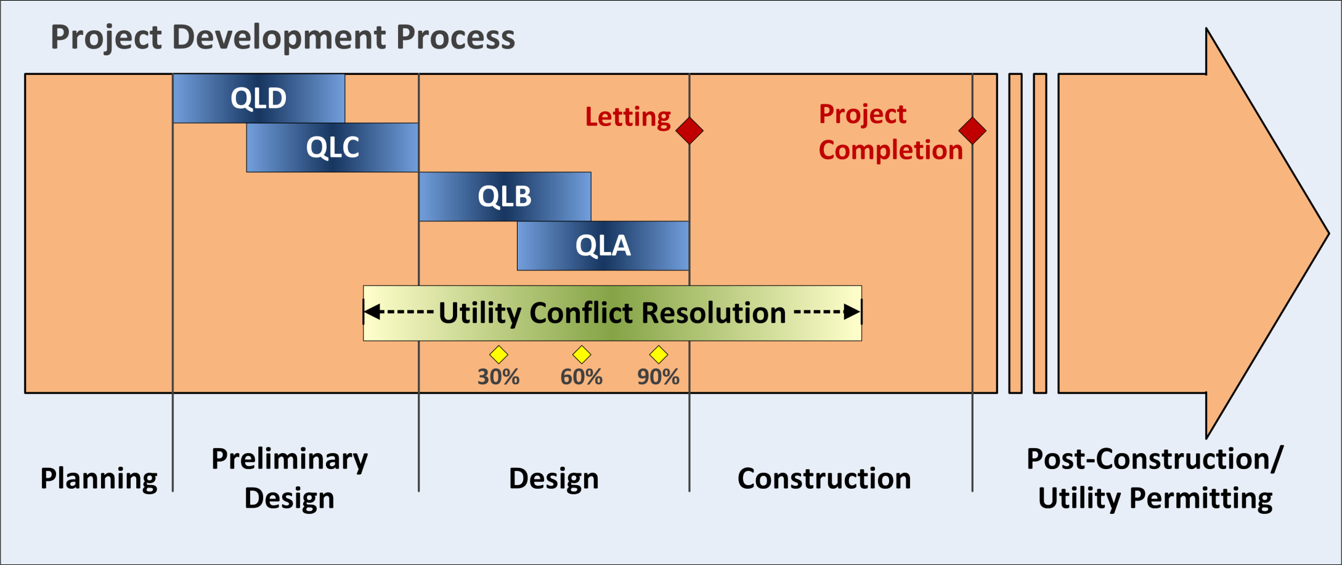
Utility Coordination Process
QLD: Existing records
QLC: Survey of aboveground utilities
QLB: Geophysical methods
QLA: Exposure (test holes/vacuum excavation)
Notes:
This slide focuses on a portion of the project development process, the utility coordination process, which may span the entire project development process from planning to post-construction. Utility conflict resolution is a portion of the utility coordination process that typically occurs at the end of preliminary design and should complete before the begin of construction.
To function properly, the utility coordination process needs utility data input, which occurs at different times of the process. Typically, as time progresses, the utility information becomes more detailed and precise. Although any type of utility data can be collected at any time of the project development process, it is typical to collect QLD and QLC data during preliminary design, and QLB and QLA data during the detailed design phase.

Slide 7
Reality Check …
Frequently cited reasons for project delays
(DOT perspective):
  Short timeframe for developing projects
  Project design changes
  Environmental process delays
  Inefficiencies in utility coordination
    Inaccurate location and marking of existing utility facilities
    Identifying utility conflicts late in the design phase
    Disagreements on recommended utility-related solutions
    Utility relocation costs not handled properly
    …
Notes:
Inefficiencies in the utility coordination process are frequently blamed for delays in the project development process. The slide shows examples of situations that produce utility coordination inefficiencies. The list is not exhaustive.

Slide 8
Reality Check …
Frequently cited reasons for project delays
(utility owner perspective):
  Limited resources (financial and personnel)
  Utility owner’s project development process protocols
  Coordination with other stakeholders during design
  Coordination with other stakeholders during construction
  Changes in DOT design and schedules
  Unrealistic schedule by DOT for utility relocations
  Internal demands (maintenance, service upgrades)
Notes:
State DOTs are not the only party affected by inefficiencies. This problem also affects other stakeholders, e.g., utility companies. Utility companies have a host of challenges of their own, including operating under tight financial conditions (frequently, utility relocation is a low priority to utilities since it is not a revenue generating activity). They also have their own plans and schedules and need to accommodate requests from a third party (i.e., the DOT). In addition, there are issues related to the coordination with the DOT.

Slide 9
Consequences of Bad Utility Information
Incomplete/inaccurate utility data = BAD data
Negative impacts:
  Disruptions during construction
  Unplanned environmental corrective actions
  Damage to utility installations
  Delays and project overruns
Notes:
Inaccurate and/or incomplete utility information can result in problems such as:
disruptions when utility installations are encountered unexpectedly during construction, either because there was no previous information about those installations or because their stated location on the construction plans was incorrect;
unplanned environmental corrective actions;
damage to utility installations, which can lead to disruptions in utility service, environmental damage, and increased risk to the health and safety of construction workers and the public; and
delays that can extend the period of project development and/or delivery and increase total project costs.

Slide 10
Utility Conflict Scenarios
Utility facility vs. transportation design feature (existing or proposed)
Utility facility vs. transportation construction activity or phasing
Planned utility facility vs. existing utility facility
Noncompliance with:
  Utility accommodation statutes, regulations, and policies
  Safety or accessibility regulations
Notes:
Potential for utility conflicts exists at most transportation projects, including the following:
interference between utility facilities and transportation design features (existing or proposed);
interference between utility facilities and transportation construction activities or phasing;
interference between planned utility facilities and existing utility facilities;
noncompliance of utility facilities with utility accommodation statutes, regulations, and policies; and
noncompliance of utility facilities with safety regulations.

Slide 11
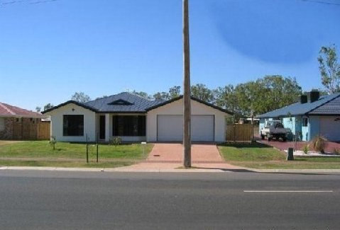
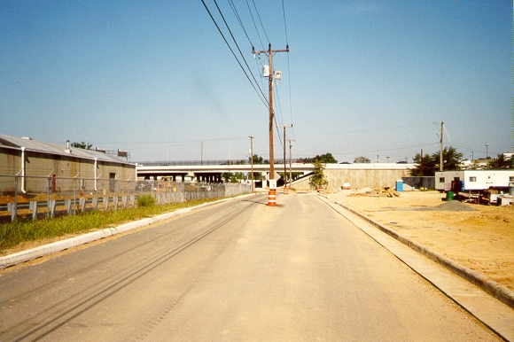
Notes:
Examples of situations where a utility facility is in conflict with a transportation facility.

Slide 12
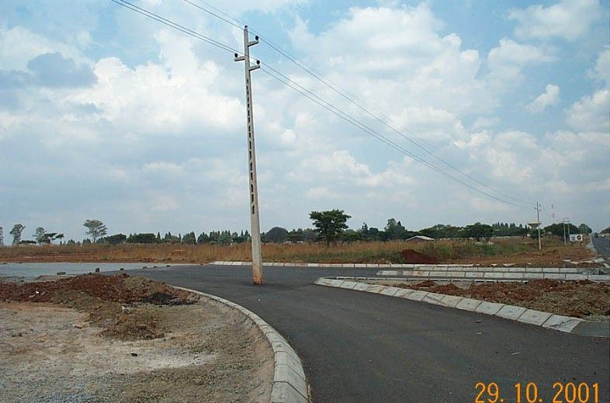
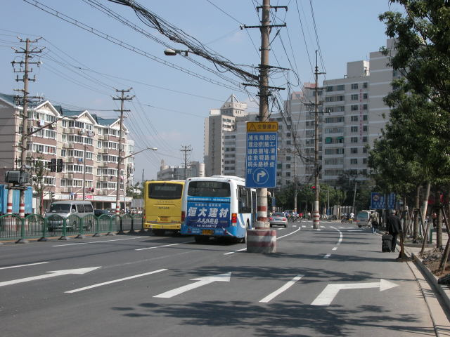
Notes:
Picture on the left: Potential conflict of utility facility with a construction phase.
Picture on the right (courtesy of Ray Sterling): Street in Shanghai. Road construction in preparation for the Shanghai Expo. The sign on the pole warns about construction (and congestion) ahead and directs drivers to take a detour to the right (not clear what drivers; presumably those who may be driving on the same lane as where the pole is located). Both poles and attached utility lines appear to be old and waiting to be relocated.

Slide 13
Solution Strategies
Remove, abandon, or relocate utilities in conflict
  Relocating utilities NOT NECESSARILY OR ALWAYS the best or most cost-effective solution
Modify transportation facility
Protect-in-place utility installation
Accept an exception to policy
Notes:
Strategies available to address utility challenges at state DOTs normally include one or more of the following options:
remove, abandon, or relocate the utilities in conflict (this is the traditional approach; however, it is not necessarily or always the best solution for the project);
change the horizontal and/or vertical alignment of the proposed transportation facility;
implement an engineering (protect-in-place) countermeasure that does not involve utility relocation or changes to the transportation project alignment; and
accept an exception to policy.

Slide 14
Transportation Design Changes
Geometric alignment (horizontal/vertical):
  Change grade
  Offset centerline, widen one side of highway
  Move ramps, driveways
Structure dimensions, other characteristics:
  Change embankment slope
  Add/modify retaining wall to reduce slope encroachment
  Redesign bridge footings and abutments, move pilings
  Redesign drainage structures
Notes:
This slide shows potential examples of transportation project design changes that could be implemented to help avoid unnecessary utility relocations.

Slide 15
Example: Widening Both Sides vs.
One side of Highway
Issues to consider:
  Widening both sides of highway impacts everyone (no one is spared!)
  Widening one side can reduce utility impacts
  Depends on what kind of utilities are affected
Notes:
In this example, a project is looking at adding lanes to a corridor, and the question is whether to widen the corridor on both sides (potentially affecting everyone) or only on one side. Widening on one side can reduce utility impacts. However, the decision should be taken after taking into consideration factors such as what kind of utilities would be affected and the total estimated cost.

Slide 16
Example: Embankment
Due to interstate widening, embankment had to be raised 50-60 feet
Major gas and water facilities in the area
Large soil settlement expected
Modified project to protect-in-place utilities:
  Foam layer
  Thin concrete cap
Costly utility relocation was avoided
Notes:
In this example from Georgia, widening an interstate highway required raising the embankment by 50-60 feet. There were major utilities in the area, and significant soil settlement was expected because of the additional weight. The DOT was able to avoid costly utility relocations by using a foam layer and a concrete cap to protect the existing utilities in-place.

Slide 17
Example: Bridge
Bridge project affected multiple utilities (power, water, sewer, etc.)
Modifying horizontal bridge alignment slightly
  Would have avoided any utility impact
  Would not have impacted right-of-way
  Would not have compromised bridge construction
Discovered during construction… too late!
Utility relocation costs = $5,000,000
Notes:
In this example from Georgia, there was a bridge project that affected many utilities. Unfortunately, only during construction it became evident that modifying the horizontal bridge alignment slightly would have avoided utility impacts without affecting the right-of-way or the construction phase. The affected utilities were relocated at a cost of $5 million, which could have been avoided.

Slide 18
Example: Power Pole
Rapid City, South Dakota
Conflict discovered at 30% detailed design
Redesign avoided utility adjustment
Additional costs were paid by utility
Notes:
Steel power pole on Catron Blvd. in Rapid City, South Dakota. The impacts to this pole were discussed in a meeting involving SDDOT and utility owner at 30% detailed design. The power company reimbursed SDDOT for the additional cost to install a small “field approach,” which allowed the pole to remain in place. Black Hills Power and Light also felt that having a flat area to park their maintenance equipment (boom truck) was a bonus.

Slide 19
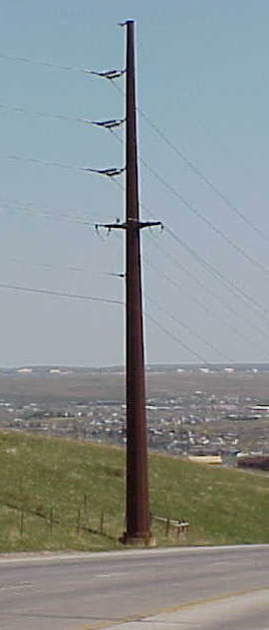

Plan View
Profile View
Field approach fill
Grading cut section
Right of Way Line
Drainage pipe
Notes:
The vertical green line, shown in the cross section view, is depicting the existing right of way line. The shaded area is showing the dirt removed using the typical grading cut section.

Slide 20
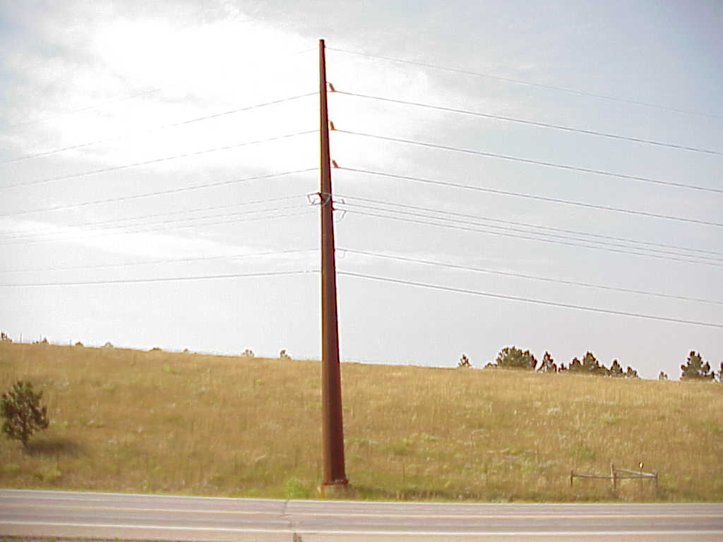

New field approach
Notes:
The field approach was designed to be small enough so that regular road drivers would not mistake it for an area to pull off the road.

Slide 21
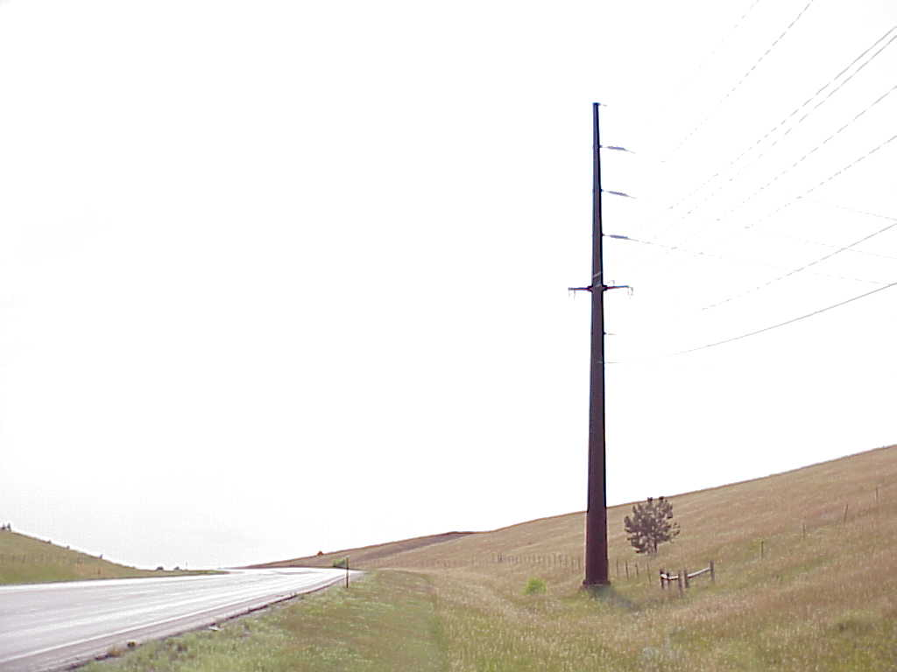
New field approach
(cross-section)
Drainage pipe
Notes:
SDDOT added a pipe under the field approach for drainage purposes.

Slide 22
Summary of Cost Savings
BHP&L estimate to relocate 69-kV
corner structure $60,000
Additional cost to add field approach - $3,000
Cost savings to the BHP&L consumers/
taxpayers $57,000
Notes:
The power company reimbursed SDDOT, which provided substantial savings to the company at no extra cost to the DOT.

Slide 23
Example: Drainage Channel
Rapid City, South Dakota
Impact discovered during preliminary project scoping inspection
Typical concrete lined drainage ditch would have impacted electrical cabinet and cables
Recommendation: redesign sloped ditch to vertical wall
Additional benefit: elimination of some right of way acquisition
Notes:
The impact to existing electrical cabinets and cables was discovered during a preliminary project scoping inspection. After some discussion, the DOT recommended to construct a vertical wall to avoid the utility conflict.

Slide 24
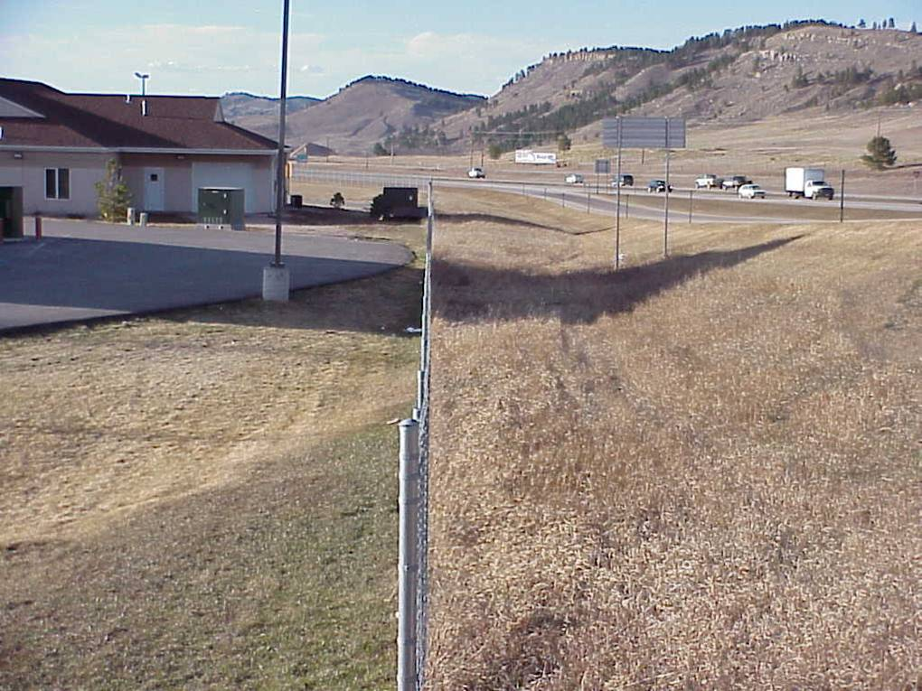
Example: Drainage Channel
Approximate centerline
of planned drainage ditch

Slide 25

Recommended Redesign
Electric cabinet and cables
Grading cut section
Vertical wall
Profile View
Notes:
The vertical wall reduced the channel cross-section, but a hydraulic analysis found that the cross-section would be adequate if the length of the concrete lining on the sloped side could be increased slightly.

Slide 26
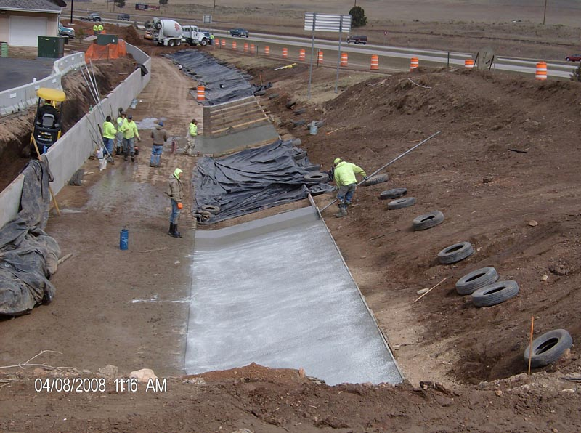

Slide 27
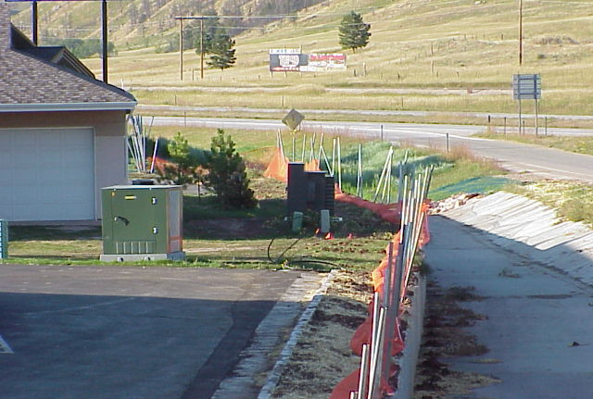

Slide 28
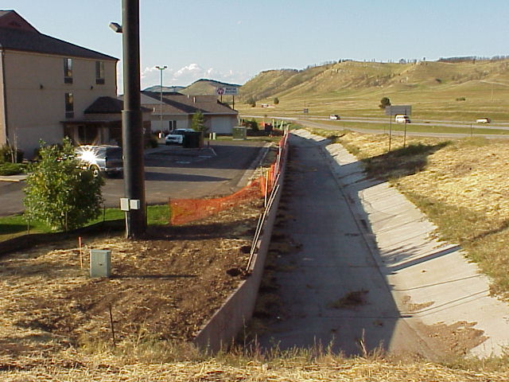

Slide 29
Summary of Cost Savings
Qwest estimate to relocate
9-Way duct system $750,000
Additional cost to re-design
storm sewer - $37,270
Cost savings to the consumers/
taxpayers $712,730
Notes:
The additional cost to redesign the storm sewer was minimal compared to the cost to relocate the electrical facilities.

Slide 30
Example: Storm Sewer and Communication Duct System
Aberdeen, South Dakota
5 blocks of communication ducts
5 vaults (5 feet x 7 feet x 12 feet) connected with 9 4-inch ducts encased in concrete
In conflict with planned storm sewer
Notes:
In this example, several vaults connected by a communication duct system were found to be in conflict with a planned sewer trunk line.

Slide 31
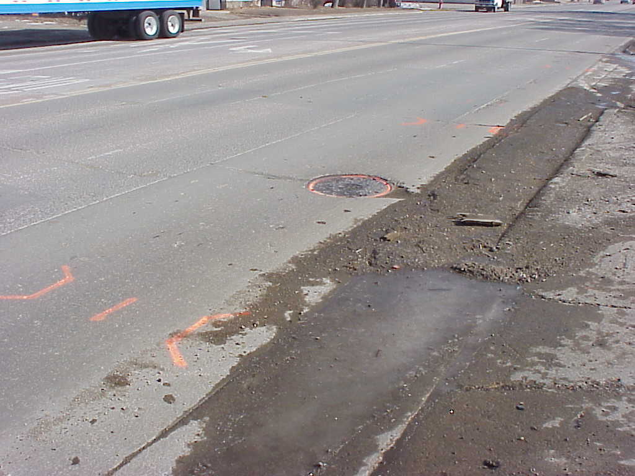
Vault and communication ducts
Planned 42” storm sewer main trunk line, type “B” drop inlets
Redesigned 42” storm sewer main trunk line,
type “S” drop inlets
Notes:
In this slide:
Yellow shows the approximate footprint of a vault and communication ducts.
Red shows the approximate footprint of the planned 42” storm sewer trunk line with type “B” drop inlets.
Blue shows the approximate footprint of the redesigned 42” storm sewer trunk line with type “S” drop inlets.
Note: The three color bands are schematic and are only intended to provide an approximate view of the facilities involved. For an accurate footprint depiction, it would be necessary to use engineering drawings.

Slide 32
Redesign of Storm Sewer Main
Type S
(main trunk under sidewalk)
Type B
(main trunk under curb & gutter)
42” storm sewer
Notes:
The storm sewer inlets were planned at the beginning and end of the trunk system, which interfered with the location of the vaults. Moving the inlets may have avoided the vaults but would have caused other problems. The type S inlets allowed the inlets to remain at the same location along the trunk line as planned initially and avoided the conflict with the vaults and duct system.

Slide 33
Summary of Cost Savings
Qwest estimate to relocate
9-way duct system $750,000
Additional cost to re-design
storm sewer - $37,270
Cost savings to the consumers
taxpayers $712,730
Notes:
Cost of the redesign were minimal in comparison to the cost savings by allowing the duct system to remain in place.

Slide 34
Example: Traffic Signal Footing
Deadwood, South Dakota
Pole to be placed in close proximity to existing utilities
Pole location surveyed on ground by DOT
Utilities in vicinity identified by One Call
High cost to relocate existing utilities
QLA utility investigation
Recommendation: Reduce pole footing diameter from 36” to 30”
Notes:
Utilities were identified by the South Dakota One Call ticket process in the immediate vicinity of a proposed signal location. The power company informed the DOT that there were 3 underground conduits coming from a transformer in the area of the proposed signal footing. The proposed signal location was surveyed on the ground by the DOT, markings were reviewed in the field, and vacuum excavation was used to confirm the location of the utilities.
The estimated cost to relocate the utilities was $95,000. At the same time, the town of Deadwood is a legalized gambling community and loss of power would have greatly affected the revenue generated by the casinos. Therefore, it was of interest to determine whether the footing could fit with the existing utilities. The typical footing diameter on a signal pole is 36.” However, at this location, this diameter would not fit between the 3 conduits. The recommendation was to decrease the footing diameter to 30” and increase the depth to equal the designed required lateral support.

Slide 35
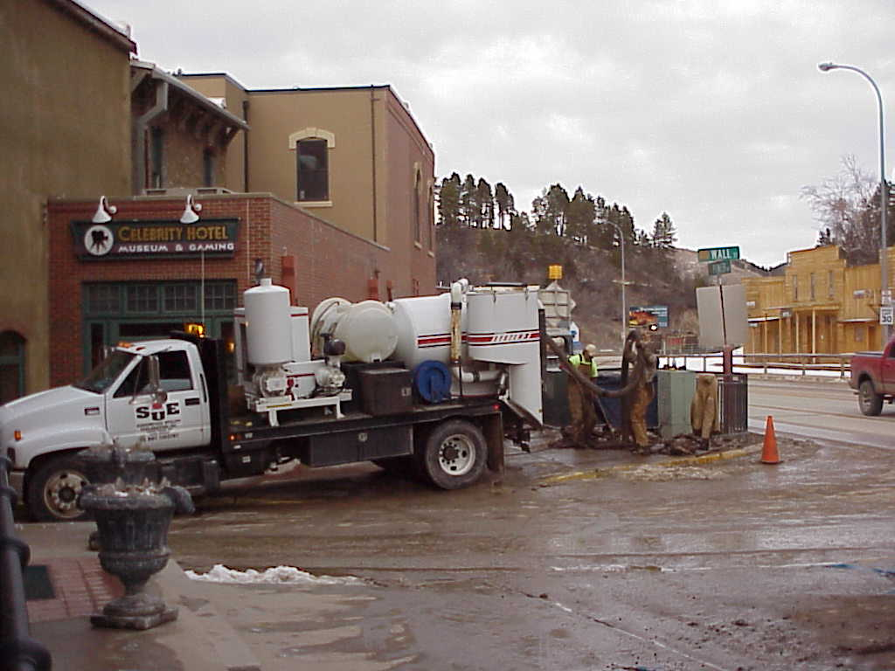
Vacuum excavation
Notes:
This picture shows the vacuum excavation to expose the utilities.

Slide 36
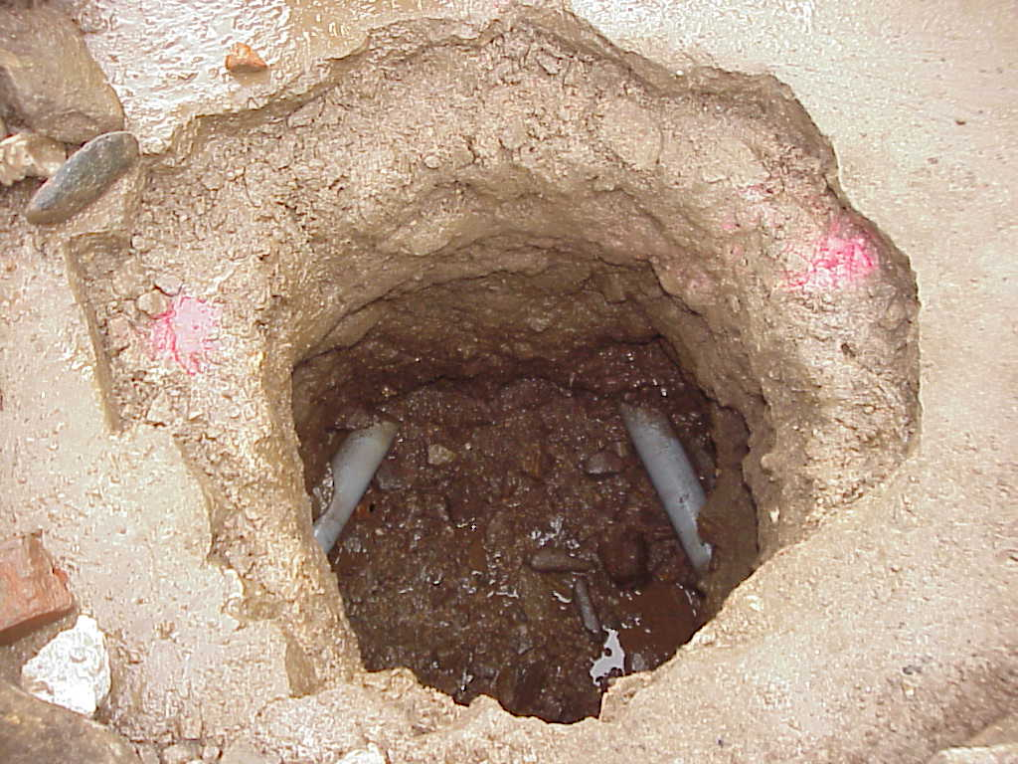
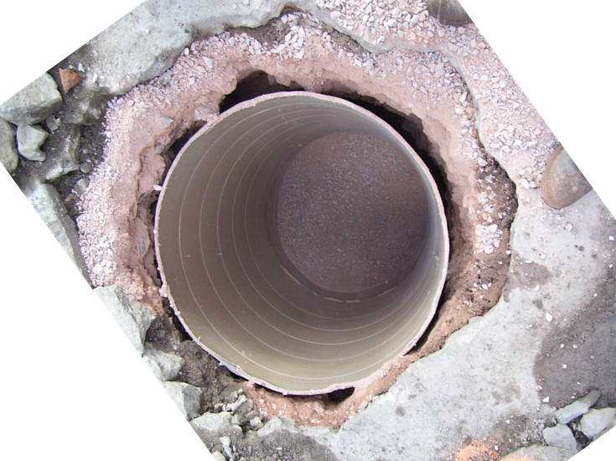
Example: Traffic Signal Footing
3 conduits interfere with 36” pole footing diameter
Redesign using 30” sonotube (longer, narrower footing)
Notes:
In the picture on the left, the third conduit is not visible. The conduit is located toward the front of the picture.
The 30” sonotube fit in between the existing conduits.

Slide 37
Summary of Cost Savings
Cost to relocate power facilities $95,000
Cost to collect QLA data - $5,785
Cost savings to taxpayers $89,215
Notes:
The cost to redesign the signal footing were negligible. The cost for the vacuum excavation were only a fraction of the estimated cost to relocate the utilities.

Slide 38
Key Concepts
Utility conflict management:
  Does not start at 60% design
  Does not end at letting
Not all projects or locations need QLB/QLA data
Goal: Avoid or minimize utility impacts
Strategies:
  Avoid unnecessary utility relocations
  Evaluate design alternatives
  Conduct utility conflict analysis
Notes:
This slide shows key concepts to keep in mind when addressing utility conflicts.

Slide 39
General References
ASCE Standard Guidelines for the Collection and Depiction of Existing Subsurface Utility Data (CI/ASCE 38-02)
AASHTO Guide for Accommodating Utilities Within Highway Right-of-Way (2005)
AASHTO Policy on the Accommodation of Utilities Within Freeway Right-of-Way (2005)
AASHTO Right of Way and Utilities Guidelines and Best Practices (2004)
FHWA Program Guide (2003)
Notes:
A number of references are available, which discuss utility accommodation and relocation issues (although not necessarily utility conflicts or utility conflict resolution matters).

Slide 40
SHRP 2 R15(B) Research Findings
2.2
Notes:
This part of Lesson 2 provides a summary of the main findings of project SHRP 2 R15(B) “Identification of Utility Conflicts and Solutions.”

Slide 41
Background and Objectives
Utility conflict matrix (UCM) an important tool for managing utility conflicts
Objectives:
  Review trends and identify best practices for the use of UCMs
  Develop a recommended UCM approach and document related processes
  Develop training materials for implementing prototype UCM
Notes:
As mentioned previously, utility conflicts are frequently blamed for unnecessary project delays and cost overruns. Utility-related activities in the project development process involves the production and exchange of enormous amount of data and supporting documents, including schematics, design files, agreements, and certifications. A critical component of this process is how to document and manage utility conflict data effectively. Utility conflict tables, also known as utility conflict matrices (UCMs) or utility conflict lists, enable users to organize and track utility conflict data. In practice, these tables or matrices support a wide range of related processes, including conflict analyses, utility agreement development, construction letting, as well as utility relocation scheduling, billings, and payments.
Practices involving the use of UCMs vary widely throughout the country, not just among states but also within states. There is a need to document these practices and develop optimized UCM concepts and techniques that can contribute to standardization and optimization of utility-related activities in the project development process. SHRP 2 Research Project R15(B) addressed this need by reviewing the state-of-the-practice around the country, identifying recommendations for best practices, developing and testing a prototype UCM concept, and developing training materials and implementation guidelines.

Slide 42
Research Team
Texas Transportation Institute
  Cesar Quiroga (PI), Edgar Kraus
Cardno TBE
  Paul Scott, Nick Zembillas, Vinnie LaVallette
Utility Mapping Services
  Phil Meis, Tom Swafford
Ash Engineering
  Janice Sands Ash, Gary Monday
Notes:
The research was led by researchers at the Texas Transportation Institute (which is part of the Texas A&M University System) with the help of three private-sector firms: Cardno TBE, Utility Mapping Services (UMS), and Ash Engineering. Cardno TBE and UMS are SUE providers, while Ash Engineering is a firm out of Tampa, Florida, which provides consulting services primarily to the utility industry.

Slide 43
Project Phases
Phase I (03/09 – 02/10)
  Surveys and interviews
  Review of national trends
  Prototype UCM development
Phase II (03/10 – 10/10)
  Work sessions (California, Georgia, Texas)
  Training material development
Phase III (11/10 – 07/11)
  Training material testing
  Implementation guideline development
  Final report

Slide 44
Surveys, Interviews, Trends, Prototype UCM
Online survey of 50 states:
  103 responses from 34 states
  82 responses from utility staff, 21 design staff
  Headquarters and district level
Follow-up interviews to obtain additional information from DOTs:
  38 interviews with representatives from 23 states
Notes:
The project included an online survey of all 50 states to identify trends and practices in utility conflict management. The survey resulted in 103 responses from 34 states. Of the 103 responses, 82 responses were from utility staff. The remaining 21 responses were from design staff. The survey involved both state DOT headquarters and district level personnel.
The research team also conducted follow-up interviews. In total, there were 38 interviews with representatives from 23 states.
State DOTs provided 26 sample utility conflict tables that further illustrated current practices (as well as “schools of thought” as to how to structure a UCM) around the country.

Slide 45
State of the Practice:
Utility Facility Data Tracking
Notes:
The research report provides a comprehensive description of the trends captured through the surveys, interviews, and sample data. These slides highlight on some of the main trends observed.
This slide summarizes the type of utility facility data that states normally track. Notice the substantial drop (from 93% to about 67%) after utility owner address, suggesting that most state DOTs tend to capture fairly basic information about who owns a specific facility, but less frequently physical characteristics such as material, encasement, diameter, or depth of cover (although these characteristics are still important to most state DOTs).

Slide 46
State of the Practice:
Utility Facility Data Tracking
Notes:
(continued).

Slide 47
State of the Practice:
Utility Conflict Data Tracking
Notes:
This slide shows trends regarding the tracking of utility conflict data.

Slide 48
State of the Practice:
Utility Conflict Data Tracking
Notes:
(continued).

Slide 49
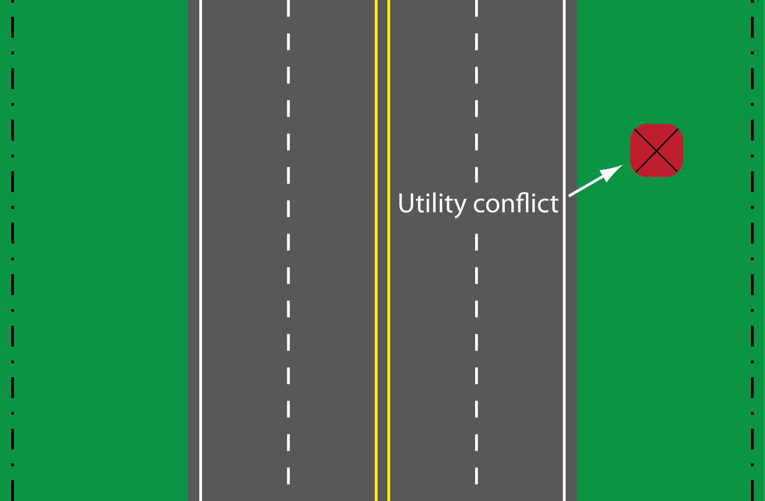
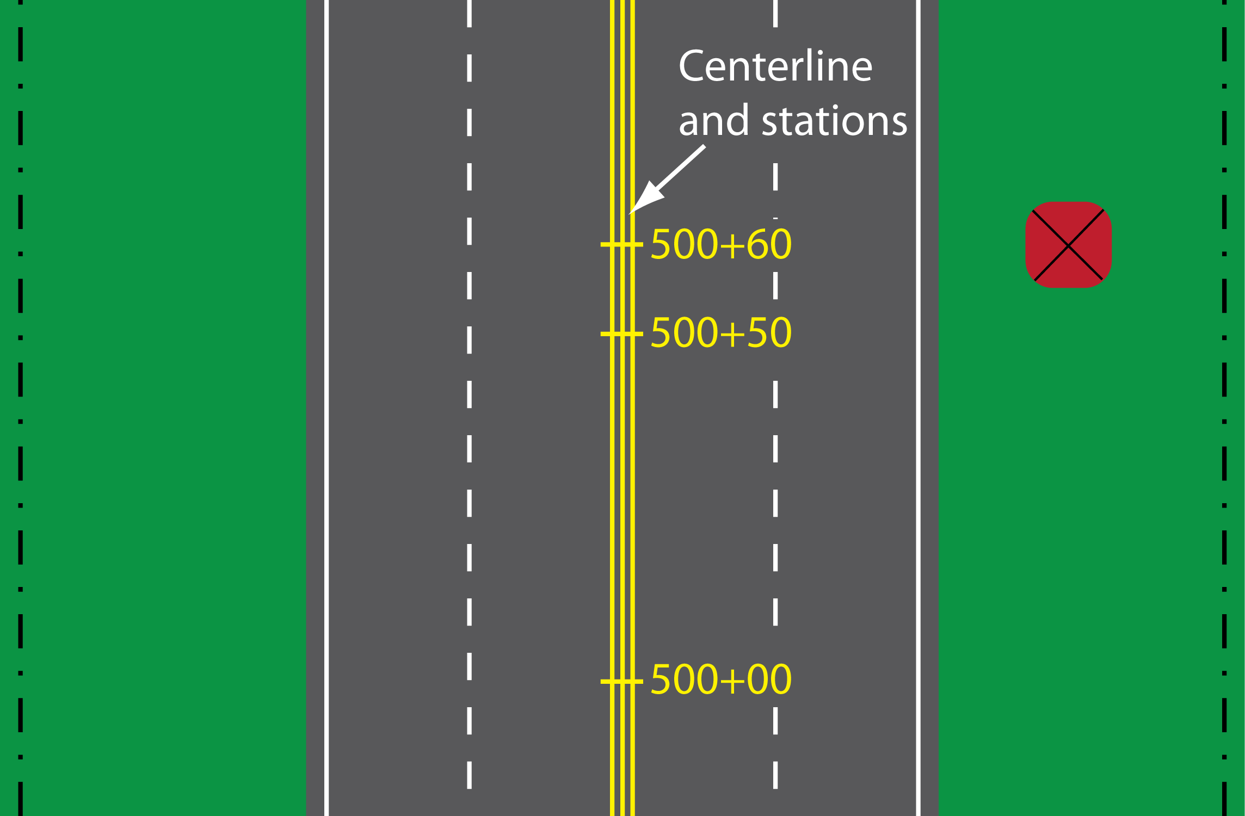
State of the Practice:
Utility Conflict Referencing
Notes:
Respondents were asked to provide information about the methods they use to identify utility conflict locations using alignments and offsets.
Project centerline and station is the most popular method for referencing utility conflicts along transportation project alignments. Similarly, the most common method for referencing utility conflict offsets is with respect to the project centerline. However, other offset methods mentioned were right-of-way line and edge of pavement (frequently, these methods are not reliable).

Slide 50
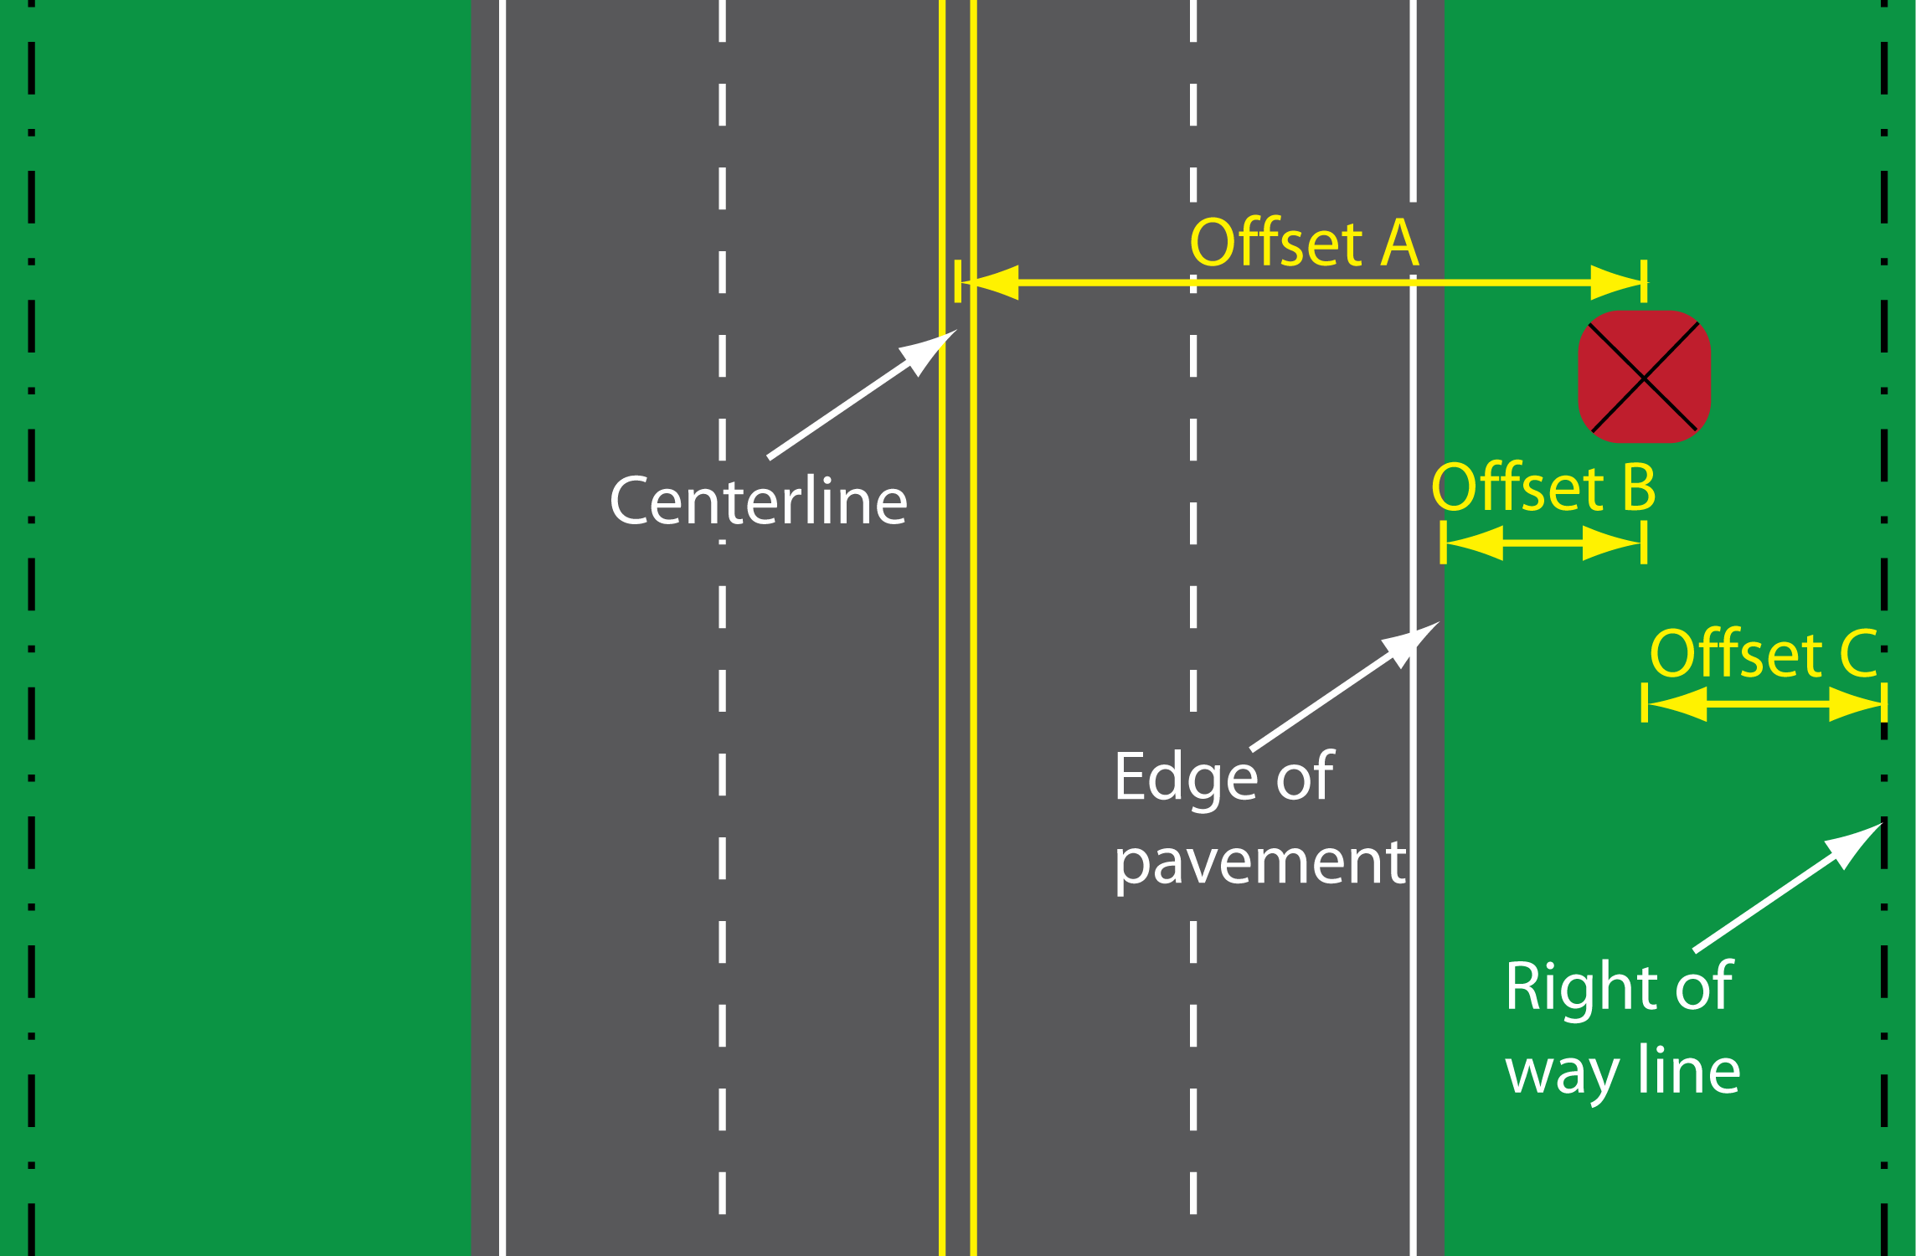
State of the Practice:
Utility Conflict Referencing
Notes:
Respondents were asked to provide information about the methods they use to identify utility conflict locations using alignments and offsets.
Project centerline and station is the most popular method for referencing utility conflicts along transportation project alignments. Similarly, the most common method for referencing utility conflict offsets is with respect to the project centerline. However, other offset methods mentioned were right-of-way line and edge of pavement (frequently, these methods are not reliable).

Slide 51
Utility Conflict Referencing:
Longitudinal Alignments
Notes:
Project centerline and station is the most popular method for referencing utility conflicts along transportation project alignments. However, respondents also indicated they use a variety of other longitudinal referencing methods, including route and mile point, control section and distance, intersection and displacement, route markers and displacement, and street blocks.

Slide 52
Utility Conflict Referencing:
Offsets with Respect to
Notes:
Similarly, the most common method for referencing utility conflict offsets is with respect to the project centerline. Other offset methods mentioned were right-of-way line, existing centerline, edge of pavement, and back of curb.
Individual table cell entries in the report indicate a specific combination of longitudinal alignment referencing system and offset referencing system.

Slide 53
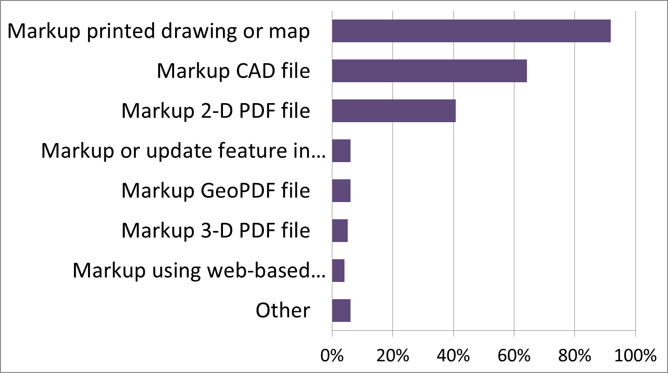
State of the Practice:
Utility Conflict Tracking
Notes:
State DOTs use a variety of methods to track and update utility conflict locations on project drawings. There is a clear preference for traditional paper-based approaches to mark up printed drawings or maps. Marking up CAD files is also common. Interestingly, more than 40 percent of respondents indicated they mark up 2-D portable document format (PDF) files, clearly indicating the increasing acceptance of the PDF file format for document editing and updating purposes. In general, state DOTs only rarely use other markup methods such as GeoPDF, 3-D GeoPDF, or web-based viewers.

Slide 54
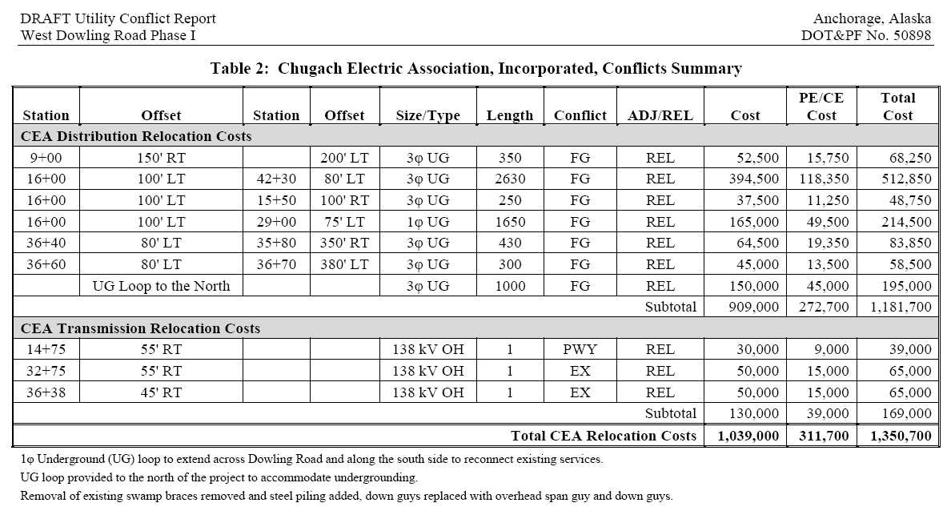
Sample (Alaska)
Notes:
This utility conflict matrix was provided by the Alaska DOT. Note the emphasis on cost items (three columns plus total), and that there are separate tables for each utility involved in the project.
[handout]

Slide 55
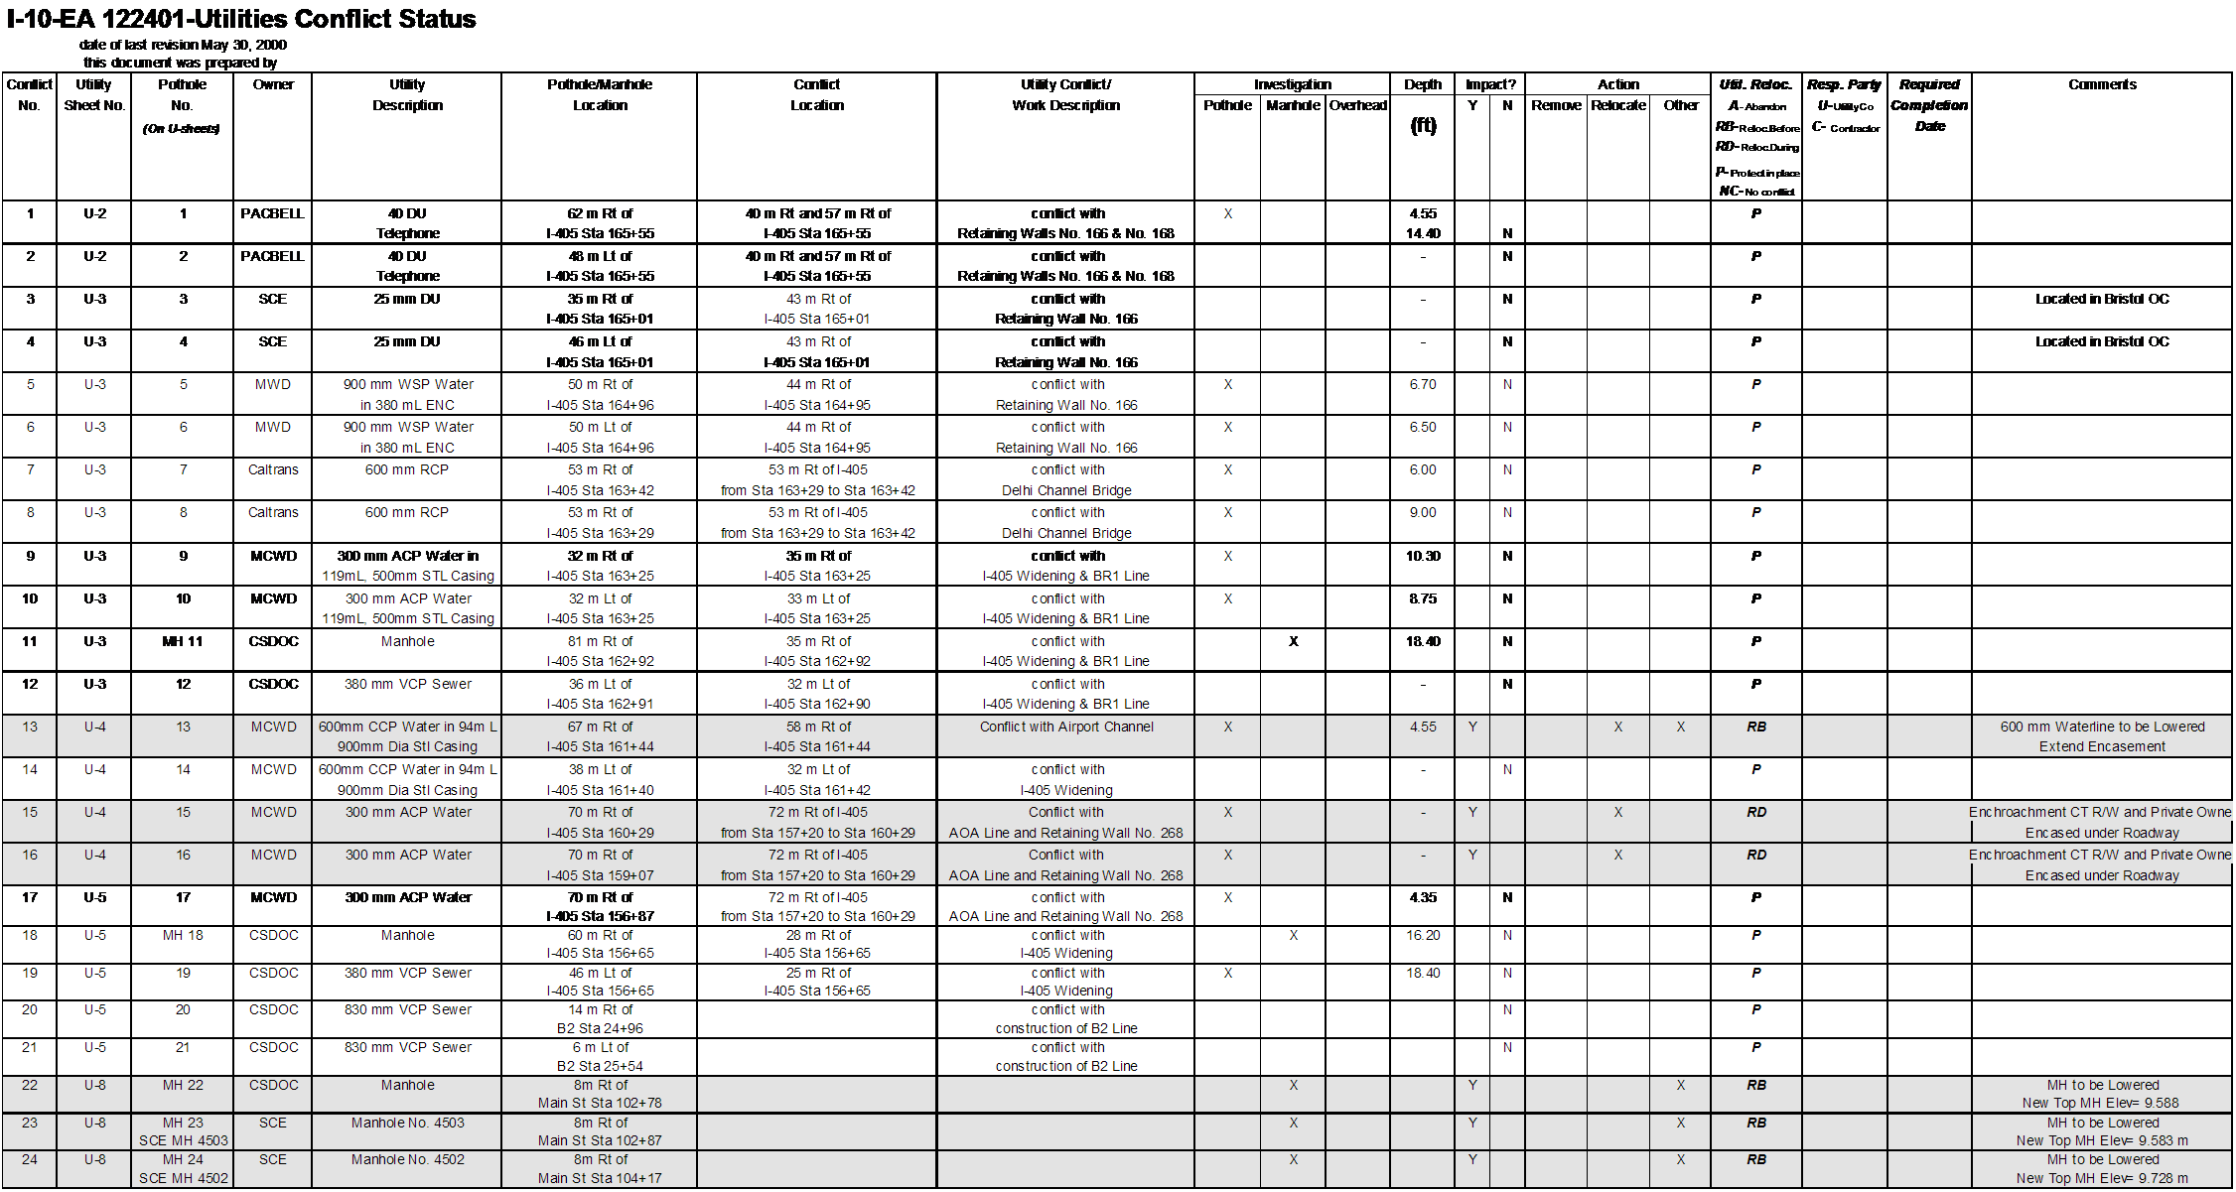
Sample (California)
Notes:
This utility conflict matrix was provided by the California DOT. Note the large number of columns and detail provided in the utility conflict matrix.
[handout]

Slide 56
Sample (Florida)
Notes:
This utility conflict matrix was provided by the Florida DOT. This matrix contains 8 columns, which is a relatively small number of columns.
[handout]

Slide 57
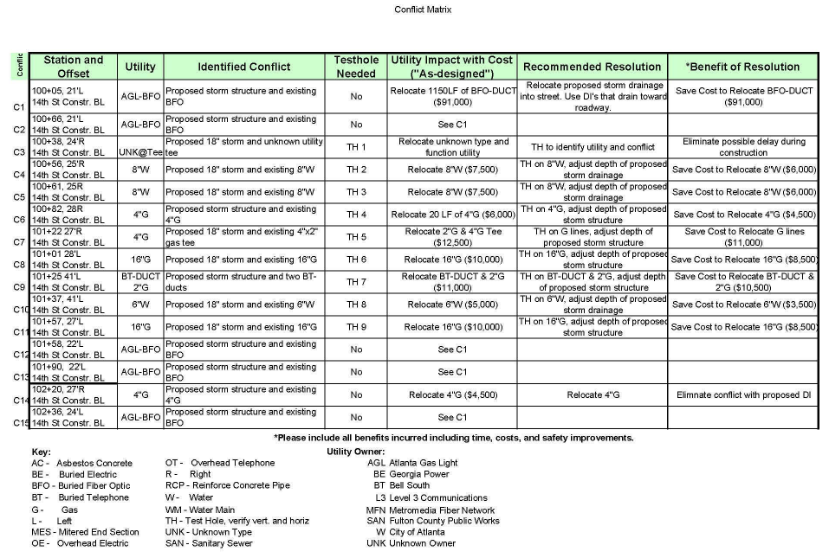
Sample (Georgia)
Notes:
This utility conflict matrix was provided by the Georgia DOT. This utility conflict matrix has 7 columns, which is also an example of a utility conflict matrix with a small number of columns. However, some of the columns contain multiple data items that other states include in separate columns.
[handout]

Slide 58
Sample (Michigan)
Notes:
This utility conflict matrix was provided by the Michigan DOT. Note the emphasis on the business process and tracking of critical dates.
[handout]

Slide 59
Sample (South Dakota)
Notes:
This utility conflict matrix was provided by the South Dakota DOT. This table only has 6 columns. Note a link to a picture is included for each utility conflict.
[handout]

Slide 60
Sample (Texas)
Notes:
This utility conflict matrix was provided by the Texas DOT. This utility conflict matrix contains a large number of data items. Note the emphasis on business process tracking and tracking of cost items.
[handout]

Slide 61
Recommendations from State DOTs
Utility conflict matrix:
  Track utility conflicts at facility level
  Maintain and update UCM regularly
  Develop UCM reports for utility companies
  Keep UCMs simple
  Use 11x17-inch page size for UCM
  Start UCM during preliminary design phase
  Include data from UCM in PS&E assembly
Notes:
Part of the research effort was to gather information from state DOTs about ideas that worked in relation to utility conflict management (in general) and utility conflict matrices (in particular).
Recommendations for best practices from state DOTs were grouped into three general categories: UCM, utility conflict management, and other. This slide focuses on UCM-level recommendations.

Slide 62
Recommendations from State DOTs
Utility conflict management:
  Use document management systems to support utility conflict management process
  Conduct “plan-in-hand” field trips with utilities
  Use One-Call to identify utilities early in the PDP
  Use RFID tags for damage prevention during construction
  Provide 3-D design details to utility owners early in the design phase
Notes:
This slide focuses on recommendations dealing with utility conflict management activities.

Slide 63
Recommendations from State DOTs
Other:
  Involve stakeholders in review of utility conflicts and solutions
  Develop effective communications with utility owners regardless of reimbursement eligibility
  Provide training to utility coordination stakeholders
Notes:
This slide focuses on other general recommendations for optimization of business practices.

Slide 64
Prototype UCM Development
Many states use tables or spreadsheets to manage utility conflicts
Different categories of data tracked
Wide range of styles and content
  26 sample tables received
  144 different data items in total
  Range of data items per table: 4 – 39
  Average number of data items per table: 14
  One size does not fit all
  Different ideas about “consensus” tables
Notes:
Feedback from state DOTs revealed the common use of UCMs to manage utility conflicts, although practices differ widely.
Two critical observations are:
One size DOES NOT fit all
Very different ideas about “consensus” tables. A “consensus” table was developed in Florida by an interagency committee composed of utility representatives, FDOT representatives, and consultants. Another “consensus” table was developed in California by a committee composed of California DOT representatives. Although the purpose of both tables was the same (to help manage utility conflicts effectively), the decision making process (and the final products) were quite different.

Slide 65
Prototype UCM Development
UCMs are not simple 2-D table products
Prototype 1: Compact, standalone UCM
  Low number of data items
  Spreadsheet (MS Excel)
  UCM spreadsheet is the product
Prototype 2: Utility conflict database
  Formal data model (ERwin)
  Tested in MS Access
  Enterprise database support (e.g., Oracle, SQL Server)
  UCM is one of many queries/reports possible
Notes:
Once the information from the states was received and processed, the next step was to develop a prototype UCM concept.
From the information provided, it became immediately evident that UCMs were not simple 2-D table products (Note: 2-D in a “tabular” sense, not in a “geographic” sense). To take this reality into consideration, the research team developed two UCM prototypes:
Prototype 1 (Compact, standalone UCM). This is a template in Excel that contains a limited number of columns (i.e., the minimum number of columns for a UCM to provide meaningful information). In this case, the UCM spreadsheet is the product.
Prototype 2 (Database-level UCM). This is a data model for managing utility conflicts and prototype Access database that provides a physical representation of the data model. The data model is generic and was built using industry standard procedures. The data model is in ERwin Data Modeler format, and can be easily exported to a variety of database environments (e.g., Oracle, SQL Server). In this case, the UCM is actually one of many queries or reports possible.

Slide 66
Prototype 1: Development
Steps to select data items for standalone UCM
  Analyze sample UCM data items
  Analyze survey results (conflict data)
  Analyze survey results (facility data)
  Consolidate/rank data items
  Identify data items to include in UCM
Result: reduced data items from 144 to 25
Notes:
This slide summarizes the steps to select the data items for the standalone UCM. In essence, the process involved analyzing the sample data received; analyzing survey conflict and facility data; consolidating, rating, and ranking data; and identifying which data items to include in the UCM.
The composite list of data items resulted from ranking data items according to use in the sample documents, ranking data items according to the frequency reported in the survey, and by combining the rankings from these data sources.
The research team then chose 25 data items to include in the standalone UCM, based on group discussions and the ranking of the data items.

Slide 67
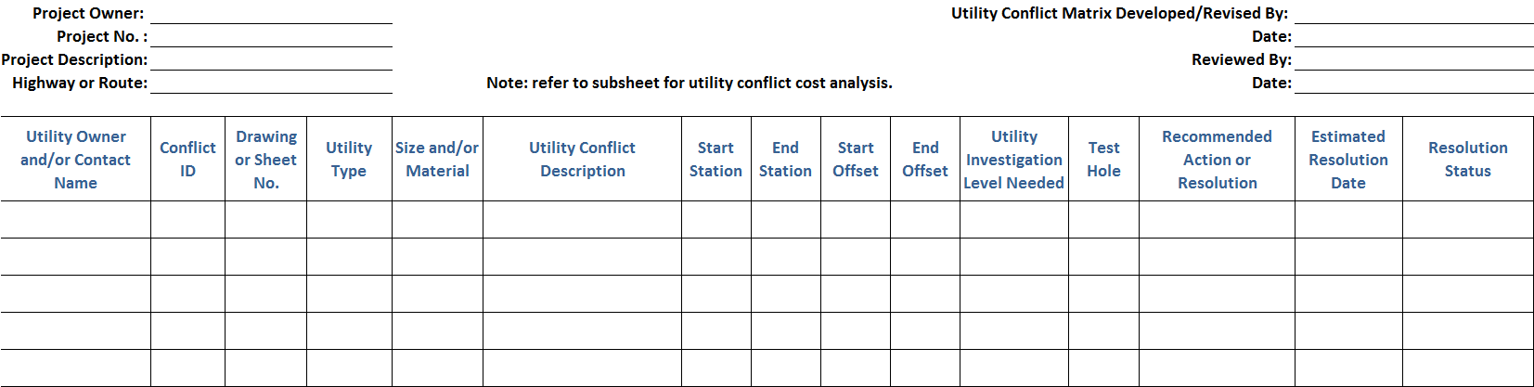
Prototype 1: Utility Conflict Matrix
UCM header: 8 data items
UCM body: 15 data items
MS Excel format
Includes drop-down lists
Notes:
This slide shows the template UCM as developed by the research team.
The prototype UCM includes 8 header data items and 15 main body data items. It also includes several drop-down lists to provide some automation to the process of populating the UCM.

Slide 68
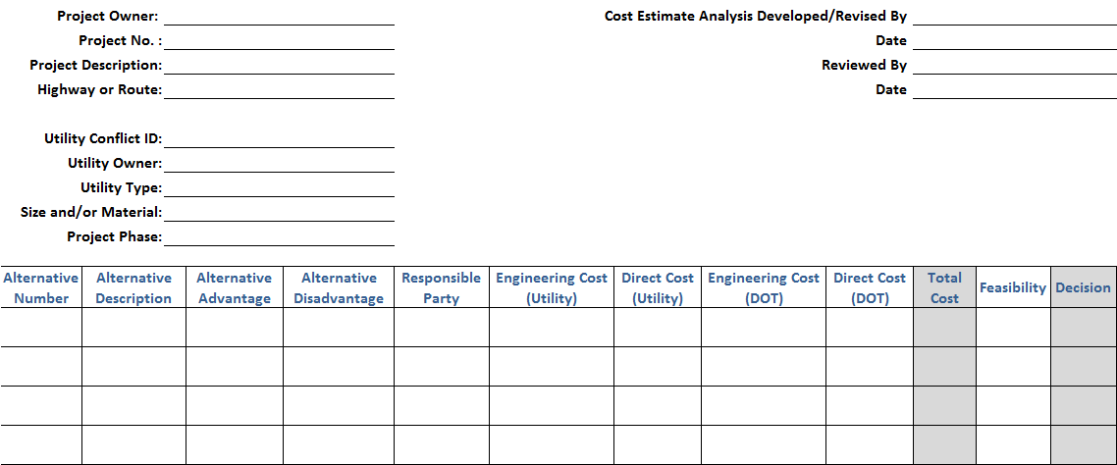
Prototype 1: Cost Estimate Analysis
Cost Estimate Analysis header: 13 data items
Cost Estimate Analysis body: 12 data items
MS Excel format, includes drop-down lists
Notes:
One of the data items in the initial version of the prototype standalone UCM was cost estimate. During work sessions with a sample of states to discuss properties and features of the prototype UCM, it became clear that having just one field to capture costs was not adequate. For example, this field would not enable an accurate depiction of which agency would be responsible for which costs. It would also not document the process used to select a utility conflict resolution strategy. This realization resulted in the need to use a second table to analyze costs and other elements associated with each utility conflict resolution strategy. This slide shows the design of the prototype sub-table developed as part of the research.

Slide 69
Prototype 2: Development
Formal data model (ERwin)
Tested in MS Access
Enterprise database support (Oracle, SQL Server)
UCM is one of many queries/reports possible
Notes:
As mentioned previously, Prototype 2 is a data model for managing utility conflicts and a prototype Access database that provides a physical representation of the data model. The data model is generic and was built using industry standard procedures. The data model is in ERwin Data Modeler format, and can be easily exported to a variety of database environments (e.g., Oracle, SQL Server). In this case, the UCM is actually one of many queries or reports possible.

Slide 70
Prototype 2: Query/Report Process
Identify report requirements
Populate database tables
  Develop and use data entry forms
Develop queries
  One-time effort for frequently-used queries
  Ad-hoc queries
Generate reports
  On-demand
Notes:
The next step after developing the logical model was to develop a physical representation in Access, and then develop queries and reports to produce UCMs.
This slide summarizes the main steps for the physical implementation of the prototype database.

Slide 71
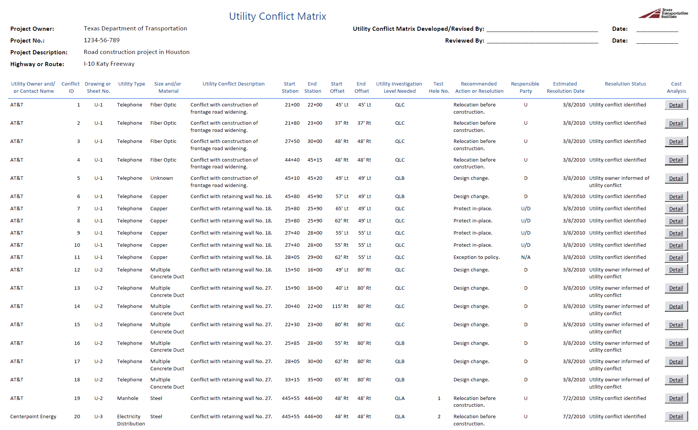
Prototype 2: UCM Report
Notes:
The final outcome of this example is the utility conflict matrix report as shown here in report view. Note the buttons on the right labeled “Detail”, which are placeholders to provide a link to cost estimate analysis sub reports.

Slide 72
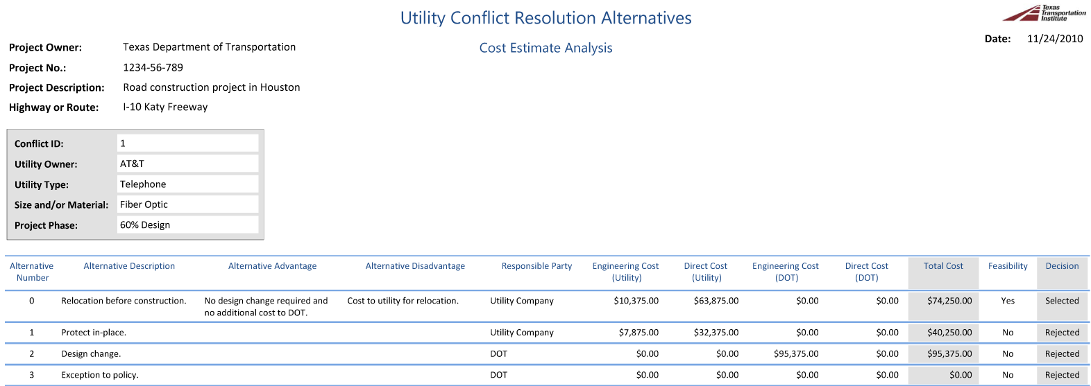
Prototype 2: Sub Report
Notes:
This slide shows sample records for the cost estimate analysis in connection with the first utility conflict from the previous slide.

Slide 73
In Summary …
UCM practices vary widely across the country
SHRP 2 R15(B) products:
  Prototype 1: Compact, standalone UCM
  Prototype 2: Utility conflict data model and database
  Training materials (Lessons 1 – 6)
  Implementation guidelines
Notes:
In response to the varying use of UCMs across the country, the research team developed two products:
Prototype 1 is a compact standalone UCM in Excel format that uses 23 data items and can be immediately used.
Prototype 2 is an flexible, scalable data model and database that can accommodate a large number of UCMs. Depending on the level of implementation, involvement by IT personnel at the DOT may be necessary.
Training materials for this course.
Guidelines for the implementation of the prototypes and training.

Slide 74
Questions and Answers
2.3

