Slide 1

TCRP A-37
Paratransit Emergency Preparedness and Operations Handbook
Boyd, Caton & Grant Transportation Group, Inc.
In Association with:
Nusura, Inc.
Final Research Presentation
Limited Use Document
This Power Point Presentation is furnished only for review by members of the TCRP Project A-37 Panel and is regarded as fully privileged. Dissemination of information included herein must be approved by the TCRP.

Slide 2




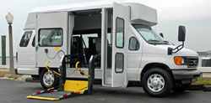
Paratransit Emergency Preparedness and Operations Handbook
Final Research Report

Slide 3
Welcome and Introductions
TCRP A-37 Panel
Liaisons and TCRP Staff
Ms. Andrea V. Busada, Chair, Broward County Transit Division
Ms. Madinah Ali, MSA Global Inc.
Mr. Richard Devylder, U.S. Department of Transportation
Ms. Susan Florentino, Portland Tri-Met
Dr. Lex Frieden, University of Texas
Mr. Erik Larson, Jaunt, Inc.
Mr. Steven F. Ponte, Eastern Contra Costa Transit Authority
Ms. Annette M. Williams, San Francisco Municipal Transportation Agency
Mr. Park Woodworth, King County Metro Transit
Mr. John R. Day, FTA
Mr. Michael Winter, FTA
Mr. Steve Dallman, TSI
Ms. Cindy Frene, National RTAP
Mr. David Hahn, APTA
Ms. Kristi Ross, Easter Seals Project ACTION
Mr. Kelly Shawn, CTAA
Mr. Stephan Parker, TRB
Ms. Megha Khadka, TRB

Slide 4
Research Team
BCG Transportation Group, Inc. –
  Paratransit and Bus Transit Safety, Security and Emergency Management Programs; Project Management; Resource Development
    Annabelle Boyd, Principal Investigator
    Ream Lazaro
    Jim Caton
    Adrian Moy
    Dain Pankratz
Nusura –
  Transportation Emergency Management; Issues Involving People with Access and Functional Needs; Training, Drills and Exercises
    Gary Gleason, Deputy Principal Investigator
    Michael Noel
    June Isaacson Kailes

Slide 5
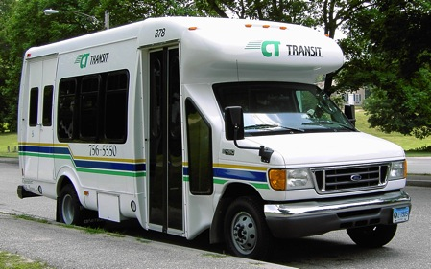
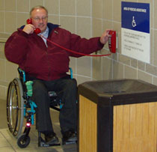
TCRP A-37 Project Goal
To develop a handbook for paratransit service providers:
Guidance and recommended practices to prepare for emergencies:
  Advance notice events: Floods, hurricanes, blizzards and pandemics, and
  No-notice events: Earthquakes, power blackouts, and acts of terrorism.

Slide 6
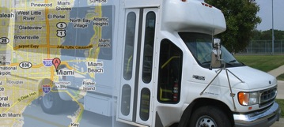

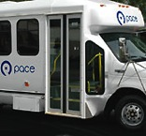

All Types of Paratransit Service
Urban, suburban, tribal and rural
ADA complementary paratransit service and demand response service

Slide 7

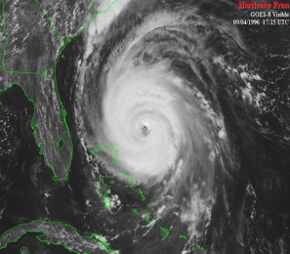

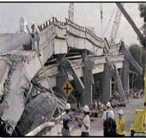


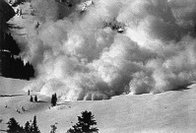



All Hazards (Natural, Technological, Intentional)

Slide 8
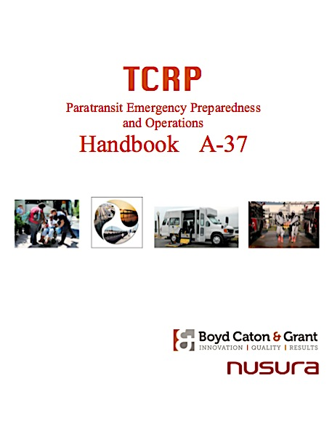
Handbook Development
Project tasks
  1: Focused Literature Review
  2: Interviews with Experts
  3: Evaluate Lessons Learned
  4: Detailed Outline for Handbook
  5: Prepare Interim Report
  6: Revise Work Plan
  7: Develop Draft Handbook
  8: Field Test and Evaluate Handbook
  9: Final Handbook, Report and Presentation

Slide 9
TCRP A-37 Phases and Tasks
Notes:
In scoping out the project, the A-37 Panel structured a series of nine logically sequenced tasks to be performed over two project phases to complete the handbook. Since the project kick-off in mid-November 2010, the BCG/Nusura team has been working on the first five tasks in Phase 1:
Task 1 – Focused literature review and review of existing practices.
Task 2 – Interviews with experts in paratransit emergency operations and preparedness.
Task 3 – Evaluation of lessons learned from paratransit operations and response during recent emergencies and special events.
Task 4 – Development of detailed outline for a Paratransit Emergency Preparedness and Operations Handbook.
Task 5 – Preparation of Interim Phase 1 Report.

Slide 10

TCRP A-37 Deliverables – Completed
Kick-off – November 7, 2010
Amplified Work Plan – November 20, 2010
Quarterly Research Progress Status Report – March 31, 2011
Phase I Interim Report – June 15, 2011
Phase I Panel Meeting – August 5, 2011
Draft A-37 Handbook – December 31, 2011
Validation Workshop Report – March 8, 2012
Final A-37 Handbook - May 5, 2012
Preliminary A-37 Final Report - May 18, 2012
Final A-37 PowerPoint Presentation - May 18, 2012
Notes:
The BCG/Nusura team has submitted three major deliverables for Phase 1 and now is supporting this meeting.
As explained in the Amplified Work Plan, the BCG team began following our proposed approach for the initial research.
The BCG/Nusura team began sharing the results of our research with the TCRP A-37 Panel at the end of March 2011 in our “Quarterly Research Progress Status Report.” This report included the results of the literature review, key findings from a series of interviews with experts on paratransit operations, a draft of our team’s proposed outline for the Final Handbook and a Gap Analysis Checklist – synched with the proposed outline that can be used by paratransit service providers to assess their current level of emergency planning and preparedness.
This Phase I Interim Report adds to the material provided in the “Quarterly Research Progress Status Report,” completing the Task 3 Lessons Learned activity, with a matrix that summarizes expert and literature opinion regarding lessons learned from paratransit operations and response during recent emergencies and special events. Another appendix has been created containing the write-ups of additional interviews conducted to evaluate lessons learned from response to emergencies, including recent events in the Southern United States, the Pacific Northwest, and the Midwest.
The Phase 1 Interim Report also includes the BCG/Nusura team’s proposed Work Plan for Phase 2 of this project.

Slide 11

Task 1 – Focused Literature Review
The research team performed the following tasks:
Task 1.1 – Kick-off Meeting
Task 1.2 – Identify and Gather Existing Literature
Task 1.3 – Review and Synthesize Data
Task 1.1 – Kick-off Meeting was held on November 7, 2010

Slide 12

Task 1 – Focused Literature Review
Task 1.2 - Identify and Gather Existing Literature
Over 150 references in the bibliography targeted to paratransit providers:
  FTA Bus Safety and Security Program references
  LexisNexis and TRIS results
  FEMA’s Lessons Learned Information Sharing Database
  CTAA, APTA, and AASHTO libraries, studies, standards and training materials
  Special NTD data analysis

Slide 13



Task 1 – Focused Literature Review
Other resources provided by:
  CDC and Association of State and Territorial Health Officials
  Easter Seals Project ACTION
  National Council on Disability
  National Institute on Disability and Rehabilitation Research
  National Rural Transit Assistance Program
  State, regional and local governments, organizations, agencies, and advocacy groups.

Slide 14





Task 1 – Focused Literature Review
Critical references include:
  Federal legal requirements and guidance;
  Targeted research and recommended practices;
  Assessments and industry association studies;
  Lessons learned from the paratransit and disability communities
Notes:
A literature review
surveys scholarly articles, books and other sources (e.g. dissertations, conference proceedings) relevant to a particular issue, area of research, or theory.
provides a short description and critical evaluation of work critical to the topic.
offers an overview of significant literature published on a topic.
Critical resources for this literature review have been issued by the Federal Emergency Management Agency (FEMA) and the U.S. Department of Transportation (U.S. DOT), including the Federal Highway Administration (FHWA) and the Federal Transit Administration (FTA). Over the last five years, these agencies have worked to reconstitute the way in which national emergency planning and preparedness processes address the great diversity of the American population.
Legal/grant requirements:
FEMA, FTA, Civil Rights
Studies and lessons learned:
FEMA, U.S DOT, FHWA, FTA
National Council on Disability (NCD)
National Institute on Disability and Rehabilitation Research (NIDRR)
National Rural Transit Assistance Program (RTAP)
Project Action
National Transit Database (NTD)
FEMA policy changes after Hurricane Katrina, specified by Congress in the Post-Katrina Emergency Management Reform Act of 2006, ensure that the National Response Framework (NRF) and the National Incident Management System (NIMS) now contain a definition of “special needs” to help emergency managers and planners understand the diverse population and the specific access and functional needs they may need to address during disasters. FEMA grants now specify that equal access requirements for people with disabilities apply to the points-of-service that address human needs, specifically the functions and activities comprising Emergency Support Function 1 (Transportation), Emergency Support Function 6 (Mass Care, Housing and Human Services) and Emergency Support Function 15 (External Affairs). FEMA has also developed recommended guidance, technical assistance and training devoted exclusively to managing access and functional needs concerns in emergency evacuations and shelter-in-place actions. New grant programs also require that special needs populations be addressed in emergency exercises. Special Needs Population: Populations whose members may have additional needs before, during, and after an incident in functional areas, including but not limited to: maintaining independence, communication, transportation, supervision, and medical care. Individuals in need of additional response assistance may include those who have disabilities; who live in institutionalized settings; who are elderly; who are children; who are from diverse cultures; who have limited English proficiency or are non-English speaking; or who are transportation disadvantaged.

Slide 15

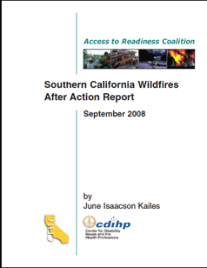

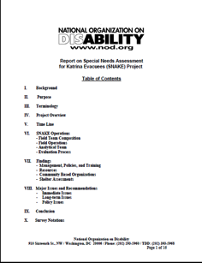
Task 1 – Focused Literature Review
Notes:
CPG 101 replaces State and Local Guide 101, which is rescinded. In addition, CPG 101 Version 2.0 supersedes CPG 101 Version 1.0, which is rescinded. CPG 101 Version 2.0 also supersedes the Interim CPG 301, which is rescinded. Also rescinded CPG 302 on managing service animals and pets during emergencies.

Slide 16
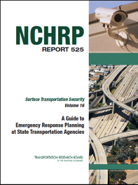
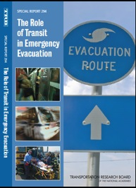
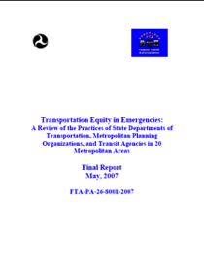

Task 1 – Focused Literature Review
TCRP/NCHRP Projects
  TCRP Special Report 294: The Role of Transit in Emergency Evacuation
  NCHRP Report 525, Vol. 16: A Guide to Emergency Response Planning at State Transportation Agencies
Federal Transit Administration
  Transportation Equity in Emergencies Study
University of Kansas
  Nobody Left Behind Project

Slide 17
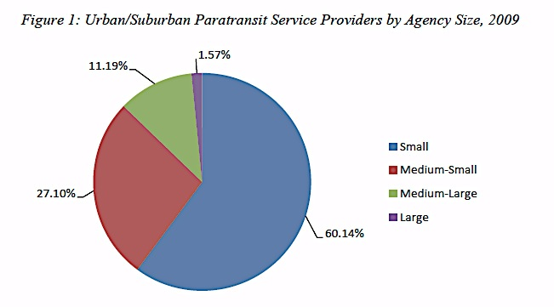
Task 1 – Focused Literature Review
Task 1.3 – Review and Synthesize Data
National Transit Database (NTD) Profiles of Urban/Suburban and Rural/Tribal Paratransit Service
Of the 1,187 rural transit operators offering demand-response service:
  • 260 rural/tribal public transportation agencies provide fixed-route and demand-response service, and
  • 927 rural/tribal public transportation agencies operate only demand-response service.
572 Urban/Suburban Paratransit Service Providers
1,187 Rural and Tribal Paratransit Service Providers
Notes:
• Agencies with fewer than 25 DR vehicles (Small),
• Agencies with a fleet size of greater than 24 but less than 100 vehicles (Medium-Small),
• Agencies with greater than 99 but fewer than 500 vehicles (Medium-Large), and
• Agencies with 500 or more DR vehicles (Large).
In total, in 2009, there were:
• 344 Small agencies,
• 155 Medium-Small agencies,
• 64 Medium Large agencies, and
• 9 Large agencies.

Slide 18
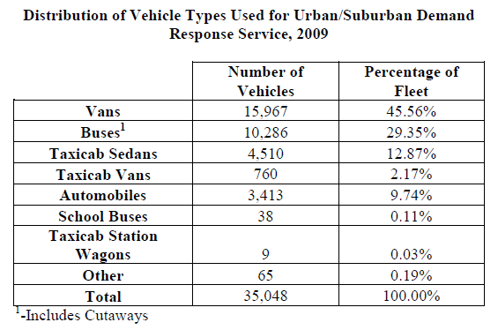
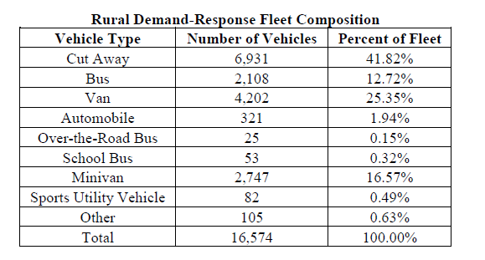
Task 1 – Focused Literature Review
Task 1.3 – Review and Synthesize Data (Continued)
572 Urban/Suburban Paratransit Service Providers
1,187 Rural and Tribal Paratransit Service Providers
100 million passenger trips
880 million passenger miles
60 million passenger trips
400 million passenger miles
Notes:
Another Task 1 activity specified in the BCG/Nusura Work Plan required the BCG/Nusura team to conduct an analysis of information available in the National Transit Database (NTD) to create a portrait of the U.S. paratransit industry, including urban/suburban operators and rural/tribal service providers. This assessment enabled the team to identify the level and types of paratransit service provided nationwide, as well as the paratransit industry’s resources and capabilities, including its equipment and fueling constraints, it personnel and service characteristics.
The NTD program defines “paratransit” service as “the type of passenger transportation that is more flexible than conventional fixed-route transit but more structured than the use of private automobiles. Paratransit includes demand response (DR) transportation services, shared-ride taxis, car-pooling and vanpooling (VP), and jitney (JT) services. Most often refers to wheelchair-accessible, demand response (DR) service.” (NTD Glossary, 2010)
Through monthly and annual reports to the NTD, the Federal Transit Administration collects data from public transportation agencies providing paratransit service. Typical data collected includes: contact information; service area characteristics; funding sources and expenditures; levels of service provided; vehicle fleet age and characteristics; and safety performance.
Public transportation agencies with paratransit services that receive Urbanized Area Formula Program (§5307) grants, or that benefit from these grants, must report directly to the NTD. Information is collected on subrecipients of FTA’s Formula Program for Other than Urbanized Areas (§5311) who provide paratransit service from the State agency, typically the State Department of Transportation, that administers the section 5311 grant program in the state.
Paratransit service can be provided through many different arrangements and operating parameters. The NTD program, for public transportation agencies in both urban and rural areas, largely collects paratransit-related service information in a set of categories related to demand-response (DR) service.
DR service is defined as “shared ride service that is scheduled in response to calls from passengers.” (NTD Glossary, 2010) In urban areas, of course, this service is provided, in large part to meet the requirements of the Americans with Disability Act (ADA). In rural areas, this service addresses critical needs in rural populations for senior citizens and vital medical transportation trips, as well as transportation to and from employment.
The NTD program recognizes that the traditional demand-response service model has been transformed in recent years, particularly in rural areas, however, pre-existing limitations in the structure of the NTD reporting system restrict the information that can be collected from modes of service other than DR that support paratransit operations. For instance, data collected for transit service that integrates traditional paratransit trips into general public transit service through route deviation or other means is reported largely under the general public transit service categories. Nevertheless, information provided in the DR service categories provides an extremely useful snapshot of urban/suburban and rural/tribal paratransit operators nationwide.

Slide 19
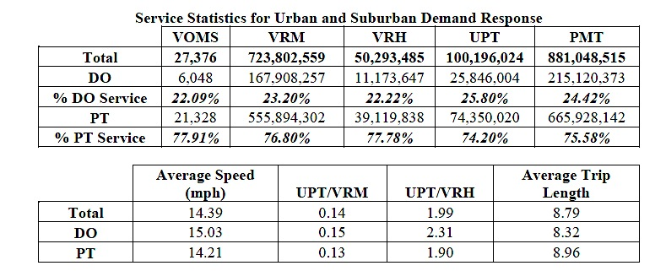
Task 1 – Focused Literature Review
Task 1.3 – Review and Synthesize Data (Continued)
Directly Operated versus Purchased Transportation in Urban/Suburban Paratransit Systems
Notes:
As indicated in the table on this slide, while the number of PT and DO paratransit services operators are roughly equal (289 PT agencies versus 283 DO agencies), the PT paratransit providers tend to serve larger and more densely populated urban areas. Therefore, in 2009, PT paratransit operators provide roughly 75 percent of paratransit passenger service, while DO service providers, working in less densely populated areas, provided 25 percent of passenger service in 2009.
The average vehicle speed for the DR industry overall is 14.39 miles per hour while the average passenger trip length is 8.79 miles. Directly operated DR service reported slightly higher speeds and slightly shorter trip lengths than purchased transportation.

Slide 20

Task 2 – Interviews with Experts

Slide 21

Task 2 – Interviews with Experts
To conduct interviews, the research team performed the following tasks:
Task 2.1 – Identify a Diverse Pool of Interview Candidates
Task 2.2 – Develop Interview Guides
Task 2.3 – Conduct Interviews and Document Results
Task 2.4 – Analyze and Synthesize Interview Results

Slide 22

Task 2 – Interviews with Experts
Task 2.1 – Identify A diverse pool of candidates
Establish a diverse pool of candidates to be intereviewed representing:
    Urban, suburban, tribal and rural paratransit providers
      Public and private (in-house or contracted)
    Access and functional needs perspectives
      Individuals and associations/agencies
    State Departments of Transportation
    Emergency Management

Slide 23

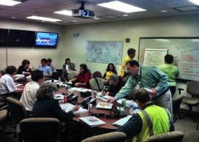

Task 2 – Interviews with Experts
  Interview a diverse pool of candidates representing (continued):
    Range of emergency experiences:
      To identify practices that worked well in real emergencies,
      To identify “lessons learned” from challenges, short-comings, and missed opportunities occurring in real emergencies, and
      To cover all hazards – not only evacuation.

Slide 24


Task 2 – Interviews with Experts
Task 2.2 – Identify Pool of Interview Candidates
Approximately 60 interviews:
  Individual and group
  Telephone and email
  Over 150 expert participants nationwide
Experts interviewed represented:
  17 urban and suburban systems
  20 rural and tribal systems
  Four (4) large contractor agencies
  Two (2) private, non-profit agencies
  Eight (8) transit and disability associations
  18 state departments of transportation
  Two (2) university research centers

Slide 25


Task 2 – Interviews with Experts
Task 2.3 – Develop Interview Guides
Two Interview Guides used:
  Guide #1: Experience with emergency preparedness and response
  Guide #2: Lessons learned from emergency events

Slide 26
Task 2 – Interviews with Experts
Guide #1: Experience with emergency preparedness and response
Agency Being Interviewed __________
Date and Time __________
On the Call:
Interviewer name and contact info ____________ Interviewee name and contact info ____________
Introduction
This discussion is part of an assessment of best practices in paratransit emergency management
Preparedness
Planning
Resource Capabilities Assessment
  What has your agency done to assess the capabilities and limitations of your paratransit resources?
ESF-1 Coordination
  Does your agency have a plan for how your agency’s paratransit resources will coordinate with public transit, school bus transportation and private sector transportation to support evacuation transportation needs?
Training
NIMS Compliance
  Are you aware of federal requirements for training staff in the Incident Command System (ICS) and the National Incident Management System (NIMS)?

Slide 27
Task 2 – Interviews with Experts
Task 2.4 – Conduct Interviews and Document Results
Guide #1 administered to experts in 35 organizations:
Access Services, El Monte, CA
ACCESS Transportation System, Pittsburgh, PA
Atomic City Transit, Los Alamos, NM
Caltrans, Sacramento, CA
CARTS, Austin, TX
CENTRO, Syracuse, NY
Charlotte County Transit Dept., Port Charlotte, FL
Coach America, North Dakota
Coast Transit Authority, Gulfport, MS
Country Roads Transit, Elkins, WV
CUTR, University of South Florida
CTAA, Washington, DC
Delmarva Community Transit, Cambridge, MD
Denver RTD, Denver, CO
Easter Seals, Chicago, Illinois
Florida DOT, Tallahassee, FL
Fresno County Rural Transit Agency, Fresno, CA
Havasu Area Transit, Lake Havasu City, AZ
KU Transportation Research Institute, Lawrence, KS
Metropolitan Transit System(MTS) Access, San Diego, California
New York State DOT, Albany, NY
Orange County Transportation Authority, Irvine, CA
Oregon DOT, Salem, OR
Paratransit, Inc., Sacramento, CA
Polk County Transit Services, Bartow, FL
Potomac Valley Transit Authority, Petersburg, WV
South Carolina DOT, Columbia, SC
Special Transit, Boulder, CO
Texas DOT, Bryan, TX
Tillamook County Transportation District, Tillamook, OR
Tri-Met, Portland, OR
Upper Great Plains Transportation Institute, Fargo, ND
Virginia Regional Transit, Purcellville, VA
Volusia County Public Transit, South Daytona, FL
West Virginia DOT, Charleston, WV

Slide 28
Task 2 – Interviews with Experts
Guide #2: Lessons learned from emergency events
Lessons Learned 1-7
Guidance/Leadership
Experience Counts
Lessons Learned 8-14
Interoperability
Personal Preparedness Training
Lessons Learned 14-21
Handling ‘In-system’ Customers When Disaster Strikes
Disaster Dispatch
Emergency Planning
Communication About Service Continuity
Interfacing with Emergency Management
Paratransit and the Emergency Operations Center
Identifying People with Evacuation Needs
NIMS Certification
Drills and Exercises
Liability Concerns
Contracted Paratransit Services
ESF-1 Coordination
Staff Disposition/Capacity
Commandeered Equipment
Pets
Recovery
Other Thoughts

Slide 29
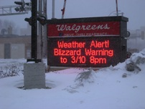


Task 2 – Interviews with Experts
Task 2.4 – Conduct Interviews and Document Results
Guide #2 administered to experts in 16 organizations:
    Alabama Department of Transportation, Montgomery, Alabama – Hurricanes, flooding, and tornados
    Bis-Man Transit/Capital Area Transit, North Dakota – Flooding and blizzards
    TOPS Broward County, Florida – Hurricanes
    FirstGroup America, Vancouver, WA – Volcanic eruptions/ashfall, earthquakes, and flooding
    Good Wheels, Inc., Fort Myers, Florida – Hurricanes
    LeeTran, Fort Myers, Florida – Hurricanes
    Louisiana Department of Transportation and Development, Baton Rouge, Louisiana – Hurricanes and flooding
    MV Transportation (nationwide), headquartered in Fairfield, California –Flooding, blizzards/snow storms, hurricanes, wildfires, and earthquakes

Slide 30

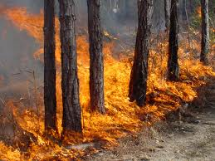

Task 2 – Interviews with Experts
    Guide #2 administered to experts in 16 organizations (continued):
    Palmetto Breeze, Bluffton, South Carolina – Hurricanes, hazardous materials spills, major accidents, and supporting response to plane crash
    Monroe County Transportation Authority, Scotrun, Pennsylvania – Snow and ice emergencies, power outages, and flooding
    Metropolitan Transit System – Access, San Diego , California and
    Denver RTD, Denver, Colorado – Wildfires, blizzards/snow and ice emergencies, power outages, supporting emergency response crews
    PennTrain, Harrisburg, Pennsylvania – Flooding, and snow/ ice emergencies
    RADAR, Roanoke, Virginia – Flooding, nursing home complex fire
    METRO ParaCruz, Soquel, California – Wildfires and supporting emergency responders
    South Central Adult Services, Valley City, North Dakota – Flooding, snow and ice emergencies, city-wide sewer system collapse

Slide 31
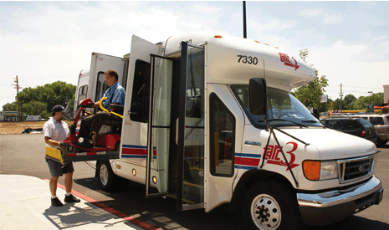
Task 2 – Interviews with Experts
Task 2.5 – Analyze and Synthesize Interview Results
The information was analyzed and incorporated into the Handbook, work plan and PowerPoint presentation as applicable

Slide 32

Task 3 – Evaluate Lessons Learned
To evaluate and identify key issues the research team conducted the following tasks:
Task 3.1 – Use the Results from Task 1 and Task 2 to Identify Recent Emergencies appropriate for Study
Task 3.2 – Identify the Issues that Impact and Affect Paratransit Emergency Preparedness and Operations
Task 3.3 – Finalize List of Recent Emergencies for Evaluation
Task 3.4 – Evaluate Lessons Learned from Recent Emergencies to Identify Best Practices
Task 3.5 Analyze and Synthesize Results

Slide 33

Task 3 – Evaluate Lessons Learned
Task 3.1 – Use the Results from Task 1 and Task 2 to Identify Recent Emergencies appropriate for Study
TCRP A-37 Lessons Learned Matrix was based on:
  Review of Literature
  Results of Interviews with Experts – Guide #1 and Guide #2
  Focused Examination of Recent Emergencies:
    2011 Tsunami Preparation and Response on West Coast
    2011 Tornados in Alabama and Missouri
    2009 and 2010-2011 Floods in Midwest
    2007 and 2011 Wildfires in West and Southwest
    2010 Snow, Ice Storms and Blizzards in East
    2005 Hurricanes Katrina and Rita

Slide 34


Task 3 – Evaluate Lessons Learned
Task 3.2 – Identify the Issues that Impact and Affect Paratransit Emergency Preparedness and Operations
The TCRP A-37 Lessons Learned Matrix included outreach with the Disability Community:
  The Disability Rights Educations and Defense Fund (DREDF)
  The National Organization on Disability (NOD)
  Easter Seals Project ACTION
  Industry-leading policy analysts
  CTAA’s ten Regional Ambassadors

Slide 35
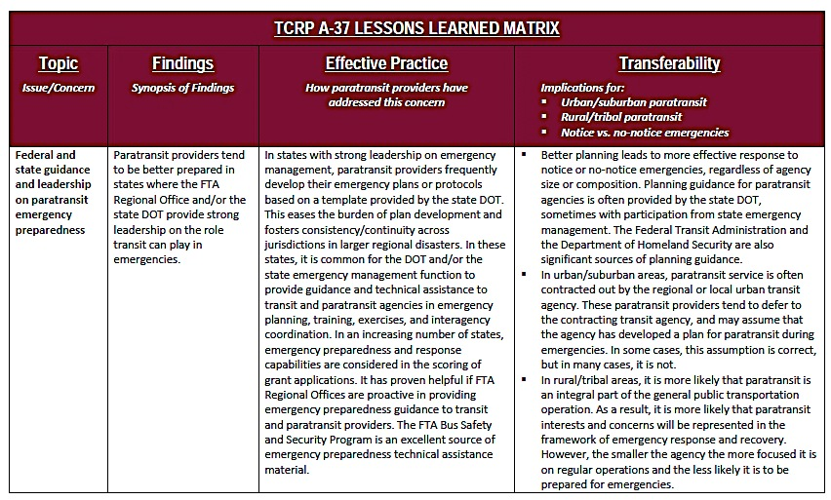
Task 3 – Evaluate Lessons Learned
Notes:
Key issues addressed in matrix include:
Emergency Management is often not receptive to input from paratransit providers when developing Emergency Operations Plans.
Emergency preparedness and operations planning often lacks sufficient detail about the role paratransit providers are scheduled to fill during emergency community response activities.
Emergency Management often has not arranged for a formal place for transportation, including paratransit, at the Emergency Operations Center.
Emergency Management often does not view paratransit as critical to mission achievement, thus emergency access to fuel and other essential material supplies for paratransit is not considered.
Emergency preparedness and operations planning has often not fully examined the limitations of paratransit resources.
Emergency preparedness and operations plans that utilize multiple transportation resources often lack a knowledgeable transportation expert to lead a coordinated response.
Emergency preparedness and operations planning often does not include a comprehensive listing of individuals identified as needing evacuation services.
Emergency preparedness and operations planning often does not sufficiently identify the special needs of individuals who need evacuation services.
Emergency preparedness and operations planning often has not addressed the need for radio communication interoperability.
Emergency preparedness and operations planning often has not addressed paratransit driver fatigue and relief concerns.
Emergency Management often has not integrated paratransit providers into emergency drills, simulations and exercises.
Paratransit management often does not participate in Local Emergency Planning Committee (LEPC) meetings.
Paratransit providers often have not formally confirmed that they have insurance coverage on transit resources to be used during community emergency response.
Some paratransit providers are reluctant to follow established protocols for releasing their equipment to Emergency Management to be operated by non-paratransit personnel.
When a paratransit provider’s fleet includes vehicles requiring CDL drivers, paratransit is often reluctant to follow Emergency Management instructions directing those vehicles to be driven by non-paratransit, non-CDL drivers.
Key external players often are not trained on the operation of paratransit vehicles.
Paratransit staff at times is unavailable to participate in community emergency response.
Paratransit vehicles often are not prepped and/or staged for effective mobilization during community emergency response
Paratransit management and staff are often not National Incident Management System (NIMS) certified.
Concern for the needs of its regular passengers may cause paratransit providers to hold back resources planned for deployment by Emergency Management.
Paratransit providers often have not fully addressed the requirements for financial reimbursement of resources deployed during emergency response.
Paratransit dispatching systems are at times susceptible to disaster impact.
Paratransit providers often do not sufficiently plan for paratransit service start-up after an emergency event.
Paratransit demand for services often changes following a disaster.
Paratransit operators typically have policies allowing service animals but not pets on board their vehicles.
Transit agencies or other entities that contract for paratransit services often lack the ability to direct the activities of their contractors during community emergency response.

Slide 36
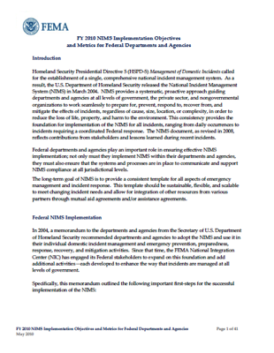
Task 3 – Evaluate Lessons Learned
Task 3.3 - Finalize List of Recent Emergencies for Evaluation
The Lessons Learned Matrix identifies 29 issues that impact paratransit emergency preparedness and response:
Federal and state guidance
Limited disaster experience
Limitation of paratransit response resources
Paratransit emergency planning
Business continuity planning
Communicating with customers and partners

Slide 37


Task 3 – Evaluate Lessons Learned
Task 3.3 - Finalize List of Recent Emergencies for Evaluation
Relationship with emergency management and participation in planning
Local Emergency Planning Committees
Paratransit’s role at the EOC
NIMS certification
Paratransit staff emergency response training
Emergency drills, exercises, simulations
Identifying individuals needing evacuation assistance

Slide 38



Task 3 – Evaluate Lessons Learned
Task 3.3 - Finalize List of Recent Emergencies for Evaluation
Physical and psychological needs of evacuees
Duplication of paratransit response commitments
Communication interoperability
Insurance coverage of paratransit resources
Staff and customer personal preparedness
Coordination of transportation resources
Paratransit emergency dispatching
Paratransit staff availability

Slide 39


Task 3 – Evaluate Lessons Learned
Task 3.3 - Finalize List of Recent Emergencies for Evaluation
Staging paratransit resources
“In-system” customers
Transporting pets
Re-entry of evacuees
Non-paratransit operation of paratransit vehicles
Contracted paratransit services
Reimbursement to paratransit for resources used
Post emergency paratransit recovery

Slide 40
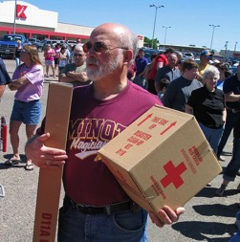
Task 3 – Evaluate Lessons Learned
Task 3.4 - Evaluate Lessons Learned from Recent Emergencies to Identify Best Practices
The research team evaluated the information from:
Previous project tasks
Actual events such as Hurricane Katrina
Project Panel and research team experiences
Task 3.5 – Analyze and Synthesize Results
The information was analyzed and incorporated into the Handbook

Slide 41

Task 4 – Detailed Handbook Outline
The research team developed an outline for the Paratransit Emergency Preparedness and Operations Handbook that considered the following tasks:
Task 4.1 – Key Findings from Literature Review, Interviews, and Past Lessons Learned to Draft Outline
Task 4.2 –Distribute Draft Outline for Review
Task 4.3 –Revise Draft Outline

Slide 42
Task 4 – Detailed Outline for Handbook
  Task 4.1 - Key Findings from Literature Review, Interviews, and Past Lessons Learned
  The emergency management cycle used for the Handbook:
    Preparedness
    Prevention
    Response
    Recovery

Slide 43
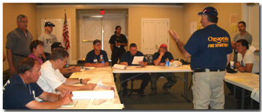
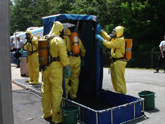
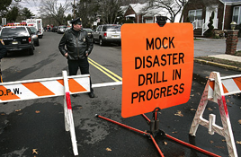
Task 4 – Detailed Outline for Handbook
Preparedness activities include:
Planning
Training
Exercises

Slide 44
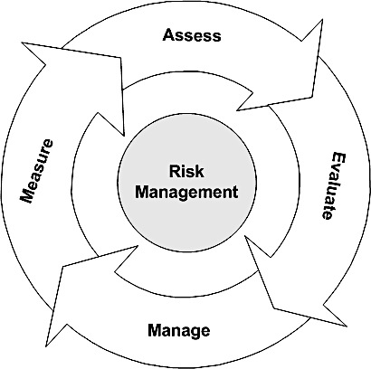
Task 4 – Detailed Outline for Handbook
Prevention activities include:
Risk Assessment
Liability Management
Education and Outreach

Slide 45
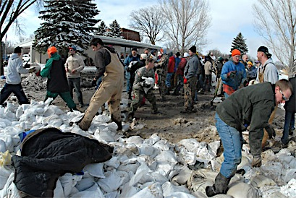
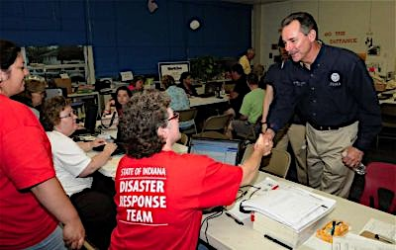
Task 4 – Detailed Outline for Handbook
Response activities include:
Communication
Coordination
Operations

Slide 46
Task 4 – Detailed Outline for Handbook
Recovery activities include:
Reconstitution
Reentry
Service Assessment
Restitution
Reconstitution
Reentry
Restitution
Service Assessment

Slide 47
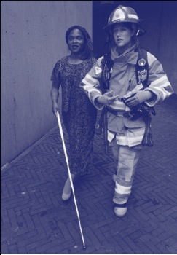
Task 4 – Detailed Outline for Handbook
Preparedness
Planning
  Resource Capabilities Assessment /
  Asset Inventory
  ESF-1 Coordination
  Interagency Coordination
  Essential Material Supply
  Duplication of Emergency Service Obligations
  Safety, Security and Emergency Prepardness
  Surge Capacity
  Contracted Paratransit Services

Slide 48
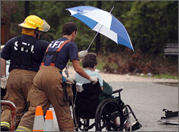
Task 4 – Detailed Outline for Handbook
Preparedness (Continued)
Training
  Incident Command System (ICS), National Incident Management System (NIMS) and National Response Framework (NRF)
  Personal and Family Preparedness
  Safety, Security and Emergency Operations
Exercises
  Discussion-based Exercises
  Operational Exercises
  Inclusion of People with Access and Functional Needs

Slide 49



Task 4 – Detailed Outline for Handbook
Prevention
Risk Assessment
  Threat and Vulnerability Assessments
  Interagency Communication and Coordination
Liability Management
  Insurance Limitations
  Memorandum of Understanding and Mutual Aid Agreements
Outreach and Education
  Customer Preparedness
  Adaptive Equipment

Slide 50

Task 4 – Detailed Outline for Handbook
Response
Communication
  Interoperability
  Emergency Communications
Coordination
  Emergency Operations Center (EOC)
  Paratransit Departmental Emergency Operations Center (DEOC)
  Staging and Pre-Positioning

Slide 51


Task 4 – Detailed Outline for Handbook
  Response (Continued)
Operations (Continued)
  Service Continuity
  Emergency Dispatching
  Individuals Needing Evacuation Assistance
  Mobilization
  Pets

Slide 52

Task 4 – Detailed Outline for Handbook
Recovery
Reconstitution
  Essential Life Support Services
  Restoring Service
Reentry
Post-disaster Service Assessment
Restitution
  Post-Crisis Counseling
  Documenting Damage
  Reimbursement

Slide 53

Task 4 – Detailed Outline for Handbook
  Task 4.2- Distribute Draft Outline for Review
The Handbook was submitted for Project Panel review as part of the interim report and interim meeting
  Task 4.3- Revise the Draft Outline
The research team reviewed and incorporated the Project Panel’s comments.
The revised outline was used to develop the
Draft Handbook as required in Task 7

Slide 54

Task 5 – Interim Report
At the conclusion of Phase 1 tasks (tasks 1-6) the research team developed the interim report in accordance with the following tasks:
Task 5.1 – Interim Report Development
Task 5.2 –Work Plan Update (Reference Task 6)
Task 5.3 –Interim PowerPoint Presentation and Meeting

Slide 55
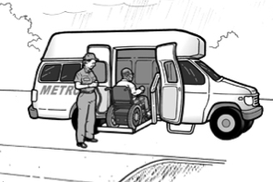
Task 5 – Interim Report
Task 5.1 – Interim Report Development
Summarized Phase 1 tasks (tasks 1-6) and research efforts
Documented the Phase 2 tasks as proposed by the work plan
Included the approach to developing the Handbook, draft bibliography and documents supporting expert interviews

Slide 56
Task 5 – Interim Report
Task 5.2 –Work Plan Development
The work plan summarized Phase 1 tasks (tasks 1-6) and research efforts
Documented the research team’s approach to Phase 2 tasks as proposed by the work plan
Provided a summary of project deliverables and schedule for submittal

Slide 57

Task 5 – Interim Report
Task 5.3 –Interim Panel Meeting and Presentation
Summarized Phase 1 tasks (tasks 1-6)
The Interim Presentation supported the interim meeting
Interim Presentation was suitable for use by Panel Members and others to describe the project and for posting on the TCRP project website

Slide 58

Task 6 – Work Plan Development and Revision
Task 6.1 –Work Plan Revision
The research team conducted the following activities:
Work plan presented and discussed with Project Panel during the interim meeting
Collected Project Panel comments and revised the work plan to incorporate comments as necessary
Provided a response to the Project Panel’s comments

Slide 59
Paratransit Emergency Preparedness and Operations Handbook
Phase 2 Work Plan and Discussion (Tasks 7-9)

Slide 60
Task 7 – Draft Handbook Development
The research team conducted the following tasks as approved in the work plan:
Task 7.1 – Address Emergency Operations and Management Plan Requirements
Task 7.2 – Create Job Aids, Checklists, Tools and Templates
Task 7.3 –Develop Capabilities Assessment Checklist
Task 7.4 –Assemble Glossary and Sample Forms

Slide 61
Task 7 – Draft Handbook Development
Task 7.1 – Address Emergency Operations and Management Plan Requirements
Handbook Contents
Chapter 1 – Executive Summary
Chapter 2 – Introduction
Chapter 3 – Capabilities Assessment
Chapter 4 – Preparedness
Chapter 5 – Prevention
Chapter 6 – Response
Chapter 7 – Recovery
Appendix - Glossary

Slide 62
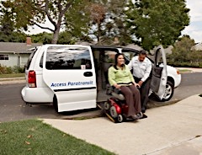
Task 7 – Draft Handbook Development
Handbook Contents
Chapter 1 – Executive Summary
In the executive summary, the Handbook’s scope and purpose is described
Applicability for urban, suburban, rural and tribal paratransit operating environments are discussed
Key details from the Preparedness, Prevention, Response and Recovery chapters are summarized and bullet pointed to quickly highlight the handbook contents

Slide 63

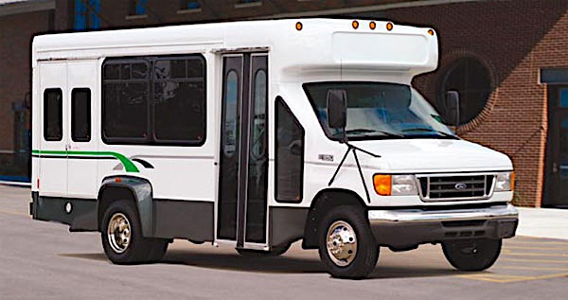



Task 7 – Draft Handbook Development
Task 7.2 - Job Aids, Checklists, Tools and Templates
Chapter 2 – Introduction
The introduction provides a background of the handbook’s research efforts, interviews and validation activities.
A definition was provided for Paratransit services and operations.
The mission of paratransit services during emergencies was explained.
An overview was provided for recommend Handbook use, including a summary of the following handbook components:
  Considerations
  Effective Practices
  Strategy
  Tools
  Resources

Slide 64
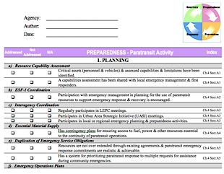
Task 7 – Draft Handbook Development
Task 7.3 - Capabilities Assessment Checklist
Handbook Chapter 3
The Capabilities Assessment Checklist is a self-assessment tool used to identify paratransit emergency preparedness and operations issues.
Agencies are requested to respond to each statement by marking “Addressed”, “Not Addressed” or “N/A” in the appropriate checkbox.
For guidance, strategies, tools and resources regarding
the statements marked as “Not Addressed,” refer to
the Handbook chapter and section listed in the
column entitled “Index.”

Slide 65

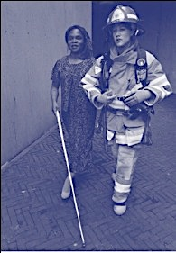
Task 7 – Draft Handbook Development
Handbook Contents
Chapter 4 – Preparedness
The preparedness chapter is the most complex in the Handbook, containing 3-sections with 14 sub-sections.
Section 4.1 – Planning: Provides guidance for coordination, supplies, obligations, plans and contracts.
Section 4.2 – Training: Recommendations for training involving NIMS, emergency and personal preparedness
Section 4.3 – Exercises: Discusses expectations of tabletop and field exercises

Slide 66

Task 7 – Draft Handbook Development
Handbook Contents
Chapter 5 – Prevention
Section 5.1 – Risk Assessment: Discusses Threat and Vulnerability Assessments (TVA) and Coordination activities.
Section 5.2 – Liability Management: Provides guidance on insurance limitations, MOUs and Mutual Aid Agreements
Section 5.3 – Education and Outreach: Discusses
Customer Preparedness and policies for
transporting adaptive or medical equipment

Slide 67
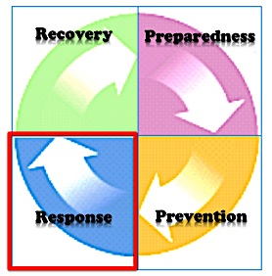

Task 7 – Draft Handbook Development
Handbook Contents
Chapter 6 – Response
Section 6.1 – Communication: Describes interoperability and communications guidelines.
Section 6.2 – Coordination: Recommendations for incident command, transit/paratransit operations center and staging vehicles/equipment.
Section 6.3 – Operations: Discusses service
continuity, emergency dispatching, mobilization
and transporting pets.

Slide 68

Task 7 – Draft Handbook Development
Handbook Contents
Chapter 7 – Recovery
Section 7.1 – Reconstitution: Sustaining essential life supporting transportation and post-disaster services.
Section 7.2 – Reentry: Recommendations for coordinating with emergency management for customer reentry.
Section 7.3 – Post-Disaster Assessment: Describes activities and plans for preparing for service demands.
Section 7.4 – Restitution: Post-crisis counseling, documenting damage and resources for reimbursement.
Reconstitution
Reentry
Restitution
Service Assessment

Slide 69

Task 7 – Draft Handbook Development
Task 7.4 –Assemble Glossary and Sample Forms
Chapter 8 – Glossary
The Handbook glossary provides definitions and explanations as necessary
Additional resources, forms and templates are provided in a resource table at the end of each Handbook section that includes hyperlinks to the FTA’s Bus Safety and Security Website

Slide 70

Task 7 – Draft Handbook Development
Addressing Project Panel Draft Handbook Comments
The Draft Handbook was reformatted to include Tools and Resource sections within the body of the Handbook for better accessibility
The Capabilities Assessment checklist was reconfigured and prioritized within the document
Additional details were added to the Handbook to reinforce discussion topics
Responses were provided for each of the Project Panel’s comment

Slide 71
Task 8 – Field Validation of Handbook
To validate the Handbook contents, the research team conducted the following tasks as approved in the work plan.
Task 8.1 – Validation Approach
Task 8.2 – Managing Logistics
Task 8.3 – Exercise Conduct
Task 8.4 – Exercise Analysis
Validation Workshop – Expected Outcomes
•Immediate increase in knowledge on effective practices – The combined results of the various components of the workshop are focused on gathering best practices, and applying them to a realistic event scenario.
•Consensus among practitioners on best practices and challenges – our combined approach promotes a broader consensus while simultaneously achieving more rapid results, at a reduced cost compared to traditional approaches.
•Validated operational concept for no-notice evacuations, tested through scenario – By combining activities into a single event, we can quickly gauge the validity of the operations concept proposed in the Handbook, in an interactive manner that will enhance its overall value to the paratransit and emergency management communities.
•Increased awareness of state of the art and state of the practice with respect to paratransit service providers – By engaging participants from multiple jurisdictions in a single exercise, we not only fully test the operations concept by validating it against various best practices simultaneously, we also accelerate the outreach process be “seeding” the transportation operations community with the outcomes of the workshop, effectively developing disciples in the process.

Slide 72

Task 8 – Field Validation of Handbook
Task 8.1 - Validation Approach
Primary means to validate the Handbook contents:
Validation Workshops – Presentations on Handbook contents and tabletop exercises that reinforced the recommended practices
Industry Reviews – Handbook distributed for review by industry experts

Slide 73

Task 8 – Field Validation of Handbook
Task 8.1 - Validation Approach
Validation Workshops
  Two (2) Workshops conducted to validate Urban and Rural content in Los Angeles, CA and Fargo, ND
  Each workshop was conducted over two-days with nearly 90-combined participants
    Workshop Day 1 – Presentation
    Workshop Day 2 – Tabletop exercise
  Workshop Evaluations resulted in strong support of
  handbook content

Slide 74
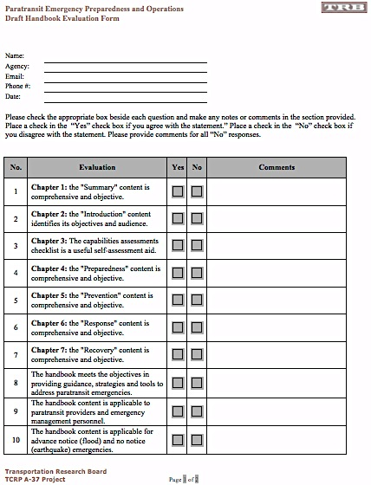
Task 8 – Field Validation of Handbook
Task 8.1 - Validation Approach
Industry Review
  The Draft Handbook was sent to a dozen industry professionals for review and comment
  The reviewers were asked to complete an evaluation form that assesses each chapter of the Handbook

Slide 75
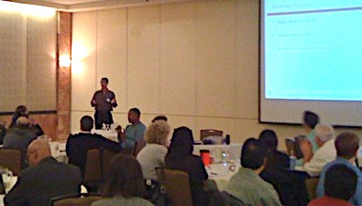
Task 8 – Field Validation of Handbook
Task 8.2 - Managing Logistics
Rural/suburban Fargo, ND and urban Los Angeles, CA were selected
The PowerPoint presentation modules followed the Handbook structure - Preparedness, Prevention, Response, Recovery
The PowerPoint summarized “Considerations”, Effective Practices, “Strategy” and “Tools” components presented in Handbook
  The Presentation included questions
  and scenarios structured to validate
  Handbook contents and receive feedback

Slide 76

Task 8 – Field Validation of Handbook
Task 8.3 - Exercise Conduct
Tabletop Exercises were conducted during the second day of the workshops
Tabletop exercises addressed no-notice and advance notice emergencies aimed at the relevant participants
  Los Angeles, CA – Earthquake Tabletop
  Fargo, ND – Flood Tabletop
Exercise Plans were developed and reviewed by the Project Panel prior to conducting at the workshops

Slide 77
Task 8 – Field Validation of Handbook
Task 8.4 - Workshop Analysis
Participants completed an evaluation form at the conclusion of the workshop
Workshop evaluations resulted in 97% support for the “Handbook/Workshop Content” category
The research team also took notes of suggestions made by workshop participants during the presentations and tabletop exercises
A workshop summary report was submitted to the Project Panel as part of the Final Report

Slide 78
Task 8 – Field Validation of Handbook
Task 8.4 - Workshop Analysis

Slide 79

Task 9 – Final Handbook, Final Report, and PowerPoint Presentation
At the conclusion of the project, the research team prepared the following documents as required:
Task 9.1 – Prepare Final Handbook
Task 9.2 – Prepare Final Report
Task 9.3 – Prepare Final PowerPoint Presentation

Slide 80

Task 9 – Final Handbook, Final Report, and PowerPoint Presentation
Task 9.1 - Prepare Final Handbook
Draft Handbook considerations included:
Project Panel comments and recommendations
Validation workshop comments as recorded by the research team
Validation workshop recommendations collected on evaluation forms
Industry review comments as applicable
Various research team recommendations and suggestions

Slide 81
Task 9 – Final Handbook, Final Report, and PowerPoint Presentation
Task 9.1 - Final Handbook Preparation
Addressing Project Panel Draft Handbook Comments
The Draft Handbook was reformatted to include Tools and Resource sections within the body of the Handbook for better accessibility
The Capabilities Assessment checklist was reconfigured and prioritized within the document
Additional details were added to the Handbook to reinforce discussion topics
Responses were provided for each of the Project Panel’s comments

Slide 82

Task 9 – Final Handbook, Final Report, and PowerPoint Presentation
Task 9.2 - Final Report Preparation
The Final Report updated the Interim Report to summarize Phase 2 tasks (tasks 7-9) and provide salient updates of Phase 1 tasks
The Final Report documents the project research efforts and deliverables
The Final Report includes nearly two dozen appendices that provide details of project tasks

Slide 83

Task 9 – Final Handbook, Final Report, and PowerPoint Presentation
Task 9.3 - Prepare Final PowerPoint Presentation
Inline with Final Report development, the Final PowerPoint Presentation updated the Interim Presentation to summarize Phase 2 tasks (tasks 7-9) and provide salient updates of Phase 1 tasks
This Final Presentation summarizes the activities documented in the A-37 Final Report and Handbook
This Final Presentation is suitable for the Panel Members and others to use in describing the project and for posting on the TCRP project website

Slide 84

TCRP A-37 Project Deliverables
Scheduled Anticipated
Quarterly Report – 9/30/11 9/30/11
Draft Handbook – 11/30/11 12/31/11
Validation After Action Report – 12/31/11 2/29/11
Quarterly Report – 12/31/11 12/31/11
Final Handbook– 3/30/12 4/30/12
Final Report and Presentation - 3/30/12 5/18/12

Slide 85

Conclusion

