Slide 1
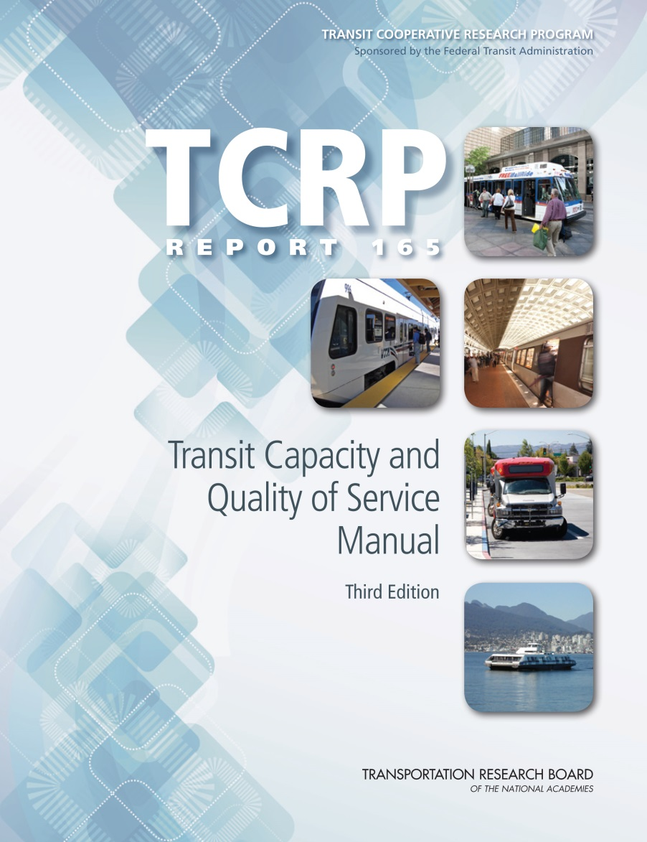
Demand Responsive Transit

Slide 2
Presentation Overview
Learning objectives
Overview of DRT service
DRT capacity
DRT quality of service

Slide 3
Learning Objectives
Gain an understanding of the different types of DRT service addressed in the TCQSM
Learn about factors affecting DRT capacity and existing tools for estimating capacity
Become familiar with the manual’s framework for evaluating DRT quality of service

Slide 4
Changes from the 2nd Edition
DRT material has been updated with information about the impacts on technology on service provision and the latest ADA requirements
Eliminated level of service (LOS) numbers from the DRT quality of service tables
Updated some of the service measures used to evaluate DRT quality of service
DRT capacity material has been completely updated and given its own chapter
  Factors influencing DRT capacity
  Available methods for estimating DRT capacity in different operating environments
  Importance of ridership demand in estimating DRT capacity

Slide 5
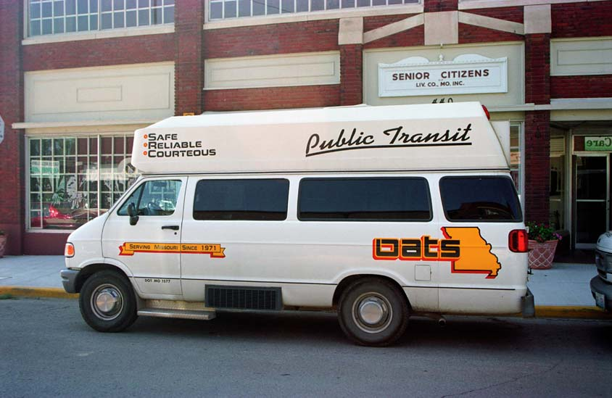
DRT Service
Types

Slide 6
Definition and Overview
DRT is a form of public transportation characterized by flexible routing and scheduling of small- to medium-size vehicles operating in a shared-ride mode between pick-up and drop-off locations according to passengers’ needs
Historically, DRT has been referred to as “dial-a-ride” service
More recently, DRT has evolved to include a range of services—
flexible transit services—that share attributes of pure DRT and fixed-route service
  Share a common element of trip reservation
  Services vary in their degree of flexibility, rider groups served, and operational and performance attributes

Slide 7
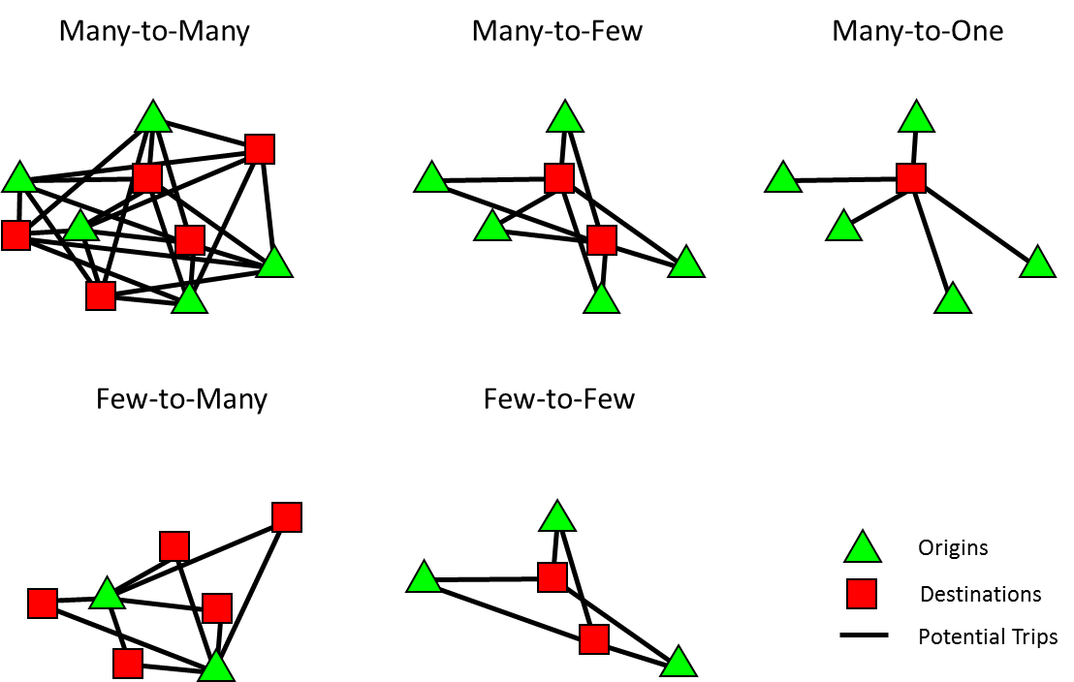
Service Pattern Types

Slide 8
General Public DRT
Flexibly routed, shared-ride service that responds to requests from the general public
Routing is typically “many-to-many” within the defined service area
  Can also be “many-to-few,” with service to a small number of frequented destinations
Scheduling may be immediate-response (similar to taxi), by advance reservation, or a combination
May be appropriate for:
  Low-density community with a geographic dispersion of trip generators
  Rural community with a limited demand for public transportation
When population densities exceed 1,000 persons per square mile, and there is some linear pattern to trip demand, transit planners generally look to service that incorporates some aspect of fixed-route or fixed-schedule service

Slide 9
Limited Eligibility DRT
Operates similarly to general public DRT, but only defined rider groups are served
  Frequently older adults and persons with disabilities
May be called “specialized transportation” and may serve as a supplement to fixed-route service
May also restrict trip purposes when funding is constrained
  For example, medical appointments, work, school, grocery shopping, and other life-sustaining trips may be prioritized
  Social and other quality-of-life trips may be served only when space is available, or not at all
Many rural DRT services have their origins as specialized transportation, expanding to serve the general public when they receive federal Section 5311 funding

Slide 10
ADA Paratransit
The dominant form of public DRT service in urban areas
Required by the Americans with Disabilities Act (ADA) for eligible persons whenever fixed-route service—urban or rural—is provided
  Eligible persons are those whose disabilities, permanent or temporary, prevent access to and/or independent use of the fixed-route service
Transit agencies must provide the minimum service requirements covered on the next slide
Transit agencies may provide “premium” service that exceeds the minimum requirements and may adopt differing policies for the premium service, as long as their basic ADA service obligations are met

Slide 11
ADA Paratransit Regulatory Requirements
Service area
  Generally, within ¾-mile corridor of bus routes and around rail stations,
  plus small “holes” within those areas
Response time
  Must accommodate service requests made the previous business day at any requested time during regular service hours
Fares
  No more than twice the base, non-discounted adult fare for fixed-route service
Trip purpose
  No trip purpose restrictions
Service hours
  Same days and hours as fixed-route service
No capacity constraints
  No waiting lists, trip caps, or patterns and practices of a substantial number of trip denials, untimely pick-ups, or excessively long trips

Slide 12
Human Service Transportation
Shared-ride, advance-scheduled transportation for users and clients of human services programs
  Serve older adults, persons with disabilities, lower-income persons, disadvantaged children, and others with social service needs
  Provide access to health care, adult day care, job training, pre-kindergarden enrichment programs, and other non-profit and public programs
Ancillary service offered by many human service agencies
  May purchase service from public or private providers
  May purchase vehicles that they operate directly
  May facilitate their clients’ use of public transportation
More than 60 federal programs that fund some type of human service transportation
FTA now requires a locally developed, coordinated public transit–human services transportation plan as a prerequisite for receiving funds from several federal grant programs

Slide 13
Flexible Transit Services (1)
DRT connector/feeder service
  Provides DRT service within a defined zone that has one or more scheduled transfer points to fixed route service
  Also provides local transportation within the defined zone
  May be possible to integrate with required ADA paratransit
Zone routes
  Combine DRT service within defined zones along a corridor with scheduled departure and arrival times at the route terminals (and possibly other points)
  Rural corridors, urban nighttime service applications
  Relatively rare

Slide 14
Flexible Transit Services (2)
Point deviation
  Provides scheduled service to a limited number of designated stops and DRT service within a defined area, without any regular route between stops
Route deviation
  Operate along a fixed route, with deviations allowed up to a certain distance, with a cap on the amount of time used for deviations per trip
  Most common DRT variant, often deployed in lower-density and rural areas

Slide 15
Flexible Transit Services (3)
Flexible route segments
  Predominately fixed route service that converts to DRT for a limited and defined portion of the route
  Relatively rare
Request stop
  Predominately fixed route, fixed schedule service that provides service to a limited number of defined stops off the fixed route by passenger request
  Differs from flag stop service in that the stops are not on the fixed route
  Provides service to locations with poor pedestrian access from the fixed route, which don’t have sufficient passenger demand to require deviating the route on every trip

Slide 16
Jitneys
Operate on fixed routes without fixed schedules or stops
Service often operated by owner-operators or small companies using vans or passenger cars
Primary form of public transportation in many developing countries, but banned in many US cities due to competition with transit & taxi services
When allowed in the US, regulated on the basis of:
  Insurance, safety, and ADA requirements only (e.g., Hudson County, NJ)
  Franchise or permit, with defined routes/service areas (e.g., Houston)
  An association, with limits on the number of vehicles operated (e.g., Atlantic City, NJ)
  Privately owned and operated, publicly regulated (routes, fares) public transit service (e.g., público systems in Puerto Rico)
  Some combination of the above

Slide 17
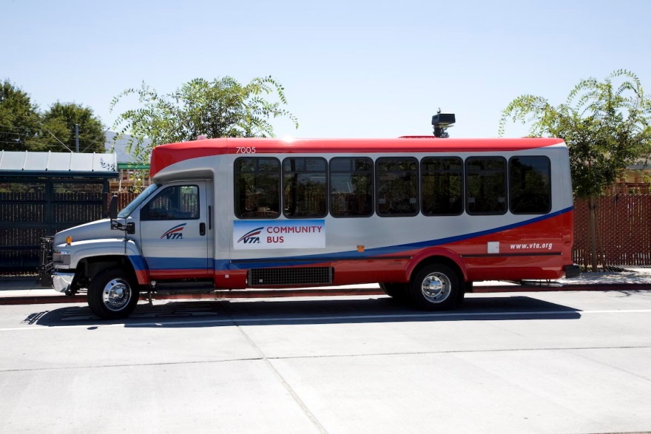
DRT Quality of Service

Slide 18
What Matters to Customers?
Service availability
  Is transit an option?
Comfort and convenience
  If it is an option, would you want to use it?
Quality of service (QOS) focuses on the passenger point of view
Other points of view are also valid and need to be considered
  May have conflicting objectives (e.g., passenger comfort vs. agency resources)
  Best-quality passenger service may not be feasible or desirable
  ADA requirements must always be met
See the Quality of Service presentation for a more in-depth presentation of QOS concepts
Notes:
Ask for responses and write the list on the flipchart/board.
Typically, all responses will fall under one of three categories on the following slides. Introduce them as one of the possible ways to aggregate the many purposes of transit.

Slide 19
QOS Framework
The QOS framework presents key performance measures that can be used in setting service standards and evaluating the QOS delivered to passengers
  Three measures of availability
  Three measures of comfort and convenience
Framework and measures intended to be applied to general public and limited eligibility DRT services only
  ADA stipulates service requirements for ADA paratransit
  Some measures may be applicable to flexible transit services, but the wide range of these services precludes developing standardized QOS tables
Notes:
Ask for responses and write the list on the flipchart/board.
Typically, all responses will fall under one of three categories on the following slides. Introduce them as one of the possible ways to aggregate the many purposes of transit.

Slide 20
Response Time
Defines how far in advance passengers must schedule a DRT trip
Measured as the minimum amount of time a rider needs to schedule and access a trip, or the minimum advance reservation time
  Includes standing-order trips, where passengers are picked up at pre-scheduled times on pre-scheduled days and do not have to call in to reserve each trip
No data collection required (measure based on service policy)
  When DRT provider policy stipulates a maximum time for when service will be provided following a request, response time can be determined by logging the call and pick-up times, or by surveying passengers
Many DRT providers also stipulate a maximum response time
  Helps to reduce number of cancellations when passenger plans change and no-shows, when the passenger forgets to cancel the reservation
Notes:
Ask for responses and write the list on the flipchart/board.
Typically, all responses will fall under one of three categories on the following slides. Introduce them as one of the possible ways to aggregate the many purposes of transit.

Slide 21
Response Time QOS
Seven service levels:
  Guaranteed (standing-order or subscription service)
  Same-day service
  Same-day service on a space-available basis
  Will-call/call when ready
  Next-day/24-hour advance reservation
  Two-day/48-hour advance reservation, up to a week
  More than one week in advance
Notes:
Ask for responses and write the list on the flipchart/board.
Typically, all responses will fall under one of three categories on the following slides. Introduce them as one of the possible ways to aggregate the many purposes of transit.

Slide 22
Service Span
Measures the days per week and hours per day that DRT service is available
Particularly important for the DRT mode because in many small urban communities and rural areas, service is not provided on a full weekly basis or even on every weekday
Service availability on weekdays allows for more “life-fulfilling trips” to be made, as opposed to “life-sustaining trips”
As number of days of service decreases, DRT service becomes more of a lifeline service
As number of hours of service per day decreases, number of trip purposes served decreases and requirement for pre-planning trips increases
Notes:
Ask for responses and write the list on the flipchart/board.
Typically, all responses will fall under one of three categories on the following slides. Introduce them as one of the possible ways to aggregate the many purposes of transit.

Slide 23
Service Span QOS: Days of Service
Five service levels:
  7 days per week
  6 days per week
  5 days per week
  1 to 4 days per week
  Less than weekly
Notes:
Ask for responses and write the list on the flipchart/board.
Typically, all responses will fall under one of three categories on the following slides. Introduce them as one of the possible ways to aggregate the many purposes of transit.

Slide 24
Service Span QOS: Hours of Service
Five service levels:
  16 or more hours per day
  12 to 15 hours per day
  9 to 11 hours per day
  5 to 8 hours per day
  Less than 5 hours per day
Notes:
Ask for responses and write the list on the flipchart/board.
Typically, all responses will fall under one of three categories on the following slides. Introduce them as one of the possible ways to aggregate the many purposes of transit.

Slide 25
Service Coverage
Measures the geographic area where DRT service is provided
Typical for service to be available throughout a jurisdiction, as opposed to fixed-route service
When service coverage and service span vary within a service area, it may be useful to map the different levels of DRT availability
No separate QOS table
Notes:
Ask for responses and write the list on the flipchart/board.
Typically, all responses will fall under one of three categories on the following slides. Introduce them as one of the possible ways to aggregate the many purposes of transit.

Slide 26
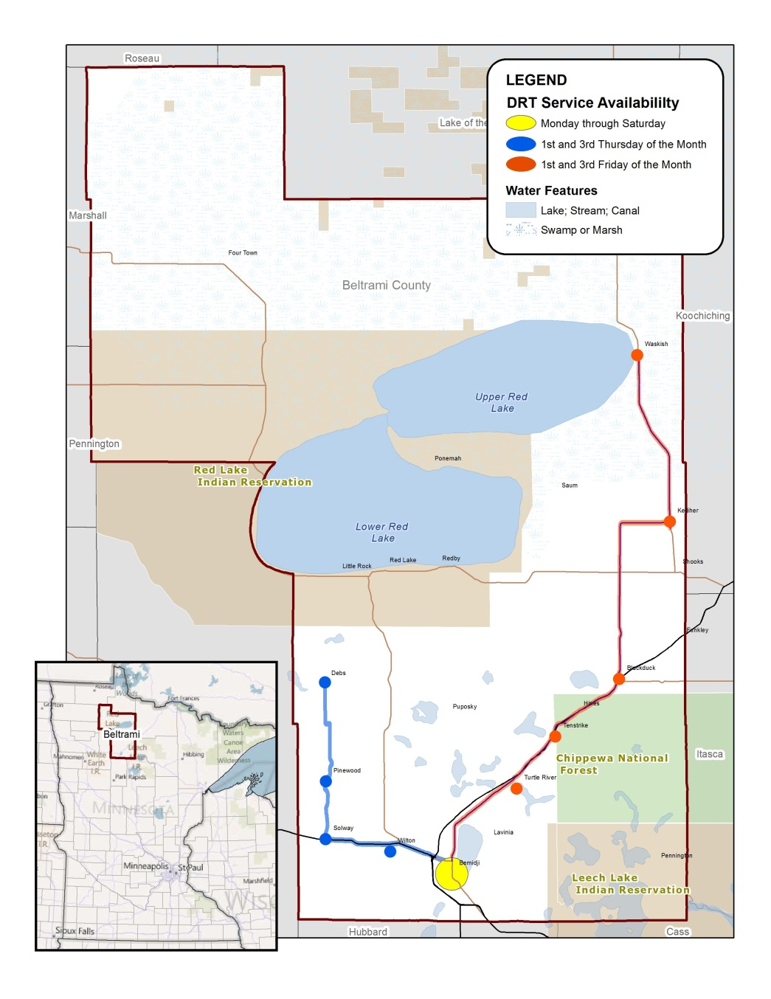

Service Coverage Map Example
Based on service span provided
to different portions of the
service area
Notes:
Ask for responses and write the list on the flipchart/board.
Typically, all responses will fall under one of three categories on the following slides. Introduce them as one of the possible ways to aggregate the many purposes of transit.

Slide 27
Reliability
A critical measure of service level from the passenger’s perspective
  Will I be able to reserve a ride when I call, or will all the rides be taken?
  Will the driver get me to my appointment on time?
Because of the shared-ride nature of DRT service, there is more variability than with fixed route service
  Available capacity to serve a trip request
  Window of time when the pick-up will occur
  Variable travel time to the destination, depending on other passenger pick-ups and traffic conditions
Two measures used to assess reliability
  On-time performance
  Trips turned down
Notes:
Ask for responses and write the list on the flipchart/board.
Typically, all responses will fall under one of three categories on the following slides. Introduce them as one of the possible ways to aggregate the many purposes of transit.

Slide 28
On-time Performance
Measures the degree to which DRT vehicles arrive at the scheduled times
  Calculated at the pick-up end of a trip
  For time-sensitive trips (e.g., work, school, medical appointments), also calculated for the drop-off end
For pick-ups, any time with the provider’s defined pick-up window is considered on-time
For drop-offs, any time at or before the required time is considered on-time
Measured by percentage of on-time trips
Calculate from driver logs
High levels of on-time performance will negatively impact productivity
Notes:
Ask for responses and write the list on the flipchart/board.
Typically, all responses will fall under one of three categories on the following slides. Introduce them as one of the possible ways to aggregate the many purposes of transit.

Slide 29
On-time Performance QOS
Five service levels—these assume 30-min “on-time” window:
  95% on-time or better
  90 to 94% on time
  80 to 89% on time
  70 to 79% on time
  <70% on time
Notes:
Ask for responses and write the list on the flipchart/board.
Typically, all responses will fall under one of three categories on the following slides. Introduce them as one of the possible ways to aggregate the many purposes of transit.

Slide 30
Trips Turned Down
Measures the degree to which passengers can obtain service at their desired time or at a negotiated time that also works for them
Calculated as the percent of service requests that are turned down due to a lack of capacity at the passenger’s desired time(s)
Most DRT providers turn down trips on an occasional basis
  Unusual demand
  Temporary shortage of drivers
Frequent trip turn-downs signal insufficient capacity
  May require adjustments to driver schedules
  May require mix of full-time and part-time driver shifts
  Might consider passenger incentives to travel at less-busy times
  May require additional vehicles after operational and policy changes to maximize efficiency have been tried
Notes:
Ask for responses and write the list on the flipchart/board.
Typically, all responses will fall under one of three categories on the following slides. Introduce them as one of the possible ways to aggregate the many purposes of transit.

Slide 31
Trips Turned Down QOS
Five service levels:
  0 to 1%
  >1 to 3%
  >3 to 5%
  >5 to 10%
  >10%
Notes:
Ask for responses and write the list on the flipchart/board.
Typically, all responses will fall under one of three categories on the following slides. Introduce them as one of the possible ways to aggregate the many purposes of transit.

Slide 32
Travel Time
Compares time to an exclusive-ride trip (i.e., no ride-sharing)
  Ideal from a passenger point-of-view, but shouldn’t be expected
  From the operator point-of-view, travel times that are either too short or
  too long are undesirable
Actual travel time can be calculated using a sample of completed trips for different passengers, using automated records from mobile data computers or written records from driver manifests
Exclusive-ride trip can be calculated from an Internet mapping program
TCQSM provides guidance on sample size to use, along with other details
Notes:
Ask for responses and write the list on the flipchart/board.
Typically, all responses will fall under one of three categories on the following slides. Introduce them as one of the possible ways to aggregate the many purposes of transit.

Slide 33
Travel Time QOS
Five service levels:
  Up to 25% longer than exclusive-ride trip
  Up to 50% longer than exclusive-ride trip
  Up to 75% longer than exclusive-ride trip
  Up to 100% longer than exclusive-ride trip
  More than 100% longer than exclusive-ride trip
Notes:
Ask for responses and write the list on the flipchart/board.
Typically, all responses will fall under one of three categories on the following slides. Introduce them as one of the possible ways to aggregate the many purposes of transit.

Slide 34
No-Shows
A no-show occurs when a passenger fails to show up for a scheduled trip
From a passenger perspective, QOS is affected because passengers already on-board the vehicle have wasted time traveling to the pick-up location and waiting for the missing rider
From a transit agency perspective, no shows reduce productivity and increase operating costs
Calculated as the sum of passenger no-shows divided by the total number of scheduled trips
Notes:
Ask for responses and write the list on the flipchart/board.
Typically, all responses will fall under one of three categories on the following slides. Introduce them as one of the possible ways to aggregate the many purposes of transit.

Slide 35
No-Show QOS
Three service levels:
  <2%
  2 to 5%
  >5%
Notes:
Ask for responses and write the list on the flipchart/board.
Typically, all responses will fall under one of three categories on the following slides. Introduce them as one of the possible ways to aggregate the many purposes of transit.

Slide 36
Potential Applications for DRT Quality of Service
Developing service standards, balancing the QOS provided with operating cost considerations
Comparing actual performance to service standards
Identifying potential problems with excessive cancellations and no-shows
Identifying the potential need for additional staff training
Identifying the potential need for additional capacity
Notes:
Ask for responses and write the list on the flipchart/board.
Typically, all responses will fall under one of three categories on the following slides. Introduce them as one of the possible ways to aggregate the many purposes of transit.

Slide 37
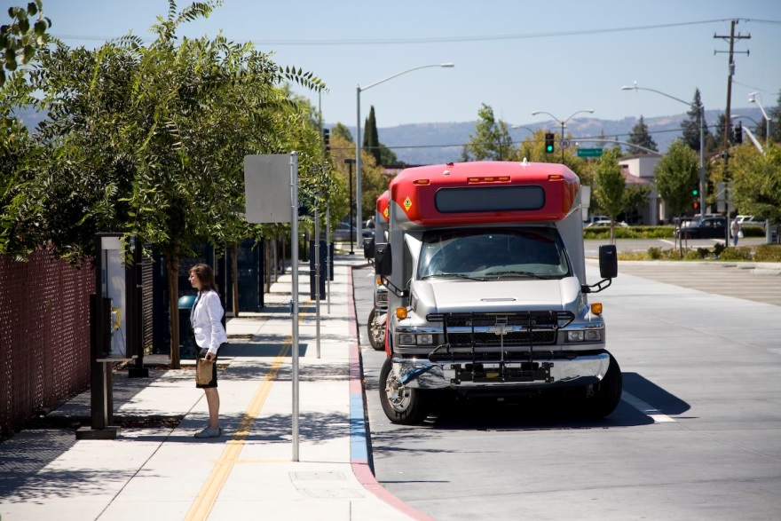
DRT Capacity

Slide 38
Differences Between DRT and Fixed Route Bus Capacity
For DRT, the question is how many vehicles and service hours to deploy to accommodate a given passenger demand and service area
Capacity depends on operating policies, such as the length of the on-time window
Similar to bus transit, capacity also depends on vehicle size
Notes:
Ask for responses and write the list on the flipchart/board.
Typically, all responses will fall under one of three categories on the following slides. Introduce them as one of the possible ways to aggregate the many purposes of transit.

Slide 39
Capacity Factors
Ridership demand
Passenger characteristics
  General public, specialized group, or ADA paratransit
Peak-period demand relative to off-peak demand
  Unlike fixed route bus, a DRT vehicle does not generally carry more passengers during peak periods
Service area size
Service area characteristics
  Geographic shape, topographic characteristics, railroad crossings
DRT trip pattern type (many-to-many, many-to-few, etc.)
Operating policies
  Size of on-time window, allowable wait time, service standards
ADA service must provide enough capacity to meet demand
Notes:
Ask for responses and write the list on the flipchart/board.
Typically, all responses will fall under one of three categories on the following slides. Introduce them as one of the possible ways to aggregate the many purposes of transit.

Slide 40
Capacity Calculation Procedures
Five methods discussed in the manual
  Analogy
  DRT resource estimation model
  Analytical model
  Non-dedicated DRT service
  Rural DRT
For the last four methods, the TCQSM refers readers to other sources for details on applying the method and, in some cases, software tools
Notes:
Ask for responses and write the list on the flipchart/board.
Typically, all responses will fall under one of three categories on the following slides. Introduce them as one of the possible ways to aggregate the many purposes of transit.

Slide 41
Analogy Method
Estimate the number of vehicles and service hours using data from one or more similar DRT systems operating in a comparable community or area
Simple and straightforward
Notes:
Ask for responses and write the list on the flipchart/board.
Typically, all responses will fall under one of three categories on the following slides. Introduce them as one of the possible ways to aggregate the many purposes of transit.

Slide 42
DRT Resource Estimation Model
Model presented in TCRP Report 98: Resource Requirements for Demand Responsive Transportation Services
Includes a software tool
Can be used for planning new DRT service or expanding existing service
With more vehicles (capacity), a DRT provider can:
  Serve more people,
  Serve a larger service area, or
  Serve the same market area with a higher service quality
Model shows tradeoffs between fleet size and share of the market served for a user-defined level of service quality
Notes:
Ask for responses and write the list on the flipchart/board.
Typically, all responses will fall under one of three categories on the following slides. Introduce them as one of the possible ways to aggregate the many purposes of transit.

Slide 43
Analytical Model
Developed by L. Fu and presented in Transportation Research Record 1841
Model estimates fleet requirements and system capacity, along with passenger-focused performance measures for user-defined operating conditions
Model considers the size of the on-time window, peak period demand, and service area size
Model does not consider vehicle size and the spatial distribution of trip demand
Notes:
Ask for responses and write the list on the flipchart/board.
Typically, all responses will fall under one of three categories on the following slides. Introduce them as one of the possible ways to aggregate the many purposes of transit.

Slide 44
Non-Dedicated DRT Service
DRT capacity provided by taxis or other transportation resources that are not solely serving the provider’s passengers
Considers both dedicated (used exclusively for DRT) and non-dedicated (e.g., taxi) services
Method includes two models:
  Driver/run optimization model
  Fu’s analytical model (described previously)
Described in TCRP Report 121: Toolkit for Integrating Non-Dedicated Vehicles in Paratransit Service
  Includes a spreadsheet-based tool
Notes:
Ask for responses and write the list on the flipchart/board.
Typically, all responses will fall under one of three categories on the following slides. Introduce them as one of the possible ways to aggregate the many purposes of transit.

Slide 45
Rural DRT
Method presented in a paper by Sandlin and Anderson in Journal of Public Transportation, Vol. 5, No. 3
Evaluates the capacity of a rural DRT system using an economic constraint model and spatial data for the DRT service area
Determines the total area that a rural DRT agency can serve and the percent of the total area that can be served with the existing fleet
Model inputs include:
  Operating costs (cost per mile)
  Demand
  Fare and desired subsidy
  Distance to stops (distance from garage to center of each census block where transit demand is generated)
Notes:
Ask for responses and write the list on the flipchart/board.
Typically, all responses will fall under one of three categories on the following slides. Introduce them as one of the possible ways to aggregate the many purposes of transit.

Slide 46
Ridership Estimation Tools
DRT ridership demand is an important input for determining DRT capacity needs
The TCQSM is not a ridership estimation guidebook, but provides references to other tools:
  TCRP Report 119: Improving ADA Complementary Paratransit Demand Estimation
  TCRP Web-only Document 49 and future products from TCRP Project B-36: Methods for Forecasting Demand and Quantifying Need for Rural Passenger Transportation
  TCRP Report 158: Improving ADA Paratransit Demand Estimation: Regional Modeling
  TCRP Report 95: Traveler Response to Transportation System Changes,
  Chapter 6—Demand Responsive/ADA
Notes:
Ask for responses and write the list on the flipchart/board.
Typically, all responses will fall under one of three categories on the following slides. Introduce them as one of the possible ways to aggregate the many purposes of transit.

Slide 47
More Information
TCRP Report 165: TCQSM
  Chapter 2, Mode and Service Concepts
  Chapter 5, Quality of Service Methods
  Chapter 7, Demand Responsive Transit
See previous slides for reports relating to capacity & ridership estimation
The TCQSM is available as:
  Free individual printed copies and PDF downloads through the TCRP Dissemination Program
  http://www.tcrponline.org
  Free PDF downloads directly from TCRP
  http://www.trb.org/TCRP/Public/TCRP.aspx (Publications section)
  or simply do an Internet search for the report number (e.g., TCRP Report 165)
  Individual or multiple copy purchases from the TRB Bookstore
  http://books.trbbookstore.org/

Slide 48
Acknowledgments and Permissions
Presentation author
  Paul Ryus (Kittelson & Associates, Inc.)
Photo credits
  All photos: Paul Ryus
This presentation was developed through TCRP Project A-15C
  Research team: Kittelson & Associates; Parsons Brinkerhoff, Quade & Douglass; KFH Group; Texas A&M Transportation Institute; and Arup
  This presentation and its contents may be freely distributed and used, with appropriate credit to the presentation authors and photographers, and the Transit Cooperative Research Program

