Slide 1
Policing and Security Practices for Small- and Medium-Sized Public Transit Systems
FINAL REPORT TO THE TRANSIT COOPERATIVE RESEARCH PROGRAM ON PROJECT F-18
NOVEMBER 21, 2014
Prepared by Countermeasures Assessment & Security Experts, LLC

Slide 2
SUMMARY
This F-18 research report is considered to be an introductory reference document with a primary user group of transit personnel at small- or medium-sized agencies without a security background whose work requires them to address, perform, or supervise security activities as a part of their overall job responsibilities. For the purpose of this report, a small transit agency is defined as serving a population of less than 50,000 people whereas a medium agency serves a population of between 50,000 and 200,000 people.
Main areas of coverage:
security risks that are typically present for small- and medium-sized transit agencies.
terrorism and homeland security, crime problems and order maintenance issues
countermeasures, plans and strategies

Slide 3
F – 18 ABSTRACT
TCRP F-18: Policing and Security Practices for Small and Medium Sized Public Transit Agencies research has determined that there are significant differences between the security risks, needs and issues facing smaller agencies when compared to those of large metropolitan transit systems.
Police and security problems at small- and medium-sized systems occur with much less frequency or magnitude of severity. Similarly homeland security or terrorism related threats rarely occur on smaller systems. However, serious crime, including violent crime does occur infrequently on smaller systems.

Slide 4
F-18 ABSTRACT
In contrast to the much more extensive and costly security related requirements necessary to protect large-sized transit agencies, the scope and extent of countermeasures warranted for small- and medium-sized agencies is correspondingly smaller.
The difference lies in the reduced infrastructure and critical asset footprint and operating characteristics of small and medium sized agencies.

Slide 5
F-18 ABSTRACT
With a few exceptions the small- and medium-sized transit agencies profiled in this study operate over the road with buses, trolleys, vans or cars that require a level of security commensurate with the protection of:
vehicles in transit on highways, rural and suburban city, borough or township streets or other roadways
infrastructure such as unstaffed bus shelters or bus stops, vehicle storage depots, bus stations and maintenance facilities necessary to support these conveyances
employees who operate the conveyances
minimal administrative and management staff
the passengers who use the agency’s transportation services.

Slide 6
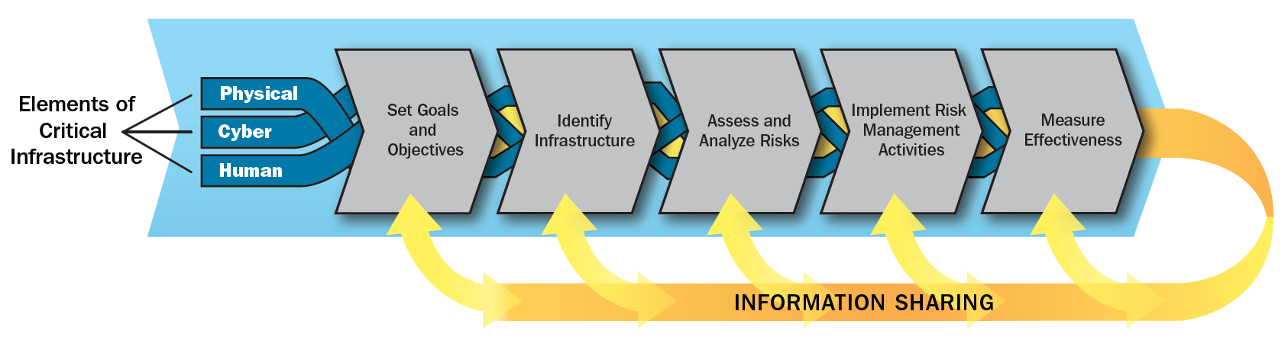
SECURITY RISK MANAGEMENT AND ASSESSMENT PROCESSES
The Department of Homeland Security (DHS) in the latest version of the National Infrastructure Protection Plan (2013) describes the three protection program areas for critical infrastructure – Physical, Cyber and Human.

Slide 7
RISK FACTORS – CRITICAL ASSETS
In the public transit environment the human asset – the protection and security of people is the foremost concern. This includes the passengers who use the system, the employees who deliver the transportation services and a third set of indirect participants who interface with transit systems such as station vendors, other building tenants or occupants, delivery persons, or those with homes or businesses in proximity to transit facilities or infrastructure.

Slide 8
RISK FACTORS – CRITICAL ASSETS
In addition to human assets, public transit agencies have an extensive range of property or infrastructure related assets as well as intrinsic or intangible assets such as goodwill. Transit vehicles—buses, trolleys, trains are the most recognizable of transit’s infrastructure, however there are also stations owned or operated by transit agencies, stops or shelters, office buildings, maintenance facilities, parking lots, information systems, communications huts and other types of property used to support services.

Slide 9
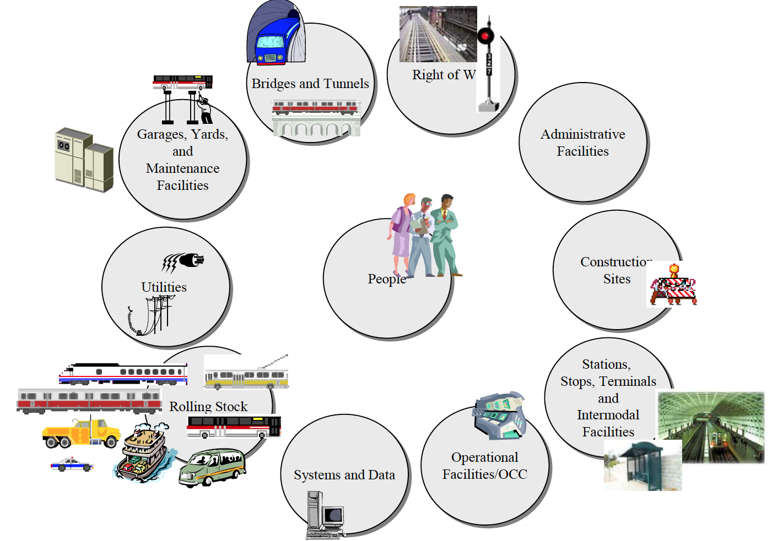
RISK FACTORS – CRITICAL ASSETS
Depending on the size and operating characteristics of the agency the listing of these assets can be quite complex.

Slide 10
SMALL-SIZED AGENCIES
Asset Type | Number of Assets
 | 0 | 1 | 2-6 | 7-12
Administrative Buildings/Facilities | 1 | 58 | 5 | 0
Maintenance Facilities (Rail Yard and Bus Garage) | 6 | 40 | 3 | 0
Passenger Terminals/Stations | 10 | 18 | 3 | 3
Intermodal Centers | 10 | 12 | 0 | 0
Elevated Structures | Yes (1)
Tunnels, Bridges and Subways | No
Private Right of Way | Yes (2)
Substations | No
The table lists the types of agency infrastructure assets that were considered in the survey of transit agencies conducted during this research project. Small agencies typically: (1) occupied one administrative building/facility (90%); (2) maintained one bus garage or repair facility (82%); (3) operated through one or less passenger terminals (82%); operated through one or less intermodal facilities (100%); and owned virtually no elevated structures, tunnels bridges or structures, private rights-of-way, or substations. The data collected do not include rolling stock.

Slide 11
MEDIUM-SIZED AGENCIES
The table lists the types of agency infrastructure assets that were considered in the survey of transit agencies conducted during this research project. Medium sized agencies typically: (1) occupied one administrative building/facility (80%); (2) maintained one bus garage or repair facility (79%); (3) operated through one or less passenger terminals (77%); operated through one or less intermodal facilities (90%); and owned some elevated structures, tunnels bridges or structures, private rights-of-way, or substations. The data collected do not include rolling stock.
Asset Type | Number of Assets
 | 0 | 1 | 2-6 | 7-12
Administrative Buildings/Facilities | 8 | 83 | 12 | 0
Maintenance Facilities (Rail Yard and Bus Garage) | 10 | 79 | 7 | 0
Passenger Terminals/Stations | 14 | 39 | 14 | 2
Intermodal Centers | 18 | 27 | 4 | 1
Elevated Structures | Yes (8)
Tunnels, Bridges and Subways | Yes (7)
Private Right of Way | Yes (5)
Substations | Yes (2)

Slide 12
SECURITY RISK
Security risk is “threat based” as opposed to “hazard based.” Avoiding, reducing and mitigating security risk at small- and medium-sized public transit agencies is the specific topic of this research. Safety and security risk are both considered under the umbrella term “All Hazards.”

Slide 13
SECURITY RISK
Public transit agencies should be prepared to respond to the following three types of security risks:
Homeland Defense/Homeland Security – The Risk of Terrorist Attack
Felony or Misdemeanor Crime – The Risk of Crime and Criminal Activity
Minor Offenses and Disorder

Slide 14
HOMELAND DEFENSE/HOMELAND SECURITY
    From worldwide perspective, transportation assets moving by air, land or sea have long been a primary target of focused attacks by hijackers, pirates, anarchists, or terrorists. Specific to public transit, terrorist attacks have been launched directly against intercity and over-the-road buses, subways, elevated trains, passenger trains, trolleys, ferries, and other types of conveyances.

Slide 15
(U//FOUO) TSA-OIA assesses the preferred terrorist tactics used against transportation systems in the Homeland are likely to be improvised explosive devices (IEDs) and armed assaults. Additional, but less frequently used, tactics that have been effective in recent attacks against transportation modes include improvised incendiary devices and arson. The graphic below illustrates, for the period of this report, actual terrorist attacks on all transportation modes (in red) and preoperational information about possible future attack methods (in yellow).

Slide 16
HOMELAND SECURITY THREATS
  Arson
  Explosives
  Weapons of Mass Destruction or Mass Effect
  Violent Confrontations/Hostage Situations
  Malicious Tampering
  Transit Vehicle as a Weapon
  Network Failure/Cyber Attack

Slide 17
FELONY OR MISDEMEANOR CRIME
    The nation’s mass transit systems and the people who use these systems are susceptible to the occurrence of felony (major) and misdemeanor crime, including both crimes against persons and crimes against property.
    Transit systems must remain open and accessible to thousands of daily customers, sometimes 24 hours a day and 7 days a week. And comingled amongst these law-abiding fare paying passengers is a criminal element whose goal is to commit crimes by taking advantage of targets of opportunity.
Notes:
Public transit is multidimensional and consists of a complex infrastructure. Large volumes of people interact in various settings including on vehicles (buses, trains and trolleys), in facilities (stations and platforms, stops, parking lots, transfer points) and in both crowded and sparse environments in urban, suburban and rural settings.
Certain types of crime are more or less likely to occur depending on the specific characteristics of a location, or perhaps even the particular geographic vicinity of a given transit route. Critical assets of the system itself are also at a risk of loss.

Slide 18
FELONY OR MISDEMEANOR CRIME
Crimes against person include homicide, aggravated and simple assault, robbery, rape, sex offenses and harassment. Each transit system experiences its own unique blend of these types of crimes in terms of frequency and severity.

Slide 19
FELONY OR MISDEMEANOR CRIME
Both small- and medium-sized transit agencies should rarely see any form of homicide on their systems. However, even these systems may not be immune to isolated incidents where murder is caused by conflict between primary or non-primary family, friends or acquaintances. Similarly, strangers in pursuit of gain or some other rational or irrational motivation may commit murder either concurrent with the commission of a felony, or as a result of mental deficiency.

Slide 20
FELONY OR MISDEMEANOR CRIME
Assault crimes are charged based on “degrees” of consequence or through determination of weapon types whether used or possessed. Simple assault or harassment may occur based solely on a non-violent offensive touching, for example spitting on another individual; while aggravated assault would be charged in circumstances where a weapon is brandished in commission of a felony or an individual is severely beaten with lasting injuries.
Along this violent or perceived violent continuum victims who suffer injury are categorized and offenders are charged with either a felony or misdemeanor offense. Small- and medium-sized transit agencies can expect to have some form of assault on passengers occur periodically, but usually along the lesser side of the continuum.

Slide 21
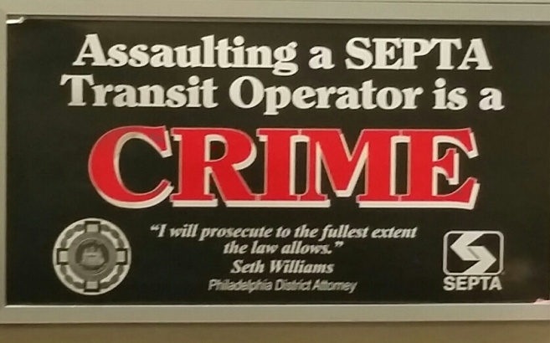
FELONY OR MISDEMEANOR CRIME
Risk factors associated with operator assaults:
Interacting directly with the public
Working alone or in isolated areas
Having a mobile workplace
Working late night or early morning hours
Working in high crime areas
Providing services to people who may be experiencing frustration (for example, with fare increases or service reductions)
Having a workplace where access is uncontrolled
Handling money or fares
Having enforcement responsibilities
Having inadequate escape routes

Slide 22
FELONY OR MISDEMEANOR CRIME
Both small- and medium-sized transit agencies must be prepared to contend with the commission of robberies against their passengers although incidents of violent attacks remain infrequent.
Rape and other felony related sex offenses rarely occur on transit systems. Victimization occurs when passengers become targets of opportunity. For example, during late night hours at an unoccupied, sparsely attended or closed station, or in a transit operated parking lot, a perpetrator may take advantage of the seclusion to prey upon an unescorted passenger.

Slide 23
FELONY OR MISDEMEANOR CRIME
Protecting against losses associated with the property and infrastructure of transit systems is largely a matter of controlling theft and vandalism.

Slide 24
FELONY OR MISDEMEANOR CRIME
By far the most prolific and costly occurrence of larceny from bus and rail transit systems alike is the stealing of metals including copper, mercury, brass, or iron from vehicles, facilities or rights of way.
Transit agencies offering light rail or commuter rail services are more likely targets of copper thieves because of the large amount of unprotected or minimally protected infrastructure that contain the metal.

Slide 25
  MINOR OFFENSES AND DISORDER
Quasi-crime, offenses or disorder can have the highest and most adverse security impact transit agencies. Problems include loitering, panhandling, runaways, truants and homeless populations which can exacerbate criminal activity.
Homelessness is not a crime, but with large numbers of the homeless population finding shelter and sleeping in transportation facilities across the country, it is a problem. A problem that’s been around for decades, analyzed, written about and confronted in many ways, but with little success.

Slide 26
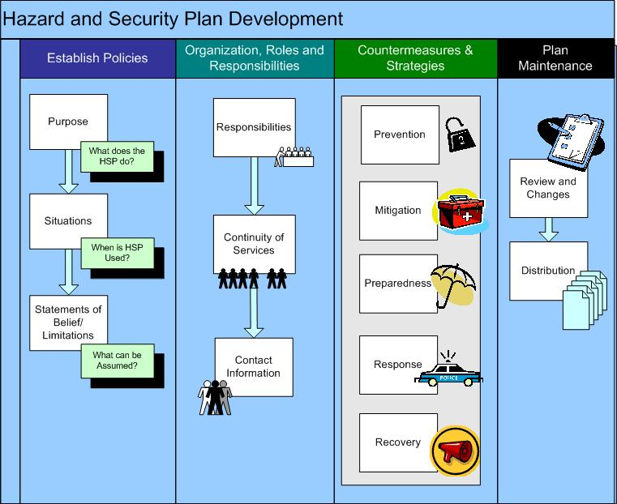
SECURITY COUNTERMEASURES
The design of a security protocol should occur only after the performance of a risk assessment and the development of a comprehensive security plan. Until these first steps are completed insufficient data will be available to make good decisions about security strategies.

Slide 27
SECURITY COUNTERMEASURES
SECURITY STAFFING – Not surprisingly, relatively few small- or medium-sized transit agencies feel the need to maintain a dedicated agency police or security force. Less than 13% of small agencies and 17% of medium-sized agencies surveyed indicated that personnel assigned specifically to perform security work were included in the operating budget. This decision not to deploy dedicated security is consistent with the crime and disorder related findings of this research project that disclose a minimal levels of security related risk for small- and medium-sized agencies.

Slide 28
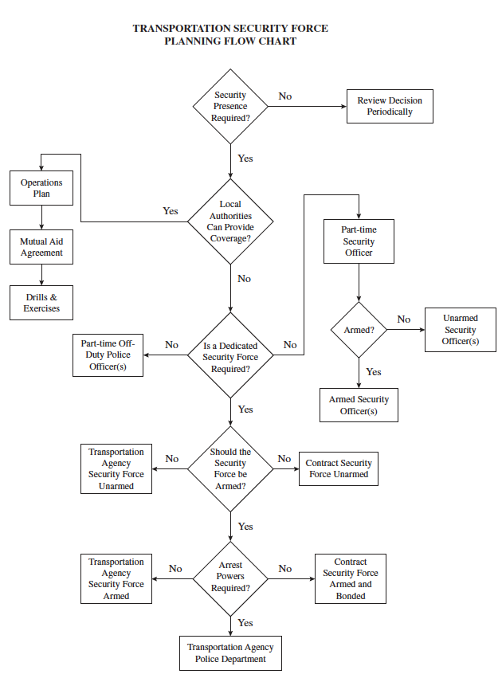
SECURITY COUNTERMEASURES
For those small- and medium-sized transit agencies whose security risks suggest that a dedicated force may be warranted the key question to be answered is whether a security presence, beyond what is available from the locale’s public safety community, is necessary to protect the system and its users.

Slide 29
SECURITY COUNTERMEASURES
Response Activities | Ease of Use | Response Value | Cost
Intelligence Information Sharing Cooperation | Medium | High—Working as a team with local planners, law enforcement and first responders. Requires the designation of a primary point of contact and dedication of significant time to maintain effective liaison. | Dollars—Low Time—High
Training, Drills Immediate Actions | Hard | High—Practicing with first responders on how to respond to and mitigate on-board vehicle violent incidents. | Dollars—High Time—High
Alarms, Panic Buttons with Police or Security Force Response | Medium | High—On-board vehicle emergency event notification technology coupled with immediate response by security forces. Vehicles with silent communication/emergency capability. | Dollars—Low Time—Very High
Surveillance with Immediate Police or Security Force Response | Hard | High—Real-time watching for suspicious activity on board vehicles remotely coupled with rapid response to incidents can create an observable omnipresent impact. | Dollars—High Time—Very High
Shadowing Vehicles | Hard | High—High visibility security patrols or bus field supervision provide immediate response capability. | Dollars—Medium Time—medium
Remote Sensors with Police or Security Force Response | Hard | High—Sensor/pager systems can be installed to detect dangerous substances, such as radioactive or biohazardous material, and alert the operator or dispatch when the vehicle has been contaminated. | Dollars—High Time—Very High
Driver Operator Security Awareness Training | Easy | High—Train employees to monitor and observe people, events, activities, and items and take careful note of irregular or suspicious behavior. | Dollars—Low Time—Low
Driver Operator Security Training | Medium | High—Customer service, conflict mitigation, self-defense or assault prevention training. Training should be provided to all drivers concerning management of hostile passengers. | Dollars—Low Time—Low
Vehicle Locators Systems (AVLs) | Medium | High—Buses should have vehicle location systems (cell/satellite locators) to know a bus’ actual location at any time from dispatch or some other centralized location. | Dollars—Medium Time—Low
Communication Protocol for Violent Incidents | Easy | High—Make sure all people involved in the communication process are trained and prepared for deployment of the process if and when necessary. | Dollars—Low Time—Low
Electronic Distress Signs | Easy | High—Emergency “Call Police” signs observable from the exterior of the vehicle. | Dollars—Low Time—Low
Personal Protective Equipment | Medium | Medium—Operator issued defensive weapons such as pepper spray. Requires policy and procedure promulgation as well as defensive tactics training. | Dollars—Medium Time—Medium
Real-Time Audio | Medium | Medium—Streaming audio. | Dollars—Medium Time—Medium
Violent Incident Emergency Response Plan | Easy | Medium—Hold-ups, hijacking, shootings, homicides, hostage situations, assaults and severe passenger disturbances on the bus. | Dollars—Low Time—Low
Surveillance without Police or Security Force Response | Hard | Low—Event recording of incidents. | Dollars—High Time—Medium
Fire Suppression Equipment | Easy | Low—Mitigating or controlling the impact of an event in progress. | Dollars—Low Time—Low
There are numerous types of countermeasures that can support the maintenance of an effective deterrence and response program for on board incidents. Many of these measures are low cost and/or low effort, consisting of policy responses, awareness and training, security planning, or coordination with local authorities.

Slide 30
SECURITY COUNTERMEASURES
For non-public spaces access control, perimeter security, intrusion detection systems and other similar types of technology can be deployed to protect facilities from external losses. However, in transit buildings that are open to the public during hours of operation security personnel or possibly surveillance systems are the primary means of providing protection.

Slide 31
SECURITY COUNTERMEASURES
The core security issue that planners must decide upon in establishing a protective environment for the occupants, passengers, employees, retail and premises of a transit station is whether an “enforcement only” level of security is appropriate. If the occurrence of crime and/or disorder is rare or infrequent the best approach may be to establish collaboration with local authorities and first responders who have enforcement responsibility for the facility.

