Slide 1
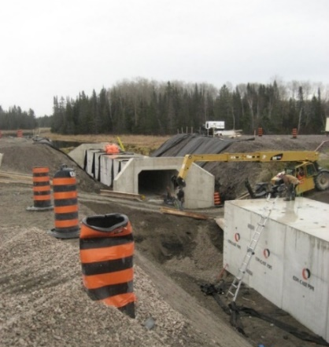
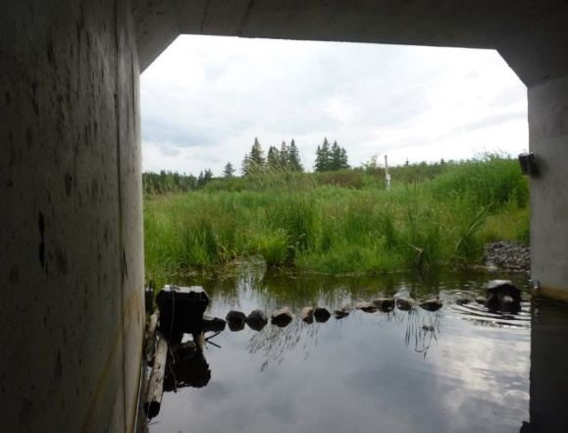
  NCHRP 25-25/TASK 113:
  Road Passages and Barriers for Small Terrestrial Wildlife: Summary and Repository of Design Examples
  September 2019
      Principal Investigators:
      Dr. Marcel Huijser & Kari Gunson in association with Louis Berger, U.S., a WSP company
      Funded By:
      National Cooperative Highway Research Program
Photo credits: Kari Gunson

Slide 2
  OBJECTIVE
  Summarize current state of practice for small
  terrestrial species (amphibians, reptiles, and
  mammals smaller than coyotes), including:
Describing the science conducted (literature-based) to evaluate the effectiveness of mitigation measures
Describing the current state of practice of implementing mitigation measures (web-based survey)
Compiling a repository of relevant plan sheets, photos, and other documents relevant to the current state of practice
Synthesizing this information into design consideration documents, case studies, and research needs

Slide 3
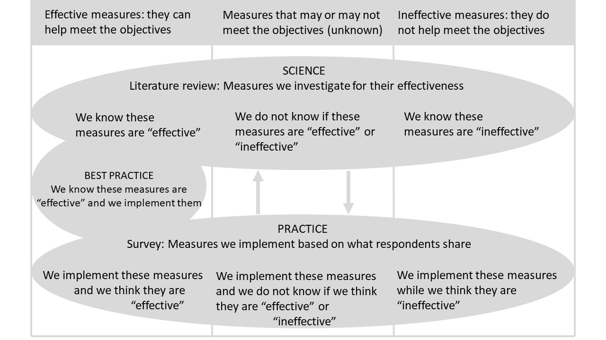
Notes:
This diagram shows a summary of information that was collected via a literature review and the expert survey. A literature review is meant to summarize the results of an investigation while an expert survey is meant to summarize the current state of practice. In the literature reviewed, objectives are formulated and effectiveness is measured and effective measures are implemented.
In our conclusions of this project, the science is not at a level where best practices are implemented and known to be effective. Currently measures are implemented and evaluated and adaptive management is sorely needed and new measures re-evaluated.

Slide 4
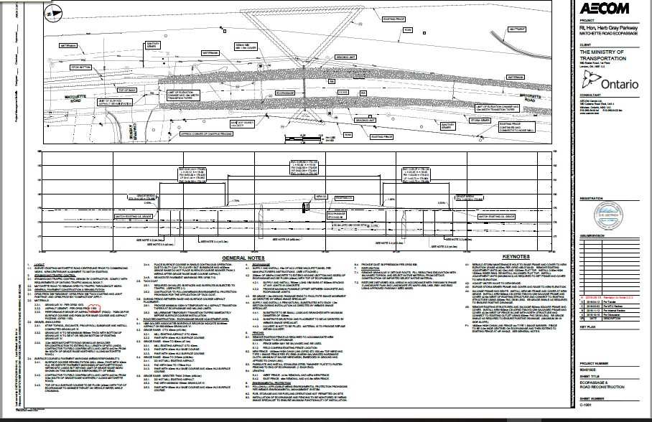
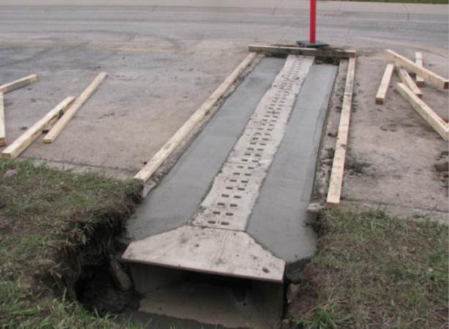
    PRODUCTS
        Reports
          Literature review and annotated bibliography
          Expert survey report
          Considerations for mitigation measures by type
          Relevant case studies
          Summary report
        Web-based repository of technical drawings, and photos
Photo credit: Cyndi Smith, Parks Canada

Slide 5
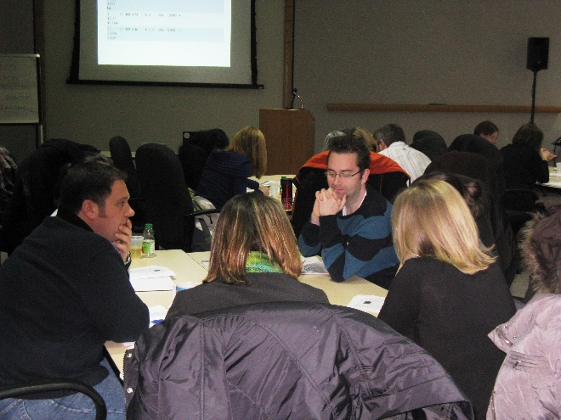
WEB-BASED EXPERT SURVEY
Photo credit: Kari Gunson

Slide 6
  METHODS
        On-line survey sent to practitioners and transportation departments via list-serves and targeted emails
        Three main sections in survey
        Measures used to reduce road mortality, primarily exclusion barriers (e.g., fences or walls)
        Measures used to provide safe crossing opportunities, primarily designated and non-designated wildlife crossing structures
            Repository of technical drawings and images from respondents

Slide 7
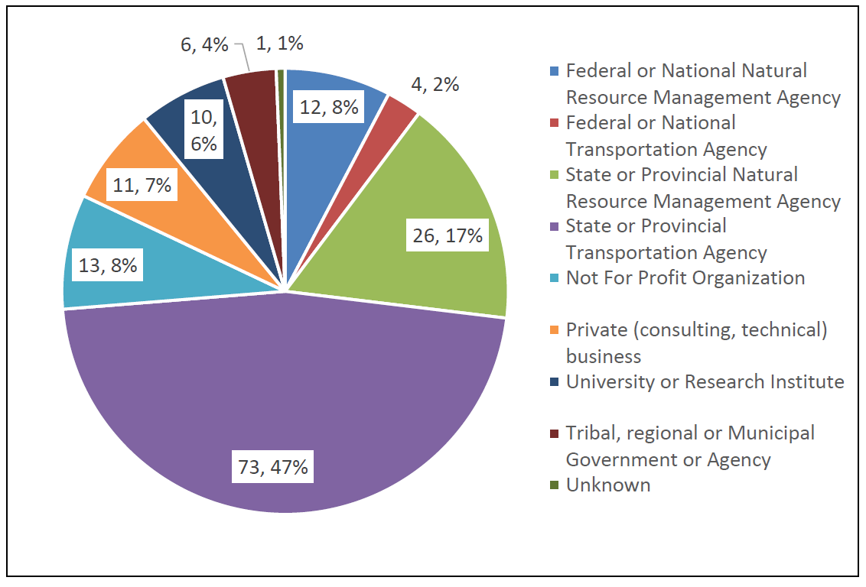
  UNIQUE RESULTS
  Respondents and affiliation
N=156
Notes:
156 respondents in total from federal or national agency (resource management and transportation), state or provincial (resource management and transportation), Not for profit, private, university, tribal, regional or municipal, and unknown.

Slide 8
  Respondents and geographical region
      41 U.S. states
      6 Canada provinces
Notes:
Numbers on map correspond to the number of respondents total from each region: western Canada (W CAN), Central Canada (C Can), eastern Canada (E Can), northwestern United States (NW), southwestern United States (SW), Midwest United States (MW), northeast United States (NE), southeast United States (SE).

Slide 9
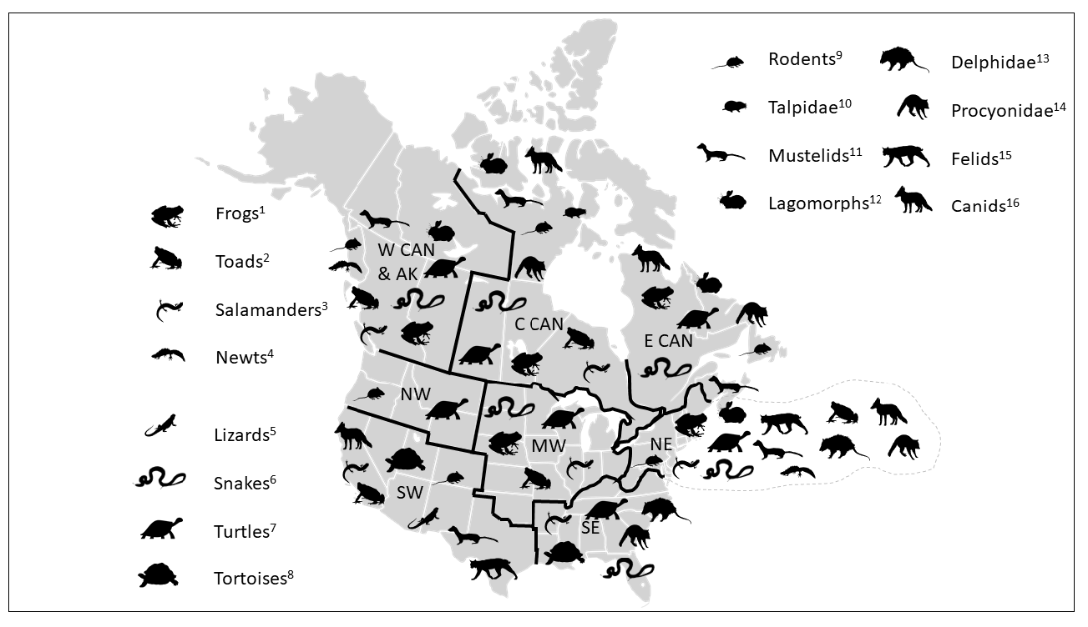
  Mitigation measures for species groups by region
Note: Superscripts indicate credit statements for animal icons; see speaker notes and Expert Survey Report.
Notes:
Superscripts refer to credits below:
Creative Commons Attribution-Share Alike 4.0 License.
¹ http://www.supercoloring.com/silhouettes/frog by Natasha Sinegina
² http://www.supercoloring.com/silhouettes/toad by Sam Fraser-Smith
³ http://www.supercoloring.com/silhouettes/salamander by Natasha Sinegina
⁴ http://www.supercoloring.com/silhouettes/newt by Rainer Theuer
⁵ http://www.supercoloring.com/silhouettes/bearded-dragon by Natasha Sinegina
⁶ http://www.supercoloring.com/silhouettes/snake by Bob Comix
⁸ http://www.supercoloring.com/silhouettes/tortoise by Natasha Sinegina
⁹ http://www.supercoloring.com/silhouettes/wood-mouse by Bob Comix
¹¹ http://www.supercoloring.com/silhouettes/weasel by Bob Comix
¹² http://www.supercoloring.com/silhouettes/rabbit by Natasha Sinegina
¹³ http://www.supercoloring.com/silhouettes/opossum by Bob Comix
¹⁴ http://www.supercoloring.com/silhouettes/raccoon by Natasha Sinegina
¹⁵ http://www.supercoloring.com/silhouettes/wild-cat by Bob Comix
¹⁶ http://www.supercoloring.com/silhouettes/red-fox by Natasha Sinegina
FLATICON https://file000.flaticon.com/downloads/license/license.pdf
⁷ https://www.flaticon.com/free-icon/turtle-facing-right_84024 by Flaticon
¹⁰ https://www.flaticon.com/free-icon/mole-mammal-animal-shape_47278 by Falticon

Slide 10
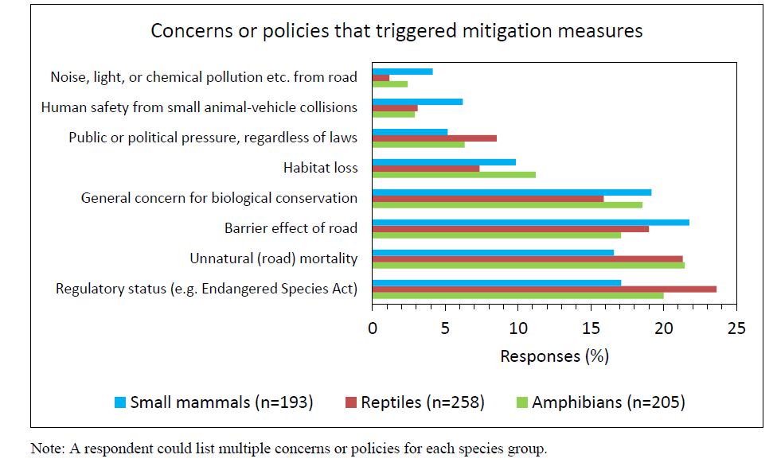
  Mitigation triggers
Notes:
Figure 4: Concerns or policies that triggered the design or implementation of mitigation measures in general for small animals. Note that a respondent could list multiple concerns or policies for each species group. A description of the types of mitigation measures follows.

Slide 11
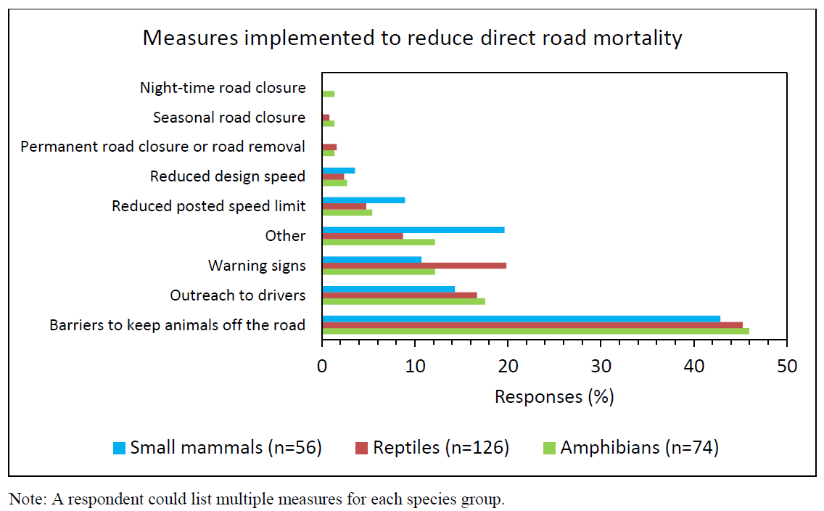
  Measures implemented to reduce road mortality
Notes:
Barriers were the most commonly implemented mitigation measure to reduce road mortality

Slide 12
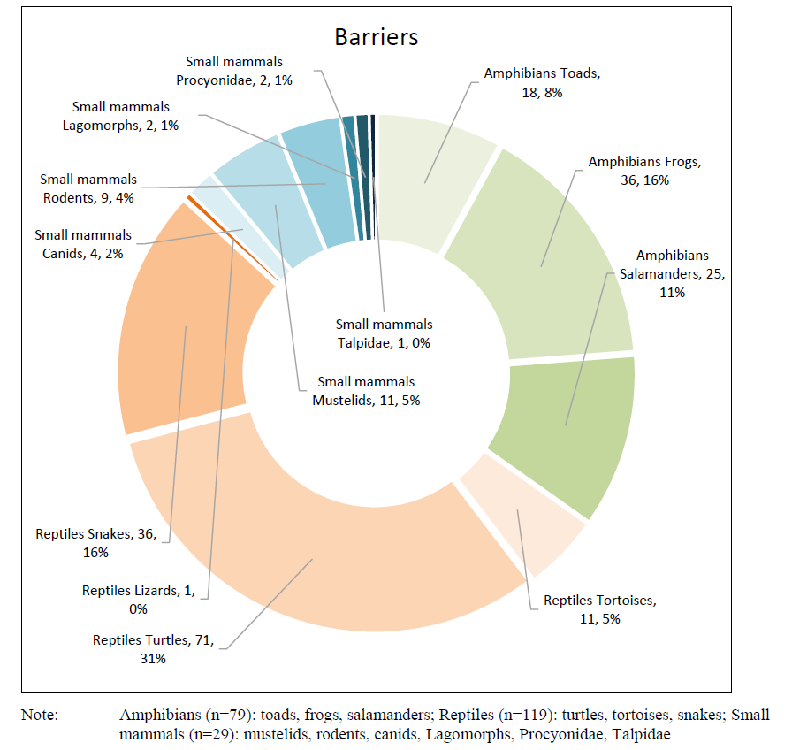
  Target species for barriers
Small
mammals
Amphibians
Reptiles
Notes:
Barriers were defined as a wall or an upright fence and were installed to exclude small animals from roads.
Most often installed for reptiles, followed by amphibians then small terrestrial mammals

Slide 13
  Characteristics of barriers
Multiple, diverse materials were used for small mammals, but chain-link or woven wire were the most common
Concrete barriers were used in six studies
Chain-link and plastic sheets were deemed the most effective in reducing barrier effect
A climbing barrier was installed at the top of the barrier, most often for amphibians (53%), followed by reptiles (46%) and small mammals (33%)

Slide 14
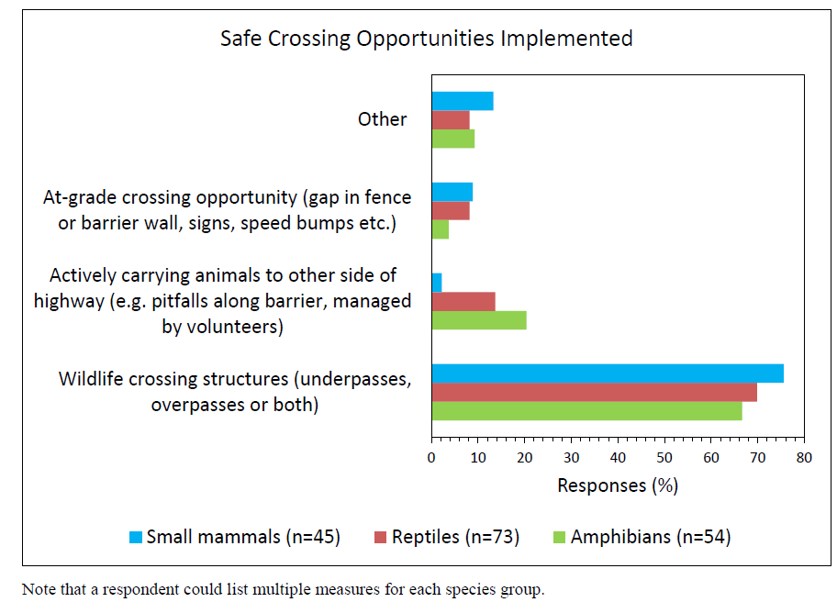
  Measures implemented for safe crossing opportunities
Notes:
Most commonly installed for reptiles (42%), followed by amphibians (31%), then small mammals (26%)

Slide 15
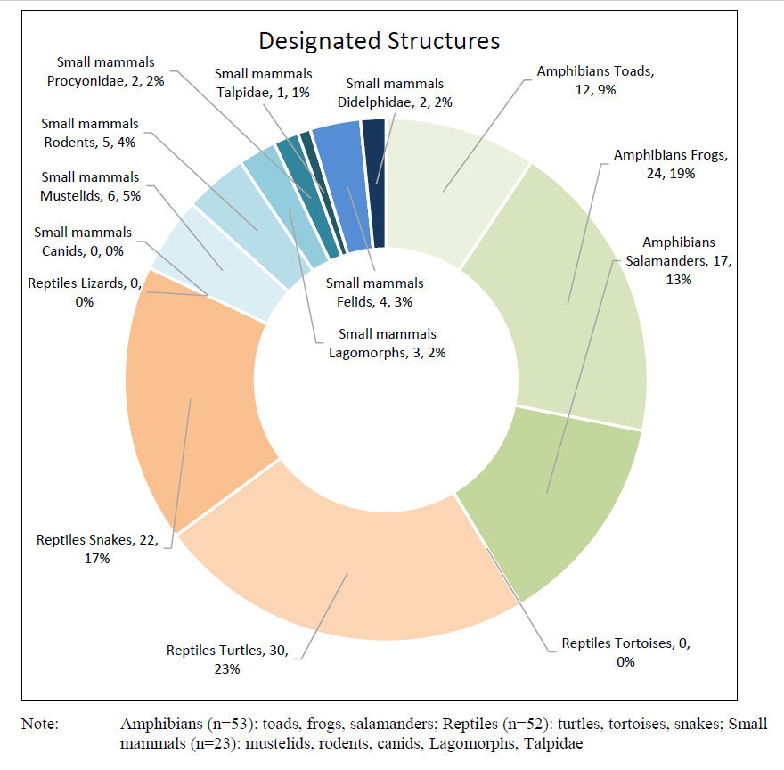
  Designated structures by target species
Small
mammals
Amphibians
Reptiles

Slide 16
  Characteristics of designated structures (amphibians and reptiles)
Amphibians:
Underpasses with a bottom
(e.g., a culvert)
Width 26 to 50 cm (0.9 to 1.6 ft) or 176 to 200 cm (5.8 to 6.6 ft)
Height 26 to 50 cm (0.81 to 1.6 ft) or 101 to 125 cm (3.4 to 4.1 ft)
Open-top structure (slots)
Cover (e.g., root wads, or rocks and boulders)
Notes:
Width and height tend to be larger for reptiles than amphibians
Designated structures more varied for reptiles
Structures more specifically designed for amphibians, e.g. open-top structures with cover

Slide 17
  Characteristics of designated structures (cont.)
Reptiles:
Underpasses with bottom or no bottom
(e.g., a culvert)
Width 26 to 50 cm (0.9 to 1.6 ft) or >200 to 300 cm (6.7 to 10.0 ft)
Height 26 to 50 cm (0.81 to 1.6 ft) or >200 to 300 m (6.7 to 10.0 ft)
Closed or an open roof structure
(e.g., grate or slots)
Cover or no cover

Slide 18
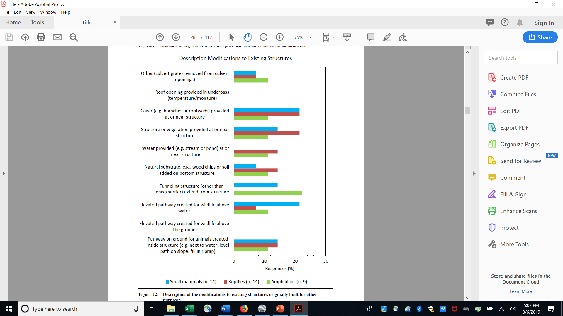
  Modifications to non-designated structures
  Cover most often added for small mammals and reptiles
  Funneling structure added to existing structure for amphibians
  Elevated pathway added for small mammals
  Vegetation added at or near structures for reptiles
Notes:
Non-designated structures were existing structures installed for other purposes such as hydrology, livestock or recreational use
These structures were then sometimes modified to facilitate small animal passage

Slide 19
  Monitoring
  Barriers were evaluated in reducing road mortality 79% of the time
      Effectiveness was < 70% for 30% of the cases when a percent reduction was given
  Crossing structures were evaluated 77% of the time
      Effectiveness at reducing the barrier effect was unknown in 48% of cases, likely, because measures used to evaluate the barrier effect reduction are more difficult to assess (e.g., genetic exchange, use by sex, and age-class)
Notes:
Monitoring for barrier effectiveness was conducted primarily by measuring the number of dead and alive animals along the barrier
Monitoring for crossing structure effectiveness was conducted primarily by measuring whether the target animals used the crossing structures

Slide 20
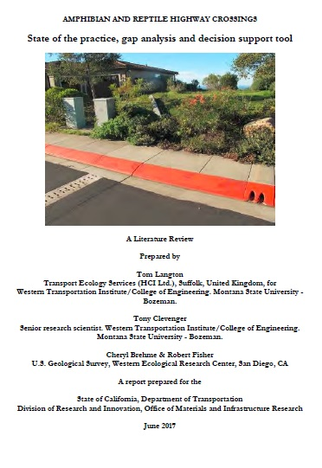
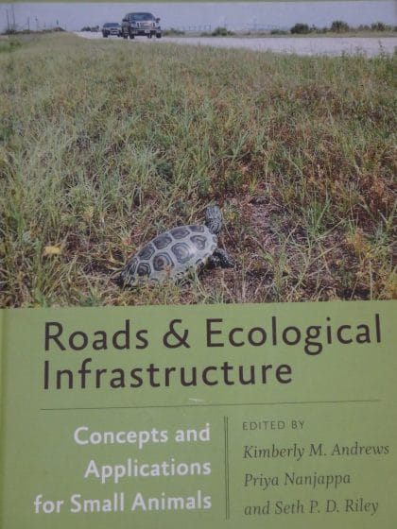
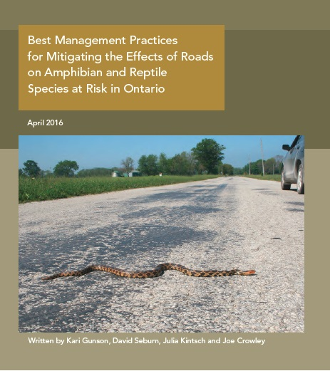
LITERATURE REVIEW
  Expanded from other compilations conducted between 2015–2017
2015
2016
2017

Slide 21
  METHODS
  In total, 127 documents were reviewed and included 6 types of literature:
  Peer-reviewed journal articles (62)
  Technical monitoring reports (30)
  Academic theses (6)
  Book case studies (2)
  Conference PowerPoint presentations (3), proceeding papers (22), abstract (1),
  and poster (1)
  Guideline documents, e.g., VicRoads (2012)
  These documents were summarized into:
  Annotated bibliography
  Literature review report

Slide 22
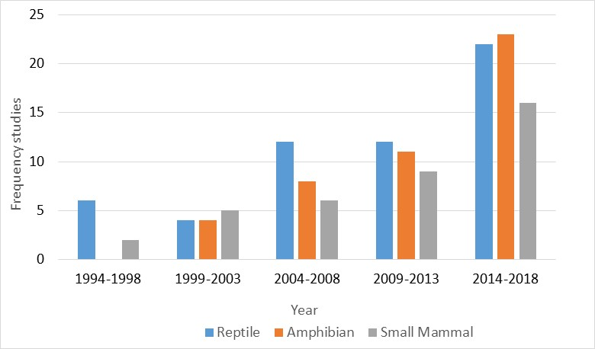
  RESULTS
  Research studies conducted by year

Slide 23
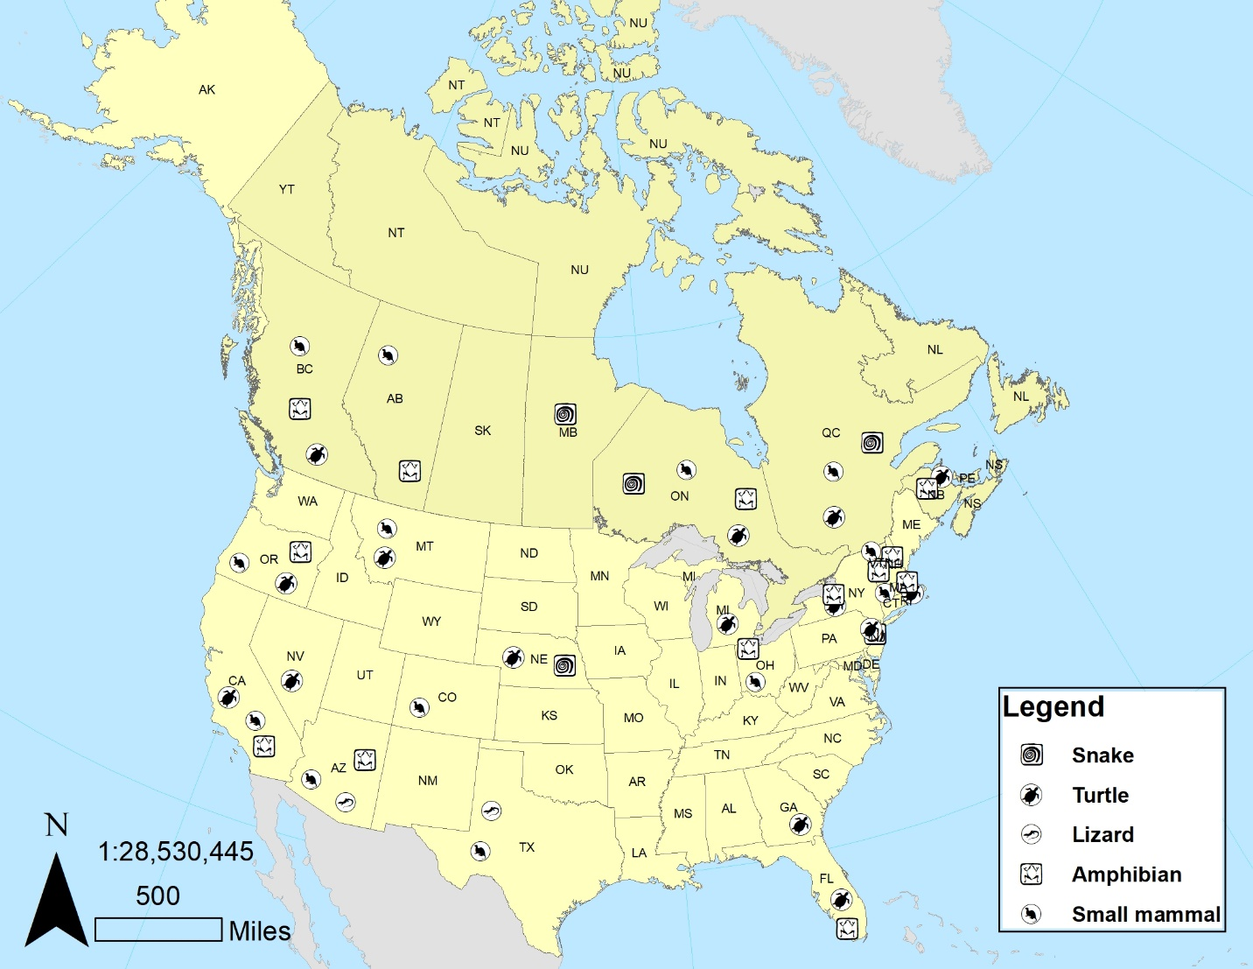
  Research studies by geographic region
15 United States
14 Europe
11 Canada
10 Australia
1 Brazil
1 South Africa
Notes:
The majority of the studies were completed in the US and Europe followed by Canada and Australia. There are a few published studies from other countries in Brazil and South Africa.
The map shows a cluster of studies in northeastern North America that includes Ontario, Quebec, New Brunswick, Massachusetts, New York and Vermont for all animal groups
There are several studies in the western states and provinces that include California, Arizona, Oregon and British Columbia
And a scattered distribution of studies in the Midwest and Alberta, Saskatchewan and Manitoba

Slide 24
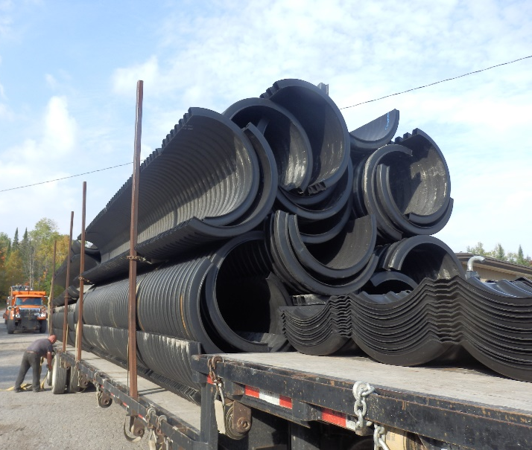
Agencies that installed mitigation
  Municipal (7)
  Residential and commercial developments (6)
  Protected ares (4)
  State or provincial (21)
Designated structures installed on:
  New road upgrade projects (34 or 72%)
  Existing roads (13 or 28%)
Road-type
  Highways (≥ 4 lanes) (47%)
  One- or two-lane roads (53%)
Photo credit: Paul Heaven

Slide 25
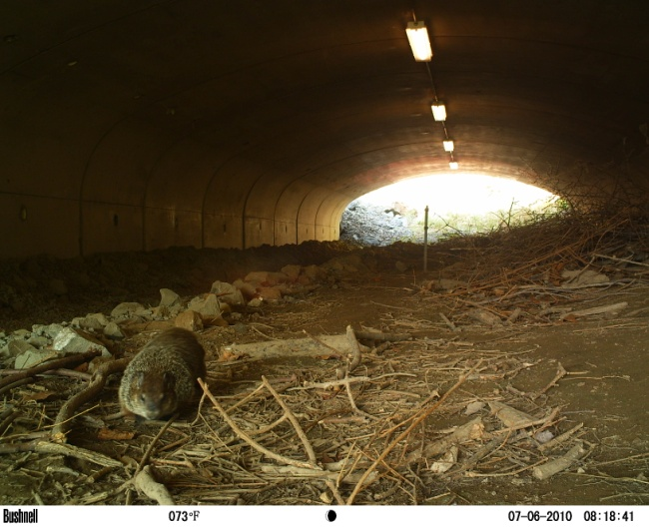
    MONITORING METHODS
    Amphibians and reptiles: diversity of methods used such as pit-fall traps, Passive Integrated Transponder (PIT) tags, tracking (sand), cameras (active, motion, and time-lapse)
    ─ Small mammals: 19 studies: 17 used camera monitoring (motion), 1 used tracking with paper, 1 used fluorescent dye, 2 used trapping, and 1 used telemetry
    ─ Monitoring completed most often for three seasons after crossing structures implemented
Photo credit: Dennis P. Quinn
Notes:
Some studies used more than 1 method so numbers are greater than 19 studies

Slide 26
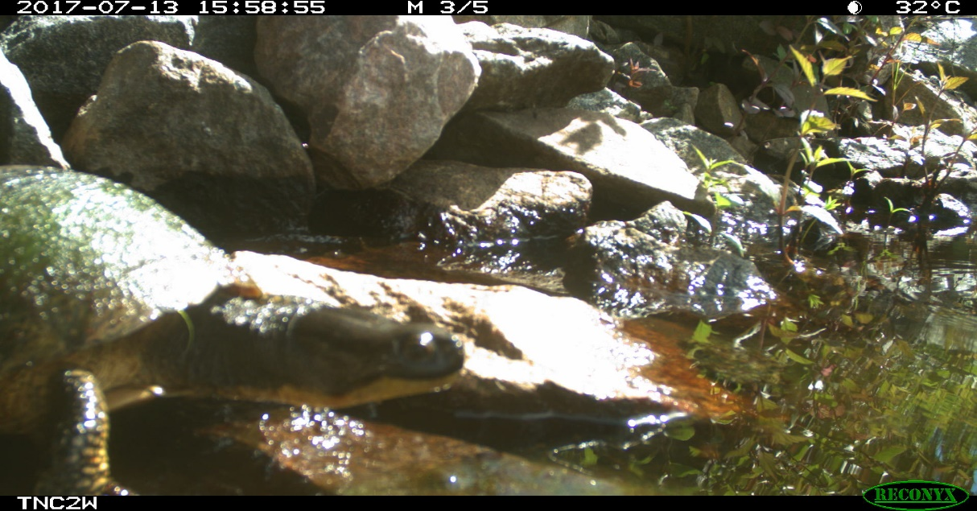
    MONITORING CONDUCTED
    In the literature review, crossing structures were monitored (49 of 57 of studies or 86%) of the time for target group(s) or species use
      ─ All but three studies showed use by target group(so or species.
      ─ One study measured change in population abundance (before and after implementation).
Photo credit: Ministry of Transportation, Eco-Kare International

Slide 27
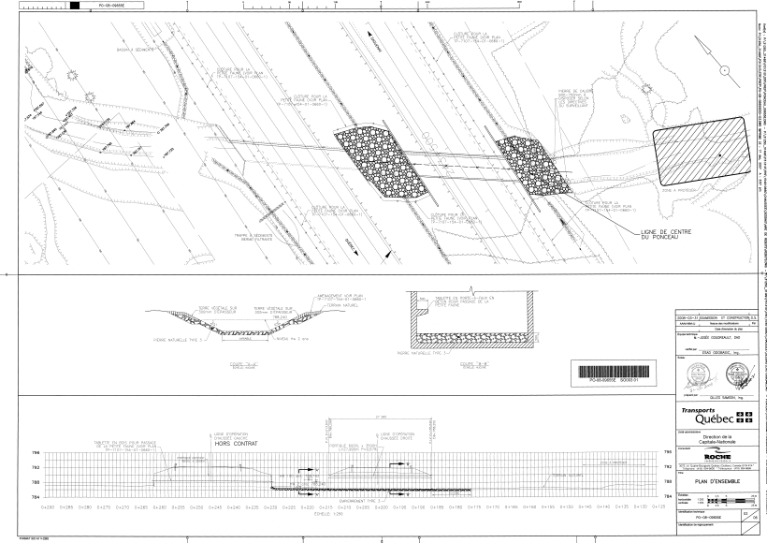
REPOSITORY
Concrete shelf in underpass, Technical Drawing: Ministère des Transports du Québec

Slide 28
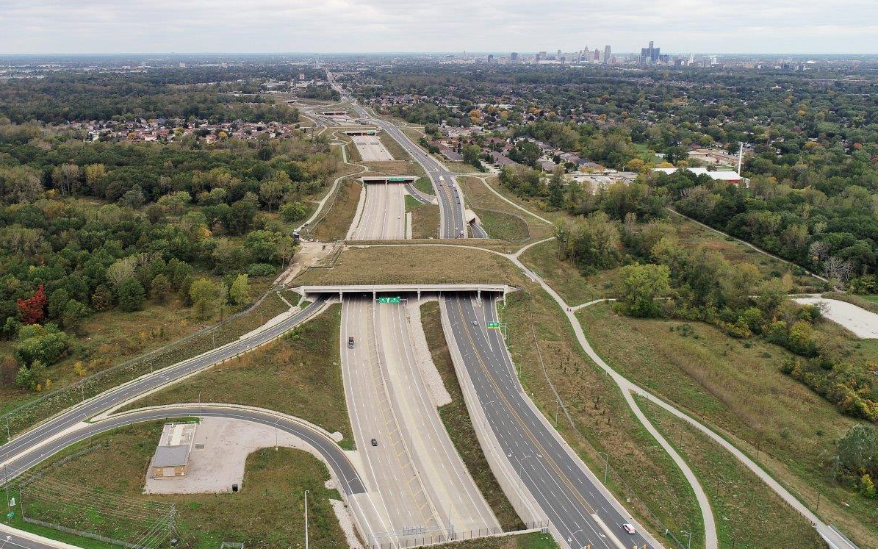
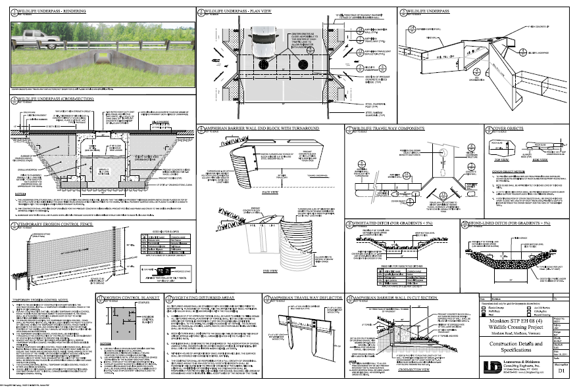
    INFORMATION SOURCES
    75 technical drawings
    ─ 20 barriers, 16 designated underpasses, 22 drainage structures with shelving, and 1 overpass
306 images
    ─ 124 amphibians,
    199 reptiles, and
    27 small mammals
  Other documents
    ─ Technical guidelines,
    reports aerial images,
    videos, and information sheets
Photo credit: Ministry of Transportation Ontario, Wood Environment & Infrastructure Solutions
Photo credit: Monkton Conservation Commission

Slide 29
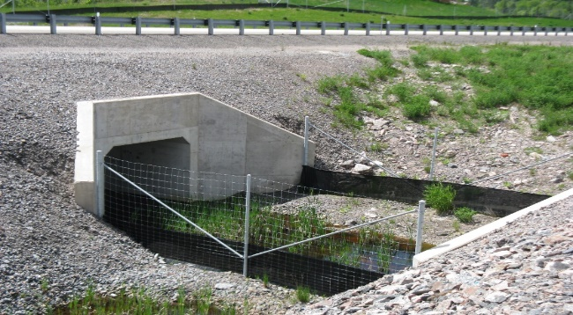
    CONSIDERATION REPORTS
    Overpasses
    Large underpass structures
        ─ Width and/or height > 3 m
    Small underpass structures
      ─ Width and/or height <= 3 m
    Small existing culvert structures
    Barriers (fence, wall or guide-wall)
    Fence-end, access road and escape opportunities
Photo credit: Kari Gunson
Notes:
A consideration report that outlined details such as location, specifications, maintenance, and habitat was completed for six mitigation structure types that were thought to be relevant to small animal safe passage across roads

Slide 30
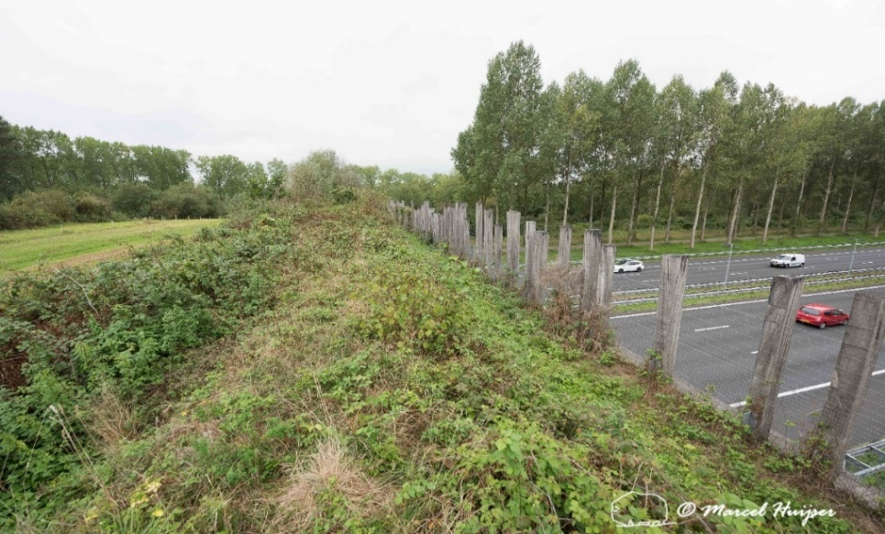
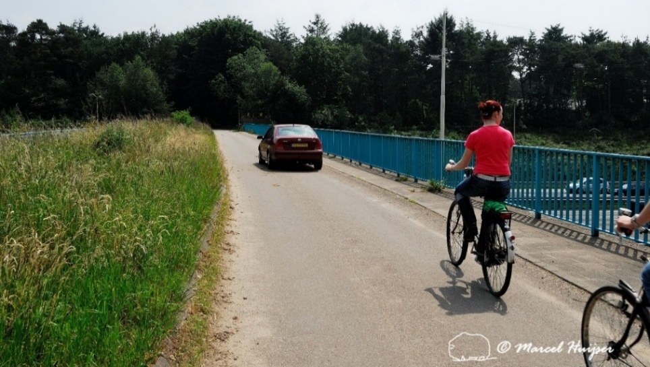
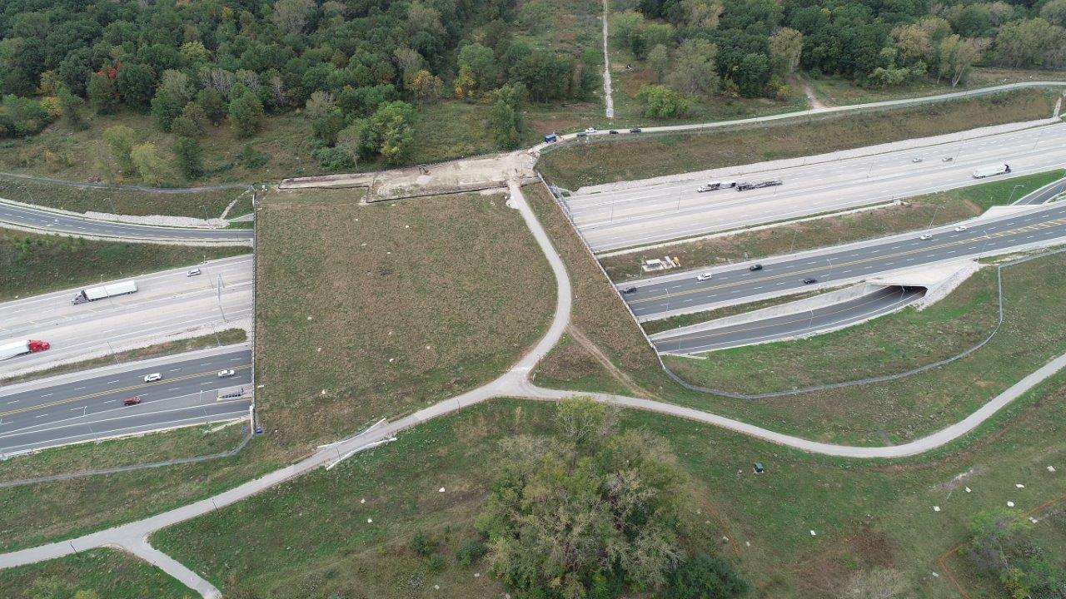
    OVERPASS STRUCTURES
    Types
─ Designated for wildlife
─ Non-designated, modified for wildlife
─ Combined designated and non-designated
(e.g., recreational)
Photo credit: Ministry of Transportation Ontario,
Wood Environment & Infrastructure Solutions
Notes:
An example of an overpass designated for wildlife is the ‘Groene Would’ overpass in the Netherlands. The Great-crested Newt was explicitly listed as a target species among other wildlife (see Case Study 1).
An example of a non-designated overpass is one in which the overpass was built for motorized traffic and bicycles and later a ‘green strip’ was added to the top of the structure.
An example of a combined designated and non-designated is seen in Ontario, Canada for endangered snakes. The overpass was designed with a bike path and planted with vegetation suitable for snakes. The bike path has an underpass on top of the overpass so snakes can cross safely (see Case Study 2).

Slide 31
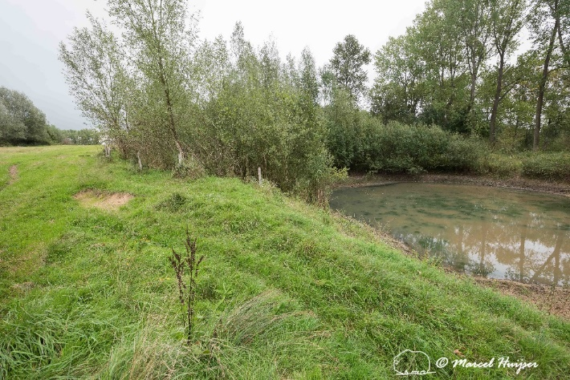
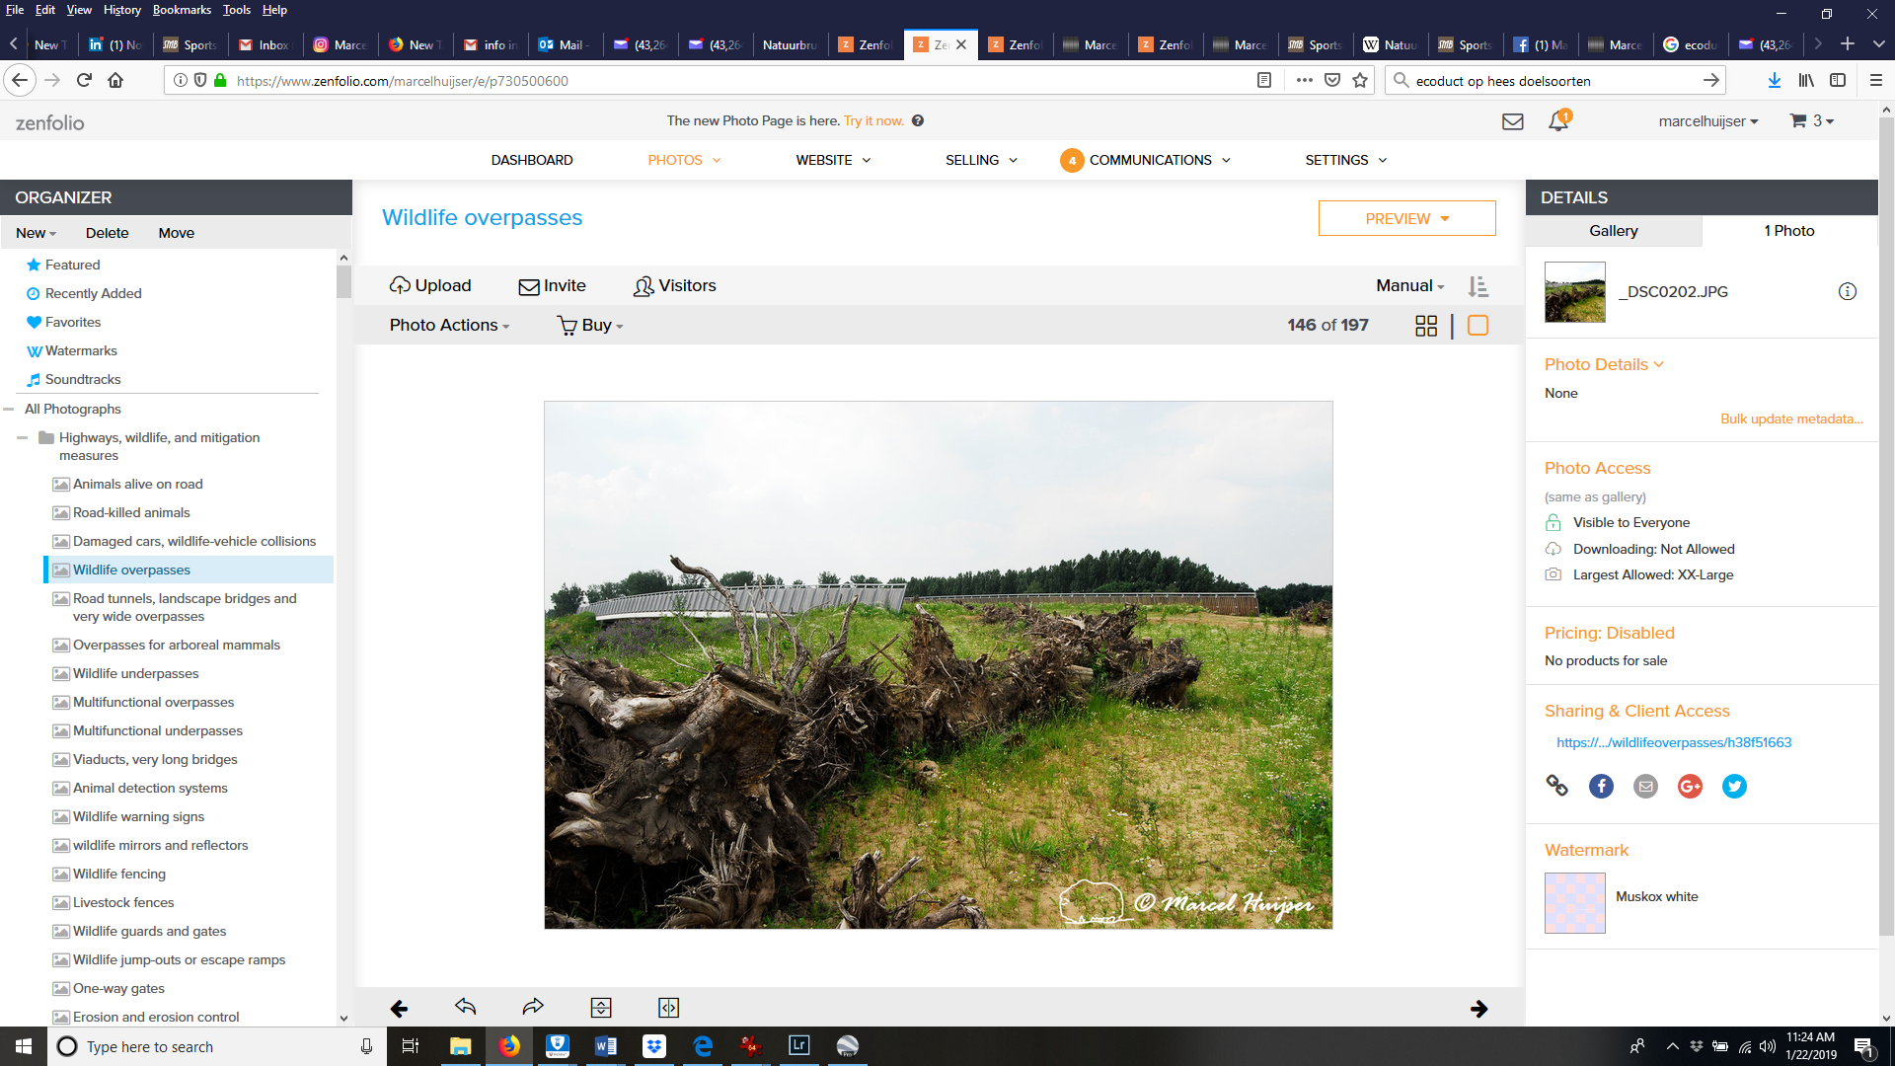
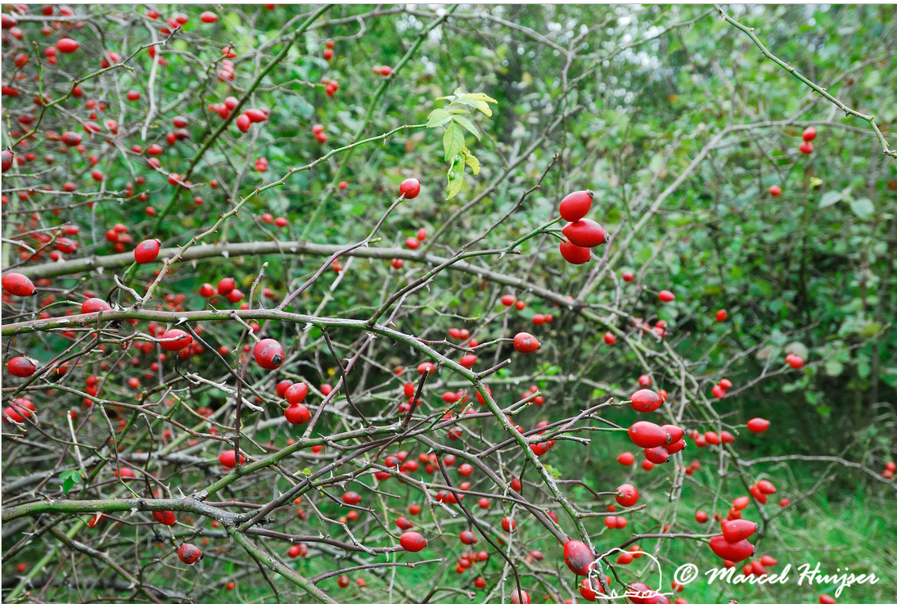
    Considerations
  ─ Slow moving animals may take days or weeks to get across (e.g., ≥ four-lane highways)
  ─ Provide resources:
  Specialized habitat
  (e.g., ponds)
  Cover
  Natural habitat
  Food (e.g., vegetation, berries, invertebrates)
Notes:
Top picture shows a pond on the left, middle picture shows cover with root wads, and the bottom picture shows berries on shrubs planted on the overpass.

Slide 32
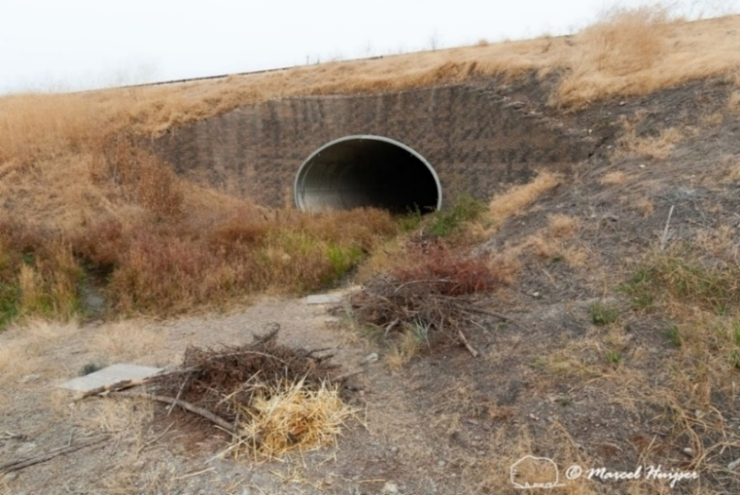
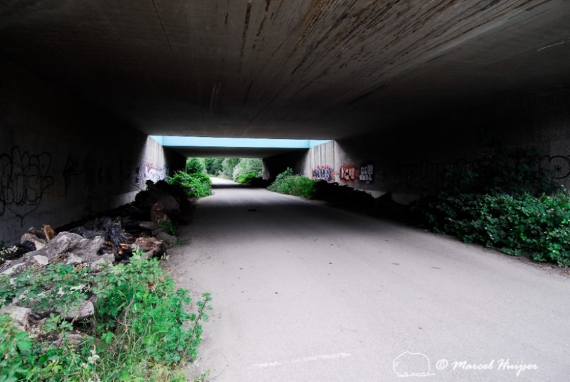
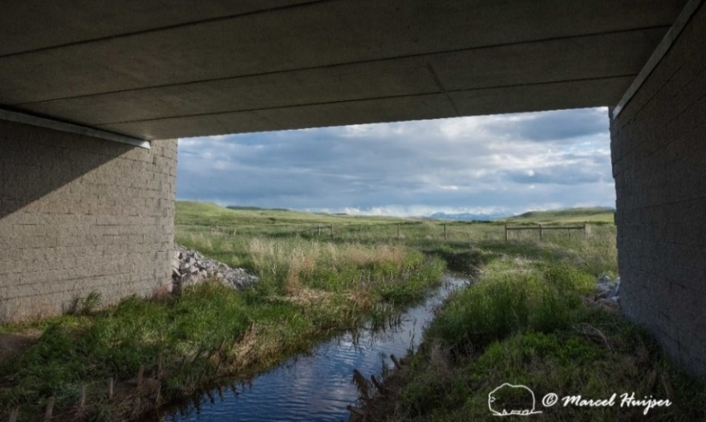
  LARGE UNDERPASS STRUCTURES (>3 m)
    Types
─ Designated for wildlife
─ Non-designated, modified for wildlife
─ Combined designated and non-designated
(e.g., hydrology)
Notes:
Non-designated large underpass structures are typically designed for water passage, livestock, pedestrians, motorized traffic, and in some cases large animal passage.
Top picture shows an arch CSP culvert that was designated for small mammals by its location and use of cover piles adjacent to the entrance of the culvert;
Middle picture shows non-designated underpass for motorized traffic and later modified for wildlife with adjacent strips of vegetation at the sides of the structure;
Bottom picture shows a combined designated and non-designated underpass that combines use for hydrology and terrestrial passage adjacent to the stream, e.g. creek-bridge pathway

Slide 33
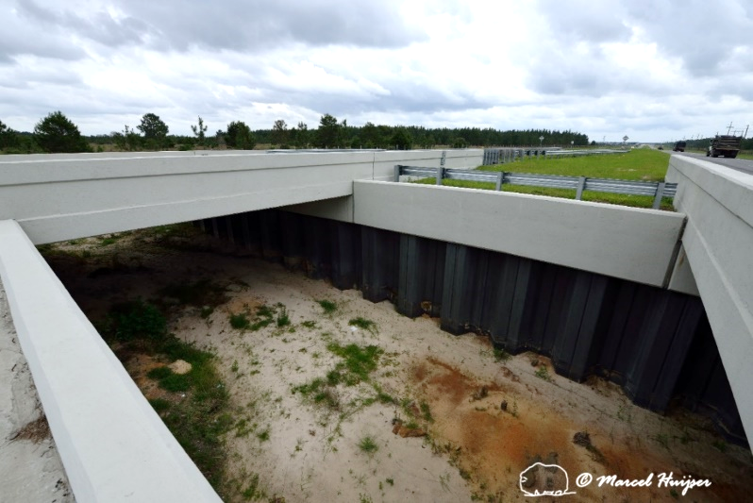
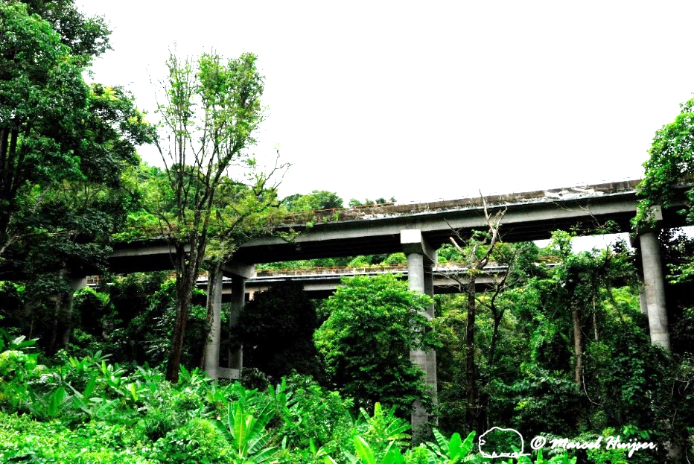
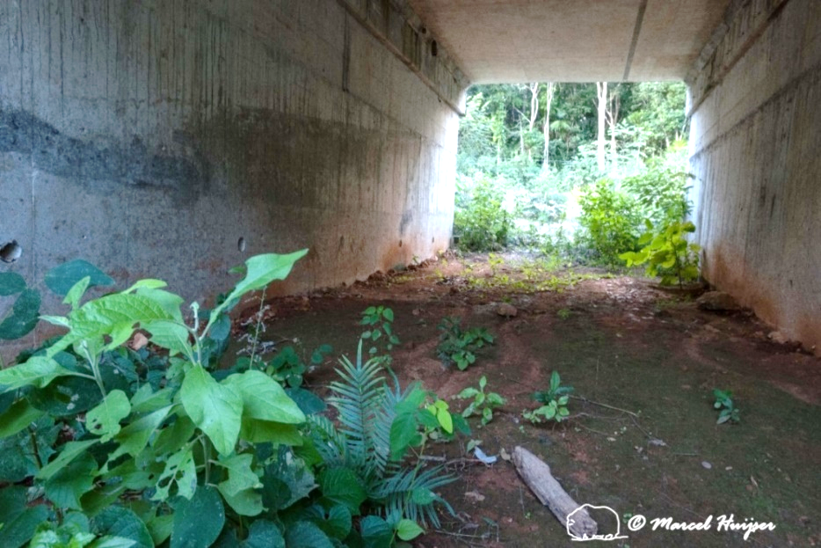
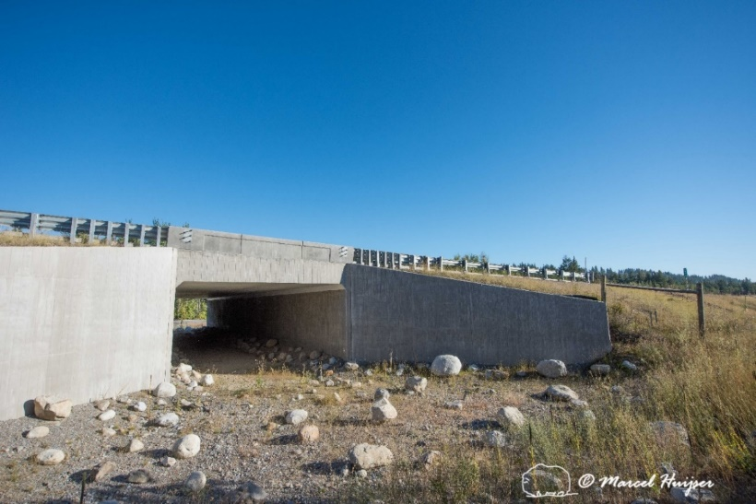
Considerations
─ Large viaduct allows light, soil, hydrology, vegetation, cover
─ Opening in median allows some light, moisture, vegetation
─ Added soil substrate encourage vegetation growth
─ Added rocks at entrance for cover

Slide 34
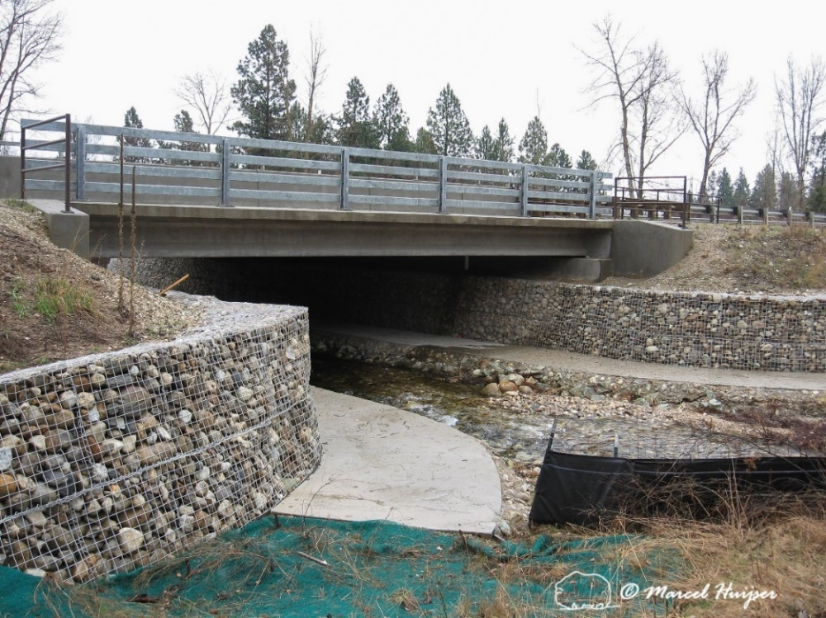
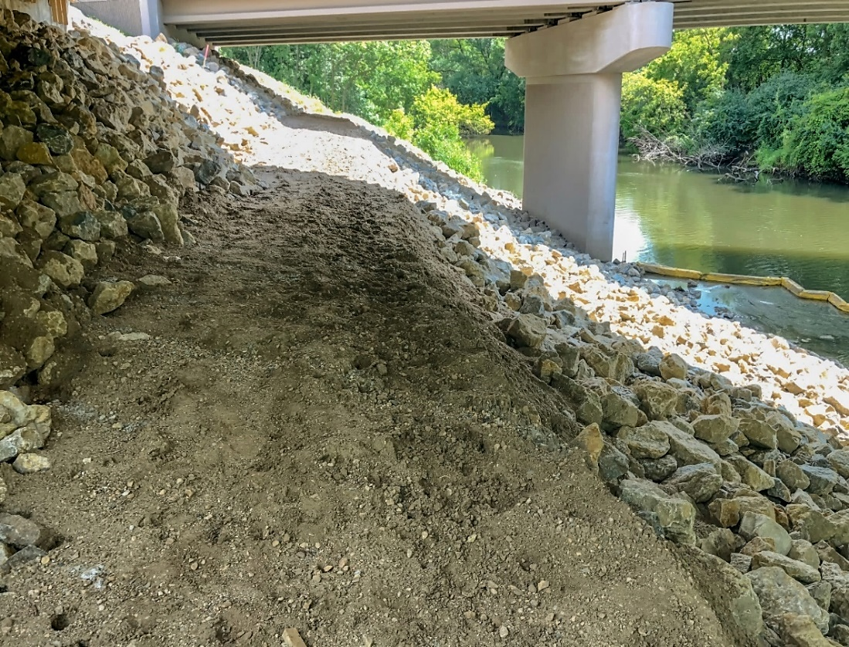
Considerations
Photo credit: Peter Leete, DNR─MnDOT liaison
Notes:
Top-left picture is an example of a creek-bridge pathway where a level path was designed and constructed through rip rap and steep slopes, bottom right picture shows paved path with gabion to control erosion

Slide 35
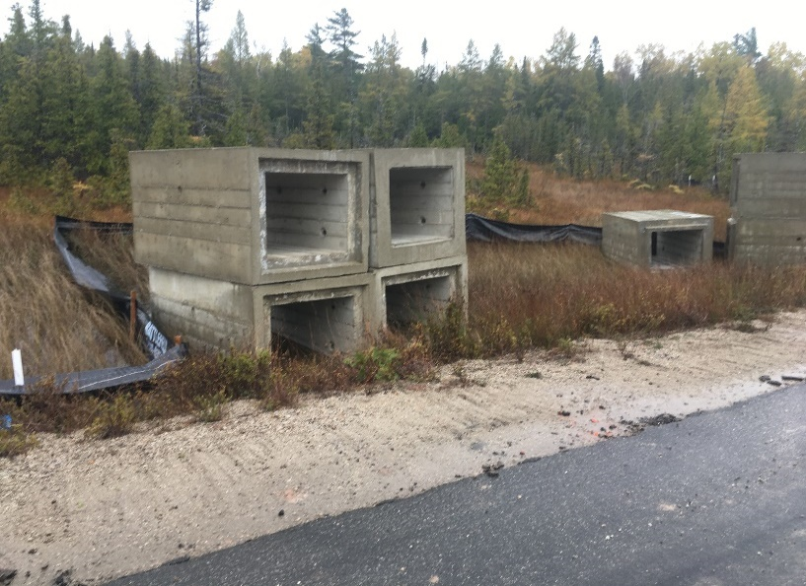
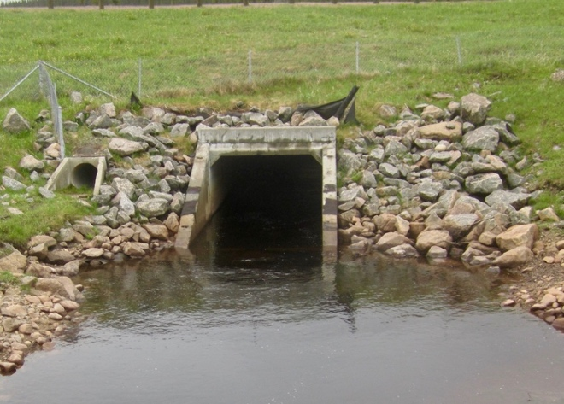
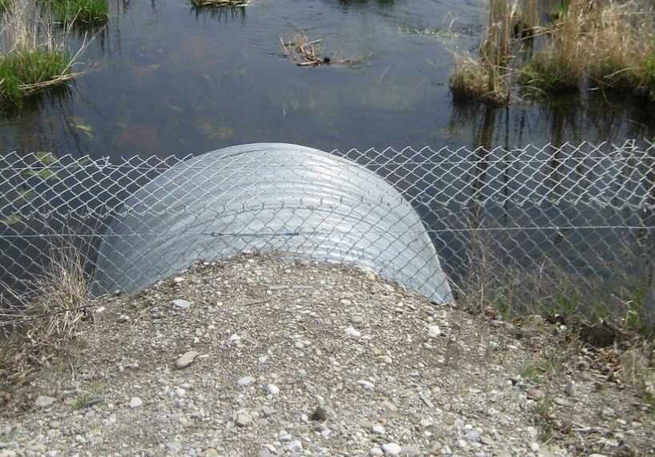
SMALL UNDERPASS STRUCTURES (≤3 m)
Types
Designated and non-designated for wildlife
Box or round
Corrugated steel, cement, or plastic pipe arch
Box culverts for snakes and turtles.
Round pipe culvert top left with drainage culvert
Photo credit:
Top: Parks Canada Agency
Middle: Jochen Jaeger
Bottom: Kari Gunson
Non-designated round CSP culvert
Notes:
Small underpass structures designated for small animals only differ from non-designated in that they are located and designed for the target species. However, often existing small underpass culverts exist in optimal locations and can be modified for passage by wildlife, e.g. by adding exclusion fence (bottom picture). Non-designated structures <=3 m are almost always designed for conveyance of water. These structures are less than or equal to 3 m in width, height or diameter.
Structures vary in shape from round (bottom picture), elliptical, arched, or box (top picture) and are made of materials that range from metals (e.g., Corrugated Steel Pipe), plastics (e.g., high-density polyethylene), polyvinyl chloride, or cement (middle picture, top left).

Slide 36
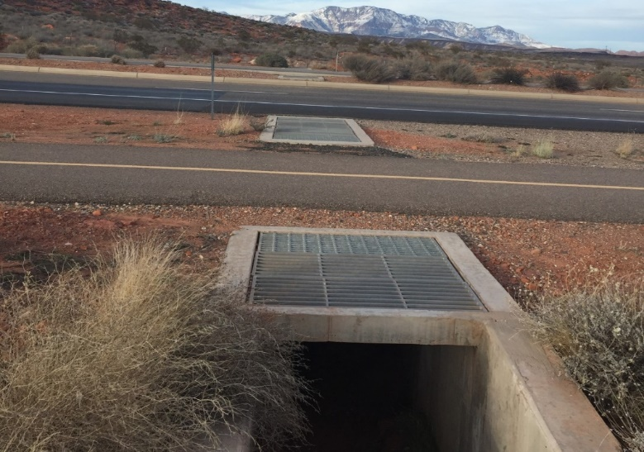
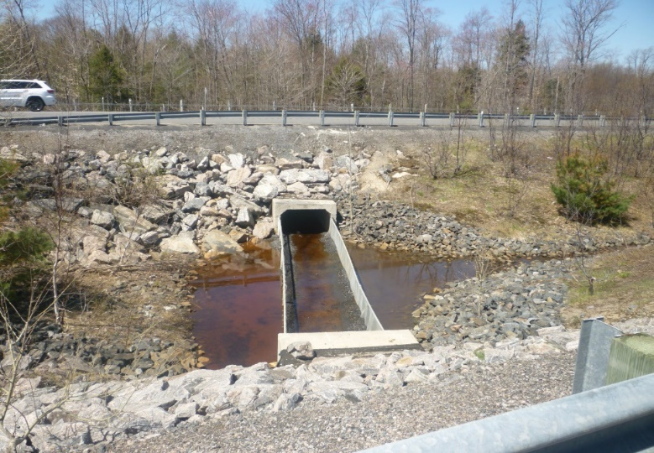
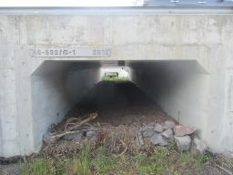
Considerations
─ Maximize openness
  Minimize length of structure
  Open culvert in median
  Include open grates or manhole
  Oversize up to 3 m in design
─ Provide cover objects and dry resting areas
─ Create natural terrestrial substrate
─ Include shelving for dry passage (Case Study 3)
Photo credits:
Top: Utah Dept. of Transportation
Middle and Bottom: Kari Gunson
Notes:
Top picture shows open grates at the entrance and exit to the tunnel and not along the road surface for safety and engineering reasons, these are easier to implement in design but can also be included as a modification in existing culverts; Middle pictures shows open fenced median in a four lane highway to minimize length and also to allow natural vegetation and light; bottom pictures shows added substrate and mulch for snakes. When not implemented in design, these criteria should be selected for or added as modifications to existing culverts.
In most cases, these structures have a bottom but, in some cases, arched culverts may be installed on footings to maintain natural substrate under the road or substrate can be added (bottom picture). Also see Case Study 5 and 6.

Slide 37
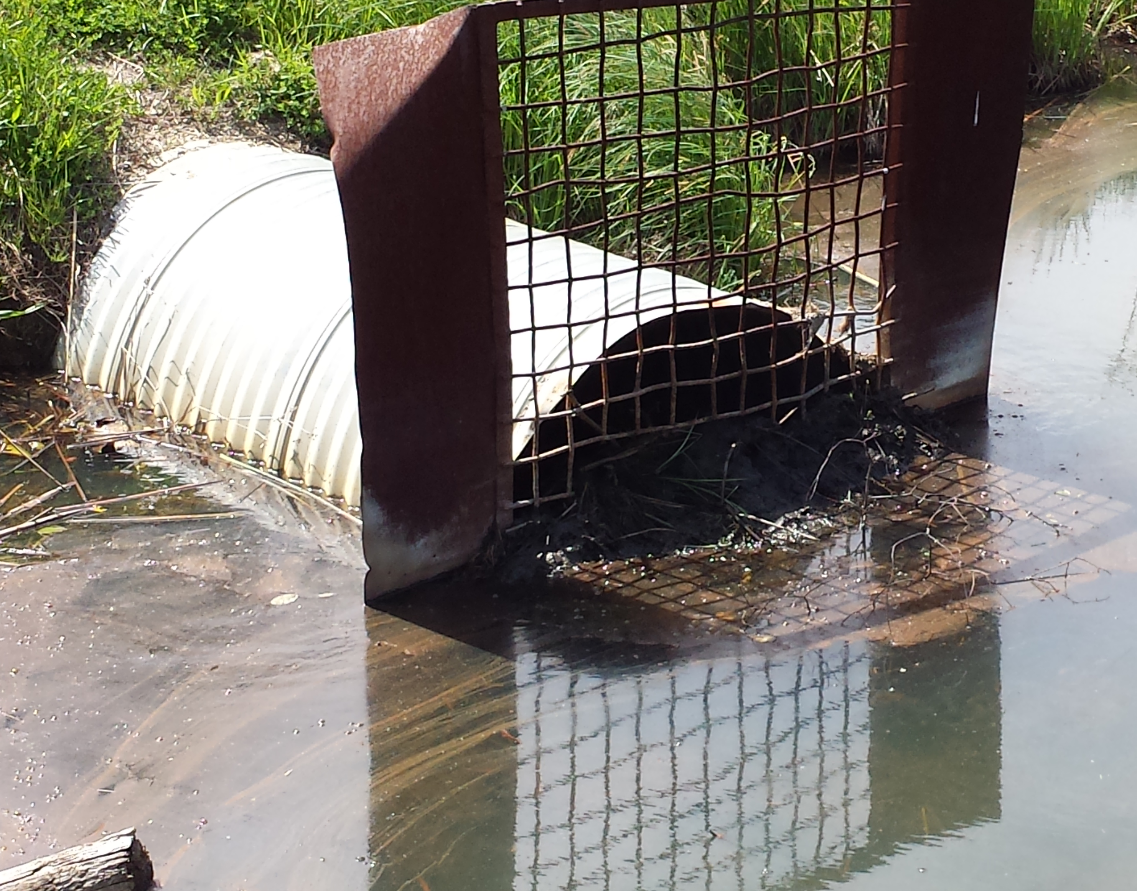
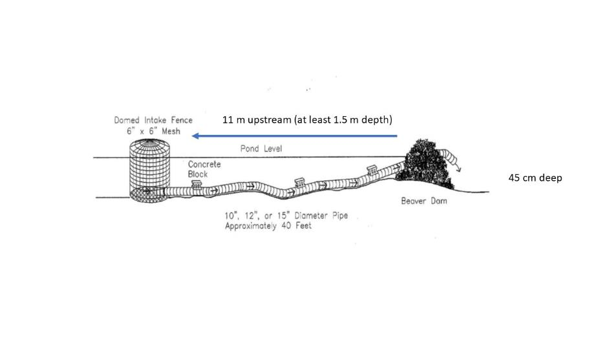
Maintenance
─ Applies primarily to non-designated culverts but also to designated culverts
─ Is required to keep culvert clear of debris, vegetation, and beaver dams
Beaver screen on existing drainage culvert
Photo credit: Ausable Bayfield Conservation Authority
Leveler pipe can be installed in nearby dam. Credit: Adapted from Beaver Institute
Notes:
When beavers exist in wetlands, often beaver screens are placed in front of culverts to protect the culvert from being dammed. However, this does not solve the problem
Because beavers will dam the screen and prevent water flow. A better solution is to use a pond leveler pipe in the nearby dam created by a beaver, create a diversionary dam, or to fence the culvert with mesh fence and include a ‘wildlife door’ to allow passage for larger turtles.

Slide 38
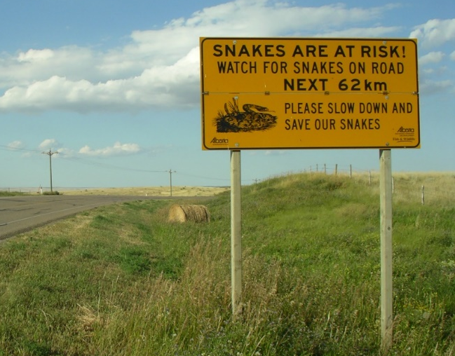



  BARRIERS
      Barriers then outreach and
      warning signs were most common
      way to reduce road mortality
      Barriers are designed to exclude animals from roads
      Wall, guide-wall or fence
Photo credit: Kris Kendall, Alberta Conservation Association
Wall
Fence
Guide-wall
Photo credit: Chris Slesar, Monkton Conservation Commission
Photo credit: Barb Beasley
Photo credit: Kari Gunson
Notes:
Barriers are the most common mitigation barrier to reduce road mortality, in addition to outreach and awareness signs specific to the target species.
Barriers are designed to exclude animals from the road, barriers are typically designed for the target species, but can also be existing and modified, such as noise barrier, guard-rails, or gabion erosion walls
Barriers are defined as walls (bottom left), and fence (bottom middle) and guide-walls (bottom right) can be used as extensions from barrier to guide animals to crossing structure, these are crucial structures because animals may walk right by the structures\.

Slide 39





Types
─ Chain link
─ Mesh
Plastic
(Hard-ware cloth/Wire)
─ Concrete wall
─ Plastic (HDPE, PVC, recycled)
─ Wood
Concrete wall
Chain-link fence
Plastic attached to guard-rail
Photo credit: Top left: Chris Slesar, Monkton Conservation Commission
Top right: Jochen Jaeger, Concordia University, Montreal
Middle: Ausable Bayfield Conservation Authority
Bottom: Kari Gunson
Mesh Hardware cloth (wire) with steel frame (left); wood frame (right)
Notes:
Various types of barrier fence; selected design should target the behavioural and physiological needs of the target species as well as built to last considering the climate, terrain and local site conditions.
Hardware cloth should not be used without a solid frame or attached to large animal fence for stability, chain-link commonly used for small mammals

Slide 40



Considerations (behavior)
─ Climbing species
  Use top lip or solid barrier
─ Slender species, e.g., snakes
  Use solid barrier
─ Burrowing species,
e.g., cray fish and small mammals
  Bury bottom
Chain-link fence with top lip
Snapping turtle climbing
Photo credit: Top: Kari Gunson
Middle and Bottom: Animex Exclusion Fencing
Eastern garter snake poking
40
Notes:
Slender species such as snakes can squeeze through smaller mesh holes and get stuck. Therefore avoid mesh fence when targeting these animals.

Slide 41

Considerations (cont.)
─ Slope and subsurface, e.g., rock
─ Vegetation
─ Continuity of barrier, e.g., presence of driveways, access roads
─ Drainage
─ Use of existing features, such as guiderails and rock cliffs
─ High water levels of existing wetland and drainage features
─ Motorist safety considerations
─ Wildlife safety, e.g., shade structures
─ Mowing requirements
─ Maintenance protocols and responsibility
─ Budget
Post requiring concrete footing in Canadian Shield rock
Photo credit: Kari Gunson
41

Slide 42
  FENCE-END, ACCESS ROAD & ESCAPE OPPORTUNITIES
Notes:
Escape opportunities are number 4 and 5 in diagram; fence end treatment example shows angled fence; access road treatment shows an underpass labelled ‘3’ to allow animals to go under access road and not ontop of road and breach the barrier system.

Slide 43



Fence-end treatments
─ Design fence to encompass entire habitat, crossing hotspots and buffers
─ Tie into habitat ecotone or topography (top)
─ Angle fence away from road (middle)
─ Include electro-mat or Texas gate (wildlife guard) (bottom)
Fence-end tie-in with cliff face
Angle fence
Photo credit: Top: Kari Gunson
Middle: Paul Heaven
Bottom: Marcel Huijser
Texas gate
Notes:
Fence-end treatments are designed to reduce access onto road where there are fence-ends

Slide 44



Access roads and trails
Right: A pedestrian gate with a “flap” to keep amphibians, mostly the common toad (Bufo bufo), out of the road corridor
Left: A wildlife guard at a low volume dirt access road
Right: A wildlife guard at a bicycle path to keep amphibians, mostly the common toad (Bufo bufo), out of the road corridor
Notes:
When access roads or trails are present along the barrier exclusion then treatments are required. These are designed to prevent access
to the road where the fence is not continuous due to motorized/pedestrian access points.

Slide 45




Escape opportunities
Jump-out for turtles (right; photo credit: Kari Gunson) and escape ramp allow animals to move from road-side to safe-side (left, photo credit: Marcel Huijser).
A one-way gate for Eurasian badgers (right) and below-grade installation allow animal to escape along its length (left; photos: Marcel Huijser).
Notes:
Escape opportunities are designed to allow animals trapped in the road corridor to escape to the ‘safe-side’ of the fence

Slide 46
CASE STUDIES
    Case Studies 1 and 2: Overpasses
    Case Study 3: Shelving within small structures for small mammals (modification and designated)
    Case Study 4: Use of non-designated (existing) drainage culverts (turtles)
    Case Studies 5 and 6: Designated underpasses (amphibians and snakes)
    Case Study 7: Barriers (amphibians)

Slide 47

CASE STUDY 1: “GROENE WOULD” OVERPASS,
NETHERLANDS
Capture-mark-recapture (belly pattern)
Three seasons
Wooden plates in dry and wet zones
6 amphibian species, 2,706 observations, 44 great-crested newt,
2 individual newts captured on
both sides
Demonstration of newts using
the overpass as habitat
.
Notes:
50-m wide (164 ft) overpass, spans the A2 motorway for 65 m (213 ft), 100 m (328 ft) approach slope on west side, 85 m (279 ft) on east side.
Small pools (“stepping stones,” about 30 cm (1 ft deep)) cascading and connecting to larger pools on either side of overpass.
The average time between consecutive captures of same individual was 28 days, indicating that these animals spend a lot of time on the bridge; it is not just a corridor, this is habitat!
van der Grift, E., F. Ottburg, R. Snep, E. van Ingen & H. van Beusekom. 2010. Werkt natuurbrug Groene Woud ook voor amfibieën? De Levende Natuur 111(2): 87-93

Slide 48

CASE STUDY 2: OVERPASS FOR SNAKES, ONTARIO
Two species at risk─the rare Butler’s Gartersnake (Thamnophis butleri) and Eastern Fox snake (Pantherophis gloydi)
Use of PIT and radio-telemetry
Connection of tall-grass prairie
Bike path with underpass
Results forthcoming
.
Photo credit: Ontario Ministry of Transportation
Wood Environment & Infrastructure Solutions
Notes:
The Rt. Hon. Herb Gray Parkway (the Parkway) is an 11-kilometer, $1.4 billion highway infrastructure project located in the municipalities of Windsor, LaSalle, and Tecumseh, in Ontario, Canada.
The effectiveness of the overpass and underpass system is currently being monitored using passive integrated transponder (PIT) tagging of snakes and radio-telemetry
https://www.hgparkway.ca/sites/default/files/downloads/Interpretive%20Sign%2005%20-%20Ecopassage.pdf

Slide 49




CASE STUDY 3: SHELVING
FOR SMALL MAMMALS
  Typically targeted for small
  mammals
  ─ Above high water level
  ─ May require entrance ramp
  Wood, concrete and metal
  Built-in or existing
Built-in wood shelving (top); concrete shelving (middle); concrete pathway (bottom) in culverts
for both hydrology and small mammals, Jochen Jaeger, Concordia University, Montreal
Metal shelving in existing culvert designed for hydrology
Notes:
Shelving is often installed for terrestrial small mammals when the structure is designed for both small mammals and drainage. For designated structures the shelving can be built-in during design. Shelving is typically made from concrete, wood or metal mesh (bottom left). For non-designated structures the shelving can be added to existing drainage culverts (bottom left).

Slide 50

CASE STUDY 3 (CONT.)
Shelving used by >17 species, primarily
marmots (Marmota monax)
─ Not used by American marten, fisher, Canada lynx,
and northern flying squirrels
Wooden ledge culverts preferred and used more by red squirrels
Pipe culverts discovered more by micromammals,
e.g., shrews and voles
Pipe culvert top left with drainage culvert
Photo credit: Jochen Jaeger
Notes:
Results from Jaeger, J. A.G., Spanowicz, A., Bowman, J. and Clevenger, A. P. 2017 Monitoring the use and effectiveness of wildlife passages for small and medium-sized mammals along Highway 175: Main results and recommendations - News Bulletin no 8. Documentation. Concordia University, Montreal.
https://spectrum.library.concordia.ca/983448/
Monitored use of small mammals at culverts with Reconyx cameras. Looked at species-specific use at different culvert designs that include wet box culverts with and without shelving. When shelving was not installed a higher dry pipe culvert was installed adjacent to the wet culvert (bottom right). Also evaluated small mammal use at at concrete versus wood shelves.
Conclusion: Combination of dry pipes with wet culverts and various types of shelving are important for multi-species passage; improved passage with longer sections of fence. This study only had 100 m each side of culvert.

Slide 51

CASE STUDY 4: USE OF EXISTING DRAINAGE
CULVERTS BY TURTLES, ONTARIO, CANADA
Found throughout Ontario’s
roads often in wetlands
Require exclusion
fencing and guide-walls to
be effective
Can be submerged or not
submerged
Found that culverts with
light may be more
attractive
Existing drainage culvert used
by freshwater turtles
Photo credit: Ausable Bayfield
Conservation Authority

Slide 52

CASE STUDY 4 (CONT.)
Conducted two years of camera monitoring (time-lapse)
Found that 4 Blanding’s turtles, 42 snapping turtles, and 14 painted turtles used
culvert
Measured a proportion of
turtles using culvert as to
those observed in habitat
Blanding’s turtles
proportionally
less than observed
Found evidence of species-specific difference in use between freshwater turtles
Blanding’s Turtle entering the 1.2-meter drainage culvert shown in red circle.
Photo Credit: Paul Heaven
Notes:
Results from recent study: Heaven, P.C., Litzgus, D., Tinker, M.T. 2019. A Unique Barrier Wall and Underpass to Reduce Road Mortality
of Three Freshwater Turtle Species. Copeia: 92-99.
Evaluated several existing drainage culverts to assess potential passage for turtles and selected a 1.2 m diameter drainage culvert (HDPE) that was 21 m long and allowed for continuous exclusion fencing along the entire habitat. The culvert was 66% submerged in spring and 35% submerged in summer and located in the middle of prime turtle wetland habitat. Boss culvert was cut in half and used sa exclusion fencing along turtle habitat.

Slide 53


CASE STUDY 5:
DESIGNATED
UNDERPASSES FOR AMPHIBIANS
Open-top tunnels most often
installed
Passage rates vary: 3% to 50%
Less than 25 m long
Placement of drift fencing is crucial
to minimize distance travelled
Tunnels no more than 30 m apart, e.g., common toad
Recommendation for raised roads
Top: Elevated road for toad passage under road in Sierra National Forest, California
Bottom: Side-view of elevated road for Yosemite Toad
Photo credit: Cheryl Brehme and
Jeff Tracey, Western Ecological
Research Station, USGS
Notes:
Completed a review of 10 peer-reviewed studies that monitored use of amphibians at designated underpasses smaller than 3 m in height and width in Europe and North America.
Passage rates vary widely from 3% to 50%; in some cases use is spurred by rain, shorter tunnels are better for slow-moving species such as Great-crested Newt
Tunnels need to be closer together for species that do not move far, e.g. 30 m for Common Toad; in cases where a known crossing hotspot occurs within a known short section of road then recommend using raised roads rather than numerous crossing structures if possible.
Require more research/monitoring to determine if used by male/female ; juvenile/adult in various seasons associated with breeding and dispersal

Slide 54

CASE STUDY 5 (CONT.)
Open-top tunnels
─ Installed in 9 of the 10 studies
─ Must be at grade and typically
installed on low-volume roads
─ Currently being installed in
Ontario for turtles
─ Advised to wash-out because
of accumulations of
chemicals, metals, and salts
Snapping turtle exiting open-top
tunnel
Photo credit Long Point Biosphere Reserve
Light inside open-top tunnel
Photo Credit: Kari Gunson
Notes:
Open top tunnels installed 45% of the time versus closed top (primarily for amphibians and reptiles) in expert survey
In peer-reviewed literature installed 10 of 11 studies. Must be at-grade with road surface, typically installed on low volume roads.

Slide 55


CASE STUDY 6: DESIGNATED UNDERPASSES
FOR SNAKES
Rattlesnakes have used structures
with dry substrate.
Colley et al. (2017) showed
open-grate, open-top crossings
used by 14 Massasauga rattlesnakes
  ─ Temperature was important
Preference is for structure that
maintains appropriate thermal
environment for target species
  ─ Open-grate tunnels
Top: Massasauga rattlesnake travelling through 1.2-m dry-pipe culvert
Photo credits: Kari Gunson with funding from Ministry of Transportation
Bottom: Open-grate and open-bottom underpass, Killbear Provincial Park, Ontario
Notes:
Results from recent study by Colley M., Lougheed S.C., Otterbein K., and J. Litzgus J. 2017. Mitigation reduces road mortality of a threatened rattlesnake. Wildlife Research.
Gunson K. 2019. Comparison du passage de tortues et de serpents dans des ponceaux de drainage le long de deux autoroutes en Amérique du Nord. Le Naturaliste canadien 143:81–84.
Compiled research has shown that Massasauga Rattlesnakes have used crossing structures with dry substrate, and open-top grates
One documented case of Massasauga using dry terrestrial 1.2 m designated culvert without open grate.
Another case of a Western Rattlesnake travelling into a 68 cm by 50 cm dry Corrugated Steel Pipe culvert in British Columbia, Canada
Temperature is important because study by Colley et al. 2017 showed only travelled in culverts between 12:47 and 17:32 when temperatures were warmer and also a study by Gunson, 2019 showed that wet culverts were used less by snakes than turtles and this may be because of temperature.
Recommend structures

Slide 56



CASE STUDY 7: BARRIERS
Target species: amphibians
Waste blocks with lifting loops
Drainage from under and behind blocks
All guide = wall ends have a semi-circle of hard plastic
Addition of cover object along wall
Addition of foam between blocks
$30.00 per linear foot (materials and installation)
Drainage pipes under barrier
Foam between waste blocks
Photo credit: Chris Slesar,
Monkton Conservation Commission
Curved plastic fence-end treatment
56

Slide 57

CASE STUDY 7 (CONT.)
Road kill
  ─ Occurs at fence ends
  ─ Where fence does not occur on both sides of road
Maintenance minimal
  ─ Vegetation clearance
  ─ Trash pick-up
Requirement of more monitoring to assess
  ─ Movement to and away from crossing structures
  ─ Fence-end effectiveness
Underpass with soil substrate and guide-walls for amphibians
Photo credit: Chris Slesar, Monkton
Conservation Commission
57

Slide 58
IMPROVED RESEARCH ON EFFECTIVE
MITIGATION
Improved study designs required to inform best practices for mitigation measures
  ─ Thoughtful research questions
  ─ Appropriate experimental design, including Before-After Control-Impact (BACI)
  ─ Power analyses to estimate minimum required sample size, based on existing data or pilot studies
─ Thresholds to evaluate effectiveness in improving connectivity and road mortality reductions
  Population abundance trends
  Genetic interchange in crossings
  Demographic use/reduction by sex and age-class during seasonal movements

Slide 59

KNOWLEDGE GAPS FOR BARRIERS
Example research questions (often species or taxa specific)
─ Effectiveness of barriers, escape opportunities (e.g., jump-outs and ramps), fence-end treatments, and or access road treatments in reducing road mortality
Variations in study design treatments
  ─ Fence designs and types
  ─ Barrier length
  ─ Maintenance conducted
Effectiveness of barriers in guiding
animals to crossing structures
  ─ Time of movement along barriers
  ─ Direction of movement along barriers
Photo: Jochen Jaeger, Concordia University

Slide 60
RESEARCH TOPICS FOR
CROSSING STRUCTURES
Effectiveness of crossing structure types in providing connectivity by measuring passage rates (passage versus rejection)
Variations in study design treatments
  ─ Crossing structure spacing
  ─ Open- and closed-top in providing preferable abiotic conditions
  (e.g., light, temperature, humidity) and undesired conditions
  (e.g., pollutants)
  ─ Open- and closed-bottom in providing preferable abiotic conditions (e.g. substrate, vegetation)
  ─ Number of structures
  ─ Specifications (e.g., < 3 m and > 3 m in width, height, and length) versus raised road
  ─ Modifications, such as presence of cover
  ─ Variations in natural and artificial light
  ─ Small animal usage with combined motorized and pedestrian use
  ─ Small animal usage with combined water passage

Slide 61
POLICY AND ORGANIZATIONAL CONCERNS
Effective coordination between agencies
Clearly defined objectives and verifiable objectives
Measures consistent with objectives
Monitoring of objectives during the process
(objectives, design, construction, evaluation)
Oversight during construction or implementation
Training for contractors
Enforcement of agreements with contractors
Photo credit: Kari Gunson

Slide 62
POLICY AND ORGANIZATIONAL CONCERNS (CONT.)
Planning and organizing maintenance efforts, responsibilities, budgets
Commitment to monitoring or effectiveness research
Commitment to adaptive management based on developing insights on effectiveness
Inclusion of small animal needs in new structures built for other purposes, e.g., non-designated structures become designated and non-designated

Slide 63

INNOVATION NEEDS
  Reduced costs/maintenance for barriers
  Other strategies such as sloped curves to improve movement (bottom right)
  Design effective barriers for species that can climb well (e.g., tree frogs)
  Reduced costs/maintenance for crossing structures
  Improved road mortality monitoring techniques
Photo credit: Parks Canada Agency
  Improved monitoring techniques for crossing structure use by small animal species (cold-blooded species, aquatic species)
  Camera technologies (e.g., motion/heat sensors, active-beam sensors)
  Different types of picture processing software

Slide 64
OVERALL RECOMMENDATIONS
Include small animal species’ requirements in structures and fence designed for large mammals, hydrology, vehicles and pedestrians
Minimize distances between structures based on maximum or mean movement distances (dozen of meters up to a few hundred meters)
Photo credit: Chris Slesar, Monkton Conservation Commission
Build a variety of types and dimensions of crossing structures rather than one design
Build robust barriers that require little maintenance from erosion, flooding, climate, and vegetation growth
Notes:
turtles will use smaller drainage tunnels (maybe not snakes)

Slide 65
OVERALL RECOMMENDATIONS (CONT.)
Provide best management practices for implementing and monitoring modifications to non-designated crossing structures to facilitate small animal passage
Use tested and robust permanent materials and installation methods for barriers, e.g., concrete or metals
Pay attention to physiological and behavioral needs of target species, e.g., add shade structures
Pay attention to detail, e.g., barriers
Implement measures to reduce potential breaches

Slide 66
FOR MORE INFORMATION
Access all project materials at the project web page:
      http://apps.trb.org/cmsfeed/TRBNetProjectDisplay.asp?ProjectID=4337

