Slide 1
ACRP Report 154 Guidebook and Toolbox
Water Efficiency Management Strategies for Airports
February 5, 2016

Slide 2
Why Is Water Efficiency Important?
Water resources are being squeezed:
Demand continues to grow for clean and safe water from increasingly stressed water resources.
Climatic changes increase the probability of variations in water availability from year to year.
Increasingly complex regulations affect both the availability and cost of potable water.
As major consumers of water, airports have an obligation to be responsible environmental stewards in the community by increasing the efficiency of their water use.
Increased water efficiency can lower airports’ costs and improve the financial as well as the environmental sustainability of their operations.

Slide 3
How to Address Water Efficiency at Airports?
Solution: TRB created resources to help airports manage water efficiency programs:
A Guidebook to help airports design, implement, evaluate, and maintain a water efficiency management program.
A Toolbox of 34 tools used by airports and other facilities to support water efficiency programs.
A spreadsheet-based End Use Water Audit Tool to help airports develop a water use baseline and water efficiency targets.

Slide 4
Overview of the Guidebook

Slide 5
The Guidebook Provides Detailed Instructions and Examples from the Real World
Each chapter explains how to carry out each step in developing and implementing a water efficiency program.
The Guidebook show how tools being used by airports and other facilities can be used to help develop and implement water efficiency programs at airports.
The Guidebook provide examples of issues and challenges airports may face and potential solutions.

Slide 6
The Guidebook Walks Facility Managers through the Steps Required to Establish a Program
Chapter 1: Why Should an Airport Reduce its Water Usage?
Chapter 2: Generating a Water Footprint Baseline.
Chapter 3: Defining Targets.
Chapter 4: Evaluating and Choosing Water Efficiency Measures and Strategies.
Chapter 5: How to Design a Program.
Chapter 6: Implementing the Water Efficiency Program.
Chapter 7: Maintaining, Evaluating, and Revising the Water Efficiency Program.

Slide 7
Chapter 1: Why Should an Airport Reduce its Water Usage?
Describes the potential value of water efficiency programs for airports.
Explains how airports can reduce water use by:
Fixing leaks and reducing water loss.
Replacing high water use fixtures, equipment, and systems with more water-efficient options.
Educating employees and occupants about water efficiency to encourage water-saving behaviors.
Discusses the role water efficiency measures can play in planning responses to droughts.

Slide 8
Chapter 2: Generating a Water Footprint Baseline
The water footprint tells us:
How much water is being used,
Where water is being used, and
How water is being used.
This chapter describes how airports can generate an estimate of their water use and establish a water footprint baseline.
The End Use Water Audit Tool is introduced in this chapter.
The chapter explains how the Tool can be used to estimate water use by end-use throughout the airport.
The chapter discusses some of the challenges airports may face when the establish the baseline and offers potential solutions.

Slide 9
Chapter 3: Defining Targets
The chapter describes how the End Use Water Audit Tool can be used to identify ways to save water.
Using the baseline, the chapter explains how to establish water efficiency targets.
Water efficiency measures include:
Airports can upgrade the water fixtures in restrooms, kitchens, and other facilities.
Airports can install water-efficient irrigation systems for landscape irrigation.
Airports can reconfigure or redesign operations to reduce water use in some areas.
Airports can institute change campaigns to modify water use behaviors.
Examples of ways to save water are provided for:
Landscaping,
Cooling towers,
Construction,
Deicing and Anti-icing, and
Water reuse.

Slide 10
Chapter 4: Evaluating and Choosing Water Efficiency Measures and Strategies
This chapter discusses how to choose which water efficiency measures to implement and how to develop an implementation strategy.
It describes the screening process used to identify measures that can be implemented.
It provides an overview of how cost-benefit analyses can identify cost-effective measures for improving water efficiency.

Slide 11
Calculating the Effect of Water Efficiency Programs on the Bottom Line
Chapter 4 describes the basic steps of a cost-benefit analysis.
Identify and measure the costs of the water efficiency program.
Identify and measure the benefits of the water efficiency program.
Discount future costs and benefits.
Calculate the impact of the water efficiency program on the bottom line.
It recommends several measures that can be used to evaluate water efficiency programs:
Net present value
Benefit cost ratios
Cost per gallon of water saved
Payback period

Slide 12
Chapter 5: How to Design a Program
This chapter explains how to design a water efficiency program.
It emphasizes the importance of involving management, employees, and other stakeholders early in the process.
Steps include:
Convening a water efficiency management team
Preparing an action plan
Considering financial resources
Educating employees and tenants

Slide 13
Chapter 6: Implementing the Water Efficiency Program
This chapter explains how the implementation strategy can increase the success of the program and can help airports achieve their water efficiency management goals.
Designing a successful strategy includes the following steps:
Assess Water Efficiency Priorities
Determine Resource Adequacy
Develop Implementation Schedule
Employee training will help ensure the effective implementation of the program.
Communication strategies that will guide outreach efforts to support the implementation of the program are described.

Slide 14
The Steps to Develop a Successful Communication Strategy Include
Step 1. Develop a Mission Statement
Step 2. Brainstorm Communication Channels
Step 3. Develop a Communication Plan
Step 4. Brand the Program
Step 5. Craft the Messaging
Step 6. Package and Distribute

Slide 15
Chapter 7: Maintaining, Evaluating, and Revising the Water Efficiency Program
This chapter explains how the water efficiency management team should periodically conduct a formal review of water end use data and action plan and determine if it is achieving the established goals.
Reviews should include:
A review of water bills and meter and submeter readings to verify that the expected water savings are achieved.
A review of the action plan, at least on an annual basis, and revise water management goals as they are achieved.
A detailed reassessment of the program every 4 years.

Slide 16
The Report Provides a Toolbox Airports Can Use to Implement Water Efficiency Programs
The Guidebook shows how the tools can be used to design and implement water efficiency programs.
The tools include the spreadsheet-based End Use Water Audit Tool, and a detailed user’s guide is included with the report.
The Toolbox includes other tools used at airports and other facilities to improve water efficiency.

Slide 17
The Toolbox

Slide 18
The Toolbox Contains 34 Tools to Design and Implement Airport Water Efficiency Programs
Tool 1: ACRP End Use Water Audit Tool
Tool 2: WaterSense Commercial Buildings Website
Tool 3: Best Management Practices for Industrial Water Users
Tool 4: Water Efficiency Manual for Commercial, Industrial, and Institutional Facilities
Tool 5: Facility Manager’s Guide to Water Management
Tool 6: Water Efficiency and Self-Conducted Water Audits at Commercial and Institutional Facilities: A Guide for Facility Managers (Second Edition)

Slide 19
The Toolbox Contains 34 Tools to Design and Implement Airport Water Efficiency Programs
Tool 7: EDF-GEMI WaterMAPP
Tool 8: Water and Energy Efficiency Program for Commercial, Industrial, and Institutional Customer Classes in Southern California
Tool 9: Federal Water Efficiency Best Management Practices
Tool 10: Water Efficiency Opportunities Airports — Best Practice Guide
Tool 11: Guidebook for Incorporating Sustainability into Traditional Airport Projects
Tool 12: Sustainable Airport Planning, Design and Construction Guidelines for Implementation on All Airport Projects

Slide 20
The Toolbox Contains 35 Tools to Design and Implement Airport Water Efficiency Programs
Tool 13: AWWA Water Loss Control Committee's Free Water Audit Software
Tool 14: Alliance for Water Efficiency Resource Library
Tool 15: WaterSense Smart Outdoor Practices
Tool 16: COOL TUNES: Run an Efficient Cooling Tower (v 1.0) Water Smart Technology Program
Tool 17: Cooling Towers: Understanding Key Components of Cooling Towers and How to Improve Water Efficiency
Tool 18: Increasing Cooling Tower Water Efficiency
Tool 19: WaterSense Rebates Finder

Slide 21
The Toolbox Contains 35 Tools to Design and Implement Airport Water Efficiency Programs
Tool 20: Database of State Incentives for Renewables and Efficiency
Tool 21: A Comprehensive Guide to Water Conservation: The Bottom Line Impacts, Challenges, and Rewards
Tool 22: Getting in Step: A Guide for Conducting Watershed Outreach Campaigns
Tool 23: Getting in Step: Engaging and Involving Stakeholders in Your Watershed
Tool 24: M52 Water Conservation Programs — A Planning Manual (First Edition)

Slide 22
The Toolbox Contains 34 Tools to Design and Implement Airport Water Efficiency Programs
Tool 25: Water Resources in the Phoenix Metro Area
Tool 26: Sustainable Water Management, Northwest Perspective, Seattle-Tacoma International Airport
Tool 27: Great Lakes / St. Lawrence River Water Conservation Model Policies & Measures
Tool 28: Survival Guide: Public Communications for Water Professionals
Tool 29: A Water Conservation Guide for Commercial, Institutional, and Industrial Users

Slide 23
The Toolbox Contains 35 Tools to Design and Implement Airport Water Efficiency Programs
Tool 30: 2012 Guidelines for Water Reuse
Tool 31: RS Means Construction Cost Indices
Tool 32: Guidelines for Estimating Unmetered Landscaping Water Use
Tool 34: National Integrated Drought Information System
Tool 35: Benefit-Cost Analysis for the Airport Improvement Program Airports

Slide 24
The End Use Water Audit Tool

Slide 25
The End Use Water Audit Tool Establishes Water Use Baselines and Efficiency Targets
Helps airports assess water use by end use and establish a water use baseline.
The tool is flexible:
Run it with minimum data and get an initial snapshot of an airports baseline.
Enter airport-specific information about end uses to get a more complete picture of an airport’s water use.
Estimates can be calibrated to actual metered data.
The tool shows where water is used now and predicts potential water savings.
Multiple versions can be used to track changes over time or to compare alternative baselines.

Slide 26
Data Requirements
The more data you have and enter, the more accurate your results. But
There are diminishing returns—some shortcuts will work fine.
Airports may not have the detailed data or the time to enter them into the tool.
Metering water use at end uses is not feasible.

Slide 27
The Tool Uses Airport-Specific Information and General Assumptions to Estimate Water Use by End Use
It uses information about flights, passengers, buildings and their sizes.
It has default values on fixture flow rates, landscape water use, cooling towers, and other water uses.
The default values can be revised as needed to use specific airport values.
The user’s guide explains each step involved in using the Tool:
Data entry
Reviewing initial results
Calibrating and verifying the Tool’s estimates
Summarizing results

Slide 28
The Tool Summarizes Airport Water Use and Potential Savings in Tables

Slide 29
… and in Simple, Customizable Graphics

Slide 30
Research Approach

Slide 31
The Research to Develop the Guidebook and Toolbox was Conducted in 4 Phases
Identify data gaps.
Fill the gaps.
Develop Guidebook and Toolbox.
Test and Finalize the Guidebook and Toolbox.

Slide 32
The First Phase of the Study
Conducted a literature and data review.
Identified gaps in information.
Built the beta version of the end use water audit tool.
Created an outline of the Guidebook and an example draft chapter.
Recruited airports to participate in the pilot test and interviews.

Slide 33
The Second Phase of the Study
Conducted a pilot test of the Tool at 6 airports.
Interviewed airport facility managers and staff at 15 airports about:
Water efficiency management programs.
Airport operations.
Challenges and obstacles of water conservation.
Tools and other materials that airports use to promote water efficiency.

Slide 34
The Third Phase of the Study
Developed a draft of the Guidebook.
Developed an initial version of the Toolbox.
Revised the End Use Water Audit Tool based on the results of the pilot tests.

Slide 35
The Fourth Phase of the Study
Four airport environmental managers tested the Guidebook and Toolbox, including the End Use Water Audit Tool
Drafted the final deliverables.

Slide 36
The Study Used the Pilot Tests and Interviews to Test the Tools and Collect Information
A list of potential participants for the pilot test and interviews was developed.
Interview topics covered include:
Airport infrastructure.
Airport organization.
Airport water resources.
Airport water efficiency management programs and practices.
Airport challenges and restrictions.

Slide 37
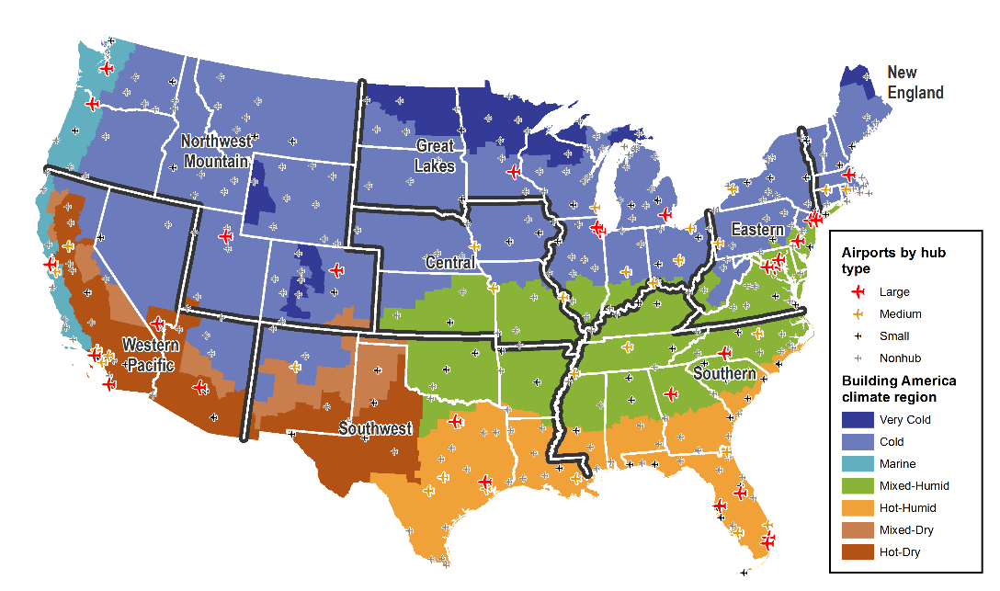
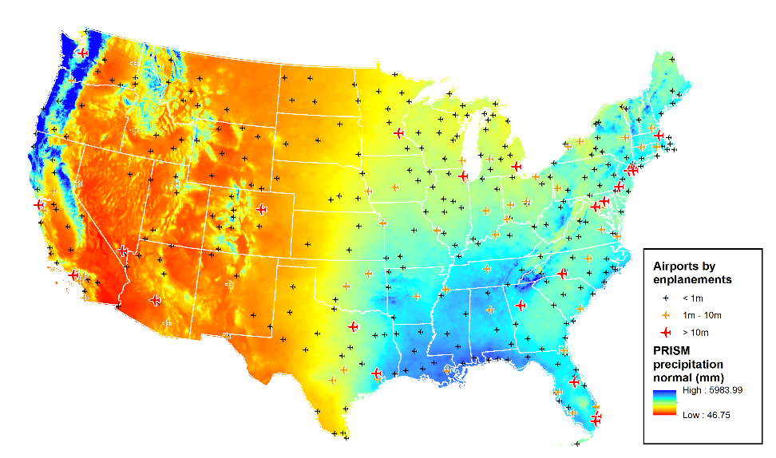
Airports were Selected from Multiple Climate Zones, Precipitation Zones, and FAA Regions

Slide 38
The Tool was Tested at Six Airports
Airport | Facility Name | Type | 2013 Enplanements | FAA Region | Climate Zone
SMO | Santa Monica Municipal | General Aviation | 3,529 | Western- Pacific | Mixed-Dry/Hot-Dry
PAH | Barkley Regional | Primary Nonhub | 20,523 | Southern | Mixed-Humid
MHT | Manchester-Boston Regional | Primary Small | 1,190,082 | New England | Very Cold/Cold
ATL | Atlanta Hartsfield-Jackson International | Primary Large | 45,308,685 | Southern | Hot-Humid
MSP | Minneapolis-St Paul International | Primary Large | 16,282,038 | Great Lakes | Very Cold/Cold
PHX | Phoenix Sky Harbor International | Primary Large | 19,525,829 | Western- Pacific | Mixed-Dry/Hot-Dry

Slide 39
Interviews were Conducted at the Six Pilot Test Airports, Plus Nine Additional Airports
Airport | Facility Name | Type | 2013 Enplanements | FAA Region | Climate Zone
VCT | Victoria Regional | Nonprimary Commercial Service | 3,288 | Southwest | Hot-Humid
PHF | Newport News/Williamsburg International | Primary nonhub | 264,279 | Eastern | Mixed-Humid
OTH | Southwest Oregon Regional | Primary nonhub | 16,864 | Northwest Mountain | Marine
TUL | Tulsa International | Primary small | 1,323,943 | Southwest | Mixed-Humid
ELP | El Paso International | Primary small | 1,363,258 | Southwest | Mixed-Dry/Hot-Dry
AUS | Austin-Bergstrom International | Primary medium | 4,902,080 | Southwest | Hot-Humid
PVD | Providence T. F. Green Airport | Primary medium | 1,885,232 | New England | Very Cold/Cold
RDU | Raleigh-Durham International | Primary medium | 4,482,973 | Southern | Mixed-Humid
SFO | San Francisco International | Primary large | 21,706,567 | Western- Pacific | Marine

Slide 40
The Guidebook and Toolbox were Ground Tested by Environmental Managers at 4 Airports
Dallas/Fort Worth International Airport.
San Diego County Regional Airport Authority.
San Francisco International Airport.
Aviation Division of the Port Authority of New York and New Jersey.

Slide 41
The products created by ACRP 02-59 will help airports design, implement, evaluate, and maintain a water efficiency management program, including developing water use baselines and water efficiency targets

Slide 42
Water Efficiency Management Strategies for Airports
Thanks!
Richard A. Krop, Ph.D., Principal Investigator
The Cadmus Group, Inc.

