Slide 1
UK automotive innovation Overview
BEIS Automotive Unit
18 July 2022
Vision and Objectives
Notes:
Cover style

Slide 2
1. Overview of the UK automotive industry 2. Policy challenges and HMG response
Vision and Objectives
Notes:
Cover style

Slide 3
1. Overview of the UK automotive industry
Vision and Objectives
Notes:
Cover style

Slide 4
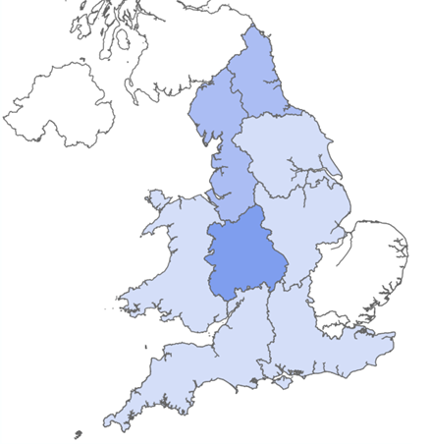
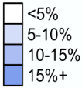
The UK automotive industry
Employment
Regional impact
Size and structure
% of total automotive employment
Employs 169,000 directly
Additional 284,000 indirectly
£16bn GVA
8.4% of UK manufacturing GVA
90% of employment outside London /South East
8/10 cars made in the UK are exported
47.3% going to the EU.
9/10 cars sold in the UK are imported
Annual pay 20% higher than national average
Productivity 42% higher than UK average
£3.8bn invested in R&D p.a. 15% of UK total & focused decarbonisation & Net Zero

Slide 5
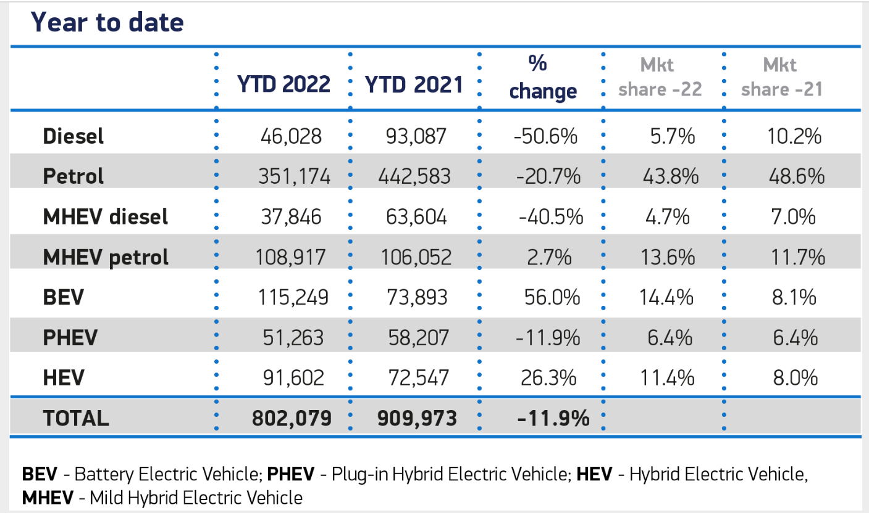
Car registrations in the UK

Slide 6
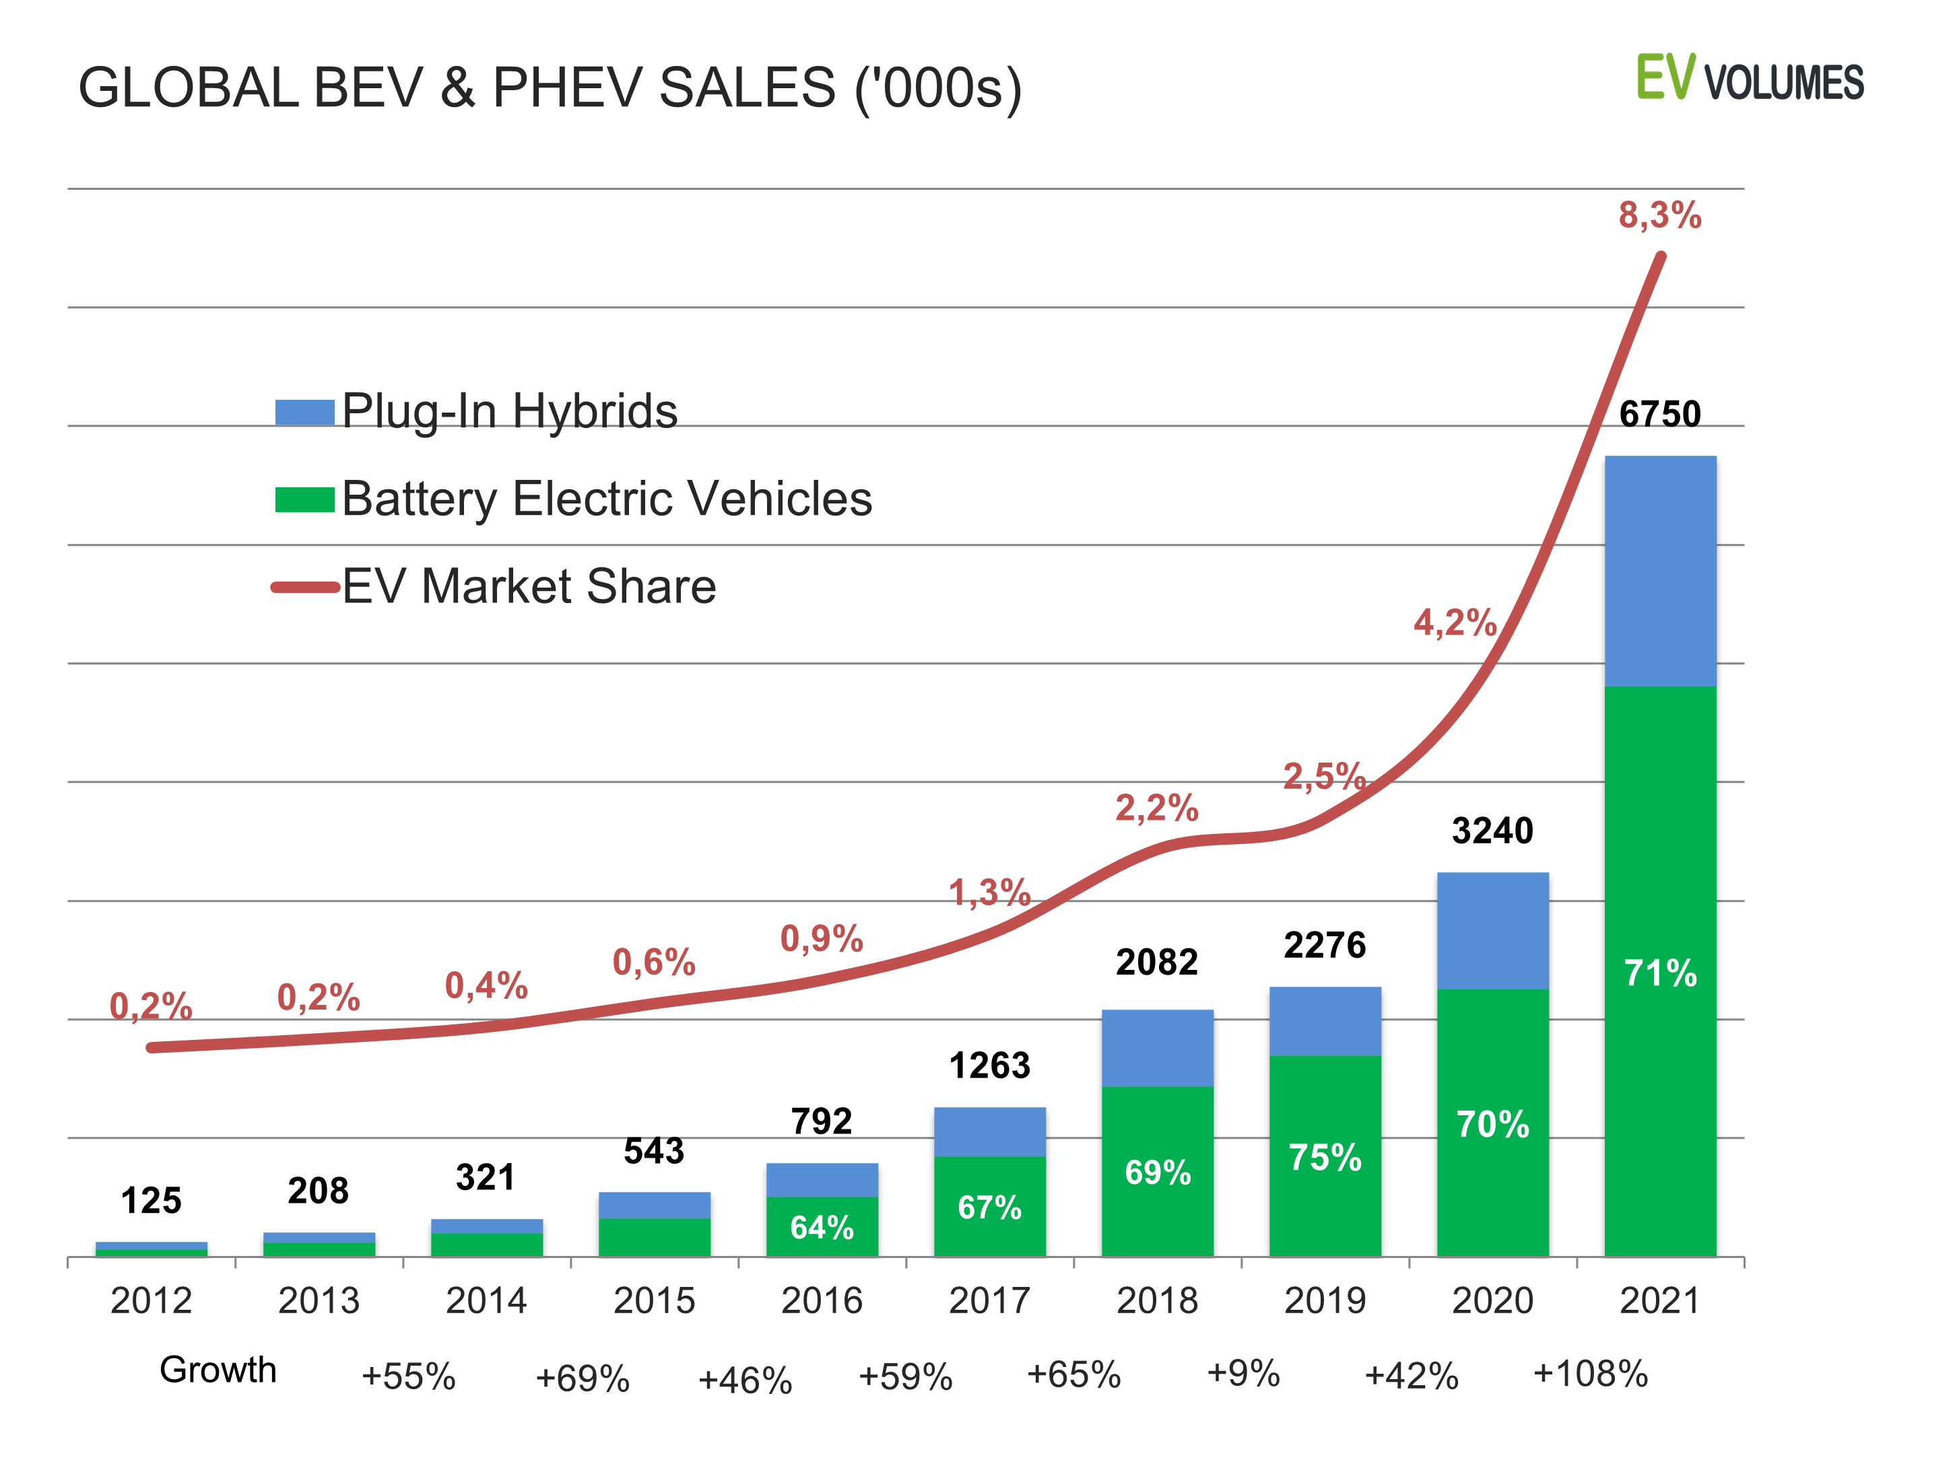
Grow in EV market demand globally
Source: EV-Volumes.com

Slide 7
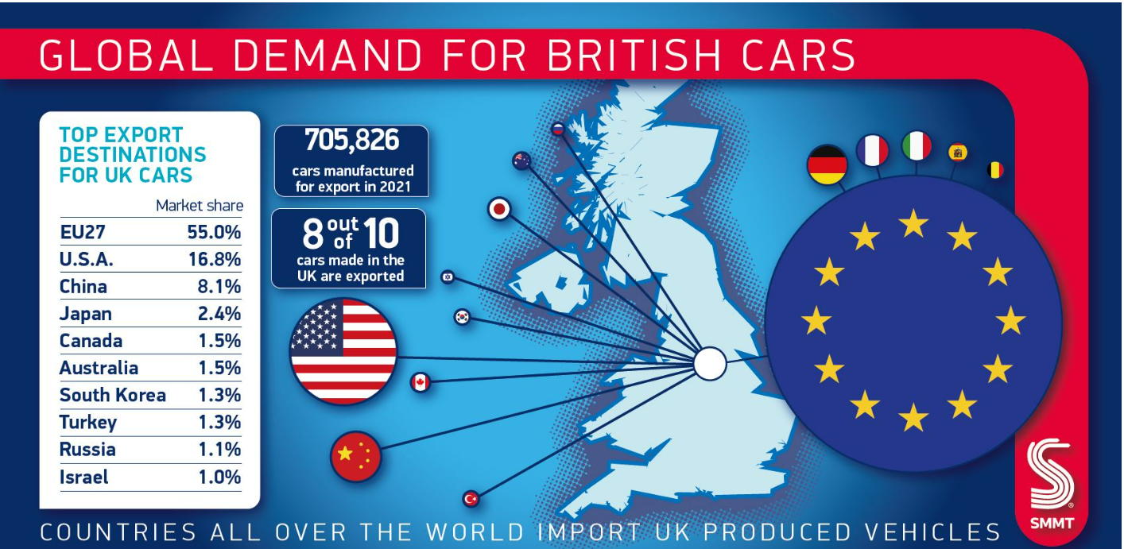
UK export profile

Slide 8
UK/USA trade – details
Export | Import
Over £8.3 billion Worth of exports which equals to 20.6% of total exports from the UK | Over £1 billion Worth of imports which equals to 1.8% of total imports to the UK
Over £7.4 billion Worth of finished vehicles exported from the UK | Over £130 million Worth of finished vehicles imported to the UK
Over £974 million Worth of components exported from the UK | Over £952 million Worth of components imported to the UK
0.96%
1.05%
4.25%
86.26%
5.77%
6.48%
10.50%
13.17%
24.54%
Source: ITC Trade Map 2018

Slide 9
2. Policy challenges and HMG response
Vision and Objectives
Notes:
Cover style

Slide 10
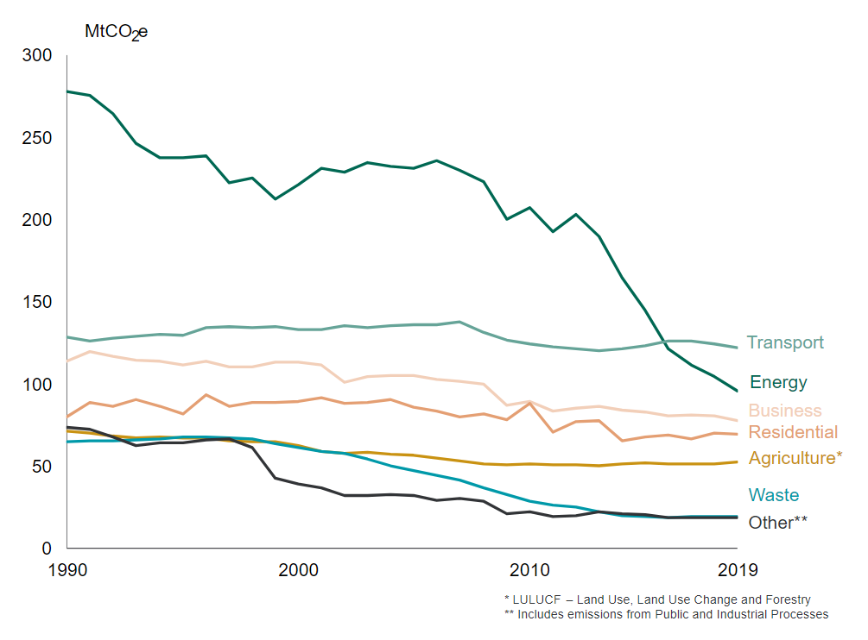
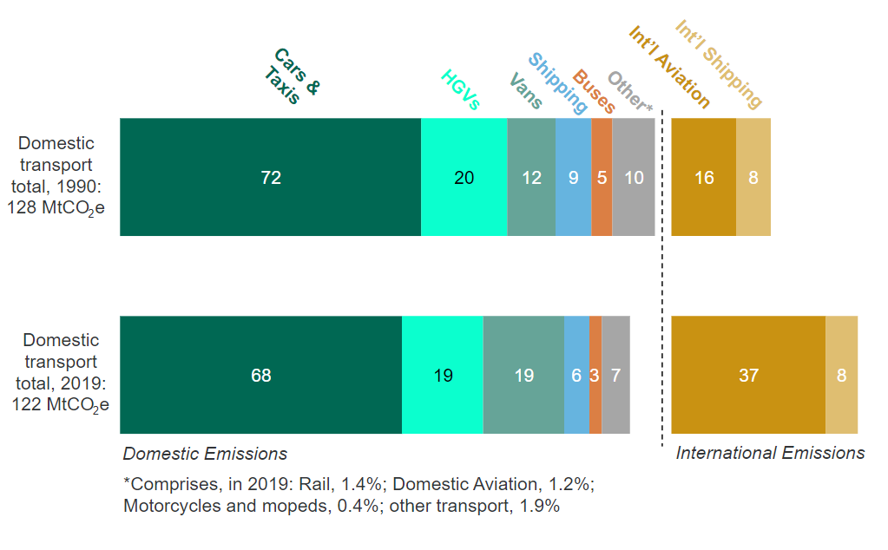
Transport, the most significant emitter
Source: Department for Transport, 2021
Source: Department for Transport, 2021

Slide 11
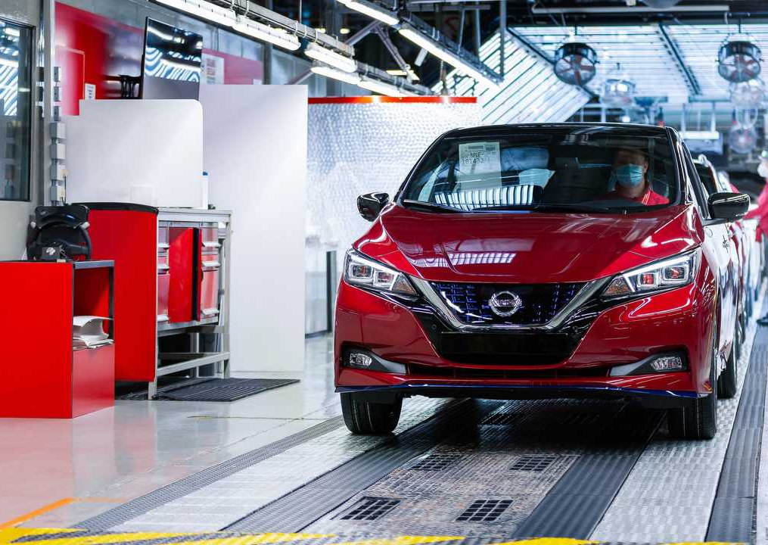
Government action so far
The UK is the first major economy to commit to a net zero target by 2050.
As part of the 2020 Ten Point Plan for a Green Industrial Revolution, we will invest £12 billion by 2030. The 2021 Net Zero Strategy builds on this.
We are ending sales of new petrol and diesel engine cars and vans in 2030. All new cars and vans will be zero emission by 2035.
We are accelerating electrification, investing over £5 billion across infrastructure, manufacturing and research & development.
Thanks to our policies and to Government and industry investments, over 1 in every 6 cars sold in the UK now has a plug.

Slide 12
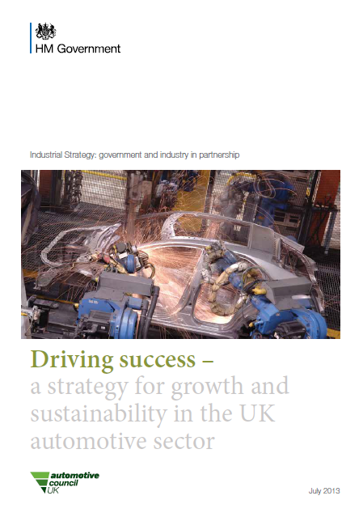
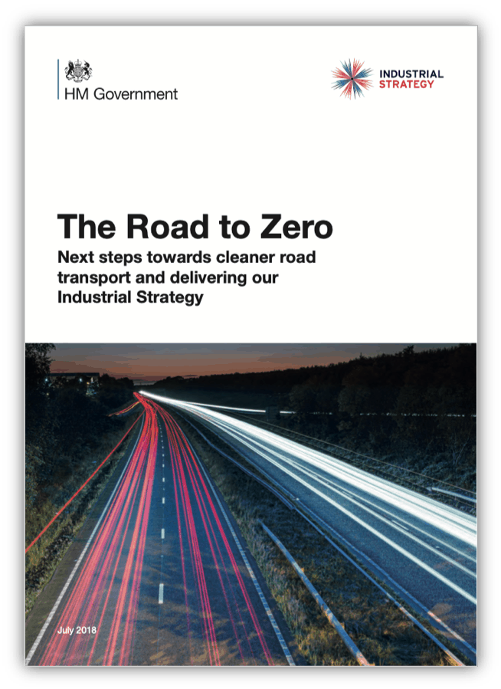
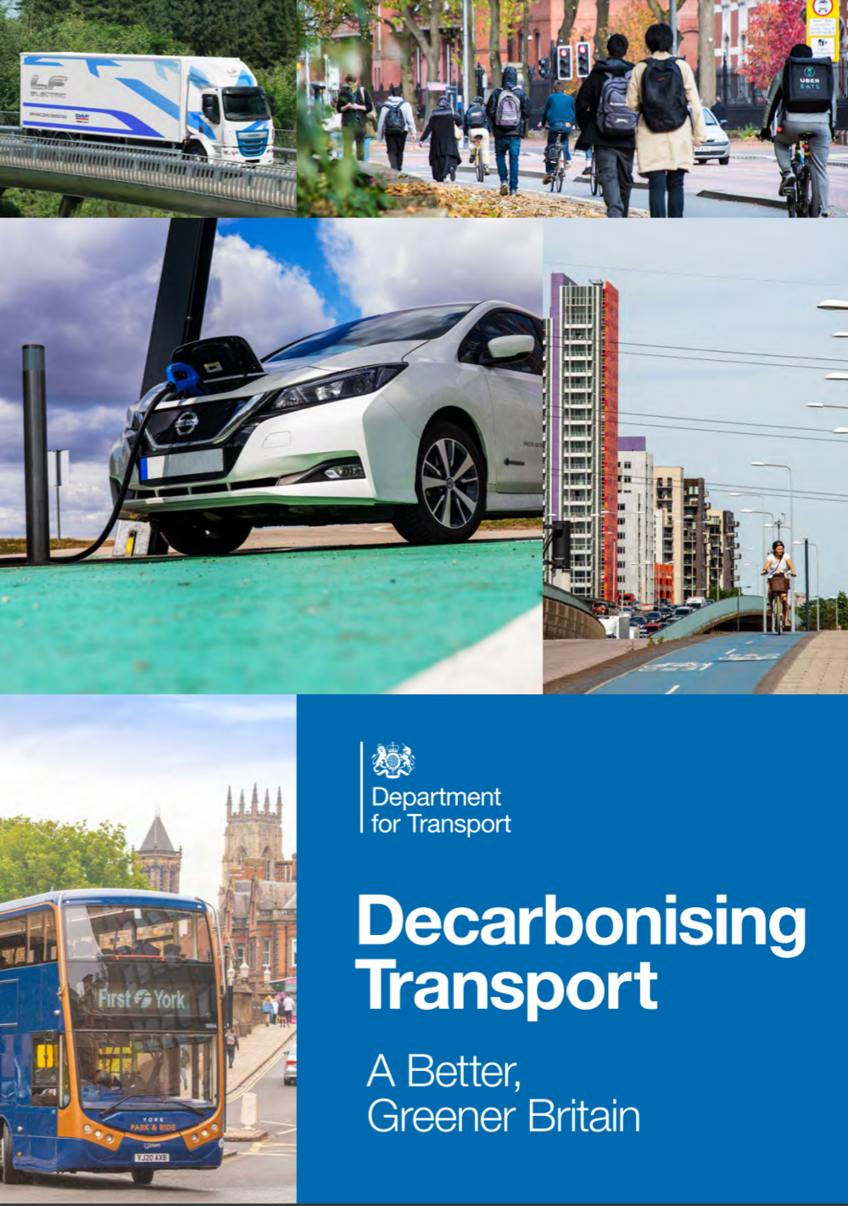
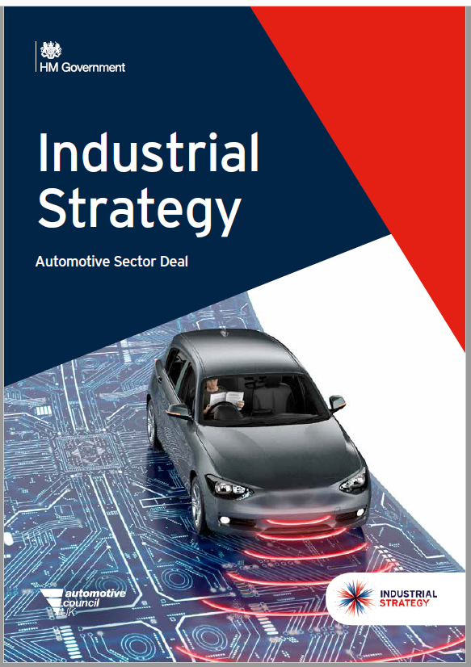
An ambitious strategic framework
2015
Paris Agreement
2019
UK Net Zero
2021
COP26

Slide 13
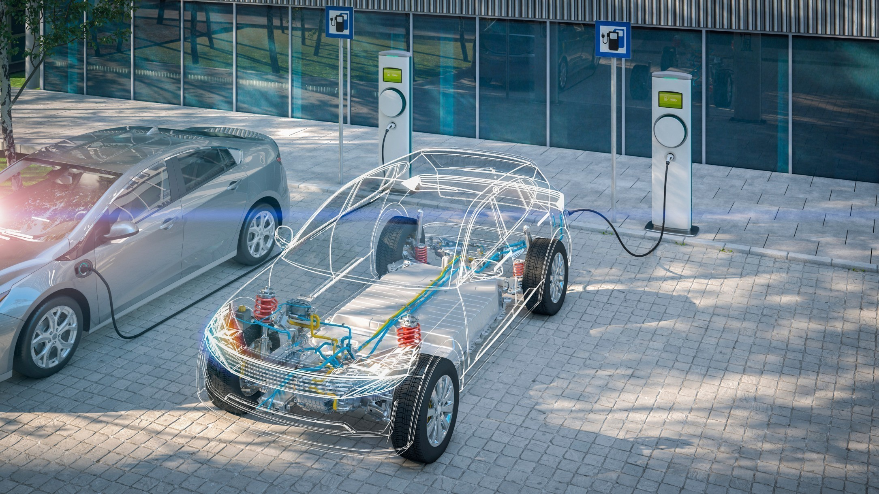
The UK Government has committed over £5 billion in infrastructure, R&D, driving demand and supply-side support.⁵
Creating the right regulatory environment including 2030 Phase Out, Zero Emission Vehicle (ZEV) mandate, infrastructure provision
Learning from industry to understand and develop supply chain plans for key areas
Encourage innovation, efficiency and keep costs low through funding
Invest in our UK skills and capability through green skills programmes, such as our Lifetime Skills Guarantee
The UK is investing heavily into electrification
£318m
Faraday Battery Challenge ZEV battery development¹
£1bn
Advanced Propulsion Centre
£80m
Driving the Electric
Revolution – power
electronics, electric
drivetrains²
£2.5bn
Office for Zero Emission Vehicles (OZEV) funding for R&D, infrastructure and purchase grants³
£850m
Automotive Transformation Fund⁴
£440m
Connected Automated Vehicle Technology

Slide 14
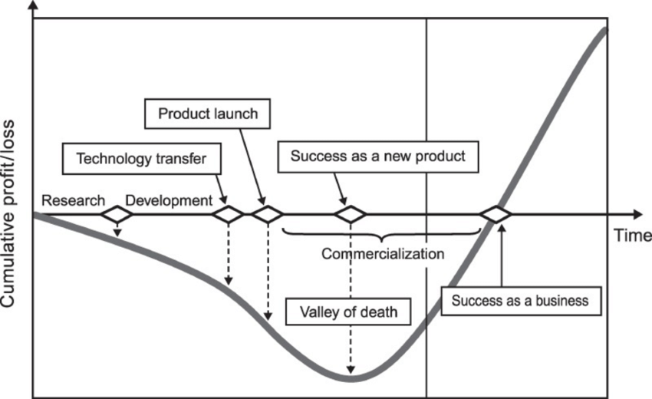
Government intervention so far
TRL 1 | TRL 2 | TRL 3 | TRL 4 | TRL 5 | TRL 6 | TRL 7 | TRL 8 | TRL 9
New idea, model or approach
Pilot project
Scale up
Multiple impacts across the supply chain, spillovers
Source: Osawa and Miyazaki (2011)

Slide 15
The role of Research Councils

Slide 16
Government intervention so far
TRL 1 | TRL 2 | TRL 3 | TRL 4 | TRL 5 | TRL 6 | TRL 7 | TRL 8 | TRL 9
Technology demonstrations, proof of concept and other collaborative research and development
Capital investment, Feasibility studies & scale up validation
Early stage research, generating a pipeline of mid-TRL projects
Late stage collaborative research and development

Slide 17
Government intervention so far
TRL 1 | TRL 2 | TRL 3 | TRL 4 | TRL 5 | TRL 6 | TRL 7 | TRL 8 | TRL 9
Early stage R&D
Technology demonstrations, proof of concept etc. in cooperation with IUK
Capital investment, feasibility studies and scale up validation

Slide 18
Government intervention so far
TRL 1 | TRL 2 | TRL 3 | TRL 4 | TRL 5 | TRL 6 | TRL 7 | TRL 8 | TRL 9
A UK-wide project developing the UK's clean and resilient supply chains in power electronics, machines and drives (PEMD).
Collaborative research and innovation

