Slide 1
The Connected Customer
Andy Fisher
18.07.2022

Slide 2
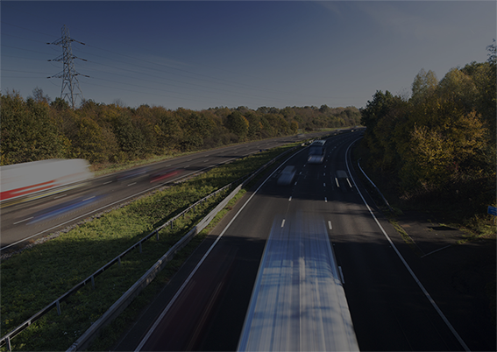
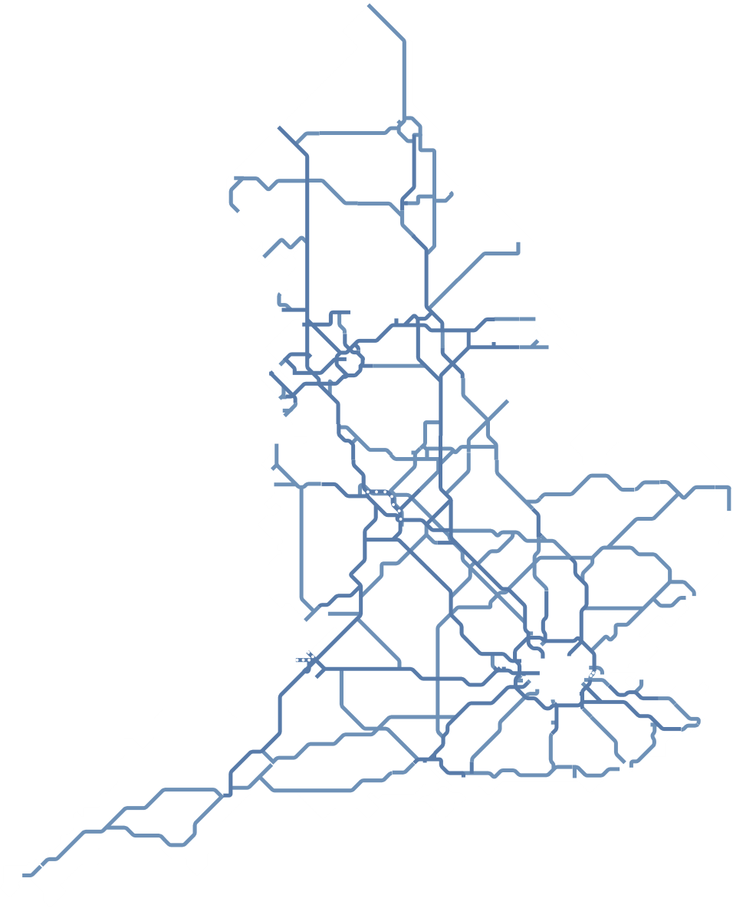





Our road network
We manage and improve over 4,300 miles of motorways and major
roads in England known as the strategic road network
10,000
miles of carriageways
20,000
bridges and other structures
100,000
street lights
150,000
signs
3,500
electronic messaging signs
100,000
sensors, including traffic sensors
4,300
miles of motorway and major A-road

Slide 3
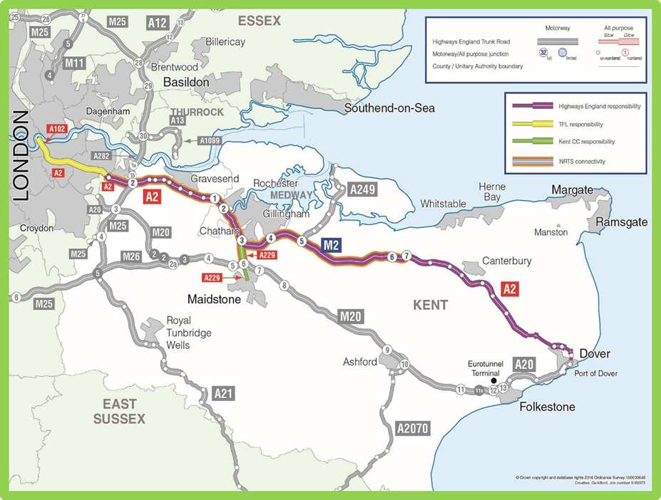



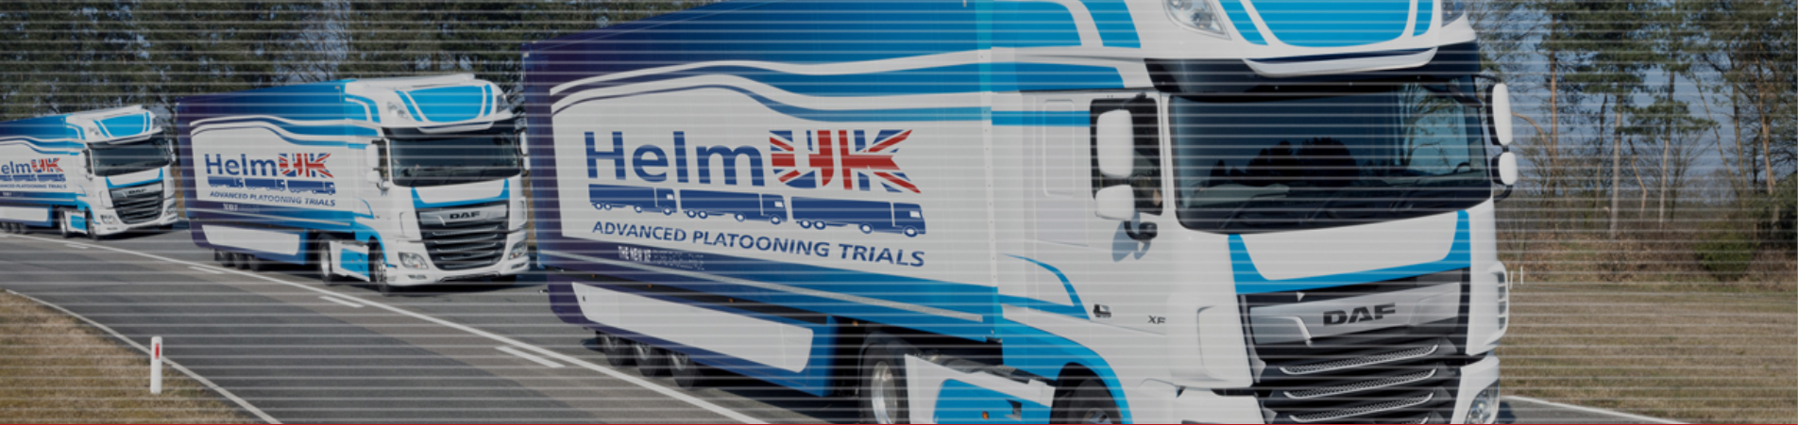



CAVIAR
Data for Road Safety
CEDR

Slide 4
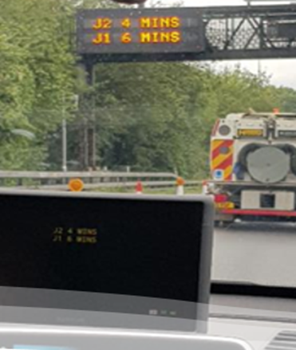
Connected Services Roadmap
Digital for Customer
Customer
OEMs and wayfinders
National Highways
Connected services developed and output
OEMs and wayfinders
Connected services delivered to customer
Connected customer:
journey/
mobile
satnav
vehicle
safety data
ITSG5 V 5G

Slide 7
Thank you
Any questions?

