Slide 1
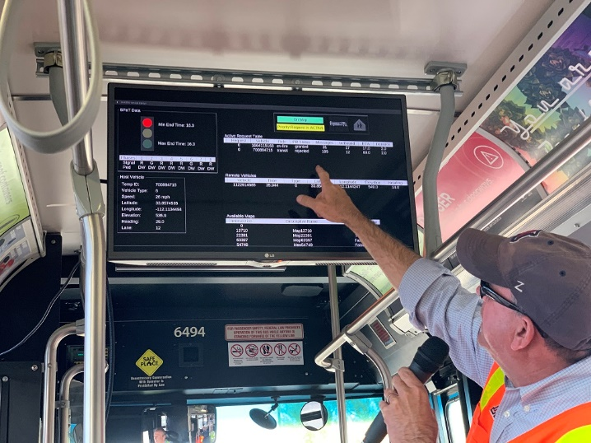
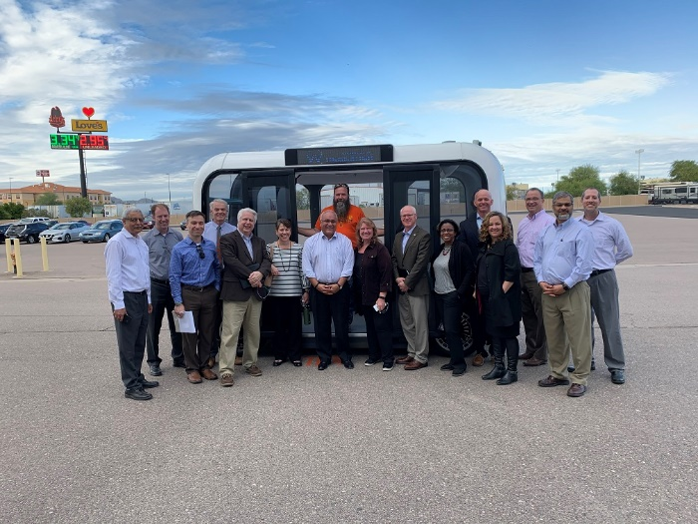
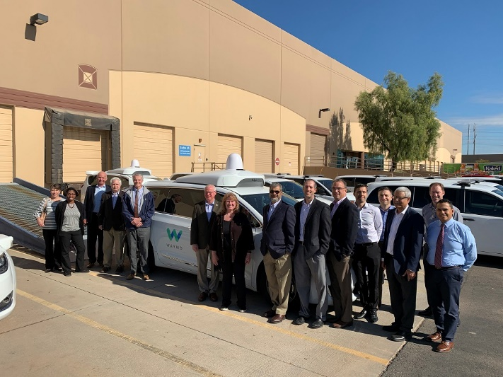
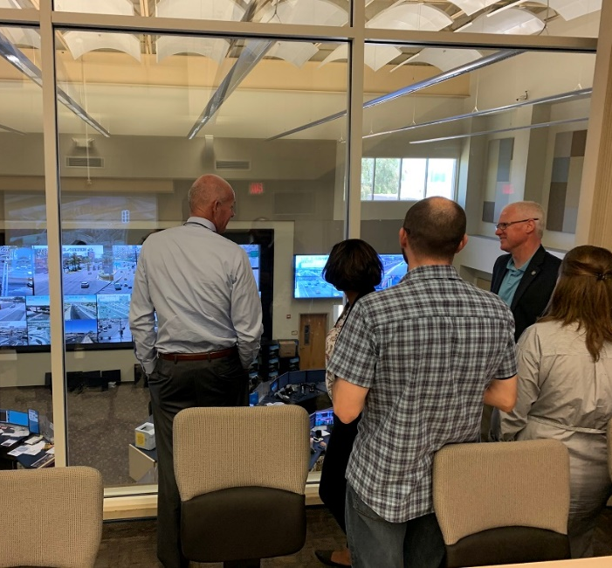
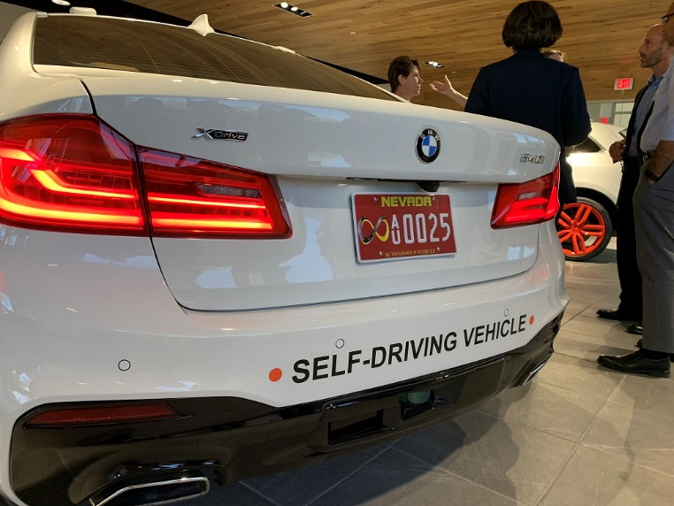
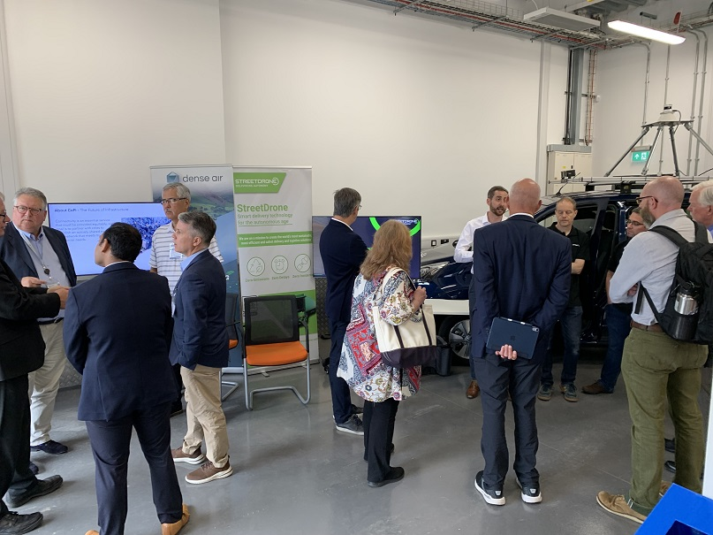
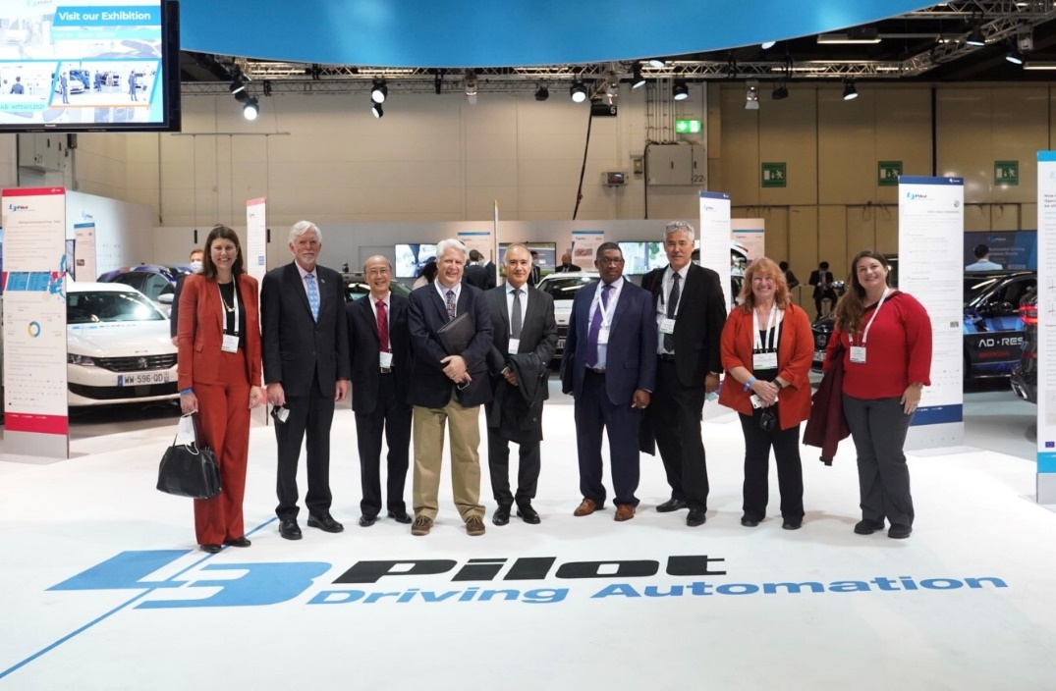
NCHRP 20-24 (128)
State-of-the-Art Review of Cooperative Automated Transportation Systems
September 2022 Update

Slide 2
NCHRP 20-24(128) Panel Representation
State & Local DOT CEOs
Associations and Industry
Delaware
Georgia
Iowa
Kansas
Maricopa County (AZ)
Missouri
New Hampshire
Utah
Washington
AASHTO
Amazon Web Services
FHWA
ITS America
TRB/NCHRP
WSP (contractor)

Slide 3
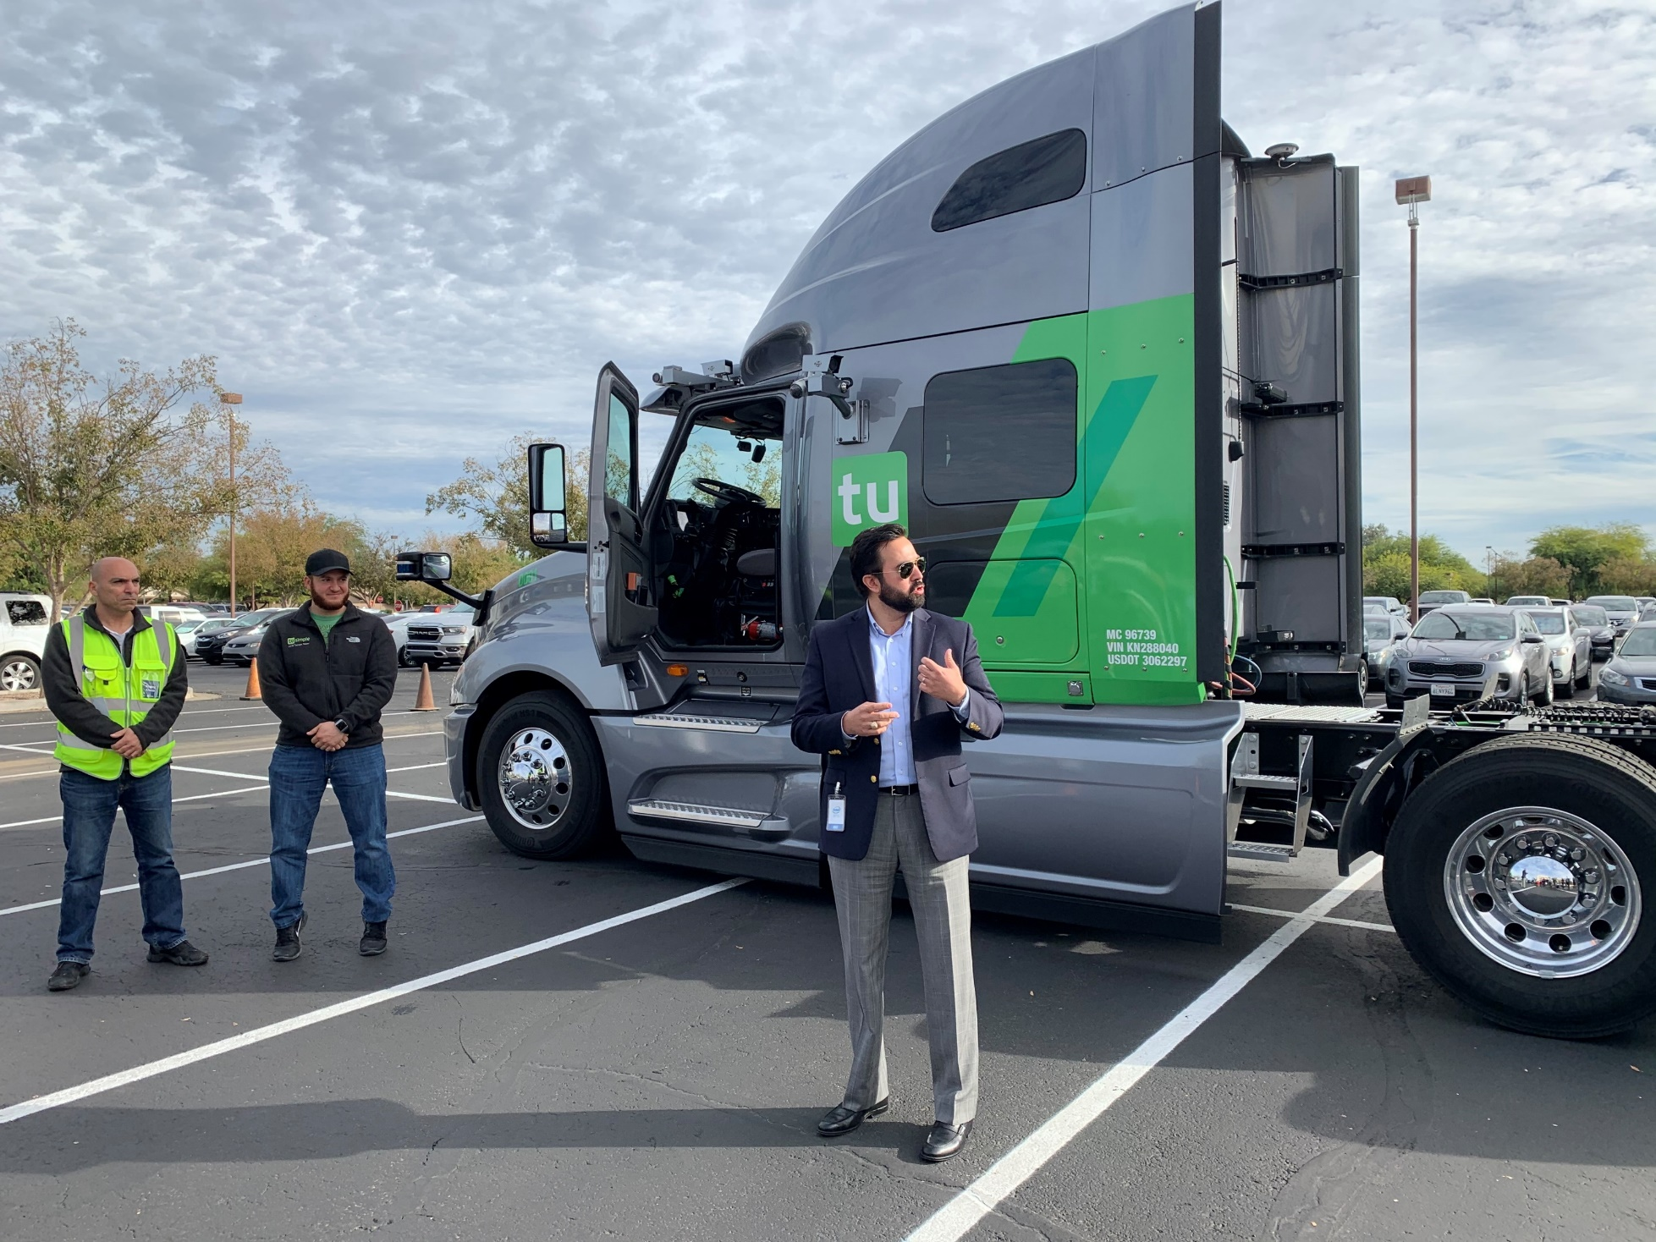
Domestic Exploration
Infrastructure Owners/Operators
States: Arizona, California, Florida, Nevada, Utah
Locals: Maricopa County (AZ), Metroplan Orlando (FL), Oakland County (MI), RTC of Southern Nevada (NV)
Cities/MPOs: Chandler (AZ), Las Vegas (NV), Marysville (OH), Scottsdale (AZ), Tempe (AZ)
Private Companies
Aptiv, Argo AI, Aurora, Beep, Cavnue, Cruise, Exponent, FedEx, Gatik, Intel, Keolis, Local Motors, Robotic Research, State Farm, TuSimple, Waycare, Waymo
Academic Institutions
University of Florida, University of Arizona

Slide 4
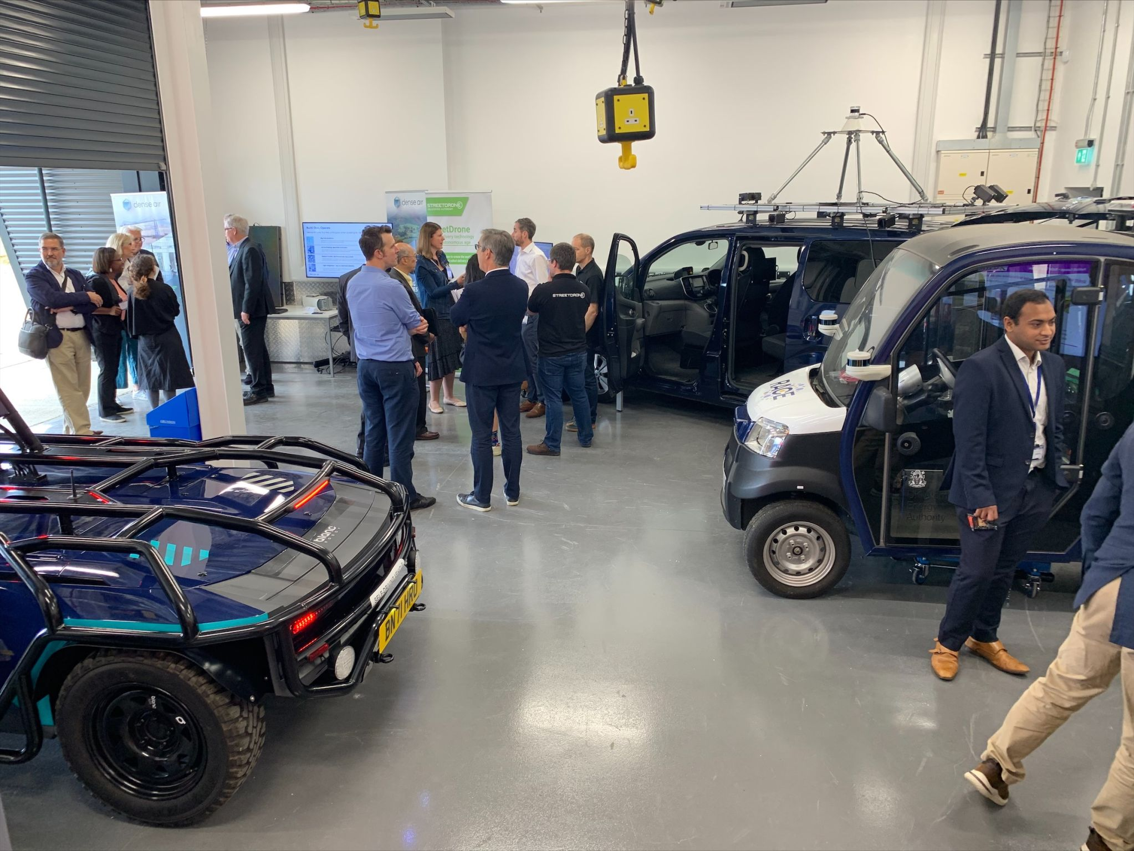
International Exploration
Infrastructure Owners/Operators
Department for Transport (UK), National Highways Agency (UK), Oxfordshire County Council (UK), Transport for London (UK), Transport for West Midlands (UK), Rijkswaterstaat (Netherlands)
Private Companies
Admiral Insurance, Appyway, Aptiv, Argo AI, BMW, Ford, Horiba Mira, Oxbotica, Toyota, Valerann, Volkswagen, UTAC, Zenzic
Academic Institutions & Associations
British Standards Institute (UK), Connekt (NL), National Road Data Warehouse (NL), Smart Mobility Living Lab (UK), University of Leeds (UK), University of Oxford (UK), University of Warwick (UK), Würzburg Institute for Traffic Science (DE)

Slide 5
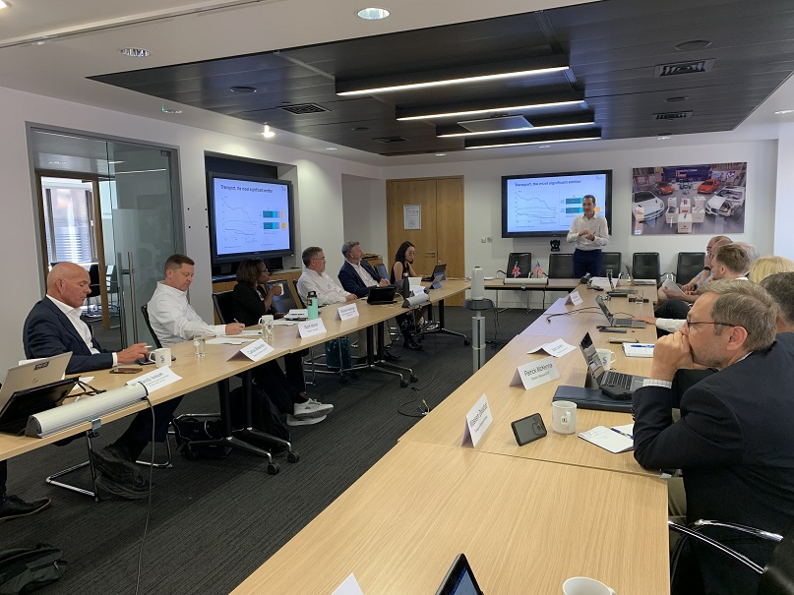
National Organizations & Committees
Key Stakeholder Organizations
National Council of State Legislators
National Governor’s Association
Transportation Committees & Conferences
AASHTO
CAT Coalition
ITS America
TRB
International Groups
CCAV – UK Center for Connected & Autonomous Vehicles
Connekt – Netherlands Mobility Consortium
L3Pilot – Consortium of European Stakeholders
SMMT – UK Society of Motor Manufacturers & Traders

Slide 6
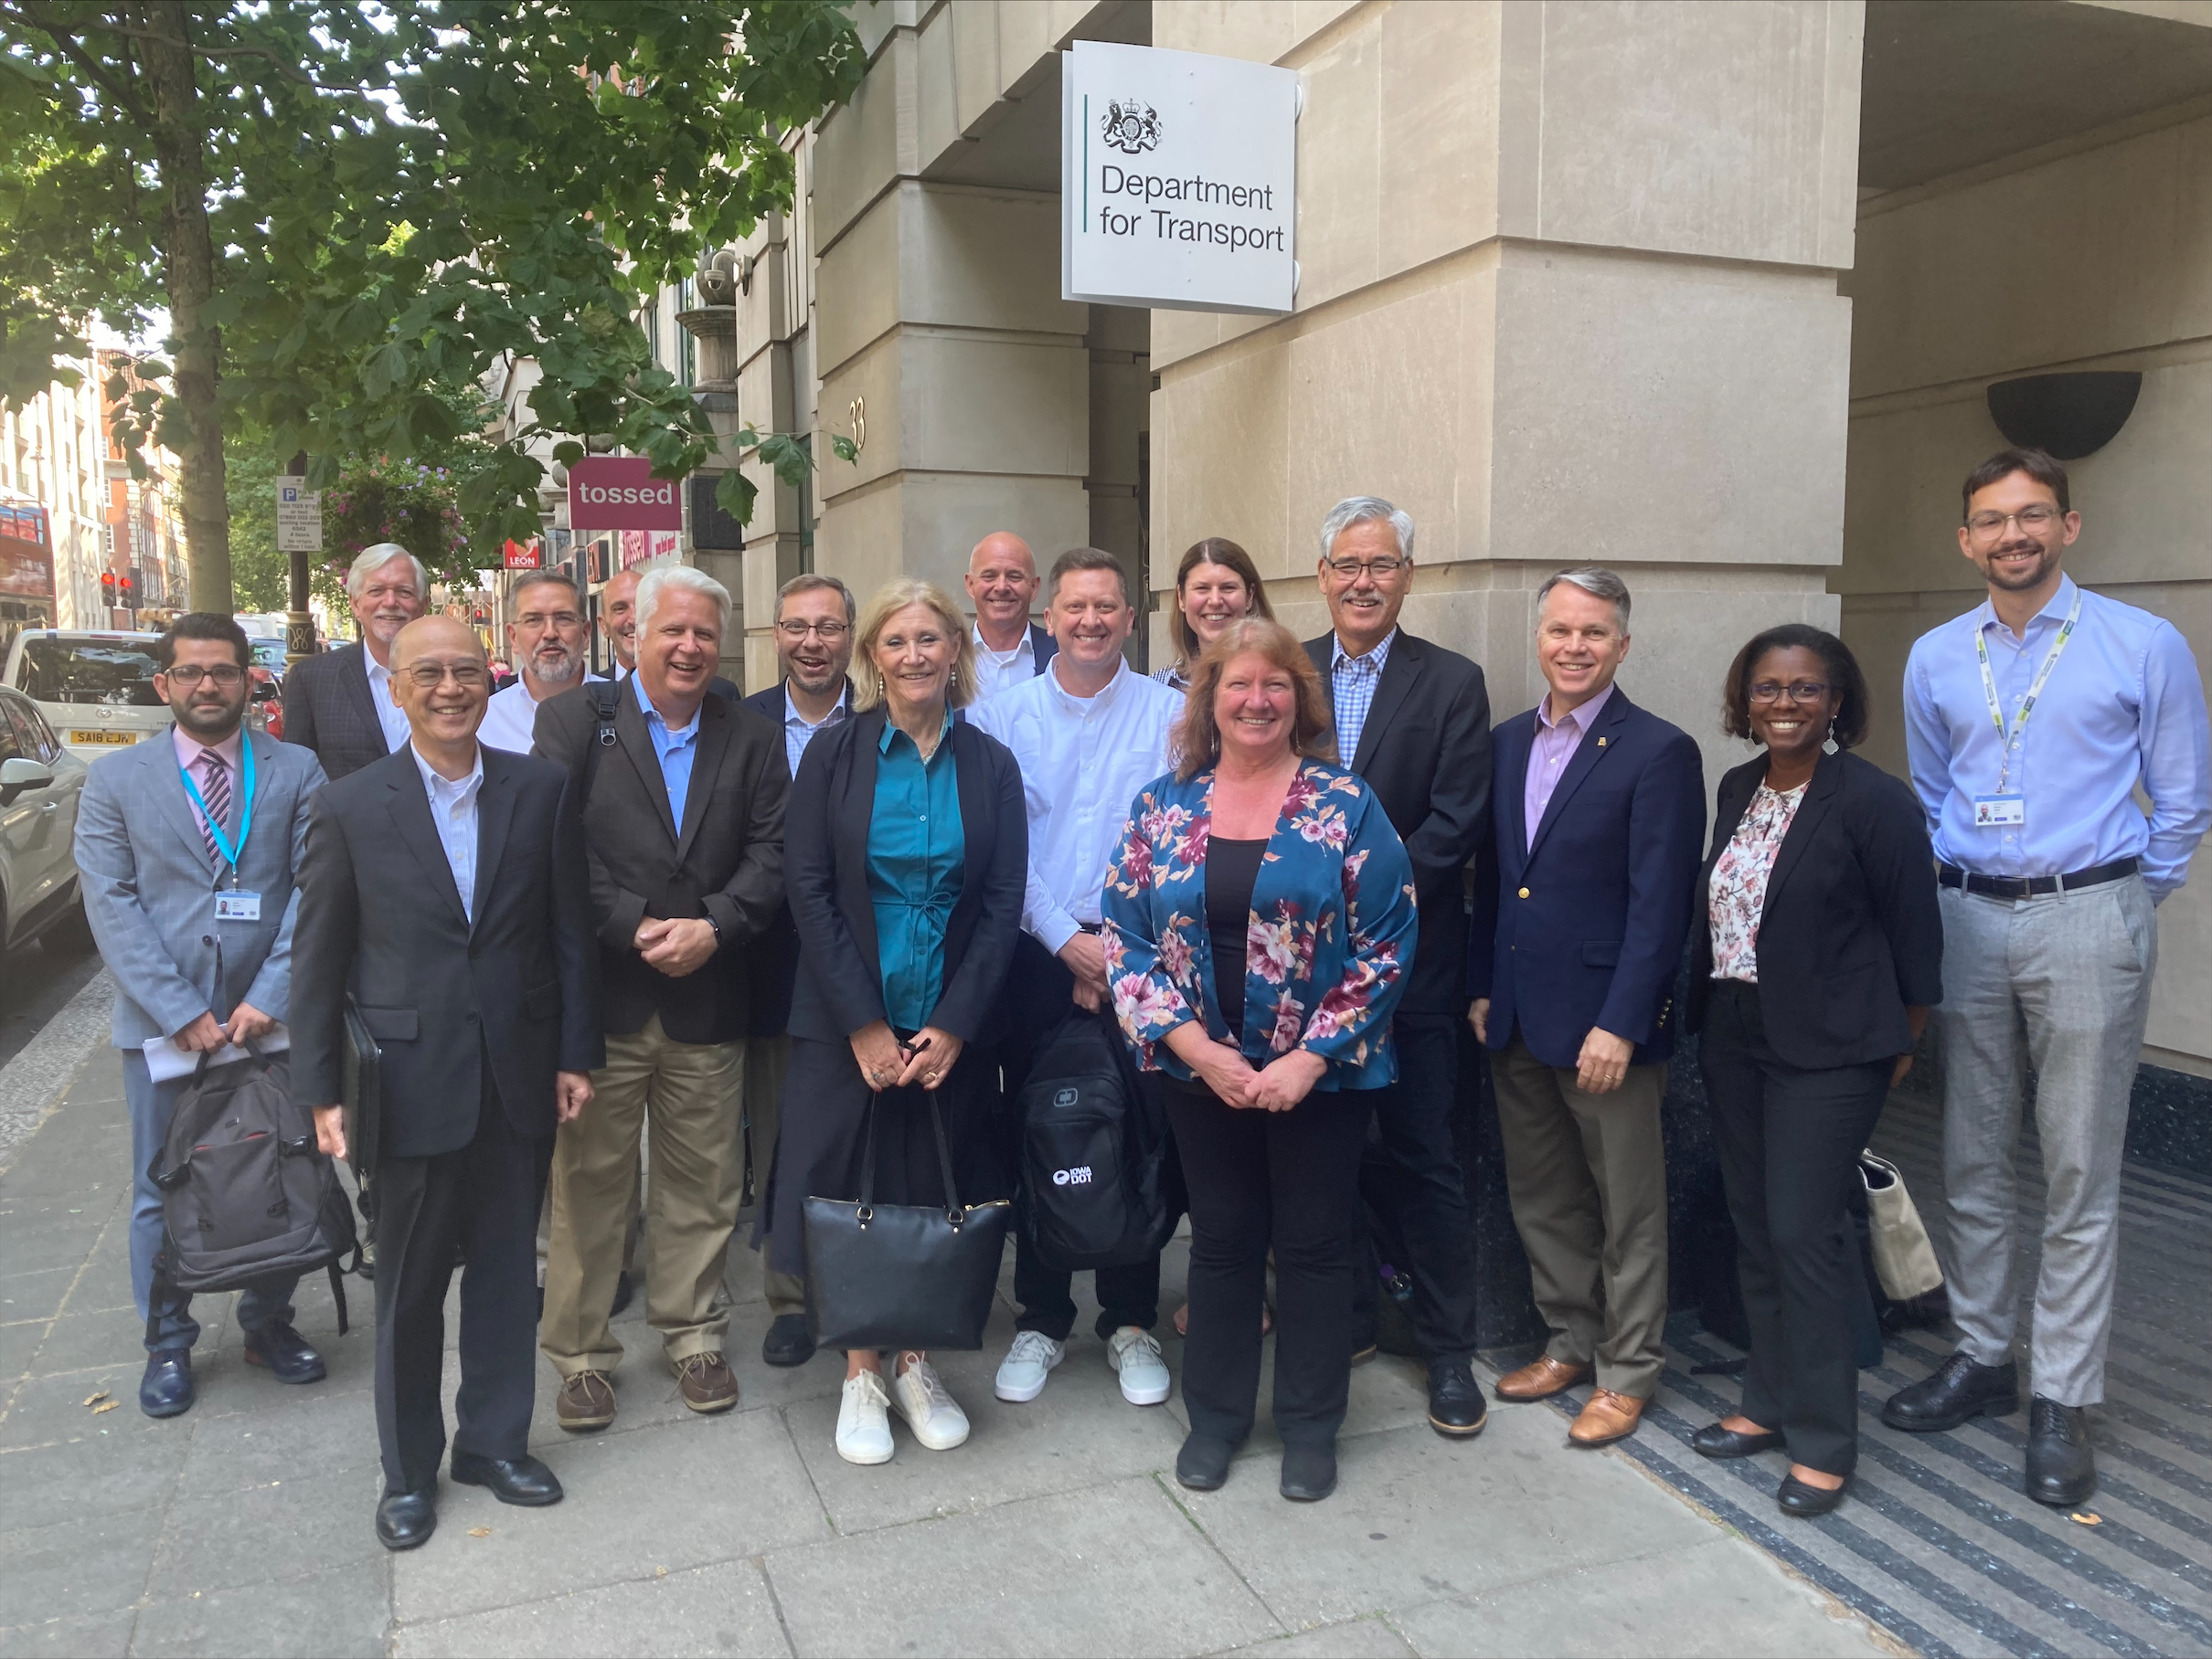
Key Issues & Topic Areas
Vision
Organizational Readiness
Partnerships
Technology & Planning
Institutional
Data
People

Slide 7
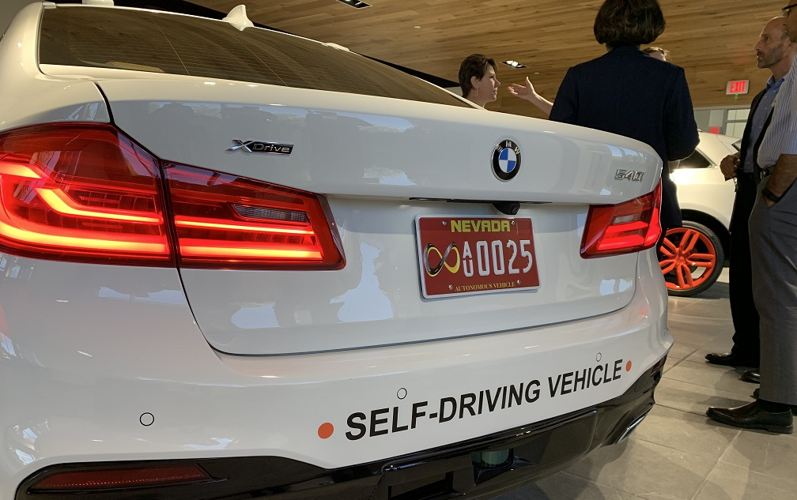
Questions?

Slide 8
Extra Slides

Slide 9
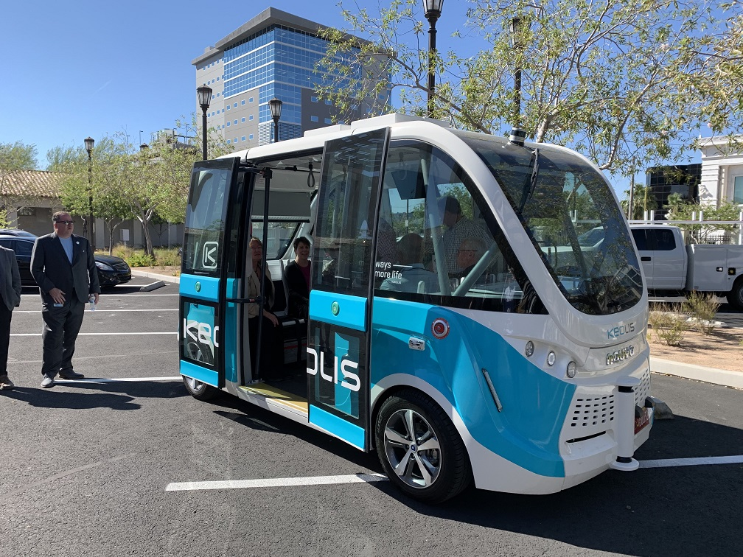
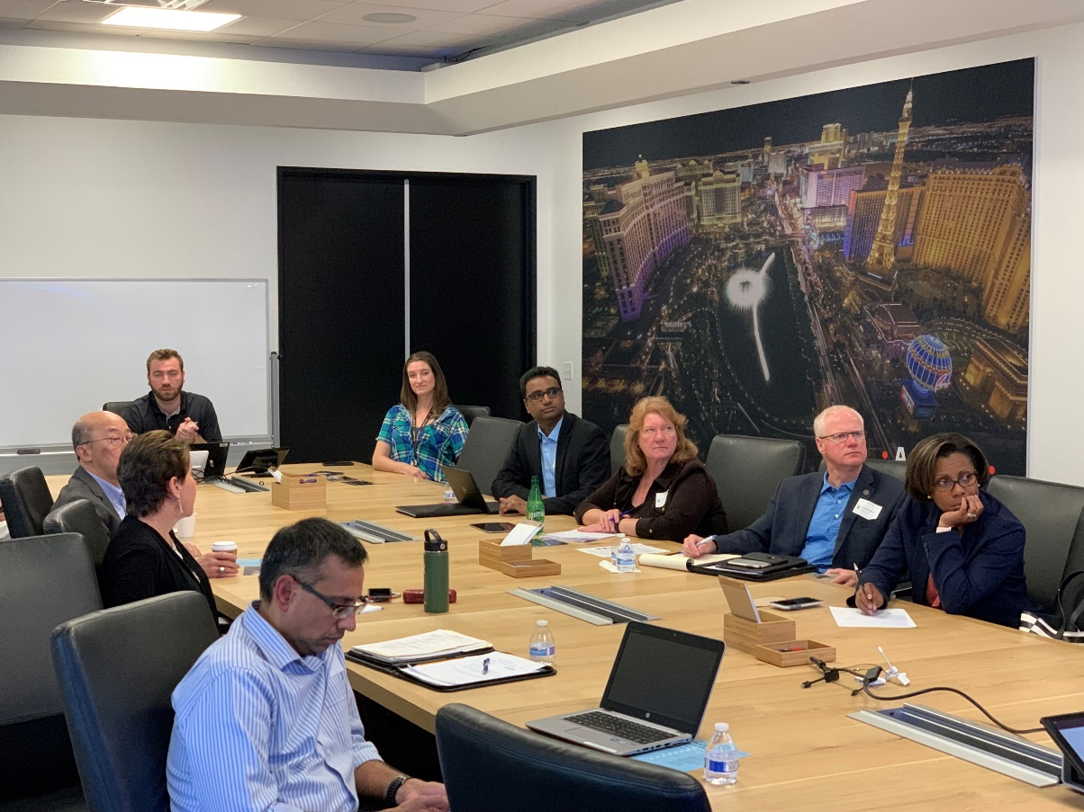
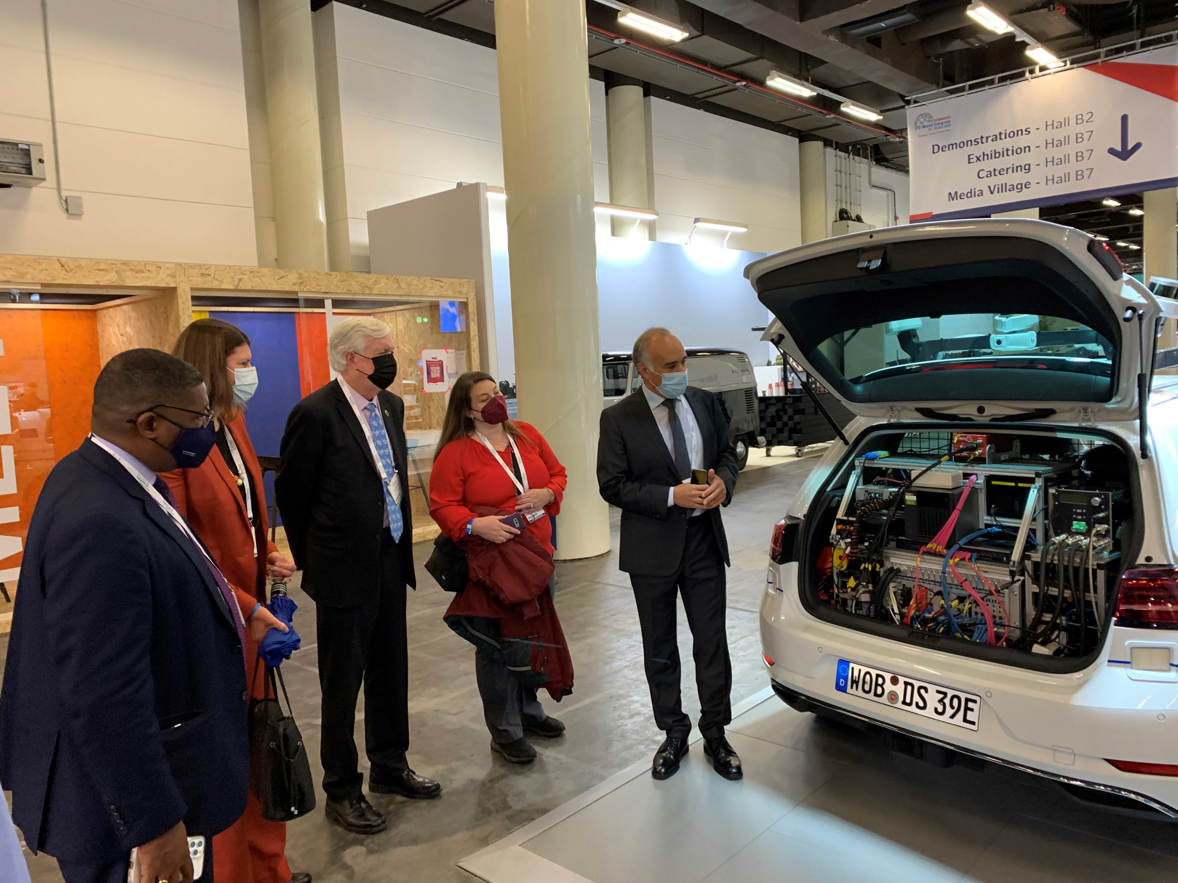
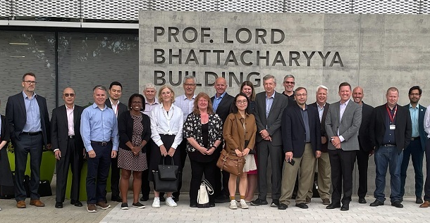
Key Issues & Topic Areas
Vision
AV lacks a singular goal-oriented focus or national vision
Future is important, but don’t lose sight of benefits today
UK government demonstrated the value of establishing milestones and a roadmap
UK also has balanced vision on technology (testing), regulation, and commercialization
Organizational Readiness
Private sector needs will differ
Improve for the human driver improves for the driverless vehicle
No universal definition for readiness
Local governments must be at the table too
UK innovation philosophy: don’t wait for money to turn up, start doing things and money will come

Slide 10
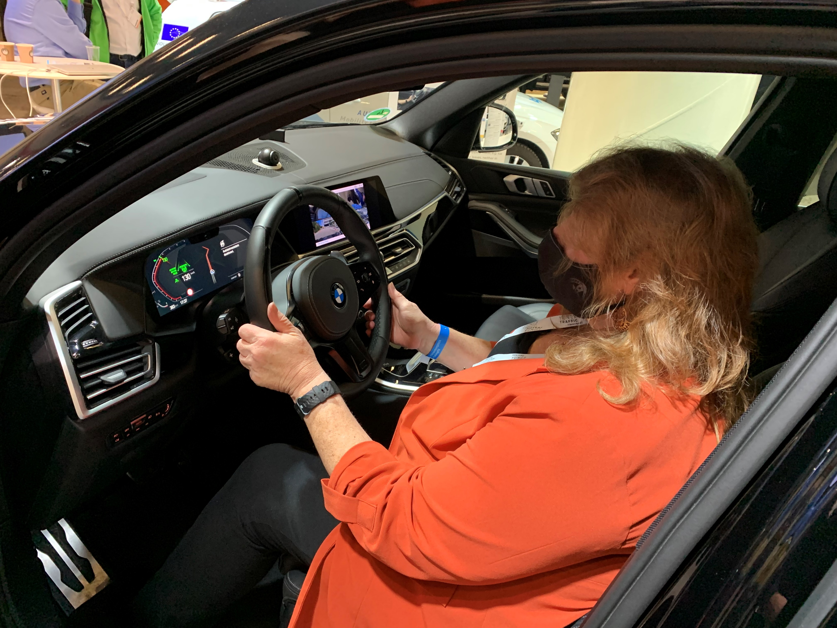
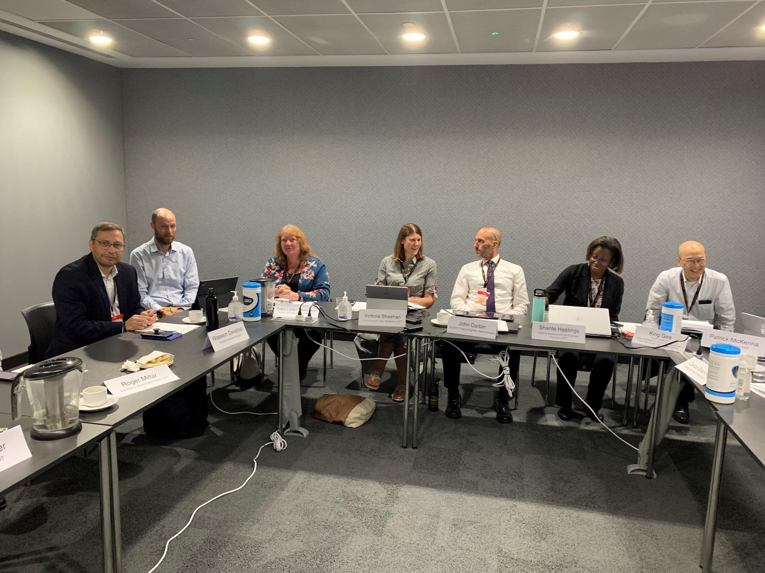
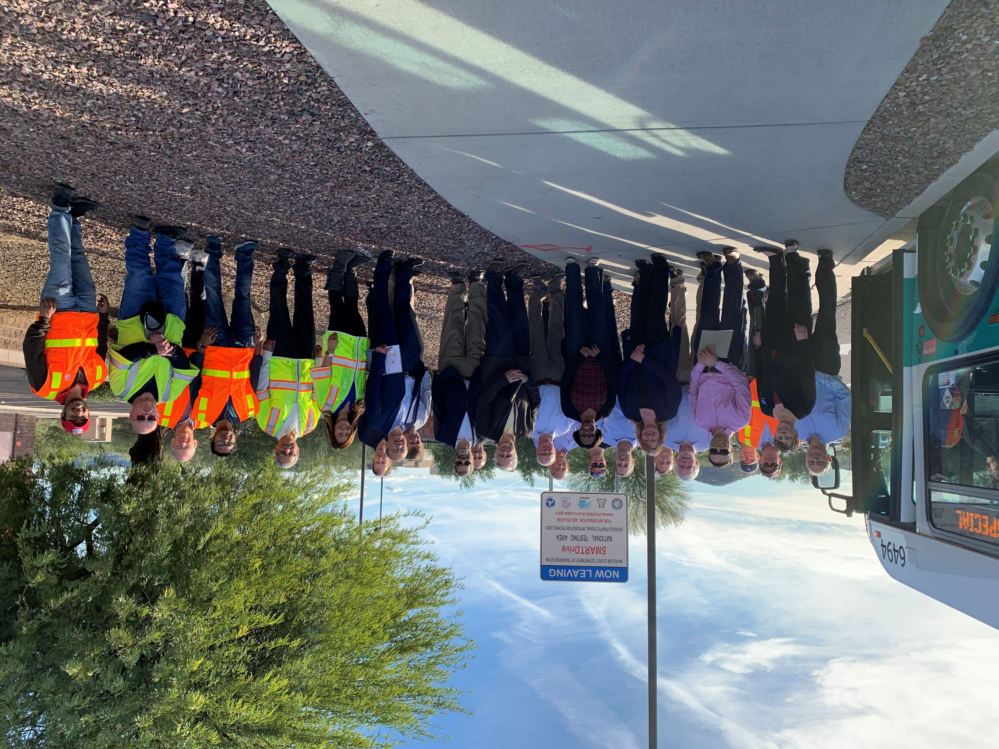
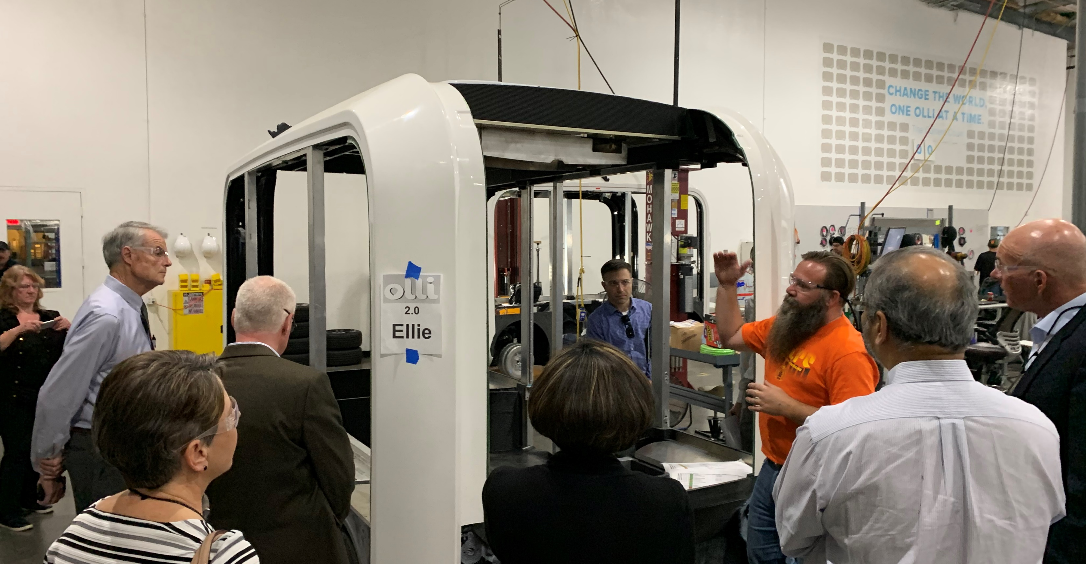
Key Issues & Topic Areas
Partnerships
Cooperation is the new competitive advantage
It’s not healthy to compete on safety
Collaboration between public & private sectors is very strong in the UK as well as throughout Europe
Technology & Planning
Don’t have to solve every problem for every scenario
CV and AV are on separate tracks with many private companies, but not universal
“If you have a robot with wheels, you have a self-driving car; if you add a SIM card, you now have a mobility solution”

Slide 11
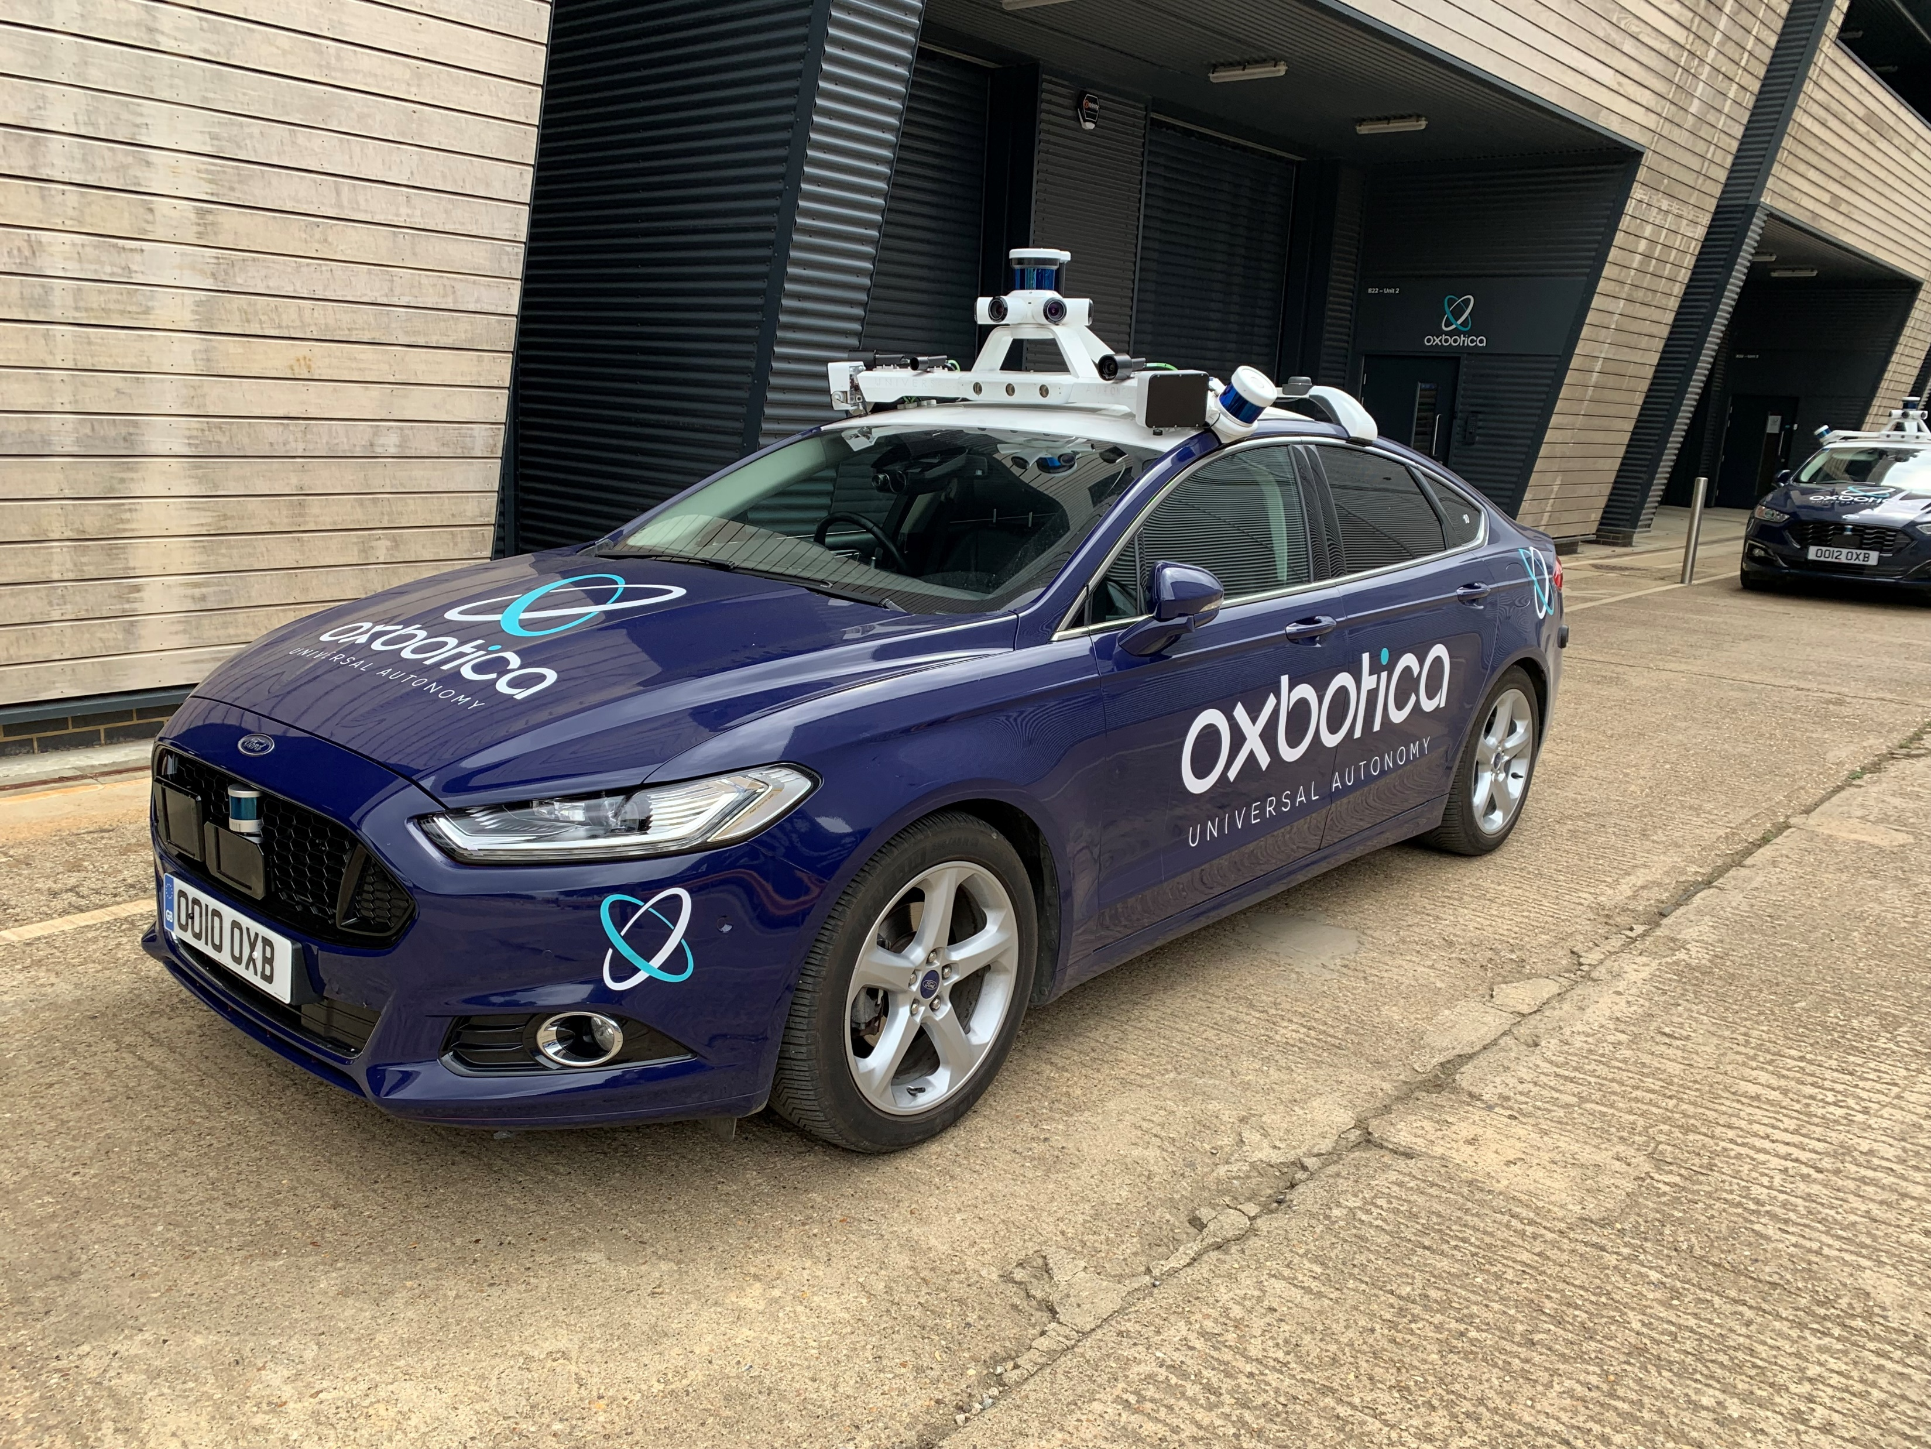
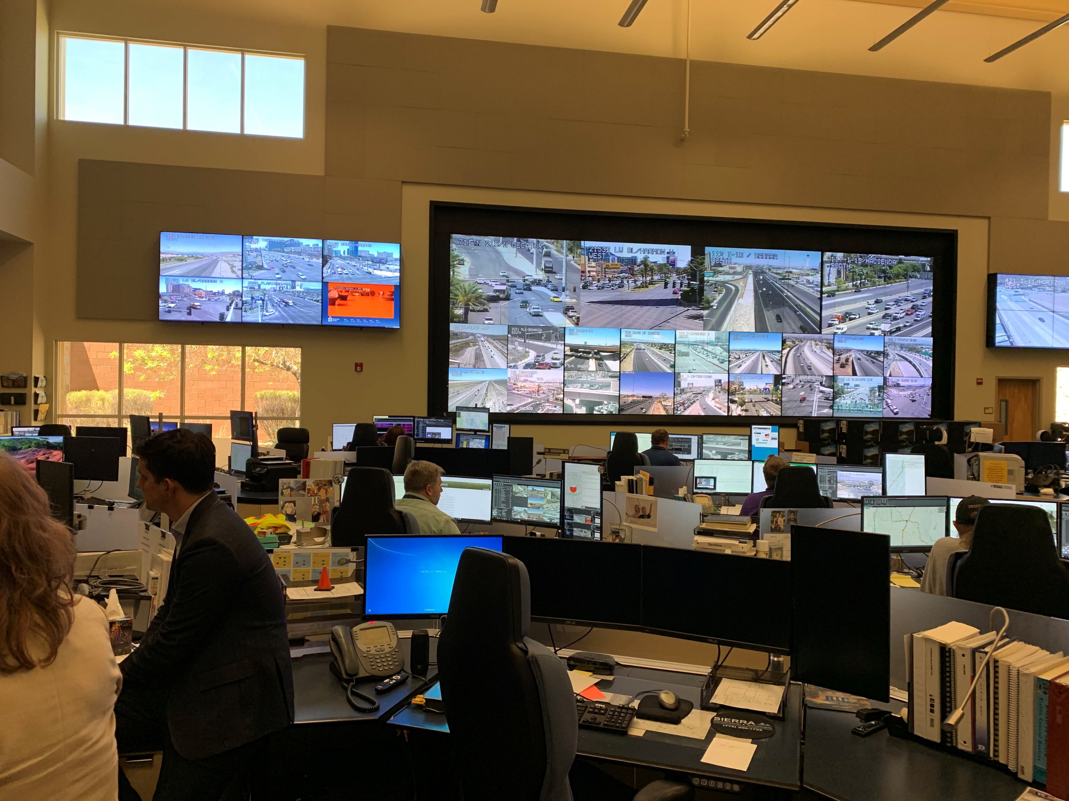
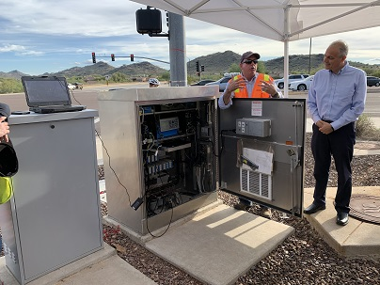
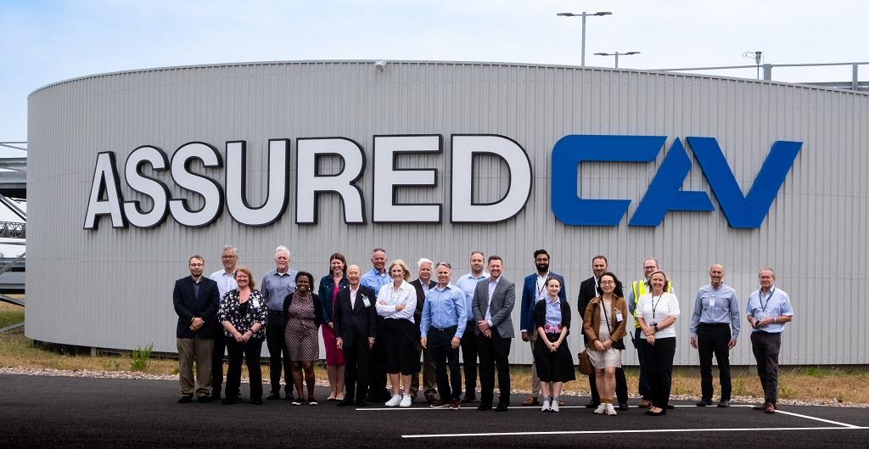
Key Issues & Topic Areas
Institutional
Multi-disciplinary work groups are an easy and successful activity to pursue
Important part of the UK program is to develop a clear regulatory framework
People
Testing can provide valuable opportunities to measure or enhance public acceptance
UK has conducted deliberate social research to gather more in-depth insight
Data
What data do we need? Don’t ask for everything
Define standards and protection/ownership of data
If you buy a vehicle today it is already sharing data with its manufacturer – so what is the government’s role and how can we broaden that sharing?

