Slide 1



AZTech Regional Archived Data System (RADS)
ITS Data Hub Deployment in Maricopa County (Arizona)
Faisal Saleem
ITS Branch Manager &
MCDOT SMARTDrive Program^{sm} Manager
Maricopa County Department of Transportation
NCHRP 20-24(128) CAT Scan Tour – West Region
Day 2: December 5, 2019
Chandler, Arizona
Maricopa County
Department of Transportation

Slide 2
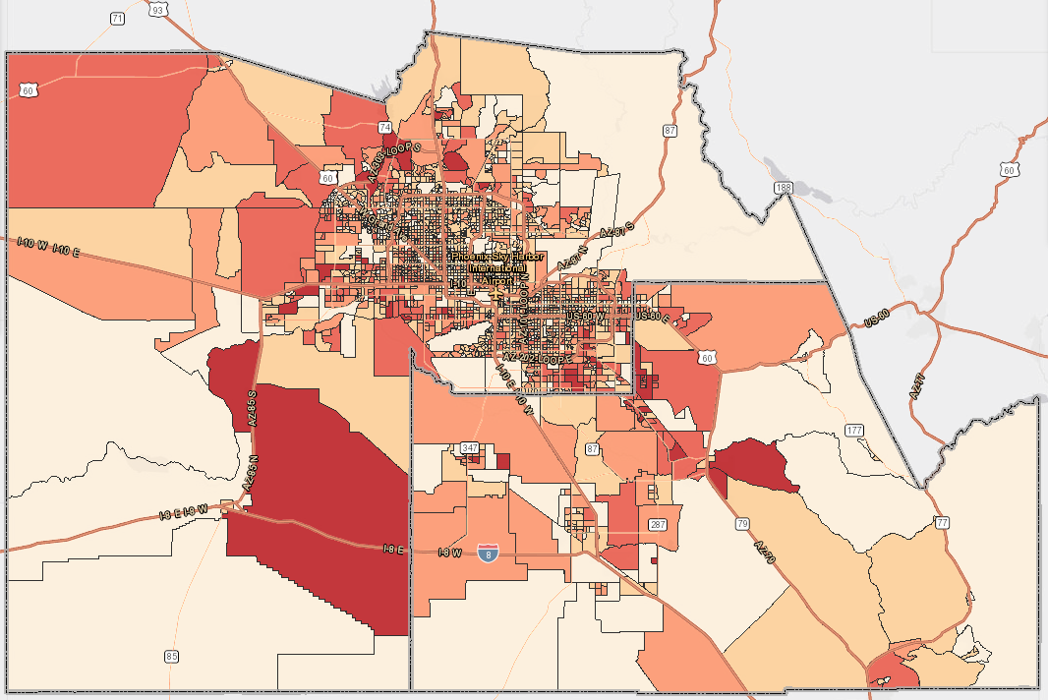
Maricopa County Region, Arizona
300+ miles of instrumented freeways
13 traffic management centers (TMCs)
Dedicated transportation fiber backbone
Anthem Connected Vehicle national testbed
AZTech – regional ITS operations partnership

Slide 3

Collaboration
1996 USDOT Model Deployment Initiative
Goal: Seamless transportation across jurisdictional boundaries

Slide 4
























Regional Partnership
26 Members
15 Cities and Towns
Arizona Division of FHWA
Maricopa Association of Governments (Local MPO)
State DOT and PD
Maricopa County DOT
Phoenix International Airport
Public Transit
Metro Rail
Regional Public Transportation Authority
Arizona State University
University of Arizona
Private Partners
Key Function: Traffic Management and Operations

Slide 5
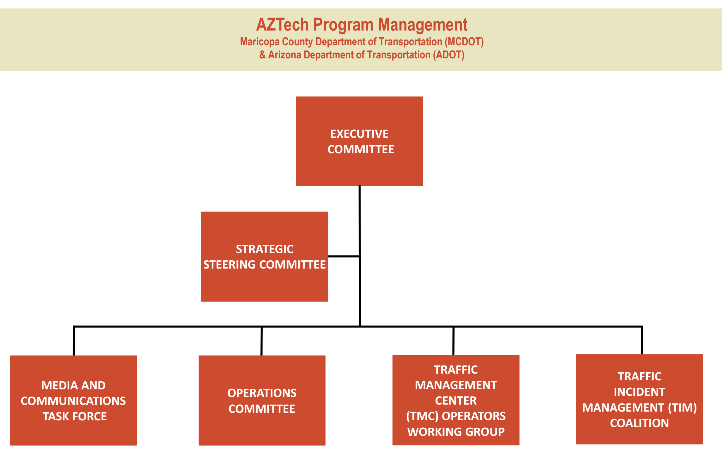
Organizational Structure

Slide 6
Key AZTech Successes
    Pilot ITS Technology Deployment
    Model Public-Private Partnership
    Traveler Information
    Traffic signal coordination across jurisdictional boundaries
    Bi-Annual Performance Indicators Book
    Transportation - Media Forums
    Cross functional training
    Adaptive Traffic Signal System Deployment
    Regional Emergency Action Coordination Team
    Pilots – CAV, ICM, Smarter Work Zone
    Regional Archived Data System (RADS)

Slide 7
Regional Archived Data System
(RADS)
The AZTech Regional Archived Data System (RADS) is a regional ITS data hub for the greater Phoenix area:
    Collects, processes, and archives ITS data from various local and regional subsystems
    Fuses data of multiple sources to provide new operational capabilities and performance measures
    RADS is jointly hosted by ADOT and MCDOT

Slide 8
Value Proposition
Trust
Provide a robust, scalable, and secured environment
Cost effective
Capitalize on regional communication infrastructure
Establish regional operational data policies
Align application development with regional priority
Support Integrated Corridor Management decision support systems
Support Emerging Technology Initiatives

Slide 9
RADS Overview
Data Warehouse
    Real-time data acquisition and archive
    Agency originated data
    Third-party data
    Use of ITS standards
Data Engines/Services
    Performance measures
    Incident management operations
    Traffic signal operations
    Connected Vehicle
    Traveler information
    Planning and modeling

Slide 10

History of RADS
Performance Measures and Operations Support
Integrated
TMCs for Sharing
Traffic Signal
Timing Data
2009
Freeway and Arterial Performance Measures
2014
ARIS Incident Notification & Monitoring System
2017
ATSPM Automated Traffic Signal Performance Measures
Event & Public Safety Data
2003 ADOT Highway
Condition Reporting
System
(HCRS) Data
2005 MCDOT Roadway
Condition Reporting
System
(RCRS) Data
Integrated
Phoenix Fire 9-1-1
CAD Data
2015
Integration of
Jurisdiction
Construction
Data
2017
Mesa Fire 9-1-1
CAD Data, Mesa
Police CAD
AZTech
Metropolitan
Model
Deployment
Initiative
Freeway and Arterial Sensor/Probe Data and Services
2003
RADS Freeway
Data
2005
Travel Time
Estimate,
Web Site
2007
Travel
Time at
Airport
2008
Travel
Time on
Freeway
DMS
2010
Travel Time
on Arterial
DMS Using Bluetooth
Sensors
(Chandler)
2011
Anthem
Connected
Vehicle
Test Bed
2012-2014
Travel Time on
Arterial DMS on
Bell Rd. (MCDOT, Peoria, Glendale, Surprise) Using Third-Party Data
2014
City of Mesa
Bluetooth
Anonymous
Re-identification
Detection
(ARID) System
2017
ARID Data
East Valley ARID (Mesa, Gilbert, Tempe) Phoenix, Glendale, Bell Rd Adaptive Project
1996
2002
2003
2004
2005
2006
2007
2008
2009
2010
2011
2012
2013
2014
2015
2016
2017

Slide 11
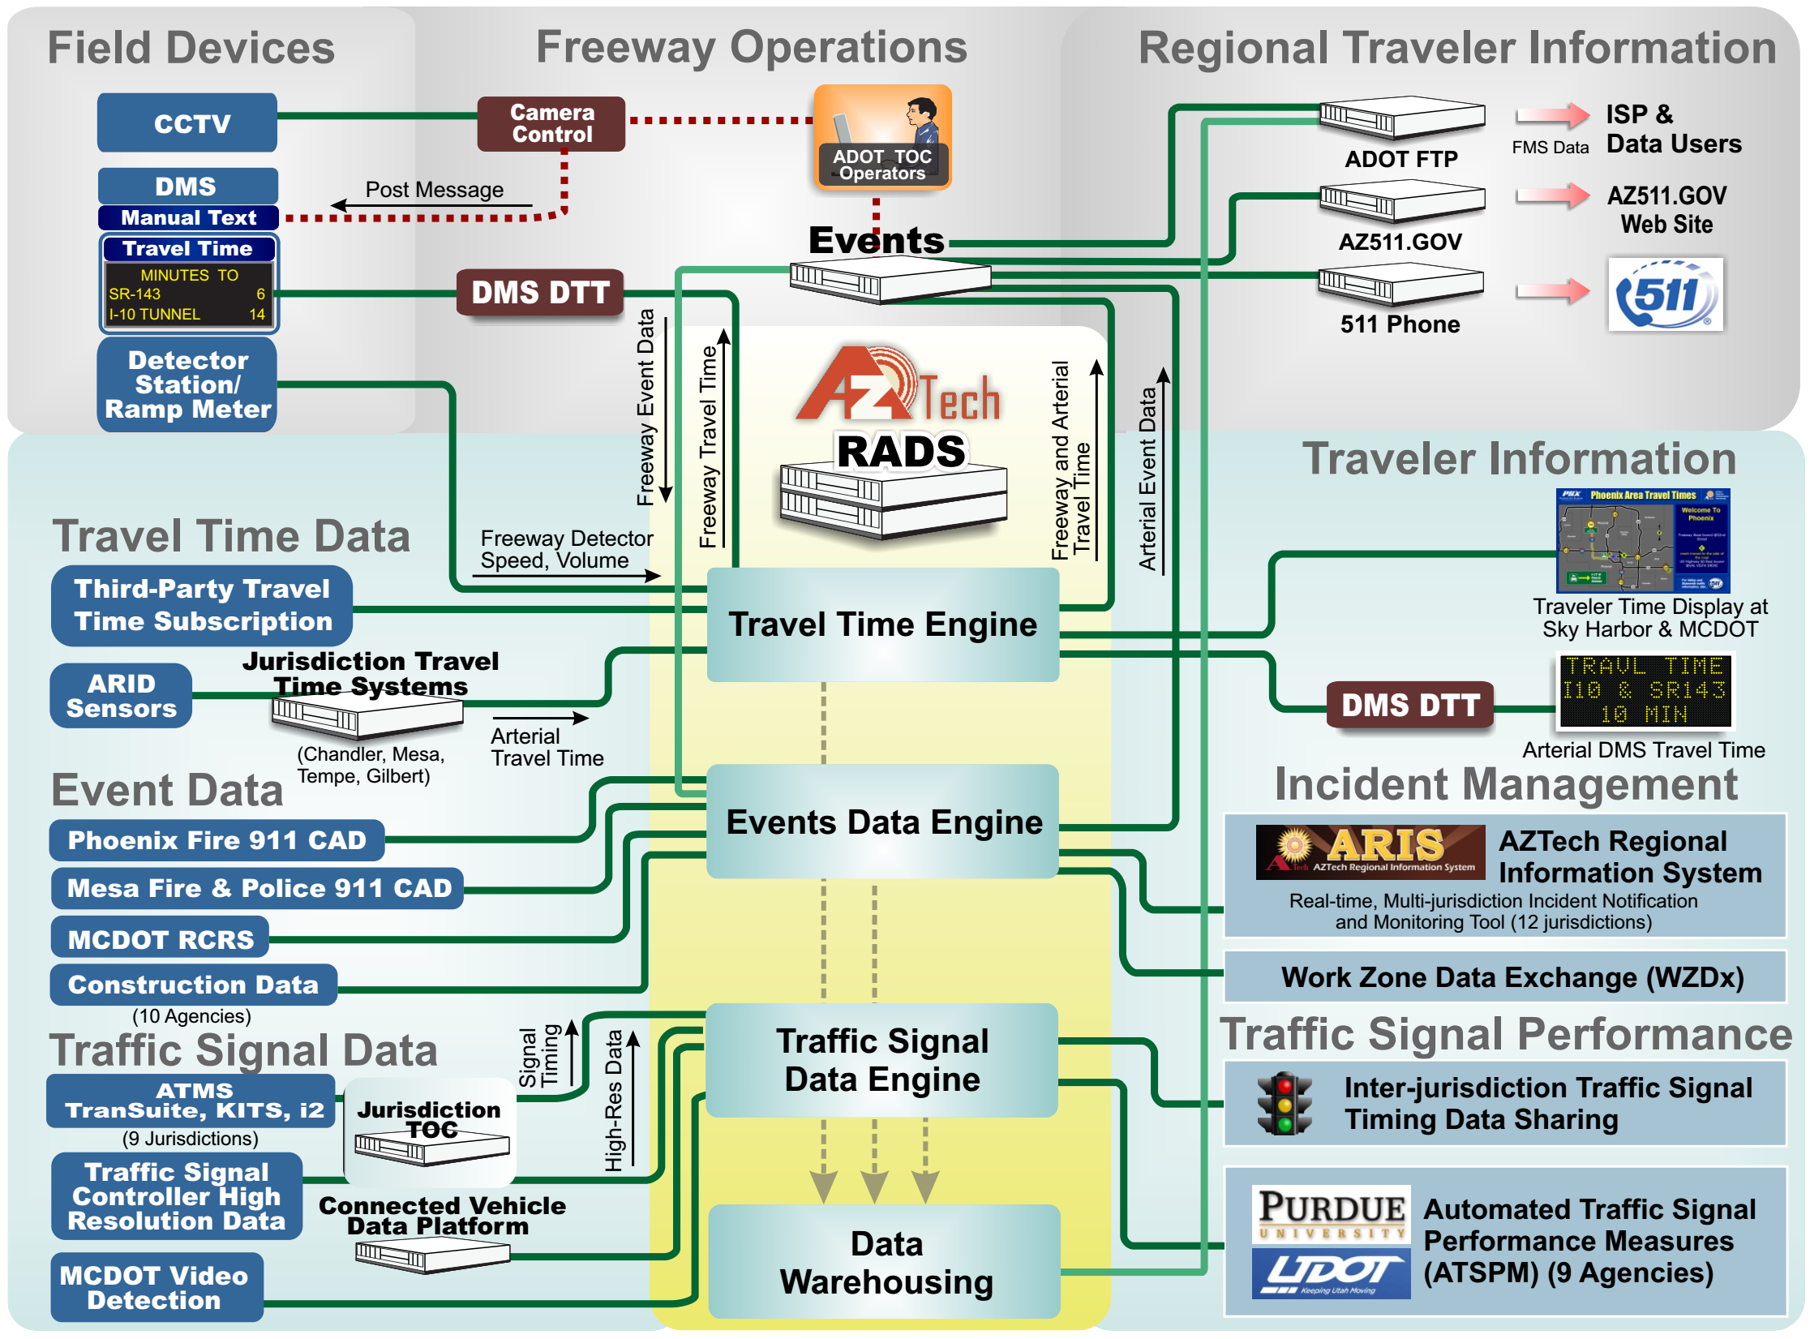
RADS and Regional ITS
Notes:
Vehicle detector data
Freeway (volume, occupancy, speed, travel time)
Arterial (travel time)
Events data from different agencies (transportation, emergency response, law enforcement)
System control parameters (signals, ramp meters, active traffic management)
Video (shared but not archived)
Connected Vehicles (future)
Public agency social media (anecdotal)
Transit
Third-party data (travel time)
Crowd source (e.g., Waze)

Slide 12
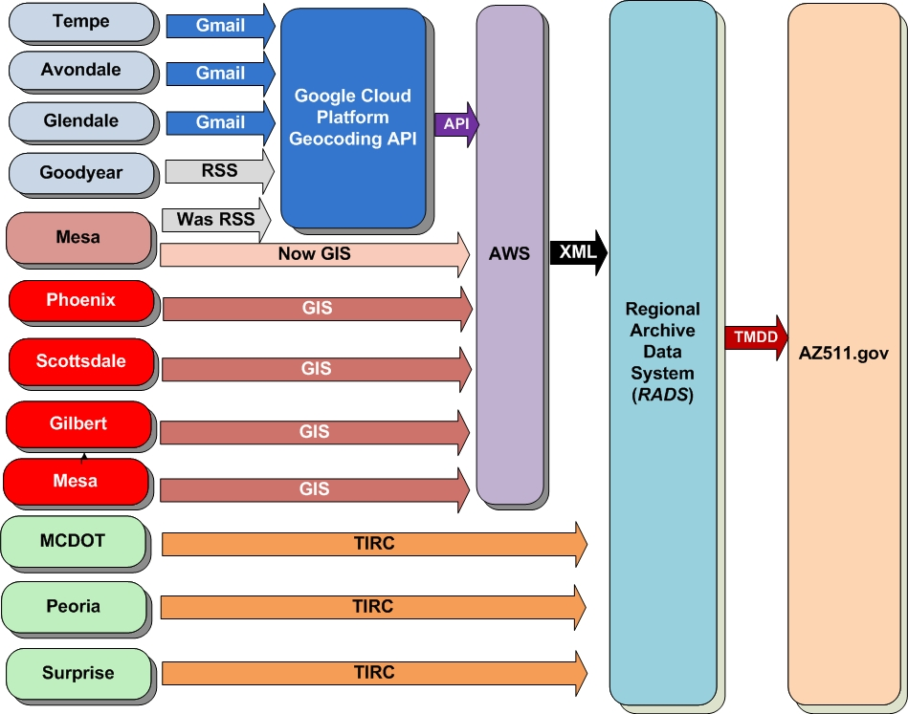
Data Sharing Example (Work Zone)

Slide 13
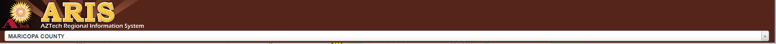
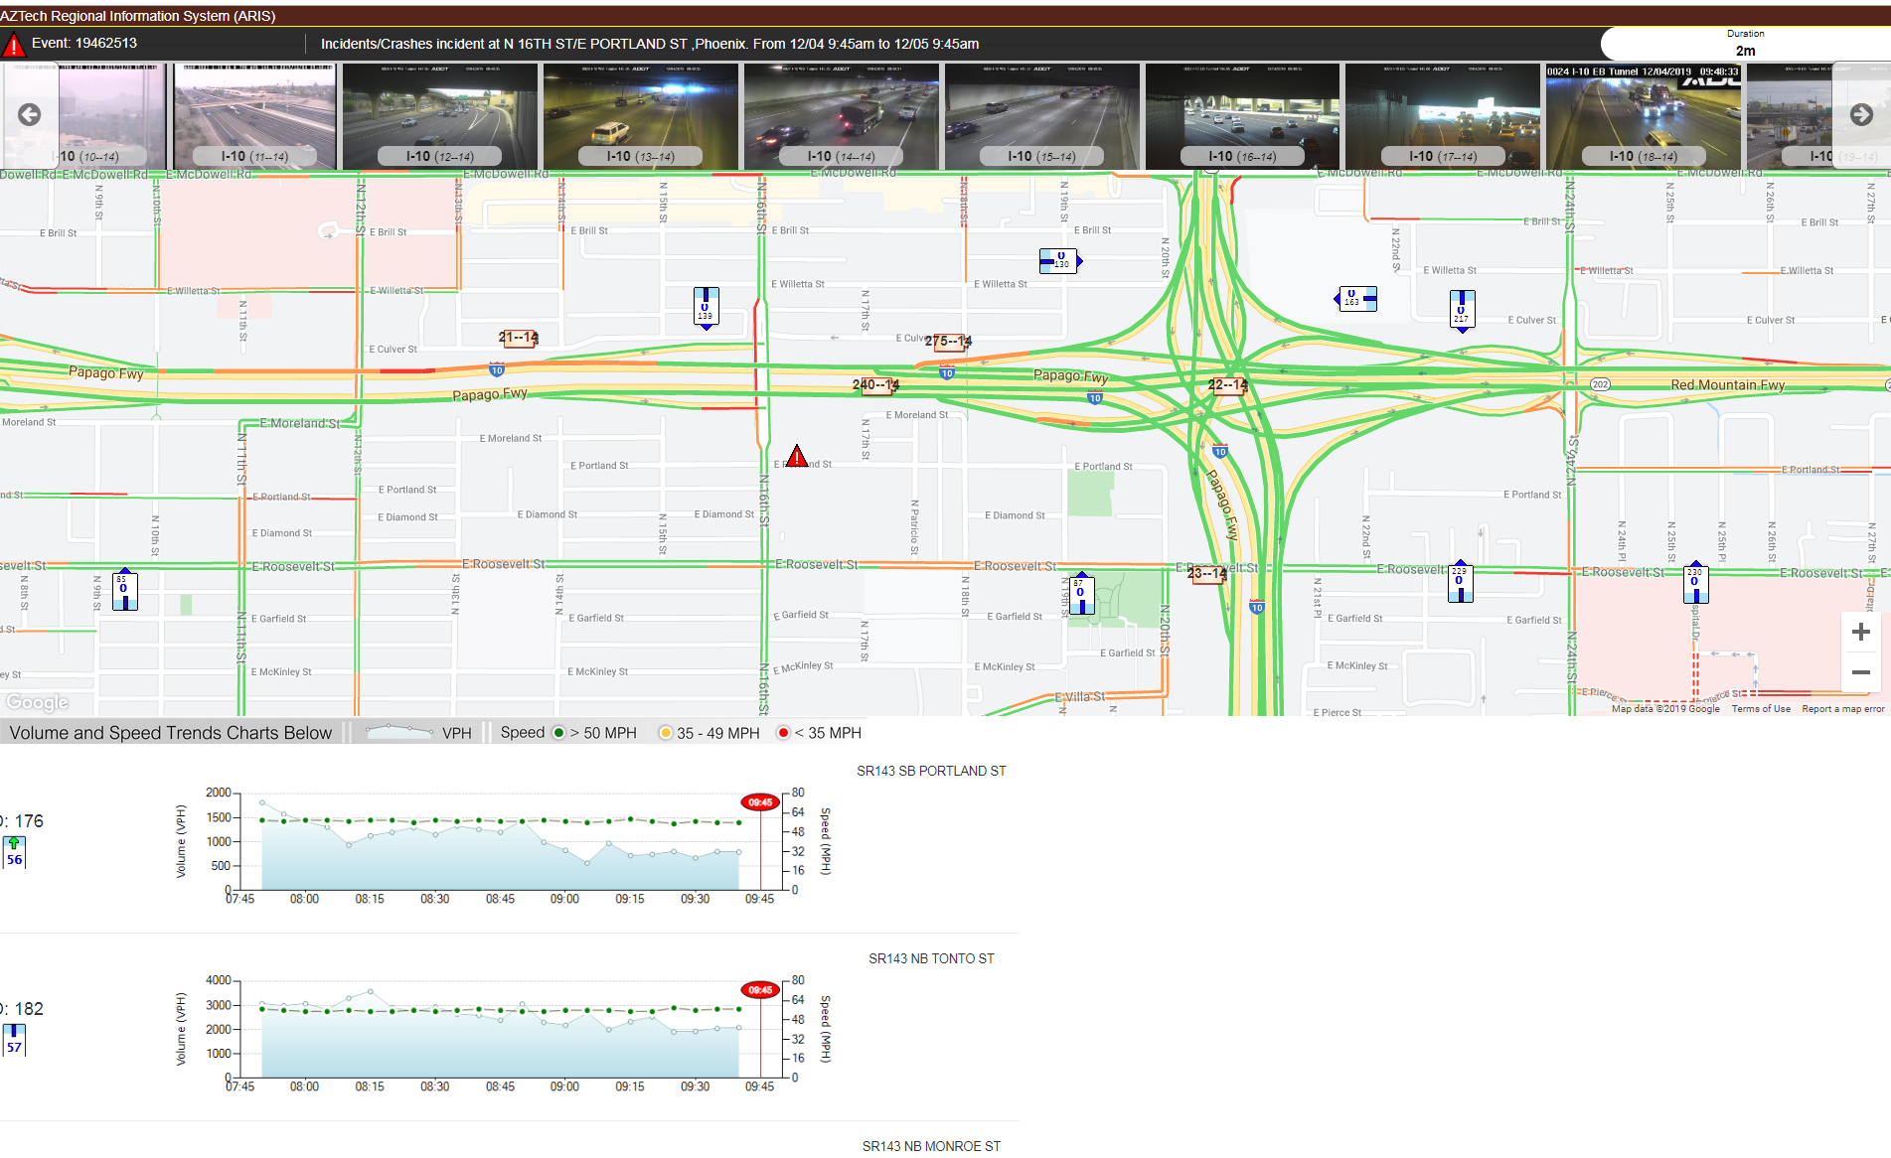
Information Dissemination
ARIS Tactical Screen

Slide 14
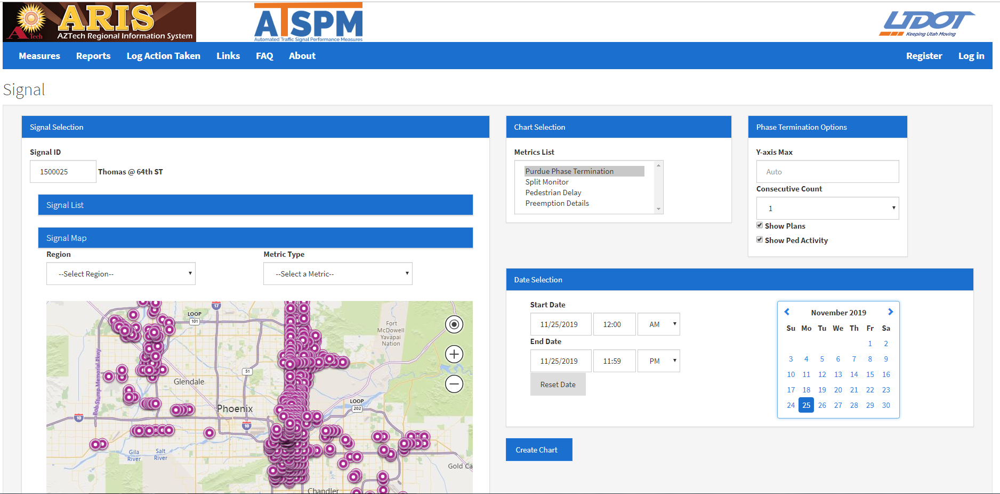
Regional Automated Traffic Signal Performance Measures
Notes:
Able to see signal performance across jurisdictional boundaries.
Help troubleshoot signal timing issues across jurisdictional boundaries
Did coordination get turned off?
Is ta signal on max recall?
Equipment malfunction??
Performance of regional signal projects – like ASCT on Bell Rd? – See how the areas that do not have ASCT are preforming to help access the need for ASCT expansion – See how the different ASCT systems are interoperating at project boundaries
Validating traffic volumes at boundaries – are they similar? Why is one agency seeing more volume then another at neighboring intersections

Slide 15
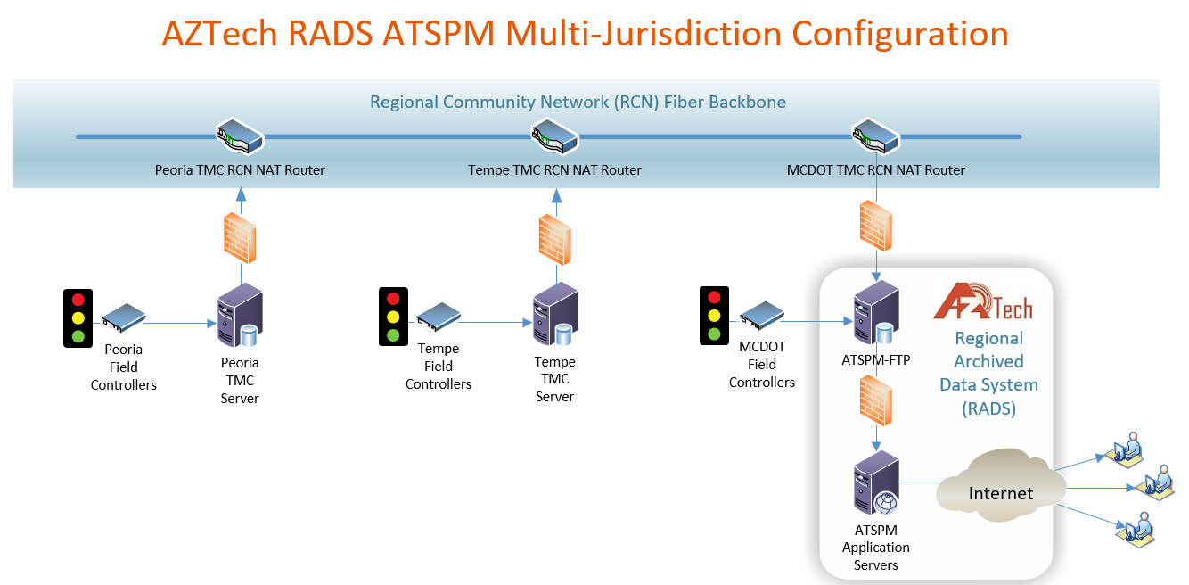
Regional Automated Traffic Signal
Performance Measures Data Architecture
AZTech RADS ATSPM Multi-Jurisdiction Configuration

Slide 16
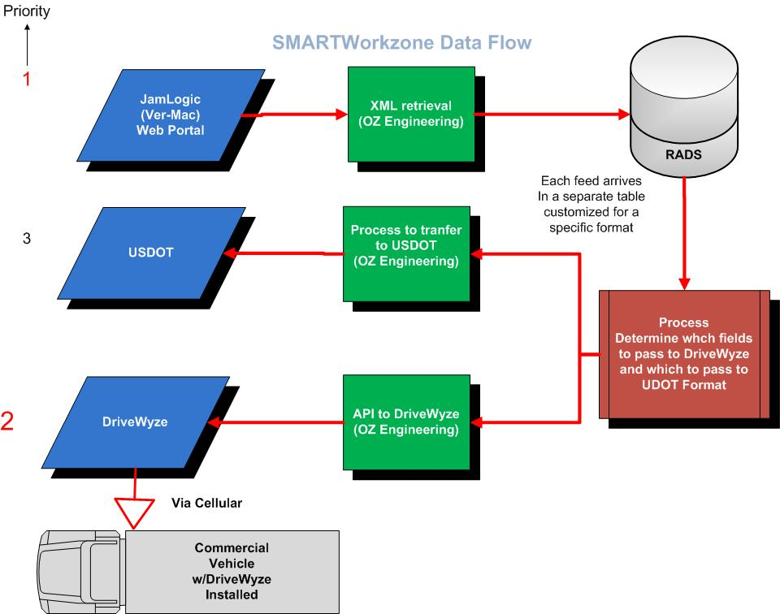
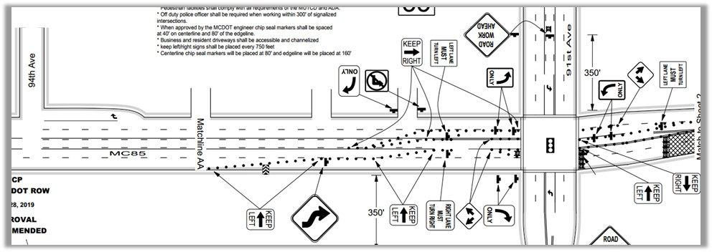
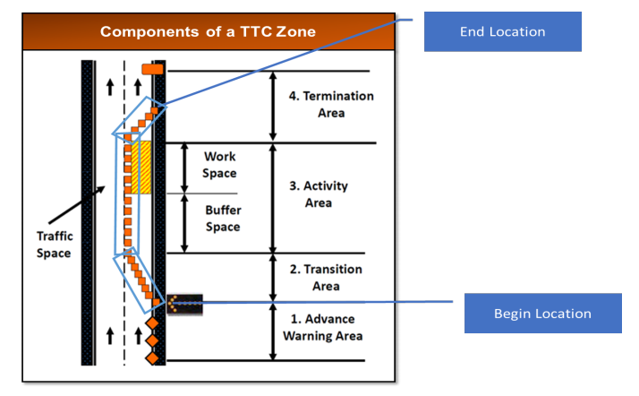
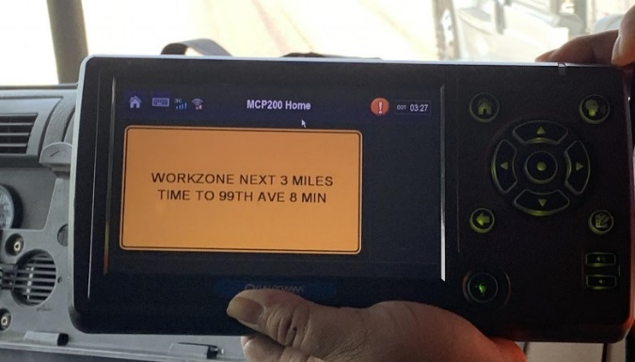
Connected & Smarter Work Zone
Data Exchange (USDOT WZDx)
Traffic Control Plan
RADS

Slide 17
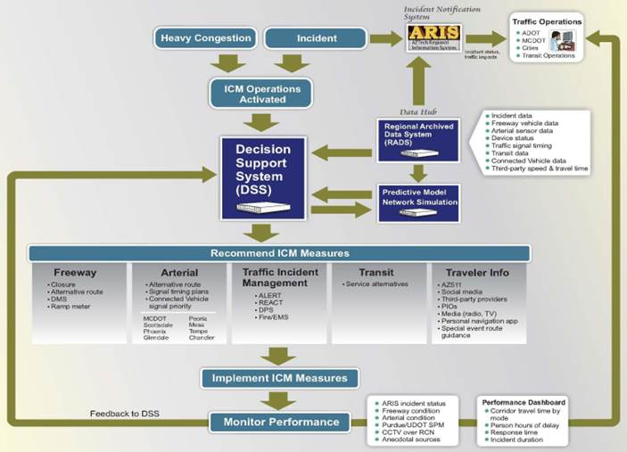
AZTech Regional Information System
(ARIS)

Slide 18

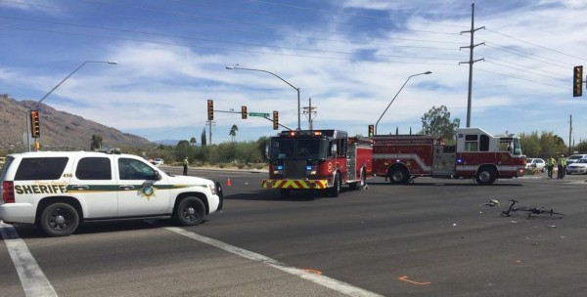
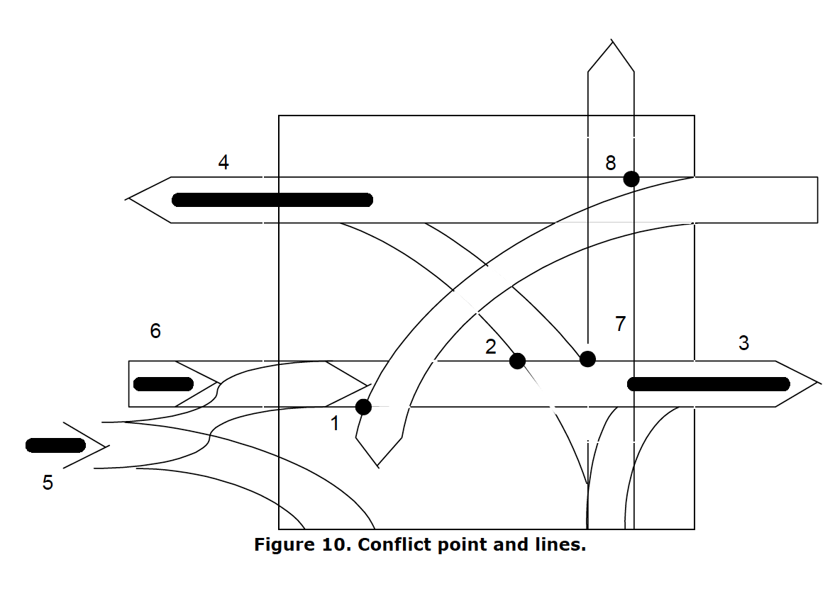
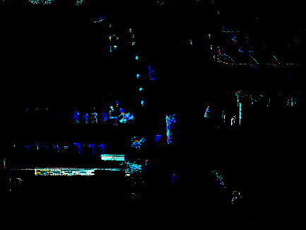
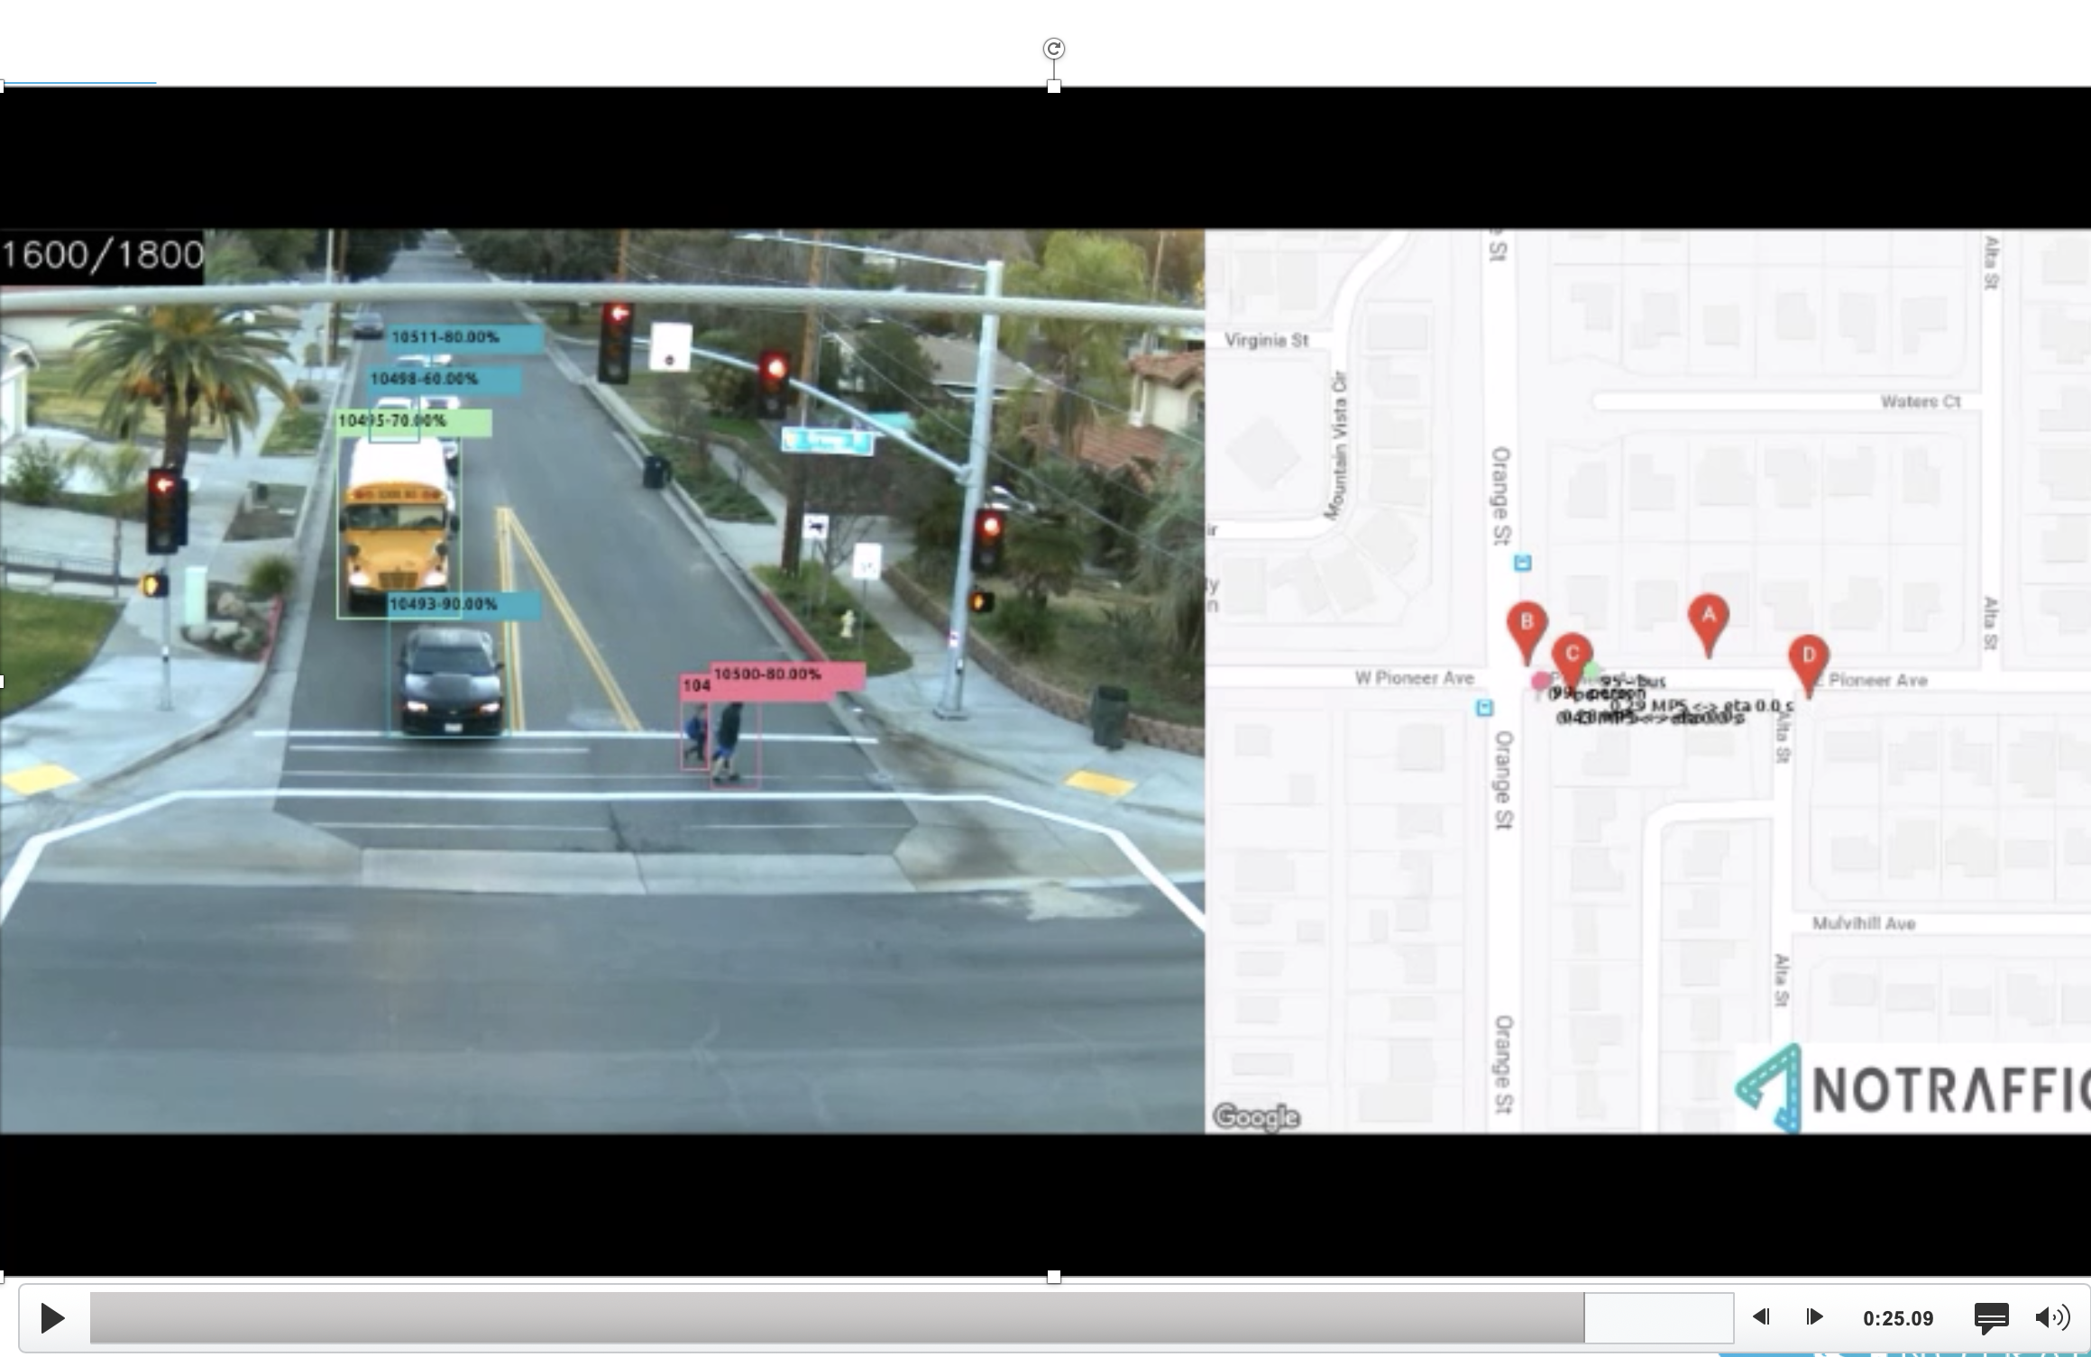
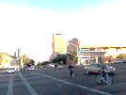
Safety Assessment of Connected and Automated Vehicles
Identify and Estimate Surrogate Safety Measures
Integrate AV Sensor Data with Infrastructure Sensor Data
Identify and Track Objects
Share Object Information with vehicles and travelers
Anthem Test Bed
Surrogate Measures of Safety
Vehicle and Infrastructure Lidar Data
Video + Artificial BSM Data

Slide 19
Data Collection – Overall Architecture
Intersection
Vehicle
RADS
19

Slide 20
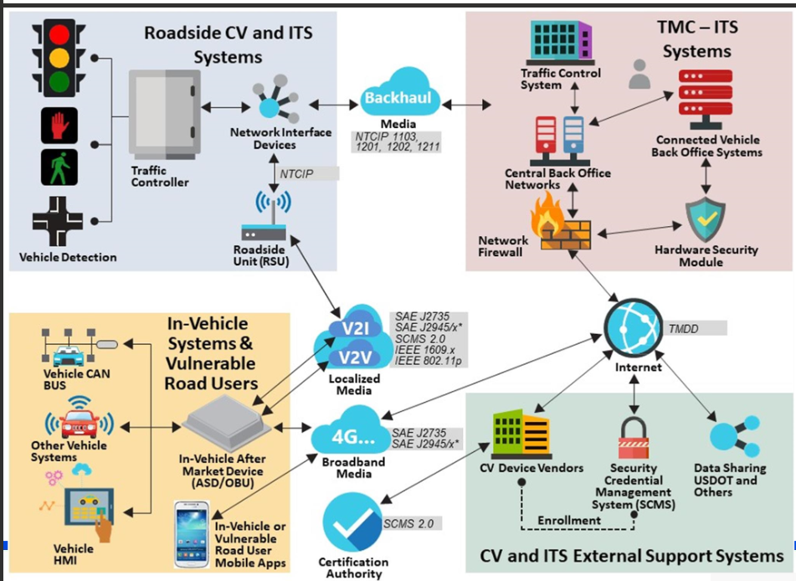
Evolving Environment
Source: CAT Coalition, TRWG

Slide 21
Future: Need for Guaranteed Service
Timely Delivery
Standardized Formats
Does not Compromise Safety
Secured
Protects Privacy

Slide 22




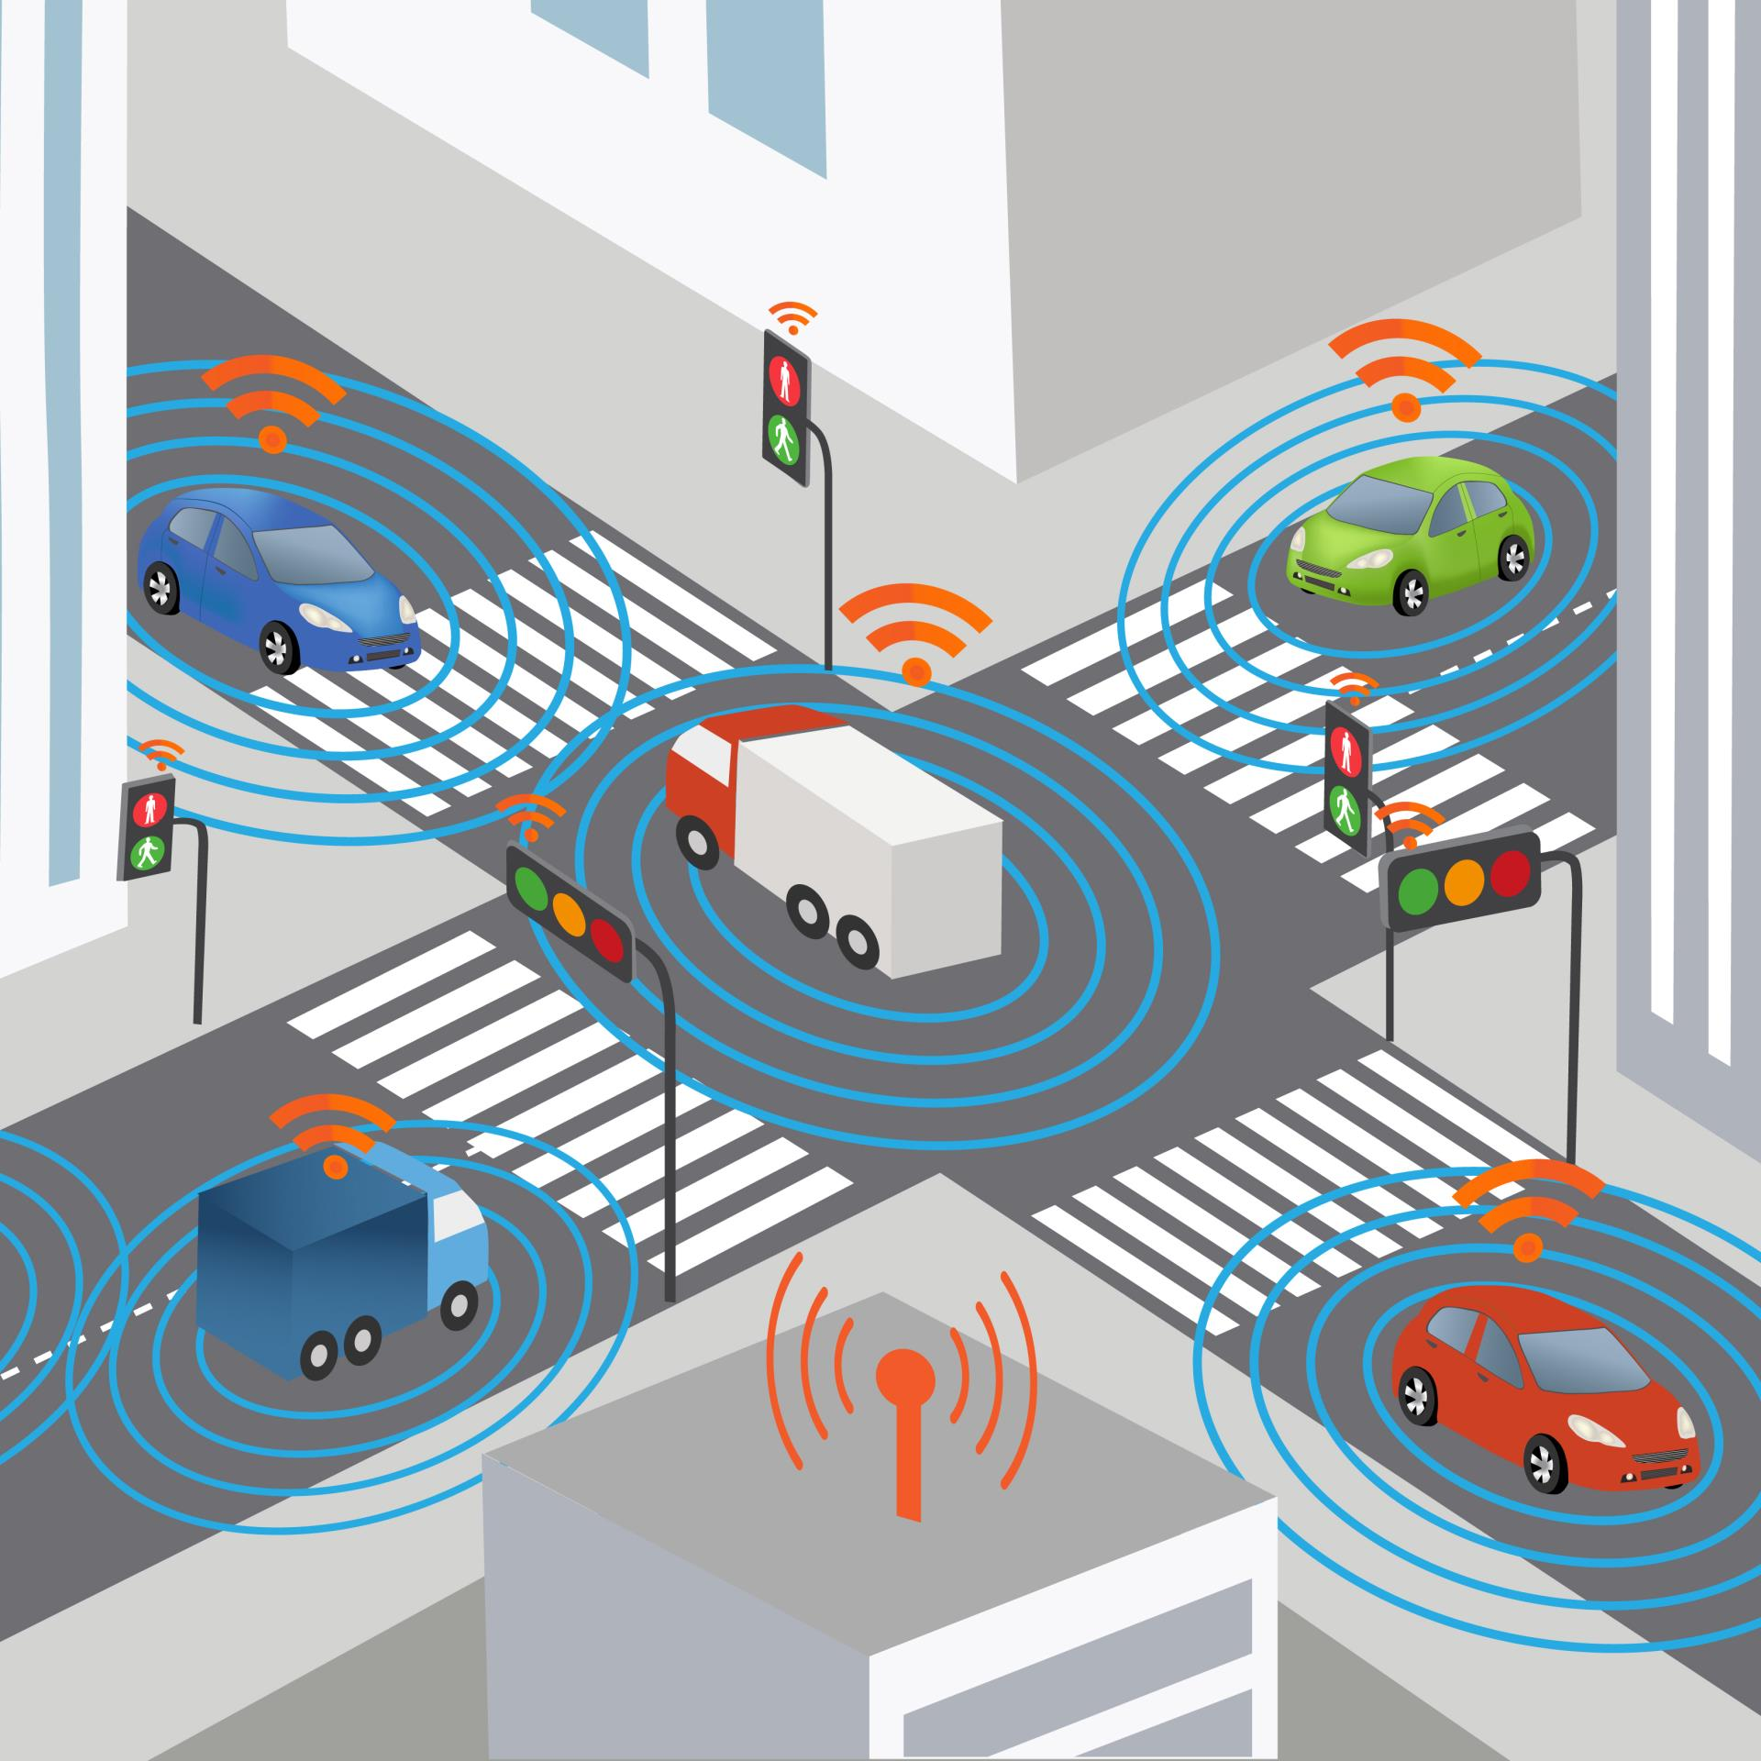
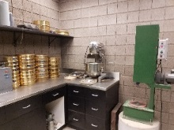
MCDOT TSMO Lab
Preparing for the Future

Slide 23
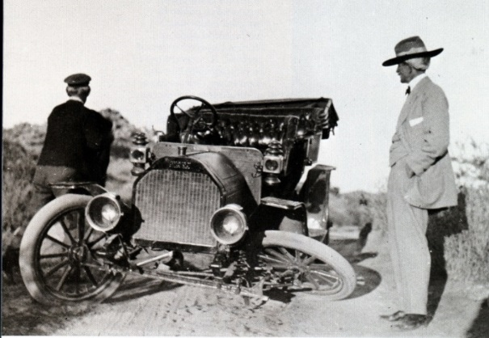
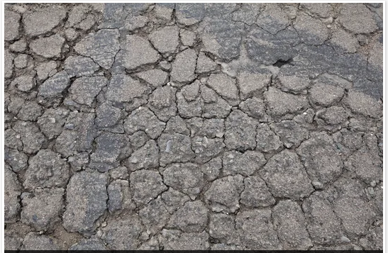
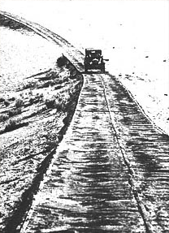
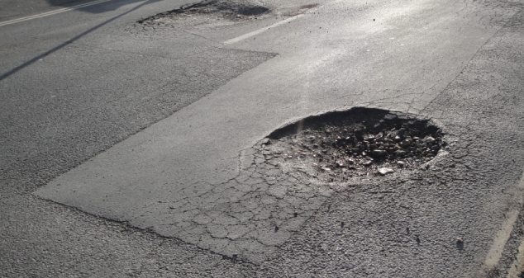
Road Failures –
Potholes, Cracks and More
Source: AZ Republic
Source: Sunland Asphalt

Slide 24

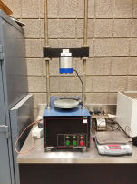
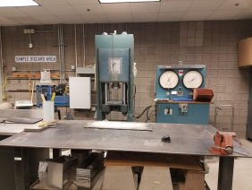
Solution
Materials
Lab
Concept

Slide 25
TSMO Lab Functions
Equipment Verificatino & Validation
Incorporate Testing Standards and
Procedures
Continuously Monitor System
System Failur and Response Recovery
Performance Metrics
Notes:
Develop processes and documentation
Verify installation, operations and performance
Validate services
Establish performance goals and metrics
Equipment
Communication systems
Data systems
Data quality assurance
Quicker response
Vulnerability Assessment
Continuous Operations Planning
Backup Operations
Recovery Process

Slide 26




Faisal Saleem
ITS Branch Manager &
MCDOT SMARTDrive ProgramSM Manager
Maricopa County Department of Transportation
Thank You!
MCDOT
2901 W. Durango St.,
Phx, AZ
Office
602-506-1241
Email:
Faisal.Saleem@
Maricopa.gov

