Slide 1
Perspectives on Automated and Connected Vehicles
Blaine D Leonard, P.E., F.ASCE
Transportation Technology Engineer
Utah Department of Transportation

Slide 2
Outline of Topics
The Big Picture
CAV Policy and Legislation
AV Shuttle Pilot
Connected Vehicle
SPaT Challenge
Deployments
CV Data Ecosystem

Slide 3
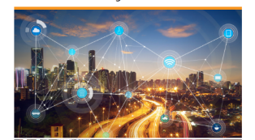
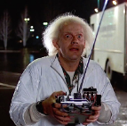
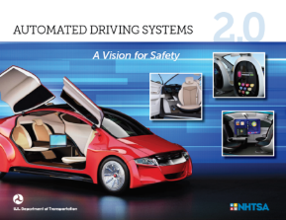
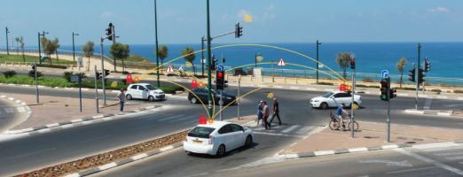
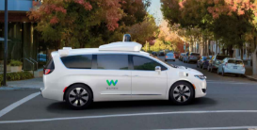
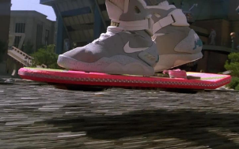
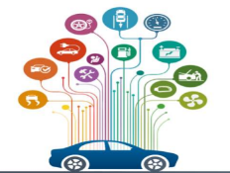
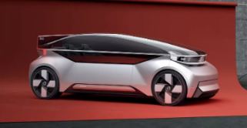
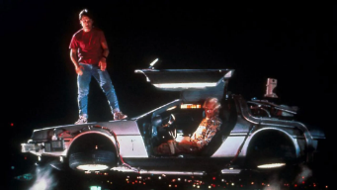
The Future
Notes:
We are on the cusp of the biggest revolution in transportation since the transition from horses to horsepower. You have heard me say that before, you have heard others.
Everything about how we move is changing – what we drive, if we drive, what we ride in, whether we steer, who we are with, how it is propelled – cars, buses, shuttles, bikes, scooters, even flying taxis – everything is changing.
You may have heard me talk about six distinct but interacting trends that are bring this change: Vehicle propulsion, demographic trends, big data, connected vehicles, automated vehicles, and mobility as a service. They are all around us.

Slide 4
Visions of the Future
Your meeting downtown is in an hour, but you leave your house - which is some 100 miles away – knowing you’ll make it on time. In fact, you’ll even have time to go over your notes on the way in. You get in your car, guide it to the expressway, and then settle down with your cup of coffee and a laptop on a tray in front of you.

Slide 5
Visions of the Future
Each compartment of the automated truck is loaded with goods. The driver verifies that the vehicle’s automated systems are in perfect operating order; she then eases into the designated lane, turning control over to the “autopilot”. She will continue to monitor progress, while checking her data sheet for the next delivery and overriding automatic control if necessary. All of the truck’s stops have been timed practically to the second; this control lets stores buy more efficiently and better manage their inventories.
Notes:
Sound familiar?

Slide 6
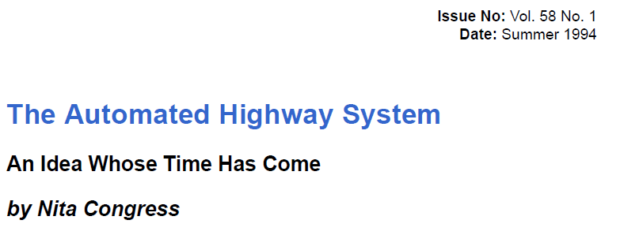
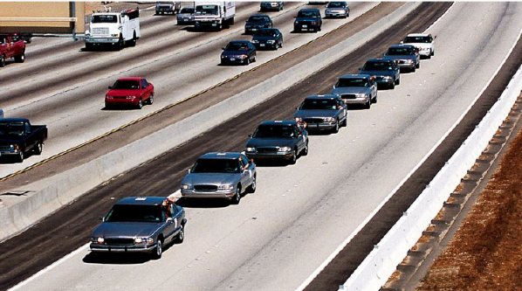
Visions of the Future
25 YEARS AGO
Notes:
Sound familiar? Now, let me tell you that those “future” scenarios are from the AHS report . . . in 1994.
25 years!

Slide 7
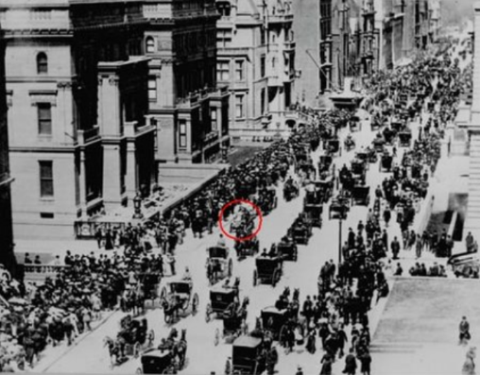
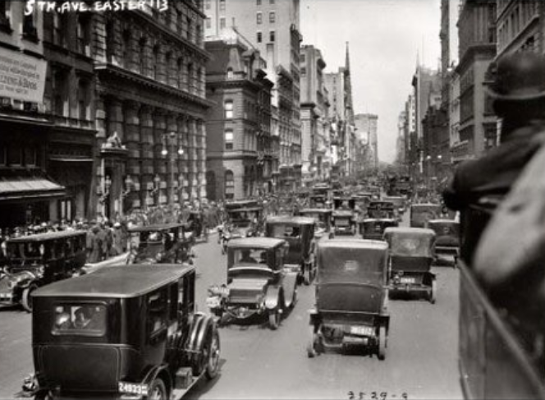
13 Years of Progress. . .
Notes:
In 13 years, in 1910, we went, literally, from a predominance of horses to horsepower, at least in the big city.
New York Easter Parade – 1910 - 1913

Slide 8
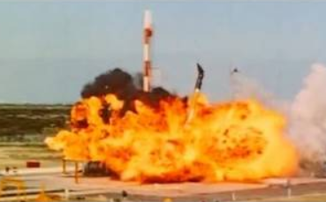
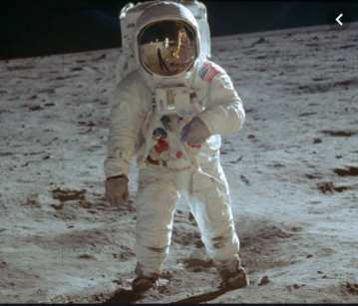
10 Years of Progress. . .
Notes:
In less than half that time, half of 25 years, we went from blowing up rockets on the pad to putting Neil Armstrong on the moon – 50 years ago, before all this great technology.

Slide 9
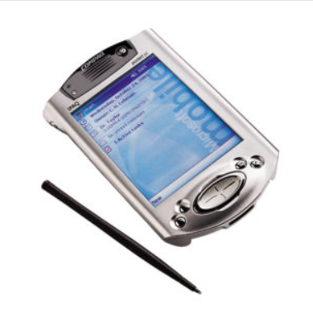
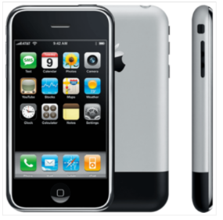
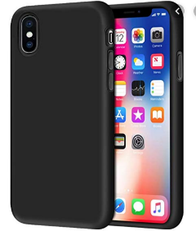
20 Years of Progress. . .
Notes:
Less than 20 years from cell phones to smart phones

Slide 10
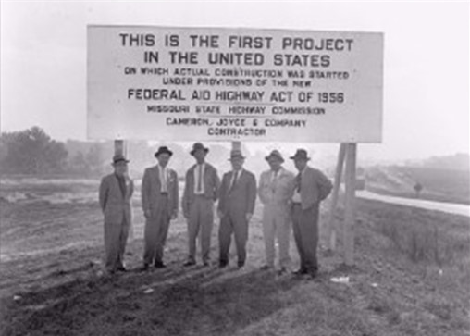
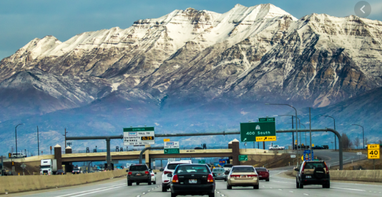
25 Years of Progress. . .
Notes:
In 25 years, we built over half of the US Interstate system.
What is wrong with us? Why is this vision, this promise of new mobility and saving lives, so elusive?

Slide 11
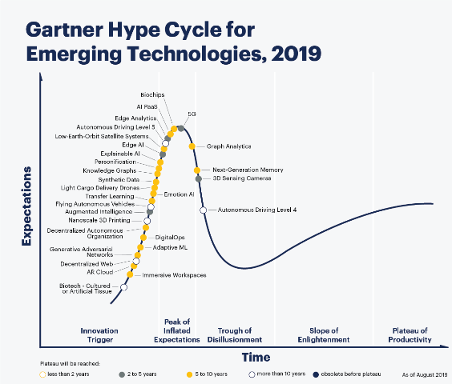
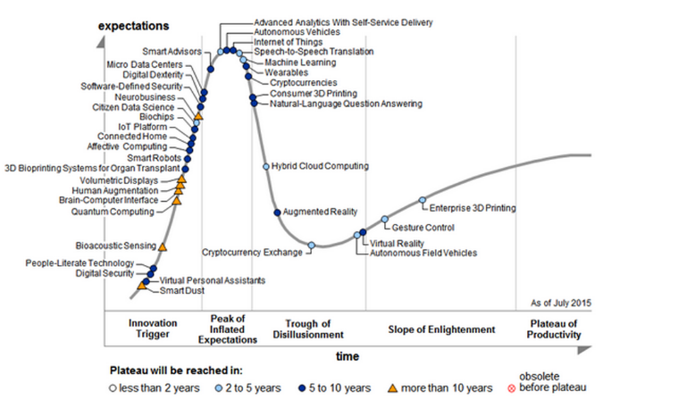
Gartner Hype Cycle for Emerging Technologies
2015
Notes:
Is it just the normal flow through the Gartner Hype cycle . . . maybe
I suggest that it isn’t, and it isn’t our fault.

Slide 12
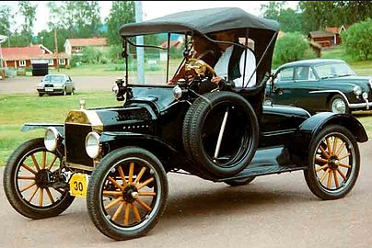
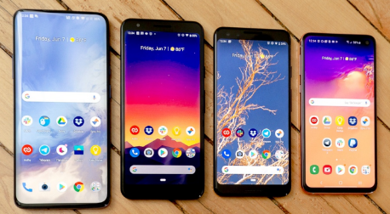
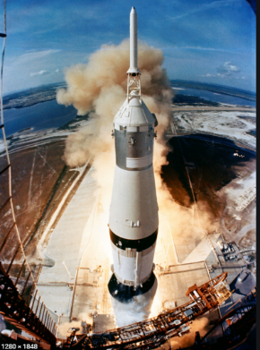
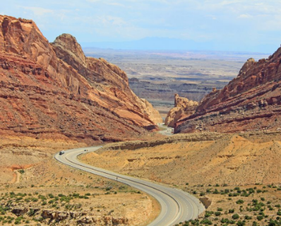
Complex Technologies. . . But Uniform Leadership
Notes:
I suggest that it isn’t, and it isn’t our fault.
We are in the middle of a very complex change, with many moving parts.
The move from horses to horsepower was driven by a few companies in a time with little regulation, using known engine technology, no news cycle, amid an industrial revolution.
The moon landing effort involved the most complex machine that man had every built – the Saturn V rocket. But, it was a single effort, federally budgeted, with a single focus, and political will.
The cell phone industry is largely driven by a handful of very large companies with a clear profit motive.
Even the interstate highway system, executed by 50 state DOTs, had a clear objective and plan, with a roadmap, federal standards and budgets, and a public need.

Slide 13
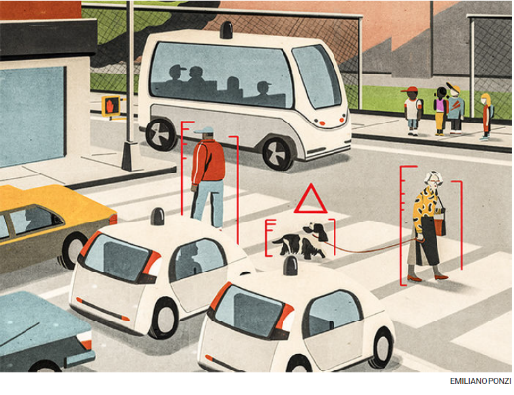
Complex Technologies . . . In a Complex Environment
Multi-faceted endeavor
Little federal budget or leadership
Varied political wills
Many end goals
Broad range of entities
Many start-ups with different motives
Notes:
This is a very complex endeavor with various goals, light vehicles, heavy vehicles, transit, etc. Partial automation, full automation, varied sensor suites, etc. Every level of government is involved from Congress to local towns. They all have different interests, political wills, and rules. Some like this, some don’t. The entities involves have a similar range – from big governments and large corporations (Ford, VW, GM), to very small AI companies, many of whom are start-ups. They are spread all over the globe, and are fiercely competing while also forming a broad variety of alliances.
These companies also have varied business models. The big ones (Ford, GM, VW) are profit driven and risk averse. The new ones are VC-funded and comfortable with risk (Tesla, Uber, many little entities). Uber, reportedly worth $80 billion, lost 5.2 billion last quarter, Lyft lost $645 million. Neither have every made a profit.

Slide 14
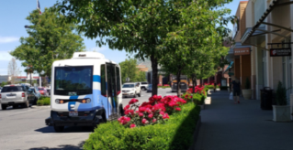
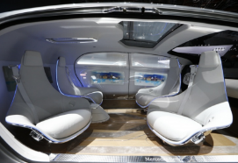
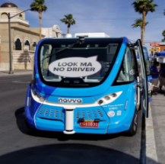
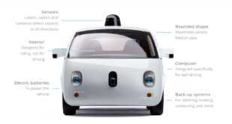
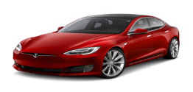
Complex Technologies . . . And Lots of Progress
Vehicle safety
Level 1 and 2 Automated Driving
Vehicle electrification
Drone technology
$100’s of millions – federal research
Private industry development
Data analytics
MaaS / MoD – new with the decade
Micromobility
Notes:
Now, that is a harsh assessment . . .
We have made a lot of progress since 1994. While the AHS report envisioned huge benefits in connected and automated vehicles, (vehicle infrastructure integration), vehicle safety, level 1 and 2 automation, vehicle electrification, and drone technology have all come a long way in just the past 8 to 10 years. All of these areas are commercially available.
The federal government has invested hundreds of millions of dollars in CV and AV research –the CV Pilots, and automated shuttles, standards development. State governments, NCHRP, AASHTO, and others have similarly invested.
Private industry has developed some very sophisticated tools
Data analytics capabilities far outshine what we could do just a few years ago.
Some of our modes, like mobility as a service and micromobility (scooters), weren’t even thought of as little as a decade or so ago. We have come a long way.

Slide 15
We are not at the beginning of the end, but at the end of the beginning – Shane Robison, VP Hewlett Packard, (possibly quoting Winston Churchill)
Notes:
We are in an exciting time, a time of great change, but a time of challenges and hurdles.
What will we do with this with these advancements?

Slide 16
Three Suggested Take-Aways
Individually Act – Start Small
Survey Large Fields, Cultivate Small Ones
- Harold Lee
Notes:
Let me tie this together with four suggestions . . . four things I think we should all do today, and walk away with:
1 – individually, we all need to act (survey large fields, cultivate small ones). Stop waiting, move forward.
2 – get involved in national efforts – committees, organizations, influencing – to make change happen.
3 – Share – take what you DO, and share it. Help others. Learn from others. Accelerate the learning curve. Support the big picture.
4 - take a risk on what you choose to act upon (the best thing to do is the right thing)
Thanks for listening to my thoughts today. Let’s learn today, and move the needle!

Slide 17
Three Suggested Take-Aways
Individually Act – and Share
Get Involved – Locally and Nationally – and Share
Many of us are more capable than some of us, but none of us is as capable as all of us.
– Tom Wilson
Notes:
Let me tie this together with four suggestions . . . four things I think we should all do today, and walk away with:
1 – individually, we all need to act (survey large fields, cultivate small ones). Stop waiting, move forward.
2 – get involved in national efforts – committees, organizations, influencing – to make change happen.
3 – Share – take what you DO, and share it. Help others. Learn from others. Accelerate the learning curve. Support the big picture.
4 - take a risk on what you choose to act upon (the best thing to do is the right thing)
Thanks for listening to my thoughts today. Let’s learn today, and move the needle!

Slide 18
Three Suggested Take-Aways
Individually Act
Get Involved – Locally and Nationally – and Share
Take a Risk
The best thing to do is the right thing
The second best thing to do is the wrong thing
The worst thing to do is nothing at all
- Theodore Roosevelt
Notes:
Let me tie this together with four suggestions . . . four things I think we should all do today, and walk away with:
1 – individually, we all need to act (survey large fields, cultivate small ones). Stop waiting, move forward.
2 – get involved in national efforts – committees, organizations, influencing – to make change happen.
3 – Share – take what you DO, and share it. Help others. Learn from others. Accelerate the learning curve. Support the big picture.
4 - take a risk on what you choose to act upon (the best thing to do is the right thing)
Thanks for listening to my thoughts today. Let’s learn today, and move the needle!

Slide 19
CAV Policy

Slide 20
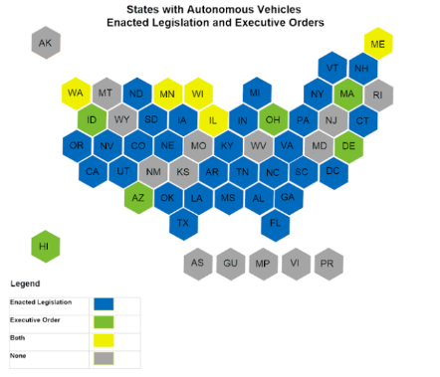
Autonomous Vehicle Legislation
Federal Jurisdiction over vehicle manufacturing
Includes recalls for malfunctions
FMVSS
US House: SELF DRIVE Act – H.R. 3388
US Senate: AV START Act – S. 1885
State Jurisdiction
Vehicle Registration
Inspection / Emissions
Driver Training / Licensing
Laws of Operation (Speed Limit, etc.)
Enforcement
Notes:
I don’t think you will use or need this slide, but the information might come up in questions. Last session the legislature passed a fairly broad bill authorizing AVs to operate on our roads. It is now legal for a highly automated vehicle (Level 3, 4, or 5) to operate on our roads, with or without a driver on board. No permit or special conditions are needed – just that the vehicle needs to be registered and insured.

Slide 21
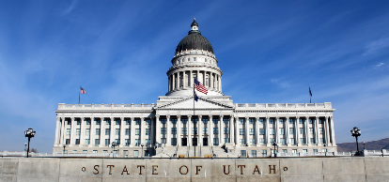
Autonomous Vehicle Legislation
Legislation passed during 2019 session
Developed by coalition of agencies and private sector interests
Worked closely with legislature and other interested / impacted parties to modify language
DMV / DPS
Insurance Industry
Automakers
TNCs
Evaluated language from other states
Passed House & Senate unanimously
Issues included:
Definitions of terms
Permission to operate on Utah roads
Testing and operation
Monitoring safe (or unsafe) behavior
Registration / Licensing
Responsibility in crash
Access to data
Didn’t solve them all
Notes:
In 2019the legislature passed a fairly broad bill authorizing AVs to operate on our roads. It is now legal for a highly automated vehicle (Level 3, 4, or 5) to operate on our roads, with or without a driver on board. No permit or special conditions are needed – just that the vehicle needs to be registered and insured.
Legislative effort started in 2017 with model language prepared by the Self Driving Coalition. Drafts

Slide 22
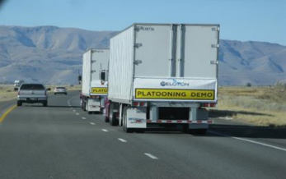
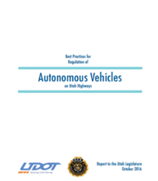
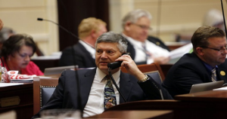
AV Regulatory Issues - Utah
H.B. 373 (2015): Following Distance Law
Allow platooning testing
H.B. 280 (2016): AV Study
Defines “autonomous vehicle”
Authorizes a study (DOT, DPS, DMV)
H.B.257 (2017): AV Task Force
Was not enacted
S.B. 56 (2018): Following Distance Law
Allow operational platooning
H.B. 371 (2018): Automated Vehicles
Allow operations of fully automated vehicles (NOT Enacted)

Slide 23
Regulatory Challenges
Data privacy / access
Security
Inconsistent regulatory environment across states
Platooning: need national interoperability

Slide 24
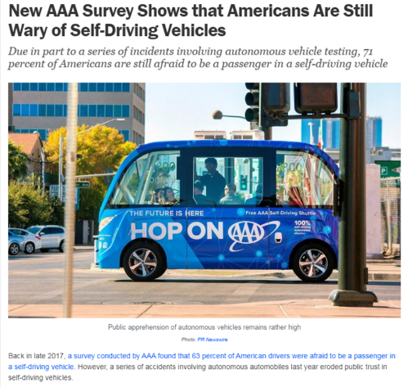
The Promise of Automated Vehicles
Afraid to be passenger in an AV:
2017: 63%
2019: 71%
By 2029, most cars will have AV technology:
2019: 55%
If we don’t trust – or use – technology that can make us safer . . .
What should we do?

Slide 25
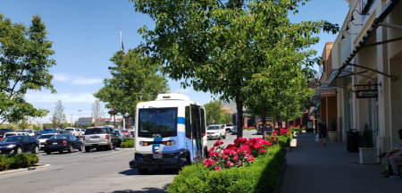
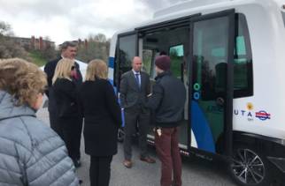
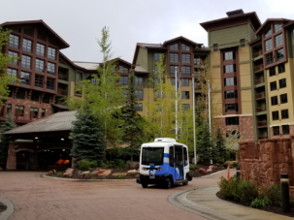
AV Shuttle Project
Deploy AV Shuttle in several locations
April 2019 – March 2020
Joint UDOT / UTA Project
Study potential uses and capabilities
First mile – last mile solution
Interaction with signals
Broad discussion about vehicle autonomy
Evaluate public responses / attitudes
Impact on “trust”
Experience Yields Trust

Slide 26
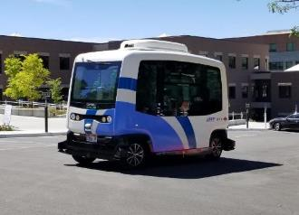
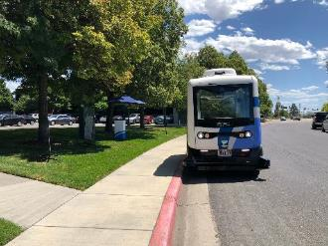
Automated Vehicle Shuttle Pilot
Canyons Resort (AASHTO Spring Mtg)
May 20-23
Station Park - Farmington
June 8 – July 6
1950 West North Temple
July 14 – August 2
University of Utah
August 19 – Sept 27
Utah State Capitol
Oct 16
Mountain America Expo Center
Oct 24 -
Safely transported over 4300 riders
Notes:
After an initial press event, we have deployed the shuttle in six public locations. We have successfully carried thousands of people on the shuttle, and have learned a lot about it’s capabilities and limitations. Many of the riders fill out a survey about their experience, and some UofU researchers are also studying rider behavior.

Slide 27
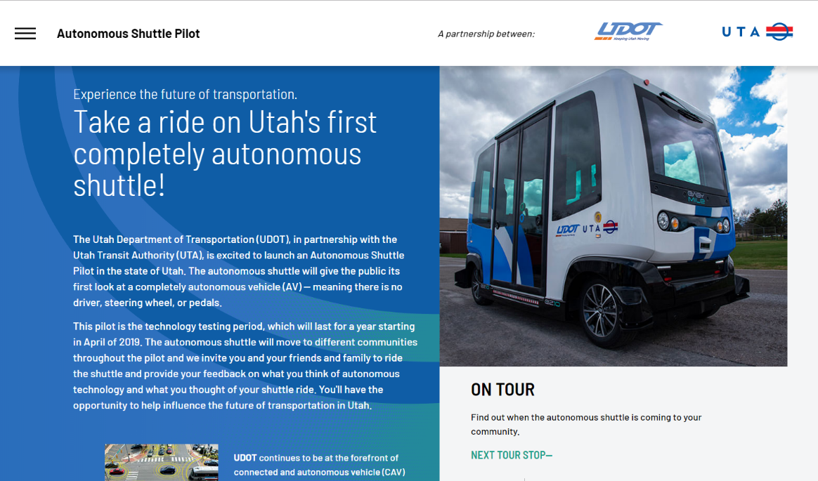
www.avshuttleutah.com
Mountain America Expo Center
Oct 22 – Dec 7

Slide 28
Automated Vehicle Shuttle Pilot
Lessons Learned
NHTSA regulatory process is cumbersome
Vehicles still not mature
Weather tolerance
Sensor “false positives” – the white moth
Mechanical issues – the ramp
Accessibility – Braille
Not practical with a human “host”
The “host” fills multiple roles

Slide 29
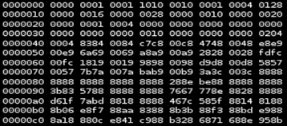
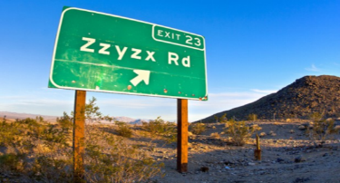
A New Paradigm

Slide 30
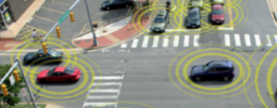
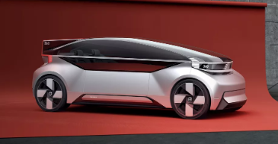
The Promise of Connected and Automated Vehicles
Human Error: Factor in 94% of Crashes
CVs: Mitigate 83% of impaired crashes (V2V)
AVs: See more / react faster / never drowsy

Slide 31
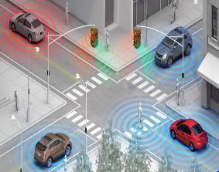
The SPaT Challenge “Local Pilots of National Significance”
Challenge state and local public sector transportation Infrastructure Owners & Operators (IOOs) to deploy DSRC infrastructure with SPaT (and MAP) broadcasts in at least one coordinated corridor or network (approximately 20 signalized intersections) in each state by January 2020.
Additional V2I Applications that build on SPaT are also encouraged!
20 Intersections in 50 states by 2020!

Slide 32
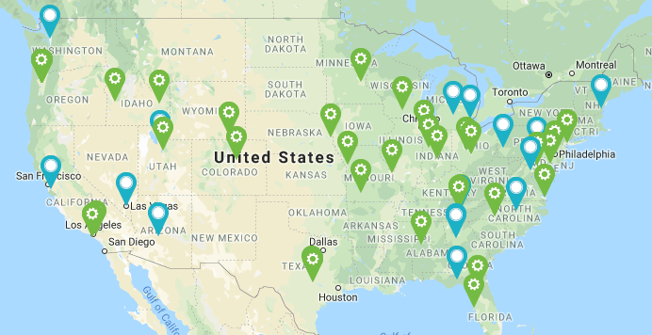
SPaT Challenge Participants
Current Count:
670 RSUs up and running;
3,325 additional locations/RSUs planned;
9,200 vehicles planned to be equipped.
47 Sites
26 States
National Operations Center of Excellence (NOCoE)
www.transportationops.org/spatchallenge

Slide 33
Connected Fleet Challenge
Agencies that have deployed infrastructure to broadcast SPaT and MAP data are now challenged to work with local partners to equip at least two vehicles (one light-duty, one heavy-duty) with an On-board Unit (OBU) to receive the SPaT and MAP data by 2021
Form Key Partnerships with Fleet Operators
Learn to Install On-Board Equipment

Slide 34
Utah Connected Vehicle Project
Connected Vehicle Application: Transit Signal Priority (TSP)
Redwood Road
Conditions: Lateness, % Occupancy
Goal: Increase transit reliability
Operational since Nov 2017
Meet the SPaT Challenge
Establish DSRC corridor
Notes:
Reliability = % of time less than 5 minutes late

Slide 35
Redwood Road Connected Vehicle Project
Transit Signal Priority (TSP)
Grant conditional priority when bus is behind schedule
Goal to improve transit schedule reliability
DSRC wireless communication technology
24 signalized intersections
10 UTA buses
Schedule reliability improved by 6%
Minimal impact to other traffic
Currently studying impact of “lateness threshold”
Benefits more complex than “schedule reliability”

Slide 36
Additional Deployments
Provo-Orem BRT Project (UVX)
Transit Signal Priority using DSRC
47 Signalized Intersections
25 Buses
Evaluation Study Underway
Operational December 3, 2018
Snow Plow Pre-emption Project (Safety)
Salt Lake Valley – 5 corridors
55 Additional Intersections
46 Snow Plows
Evaluation Study Underway
Operational in March 2019

Slide 37
EXISTING PROPOSED
UTA TSP
UDOT Plows
Additional Vehicle Deployment:
60 UTA Buses
30 UDOT Plows
Connected Vehicle Roadside Infrastructure Deployments
Notes:
Foothill – UTA Route 228 (changed)
State Street: Routes 200 / 201
Utah County State Street: Route 850
More Redwood (123rd to Porter Rockwell), Mountain View Corridor, 7200 South, 90th South, Wasatch Boulevard
SR-92 Timpanogos Highway; SR-85 2100 North; SR-73 Main Street;

Slide 38
Connected Vehicle Data Ecosystem Project

Slide 39
Notes:
Today’s vehicles have a wealth of information on board, much of which can help us be aware of road conditions, make good decisions, and help other drivers be safer. We are looking for more ways to take advantage of the wireless communications spectrum dedicated to Intelligent Transportation Systems that was set aside by the FCC way back in 1999, but has not been utilized at scale with measurable impact since.
With connected vehicle technology, much of this data will soon be available to us. We need to be ready to harnass this massive amount of data and use it appropriately and beneficially. The goal is to ultimately provide visibility to everything that’s happening on the road anywhere in a given state – in real time.
UDOT has entered into a partnership with Panasonic, a leading automotive “Tier 1” supplier, to leverage this data.

Slide 40
Basic Safety Message Data Mapping
Notes:
Here are a few examples of the kind of data that will be broadcast from vehicles in a standardized message (as defined by the Society of Automotive Engineers). Everything we are doing with connected vehicles is being done in accordance with national standards, and in cooperation with other states, the federal government, and with the industry.

Slide 41
UDOT & Panasonic
Connected Vehicle Ecosystem Project
Notes:
The Connected Vehicle Data Ecosystem project with Panasonic involves three major elements:
The system incorporates On-Board Equipment (OBE) – equipment inside vehicles that transmits and receives data between vehicles and to and from the infrastructure.
There’s also roadside units, or Roadside Equipment (RSE) – equipment installed on the infrastructure that transmits and receives data to and from vehicles.
And ultimately our V2X Data Ecosystem (VDE) – A tiered data environment with managed access for software developers and partners to provide innovative transportation solutions

Slide 43
Connected Vehicle Data Ecosystem Deployments
Phase I: Data Collection
Crash / Incident Detection
Weather Event Data
Data Visualization
Deploy along I-80
Phase A: V2I Applications
Spot Weather Impact Warning
Curve Speed Warning
Deploy on:
Interstate Curves
Big Cottonwood Curves
Near Park City

Slide 44
Connected Vehicle Data Ecosystem Project
Short-term Benefits
Faster scale-up of deployment
Production grade hardware
Expertise in vehicle connectivity
Large-scale data analytics system
Leverage value of data
Multiple applications for various use cases
Potential partnerships with OEMs
Long-term Benefits
Save lives
Improve mobility
Prepare for broad deployment in OEM vehicles

Slide 46
Why DSRC? - Connected Vehicle V2X Options
DSRC
Meets TEA-21 requirements
Developed and evolved to meet specific needs
802.11 standards (like WiFi)
Tested, proven, available
Widespread deployment consensus
Free broadcast
Future Path to IEEE NGV

Slide 47
Connected Vehicle V2X Options
DSRC
Meets TEA-21 rqmts
Meets specific needs
Standards driven
Tested, proven, available
Deployed
Free broadcast
Future Path: IEEE NGV
C-V2X
Cellular 4G-LTE technology (not “5G”)
Built on 3GPP Release 14 (2017) and 15 (2018)
No independent testing (despite claims)
No wide-scale testing or deployment
Not broadly commercially available
Not interoperable with DSRC
Has no legal spectrum
No added benefits

Slide 48
Connected Vehicle V2X Options
DSRC
Meets TEA-21 rqmts
Meets specific needs
Standards driven
Tested, proven, available
Deployed
Free broadcast
Future Path: IEEE NGV
C-V2X
Cellular 4G-LTE technology
3GPP Rel 14 /15
No independent testing
No wide-scale deployment
Not commercially available
Not interoperable
No spectrum
No added benefits
Cellular 5G technology
Generic use: IoT
NR-V2X
3GPP Rel 16 (pending)
Will not interoperate or co- exist with C-V2X
Subscription fee
Still in it’s infancy

