Slide 1
Connected and Automated Vehicle (CAV)
Readiness Study
NCHRP 20-24(128) State-of-the-Art Review of Cooperative Automated Transportation (CAT) Systems
September 28, 2020
Notes:
The purpose of the MetroPlan Orlando Connected and Automated Vehicle (CAV) Readiness Study is to provide area stakeholders with a thorough evaluation of the current preparedness of local counties and cities for the emergence of CAVs, as well as to recommend next steps to proactively enhance their preparation.
Over a year-long period, the project team created three interim task memorandums, conducted a series of stakeholder workshops, solicited input from the MetroPlan Orlando Committees and Board, hosted a final stakeholder meeting to present draft recommendations, and summarized the results of all of this information in this final report. The intended audience of this final report is ultimately the Central Florida region’s leaders and stakeholders. While this report is complemented by a final presentation, the written report itself serves as a critical element to communicate and document results and recommendations from the study, ensuring awareness and adoption of the principles proposed and a foundation for the resulting actions to be taken in the coming years.
Caveat: The intent of the study was not to answer questions and unknowns about CAVs.

Slide 2
Commissioned Study
CAV Readiness Study
Tasks
CAV Industry Best Practices Review
Evaluation of Existing Local Capabilities
Host Public Involvement Workshops
Provide Recommendations for CAV Preparedness
Final Report
Purpose
Assess the region’s readiness for arrival and integration of connected and automated vehicles (CAVs)
Notes:
We commissioned this study to assess the region’s CAV readiness and to increase MetroPlan Orlando’s knowledge and expertise for planning for the future.
The four tasks included a pair of technical memos to identify CAV best practices and existing local capabilities, followed by public workshops in each of the 3 counties (Osceola, Seminole, and Orange). Stakeholder input was extremely important in this study. We ended with CAV recommendations for the future.
Steering Committee Members:
Frank Consoli, P.E., City of Sanford
Brett Blackadar, P.E., City of Altamonte Springs
Hazem El-Assar, P.E., Orange County
Tawny Olore/Alex Laffey, Osceola County
Tom O’Hanlon, CAC
Robert Melia, Citizen Advocate/System User
William “John” Slot, LYNX
Virginia Whittington, MAC
Prime Consultant: WSP; Subconsultant Global 5

Slide 3
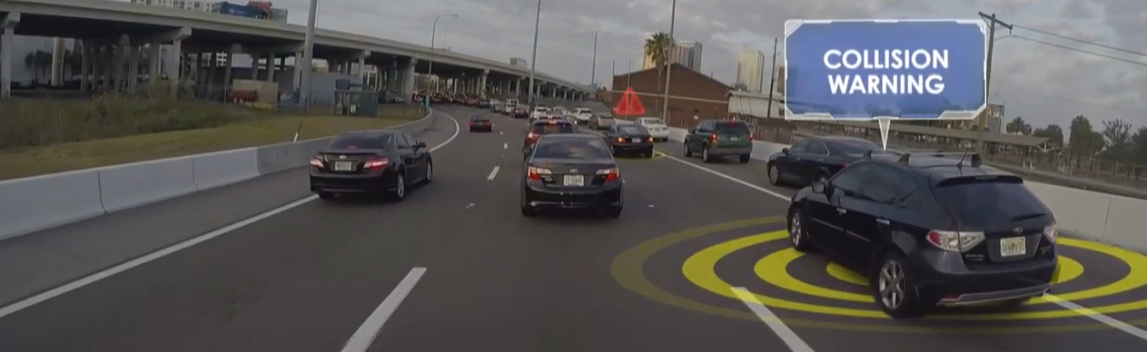
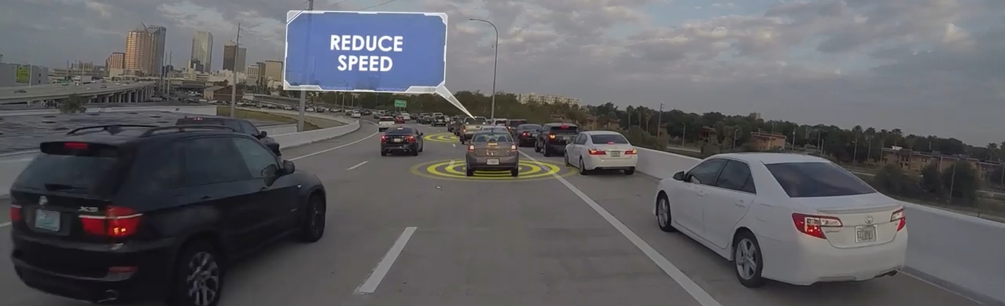
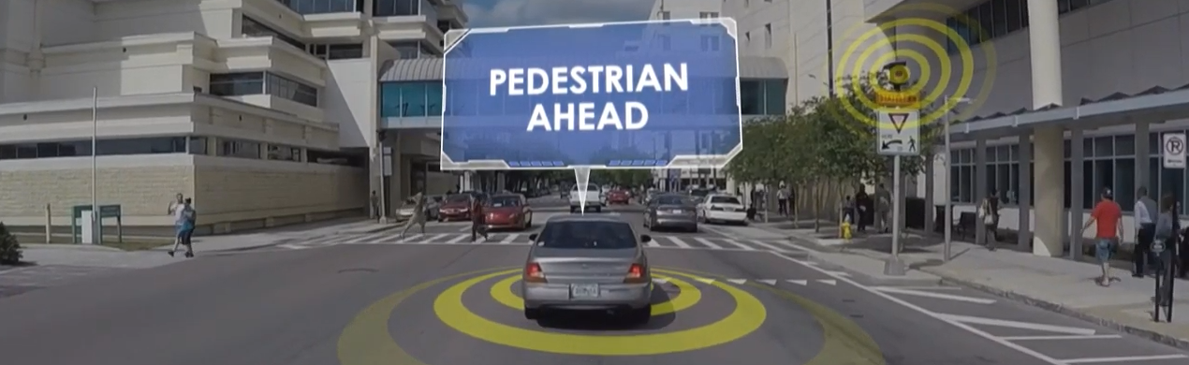
Connected Vehicle (CV)
Onboard wireless communications share information to:
Improve safety
Increase mobility
Reduce congestion
IMAGE SOURCE: THEA CONNECTED VEHICLE PILOT
Notes:
For anyone new to this technology, connected vehicles communicate with other vehicles, the infrastructure and smartphones held by pedestrians, cyclists and wheelchair occupants. GM’s OnStar has existed for two decades as an early example of connectivity – if you’re in an accident the technology can automatically alert an operator to assist you. The future potential of connectivity will be rely on super-fast communications where vehicles can “talk” to each other, to the roadside, and to mobile devices. This super-fast communications technology will allow future connected vehicles to receive real-time alerts that can help prevent crashes, reduce congestion, and improve pedestrian safety. If vehicle computers are all talking to each other, theoretically they shouldn’t crash into each other!

Slide 4
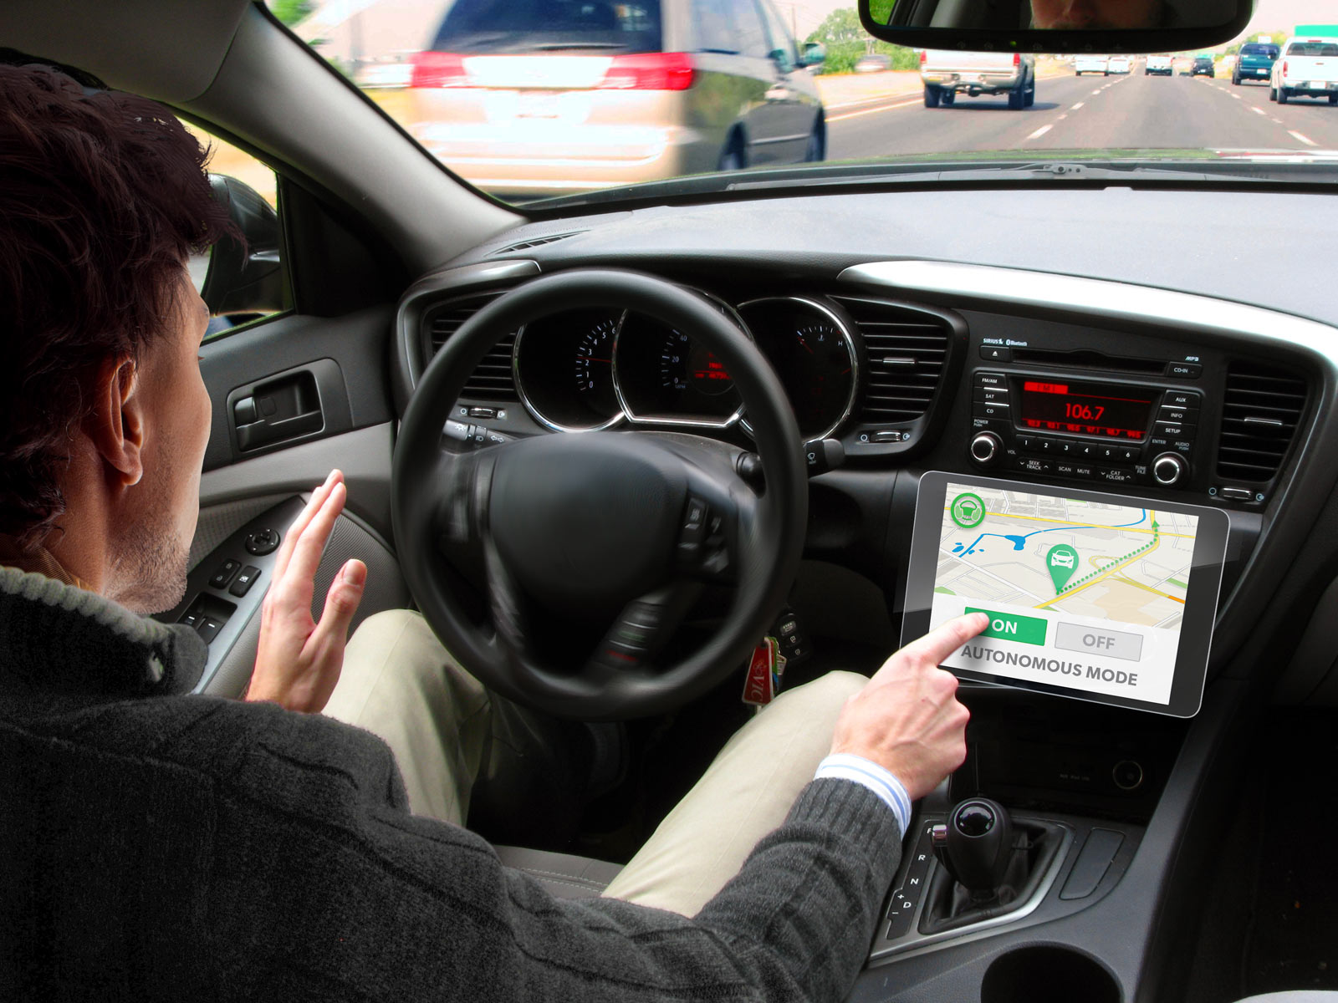
Automated Vehicle (AV)
One or more aspects of safety-critical driving functions controlled by something other than direct input by human driver
IMAGE SOURCE: USDOT
Notes:
Driving is a series of decisions and actions – when you string these tasks all together you are able to drive. Technology is rapidly becoming available to start reducing some of those tasks – such as lane departure warning, parking assist, automatic emergency braking, and even advanced cruise control systems that can adapt if the vehicle in front of you is slowing down.
The next generation of automated vehicle technology that is already getting ready to hit the streets will provide more and more assistance to the point where it can manage complex decisions and reactions, en route to eventual self driving capabilities.

Slide 5
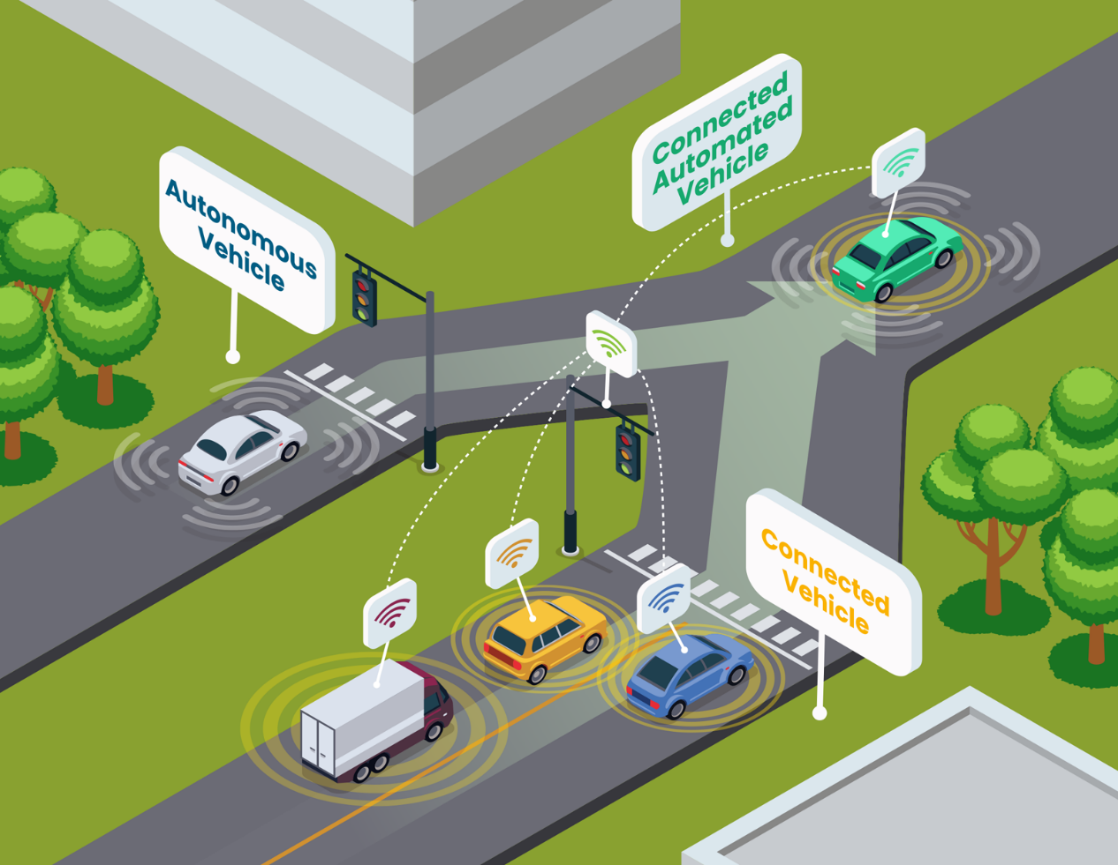
Connected Automated Vehicle (CAV)
CAV Readiness Study
The vehicle of the future may not have a steering wheel or pedals – it will combine CV and AV capabilities
IMAGE SOURCE: USDOT
Notes:
The fully automated, self driving vehicle of the future that may not need a steering wheel and pedals for accelerating or braking – it will be a connected automated vehicle, or CAV, that combines all capabilities of connected vehicles and automated vehicles.
Five Levels of Automation (SAE Standard)
Levels of Automation (suggested plain language)
Safe Driving / ADAS* – hands on wheel, feet on pedals at ALL times
Self-Driving Car – hands off wheel, feet off pedals SOME of the time
Driverless – Car drives itself

Slide 6
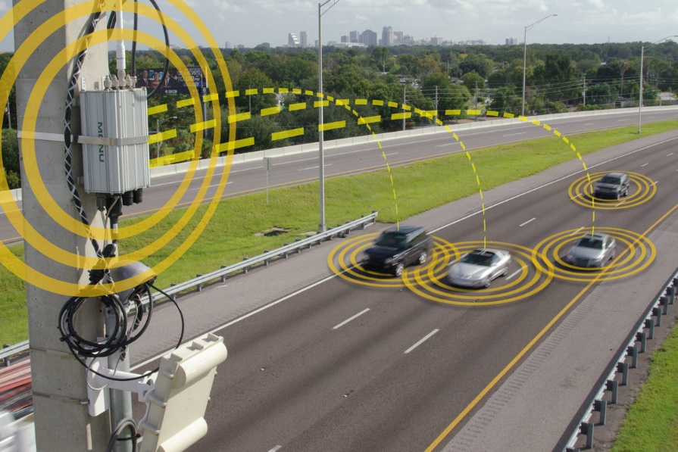
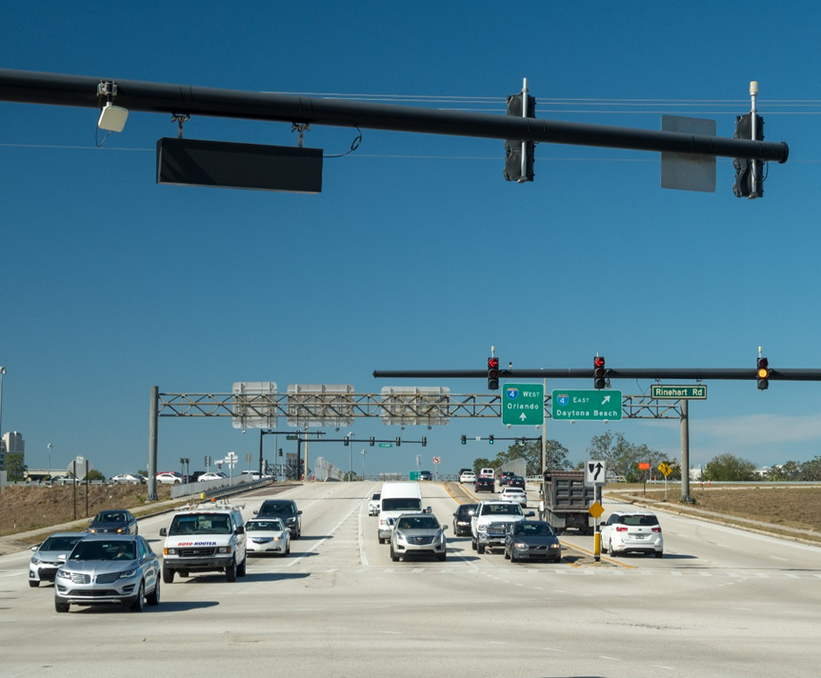
Foundational Research
Early tasks in the project produced Technical Memorandums on:
Industry CAV Best Practices
Evaluation of Local Existing Capabilities
Notes:
In the first technical memorandum MetroPlan Orlando completed an analysis of CAV best practices to provide base findings that can be applied in Central Florida.
This foundational research helped identify core needs of successful CAV projects around the country: making sure they are feasible, innovative, satisfy a local need, and recognize the need for regional equity. They found that other agencies around the country are starting to consider CAV technologies to inform the decision-making process for funding and development – and that many will match local needs and capabilities with emerging industry trends. In addition to these conclusions, MetroPlan Orlando also had the opportunity to share best practices from other regions and agencies to build planning expertise that goes beyond technology development and assessment.
For the second technical memorandum, more than two dozen local transportation engineers, managers and planners were interviewed about the roadway infrastructure, staffing proficiency, system and network capabilities, potential CAV testing locations, training plans and equity challenges.

Slide 7
Potential Opportunities
Establish CAV consortium
Advance CAV deployments
Install enhanced communication networks
Expand workforce CAV knowledge
Develop region-wide training
Solve or mitigate equity challenges
Notes:
Based on the early tasks, MetroPlan Orlando concluded that region-wide collaboration, training, consistent use of technology and equity solutions are needed to be CAV ready. We then took those preliminary ideas into our public workshops to explore further.

Slide 8
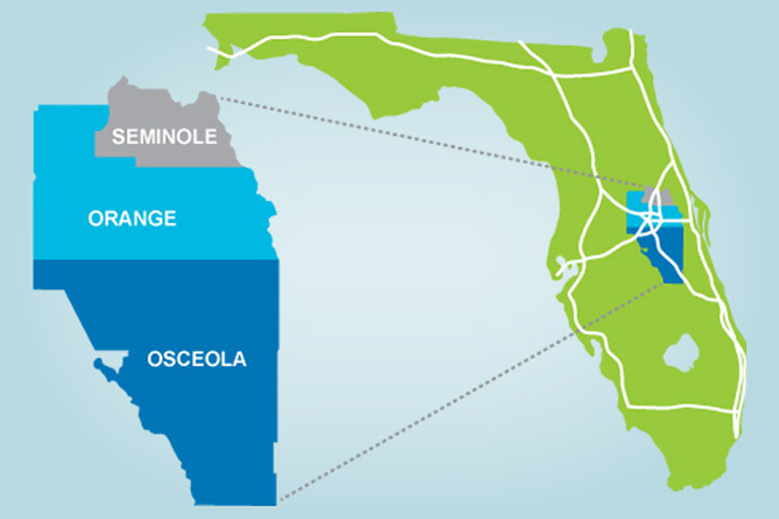
Public Engagement Workshops
Seminole County
Lake Mary Events Center Tues, Nov 12, 2019
Orange County
First United Methodist Downtown Orlando
Tues, Nov 19, 2019
Osceola County
Kissimmee Civic Center Tues, Oct 29, 2019
Notes:
As noted earlier, stakeholder input was a critical component of this project. MetroPlan Orlando conducted three public workshops in the three counties – Orange, Osceola and Seminole – where MetroPlan Orlando leads regional transportation planning efforts. The goals of each workshop were to increase awareness of CAV activities and how they might impact future regional planning efforts, to discuss and share information on opportunities for public and private sector relationship building, and to solicit feedback for increasing MetroPlan’s CAV planning and prioritization exercises in the future.
As attendees entered each workshop location, display boards told the story of why the CAV Readiness Study is needed; defined differentiators between connected vehicles (CV), automated vehicles (AV) and CAVs; presented study findings; and showed anticipated CAV impacts on future urban development. Attendees also had the opportunity to take a 10-question survey soliciting their opinions about riding in CAVs, safety, policy concerns and how they think CAVs could impact their surroundings.
I provided a presentation during each workshop which defined AV, CV and CAV concepts, and also presented findings from the completed technical memorandums that reviewed CAV industry best practices and evaluated existing local capabilities. This concluded with some Q/A. Attendees with smartphones were provided access to a live polling website which produced results in real time that MetroPlan displayed on the presentation screen.

Slide 9
Generally Favorable Opinions of CAV Concepts
CAV Public Engagement
 | Osceola | Seminole | Orange | Total | Average
Very enthusiastic | 9 | 4 | 6 | 19 | 6.3
Somewhat enthusiastic | 3 | 8 | 9 | 20 | 6.7
Neutral | 1 | 1 | 0 | 2 | 0.7
Somewhat worried | 0 | 3 | 2 | 5 | 1.7
Very worried | 1 | 1 | 1 | 3 | 1.0
Notes:
Attendees at all three workshops consistently showed an understanding and favorable opinion of CAV concepts.

Slide 10
Concerns, Challenges, and Opportunities
CAV Public Engagement
Biggest Concerns:
Safety, privacy, and data security
Biggest Challenges:
Vehicle technology development, workforce training, and data storage
Biggest Opportunities:
Educating the public, cross-agency knowledge sharing, and equity in CAV testing/pilot programs across both urban and rural areas
Notes:
Attendees had safety, privacy and data security concerns, along with believing that vehicle technology development, workforce training and data storage will be the biggest challenges in the region as CAVs emerge on public roads.
Attendees also agreed that future planning opportunities include prioritizing funding in the region to educate the public and forming a cross-agency consortium to share knowledge and make recommendations to ensure that CAV testing and pilot programs are deployed equally in urban and rural areas.

Slide 11
CAV Recommendations
Planning & Policy
Infrastructure Guidelines
Data Collection & Management
Pilot Projects
Staffing & Training
Notes:
Following the public workshops, we turned our attention to developing and documenting all the recommendations for leaders to evaluate in terms of developing short-term to mid-term concepts and plans for CAV preparedness. They were organized in these categories.

Slide 12
Planning & Policy
Executive Guidance
Ensure leadership is on-board
Establish clear roles & responsibilities
Long-Range Transportation Planning
Align CAV with committees or partnerships
MetroPlan 2045 Metropolitan Transportation Plan
Notes:
Planning & Policy
Executive Guidance
Awareness and periodic engagement from senior leadership representing all of the stakeholder agencies is necessary to maintain momentum. While each agency will undoubtedly have their own priorities and unique challenges, there will be many common themes and opportunities that are best achieved through executive leadership.
Long-Range Transportation Planning
CAV applications will be continually evolving with new technologies emerging and local jurisdictions becoming more familiar and addressing infrastructure and communication improvements to foster CAV. Integrate into planning activities being undertaken by MetroPlan Orlando, as well as other regional partners such as LYNX, the Florida Department of Transportation (FDOT), Central Florida Expressway Authority (CFX) and local counties and cities.

Slide 13
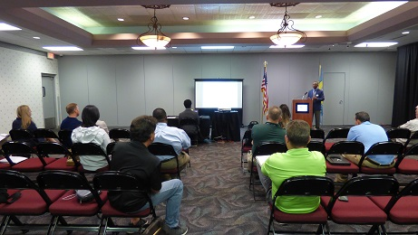
Planning & Policy (cont.)
Site Development
Develop guidelines and promulgate best practices
Identify CAV zone(s)
Monitor parking trends
Equity
Vertical
Horizontal
Notes:
Planning & Policy
Site Development
CAVs bring great opportunities to transform the built environment in ways that, where appropriate, can refocus communities towards the needs of humans instead of the movement of automobiles. CAVs will change the way users access their vehicles, bring reductions in demand and space needed for parking, yield opportunities for road diets and complete streets, and require major redesigns to transportation corridors and development sites to accommodate passenger drop-offs and pick-ups.
Parking and information and commercial signage
Equity
“Vertical equity” means that the broadest possible cross-section of Floridians experience CAV benefits, demonstrations, and challenges
In “horizontal equity,” each agency within the MetroPlan Orlando region is at a different level when it comes to system capabilities, and each agency has different challenges that they are facing in terms of providing predictable and reliable multi-modal options
EJ Performance measurement

Slide 14
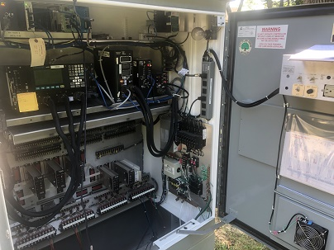
Infrastructure Guidelines
Review new and evolving national infrastructure guidelines
Signalized intersections
Signing & pavement markings
TSM&O/ITS Guidelines
Maintenance
Notes:
Infrastructure Guidelines
Roadway Technology
Roadway infrastructure requirements and guidelines are a key component to successfully deploying CAV technologies and ensuring interoperability throughout the MetroPlan Orlando planning area. This includes updated signing and pavement markings, as well as traffic signal hardware
TSM&O/ITS Guidelines
CAV technologies are part of the larger TSM&O and Intelligent Transportation System (ITS) framework, which supports the safe and efficient movement of people and goods throughout the MetroPlan Orlando planning area. As CAV technologies are further developed, guidelines that define CAV’s role within this framework will be needed.
Maintenance
The deployment of CAV technologies will bring additional maintenance responsibilities for local jurisdictions, the state, and private industry partners. Clear guidance is needed to define who will maintain this equipment, and training will be required for those performing maintenance on newly deployed CAV technologies.
NCHRP 20-24(112) focuses on developing a consensus Connected Road Classification System that will be useful to state and local DOTs and MPOs that are planning or implementing CAV-compatible infrastructure. The project is based on the premise that an important decision facing each infrastructure owner/operator is the level to which they intend to equip their roadways for the impending rollout of CAVs.

Slide 15
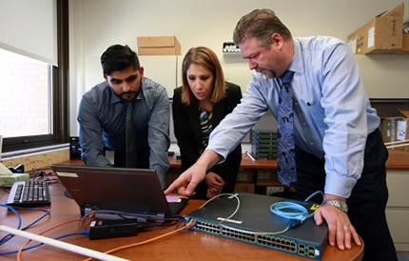
Data Collection & Management
Data Governance
Data Collection/Storage
Sharing
Security
Notes:
Data Collection & Management
Data Governance
Data governance includes the systems for managing data as well as the decision-making authority on data policies and data stewardship. The ultimate responsibility for data governance for the region should be at the state level, with FDOT setting clear and consistent guidance
Data Collection/Storage
As vehicles, infrastructure, and other objects in the transportation system become increasingly more connected, there will be ample opportunities to collect data via information that is transmitted for other purposes.
Data Sharing
Policies on whether and how to share data with entities other than the agency collecting and storing the data will need to be determined in order to support novel uses of CAV data while protecting data value, privacy, and security.
Data Security
Collecting, storing, and sharing CAV data brings with it the responsibility to ensure this information is protected. Learning from best practices elsewhere, including in other industries, agencies within the region will need to implement strong systems to maintain data security.

Slide 16
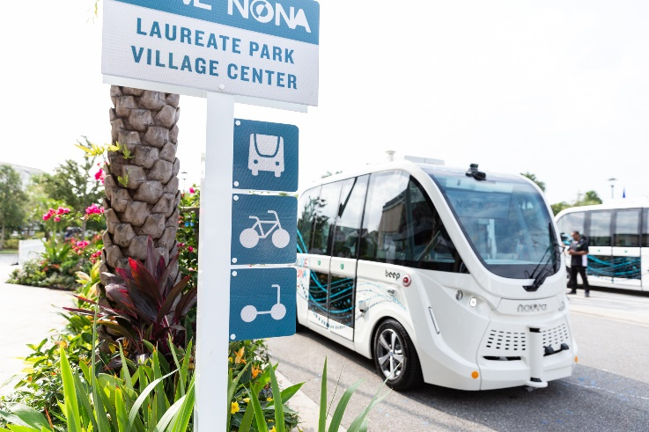
Pilot Projects
Identify corridors for potential applications
Establish use cases for AV pilot projects
Partner with local interest groups to gain user insight
Federal grant/funding opportunities
Notes:
Pilot Projects
CV Pilot Projects
With the advent of new CV technology, new opportunities to test these technologies through pilot projects should be undertaken. This would build on initial efforts led by FDOT along the SR 434 corridor in Seminole County, and on the University of Central Florida (UCF) campus.
AV Pilot Projects
Promote specific applications to test new AVs and technology within the MetroPlan Orlando planning area.
CAV Testing
As CAV technologies evolve, continual testing will be required to assess the impact of new technologies on roadway operations and safety. Accomplish this through CV and AV pilot projects, and through use of the new SunTrax testing facility.
A simple way for a region or municipality to launch a CV pilot is by outfitting an agency’s maintenance fleet, private partner fleets, or other publicly owned vehicles such as transit vehicles, to create a critical mass of vehicles on the roadway that enables somewhat frequent interactions between CVs to occur. This approach is being used in the NYC DOT pilot, which includes equipping transit vehicles and other large privately-owned fleets such as taxis and UPS trucks with aftermarket safety devices and OBE that converts a regular vehicle into a connected vehicle.
US DOT Intelligent Transportation Systems Joint Program Office, “Connected Vehicle Pilot Deployment Program: New York City (NYC) DOT Pilot”, https://www.its.dot.gov/pilots/pilots_nycdot.htm.

Slide 17
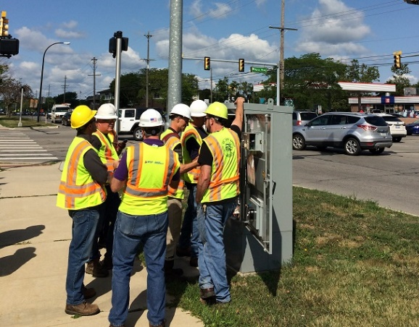
Staffing & Training
Recruitment/Retention
Offer existing staff new opportunities
Address recruitment challenges for data scientists
Training
Identify regional training efforts
Seek out external training opportunities
Notes:
Staffing & Training
Recruitment/Retention
The widespread adoption of CAVs is expected to have varying impacts on workforce needs, including the already emerging challenge of finding, attracting, and retaining employees with the right skillsets needed to operate, maintain, manage, and plan the transportation network. Meeting this challenge will require incorporating lessons learned from other regions and parts of the country, including investing in local training programs, promoting staff engagement and growth, and exploring new ways to hire qualified applicants.
Training
While one potential solution to supporting the recruitment and retention of qualified applicants would be to enhance training of existing and potential staff, training in some new types of skillsets is not yet widely available. Much of this training can be built up within the region as experience in these emerging fields begins to grow, but it will also be important, particularly in the shorter-term, to look elsewhere for training opportunities and knowledge sharing of lessons learned.

Slide 18
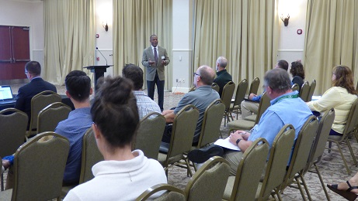
What’s Next for CAVs
What’s Next?
Conduit
Convener
Collaboration
Notes:
Conclusions (1 of 2)
The recommendations presented are far-reaching, but the overall intention is to build policies and procedures that will help guide agencies within MetroPlan Orlando’s planning area through the introduction and adoption of CAV technologies. As next generation mobility applications and technologies continue to evolve and improve, the timeline for CAV introduction and adoption will be impacted by the readiness of the technology and also by the readiness of the regulatory environment – coupled of course with the receptiveness of the overall public who are the ultimate users.
MetroPlan Orlando has the opportunity to act as an information conduit to help share best practices from other regions and agencies. It can also be a convener to foster collaboration and build a planning expertise that goes beyond technology development and assessment by implementing the recommendations.

Slide 19
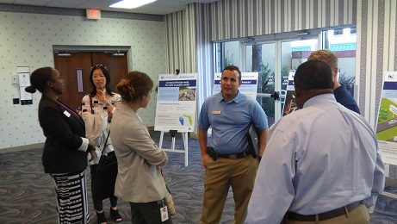
What’s Next for CAVs
What’s Next?
Pilots
Reflect needs
Available funds
Scenarios for MTP
Notes:
Conclusions (2 of 2)
It is worth noting that the recommendations may not be implemented in the same way or on the same timeline by all regional agencies. Each organization is currently at a different level of capability and maturity with CAV and may have different priorities for the types of outcomes they would like to see first. While some agencies are already conducting real-world pilot tests, others are still wrapping their heads around basic terminology. Therefore, an action item that might be longer term for one agency, could be nearer term for another agency.
The importance of these recommendations, however, is to put the full menu in front of all regional agencies, and stakeholders more broadly, so they can pick and choose what suits their current capacity and status – and for the region to coordinate on a common set of actions, recognizing they won’t all be accomplished at the same pace across every agency or jurisdiction. The implementation of these recommendations will also depend on funding availability, as well as integration with other ongoing equipment and infrastructure upgrades and how they could be modified in a cost-effective way, to best pursue the overall investment while enabling future trends in transportation like CAV.

Slide 20
Questions?
What’s Next for CAVs

Slide 21
Thank You
MetroPlanOrlando.org | (407) 481-5672
250 S. Orange Ave., Suite 200, Orlando, FL 32801

