Slide 1

CV LESSONS LEARNED AT THE LOCAL LEVEL
Gary Piotrowicz, PE, PTOE
Deputy Managing Director/
County Highway Engineer

Slide 2
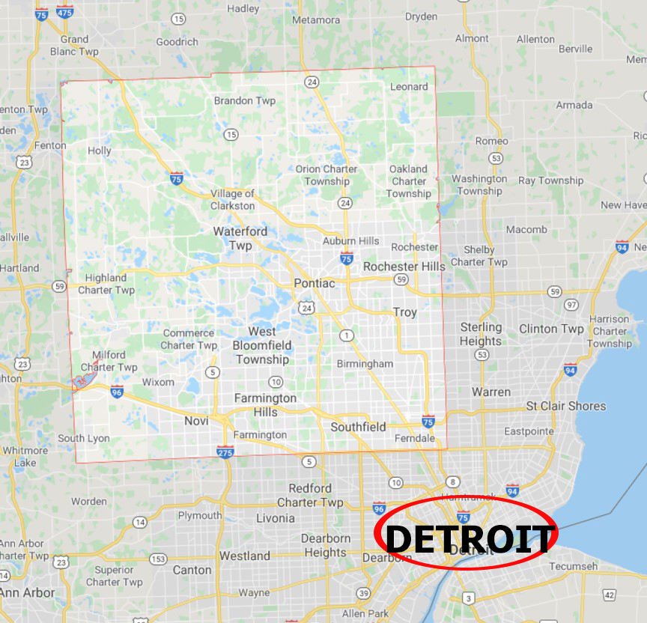
Road Commission for Oakland County (RCOC):
1.2 million people
900 square miles
Largest county road system in Michigan
Separate unit of government; not part of county general government
Maintenance contract with Mich DOT
Oakland County

Slide 3





RCOC’s Connected-Vehicle Background
RCOC was an early adopter of ITS technologies with creation of FAST-TRAC program in 1992
First adaptive traffic-signal system in nation (SCATS)
One of first local agencies involved in connected mobility going back to early 2000s.
Extensive experience in ITS field installations and operations
  Maintain signals for most cities and Mich DOT totaling over 2000 devices
We have used our O&M experience to leverage CV partnerships with:
  FHWA
  Michigan DOT
  Big Three auto companies
  Top-tier auto suppliers
  Connected/autonomous-vehicle companies
  Top academic institutions
  Oakland County general government
This has allowed us to partner on more than 20 CV projects.

Slide 4
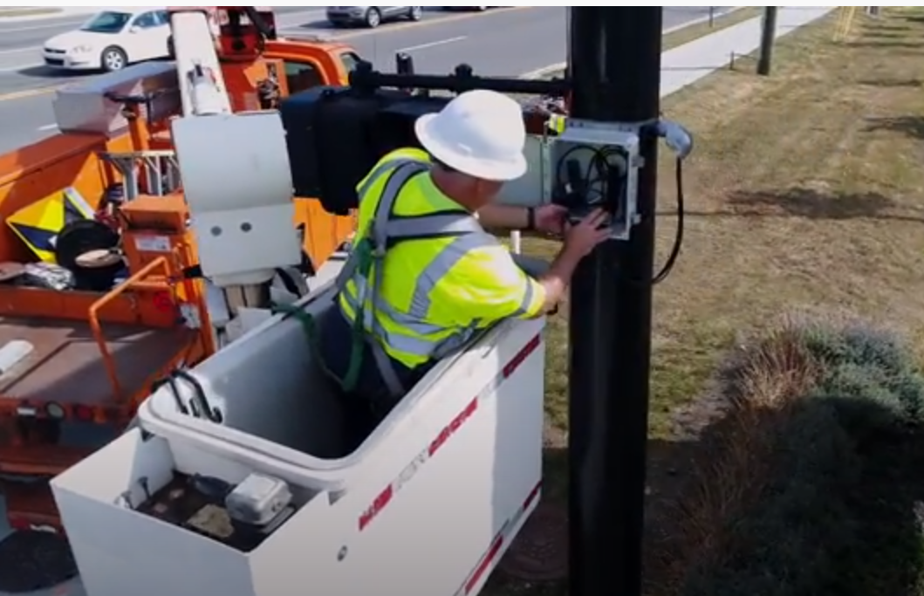
Lessons Learned from CV Field Test Deployments
Pushed industry for field-hardened equipment
Access to field equipment for maintenance
Remote software updates
Status monitoring software
Remote hard reset of equipment
More up-front planning for field installations
  Detailed survey of intersection
  Build as much as possible in controlled environment led to:
    Mocked up and tested in shop
    Minimize cable cuts in field
    Quicker installation
    Fewer install issues
Long term reliability of field equipment under wide scale deployment is still un-known
  Plan for significant O&M, then plan to do more
Photo of RCOC crew installing DSRC device

Slide 5

Need for a CV Business Model
Oakland County Economic development professionals recognized there was no CV business model.
Nationally – couldn’t find any examples.
Oakland County, in partnership with RCOC, created RFP & hired firm to develop a CV business model.
First task: Survey of industry regarding
financing and public willingness to pay
  Investors
  Automakers
  Suppliers
  Public agencies/Universities
Project stalled due to changes in personnel and political landscape.
First known effort to create a viable business model to monetize connected mobility.

Slide 6
What We Learned from Business-Model Process
Survey said: People willing to pay for CV equipment and apps.
But, investors in transportation field are risk averse.
A big obstacle to moving forward: Without a federal mandate, connected-vehicle infrastructure is a hard sell for investors.
The bottom line: Without a viable business model, and in the absence of substantial federal funding and mandate, widespread deployment is challenging.
The question remains: How does connected mobility generate enough revenue to fund widescale deployment & operations?
Meanwhile, other countries move forward with deployment thanks to federal mandates & subsidies.

Slide 7
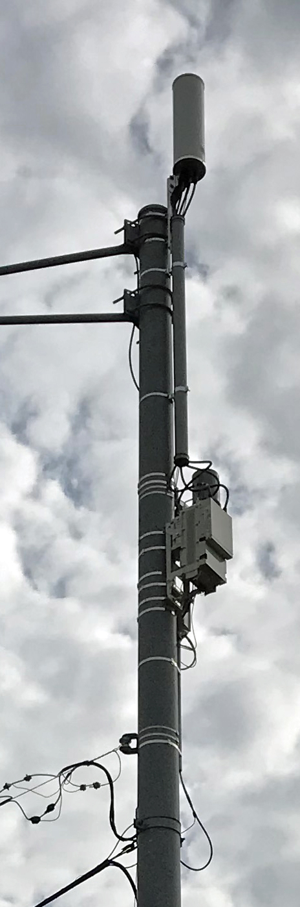
RCOC Small-Cell Success Story
RCOC saw small cell/5G coming & recognized possibility need for a CV business model
RCOC public-private partnership
  Goal: raise money to support deployment of CV including on-going O&M
  We hired a third party to broker agreements with cellular companies
  Ensures standardized permitting & deployment processes
  Shared revenue with broker
Currently 267 sites
  One-time permit fee per site: $500 ( $133,500)
  Current lease revenue to RCOC: $250,000 per year
Future
  Have cellular companies install DSRC as part of small cell
  Use cellular companies communication backbone

Slide 8
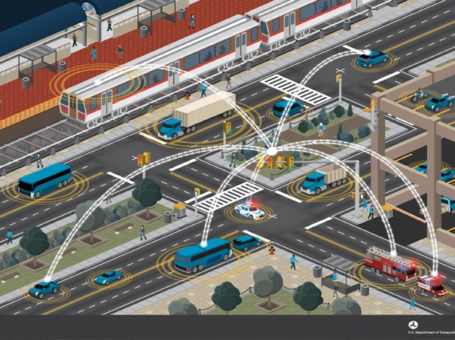
Other Lessons Learned Through Involvement in Connected Mobility
Lack of consensus on DSRC vs cellular is a real problem as it leads to uncertainty
Collaboration with automakers is positive
  In the past, auto manufacturers and road agencies did not talk
  Now, we have to collaborate
  Automakers, suppliers and infrastructure owners/operators now regularly partner on projects
Need to find engineers and technicians that have broader expertise

Slide 9
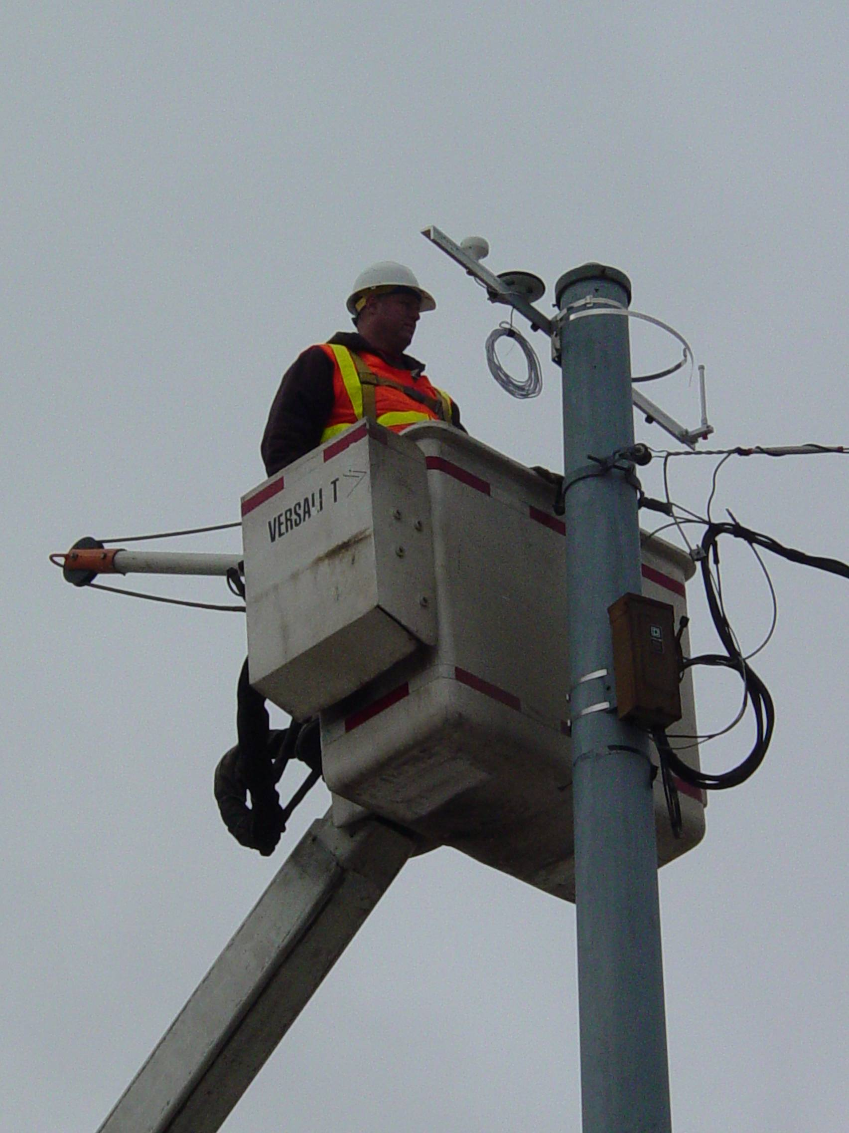
Other Lessons Learned: Get Involved
Do field demonstrations
  Help others
Committees/Research
  ITE
  TRB
  NCHRP
  USDOT/FHWA
  ITSA
Scan tours (host and visitor)

Slide 10
Other Lessons Learned: Imagine
The use of VII data will likely require a major paradigm shift that changes the way road agencies do business
Can there be too much data? How and why we collect data would be different
Traffic Signal Studies
  Studies for new signals or left turn phasing
Operations
  MOEs (travel time, delays)
  24 hour system effectiveness monitoring
  Respond to complaints
  Re-timing (including “on a shoe string”)
Planning
  New signal studies
  Left turn studies
  Counts (instant, more of, more detailed, historical, cheaper)
Maintenance
  Snow status, road condition
  Pot hole management
Asset Management
  Pavement condition
Safety
  Identify high risk locations
  Applications to improve safety (curve speed, red light running, stopped traffic, slippery road)

Slide 11
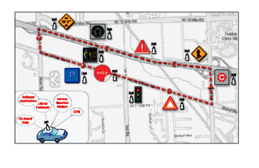
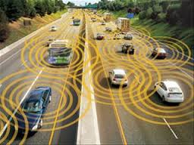
RCOC’s Connected-Vehicle Projects
Began early 2000’s, pre DSRC
Field tests with automakers, suppliers, researchers
Numerous Federally sponsored tests
Projects with foreign countries/companies
Single intersections up to over 60

Slide 12
Thank-You…………..
Questions????

Slide 13
Connected Vehicle Installations in Oakland County (additional slides not shown on Zoom meeting)

Slide 14
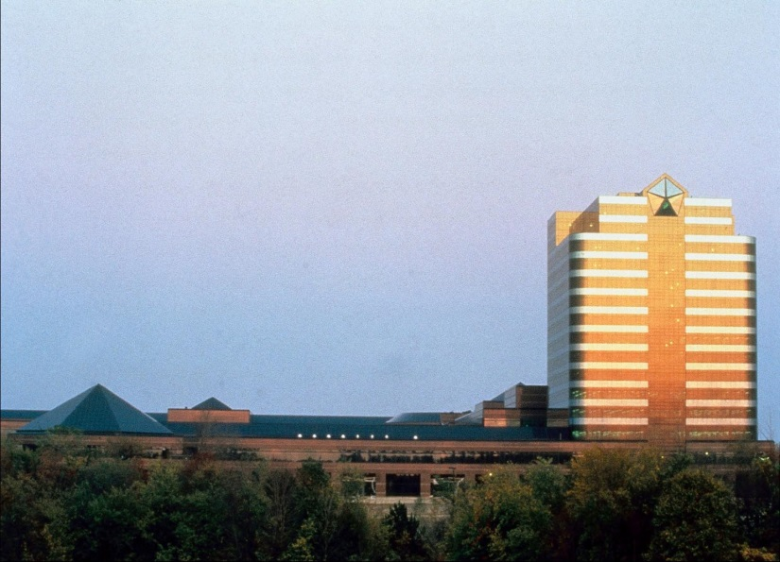
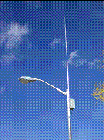
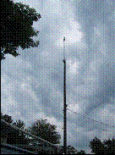
Daimler Chrysler (DCX) HQ Installation (2005)
Installation of wireless network on six traffic signals around HQ and nearby intersecitons
Joint project between RCOC, MDOT, Chrysler, and Ottawa Wireless
Chrysler instrumented “fast-feedback” cars to communicate across the wireless network
Intent: Retrieve real-time probe and diagnostic data from vehicles
RCOC/MDOT received “probe-vehicle” information

Slide 15

Ford Lincoln (2005)
Motorola Wireless Radio Link to test “Wi-Fi” at RCOC intersection
Link to run SCATS communications and “Wi-Fi” Internet Access Point
Software in Lincoln used to transfer data to Ford research labs

Slide 16
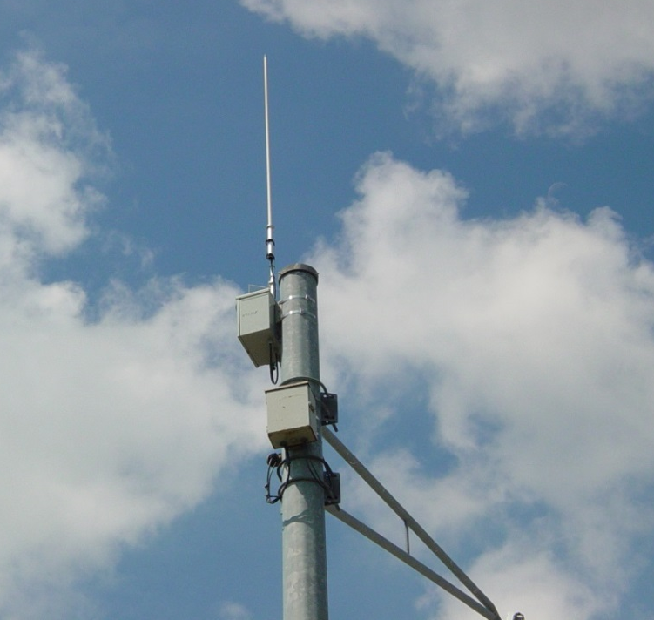
Motorola DSRC Test (2006)
Motorola’s first large-scale field test of DSRC
Located at several signals around RCOC facilities
Chose RCOC based on our knowledge, experience and ability to get it done
Learned about range, reliability, band width and installation issues
Tested vehicle-to-vehicle and vehicle-to-infrastructure communications

Slide 17

Cooperative Intersection Collision Avoidance System (CICAS) (2006)
Goal: Implement field trials that demonstrate improved intersection safety by alerting vehicles that are about to run a stop sign or traffic signal
Two test intersections were in Oakland County
Other field trials in Virginia and California
Worked with Crash Avoidance Metrics Program (CAMP)

Slide 18
Data Use Analysis and Processing (DUAP) (2006-Present)
Ongoing effort led by MDOT with stakeholders from all over U.S. and Europe
Evaluate the use of Connected-Vehicle data for public-sector purposes
  Responding to safety concerns
  Managing traffic
  Managing transportation assets
Goal is to answer the question “How can public agencies use Connected-Vehicle data?”

Slide 19
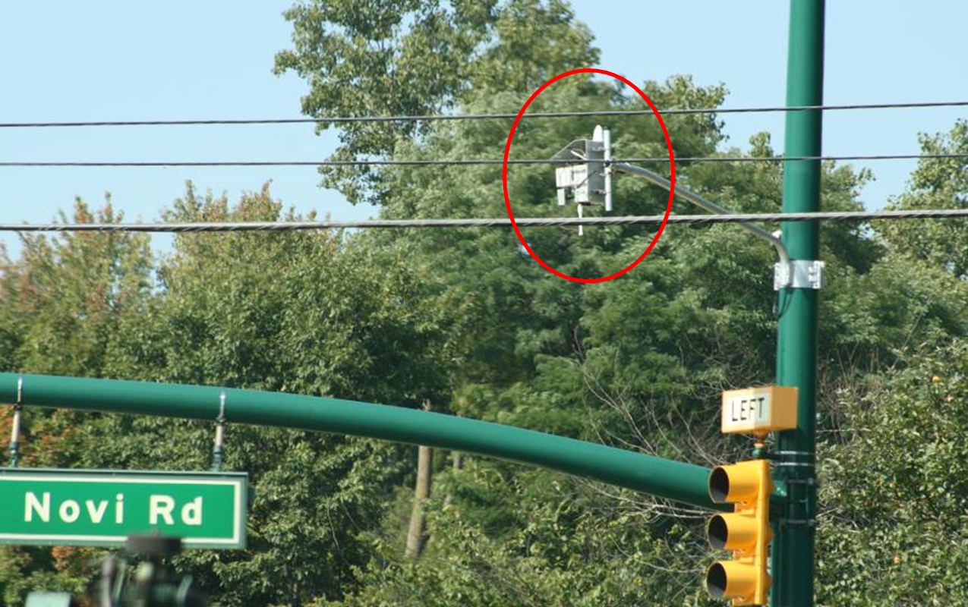
National Connected Vehicle Proof of Concept (POC) (2007)
Joint project with MDOT and FHWA, located in Oakland County
First large-scale demonstration in the U.S.
55 road-side equipment (RSE) units installed at 43 traffic signals
Covered about 45 square miles
Successfully proved that data could be shared between infrastructure and vehicles in a timely, accurate and useful manner

Slide 20
Connected Vehicle Proving Center (CVPC)/Center for Automotive Research (CAR) (2008)
Joint project with MDOT
Two traffic signals located in Oakland County
Real-time traffic-signal distribution application
Test vehicle-to-intersection applications

Slide 21
ITS Michigan Annual Meeting (2008)
Connected-Vehicle Model Deployment Demonstration
Joint demonstration with MDOT and several consulting firms
Applications included:
  Intersection status with SPaT data
  Slippery pavement on bridge alert
  Bridge monitoring and height warning
  Emergency-vehicle alerts

Slide 22
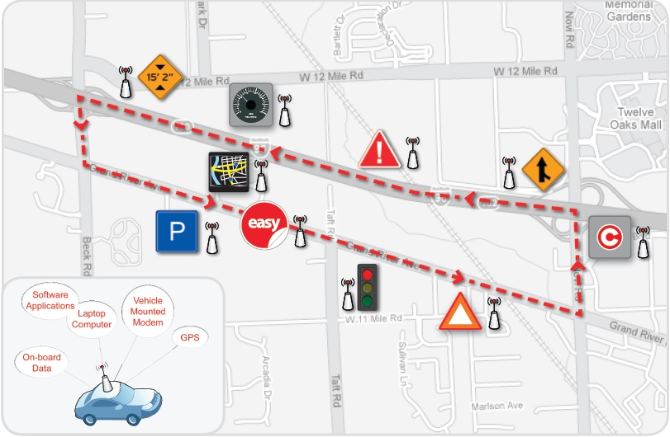
ITS Michigan Model Deployment

Slide 23
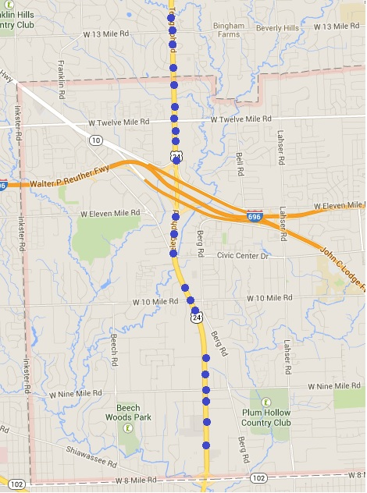
MDOT Telegraph Expansion Project (2010)
22 RSEs in Southfield
Send SPaT information
Open test bed

Slide 24
MDOT Telegraph Expansion Project cont’d
Updated with new DSRC up to 13 Mile Road (2019)
Plan to install DSRCs all the way to Dixie (2020-2021)
RCOC is the installer
Federally funded project

Slide 25
Taiwan SPaT Demo (2011)
Joint project with MDOT, UMTRI and HRC
Tested at two traffic signals in Oakland County
Demonstrate in-vehicle wireless communication to give driver signal-timing info, Green Wave
Cellular and DSRC communications were tested

Slide 26
MDOT Connected-Vehicle Guidance Documents (2012)
Project with MDOT and Mixon Hill
Develop guidelines and lessons learned for future C-V test beds

Slide 27
Connected-Vehicle Safety Pilot Project (2012-13)
Research program to demonstrate the readiness of DSRC-based connected-vehicle safety applications for nationwide deployment.
Used 3,000 cars, trucks & transit vehicles equipped with wireless connected-vehicle devices in Ann Arbor.
Created a highly concentrated test environment of equipped vehicles operating on public streets.
This one-year model deployment was the first test of this magnitude of connected-vehicle technology in a real-world, multimodal operating environment.
RCOC helped install and maintain the infrastructure.

Slide 28

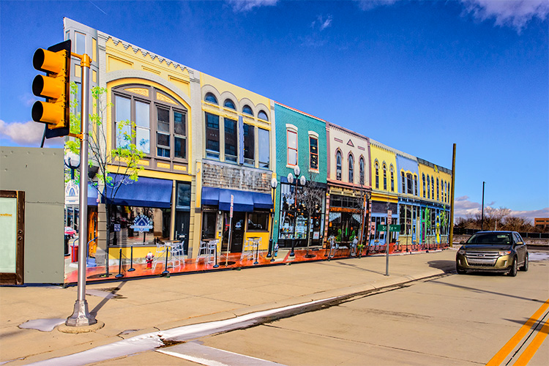
M City
Partnership of industry & government at U of M to transform global mobility by dramatically improving transportation safety, accessibility, efficiency & sustainability.
Intended to accelerate progress in areas such as connected-vehicle systems, driverless vehicles, shared vehicle and advanced-propulsion systems.
Focus = model deployment allowing researchers to test concepts in connected and automated vehicles in off- and on-road settings.
RCOC is a partner in M City.

Slide 29

2014 ITS World Congress
The ITS World Congress is an international gathering of leaders in the ITS/connected-vehicle field.
It has been held in NYC, Paris, London, LA, Barcelona, Turin, etc.
RCOC was instrumental in bringing the event to Detroit in 2014
Partner in numerous live demonstrations
The event was deemed one of the most successful World Congresses ever.

Slide 30
Woodward Ave DSRC Instrumentation 2020
MDOT Project to instrument Woodward Avenue from Campus Martius to Pontiac.
RCOC Portion is 8 Mile through Pontiac
RCOC is installing all the units and updating the Traffic Signal Cabinets and controllers.

Slide 31
Auburn Hills DSRC Install with MDOT (2019)
Three Locations
  Brown and Jamm
  Joslyn and Pacific
  I-75 and Chrysler

Slide 32
DSRC Installs –RCOC Project 2019
Collaboration with Kapsh and CAR
Three locations
  Halsted and 11 Mile
  Halsted and Amerisure Drive
  Halsted and Hills Tech

Slide 33
RCOC, Auburn Hills – Continental Testbed
Two locations
  Auburn Hills and Squirrel (North)
  Auburn Hills and Squirrel (South)
Two intersections are instrumented for I to V, I to X and V to X testing.

