Slide 1
Zenzic: Partnerships & Collaboration
Phillip Ironside,
Bhavin Makwana,
20 July

Slide 2
“By 2030, the UK is benefiting from proven connected and automated mobility, with an increasingly safe and secure road network, improved productivity and greater access to transport for all. Next-generation services and technology and designed and developed in the UK, powered by high-value skills and a strong supply-chain, driven by public demand. We are a world leader”
UK CAM Roadmap to 2030 – Vision Statement

Slide 3
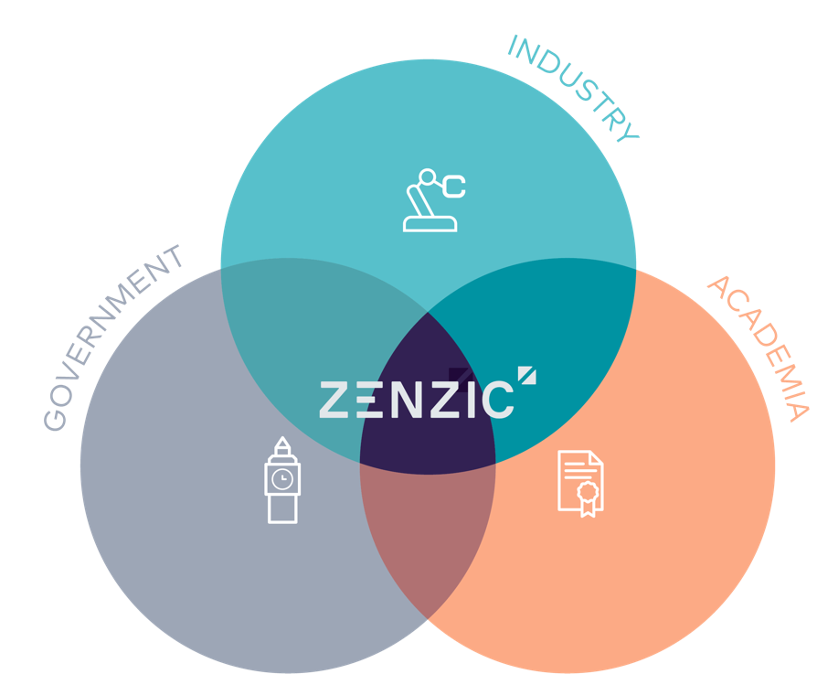
Enabling the UK to be a world leader in the development and deployment of CAM by 2030.
Bring together industry, government, and academia across all relevant sectors to develop and deploy CAM in the UK.
Insights
Hold the strategic vision and roadmap for the UK CAM ecosystem, providing informed guidance to government, industry and academia.
Innovation
Channel investment into targeted CR&D into late-stage tech and CAM Scale-Up programmes accelerating new technology the CAM market opportunity.
Collaboration
Provide the trusted brand and front door to a collaborative CAM supply chain, promoting and driving inwards investment.
Effective Innovation relies on both Insights and Collaboration.

Slide 4
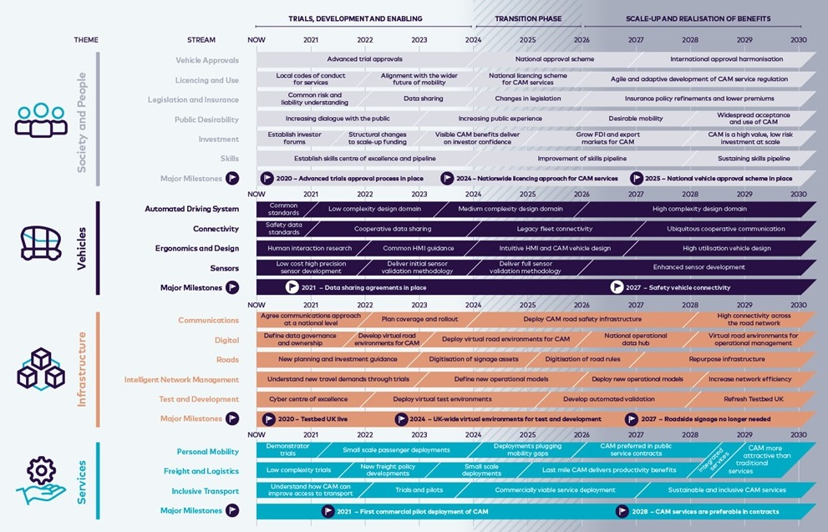
UK consensus view: CAM Roadmap to 2030
200+
300+
“… the roadmap highlights significant challenges that require cross industry support such as cyber resilience, use of simulation environments, sign-off and type approval, and in-use compliance … Connected and Automated Mobility is the future and the roadmap provides a direction and a well ordered set of critical enablers” - Craig Stephens, Director: Controls & Automated Systems R&A, Ford Motor Company
Download your copy of the roadmap report

Slide 5
Coordination of CAM in the UK
Zenzic’s mission remains to enable Centre for Connected and Autonomous Vehicles’ (CCAV) ambition to progress technologies, products, and services into commercial offerings. The focus of today’s discussion is:
CAM Testbed UK – building on collective test and development capability of the UK
CAM Scale-Up – design to accelerate start-ups and disruptors entering the CAM sector
CAM supply chain – joint invest to enable the commercialisation of CAM at scale

Slide 6
CAM Testbed UK

Slide 7
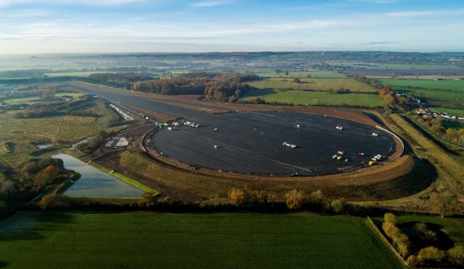
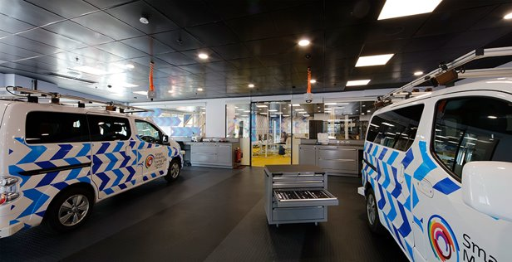
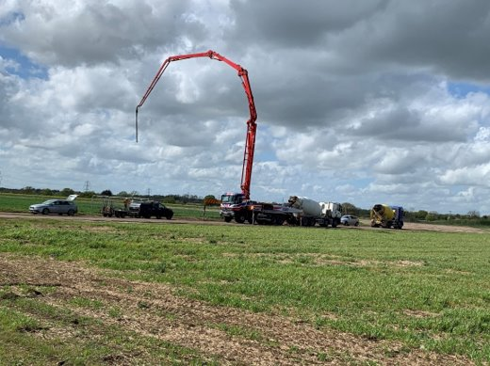
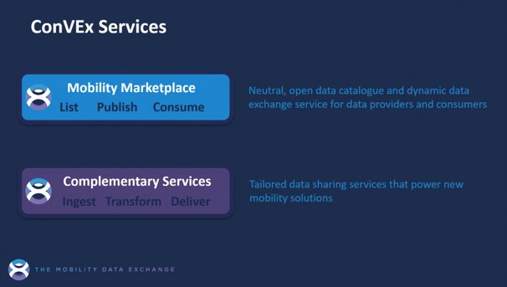
A brief history
2016
2017- present
£200m
Public/private investment

Slide 8
Interoperable, complementary and competitive

Slide 9
Interoperable, complementary & competitive

Slide 10
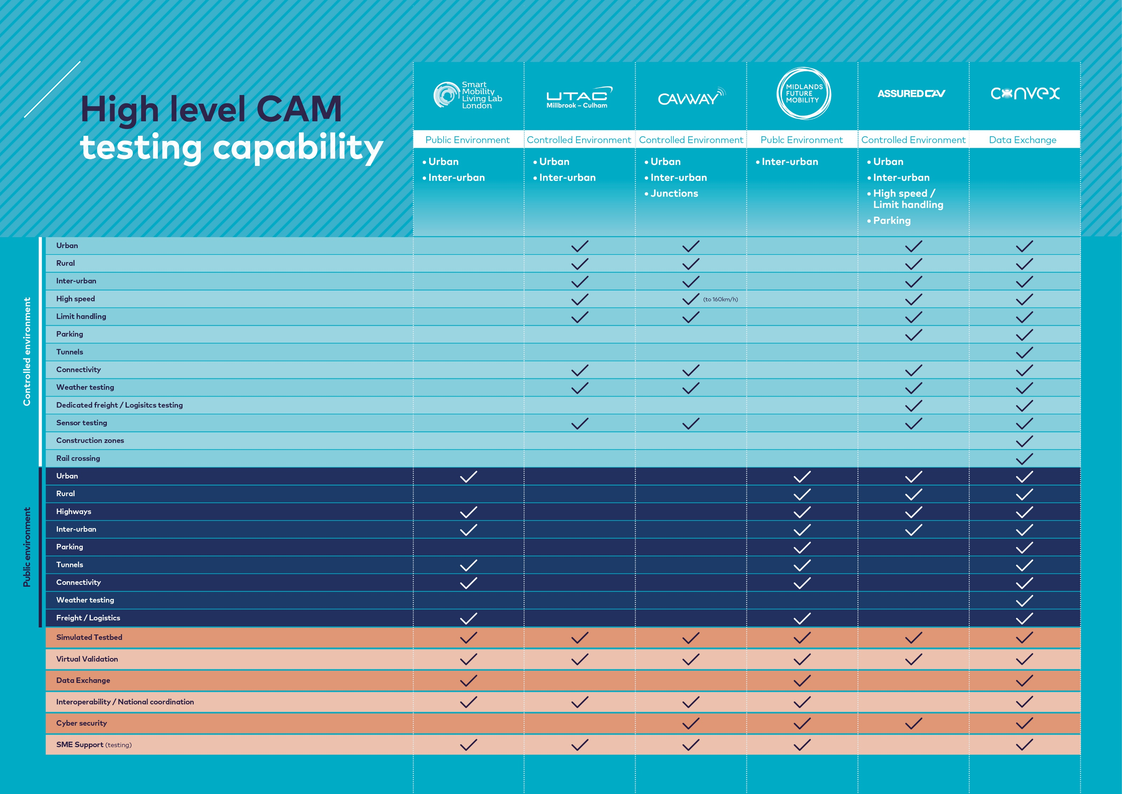

Slide 11
Collaborative projects
Interoperable simulation
Safety case guidance
Cyber resilience
Consumer safety rating
V&V through simulation
V2X Data services
Zenzic CAM Scale-Up

Slide 12
CAM Scale-Up programme

Slide 13
Zenzic CAM Scale-Up programme
The Zenzic CAM Scale-Up programme offers selected start-up and SME participants an opportunity to develop innovative CAM solutions at pace.
Successful start-ups and SMEs will get the opportunity to partner and collaborate with corporate partners throughout the programme. The goal for participants is to complete the programme with ready-for-market products and services that can meet required safety standards and operate in real-world environments.
The intention is that, upon exiting the programme, participants will have demonstrated their products operate in real-world environments. The aim is to accelerate delivery to market, build partnerships, attract investment and improve valuations.
The CAM Scale-Up programme is fully funded by UK government’s Centre for Connected and Autonomous Vehicles. It is run by Zenzic in partnership with Plug and Play. A global innovation platform, Plug and Play is has created the ultimate start-up ecosystem in many industries, and is instrument in securing private investment
accelerates delivery to market
The Zenzic CAM Scale-Up
programme offers start-ups and SMEs a boost like
nothing else
builds partnerships
attracts investment
improves valuations
increases innovation through collaboration

Slide 14
CAM Scale-Up: more than funding
Access to world class facilities
The funded programme grants access to world class facilities of CAM Testbed UK. The SME journey benefits from the deep technical knowledge that testbeds can offer
A stage for investment
Delivery partner PnP provide the stage for SMEs to address a global, tech savvy investor community. Candidates are coached and mentored to pitch to win
A helping hand
Zenzic is fully invested in accelerating CAM technology to market. A delivery lead is dedicated to make sure SMEs maximise the value of the programme
Access to an elite eco system
The enduring relationship with Zenzic give signposting and access to follow on opportunities, either with corporate partners, accessing future funding, or amplifying a key message. Zenzic provides the catalyst for a CAM network
Successful launch
The corporate partner program provides a critical friend to SME. CAM roadmap instruction hones understanding of the opportunity and ‘fresh eyes’ offers independent critique of the business plans

Slide 15
CAM Scale-Up: community perspective
CCAV…
An instrument for delivering on key policy objectives that can be readily tailored to focus on key CAM topics. Safeguarding of the nearly £200m invested by government and industry into CAM testbeds, growing and domestic supply chain, attracting private and foreign investment
CAM Testbed UK
Pipeline of new entrants, innovators and disruptors with a CAM focus. Raised profile and additional corporate engagement, new and enduring relationships. Short-term plugging of revenue gaps
Investor Community
Access to the excellent set of investor ready SMEs, set to establish in the UK mobility sector, unlocking new corporate partnerships/investments from its global investor network, driving further FDI opportunities in the UK
Corporates
Access to a low-risk R&D pipeline of emerging start-ups and SMEs. Opening up opportunities to explore innovate solutions and growth potential
Zenzic
Proof points for the CAM mission, amplifying value of world class capability, building critical mass to deliver supply chains, attract private investment and generate the benefits of wide scale CAM commercialisation

Slide 16
Cohort 1 success stories

Slide 17
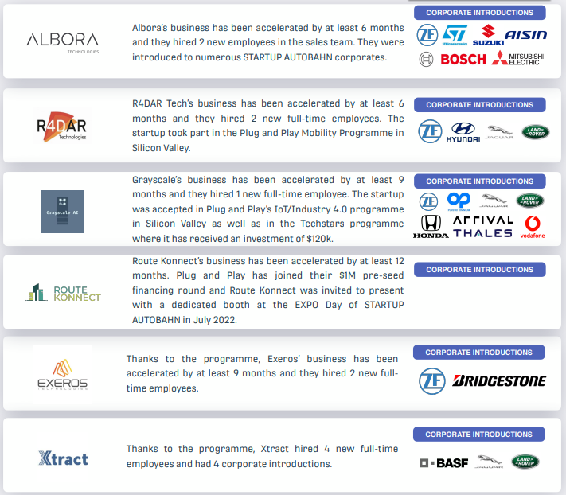
Cohort 2 success stories

Slide 18
UK CAM Supply Chain

Slide 19
CAM a maturing sector
Moving from an CAM ecosystem to supply chain
Tangible opportunity for the UK in the global CAM supply
Needs a greater understanding

Slide 20
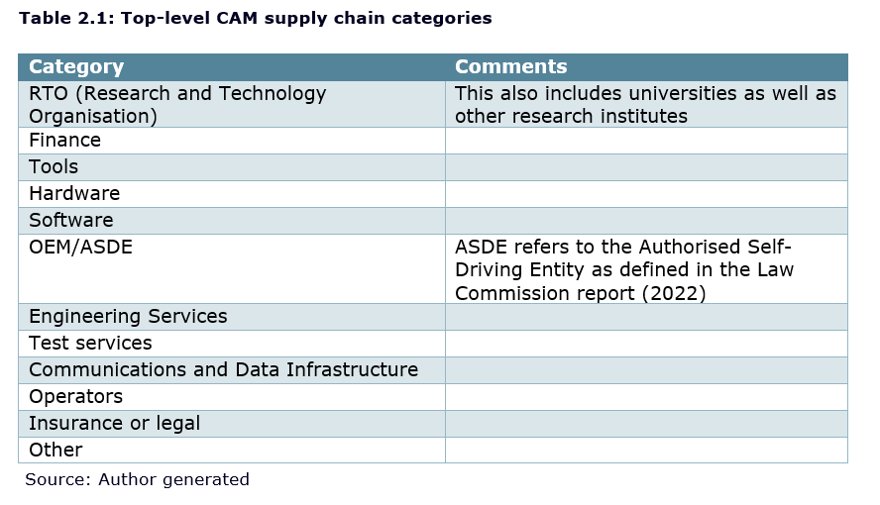
Categories
12 top level categories
79 sub-categories

Slide 21
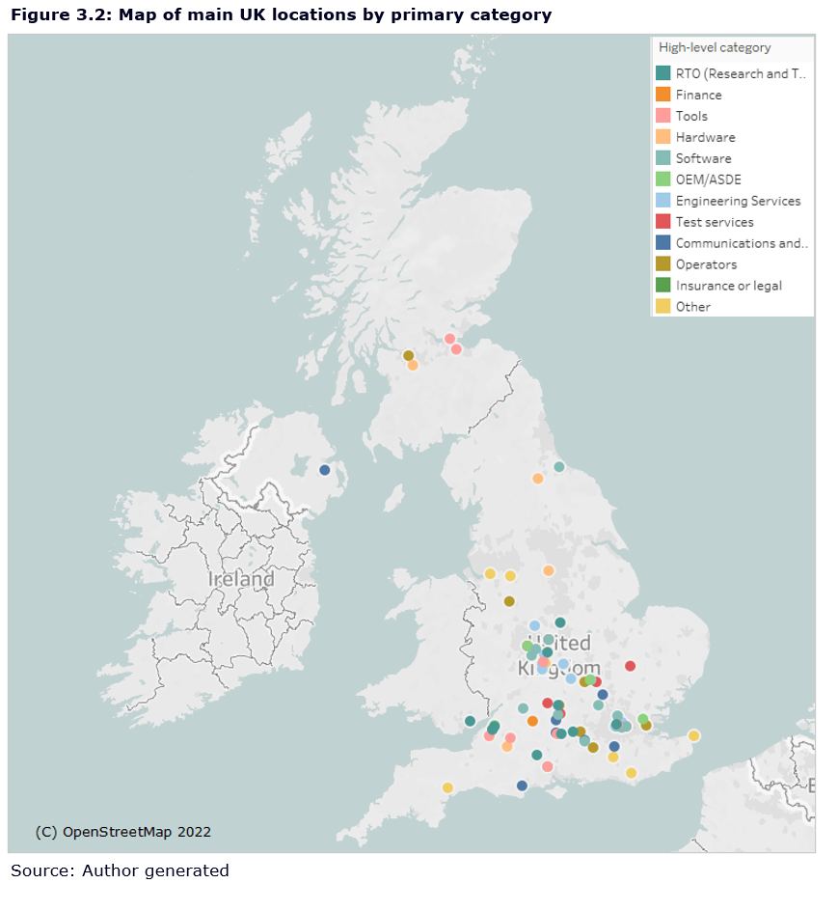
Geographic distribution

Slide 22
UK capabilities strengths
Software
(Data, AI, safety and security)
RTO
(Research and Technology Organisation)
Tools
(simulation, test, and analysis)
Test services
Insurance and/or legal
Notes:
Backed by strong Eng Skills, Comms and Data infra, OEMs, Operations and Finance

Slide 23
Thank you
phillip.ironside@zenzic.io
bhavin.makwana@zenzic.io
zenzic.io

Slide 24
Zenzic CAM Scale-Up programme
A government-funded programme supporting start-ups and SMEs looking to deliver a new product and or service into the CAM ecosystem. Selected companies will receive a share of £500,000 funding for testing and accelerated delivery to market.
Increased visibility in CAM ecosystem
Access to the most advanced CAM testing facilities in the UK
High pace programme with competitive application process
Share of 500k government funding
Accelerate delivery to market
Testing in real-world environments
PlugNPlay partner: access to global investor network

Slide 25
