Slide 1
Caltrans Connected and Automated Vehicles
Brian Simi
Office of Traffic Operations Research
Division of Research, Innovation & System Information
Cooperative Automated Transportation (CAT)
Domestic Scan Tour
Phoenix, Arizona
December 5, 2019

Slide 2
Government of California Structure (Partial)
Governor’s Office
Governor’s Office of Planning & Research
California State Transportation Authority (CalSTA)
California Public Utility Commission
Caltrans
California Highway Patrol
Office of Traffic Safety
Air Resource Board
Energy Commission
Department of Motor Vehicles
Autonomous Vehicle Visioning Sessions

Slide 3
AV PRINCIPLES
Shared-Use
Pooled
Low-Emissions
Part of an efficient multimodal system
Efficient Land Use
Complete and Livable Streets
Transportation Equity
http://opr.ca.gov/docs/20181115-California_Automated_Vehicle_Principles_for_Healthy_and_Sustainable_Communities.pdf
Notes:
Automated Vehicle Principles for Healthy and Sustainable Communities works with Addressing Equity, Sustainable and Social Justice.
This document was created by the California Multi-agency Workgroup on AVs (automated vehicles),
comprised of staff representatives from CalEPA, CalSTA, Caltrans, CARB, CDPH, CEC, DGS, DMV, Go-Biz,
OPR, and SGC. Additionally, CPUC staff participates in the workgroup. This document does not yet
represent an official position or decision of the participating agencies or commissions.
The mission of the workgroup is that by recognizing that AVs have tremendous potential to improve transportation
and our communities, the multi-agency working group works to ensure that connected and AV
transformation accelerates in California with clear environmental benefits and attention to equity
issues. This includes consideration of the effects of AVs on GHG and criteria pollutant emissions, land
use patterns, VMT, health, economic development, and equitable access.
Shared-use. Maximize deployment of shared-use vehicles as an alternative to personal car ownership.
Pooled. Maximize ride-sharing by encouraging pooling, prioritizing pooled vehicles’ mobility, and providing for shared-vehicle passenger safety and comfort.
Low-emissions. Maximize deployment of AVs as low-emission vehicles in the near term and zero emission vehicles in the long term, and employ eco-driving strategies. Right-sized. Promote use of vehicles that are sufficiently sized, but not oversized, for the trip purpose.
Part of an efficient multimodal system. Deploy AVs as part of a multimodal system that transports people and goods to destinations quickly and efficiently and, taken as a whole, that is energy-efficient, space-efficient, environmentally benign, and beneficial to human health.
Efficient land use. Facilitate compact infill development rather than accelerating sprawl; complement the deployment of AVs with implementation of robust policy supporting the State Planning Priorities.
Complete and livable streets. Prioritize people rather than vehicles, improve real and perceived safety for vulnerable road users, provide an array of transportation mode options, and provide quality public space by taking advantage of shared AVs’ reduced need for parking and right-of way space.
Transportation Equity. Improve affordable access to destinations and goods through AV deployment, particularly among low-income and disadvantaged communities and individuals with physical impairments. Approach AV vehicle travel, refueling, and AV storage in a manner that improves health, safety, environmental, and livability outcomes in those communities. Address the special transportation needs of rural residents and communities in a manner that improves access to destinations and goods without inducing sprawl.

Slide 4
AV WORKING GROUP
Safe Operation and Infrastructure
Land Use, Environment, and Sustainability
Workforce Transformation and Economic Development
Notes:
As a part of this effort, we will be convening sub-workgroups comprised of Subject Matter Experts (SMEs) from various departments and agencies across the state. Each sub-workgroup will be responsible for identifying specific strategies and actions in their assigned subject area. While these topic areas may be adjusted, we are looking for SMEs to participate in the following groups:
1 – Safe Operation and Infrastructure group, which will generally focus on safety-related elements and infrastructure needed to deploy these vehicles. This could include licensing, traffic safety, enforcement, infrastructure improvements, transit, and transportation systems.
2 – Land Use, Environment, and Sustainability group, which will generally focus on the impact on greenhouse gas emissions and vehicle miles traveled while considering land use policies, the intersection between housing and transportation, the integration of the transit system within a multi-modal system, and congestion management.
3 – Workforce Transformation and Economic Development group, which will generally focus on changes to existing workforce and industries, attraction of and investment by AV-related businesses, and access to destinations, goods, and employment.

Slide 5
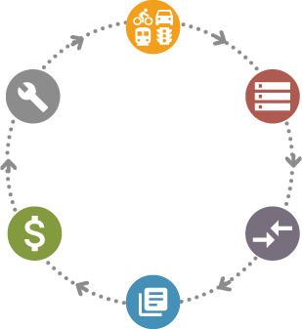
California Senate Bill 1 (SB1)
Started in 2018
Will provide $50 Billion in ten years
Funding will be mostly for transportation infrastructure maintenance
Maintenance
And
Operations
Corridor Analysis
System-Wide Needs
Road Maintenance and Rehabilitation Program
2030(d) - To the extent possible and cost effective, and where feasible, the department and cities and counties receiving funds under the program shall use advanced technologies and communications systems in transportation infrastructure that recognize and accommodate advanced automotive technologies that may include, but are not necessarily limited to, charging or fueling opportunities for zero-emission vehicles, and provision of infrastructure-to-vehicle communications for transitional or full autonomous vehicle systems.”
Identify
Projects
Centralized Needs Database
Program and Deliver Projects
Notes:
Refer to slide
A Corridor Planning Guidebook has been developed with guidance on CAV planning and is consistent with SB-1 requirements
Chapter 2 of SB-1 talks about Road Maintenance and Rehabilitation Program, and Section (d) specifically says “To the extent possible and cost effective, and where feasible, the department and cities and counties receiving funds under the program shall use advanced technologies and communications systems in transportation infrastructure that recognize and accommodate advanced automotive technologies that may include, but are not necessarily limited to, charging or fueling opportunities for zero-emission vehicles, and provision of infrastructure-to-vehicle communications for transitional or full autonomous vehicle systems.”
In partnership with other functional areas across Caltrans, A Strategic Work Plan on Planning for Operations was prepared.
The P4OPs SWP is Caltrans’ guide on Planning for Operations, creating a statewide framework for multimodal system management planning.
It identifies the specific steps needed to implement multimodal system management planning at Caltrans and prioritize implementation actions.
A major goal of the SWP is to develop Caltrans business practices to deliver safe, sustainable and efficient operational strategies system-wide over the long term.
Much of this effort points to identifying CAV elements as part of Caltrans infrastructure and developing TSMO Strategies.
TSMO, or Transportation Systems Management and Operations, is a broad set of strategies that aim to optimize the safe, efficient, and reliable use of the existing and planned transportation infrastructure for all modes.
It is about strategies to improve management of our transportation system. Development of a TSMO plan should include CAV, needs specific corridors including ICM strategies and element deployment.
Things for us to think about -- How can we fund the needed infrastructure? Our SHOPP is both fiscally and performance constrained.
TMS is one of the four anchor assets that are used to scope SHOPP projects, and CAV deployment is achieved by taking a corridor approach in the installation of elements to achieve V2X and V2I connectivity.
Connected Vehicle Infrastructure into Project Initiation Reports
In January, CAV guidance was created for PIRs. A few examples of language that can be included in PIRs are:
“This project will include Connected Vehicle (CV) communications equipment to support safety and mobility applications that can reduce injury and fatal collisions and reduce congestion and greenhouse gas emissions.”
“The installation of Dedicated Short-Range Communication (DSRC) Radios will provide vehicle to infrastructure (V2I) connectivity from the field devices such as traffic signals to DSRC equipped vehicles.”
And “When installed at a traffic signal, the traffic signal controller may need to be upgraded to the latest standard to accommodate the CV applications being used.”

Slide 6
Caltrans Projects
CAV Strategic Plan
AV Summit
Truck Platooning
AV Preparation on State Highways

Slide 7
CAV STRATEGIC PLAN
CAV Strategic Planning Framework (ongoing)
Provides guidance for CAV Preparation and Deployment and the foundation for a full CAV Strategic Plan
Being developed with PATH and CAVita
Internal CAV Workshop to gather input (April 18, 2019)
White Paper to summarize findings from other states and recommendations for near-term actions
CAV Strategic Plan (Ongoing)
Builds on CAV Strategic Planning Framework
Caltrans has funded this effort for FY 2018-19
The project is active and the project team has planned detailed interviews with key Caltrans personnel
CAV Implementation Plan (Planned)
Will build upon the CAV Strategic Plan

Slide 8
AV SUMMIT
Active Project
Work will consist of:
National survey of state DOT’s to understand what activities other State DOT’s have initiated with respect to Autonomous Vehicles (AV)
Conduct a summit to hear from AV and tier one manufacturers about their expectations from Caltrans on infrastructure improvements
Builds on existing completed research
Results are expected to be available around July 2020

Slide 9
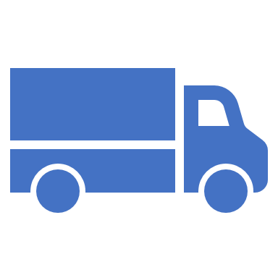
TRUCK PLATOONING
Under a federal grant, worked with UC Berkley, Volvo and others and developed and tested a Cooperative Adaptive Cruise Control (CACC) system that enabled safe close-spaces truck platooning operations.
Results of the experiments showed:
10 to 15 percent fuel savings for a three-truck platoon
Enhanced safety, through coordinated braking with minimal delay
Improved traffic flow stability, reducing stop and go effects
Increased the effective capacity of highway lanes, which reduces the adverse effects of congestion.
Currently:
Worked with UC Berkeley and others and submitted an application for a federal grant to perform additional truck platooning tests on trucks that are in revenue service across multiple states along the I-10 corridor

Slide 10
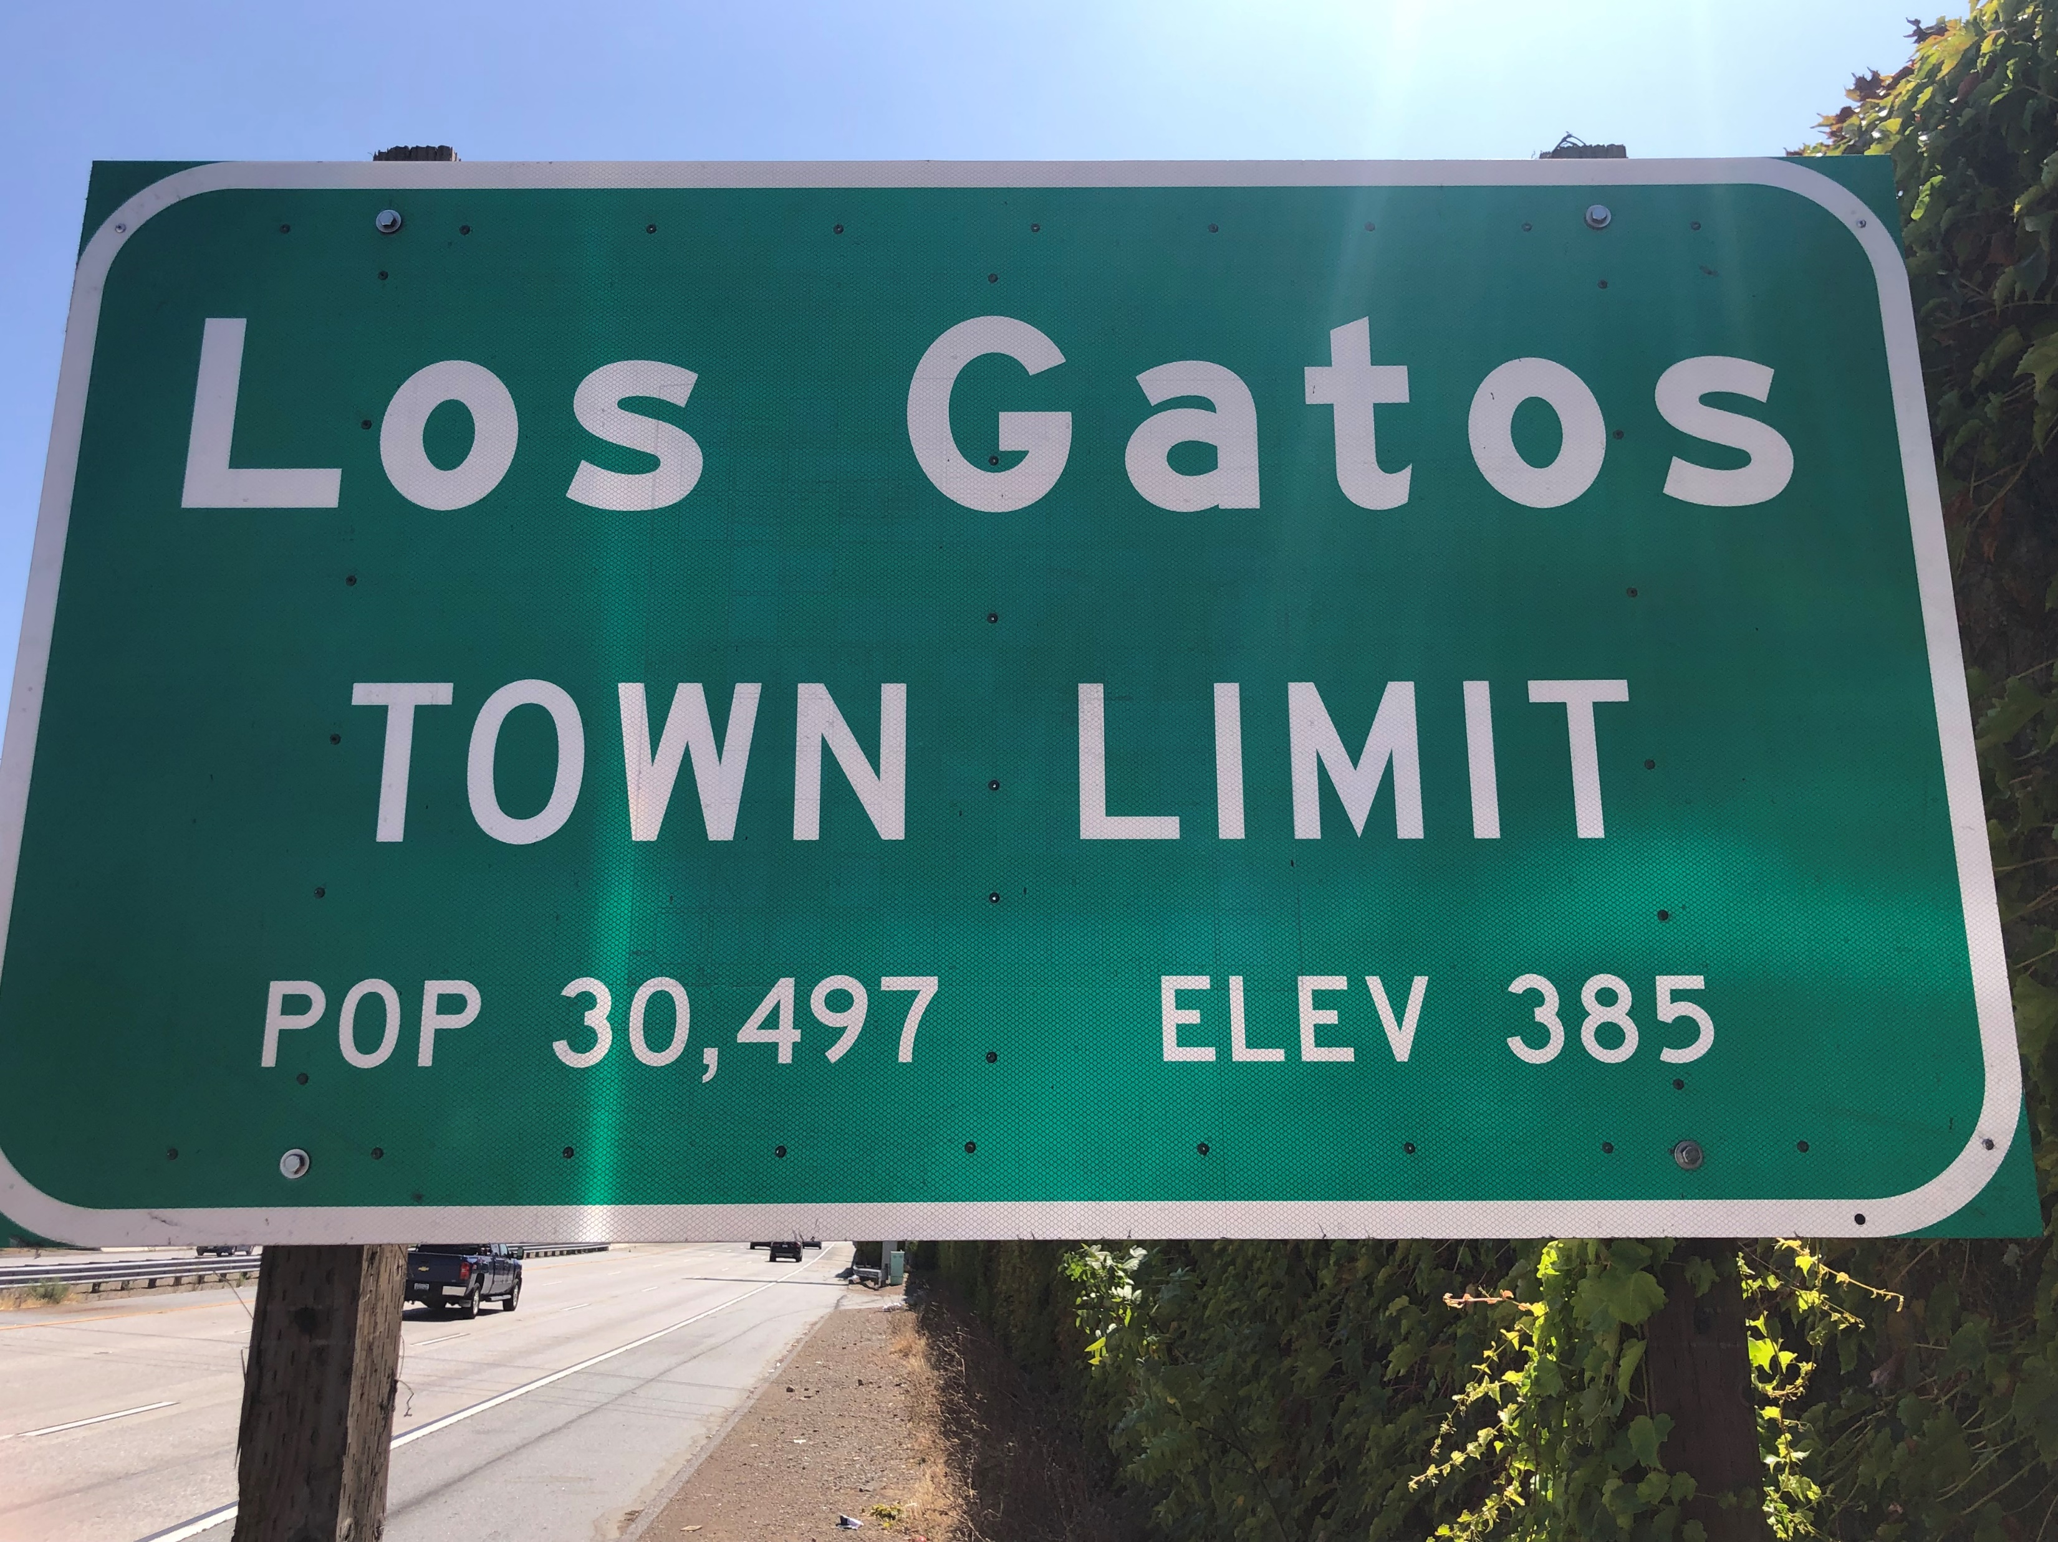
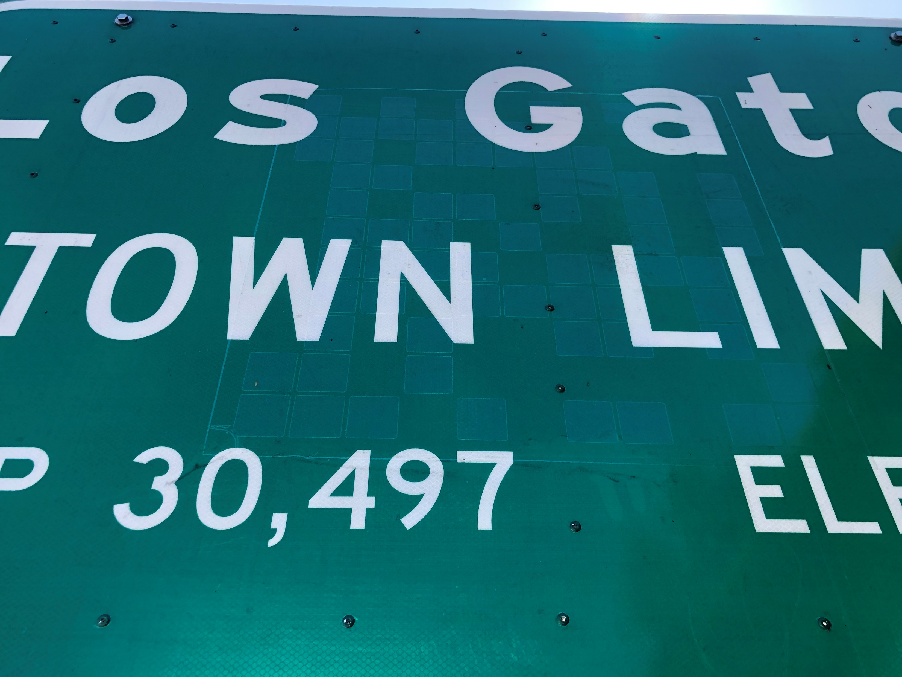
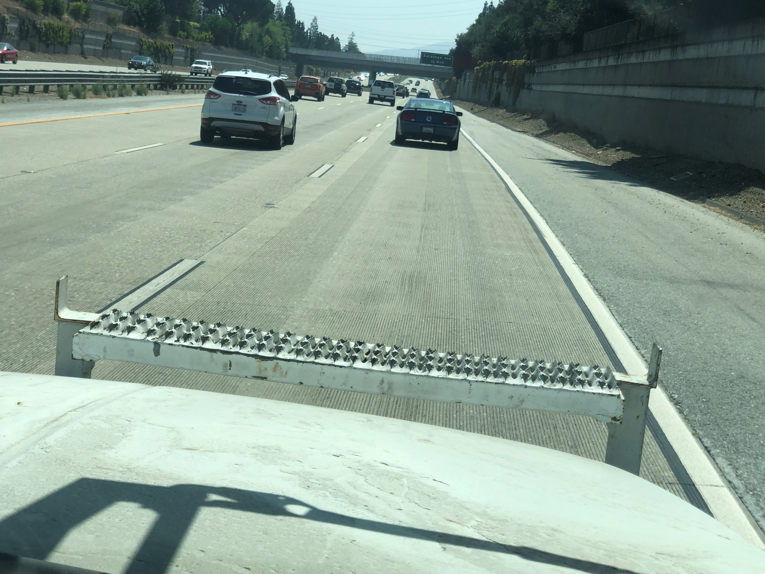
AV PREPARATION ON STATE HIGHWAY
Caltrans is testing six inch striping high retroreflective striping and intelligent signs on state route 85
State standard has been upgraded to 6 inch striping
This testing is being done in order to provide Autonomous Vehicle(AV) manufacturers to test their systems in live highway setup.
The striping and intelligent signs are manufactured by 3M
The intelligent signs looks like a regular sign to a human eye
The intelligent sign provides additional information to the AV vision sensors

Slide 11
Caltrans Partnerships
Valley Transportation Authority (VTA)
NoTraffic
Blackberry
Prospect Silicon Valley
MMITSS (Pooled Fund Study)

Slide 12
Valley Transportation Authority (VTA)
Work in progress under technical partnership
Development of Conditional Transit Signal Priority (TSP) on 5 buses
Conditional TSP allows priority only with the system approval
Testing will be done on the existing Palo Alto DSRC test bed
VTA route 22 buses will be upgraded with On Board Units (OBUs) to communicate with the Roadside Units (RSUs)
Results are expected to be available by June 2020

Slide 13
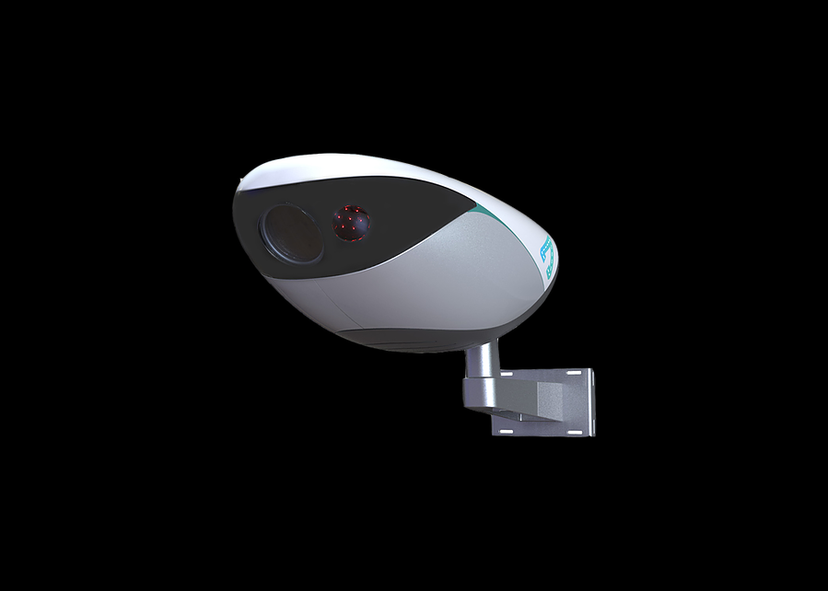
NOTRAFFIC
Work in progress under technical partnership
Deploy Notraffic sensors at four intersections on the Palo Alto Test Bed
Application development to detect pedestrians and bicyclists and use this information to alert the VTA bus driver
Traffic data collection and possible use of this data for increased traffic throughput

Slide 14
BLACKBERRY
Memorandum of Understanding (MOU) is in progress
Security Credential Management System (SCMS) will be tested and implemented on the Palo Alto test bed using Blackberry service
Expected completion date is June 2020
After Implementation the users will have to signup with Blackberry in order to conduct testing at the Palo Alto test bed
Notes:
The existing test-bed requires an OBU to listen to the broadcasts (SPaT, MAP and RTCM). With the FHWA sponsored SCMS system the users will have to get security certificates from Blackberry to operate, once the system gets implemented.

Slide 15
PROSPECT SILICON VALLEY
Active partnership with Prospect Silicon Valley (PSV)
PSV is a nonprofit cleantech innovation hub that focuses on advanced mobility and energy solutions for urban communities.
Caltrans uses PSV partnership in collaborating with public and private partners to enhance capabilities in the field of Connected and Automated Vehicle technology
Partnership with Valley Transportation Authority, Notraffic and Sinwave are a result of PSV partnership

Slide 16
Multi-Modal Intelligent Traffic Signal System (MMITSS)
MMITSS is a project under the Connected Vehicle Pooled Fund Study (CV PFS) entitled “Program to Support the Development and Deployment of Connected Vehicle System Applications.”
Virginia Department of Transportation leads the pooled fund effort
Partners consists of state and local transportation agencies and the Federal Highway Administration (FHWA)
Caltrans has developed Roadside Equipment (RSEs) in collaboration with Maricopa County in Arizona
Caltrans RSE is 2070 based while Maricopa County solution is NEMA based
Application development that provides differential GNSS correction without the need of a differential GNSS base station

Slide 17
AV/CAV Test Beds in California
Palo Alto CAV Test Bed
San Diego AV Regional Proving Ground
GoMentum Station

Slide 18
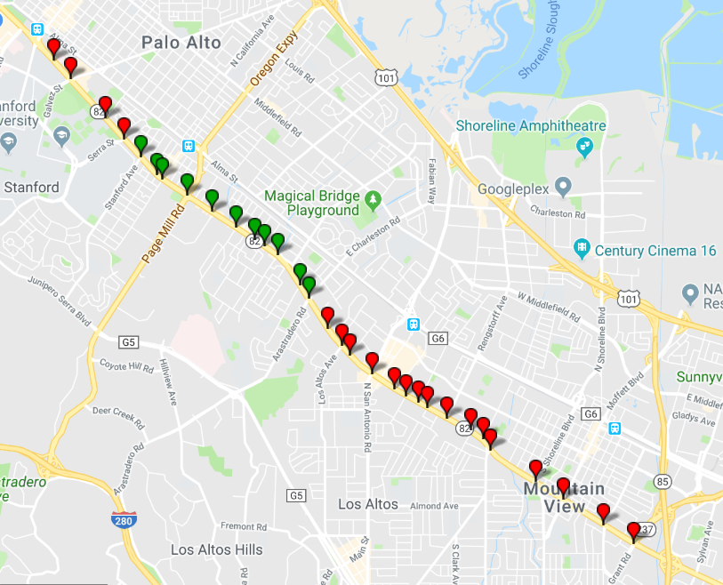
Palo Alto CAV Test Bed
Located in Silicon Valley, City of Palo Alto
Sixteen Intersections are fully Operational
Broadcasting SPaT, MAP and RTCM messages
Accepts BSM messages from OBUs
SCMS tested -- Implementation by June 2020
A total of 31 consecutive intersections -- planned to be completed by January 2021
Planned Applications
Conditional TSP (Ready by October 2020)

Slide 19
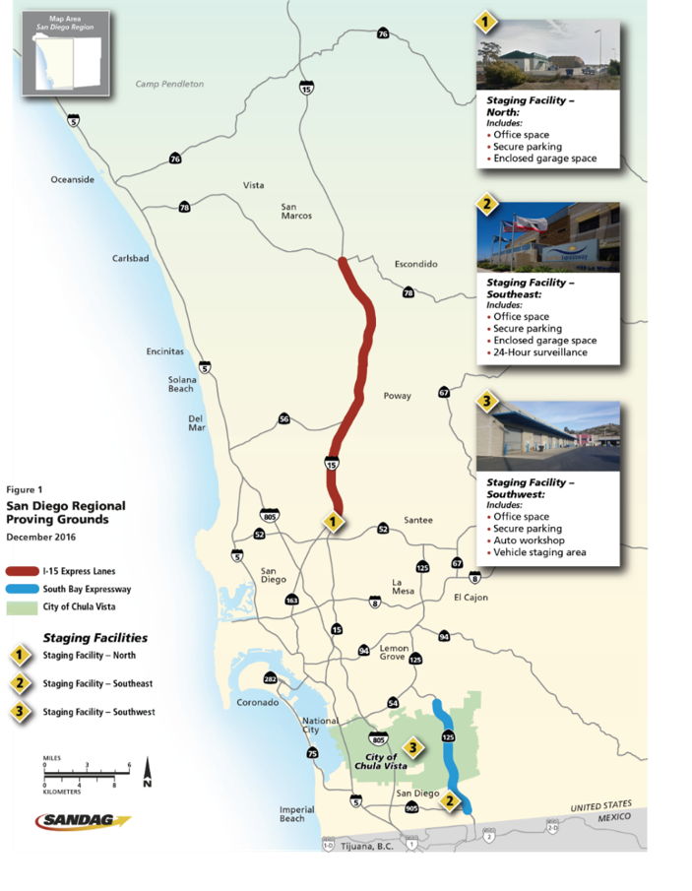
SAN DIEGO REGIONAL AV PROVING GROUND
Facilitate testing and validation of AV technologies while ensuring public safety and security
Partners include SANDAG, Caltrans D-11 & City of Chula Vista
I-15, State Route 125, Chula Vista, Miramar Marine Corps Air Station
Needs permit to conduct testing
Notes:
Caltrans is open for business for AV testing also. Any company can come and test their technologies. Need to get permit from DMV for testing but if it needs lane closing or encroachment, then they need permit from Caltrans also.

Slide 20
San Diego Regional AV Proving Ground
The following applications are under testing phase:
V2X Expanded CMS messages
V2X Queue Warning
SPaT Broadcast
BSM Broadcast
C-V2X technology
Narrow Lane (9 feet) for AV

Slide 21
GoMentum Station
Located in Silicon Valley, City of Concord
Owned and Operated by Contra Costa Transportation Authority (CCTA)
Provides controlled environment testing under urban and rural settings
Underpasses, over­passes, tunnels and railroad tracks
Multiple lane types including one-way, two-way, merge and round-about
Shared and separated bike lanes
Remotely programma­ble traffic signals
Various technologies under testing
DSRC Based TSP
Bike Signal Priority
Dual Signal Controller Processors for V2X
Mid Block Pedestrian Crosswalk Alert

Slide 22
CALIFORNIA AV REGULATIONS
Testing of AV in California:
62 Manufacturer Testing Permits issued by DMV for passenger vehicles
139 collisions reported
AV regulations for testing with a safety driver became effective on September 16, 2014 (Level 3 and above)
The Office of Administrative Law (OAL) approved the driverless testing and deployment regulations, and they became effective on April 2, 2018
Waymo recently became the first company to receive permission to test true driverless vehicle
Currently, DMV is working on commercial delivery vehicle regulations (for vehicles less than 10,001 pounds)
Notes:
CA is open for AV testing and DMV is setting regulations for this purpose.

Slide 23
ITS WORLD CONGRESS 2020
Caltrans will be a participant at the ITS World Congress
Caltrans will also be providing and supporting demonstrations and Tours

Slide 24
CHALLENGES
Cybersecurity and Data Privacy
Staff Resources
Legal
Equipment
Maintenance
Design
Traffic Operations
Notes:
Traffic Operations:
Identify critical Safety & Mobility Applications
Infrastructure Improvements (Traffic Signals, Signing and Striping, Managed Lanes)
CAV was born in TSMO world – so much broader. Multi-modal aspect.
Policy and process changes needed to ensure consistency of implementation and deployment for CAV.
All existing projects should be looked at to ensure the CAV technologies will be interoperable once deployed/implemented
Caltrans might support certain application like Transit Signal Priority or Heavy Freight Priority on its intersections.
Identify which capabilities are ready for implementation. Prioritize investment opportunities
Make short, medium, and long term implementation plans
Design:
(1) New Design Standards and Specifications will be created
Signing and Striping
Standardizing Vehicle to Infrastructure (Roadside Equipment)
Policy and Process Changes
Project Develop Plans (PIDs, etc.)
Process changes needed to ensure consistency of implementation
Statewide standard application support
Interoperability with OEM applications
Regional and Local considerations
Policy and process changes needed to ensure consistency of implementation and deployment for CAV.
Purchasing Road Side Units (RSU’s) that are capable of communicating with CAV. These needs to be standard for all 12 districts. Will need to work with Design to ensure it’s compatible with “CAV Developed” standards and specifications.
Project development plans will need to plan for CAV technologies.
All existing projects should be looked at to ensure the CAV technologies will be interoperable once deployed/implemented
MAINTENANCE:
Maintenance and upkeep of CAV infrastructure
Additional responsibilities for new equipment and infrastructure
Signing and striping
V2I communications infrastructure
Asset management
Opportunities to improve work zone safety
Cost of Maintenance
Adjustments to SHOPP
State Highway Operation and Protection Program (SHOPP) Project
Nominations and Asset Management
Additional Maintenance needs
Lifecycle of equipment is currently being developed as new CAV are deployed.
(2) Cost to maintain equipment is unknown
(3) Adjustments to the existing SHOPP program will need to be made as CAV deployment is achieved by taking a corridor approach in the installation of elements to achieve V2X and V2I connectivity.
EQUIPMENT:
Type of Equipment
Road Side Units (RSU)
On Board Units (OBU)
Initial Cost of Equipment
AASHTO Fleet Challenge
Adding RSUs and OBUs to Qualified Product List (QPL)
Purchasing Road Side Units (RSU’s) that are capable of communicating with CAV. These needs to be standard for all 12 districts. Will need to work with Design to ensure it’s compatible with “CAV Developed” standards and specifications.
The initial cost for equipment needs to be programmed.
Caltrans should participate in the Connected Fleet Challenge and install OBU in a few select vehicles as a pilot project. These vehicles will be capable of broadcasting the Basic Safety Message (BSM) to Roadside Units (RSUs) and of receiving SPaT, MAP, and other data messages that are being broadcast by the infrastructure.
Ultimately once the RSUs and OBUs are standardized, they need to be added to QPL and made available from Caltrans Warehouse.
LEGAL:
Issues affecting the policies
Machine vision versus the human vision
Design for people or machines
Crash liability
Understanding liability impacts
Legislation may be needed to cover crash liability
Vehicle Data Privacy and Ownership concerns
Present signage is adequate for human vision. The same can not be said for machine vision. Legal impacts could be critical as the vehicle manufacturers try to shift the crash responsibility to Caltrans stating that the signs are hard to be recognized by on-board cameras.
Intersections will be broadcasting the SPaT, MAP (Intersection Description) and RTCM (GPS Correction) to the vehicles. Would it impact us legally? What if the DSRC radio is out of service due to failure or regular maintenance. What legal implications might this bring?
Can Caltrans share the information that will be collected by BSM (Basic Safety Message). This information could consist of number of vehicle, their destinations etc.
Under level 3 and above automation, since the human will be out of the driving loop, the vehicle manufacturers could blame the infrastructure for a crash. Legislation may be needed to cover crash liability for the department.
INFORMATION TECHNOLOGY ISSUES:
Data Management
Data management (sharing, usage, etc.)
Application Support
CV System and Application development
Cybersecurity concerns
Security Credentialing Management System (SCMS)
With the deployment of RSUs, the intersections will be generating a lot of data. How to keep this data safe and be made available to proper entities will require innovative solutions.
Caltrans might support certain application like Transit Signal Priority, red light violation warning, work zone safety alert warning. This could potentially pose additional burden on IT department for proper support.
Cyber Security is quite obvious. We need to be safe under cost constraints. This could be challenging.
STAFF RESOURCES:
Cost of additional staff
Change in type of Staff Needed for CAV Roadside equipment Implementation
Electrical / Electronics Engineers
Electrical / Electronics Technicians
Training for Staff

