Slide 1
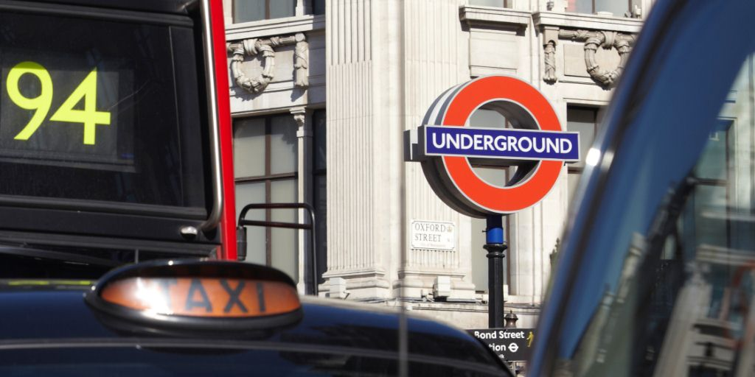
Tuesday 19th July
TfL – Data led network management
Adam Duff
Network Management

Slide 2
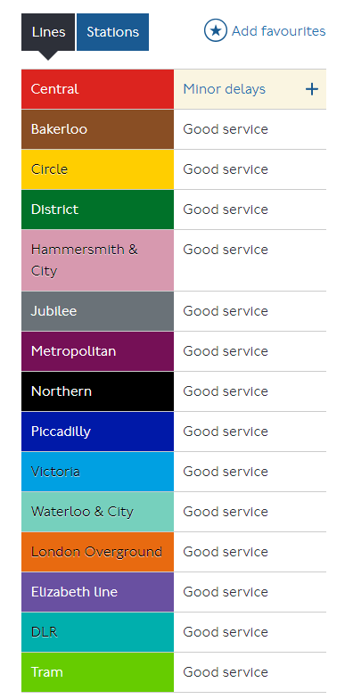
London’s Data Sources
In Network Management, data is gathered from various data sources and systems across and grouped into 6 distinct areas, shown with some datasets as examples:
TfL Rail & Underground service status automatically updates from real time line data, with human oversight for public facing information – feeds to partners.
Vehicles
Pedestrians
Cycles
ANPR
LCAP
iBUS
INRIX
n/a
Strava
Control
Assets
Events
DLOG
OUTCAST
UTC
ASTRID
SFM
COV-IMS
HORUS
WAZE
One.Network
CCTV

Slide 3
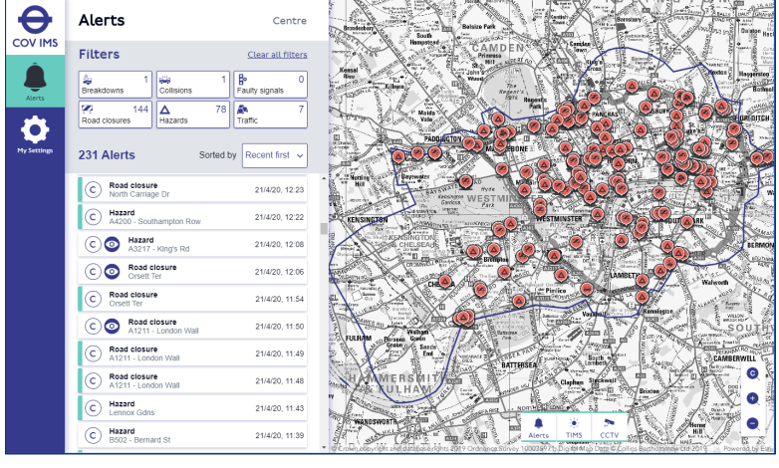
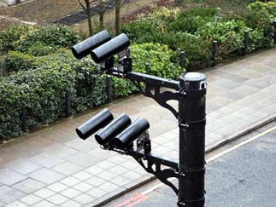
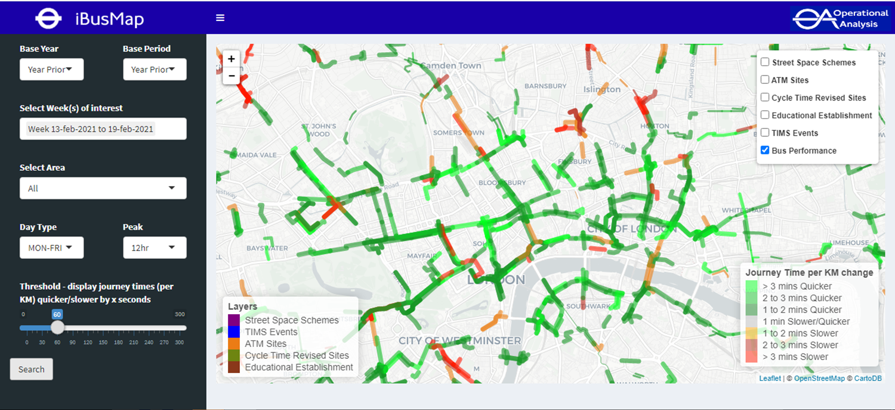
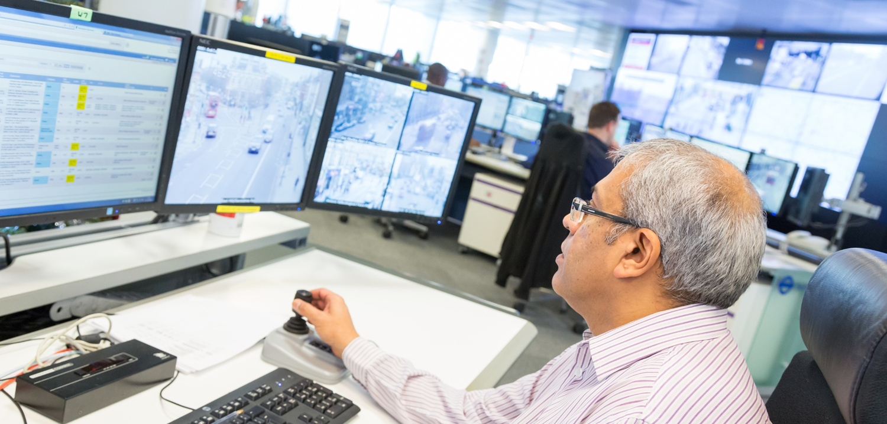
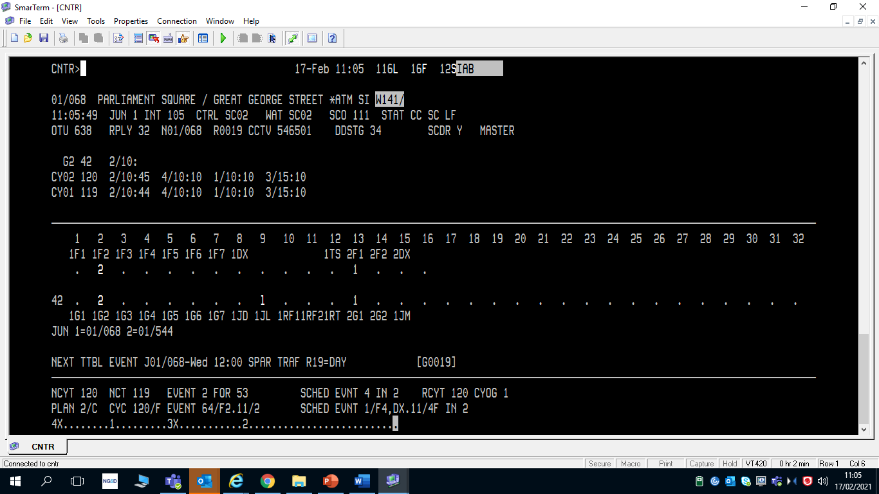
Using Data to manage London's road network
Harnessing a range of data sources our control room operators can monitor performance, spot incidents and optimise the network with informed decisions.
COV-IMS
CCTV, ANPR, RODAT
iBus (NIMBUS)
“Network Intelligence”
Deploy/review UTC
signal timing strategies
NMCC Operator
UTC/SCOOT (becomes SITS/RTO)

Slide 4
Common Operational View Incident Management System
(COV IMS)
GIS mapping service showing the following data sources.
Planned roadworks from our permitting database (location, reason, works owner, start/finish).
Incidents added live by NMCC operators in real time.
Data feed from Waze from cloud sources ‘user reported issues’
Optional overlays of UTC and other SCOOT performance data, ie congestion.
Feeds back out to partner apps/services.

Slide 5
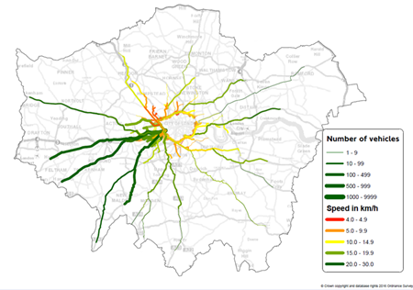
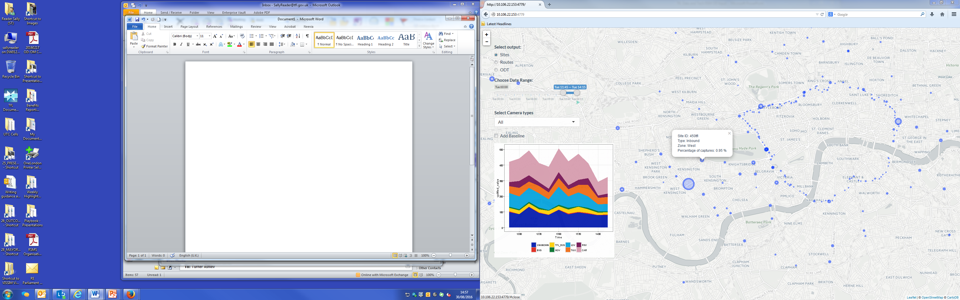
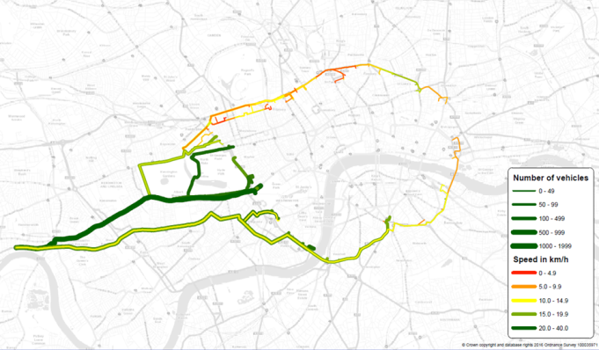
Real Time Operations - RODAT
Existing on-street sensors
Flow and Journey Times along routes ending at Piccadilly – AM Peak 0700-1000
Automatic Traffic Counters
ANPR
cameras
SCOOT
Data fusion
Innovative algorithms & computing
Outputs
Flow and Journey Times along routes originating from the A4 GWR – AM Peak 0700-1000
Real-time detailed view of traffic behaviour on our network
ANPR
ATC
SCOOT
Combined Data

Slide 6
Using data to make our network fit for the future
Data Led Planning
City Planning Tool (analysis of all performance and safety data in the TfL data warehouse)
Traffic survey data (incl Pedestrian and cycling)/Network instrumentation.
Policy to inform scheme requirements/outcomes
Mayors Transport Strategy (includes Vision Zero)
Healthy Streets Manual
Outcome driven design process
Modellers, designers and network managers working together to produce designs which have the best blend of required outcomes.
Safety & Performance Monitoring
Internally developed dashboards linked to our data warehouse giving a range of long term and ‘near to real time’ performance monitoring of our bus and road network.
Community/Stakeholder engagement
Use of operational and strategic modelling to inform decision making and public consultation.
Quarterly review of safety and performance to understand trends/take action.
LTN 1/20

Slide 7
What do CCAV’s mean for London?
Challenges
Potential for more road traffic if affordable autonomous options flood the market; barrier to sustainable/active travel?
Impact on safety/vision zero; are there any network types where they are more/less suited > policy.
Opportunities
SITS/RTO is designed to accept input data from a wide range of sources/sensors; CCAV’s could provide network real time performance data.
Self reporting of incidents/breakdowns; improved response.
Impact on throughput at junctions (acceleration/follow distance). Affects real life & scheme modelling.
Unknowns
No common data sharing protocol between OEMs/3rd parties; limits usefulness of the data.
Could provide DRT alternative.

Slide 8
Adam Duff
Performance & Planning Mgr
197 Blackfriars Road, Southwark, London
adam.duff@tfl.gov.uk
+44 7703 462091

