Slide 1
US TRB State of the Art Review of Cooperative Automated Transportation Systems
Connected Local Infrastructure
Darren Capes FIHE FIET
ITS Policy Lead
18 July 2022

Slide 2
Connected and Autonomous Vehicles
Connected Vehicles
…are already here
Vehicles with high levels of connectivity are already on sale
The time-frame is now to five years
Close links to enhanced safety features, alternative fuels, new ownership models
Huge volumes of data are already flowing between vehicle and manufacturer
Buyers and users of vehicles are coming increasingly to expect new services
Infrastructure must keep up with this
What is government’s role in this space?

Slide 3
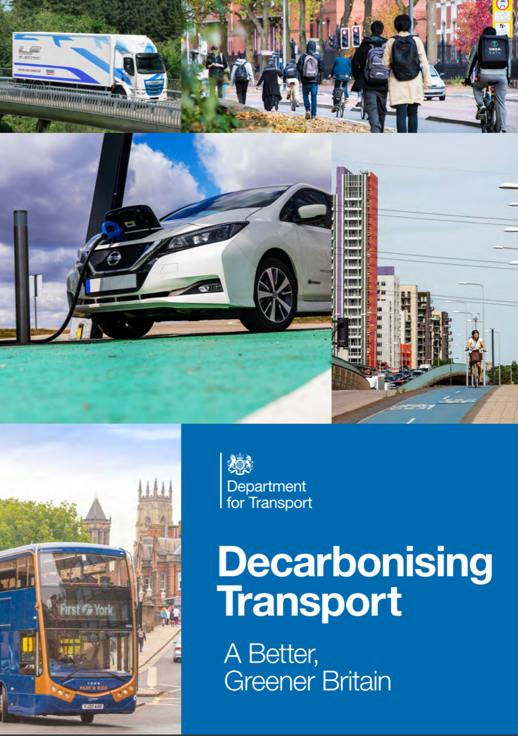
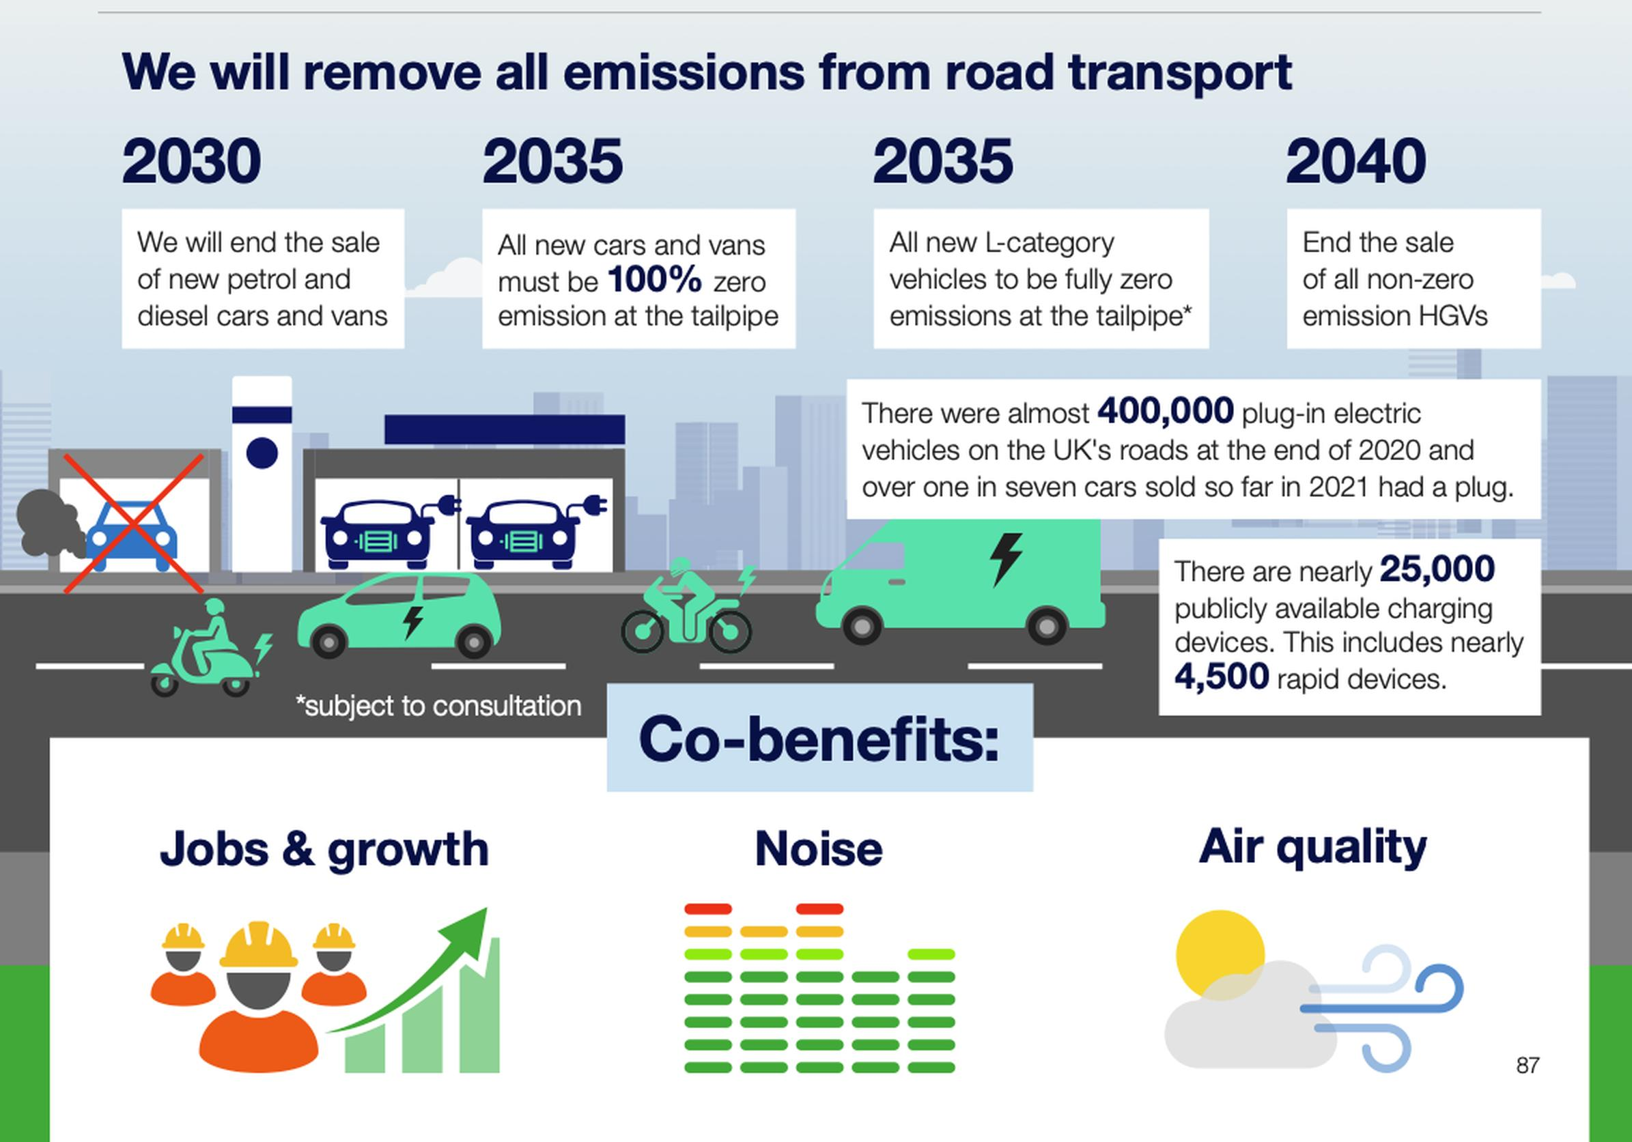
National Impetus
High level strategy
The Transport Decarbonisation Plan
Future of Mobility Urban Strategy
Bus Back Better, (and others)
A high-level commitment to the end of hydro-carbon fuelled vehicles and net zero
Increasingly connected vehicles will be central to achieving this
Will also allow us to do existing things better…

Slide 4
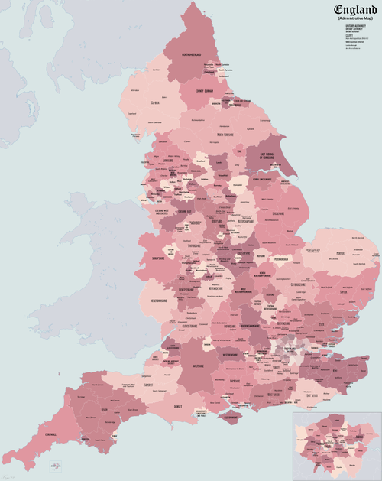
Delivering better Services
At a national and local level
In England there are 154 local highway authorities responsible for around 96% of the road network
They vary massively in size and resources
Cover large cities, urban and rural areas
Responsible for nearly all urban and city roads
Increasingly complex picture
Two tier
Unitary
Sub national bodies
Each is responsible to its elected members and electorate
Legislation provides the framework but not the detail
We need to work to ‘sell’ the need for new technologies and services and the benefits they will bring

Slide 5
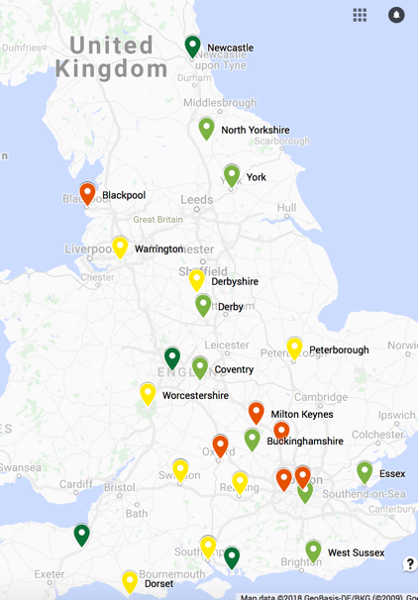
Delivering better Services
At a national and local level
Urban Traffic Management
Asset Management
Road safety
Journey planning
Car parking and loading
Logistics
Access for all
Urban / rural transport
The C-ITS Pilot Projects
Over 35 Projects throughout England
£5m funding
Projects in FIVE KEY AREAS
Signal Phase and Timing (SPAT)
Smart Parking
Connected Information and Technologies
Asset Management
Opening Local Authority Data

Slide 6
Delivering better Services
At a national and local level
We support initiatives to promote understanding and build business cases
We work with others in the sector to achieve this

Slide 7
Delivering better Services
Providing Guidance
Business case development
Procurement support
Cyber Security
Knowledge and experience exchange
Setting Standards
National Access Point (NAP)
National Parking Platform
APDS – Alliance for Parking Data Standard
Digital Traffic Regulation Orders (DTRO)
Digital traffic signal controller standards
Growing existing equipment and software standards (UTMC and TOPAS)

Slide 8
Get in touch; darren.capes@dft.gov.uk
Darren Capes FIHE FIET
ITS Policy Lead
18 July 2022

