Slide 1
US TRB State of the Art Review of Cooperative Automated Transportation Systems
Connected Infrastructure
Gary Crockford – Connected Roads Policy
18 July 2022
OFFICIAL

Slide 2
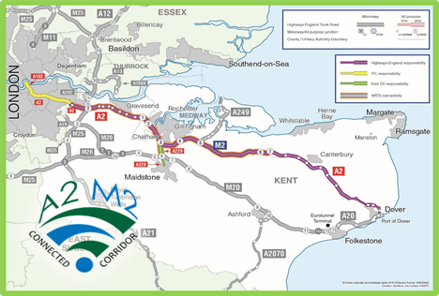
Background to ‘Connected Services’ in the UK
Piloting of Connected Services in the UK
Widespread pilots of Connected Vehicle Services
Focus on technical testing, standardisation and harmonisation
Creating a better understanding of services (GLOSA, IVS etc)
Evaluations to facilitate a business case
Piloting is continuing in projects with wider focuses including automation & 5G
Complimentary Activities
Research into Connected Vehicle Data
Work on digitising the network (TN-ITS, TRO-D)
Work on Cyber Security
Work on cellular coverage and spectrum usage
Development of a V2X testing environment
Work on skills development and procurement guidance

Slide 3
Learning from pilots
Technology & Data
The Technology works and common standards/specifications achieve interoperability
Hybrid (Wi-Fi + Cellular) communications is very effective
Mature ITS sector could be a barrier as legacy systems need to be adapted
Quality Data is required to develop sustainable services
Driver (User) Interaction & Safety
Services offered were liked and they would use them!
No desire to pay for discrete services (to be expected)
Integration into existing devices (Sat Nav/App) is preferred as it can be customised
Distraction is a key issue, but more research is required
Business Case
Impact Assessment difficult due to the scale and duration of the pilot projects;
Ideally longer, larger pilots (Deployments) needed on ‘naked roads’
Potential to influence behaviour and achieve key benefits (Congestion, Safety & Emissions)
Complexity of the ‘cooperative’ eco-system makes this difficult
Drawing on examples where business case data exists is important (i.e. Talking Traffic)

Slide 4
What next?
Moving from ‘closed’ ITS to ‘open’ cooperative Systems
The UK has a well established and mature ITS environment
‘Closed’ systems collect (and/or buy) data, process it and provides it to users
The role of the road authority changes in an ‘open’ (or cooperative) system
Engaging with all parts of the ‘eco-system’ is vital to establish how this will work?
What services do we want to deploy and how?
Many services have been piloted and tested.
Are they the right ones and what do potential users think?
Some services are ITS (broadcast only) whilst others are C-ITS (co-operative) to add value
Basic building blocks for the future
The right data to the right level of ‘quality’ to deliver reliable and scalable services?
The necessary relationships in place to support delivery?
The skills necessary to do this?
A picture of what will the future system will look like and how will it be governed?
The Challenge is how to overcome technology choice barriers and bring the new transport initiatives together in a consistent, harmonised way. Should we think about creating one national holistic transport network encompassing all of these?

Slide 5
Thank you and Questions
Contact Details:
Gary Crockford
Traffic & Technology Division
Connected Roads Policy
E-mail: gary.crockford@dft.gov.uk

