Slide 1
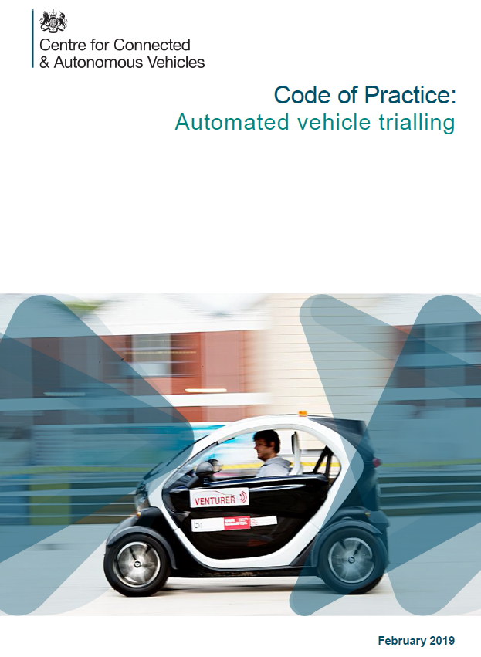
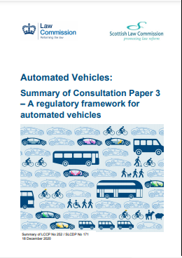
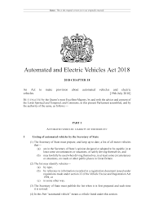
A clear regulatory framework
Law Commissions’ review
Automated & Electric Vehicles Act 2018
Engagement with UNECE (World Forum for Harmonisation of Vehicle Regulations)
CAVPASS
Code of Practice
on Automated Vehicle trialling updated 2021
Connected and Automated Vehicles: Process for Assuring Safety and (Cyber) Security

Slide 2
Key outputs of the Law Commission review
New legal entities
Authorised Self-Driving Entity
User in charge
Licenced fleet operator
New regulatory framework on use of self-driving vehicles
New assurance process
New monitoring & enforcement process
New incident investigation

Slide 3
Three key phases
Vehicle approval
Authorisation
In-use monitoring
Transfer of liability away from vehicle occupant
Enables the vehicle occupant(s) to perform activities other than driving
Due diligence - financial standing, presence in the UK, good repute
Safety and security assurance is on-going throughout the life of the vehicle
Key data and metrics to indicate a potential safety or security concern before harm arises
Processes to enable effective use of the data collected
Safety and security of the whole vehicle
Dependent upon the operating environment – vehicle capability, use-case and operating environment need to be compatible
How do we sufficiently assess the behavioural competence of the vehicle?

Slide 4
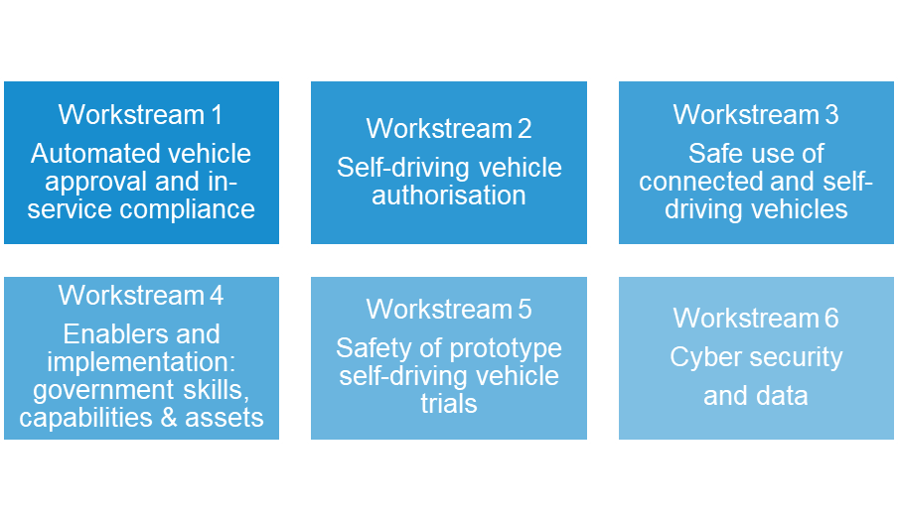
Connected and Automated Vehicles: Process for Assuring Safety and Cyber Security (CAVPASS)
To provide confidence that CAVs on UK roads are safe and cyber resilient.
Cross-departmental programme, closely involving Government agencies

