Slide 1
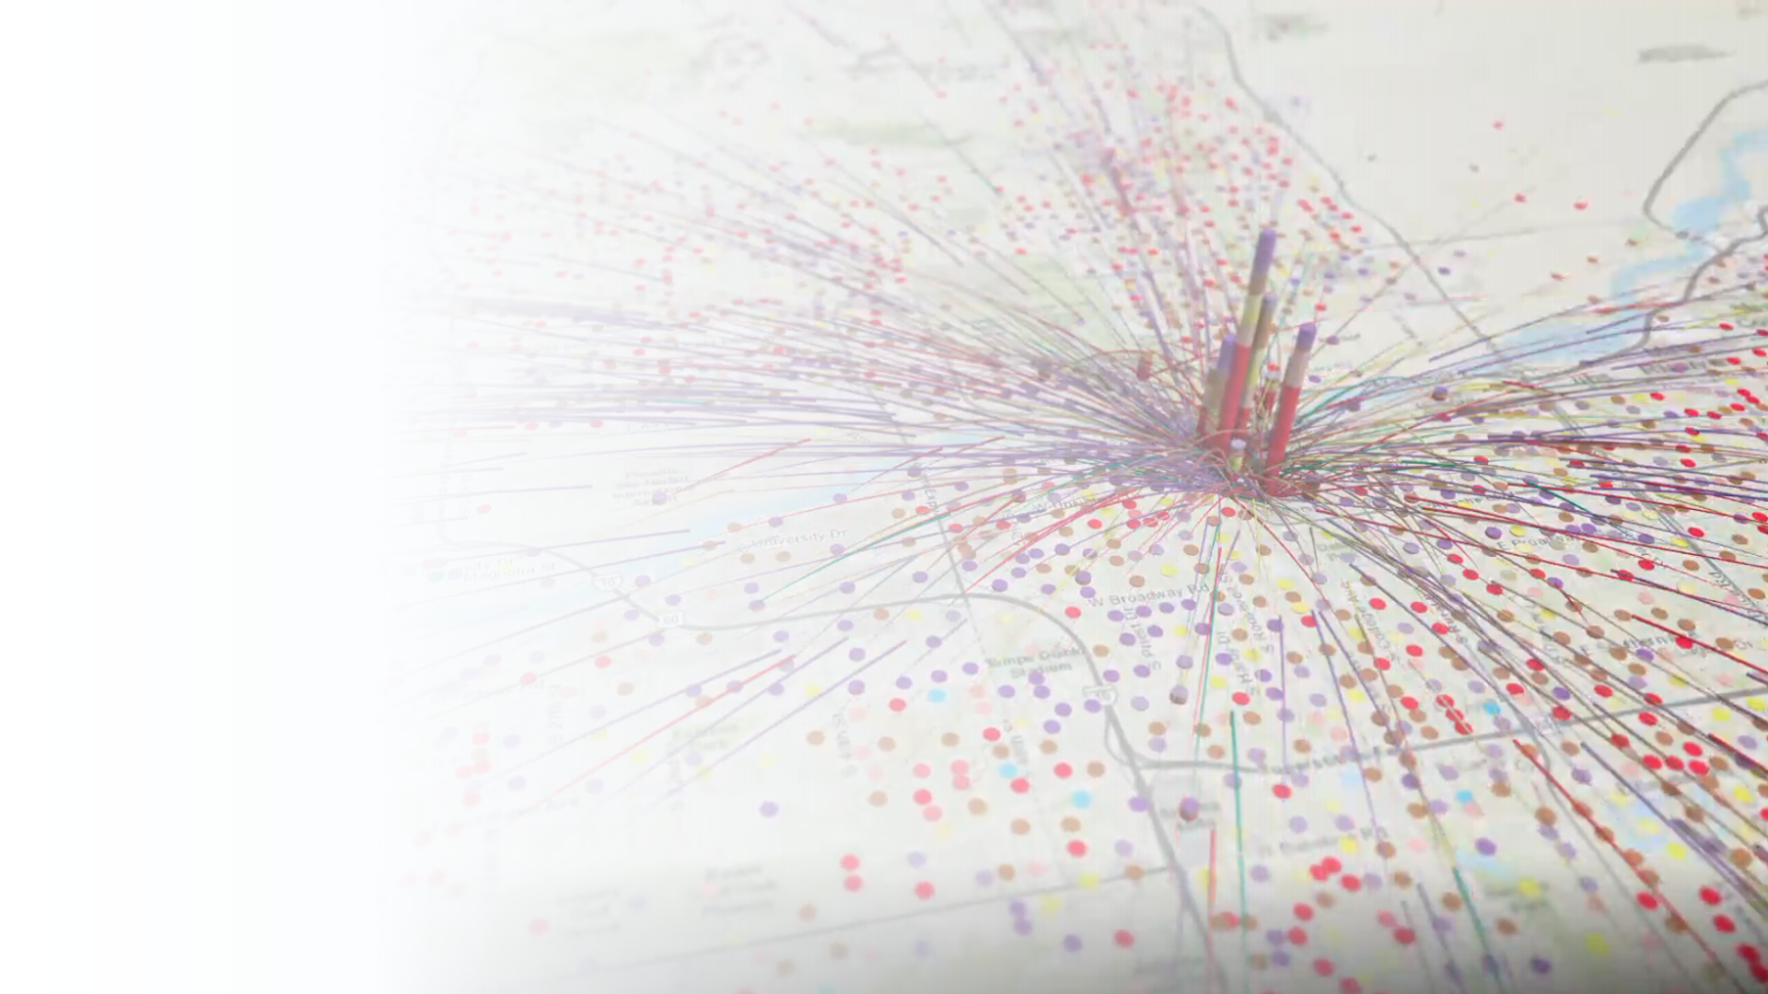

Autonomous Vehicle
Modeling and Forecasting
Arup Dutta, Ph.D.
Travel Demand Model Program Manager
Maricopa Association of Governments
NCHRP 20-24(128) Cooperative Automated Transportation (CAT) Systems Domestic Scan Tour December 5, 2019

Slide 2
Models Maintained by MAG

Slide 3






MAG: Main Areas of Model Application
Land Use
&
Socioeconomic Projections
Travel Demand
&
Traffic Projections
Air Quality Analyses

Slide 4


Travel Data
Traffic Data
Infrastructure Data
Socio-Economic Data
Household Travel Surveys
Establishment Surveys
Special Events Surveys
University Travel Surveys
Airports Travel Surveys
Transit On-Board Surveys
GPS Data
Passive Mobility Data
...
Traffic Volume/Counts
Traffic Speed
Intersection Turning Counts
Vehicle Classification Counts
Vehicle Occupancy Survey
…
Roadway Network
Transit Network
Bike Network
Navigation Network
…
Population Data
Employment Data
Household Data
Existing Land Use
Future Land Use
Business Establishments
…
Transportation Models
Travel Demand Models
Microsimulation
Model
Behavioral-based Freight Model
Model
Outputs
….

Slide 5
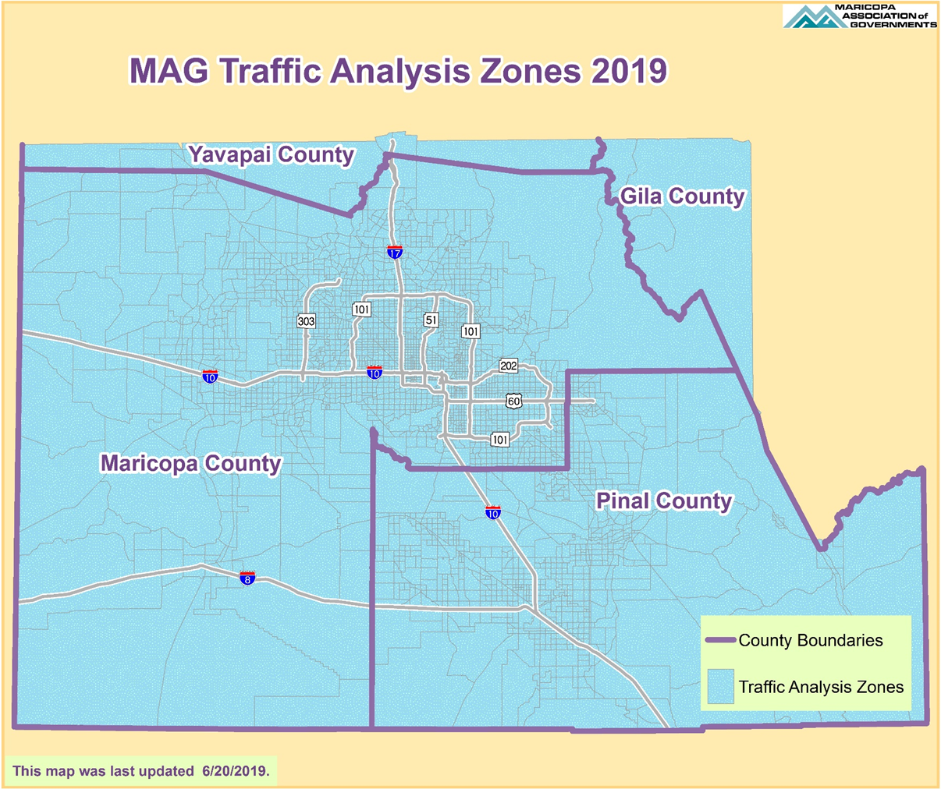

Evolution of Transportation Models
Four-Step Trip-Based
Activity-Based (ABM)

Slide 6








1=Population synthesis
1.0=Major university (ASU)
1.1=Core PopSyn
MAG ABM Model
High-level Structure
2=Long-term usual work & school
2.1=Workplace type & location
2.2/3=University/school location
3=Mid-term mobility attributes
3.1=HH car ownership
3.2=Person transit pass
4=Special Event participation
4.1=Participation & party
4.2=Allocation to synthetic population
- time-space constraints
5=Day level activity participation and prioritized tour skeletons
J
5.1=Coordinated Daily Activity Pattern (CDAP) type
M
N
H
5.2=Mandatory activities and tour skeletons
5.3=Fully joint tours for shared activities
5.4=HH maintenance tasks
5.5=Person discretionary activities
6=Tour formation
6.0=Day segment time windows
6.1=Activity allocation to day segments
6.2.1/2=Mandatory and escort tours
6.2.3=Individual non-mandatory tours
6.2.4=Work-based sub-tours
7=Tour & trip details
7.1=Tour TOD
7.2=Tour & trip mode
7.3=Trip departure & stop duration
7.4=Schedule consolidation (iSAM)
7.5=Car allocation (carTrack)

Slide 7
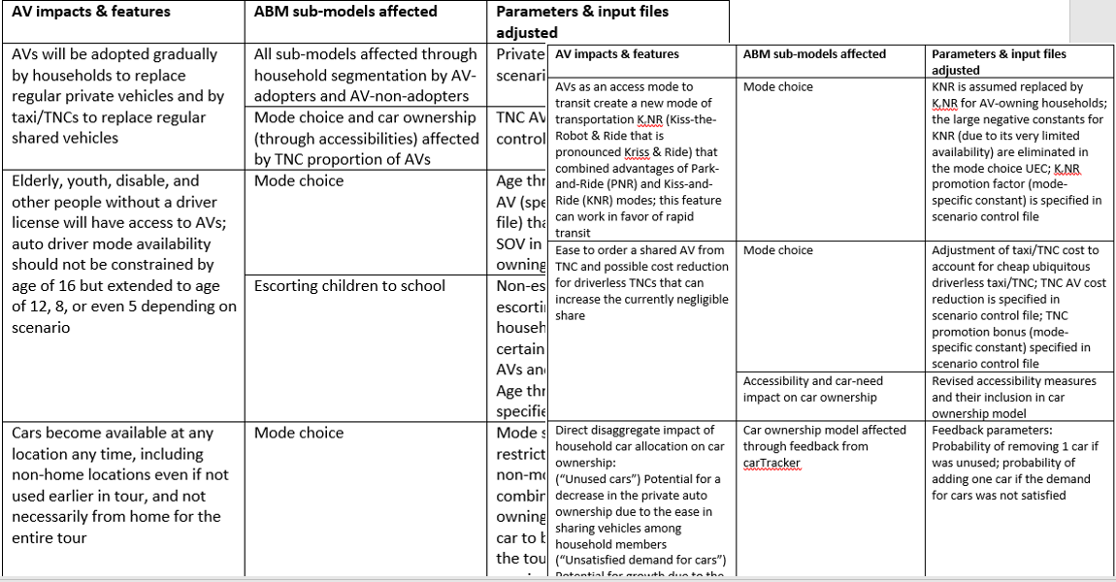
ABM Components Impacted By AV Modeling

Slide 8
AV Implications for Transportation/Urban Planning
Earlier focuses:
  Congestion reduction due to a better use of road capacity
  VMT growth due to ZOV and higher trip rates
  Replacement for transit (especially with MaaS/TNCs)
Recent recognition:
  Parking demand, regulations, and tradeoffs with ZOV repositioning; possibility to remove parking from the city centers and replace it with AV staging areas
  Integration with mass rapid transit and reshaping stations & services
  Impacts on car ownership and interplay between privately owned AVs and shared AVs in TNCs
  Mobility equity and special population groups (elderly, disable)
  Far-reaching concept of a “smart city” (how the land-use could/should be reshaped with AVs)
Notes:
AV

Slide 9
AV Impacts Reflected in Travel Model

Slide 10
Requirements for Consistent Modeling of AVs
One generic approach that can handle regular vehicles and AVs in a single modeling framework:
  Not a special AV model or post-processing!
  AV penetration rate as a scenario parameter:
    If 0% - standard ABM for all HHs
    If 100% - AV version for all HHs
    If between 0% and 100% - HHs are split into 2 groups
    Separate penetration rate for shared AVs in TNC
  Other essential parameters / AV assumptions:
    Listed in the global control file
    Due to many factors of uncertainty multiple scenario analysis is essential

Slide 11
AV Impacts on Travel Demand
Elderly, youth, disabled, and other people without a driver license will have access to AVs; auto mode availability unconstrained by driving age limits:
  Mode choice
  Escorting needs reduced or completely eliminated
Cars become available at any location any time, including non-home locations even if not used earlier in tour, and not necessarily from home for the entire tour:
  Mode choice and multi-modal tour mode combinations
Empty repositioning trips made by AVs facilitate intra-household sharing of cars:
  carTracker for owned AVs
  Empty trip sub-model for TNC
Ease to order a shared AV from TNC:
  Mode choice (cheap ubiquitous driverless taxi/TNC that can increase the currently negligible share)
  Accessibility and car-need impact on car ownership

Slide 12

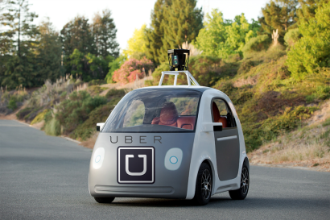
Cars Available at Any Location Any Time, Not Necessarily from Home for Entire Tour
  ABM: Trip mode combinations on the tour less restrictive with any sequence of auto (AV) and transit
Home
Work
Shop
Shop

Slide 13
AV Impacts on Car Ownership
For owned AVs:
  (“Unused cars”) Potential for a decrease in the private auto ownership due to the ease in sharing vehicles among household members
  (“Unsatisfied demand”) Potential for growth due to the replacement of escorting and overall AV attractiveness
For shared AVs:
  (“Unused cars”) Potential for a decrease in the private auto ownership due to the ease in sharing vehicles among HH members and availability of TNC

Slide 14
Adjustments of Network Capacity and Speed for AVs
How to adjust network capacities and speeds for different AV penetration rates

Slide 15
AV Related Parameters Introduced in MAG ABM
Household owned AV proportion
Parameters affecting travel demand:
  TNC AV proportion
  TNC cost discount for TNC AVs
  Minimum age threshold for traveling alone without adult supervision
Parameters affecting highway network:
  Capacity improvement factor for 100% AV penetration
    Freeway and other
  Speed improvement factor for 100% AV penetration
    Freeway and other
TNC promotion factor
Notes:
Defined in global parameter file
Cost discount as driverless cars may be cheaper (no need to pay driver)

Slide 16
AV Scenario Run
Base Year (2018) and 100% AV scenario runs

Slide 17
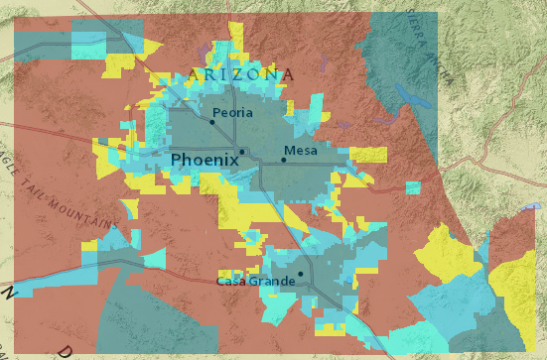
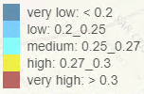
Impact on Accessibility to Non-Mandatory Activities by Auto
Owned access AVs w/ road cap effect

Slide 18
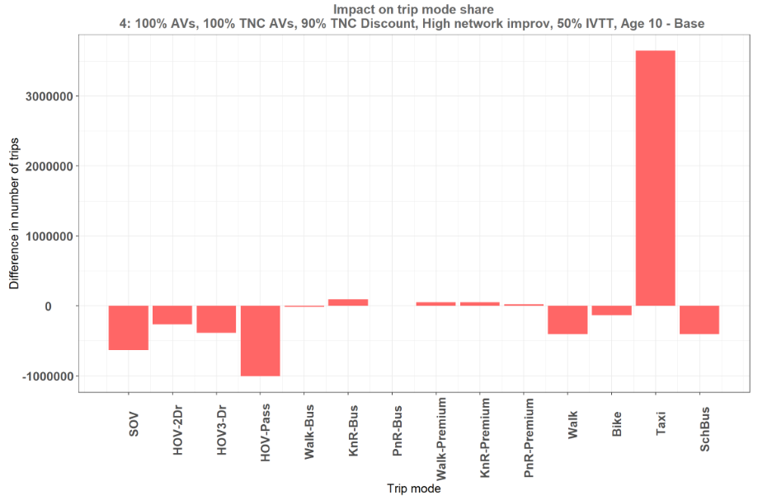
Impact on Mode Choice: All Effects
Increase in Taxi (TNC)
Decrease in auto driver
Notes:
Cheap TNC still a very attractive alternative. The decrease in number of SOV trips is lesser than previous scenario which didn’t have private AVs

Slide 19
Impact on Mode Choice for Pre-driving Age Children

Slide 20
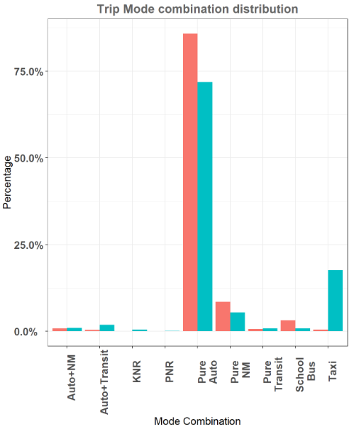
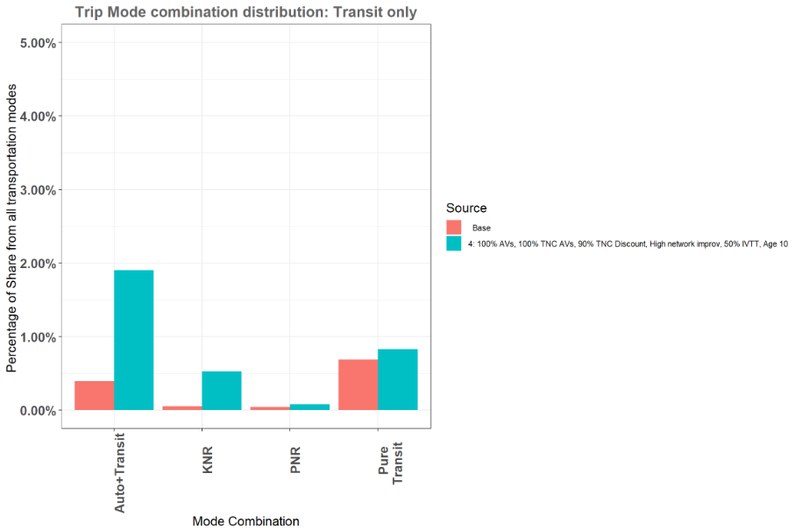
Impact on Multi-modal Tours
Increase in Auto+transit tours for owned AV scenarios
AV solves first and last mile issue
Notes:
Property of Avs that they can be made available at any place and any time made it easier to use it with other travel modes. For AV scenarios, we see an increase in auto+transit and KNR tours.

Slide 21
Person Trips - Change from Base
Person trips increase from Baseline scenario

Slide 22
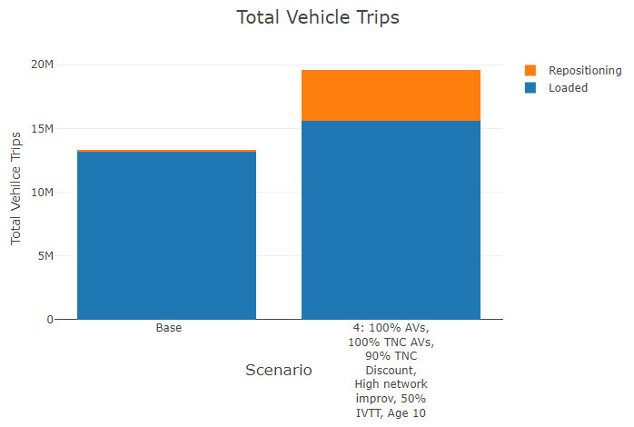
Repositioning with a driver
Notes:
Empty (repositioning) trips in base refers to unloaded taxis. More TNC means more unloaded vehicle trips.

Slide 23
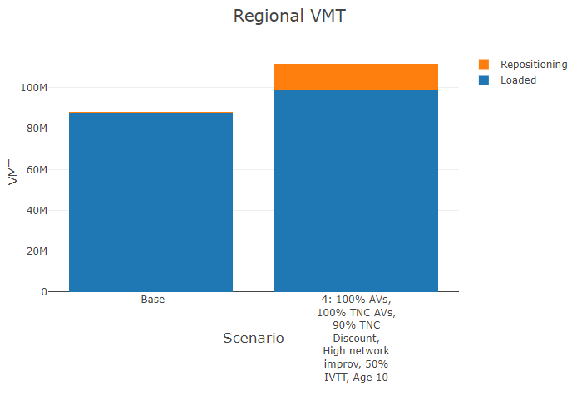

Slide 24
Thank you!
For More Information: https://www.azmag.gov/Programs/Transportation/System-Analysis-and-Forecasting
Vladimir Livshits
Director of Transportation Technologies and Services
Maricopa Association of Governments
vlivshits@azmag.gov
Arup Dutta
Travel Demand Model Program Manager
Maricopa Association of Governments
adutta@azmag.gov

