Slide 1
Connected Marysville
A plan to build a fully connected City

Slide 2
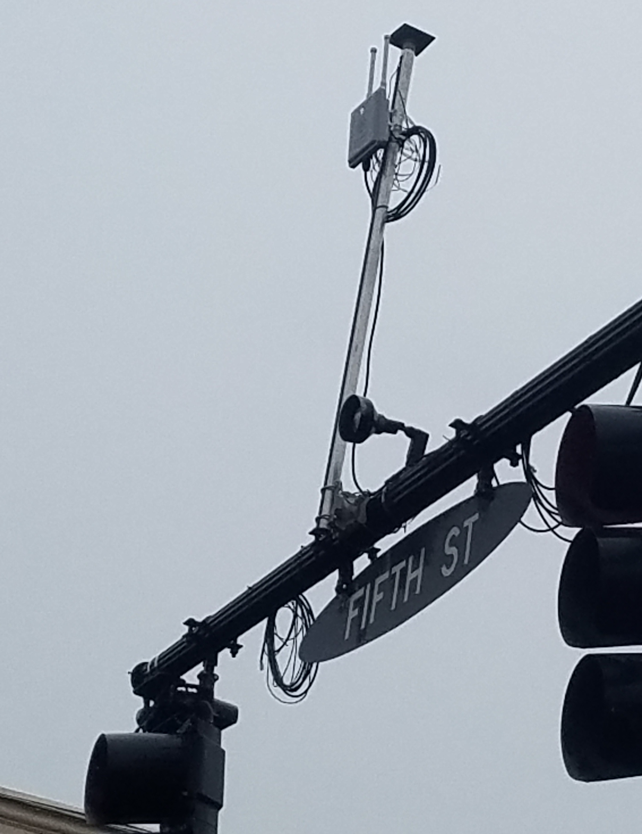
Connected Marysville Plan
27 Traffic Signals outfitted with RSUs
500 vehicles outfitted with OBUs
Redundant Fiber Network
Online repository for collected data from vehicles
A component of the US33 Smart Mobility Corridor

Slide 3
Why Marysville, ohio?
US 33 Smart Mobility Corridor
  ODOT, TRC, OSU, Union County, Marysville, Dublin
  $5.9 Million ATCMTD Grant, $16 Million ODOT Investment
Small Town, Lower Traffic Volumes
  Connected vehicles won’t get lost in the crowd
  Anywhere, USA
Home of Honda’s largest manufacturing and R&D facilities in North America
  End user feedback allows for “right size” design

Slide 4
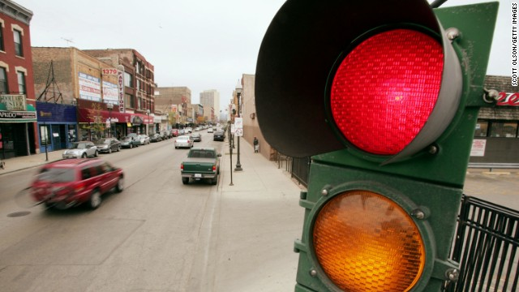
Proposed Applications
Red Light Violation Warning

Slide 5
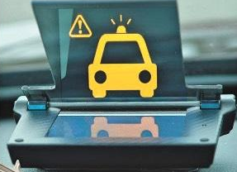
Proposed Applications
Emergency Vehicles

Slide 6
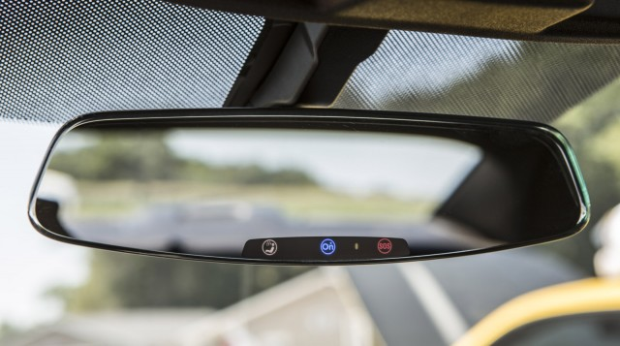
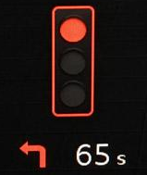
Proposed Applications
SPaT/MAP Messages

Slide 7
Proposed Applications
BSM Message Polling
  Collect Basic Safety Messages from CVs using V2I
  Organize in online data repository
  Query data that can be used to optimize operations
    Speed
    Hard Breaking
    Anti Lock Breaks Engaged (BSM Part 2)
    Airbag Deployed (BSM Part 2)

Slide 8
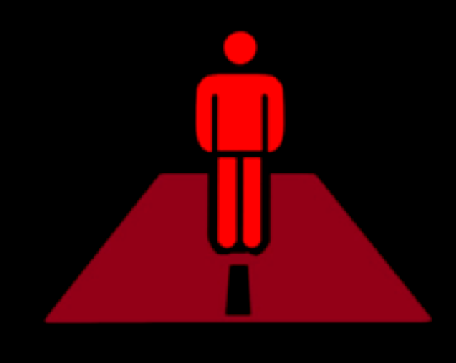
Proposed Applications
Pedestrian Crossing Warning

Slide 9
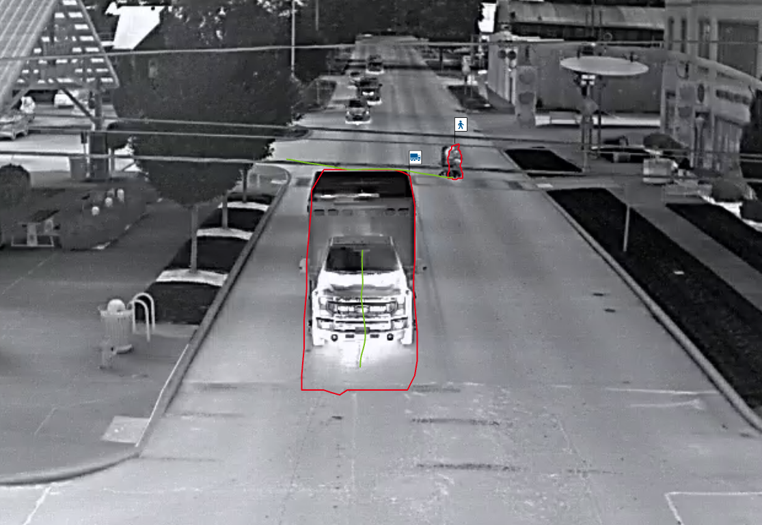
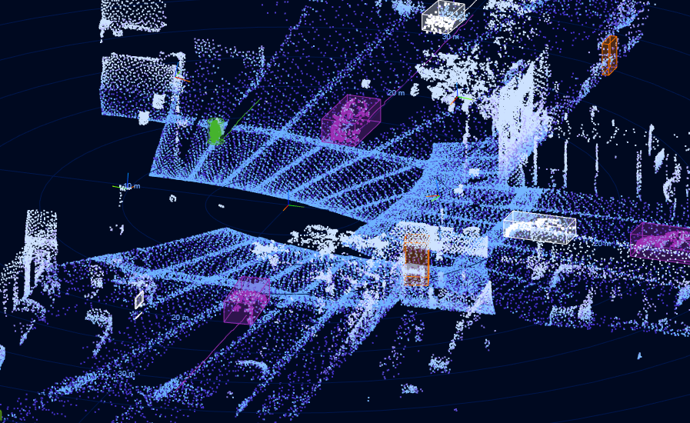
Pedestrian detection
Thermal Cameras
Lidar

Slide 10
Volunteer Drivers
Recruit Volunteers
  400 OBUs to be installed on vehicles owned by City residents
  4:1 Recruitment Ratio
  18 month test period
Provide Incentives
  Monetary Donation to non-profit organization of choice
  Use groups to help recruit drivers (baseball leagues, booster programs)
IRB (Institutional Review Board)
  Led by University of Cincinnati
Analyze BSM data collected

Slide 11
Thank you
Mike Andrako, PE
Public Service Director, City of Marysville
mandrako@marysvilleohio.org

