Slide 1
ACRP 07-09:
Apron Planning and Design Guidebook

Slide 2
ACRP 07-09: Apron Planning and Design Guidebook
Research Team:
Ricondo & Associates, Inc.
Airport Development Group, Inc.
Aviation Safety and Security Education Training, LLC
Kimley-Horn and Associates, Inc.
Two Hundred, Inc.

Slide 3
ACRP 07-09 Project Panel
Jorge E. Panteli, McFarland-Johnson, Inc. (Chair)
Mark B. Gibbs, City and County of Denver
Stacy L. Jansen, PE, LEED, Burns & McDonnell Engineering Co.
James McCluskie, Reno-Tahoe Airport Authority
Kiran Merchant, Port Authority of New York and New Jersey
Kenneth P. Stevens, University of Westminster
Michael A Meyers, PE, FAA Liaison
Stephen F. Maher, PE, TRB Liaison

Slide 4
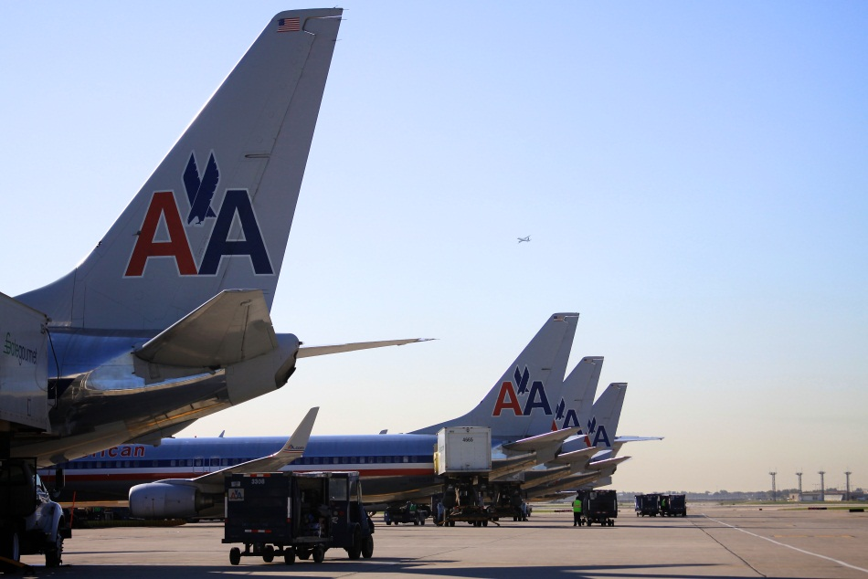
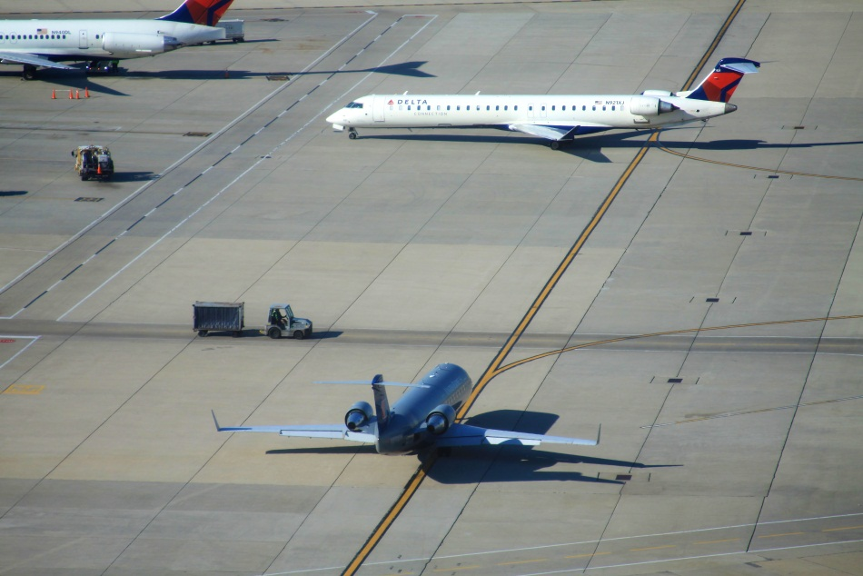
Agenda
Introduction and Research Purpose
Planning and Design Process
Understanding the Apron
Apron and Planning Design Guidance

Slide 5
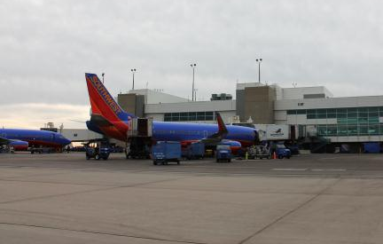
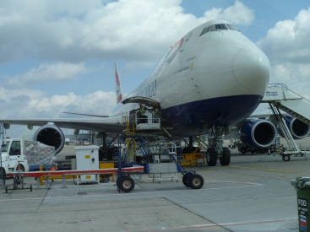
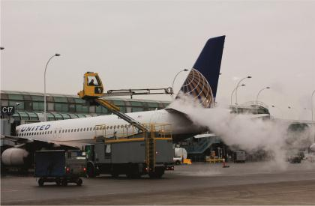
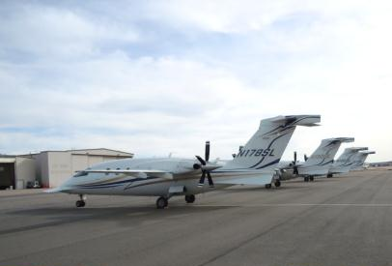
Introduction
Aprons are among the most congested areas at an airport:
Aircraft movements
Passengers and cargo
Ground service equipment
Airline/supplier personnel
CHALLENGE: Lack of comprehensive and complete guidance in a readily accessible form
OPPORTUNITY: Consolidate guidance without presenting a prescriptive approach

Slide 6
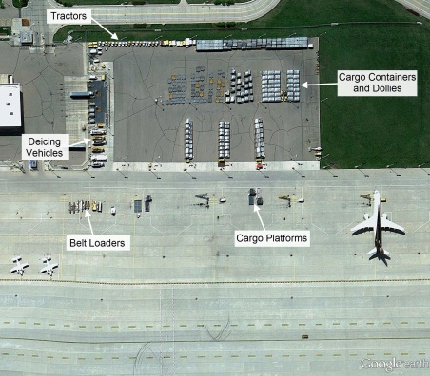
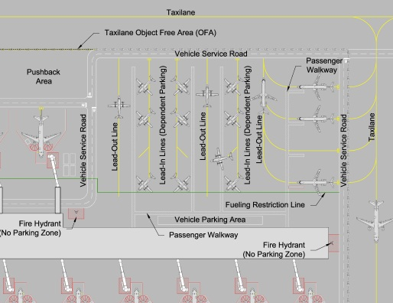
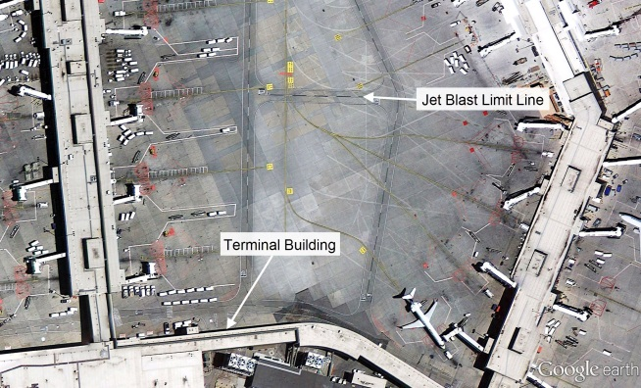
Research Objectives
Develop a guidebook to describe best practices for comprehensive apron planning and design that enhances operational efficiency and safety
The Guidebook is intended to assist planners, designers, airport operators and other stakeholders in enhancing the operational efficiency, safety, and flexibility of aprons
It does not relieve the user of the need to thoroughly understand the specific operating environment at the project area
Provide a conduit to other apron planning and design information

Slide 7
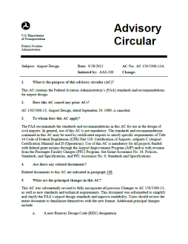
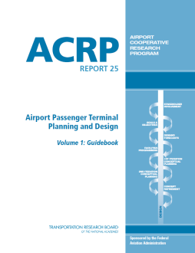
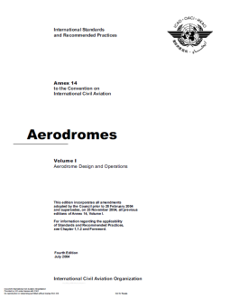
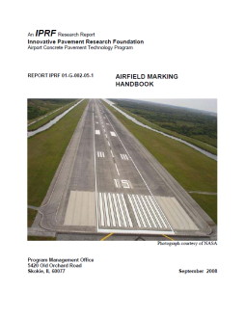
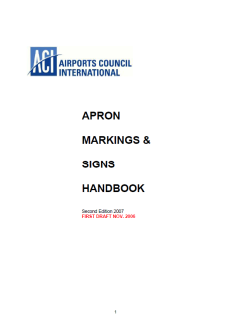
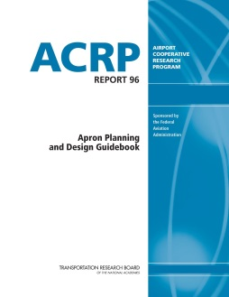
Research Approach
Conducted literature search to identify existing apron planning and design guidance
Evaluated literature to identify limitations and enhancements of existing guidance and to inform site visits
Performed apron observations at a variety of airports to explore best practices for planning and operating apron facilities
Observations
&
Research
+
=

Slide 8
Guidebook Organization
Chapter 1, Introduction
Presents background on the research project.
Chapter 2, Apron Planning and Design Process
Describes the general apron planning and design process including stakeholder and agency involvement.
Chapter 3, Understanding the Apron Environment
Summarizes the different types of aprons, activities (aircraft, passengers, employees, vehicles) that occur in apron environments, and GSE used to support these activities.
Chapter 4, Apron Planning and Design
Provides detailed guidance on various apron planning considerations, design implications, and related regulations/guidance.

Slide 9
Apron Planning and Design Process
Level of planning detail will influence which steps are completed
Master planning requires conceptual planning
Development program and design projects require very detailed planning

Slide 10
Stakeholder & Agency Involvement
Stakeholder and agency involvement helps ensure the needs and requirements of these parties are considered throughout the planning process
Provides broader perspective and informs planners and designers of relevant operational, environmental, and design factors
Enhances support for an apron project
Airport Tenants
Airport Management and Staff
Third-party Service Providers
FAA
TSA
U.S CBP
Local Police and Fire
Air Quality
State Wildlife
Historical Agencies
Wastewater/Water Quality/Wetlands

Slide 11
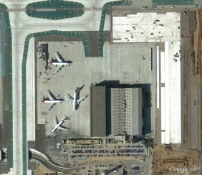
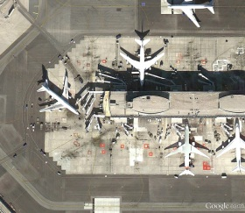
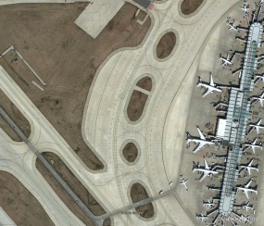
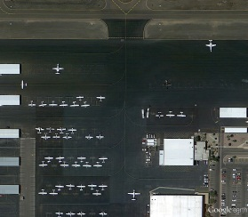
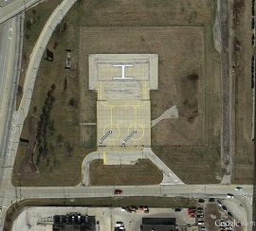
Understanding the Apron Environment
Critical to responsive and effective planning and design
It is the responsibility of the planner or designer to understand the physical and operational environment of the specific airport apron area before
Engage stakeholders in understanding the environment
The Guidebook provides information on the activities, vehicles, and equipment utilized on the different apron types:
Terminal
Deicing
Cargo
Maintenance
Remote
General Aviation
Helipads

Slide 12
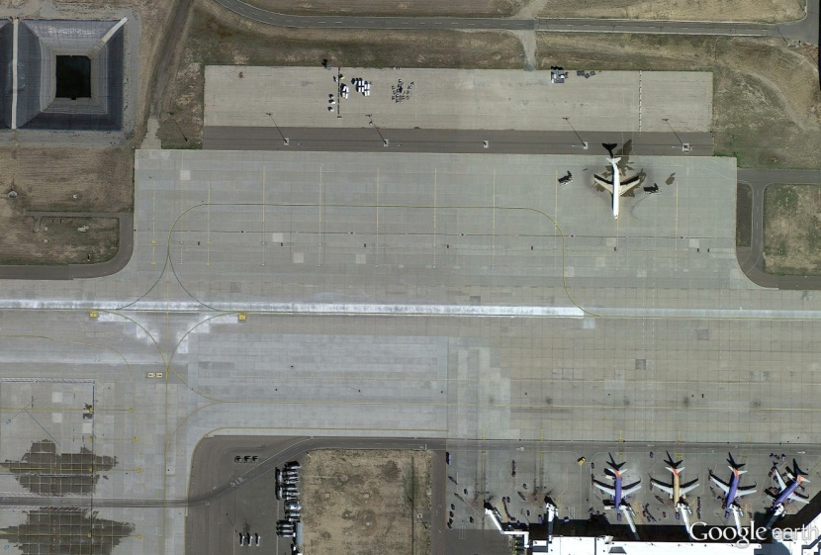
Planning Considerations
Functional Apron Capacity
Accommodate anticipated demand, irregular operations, new users or tenants, and/or future aviation demand
Operational Efficiency
A measure of how an apron supports day-to-day operations
Minimize dependencies in operations, aircraft parking, taxi flows, aircraft servicing
Flexibility
Accommodate diverse fleets, changing operating characteristics, and irregular operations
Plan aprons for multiple purposes (e.g., single apron for deicing, remote overnight parking, aircraft holding)

Slide 13
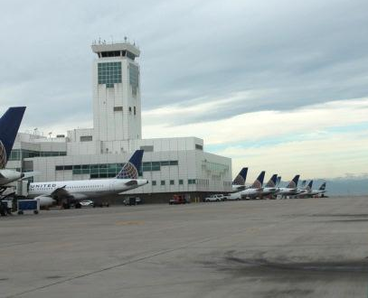
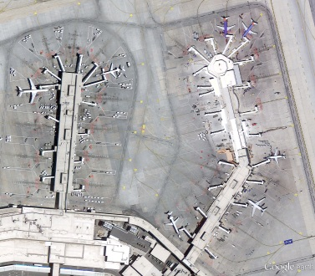
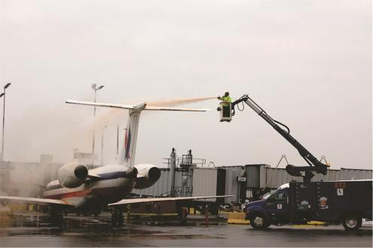
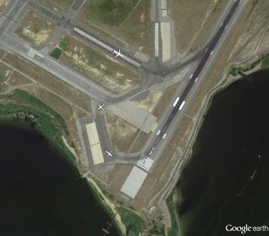
Planning Considerations
Operational Factors
Reflect unique characteristics of airport
Consider types of operations (cargo, deicing, general aviation), aircraft turn times, fleets, lease types, airline operation (hubbing/origin-destination, international/domestic)
Site Constraints
Understand specific site constraints
Consider both physical and operational (aircraft ground flows, aeronautical surfaces, clearance areas, tower line of sight, and environmental considerations)

Slide 14
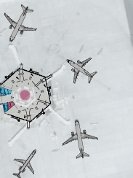
Determining Apron Demand
Methodology depends on type of apron project
Defining apron requirements to support master planning is different from forecasting demand for reconfiguration of an existing apron.
Sources
Direction from airport operator, tenant or lessee
Historical relationships
FAA or national forecasts
Aircraft fleet orders
Planned developments/leases
Based/itinerant aircraft
Air service marketing

Slide 15
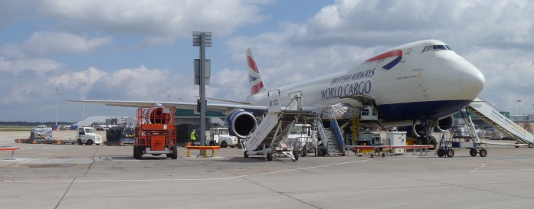
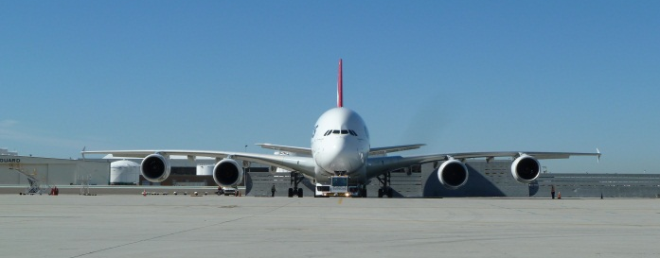
Fleet Evolution
Changes in fleet may require changes to physical layout and operational needs
Wingtip devices
New large aircraft (A380, 747-8)
Trend of increasing wingspans
Equipment needs
Increased ground power unit capacity
Data / internet connections
Phasing out of models or sizes of aircraft

Slide 16
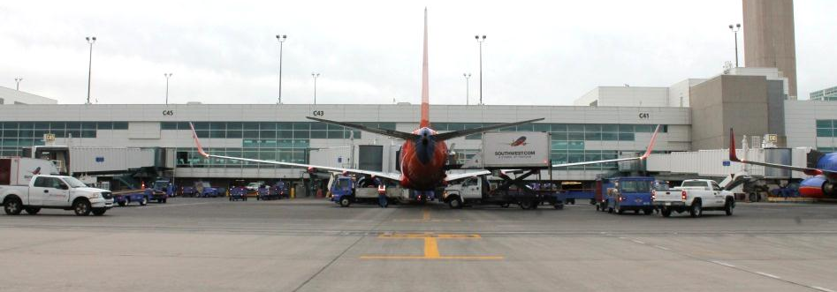
Aircraft Clearances
FAA provides guidance on nose-to-building clearances, but not on wingtip clearances in apron areas
ICAO provides planning criteria for wingtip clearances
Wingtip clearances usually determined by airport or apron lessee
In some cases reduced horizontal wingtip clearance or vertical clearance may be allowed during a gate entry/exit maneuver
Airport may set clearance standards on all aircraft parking positions or, at a minimum, between leaseholds
Allow space for maneuvering of GSE and emergency vehicle access and servicing aircraft

Slide 17
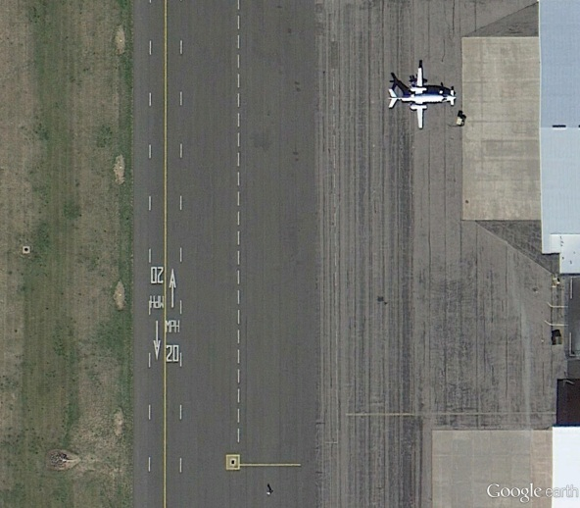
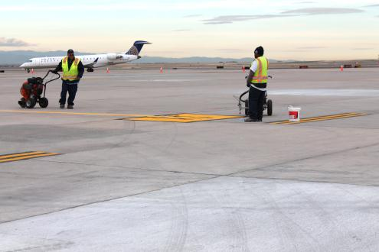
Apron Markings
Apron-related Airfield Marking
Taxiways, taxilanes, holding positions, non-movement area boundaries, and roadways
Standards established by FAA
Apron Markings
No guidance currently published by FAA
Industry guidance is available and summarized in Guidebook
Markings vary among airports and aprons, influenced by operation and size of apron
Determined by airport operators and/or apron lessees

Slide 18
Apron Configuration
Ensure that aprons comply with aeronautical surfaces and runway/taxiway areas
Incorporation of pushback areas may reduce taxi congestion
Vehicle service roads can be placed in front of (head-of-stand) or behind (tail stand) aircraft
Ensure there is sufficient space for GSE storage and staging, either locally or remotely
Aprons may need to be visible from ATCT or ramp towers

Slide 19
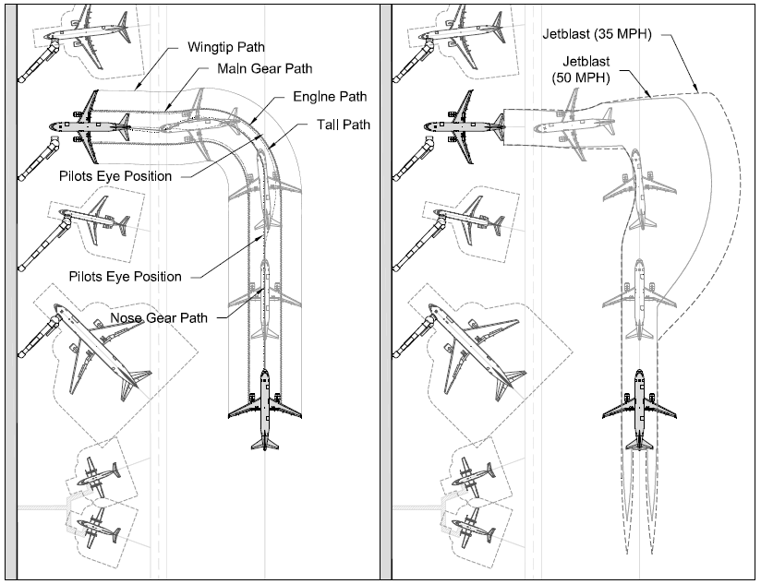
Technology/Planning Tools
Computer-aided design (CAD) allows for analysis of different apron configurations
Add-on programs allow for simulation of aircraft and vehicle movements and aircraft servicing
Path tracking
Jet blast velocity tracking
Aircraft servicing layouts
Passenger loading bridge analysis
Pavement strength software
FAARFIELD (FAA) assists with designing new and modifying airfield pavements

Slide 20
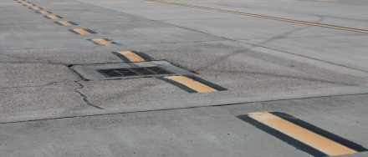
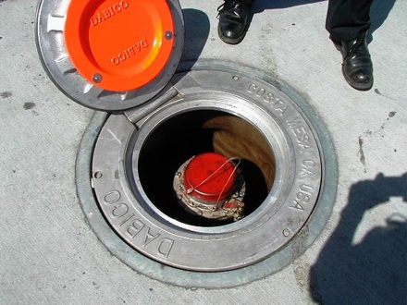
Design Implications
Consider benefits of different pavement types
Drainage: follow regulations and consider long-term expansion potentials
Construction impacts: pavement replacement may require operational plans to route aircraft around construction and accommodate weather-related limitations
Hydrant fueling systems: need to follow NFPA requirements and consider aircraft parking positions and loading bridge operational ranges
Paint and reflective materials vary and selection should consider durability, weather conditions, and cost.
Lighting should follow Illuminating Engineering Society guidelines.

Slide 21
Management/Operational Policies
Airports use management and operational policies to enhance safety and manage the utilization of aprons.
Examples:
Lease stipulations requiring minimum utilization of aprons
Require vehicle and aircraft parking and flow plans
Varying lease types (exclusive, preferential, common use)
Establishing wingtip clearances between parking positions or between leaseholds
Enforce required aircraft parking apron for apron to building or lease area
Deicing and fueling consortiums

Slide 22
Related Regulations/ Guidance/References
FAA
Advisory circulars and orders provide guidance
SMS
May become part of apron planning process as guidance matures
Sustainability
Initiatives can be incorporated that support airport operator goals
VALE Program
Provides funding for electrification projects to improve air quality
Environmental Regulations
NEPA process and state environmental planning requirements
NFPA
Published codes and standard to minimize the risk of fires in the apron environment
ICAO
As the FAA increases harmonization with ICAO guidance, it is anticipated to be increasingly reflected in apron facilities

Slide 23
Additional Information
ACRP Report 96 Apron Planning and Design Guidebook
http://onlinepubs.trb.org/onlinepubs/acrp/acrp_rpt_096.pdf

