Slide 1
ACRP 02-63: quantifying airport ground access vehicles (gav) activity for emissions modeling Tutorial
CLICK HERE TO BEGIN

Slide 2
instructions
This button will move you forward a step in the Tutorial.
This button will take you back a step.
And this one will take you to the next section.
At any time, you can press the button to return to the slide index.
Throughout this Tutorial there are underlined terms, click on these terms for more information.
For more information on any topic, please refer to the ACRP 02-63 Guidebook.
Next Section
Index

Slide 3
index
Overview
Air Quality-Related Computer Models
GAV Categories
Operational Characteristics
GAV Infrastructure and General Emission Model Data Requirements
Specific Data Requirements
Collecting Existing Conditions Data
Deriving Future Conditions
Regional (Off-Airport) Data
Acknowledgments
For information on a particular subject, hover over and click on the provided links.

Slide 4
overview
Primary reasons to compute GAV-related emissions:
To document levels or evaluate reduction measures.
To comply with requirements of the National Environmental Policy Act (NEPA).
To submit to a regulatory agency for inclusion in a State Implementation Plan (SIP).
This Tutorial provides analysts (e.g., air quality, traffic, planning) with methods to obtain/derive GAV-specific data for use in emissions modeling.
See Chapter 1 of the 02-63 Guidebook for more information.
Index
Next Section

Slide 5
National Environmental Policy Act (NEPA)
The NEPA is an environmental law designed to promote the enhancement and protection of the environment. It was enacted on January 1, 1970 and most significantly requires all executive federal agencies to prepare Environmental Assessments (EAs) and Environmental Impact Statements (EISs) which disclose the potential environmental impacts of proposed agency actions.
Index

Slide 6
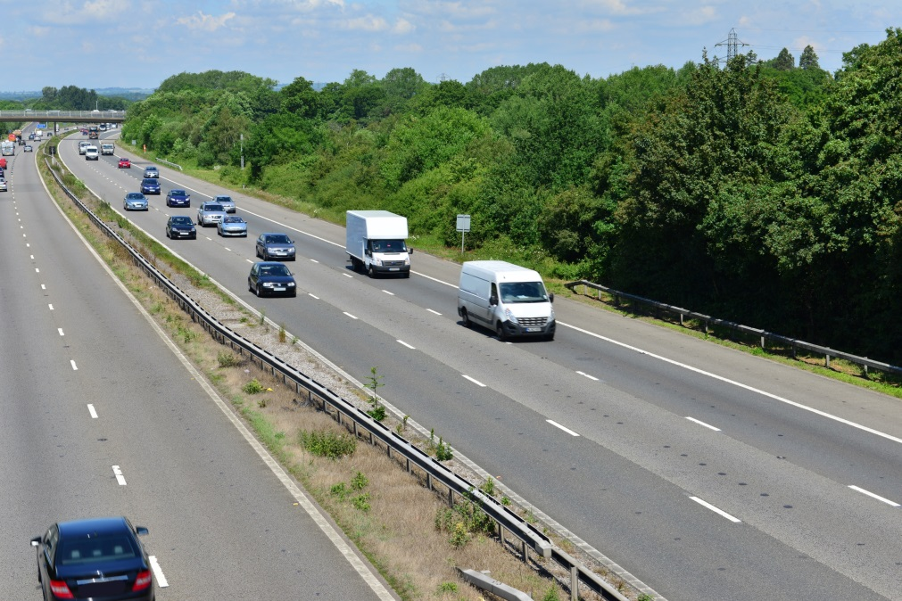
State implementation plan (SIP)
A SIP is a document developed by state agencies and approved by the Environmental Protection Agency (EPA) in support of cleaning up a polluted area and bringing it back into compliance with the Clean Air Act. It typically consists of narrative, rules, technical documentation and agreements that individual states will use to remediate affected areas.
Index
Next Section

Slide 7
Air quality-related COMPUTER models
Emission rate models
Dispersion models
Hot-spot models
There are three general types of computer models that are used to prepare estimates of GAV-related emissions.
See Chapter 2 of the 02-63 Guidebook for more information.
Index
Next Section

Slide 8
Emission rate models
The MOVESª and EMFAC^{b} models are emission rate models that provide emission rates for on-road motor vehicle emissions. On-road vehicles are vehicles designed and equipped to travel on public roadways. All of the typical GAV for an airport project will be on-road vehicles. Notably, MOVES is used to estimate vehicle emissions in all states except California, where the use of EMFAC is required.
ª MOVES – MOtor Vehicle Emission Simulator
^{b} EMFAC – Emission Factors model
Index

Slide 9
Dispersion ModelS
Dispersion models simulate the dispersion of gases over a surrounding area. The Federal Aviation Administration (FAA) currently requires use of the Aviation Environmental Design Tool (AEDT), which uses AERMOD, the EPA-preferred atmospheric dispersion model. Notably, the current AEDT release does directly process GAV sources. Instead, output from MOVES is imported into AEDT.
Index

Slide 10
Hot-Spot Models
Some projects that involve GAV may also require hot-spot analysis. Hot-spots are small areas with the potential for high concentrations of pollutants (e.g., roadway intersections, terminal curbsides). The EPA’s CAL3QHC and CAL3QHCR computer models are currently used to prepare hot-spot analysis; however, the agency has proposed replacing these models with AERMOD.
Index
Next Section

Slide 11
GAV Categories
GAV are typically located on the landside of an airport. Users of these vehicles include airline passengers, employees of the airport, airline or airport tenants, and airport support vehicles (e.g., vehicles delivering supplies).
Examples of the types of vehicles in each group of GAV and their emission rate model equivalents can be viewed by clicking on any of these hyperlinks.
Courtesy Vehicles
Scheduled Buses
Service and Delivery Vehicles
Transportation Network Company Vehicles
Air Cargo Vehicles
Door-to-Door/Shared Ride Vans
Private Vehicles
Rental Cars
On-Demand and Pre-Reserved Taxicabs
On-Demand and Pre-Arranged Limousines
See Chapter 3 of the 02-63 Guidebook for more information.
Index
Next Section

Slide 12
Example Private vehicles
Cars
Vans/SUVs
Pickup Trucks
Motorcycles
Index

Slide 13
Moves/emfac equivalents – Private vehicles
Vehicle Type | Example | Moves Equivalent |  | EMFAC Equivalent
 |  | Vehicle Type | Fuel Type(s) | Vehicle Type | Fuel
Automobiles | Chevrolet Malibu | Passenger Car | Gas, Diesel, E-85, Electric | Passenger Car | Gas, Diesel
Vans/SUVs | GMC Savana | Passenger Truck | Gas, Diesel, E-85, Electric | Light Duty Truck (1 and 2) Medium-Duty Truck, Light-Heavy Duty Truck (8,501-10,000 lb) | Gas, Diesel
Pickup Trucks | Ford F-150 | Passenger Truck | Gas, Diesel, E-85, Electric | Light Duty Truck (1 and 2) Medium-Duty Truck, Light-Heavy Duty Truck (8,501-10,000 lb) | Gas, Diesel
Motorcycles | Victory Gunner | Motorcycle | Gas | Motorcycle | Gas, Diesel
Index
Next Section

Slide 14
EXAMPLE Rental CarS
Cars
Vans/SUVs
Pickup Trucks
Index

Slide 15
MOVES/EMFAC EQUIVALENTS – Rental Cars
Vehicle Type | Example | Moves Equivalent |  | EMFAC Equivalent
 |  | Vehicle Type | Fuel Type(s) | Vehicle Type | Fuel
Automobiles | Chevrolet Malibu | Passenger Car | Gas, Diesel, E-85 | Passenger Car | Gas, Diesel
Vans/SUVs | GMC Savana | Passenger Truck | Gas, Diesel, E-85, Electric | Light Duty Truck (1 and 2) Medium-Duty Truck, Light-Heavy Duty Truck (8,501-10,000 lb) | Gas, Diesel
Pickup Trucks | Ford F-150 | Passenger Truck | Gas, Diesel, E-85, Electric | Light Duty Truck (1 and 2) Medium-Duty Truck, Light-Heavy Duty Truck (8,501-10,000 lb) | Gas, Diesel
Index
Next Section

Slide 16
Example On-demand and pre-reserved taxicabs
Cars
Vans/SUVs
Index

Slide 17
Moves/emfac equivalents- On-Demand and pre-reserved Taxicabs
Vehicle Type | Example | Moves Equivalent |  | EMFAC Equivalent
 |  | Vehicle Type | Fuel Type(s) | Vehicle Type | Fuel
Automobiles | Ford Crown Victoria | Passenger Car | Gas, Diesel, E-85 | Passenger Car | Gas, Diesel
Vans/SUVs | GMC Savana | Passenger Truck | Gas, Diesel, E-85, Electric | Light Duty Truck (1 and 2) Medium-Duty Truck, Light-Heavy Duty Truck (8,501-10,000 lb) | Gas, Diesel
Index
Next Section

Slide 18
Example Transportation Network Company vehicles
Cars
Vans/SUVs
Pickup Trucks
Index

Slide 19
Moves/emfac equivalents – Transportation Network Company
Vehicle Type | Example | Moves Equivalent |  | EMFAC Equivalent
 |  | Vehicle Type | Fuel Type(s) | Vehicle Type | Fuel
Automobiles | Chevrolet Malibu | Passenger Car | Gas, Diesel, E-85 | Passenger Car | Gas, Diesel
Vans/SUVs | GMC Savana | Passenger Truck | Gas, Diesel, E-85, Electric | Light Duty Truck (1 and 2) Medium-Duty Truck, Light-Heavy Duty Truck (8,501-10,000 lb) | Gas, Diesel
Pickup Trucks | Ford F-150 | Passenger Truck | Gas, Diesel, E-85, Electric | Light Duty Truck (1 and 2) Medium-Duty Truck, Light-Heavy Duty Truck (8,501-10,000 lb) | Gas, Diesel
Index
Next Section

Slide 20
EXAMPLE ON-Demand and Pre-Arranged Limos
Index

Slide 21
MOVES/EMFAC EQUIVALENTS – on-demand and Pre-Arranged limos
Vehicle Type | Example | Moves Equivalent |  | EMFAC Equivalent
 |  | Vehicle Type | Fuel Type(s) | Vehicle Type | Fuel
Automobiles | Lincoln Town Car | Passenger Car | Gas, Diesel, E-85 | Passenger Car | Gas, Diesel
Index
Next Section

Slide 22
Example Courtesy Vehicles
Minibus
Vans
Bus
Index

Slide 23
Moves/emfac equivalents – Courtesy Vehicles
Vehicle Type | Example | Moves Equivalent |  | EMFAC Equivalent
 |  | Vehicle Type | Fuel Type(s) | Vehicle Type | Fuel
Vans | Ford E150 | Light Commercial Truck | Gas, Diesel, E-85 | Light-Heavy Duty Truck (up to 8,501 lb), Light-Heavy Duty Truck (8,501-10,000 lb) | Gas, Diesel
Minibus | Turtle Top Odyssey | Short-Haul Single-Unit Truck | Gas, Diesel | Light-Heavy Duty Truck (10,001-14,000 lb) | Gas, Diesel
Bus | Motor Coach Industries 102-DW3SS | Transit Bus | Gas, Diesel, CNG | Urban Bus | Diesel, Gas, Natural Gas
Index
Next Section

Slide 24
Example Scheduled or Charter Bus
Index

Slide 25
Moves/emfac equivalent – Bus (Scheduled or charter)
Vehicle Type | Example | Moves Equivalent |  | EMFAC Equivalent
 |  | Vehicle Type | Fuel Type(s) | Vehicle Type | Fuel
Bus | Motor Coach Industries 102-DW3SS | Transit Bus | Gas, Diesel, CNG | Urban Bus | Diesel, Gas, Natural Gas
Index
Next Section

Slide 26
Example Service/Delivery Vehicles
Vans
Medium Truck
Heavy Truck
Index

Slide 27
Moves/emfac equivalents – Service/delivery vehicles
Vehicle Type | Example | Moves Equivalent |  | EMFAC Equivalent
 |  | Vehicle Type | Fuel Type(s) | Vehicle Type | Fuel
Vans | GMC Savana | Light Commercial Truck | Gas, Diesel, E-85, Electric | Light-Heavy Duty Truck (8,501-10,000 lb) | Diesel, Gas
Trucks | Kenworth T170 | Short-Haul Single-Unit Truck | Gas, Diesel | Medium-Heavy Duty Diesel Truck (10,001-26,000 lb) | Diesel
 | Kenworth T270 | Refuse Truck | Gas, Diesel | Heavy-Heavy Duty Diesel Solid Waste Collection Truck | Diesel, Natural Gas
Index
Next Section

Slide 28
Example Door-to-door/shared ride van
Index

Slide 29
Moves/emfac equivalents – Door-to-door/shared ride vans
Vehicle Type | Example | Moves Equivalent |  | EMFAC Equivalent
 |  | Vehicle Type | Fuel Type(s) | Vehicle Type | Fuel
Vans | Ford E150 | Light Commercial Truck | Gas, Diesel, E-85 | Light-Heavy Duty Truck (up to 8,501 lb), Light-Heavy Duty Truck (8,501-10,000 lb) | Gas, Diesel
Index
Next Section

Slide 30
Example Air Cargo Vehicles
Vans
Light/Medium Trucks
Heavy Truck
Index

Slide 31
Moves/emfac equivalents – Air Cargo Vehicles
Vehicle Type | Example | Moves Equivalent |  | EMFAC Equivalent
 |  | Vehicle Type | Fuel Type(s) | Vehicle Type | Fuel
Semi-Trailers | Kensworth T800 | Short-Haul Combination Truck | Gas, Diesel | Heavy-Heavy Duty Diesel Tractor | Diesel
Light Trucks | Freightliner P1000 | Short-Haul Single-Unit Truck | Gas, Diesel | Light-Heavy Duty Truck (10,001-14,000 lb) Medium-Heavy Duty Diesel Truck (14,001-26,000 lb) | Gas, Diesel
Vans | GMC Savana | Light Commercial Truck | Gas, Diesel, E-85, Electric | Light-Heavy Duty Truck | Diesel, Gas
Index
Next Section

Slide 32
Operational characteristics
There are three factors that determine the level of emissions for each individual vehicle within a type of GAV:
Fuel Type
Operating Speed
Idle/Dwell Time
See Chapter 3 of the 02-63 Guidebook for more information.
Index
Next Section

Slide 33
GAV Fuel Types
Fuel type
The most common fuel types are listed below,. click on each for a description and how it affects AQ emissions:
Diesel
Compressed Natural Gas (CNG)
Liquefied Petroleum Gas (LPG)
Ethanol (E-85)
Electric
You can click on any hyperlinks to the left for more information about a specific fuel (including their key attributes) or click “Next” to view information on all the fuel types.
Index

Slide 34
Diesel
There are several forms of diesel fuel, the most common of which is petroleum diesel. This fuel is produced via fractional distillation of crude oil.
Key attributes:
Commonly used.
High emission potential.
Index

Slide 35
Compressed Natural Gas
Compressed natural gas (CNG) is methane stored at high pressures.
Key attributes:
Generally lower greenhouse gas (GHG) emissions than comparable gasoline and diesel-fueled vehicles.
Common in programs to reduce fleet emissions.
Index

Slide 36
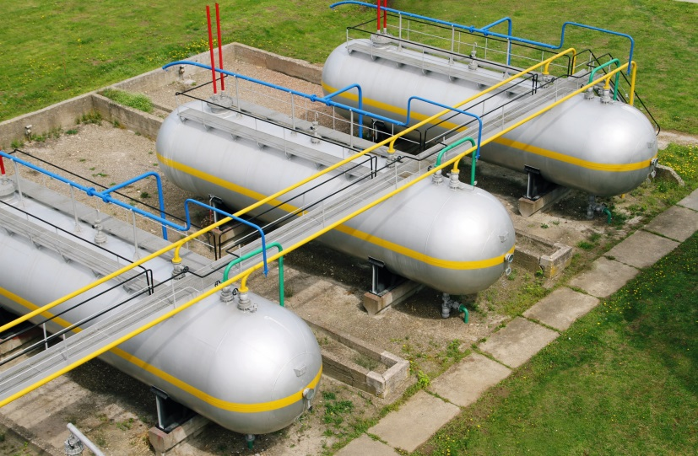
Liquid Petroleum Gas
Liquid petroleum gas (LPG) is a flammable mixture of hydrocarbon gases, typically propane or butane.
Key Attributes:
Lower CO₂ emissions than traditional fuels.
Index

Slide 37
Ethanol (E-85)
E-85 is an ethanol gasoline blend that contains a maximum ethanol content of 85% percent by volume.
Key Attributes:
Widely available flex-fuel.
Fewer volatile components than gasoline, which means fewer emissions from evaporation.
Index

Slide 38
Electric
Electric vehicles are propelled using an electric motor rather than an internal combustion engine.
Key Attributes:
Negligible emissions (only those at power generating facilities and from tire and brake wear).
Requires special infrastructure to support use.
Index

Slide 39
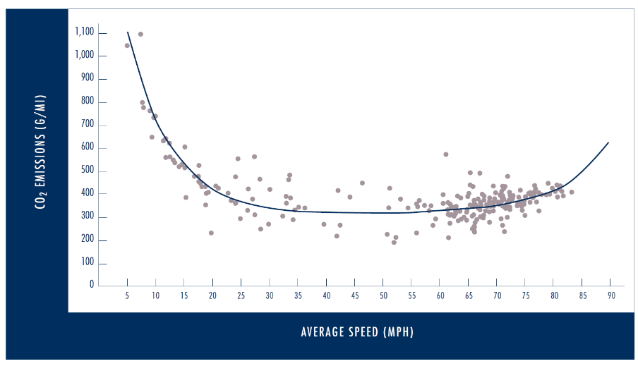
vehicle Speed
The second factor to take into consideration for a GAV fleet is the average operational speed of the vehicles.
Speeds less than10 miles per hour (mph) see much higher carbon dioxide (CO₂) emissions than higher speeds.
Average speed largely dependent on location in airport.
Emission-Speed Plot of Individual Trips or Trip Segments (Source: Traffic Congestion and Greenhouse Gases, University of California, Riverside, 2016)
Index

Slide 40
idle/dwell time
The final factor to consider: vehicular idle/dwell time (i.e., delay).
Define the time during which engines are running and vehicles are immobile.
Typically occurs at curbside, intersections, and traffic lights.
Index
Next Section

Slide 41
Gav infrastructure and GENERAL EMISSION MODEL Data REQUIREMENTS
The table on the next slide lists the general and specific areas at which GAV operate at an airport and the types of vehicles in each area. General emission model data requirements are also provided for each area.
On an airport’s landside, most GAV operate in the following areas:
Roadways
Parking facilities
Hold areas
If an airport has such services/areas, GAV may also operate in locations such as a transit bus stop or a “Kiss-n-Fly” drop-off location.
Index
Next Section

Slide 42
Infrastructure/ GENERAL Data REQUIREMENTS
GAV Infrastructure |  | Required Data
General | Specific | Volume |  | Fleet Mixª | Average Speed^{b} | Idle/ Dwell Time
 |  | Entering | Exiting
Roadways | Access | X |  | X | X
 | Curbside | X |  | X |  | X
 | Circulation | X |  | X | X
 | Service | X |  | X | X
 | Cargo | X |  | X | X | X
 | Airfield | X |  | X | X
Parking Facilities | Surface | X | X
 | Multi-level | X | X
 | Employee | X | X
 | Cell Phone | X | X |  |  | X
 | Hotel | X | X
Vehicle Staging/ Queuing Areas | On Demand Taxi/Limo | X | X |  |  | X
 | Limo | X | X |  |  | X
 | Door-to-door/ Shared Ride | X | X |  |  | X
 | Hotel/Motel Shuttles | X | X |  |  | X
 | Parking Shuttles (on airport) | X | X |  |  | X
 | Parking Shuttles (off airport) | X | X |  |  | X
 | TNC | X |  |  |  | X
Other | Kiss-n-Fly | X |  |  |  | X
 | Transit Stop | X |  |  |  | X
 | Pre-arranged Taxi/Limo | X |  |  |  | X
 | Charter Bus | X |  |  | X | X
 | Cargo Facilities | X |  | X | X | X
ª A GAV fleet mix is not required in areas where only one group of GAV operate (e.g., it can be assumed that only a private vehicles operate in an airport parking facility). ^{b} A nominal vehicle speed of 20 miles-per-hour or less can be assumed for all parking facilities, vehicle staging/queuing areas and other areas of an airport.
See Chapter 4 of the 02-63 Guidebook for more information.
Index
Next Section

Slide 43
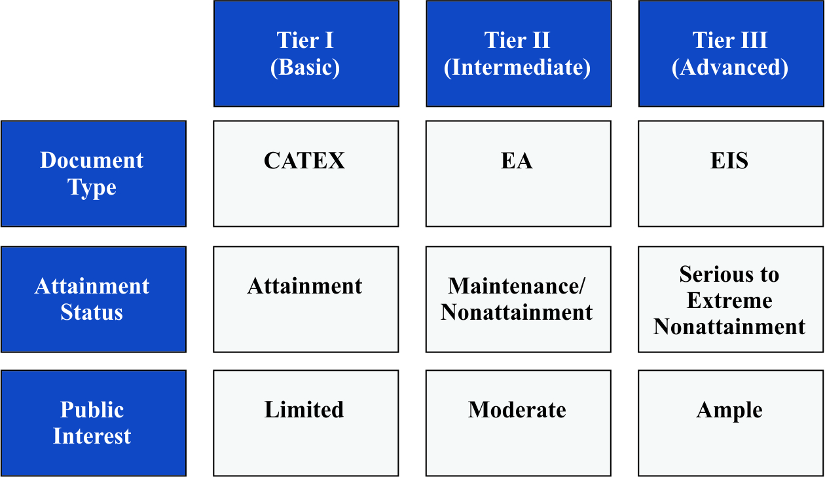
SPECIFIC Data requirementS
GAV data requirements can be segregated into three tiers:
Tier I (Basic)
Tier II (Intermediate)
Tier III (Advanced)
See Chapter 5 of the 02-63 Guidebook for more information.
Index
Next Section

Slide 44
Document type
There are three types of environmental documentation, for which varying levels of data are required. The three, in order of data level requirements, are:
Categorical Exclusion (CATEX) - Projects for which a CATEX can be performed should have no notable effect on air quality conditions: Tier 1 (Basic).
Environmental Assessment (EA) - EAs are prepared when the significance of project-related impacts are expected to be minimal or uncertain: Tier II (Intermediate).
Environmental Impact Statement (EIS) - Prepared for projects that may significantly affect the quality of the human and natural environment: Tier III (Advanced).
Index

Slide 45
Attainment Status
An area’s status can be obtained from EPA at: https://www3.epa.gov/airquality/greenbook/
The EPA-designated National Ambient Air Quality Standard (NAAQS) attainment status for a project area is a key factor in determining data level requirements.
Attainment – Pollutant levels are below the NAAQS: Tier I (Basic).
Maintenance/Non-attainment - Pollutant levels previously greater than and moderately above the NAAQS: Tier II (Intermediate).
Serious/Extreme Non-attainment – Pollutant levels are well above the NAAQS: Tier III (Advanced).
Index

Slide 46
Public Interest
The final factor to consider is the public’s interest in the project
If there is limited interest (e.g., minor runway extension): Tier I (Basic)
Moderate interest (e.g., a runway extension): Tier II (Intermediate)
Substantial interest (e.g., new airport): Tier III (Advanced)
Index

Slide 47
Project Types &tier levels
Project/Action Category | Model GAVª | Tier I | Tier II | Tier III
Project Type
New Airport | H |  |  | X
New Runway | M |  | X
Major Runway Extension | M |  | X
New or Expanded Terminal | H |  |  | X
Relocated Terminal | H |  |  | X
Roadway Modifications | H |  |  | X
New or Expanded Cargo or FBO Facility | M |  | X
New or Expanded Parking | H |  |  | X
New or Expanded Utility Plant | L | X
New Fuel Storage System | L | X
New or Modified Taxiway | L | X
Runway Safety Area | L | X
Runway Rehabilitation | L | X
Obstruction Removal | L | X
Air Traffic Control Tower | L | X
Action Type
Increase in Aircraft Operations | H |  |  | X
Change in Runway Utilization | M |  | X
Change in Vehicle Mix | M |  | X
Increase in Aircraft Taxi Time/Delay | L | X
Increase in Motor Vehicle Trips | H |  |  | X
Air Traffic Procedures < 3,000 ft. | M |  | X
Air Traffic Procedures > 3,000 ft. | L | X
Land Acquisition | L | X
Navigational System | L | X
ª Indicates likelihood that GAV emissions will be modeled = High = Medium = Low
This table lists potential airport-related projects, indicates what the likelihood is that GAV emissions will be modeled and suggests the data collection level.
The following tables more specifically provide the emissions model data requirements for each tier level.
Index

Slide 48
Tier I
GAV Infrastructure |  | Required Data
General | Specific | Volume | Fleet Mixª | Speed | Idle/ Dwell Time
Roadways | Access | Average daily trips entering airport. | Assume a 50/50 split of passenger cars/trucks and composite fuel. | Assume 20 miles per hour (mph). | Not considered in analysis.
 | Curbside
 | Circulation
 | Service
 | Cargo
Parking Facilities | Surface | If project involves parking, average daily trips to parking facility of interest. | Assume a 50/50 split of passenger cars/trucks and composite fuel. | Assume 10 mph. | Not applicable.
 | Multi-level
 | Employee
 | Cell Phone
 | Hotel
 | Rental Car
 | Off-Airport
Vehicle Staging/ Queuing Areas | On Demand Taxi/Limo | If project involves a staging area(s), average daily trips to area of interest. | Assume a 50/50 split of passenger cars/trucks and composite fuel for taxi/limo and TNC areas. For shared ride and shuttle areas assume 50/50 split of light commercial trucks and short-haul single‐unit trucks and a composite fuel. | Assume 10 mph. | Dwell times are assumed.
 | Limo
 | Door-to-door/ Shared Ride
 | Hotel/Motel Shuttles
 | Parking Shuttles (on airport)
 | Parking Shuttles (off airport)
 | TNC
Other | Kiss-n-Fly | If project involves one of the “other” GAV areas, average daily trips to the area. | Assume a 50/50 split of passenger cars/trucks and a composite fuel for kiss-n-fly, taxi/limo areas. For transit stop/charter bus areas assume transit bus and composite fuel. For cargo facilities assume a short-haul single-unit truck and composite fuel. | Assume 10 mph. | Dwell times are assumed.
 | Transit Stop
 | Pre-arranged Taxi/Limo
 | Charter Bus
 | Cargo Facilities
Index

Slide 49
Tier II
GAV Infrastructure |  | Required Data
General | Specific | Volume | Fleet Mixª | Speed | Idle/ Dwell Time
Roadways | Access | Average daily trips for each specific area. | Vehicle mix percentages for GAV identified in Table 3-1 (GAV Infrastructure) for each area. | Use posted speeds for access, circulation and service areas. For curbside and cargo assume 20 mph. | Not considered.
 | Curbside
 | Circulation
 | Service
 | Cargo
Parking Facilities | Surface | If project involves parking, average daily trips to lot. | Assume a 50/50 split of passenger cars/trucks and composite fuel. | Assume 10 mph. | Not applicable.
 | Multi-level
 | Employee
 | Cell Phone
 | Hotel
 | Rental Car
 | Off-Airport
Vehicle Staging/ Queuing Areas | On Demand Taxi/Limo | If project involves a staging area(s), average daily trips to area of interest. | Assume a 50/50 split of passenger cars/trucks and composite fuel for taxi/limo and TNC areas. For shared ride and shuttle areas assume 50/50 split of light commercial truck and short-haul single‐unit truck and composite fuel. | Assume 10 mph. | Dwell times are assumed.
 | Limo
 | Door-to-door/ Shared Ride
 | Hotel/Motel Shuttles
 | Parking Shuttles (on airport)
 | Parking Shuttles (off airport)
 | TNC
Other | Kiss-n-Fly | If project involves one of the “other” categories, average daily trips to area. | Assume a 50/50 split of passenger cars/trucks and composite fuel for kiss-n-fly, taxi/limo areas. For transit stop and charter buses assume transit bus and composite fuel. For cargo facilities assume a short-haul single-unit truck and composite fuel. | Assume 10 mph. | Dwell times are assumed.
 | Transit Stop
 | Pre-arranged Taxi/Limo
 | Charter Bus
 | Cargo Facilities
Index

Slide 50
Tier III
GAV Infrastructure |  | Required Data
General | Specific | Volume | Fleet Mixª | Speed | Idle/ Dwell Time
Roadways | Access | Peak hour data and temporal factors (peak hour to average day, week, and month). | Vehicle fleet mix for each area. | Use observed, measured actual or derived speeds for access, circulation and service areas. For curbside and cargo assume 20 mph. | Use airport-specific idle/dwell times for curbside.
 | Curbside
 | Circulation
 | Service
 | Cargo
Parking Facilities | Surface | Peak hour data and temporal factors (peak hour to average day, week and month). | Assume a 50/50 split of passenger cars/trucks using a composite fuel. | Assume 10 mph. | Not applicable.
 | Multi-level
 | Employee
 | Cell Phone
 | Hotel
 | Rental Car
 | Off-Airport
Vehicle Staging/ Queuing Areas | On Demand Taxi/Limo | Peak hour data and temporal factors (peak hour to average day, week and month). | Assume a 50/50 split of passenger cars/trucks and composite fuel for taxi/limo and TNC areas. For shared ride and shuttle areas, use airport-specific vehicle fleet mix and composite fuel. | Assume 10 mph. | Dwell times are assumed.
 | Limo
 | Door-to-door/ Shared Ride
 | Hotel/Motel Shuttles
 | Parking Shuttles (on airport)
 | Parking Shuttles (off airport)
 | TNC
Other | Kiss-n-Fly | Peak hour data and temporal factors (peak hour to average day, week and month). | Assume a 50/50 split of passenger cars/trucks and a composite fuel for kiss-n-fly, taxi/limo areas. For transit stop and charter buses assume transit bus and composite fuel. For cargo facilities assume a short-haul single-unit truck and composite fuel. | Assume 10 mph. | Dwell times are assumed.
 | Transit Stop
 | Pre-arranged Taxi/Limo
 | Charter Bus
 | Cargo Facilities
Index
Next Section

Slide 51
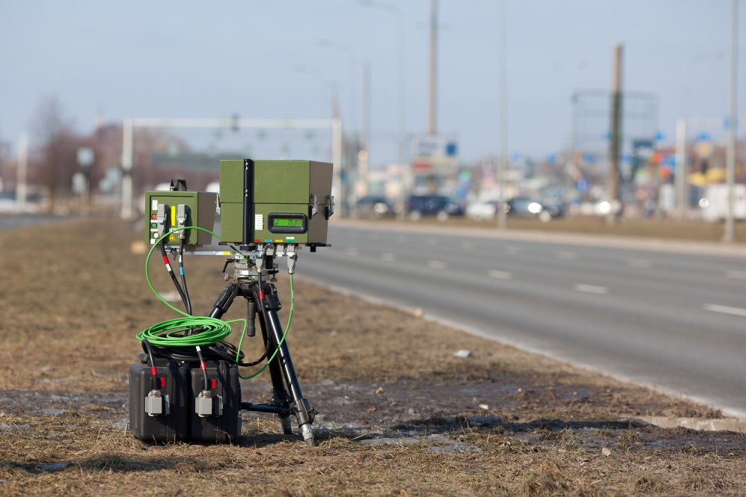
Collecting existing condition Data
For the purpose of emissions modeling, various data collection methods have been rated by each method’s ability to collect GAV volume, mix, and speed, among other factors.
See Chapter 6 of the 02-63 Guidebook for more information.
Index

Slide 52
data Collection methods for existing conditions
Simple | Automated | Intelligent
Manual Traffic Counts (V, C, T) | Pneumatic road tubes (V, C, S, T) Video image processors and recording data collection (V, S, C, P/T) | Inductive loop detectors (V, C, S, P) Magnetic sensors (V, S, P) Microwave radar sensors (V, C, S, P) Active infrared sensors (V, C, S, P) Passive infrared sensors (V, S, P) Laser radar sensors (V, C, S, P) Acoustic array sensors (V, S, P) Pulse/Doppler ultrasonic sensors V, S, P) Piezo-electric sensors (V, C, S, P) Bending plates (V, C, P) Sub-pavement magnetometers (micro-loops) (V, S, P) Weigh-in-motion sensors (V, C, P) GPS cell phone data collection (V, C, T)
Application: V = Volume, C = Vehicle Classification, S = Speed, P = Permanent and T = Temporary.
This table lists methods to collect existing volumes, mixes and speeds. The ability of each option to do so is also indicated.
To view the pros and cons of a method, click on the method.
Index
Next Section

Slide 53
Manual Traffic Counts
Pros:
Easy to set up
Accurate classification
Can also measure speed with handheld radar
No installation costs
Cons:
Labor intensive
Weather restricted
High staffing requirements
Index

Slide 54
Pneumatic Road Tubes
Air tubes over the roadway detect changes in pressure when compressed by a passing vehicle.
Pros:
Automated collection 24 hours a day
Temporary or permanent installation
Low staffing requirements
Con:
Can’t determine classification at level needed for air quality analysis
Index

Slide 55
Video image processors and recording data collection
Video cameras linked to a computer process digital imagery and record passing vehicle characteristics.
Pros:
Non-destructive installation
Classify speed/category/volume
Cons:
Weather can interfere in collection
Cost
Vehicle classification may require manual intervention for air quality level detail
Index

Slide 56
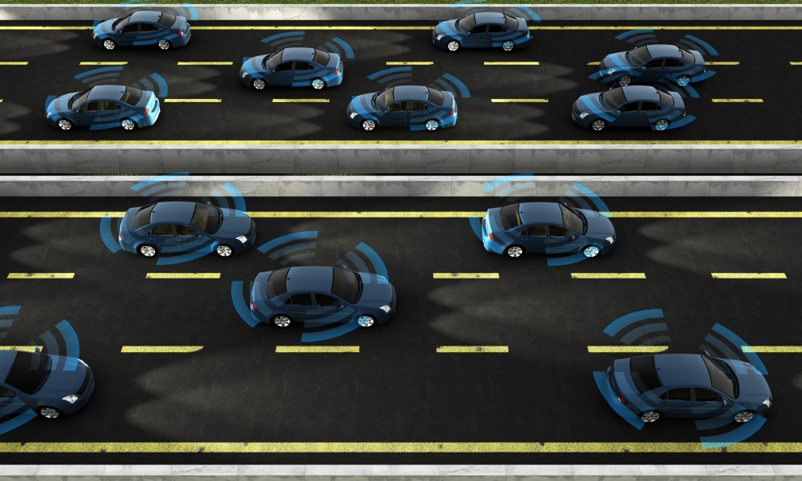
Inductive Loop Detectors
Passing vehicles are detected by a moving magnet creating a current in the wire loop. Different frequencies differentiate between vehicle classes.
Pros:
Detect speed/volume/basic class
24-hour counting
Cons:
Permanent in-road installation
Cost
Index

Slide 57
Magnetic Sensors
Passive monitoring of the shifts in Earth’s magnetic field created by passing vehicles.
Pros:
Passive 24-hour counting
Capture volume/speed
Cons:
In-road construction
Cannot determine classification
Slow-moving traffic situations may lead to inaccurate counts due to low distance between vehicles
Index

Slide 58
Microwave Radar Sensors
Radar sensors send a microwave signal and measure the return time to determine speed. Multi-emitter systems can track classification.
Pros:
Track speed/volume/classification
Above-ground installation
24-hour counting
Con:
Complex network required for full measurements
Index

Slide 59
Active Infrared Sensors
Active infrared sensors send an infrared signal and measure the return time to determine speed. Multi-emitter systems can track classification.
Pros:
Track speed/volume/classification
Above-ground installation
24-hour counting
Con:
Complex network required for full measurements
Index

Slide 60
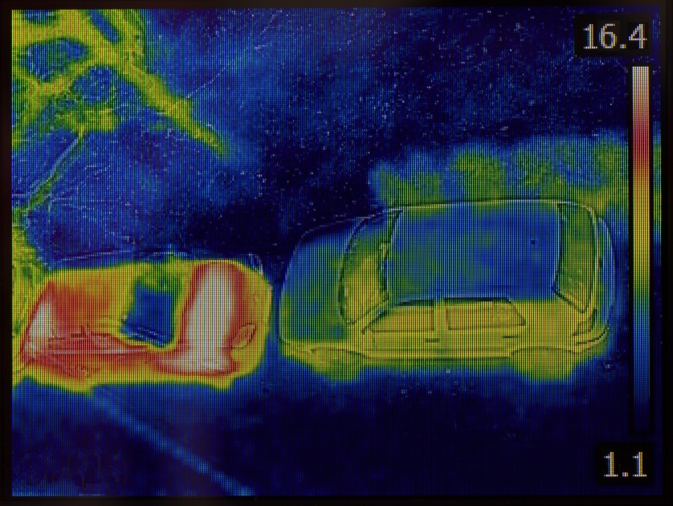
Passive Infrared Sensors
Sensors detect infrared emissions from vehicles, road surfaces, and objects in their field of view.
Pros:
Capable of monitoring speed, volume, class
Non-damaging installation
24-hour counting
Con:
Complex array required for detection beyond just volume
Index

Slide 61
Laser Radar Sensors
Emit lasers to scan traffic lanes. Modern solutions able to produce 3-D imagery for classification.
Pros:
Monitor volume, speed, and classification
Non-destructive installation
Highly accurate
24-hour coverage
Cons:
Full classification requires human intervention
Cost
Index

Slide 62
Acoustic Array Sensors
Detect acoustic energy generated by passing traffic. Can detect speed with multi- sensor array.
Pros:
24-hour counting
Non-destructive installation
Cons:
Do not provide any classification
Multi-sensor network required to gain more than volume statistics
Index

Slide 63
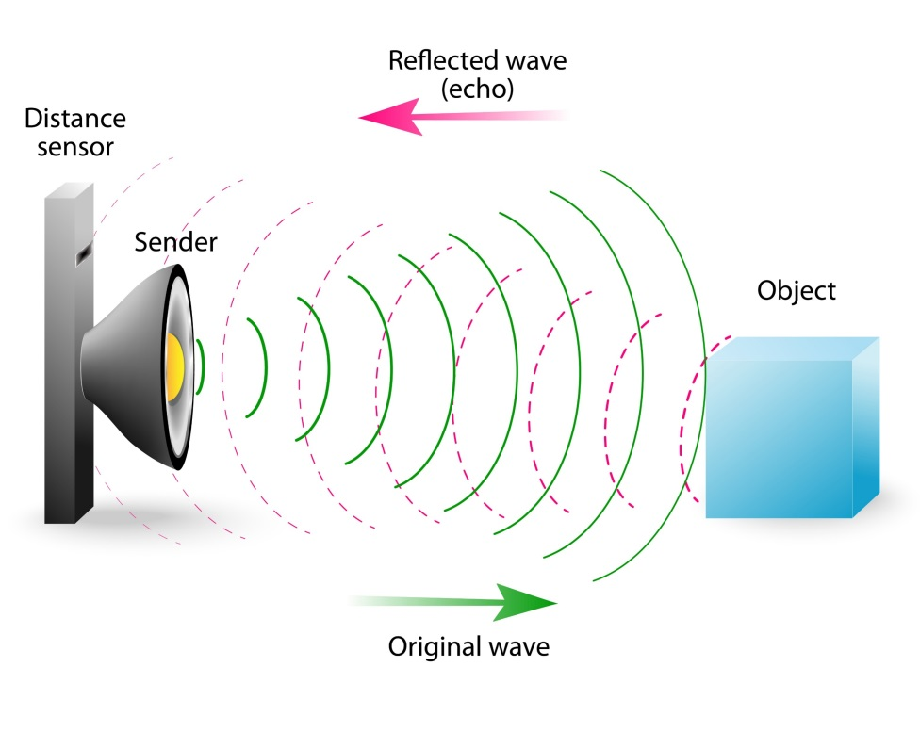
Pulse/Doppler Ultrasonic Sensors
Operate similar to a bat by emitting sound waves and detecting changes in return time.
Pros:
24-hour counting
Non-destructive installation
Cons:
Lack ability to classify passing vehicles
Strict setup parameters
Index

Slide 64
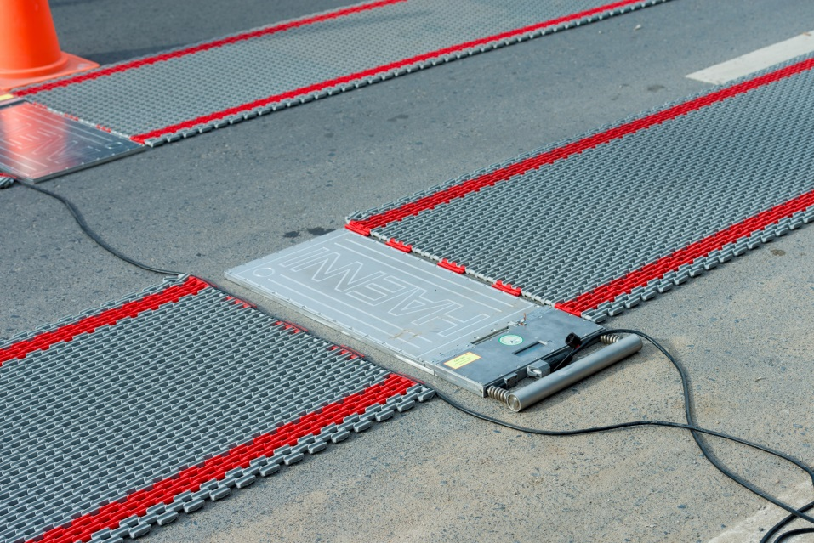
Piezo-electric sensors
Measure pressure created by axle weights of passing traffic. Meant to replace bending plates.
Pros:
24-hour counting
Monitor volume, speed, and classification
Cons:
Non-specific classification
Installation damaging and permanent
Index

Slide 65
Bending Plates
Steel plates attached to sensors that detect pressure of passing vehicles overhead.
Pros:
24-hour counting
Low maintenance
Cons:
Cannot detect speed
Non-specific classification
Expensive and destructive installation
Index

Slide 66
Sub-Pavement Magnetometers (micro-loops)
Detect shifts in the magnetic field of the Earth created by vehicles passing over the sensor.
Pros:
24-hour coverage
Low maintenance
Accurate
Cons:
Destructive installation
Lack vehicle classification
Index

Slide 67
Weigh-in-motion sensors
Essentially, large scales that measure the weight of passing vehicles.
Pros:
24-hour coverage
Cons:
Lack ability to classify vehicles
Installation cost
Index

Slide 68
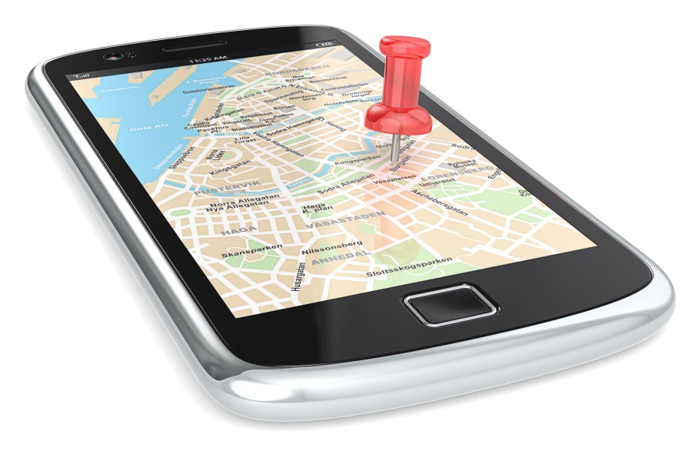
GPS cell phone data collection
Cell phone data collection is a relatively new way of monitoring traffic flow. It is generally used over a much larger area than an airport to create a map of general traffic flow and potential congestion points. This wouldn’t be particularly helpful in the scope of the airport itself, but could help in determining the effects of a project on the surrounding areas.
Index
Next Section

Slide 69
Deriving Future conditions
For a Tier I (Basic) assessment, an analyst may choose to simply multiply the existing roadway volume/vehicle mix by growth factors. For more detailed assessments, ACRP Report 40 provides the following four-step process to derive airport-related GAV activity:
Step 1 – Estimate traffic volume for each on-airport land use (i.e., trip generation)
Step 2 – Determine trip distribution
Step 3 – Analyze the travel mode choice
Step 4 – Distribute the estimated traffic volumes to the airport roadways
See Chapter 6 of the 02-63 Guidebook for more information.
Index

Slide 70
step 1 – Trip Generation (passengers)
Summary of Methods to Estimate Future Passenger-related Traffic
The factors that Influence future passenger-related GAV are:
Growth in Passengers
Originating and Destination (O-D) Passengers
Passenger Characteristics
Lead and Lag Times
Travel Mode Choices
Vehicle Occupancy
Traffic Circulation Patterns
Factor | Tier I (Basic) | Tier II (Intermediate) |  | Tier III (Advanced)
Future air passenger growth | Use FAA TAF, airport master plan or documented regional or economic growth forecast |  |  | Analysis based on airport-specific future flight schedule, aircraft size, and load factor
Shifts in O-D air passengers | Use existing FAA airport O-D data and assume no shift in O-D mix | Estimates from recent master plans and/or analysis based on airport-specific future flight schedules and airline hub activity
Passenger characteristics | Air passenger survey
Lead and lag times | Air passenger survey or data from peer airports
Travel mode choices | Air passenger survey or comprehensive count program
Vehicle occupancy | Data from peer airports | Curbside observations | Air passenger survey
Traffic circulation patterns | Data from peer airports | Air passenger survey | Origin-Destination license plate survey or microsimulation
Index

Slide 71
Growth in Passengers
Future passenger numbers are a function of future flight schedule, aircraft size (number of seats) and anticipated percentage load factor.
Timeframe of growth important, is it distributed or focused?
Information can be found in airport master plans, FAA Terminal Area Forecast (TAF) and other sources.
Index

Slide 72
Originating and Destination Passengers
Not all passengers that arrive at the airport have impact on GAV metrics.
GAV increase isn’t typically at the same rate as other metrics.
If the increase in passengers is largely due to increase in connecting flights rather than local passengers, GAV levels are less affected.
Sources include recent master plans, and traffic studies.
Index

Slide 73
Passenger Characteristics
Types of passengers are important for GAV considerations
Trip purpose
Place of residence (local vs. non-resident)
Type of flight (short-haul domestic, long-haul transborder, or overseas)
Typically gathered via passenger surveys
Index

Slide 74
Lead and Lag Times
Measurement of the difference in time between GAV arrival and departure vs. aircraft arrival and departure.
Typically won’t change between future and present unless a significant change to passenger processing time takes place.
Index

Slide 75
Travel Mode Choices (passengers)
Used to convert volume of air passengers to volume of GAVs.
Derived from number of choices of available transportation from the airport itself.
Passenger characteristics such as trip purpose and place of residency are also important for determination.
Index

Slide 76
Vehicle Occupancy
Typically collected through passenger surveys or through curbside observations.
The number of passengers per vehicle is important in determining change in GAV levels over time.
Index

Slide 77
Traffic Circulation PAtterns
Vehicle paths through the airport property and beyond can depend on the type of GAV.
Both GAV type and roadway configuration help determine the GAV behavior.
Unless the project is going to create significant changes to the roadway network, circulation patterns are unlikely to change.
Index

Slide 78
Step 2 – Trip Distribution
The process differs between non-hub/small-hub airports and large airports with multiple entry points.
Index

Slide 79
Non-hub/small airports
Typically only have single entry/exit points.
All vehicles enter/exit via one roadway.
Regional approach may be required to determine the proportion of left-turn, right-turn, and through traffic at the intersection of the airport access point and the regional highway network.
Index

Slide 80
Large airports
Could have more than one entry/exit point.
More advanced data collection techniques may be required to capture GAV movements in all areas.
Index

Slide 81
Step 3 – Mode choice analysis
In regional planning, this step is conducted using sophisticated travel demand forecasting models.
Rarely required in an airport setting.
Only necessary if major changes to transportation travel modes are proposed (scheduled public bus, rail service or expansion of an existing service).
Index

Slide 82
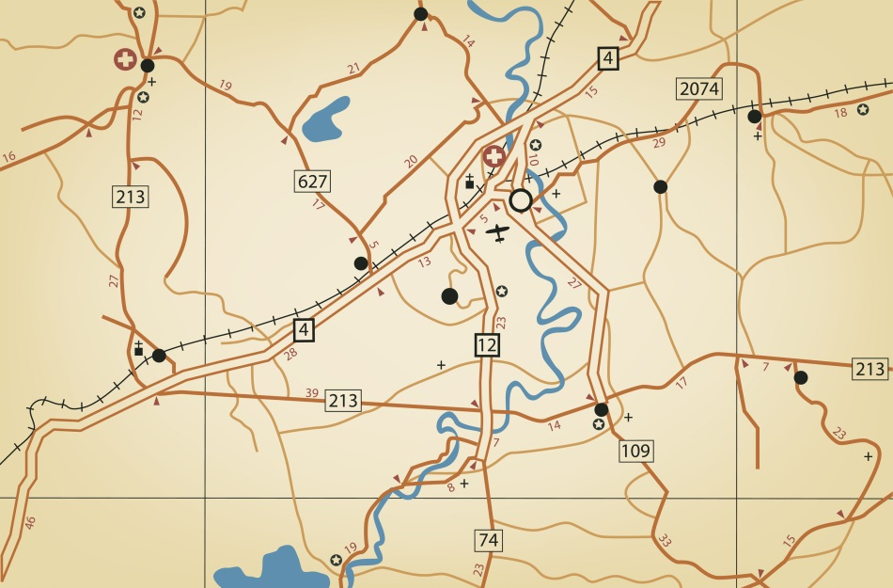
Step 4 – Trip assignment
Assigning the traffic volumes generated by airline passengers, visitors, employees, air cargo, and service/delivery vehicles requires information from three basic categories:
Where vehicles enter or exit the airport
Final and interim destination or origination points on the airport
Routes and paths available to the vehicles
Index

Slide 83
Non-Passenger-related gav
Factor | Tier I (Basic) | Tier II (Intermediate) | Tier III (Advanced)
Visitors | Data from peer airports | Air passenger survey | Origin-destination license plate survey or microsimulation
Employees | Assume as part of background volumes | Development of employee trip generation rates based on entry and exit counts at employee parking areas (if no additional modal options) and total number of employees | Development of employee trip generation rates based on data from employee transportation survey and total number of employees
Air cargo | Assume as part of background traffic | Development of air cargo trip generation rates based on entry and exit counts at air cargo area and total tonnage of cargo over time
Other airport land use | Assume as part of background traffic | Use of Institute of Transportation Engineers (ITE) trip generation rates (if applicable)
Non-airport vehicles using airport roadways | Assume proportion of vehicle volume cut-through traffic | License plate survey or regional travel demand model
Index
Next Section

Slide 84
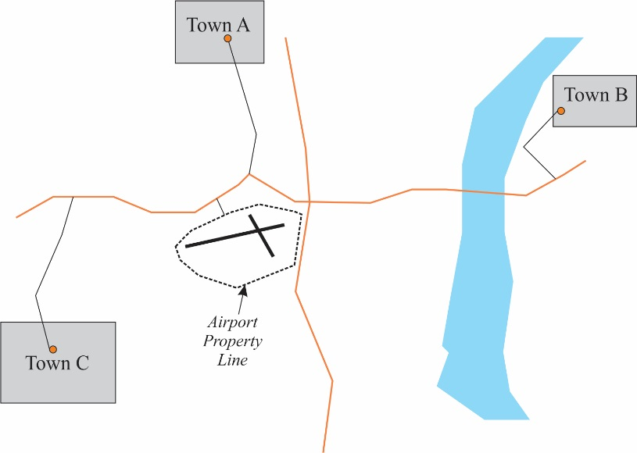
Regional (off-airport) GAV data
Population = 1,000
Distance = 5 miles
Emissions associated with GAV that occur outside the airport boundary are a function of travel distance, speed and roadway conditions (i.e., delay). These data are commonly calculated as “vehicle-miles traveled (VMT)”.
One approach to estimating off-airport miles traveled per vehicle for a Tier I (and possibly Tier II) assessment is commonly referred to as the “gravity model”—the calculation of a weighted value based on the population of, and distance to, surrounding areas.
Population = 2,000
Distance = 8 miles
Population = 500
Distance = 3 miles
Miles Traveled/Vehicle
((Town “A” - 1,000 people x 5 miles) + (Town “B” - 2,000 people x 8 miles) + (Town “C” – 500 people x 3 miles)) / Total People = 6.4 miles/vehicle
See Chapter 6 of the 02-63 Guidebook for more information.
Index

Slide 85
acknowledgments
Project staff for ACRP Research Report 180 (ACRP Project 02-63) and Tutorial
Michael Kenney, KB Environmental Sciences, Inc. (KBE)
L. Carrol Fowler, KBE
David Wood, KBE
Paola Pringle, KBE
Cristina Schoonard, KBE
Laura Castelli, Vanasse Hangen Brustlin, Inc.
Alexandra Marcucci, Sierra Research
Project Panel
David Breen, Port of Portland-Portland International Airport (Chair)
Jay Brolin, Rhode Island Airport Corporation
Nicholas Kozlik, RS&H
Scott Peterson, Boston Region Metropolitan Planning Organization
Alice Price, Atkins
Mohammed Majeed, Federal Aviation Administration Liaison
Joseph Navarrete, Transportation Research Board Project Manager
Index

