Slide 1
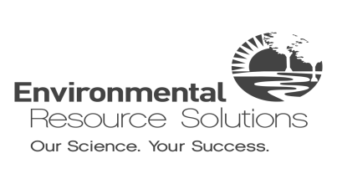
ACRP 02-70
Wetland Mitigation –
A Guidebook for Airports
1

Slide 2
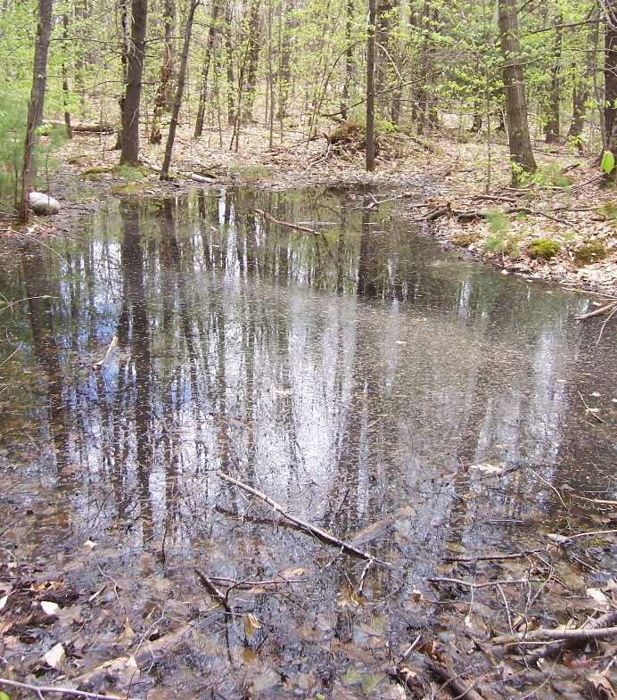
Topics Covered
Definition of wetlands/ waters of the U.S.
Regulatory environment
Wetland mitigation and challenges at airports
Types of mitigation
Case studies in wetland mitigation for airports
Other resources
Vernal pool Hartness State Airport, Vermont
2

Slide 3
What is a wetland?
U.S. Army Corps of Engineers (USACE) and U.S. Environmental Protection Agency (USEPA) define wetlands as:
…areas that are inundated or saturated by surface or groundwater at a frequency and duration sufficient to support, and that under normal circumstances do support, a prevalence of vegetation typically adapted for life in saturated soil conditions.
3

Slide 4
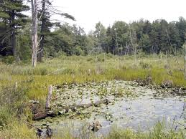
What is a wetland?
Wetlands include, but are not limited to:
Swamps
Marshes/salt marshes
Ponds
Bogs
Wet meadows
Floodplain forests
Estuaries
How will you know if you have a wetland?
Wet meadow
4
Notes:
Speaker to point out that there are numerous types of wetlands, and they way a wetland looks can vary significantly by region. A qualified wetland scientist must identify whether a wetland is present through a wetland delineation. (Leads into next slide.)

Slide 5
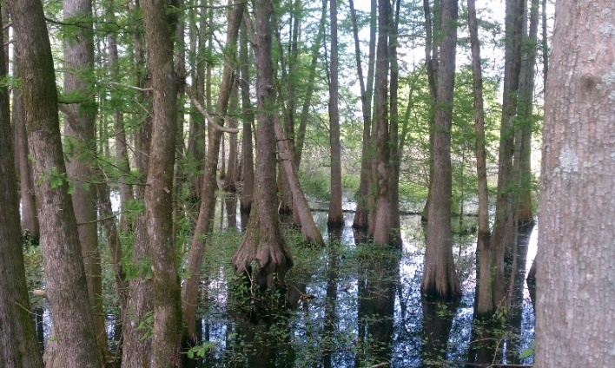
How will you know if you have a wetland?
A wetland scientist will conduct a wetland delineation to determine the presence of wetlands and identify the boundary.
Note: Not all delineated wetlands may be jurisdictional. Local, state, and federal regulators decide this.
Forested wetland
5
Notes:
Speaker to point out that there are numerous types of wetlands, and they way a wetland looks can vary significantly by region. A qualified wetland scientist must identify whether a wetland is present through a wetland delineation. (Leads into next slide.)

Slide 6
USACE wetland criteria
A federally jurisdictional wetland must have three characteristics:
6
Notes:
When performing a wetland delineation, a wetland scientist will check to see if the following three items are present. Unless all three characteristics are present, the area will not be considered a jurisdictional wetland under Section 404 of the Clean Water Act!

Slide 7
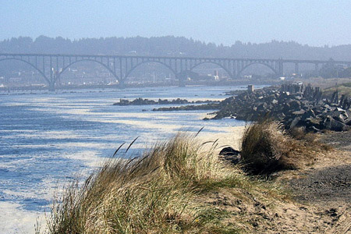
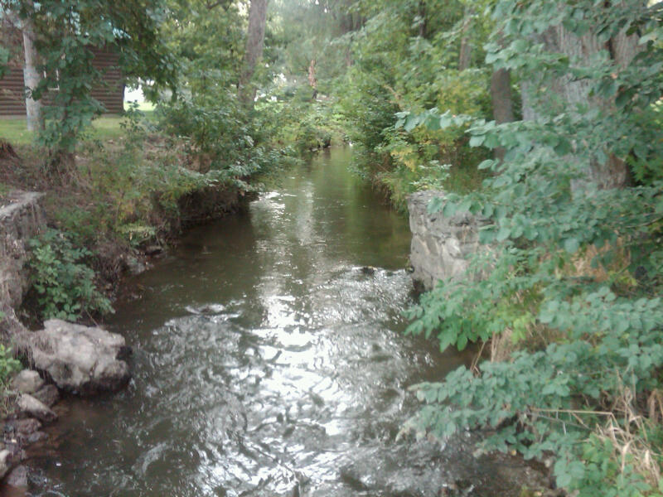
What are waters of the United States?
The USACE/USEPA definition of Waters of the U.S. includes, but is not limited to:
Navigable waters and their tributaries
Wetlands and open waters next to jurisdictional waters
Waters with significant nexus (connection) to a navigable water or in the 100-year floodplain of a navigable waterway
Coastal waters
(August 2015 definition)
Navigable water
Tributary of navigable water
7
Notes:
1 Explain what waters of the US are – current status.
State that the list is not comprehensive. We should mention something to the effect that the 2015 def includes these and other waters.
Introduce the idea of nexus.
Notes from Janet Keilor’s recommendations: The August 2015 definition of waters of the US is stayed by the courts and not in effect. Inform audience as to what definition is in effect today. Because the written content of the regulatory definition is too long for a slide, and the issue is so controversial that paraphrasing must be done very carefully, I suggest that ACRP adapt the content from a slide published on the USACE website, as indicated below. Finally, the changes I suggest to the August 2015 slide definition and text in the report are to better align the exact word choice with the August 2015 rule. For example the rule uses the term “adjacent waters” and perhaps the choice of the term “tidal waters” was to paraphrase, but better to stick with the term “adjacent waters”
August 2015 definition: (Stayed)
Navigable waters
Interstate waters and wetlands
Territorial seas
Impoundments
Adjacent waters
Additional waters shown to have a significant nexus to other waters
1986/1988 definition (adapted from https://usace.contentdm.oclc.org/utils/getfile/collection/p16021coll5/id/1423 slide 2)
Traditional navigable waters
Interstate waters including interstate wetlands
Other waters including intrastate, non-navigable waters with interstate/foreign commerce connections
Impoundments of waters otherwise defined as waters of the U.S.
Tributaries of the above
Territorial seas
Adjacent wetlands
Explain what is NOT a water of the U.S. (isolated ponds, etc.)

Slide 8
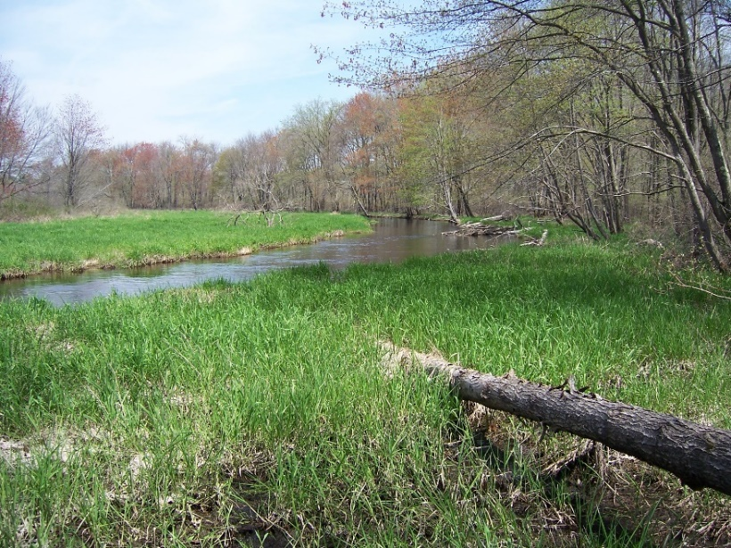
Wetland Mitigation – A Guidebook For Airports
Red maple swamp-floodplain, Manchester-Boston Regional Airport,
New Hampshire
8

Slide 9
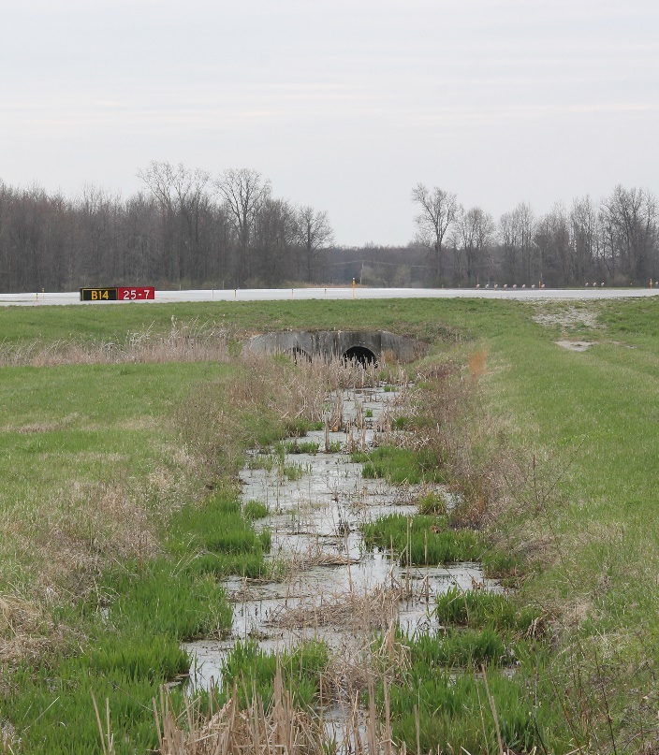
Wetland Challenges at Airports
Wetlands are not compatible with airport operations!
The regulatory environment is complex with multiple jurisdictions (federal, state and local agencies).
Multiple agencies can take jurisdiction.
Wetland impacts often occur as part of a larger project that can affect multiple resources.
Jurisdictional ditch at Toledo Express Airport, Ohio
9
Notes:
Wetlands and waters of the U.S. can pose real challenges to airport operators. As we mentioned earlier, wetlands are incompatible with airport operations.
Airport Operators need to keep the aircraft operations area well drained and free of open water. And open water resources can attract hazardous wildlife!
And the regulatory environment associated with wetlands is complex!
What looks like an ordinary drainage ditch, such as the one shown on this slide, might be connected to a jurisdictional waterway, such as a river or stream, and be considered a jurisdictional wetland or water way as a result. Mowing or grading could require a permit from the Corps and/or local resource management agencies, who may define wetlands differently. For example, some counties in California will take jurisdiction if only one of those three wetland characteristics are present (hydrology, hydrophytes OR hydric soils).
To further complicate things, multiple agencies, such as the Corps and a State agency.
In addition, wetland impacts are often just one impact associated with a larger project, such as a runway improvement, which would require outreach to numerous agencies.
For example: Wetlands provide important habitat. Impacts to a wetland could affect listed species.

Slide 10
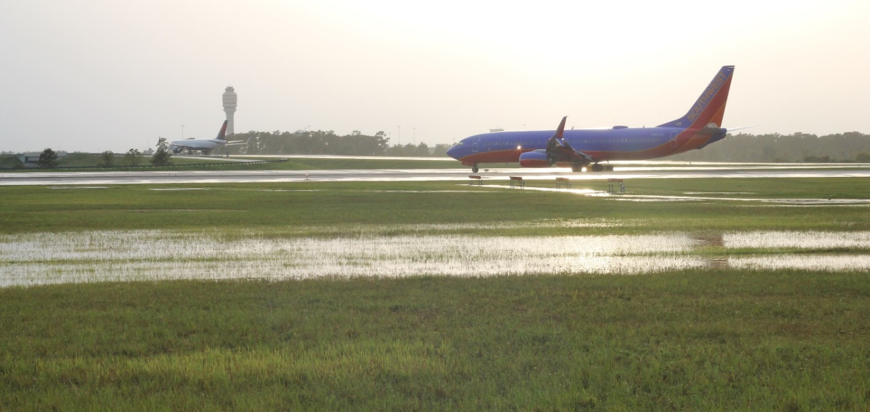
Project Goal
Provide a clear, concise, and readable guidebook for airport staff, regulators, and consultants to address wetland mitigation at airports.
Standing water can attract hazardous wildlife and pose risks to the traveling public
10

Slide 11
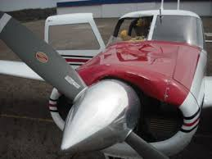
Wetland Challenges at Airports
Potential Wildlife Hazards
Wetlands provide food, water, and shelter for wildlife that can be hazardous to aviation.
The FAA identifies separation criteria* to avoid strikes:
5,000 feet (piston-powered aircraft)
10,000-feet (turbine-powered aircraft)
5 miles from approach/ departure corridors
More than 207,000 wildlife strikes reported to FAA since 1990
*Separation criteria source: FAA AC 150/5200-33B, Hazardous Wildlife Attractants On or Near Airports
11
Notes:
Wetland and open water are known to attract potentially hazardous wildlife, and FAA provides guidance about wetlands and wetland mitigation in AC 150/5200-33B, “Wildlife Hazard Attractants ON and Near Airports.” According to the guidance, open water resources and wildlife mitigation sites should not be constructed within specified distances of the airport operation and approach/departure corridors.

Slide 12
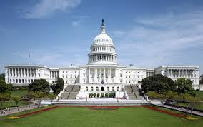
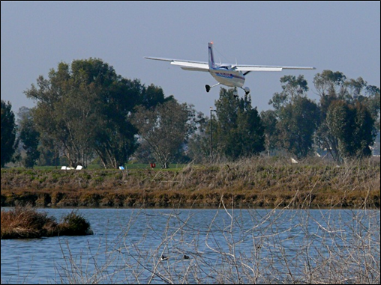
Guidebook Contents
Regulatory environment
Wetland identification and impacts
Mitigation types
Airport-related constraints
Engineering and design issues
Costs and funding
Public outreach and stakeholder management
Case studies
12

Slide 13
Regulatory Environment
13

Slide 14
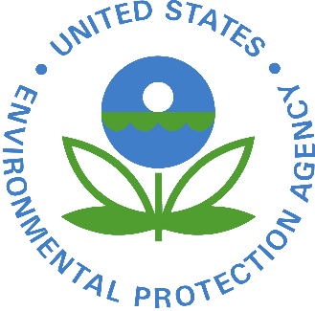
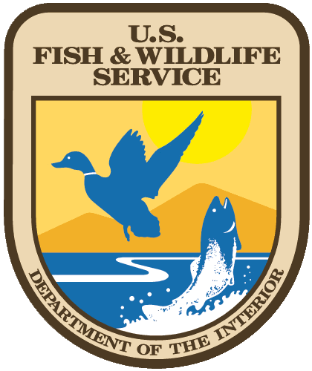
Complex Regulations
Multiple agencies (federal, state, regional and local agencies) govern wetlands.
14

Slide 15
Federal Regulations
Federal Clean Water Act (CWA) of 1972
The CWA established a structure for regulating discharges of pollutants into the Waters of the United States and quality standards for surface waters.
Wetland issues are addressed in Sections 401, 402 and 404 of the CWA.
15

Slide 16
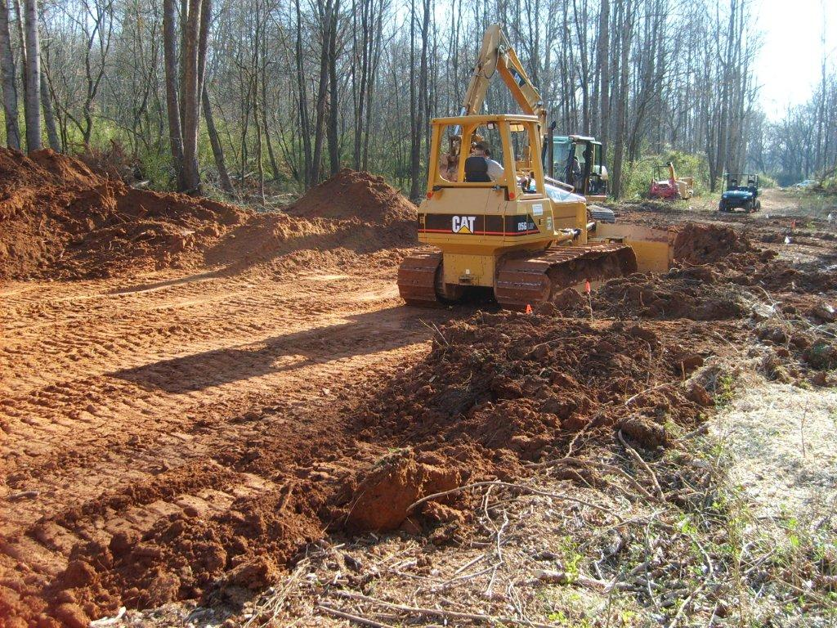
Federal Regulations: CWA – Section 404
Section 404 regulates discharges of dredged and/or fill material into waters of the U.S., including wetlands.
USACE has implementation authority.
U.S. Fish and Wildlife Service regulates impacts to fish and wildlife.
Section 404 prevents destruction of wetlands and waters of the U.S. from grading/filling or dredging
16
Notes:
Wetland delineation are required to identify wetlands in the project area. And USACE determines if jurisdiction or not. Even if USACE doesn’t take jurisdiction from regulatory standpoint, states may and require sequencing of impact and mitigation.

Slide 17
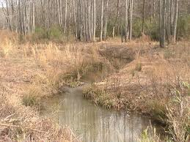
Federal Regulations CWA Section 404
Compensatory Mitigation
USACE and USEPA usually require mitigation for unavoidable adverse impacts to wetlands and waters of the U.S. through:
Restoration – Re-establishment or rehabilitation
Establishment – Creation or enhancement
Preservation – Other wetlands, streams, and aquatic resources
Tributaries of navigable waters are jurisdictional waters of the U.S.
17
Notes:
Most nationwide have a threshold limit above which they require mitigation. It will differ in various regions. The nationwide usually have a 1/10th of an acre as that threshold but it can be lower.

Slide 18
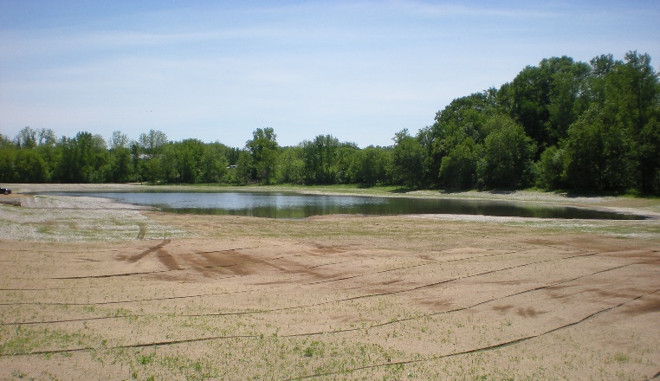
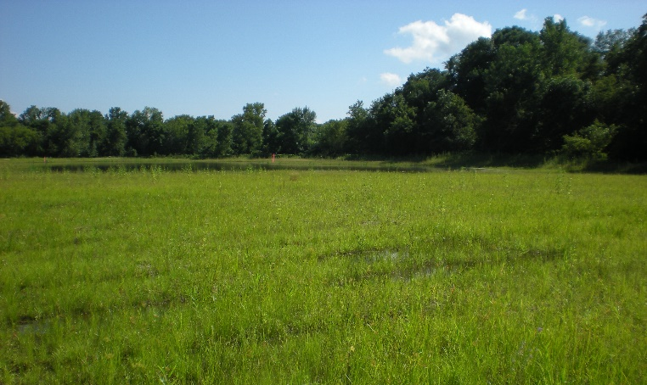
Federal Regulations CWA Section 404
Wetland Mitigation types
Mitigation banks
In-lieu-fee programs
Permittee-responsible mitigation
Above: Sugar Creek mitigation site before revegetation, La Crosse Regional Airport, Wisconsin
Left: Sugar Creek mitigation site following revegetation
18

Slide 19
Federal Regulations:
CWA Section 401
A Section 404 permit is not valid without an approved 401 certification.
States and Tribes may review and approve, conditionally approve, or deny 401 Water Quality Certifications for activities that may result in a discharge to waters of the U.S. including wetlands.
Early coordination is recommended.
19

Slide 20
Federal Regulations:
CWA Section 402
A framework to permit the discharge of pollutants through point sources to waters of the U.S. through Individual or General Permits.
Most states implement/manage the Section 402 permit process.
Projects that modify stormwater infrastructure may require Stormwater Pollution Prevention Plan revisions.
• Actions that disturb more than 1 acre of ground surface will require coverage under a construction stormwater discharge permit.
20

Slide 21
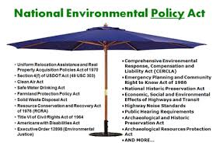
National Environmental Policy Act of 1969 (NEPA)
Primary federal regulation for environmental protection
A process to comply with federal laws and regulations
Applies to all federal actions
21
Notes:
NEPA is a broad law that addresses a host of environmental protection laws.
As a federal agency, FAA is required—and by extension airport operators are required—to comply with NEPA for all federal actions.
A federal action at an airport can include:
Federal Funding for a project
Changes to an ALP
A proposed project that requires a federal permit.
FAA is the lead agency pursuant to NEPA.

Slide 22
NEPA and FAA
FAA is the Federal lead agency for most airport-related wetland mitigation projects.
FAA NEPA guidance:
FAA Order 1050.1 - Environmental Impacts: Policies and Procedures
FAA Order 5050.4 - National Environmental Policy Act Implementing Instructions for Airport Actions
Airport sponsors must work closely with regional FAA environmental staff throughout the NEPA and mitigation planning process.
22

Slide 23
NEPA Documentation
Federal agencies prepare a NEPA document prior to decision making.
NEPA facilitates concurrence from agencies associated with potentially affected resources.
One of three NEPA documents may apply: Categorical Exclusion (Cat Ex), Environmental Assessment (EA), or Environmental Impact Statement (EIS).
NEPA documents identify resources, potential impacts, and necessary mitigation.
23
Notes:
Level of NEPA depends on activity and type of wetland permit required. There is potential to Cat Ex a project with wetland impact if can be permitted under a general permit.

Slide 24
How to Address and Mitigate Wetland Impacts
24

Slide 25
Mitigation Process Flow Chart
Using this process flow chart (see PDF handout and the executive summary) will help airport decision-makers determine their wetland mitigation needs.
25
Notes:
Speaker: This flow chart is found in the brochure resource published as a Guidebook companion, in chapter X of the Guidebook, and as a handout for this webinar.

Slide 26
Mitigation Types: Banking (credits) Permittee-responsible In-lieu-fee
26

Slide 27
Banking (Credits)
Off-site source of mitigation guaranteed by a third party. The airport operator purchases credits in a mitigation bank to off-set wetland impacts.
Pros | Cons
Agency-preferred approach Off-site mitigation may alleviate wildlife hazard concerns Airport operator pays one-time fee Mitigation bank is responsible for site success | Prices are variable and market driven Mitigation banks may not offer the type of mitigation necessary Credits might not be available
27

Slide 28
Permittee–Responsible Mitigation
Airport operator creates, enhances and/or preserves a wetland.
Pros | Cons
Can be cost effective if airport has sufficient property for mitigation Only option if existing credits or in-lieu-fee programs are unavailable | Property acquisition may be expensive Airport operator is responsible for design, construction, monitoring, and long-term management Risky and time-consuming Agencies may accept if banking options are not available Long-term conservation easement required (not desirable to FAA)
28
Notes:
Need to add notes:
Banking is agency preferred but not always available

Slide 29
In-Lieu-Fee Mitigation
Airport operator provides funds to an in-lieu mitigation sponsor, such as a public agency or not-for-profit organization.
Pros | Cons
Off-site mitigation may alleviate wildlife hazard concerns Low risk: in-lieu-fee sponsor is responsible for success of mitigation | Prices may vary Programs/opportunities may not be available
29

Slide 30
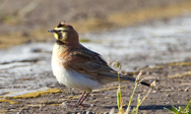
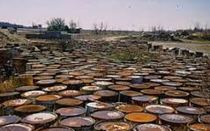
Mitigation Planning Considerations
Site-related Constraints
Sufficient area for mitigation
Distance from Air Operations Area (AOA)
Potential effect:
Cultural resources
Listed species/critical habitat
Invasive species
Hazardous materials
Streaked Horned Lark (threatened species)
Hazardous waste site
30
Notes:
When identifying a location of a mitigation site, it’s not enough to consider what you need to establish. You need to think about the potential effect of mitigation construction as well. For example,
Do you have sufficient area to construct the necessary mitigation (acreage)?
Is it sufficiently far enough away from the AOA to prevent new wildlife hazards?
What is on the site now?
Will it effect a listed species or its critical habitat to create more impacts?
Will it affect an area that includes cultural resources
Are invasive species likely to affect the outcome?
Do you have to clean up the site in order to use it first????

Slide 31
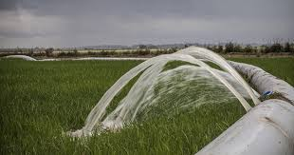
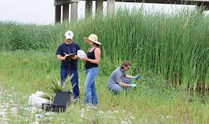
Engineering/Design Considerations
Available Land
Airport owns/can afford suitable property
Available water source and water rights
Effect on airport operations (construction and operation)
Long-term monitoring/ maintenance, and stewardship
Conservation easement
Mitigation sites must have dependable source of water
Long-term site monitoring required to determine success
31
Notes:
When identifying a location of a mitigation site, it’s not enough to consider what you need to establish. You need to think about the potential effect of mitigation construction as well. For example,
Do you have sufficient area to construct the necessary mitigation (acreage)?
Is it sufficiently far enough away from the AOA to prevent new wildlife hazards?
What is on the site now?
Will it effect a listed species or its critical habitat to create more impacts?
Will it affect an area that includes cultural resources
Are invasive species likely to affect the outcome?
Do you have to clean up the site in order to use it first????

Slide 32
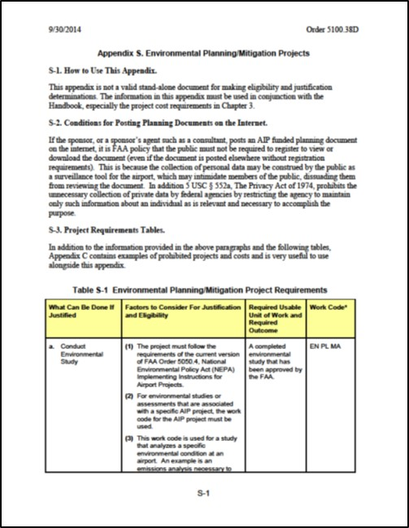
Mitigation Funding
Costs
Permitting costs (including NEPA compliance)
Mitigation components (vary by mitigation type)
Funding
AIP eligible if AIP-project related
AIP Order 5100.38D, Airport Improvement Program Handbook, Table S-1
Order 5100.38D identifies grant-eligible mitigation costs.
32
Notes:
When identifying a location of a mitigation site, it’s not enough to consider what you need to establish. You need to think about the potential effect of mitigation construction as well. For example,
Do you have sufficient area to construct the necessary mitigation (acreage)?
Is it sufficiently far enough away from the AOA to prevent new wildlife hazards?
What is on the site now?
Will it effect a listed species or its critical habitat to create more impacts?
Will it affect an area that includes cultural resources
Are invasive species likely to affect the outcome?
Do you have to clean up the site in order to use it first????

Slide 33
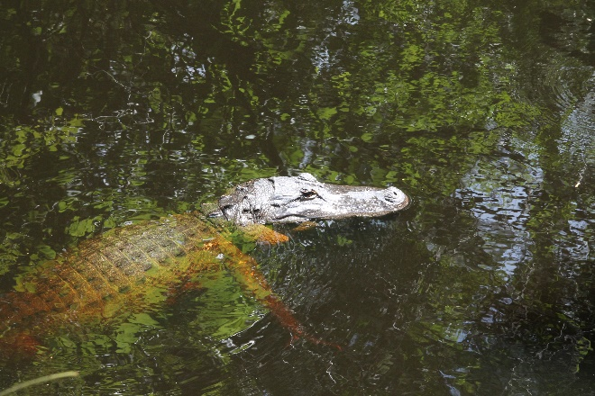
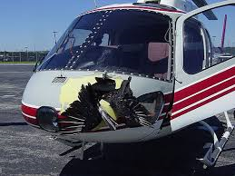
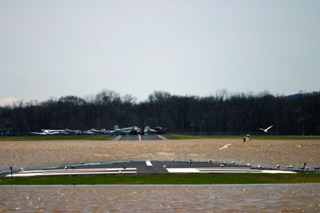
Case Studies
Six case studies
Various mitigation strategies
Diverse airports nationwide
Cecil Airport
La Crosse Regional Airport
Refer to Chapter 9 in the guidebook for all case studies.
33

Slide 34
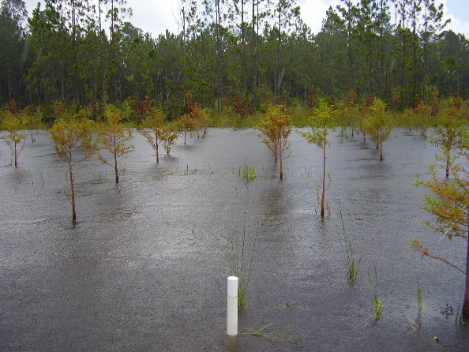
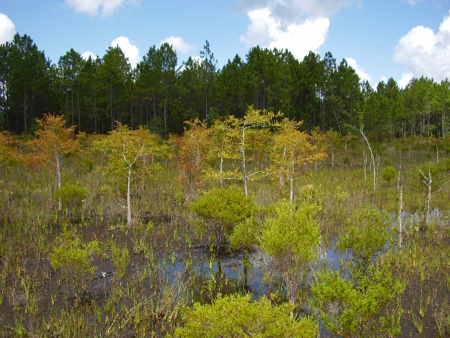
Cecil Airport/Commerce Center Jacksonville, Florida
Master Plan Development for the new Cecil Airport/Commerce Center
>500 acres of jurisdictional wetlands (1/3 within airport boundary)
City worked with federal, state, and local agencies to identify aviation-compatible mitigation through:
On-site wetland preservation and creation
Contribution to regional conservation efforts
Wetland creation site
Wetland conservation area
34

Slide 35
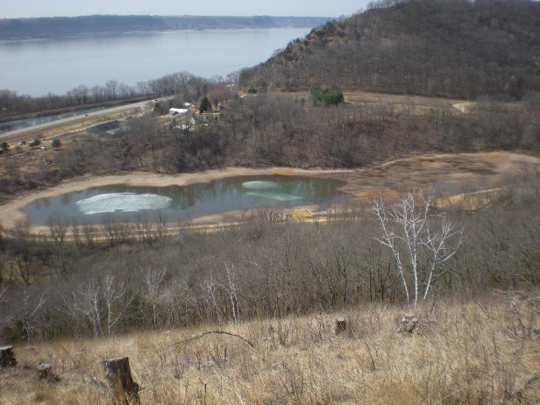
La Crosse Regional Airport La Crosse, Wisconsin
Taxiway relocation project affected wetlands and fishery located within National Wildlife Refuge:
Separate mitigation site identified to compensate for each impact
City of La Crosse provided fishery mitigation in a City park
Established conservancy assumed stewardship of wetland mitigation bank site adjacent to its property
March 2010
Established 2014
35

Slide 36
More Information
More information can be acquired through the Transportation Research Board website (trb.org) by searching for “ACRP Research Report 198.”
36

Slide 37
Q & A
Sugar Creek construction, 2009 La Crosse Regional Airport, Wisconsin
37

Slide 38
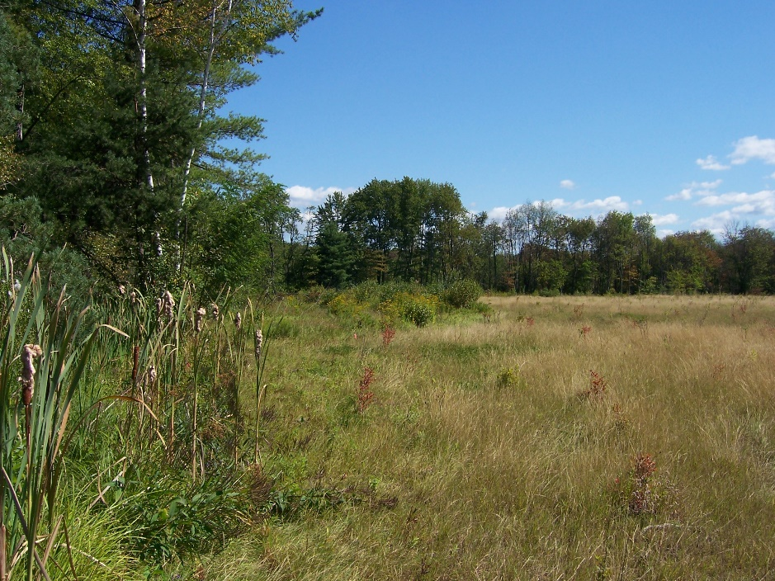
Thank you!
Runway 24 Safety Area Improvement Project – Manchester-Boston Regional Airport, New Hampshire
38

