Slide 1
Airport Land Use Compatibility Overview
2016
Provided as a resource by Mead & Hunt, Inc., 2019

Slide 2
Introduction
General aviation airports are an integral link to our nation’s transportation system and contribute to the vitality of our economy.
One of the greatest concerns facing these airports today is “encroachment”—the continued pressure brought by incompatible land uses that threaten and limit the operation of airports.
Individually, many incompatible land use decisions may appear to have a negligible impact.
Collectively and over time, poor land use decisions can lead to the restriction of airport activity or to airport closure, slowly eroding our aviation system.

Slide 3
Overview
Airport Compatible Land Use
Airport Compatibility Concerns
Legal Basis for Airport Land Use Compatibility
Techniques for Implementation
Industry Resources
Sample Audience Participation Exercises

Slide 4
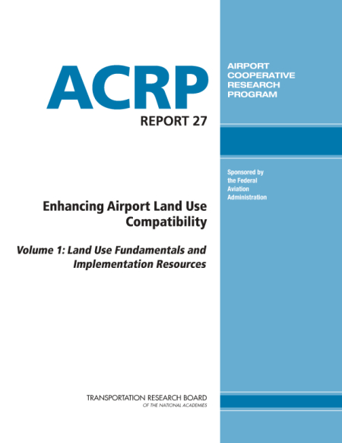
Airport Compatible Land Use
A land use that can coexist with a nearby airport without either constraining the safe and efficient operation of the airport or exposing people living and working nearby to unacceptable levels of noise or hazards.
Definition Source: ACRP Report 27, Enhancing Airport Land Use Compatibility

Slide 5
Airport Land Use Compatibility Concerns

Slide 6



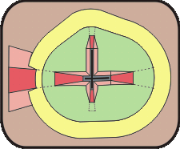
Four Compatibility Concerns
9
Noise | Overflight
Safety | Airspace Protection

Slide 7
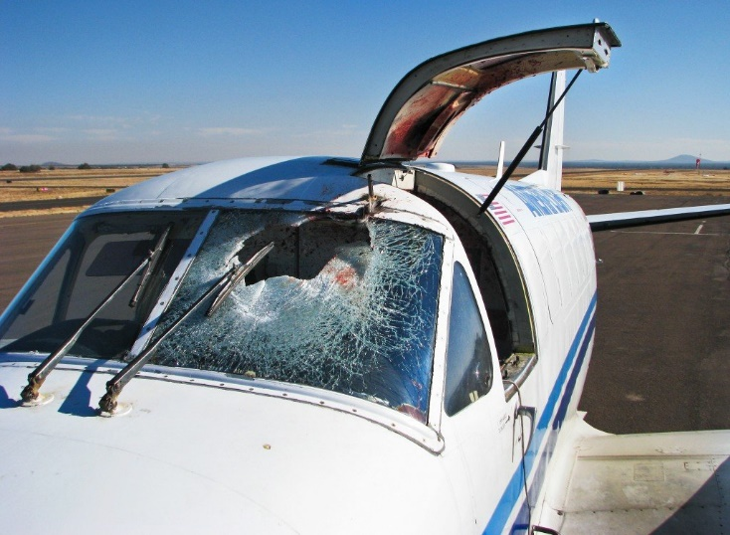
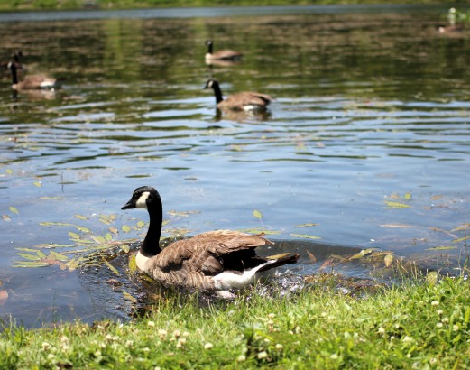



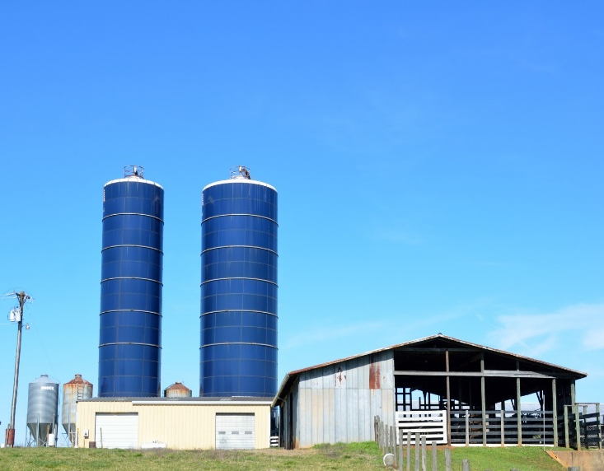
Land Uses that Affect Airport Operations

Slide 8
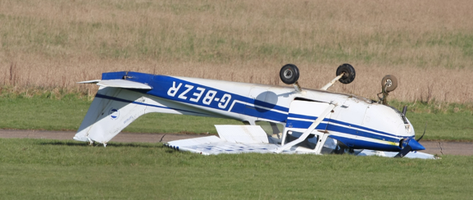
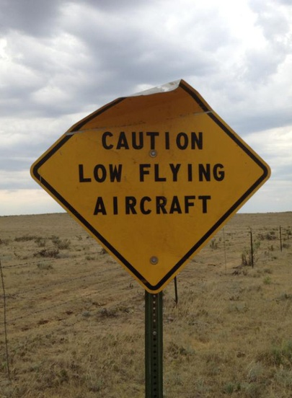
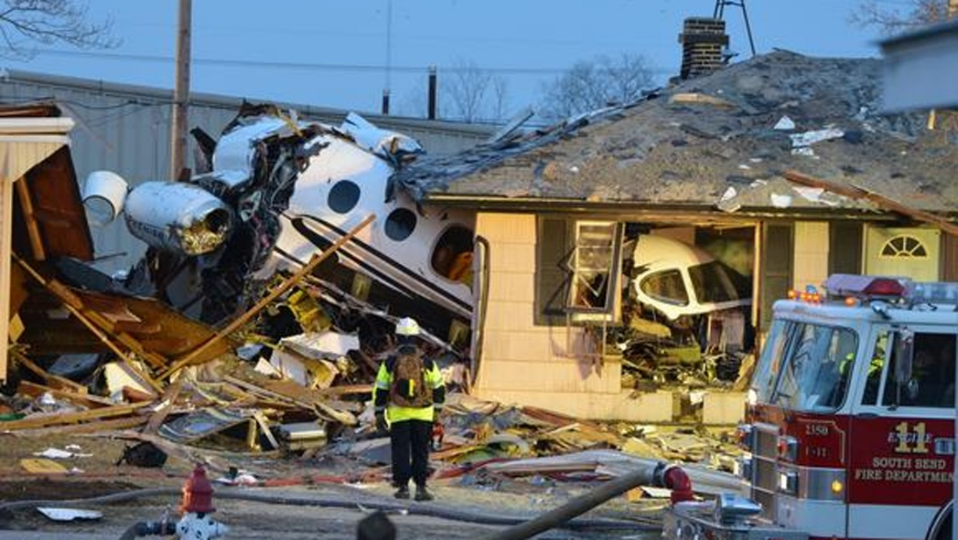
Airport Impacts on Nearby Land Uses

Slide 9
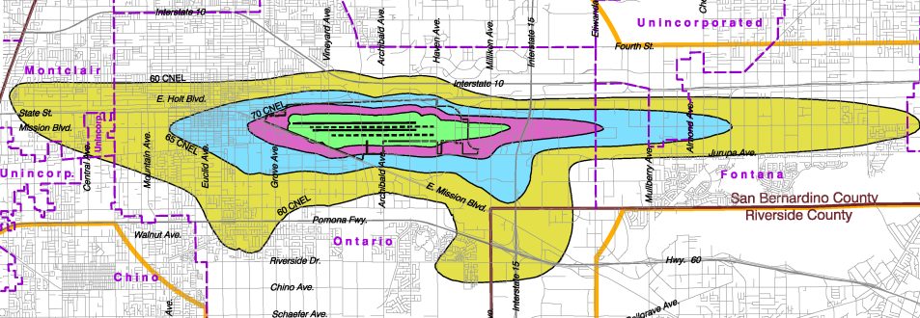
Noise
Concern: Disruption of Human Activities
Measurement: Day Night Level (DNL) Contours
  65 DNL basis for most FAA criteria
Scope: Varies by Character of Environs
  55 dB DNL: Rural Areas
  60 dB DNL: Suburban Areas
  65 dB DNL: Urban Areas
Objective: Avoid New Noise-Sensitive Uses in Noise-Impacted Areas

Slide 10
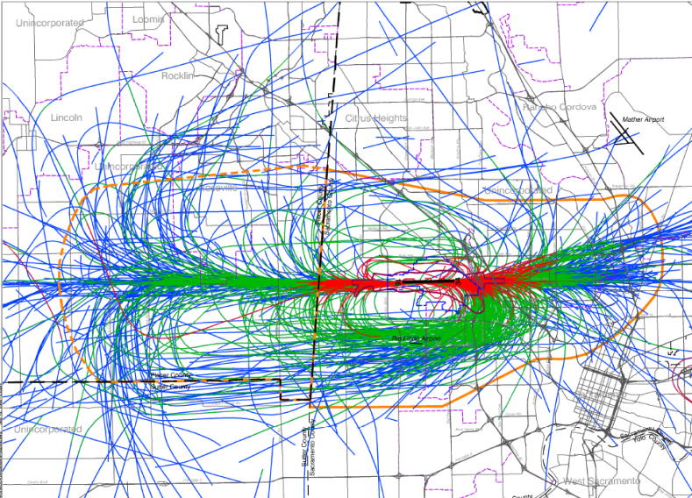
Overflight
Concern: Annoyance
Measurement: Frequency of Overflight and Single-Event Noise Levels
Scope: Primary Traffic Patterns
Objective: Increase Buyer/Renter Awareness of Airport Proximity

Slide 11

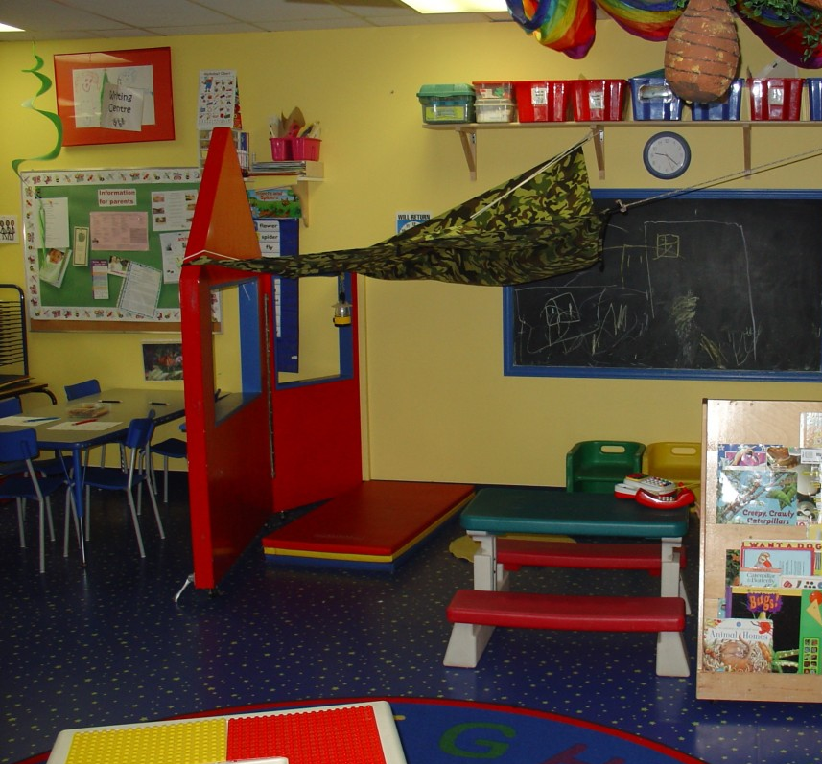

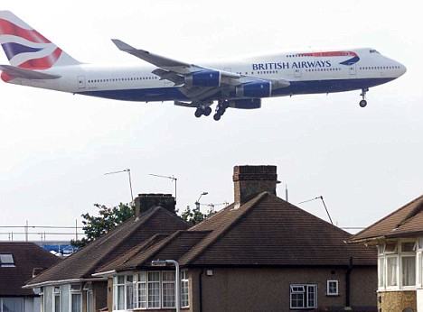
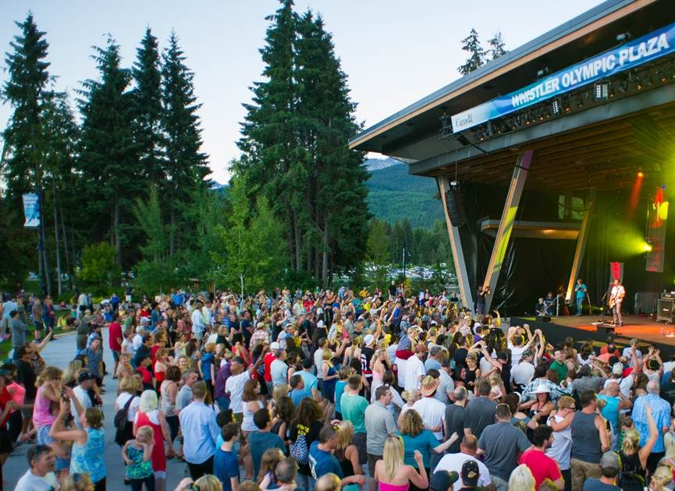
Noise-Sensitive Land Uses
Library
Schools
Churches
Residences
Amphitheaters
Natural Areas Managed for Quiet

Slide 12
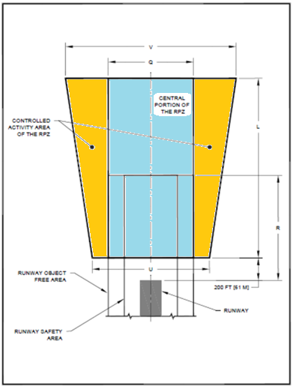

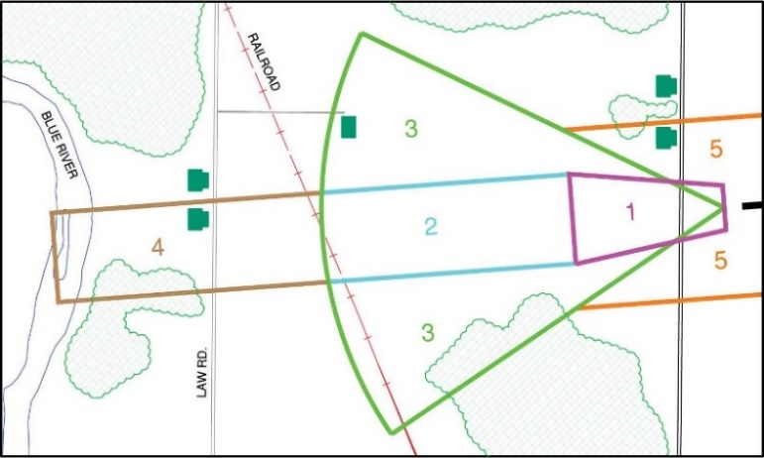
Runway Protection Zone “RPZ”
Safety
Concern: Risk to People and Property
Measurement: Historical Nationwide Aircraft Accident Location Data
Scope:
  Greatest Near Runway Ends (e.g., Runway Protection Zone)
  Extends Out to About 2 Miles
Objective: Limit Number of People and Risk-Sensitive Uses in Uncertain Areas

Slide 13
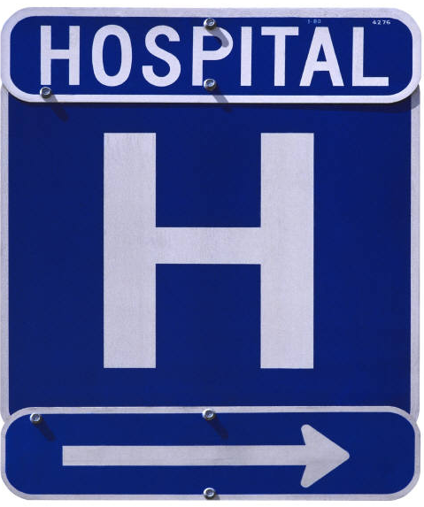
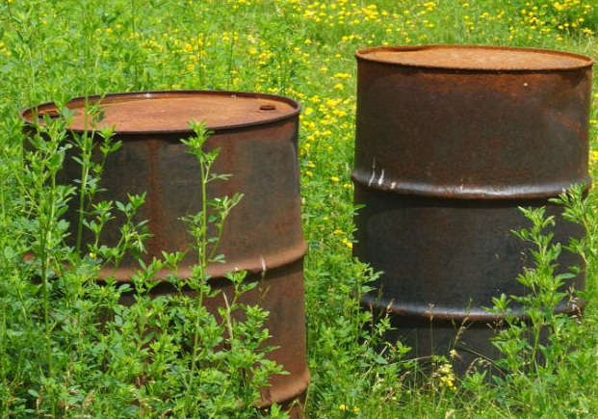
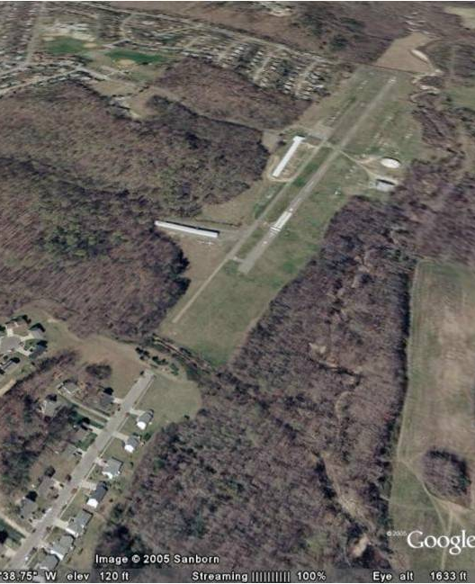
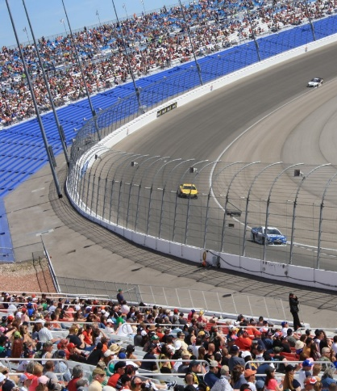
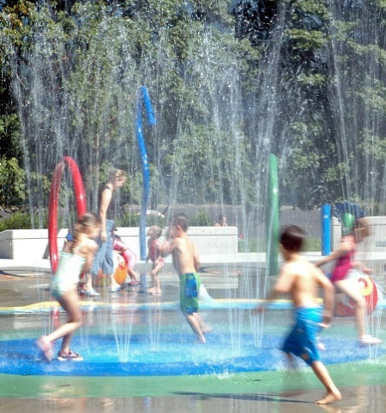
Risk-Sensitive Uses
  Concentrations of people near airports
  Residential development
  Hospitals
  Schools
  Recreational uses
  Storage of hazardous materials

Slide 14
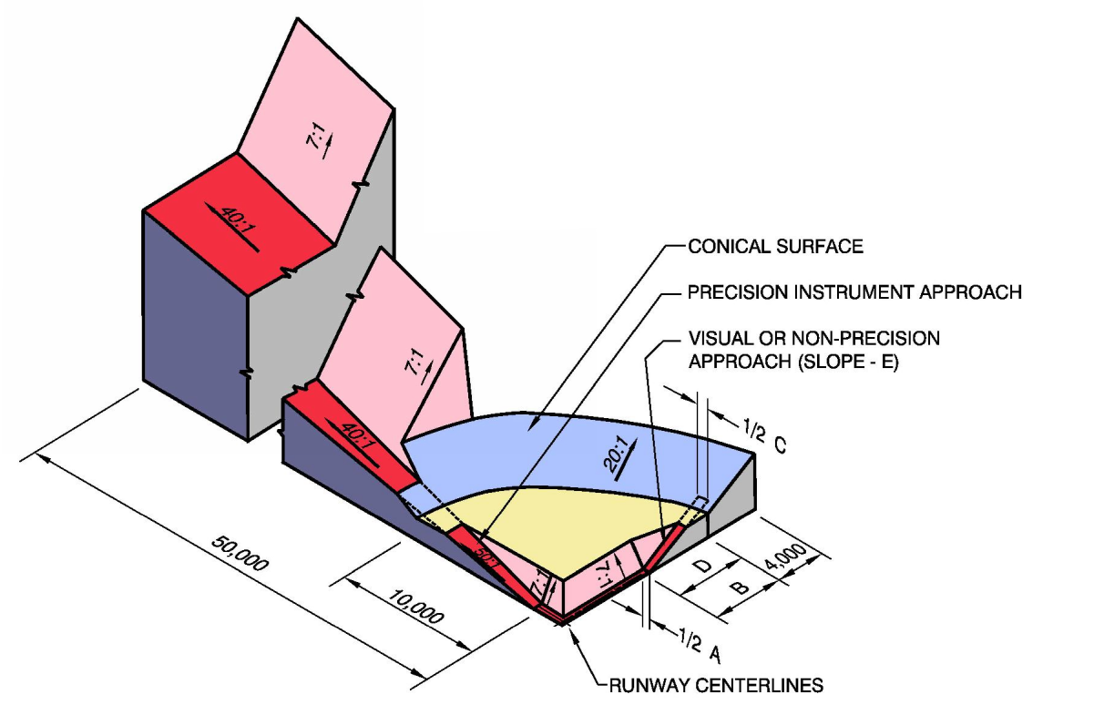
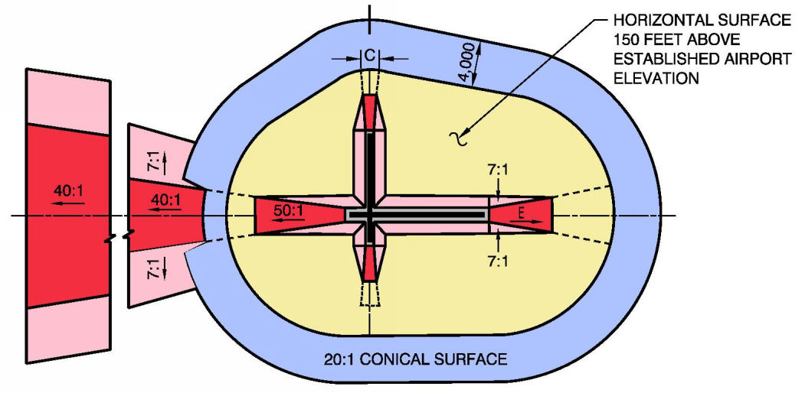
Airspace Protection
Concern: Hazards to Flight
  Physical, Visual, Electronic, Wildlife
Measurement: Airspace Surfaces and Other FAA-Defined Criteria; proximity of bird attractants
Scope: Mostly within 3 Miles; Farther along Instrument Approach Routes
Objective: Avoid New Hazards

Slide 15


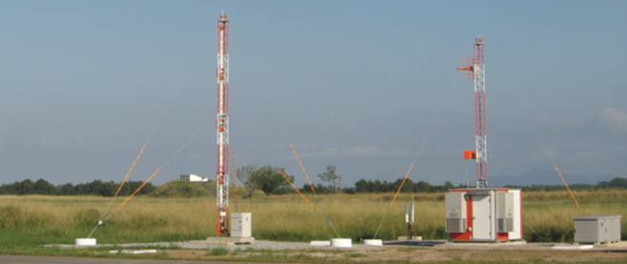

Tall Structures
Concerns: Obstructions to flight including penetrations of 14 CFR Part 77 and other airspace surfaces.
Example Land Uses:
Cell towers
Power lines
Vegetation
Wind turbines
Buildings (high-rises)
Transportation Structures (elevated roadways, rail facilities)

Slide 16

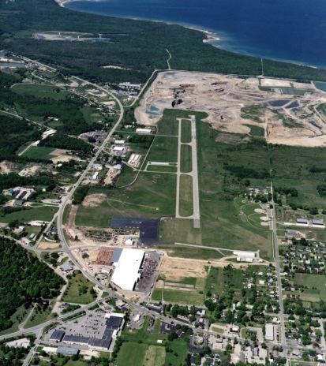


Visual Obstructions
Concerns:
  Smoke/steam emissions (e.g., industrial)
  Dust (e.g., gravel extraction)
  Glint or glare (e.g., solar panels)
  Light emissions
Example Land Uses:
  Industrial
  Farmland
  Water bodies
  Solar facilities

Slide 17
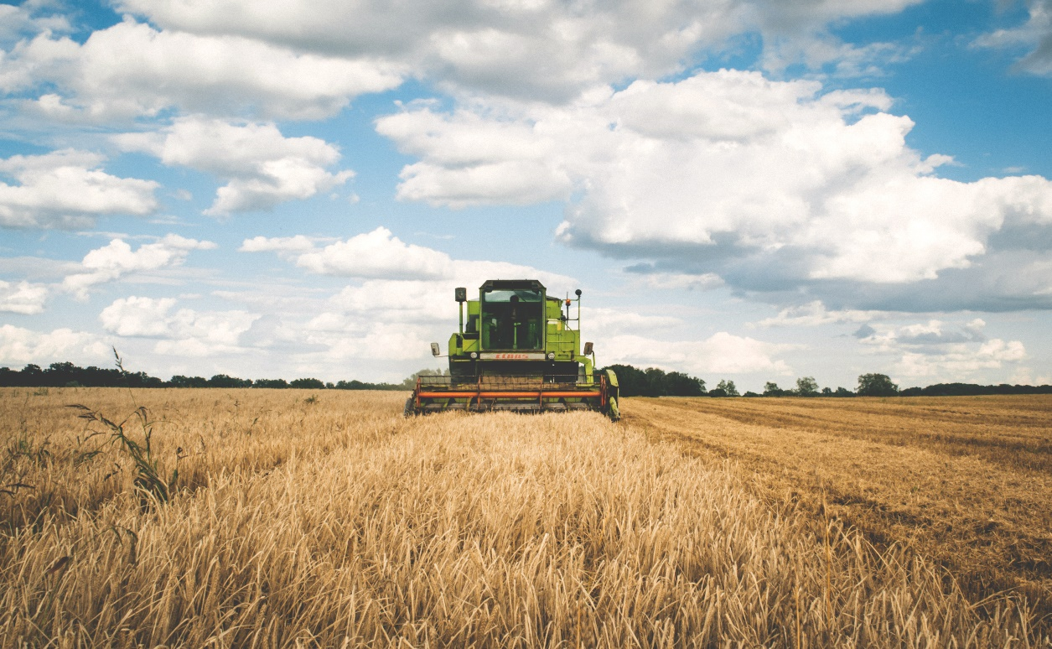
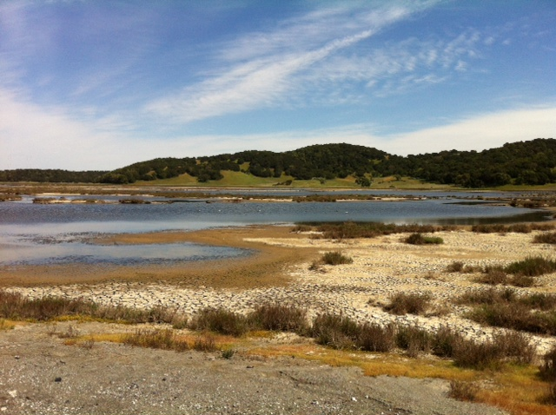
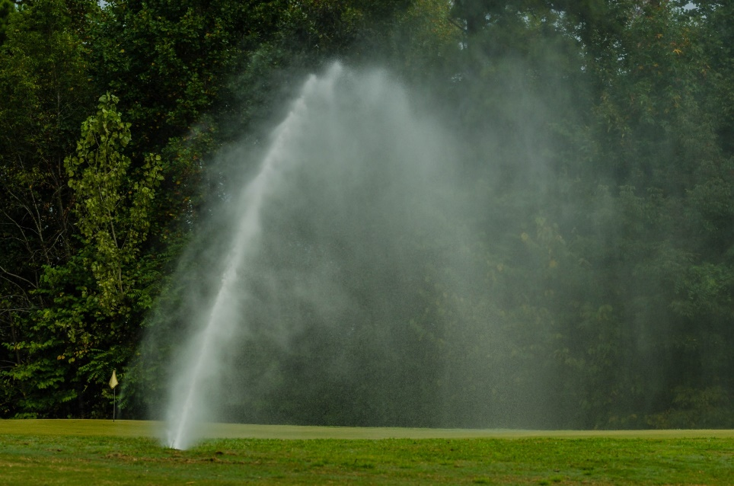
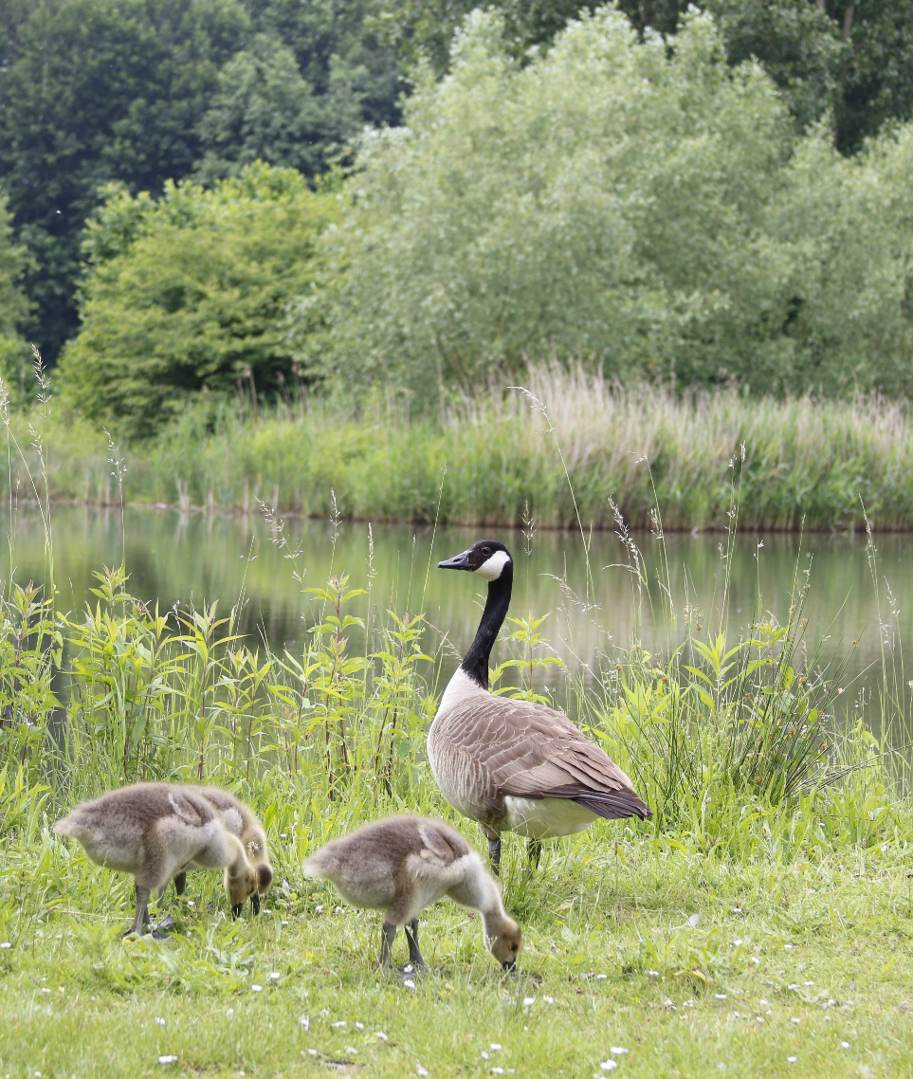
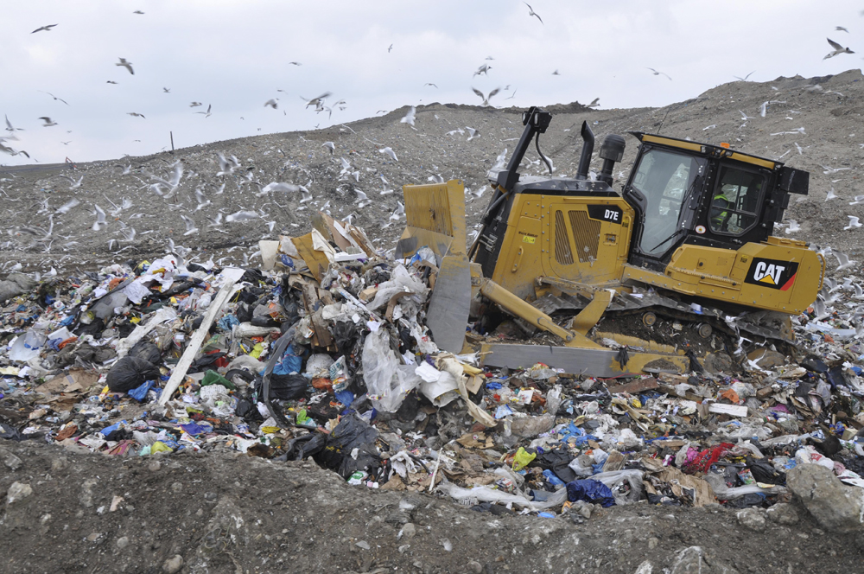
Wildlife Attractants
Concern: Introducing hazards to aircraft
Example Land Uses:
  Municipal solid waste facilities/landfills
  Sewage treatment facilities
  Farmland
  Water bodies including retention ponds and wetlands
  Recreational areas

Slide 18
Consequences of Incompatibility

Slide 19
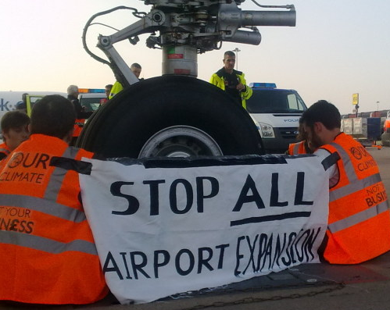
  Impacts to airport viability, including constraining the airport’s operations and limiting future airport development
  Impacts to runway approach and departure surfaces
  Increased safety risk due to obstructions or wildlife hazards
  Reduced community support for airport
Consequences of Incompatibility to Airports

Slide 20
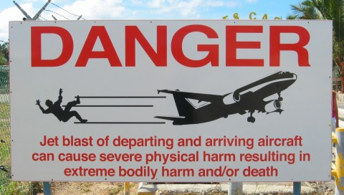

Consequences to people living near an airport
  Exposure to aircraft noise and emissions, and safety concerns

Slide 21

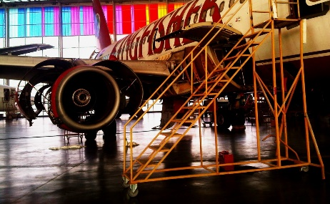
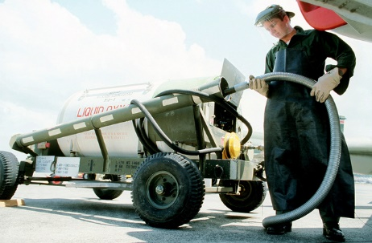

Economic Consequences of Incompatibility
Consequences to local and regional jurisdictions:
  Unrealized local/regional economic development due to airport growth constraints
Economic consequences (airport and community)
  Potential for litigation (and associated costs)
  Lost revenue and development opportunities

Slide 22
Roles and Responsibilities

Slide 23
Who is responsible for airport land use compatibility?
Federal and state aviation agencies develop regulations and guidelines
Local government officials, land use planners, and airport sponsors must adopt and enforce airport compatibility measures.

Slide 24
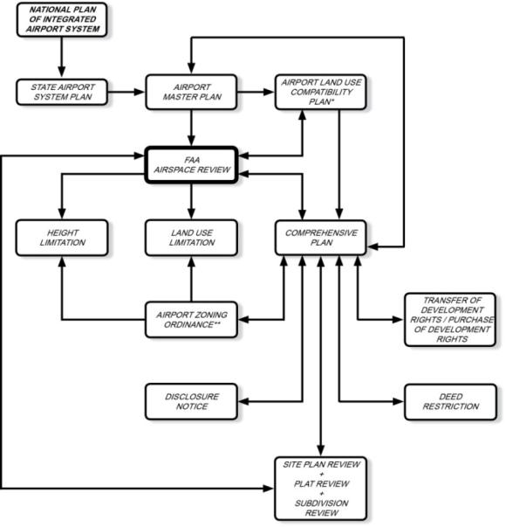
Roles & Responsibilities
Federal
  FAA
  Other federal agencies
State
  State aviation agencies
  Other state agencies
Regional
  Planning agencies
Local
  Planning & zoning authorities
Airports
  Sponsors & stakeholders

Slide 25
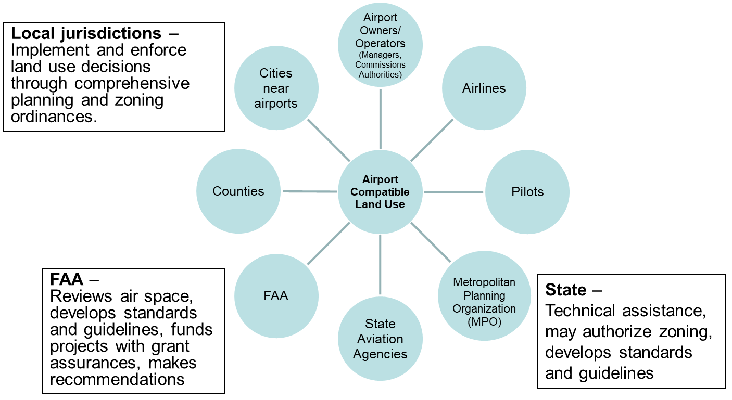
Numerous Planning Partners

Slide 26
Legal Basis for
Compatibility

Slide 27
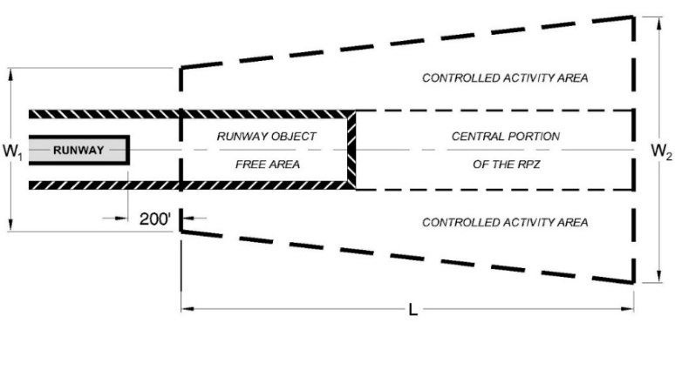
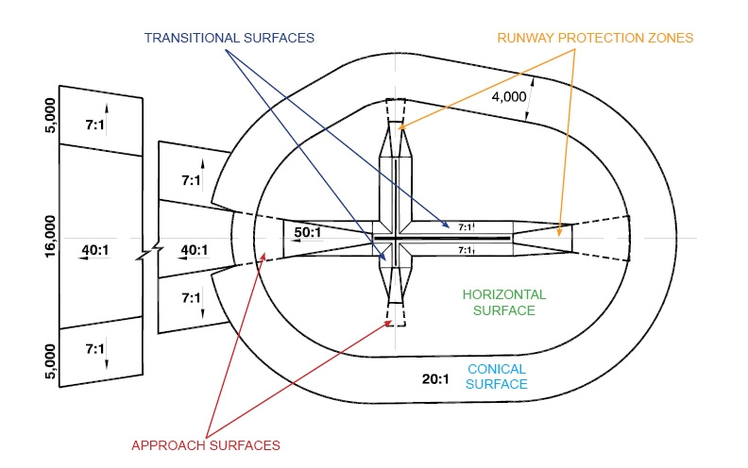
Sample FAA Criteria
  AC 150/5300-13, Airport Design
  AC 150/5200-33, Hazards Wildlife Attractants on or near Airports
  Federal Aviation Regulations (FAR) Part 77 Safe, Efficient Use and Preservation of Navigable Airspace (height restrictions)
  Grant Assurances Nos. 20 and 21

Slide 28
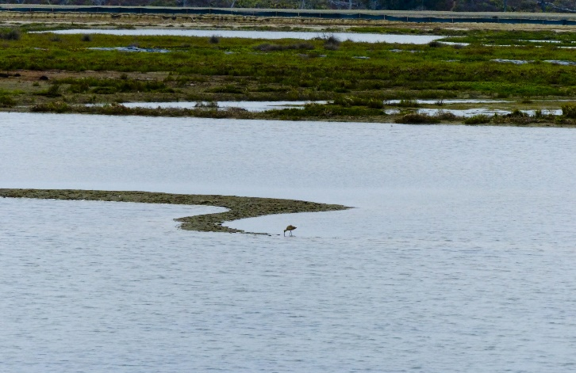
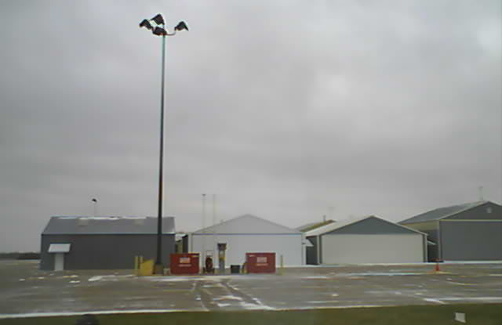
Grant Assurance #20:
Hazard Removal and Mitigation
The airport sponsor will take appropriate action to assure terminal airspace is cleared and protected by removing existing hazards and preventing future hazards.

Slide 29
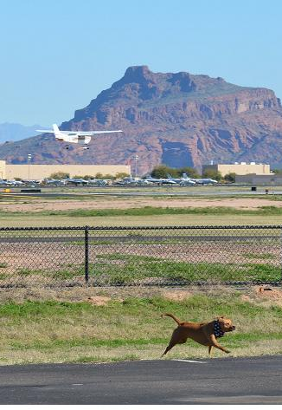
Grant Assurance #20:
MUST mitigate immediately!
Solutions:
  Set up a process to periodically review the land use on and around the airport, paying special attention to approaches.
  If you have trees in the approach, schedule periodic trimming,
  Work with local planning boards on limiting structures and activities that cause/create hazards.
  Get to know your local planning boards, elected officials and decision makers

Slide 30
Grant Assurance #21
Compatible Land Use
  The airport sponsor will take appropriate action, to the extent reasonable to restrict the use of land in the vicinity of the airport to activities compatible with normal airport activities.
  In addition, it will not permit change in land use, within its jurisdiction, to reduce compatibility with any noise compatibility program measures upon which Federal funds have been expended.

Slide 31

Grant Assurance #21
Take REASONABLE steps to resolve.
Take action on those items that are within your span of control:
  Notify pilots - NOTAMS
  Get airport compatibility zoning adopted and implemented
  Monitor airport environs
  Review development proposals (use common sense)
    Is it too high? Is it a hazard to air navigation?
    Does it distract pilots using your airport?
    Is it a noise-sensitive use?
    Is the development in a high risk area such as a Runway Protection Zone (RPZ)?
Span of control

Slide 32
Grant Assurance #21
Other Possible Actions
  Acquire the land in fee simple.
    Recommend acquisition for OFA, TOFA, and RPZs.
    Off airport wildlife attractants – Possibly acquire land to prevent problem and resell. May not be eligible for federal funding.
  Acquire a land use and height easement
  Recommend the review of existing easements to assure land use condition.
  Caution – usually costs as much as FEE SIMPLE and equally disruptive.

Slide 33
Sample State Guidance
CA: mandatory Airport Land Use Commission
IA: guidance with recommended zones
MI: state adopted approach plans – 5 zones
MN: mandatory zones (3)
OR: mandatory Airport Planning Rule – 3 zones
SC: state review of local permits in airport safety and land use zones – “CLUE” GIS Tool
WA: growth Management Act (GMA) governs planning with State DOT providing guidance
WI: 3 mile extraterritorial boundary

Slide 34
Tools and Techniques

Slide 35
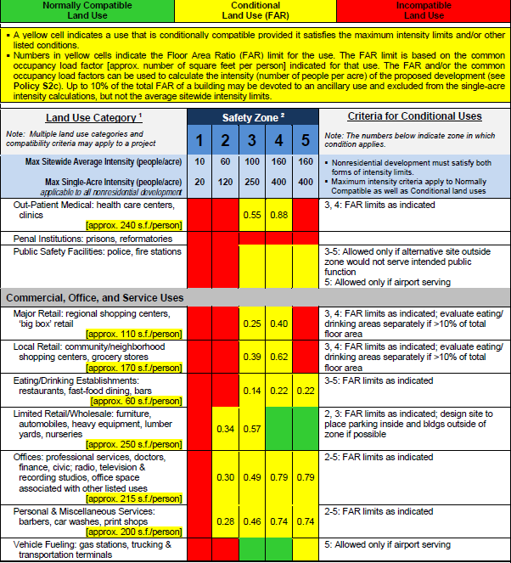
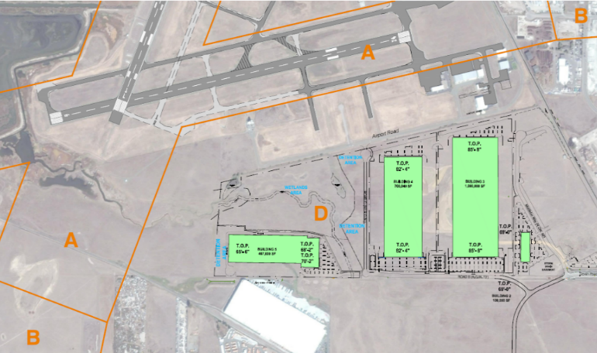
Planning and Zoning
Comprehensive Plan
Area Plans
Joint or Regional Planning and Extraterritorial Zoning
Airport Land Use Compatibility Plans including zoning ordinances
  FAR Part 150 Study
  Vision 100 Section 160 Program
Airport Master Plan/Airport Layout Plan
Site Plan Review and Plat Review
Dedications, Deed Restrictions

Slide 36
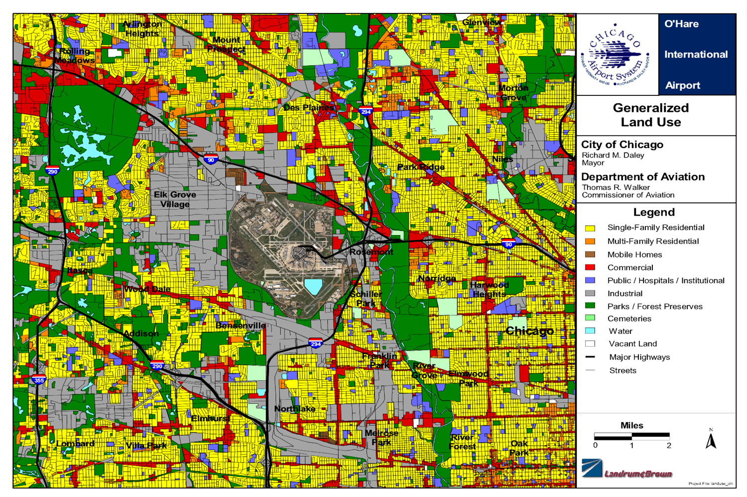
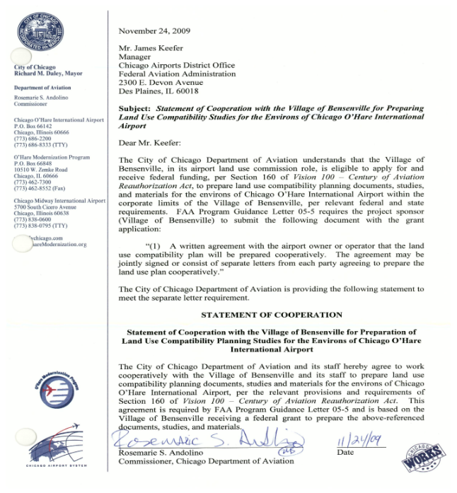
Airport Compatible Land Use Plans

Slide 37
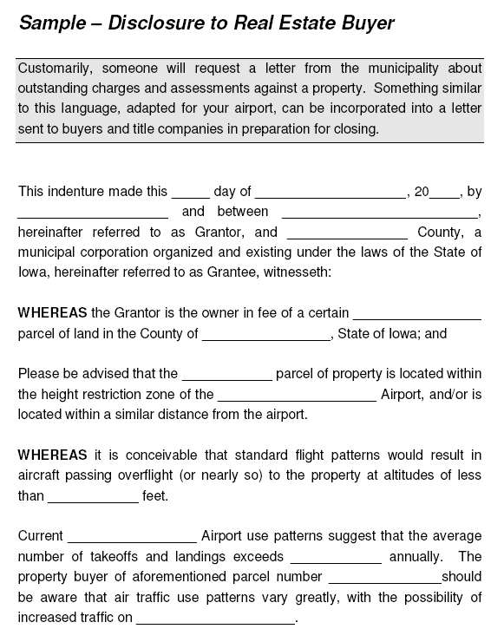
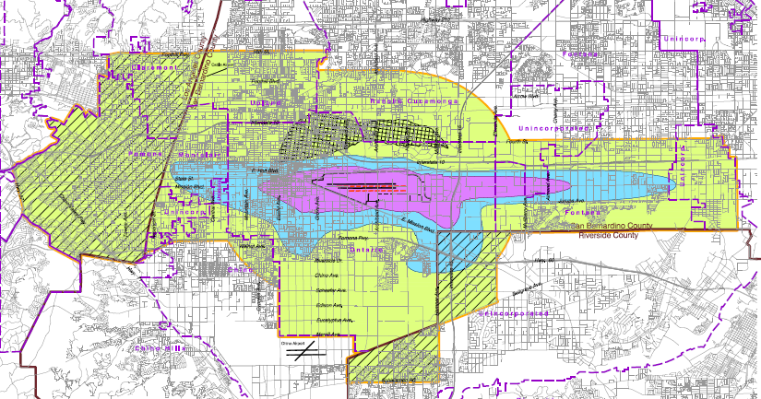
Land Acquisition and Easements
Fee Simple Acquisition
  Long term protection
  Loss of tax base
Avigation Easements
  Requires continual review
  & enforcement
Real Estate Disclosure
  Hard to enforce
  Often “lost” in paperwork

Slide 38
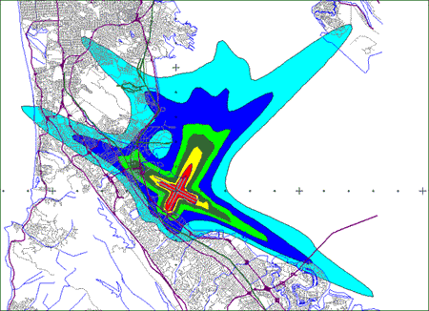
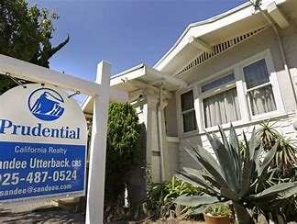
Noise Abatement
Noise compatibility program (FAR Part 150)
Building codes
  To ensure interior noise levels of 45dB or less for noise sensitive structures.
Sound barriers
Sound insulation
Quieter Home Program
Source: Mead & Hunt

Slide 39
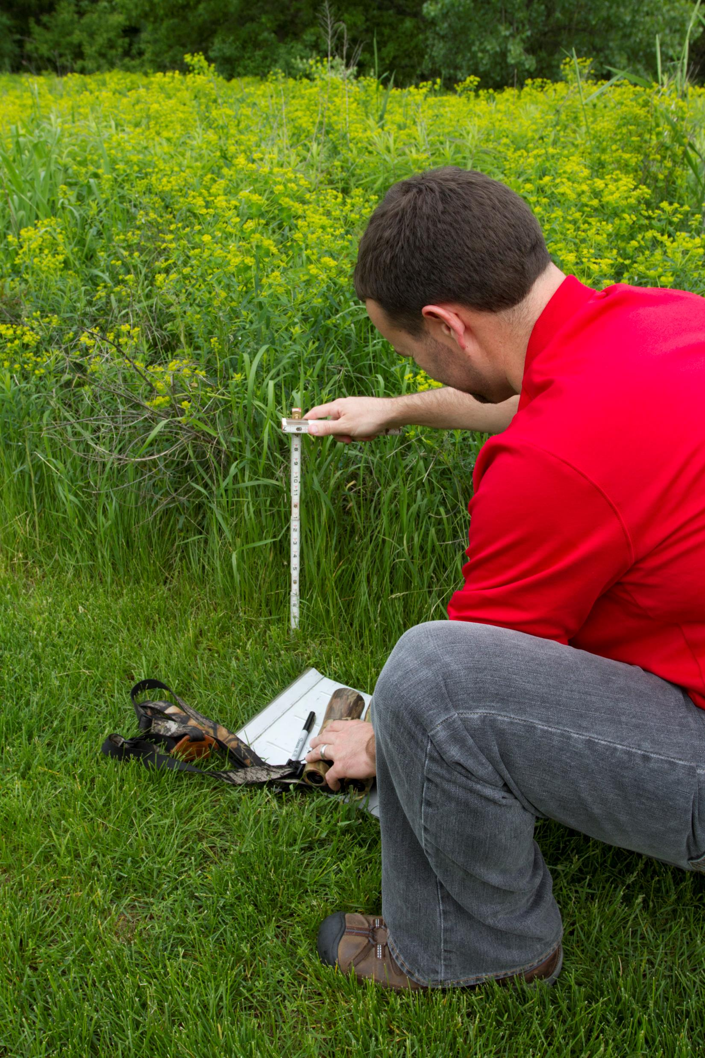
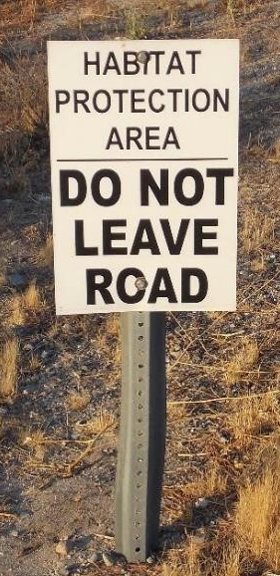

Wildlife Management
Wildlife hazard assessments (WHA)
Wildlife hazard management plans (WHMP)
Best management practices (BMPs)
Local environmental agency coordination
Source: All photos Mead & Hunt

Slide 40


Education and Outreach
Topics to convey
  Importance of compatible uses
    On- and off-airport
  Consequences of incompatibility
  Liability concerns
Audiences
  Elected officials
  Local planners
  General public
  Pilots
Source: Mead & Hunt

Slide 41
Ongoing Coordination and Input
National Association of State Aviation Officials (NASAO) and FAA MOU on Airport Compatible Land Use
Aviation/Airport stakeholders, including:
  American Association of Airport Executives (AAAE)
  Airports Council International – North America (ACI-NA)
  Airports Consultant Council (ACC)
  Airline Pilots Association (AOPA)
American Planning Association

Slide 42
Resources

Slide 43




Resources
  ACRP Report 27
  Mineta Transportation Institute Report 06-05
  State Land Use Guidebooks (CA, FL, IA, OR, PA, WA, etc.)
  Legal Research Digest 5 – Responsibility for Implementation of Airport Land Use Zoning Restrictions
  Legal Research Digest 14 – Achieving Airport-Compatible Land Uses and Minimizing Hazardous Obstructions in Navigable Airspace

Slide 44
FAA Regulatory/Guidance References
Code of Federal Regulations
  14 CFR Part 77 SAFE, EFFICIENT USE, AND PRESERVATION OF THE NAVIGABLE AIRSPACE
  14 CFR Part 150 Airport Noise Compatibility Planning
  14 CFR Part 139.337 Wildlife Hazards
  40 CFR Part 258.10, Municipal Solid Waste Landfills, Location Restrictions, Airport Safety
  http://www.ecfr.gov/cgi-bin/ECFR?SID=4f29c1a8529ec46bb53bd2bd7e3948a5&page=browse
FAA Advisory Circulars (AC)
  AC 150/5190-4A A Model Zoning Ordinance to Limit Height of Objects Around Airports
  AC 150/5020-1 Noise Control and Compatibility Planning for Airports
  AC 150/5070 Airport System Planning Process
  AC 150/5100-17 Land Acquisition and Relocation Assistance for AIP Assisted Airport Projects
  AC 150/5200-33 Hazardous Wildlife Attractants on or near Airports
  AC 150/5200-34 Construction or Establishment of Landfills near Public Airports
  AC 150/5300-13A Airport Design
  AC 70/7460-2K Proposed Construction or Alteration of Objects that May Affect the Navigable Airspace
  http://www.faa.gov/airports/resources/advisory_circulars/

Slide 45
Audience Participation Group Exercise

Slide 46
Good or Bad
Land Use?
(Yes or No)

Slide 47

Shopping Mall
Residential
Neighborhood

Slide 48

Light Industrial / Business Park

Slide 49

Children’s School

Slide 50


Slide 51
Good or Bad
Land Use?
(Small Group Activity)

Slide 52


