Slide 1
ACRP 06-06: Cultivating Talent in the Airport Environment
Presentation of Findings
Dr. Jessica Jenkins, ICF
Dr. Candace Blair Cronin, ICF
Dr. Allison Alexander, ICF
Chelsey Jackson, ICF
Sasha Iliev, ICF
Kelly Dray, ICF

Slide 2
Project Goal
A “playbook,” for airport leaders and managers, that will provide
inspiring, tested, and readily implementable techniques to enhance
talent cultivation and knowledge transfer within airport organizations.

Slide 3
Work Performed
Conducted Literature Review
Reviewed literature to develop an understanding of the issues that impact the ability of the airport industry to retain individuals who can lead, guide, manage, and carry out airport-centric initiatives
Conducted Gap Analysis
Conducted interviews and focus groups to identify challenges and barriers to talent cultivation and professional growth
Developed Strategies and Tools
Developed strategies, or plays, that will enable airport leaders and managers to enhance talent cultivation within airport organizations
Conducted interviews with airport leaders to understand innovative and successful workforce strategies being implemented, and developed case studies
Developed Metrics to Measure Effectiveness
Identified metrics that airport leaders and managers can use to measure the effectiveness of each play
Developed Playbook
Plays are broken into three workforce challenge areas: Creating an Environment That Cultivates Talent, Supporting Employee Growth, Preparing to Meet Future Talent Needs
Includes a Needs Assessment to help airport leaders and managers understand where the airport/organization has a need for improvement around talent cultivation

Slide 4
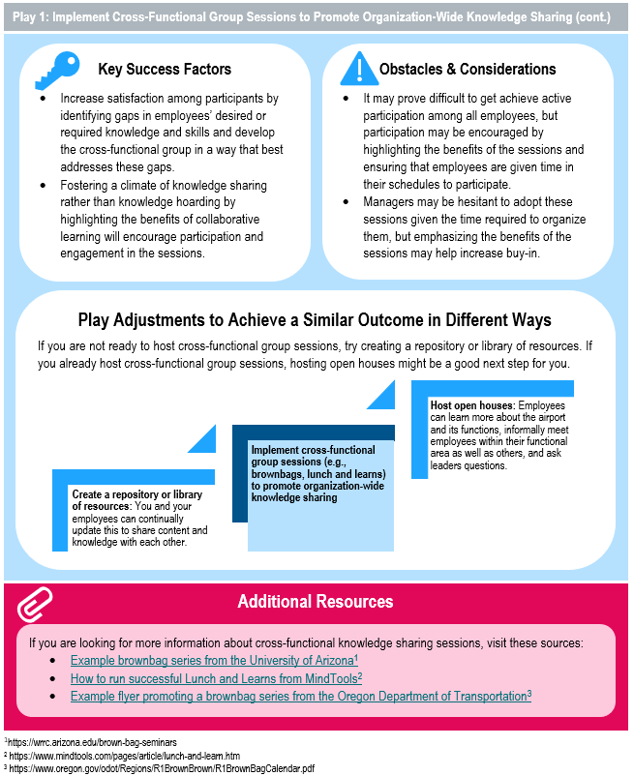
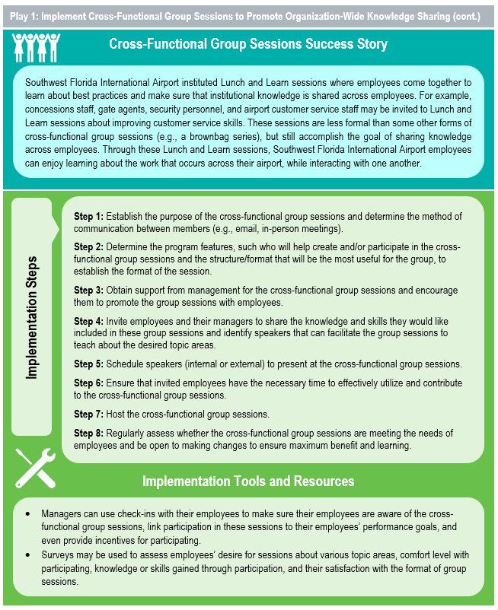
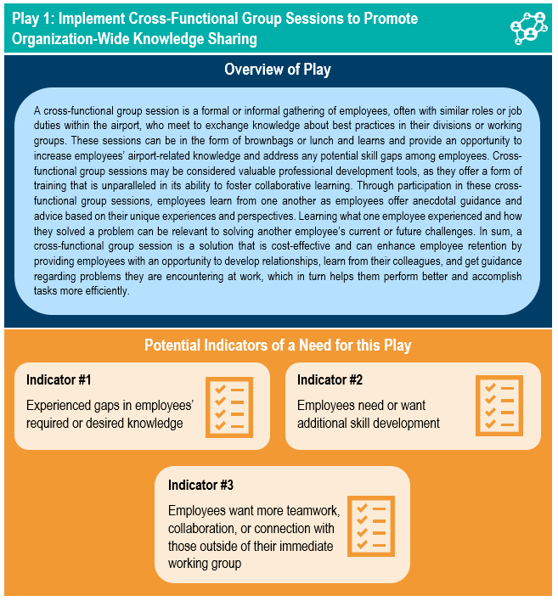
Talent Cultivation Playbook
Designed for quick and easy application
Can be used by airports of different types and sizes
Addresses all levels of the organization from entry level through leadership
Includes approaches that are tactical, strategic, and structural in nature
Each play includes:
Brief description
Potential indicators of a need for the play
Detailed implementation steps
Success story
Key success factors
Potential obstacles and considerations
Additional resources
Metrics to measure success
Related case study examples

Slide 5
Workforce Challenge Areas
Plays are broken into 3 workforce challenge areas
Creating an Environment that Cultivates Talent
Supporting Employee Growth
Preparing to Meet Future Needs
Workforce Challenge Areas

Slide 6
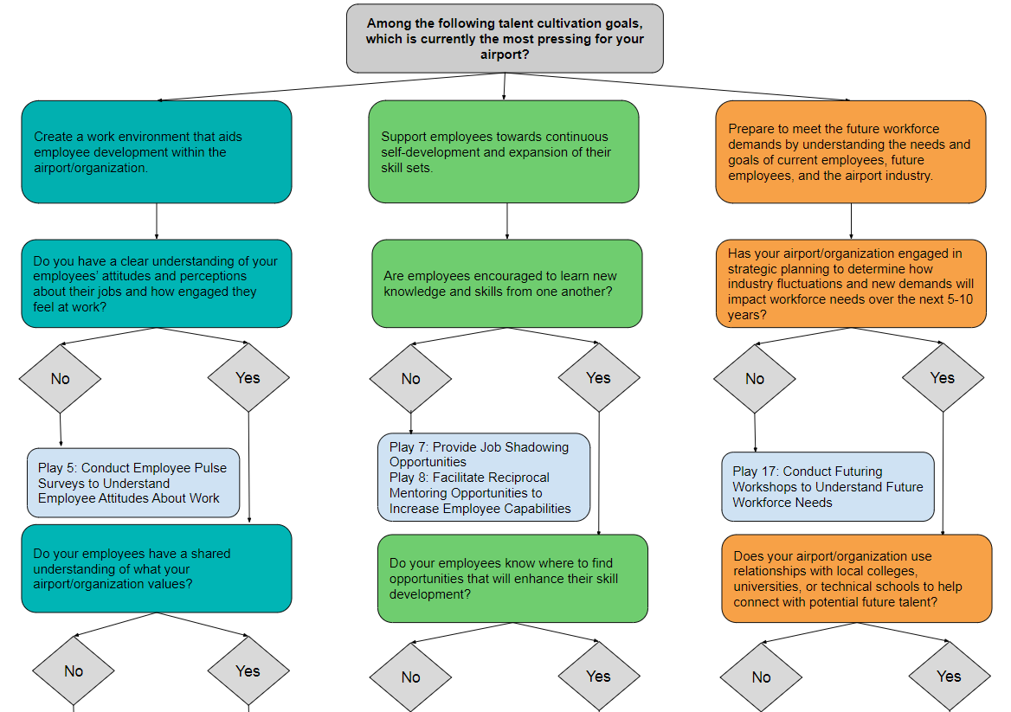
Needs Assessment
Purpose: Help airport leader or manager understand where the airport/organization has a need for improvement around talent cultivation
Airport leader or manager answers the questions to identify play(s) designed to help solve their specific talent cultivation challenges

Slide 7
Plays: Creating an Environment That Cultivates Talent
Play | Overview
Implement cross-functional group sessions to promote organization-wide knowledge sharing | A cross-functional group session can enhance employee retention by providing employees with an opportunity to develop relationships, learn from their colleagues, and get guidance regarding problems they are encountering at work, which in turn helps them perform better and accomplish tasks more efficiently.
Host “learning moments” forums to share lessons learned | Learning moments forums can be described as formally organized and structured discussions in which employees share something they learned, a best practice they developed, or skills they utilized to accomplish a difficult goal.
Facilitate Think Tank forums to promote innovation | “Think Tank” forums are useful for encouraging innovation amongst employees and allowing employees to have their voices heard in decision-making processes, both of which help increase employee engagement and satisfaction.
Conduct group visioning sessions with employees to outline shared values and goals | Group visioning sessions may be described as formally organized gatherings of employees with the purpose of establishing goals to work towards as a team and values to uphold in pursuit of these goals.
Conduct employee purse surveys to understand employee attitudes about work | Employee pulse surveys can provide airport managers with an easy and cost-effective way to track their employees’ attitudes throughout the year.
Articulate a peer-nominated employee recognition approach to honor work successes | An employee recognition program is a system used to acknowledge individuals who go above and beyond when performing their job duties and deserve to have their work successes celebrated.

Slide 8
Plays: Supporting Employee Growth
Play | Overview
Provide job shadowing opportunities to broaden employee skills | Job shadowing provides employees the opportunity to learn about and observe the responsibilities and interactions of different jobs within the airport without transitioning from their current role.
Facilitate reciprocal mentoring opportunities to increase employee capabilities | Facilitating a reciprocal mentoring program is a cost-effective strategy for encouraging collaborative learning within the airport and provides employees with opportunities to engage with and learn from their colleagues.
Guide employees in pursuing relevant training or certifications to improve their skills | Managers may be able to generate a list of acceptable training opportunities for employees by consulting with the HR department or training personnel, discussing possible opportunities with other department managers, inquiring about any opportunities offered by organizations such as the AAAE or ACI–NA, and searching the internet for any relevant programs.
Conduct constructive feedback sessions for leaders to promote consistency across employees | Constructive feedback involves using facts (versus opinions) to support appraisals of employees’ performance, describing the impact of employees’ actions, and providing guidance for future behavior.
Share sources for publicly available developmental opportunities to promote growth | Providing employees with resources that may aid in their personal and professional development (e.g., online training materials, magazine subscriptions, research articles, conference or workshop materials) is a cost-effective way to encourage their skill-building and knowledge growth and to support a knowledge-sharing culture.
Facilitate career path discussions to share career development opportunities with employees | A career path is a sequence of different jobs that an employee can progress through within an organization, which can guide them and provide an understanding regarding how to reach their overall career goals.

Slide 9
Plays: Preparing to Meet Future Needs
Play | Overview
Create partnership opportunities for airport leaders to engage with academic programs | Fostering relationships and partnership opportunities with academic programs can help create a pipeline for new talent in the airport, resolve the learning gaps that new employees may have when first entering the airport industry after completing their education, and provide current airport employees an avenue to continue their education.
Conduct “stay interviews” to learn from employees and improve employee retention | Stay interviews should be conducted during an employee’s tenure at the airport to help managers better understand what makes employees remain at the organization and what factors might cause them to leave.
Design internal internship opportunities to prepare future talent | Internal internships are opportunities in which employees work in a different position and/or functional area for a fixed period (e.g.,1-3 months, full year) with the purpose of developing their knowledge, skills, and abilities (KSAs). Employees who participate in internships can gain exposure to other career paths and pursue their career goals and aspirations.
Create a personal career narrative to share work experiences with employees | A personal career narrative is a short description of why individuals selected their career or field, how they have progressed in their career, and their short- and long-term goals.
Conduct futuring workshops to understand future workforce needs | A futuring workshop involves a thought exercise in which managers, key stakeholders, and employees describe the current trends and demands for the specific airport or the airport industry that will impact workforce needs in the future.

Slide 10
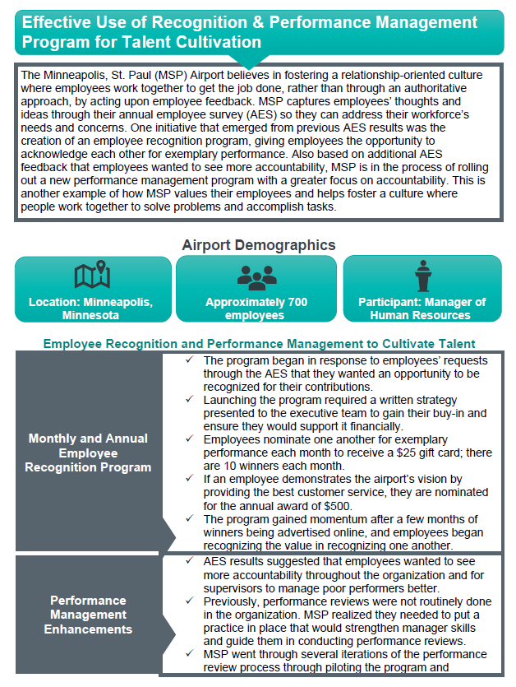
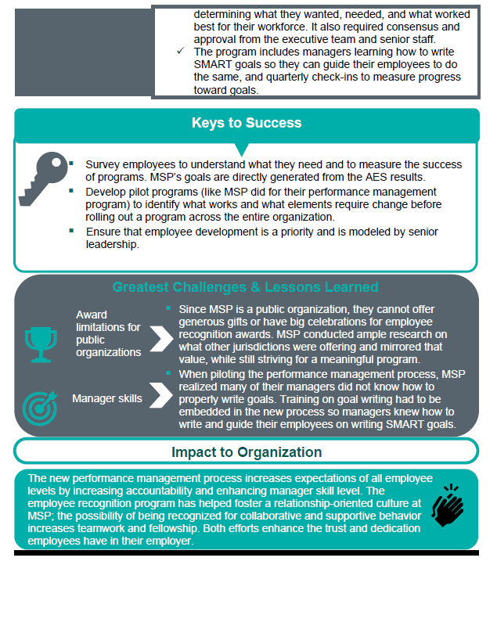
Case Studies
Purpose: Provide examples that airport leaders and managers can reference to see how airports have been successful in creating an environment that enhances talent cultivation, supporting employee growth, and preparing the airport to meet future talent needs
Each case study includes:
Brief description
Airport demographics
Implementation information
Keys to success
Challenges and lessons learned
Impact to the organization
Airports
Minneapolis-St. Paul International Airport
Naples Airport
Philadelphia International Airport
San Diego International Airport
San Luis Obispo Airport

Slide 11
Metrics and Metric Scorecards
Purpose: Provide a consistent and quantifiable approach to evaluate the impact of talent cultivation plays
The metrics are designed to be easily understood and used, have broad applicability, and be adaptable to the needs of diverse audiences
Metrics:
Time to implement
Cost to implement
Amount of time to realize results
Sustainability
Stakeholder support
Percentage of employees able to participate
Percentage of individuals who participated (of those able to participate)
Supervisor perception of employee performance post implementation of play
Percentage of participants satisfied with the experience

Slide 12
Metric Scorecard
Metric Scorecard Title of Play: [Insert Play Title Here]
Metrics | 0-25 | 26-50 | 51-75 | 76-100 | Score
Time to implement | Over 12 months | 6 to 12 months | 3 to 6 months | Less than 3 months
Cost to implement | More than budget target | Right at budget target | Slightly under budget target | Significantly under budget target
Amount of time to realize results | Over 12 months | 6 to 12 months | 3 to 6 months | Less than 3 months
Sustainability | One-time occurrence | Information or context must be continually updated to remain current | Information or content can be updated annually and reused | Can occur frequently with minimal maintenance
Stakeholder support | Stakeholders unaware of program | Stakeholders know of program and do not support it | Stakeholders know of program and slightly support it | Stakeholders fully support the program
Percentage of employees able to participate | Up to 25% of employees can participate | 25% to 50% of employees can participate | 50% to 75% of employees can participate | 75% or more of employees can participate
Percentage of employees that participated (of those able to participate) | Up to 25% of employees can participate | 25% to 50% of employees can participate | 50% to 75% of employees can participate | 75% or more of employees can participate
Supervisor perception of employee performance post implementation of play | Decline in performance | No change in performance | Slight improvement in performance | Significant improvement in performance
Percentage of participants satisfied with the experience | Less than 50% satisfied | 50% to 75% satisfied | 75% to 90% satisfied | Greater than 90% satisfied
Total Score:
All metrics associated with each play should be used together to evaluate the play, and then a new scorecard can be completed for a second play if comparison is desired
By comparing the plays using a consistent set of metrics and anchors, airport leaders can simplify difficult decisions and articulate the costs and benefits of each approach

Slide 13
Implementation Memorandum
Purpose: Provide guidance, including recommendations on how to put the findings into practice, identify institutions for applying findings, identify issues affecting implementation and associated solutions, and recommend methods of identifying and measuring impacts.
Recommendations for Putting the Research Findings/Products into Practice Incremental use of selected plays Airport-wide talent cultivation processes and procedures Sharing and promotion of playbook | Institutions to Lead Application of Research Findings and Products Research participants and associated airports/organizations American Association of Airport Executives Airports Council International – North America
Issues Affecting Implementation and Recommended Actions Manager-focused Consistent application across employees | Recommended Methods of Identifying and Measuring Impacts of Implementation Measuring impacts of play implementation Measuring impacts of playbook implementation

