Slide 1
A Guidebook to Prepare Airports for Transformations in Wireless Connectivity
Antonio Correas
ACRP 03-57 Principal Investigator Skymantics

Slide 2
The Airport Cooperative Research Program (ACRP) is sponsored by the Federal Aviation Administration. ACRP is administered by the Transportation Research Board (TRB), part of the National Academies of Sciences, Engineering, and Medicine. Any opinions and conclusions expressed or implied in resulting research products are those of the individuals and organizations who performed the research and are not necessarily those of TRB; the National Academies of Sciences, Engineering, and Medicine; or ACRP sponsors.

Slide 3
Contents
Problem Statement
How wireless can help airports
Taxonomy of wireless architectures
Cost considerations
Wireless technology transition
Airport wireless evolution web assessment tool
After investment decision: practical aspects

Slide 4
Problem Statement
Airports are continually expanding or upgrading their facilities. Expansion/upgrade implies the use and addition of connected electronic devices.
Emergent wireless technologies support varying connectivity capabilities and types of devices (phones, computers, sensors, vehicles, robots, UAS).
Growth of connected networks has the opportunity to become flexible and effective by use of wireless, however it introduces new complexity

Slide 5
How wireless can help airports
Wireless gives flexibility and mobility to provision of networks.
Wireless connectivity allows airports to commercialize its network resources via new business models (e.g., connectivity as a service).
Compared to a cabled network, wireless infrastructure is leaner:
Making changes to the infrastructure requires a lower time and financial resource investment
Adding devices to the network require a lower marginal cost
Notes:
Some electronic devices are naturally mobile, making wireless a requirement to unlock specific airport services
Mobile devices can generally be repositioned without considerably altering the network infrastructure

Slide 6
How wireless can help airports
Wireless Use Case Categories
Passenger experience and commercial service
Airport/airline operations
Safety, security and surveillance
Autonomous vehicles and robotics
Incident response and recovery
Travel health

Slide 7
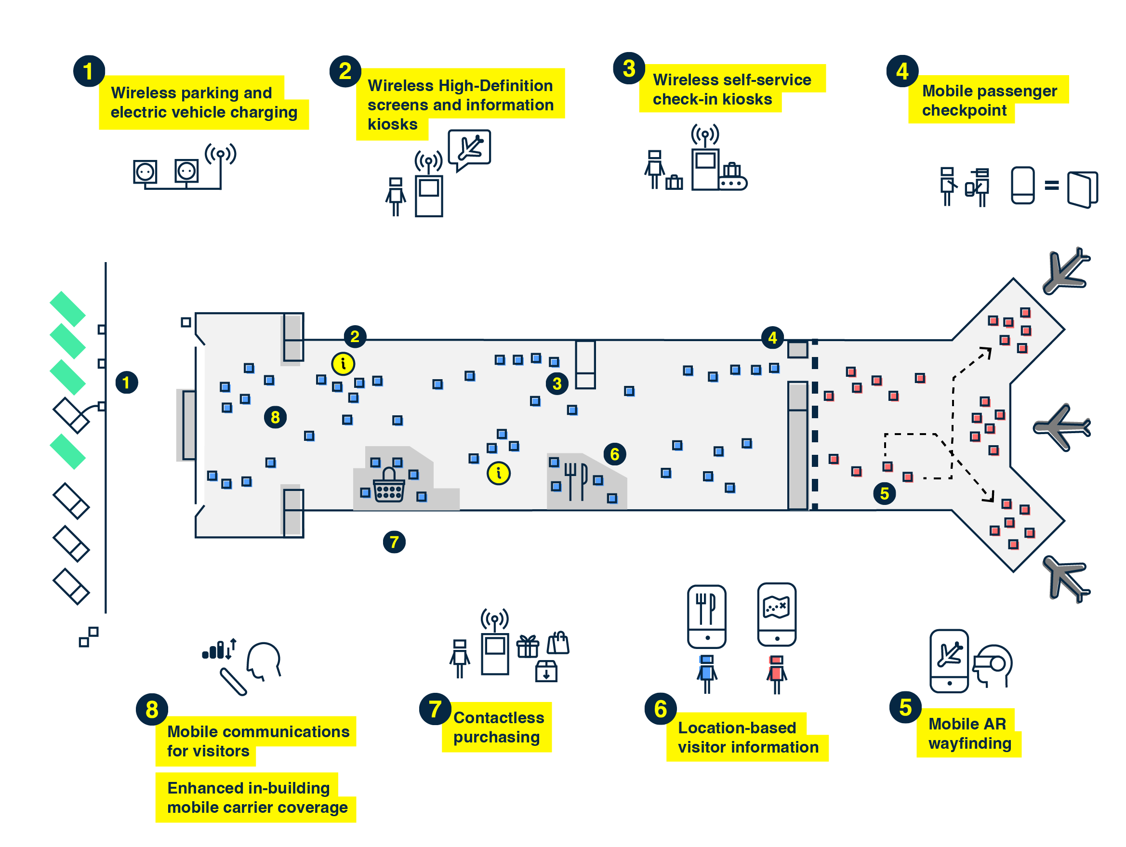
Passenger experience and commercial services
Notes:
Wireless parking and EV charging: Parking occupancy systems, consisting of wireless sensors depicting available parking spots and EV charging stations which need to connect to a network to process payments and to relay information about the EV charging status.
Wireless High-Definition screens and information kiosks: Interactive information kiosks have smart search capabilities, mobile wayfinding integration, and also have the ability to remotely control information on touch screens using the content management system.
Wireless self-service check-in kiosks: Self-service kiosks expedite passenger processes in airports by allowing travelers to check- in, tag and drop their checked baggage themselves. Wireless connectivity enables service integration with "accessible anywhere" kiosks, which allows flexible deployment of fixed or mobile counters and kiosks.
Mobile passenger checkpoint: wireless-enabled biometrics technology would allow airports to set up mobile and flexible passenger processing stations for verification of travelers' identity for immigration and passport control purposes.
Mobile AR wayfinding: Augmented Reality (AR) applications running on smartphones expand the quality of information accessible by passengers.
Location-based visitor information: Information to a passenger and visitor over an airport app can be tailored depending on the current location, improving wayfinding information, and creating marketing opportunities based on retail advertisement, thereby providing a personalized traveler experience.
Contactless purchasing: Customers are now able to self-check-out at payment kiosks by scanning their products and simply swiping their credit or debit cards to complete the transaction.
Mobile communications for visitors: Airport provision of cellular/Wi-Fi/Bluetooth to personal electronic devices enables travelers to stay connected for entertainment and business tasks.
Enhanced in-building mobile carrier coverage: the airport network provider effectively manages the mobile carrier, and is required to provide infrastructure capacity to mobile carriers. This allows mobile carrier subscribers to seamlessly handover direct cellular service and in-building DAS or Wi-Fi radio access network.

Slide 8
Passenger experience and commercial services
Differentiating/Cutting Edge benefits
Reduction in the amount of required airport personnel to assist travelers.
Reduction in carbon footprint of construction.
Generation of new aeronautical and non-aeronautical revenue streams.
Enhanced predictability of operations and passenger flow.
Enhancement of volume and location of information points for travelers.
Notes:
Reduction in the amount of required airport personnel to assist travelers. With less staff required for overall employment, screening and badging needs would also decrease, thereby decreasing the paperwork and liabilities of non-airport and airport operations related workers who are employed.
Reduction in the costs of cabling infrastructure and carbon footprint of construction.
Generation of new aeronautical and non-aeronautical revenue streams in the form of service infrastructure to airlines and new revenue stream to which airports did not have access before.
Enhanced predictability of operations and passenger flow allows airports to achieve better utilization of assets and increases operational efficiency.
Enhancement of volume and location of information points for travelers.

Slide 9
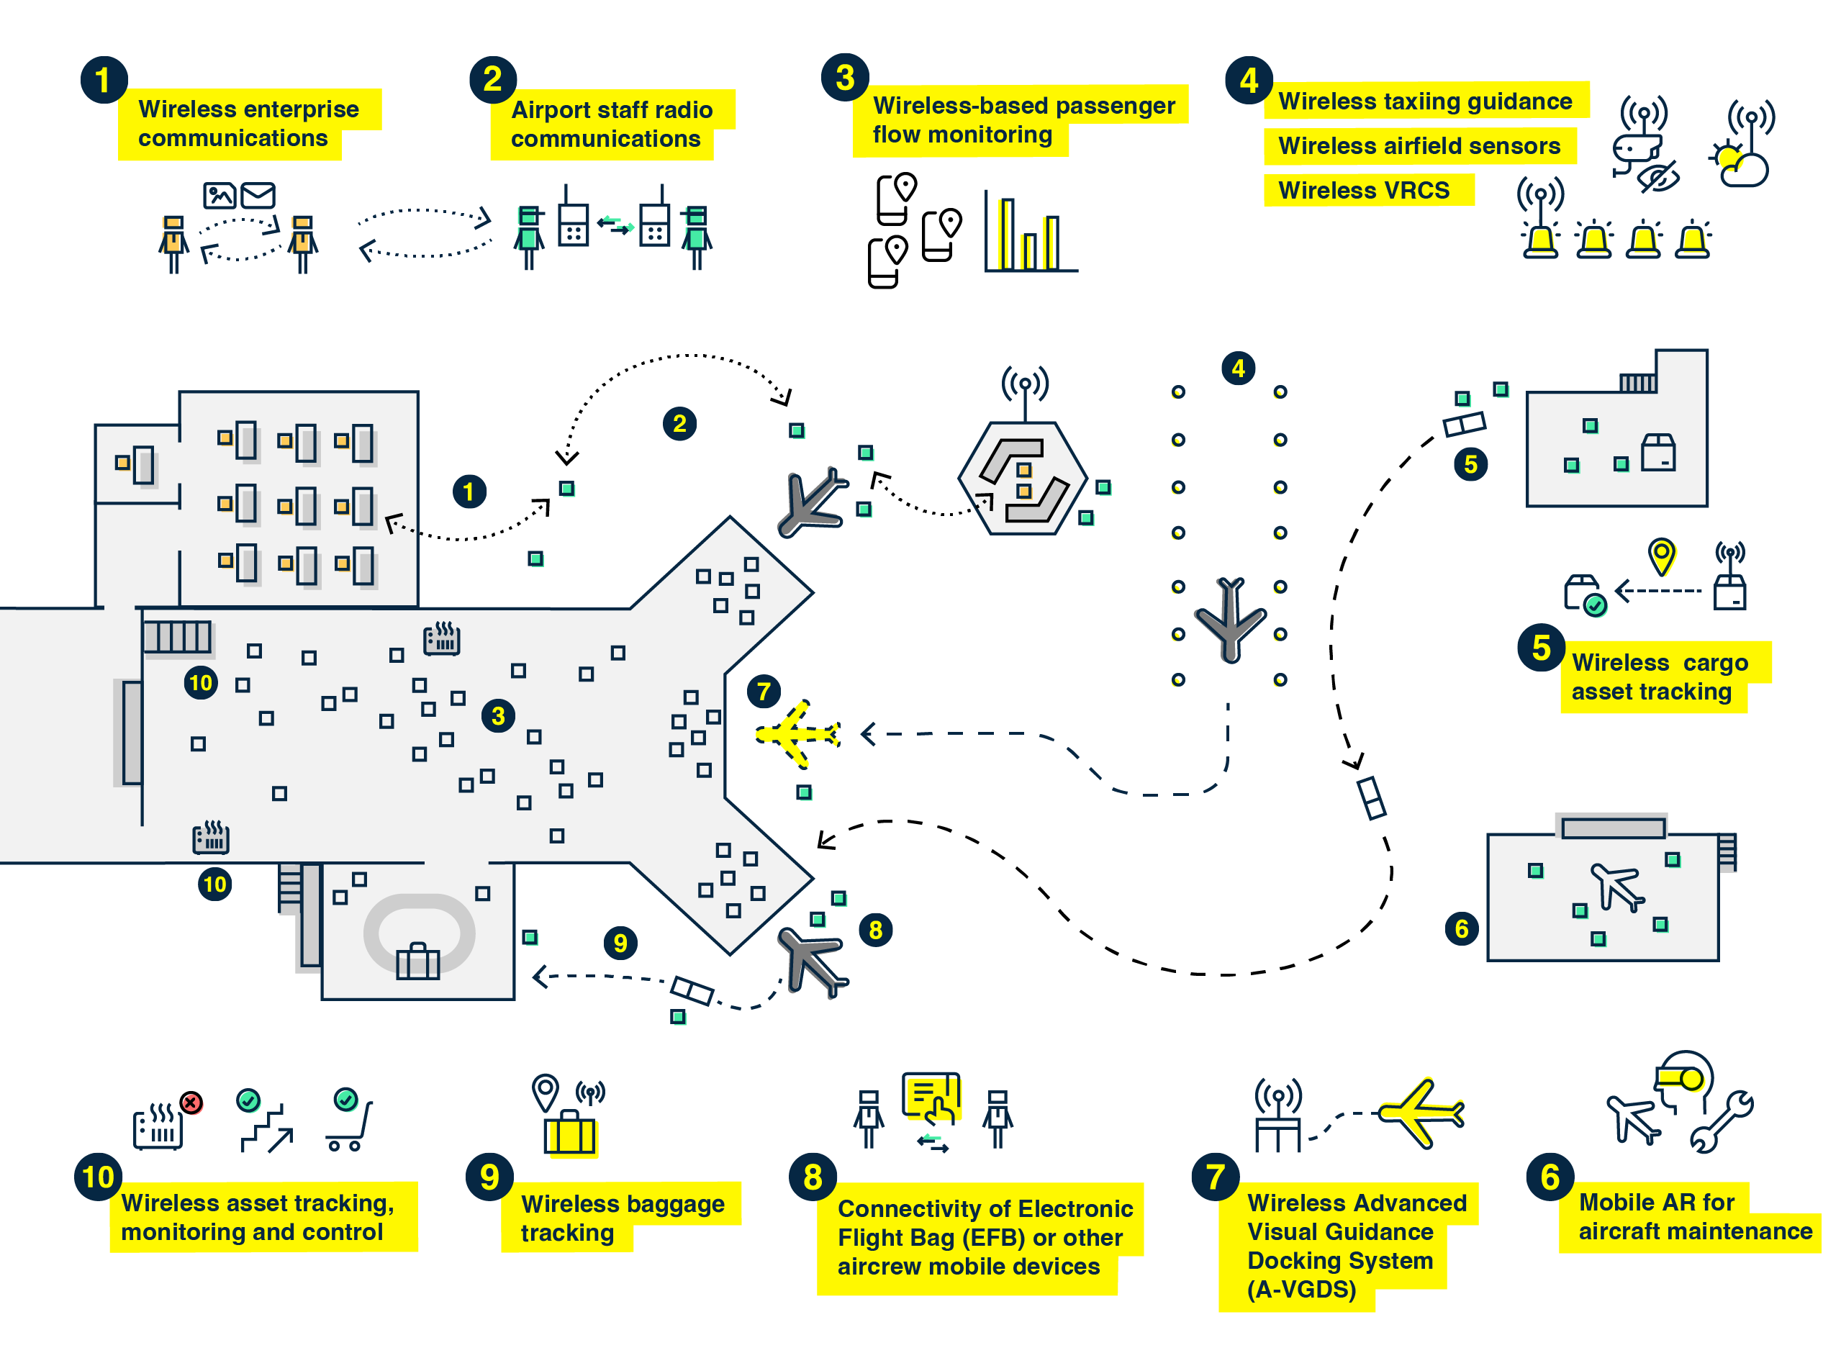
Airport/airline operations
Notes:
Wireless enterprise communications: refers to data communication for electronic devices for airport staff and tenants
Airport staff radio communications: consists basically on voice communication for airport and airline staff to help coordinate their operations throughout the airport
Wireless-based passenger flow monitoring: help obtain insights on passenger behaviour and use of terminal space through sensing the position and movement of passengers using wireless technologies
Wireless taxiing guidance, airfield sensors and Virtual Ramp/Ground Traffic Control System (VRCS): support safe and efficient aircraft taxiing through electronic devices and sensors located airside and communicated wireless
Wireless cargo asset tracking: sensing the location and movement of cargo pallets to prevent delays in operations due to unknown location, as well as prevent theft or loss of assets
Mobile AR for aircraft maintenance: consists on augmented reality (AR) software systems fed through wireless communications that help maintenance personnel perform faster and more accurate maintenance operations
Wireless Advanced Visual Guidance Docking System (A-VGDS): allows aircraft to dock and park within the apron using enhanced visual guides and alerts for pilots, which improves safety as well as accuracy
Connectivity of Electronic Flight Bag (EFB) or other aircrew mobile devices: allows flight crews to forgo the traditional multiple paper- based documents and charts, thereby achieving a paperless flight deck.
Wireless baggage tracking: wireless connectivity allows greater flexibility providing baggage handlers at the apron by providing real-time data from departure control systems to indicate the status of the luggage
Wireless asset tracking, monitoring and control: empowering airport authorities to monitor, control, and track assets through wireless connectivity embedded into airport assets such as vehicles, escalators, lights, or displays.

Slide 10
Airport/airline operations
Differentiating/Cutting Edge benefits
Wireless coverage supports mobility
Understanding the way passengers utilize the terminals can help managers optimize the use of terminal space.
Preventive maintenance
Remotely control assets from a control room saving time and resources.
Improve situational awareness
New aeronautical revenue streams
Notes:
Wireless coverage supports mobility in the terminal and airfield, allowing the execution of operational tasks on the field while minimizing displacements.
Understanding the way passengers utilize the terminals can help managers locate concessions more effectively, identify operational inefficiencies through bottlenecks, reassign gates to better distribute passengers within the terminal, or redesign the building to improve the overall passenger experience.
Additionally, Historical data on passenger movements can be used to drive data-based optimization of commercial activity.
Preventive maintenance by anticipating any malfunctioning and increasing efficiency by using data to better use the assets.
Airports can leverage the power of wireless loT to remotely control assets from a control room saving time and resources.
New surveillance technology including sensors and visual display facilities to maximize situational awareness and forecasting accurate turns.
Wireless communications also have the benefit of saving cable infrastructure costs and associated construction and maintenance, or as a complementary communication solution to wireline networks.
Reliable common wireless network connection ensures that all data and processes work seamlessly and therefore provides reliable predictive, projective plans which ensures the safety of intended flights, thereby reducing turnaround time at the gate.
New aeronautical revenue streams i.e. airlines can be offered a mobile AR service for a fee for using the AR enabled maintenance for the benefit of avoiding flight cancellation and delays which would compound into the operational efficiency and cost throughout the airline in a domino effect.

Slide 11
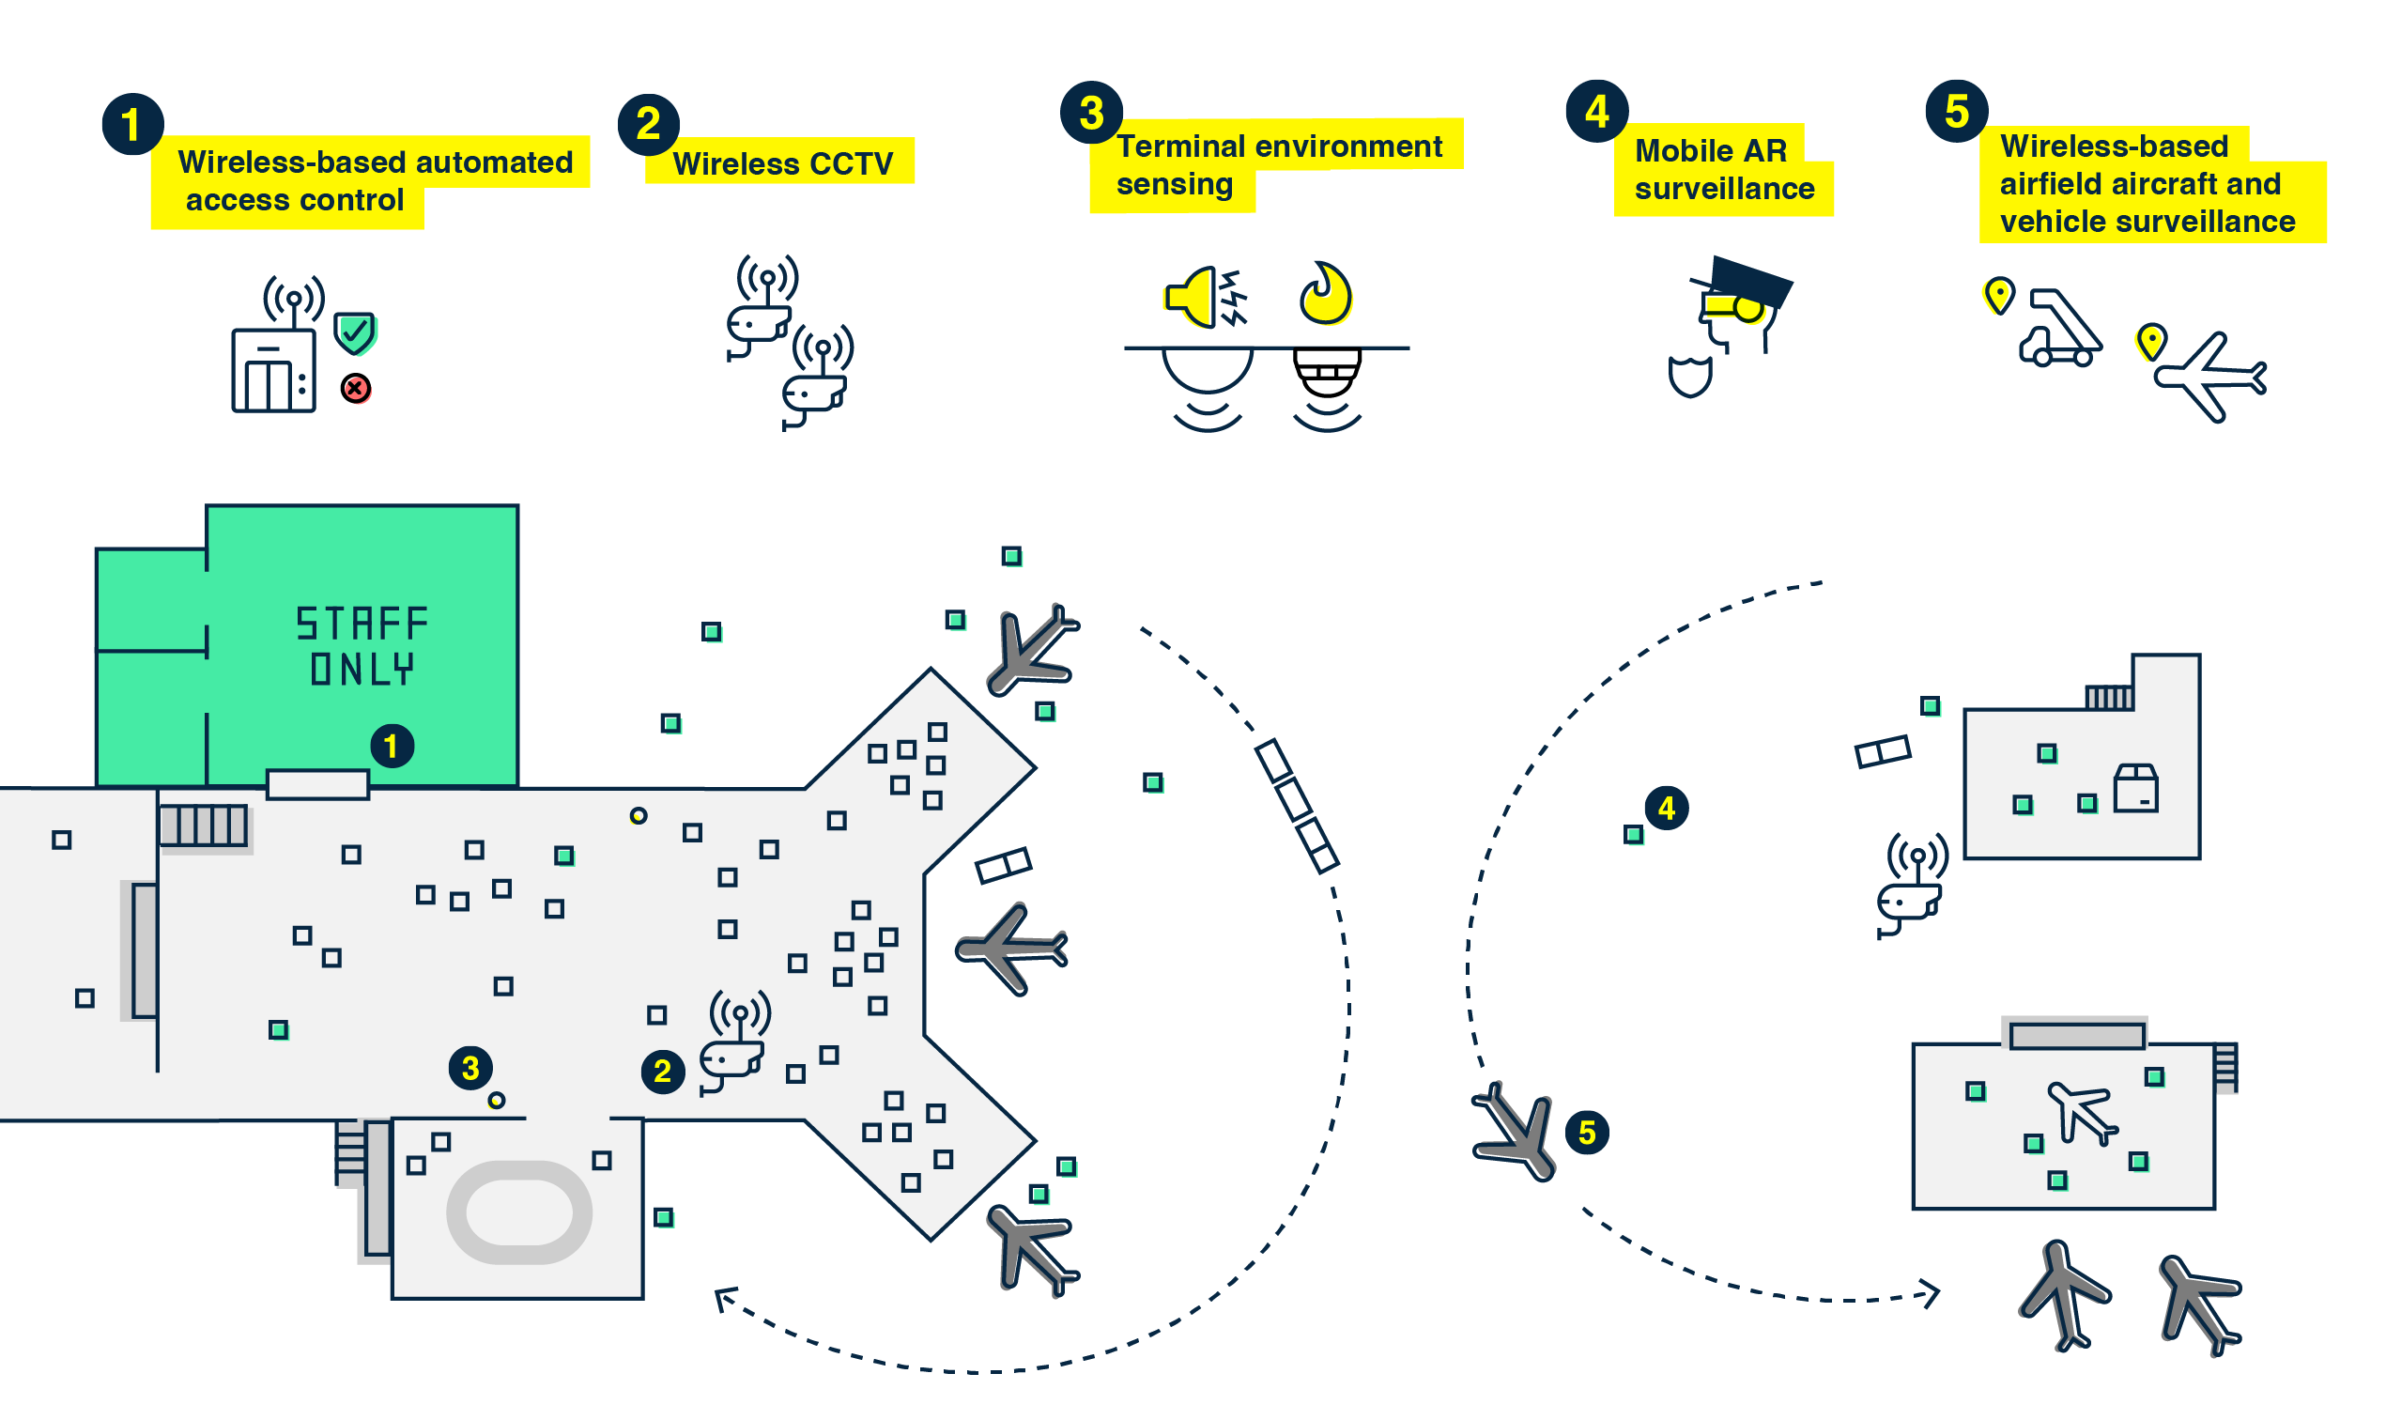
Safety, security and surveillance
Notes:
Wireless-based automated access control: automation of access control increases security by providing a higher level of control over access to restricted areas. This can also incorporate the ability to secure laptops and other confidential or sensitive devices. When attempting to enter a restricted area, biometrics sensors would identify the person and grant access based on the access profile of the person.
Wireless Closed Circuit TV surveillance: Wireless security cameras have the capability to transmit live video footage over Wi-Fi or cellular networks and are useful as backup communications link, to facilitate remote footage view, or for security cameras placed in locations not covered by wired infrastructure for quick deployment of video feeds.
Terminal environment sensing: A diverse set of sensors allow controllers to monitor several terminal environment parameters such as air temperature, smoke, air quality, and sound levels.
Mobile AR surveillance: on-site security personnel can use AR glasses to communicate the security environment of the surveilled location effectively in real time through textual and visual context information.
Wireless-based airfield vehicle and aircraft surveillance: Although Airport Surface Surveillance Capabilities (ASSC) and Airport Surface Detection Equipment (ASDE-X) are specific FAA systems, they can technically share airfield surveillance information with the airport and other stakeholders, such as airlines and FBOs, operating in the ramp and parking areas of the airfield, to achieve common situational awareness. The airport may also operate other aircraft and vehicle surveillance equipment on the apron, taxi and runway areas using low-cost surveillance technologies.
Wireless airfield sensors: long-range reliable wireless communications such as cellular and AeroMACS can be deployed to enable the timely exchange of information gathered by environment monitoring systems with authorized airport stakeholders and provide a common situational awareness of the airfield status.
Wireless Virtual Ramp/ground traffic Control System (VRCS): Virtual Ramp control systems use a set of dedicated cameras that provide controllers a video feed coverage of any blind spots which may not be in the line of sight of controllers. It combines different systems to create a graphical video stream of the airfield, terminals, gates, cargo facilities and maintenance fields.

Slide 12
Safety, security and surveillance
Differentiating/Cutting Edge benefits
Long-range wireless technologies are an adequate alternative to security-related wirelines
Deploying wireless, battery-powered sensors directly for simple monitoring tasks is a cost-efficient manner to expand coverage of sensing sites in remote locations without direct access to power sources.
Wireless-based automated access control allows airports to expand the coverage of security control points, which enhances scope of security activities.
Potential of automatically detecting events around the airport perimeter such as Foreign Object Detection (FOD), security breaches, reducing time to respond.
Notes:
Long-range wireless technologies are an adequate alternative to wireline infrastructure to reduce costs of construction and maintenance for connectivity with equipment which are located in remote areas, or as a backup communications link to improve reliability.
Deploying wireless, battery-powered sensors directly for simple monitoring tasks is a cost-efficient manner to expand coverage of sensing sites in remote locations without direct access to power sources.
Wireless-based automated access control allows airports to expand the coverage of security control points around the terminal and airfield, which enhances the scope of security activities.
Potential of automatically detecting events around the airport perimeter such as Foreign Object Detection (FOD), security breaches, enhancing situational awareness, reducing time to respond.

Slide 13
Safety, security and surveillance (cont’d)
Differentiating/Cutting Edge benefits
Reduction of workload for controllers saves time and additional work.
More flexible placement of sensors among the terminal building.
More accuracy in the environmental awareness of events and incidents to be assessed and shared within the security team.
Augments the capabilities and connectivity of the security agents in the field, reducing the dependency on central control rooms and allows them to respond to threats more quickly and adequately.
Security agents would be able to share, assess and respond to threats more effectively without the need of a centralized IT security infrastructure.
Notes:
Reduction of workload for controllers which saves time and additional work due to clear viewing capabilities of all airfield areas of airports. This allows them react faster to potential security and safety hazards.
Using wireless connectivity for sensors allows a more flexible placement among the terminal building and reduces installation cost by eliminating the need for additional cabling.
Enables an augmentation of surveillance area covered, and more accuracy in the environmental awareness of events and incidents to be assessed and shared within the security team. Allows security personnel and dispatchers to respond to threats more quickly and adequately.
Augments the capabilities and connectivity of the security agents in the field, reducing the dependency on central control rooms. Security agents would be able to share, assess and respond to threats more effectively without the need of a centralized IT security infrastructure.

Slide 14
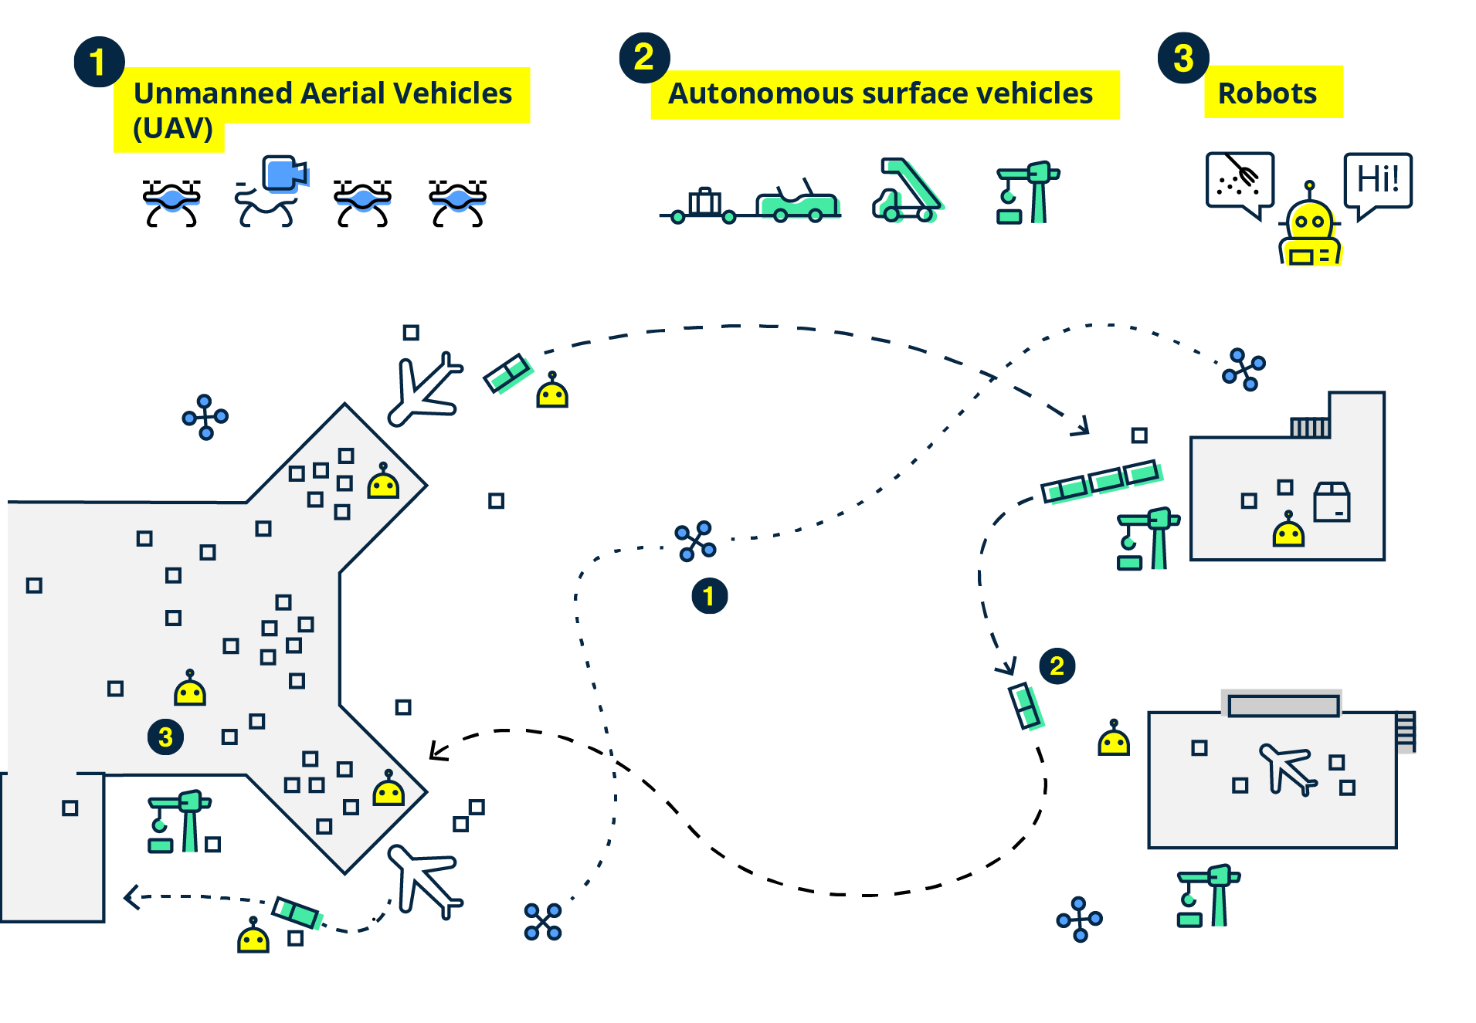
Autonomous vehicles and robotics
Notes:
Unmanned Aerial Vehicles (UAV): UAV can be used for carrying out inspections, providing aerial mapping, calibrating NAVAIDS, monitoring wildlife or transporting assets. Airports can also use UAVs for transporting goods within their grounds to speed up delivery time, safely transporting hazardous elements, and reducing the inherent security risks of ground transportation. Drones could someday provide last-mile deliveries of packages from the airport.
Autonomous surface vehicles: These vehicles move along predetermined paths and use a range of sensors to navigate, detect and avert any obstacles on their path. Though the vehicle is driven autonomously, it is supervised and monitored remotely by a human controller or a fleet management software through a wireless connection.
Mobile robots: Robots can be used to support an airport's surveillance capabilities, for cleaning and sanitizing airport terminals and they can also serve as automated mobile assistants that enhance customer experience as well as aid in terminal operations.

Slide 15
Autonomous vehicles and robotics
Differentiating/Cutting Edge benefits
Eliminates the need for personnel to be actively involved in the manual operational activities of the airport
Allows personnel to monitor and control its activities, often from a remote post.
Airport operations tasks safer for personnel.
Automation of operational tasks and is performed more accurately than by personnel manually.
Al technologies enable automatic identification of dangerous activities, faces and license plates.
Notes:
Autonomous vehicles eliminate the need for personnel to be actively involved in the manual operational activities of the airport and instead allows personnel to monitor and control its activities, often from a remote post. This makes airport operations tasks safer for personnel.
Autonomous surface vehicles automates operational tasks and is performed more accurately than by personnel manually.
Al technologies enable robots to automatically identify dangerous activities, faces and license plates therefore providing its controllers with enhanced situational awareness.

Slide 16
Autonomous vehicles and robotics (cont’d)
Differentiating/Cutting Edge benefits
Robots can automatically report on the status of their process and make smarter decisions automatically.
Drone inspections eliminate the need for inspectors to be physically present at hazardous conditions which reduces risks to personnel, saves money in staff insurance and time.
Allow controllers to perform their duties from the operations room, using the private or mobile carrier cellular network, instead of requiring radio line of sight using a handheld device.
Notes:
Robots can automatically report on the status of their process and make smarter decisions automatically, reducing dependence on staff actions, thus improving labor efficiency.
Drone inspections eliminate the need for inspectors to be physically present at hazardous conditions therefore reducing risks to personnel.
UAVs also save time in inspection preparations and money in staff insurance.
Cellular systems allow controllers to perform their duties from the operations room, located in the airport or beyond, using the private or mobile carrier cellular network, instead of requiring radio line of sight using a handheld device.

Slide 17
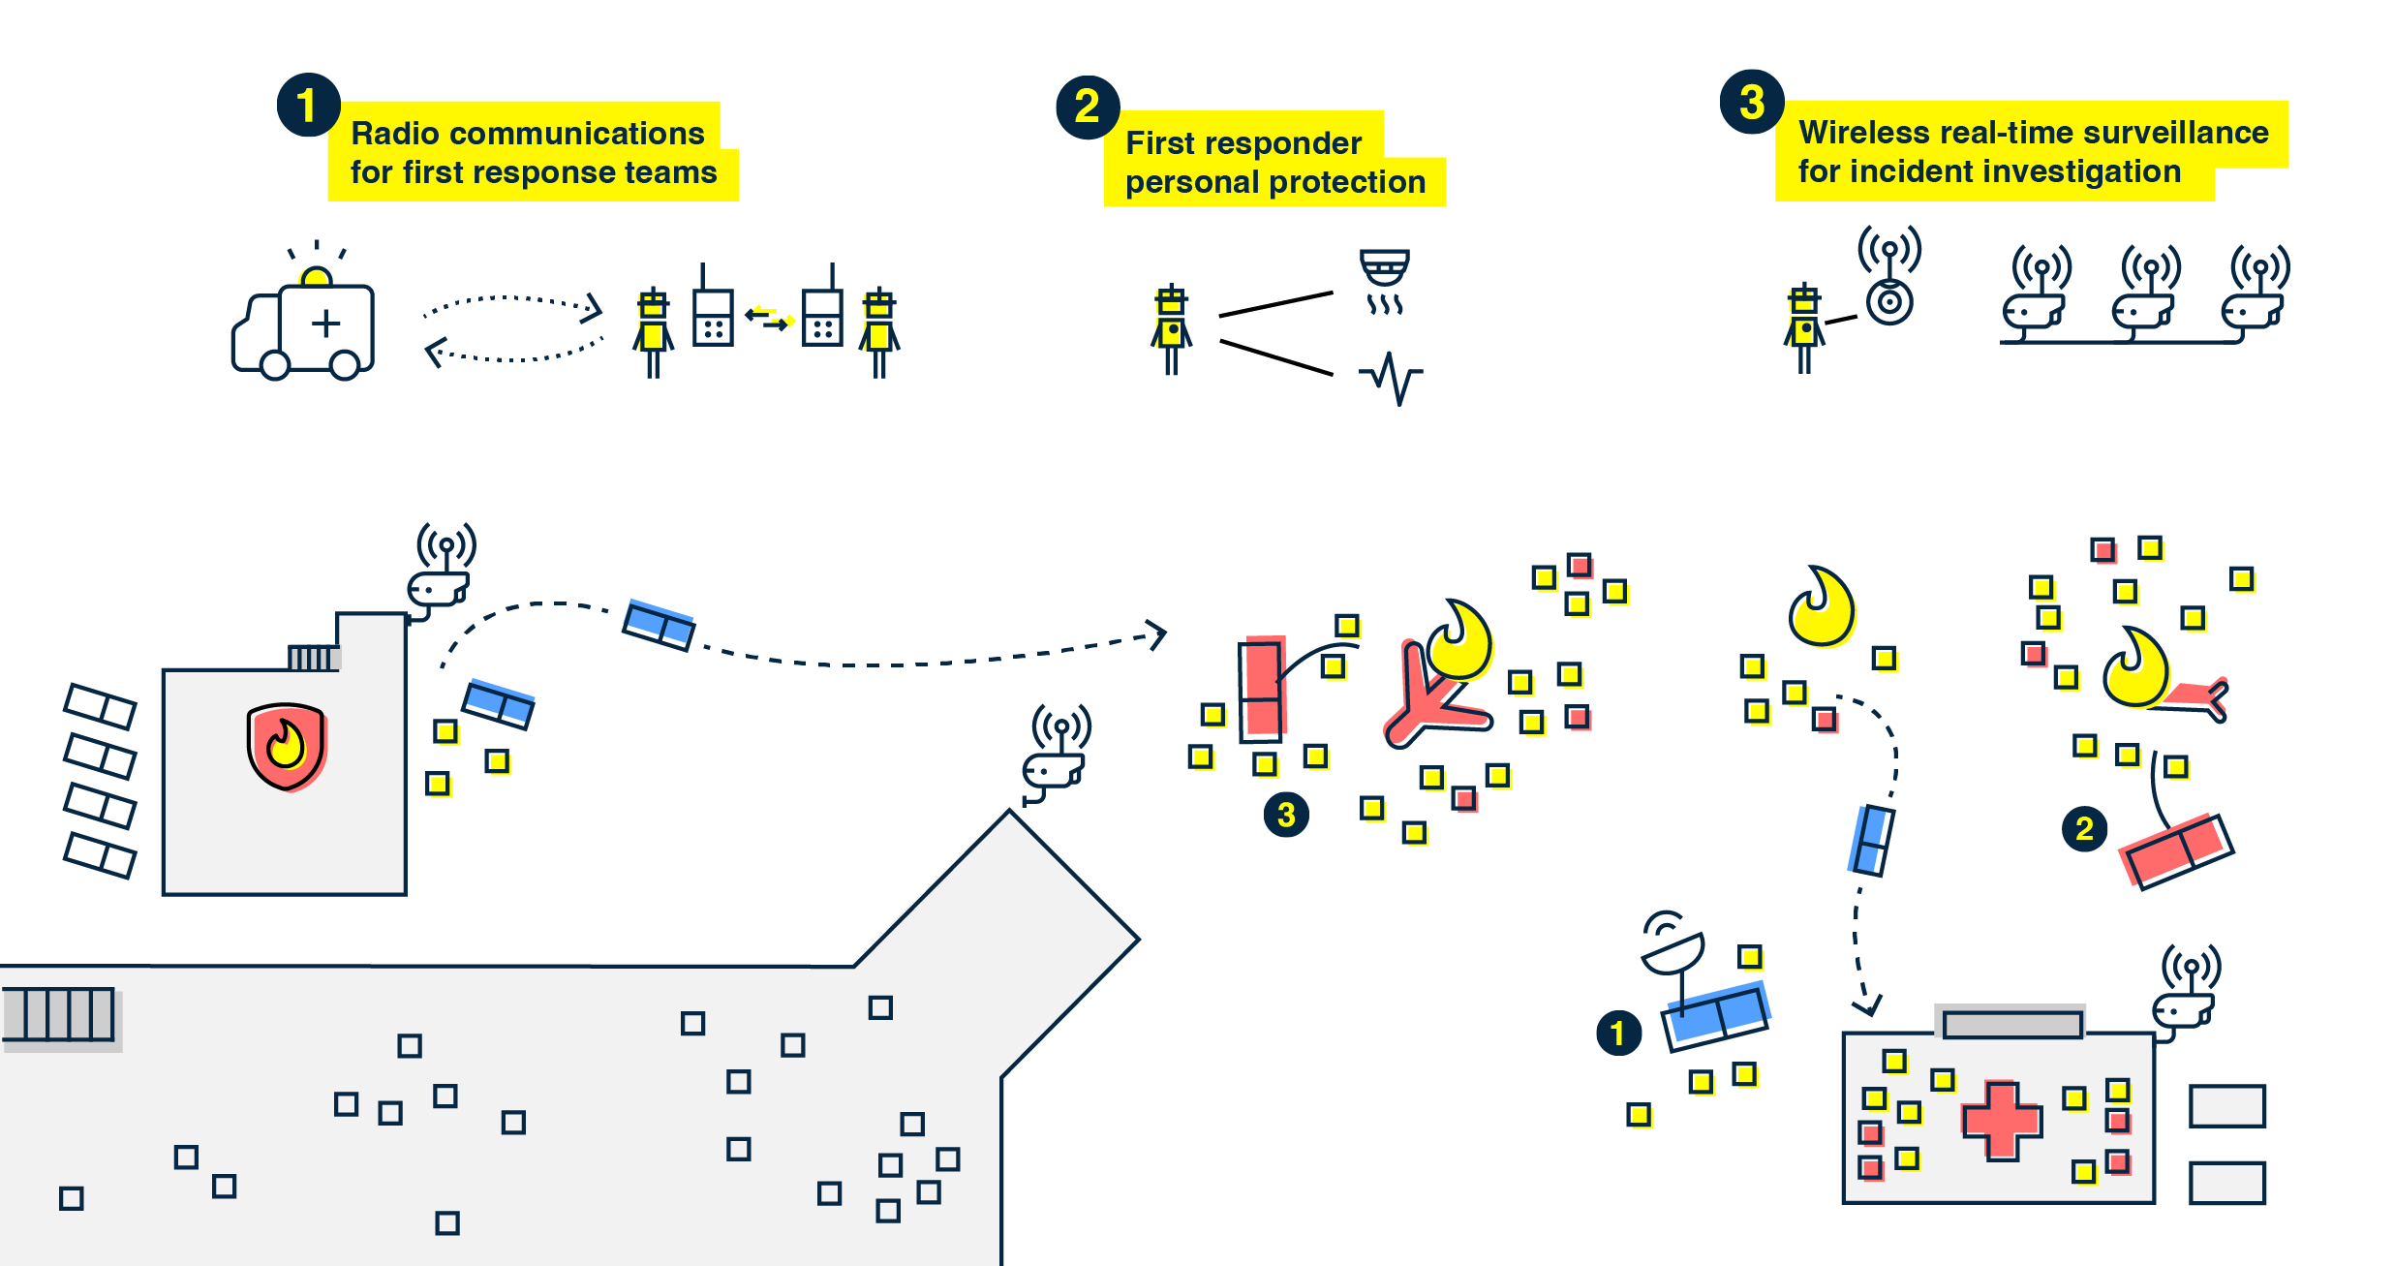
Incident response and recovery
Notes:
Radio communications for first response teams: First responder teams can communicate via direct voice or message channels or using network relays to cover the incident zone. medical assessments, or airport GIS updates can be disseminated to share awareness of the incident and victim status with other members of the team, or with a command center located in the airport or outside.
First responder personal protection: To enhance the safety of those risking their lives, wearable sensing technology can monitor and keep track of the first responder agent's vital organs status and environmental data including temperature and air quality can be monitored to trigger a hazardous situation alert.
Wireless real-time surveillance for incident investigation: Video Content Analytics (VCA) technology, allows airports to expedite footage investigation and enhance situational awareness with the additional benefit of extrapolating operational intelligence from the footage. In addition, surveillance devices equipped with wireless communication capabilities may transmit the captured data in real time to avoid the risk of being lost during the incident.

Slide 18
Incident response and recovery
Differentiating/Cutting Edge benefits
Better coordination of tasks in time-critical responses to incidents which can be mitigated and resolved faster than usual.
Enhances the awareness of the conditions under which first responders work. Allows tasks executed by first responders to be more controlled by leaders from a remote location.
Provides enhanced awareness of the sequence of events taking place during an incident or accident.
Allows for more appropriate decisions to be made, which enhances the overall safety of operations during an incident.
Notes:
Enhanced means of communication allows for better coordination of tasks in time-critical responses to incidents which can be mitigated and resolved faster than usual, even requiring less personnel on the ground.
Enhances the awareness of the conditions under which first responders work. This allows for the tasks the first responders carry out to be more controlled by leaders from a remote location.
Provides enhanced awareness of the sequence of events taking place during an incident or accident. Allows for more appropriate decisions to be made, which enhances the overall safety of operations during an incident.

Slide 19
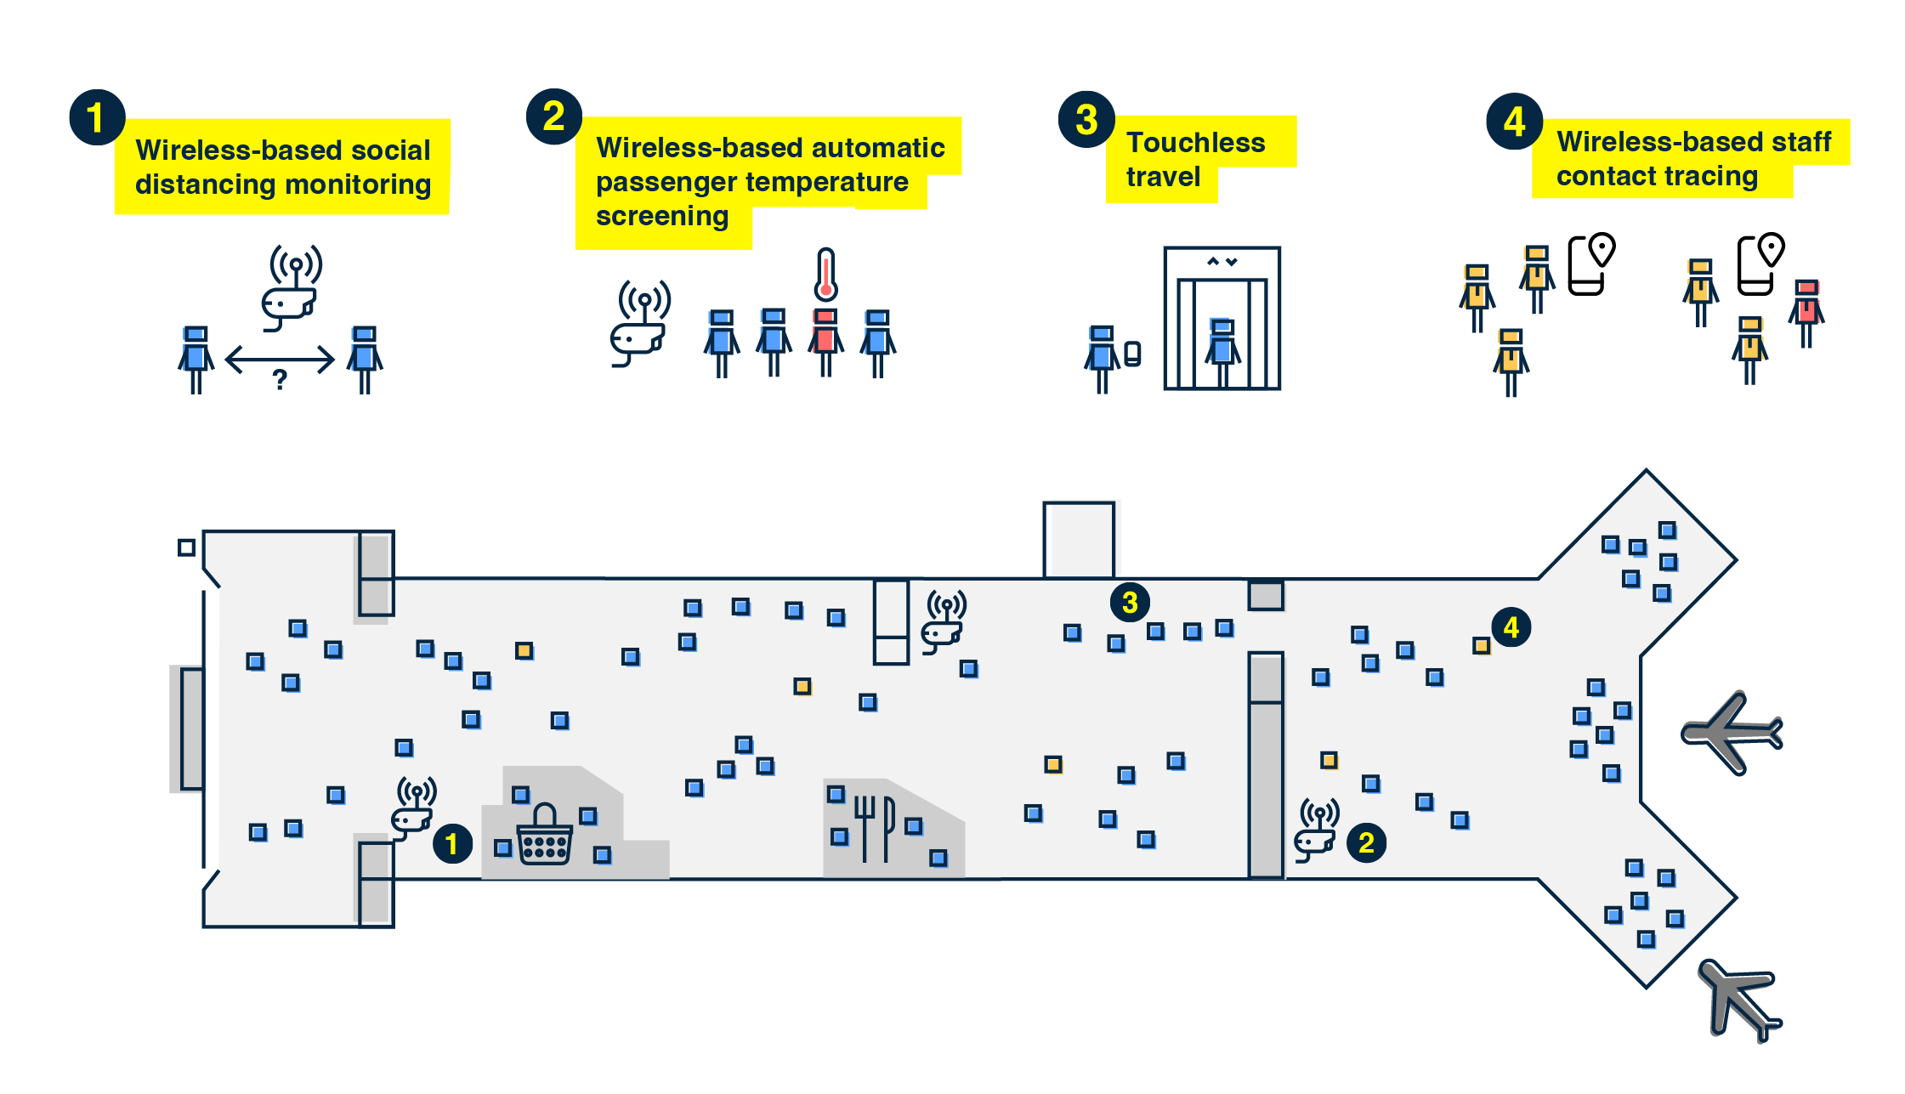
Travel health
Notes:
Wireless-based social distance monitoring: Virtual queueing and passenger density management is a recent technology which tracks movement and uses machine learning in order to produce real time and predictive density insights that would help airports manage passenger traffic in the terminals. Moreover, it enables travelers to pre-book slots at security checkpoints instead of waiting in line.
Wireless-based automatic passenger temperature screening: thermal screening technology has the capability to monitor the temperature of multiple travelers moving along the terminal without incurring any physical contact which may put employees at risk.
Touchless travel: Touchless travel can apply to all activities that are part of the passenger experience in the airport, including self-service, item ordering and payment as indicated above, but also others like smart restrooms.
Wireless-based statt contact tracing: Airports can perform contact tracing among their employees by using the airport provided enterprise mobile device to record historical data of the whereabouts of employees when working in the airport facilities .

Slide 20
Travel health
Differentiating/Cutting Edge benefits
Increase the safety level of the traveling public by ensuring safe distance among travelers to mitigate any chance of contracting COVID-19.
Reduce the number of airport staff required to interact with and assist travelers during their travel experience at the airport.
Contact tracing helps to inform the airport on who has been exposed to the infected employee and this allows the airport to take mitigative steps.
Contact tracing allows the arrangement for other staff to take over the shift of the infected employee to ensure continual operations with minimal disruptions.
Notes:
Increase the safety level of the traveling public. It ensures that a safe distance is kept among travelers to mitigate any chance of contracting COVID-19.
Using wireless thermal cameras allows quick deployment in temperature control areas without the need of additional staff or cabling infrastructure.
Reduce the number of airport staff required to interact with and assist travelers during their travel experience at the airport.
Contact tracing will help to inform the airport on who has been exposed to the infected employee and this will also allow the airport to take mitigative steps.
Contact tracing allows the arrangement for other staff to take over the shift of the infected employee to ensure continual operations with minimal disruptions. This can be all done automatically via tracking apps, which record the location history of staff, without the need of costly and inaccurate surveys.

Slide 21
Taxonomy of wireless architectures
Summary of wireless technology standards
Technology type | Data Transmission Type | Common Examples
Cellular | Medium-distance, indoor and outdoor communications | Handheld and wearables, sensors, vehicles anywhere in terminal and airfield
Wi-Fi | Short-distance, high-volume data communications | Computers, kiosks, handheld, and other electronics devices in terminal and apron
AeroMACS | High-volume data, sensitive outdoor communications | Handheld and mounted devices
Land Mobile Radio | Voice-only reliable communications | Handheld and mounted devices
Unlicensed LPWAN | Low-volume data, long-distance communications | Fixed sensors in terminal and airfield, including remote areas
Personal Area Networks (PAN) | Location-based services | Fixed and mobile sensors in terminal and airfield, handheld, ID scanning for access security
Radio-Frequency Identification (RFID) | Tracking and identification services | Baggage/pallet tracking. ID scanning for access security
Notes:
There are 7 wireless technology types (or families), among which there are several standards with different characteristics and uses
Each technology has specific characteristics that makes it more suitable for a type of applications and devices

Slide 22
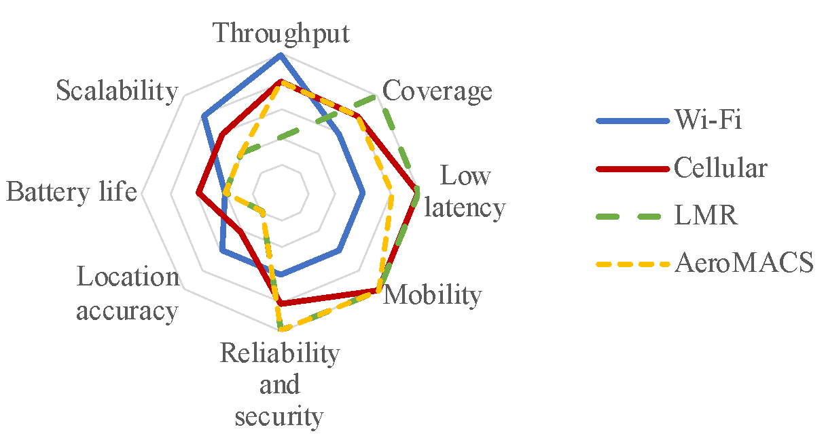
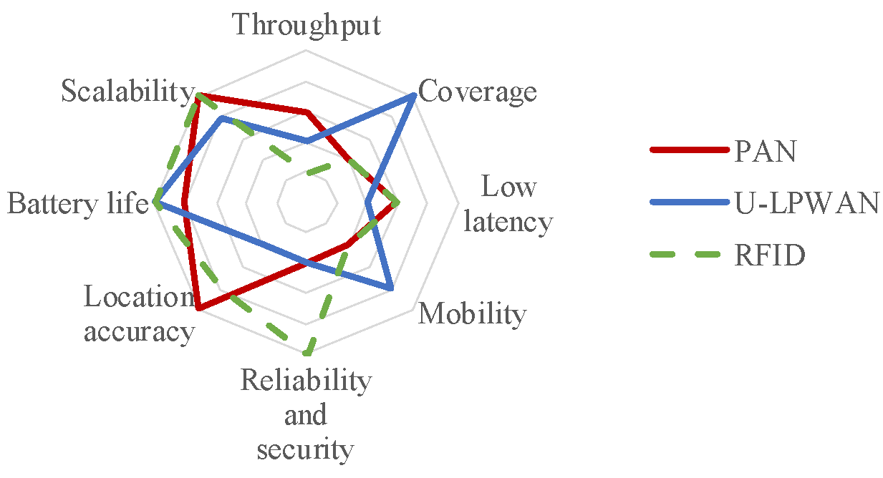
Taxonomy of wireless architectures
Why so many technologies?
Technologies have a variety of characteristics which make them ideal for specific applications and environments. There is no one-size-fits-all.

Slide 23
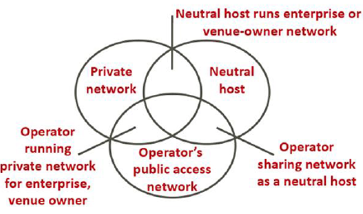
Taxonomy of wireless architectures
 | Control | Responsibility of service quality | Participation in revenue and cost
Private Network | HIGH (controls network configuration and data) | HIGH (full responsibility of service quality) | HIGH (Full revenue and cost burden)
Neutral Host | MEDIUM (within agreement with 3rd party) | MEDIUM (SLA with 3rd party) | MEDIUM (Revenue/cost sharing)
Operator’s Public Access Network | LOW (3rd party owns the network) | LOW (3rd part has SLA directly with consumer) | LOW (Subscription Cost)
Notes:
Airports have the possibility of deciding whether to own or not own their wireless networks. This can have an impact on finances and day-to-day operations

Slide 24
Cost Considerations
Expenses are dependent on the size of the network and complexity of the environment, which may make the installation require additional equipment or infrastructure.
CAPEX
OPEX
User expenses
Risk and liability
Opportunity costs
Notes:
Capital expenses are the costs of procurement and upgrade of wireless networks. These expenses become assets for the owner of the network and are depreciated over the life of the asset.
Operating expenses are the costs incurred to ensure the operation and maintenance of the wireless network. The owner of the wireless network generally also pays the spectrum license fees periodically, if it is required. Most operating expenses associated with wireless network operation are fixed, they are preset costs paid in periodic terms. However, there may be variable costs, such as a radio or backbone network access, which are paid per volume unit or following enterprise subscription plans.
User expenses are the costs incurred by the end user for the use of the wireless service. From the point of view of accounting, they are either capital or operating expenses.
Capital user expenses include cost of purchase, repair and replacement of user devices and enterprise network components when these are owned by the user.
Operating user expenses include subscription fees for the wireless service, and the equipment and device rental fee if they are provided by the network operator.
Risk and liability costs are incurred when the network operator or user encounters a situation where it is liable for additional expenses not included in the capital or operating expense estimations.
Opportunity costs are foregone benefits that would have been derived if a different alternative were chosen.

Slide 25
Cost considerations: CAPEX / OPEX
Approximate CAPEX and OPEX by surface unit per technology type
CAPEX | Indoor ($/sqft) | Outdoor ($/acre)
Private Cellular 4G | Medium | Low
Private Cellular 5G | High | Medium
Public Cellular 4G | Low | Low
Public Cellular 5G | Low | Low
Public Cellular DAS 4G | Medium
Public Cellular DAS 5G | High
Wi-Fi 4 | Low | High
Wi-Fi 6E | Medium | High
AeroMACS |  | Low
LMR | Low | Low
U-LPWAN | Low | Low
PAN | Low | Medium
RFID | Low | Medium
OPEX | Indoor ($/sqft) | Outdoor ($/acre)
Private Cellular 4G | High | High
Private Cellular 5G | High | High
Public Cellular 4G | Low | Low
Public Cellular 5G | Low | Low
Public Cellular DAS 4G | High
Public Cellular DAS 5G | High
Wi-Fi 4 | Medium | High
Wi-Fi 6E | Medium | High
AeroMACS | Low | Medium
LMR | Medium | Low
U-LPWAN | Low | Low
PAN | Low | Medium
RFID | Low | Medium

Slide 26
Wireless technology transition:
step-by-step checklist
Use case assessment
Determination of technology transition scenarios
Technology investment decision-making
Transition planning
System deployment
Management and maintenance
Notes:
Use Case Assessment
This deals with the Identification of business goals and value proposition desired from wireless technologies and the identification of desired wireless use cases.
Determination of Technology Transition Scenarios
This deals with selection of feasible combinations of wireless technology architectures by Identification of current and target wireless architectures, engagement strategies and minimum maturity levels required to enable the desired business models.
Technology Investment Decision Making
This deals with comparison and selection of one technology combination for implementation (TP) by determination of benefits and risks of the combination of technologies (TP) and alignment of airport financial budget.
Transition Planning
This deals with the development of financial and procurement plans, supplier management strategy, operational plan and Integration of IT cybersecurity plan into Airport Security Plan.
System Deployment
This deals with compliance requirements, obtaining authorization to deploy and fund system, Determination of supplier capabilities and launch procurement process, performing RF survey, planing radio network, installation of infrastructure and software, development of a monitoring/troubleshooting system, a maintenance plan, and a go-live plan. It also includes testing and validating the system, Performing vulnerability assessment, running acceptance tests and activating new wireless networks following the go-live plan.
Management and Maintenance
This encompasses performance monitoring, troubleshooting, KPI reporting, Network management, maintenance, updates, device/user policy management continuous network optimizations, cyber security monitoring, identification and mitigation of vulnerabilities and network recovery.

Slide 27
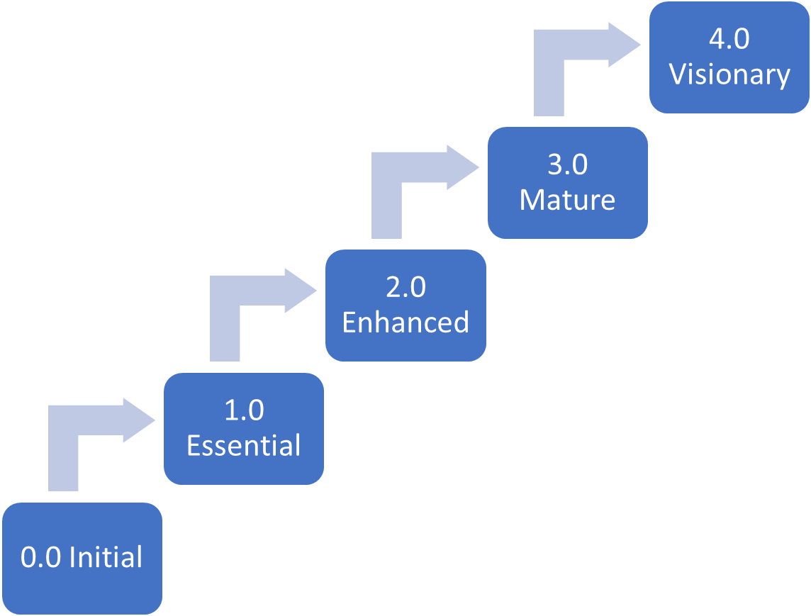
Wireless technology transition:
Maturity framework
Airport 4.0 (full digitalization)
Airport 3.0 (initial digitalization)
Airport 1.0/2.0 (analogue)
Notes:
how is this useful?
elaborate on levels
AC: I propose to make a new figure without the small text. Move the small text to the script here.
0.0 Initial
- Heterogeneous coverage & capacity across facilities
- Still improving wideband Internet access at the facility.
1.0 Essential
- Basic tactical communications
- some IT resources, limited spectrum management,
- commercial agreements with wireless providers
2.0 Enhanced
- Improved capacity & reduced latency for more stringent wireless applications
- Airport offers managed wireless services & initial loT for reliability of operations
3.0 Mature
- Centralized wireless platform, auto-adjusting for variable capacity & security.
- Tailored wireless service offering & scaled up capacity.
- Expanded loT for reliability & smart building efficiency, cloud-based management
4.0 Visionary
- Large-scale loT, big data management & airport-wide Al
- Cloud & edge applications for varying data & safety requirements.

Slide 28
Wireless technology transition:
Business models
Real Estate Rental
Managed Services
Shared Services
Network as a Service (NaaS)
Service Brokerage
Freemium
Fractionalization
Standardization
Automation
Notes:
Real estate rental: Revenue from rental fees, integrated cabling and utilities, easement agreements. Traditional, easy to implement but limited gains for the airport
Managed services: Airport as wireless service integrator. Requires level of ownership and planning, with costs associated. Allows to bundle services as utilities, gives full control over service offer.
Shared services: Airport is property owner and directs the service offer while provision is done by IT supplier. Some control over pricing and costs.
Naas: Integrate all network resources by a single entity (airport or partner entity). Allows to minimize costs, control over customization of service performance per client.
Service brokerage: Airport acts as intermediary, facilitator role to promote creation of value, innovation, and fund access.
Freemium: Maximize revenue generation for customers with high performance requirements.
Fractionalization: Airport is owner and commercializes dedicated resources of the wireless network.
Standardization: Cost efficiency and reliability by promoting economies of scale in wireless technologies across the airport industry.
Automation: Cost efficiency and reliability by minimizing participation oh humans in airport processes.

Slide 29
Wireless technology transition:
Engagement strategies
Hands-off
Network Responsibilities | Owner | Network Planning | Operation & Maintenance
Airport Operator
Delegated Entity | X | X | X
Facilitator
Network Responsibilities | Owner | Network Planning | Operation & Maintenance
Airport Operator | X | X
Delegated Entity | X | X | X
Provider
Network Responsibilities | Owner | Network Planning | Operation & Maintenance
Airport Operator | X | X | X
Delegated Entity |  | X | X
Notes:
Hands-off: Airport not involved in provision of wireless connectivity. Limited control, supports non or few costs buy generates no direct revenue for airport (it can generate value for stakeholders)
Facilitator: Partition of network ownership and planning between airport and a delegated entity. Airport has a role in general direction and requirements of wireless services, and as facilitator to ensure the generation of value. Day-to-day operations and maintenance are delegated via a partnership agreement with one or several service providers.
Provider: Airport intends to be a service and infrastructure integrator. Airport funds, plans and operates the network, has the main responsibility for provision of services, and centralizes the generation of value. Some planning, operation and maintenance duties can be delegated to service providers.

Slide 30
Wireless technology transition:
Web Assessment Tool
This tool aims to help airports make informed decisions on their wireless technologies options and associated use cases for deployment using the steps outlined below:
Use case assessment
Identify wireless use cases
Outline potential technologies
Determination of technology transition scenarios
Identify wireless architectures and engagement strategies
Select candidate combinations of technology
Technology investment decision-making
Compares TCO and life cycle
Determine benefits and risks (SWOT)
Accessible below:
https://crp.trb.org/uat/acrp0357/
Notes:
The web tool allows airports to assess their technology options and associated costs and benefits, and discusses their use in the context of implementing wireless technologies within airport environments.
The webtool also generates downloadable reports for aviation personnel to use.

Slide 31
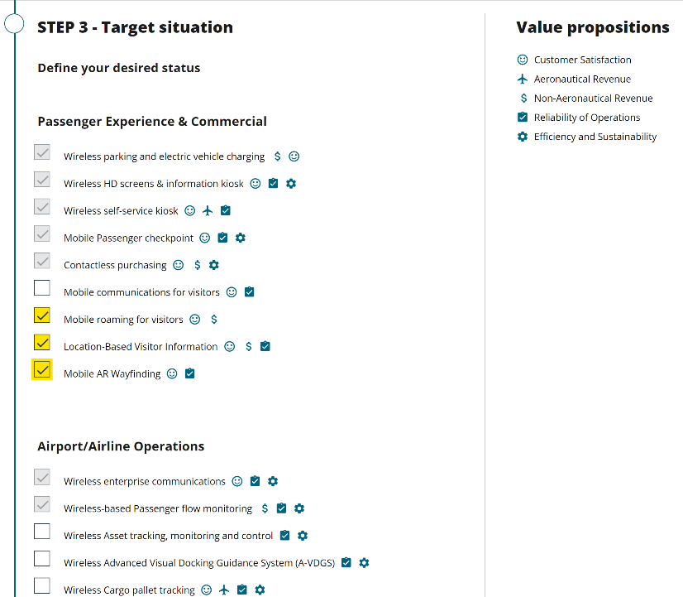
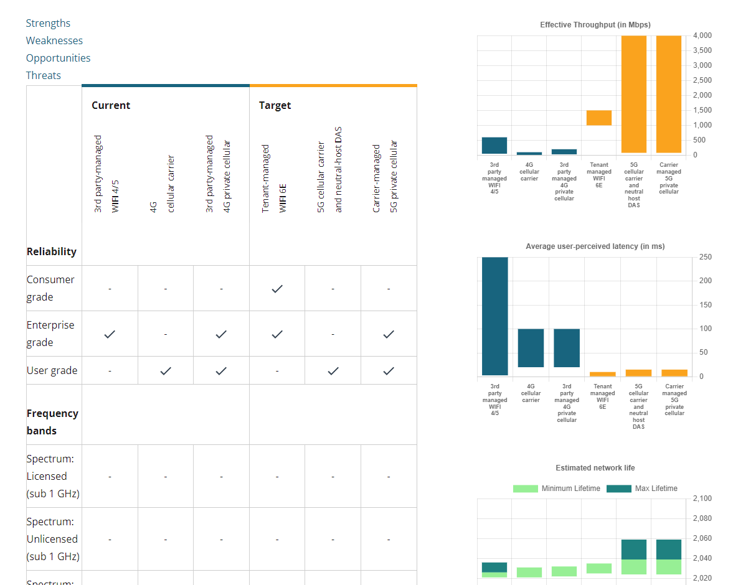
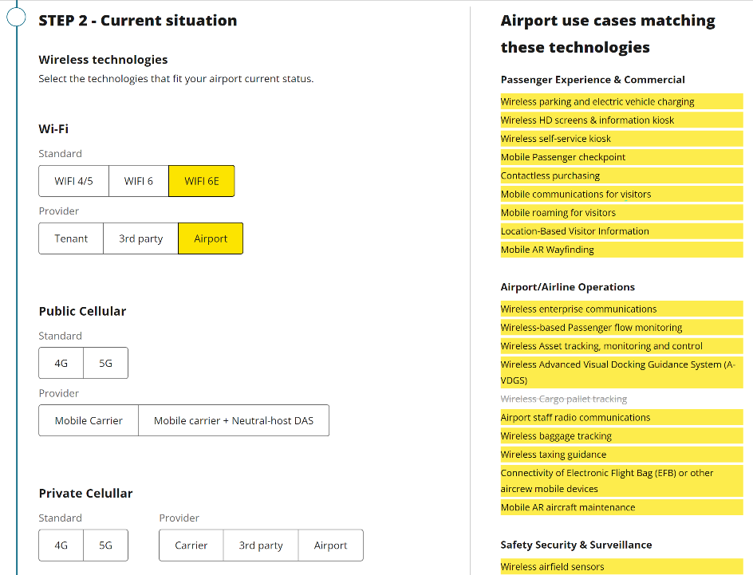
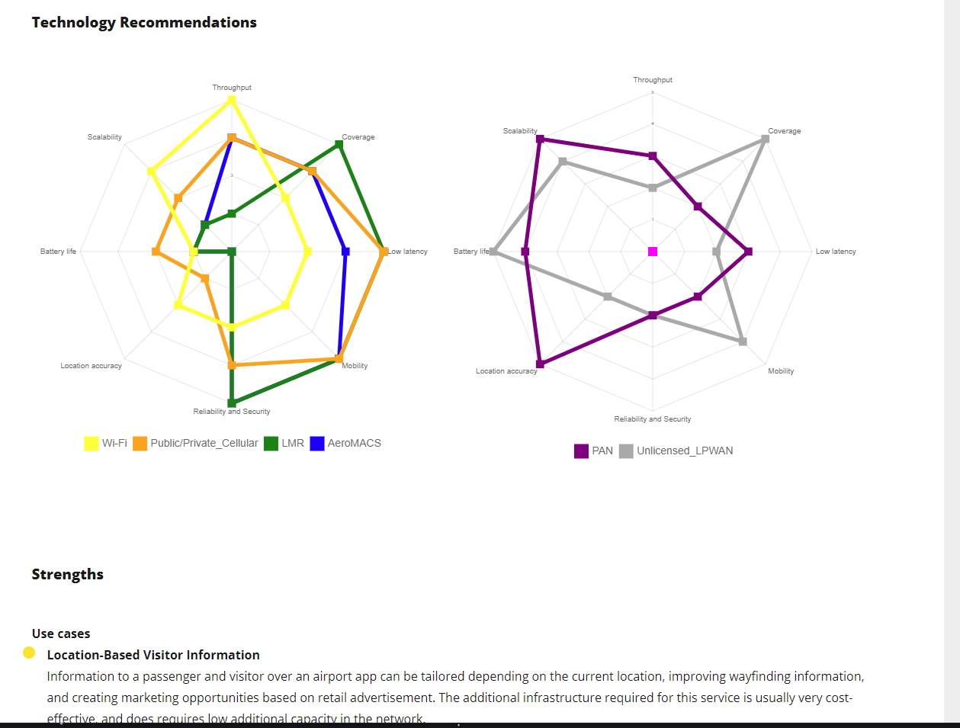
Wireless technology transition:
Web Assessment Tool
Web assessment tool link: https://crp.trb.org/uat/acrp0357/

Slide 32
After investment decision: practical aspects
Organizational structure
Organizational flexibility (wireless systems encompass operations across departments)
Key staff roles to promote the network (understand and communicate value)
Reliance on vendors (suppliers, contractors) on installation, operation and maintenance
Consider multi-vendor strategy

Slide 33
After investment decision: practical aspects
Operational and Financial planning
Long-term planning required
Grant funding for wireless networks is limited
Innovation and partnership with stakeholders are strong strategic drivers
Local community, innovation lab, internal innovation department
Identify needs across departments and find common value
OPEX models well adapted for rapid variations

Slide 34
After investment decision: practical aspects
Network planning
Securing spectrum
Unlicensed: equipment certification
Licensed: enrollment with mobile carriers
Shared: application to spectrum management office
Site survey(s)
Predict performance for certain spaces, traffic use, environment
Identify sources of interference
Cybersecurity
Cyber physical protection, isolation of wireless networks, protection against BYOD, plan for updates/upgrades

Slide 35
After investment decision: practical aspects
Operation and Maintenance
Monitoring and troubleshooting plan
Business and technical KPIs
Plan for technology updates and upgrades
Higher traffic levels
New sources of interference
New cyber security threats
New regulation

Slide 36
Thank you! www.TRB.org/ACRP

