Slide 1
ACRP 11-02 Task 30
Research Roadmap in the Area of Design and Construction of Airport Facilities
Katherine Preston
Principal Consultant
HMMH
Roddy Boggus
Vice President, Aviation Building Service Group Leader
RS&H
Notes:
This presentation provides information about the Airport Cooperative Research Program, or ACRP, project 11-02 Task 30, “Research Roadmap in the Area of Design and Construction of Airport Facilities”
The research effort was led by Katherine Preston of Harris Miller Miller & Hanson (HMMH) and Roddy Boggus, of RS&H.

Slide 2
Background and Objective
ACRP relies on a flow of quality research ideas from airport industry practitioners into the program. The intent of a roadmap is to facilitate industry development of problem statements and identify future research needs.
The objective of this project is to develop a research roadmap in the area of airport design and construction, optimized for broad dissemination on the web.
The roadmap should include a prioritized list of topics/ themes for the industry, and for ACRP, to consider for the next 3 to 5 years
Notes:
PAGE DOWN
Over the past ten years, ACRP has undertaken hundreds of high-quality, applied research projects to improve practice in the airport industry. In order to conduct research, ACRP relies on a flow of quality research ideas from airport industry practitioners into the program. While there is no shortage of research needs within the airport industry, there is often a lack of time for practitioners to develop problem statements and identify knowledge gaps. The intent of a roadmap is to facilitate industry development of problem statements and identify future research needs.
PAGE DOWN
The objective of this project was to develop a research roadmap in the area of airport design and construction, optimized for broad dissemination on the web.
PAGE DOWN
The roadmap includes a prioritized list of topics or themes for the industry and ACRP to consider developing into research projects over the next 3 to 5 years.

Slide 3
Approach to Research
Identify the challenges and knowledge gaps facing airports in the area of design and construction
Gather information through a literature review and extensive stakeholder engagement
Develop a strategic roadmap of individual research ideas organized by high-level themes and subtopics
Prioritize ideas according to a set of criteria and input from the Project Panel
Design Roadmap to integrate with ACRP’s IdeaHub
Notes:
This slide outlines the research approach and process.
The research roadmap was developed first by identifying challenges and knowledge gaps facing airports in the area of design and construction.
This was accomplished through a literature review of relevant published and in-progress research, as well as extensive stakeholder engagement. Stakeholders included airports of all sizes, airport consultants, airlines, trade associations and the FAA.
This information was used to develop a strategic roadmap of individual research ideas, which were categorized by high-level themes, and a set of more specific subtopics.
The research ideas were then prioritized using a set of criteria that mirrors the process used by the ACRP to prioritize problem statements, along with input from the Project Panel.
Finally, the visual research roadmap was designed for dissemination via web and to integrate with ACRP’s Idea Hub. Idea Hub is ACRP’s online platform for the cooperative development of problem statements.

Slide 4
Research Products
Written Research Roadmap Report: Narrative report describing the research process, stakeholder outreach, knowledge gaps, high-level themes, research ideas and prioritization criteria.
Visual Research Roadmap: A graphic research roadmap depicting research ideas by high-level themes, subtopics and relative priority.
Research Idea Database: A searchable database of over 40 research ideas that can be developed into problem statements by industry practitioners.
Notes:
This research project resulted in three main products.
The first is a written report that summarizes the research approach, results of the literature review, a description of the stakeholder engagement process as well as the findings. In this case, the findings are a set of research ideas and the categorization by theme and subtopic. The report contains a description of each theme and the list of research ideas, along with each idea’s objective, that fall within that theme.
The second product is the visual research roadmap. The roadmap is interactive and displayed online. A description of how to use the roadmap appears later in this presentation.
The third and final product is the database of research ideas, in Excel format. For each idea, the spreadsheet contains a working title, objective statement, background information, source of the idea, related research, the theme and subtopic. These ideas may evolve over the course of the 5-year roadmap timeframe, as more information becomes available and technology changes.
The intent is that these research ideas will serve as the basis for practitioners to develop into more complete problem statements.

Slide 5
Findings
The results of the literature review and stakeholder engagement led the research team to identify 40 research ideas for inclusion on the roadmap.
The ideas are grouped into 7 high-level themes and further categorized into 12 subtopics
The ideas were prioritized for placement on the roadmap through consideration of 5 criteria
Many of the ideas are multi-disciplinary and address topics relevant to other ACRP research areas.
Notes:
This slide summarizes some key findings.
(Narration – read bullets as written then add text below)
The high-level themes, subtopics and prioritization criteria are described on the next several slides.
One important finding from this project is that airport design and construction processes are affected by (and in turn affect) all other areas of an airport’s management and operation.
As airports modernize, the need to collaborate and coordinate activities across virtually all disciplines has become apparent, particularly with the outsized role that new technologies are playing in this industry, and depicted in the roadmap. Many of the ideas on this roadmap align closely with multiple traditional ACRP research areas, such as administration, human resources, operations and environment for example. Because of the multi-disciplinary nature of the research needs, the perspectives of design and construction practitioners should be included when considering ACRP research needs in these other areas.

Slide 6
High-Level Themes
The 7 high-level themes are described in the report and listed below, from the theme with the most research ideas to fewest in that category:
Customer Service
Integrating Advanced and Disruptive Technologies
Project Management, Delivery and Finance Models
Safety, Security and Terrorism
Sustainability and Resilience of Infrastructure
General Design and Construction
Workforce Development
Notes:
The 7 high-level themes are as follows [PAGE DOWN FOR EACH TO APPEAR]:
Customer Service
Integrating Advanced and Disruptive Technologies
Project Management, Delivery and Finance Models
Safety, Security and Terrorism
Sustainability and Resilience of Infrastructure
General Design and Construction, and
Workforce Development;
These are listed in order from the theme with the greatest number of research ideas in that category to the fewest.

Slide 7
Subtopics
The 12 subtopics are listed below, from the subtopic with the most research ideas to fewest in each category:
Passenger Experience
Integrating Technology and Data
Finance and Revenue Development
Alternative Approaches to Project Delivery Mechanisms
Sustainable Design and Construction
Innovative Approaches to Security / TSA Operations
7. Construction Best Practices, Guidance, Tools
8. Modernizing and Retrofitting Airport Facilities
9. Construction Materials
10. Accommodating Changing Demographics
11. Curbside, Roadways and Vehicles
12. Unmanned Aerial Systems
Notes:
The twelve subtopics are as follows:
[PAGE DOWN to reveal 1 - 6] 1) Passenger Experience
2) Integrating Technology and Data
3) Finance and Revenue Development
4) Alternative Approaches to Project Delivery Mechanisms
5) Sustainable Design and Construction
6) Innovative Approaches to Security / TSA Operations
[PAGE DOWN to reveal 7-12]
7) Construction Best Practices / Guidance and Tools
8) Modernizing and Retrofitting Airport Facilities
9) Construction Materials
10) Accommodating Changing Demographics
11) Curbside, Roadways and Vehicles
12) Unmanned Aerial Systems
Integrating Advanced or Disruptive Technologies is considered both a high-level theme and a subtopic. This reflects the rapid pace of technological change and adoption within the airport and aviation industry, and the integral nature of airport IT systems to all areas of operations and an airport’s line of business. So while a research idea may be primarily about ensuring continuity of operations (the theme), a key component of the objective may be integrating a new technology or using existing technology in a new way to address the challenge.

Slide 8
Prioritization Criteria
The 5 prioritization criteria are listed below. The first criteria applied was to ensure research ideas were not duplicative of efforts undertaken elsewhere. Ideas that passed that test were then ranked based on the following criteria:
Applicable
Timely
Implementable
Understandable
Collaboration and Coordination
Notes:
The 5 prioritization criteria are listed on this slide and explained in further detail in the report. The criteria categories were selected to align with the criteria applied by ACRP for evaluating submitted problem statements each year.
First, each research idea was evaluated to ensure that the topics have not been, nor are currently being addressed by ACRP, the FAA or other research institutions. Some of the research ideas may be similar to existing or on-going research, but may look at a different aspect of a particular problem, or were updates to older research, and were thus retained.
The applicability criteria refers to the approximate portion of the airport industry that could potentially benefit from the results of the research idea.
The timeliness criteria addresses the urgency of the research need. For example, Is there sufficient data available to conduct the research? Or, is additional time necessary for the impacts of the problem or challenge to be better understood by industry?
The next two categories, Implementable and Understandable, are more easily applied to fully formed problem statements rather than research ideas. However, they address two important considerations and were thus included. The Implementable criteria refers to the ability of ACRP to conduct the research and the likely ability of airports to implement research findings.
The collaboration and coordination criteria was added due to the multi-disciplinary nature of many of the research ideas generated. This also speaks to a need for better coordination across the industry to address systematic challenges and disruptive technologies.

Slide 9
Visual Research Roadmap
The visual research roadmap is explained on the next several slides.
The roadmap presented on ACRP’s Web Resources website is interactive, and allows the user to hover over each icon for a full description of each research idea.
Notes:
The visual research roadmap is presented on the next slide, along with a description of the different components and how to read the roadmap. The version of the roadmap on ACRP’s website is interactive. When the user hovers over each research idea icon, the idea title, background and objective statement will appear in a text box.

Slide 10
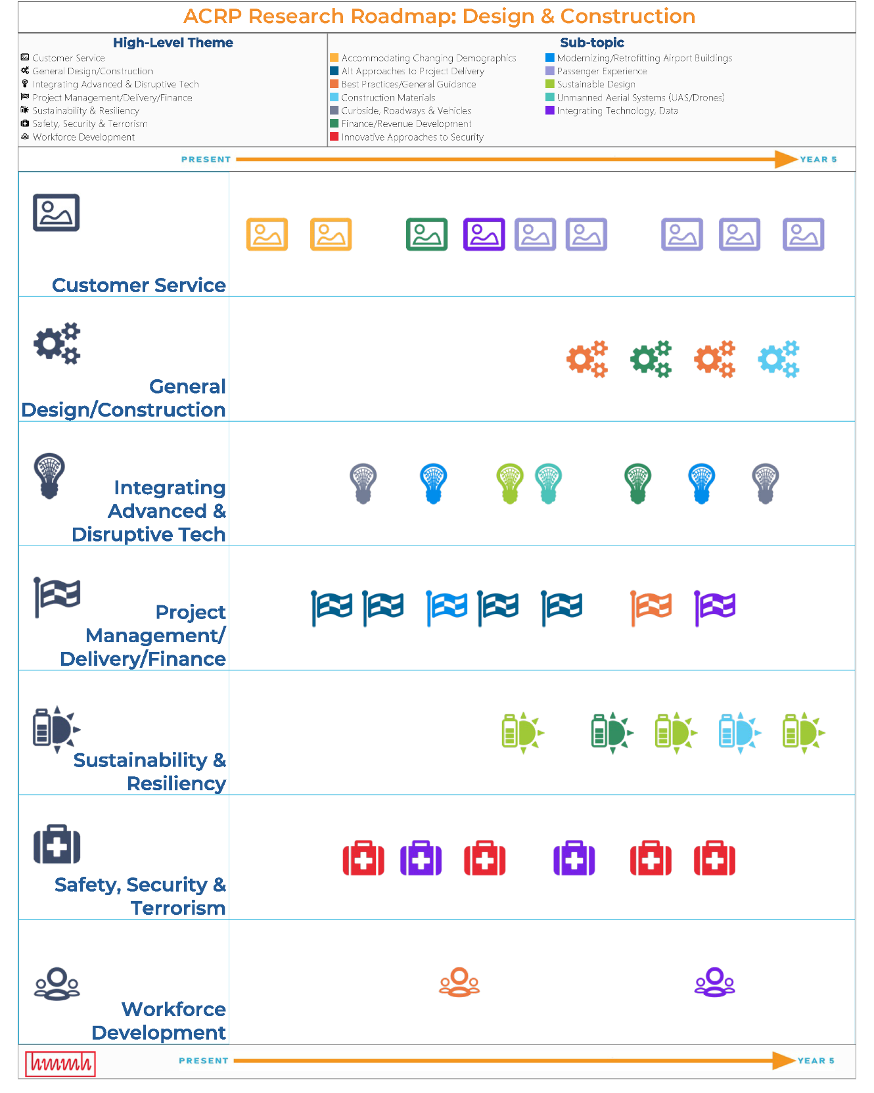
High-Level Themes are represented by icons and listed down the left-hand side of the roadmap
Notes:
The visual research roadmap is intended to display a lot of information quickly and efficiently.
Each of the 40 research ideas is represented by an icon. The icons correspond to the 7 high-level issue areas, or themes, in which the idea has been categorized.
PAGE DOWN
Each high-level issue area and its corresponding icon appear down the left-hand side of the roadmap, on the Y-axis.

Slide 11
High-Level Themes are represented by icons and listed down the left-hand side of the roadmap
Subtopics represented by colors
Notes:
Each of the 12 subtopics are listed at the top of the roadmap, and assigned a different color.
PAGE DOWN
Therefore, each individual research idea is represented by both an icon indicating its high-level theme, and a color for its subtopic category. Users can click on any of the subtopics to display only the research ideas in that category.

Slide 12
High-Level Themes are represented by icons and listed down the left-hand side of the roadmap
Subtopics represented by colors
The roadmap timeline is shown on the X-Axis, as a continuum from the present to 5 years out.
Notes:
The timeline is shown as a continuum on the X axis, and runs from the present on the left-hand side, (PAGE DOWN) to five years out, on the right-hand side.

Slide 13
High-Level Themes are represented by icons and listed down the left-hand side of the roadmap
Subtopics represented by colors
The roadmap timeline is shown on the X-Axis, as a continuum from the present to 5 years out.
The relative priority of each idea is shown by place on the timeline
Notes:
The priority of each research idea is shown by its placement on the research roadmap, based on application of the criteria which resulted in an overall prioritization score.
PAGE DOWN TWICE
For ideas that achieved the same overall score, the research team took into account the individual “timeliness” score to refine placement on the roadmap.

Slide 14
High-Level Themes are represented by icons and listed down the left-hand side of the roadmap
Subtopics represented by colors
The roadmap timeline is shown on the X-Axis, as a continuum from the present to 5 years out.
The relative priority of each idea is shown by place on the timeline
Individual research ideas are represented by the icons. Idea titles, objective and background information appears when you hover
Research Idea: Integrating TNCs into Ground Transportation Infrastructure
Objective: The objective is to develop design guidelines and best practices for incorporating TNCs into ground transportation infrastructure, including TNC user agreements and fee structures to properly monetize airport infrastructure.
Background: TNCs have revolutionized ground transportation options for passengers traveling to and from airports. Airports have worked at the local level to integrate these services into the airport environment and ensure some cost and regulatory parity with other ground transportation service providers. However, research is needed to develop design guidelines and best practices for incorporating TNCs into ground transportation infrastructure, in addition to how airports can develop TNC user agreements and fee structures.
Notes:
PAGE DOWN TWICE
On the interactive web-version of the roadmap, the research idea title, background information and objective appear when the user hovers over the icon.

Slide 15
The roadmap can be customized to only show ideas in certain subtopics of interest. To do so, click on the subtopics to hide in the upper right-hand key and select “exclude”.
Notes:
The roadmap can be customized to only show ideas in certain subtopics of interest. To do so, click on the subtopics key (PAGE DOWN) in the upper right-hand corner, and a dialog box will appear with the option to include or exclude certain topics.

Slide 16
This slide depicts the roadmap with only ideas in the following subtopics shown:
Finance/Revenue Development
Passenger Experience
Sustainable Design
Integrating Technology
To return all ideas to the roadmap, simply hit the refresh button at the top of the webpage.
Notes:
Read text on slide.

Slide 17
The Interactive Roadmap can be accessed on the ACRP website.
Notes:
The interactive roadmap can be accessed online at ACRP’s website, the address of which is included on the last page of this presentation.

Slide 18
Research Idea Database
The 40 research ideas are contained in an Excel file and organized by several columns of information
Notes:
The Research Idea Database contains all the relevant information on the research ideas. Users can sort the ideas by several pieces of information, including Theme, subtopic, Title, keyword, related research and ACRP IdeaHub Tags.

Slide 19
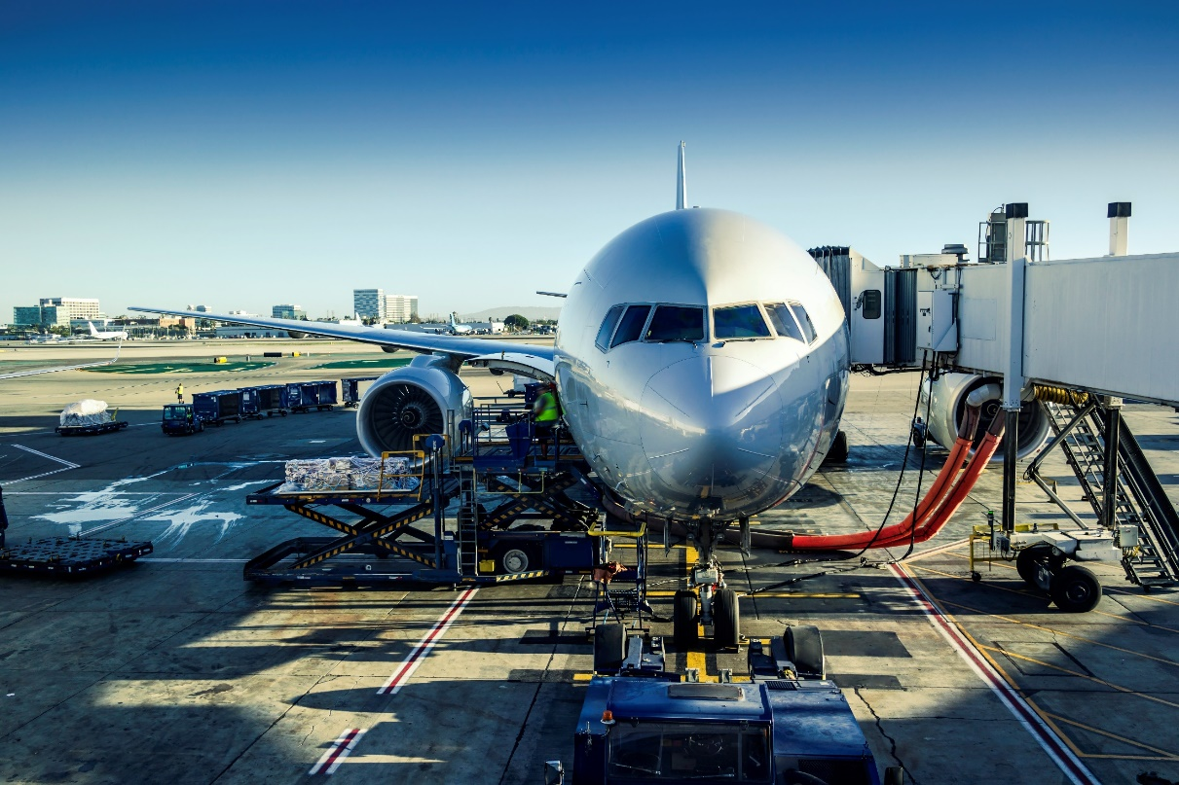
Research Products for the Roadmap in the Area of Airport Design and Construction can be found here
Thank You
http://www.trb.org/ACRP/ACRP.aspx
Notes:
Thank you.
All of the products associated with this research roadmap project can be accessed by going to the ACRP website at http://www.trb.org/ACRP/ACRP.aspx

