Slide 1
Airport Obstruction management
<insert airport photo>
<Insert name of airport> <Insert meeting/event name>
<insert location and date>
Notes:
<This presentation was designed to be customizable for your airport circumstances with the general audience being the local government planning/zoning staff, local elected officials, and the general public. Please read through and edit the notes for the presentation to suit your airport conditions.>

Slide 2
What is Airport Obstruction Management?
It is the practice of protecting the navigable airspace around an airport and beyond by implementing measures to protect airport approaches, departures and navigable airways from encroachment by objects and terrain.
Aircraft access to airports can be affected by tall structures (such as buildings, antennae, smokestacks or silos), vegetation, terrain or even by vehicles and infrastructure utilized by other modes of transportation, such as roadways, railroads and waterways.
Notes:
<Read the slide content, then explain the following> So, when we discuss navigable airspace, what does that entail? Generally speaking, it is the airspace available for landing, taking off, and maneuvering of aircraft. That airspace should be kept clear from encroachment by tall objects and terrain. When discussing encroachment as it relates to airport obstruction management, the term signifies that an object may have an adverse effect on the ability of aircraft to take off, land, or maneuver.

Slide 3
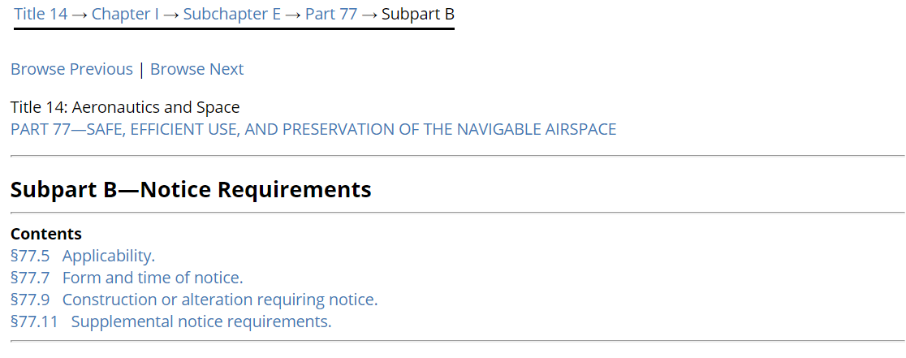
Why is it necessary? – It’s the law!
FAA must be notified of any proposals that exceed FAR Part 77 notification criteria
Notes:
The federal government administers and enforces federal regulations that pertain to the safe and efficient use of navigable airspace. The regulations are contained in Title 14 Code of Federal Regulations Part 77, the requirements of which will be discussed further in this presentation. The law requires that any person or entity that proposes to establish a structure which would exceed the notification criteria contained in this regulation notify the FAA of the proposal. Notification is required via submission of FAA Form 7460-1 either electronically or by mail.

Slide 4
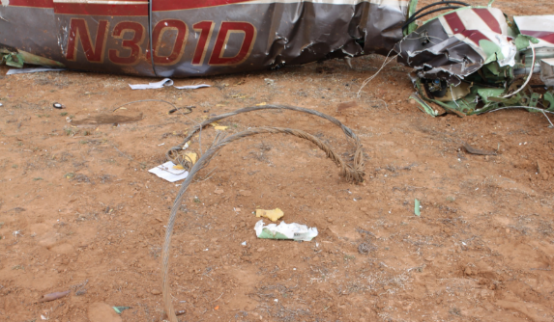
Why is it necessary? – Safety
Notes:
Airplanes and tall objects don’t mix! The photos depict the wreckage of a Piper Malibu in Lubbock, TX. The 2015 accident was attributed to the pilot’s loss of situational awareness, resulting in the collision with a guy wire for a TV tower. The pilot was the sole fatality in this accident. Tall structures and vegetation pose an additional safety risk to aircraft especially in bad weather or conditions of low visibility.

Slide 5
Why is it necessary? – Airport Efficiency
Notes:
The criteria and regulations established by the FAA and certain state aviation agencies for airport safety and efficiency are expressed three-dimensionally as airspace “imaginary surfaces.” These surfaces depict criteria that have to be met in order for the aircraft to be able to navigate to, land at, and depart airports. Safety thresholds such as minimum visibility and ceilings are established by the FAA for specific airports to ensure obstacle clearance. When existing obstructions are not managed or removed, or when new obstructions are introduced, the FAA has to maintain the margin of safety by increasing the required visibility and ceiling criteria for airport operations. That reduces the efficiency of the airport by placing more restrictive operating limitations upon the pilots attempting to use it.

Slide 6
Why is it necessary? – Adverse ECONOMIC IMPACT
Notes:
Reduction of airport operational capability and efficiency affects airport users. While the effects will vary from circumstance to circumstance, impacts on airport efficiency due to obstructions may lead to a loss in a number of ops (resulting in lower fuel sales, ramp fees, etc.), reduction in based aircraft, or loss of on-airport and even off-airport aviation-dependent businesses. Airports contribute directly and indirectly to the local economy through airport user expenditures and, beyond the airport fence, in employment of community members by airport businesses.

Slide 7
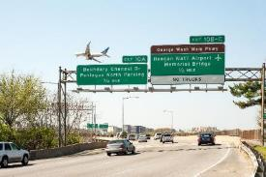
What needs to be Managed?
Vegetation
Tall Structures (buildings, towers, antennas)
Cranes
Traverseways
Notes:
There are a number of object types that may affect navigable airspace. Vegetation, tall structures, cranes and construction equipment, and traverseways (such as roads and driveways, parking lots, railways, waterways) may affect operations at the airport and beyond. Each of the object groups has associated special considerations. Those tall structures that are determined by the FAA to exceed certain criteria, which will be discussed a bit later, may be required by the FAA to be marked (painted) and lighted for conspicuity. Marking and lighting may be part of an FAA recommendation to mitigate the hazards presented by a tall structure to flying aircraft, but a similar approach may not be plausible for vegetation, which typically will need to be trimmed or removed. Cranes that impact the airspace present a particular challenge. Due to how quickly cranes can, and at times, need to be deployed, “pop-up” impacts from cranes need to be monitored and addressed within a shorter timeframe than impacts from other obstructions. The FAA also evaluates impacts of transportation infrastructure on navigable airspace by assigning a hypothetical height above traverseway surfaces according to the vehicles that utilize it: 10 feet for private roads and parking lots, 15 feet for public roadways, 17 feet for interstate highways, 23 feet for railroads, and the height of the tallest object than would normally traverse a waterway for waterways. Therefore, impacts on navigable airspace should be accounted for during transportation infrastructure planning as well.

Slide 8
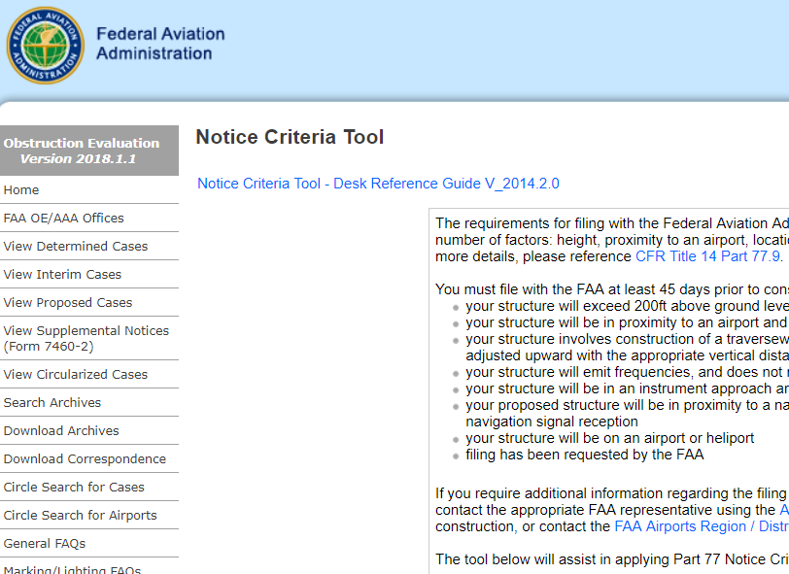
Obstruction notification and Responsibility
Notifying the FAA
<State Requirements – remove if
not applicable>
Notes:
So, who is responsible for notifying the FAA of a potential or existing obstruction and initiating the FAA obstruction evaluation process? Generally, the responsibility for notifying the FAA and initiating the formal obstruction evaluation and airport airspace analysis process lies with the proposal sponsor (either owner or owner’s representative). It may be a person, a business entity, or even a political subdivision. It is very important to note that the FAR Part 77 notification criteria are far more stringent than the FAR Part 77 obstruction evaluation criteria. Therefore, many of the objects that require filing of a notification with the FAA will not exceed the Part 77 obstruction evaluation criteria. The process can be initiated by visiting the FAA obstruction evaluation site and utilizing the notice criteria tool to determine whether the FAA has to be notified. If the results of the notice criteria tool analysis state that notification of the FAA is required, the obstruction evaluation process can be initiated by filing FAA Form 7460-1 on the same site.
<If your state requires additional notice or has a separate process for obstruction evaluation, please include those requirements as part of the discussion.>

Slide 9
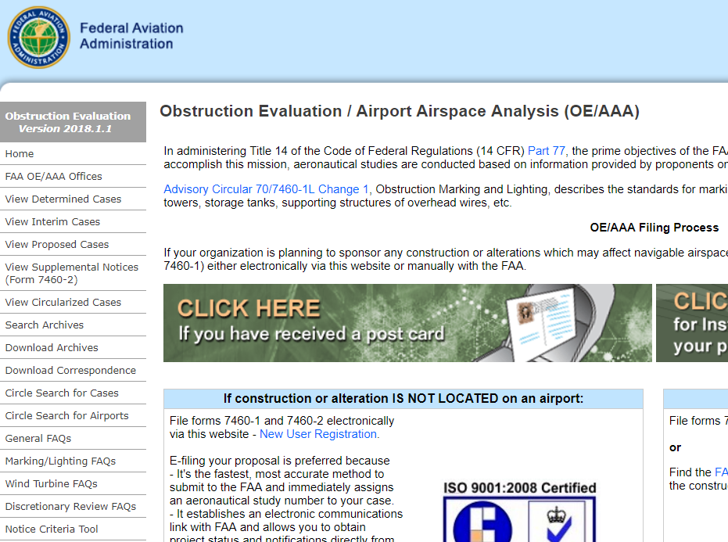
FAA Obstruction Evaluation Process and Determinations
OE/AAA Process
Determination Types and Their Meanings
Does Not Exceed
Exceeds But OK
Determination of No Hazard
Determination of Hazard
Notes:
When a proponent files FAA Form 7460-1, known as the Notice of Proposed Construction or Alteration, the agency undertakes an internal process initially, followed by an external obstruction evaluation process. During the internal process, the agency initially determines whether the proposal exceeds the Part 77 obstruction evaluation criteria. If it exceeds notification criteria but does not exceed obstruction evaluation criteria, it will not have an impact on navigable airspace and no further review is required. If it does exceed evaluation criteria, it will be reviewed by a number of FAA specialists in various areas of airspace analysis, as well as external stakeholders such as the airport and its users. If the proposal exceeds standards but does not affect airspace more than the impacts of existing structures, an “Exceeds but OK” (EBO) determination is issued. If the proposal impacts airspace and has a substantial effect on air navigation that can be mitigated (for example, by adjusting an instrument procedure), a “Determination of No Hazard” (DNH) will be issued. If the proposed structure exceeds standards and has a substantial adverse effect on air navigation that cannot be mitigated, the agency will issue a “Determination of Hazard.” All EBO and DNH determinations will usually be predicated on marking and lighting conditions to ensure aviation safety.

Slide 10
FAA Authority and Limitations
FAA cannot regulate, permit, or prohibit development!
Notes:
Contrary to popular belief, the FAA has no authority to regulate establishment of tall structures. While notifying the FAA of a proposal that exceeds Part 77 notification criteria is required by federal law, a proponent may construct the structure even if it receives a Determination of Hazard from the FAA. As a result, the most reliable methods of protecting navigable airspace from encroachment are in the hands of local governments. Ensuring that a tall structure proponent has received a final determination from the FAA prior to obtaining a local government permit to commence construction serves to protect the local airport and navigable airspace above the jurisdiction. <If your state has airspace protection authority, include that discussion here.>

Slide 11
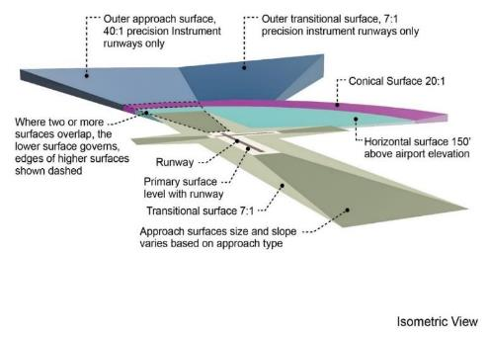
Criteria and Regulations AFFECTED By Obstructions
CFR Part 77 Obstruction Evaluation Criteria
Primary Surface
Approach Surface
Transitional Surface
Horizontal Surface
Conical Surface
Notes:
Part 77 obstruction evaluation surfaces serve as the initial screen of further impacts on the airport’s instrument procedures and design standards. When any of these surfaces are impacted, the agency undertakes a more detailed evaluation of the proposal, involving specialists in instrument procedure design, airport design, navigational aid performance, etc. Additionally, the proposal is likely to be circulated to external stakeholders, such as Department of Defense representatives, airports in the vicinity of the proposal, state aviation agencies, and even airport users.

Slide 12
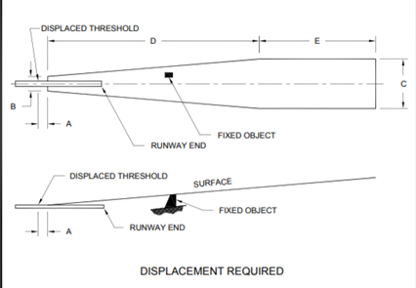
Criteria and Regulations AFFECTED By Obstructions
Airport Design Standards
Runway Threshold/Runway End Siting
Availability of Approaches
Notes:
The proposal being evaluated as a part of the obstruction evaluation and airport airspace analysis process may be found to impact the design standards for the airport’s existing or proposed elements, such as the airport’s runways. One of the criteria sets includes siting standards for the location of runway ends or runway thresholds, which ensure that an aircraft can safely clear obstacles on approach to landing. Affecting the runway threshold or runway end siting criteria will potentially reduce runway length or availability of landing distance for arriving aircraft. Additionally, impacts on airport design standards may result in the FAA having to reduce the number and type of instrument approaches or limit the types of aircraft that may utilize the approach. This may prevent certain aircraft from being able to use the facility in the future and jeopardizes the public investment in the airport and its improvements.

Slide 13
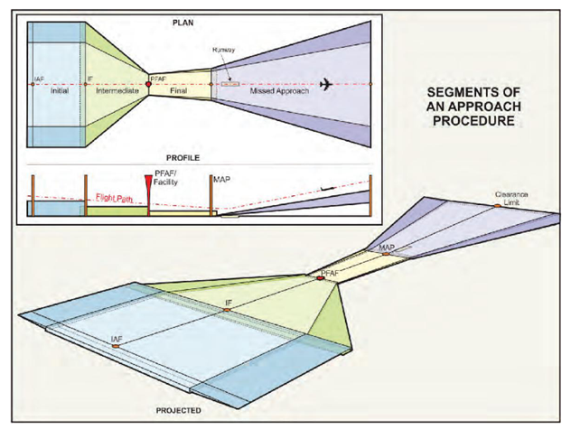
Criteria and Regulations AFFECTED By Obstructions
Instrument Procedure Design Criteria
Instrument Approaches
Missed Approaches
Visual Area Obstacle Identification Surfaces
Notes:
Another set of criteria that may be affected by an obstruction is the instrument procedure design criteria. These criteria specify how the instrument approach and missed approach procedures are developed and to what tolerances and minimums. Affecting these criteria may result in an increase in approach minimums, restricting operations during low visibility, or may result in discontinuation of the approaches altogether. Additionally, the visual area obstacle identification surface (OIS) protects aircraft as they descend below established minimums but before they land. Affecting the visual area OIS can potentially result in the approaches being not authorized for use at night. All of the effects will reduce airport efficiency and the margins of safety.

Slide 14
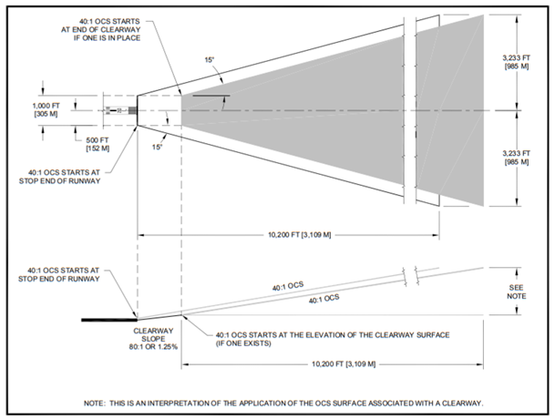
Criteria and Regulations AFFECTED By Obstructions
Instrument Departure Criteria
Notes:
Not unlike the criteria that specify how an instrument approach procedure is designed, the FAA follows a set of criteria for the design of departure procedures that allow aircraft to take off from the airport in poor weather. Impacting those criteria may result in the aircraft being required to climb at a higher than standard rate. Some of the aircraft utilizing the airport may be unable to comply with that requirement and will be unable to operate from the airport in conditions of poor or reduced visibility.

Slide 15
Criteria and Regulations AFFECTED By Obstructions
Air Carrier Obstacle Identification and Accountability
What needs to be considered by airlines, cargo, and charter operators?
What effect does it have on the airport and community?
Notes:
Certain air carriers, including airlines, air taxi/charter, and cargo operators are required to meet requirements contained in FAR Parts 121 and 135. These regulations include a requirement for the operators to consider and account for all known obstacles in the aircraft path or the airport area when developing emergency procedures for the possibility that an aircraft loses an engine after takeoff or on climb-out. These procedures are airport and air carrier specific, and protecting air carrier operational requirements necessitates a great deal of coordination between air carriers and the airport. As a result, if the aircraft needs to meet certain climb performance requirements to clear a new obstacle, the operator may limit the number of passengers, amount of fuel or cargo, or size of the aircraft, or even stop operating to and from the airport.

Slide 16
Criteria and Regulations AFFECTED By Obstructions
State Regulations and Criteria
<hide/remove slide, if not applicable>
Notes:
<If state criteria, such as airport inspection/licensing, are in effect in your state, verify how they may be affected by obstructions and include the discussion here.>

Slide 17
Additional effects on airports and the Airport sponsor
Federal Grant Assurances and
State Requirements
<hide/remove slide, if not applicable>
Notes:
Airports that accept federal <and state if applicable> infrastructure improvement funds are subject to the requirements of grant assurances. These assurances include the requirement that the recipient of the grant funds protect the airport and airspace from encroachment by incompatible land uses and tall structures. Failure to do so may result in the airport losing funding eligibility or even being required to repay the grant funds to the FAA.

Slide 18
What is your role in the process?
Educating the community and landowners
Enforcing local regulations
Providing planning and zoning assistance and resources
Facilitating discourse
Notes:
So where do you come in? A functional airport obstruction management program requires continued coordination between the airport and non-airport stakeholders with an open exchange of information. The key role that you play in the process is helping the airport to educate the community, development proponents, crane operators, and landowners about the federal <and state> requirements related to airport obstruction management. Research shows that frequently lack of compliance with obstruction management requirements lies in a lack of knowledge and technical information on the part of tall structure proponents. Second, as discussed earlier, the FAA has no regulatory authority to prevent or prohibit establishment of an airport hazard. At the local level, it is your responsibility and authority to administer and enforce regulations that protect the airport and airspace from encroachment. Providing planning and zoning assistance to tall structure proponents and helping the airport to stay ahead of the development process so that it can participate in making decisions that may affect it is critical. Additionally, any tools or resources available to you as local government staff, such as GIS, can be integrated to promote interoperability of airport and local government resources and availability of information. Lastly, facilitating discussion between the airport and various stakeholders can reduce conflict between airport and non-airport interests and promote the search for win-win solutions.

Slide 19
Resources Available to you
FAA Resources – oeaaa.faa.gov
Airport Cooperative Research Program Guidance -- www.trb.org/Publications/PubsACRPProjectReports.aspx
State Resources <remove if not applicable>
Airport Assistance <remove if not applicable>
Notes:
The good news is that there are a number of resources available to you that provide technical guidance on airport obstruction management. The FAA OE/AAA website—oeaaa.faa.gov—contains guidance related to the FAA obstruction evaluation process as well as contact information for FAA personnel responsible for program implementation in your geographic area. The Airport Cooperative Research Program (ACRP) is part of the Transportation Research Board of the National Academies of Sciences, Engineering, and Medicine. The applied research conducted by ACRP includes reports published on airspace analysis and best practices for airport obstruction evaluation. ACRP Report 38 and ACRP Research Report 195 are helpful references in this subject area. The ACRP site and all associated publications can be found at www.trb.org/Publications/PubsACRPProjectReports.aspx. <Include resources and guidance information available from the state.> <Include a discussion of what assistance the airport is capable of and is willing to provide.>

Slide 20
Contact information/Questions
<Insert Contact Information>

