Slide 1
E-scooter Safety Issues and Solutions
Project Overview and Findings From the Behavioral Traffic Safety Cooperative Research Program, BTS-10 Project
Notes:
This slide deck presents an overview of the Behavioral Traffic Safety Cooperative Research Program, BTS-10 Project, and its key findings. For details, see the Final Report and/or the Toolbox produced.

Slide 2
Slide Deck Overview
Introduction
Background and project motivation, goals, principles, and evidence base
General findings
E-scooter usage, context, safety concerns, and injury contributors
Current and potential safety management practices and future research needs
Takeaways for local micromobility program managers
Takeaways for state highway safety officials and policy makers
Summary of project deliverables
Acknowledgements
Notes:
This presentation will provide an introduction that covers the project background, motivation, and goals, as well as overarching principles and the evidence base used or created in the process.
It will highlight general findings related to e-scooter usage, context, and safety and injury contributors as well as a summary of current and potential safety management practices.
It also offers key takeaways for two primary audiences: 1) local micromobility program managers and 2) state highway safety officials and related policy makers.
Finally, it provides a summary of the project deliverables and team and sponsor acknowledgements.

Slide 3
Background
E-scooters are a form of powered micromobility
Source: BTS-10 project team
Notes:
While legal definitions vary in different regions, this project defines an e-scooter as a two- or three- wheeled device powered by an electric motor, consisting of a platform between the front and rear wheels that the rider stands on (and in some cases a seat that the rider sits on) and a steering column with handlebars that allow the rider to steer, accelerate, and brake. In contrast with electric bicycles and mopeds, e-scooters do not have pedals.
An e-scooter is a form of powered micromobility, a class of small transportation devices used for personal transport or goods delivery. E-scooters, both sitting and standing types, are typically low speed (max speed of 30 mph/48 km/h or less), light weight (200 lbs/45.4 kg or less), and partially or fully motorized (usually by an electric motor).

Slide 4
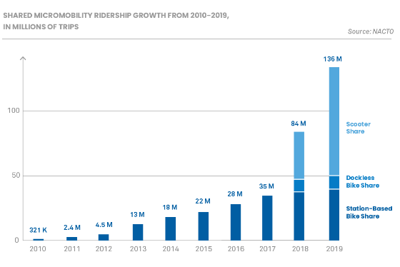
Project Motivation
E-scooter usage continues to grow, both with personally-owned devices and shared ones
E-scooters offer convenience, access to transit and other travel modes, and are generally considered low-cost, highly efficient, and low-impact forms of travel
As a legitimate and growing transportation mode, e-scooter safety risks deserve attention from transportation policy makers, practitioners, and injury prevention partners
Source: National Association of City Transportation Officials, Shared Micromobility in the U.S.: 2019. https://nacto.org/shared-micromobility-2019/
Notes:
This project seeks to build upon existing research to date, identify key gaps in knowledge and data related to e-scooter behavioral safety, and develop evidence-based guidance that can enhance the coordination of behavioral safety programs and countermeasures with a broader toolbox of approaches to improve safety for all road users.

Slide 5
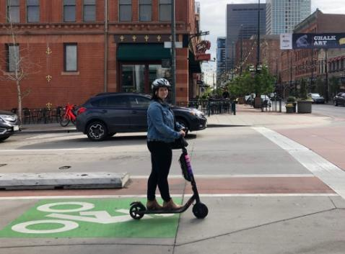
BTS-10 Project Goals
This effort used multiple methods of data collection and analysis to describe e-scooter:
Current state of use, context, and safety issues;
Injury information, including circumstances, severity, and comparison of injury trends to other modes;
Safety management practices, both existing and those that may be of interest or are being considered; and
Additional research needs.
Source: www.pedbikeimages.org / Toole Design
Notes:
See text on slide.

Slide 6
BTS-10 Project Lens: A Safe and Equitable System
The project team recognized these key Safe System principles in the development of the research project and subsequent deliverables:
E-scooter-related fatalities are unacceptable: Proactive efforts to prevent severe and fatal injuries are critically needed.
Humans make mistakes, have limitations, and are vulnerable: Safety management practices must anticipate and accommodate human behaviors and limitations to help avoid serious and fatal injuries.
Redundancy is critical and responsibility is shared by system designers: Risk reduction involves all parts of the system working together.
An equitable transportation system ensures safe, sustainable, and convenient options for all: Equity principles should be considered within the context of micromobility and support for micromobility in cities and towns.
Notes:
See text on slide.

Slide 7
BTS-10 Project Evidence Base
Evidence | Description
Literature review | Reviewed and synthesized 349 studies identified between 2017 and October 2020, including peer-reviewed articles and pilot program reports
Practitioner survey | Asked about 70 different practices and approaches to safety management; received 207 responses from 85 cities in 38 states with existing micromobility programs.
Populus Groundtruth survey | Examined e-scooter ridership travel behavior and demographics using a sampling of 18 metro areas in an ongoing travel survey.
NC emergency department visit data | Compared patient (age 14-59) injuries from 487 e-scooter riders, 1,581 bicyclist, and 1,440 pedestrians from same Emergency Departments (in 5 NC counties) and time period.
Field observations of e-scooters and cyclists | Examined social and environmental factors affecting or constraining e-scooter rider behaviors related to sidewalk riding and decisions around parking. Gathered field and video data from two cities in October 2021.
Interviews with micromobility program managers | Interviewed staff from five city agencies to help fill gaps identified through the literature review and practitioner survey related to community engagement, engagement with State Highway Safety Offices (SHSOs), planning and operations, and data and analysis.
Notes:
The table in this slide provides a summary of the sources of information used or developed to support the research. See the Final Report for a detailed discussion of the study methods, as well as Appendices that provide study data collection protocols and forms.

Slide 8
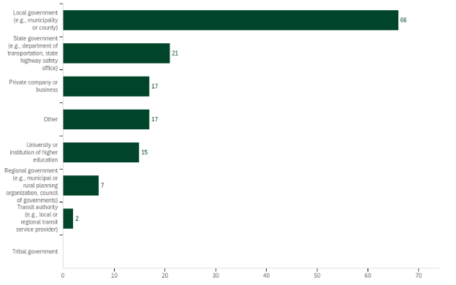
Practitioner Survey Participant Highlights
Position Type
Organization Type
Source: BTS-10 project team
Notes:
Notably, in the practitioner summary, we received responses from 207 individuals, who represented a range of position types and organizational types. This was important in understanding the different ways that different professionals may be approaching e-scooter safety and in getting a sense of what information or practices they were interested in receiving guidance around.

Slide 9
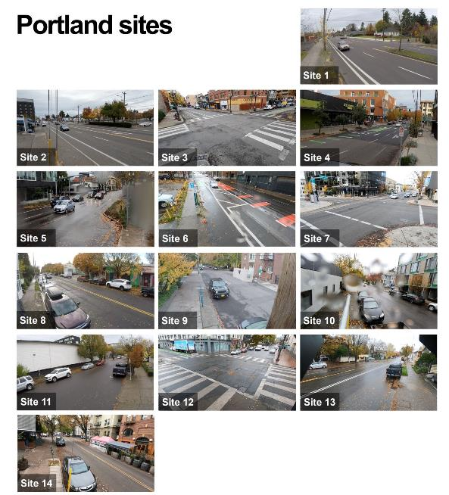
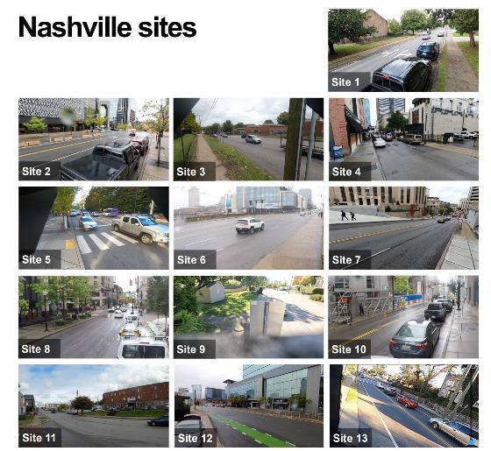
Field Data Collection Highlights
Source: BTS-10 project team
Notes:
The field data collection efforts conducted in October 2021 gave the team an opportunity to “ground truth” the observations and trends gleaned from Phase I of the project as well as pilot test different data collection methods that could be used by a variety of stakeholders to continue to advance program development and evaluation.

Slide 10
General Findings: State of use, context, and safety issues
Characteristics | Pedestrians | E-scooter Riders | Bicycle Riders
Demographics | More females than males; all ages and income levels. | Slightly more males than females (though highly variable by location); majority of shared e-scooter users are between the ages of 18-35 years old; skew white and middle-income. | Many more male riders than female riders; average age is slightly older than e-scooter riders and higher income.
Speed range | Walking speed is typically 3.5 ft/sec or 2 MPH. | Riding speed can be limited by policy or geographic location; range from 10-15 MPH. | Ranges from 8-13 MPH for traditional bikes and higher for e-bikes (10-15 MPH).
Travel behaviors | More likely to be accessing transit than e-scooter or bicycle modes. | Seasonal ridership similar to bicycles; helmet use is lower for e-scooters than for bicyclists; more likely to be using shared devices than owned devices, in comparison to bicycles. | Similar to e-scooter riders, though less nighttime ridership and longer average trip length.
Facility preferences | Prefer sidewalks when provided the option. | Prefer separated bike facilities over sidewalks when provided the option. | Prefer separated bike facilities when provided the option.
Notes:
Multiple studies and surveys of US cities have indicated that:
Males ride e-scooters more often than females
White e-scooter riders are overrepresented in relation to Black, Latinx, Asian, or Pacific Islander
Riders aged 18-34 are overrepresented compared to other age groups
Middle income riders are overrepresented compared to low and high incomes
Most programs are operating in urban areas; this study found no programs on Tribal lands in the US, possibly due to issues related to remoteness and lack of internet access needed to support the app. There is a concentration of programs in downtown and on university campuses, so that may be reflected in some of the age and other sociodemographic characteristics of riders.
Regarding perceptions of safety, the most reported concerns among e-scooter riders included:
Concern for hitting someone or being hit
Feeling unsteady
Lack of safe spaces to ride/ strong desire for bike facilities
Concerns for racial profiling when riding or if stopped

Slide 11
General Findings: E-scooter injury circumstances and contributing factors
Characteristics | Pedestrians | E-scooter Riders | Bicycle Riders
Impairment patterns | In 2020, about 10% of non-fatally injured pedestrians and 31% of fatally injured pedestrians are reported as being alcohol or drug impaired. 16% of drivers involved in pedestrian crashes were impaired, not counting hit and run incidents where driver condition is unknown (National Center for Statistics and Analysis 2022). | About 6% of non-fatally injured e-scooter riders reported as being alcohol or drug impaired. Of the 69 known e-scooter fatalities in the US, an estimated 4% involved reportedly impaired riders, another 4% were ruled to have not involved impairment, and the remaining cases were unknown or missing impairment data (Cherry et al 2022). | In 2019, about 6.5% of non-fatally injured bicyclists and 20% of fatally injured bicyclists (involved in motor vehicle crashes, only) were reported as being alcohol or drug impairment. Around 12% of drivers involved in bicycle crashes were impaired, not counting hit and run incidents where driver condition is unknown (National Center for Statistics and Analysis 2021).
Injury profile | Data on falls and crashes with modes other than drivers are lacking, but most fatal injuries involve a motor vehicle. | More falls and fewer motor vehicle involved crashes than other modes: 90% of injuries occur off road and/or do not involve a motor vehicle; 70% of fatal injuries involve a motor vehicle. May be more vulnerable to roadway surface irregularities (including stormwater grates, rail crossings, cracks, etc.) than bicycles. Hardware failure or malfunction and rider inexperience are also contributing factors. | Data on falls and crashes with modes other than drivers are lacking, but most fatal injuries involve a motor vehicle.
Notes:
Injury studies included in this study highlight that e-scooter injury patient makeup that skews white, male, and early 30s, mirroring rider demographic trends. Fatal injuries have a higher proportion of:
In-street/involving motor vehicles
Alcohol involvement
Nighttime riding (50+%)
Large truck or SUV involvement
See the Toolbox for the table shown here and full citations.

Slide 12
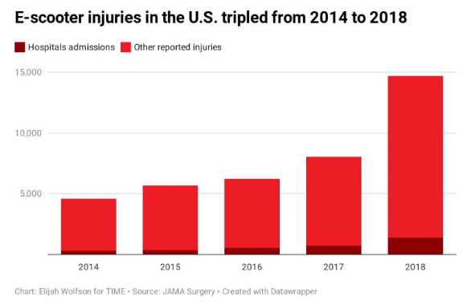
Proper helmet-wearing reduces public healthcare costs, but current e-scooter helmet use is low
Head injuries, including traumatic brain injuries, are the most common type of e-scooter injury requiring medical treatment (28-40%).
Fractures, particularly involving the lower arm and wrist, are also common (25-31%).
Studies of injured pedestrians in one state found that more than half rely on publicly funded healthcare programs.
This study and others have observed e-scooter helmet use is low, and consistently lower than bicyclist helmet use.
Notes:
The project also found that e-scooter helmet use is low, and often lower than bicycle helmet use, and that head injuries are among the most common type of e-scooter injury requiring medical treatment (Aizpuru et al. 2019; Kobayashi et al. 2019; Trivedi et al. 2019; Moftakhar et al. 2020; Harmon et al., 2021); see full citations in the Final Report.

Slide 13
General Findings: Safety management practices
Wide range of practices taking place
Very few robust evaluations of safety interventions and/or impacts
Source: BTS-10 project team
Notes:
The practitioner survey asked about 70 different practices and approaches to e-scooter safety management and found a wide range of practices across locations/agencies.
The most reported practices involved operator regulations and policy-making during the e-scooter vendor permitting stage, along with safety communication and messaging to the public. Very few communities had clearly established vehicle speed management efforts, safety and equity plans, e-scooter data collection and evaluation efforts, or emergency response plans in place to support road user safety when launching or expanding e-scooter programs.

Slide 14
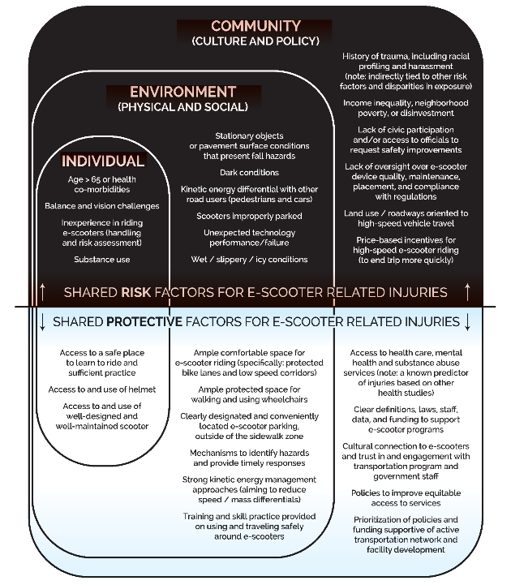
What makes e-scooter riders safe?
Safe System principles of:
Separation of road users (in space or in time of facility use)
Spaces for practice and opportunities to gain experience
Inclusive, friendly streets designed for e-scooter usage
Slow vehicle speeds
Source: BTS-10 project team
Notes:
This study aimed to establish Safe System principles that can be applied to reduce e-scooter injury risk factors and increase protective factors. The risk and protective factors affecting e-scooter user outcomes are also shared by other road users, including pedestrians, bicyclists, and drivers, such that efforts to reduce risk factors and increase protective factors may have positive benefits for all road users. Notably, many of the practices most likely to provide protection for e-scooter users were those least often reported in the safety management practice survey, such as snowing vehicle speeds and providing separated space for e-scooter use. See the Toolbox for more discussion on how these principles also relate to evidence-based safety measures.

Slide 15
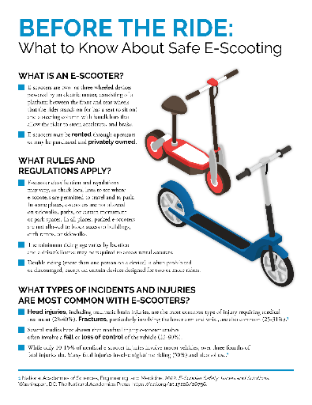
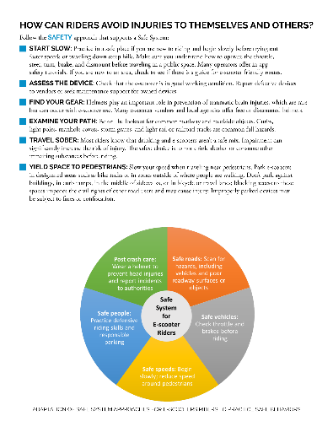
What can individual riders do to protect themselves?
Source: BTS-10 project team
Notes:
While the study aimed to take a Safe System approach in looking at system safety factors and efforts that can be taken by system owners and designers, the project team also developed safety messaging to support individual behaviors and outreach to the public about e-scooter safety issues. This example PSA is provided in the Toolbox.

Slide 16
Toolbox offering: A summary of safety management practices
Domain | Description of Safety Management Practice | Current Level of Adoption | Current Strength of Injury Prevention Evidence
Categorizes the practices in terms of which primary Safe Systems area it falls under: Safe Roads Safe Vehicles Safe Speeds Safe People Post-Crash Harm Reduction Safety Evaluation | Provides a description of the practice and indicates the typical agency lead (S = SHSO; D= State DOT; L = Local agency); also links to the relevant section of the final report to find additional resources or supporting literature | Based on the BTS-10 survey and literature review, indicates low, medium, or high levels of current adoption | Based on the BTS-10 literature review and expert input, indicates the current evidence base supporting the practice: No demonstrated effectiveness; Limited or no high-quality evidence; Promising/ Likely effective; or High demonstrated effectiveness
Notes:
In the project Toolbox, the team provides a list of safety practices in connection to its Safe System domain; describes the practice and typical agency lead; indicates the current level of adoption; and provides the evidence base supporting the practice.

Slide 17
General Findings: Additional research needs
Studies on the experiences, attitudes, and perceptions, and injury outcomes of people with disabilities in relation to e-scooters
Studies on the experiences, attitudes, and perceptions, and injury rates and outcomes of people in different socioeconomic groups (age, gender, race, ethnicity, income)
Studies/evaluations of local e-scooter practices related to speed management, pavement quality management/maintenance, design of transition zones, parking policy/design, and communications/engagement techniques
Studies/evaluations of the equity of various e-scooter practices (geofencing, service restrictions, enforcement, data or other program and permitting requirements)
Evaluations, resources, or guidance on equitable community practices to build civic engagement in e-scooter programs, network planning, and policy decisions
Notes:
See text on slide for additional research needs identified; more on this can be found in the Final Report.

Slide 18
Key Takeaways for Local Micromobility Program Managers
Micromobility parking is a civil rights issue and a safety issue
Planning for equitable allocation of parking infrastructure is a must
Micromobility programs will not succeed if riders have bad experiences or are injured
Proactive community engagement and hazard identification can pre-empt injuries and complaints
Seek ways to mitigate harmful behaviors, as well as reduce the harm when injuries do occur
Partner and plan for harm reduction and addressing the deadliest combinations of risk factors
Community engagement offers opportunities to address equity and build a culture around safety
Notes:
While the Final Report and the Toolbox offer a lot of information, here are three key takeaways for local program managers.

Slide 19
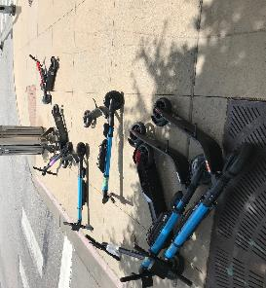
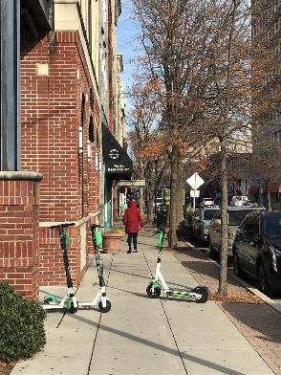
Micromobility parking is a civil rights issue and a safety issue
“Public rights-of-way and facilities are required to be accessible to persons with disabilities through the following statutes: Section 504 of the Rehabilitation Act of 1973 (Section 504) (29 U.S.C. §794) and Title II of the Americans with Disabilities Act of 1990 (ADA) (42 U.S.C. §§ 12131-12164). These statutes prohibit public agencies from discriminating against persons with disabilities by excluding them from services, programs, or activities. These statutes mean that the agency must provide pedestrian access for persons with disabilities to the agency's streets and sidewalks, whenever a pedestrian facility exists. Regulations implement this require­ment by imposing standards for accessible features such as curb cuts, ramps, continuous sidewalks, and detectable warnings." (FHWA).
Planning for parking helps preempt ADA concerns and complaints and reduce tripping and fall hazards
Where you place the parking matters
Source: BTS-10 project team
Source: BTS-10 project team
Notes:
Communities often receive a lot of complaints about improper parking, but the evidence also shows that they’re properly parked at high ratios in some place (98%), and more so than vehicles (75%). However, other cities have found much lower parking compliance (Portland, 30%). Parking compliance was highest in cities with “lock-to” policies (like San Francisco) and with established parking zones or corals.
The Final Report provides more information on injuries and complaints in relationship to poorly parked scooters. In short, planning for parking is important for both reducing ADA concerns and for preventing tripping and fall hazards.

Slide 20
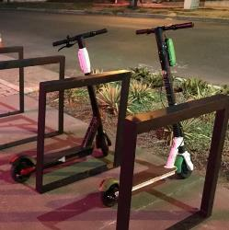
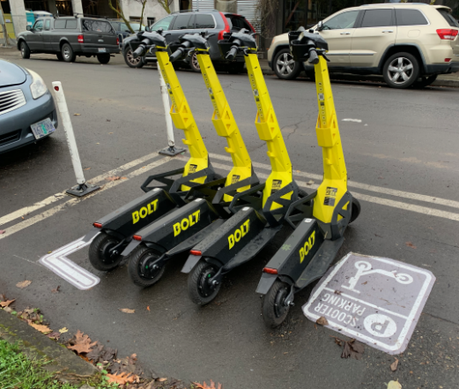
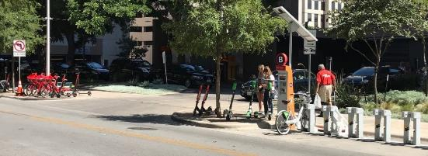
Plan for equitable allocation of parking infrastructure
Source: BTS-10 project team
Source: www.pedbikeimages.org/ TREC
Source: BTS-10 project team
Notes:
Many parking management approaches discussed in the Final Report, toolbox, and case studies, including:
Repurposing vehicle parking for e-scooter parking expansion
Designated parking areas
Paired with charging stations
Paint and corral-based approaches
Rider incentives (and photo verification)
Geofencing and “lock-to” policies

Slide 21
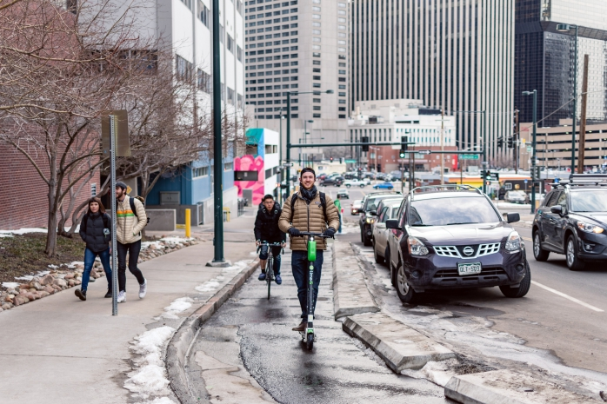
Micromobility programs will not succeed if riders have bad experiences or are injured
Percent of injuries involving first time or novice riders: 30%
Some agencies and operators indicated that injured riders quit riding after an incident
Source: www.pedbikeimages.org/ Toole Design Group
Notes:
While long-term projections of e-scooter travel is variable by location and has been affected by the COVID-19 pandemic, early indications from agencies and surveys of riders indicates that safety concerns (perceived or actual) may limit e-scooter ridership. At least one study found that novice riders were more likely to be represented among those who had received medical treatment for an e-scooter related injury (see the Final Report for more).

Slide 22
How can communities be proactive about e-scooter safety?
Is your risk reporting program adequately staffed?
Do you have a system in place to provide equitable responses?
Do you have a system in place to respond to systemic issues?
Are you leveraging opportunities for community members to share data?
Is your roadway network ready for e-scooters?
Pavement conditions
Transition zones
Separated bicycle facilities
Notes:
There are many ways that agencies can be proactive regarding e-scooter safety management efforts. Both the Final Report and the Toolbox speak to efforts that can be used to consider equity, identify systemic issues, leverage input from the community, and screen the roadway network for e-scooter risks.

Slide 23
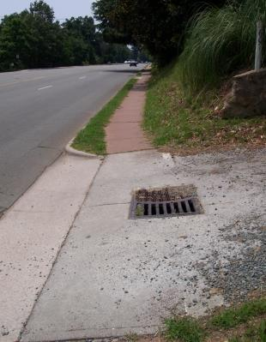
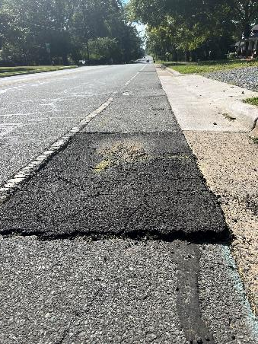
Proactive risk identification can pre-empt injuries and complaints
90% of e-scooter injuries occur off road and/or do not involve a motor vehicle
Screen the network for:
Stationary objects: curbs, light poles, manhole covers, grates, railroad tracks
Poor roadway surface conditions (potholes, pavement cracks, lips)
Topography challenges
Poor lighting
Source: BTS-10 project team
Source: www.pedbikeimages.org/ Reed Huegerich
Notes:
One recent study found that “Deeper potholes increased the likelihood and severity of falls. While potholes 3cm deep caused no falls in the simulations, potholes with depths of 6cm and 9cm caused falls in 75 per cent of cases.” This was reported in “Computational prediction of head-ground impact kinematics in e-scooter falls” by Pasinee Posirisuk, Claire Baker, and Mazdak Ghajari. Published 13 January 2022 in Accident Analysis and Prevention.
The Toolbox offers a checklist that agencies and partners can use to screen their network for hazards specific to e-scooter riders, such as roadway surface conditions.

Slide 24
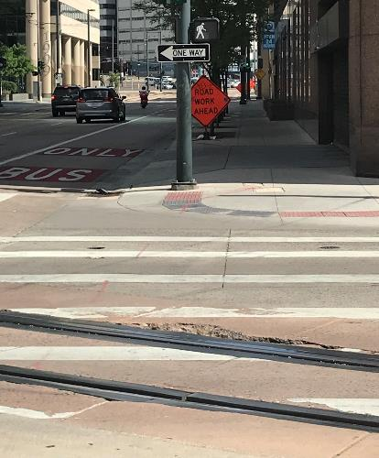
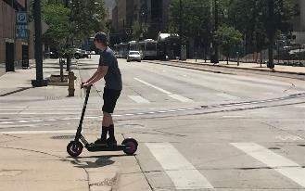
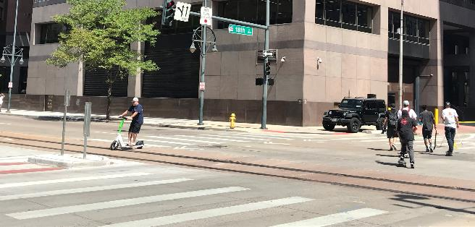
Key issue: pavement hazards at rail crossings, intersections, and transitions to sidewalk
Source for all photos on this slide: BTS-10 project team
Notes:
The Final Report presents information that shows that 70% of fatal injuries involve a motor vehicle. In some cases, surface conditions can cause an e-scooter rider to lose control and be thrown into the pathway of moving vehicles. These types of conditions can have catastrophic outcomes. In particular, transition areas such as crosswalks that lead to sidewalks and corners where e-scooter parking hubs are located may be priority locations to screen for pavement hazards. Light and heavy rail crossings, especially those that are skewed and cannot be crossed by e-scooter riders at a perpendicular angle, are also known concerns for e-scooters.

Slide 25
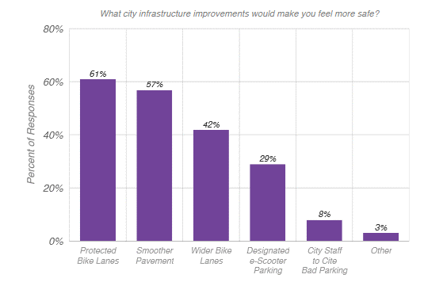
Connected, low stress bike networks also work for e-scooter safety and perceptions of comfort
Roads with bike lanes are associated with:
Fewer e-scooter injuries
Less sidewalk riding
More satisfied e-scooter riders
Source: Bird Report: A Look at E-scooter Safety, April 2019
Notes:
The Final Report discusses how roads with separated or protected bike lanes are associated with fewer e-scooter injuries as well as lower rates of sidewalk riding and higher perceptions of comfort among surveyed e-scooter riders.
This finding was established from pilot e-scooter program reports and other literature summarized as well as validated in the field observations conducted by the project team.

Slide 26
Example: Denver data coordination for systemic risk detection
Map Showing E-scooter Trips from 2018-2022 in Denver, CO.
Source: Ride Report, 2022
Notes:
In the Toolbox, a case study of Denver, CO presents an example of how a community can utilize its e-scooter rider data to help screen for systemic risks across a network. As the Toolbox mentions, “Denver’s current shared micromobility program requires public access to data. Operators must make available via a public application programming interface that meets the standards of the General Bikeshare Feed Specification (GBFS), that can be used to show a “real time dashboard” of e-scooter location and availability to riders and to the city. In addition, via the real time dashboard, operators must provide the city with data that includes information on incidents, complaints, and crashes (City and County of Denver 2020).” This data, in combination with infrastructure quality data, travel volume data, speed data, etc., may be useful in identifying and prioritizing locations for improvement.

Slide 27
Toolbox offering: E-scooter risk assessment tool
Provides a list of discussion prompts
Can be used in “road safety audit” like activities, or could be integrated into routine travel surveys
Source: BTS-10 project team
Notes:
Here is a screenshot of the Risk Assessment Tool provided in the Toolbox. It offers a checklist that agencies and partners can use to screen their network for hazards specific to e-scooter riders and can be a useful tool for community engagement and input.

Slide 28
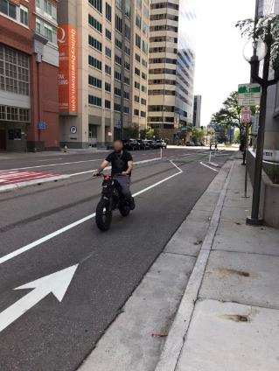
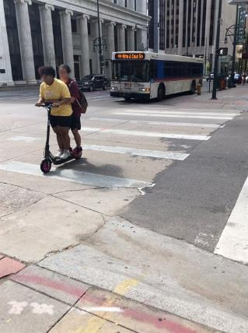
Mitigating harmful behaviors
Humans being humans, we are likely to continue seeing:
Social (double) riders
Stunt/trick riders
Wrong-way riders
Inexperienced or confused road users
Impatient or indifferent road users
Impaired road users
Riders without helmets
Not all these behaviors pose serious injury risks, and not all occur at the same frequency
Some of these behaviors can be mitigated through thoughtful roadway design practices and community engagement
Source: BTS-10 project team
Source: BTS-10 project team
Notes:
As noted in the Toolbox discussion of Safe System principles, the Safe System approach acknowledges that humans make mistakes, have limitations, and are vulnerable. Like pedestrians and bicyclists, e‑scooter riders have few available protections from the energy forces produced by large and heavy vehicles with which they share roadway space. As e-scooters remain a relatively recent technology introduction to many U.S. residents and visitors, many riders lack experience and may be prone to error while riding. While the project literature and field observations showed evidence of double riders, wrong way riders, and low helmet usage, these behaviors were not identified as the priority factors contributing to severe and fatal incidents. Safety management practices must anticipate and accommodate human behaviors and limitations to help avoid serious and fatal injuries. Some of the previous slides show ways in which screening and improvements to the built environment may not only reduce the risks that contribute to a crash but may also help encourage safe and appropriate usage of facilities.

Slide 29
A particularly dangerous combination
Binge drinking opportunities
Young adults
Cars and trucks moving at lethal speeds
E-scooters mixing with traffic
What can be removed from this dangerous mix?
Austin, TX example: experimented with a car-free zone at night in entertainment district where e-scooter ridership is high
Nashville, TN example: heightened impairment screening via tech prior to scooter rental
Source: BTS-10 project team
Notes:
From the review of fatal and serious e-scooter incidents, the project team identified one particularly dangerous combination of risk factors. Particularly, when e-scooters are available in close proximity to higher speed traffic, large vehicles, and establishments that provide opportunities for binge drinking (such as entertainment districts near college campuses), there may be an elevated risk of a severe or fatal e-scooter injury.
In this project, the team identified two communities that had experienced this particular combination, each of which took a different policy approach following a serious e-scooter crash. See notes on slide for Austin, TX and Nashville, TN examples.

Slide 30
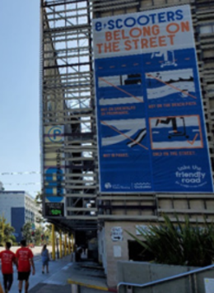
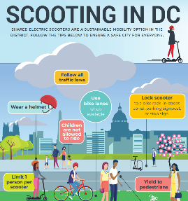
Community engagement offers opportunities to address equity and build a culture around safety
Public engagement plans can focus on:
Setting and clarifying rules of the road and safe places for e-scooter use or practice
Building social norms of courtesy and empathy among all road users
Establishing ambassador programs to onboard newcomers, model leadership, and grow helmet-use culture
Identifying alternatives to penalties and punishments that may perpetuate inequities
Partnering on helmet giveaways and helmet access programs
Engaging with system designers on safety policies, plans, and approaches to address e-scooter needs
Source: District of Columbia
Source: City of Santa Monica
Source: City of Spokane
Notes:
See text on slide.

Slide 31
Key Takeaways for State Highway Safety Officials and policy makers
Definitions and policy support
Local agencies need state-level support in defining emerging devices and prioritizing the safety of vulnerable road users in policy and legislative documents
Data collection and data improvement
State leadership is needed to improve e-scooter safety data standards, data collection, and support for local program evaluation
Program and partner support
State Highway Safety Offices can play a key role in providing local funding and program support as well as coordinating with key partners, such as Emergency Service Providers, to integrate and share plans and safety data
Notes:
Here are three key takeaways for State Highway Safety Officials and policy makers.

Slide 32
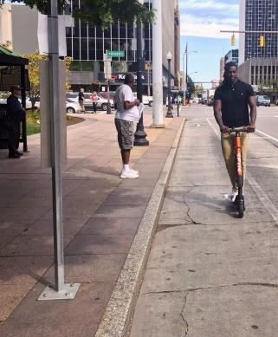
Definitions and policy support are currently lacking in most states
Many discrepancies in state laws pertaining to e-scooters and classification (e.g., as a pedestrian, bicycle, moped, motorcycle, or unique mode of transport)
State laws may not align with neighboring states and/or local municipalities and ambiguity may lead to rider confusion regarding legal operating environments
Vague or non-existent classification makes classification and consistency in police reported crash data more challenging
Source: pedbikeinfo.org/Toole Design Group
Notes:
There are myriad discrepancies in state level laws pertaining to e-scooters. Currently, state laws relating to micromobility are inconsistent, and in some cases, non-existent, and there is no clear guidance at the Federal level that could lead to better understanding and legal conformity. Some states classify e-scooters as bicycles, mopeds, or another mode. In some cases, poorly written state laws create a conflict within the very statute intended to regulate the devices. Many laws are written in unclear terms that seem to conflict within other parts of the statute, are not aligned across states, or conflict with laws or regulations of local municipalities. A vehicle’s legal characterization determines where it can be ridden with regards to whether it is allowed in the travel lane, in bike lanes, or on sidewalks. Clarity on this subject is fundamental to regulating micromobility devices.
For more on these issues, see companion research synthesis that is forthcoming: NCHRP Synthesis 597: Micromobility Policies, Permits, and Practices.

Slide 33
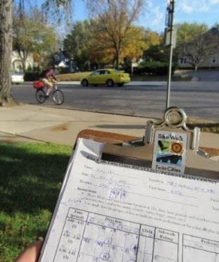
E-scooter data gaps identified
Lack of data on rates, characteristics, and prevalence of less-severe injuries (not captured in police or medical data systems)
Lack of measures of e-scooter access, exposure, and safety/comfort outcomes (relative to other modes of travel) disaggregated by age, gender, race, ethnicity, and income
Lack of data standards and case definitions for e-scooter related falls, injuries, and other safety outcomes
Lack of consistent e-scooter exposure data and monitoring practices
Lack of data integration to link injury outcomes to spatial/roadway context
Lack of data on privately owned e-scooter usage, exposure to risk, and safety outcomes
Source: pedbikeinfo.org/Toole Design Group
Notes:
This project identified numerous data deficiencies regarding e-scooters. In many cases, lack of quality and consistent data was cited as a barrier to safety management program development and evaluation.

Slide 34
Toolbox Offering: Data improvement support
Principles of quality data
Overview of key data sources and elements for examining e-scooter risks
Community “checklist” (shown in previous slide)
Protocols and data collection forms for manual and video data collection (provided in Final Report)
Source: BTS-10 project team
Notes:
In the project Toolbox, the project team provided guiding principles on quality data and an overview of key data sources. It provides a checklist for community-based data collection as well as additional data collection guidance and example forms in the Final Report. These were pilot tested in the two communities where field observations occurred.

Slide 35
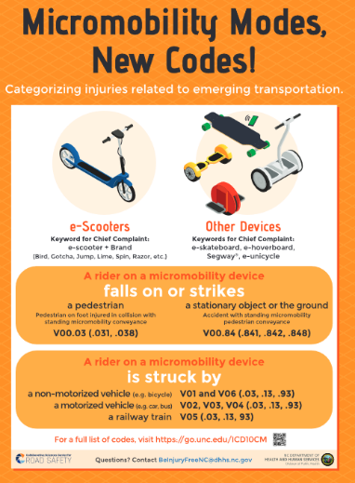
E-scooter program and partner support
State Highway Safety Offices (SHSOs) can play a role in:
Engaging Traffic Records Coordinating Committees (TRCCs) on e-scooter data improvements
Sharing and standardizing best practices in police and healthcare system e-scooter injury coding and crash reporting
Assisting communities in getting funding for safety programs, community engagement efforts, and data improvements
Toolbox case studies: Chicago, IL; Denver, CO, Nashville, TN; Portland, OR; and Washington, DC
Source: UNC Highway Safety Research Center, 2020
Notes:
There are many ways that SHSOs can advance e-scooter safety, particularly in relation to advancing and coordinating e-scooter injury data improvements and safety program development and evaluation. The case studies in the toolbox show examples from five cities and in many cases describe the role of collaborating with SHSOs to address e-scooter safety issues.

Slide 36
BTS-10 Research Products for additional info, guidance, and resources
Research Results Digest: https://nap.nationalacademies.org/catalog/26756/e-scooter-safety-issues-and-solutions
Toolbox: add link when available or direct to main project page
Fundamental concepts related to e-scooter safety
Promising practices to improve e-scooter safety
Data tools and methods for safety evaluation
Additional resources and examples
Final Report: add link when available or direct to main project page
Implementation Guidance Memo: add link when available or direct to main project page
Notes:
See these products for additional information, guidance, and resources.

Slide 37
Project Team Acknowledgment
This project involved contributions from the following individuals:
Laura Sandt, UNC-HSRC (Principal Investigator)
Alyson West, UNC-HSRC
Katie Harmon, UNC-HSRC
Kristin Blank, UNC-HSRC
Meg Bryson, UNC-HSRC
Tab Combs, UNC-DCRP
Rebecca Sanders, Safe Streets Research & Consulting
Charles T. Brown, Equitable Cities
Regina Clewlow, Populus
Stephanie Seki, Populus
Chris Cherry, UTK
Student Research Assistants: Emma Sexton, Nitesh Shah, Yi Wen, Mojdeh Azad, and Ashkan Neshagarian, all at UTK
Notes:
See text on slide.

Slide 38
Acknowledgment
This presentation is a deliverable of Behavioral Traffic Safety Cooperative Research Program (BTSCRP) Project BTS-10. BTSCRP is sponsored by the Governors Highway Safety Association and funded by the National Highway Traffic Safety Administration. BTSCRP is administered by the Transportation Research Board (TRB), part of the National Academies of Sciences, Engineering, and Medicine. Any opinions and conclusions expressed or implied in resulting research products are those of the individuals and organizations who performed the research and are not necessarily those of TRB; the National Academies of Sciences, Engineering, and Medicine; or BTSCRP sponsors.
Notes:
See text on slide.

