Slide 1
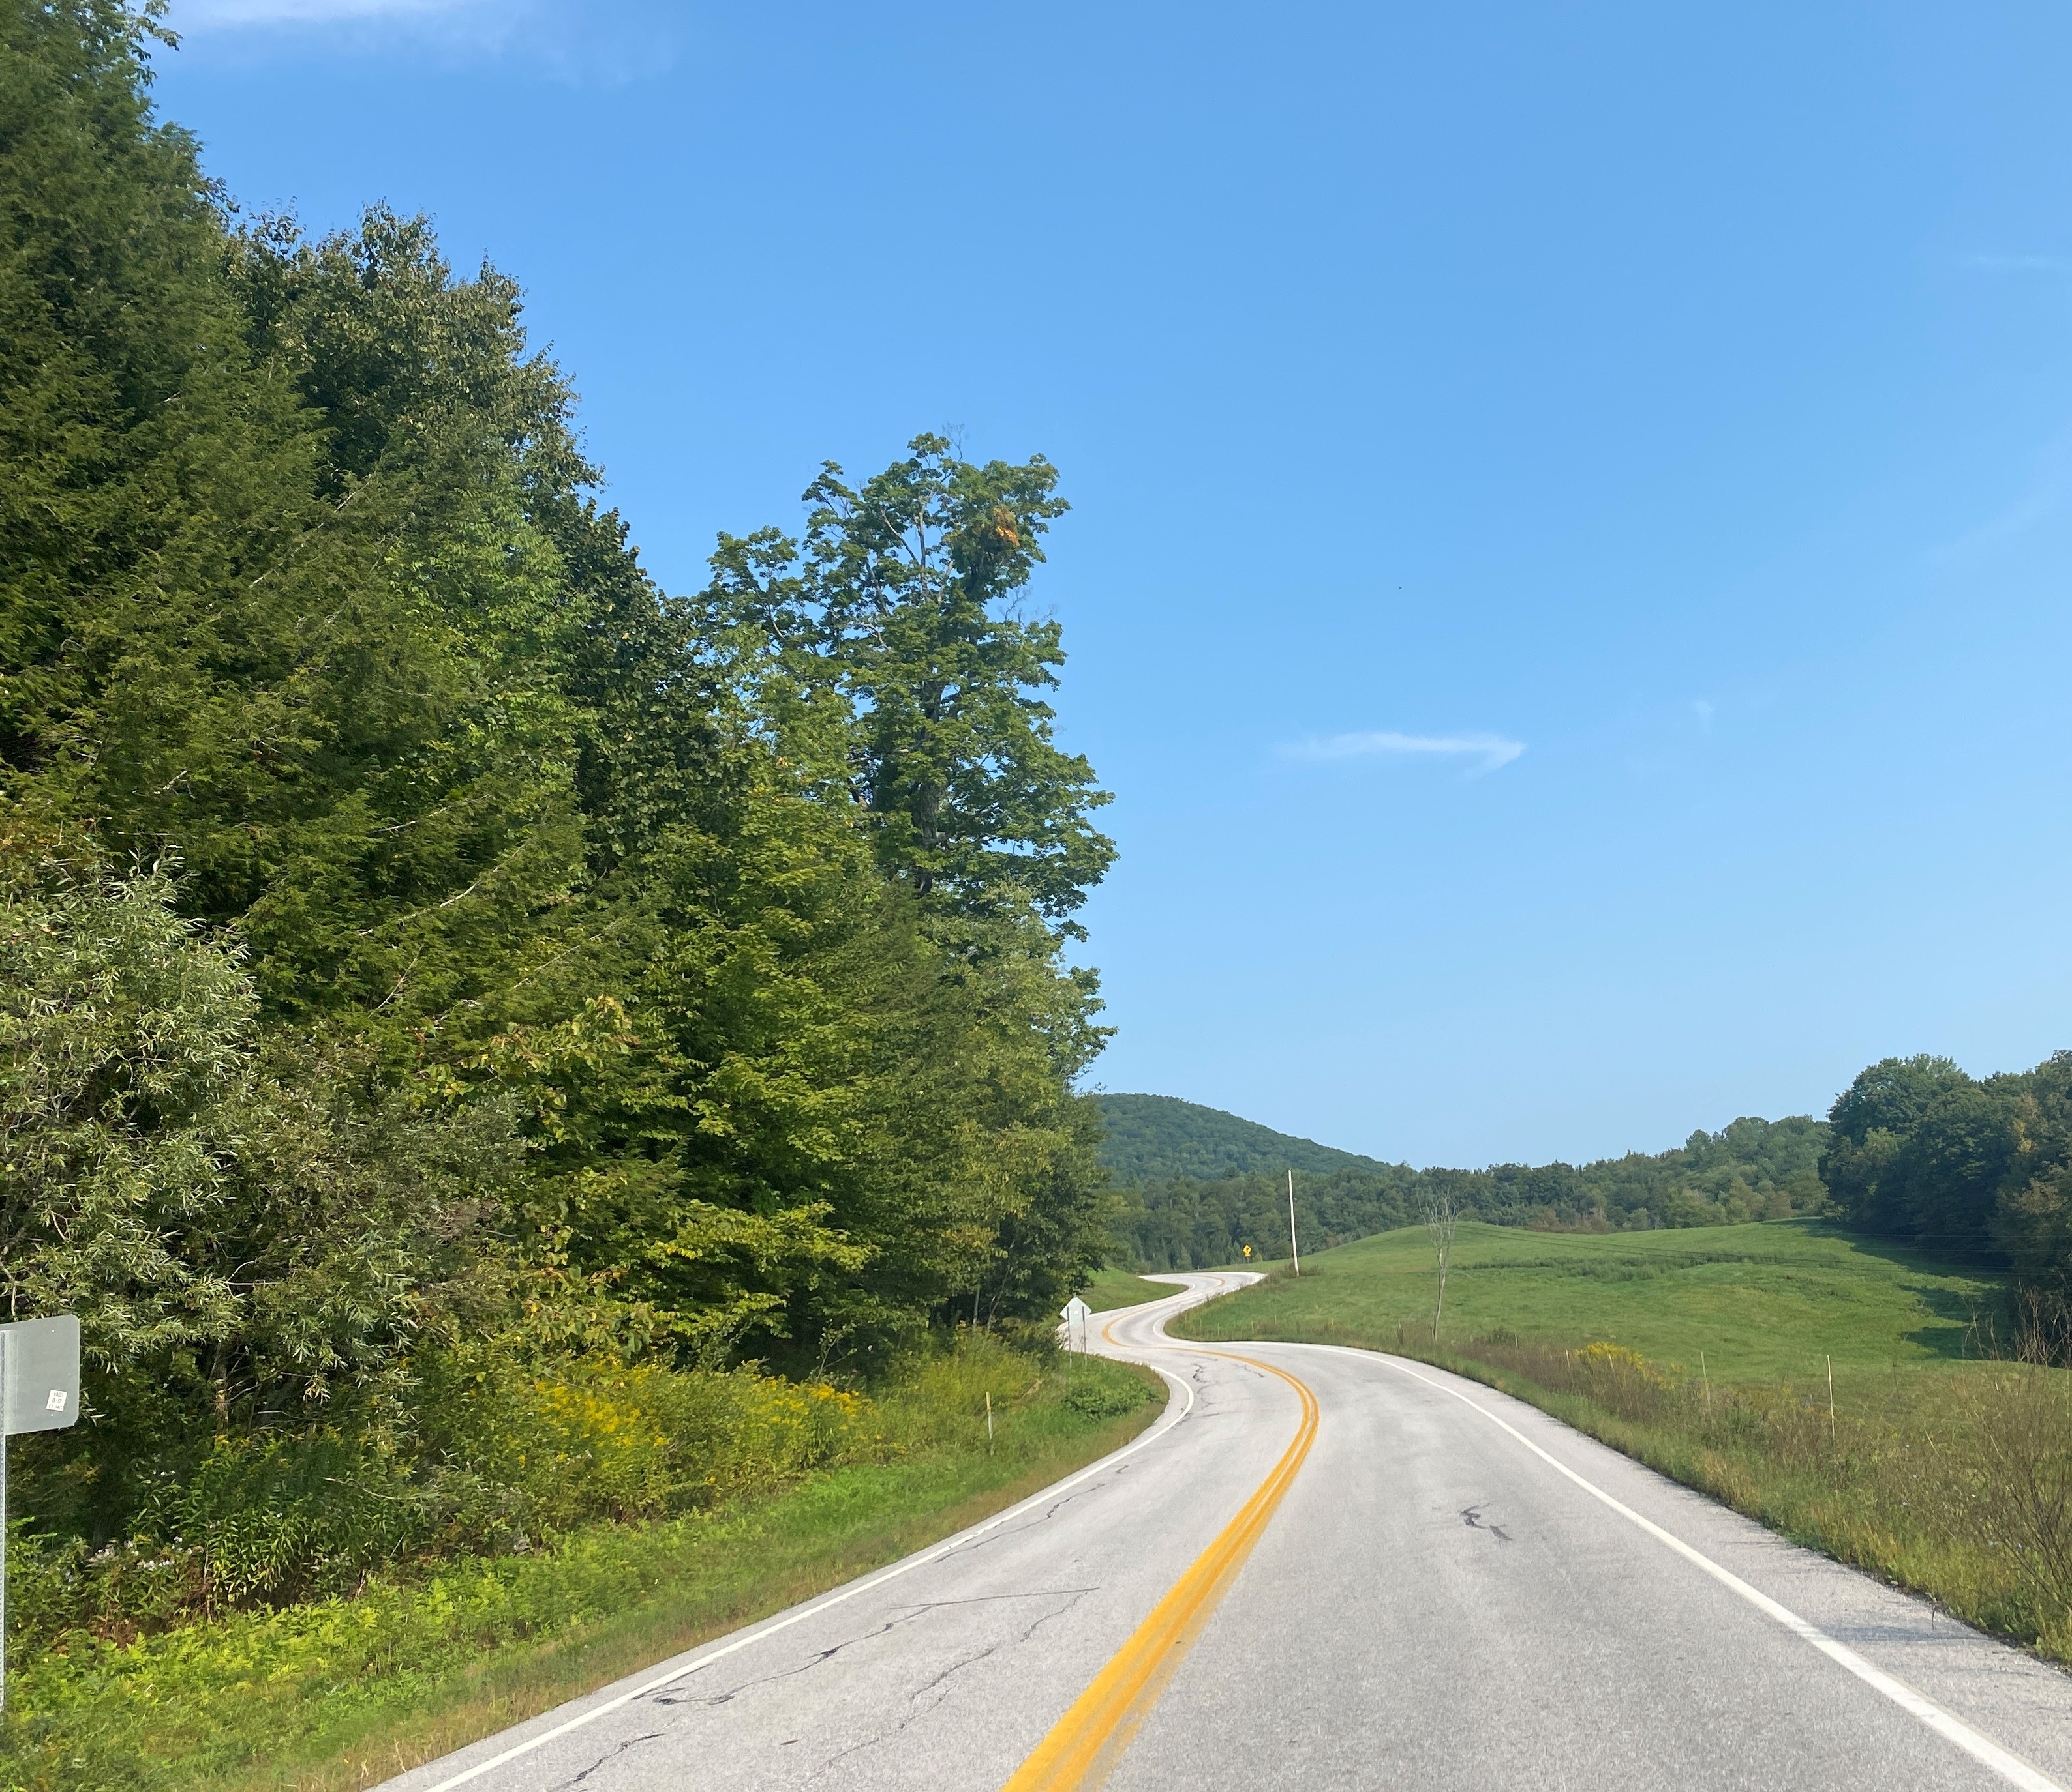
BTS-15: Highway Safety Behavioral Strategies for Rural Areas
Presented: x x, 2023
For: xxx
Notes:
[Make sure to fill in the date and who this was presented to.]

Slide 2
Project Need
Safety of rural roads should be prioritized
70% of the U.S. road network is comprised of rural roads
19% of population lives in rural areas
9 times the lane miles per 100,000 residents in rural versus urban areas
46% of the crashes occur in rural areas
risk of fatality or serious injury on a mileage basis is two times higher on rural than urban roads
Rural roads are unique for many reasons
Need for a toolkit focused on rural and tribal transportation practitioners
Data Source: National Highway Traffic Safety Administration (NHTSA) 2020
Notes:
In our quest for zero roadway fatalities and serious injuries, safety on rural roads should also be prioritized. Rural roads comprise 70% of the U.S. road network, but only 19% of the population of the U.S. This means there are 9 times the lane miles per 100,000 residents in rural versus urban areas. Additionally, as of 2020, 46% of the crashes occurred in rural areas which means the risk of fatality or serious injury on a milage basis is two times higher on rural versus urban roads.
Rural roads are unique for many reasons (including but not limited to varying terrain and road conditions, wildlife on the roadways, long distances, unfamiliar drivers, etc.), which poses challenges for rural transportation practitioners who lack resources and funding but have large geographical jurisdictions.
For these reasons, there was a need to create a toolkit focused specifically on rural and tribal transportation practitioners, which is where this project came in.

Slide 3
Project Objective
Develop a behavioral traffic safety countermeasure toolkit for highway safety stakeholders (e.g., tribal authorities, local government, law enforcement, emergency responders, engineers) to reduce the frequency and severity of motor vehicle crashes on rural roads.
Notes:
The project objective was to [read slide].

Slide 4
Project Approach
Phase I
Task 1: Define Rural Area Roads
Task 2: Data Analysis
Task 3: Literature Review
Task 4: Case Studies
Task 5: Phase II Work Plan
Task 6: Interim Report
Phase II
Task 7: Toolkit Creation
Task 8: Training Materials, Instructional Aids, and Evaluation Methods
Task 9: Final Report
Notes:
The project team was led by the Western Transportation Institute at Montana State University and included staff from EBP US, the University of Iowa’s College of Public Health, and the Center for Health and Safety Culture at Montana State University.
The project team divided the project into two Phases and nine tasks as shown on the slide.

Slide 5
Defining Rural: County Classification
Notes:
Currently, multiple definitions of rural exist and tend to differ depending on the agency and funding source. Therefore, the first step in the project was to identify a consistent definition of rural.
To create this definition, the project team considered the level of spatial detail available for analysis; social and physical context that would impact a safety-oriented classification such as driver behavior, local culture, and physical design; level of categorical detail, as too few categories would fail to generate meaningful differences among rural areas and roads, but too many categories would make the analysis overly detailed and less useful for safety officials; flexibility of the system when subject to change; and compatibility of the system with this research project.
The project team built a classification system focused on counties and based off a combination of past efforts. It includes eight rural categories (tribal, agriculture and extraction, older age, destination county, remote, rural towns, micropolitan, and fringe) and a metropolitan category to enable comparisons between rural and urban areas. The above process diagram details how this classification system was used.

Slide 6
U.S. Counties by Classification Category
Notes:
This map shows U.S. counties shaded according to their classification category. There were a total of 2,433 rural counties in the U.S. In ascending order, the counties were fringe (762), micropolitan (412), agriculture and extraction (347), remote (274), rural towns (261), destination (219), tribal (94), and older-age (64).

Slide 7
Data Analysis
Road types
Interstate
Other freeway and expressway
Other principal arterial
Minor arterial
Major collector
Minor collector
Local
Data analysis approach
Crash frequency and incidence analysis
Crash severity analysis
Behavioral factors analysis
Crash reduction analysis
Notes:
Rural areas have various physical, cultural, and socioeconomic characteristics that influence road safety. Therefore, the project’s safety analysis focused on different county types and road types to capture the wide variation in rural place. For road types, the research team used FHWA’s Highway Functional Classification System when categorizing rural roads (interstate, other freeway and expressway, other principal arterial, minor arterial, major collector, minor collector, and local). The data analysis conducted focused on crash frequency and incidence analysis, crash severity analysis, behavioral factors analysis, and crash reduction analysis.

Slide 8
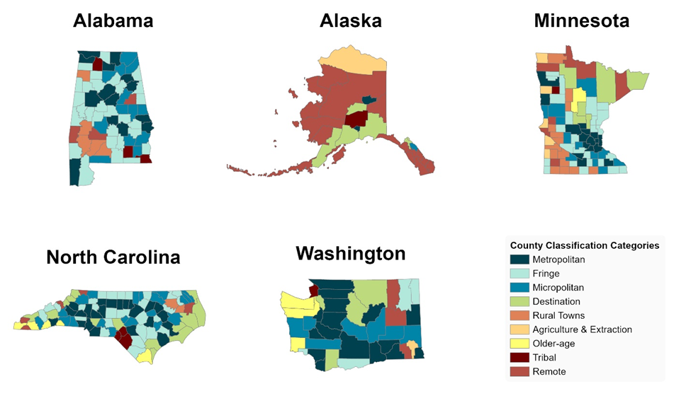
State-Level Analysis
Notes:
In conducting the data analysis, the research team used data from Alabama, Alaska, Minnesota, North Carolina, and Washington State. These states offered the necessary data and attributes for the analysis (including county identifiers, roadway functional class, and detailed crash information). While the states are not representative of the entire U.S., the research team believed that these states vary enough in climate, topography, and cultural characteristics to offer insights that will apply to other states with similar conditions. Some panel members questioned the use of Alaska for data analysis, as it can be considered an outlier not being within the contiguous U.S., but with the focus of this project being rural and tribal, it was ultimately decided that it should remain included.

Slide 9
County Type Data Analysis Findings
Crashes are more likely to be fatal in rural counties than they are in Metropolitan counties
Agriculture and Extraction, Destination, and Remote counties have the highest shares of speeding-related fatal crashes and fatal crashes involving a drunk driver
Agriculture and Extraction and Remote counties have the highest share of fatal crashes involving a distracted driver
Destination counties are unique among other rural county types, suggesting that visitors play some role in safety outcomes
Micropolitan counties behave similarly to Metropolitan counties regarding the factors that influence crash incidence (number of lanes, lane widths, and presence of urban areas or clusters)
Fatal crashes involving unrestrained or unhelmeted occupants are especially common in Remote, Rural Town and Tribal counties
Notes:
Some example high-level and statistically significant takeaways from the data analysis by county type include: [read slide contents]. For more details, please see the Phase II Report.

Slide 10
Road Type Data Analysis Findings
As measured by crashes per road mile, most rural crashes take place on just three road types: Other Principals and Arterials, Minor Arterials, or Major Collectors
As measured by crashes per million VMT, most rural crashes take place on Interstates
Minor Arterials show greater crash incidence as VMT increases, suggesting a need to focus on safe driving practices in heavy traffic
In three of the states analyzed—Alabama, Minnesota, and North Carolina—Minor Collectors stand out as the road type where fatal crashes and crashes involving injuries, but no fatalities, are most common
Local Roads are among the least injurious road types in each state analyzed
Crashes are more likely on rural road types that pass through urban clusters
Notes:
Some example high-level and statistically significant takeaways from the data analysis by road type include: [read slide contents]. For more details, please see the Phase II Report.

Slide 11
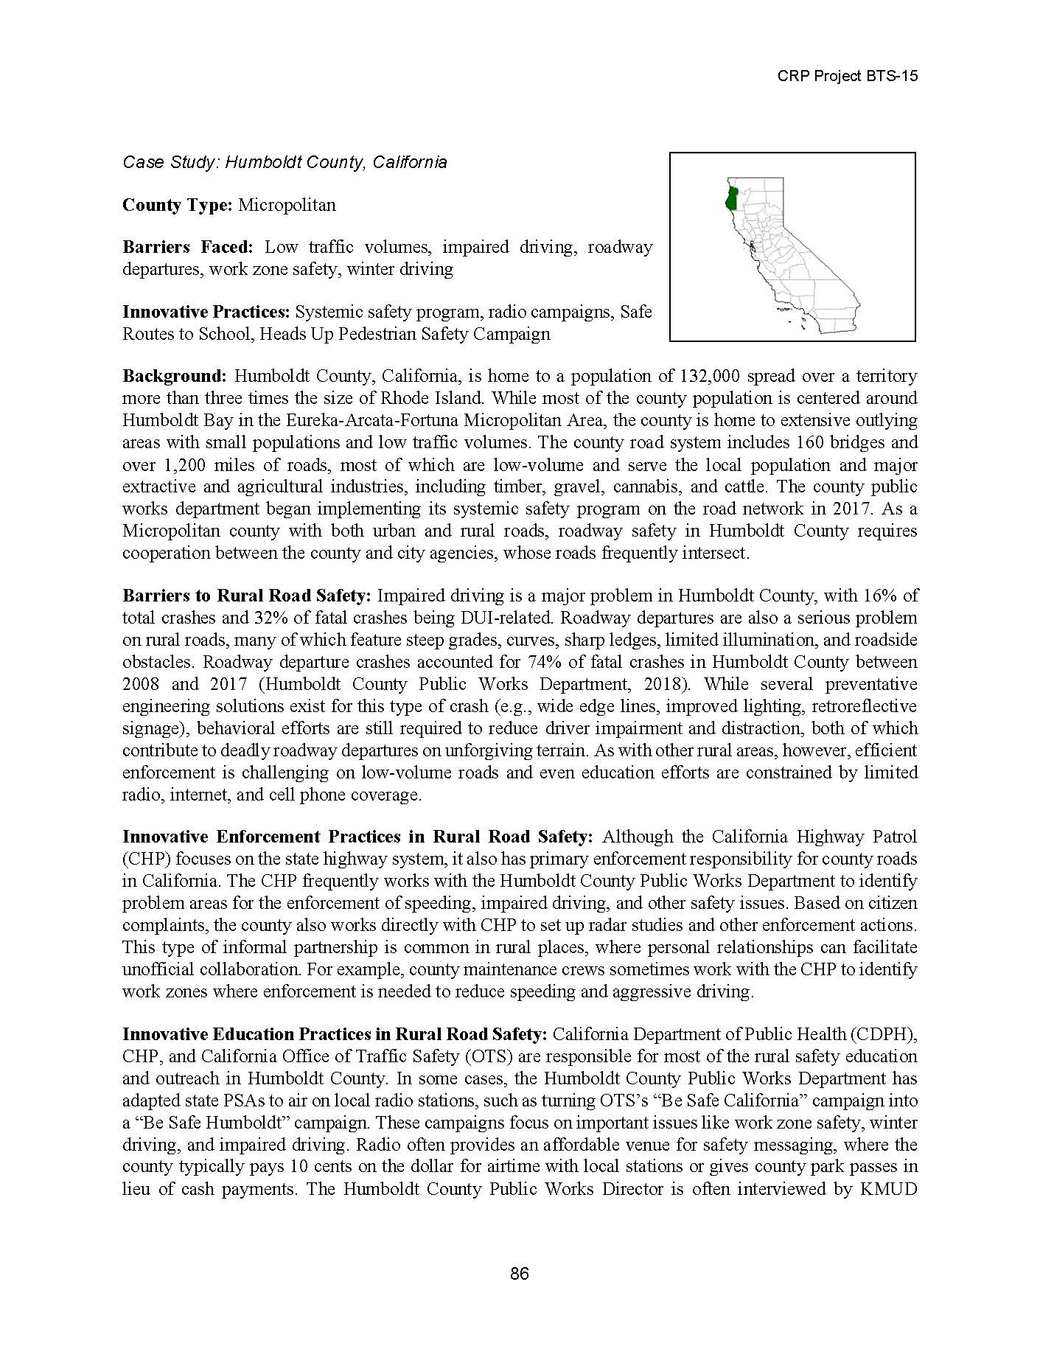
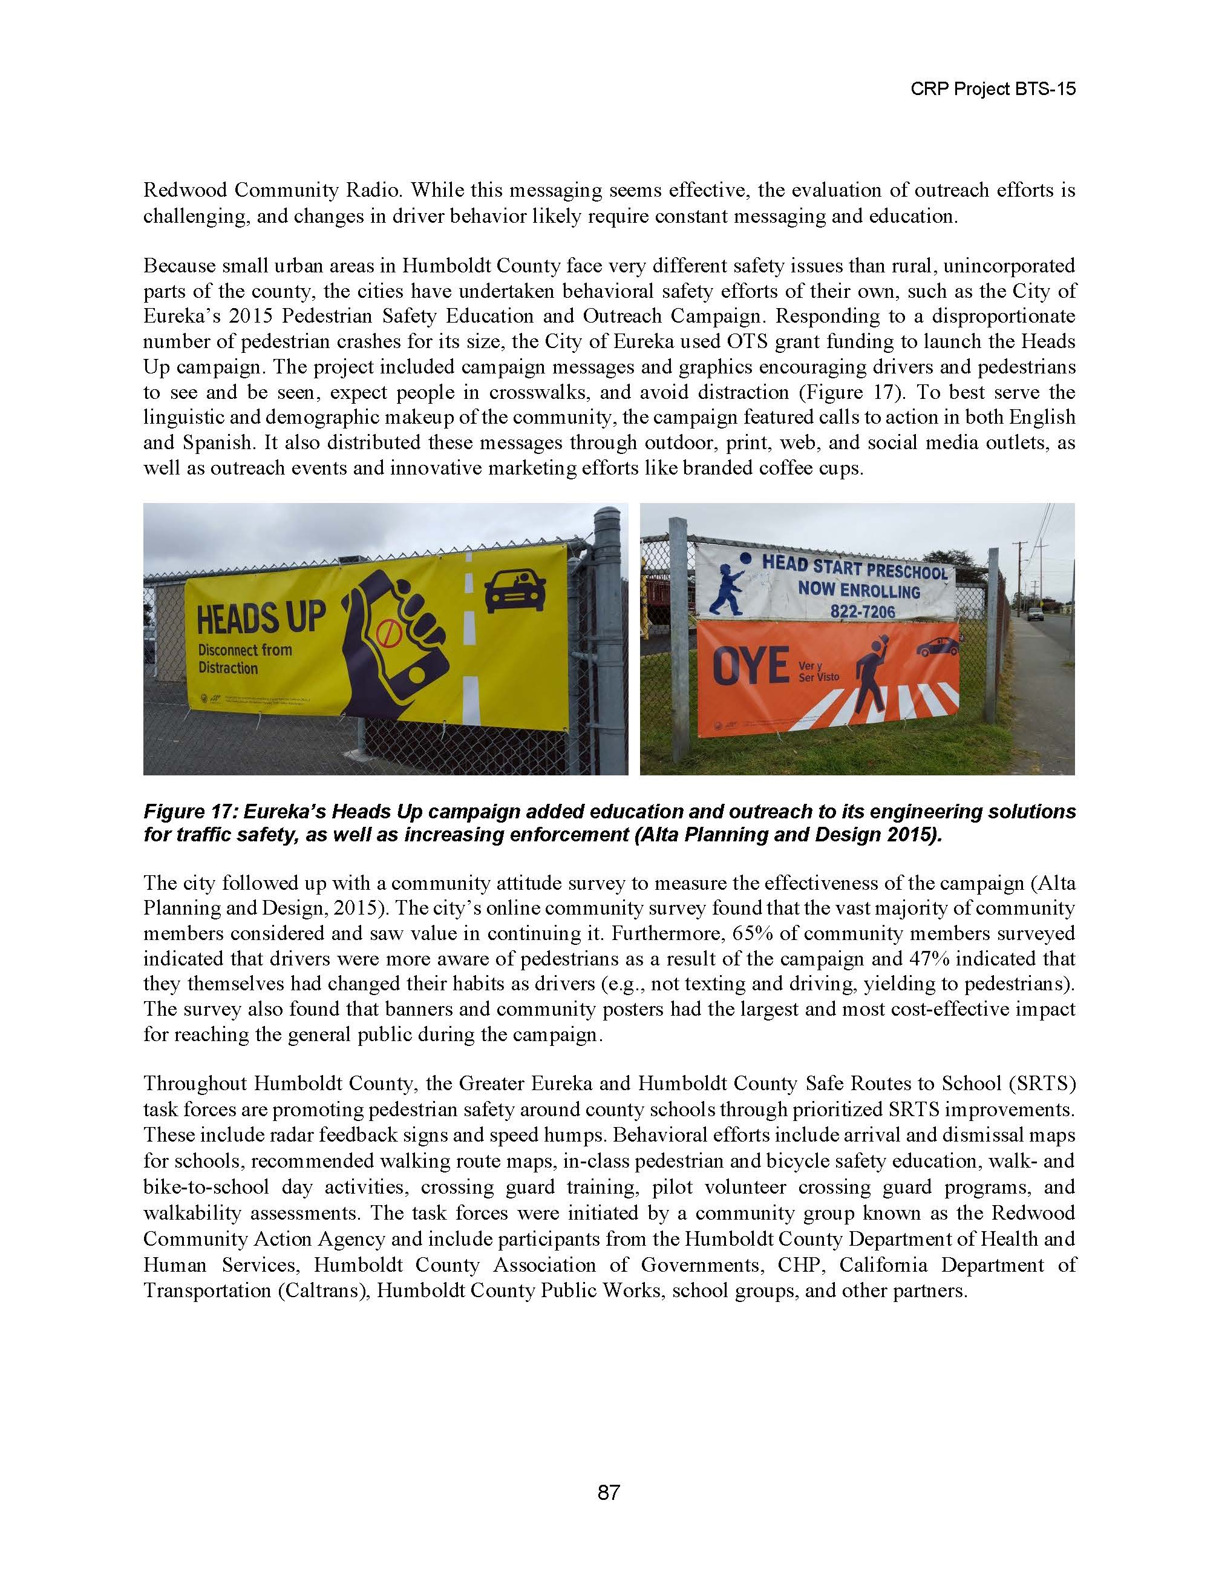
Case Studies
Boone County, Nebraska
Cameron County, Pennsylvania
Hancock and Kennebec Counties, Maine
Humboldt County, California
Keweenaw County, Michigan
Morgan County, Kentucky
Orange and Orleans Counties, Vermont
Ravalli County, Montana
Ziebach County, South Dakota
Notes:
The information identified in the first few tasks was then used to document nine case studies of rural counties across the country. These two-page case studies included information on county type, barriers faced, background information and innovative practices.

Slide 12
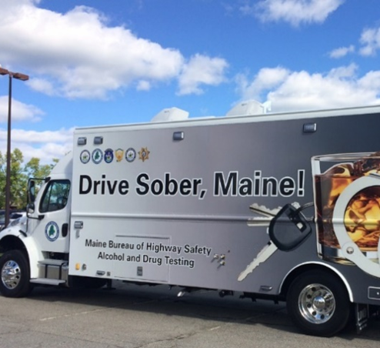
Case Studies (cont.)
Boone County, Nebraska
County type: Agriculture & Extraction
Barriers Faced: Distracted driving, driver attentiveness, speeding, impaired driving, large vehicles
Innovative Practices: Targeted enforcement, vehicle rollover simulator, PSAs targeted at drivers of pickup trucks
Cameron County, Pennsylvania
County type: Remote
Barriers Faced: Distracted driving, speeding, impaired driving, winter weather, wildlife collisions
Innovative Practices: High visibility enforcement, Selective Traffic Enforcement Program, youth-oriented education programs
Hancock and Kennebec Counties, Maine
County type: Destination (Hancock) and Micropolitan (Kennebec)
Barriers Faced: Speeding, impaired driving, seatbelt use
Innovative Practices: High visibility enforcement, Target Occupant Protection Awareness Zones program, voluntary compliance, Roadside Testing Vehicle, sports marketing program, anti-speeding banners
Notes:
[These three slides include detailed information on the case studies. They can be discussed or hidden based on the time available to the presenter]

Slide 13
Case Studies (cont.)
Humboldt County, California
County type: Micropolitan
Barriers Faced: Low traffic volumes, impaired driving, roadway departures, work zone safety, winter driving
Innovative Practices: Systemic safety program, radio campaigns, Safe Routes to School, Heads Up Pedestrian Safety Campaign
Keweenaw County, Michigan
County Type: Remote
Barriers Faced: Distracted driving, speeding, impaired driving, roadway departures, seasonal traffic, seatbelt use, winter weather
Innovative Practices: Police ride-alongs in road maintenance vehicles, seatbelt enforcement zones, dynamic message signs, vehicle rollover simulator
Morgan County, Kentucky
County Type: Rural Towns
Barriers Faced: Low-volume roads, seatbelt and helmet use, impaired driving, roadway departures, emergency response
Innovative Practices: Social media campaigns, enforcement targeted at speeding and vehicle OP
Notes:
[These three slides include detailed information on the case studies. They can be discussed or hidden based on the time available to the presenter]

Slide 14
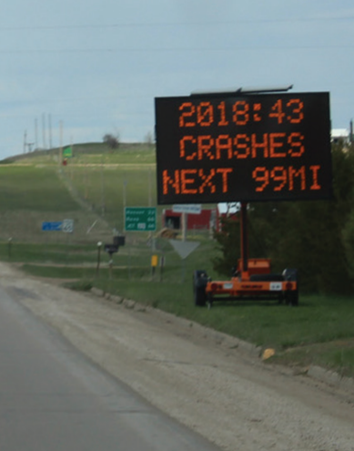
Case Studies (cont.)
Orange and Orleans Counties, Vermont
County Type: Micropolitan (Orange County) and Rural Towns (Orleans County)
Barriers Faced: Seatbelt use (especially among young, male pickup truck drivers), impaired driving (especially at night)
Innovative Practices: OP enforcement, seatbelt messaging, Click it or Ticket, Drive Well Vermont, cooperation with neighboring states
Ravalli County, Montana
County Type: Older-Age
Barriers Faced: Impaired driving, emergency response, wildlife collisions, aging drivers
Innovative Practices: DUI Task Force program/Impaired Driver Education Program, Responsible Alcohol Sales Training program, Selective Traffic Enforcement Program, older driver education
Ziebach County, South Dakota
County Type: Tribal
Barriers Faced: Seatbelt and helmet use, roadway departures, motorcycle safety, speeding, impaired driving
Innovative Practices: Motorcycle rider education program, dynamic message signs, fatal crash markers
Photo Source: Brunner 2019
Notes:
[These three slides include detailed information on the case studies. They can be discussed or hidden based on the time available to the presenter]
Photo is on South Dakota highway

Slide 15
Literature Review Findings
In general, the studies reviewed indicate that many types of prevention strategies show promise in improving rural roadway safety
The studies indicated the following generalizations:
Speed control through both roadway design and policy approaches significantly reduces average speeds and crashes
Road design demonstrated effectiveness in reducing loss of control and crashes from roadway departure
The few novice driver interventions for rural driving evaluated show impact on knowledge, attitudes, behavior, and driving safety
ATV safety interventions mostly focused on children and had mixed results about effectiveness
States vary in their adoption of the Vision Zero initiative and overall, rural roads and areas do not seem to be a specific target when discussing Vision Zero in most states
Notes:
The literature review started by documenting an overview of transportation safety, rural roadway characteristics, rural road users and culture, rural road barriers, and rural safety coalitions. It then focused on evaluation studies of prevention and intervention programs that have a behavioral approach to reducing rural roadway traffic injuries. The final portion of the literature review included an overview of zero deaths campaigns.
Some of the findings include: [read the slide].

Slide 16
Literature Review Findings (cont.)
The overall quality of the studies reviewed was relatively weak compared with the general evidence base for health-related studies
It remains a challenge to identify effective single-component interventions, how these interventions might work together for population-level impact, and how evidence-based strategies can be translated to new populations
Barriers to implementing behavioral rural traffic safety interventions must be considered, including geospatial, engagement, infrastructure, resource, rural specific risk, cultural, and rural data barriers
Future interventions for rural populations must consider growing diversity in race/ethnicity; a wide range and increasing disparity in income and education; and an aging population
Notes:
The major outcome of the literature review was the identification that there is a shortage of evaluations that have been conducted on behavioral strategies in rural areas, especially for vulnerable road users.
Additional details related to the evaluations included: [read slide contents].
Because the findings of the literature review did not yield the anticipated number of evidence-based strategies tested in rural settings, there was a need to adjust the focus of the rural toolkit to be created in Phase II. The research team determined that guidance focusing on adapting countermeasures/strategies for rural areas would be extremely beneficial to rural stakeholders and help advance the state of the practice.

Slide 17
Guidance Document Guidance for Improving Roadway Safety in Rural and Tribal Settings
For anyone who wants to improve roadway safety in rural and tribal settings
Focuses on:
countermeasures and strategies to grow safer decisions by road users (often called behavioral countermeasures or strategies)
resources for safer roads (often engineering or maintenance practices that improve safety) and safer speeds
Four chapters to help practitioners be more effective in their efforts to improve roadway safety
A complementary video on creating a logic model for a countermeasure or strategy
Notes:
The final deliverable for this project included a toolkit entitled Guidance for Improving Roadway Safety in Rural and Tribal Settings. The guidance document is: [read contents of the slide].
[note that the promotional video could also be embedded and played on this slide]

Slide 18
Guidance Document Chapters
A high-level overview of how behavioral countermeasures/strategies work
Understanding how behavioral countermeasures/strategies work will help practitioners be more effective in selecting, adapting, and implementing countermeasures/strategies in their community. Countermeasures/strategies will not be effective in changing behavior unless they are implemented well.
Guidance on steps and resources to develop a plan to improve roadway safety
Improving roadway safety takes time. Having a plan will help practitioners be more effective in the long term. It can also help them obtain funding to support their efforts.
Guidance on resources to identify, select, and adapt countermeasures/strategies to use in your community
There are several resources available with ideas on how to improve roadway safety. This section will help practitioners identify resources suitable for their community.
Specific actions you can take to be more effective over time
Countermeasures/strategies to improve roadway safety have limited impact if implemented only once. Each time practitioners implement a strategy they can learn what worked and what didn’t so that they can be more effective the next time.
Notes:
The four chapters in the Guidance document include: [read the slide contents].

Slide 19
Recommended Research
Evaluations for evidence-based behavioral strategies in rural areas that also contain a control group
Opportunity to continue building off this project’s definition of rural with additional data
Identify and evaluate relevant countermeasures for Agriculture and Extraction counties, as they had a uniqueness related to culture and norms surrounding speeding and drunk driving
Create and evaluate more rural-specific educational programs or rural-specific information to include in existing educational programs which would be valuable for both rural and urban drivers
Notes:
The research team also identified future rural research needs. These included: [read slide contents].

Slide 20
Recommended Research (cont.)
Larger studies that examine the impact of multiple approaches, especially those that combine road design, policy, and campaign approaches
Systematic evaluation of youth ATV safety outside of the school setting
Studies considering cost–benefit of behavioral interventions.
Studies that translate effective programming of vulnerable users from urban to rural environments
Studies that identify ways to reduce risk factors specific to rural environments
General rural driving safety evaluations that examine multiple components of safety for larger sample sizes
Evaluation of the rural road safety education programs from a wide variety of agencies
Notes:
Additional research needs that would contribute to current knowledge and practice include: [read slide contents].

Slide 21
Download Materials Here
Phase II BTS-15 Final Report
Guidance for Improving Roadway Safety in Rural and Tribal Settings
Complimentary Logic Model Training
https://apps.trb.org/cmsfeed/TRBNetProjectDisplay.asp?ProjectID=4798

Slide 22
Questions & Contacts
Richard Retting
CRP Senior Program Officer
RRetting@nas.edu
Jaime Sullivan
Principal Investigator
Jaime.sullivan2@montana.edu
(774) 571-3503

Slide 23
This presentation was developed by the Western Transportation Institute and the Center for Health and Safety Culture, Montana State University, Bozeman, MT; the University of Iowa, Iowa City, IA; and EBP US, Boston, MA, under Behavioral Traffic Safety Cooperative Research Program (BTSCRP) Project BTS-15. More information about this topic can be found in BTSCRP Research Report 8: Highway Safety Behavioral Strategies for Rural and Tribal Areas: A Guide and BTSCRP Web-Only Document 4: Highway Safety Behavioral Strategies for Rural Areas, which are available on the National Academies Press website (nap.nationalacademies.org).
The Behavioral Traffic Safety Cooperative Research Program (BTSCRP) is sponsored by the Governors Highway Safety Association and funded by the National Highway Traffic Safety Administration. BTSCRP is administered by the Transportation Research Board (TRB), part of the National Academies of Sciences, Engineering, and Medicine. Any opinions and conclusions expressed or implied in resulting research products are those of the individuals and organizations who performed the research and are not necessarily those of TRB; the National Academies of Sciences, Engineering, and Medicine; or BTSCRP sponsors.

